Slide 2
Outline
Chain of threats: faults, errors, failures
Classification of faults
Organization of fault tolerance
  (i) Error detection
  (ii) Error recovery: error handling (backward/forward recovery, masking)
  and fault handling.
Conclusions

Slide 3
Textbook and other references
[Sieviorek et al. 1998] D. P. Siewiorek R.S. Swarz, Reliable Computer Systems Design and Evalutaion, 2nd Ed. Digital Press, 1998. Chapter 5 (part).
[Avizienis et al. 2004] A. Avizienis, J.C. Laprie, B. Randell, C. Landwehr.
Basic Concepts and Taxonomy of Dependable and Secure Computing.
IEEE Transactions on Dependable and Secure Computing, Vol. 1, N. 1, 2004.

Slide 4
Dependability: a definition
A system is designed to provide a certain service
Dependability is the ability of a system to deliver the specified service
also in presence of faults and malfunctions.
Dependability is “that property of a computer system such that reliance can justifiably be placed on the service it delivers”

Slide 5
Systems and components
A system is made out of components. Each component is a system in its own right
COMPUTER
Program
Memory
CPU
Display
Data
Memory
interface
with
customer
Travel reservation system (simplified)
Keyboard
operator
interface
with
airlines
work-
station
INTERCONNECTION
database
server
network

Slide 6
Failure, fault, error
If the system stops delivering the intended service, we call this a failure.
The correct service may later restart.
For instance:
- deliver 200 Euro when you asked 20 Euro
We call the causes of failures faults
A fault causes an error in the state of the system
The error causes the system fail.

Slide 7
Dependability attributes
Dependability is a concept that encompasses multiple properties:
- Availability
readiness for correct service
- Reliability
continuity of correct service
- Safety
absence of catastrophic consequences on the user(s) and the environment
- Confidentiality
the absence of unauthorized disclosure of information
- Integrity
absence of improper system alterations
- Maintainability
ability to undergo modifications and repairs
Dependability properties can be measured in terms of probability

Slide 8
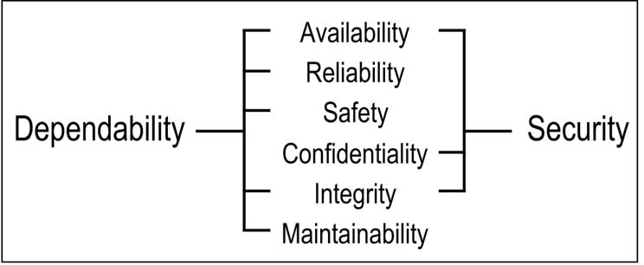
Dependability attributes

Slide 9
Computing systems failures
Computer failures differ from failures of other equipment
Subtler failures than “breaking down” or “stopping working”, ..
The computer is used to store information: there are many ways information can be wrong, many different effects both within and outside the computer
Small hidden faults may have large effects (digital machine)
Computing systems are complex hierarchies relaying on hidden components

Slide 10
What is a system?
System: entity that interacts with other entities, i.e., other systems, including
- hardware,
- networks,
- operating systems software,
- application software,
- humans, and
- the physical world with its natural phenomena.
These other systems are the environment of the given system.
The system boundary is the common frontier between the system and its environment.
Fundamental properties of a system:
functionality, performance, dependability and security, and cost.

Slide 11
System
Function of a system:
what the system is intended to do and is described by the functional specification in terms of functionality and performance.
Behavior of a system:
what the system does to implement its function and is described by a sequence of states.
State of a system:
is the set of the following states: computation, communication, stored information, interconnection, and physical condition.
Structure of a system:
what enables it to generate the behavior.
A system is composed of a set of components bound together in order to interact, where each component is another system, etc. The recursion stops when a component is considered to be atomic
The total state of a system is the set of the (external) states of its atomic components

Slide 12
System
Service delivered by a system (in its role as a provider):
its behavior as it is perceived by its user(s)
A user is another system that receives service from the
provider. The part of the provider’s system boundary where
service delivery takes place is the provider’s service interface.
The part of the provider’s total state that is perceivable
at the service interface is its external state; the remaining part
is its internal state.
The delivered service is a sequence of the provider’s external states.
A system may sequentially or simultaneously be a provider and a user
with respect to another system, i.e., deliver service to and receive service from that other system.
User intseerface: the interface of the user at which the user receives service

Slide 13
Threats to Dependability
Correct service is delivered when the service implements the system function.
A service failure, often abbreviated failure, is an event that occurs when the delivered service deviates from correct service. A service fails either because it does not comply with the functional specification,
or because this specification did not adequately describe the
system function.
Failure is a transition from correct service to incorrect service,
Restoration is the transition from incorrect service to correct service.
failure
correct
service
incorrect
service
restoration

Slide 14
Threats to Dependability
A service failure means that at least one (or more) external state of the system deviates from the correct service state. The deviation is called an error.
The deviation from correct service may assume different forms that are called service failure modes and are ranked according to failure severities.
Fault: the adjudged or hypothesized cause of an error.
Faults can be internal or external of a system. The prior presence of a vulnerability, i.e., an internal fault that enables an external fault to harm the system, is necessary for an external fault to cause an error and possibly subsequent failure(s).
A fault first causes an error in the service state of a component that is a part of the internal state of the system and the external state is not immediately affected.
For this reason, the definition of an error is the part of the total state of the system that may lead to its subsequent service failure. It is important to note that many errors do not reach the system’s external state and cause a failure.

Slide 15
Threats to Dependability
internal
fault
error
failure
component A
A fault causes an error in the internal state of the system. The error causes the system to fail
Partial failure: Services implementing the functions may leave the system in a degraded mode that still offers a subset of needed services to the user. The specification may identify several such modes, e.g., slow service, limited service, emergency service, etc. Here, we say that the system has suffered a partial failure of its functionality or performance.

Slide 16
Means for achieving dependability
A combined use of methods can be applied as means for achieving dependability. These means can be classified into:
1. Fault Prevention techniques
to prevent the occurrence and introduction of faults
– design review, component screening, testing,
quality control methods, ...
– formal methods
2. Fault Tolerance techniques
to provide a service complying with the specification in
spite of faults
3. Fault Removal techniques
to reduce the presence of faults (number,seriouness, ...)
4. Fault Forecasting techniques
to estimate the present number, the future incidence, and the consequences of faults

Slide 17
Dependability tree
(*) Security: Availability, Confidentiality, Integrity

Slide 18
Threats to dependability
The life cycle of a system consists of two phases:
- development
- use
Development phase includes all activities from presentation of the user’s initial concept to the decision that the system has passed all acceptance tests and is ready to deliver service in its user’s environment. During the development phase, the system interacts with the development environment and development faults may be introduced into the system by the environment.
The development environment of a system consists of the following elements:
1. the physical world with its natural phenomena
2. human developers, some possibly lacking competence or having malicious objectives
3. development tools: software and hardware used by the developers to assist them in the developmen process
4. production and test facilities
The use phase of a system’s life begins when the system is accepted for use and starts the delivery of its services to the users.
The system interacts with its use environment.

Slide 19
Threats to dependability
Use consists of alternating periods of correct service delivery (to be called service delivery), service outage, and service shutdown.
A service outage is caused by a service failure. It is the period when incorrect service (including no service at all) is delivered at the service interface.
A service shutdown is an intentional halt of service by an authorized entity.
Maintenance actions may take place during all three periods of the use phase. Maintenance, following common usage, includes not only repairs, but also all modifications of the system that take place during the use phase of system life.

Slide 20
Forms of Maintenance
Maintenance involves the participation of an external agent, e.g., a repairman, test equipment, remote reloading of software.
Furthermore, repair is part of fault removal (during the use phase), and fault forecasting usually considers repair situations. In fact,
repair can be seen as a fault tolerance activity within a larger system that includes the system being repaired and the people and other systems that perform such repairs.

Slide 21
notes
A component failure may cause a system failure, but a system failure does not require a component failure
Such failures are caused by system design faults

Slide 22
Types of faults
Failures may have many different causes or faults:
- chip suffers permanent electrical damage
- undersized fan (design fault) allows overheating on hot days
- Chip malfunction (physical fault)
- The machine works ok after cooling down (the fault is transient)
- Operator pushes the wrong button
- Cosmic ray particle causing transient upset in execution
- Defect in software
………..

Slide 23
Types of faults
Caused by what?
Physical faults
Human-Made faults
Why?
Accidental faults
Intentional non malicious faults / Intentional malicious faults
When?
Development faults: design, manufacturing, configuration, upgrading
Operational faults: in use or maintenance
Where (with respect to the system)?
Internal faults
External faults
How long?
Permanent faults
Transient faults

Slide 24
Faults are classified according to eight basic viewpoints

Slide 25
Characteristics of faults
Identified combinations:
three major partially overlapping groupings
Development faults
that include all fault classes occurring during development
Physical faults
that include all fault classes that affect hardware
Interaction faults
that include all external faults.
(31 combinations have been identified)
The names at the bottom identify the names of some illustrative fault classes

Slide 26
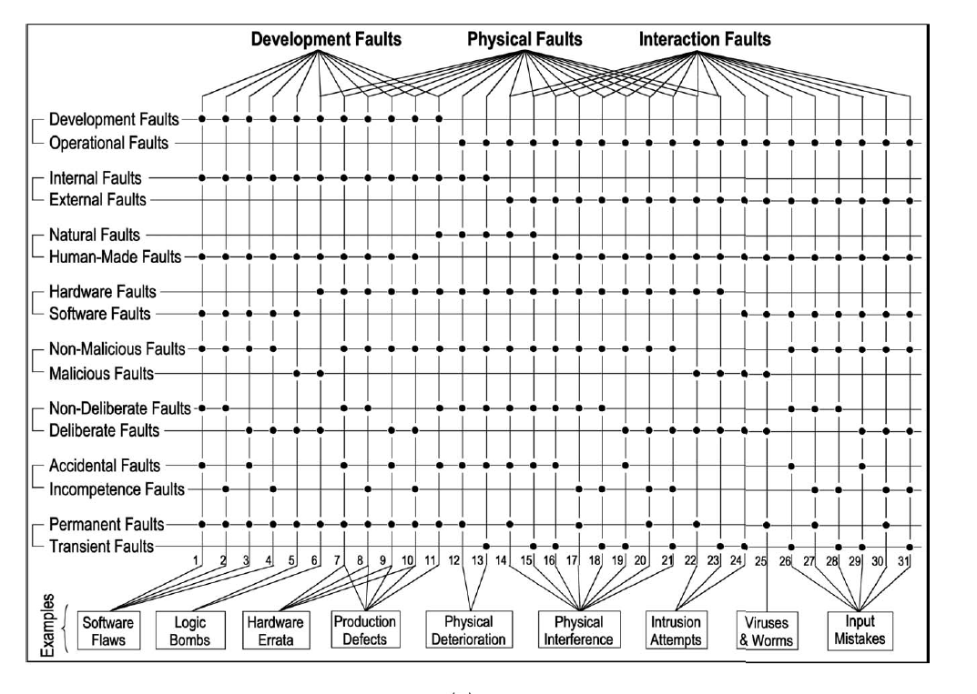
Faults classification

Slide 27
Natural faults
Natural faults (11-15) are physical (hardware) faults that are
caused by natural phenomena without human participation.
Production defects (11) are natural faults that originate during development.
During operation the natural faults are either internal (12-13), due to natural processes that cause physical deterioration, or external (14-15), due to natural processes that originate outside the system boundaries and cause physical interference by penetrating the hardware boundary of the system (radiation, etc.) or by entering via use interfaces (power transients, noisy input lines, etc.).

Slide 28
Natural faults

Slide 29
Human-Made Faults
The definition of human-made faults (that result from human actions) includes absence of actions when actions should be performed, i.e., omission faults, or simply omissions. Performing wrong actions leads to commission faults.
The two basic classes of human-made faults are:
Malicious faults, introduced during either system development with the objective to cause harm to the system during its use (5-6), or directly during use (22-25).
Nonmalicious faults (1-4, 7-21, 26-31), introduced without malicious objectives. We distinguish:
1) nondeliberate faults that are due to mistakes, that is, unintended actions of which the developer, operator, maintainer, etc. is not aware (1, 2, 7, 8, 16-18, 26-28);
2) deliberate faults that are due to bad decisions, that is, intended actions that are wrong and cause faults (3, 4, 9, 10, 19-21, 29-31).

Slide 30
Human-Made
Faults

Slide 31
Human-Made Faults
Non-malicious development faults are Software and Hardware faults.
Hardware faults: microprocessor faults discovered after production (named Errata).
They are listed in specification updates

Slide 32
Human-Made Faults
Deliberate, nonmalicious, development faults (3, 4, 9, 10) result generally from trade offs, either 1) aimed at preserving acceptable performance, at facilitating system utilization, or 2) induced by economic considerations.
Deliberate, nonmalicious interaction faults (19-21, 29-31) may result from the action of an operator either aimed at overcoming an unforeseen situation, or deliberately violating an operating procedure without having realized the possibly damaging consequences of this action

Slide 33
Human-Made Faults
Deliberate, nonmalicious faults are often recognized as faults only after an unacceptable system behavior; thus, a failure has ensued.
The developer(s) or operator(s) did not realize at the time that the consequence of their decision was a fault.
It is usually considered that both mistakes and bad decisions are accidental, as long as they are not made with malicious objectives.
However, not all mistakes and bad decisions by nonmalicious persons are accidents. We introduce a further partitioning of nonmalicious human-made faults into
1) accidental faults, and 2) incompetence faults.
HOW TO RECOGNIZE INCOMPETENCE FAULTS? Important when consequences that lead to economic losses or loss of human life.

Slide 34
Malicious faults
Malicious human-made faults are introduced with the malicious objective to alter the functioning of the system during use.
The goals of such faults are:
- to disrupt or halt service, causing denials of service;
- to access confidential information; or
- to improperly modify the system.
They are grouped into two classes:
Malicious logic faults that encompass development faults (5,6) such as Trojan horses, logic or timing bombs, and trapdoors, as well as operational faults (25) such as viruses, worms, or zombies.
Intrusion attempts that are operational external faults (22-24). The external character of intrusion attempts does not exclude the possibility that they may be performed by system operators or administrators who are exceeding their rights, and intrusion attempts may use physical means to cause faults: power fluctuation, radiation, wire-tapping, heating/cooling, etc.

Slide 35
Malicious faults

Slide 36
Malicious faults
What is colloquially known as an “exploit” is in essence a software script that will exercise a system vulnerability and allow an intruder to gain access to, and sometimes control of, a system.
In the terms defined here, invoking the exploit is an operational, external, human-made, software, malicious interaction fault (24-25).
Heating the RAM with a hairdryer to cause memory errors that permit software security violations would be an external, human-made, hardware, malicious interaction fault (22-23).
The vulnerability that an exploit takes advantage of is typically a software flaw (e.g., an unchecked buffer) that could be characterized as a developmental, internal, human-made, software, nonmalicious, nondeliberate, permanent fault (1-2).

Slide 37
Interaction Faults
Interaction faults occur during the use phase, therefore they are all operational faults. They are caused by elements of the use environment interacting with the system; therefore, they are all external. Most classes originate due to some human action in the use environment; therefore, they are human-made.
They are fault classes 16-31. An exception are external natural faults (14-15) caused by cosmic rays, solar flares, etc. Here, nature interacts with the system without human participation.
A broad class of human-made operational faults are configuration faults, i.e., wrong setting of parameters that can affect security, networking, storage, middleware, etc. Such faults can occur during configuration changes performed during adaptive or augmentative maintenance performed concurrently with system operation (e.g., introduction of a new software version on a network server); they are then called reconfiguration faults.

Slide 38
Interaction faults

Slide 39
Interaction Faults
A common feature of interaction faults is that, in order to be “successful,” they usually necessitate the prior presence of a vulnerability, i.e., an internal fault that enables an external fault to harm the system.
Vulnerabilities can be development or operational faults; they can be malicious or nonmalicious, as can be the external faults that exploit them.
There are interesting and obvious similarities between an intrusion attempt and a physical external fault.
A vulnerability can result from a deliberate development fault, for economic or for usability reasons, thus resulting in limited protections, or even in their absence.

Slide 40
Permanent/Transient faults
Permanent fault
a fault continuous and stable.
It remains in existence if no corrective action is taken.
Transient fault
a fault that can appear and disappear within a very short
period of time

Slide 41
Failures

Slide 42
Failures
The service failure modes characterize incorrect service according to four viewpoints:
1. the failure domain,
2. the consistency of failures,
3. the detectability of failures and
4. the consequences of failures on the environment.
1. The failure domain viewpoint leads us to distinguish:
content failures
the content of the information delivered at the service interface (i.e., the service content) deviates from implementing the system function.
timing failures
the time of arrival or the duration of the information delivered at the service interface (i.e., the timing of service delivery) deviates from implementing the system function.

Slide 43
Failures
Failures when both information and timing are incorrect fall into two classes:
halt failure, or simply halt, when the service is halted (the external state becomes constant, i.e., system activity, if there is any, is no longer perceptible to the users);
a special case of halt is silent failure, or simply silence, when no service at all is delivered at the service interface (e.g., no messages are sent in a distributed system).
erratic failures
otherwise, i.e., when a service is delivered (not halted), but is erratic (e.g., babbling).
2. The consistency viewpoint of failures leads us to distinguish, when a system has two or more users:
consistent failures.
the incorrect service is perceived identically by all system users.
inconsistent failures.
some or all system users perceive differently incorrect service (some users may actually perceive correct service); inconsistent failures are usually called, Byzantine failures.

Slide 44
Failures
3. The detectability viewpoint addresses the signaling of service failures to the user(s). Signaling at the service interface originates from detecting mechanisms in the system that check the correctness of the delivered service.
When the losses are detected and signaled by a warning signal, then signaled failures occur. Otherwise, they are unsignaled failures.
The detecting mechanisms themselves have two failure modes:
1) signaling a loss of function when no failure has actually occurred, that is a false alarm, 2) not signaling a function loss, that is an unsignaled failure.
When the occurrence of service failures result in reduced modes of service, the system signals a degraded mode of service to the user(s).
Degraded modes may range from minor reductions to emergency service and safe shutdown.

Slide 45
Failures
4. Grading the consequences of the failures upon the system environment enables failure severities to be defined.
Two limiting levels can be defined according to the relation between the benefit (in the broad sense of the term, not limited to economic considerations) provided by the service delivered in the absence of failure, and the consequences of failures:
minor failures
where the harmful consequences are of similar cost to the benefits provided by correct service delivery;
catastrophic failures
where the cost of harmful consequences is orders of magnitude, or even incommensurably, higher than the benefit provided by correct service delivery.

Slide 46
Errors
An error is detected if its presence is indicated by an error message or error signal. Errors that are present but not detected are latent errors.
Whether or not an error will actually lead to a service failure depends on two factors:
The structure of the system, and especially the nature of any redundancy that exists in it: protective redundancy, introduced to provide fault tolerance, that is explicitly intended to prevent an error from leading to service failure. Unintentional redundancy (it is in practice difficult if not impossible to build a system without any form of redundancy) that may have the same presumably unexpected result as intentional redundancy.
The behavior of the system: the part of the state that contains an error may never be needed for service, or an error may be eliminated (e.g., when overwritten) before it leads to a failure.
Some faults (e.g., a burst of electromagnetic radiation) can simultaneously cause errors in more than one component. Such errors are called multiple related errors.
Single errors are errors that affect one component only.

Slide 47
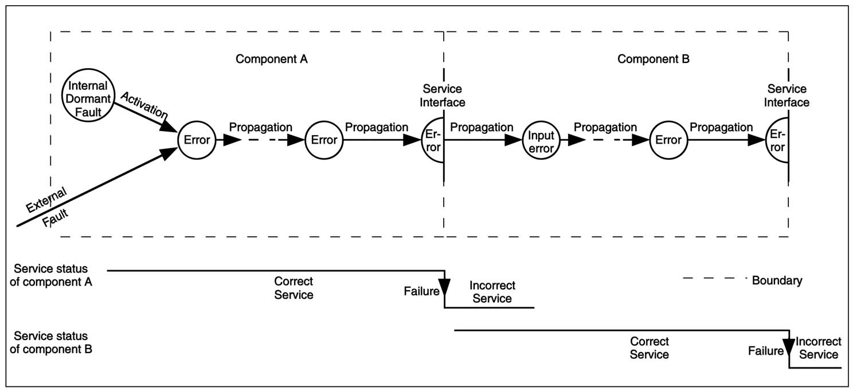
Relationship Faults-Errors-Failures

Slide 48
Chain of threats
A fault is active when it produces an error; otherwise, it is dormant.
An active fault is either
an internal fault that was previously dormant and that has been activated by the computation process or environmental conditions, or
an external fault.
Fault activation is the application of an input (the activation pattern) to a component that causes a dormant fault to become active.
Most internal faults cycle between their dormant and active states.

Slide 49
Chain of threats
Error propagation within a given component (i.e., internal propagation) is caused by the computation process.
An error is successively transformed into other errors.
Error propagation from component A to component B that receives service from A (i.e., external propagation) occurs when, through internal propagation, an error reaches the service interface of component A.
At this time, service delivered by A to B becomes incorrect, and the ensuing service failure of A appears as an external fault to B and propagates the error into B via its use interface.

Slide 50
Chain of threats
A service failure occurs when an error is propagated to the service interface and causes the service delivered by the system to deviate from correct service.
The failure of a component causes a permanent or transient fault in the system that contains the component.
Service failure of a system causes a permanent or transient external fault for the other system(s) that receive service from the given system.

Slide 51
Chain of threats
Given a system with defined boundaries, a single fault is a fault caused by one adverse physical event or one harmful human action.
Multiple faults are two or more concurrent, overlapping, or sequential single faults whose consequences, i.e., errors, overlap in time, that is, the errors due to these faults are concurrently present in the system.
Consideration of multiple faults leads one to distinguish 1) independent faults, that are attributed to different causes, and 2) related faults, that are attributed to a common cause.
Related faults generally cause similar errors, i.e., errors that cannot be distinguished by whatever detection mechanisms are being employed, whereas independent faults usually cause distinct errors.
However, it may happen that independent faults (especially omissions) lead to similar errors, or that related faults lead to distinct errors. The failures caused by similar errors are common-mode failures.

Slide 52
The Means to attain Dependability

Slide 53
Fault prevention techniques

Slide 54
Fault prevention techniques
Fault prevention techniques are intended to keep faults out of the system at the design stage
Related to general system engineering techniques (design methodolgies, construction rules, use of high reliable components).
These include
- a rigid software development process and
formal methods

Slide 55
Fault tolerance techniques

Slide 56
Fault tolerance
ability of the system to deliver a correct service after the
occurrence of faults
Why fault tolerance techniques?
even with the most careful fault avoidance, faults will eventually occur and result in a system failure
Fault tolerance techniques:
carried out via error detection and system recovery, redundancy to counteract the effects of faults
Protective redundancy: additional components or processes that mask or correct errors or faults inside a system so they do not become observable failures in its service

Slide 57
Organisation of fault tolerance
Possible phases in response to fault manifestation
- Error detection
- Damage containment
- Damage assessment/diagnosis
- Reconfiguration
- Error recovery / restart
- Fault treatment / repair / reintegration

Slide 58
Organisation of fault tolerance

Slide 59
Error detection and system recovery

Slide 60
Error recovery

Slide 61
Error Recovery
Forward recovery
transform the erroneous state in a new state from which the system can operate
Backward recovery
bring the system back to a state prior to the error occurrence
- Checkpointing
- Recovery block
Backward and forward recovery are not exclusive
they can be combined if the error persists

Slide 62
Forward error recovery
Requires to assess the damage caused by the detected error or by errors propagated before detection
Usually ad hoc
Example of application:
real-time control systems, an occasional missed response to a sensor input is tolerable
The system can recover by skipping its response to the missed
sensor input.

Slide 63
Backword/Forward error recovery
Forward error recovery can be incorporated in recovery blocks to complement the underlying backward error recovery.
Assume a real-time program communicated with its environment from within a recovery block then, if recovery were invoked, the environment would not be able to recover along with the program and the system would be left in an inconsistent state.
In this case, forward recovery would help return the system to a consistent state by sending the environment a message informing it to disregard previous output from the program.

Slide 64
Backword/Forward error recovery
State of a computation
Program visible variables
Hidden variables (process descriptors, …)
“External state” (files, outside words (for example alarm already given to the aircraft pilot, …)
Computing systems must talk to the outside world.
These actions ought to be correct
If they are not, the computer may still limit or undo the damage by a compensating action
For example: a cash dispensing machine gives money
forward recovery: tell the bank to ask for the money back

Slide 65
Strategies
Solid (or hard) faults: faults whose activation is reproducible
Elusive (or soft) faults: faults whose activation is not systematically reproducible

Slide 66
Error detection: Replication checks
Make available
- two or more copies of data item that may be corrupted
- a mechanism that compares them and declares an error if differ
The two copies must be unlikely to be corrupted together in the same way
Types of checks
Coding
Self-checking circuitry
Reversal Checks
the specified function of the system is to compute a mathemathical function,
output = F(input)
If the function has an inverse function F’, such that F’(F(x))=x, we can compute F’(output) and verify that F’(output) = input
Specification checks (use the definition of “correct result”)
Examples
Specification: find the solution of an equation
Check: substitute results back into the original equation
Reasonableness Checks
Divide by 0
Acceptable ranges of variables
Acceptable transitions
Probable results
…………..

Slide 67
Error detection
Effectiveness of error detction measured by
Coverage:
probability that an error or fault is detected conditional on its occurence
Latency:
time elapsing between the occurrence of an error and its detection (a random variable)
how long faults/errors remain undetected in the system
Damage Confinement:
error propagation path
the wider the propagation, the more likely that errors will spread outside the system
Preventing error propagation:
- “minimum priviledge”
- discriminating on type of use, users, ..
- Protection mechanisms: message-passing versus sharing memory, hardware and time for authorization

Slide 68
System structuring principles(mutual suspicion)
1)Each component examines each request or data item from other components before acting on it
For example, each software module checks legality and reasonableness of each request received
added overhead
need for providing: signalling back to requestor and own strategy for
dealing with erroneous requests
2) Make error confinement areas coincide in different views of the system:
boundary at interfaces between layers

Slide 69
Fault handling

Slide 70
Fault location
can the error detection mechanism identify the faulty component/task with sufficient precision?
- LOG and TRACES are important
- diagnostic checks
What if diagnostic information / testing components are themselves damaged?
System level diagnosis:
A system is a set of nodes:
- who tests whom is described by a testing graph
- checks are never 100% certain
Suppose A tests B.
If B is faulty,
A has a certain probability (we hope close to 100%) of finding out.
But if A is faulty too,
it might conclude B is OK; or says that C is faulty when it isn’t

Slide 71
Fault treatment
Faulty components could be left in the system
- faults can add up over time
Reconfigure faulty components out of the system
1)physical reconfiguration
turn off power, disable from bus access, ..
2) logical reconfiguration:
don’t talk, don’t listen to it
Excluding faulty components will in the end exhaust available redundancy
-insertion of spares
-reinsertion of excluded component after thorough
testing, possibly repair
Newly inserted components may require:
- reallocation of software components
- bringing the recreated components up to current state

Slide 72
Organisation of fault tolerance

Slide 73
Fault removal

Slide 74
Fault removal techniques
Fault diagnosis
- Nature and location of faults
Fault passivation
- Removing the components identified faults
checking whether the system adheres
to properties, specific to the considered system
diagnosing the fault which prevented the
verification conditions from being fulfilled (nature, location)
performing the necessary corrections
fault passivation, ……………………

Slide 75
Fault removal techniques
Important aspects:
1. Coordination of the activity of multiple components: preventing error propagation from affecting the operation of non failed components
2. Signalling of the component failure to its users. This may be accounted for within the framework of exceptions
Exception handling provided in some languages is a convenient way for implementing error recovery

Slide 76
Fault forecasting

Slide 77
Fault forecasting techniques
by performing an evaluation of the system behaviour with respect to fault occurrence and activation
Evaluation
- non-probabilistic: determining the minimal pathset of a fault tree conducting a Failure Mode and Effect Analysis (FMEA)
- probabilistic: determining the conformance of the system
to dependability expressed in terms of probabilities associated to some of the attributes of dependability, measures of dependability

Slide 78
Conclusions
fault tolerance uses replication for fault masking and relies on the independency of redundancies with respect to the process of fault creation and activations
When tolerance to physical faults is foreseen, the channels may be identical, based on the assumption that hardware components fail independently
When tolerance to design faults is foreseen, channels have to provide identical service through separate designs and implementation (through design diversity)
Fault masking will conceal a possibly progressive and eventually fatal loss of protective redundancy.
Practical implementations of masking generally involve error detection (and possibly fault handling), leading to masking and error detection and recovery.

