Slide 2
Outline
fault tolerant computing: why and what
computer-based systems: faults and failures
forms of redundancy:
- Hardware redundancy
- Information redundancy
- Timing redundancy
- Software redundancy
effectiveness of fault tolerance

Slide 3
Textbook and other references
[Sieviorek et al. 1998]
D. P. Siewiorek R.S. Swarz, Reliable Computer Systems Design and Evalutaion, 2nd Ed. Digital Press, 1998, chapter ….
[Avizienis et al. 2004]
A. Avizienis, J.C. Laprie, B. Randell, C. Landwehr. Basic Concepts and Taxonomy of Dependable and Secure Computing. IEEE Transactions on Dependable and Secure Computing, Vol. 1, N. 1, 2004
[Popov et al. 2001]
P.Popov, L. Strigini, The Reliability of Diverse Systems: a contribution using Modelling of the Fault Creation Process, Intern. Conf. on Dependable Systems and Networks, DSN 2001.

Slide 4
Fault tolerant computing: why and what
Computers are increasingly used in safety-critical systems:
- transport (automotive, railways, aerospace, ...)
- medicine
- process control
- ....
Future safety-critical systems will be more automated and more dependent on computers
Fault tolerant computing:
the ability of the system to deliver the expected functionality during its operational life also in case of malfunctions ( important in safety-critical systems, systems whose failure may result in death or serious injury to people, loss or serious damage of equipment, or environmental harm)

Slide 5
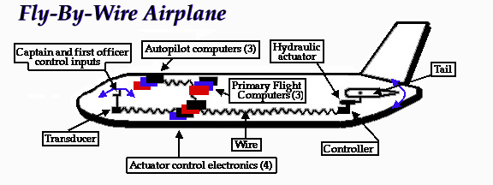
Transport systems: Aerospace
http://www.aviationcoaching.com/wp-content/uploads/2015
/08/fly-by-wire-system.jpg
Earliest aircraft: controlled by the pilot using the steel cables, pulleys and hydraulic actuators
Fly-by-wire (FBW) system: all commands and signals are transmitted electrically along wires.
These signals are sent to flight-control computers (FCS) that reconvert the electrical impulses into instructions for control surfaces like wing flaps or the tail.
Potentiometers in the control surfaces measure their position and transmit that data back to the flight computer.
Flight computers can be programmed to carry out adjustments to control surfaces automatically.

Slide 6
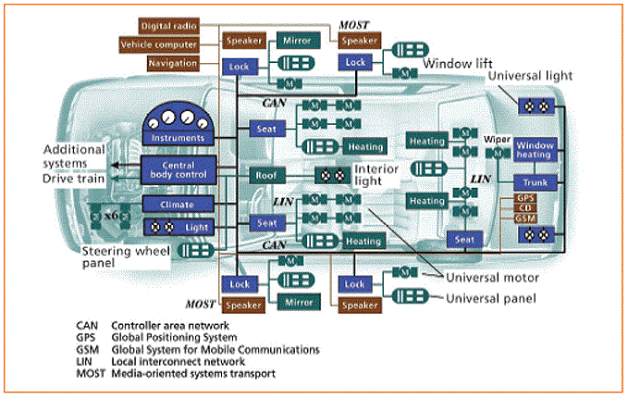
Transport systems: Automotive
Sensing and Computing in Cars
Over 80 different embedded processors, interconnected with each other.
Key ECUs (Electronic Control Unit):
Engine Control Modul (ECM)
Electonic Brake Control Module (EBCM)
Transmission Control Module (TCM)
Vehicle Vision System (VVS)
Navigation Control Module (NCM)
…
Main vehicle control systems replaced with electronic controls (no physical connection):
throttle - Electronic Throttle Control
brakes - Brake-by-Wire
steering - Steer-by-Wire

Slide 7
Fault tolerant computer-based systems
For a computer based safety-critical system, the safety of the system depends strongly on its computers.
Faults are unexpected events that may compromise the system functionality
Faults in computer systems:
hardware faults (e.g., stack-at 0 of a line, memory cell bit flip)
software faults (e.g., a bug in the code)
Types of faults: Design faults:unintended system function due to incomplete problem description
Human interaction faults: the system includes the operator
Hursh environment faults: electrical damage, wide temperature range , cosmic ray particle …
General questions: How to build dependable computer-based systems. Can we justifiably trust the dependability of such systems?

Slide 8
Fault tolerant computer-based systems
1. a system is as strong as its weakest component
Hw and sw systems relaying on hidden components
2. small hidden faults may have large effects (digital machine)
Computer failures differ from failures of other equipment
Subtler failures than “breaking down” or “stopping working”, ..
The computer is used to store information: there are many ways information can be wrong, many different effects both within and outside the computer

Slide 9
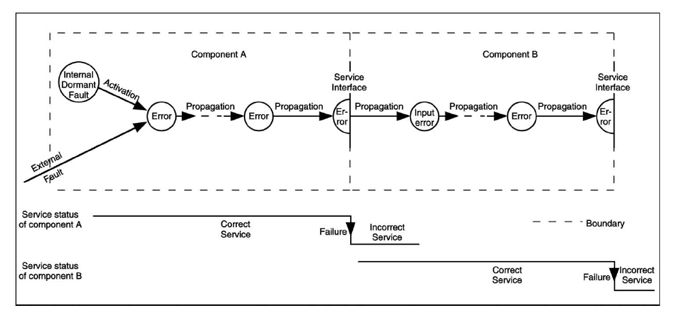
Chain of threats: Faults -> Errors -> Failures
Taken from [Avizienis et al. 2004]

Slide 10
Replication
Make available
- two or more copies of data item that may be corrupted
- a mechanism that compares them and declares an error if they differ
The two copies must be unlikely to be corrupted together and in the same way
Examples: Duplicated circuitry, Transmit messages twice, Store data in two separate places (e.g. mirrored disks)
Replication: can have a very important impact on a system in the area of performance, size, weight, power consumption and others

Slide 11
Redundancy in fault tolerant computing
HARDWARE REDUNDANCY
Physical replication of hw (the most common form of redundancy)
The cost of replicating hw within a system is decreasing because the costs of hw is decreasing
INFORMATION REDUNDANCY
Addition of redundant information to data in order to allow fault detection and fault masking
TIME REDUNDANCY
Attempt to reduce the amount of extra hw at the expense of using additional time
SOFTWARE REDUNDANCY
Tolerating faults in software

Slide 12
HARDWARE REDUNDANCY

Slide 13
Hardware redundancy
Passive fault tolerant techniques
use fault masking to hide the occurrence of faults
rely upon voting mechanisms to mask the occurrence of faults
do not require any action on the part of the system / operator
generally do not provide for the detection of faults
Active fault tolerance techniques
use fault detection, location and recovery
detect the existence of faults and perform some actions to remove the faulty hw from the system require the system to perform reconfiguration to tolerate faults
common in applications where temporary, erroneous results are acceptable while the system reconfigures (satellite systems)
Hybrid approach
very expensive
often used in critical computations in which fault masking is required to prevent momentary errors and high reliability must be achieved

Slide 14
Passive fault tolerance technique:TMR
1. Triple Modular Redundancy (TMR) – fault masking
Module 1
Module 2
Voter
output
Voter is a single point of failure
Module 3
Triplicate the hw (processors, memories, ..) and perform a majority vote to determine the output
- 2/3 of the modules must deliver the correct results
- effects of faults neutralised without notification of their occurrence
- masking of a failure in any one of the three copies
Good for transient faults
For permanent faults, since the faulty module is not isolated, the fault tolerance decreases

Slide 15
Cascading TMR with triplicated voters
Taken from [Siewiorek etal., 1998]
The effect of partitioning of modules (A, B, C) is that the design can withstand
more failures than the solution with only one large triplicated module
The partition cannot be extended to arbitrarily small modules, because reliability improvement is bounded by the reliability of the voter
Triplicated voters: voter errors propagates only of one step

Slide 16
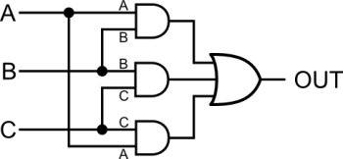
TMR: the Voter
Reliable Voters
Hardware voters are bit voters that compute the majority on n input bits. Optimal designs of hardware voters with respect to circuit complexity, number of logic levels, fan-in and fan-out and power dissipation
1 bit voter
Difficulties
Delay in signal propagation:
- due to the voter
- due to multiple copies synchronisation
Trade-off : achieved fault tolerance vs hw required
OUT = AB + BC + AC

Slide 17
Problems with voting procedure on analog signals
using multiple analog to digital convertes and performing bit-by-bit voting on their digital output is not satisfactory
The three results from the analog to digital converters may not completely agree, for example, they could produce a result which differs for the least-significant bit even if the exact signal is passed through the same converter
perform voting in the analog domain:
→ average the three signals → choose the mean of the two most most similar signals
→ choose the median of the three signals (pseudo voting)

Slide 18
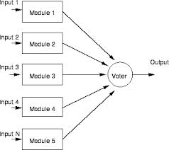
N-Modular Redundancy
2. NMR N is made an odd number
Coverage: m faulty modules, with N = 2m +1
5MR: tolerates 2 faulty modules
7MR: tolerates 3 faulty modules
……..

Slide 19
Active hw redundancy
Duplication with comparison scheme (Error detection)
Two identical pieces of hw (Module1 and Module 2) are employed
they perform the same computation in parallel
when a failure occurs, the two outputs are no more identical and a simple comparison detects the fault Then the comparator (hw component) selects the correct output and reconfigure the switch to select the correct value
the comparator must select the correct value
Dual-modular redundancy
(also Duplex system)
Module 1
input
output
comparator
switch
Module 2

Slide 20
Active hw redundancy: the comparator
Assumption: the two copies must be unlikely to be corrupted together in the same way
The comparator applies checks to select the correct output
Types of checks
Coding
Self-checking circuitry
Reversal Checks Assumption: the specified function of the system is to compute a mathemathical function F and the function has an inverse function F’, such that F’(F(x))=x Check: let output = F(input). Compute F’(output) and verify that F’(output) = input
Specification checks (use the definition of “correct result”) Example: Specification: find the solution of an equation Check: substitute results back into the original equation
- Reasonableness Checks Divide by 0 Acceptable ranges of variables Acceptable transitions Probable results
…………..

Slide 21
Active hw redundancy: the comparator
Problems
need to check if the output data are valid. The comparator may not be able to perform an exact comparison, depending on the application area (digital control applications)
faults in the comparator may cause an error indication when no error exists (false postive) or possible faults in duplicated modules are never detected (false negative)
Coverage
detects all single faults except those of the comparison element
Advantages
simplicity, low cost, low performance impact of the comparison technique, applicable to all levels and areas

Slide 22
Active redundancy
2. Stand-by sparing (error detection, reconfiguration)
Part of the modules are operational, part of the modules are spares modules (used as replacement modules)
The switch can decide no longer use the value of a module (fault detection and localization). The faulty module is removed and replaced with one of the spares.
hot spares the spares operate in synchrony with the on line modules, and they are prepared to take over
warm spares the spares are running but receive inputs only after switching
cold spares the spares are unpowered until needed to replace a faulty module
Module 1
error detection
input
output
Module 2
.
error detection
.
.
switch
Module n
As long as the outputs agree, the spares are not used.
error detection

Slide 23
Different schemes can be implemented
Pair-and-spare approach
- A module is a duplex system, pairs connected by a comparator
- Duplex systems are connected to spares by a switch
- As long as the two outputs agree, or the comparator can detect the right value, the spare is not used. - Otherwise, the comparator signals the switch that it is not able to compute the right value and the switch operates a replacemnet using the spare.
Module 1
comparator
Module 2
input
output
Module 1
comparator
switch
Module 2
spare
Pair results are used in a spare arrangment. Spare components at coarser granularity.
Not all four copies must be synchronised (only the two pairs)

Slide 24
Hybrid approaches
Combine both the active and passive approaches
Very expensive in terms of the amount of hw required to implement a system
Applied in commercial systems, safety critical system (aviation, railways, …)
NMR with spares (Reconfigurable NMR):
Modules arranged in a voting configuration
- spares to replace faulty units
- rely on detection of disagreements and determine the module(s) not agreeing with the majority

Slide 25
Reconfigurable NMR
N redundant module configuration (active modules)
Voter (votes on the output of active modules)
The Fault detection units 1) compares the output of the Voter with the output of the active modules 2) replaces modules whose output disagree with the output of the voter with spares
Fault detection
unit
Disagreement
detection
Module 1
.
.
. .
Module N
SWITCH
(select N
out-of N+M)
Active
units outputs
Spare
Module 1
Reliablity as long as the spare pool is not empty
Coverage TMR with one spare can tolerate 2 faulty modules
(mask the first faulty module; replace the module; mask the second faulty module)
.
.
Voter
. .
Spare
Module M
output

Slide 26
Hw redundancy techniques: summary
Key differences
Passive: rely on fault masking
Active: rely on error detection, location and recovery
Hybrid: emply both masking and recovery
Passive provides fault masking but requires investment in hw (5MR can tolerate 2 faulty modules)
Active has the disadvantage of additional hw for error detection and recovery, sometimes it can produce momentary erroneous outputs
Hybrid techniques have the highest reliability but are the most costly (3MR with one spare can tolerate 2 faulty modules)

Slide 27
INFORMATION REDUNDANCY

Slide 28
Coding
Information is represented with more bits that strictly necessary: says, an n-bit information chunck is represented by
n+c= m bits
Among all the possible 2^{m} configurations of the m bits, only 2^{n} represent acceptable values (code words)
if a non-code word appears, it indicates an error in transmitting, or storing, or retrieving …
Set of all
possible words
2^{m}
Set of
code words
2^{n}
Parity code
for each unit of data, e.g. 8 bits, add a parity bit so that the total number of 1’s in the resulting 9 bits is odd
receiver node
sender node
10100000 1
10100100 1
byte
parity
bit
communication
channel
one bit flip
Two bit flips are not detected
not a codeword

Slide 29
Coding
Codes
encoding: the process of determining the c bit configuration for a n bit data item
decoding: the process of recovering the original n bit data from the m bit total bit
Separable code: a code in which the original information is appended with new information to form the codeword. The decoding process consists of simply removing the additional information and keeping the original data
Nonseparable code: requires more complicated decoding procedures
Parity code is a separable code
Additional information can be used for error detection and may be for error correction

Slide 30
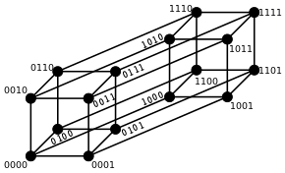
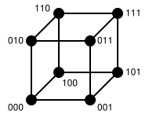
Examples of codes
boxed words: code words
Parity-code
odd parity
3-bit words – 4 code words
4-bit words – 8 code words
4-bit words – 8 code words

Slide 31
Examples of codes
CD - complemented duplication
m/n code: m bit equal to 1
2/4 code
4-bit words - 4 code words
4-bit words - 6 code words

Slide 32
Distances and data spaces
Hamming distance between two data items: count the number of bits that are different
A code such that the Hamming distance between two code words is > k will detect all errors that flip up to k bits
Memories of computer systems. Parity bit added before writing the memory. Parity bit is checked when reading.
Useful distance measures depend on type of data and faults
Bank account numbers should be such that mistyping a digit does not credit the wrong account.
Parity-code: Hamming distance 2
001
101
011
111
000
100
010
110
undetectable
detectable

Slide 33
Codes for error correction
Minimum Hamming distance: minimum distance between two code words
A code such that the minimum Hamming distance is k will detect up to k-1 single bit errors
correctable
uncorrectable
A code such that the minimum Hamming distance is k will correct up to d errors, where k = 2d +1
correctable
Hamming distance 3:
detects 1 or 2 bits errors
correct 1 bit error
The corrupted data is closer to the correct data than to any other code word

Slide 34
Arithmetic codes
An arithmetic code guarantees that
if inputs are code words and the operation is performed correctly results are code words too
Arithmetic
operation
Implementation of the arithmetic operation (hardware or software) must be modified to operate on the code
The set of code words of an arithmetic code A is closed with respect to a specific set of operations.
A(b*c) = A(b) * A(c ) where * is one of a set of operations
3N codes
Multiply the data by 3 (this add 2 bits of redundancy)
Error checking is performed by confirming that the received word is divisible by 3

Slide 35
Checksumming
applied to large block of data in memories
coverage: single fault
Original data
Received data
d_{n}
r_{n}
d_{n-1}
r_{n-1}
checksum for a block of n words is formed by adding together all of the words in the block modulo-k, where k is arbitrary (one of the least expensive method)
d₂
r₂
d₁
r₁
- the checksum is stored with the data block
- when blocks of data are transferred (e.g. data transfer between mass-storage device) the sum is recalculated and compared with the checksum
- checksum is basically the sum of the original data
Checksum on
Original data
Checksum on
received data
compare
Received version
of checksum
Code word = block + checksum

Slide 36
Checksumming
Disadvantages
- if any word in the block is changed, the checksum must also be modified at the same time
- allow error detection, no error location: the detected fault could be in the block of s words, the stored checksum or the checking circuitry
- single point of failures for the comparison and encoder/detector element
Different methods differ for how summation is executed

Slide 37
Error correcting codes -ECC
Two-dimensional parity
row
parity
Odd parity
n-bit words
1 0 1 …. 0 1
0 0 1 …. 1 1
1 1 1 …. 0 0
1 0 0 …. 0 0
k words
parity error
0
column
parity
parity error
Error location is possible for single-bit error: one error in the row parity vector, one error in the column parity vector
A single-bit error in the parity column or parity row column is detected
Single-error correcting code (SEC): detect and correct 1-bit error

Slide 38
Hamming Code (I)
Parity bits spread through all the data word
Parity bits
all bit positions that are powers of two : 1, 2, 4, 8, etc.
Data bits
all other bit positions
(number the bit positions starting from 1: bit 1, 2, 3, etc..)
Taken from: http://en.wikipedia.org/wiki/Hamming_code#Hamming_codes
Parity bit pj covers all bits whose position has the j least significant bit equal to 1
Each data bit is included in a unique set of 2 or more parity bits, as determined by the binary form of its bit position

Slide 39
Hamming code (II)
Taken from: http://en.wikipedia.org/wiki/Hamming_code#Hamming_codes
Parity bit p1 covers all bit positions which have the least significant bit set: bit 1 (the parity bit itself), 3, 5, 7, 9, etc.
Parity bit p2 covers all bit positions which have the second least significant bit set:
bit 2 (the parity bit itself), 3, 6, 7, 10, 11, etc.
Parity bit 4 covers all bit positions which have the third least significant bit set:
bits 4–7, 12–15, 20–23, etc.
Parity bit 8 covers all bit positions which have the fourth least significant bit set:
bits 8–15, 24–31, 40–47, etc.

Slide 40
Hamming code (III)
Taken from: http://en.wikipedia.org/wiki/Hamming_code#Hamming_codes
Overlap of control bit: a data bit is controlled by more than one parity bits
Minimum Hamming distance: 3
Double-error detection code
Single-error correction code
SEC-DED code

Slide 41
Self checking circuitry
Necessity of reliance on the correct operation of comparators and code checkers that are used as hard-core for fault tolerant systems
Self-checking circuit given a set of faults, a circuit that has the ability to automatically detect the existence of the fault and the detection occurs during the normal course of its operations
Typically obtained using coding techniques: circuit inputs and outputs are encoded (also different codes can be used)
Basic idea:
fault free + code input -> output: correct code word
fault + code input -> output: (correct code word) or (non code word)

Slide 42
Self checking circuitry
Self-testing circuit: if, for every fault from the set, the circuit produces a noncode output for at least one code input (each single fault is detectable)
Fault-secure circuit: if, for every fault from the set, the circuit never produces a incorrect code output for a code input (i.e. correct code output or noncode output)
Totally self-checking (TSC): if the circuit is self-testing and fault-secure

Slide 43
two-input TSC comparator
two signal input comparator (A, B)
output equal to 0 if inputs are equal; 1 otherwise
Fault assumption:
single fault
stuck-at-1/stuck-at-0 of each line in the circuit
Coding: 1/2 (dual-rail signal: coded signal whose two bits are always complementary)
A B C
0 0 0
0 1 1
1 0 1
1 1 0
B
C
A
A : A1 A2
0 : 0 1
1 : 1 0

Slide 44
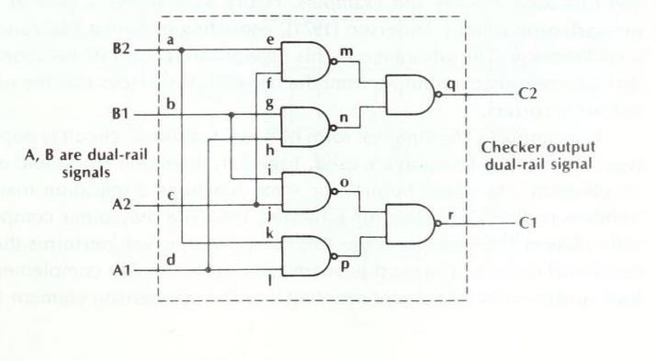
two-input TSC comparator
output 0 if inputs are equal; 1 otherwise
Fault free
A =0, B =1 different input
m=1, n =1, q=0
o = 0, p=1, r= 1
c2=0
c1=1
c1c2: code word
Output = c1 = 1 correct
vvvvv
0
0
vvvvv
vvvvv
1
vvvvv
1
1
vvvvv
vvvvv
0
Taken from:[Siewiorek et al., 1998]

Slide 45
two-input TSC comparator
output 0 if inputs are equal; 1 otherwise
Faulty:
A=0, B=1 different input
m: stuck-at-0
c2 = 1
c1 = 1
c1c2: non code word
Output = error
0
0
1
1
1
0
Taken from:[Siewiorek et al., 1998]

Slide 46
two-input TSC comparator
output 0 if inputs are equal; 1 otherwise
Faulty:
A=0, B=1 different input
m: stuck-at-1
c2=0
c1=1
c1c2: code word
output = c1 = 1 correct
0
0
1
1
1
0
Taken from:[Siewiorek et al., 1998]

Slide 47
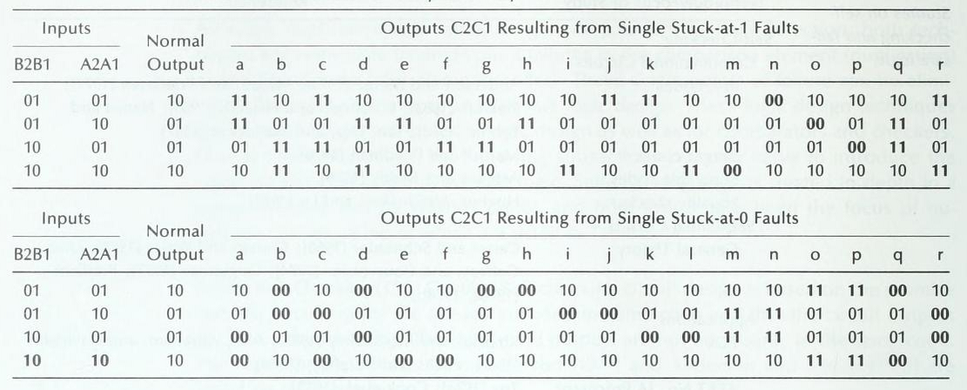
two-input TSC comparator
Taken from:[Siewiorek et al., 1998]
For each fault, there exists at least one input configuration such that the output is a non code word
If the output is a code word, the output is correct

Slide 48
n-input TSC comparator
n-input TSC comparator: tree of two input self checking comparators

Slide 49
TIME REDUNDANCY

Slide 50
Time redundancy techniques (I)
Attempt to reduce the amount of extra hw at the expense of using additional time
Repetition of computations
- compare the results to detect faults
- re-execute computations (disagreement disappears or remains)
good for transient faults no protection against permanent fault - problem of guaranteeing the same data when a computation is executed
Data
Computation
Store
result
time t₀
error
Compare
results
time t₀+d
Encode
Data
Computation
Decode
result
Store
result
Data

Slide 51
Time redundancy techniques (II)
Use a minimum of extra hw to detect also permanent faults - encode data before executing the second computation
Example: data transmitted over a parallel bus
- stuck at of a line of the bus
t0: transmit original data
t0+d : transmit complement data
When a fault occurs: received data not complements of each other
t0 : 1 0 1 1 -> 1 0 0 1
t0+d : 0 1 0 0 -> 0 1 0 0
Transmission error free, each bit line alternate between a logic 1 and a logic 0 (alternating logic)
line stuck at 0

Slide 52
SOFTWARE REDUNDANCY

Slide 53
Faults in the software
input
output
Software is subject to
design flaws: - mistakes in the interpretation of the specification that the software is supposed to satisfy (ambiguities) - mistakes in the implementation of the specification: carelessness or incompetence in writing code, inadequate testing
operational faults: incorrect or unexpected usage faults (operational profile)
sw

Slide 54
Faults in the software
Design flaws:
hard to visualize, classify, detect, and correct.
closely related to human factors and the design process, of which we don't have a solid understanding
only some type of inputs will exercise that fault to cause failures. Number of failures depend on how often these inputs exercise the sw flaw
apparent reliability of a piece of software is correlated to how frequently design faults are exercised as opposed to number of design faults present

Slide 55
Software redundancy
Due to the large cost of developing software, most of the software dependability effort has focused on
fault prevention techniques and testing strategies
Multi-version approaches
replicate the software mainly used in safety-critical systems (due to cost)

Slide 56
Multi-version approaches
Software diversity
a simple duplication and comparison procedure will not detect software faults if the duplicated software modules are identical
Independent generation of N >= 2 functionally equivalent programs, called versions, from the same initial specification.
Upon disagreement among the versions?
- retry or restart (fault containment)
- trasition to a predefined safe state
- reliance on one of the versions

Slide 57
N-version programming (I)
independently developed versions of design and code
Technique: independent design teams using different design methodologies, algorithms, compilers, run-time systems and hardware components
- vote on the N results produced
Program
Inputs
Program
Version 1
Program
Outputs
Program
Version 2
Voter
.
.
.
.
Program
Version N
Program
Inputs

Slide 58
N-version programming (II)
Disadvantages
-cost of software development
-cost of concurrent executions -potential source of correlated errors, such as the original specification. Specification mistakes: not tolerated
Practical problem
in implementing the software Voter for comparing the results generated by the copies because of the differences in compilers, numerical techniques and format conversions.

Slide 59
N-version programming (II)
Software voter (single point of failure)
not replicated: must be simple and verifiable
must assure that the input data vector to each of the versions is identical
must receive data from each version in identical formats or make efficient conversions must implement some sort of communication protocol to wait until all versions complete their processing or recognize the versions that do not complete

Slide 60
N-self-checking programming
based on acceptance tests rather than comparison with equivalent versions
Program
Inputs
N versions of the program are written
each version is running simultaneously and includes its acceptance tests
The selection logic chooses the results from one of the programs that passes the acceptance tests
Tolerates N-1 faults (independent faults)
Selection
Logic
Program
Version 1
.
.
Accepptance
tests
Program
Version N
Program
Inputs
Acceptance
tests
Program
Outputs

Slide 61
Design diversity
Design diversity
Cannot adopt the hardware analogy and assume versions fail independently
Empirical evidence that there will be common faults There is evidence that diversity delivers some improvement over single versions
Related faults may result from dependencies in the separate designs and implementations (example: specification mistakes)

Slide 62
Design diversity
Functional diversity
Assign to independent software versions diverse functions that compute the same task
For example, in a plant, diverse measurement signals, actuators and functions exists to monitoring the same phenomenon
Diverse functions
for example, functions that ensure independently that the plant safety targets are met.

Slide 63
Recovery-block technique
based on an one acceptance test and a single alternate is run at a time
Basic structure: Ensure T By P
else by Q
else error
Accettability of the result is decided by an acceptance test T. Primary alternate P, secondary alternates Q
variables global to the block automatically checkpointed if they are altered within the block
the primary alternate is executed and subjected to an acceptance test to detect any error in the result. If the test is passed, the block is exited; otherwise the content of the recovery cache pertinent to the block is reinstated, and the second alternate is executed.
This cycle is executed until either an alternative is successful or no more alternatives exist. In this last case an error is reported.
checkpoint
Acceptance
test

Slide 64
Recovery-block technique
Combines elements of checkpointing and backup
- checkpoint: a copy of the current state for possible use in fault tolerant techniques
- releases the programmer from determining which variables should be checkpointed and when
- linguistic structure for recovery blocks requires a suitable mechanism for providing automatic backward error recovery.
Program Inputs
Primary
Version
Program Outputs
Secondary
Version 1
N-to-1
Program
Switch
Acceptance
Tests
.
.
.
.
Test Result
Secondary
Version N-1

Slide 65
Checkpointing: basic issues
- may be taken automatically (periodically) or upon request by program
- resetting the system and process state to the state stored at the latest checkpoint needs mechanisms in run-time support (rollback)
- need to be correct (consistency of checkpoints)
- need eventually to be discarded
- overhead of saving system state (minimize the amount of state information that must be saved)
Process A
1
5
d
Process B
3
b
4
Process C
x
2
a
c
6
e
Checkpoint
x
Error
Message passed
domino effect

Slide 66
Effectiveness of fault tolerance
Example: Stable storage
RAID (Redundant Arrays of Independent Disks) technology
disk organization techniques that manage a large numbers of disks, providing a view of a single disk of high capacity and high speed by using multiple disks in parallel, and high reliability by storing data redundantly

Slide 67
Magnetic disk
Read failure
To deal with read failure, computes and attaches checksums to each sector to verify that data is read back correctly
If data is corrupted, with very high probability stored checksum won’t match recomputed checksum
Write failure
Ensure successful writing by reading back sector after writing it

Slide 68
RAID
Redundant information stored on multiple disks to recover from failures
Mirroring
Coding: Block-Interleaved Parity
Disk
Mirrored Disk
Block-level striping
block 0
block 1
block 2
block 3
parityblock 0-3
block 4
block 5
block 6
block 7
parityblock 4-7
Parity block on a diferent disk for toleranting disk failure
block 8
block 9
block 10
block 11
parityblock 8-11

Slide 69
RAID
Coding: Block-Interleaved Distributed Parity
parityblock 0-3
block 0
block 1
block 2
block 3
block 4
parityblock 4-7
block 5
block 6
block 7
block 8
block 9
parityblock 8-11
block 10
block 11
block 12
block 13
block 14
parityblock 11-15
block 15
block 16
block 17
block 18
block 19
parityblock 15-19

Slide 70
RAID
Coding: Hamming code
Bit-level striping
10
00
…
Disk1
Disk2
Disk7
Disk8
1 0 0 0 1 1 0 1
0 0 1 0 0 1 1 1
Byte
Byte
Hamming(7, 4)
ECC
10
00
Disk1
Disk2
Disk3
Disk4
Disk5
Disk6
Disk7

Slide 71
Conclusions
Fault tolerance uses replication for error detection and system recovery
Fault tolerance relies on the independency of redundancies with respect to the process of fault creation and activations
Fault masking will conceal a possibly progressive and eventually fatal loss of protective redundancy
Practical implementations of masking generally involve error detection (and possibly fault handling), leading to masking and error detection and recovery

Slide 72
Conclusions
When tolerance to physical faults is foreseen, the channels may be identical, based on the assumption that hardware components fail independently
When tolerance to design faults is foreseen, channels have to provide identical service through separate designs and implementation (through design diversity)

