Slide 1
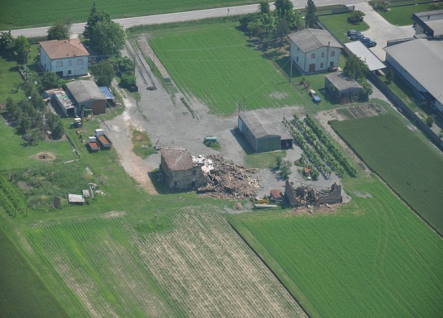

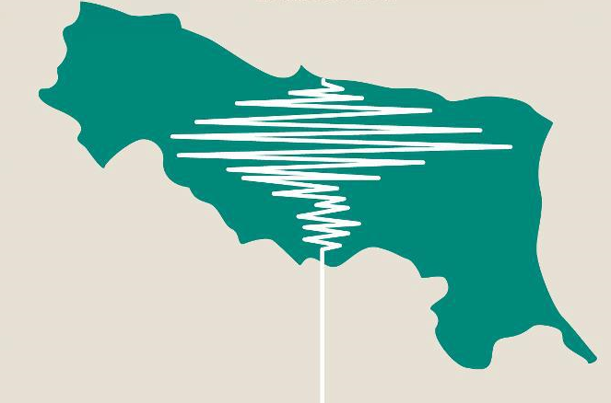

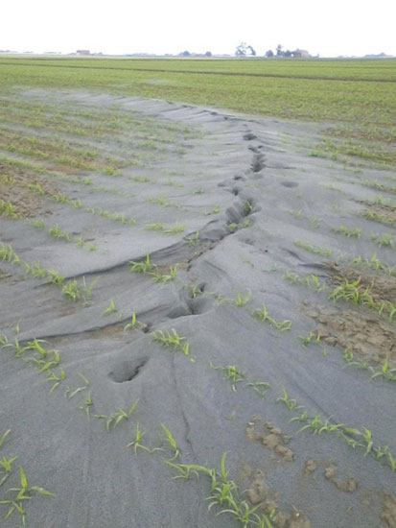
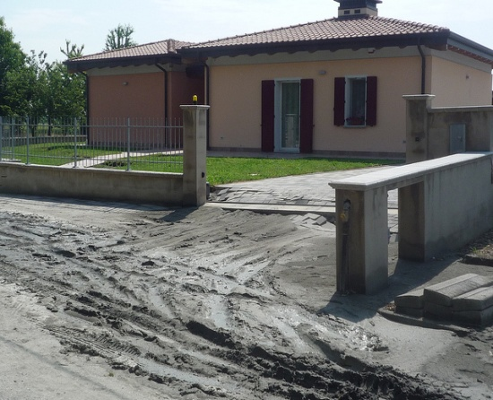
Evaluating liquefaction potential of soils using CPT: A case study in the central Po River plain, Italy
Meisina C., Lo Presti D., Persichillo M.G.

Slide 2
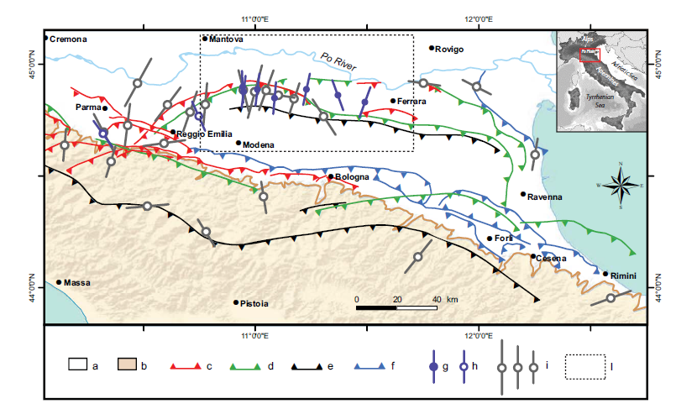
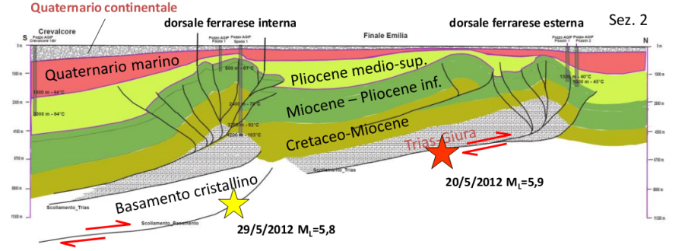
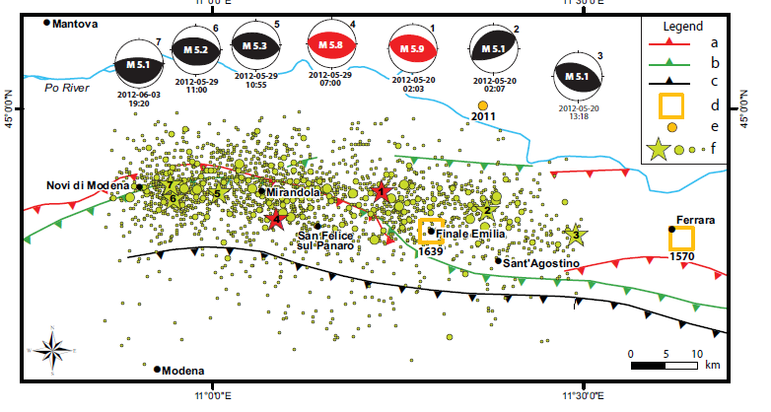
2012 EMILIA ROMAGNA EARTHQUAKE
TWO MAIN SHOCKS:
20th May: Mw= 5.9; Depth= 6.3 Km
29th May: Mw= 5.8 ; Depth= 10.2 Km
(Martelli e Romani, 2012)
http://ingvterremoti.wordpress.com/ modified by EMERGEO W.G., NHESS, 2013
(Emergeo working group, 2013)
(a) Po Plain units (Plio–Quaternary); (b) Apenninic Units (Meso–Cenozoic); (c) active and recent (<1 My) shallow thrusts; (d) active and recent thrust fronts in the Meso–Cenozoic carbonatic sequence; (e) active and recent thrust fronts in the basement; (f) reactivated thrust fronts of the Pliocene–Early Pleistocene (4.5–1 My); (g) maximum horizontal stress orientation from earthquake focal mechanisms of M 5.0 events of the Emilia 2012 sequence; (h) maximum horizontal stress orientation from past earthquakes (Mw 5.0 Parma 1983 and Mw 5.4 Reggio Emilia 1996); (i) maximum horizontal stress orientation from borehole breakouts
MAIN EFFECTS:
27 lives were lost;
damage to infrastructures (roads, pipelines);
economic losses of some 2 billion euros

Slide 3
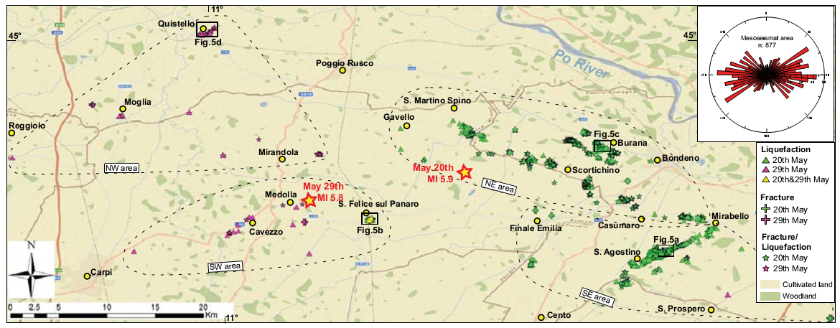
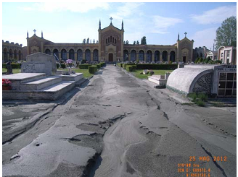
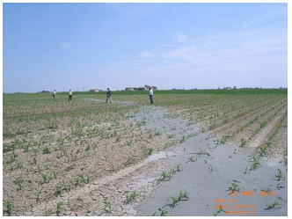
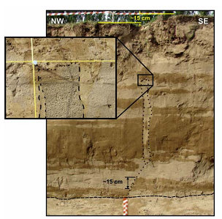
LOCATION OF LIQUEFACTION PHENOMENA
(Emergeo working group, 2013)
NW
NE
SW
SE
1362 sites with geological coseismic effects:
768 fracture/liquefaction; 485 liquefaction; 109 fracture
The most prominent liquefaction phenomena of last century observed mainly within a distance of about 21 km from the epicenter and were spread over an area of about 1200 km2:
(Lo Presti et al. 2013)

Slide 4
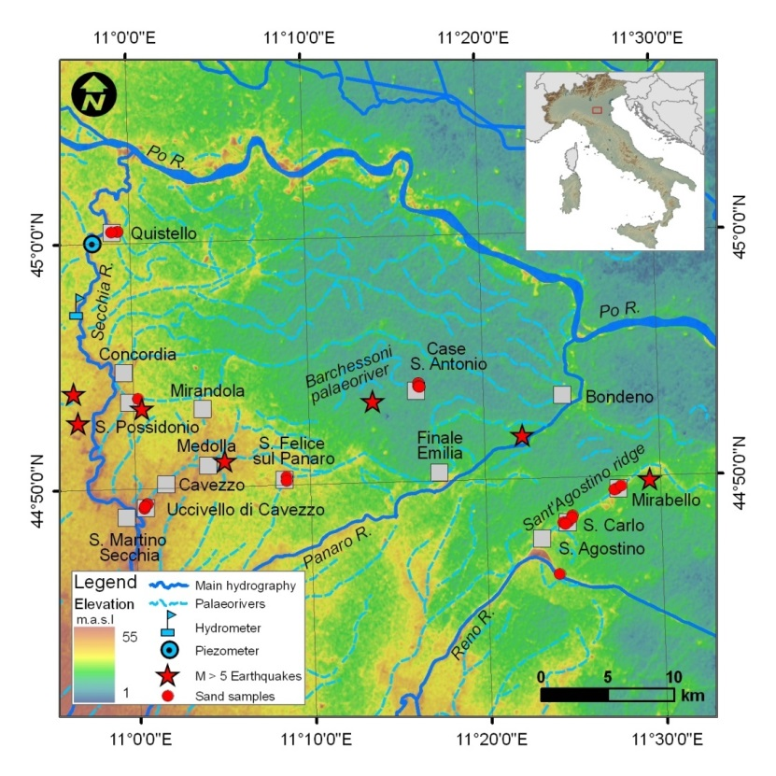
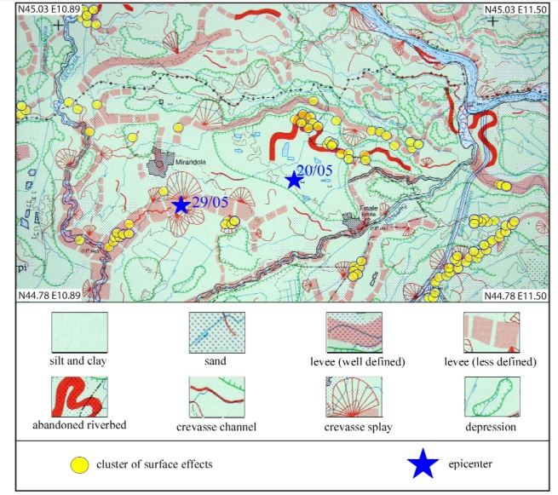
LOCATION OF LIQUEFACTION PHENOMENA
Liquefaction events were not randomly distributed, but appeared to be concentrated along alignments which follow the abandoned riverbeds (Secchia, Reno, Panaro and Po rivers).
Bertolini & Fioroni, 2012
SRTM (Shuttle Radar Topography Mission; ~90 m cell size), Ninfo et al., 2012
The geomorphologic framework is characterized by complex drainage and ancient drainage patterns of the Po, Secchia, Panaro and Reno Rivers, strongly influenced by climate, tectonic and human activities

Slide 5

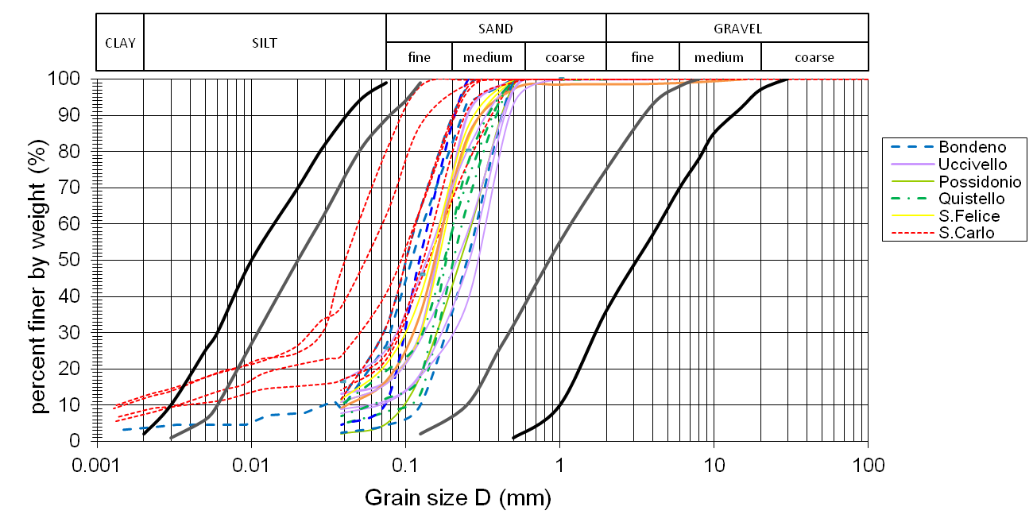
Grain size distribution of liquefied soils. The black lines correspond to the boundaries for potentially liquefiable soils; the grey lines represent the interval with high potentially liquefiable soils (uniformity coefficient > 3.5) (NTC, 2008).

Slide 6
THE PROBLEM
How evalutate liquefaction potential for land use planning?
AIMS OF THE WORK
Verify the applicability of the most used simplified methods, based on CPT/CPTU data, for liquefaction potential in the study area
Determine how sensitive are the methods to changes in the value of the input parameters;
Verify the correctness of the predictions of liquefaction comparing the results with the liquefaction effects inventory.

Slide 7


WORKFLOW METHODOLOGY
DOWNLOAD SURVEY DATA (http://ambiente.regione.emilia-romagna.it)
PENETROMETRIC TEST DATABASE
(151 CPTU; 15 CPT electric tip; 2000 CPT mechanical tip)
STRATIGRAFIC LOG (upper 20-30 m)
QUALITY AND RELIABILITY ASSESSMENT:
Test location;
Presence of continuous records;
Period of test execution
Division by morphological and lithological location:
L1=ancient riverbed; L2= ancient levee ridge;
L3= plain
423 CTP/CPTU
selected
INPUT PARAMETERS
PGA
Mw
Water table depth
Geotechnical characteristics
Penetrometric measurements
qc (Mpa);fs (MPa); u (MPa) in CPTU dataset
SENSITIVITY ANALYSIS (LPI-PGA; LPI-Mw; LPI-water table; LPI- γ)
FS(z) = CRR(z)/CSR(z)
(Robertson, 2009; Idriss & Boulanger, 2008; Moss et al. 2006; Boulanger & Idriss, 2014)
εv = volumetric consolidation strain
z = depth to the layer of interest for liquefaction (m)
F1 =
0 for FS(z) > 1
(1-FS(z)) for FS(z) < 1
W(z)=10-0.5z ; z = depth (m)
(Iwasaki et al., 1978)
(Tonkin & Taylor Ltd , 2013)

Slide 8
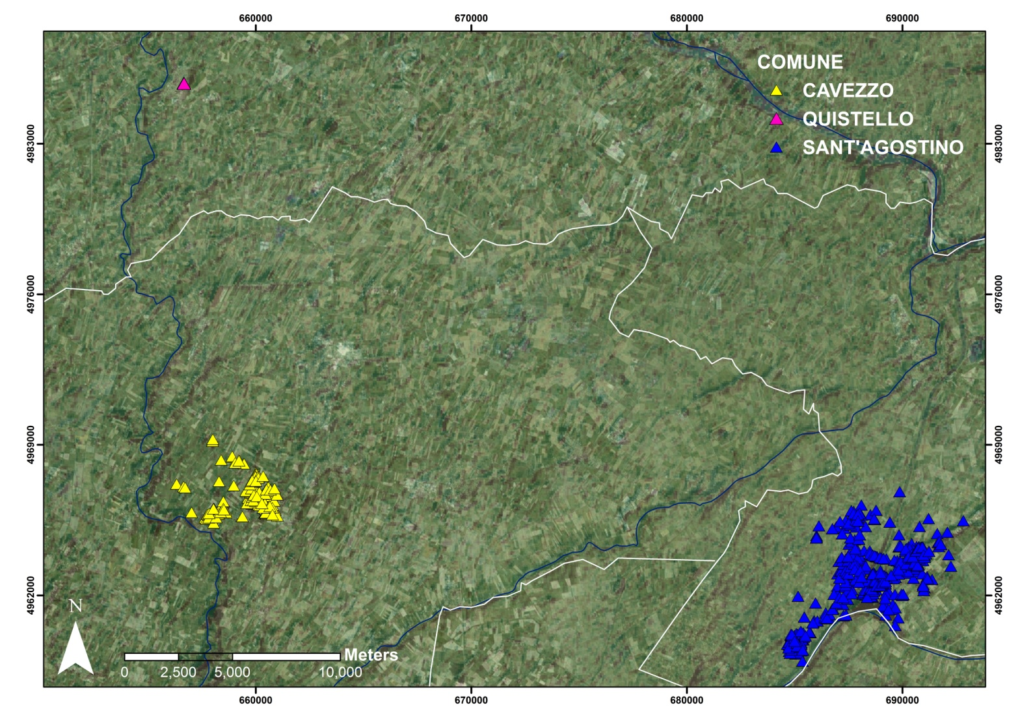
PENETROMETRIC TESTS
STUDY SITES
Po R.
NW
SE : San Carlo
Liquefaction during the 20 May shock
High density of observations
Strong interaction with infrastructures
SW: Cavezzo
Liquefaction during the 29 May shock
Observations concentrated near the main canal
light interaction with infrastructures
NW: Quistello
Liquefaction during the 29 May shock
Low density of coseismic effects
light interaction with infrastructures
Secchia R.
SW
Panaro R.
SE

Slide 9
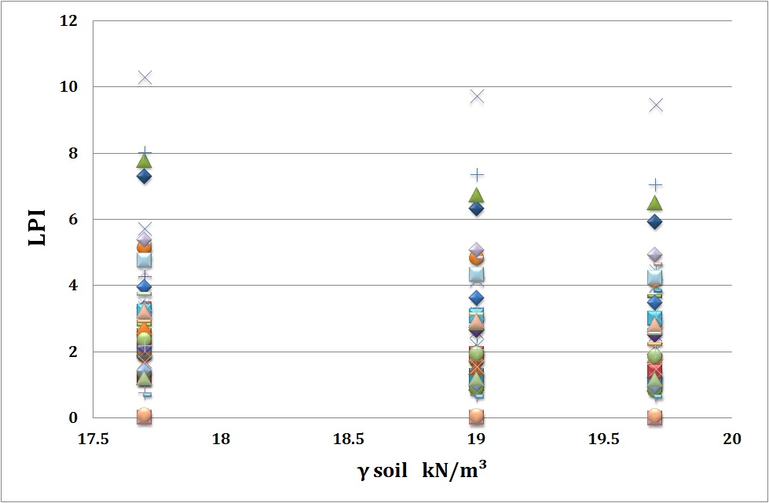
SENSITIVITY ANALYSIS
LPI-γ
Evaluation of the response of liquefaction potential with respect to changes in input parameters
Not very sensitive
High Risk
17.7 -19.7 kN/m³
Romeo, 2012
Low Risk

Slide 10
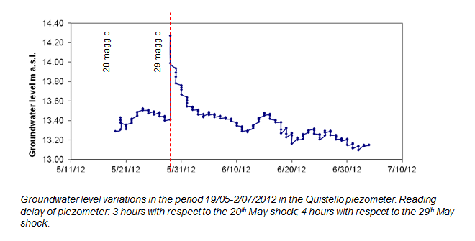
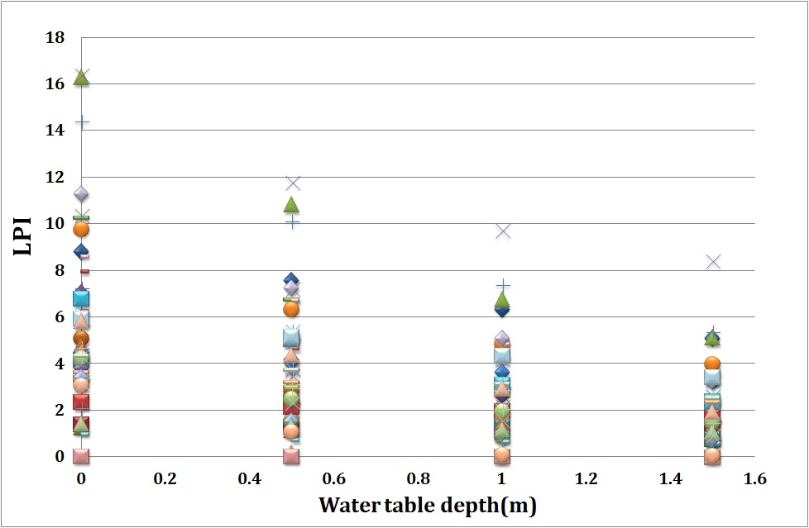
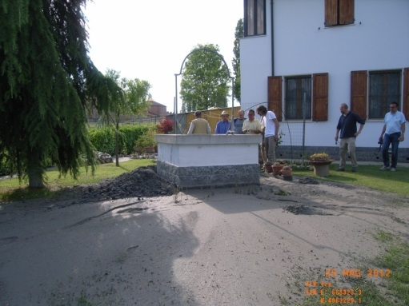
SENSITIVITY ANALYSIS
LPI-Water table depth
Very sensitive
Very High Risk
High Risk
after the May 29th earthquake the piezometric pressure showed an increase of 8 kPa, equal to a short-lasting uplift of 86 cm
Low Risk

Slide 11
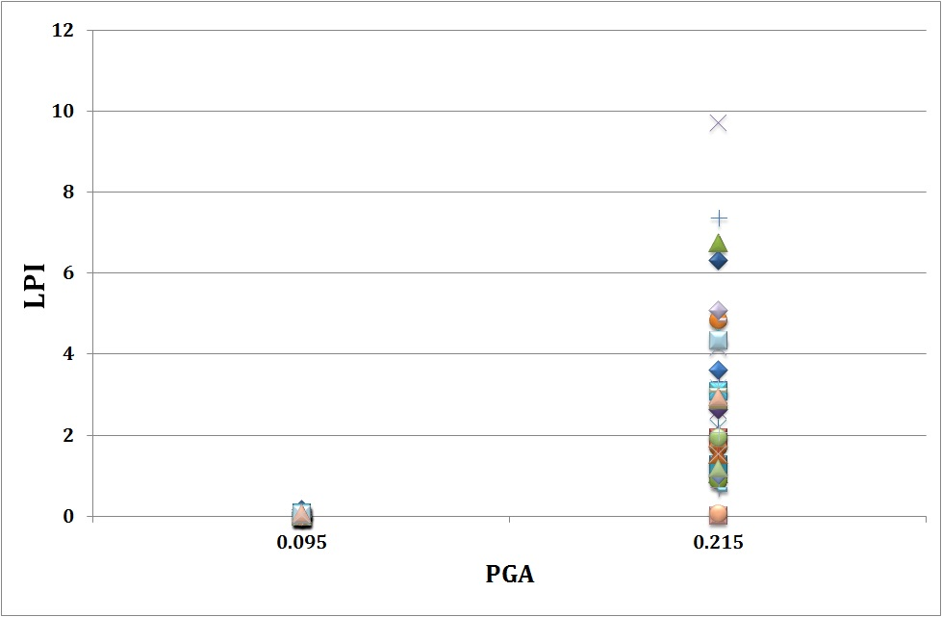
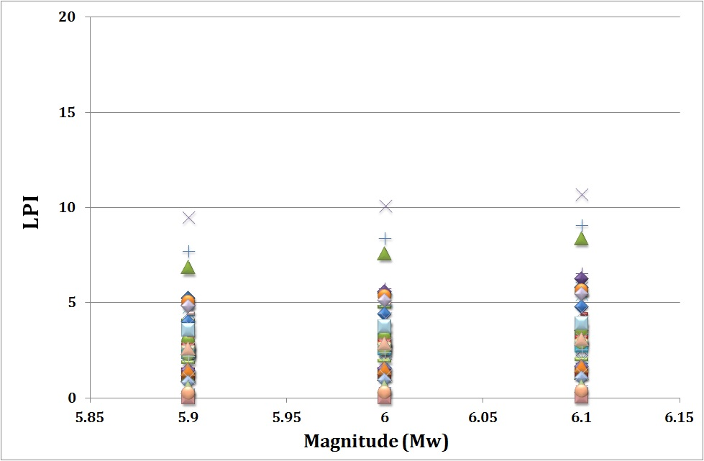
SENSITIVITY ANALYSIS
LPI-PGA
LPI-Mw
Very sensitive
Not very sensitive
High Risk
Very High Risk
High Risk
LPI increases of 10-15%
Low Risk
Low Risk

Slide 12
INPUT PARAMETERS: PGA and Mw
seismic hazard Maps (NTC 2008)
from instrumental recordings
from seismic response analysis
The PGAs are obtained following a probabilistic approach.
NTC 2008 suggest coefficients of amplification for the PGAs in order to account for both stratigraphic and topographic effects (negligible).
the soils have been considered as belonging to class C (medium stiff clay or medium dense sand with deep bedrock, below 30 m, and average shear wave velocity of the top 30 m in between 160 and 360 m/s) or class D (soft clay or loose sand with deep bedrock, below 30 m, and average shear wave velocity of the top 30 m lower than160 m/s).
PGAs for a return period of 475 years, i.e. for an exceedance probability of 10 % over a life time of 50 years.
Site | PGA (rock – A soil) | PGA (C soil) | PGA (D soil)
San Carlo, Sant’Agostino | 0.153 | 0.223 | 0.275
Mirabello | 0.147 | 0.216 | 0.264
Uccivello di Cavezzo | 0.150 | 0.220 | 0.271
San Possidonio | 0.138 | 0.206 | 0.249
Quistello | 0.097 | 0.145 | 0.174

Slide 13
seismic hazard Maps (NTC 2008)
from instrumental recordings
from seismic response analysis
the National accelerometric network (RAN) was incremented by installing temporary additional accelerometric stations.
PGA attenuation on C soil vs available predictive laws.
The attenuation with distance and magnitude scaling of the peak ground motion parameters, PGA and PGV, and the acceleration spectral ordinates (5% damping) at different periods, observed on May 29th, have been compared to the values inferred from ground motion prediction equations (GMPE) of the ITA10 (Bindi et al., 2011), recently derived from a qualified data set almost entirely consisting of crustal events recorded in the central – southern Apennines (reverse fault mechanism and appropriate site conditions are assumed).
Due to the scarce information about local site conditions, the observations were grouped into two classes: soft sites (EC8 class C, grey circles, for a comparison with ITA10 class C) and rock and stiff soil (EC8 class A and B, black circles, for a comparison with ITA10 class A).
for distances < 20 km the attenuation of PGA is quite negligible.
for the 29th May event the PGA remains constant and equal to about 0.23 – 0.25g.

Slide 14
seismic hazard Maps (NTC 2008)
from instrumental recordings
from seismic response analysis
INPUT PARAMETERS: PGA and Mw
Lai et al. (2012) have obtained, for a location in San Carlo (20th May event) a PGA on type D soil equal to 0.215g.
PGA = 0.215g and M_{w} = 5.9 for the 20th May event
PGA = 0.215g and M_{w} = 5.8 for the 29th May event
PGA = 0.15g for Quistello and M_{w} = 5.8;

Slide 15

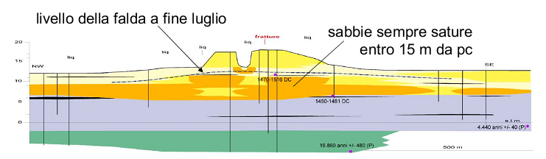
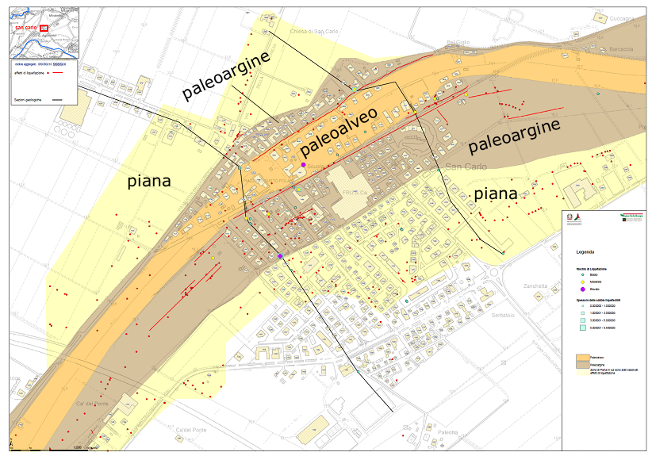
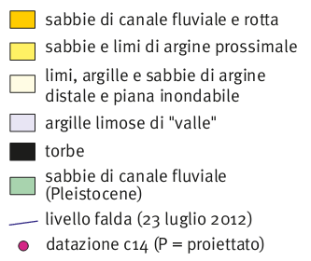
RESULTS: SE – SAN CARLO
L2
L3
L1
High spatial variability of soil characteristics
Martelli, 2013

Slide 16
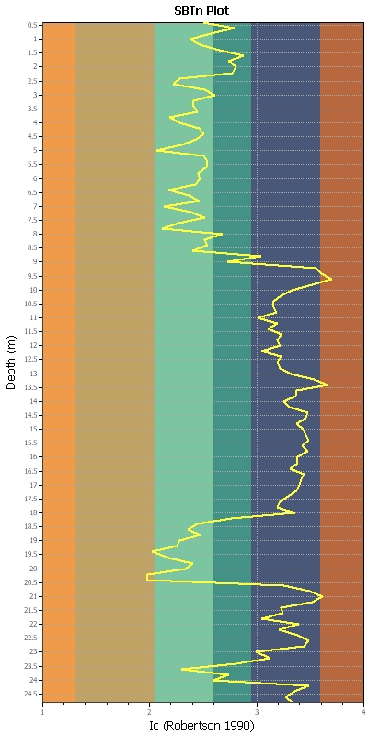
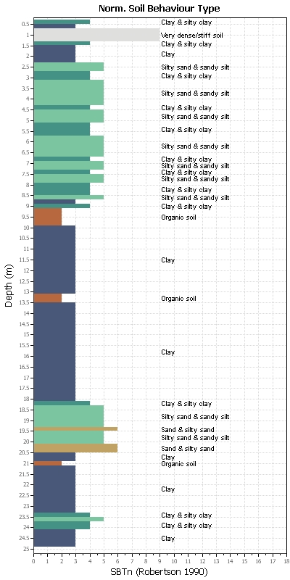

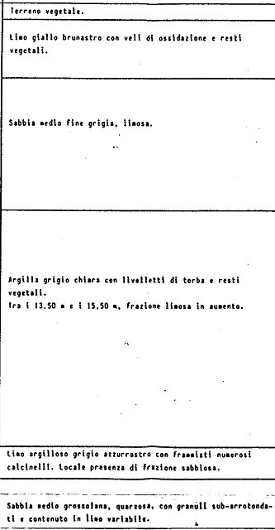
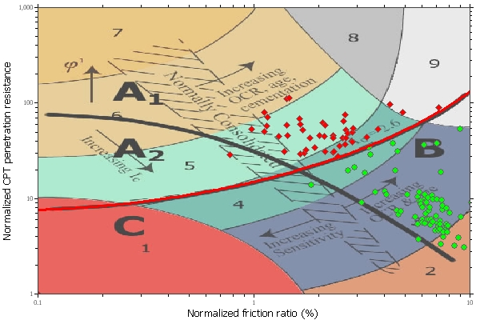
RESULTS : SE – SAN CARLO
L1 – Ancient Riverbed
2 liquifiable horizons:
A) 5-10 m thickness (alluvial deposits of the Reno River and old river banks)
B) 1-7 m thickness
0.5
5: silty sand and sandy silt
6: clean sand to silty sand
Liquefiable horizons | Robertson, 2009 | Idriss & Boulanger, 2008 | Moss et al. , 2006
A | - | 2,8-8,6m | 2,6-8,6m
B | - | - | -
25

Slide 17
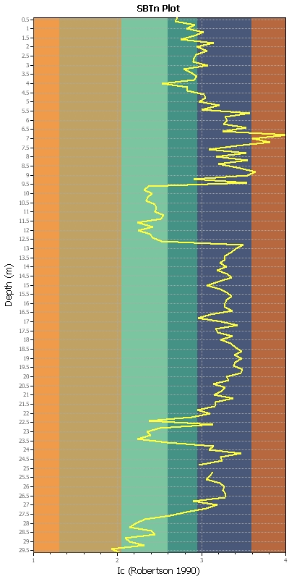
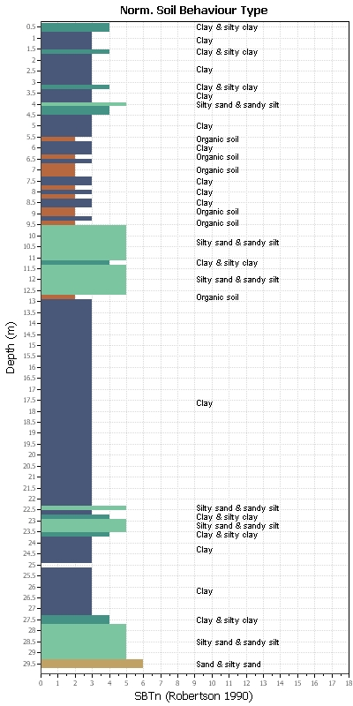
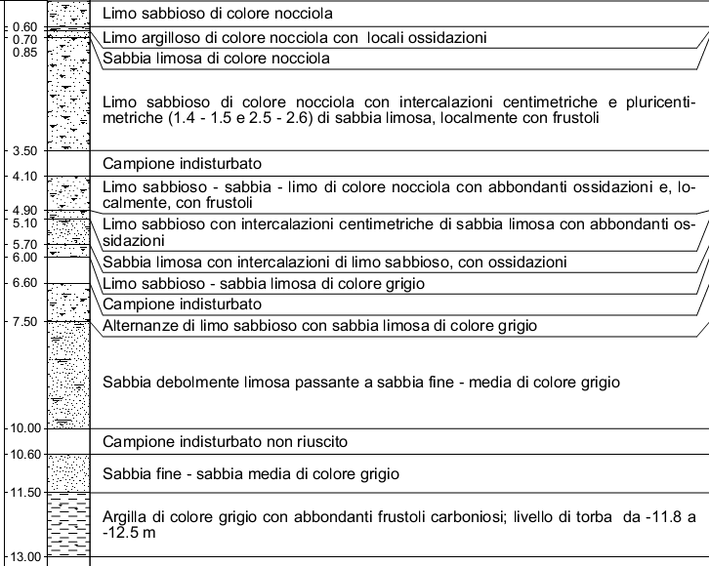
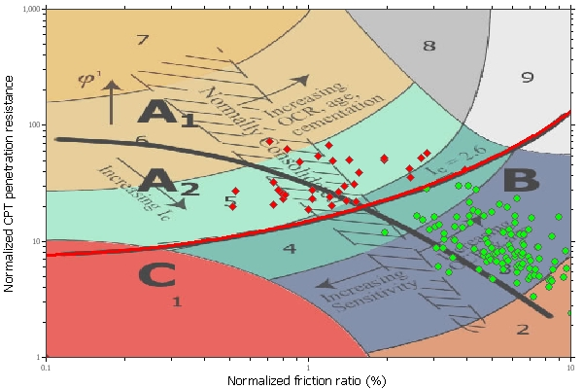
RESULTS : SE – SAN CARLO
L2 – Ancient levee ridge
0.5
Liquefiable horizons | Robertson, 2009 | Idriss & Boulanger, 2008 | Moss et al. , 2006
 | 9,6-12,6m | 9,6-12,6m | 9,6-12,6m
29.5

Slide 18
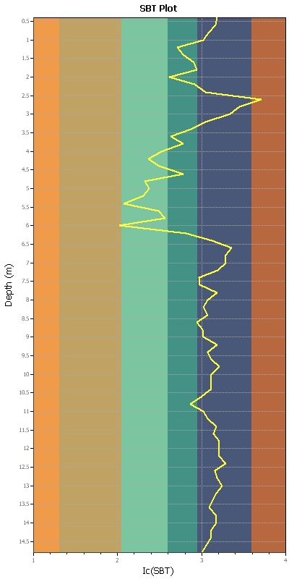
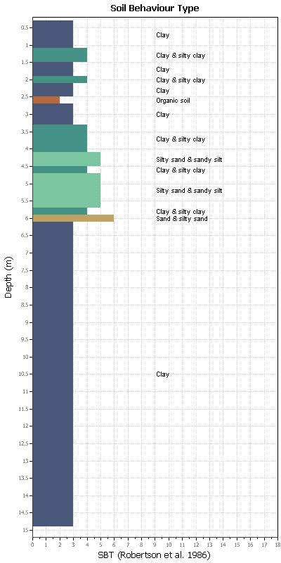
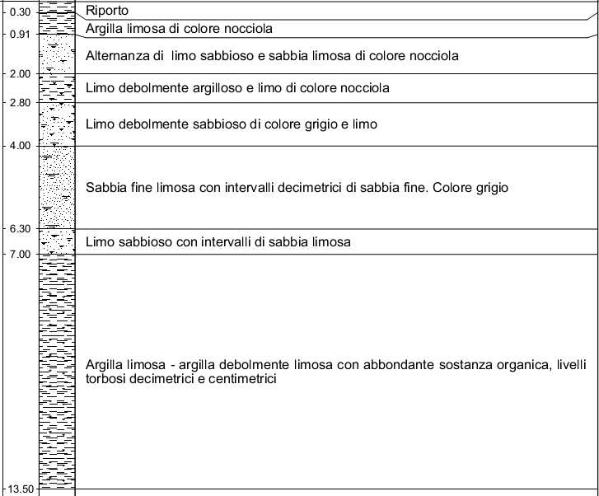
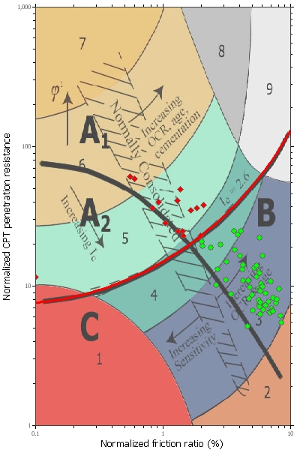
RESULTS : SE – SAN CARLO
L3 – Plain
0.5
Liquefiable horizons | Robertson, 2009 | Idriss & Boulanger, 2008 | Moss et al. , 2006
 | - | 4-6m | 4-6m
15

Slide 19
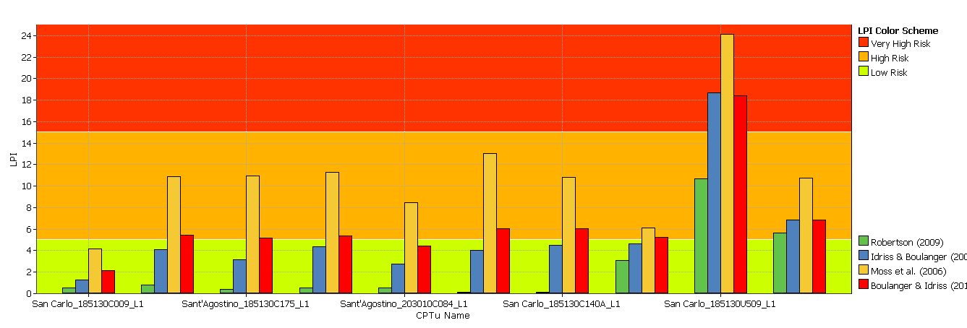
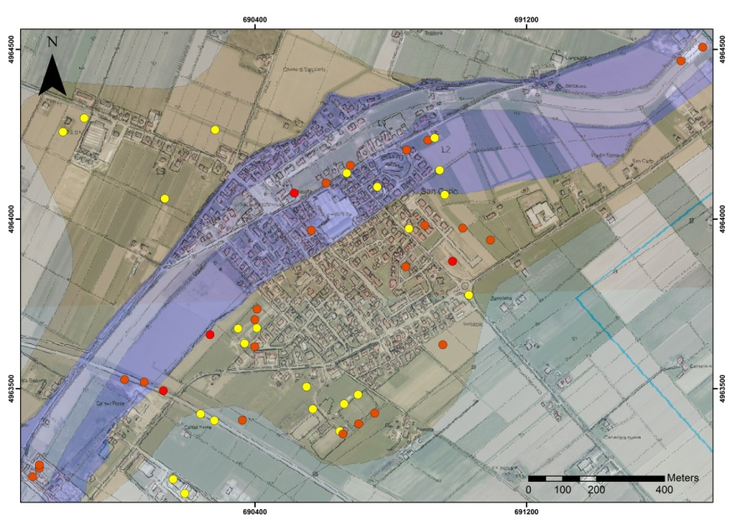
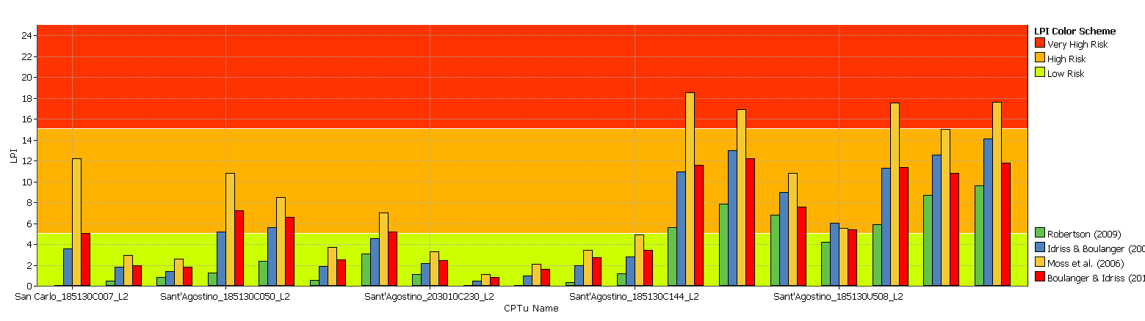
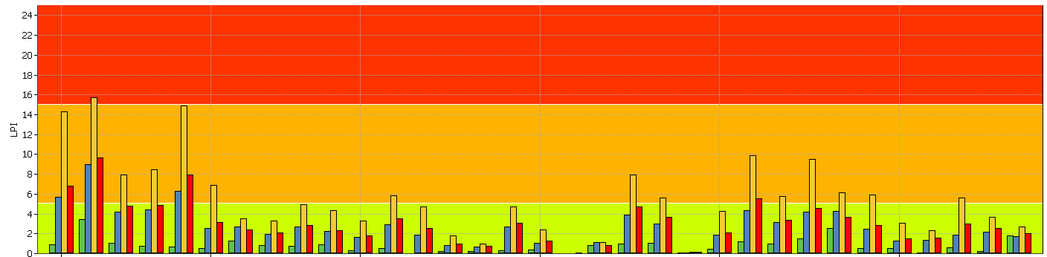
LPI: SE - San Carlo
L1: Ancient Riverbed
L3
L2
L1
L2: Ancient levee ridge
L3
LPI Color Scheme
L3: Plain
Very High Risk
High Risk
Low Risk
Liquefaction effects occurred at a distance less than 50 m
Robertson (2009)
Idriss & Boulanger (2008)
Moss et al. (2006)
Boulanger & Idriss (201)

Slide 20

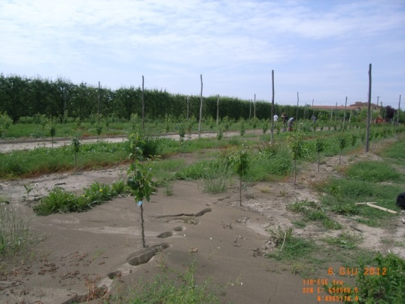
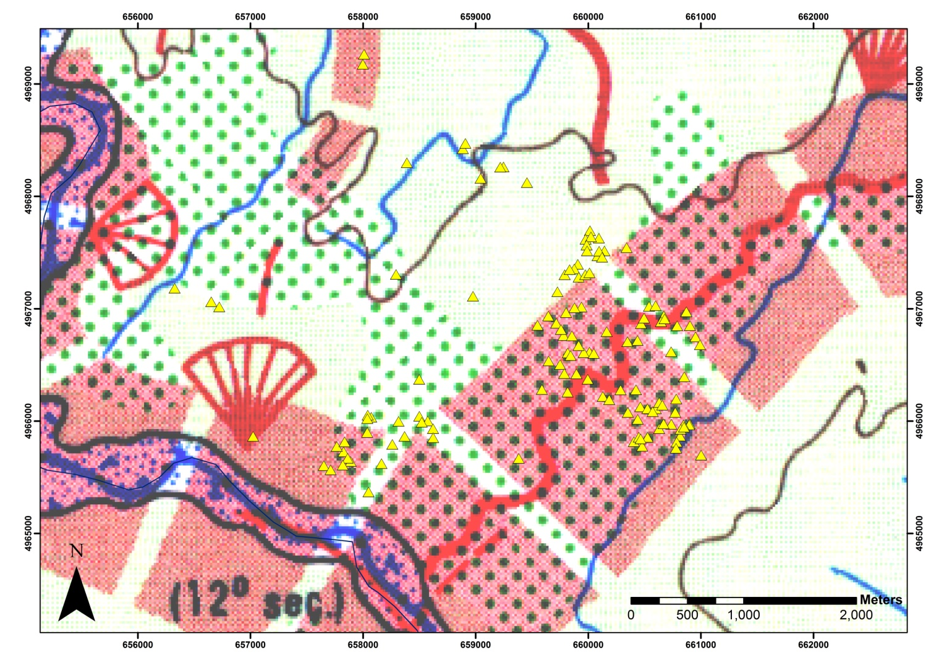
RESULTS: SW - CAVEZZO
29th May 2012 (M= 5.8) (5 km from epicenter)
Cavezzo (23 m a.s.l.) is on the Secchia fluvial ridge, which is orientated NW-SE. It was active during Roman and Medieval times till XII-XIII A.D.
(Castiglioni et al., 1999)
CPT/CPTU

Slide 21
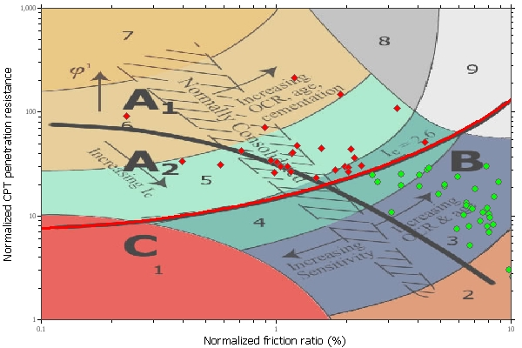
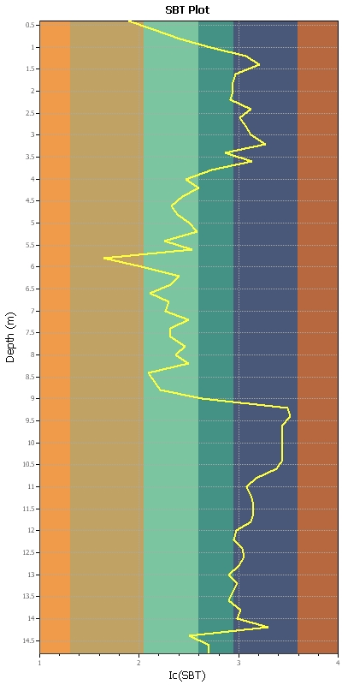
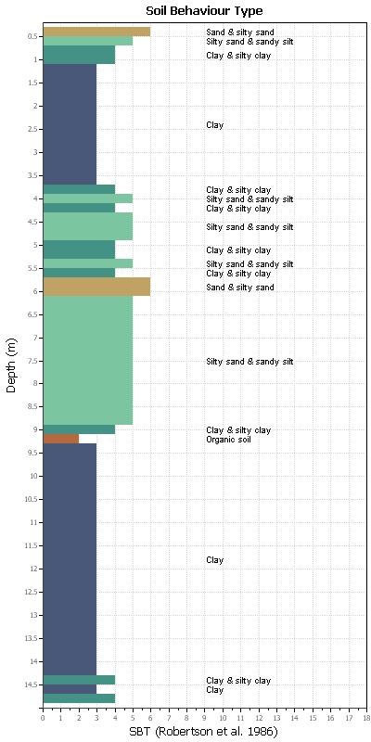
RESULTS: SW – CAVEZZO
L1 – Ancient Riverbed
0.5
Liquefiable horizons | Robertson, 2009 | Idriss & Boulanger, 2008 | Moss et al. , 2006
 | 6,5-9 m | 4-9 m | 4-9 m
14.5

Slide 22
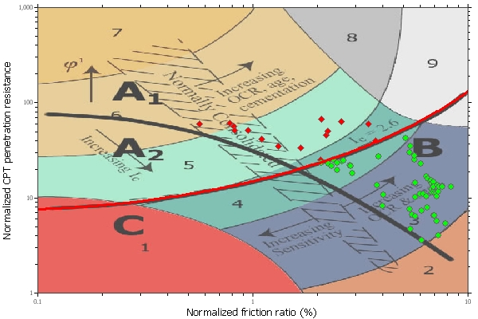
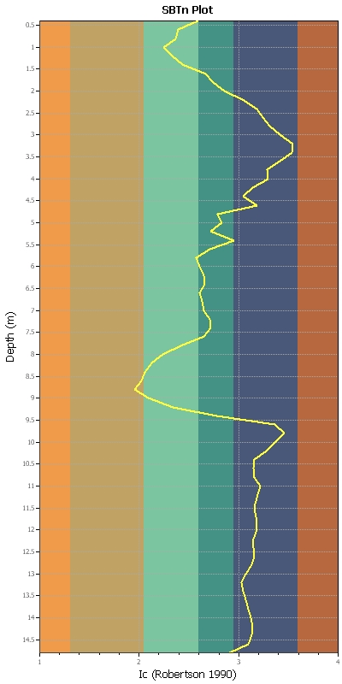
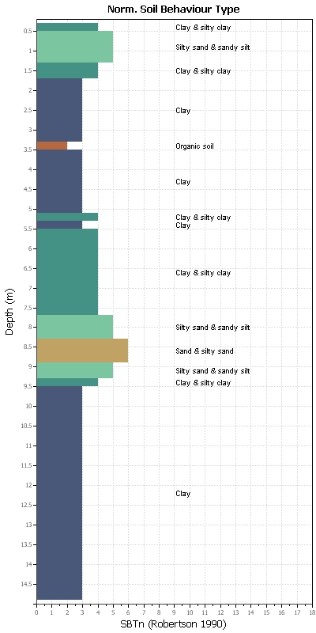
RESULTS: SW – CAVEZZO
L2 – Ancient levee ridge
0.5
Liquefiable horizons | Robertson, 2009 | Idriss & Boulanger, 2008 | Moss et al. , 2006
 | 8-9 m | 8-9 m | 8-9 m
14.5

Slide 23
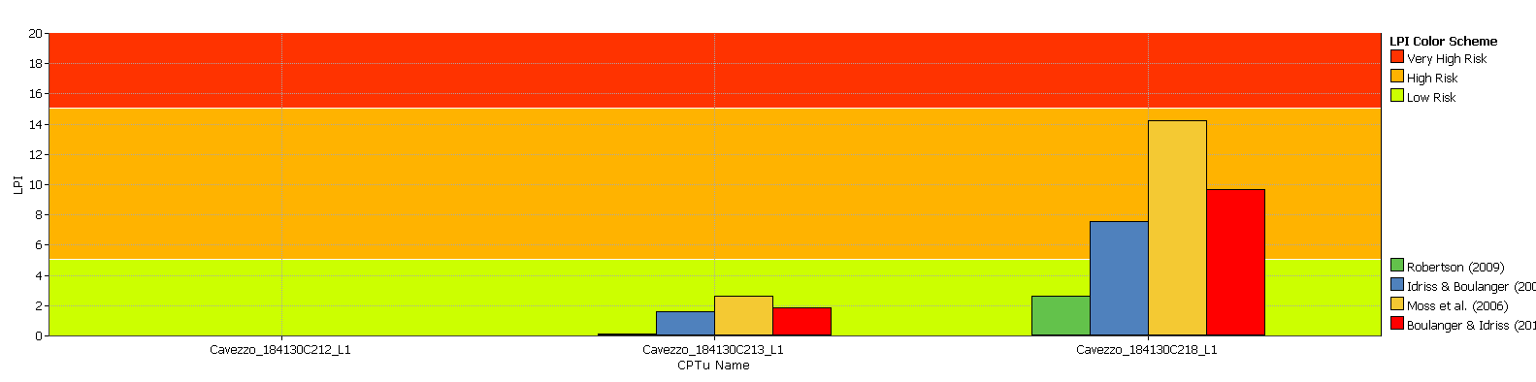
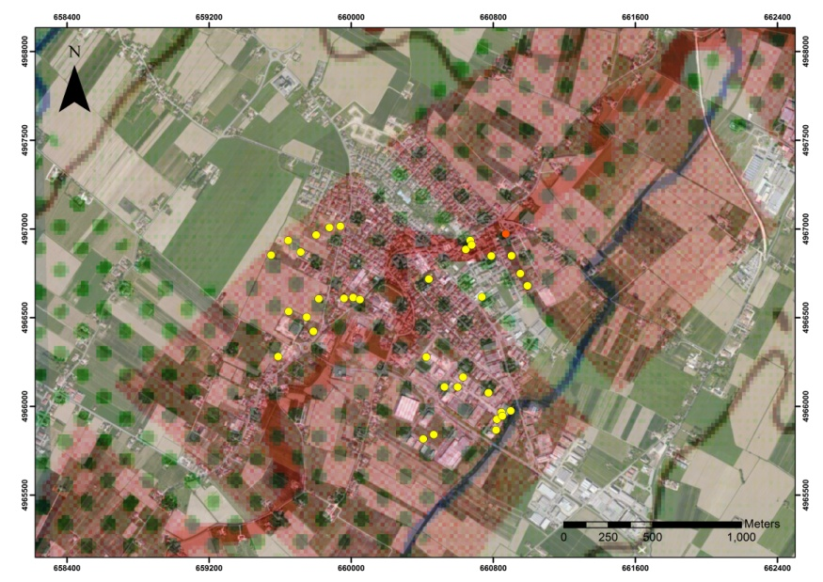

LPI: SW - Cavezzo
L1: Ancient Riverbed
L2
L1
L2: Ancient levee ridge
LPI Color Scheme
Very High Risk
High Risk
Low Risk
Liquefaction
Robertson (2009)
Idriss & Boulanger (2008)
Moss et al. (2006)
Boulanger & Idriss (201)

Slide 24


RESULTS: NW - QUISTELLO
Penetrometric tests
Castaldini, 2014

Slide 25


RESULTS: NW - QUISTELLO
CPTu4
CPTu3
CPTu2
CPTu1
Liquefaction
CPTu
Castaldini, 2012
Calzolari, 2012
Penetrometric test near liquefaction phenomena (20-30 m)

Slide 26






RESULTS: NW - QUISTELLO
CPTu4
CPTu1
CPTu3
CPTu2
16

Slide 27



Penetrometric test far from liquefaction phenomena
fine silty sands (Dr=70-100%, γ=18.5 kN/m³, qc=3-10 MPa)
silty clay (cu=44-73 kPa; γ = 19 kN/m³; qc=3.7-5.5 MPa).
sand and silty sand (Dr=55-75%; qc=8.8-23.5 MPa).
At the testing time (September 2003), the water table was at 4.3 m depth from the ground level.

Slide 28

LPI: NW - Quistello
L1: Ancient Riverbed
LPI Color Scheme
Very High Risk
High Risk
Low Risk
Liquefaction
Robertson (2009)
Idriss & Boulanger (2008)
Moss et al. (2006)
Boulanger & Idriss (201)

Slide 29

LPI vs LSN
SE - San Carlo
SW - Cavezzo
NW - Quistello
L2
L3
L2
L2
L1
L1
L1
L1
L2
L1
L3
L1
LSN Color Scheme
LPI Color Scheme
Severe damage, extensive evidence of liquefaction (LSN > 50)
Very High Risk (LPI>15)
Major expression of liquefaction (40≤LSN≤50)
L1: Ancient riverbed
L2: Ancient levee ridge
L3: Plain
High Risk (5≤LPI≤15)
Moderate to severe expression of liquefaction (30≤LSN≤40)
Low Risk (0≤LPI≤5)
Moderate expression of liquefaction (20≤LSN≤30)
Minor expression of liquefaction (10≤LSN≤20)
Little to no expression of liquefaction (0≤LSN≤10)

Slide 30
CONCLUSIONS
The results highlighted the very high spatial variability of penetration resistance, due to the vertical and lateral heteropic changes in stratigraphy, which complicates the liquefaction potential assessment
The sensitivity analysis underlined the importance in determining of input parameters, in particular the water table depth and the PGA.
Among the simplified methods used, Robertson, (2009) underestimates the thickness and number of layers susceptible to liquefaction in the area of the ancient riverbed of first site.
The differences that we have between Idriss & Boulanger, (2008) and Moss et al. (2006) are almost purely quantitative, it is significant only the change in the LPI value.
The methodology of Idriss & Boulanger, (2008) seems to be the most applicable to the study area, since it shows a good correspondence with the detected coseismic phenomena.
The LSN parameter underestimates the liquefaction potential in the study area.

