Slide 2
Outline
Reliability and Availability modelling
Exponential failure law for the hardware
Combinatorial models
  Series/Parallel
  Fault Trees
State based models: Markovian models
  Discrete time Markov chain
  Continuus time Markov chain

Slide 3

Textbook and other references
[Sieviorek et al. 1998] D. P. Siewiorek R.S. Swarz, Reliable Computer Systems Design and Evalutaion, 2nd Ed. Digital Press, 1998. Chapter 5 (part).
Tools https://www.mobius.illinois.edu/

Slide 4
Quantitative evaluation of Dependability
Faults are the cause of errors and failures. Does the arrival time of faults fit a probability distribution?
If so, what are the parameters of that distribution?
Consider the time to failure of a system or component.
It is not exactly predictable - random variable.
probability theory
Evaluation of Failure rate, Mean Time To Failure (MTTF), Mean Time To Repair (MTTR), Reliability (R(t)), Availability (A(t)) function

Slide 5
Definition of dependability attributes
Reliability - R(t)
conditional probability that the system performs correctly throughout the interval of time [t0, t], given that the system was performing correctly at the instant of time t0
Availability - A(t)
the probability that the system is operating correctly and is available to perform its functions at the instant of time t

Slide 6

Definitions
Reliability R(t)
Unreliability Q(t)
Q(t) = 1 – R(t)
Failure probability density function f(t)
the failure density function f(t) at time t is the
number of failures in Δt
dQ(t)
- dR(t)
f(t) =
=
dt
dt
Failure rate function λ(t)
the failure rate λ(t) at time t is defined by the
number of failures during Δt in relation to
the number of correct components at time t
f(t)
- dR(t)
1
λ(t) =
=
R(t)
dt
R(t)

Slide 7
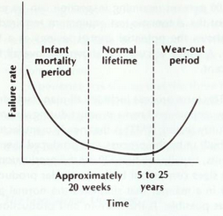
Hardware Reliability
λ(t) is a function of time
(bathtub-shaped curve )
λ(t)
λ(t) constant > 0
in the operational phase
Constant failure rate λ
(usually expressed in number of failures for million hours)
= 1/200 one failure every 2000 hours
λ
Taken from: [Siewiorek et al.1998]
Early life phase: there is a higher failure rate due to the failures of weaker
components (result from defetct or stress introduced in the manufacturing
process). Wear-out phase: time and use cause the failure rate to increase.

Slide 8
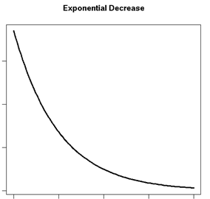
Hardware Reliability
Constant failure rate
λ(t) = λ
Reliability function
R(t) = e–λt
Probability density function
f(t) = λe–λt
f(t)
- dR(t)
1
λ(t) =
=
R(t)
dt
R(t)
R(t)
time
the exponential relation between reliability and time is known as exponential failure law

Slide 9
Time to failure of a component
Time to failure of a component can be modeled by a random variable X
F_{X} (t) = P[X<=t ] (cumulative distribution function)
F_{X} (t) unreliability of the component at time t
Reliability of the component at time t
R (t) = P[X > t] = 1 – P[X <= t] = 1 – F_{X} (t)
R(t) is the probability of not observing any failure before time t

Slide 10
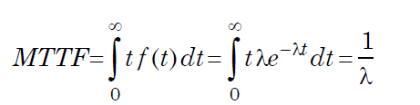
Time to failure of a component
Mean time to failure (MTTF)
is the expected time that a system will operate before the
first failure occurs (e.g., 2000 hours)
λ = 1/2000 0.0005 per hour
MTTF = 2000 time to the first failure 2000 hours
Failure in time (FIT)
measure of failure rate in 109 device hours
1 FIT means 1 failure in 109 device hours

Slide 11
Failure Rate
- Handbooks of failure rate data for various components are available from
government and commercial sources.
- Reliability Data Sheet of product
Commercially available databases
- Military Handbook MIL-HDBK-217F
- Telcordia,
- PRISM User’s Manual,
- International Eletrotechnical Commission (IEC) Standard 61508
- …

Slide 12
Distribution model for permanent faults
MIL-HBDK-217 (Reliability Prediction of Electronic Equipment -Department of Defence)
Statistics on electronic components failures studied since 1965 (periodically updated).
Chip failure rates in the range 0.01-1.0 per million hours
λ = τ_{L}τ_{Q}(C₁τ_{T} τ_{V} + C₂τ_{E})
τ_{L} = learning factor, based on the maturity of the fabrication process
τ_{Q} = quality factor, based on incoming screening of components
τ_{T} = temperature factor, based on the ambient operating temperature
and the type of semiconductor process
τ_{E} = environmental factor, based on the operating environment
τ_{V} = voltage stress derating factor for CMOS devices
C₁, C₂ = complexity factors (based on number of gates, or bits for memories and number of pins)

Slide 13
Model-based evaluation of dependability
a model is an abstraction of the system that highlights the important features for the objective of the study
Methodologies that employ combinatorial models:
Reliability Block Diagrams, Fault tree, ….
State space representation methodologies:
Markov chains, Petri-nets, SANs, …

Slide 14
Combinatorial models

Slide 15
Combinatorial models
offer simple and intuitive methods of the construction and solutions of models
Assumptions:
independent components
each component is associated a failure rate
model construction is based on the structure of the systems (series/parallel connections of components)
inadequate to deal with systems that exhibits complex dependencies among components and repairable systems

Slide 16
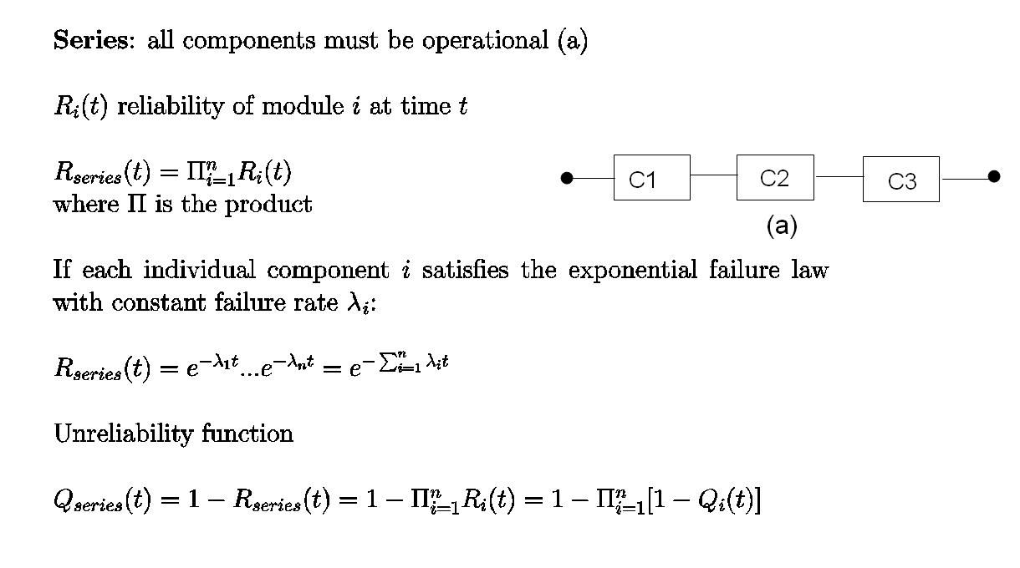
Combinatorial models

Slide 17
Combinatorial models
If the system does not contain any redundancy, that is any component must function properly for the system to work, and if component failures are independent, then
the system reliability is the product of the component reliability, and it is exponential
- the failure rate of the system is the sum of the failure rates of the individual components

Slide 18
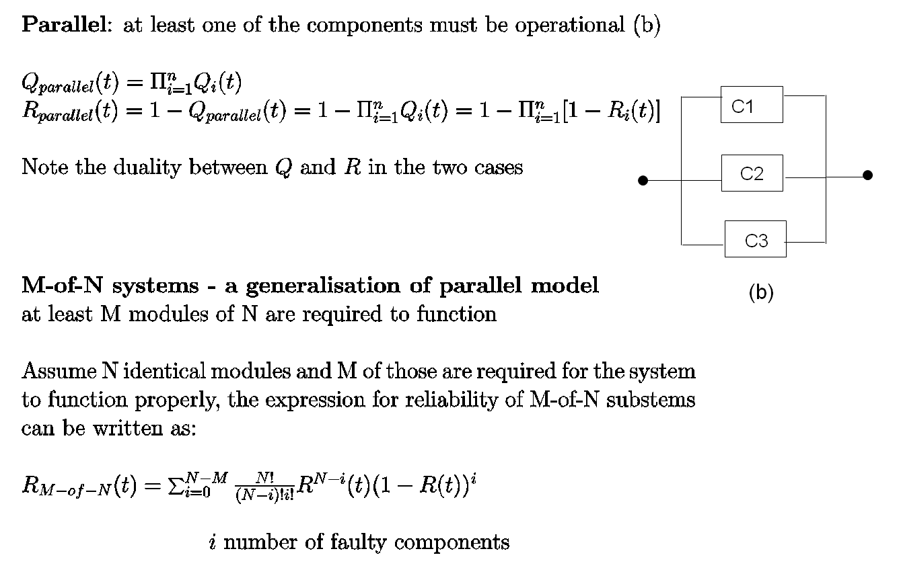
Combinatorial models
( ) =
N
N!
(N-i)!
I
i!
Binomial coefficient

Slide 19
Combinatorial models
If the system contain redundancy, that is a subset of components must function properly for the system to work, and if component failures are independent, then
the system reliability is the reliability of a series/parallel
combinatorial model

Slide 20
Combinatorial models
Series/Parallel models
An example:
Multiprocessor with 2 processors and three shared memories

Slide 21
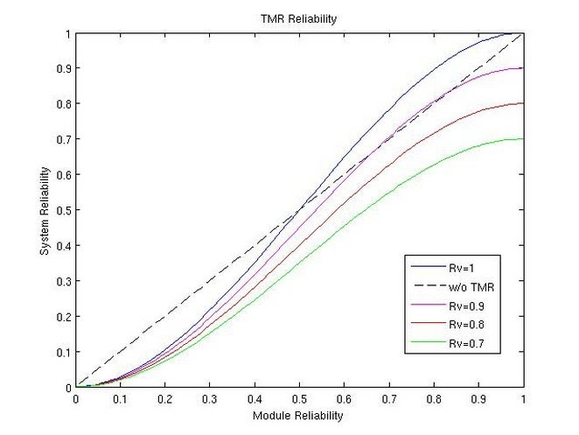
TMR versus Simplex system
Simplex system
failure rate of module m
R_{m} = e –λt
R_{simplex} = e –λt
TMR system
R_{V}(t) = 1
R_{TMR} = Σ 1
= (e –λt )3 + 3(e –λt )2 (1- e –λt )
m
3
(e –λt )3-i (1- e –λt )i
_{i=0}
i
R_{TMR} > R_{m} if R_{m} > 0.5
m1
m2
V
m3
2 of 3
Taken from: [Siewiorek et al.1998]

Slide 22
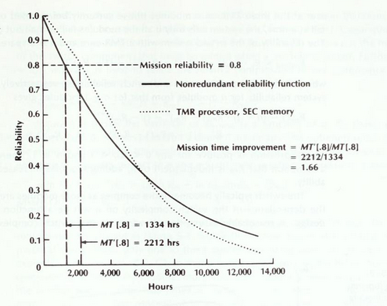
TMR: reliability function and mission time
R_{simplex} = e –λt
MTTF_{simplex} =
TMR system
R_{TMR} = 3e –2λt -2e –3λt
MTTF_{TMR} =
_
1
λ
_
_
3
5
1
2
_
- _
=
>
2λ
3λ
6λ
λ
TMR worse than a simplex system
but
TMR has a higher reliability for the first 6.000 hours
TMR operates at or above 0.8 reliability
66 percent longer than the simplex system
S shape curve is typical of redundant systems: above
the knee the redundant system has components that tolerate
failures; after the knee the system has exhausted redundancy
Taken from: [Siewiorek et al.1998]

Slide 23
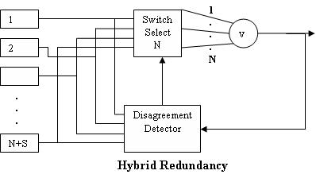
Hybrid redundancy with TMR
Symplex system
λ failure rate m
R_{m} = e –λt
R_{sys} = e –λt
Hybrid system
n=N+S total number of components
S number of spares
Let N = 3 R_{SDV}(t) = 1
failure rate of on line comp
failure rate of spare comp
The first system failure occurs if 1) all the modules fail; 2) all but one modules fail
R_{Hybrid} = R_{SDV}(1- Q_{Hybrid})
R_{Hybrid} = (1 – ( (1-R_{m})n + n(R_{m})(1-R_{m})n-1 ))
m1
m2
SDV
...
mn
Taken from: [Siewiorek et al.1998]
R_{Hybrid(n+1) –} R_{Hybrid(n)} >0
adding modules increases
the system reliability under the
assumption R_{SDV} independent of n

Slide 24
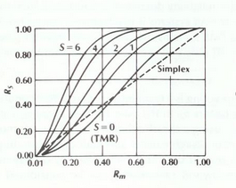
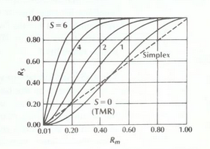
Hybrid redundancy with TMR
Hybrid TMR system reliability R_{S} vs individual module reliability R_{m}
S is the number of spares
R_{SDV} =1
System with standby failure rate equal to on-line failure rate
System with standby failure rate equal to 10% of on line failure rate
TMR with one spare is more reliable than simplex system if R_{m}>0.23
TMR with one spare is more reliable than simplex system if R_{m}>0.17

Slide 25
Fault Trees
Consider the combination of events that may lead to an undesirable situation of the system
Describe the scenarios of occurrence of events at abstract level
Hierarchy of levels of events linked by logical operators
The analysis of the fault tree evaluates the probability of occurrence of the root event, in terms of the status of the leaves (faulty/non faulty)
Applicable both at design phase and operational phase

Slide 26
Fault Trees
G0
TOP EVENT
Describes the Top Event (status of the system)
in terms of the status
(faulty/non faulty) of the Basic events (system’s components)
OR
G2
G3
GATE SYMBOL
AND
OR
G4
E3
E2
EVENT SYMBOL
E1
OR
E4
E5

Slide 27
Fault Trees
AND gate
Components are leaves in the tree
Component faulty corresponds to logical value true, otherwise false
Nodes in the tree are boolen AND, OR and k of N gates
The system fails if the root is true
AND
True if all the components
are true (faulty)
C1
C2
C3
OR gate
OR
True if at least one
of the components is true (faulty)
C1
C2
C3
K of N gate
2 of 3
True if at least k of the components
are true (two or three
components) (faulty)
C1
C2
C3

Slide 28
Fault Trees
Example
Multiprocessor with 2 processors and three shared memories
-> the computer fails if all the memories fail or all the processors fail
Top event
System failure
OR
AND
AND
P1
P2
M1
M2
M3

Slide 29
Conditional Fault Trees
Example
Multiprocessor with 2 processors and three memories:
M1 private memory of P1, M2 private memory of P2, M3 shared memory.
Top event
system
Assume every process has its own private memory plus a shared memory
Operational condition: at least one processor is active and can access to its private or shared memory
repeat instruction: given a component C whether or not the component is input to more than one gate, the component is unique
AND
OR
OR
AND
AND

Slide 30
Conditional Fault Trees
If the same component appears more than once in a fault tree, the independent failure assumption. We use conditioned fault tree is violated
If a component C appears multiple times in the FT
Q_{s}(t) = Q_{S|C Fails}(t) Q_{C}(t) + Q_{S|C not Fails}(t) (1-Q_{C}(t))
where
S|C Fails is the system given that C fails
and
S|C not Fails is the system given that C has not failed

Slide 31
Minimal cut sets
1. A cut is defined as a set of elementary events that, according to the logic expressed by the FT, leads to the occurrence of the root event.
2. To estimate the probability of the root event, compute the probability of occurrence for each of the cuts and combine these probabilities
TOP
OR
Cut Sets
Top = {1}, {2} , {G1} , {5} = {1}, {2} , {3, 4} , {5}
1
2
5
G1
AND
Minimal Cut Sets
Top = {1}, {2} , {3, 4} , {5}
3
4

Slide 32
Minimal cut sets
TOP
OR
Q_{Si}(t) = probability that all components in the minimal cut set Si are faulty
Q_{Si} (t) = q₁(t) q₂(t) … q_{ni}(t) with Si ={1, 2, …, ni }
The numerical solution of the FT is performed by computing the probability of occurrence for each of the cuts, and by combining those probabilities to estimate the probability of the root event
1
2
5
G1
AND
3
4
Minimal Cut Sets
Top = {1}, {2} , {3, 4} , {5}
Assumption: independent faults of the components

Slide 33
Minimal cut sets
Minimal Cut Sets
Top = {1}, {2} , {3, 4} , {5}
TOP
OR
S₁
= {1}
S₂
= {2}
S₃
= {3, 4}
S₄
= {5}
1
2
5
G1
Q_{Top} (t) = Q_{S1} (t) + … + Q_{Sn} (t)
n number of mininal cut sets
AND
3
4

Slide 34
Fault Trees
Identification of critical path of the system
  - Definition of the Top event
  - Minimal cut set (minimal set of events that leads to the top event)
Analysis:
- Failure probability of Basic events
- Failure probability of minimal cut sets
- Failure probability of Top event
- Single point of failure of the system: minimal cuts with a single event

Slide 35
State-based models

Slide 36
State-based models
Characterize the state of the system at time t:
- identification of system states
- identification of transitions that govern the changes of state within a system
Each state represents a distinct combination of failed and working modules
The system goes from state to state as modules fail and repair
The state transitions are characterized by the probability of failure
and the probability of repair

Slide 37
Markov model
graph where nodes are all the possible states and arcs are the possible transitions between states (labeled with a probability function)
1-p_{f}
p_{f}
1
Reliability model
0
1
1-p_{f}
p_{f}
1-p_{r}
Availability model
0
1
p_{r}

Slide 38
Markov models
Markov models (a special type of random process) :
  Basic assumption: the system behavior at any time instant depends only on the current state (independent of past values)
Main points:
- systems with arbitrary structures and complex dependencies
- assumption of independent failures no longer necessary
- can be used for both reliability and availability modeling

Slide 39
Markov process
In a general random process {X_{t} }, the value of the random variable X_{t+1} may depend on the values of the previous random variables
X_{t0} X_{t1} ............X_{t}
Markov process
the state of a process at time t+1 depends only on the state at time t, and is independent on any state before t
Markov property: “the current state is enough to determine
the future state”

Slide 40

Markov chain
A Markov chain is a Markov process X with discrete state space S
A Markov chain is homogeneous if it has steady-state transition probabilities
The probability of transition from state i to state j does not depend by the time. This probability is called p_{ij}
We consider only homogeneous Markov chains
- discrete-time Markov chains (DTMC) / Continuous-time Markov chains (CTMC)

Slide 41
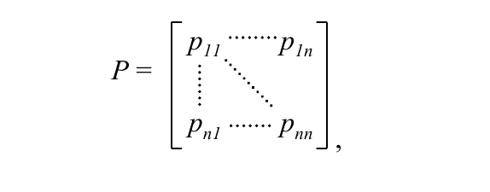
Transition probability matrix
If a Markov process is finite-state, we can define the transition probability matrix P (nxn)
pij = probability of moving from state i to state j in one step
row i of matrix P:
probability of make a transition starting from state i
column j of matrix P:
probability of making a transition from any state to state j

Slide 42
Discrete-time Markov chain (DTMC)
State space distribution
State occupancy vector at time t π(t) = [π₀(t), π₁(t), π₂(t) , …]
Probability that the Markov process
is in state i at time-step t
    π_{i}(t) = P{X_{t} = i}
Initial state space distribution
π(0)
= (π₁ , …, π_{n} )
(0)
(0)
A single step forward
π(1) = π(0) P
State occupancy vector at time t π(t) = π(0) P^{t}
System evolution in a finite number of steps computed starting from the initial state distribution and the transition probability matrix

Slide 43

Limiting behaviour
A Markov process can be specified in terms of the state occupancy probability vector p and a transition probability matrix P
π(t) = π(0) Pt
The limiting behaviour of a DTMC (steady-state behaviour)
The limiting behaviour of a DTMC depends on the characteristics of its states. Sometimes the solution is simple

Slide 44
Steady-state behaviour
THEOREM:
For aperiodic irreducible Markov chain for each j and are independent from π(0)
Moreover, if all states are recurrent non-null, the steady-state behaviour of the Markov chain is given by the fixpoint of the equation:
π(t) = π(t−1) P with Σ_{j} π_{j} =1
π_{j} is inversely proportional to the period of recurrence of state j

Slide 45

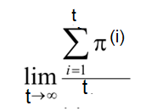
Time-average state space distribution
1 2
1 0 1
2 1 0
P=
For periodic Markov chains
doesn’t exist (caused by the probability of the periodic state)
1
1
2
Compute the time-average state space distribution, called π*
1
π(0) =(1,0)
state i is periodic with period d=2
π* =
π(0) = (1,0)
π(1) = π(0) P π(1) = (0,1)
π(2) = π(1) P π(2) = (1,0)
………..

Slide 46
Simplex system
{X_{t} } t=0, 1, 2, …. S={0, 1}
- all state transitions occur at fixed intervals
probabilities assigned to each transition
The probability of state transition depends only on the current state
State 0 : working
State 1: failed
1-p_{f}
p_{f}
0
1
Failure probability
p_{f}
p_{r}
next
state
0
1
1-p_{f}
p_{f}
0
- pij = probability of a transition from state i to state j
- pij >=0
- the sum of each row must be one
P =
0
1
1
current
state

Slide 47
Simplex system with repair
{X_{t} } t=0, 1, 2, …. S={0, 1}
- all state transitions occur at fixed intervals
probabilities assigned to each transition
The probability of state transition depends only on the current state
State 0 : working
State 1: failed
1-p_{f}
p_{f}
1-p_{r}
0
1
Failure probability
p_{f}
Repair probability
p_{r}
p_{r}
next
state
0
1
1-p_{f}
p_{f}
0
- pij = probability of a transition from state i to state j
- pij >=0
- the sum of each row must be one
P =
p_{r}
1- p_{r}
1
current
state

Slide 48
Simplex system with repair
initial state: working
[p₀(0), p₁ (0)] = [ 1, 0]
[ 1, 0]
0.9
0.1
[p0(1), p1(1)] =
= [ 0.9, 0.1]
0.5
0.5
State j can be made an trapping state with pjj = 1

Slide 49
Simplex system with repair
probability of being in a state after 1 time-step
1-p_{f}
p_{f}
[p₀(n), p₁(n)] = [p₀(n-1), p1(n-1)]
p_{r}
1- p_{r}
probability of being in a state after n time-steps
n
1-p_{f}
p_{f}
[p₀(n), p₁(n)] = [p₀(0), p₁(0)]
p_{r}
1- p_{r}

Slide 50
Continuous-time Markov model
state transitions occur at random intervals
transition rates assigned to each transition
Markov property assumption
the length of time already spent in a state does not influence either the probability distribution of the next state or the probability distribution of remaining time in the same state before the next transition
These assumptions imply that the waiting time spent in any one state is exponentially distributed
Thus the Markov model naturally fits with the standard assumptions that failure rates are constant, leading to exponential distribution of interarrivals of failures

Slide 51
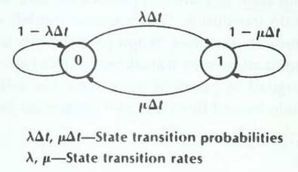

Simplex system with repair
state 0: working
state 1: failed
failure rate
μ repair rate
:
Continuous time
Transition matrix P: transition rate
Probability of being in state 0 or 1 at time t+Δt
Taken from: [Siewiorek et al.1998]

Slide 52


Simplex system with repair
probability of being in state 0 at time t+Δt
Performing multiplication, rearranging and dividing by Δt, taking the limit as Δt approaches to 0:

Slide 53

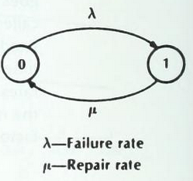
Simplex system with repair
Continuous time Markov model graph
T matrix
The change in state 0 is minus the flow out of state 0 times the probability of being in state 0 at time t, plus the flow into state 0 from state 1 times the probability of being in state 1.
The set of equations can be written by inspection of a transition diagram without self-loops and Δt’s

Slide 54
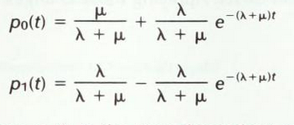
Simplex system with repair
A(t)
p₀(t) probability that the system is in the operational state at time t, availability at time t
The availability consists of a steady-state term and an exponential decaying transient term

Slide 55
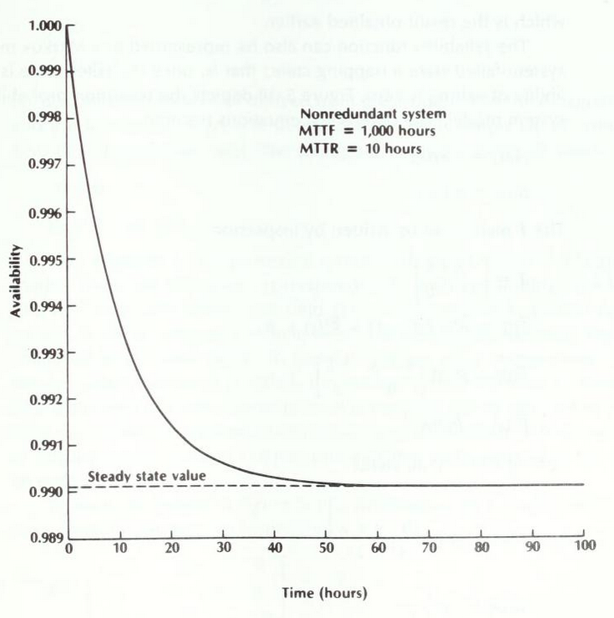
Availability as a function of time
λ = 0.001
μ = 0.1
The steady-state value is reached in a very short time
Taken from: [Siewiorek et al.1998]

Slide 56


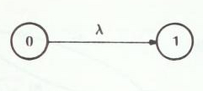

Continuous-time Markov models: Reliability
Single system without repair
failed state as trapping state
T =
λ = failure rate
λΔt = state transition probability
Continuous time Markov model graph
We can prove that:
Reliability
Unreliability

Slide 57


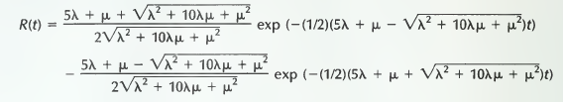
TMR system with repair
Rates: λ and μ
Identification of states:
3 processors working, 0 failed
2 processors working, 1 failed
1 processor working, 2 failed
T =
Reliability R(t) = 1- p2(t)
P(0) = [1, 0, 0]

Slide 58
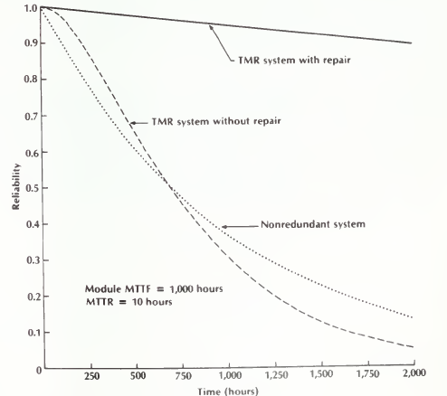
Comparison with nonredundant system and TMR without repair
Taken from: [Siewiorek et al.1998]

Slide 59
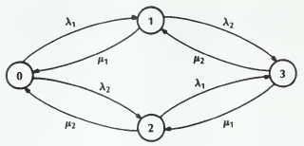

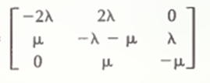
Dual processor system with repair
A, B processors
Rates: λ1, λ2 and μ1, μ2
Identification of states:
A, B working
A working, B failed
B working, A failed
A, B failed
Rates: λ1= λ2 and μ1=μ2
Availability
A(t) = 1- p₂(t)
p(0) = [1, 0, 0]
T =

Slide 60
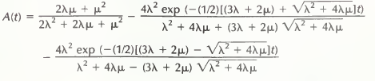

Dual processor system with repair
Steady state value
steady-state availability

Slide 61


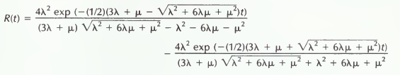
Reliability model
making state 2 a trapping state
T=
p(0) = [1, 0, 0]
Reliability R(t) = 1- p₂(t) R(t)=p₀(t) + p₁(t)

Slide 62
TMR system with repair
Rates: λ and μ
Identification of states:
3 processors working, 0 failed
2 processors working, 1 failed
1 processor working, 2 failed
T =
P(0) = [1, 0, 0]
Reliability R(t) = 1- p2(t)

Slide 63
Comparison with nonredundant system and TMR without repair

Slide 64
Multiprocessor
Multiprocessor system with 2 processors and 3 shared memories system.
System is operational if at least one processor and one memory are operational.
λ_{m} failure rate for memory
λ_{p} failure rate for processor
X random process that represents the number of operational memories and the number of operational processors at time t
Given a state (i, j):
i is the number of operational memories;
j is the number of operational processors
S = {(3,2), (3,1), (3,0), (2,2), (2,1), (2,0), (1,2), (1,1), (1,0), (0,2), (0,1)}

Slide 65
Reliability modeling
λ_{m} failure rate for memory
λ_{p} failure rate for processor
(3, 2) -> (2,2) failure of one memory
(3,0), (2,0), (1,0), (0,2), (0,1) are absorbent states

Slide 66
Availability modeling
Assume that faulty components are replaced and we evaluate the probability that the system is operational at time t
Constant repair rate m (number of expected repairs in a unit of time)
Strategy of repair:
only one processor or one memory at a time can be substituted
The behaviour of components (with respect of being operational or failed) is not independent: it depends on whether or not other components are in a failure state.

Slide 67
Availability modeling
λm failure rate for memory
λp failure rate for processor
μm repair rate for memory
μp repair rate for processor

Slide 68
Conclusions
Quantitative dependability evaluation
- guiding design decisions
- assessing systems as built
- mandatory for safety critical systems
Model construction techniques
- scalability challenge
- decomposition/aggregation approaches
High-level modelling formalisms
  Stochastic petri Nets
  Stochastic Activity networks
The overall model is decoupled in simpler and more tractable submodels, and the measures obtained from the solution of the sub-models are then aggregated to compute those concerning the overall model

