Slide 1
The Python language: general notions
History
1991: First version, Python 0.9
2000: First release of Python 2.0
2008: First release og Python 3.0
2020: Last Python 2 version (2.7.18)
2020: Discontinued support to Python 2
2022: Current version: 3.10.2 (2022)
It is an interpreted (instead of compiled) language. The interpreter must be present in the machine where a Python program is run
Python instructions can form a program or be executed in interactive shells.
It is dynamically-typed, meaning that the type of data is established at run time
It include a "garbage-collector" that frees the memory which is no more used
It is strongly object-oriented (like C++).

Slide 2
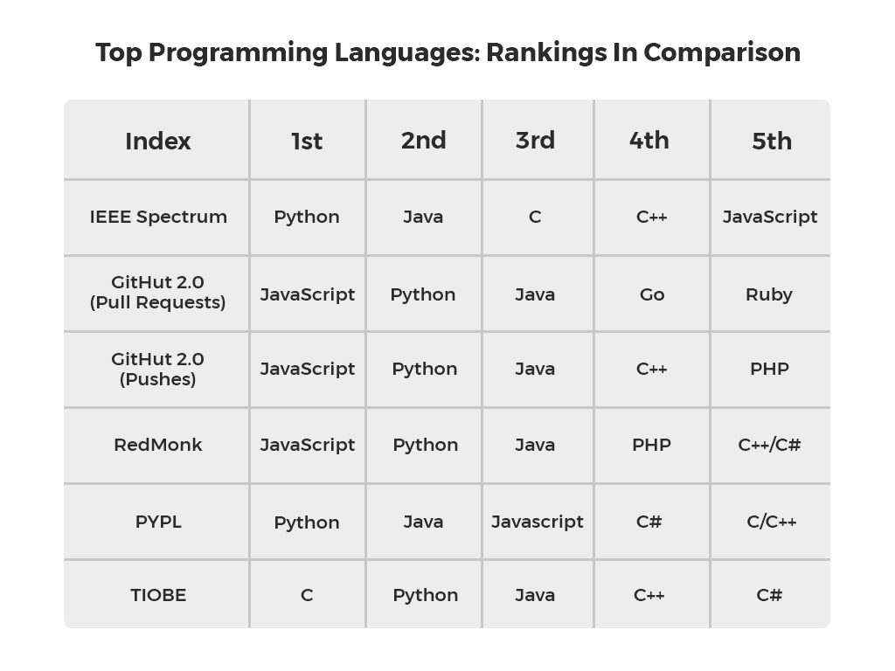
Top programming languages in 2021

Slide 3
Types in Python
Python includes very versatile types. Here we give an example of the most commonly used types:
Scalar types
int (of potentially unlimited value)
bool (True, False)
float (double precision floating point numbers)
Character arrays:
str (string, array of "Unicode" characters. Characters different number of bytes. Most printable characters from different alphabets are supported)
bytes (array of ASCII, characters, each one represented by a single byte, useful to communicate with hardware components)

Slide 4
Array-like data types
Lists and Tuples : these are ordered collection of elements that can be of any type. The type included in a list (or tuple) do not need to be homogeneous.
Syntax for lists:
a=[12.3,"abc",10] This is a list of three elements, a float, a string and an integer.
a=[[2,3],[0.23, "ab"]] This is a list, whose elements are other two lists.
Tuples are simply constant lists, i.e. lists whose elements can't be changed. The syntax is the same but with round brakets:
a=(12.3,"abc",10)
Indexing is similar to the case of the c language: elements are associated to an integer index, starting from 0:
a=[12.3,"abc",10]
a[0] returns 12.3

Slide 5
Indexing in Python
Negative indices are allowed. A negative index starts counting from the bottom of the list.
a=["a","b",6.1,10,5.6]
a[-1] is 5.6, a[-2] is 10 and so on
Slicing. Applying slicing to a list produces a subset of the original list.
a[i1:i2] returtns a sublist including elements from i1 and i1-1
Example: a[2:4] returns the list [6.1,10]
a[i1:i2:s] returns obtain elements from i1 and i1-1 by step s
a[0:4:2] returns ["a",6.1] If the step is omitted, 1 is used
If the start or the stop is omitted, the beginning or the end of the list are used, respectively:
a[:3] returns ["a","b",6.1], while a[::2] returns all the elements with even indices (both start and stop are omitted).

Slide 6
Dictionaries
Dictionaries are similar to lists and tuples, but accept non-integer indices
Syntax:
a={"chiave a": 12.3,"chiave b": "aabb", "key":1.89} creates a dictionary.
Each entry in the dictionary is formed by a key and a value. Keys and values can be of any type. Dictionaries are particularly usefun when all keys are strings, as in the example.
To retrieve a value, it is necessary to specify the key, as floows:
a["chiave b"] returns "aabb". a["key"], returns 1.89.

Slide 7
Flow control statements: conditional
if <condition 1> :
statement 1.1
….
statement 1.n
elif <condition 2>:
statement 2.1
….
statement 1.m
else:
statement e.1
….
statement e.k
Note: each statement block to which the condition 1 applies is defined by the indentation (one "tab").The same is valid for the elif (= else if)and else sections.
It is possible to introduce an arbitrary number of "else if" sections
Example
if x==1:
z=x*45.2
print(z)
elif x>=2:
z=2**x
print(z)
else:
z=0
print(x,z)

Slide 8
Flow control: while loops
The while loop is similar to its equivalent construct in C / C++. Here we show just an example combined with an "if" construct, in order to show nested indentation.
while (x>1):
if x<=0:
x=-x
print("sign reversal")
x=x/2
print("x= ",x)

Slide 9
The for loop
The for loop is used to iterate across the elements of any "iterable" object. Simple iterable objects are lists and tuples.
Example 1
Syntax:
a=[1, "abc", 3.4]
for i in a:
print (i)
for <variable> in <iterable>:
statement 1
……
statement n
The range(i1,i2,step) function produces an iterable that includes integers from i1, to i2 with step s. Note that i2 is excluded from the set.
range(10) means all integer values from 0 to 9.
Example 2
Sequence of integer numbers
for i in range(10):
z=3*i
print (i,z)

Slide 10
Functions in Python
Functions in Python can make operation on the arguments and return any kind of data types. The type of the arguments and of the return values is not predefined and can change at run time. This is a very powerful property, but must be used with care since it can cause run time errors or data type inconsistency.
Example of function definition:
a, b are mandatory arguments
c is an optional argument. If it is not explicitly passed to the function, the default value 2 is assumed.
def my_fun(a,b,c=2):
z=a*b/c
return z
Call to the function "my_fun"
y=my_fun(1.2,2.34,33)
yy=my_fun(2.5,11)

Slide 11
Classes in Python
It is better to use an example to show the various elements of a class in Python
"object" is a standard parent class, that has to be specified if our class does not inherit from a parent class
class mia(object):
def __init__(self,i,v):
self.current=i
self.voltage=v
def power(self):
return self.curremt*self.voltage
def resistance(self):
return self.voltage/ self.current
def set_current(self,cur):
self.current=cur
Initialization function that is called when an istance of the class is created
Member functions of the class
a=mia(1.5e-3,2.0) creates an istance of class "mia"
a.currents returns 1.5e-3
a.power() returns 3.0e-3 (3 mW)

Slide 12
Modules
The Python language includes a very small number of built-in functions.
In order to add functions and classes, modules can be loaded. For example, if we need to use mathematical functions, we can load the "math" module:
import math Loads (imports) the "math" module
math.sin(10) Uses the "sin" function of module "math"
from math inport * Imports all functions from module math
sin(10) If functions are directly imported, it is not necessary to specify the
module
from math import sin, cos It is possible to import only individual functions
sin(10)*cos(2)
import math as mt A module can be imported and referenced with a shortcut
mt.sin(10)

Slide 13
The Python standard library
The standard python library includes modules that cover a very large variety of programming purposes. The following list shows just a few examples.
Module Function
math Mathematical functions
os Access to operating system commands (file system navigation, etc)
sys Includes access to run-time parameters, such as command line arguments
time Time (current time, etc) and delay functions such as time.sleep(sec)
ctypes For calling functions from libraries writen in other languages (such as C)
tkinter Graphical interfaces
The standard library includes mocules devoted to html, xml, json format decoding and encoding, management of e-mail servers and clients, soket implementations, string manipulation, input-output handling and much more.

Slide 14
Optional modules
Besides the rich collections of modules included in the standard library, python programmers can rely on modules developed within the wide Python community. Some popular modules are:
numpy, scipy, matplotlib: all kind of numerical calculations for scientific purposes and 2d-3d plotting functions
pandas, seaborn: processing and plotting facilities for statistical data
sympy : symbolic calculation
pyserial a simple interface for serial ports and virtual serial ports
PyVisa control intsruments that adhere to the VISA standard
pyQt5 : Qt-style graphycal interfaces

