Slide 1
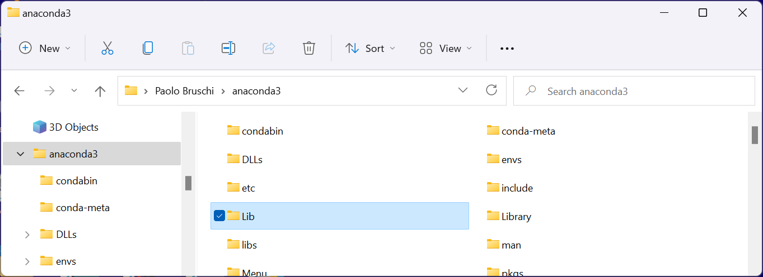
Structure of Anaconda Installation
Anaconda installs its binaries and a full python tree into a single directory, named "anaconda3" (the anaconda root directory)
In a windows OS, the default location of the anaconda directory is in the user home dir usually: c:\utenti\<nome_utente>, oppure c:\users\<nome_utente>
Within the anaconda root directory there are several sub-dir. The most interesting from the user point of view are "Lib" and "envs"
"Lib" includes all modules that are used by python.
"envs" includes alternative environments (e.g. a python 2 installations)

Slide 2
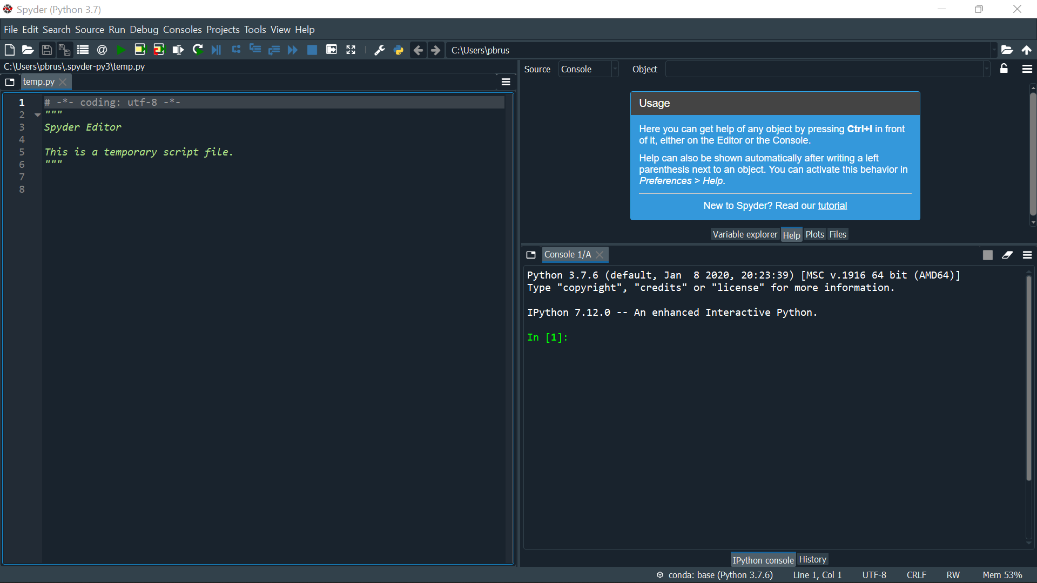
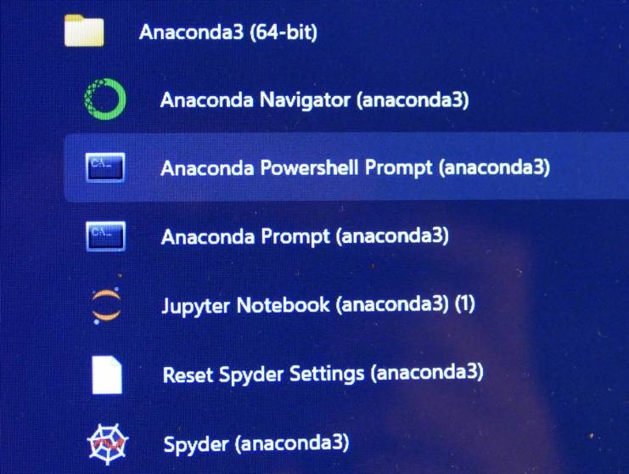
Possible ways to use Anaconda: the Spider
The easiest way to use Anaconda to develop and run python programs is through the "Spider" program. Spider is an IDE (Integrated Development Environment) explicitly written for scientists and data analysts. For more information see: https://www.spyder-ide.org/
Interactive console: directly run simple python statements and show results
Anaconda entry in the
Start Menu (Windows 11)
File editor (load, create, save and execute python programs)
Spider

Slide 3
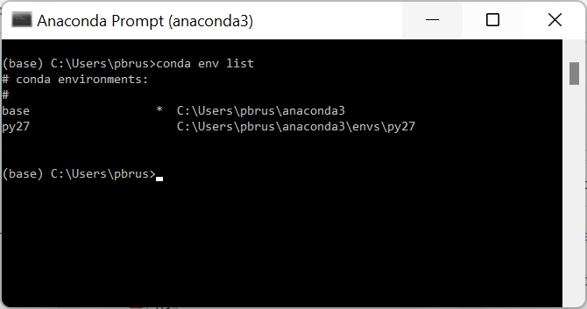
The "Anaconda Prompt"
Anaconda entry in the
Start Menu (Windows 11)
The anaconda prompt is a standard windows shell ("cmd window") customized with all required anaconda paths.
It can be used to launch anaconda ("conda") commands such:
>conda install module_name
Installs "module_name" python module. Anaconda comes with a huge set of modules, but some specialized ones can be missing.
>conda list
Shows the complete list of installed modules and their version
The Anaconda prompt can be used also to manage environments, if we want different configurations, such as having also a Python 2 environment for back-compatibility. The default environment is called "base" and is created when Anaconda is installed.
Prompt

Slide 4
A fast way to use Anaconda: the Idle environment
Idle is the standard editor that comes with a basic Python installation. It is less integrated than Spider, but it is much faster to start and simpler to use, especially when editing several modules at the same time. It comes also with Anaconda but needs a few operation to get it fully functional and integrated with the Anaconda modules.
There are two possible Idle windows:
The Idle editor (a simple text editor with syntax coloring customized for python). A program can be directly run from the editor window.
The idle shell: it is the interactive windows where python commands can be executed. It is automatically opened when a program is executed from the Idle editor window.

Slide 5
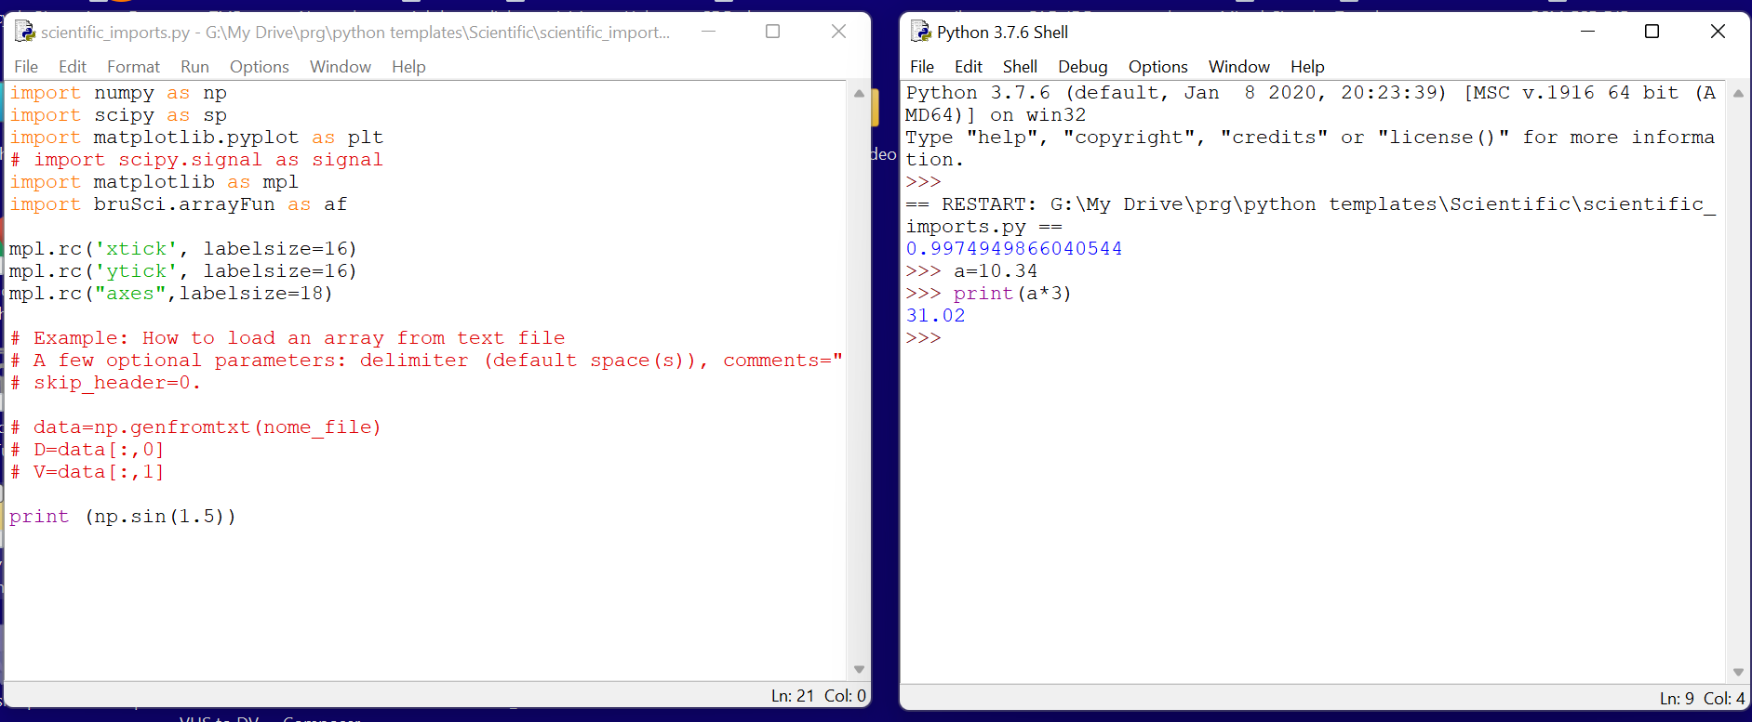
Example of idle windows
Idle editor window. It is possible to have an arbitrary number of editor windows opened in the desktop.
Idle shell window opened after executing the program in the editor window. Additional commands were executed interactively

Slide 6
How to access the Idle editor from the Anaconda installation
In a standard native python installation, Idle becomes the default editor. Generally, windows is instructed to assign any file ending with ".py" to Idle
This does not occur if python is installed through the Anaconda distribution. A few additional steps are required.
Create a batch file that adds the Anaconda path to the standard windows path
Insert a line that calls the Idle program. Since Idle is completely written in Python, this means invoking the python interpreter to execute the idle module.
Instruct Windows to use the created batch file to open all files ending with the extension .py

Slide 7
The easiest way: download the predefined batch file and modify it
Download the idle_py3.bat batch file from:
http://docenti.ing.unipi.it/~a008309/mat_stud/Sensor_Systems/python/
To download the file, right click on the file in the browser and choose "save link as"
Important! If anaconda is really installed in your windows user home dir, the batch should work with no modifications. Just double click on in to see if the Idle shell opens correctly.
Otherwise, the correct anaconda home-dir should be set. The batch file can be opened with a text editor (notepad is ok, best is notepad++).
Locate the following instruction in the batch file:
set ana_home=%homedrive%%homepath%\anaconda3
This is the path of the user home dir.
Replace these two with the actual path
This is the disk where the user directory is located (e.g. c: )
This is the path of the user home dir

Slide 8
Complete idle_py3.bat file
@echo off
rem **** Check that anaconda is actually installed into the user home dir
rem **** and that the name of the anaconda install dir is correct
rem **** For different environment (envs) than the default one:
rem **** Set ana_home to the home of the environment (generally located in the envs subdir)
set ana_home=%homedrive%%homepath%\anaconda3
set idle_home=%ana_home%\Lib\idlelib
rem **** Add required entries to the windows path
set Ana_path=%ana_home%;%ana_home%\Library\mingw-w64\bin;%ana_home%\Library\usr\bin
set Ana_path=%Ana_path%;%ana_home%\Library\bin;%ana_home%\Scripts;%ana_home%\bin;%ana_home%\condabin
set PATH=%Ana_path%;%PATH%
rem you can add a path to user directories where you want to put some personal modules
rem that you want python to search for
rem just set the varieble PYTHONPATH to your custom library path
start "IDLE" "%ana_home%\pythonw.exe" "%idle_home%\idle.pyw" %1 %2 %3 %4 %5 %6 %7 %8

Slide 9
How to instruct windows to open python (.py) files with the batch file
First of all, save the idle_py3.bat file in a directory of your choice. Use a directory that you can locate easily. Prefer a directory on your local file system, not a cloud location (Dropbox, Google Drive, OneDrive ...).
Create a file with the extension ".py". You can download the scientific_imports.py from the same location than the batch file.
Go over the .py file and right-click on it to reach the "open with ..." entry. In windows 11, the menu that appears with a right-click on a file is restricted. To see the full menu, choose "Show more options" from the initial menu entries
In the "open with" menu, select the option "Always use this app to open files" and then choose "more apps" and after that " "look for another app in the PC". This let you browse in the pc file system until you find and select the idle_py3.bat batch file.
After this, it should be possible to open python files just double-clicking on it.

