Slide 1
Optical Image Sensors
Classification of ranges on the basis of wavelength:
Infrared (λ: 0.9-30 μm)
SWIR (Short-wavelength IR)
MWIR (Medium-wavelength IR)
LWIR (Lomg-wavelength IR)
Visible (λ: 0.4-0.76 μm)
Ultra Violet (UV) (λ: 0.01-0.4 μm)
Near-UV: 0.3-0.4 μm (UVB-UVA sub-bands)
Deep UV < 0.3 μm (UV-C)

Slide 2
Applications on the basis of Wavelength
SWIR (0.9-3 μm): Clear vision through smog and fog (Automotive, Aerospace etc.)
Inspection devices for Solar Cells, Food, Industry, Counterfait detection
Note: many materials (plastic, living tissues) that are opaque in the visible range
become transparent in the SWIR range.
MWIR (3-5 μm): Detection of gas leaks (Methane, Propane, Ethanol vapors, etc)
Thermal cameras
LWIR (8-15 μm): Ambient temperature thermal-cameras
Visible (0.4-0.76 μm): Photography Video recording, Artificial vision, advanced robotics etc. !
UV (0.01-0.4 μm): Inspection of industrial processes (e.g. Surface contaminant detection, detection
of ultra small defects, such as scratches on a surface)

Slide 3
Type of sensors, depending on wavelength
SWIR: Silicon λ< 1.1 μm
Germanium λ: 0.8-1.6 μm
GaAs λ: 0.8-1.8 μm
InGaAs λ: 0.6-2.6 μm
InAs λ: 0.9-3.5 μ
PbS λ: 1-3.3 μm
Photodiodes
Photoconductors (resistive detectors)
MWIR: PbSe λ: 1-5.2 μm
HgCdTe λ: 1-5 μm
Photodiodes
Photoconductors
LWIR: HgCdTe λ: 1-15 μm
Bolometers and pyroelectric detectors: (based on energy to temperature conversion)
Visible: Silicon
UV: Silicon, GaN, SiC photodiodes

Slide 4
Photodiodes: dark current
In a photodiode the measured current is due to hole-electron pairs that are generated:
By photons
By phonons (thermal energy)
Signal
Dark current
Dark current sets a detection limit of a given photodiode.
Dark current can be compensated for, but this approach is not sufficient because:
Dark current depends on temperature
It is different from pixel to pixel
It is affected by considerable noise

Slide 5
Dark current in IR photodetectors
In order to enable detection of medium-long wavelength IR, the semiconductor must have a small energy gap.
This strongly increases the dark current and related noise, degrading the detection limit of photodiode IR detectors.
For this reason, MWIR and LWIR detectors are often cooled down to cryogenic temperatures. Compact Peltier-cell based solid state micro-refrigerators are often used to maintain small size and portability of the devices
Bolometers does not suffer from this problem and can operate at room temperature with no need of refrigeration.

Slide 6
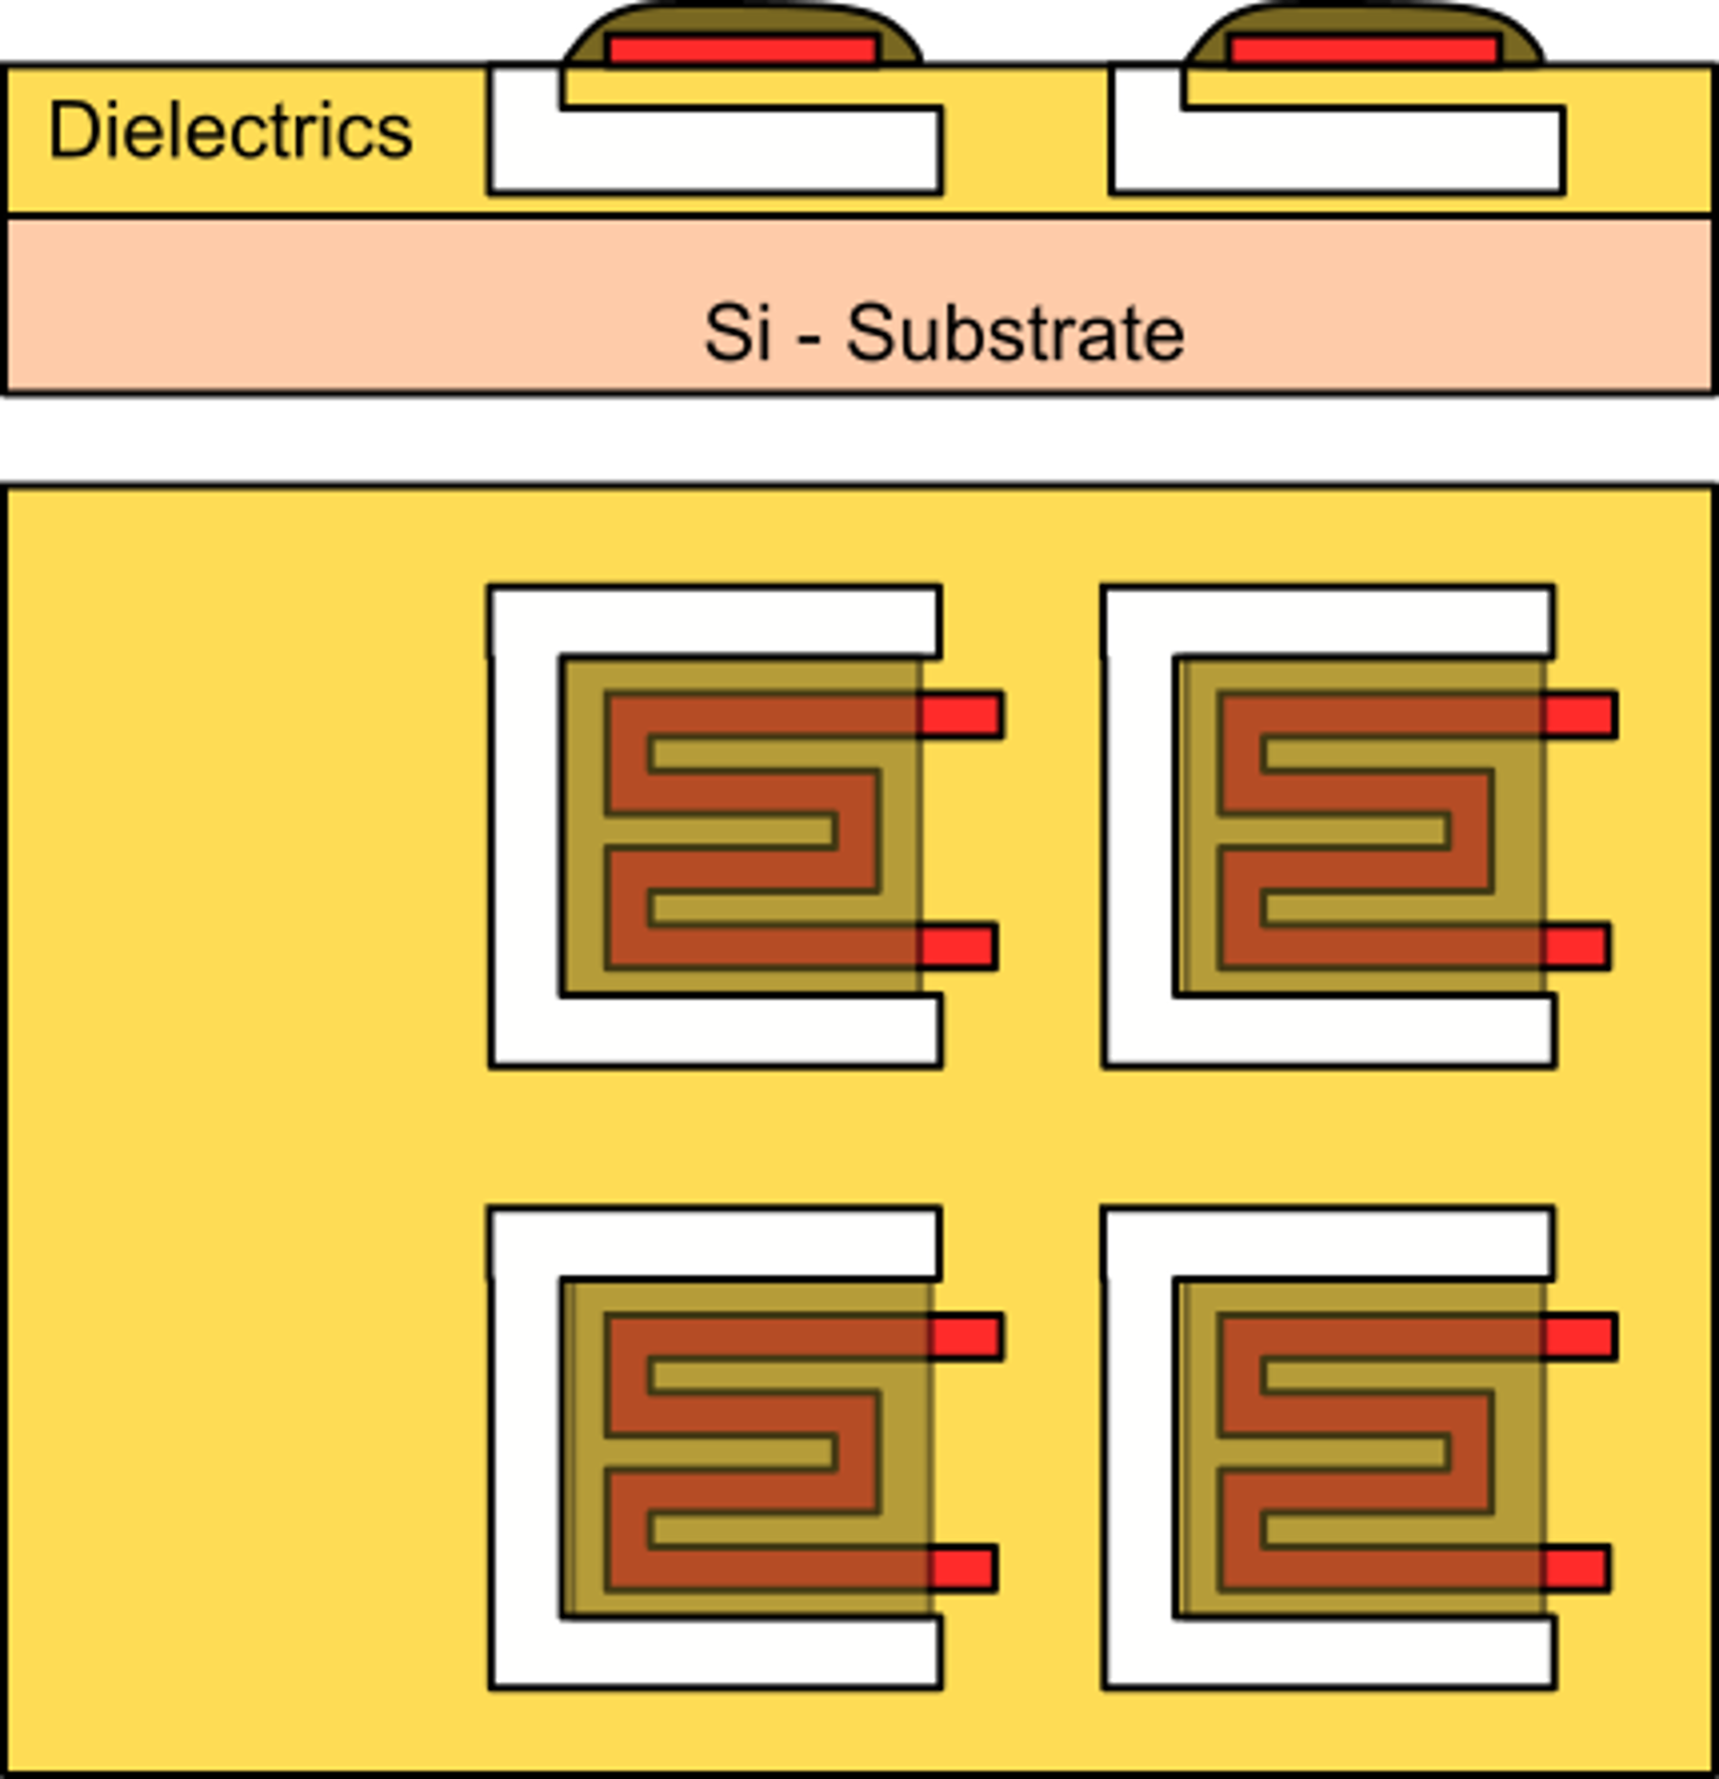
Micro bolometer
IR absorption layer
Cavity, for thermal insulation
(requires Micromachining)
Bolometers are based on a different principle than photodiodes and photoconductors.
The impinging radiation power heats-up the corresponding pixel. The temperature increase with respect to the substrate constitutes a measure of the total radiation energy received by the pixel.
one
pixel
The temperature variation is measured as a resistance change.
Temperature
sensitive resistor

Slide 7
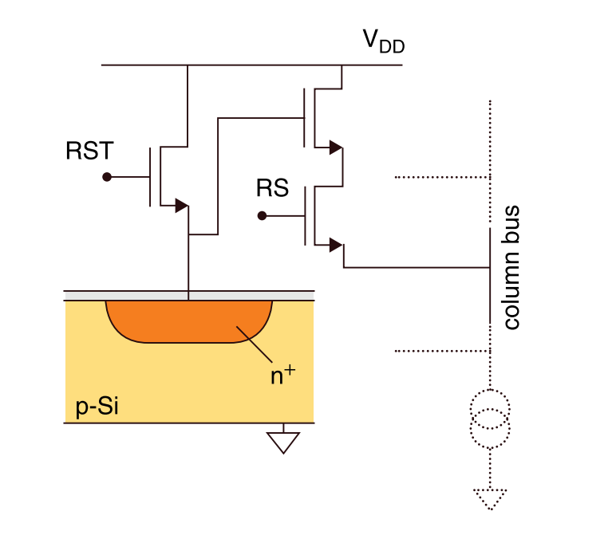
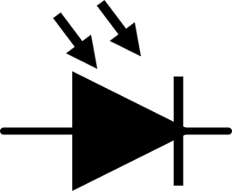
Imagers for the visible spectral range
There are two main types of imagers, that are commercialized with two denominations:
CCD: charge coupled devices
A CCD sensor is based on MOS capacitors that are periodically pushed into depletion zone and collect photogenerated charge as mobile charge.
Charge is shifted from a pixel to the adjacent with a proper timing of the polysilicon gates
CMOS: (CIS = CMOS Image Sensor)
A CMOS imager consists in an array of photodiodes integrated in a standard CMOS process

Slide 8
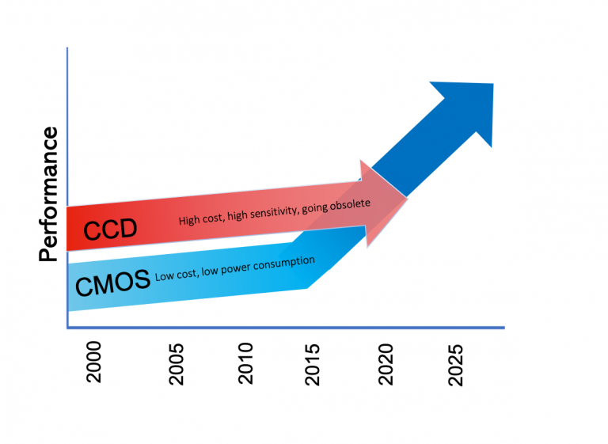
Actual trend in imager technology
CCD has lost their initial superiority in terms of resolution and image quality, due to the much simpler pixel architecture and by the smart approach to charge transmission from the individual pixels to the periphery of the imager.
A standard, inexpensive CMOS technology can be used.
The circuit that can be integrated on the imager chip are much more complicated. Digital conversion is operated on the same chip and the output data are digital.
Several important imager productors has discontinued development of CCD Imagers

Slide 9
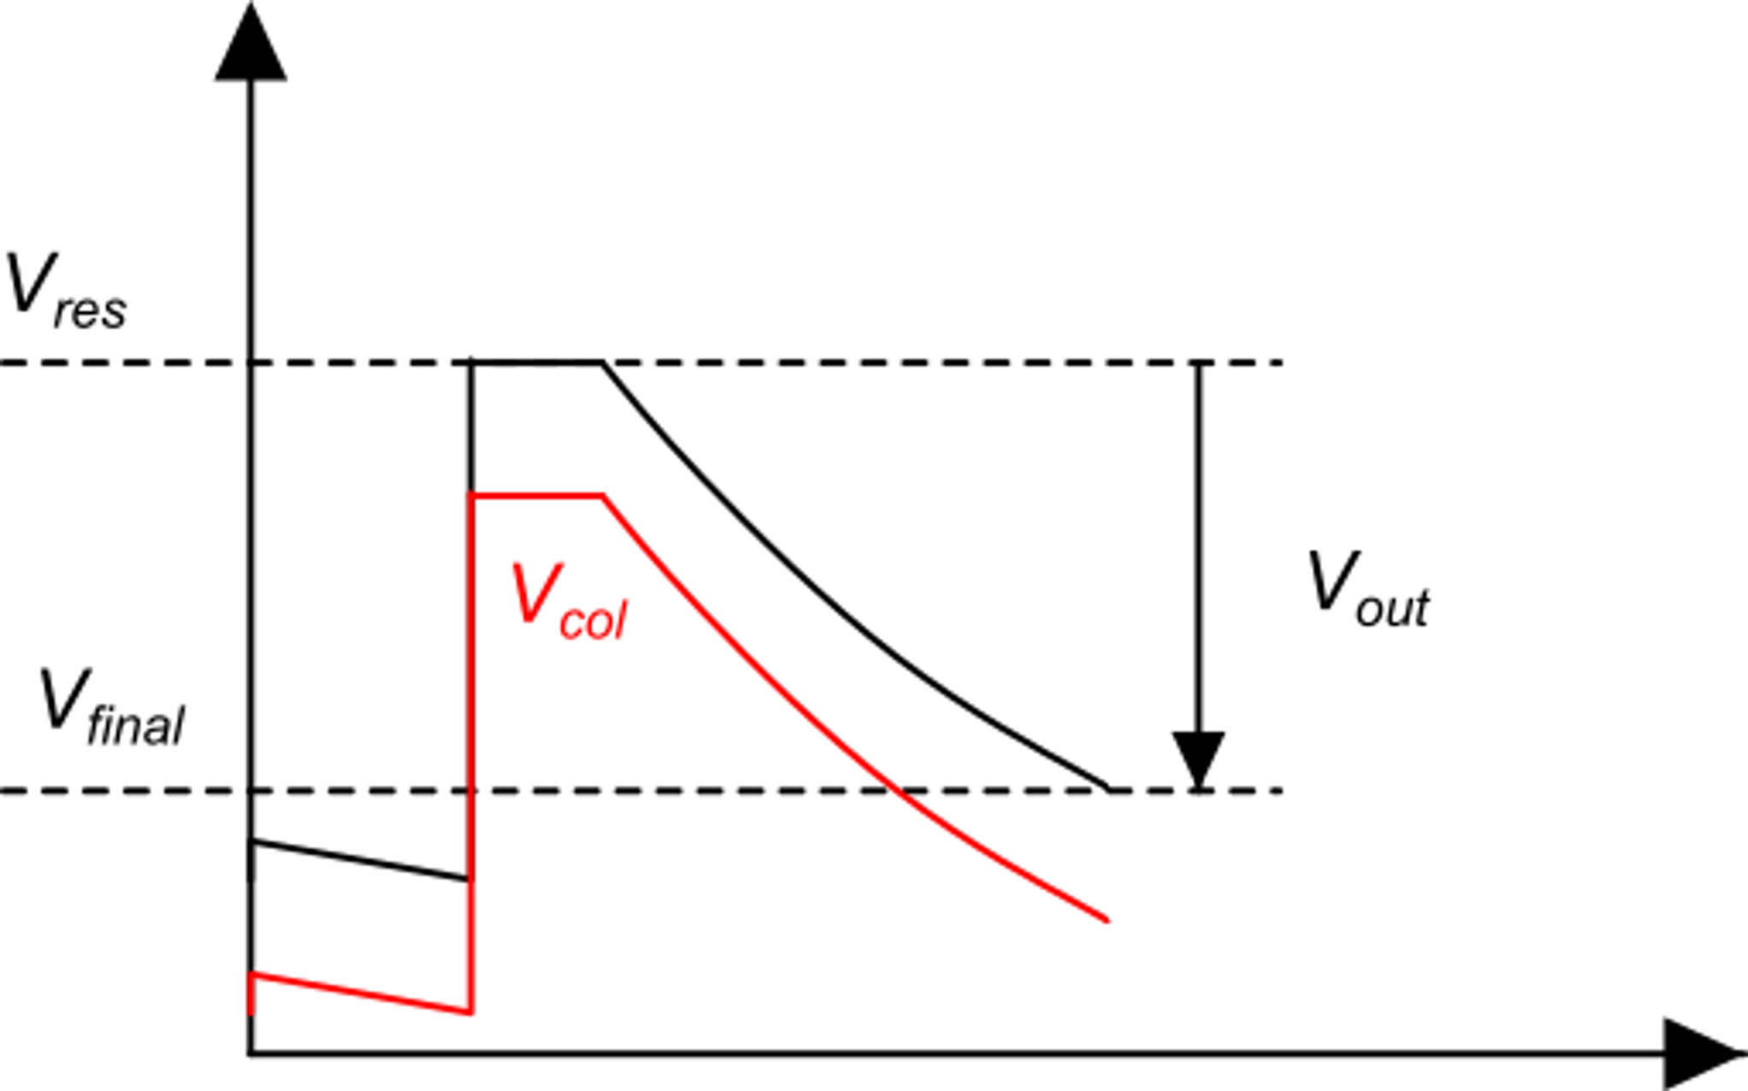
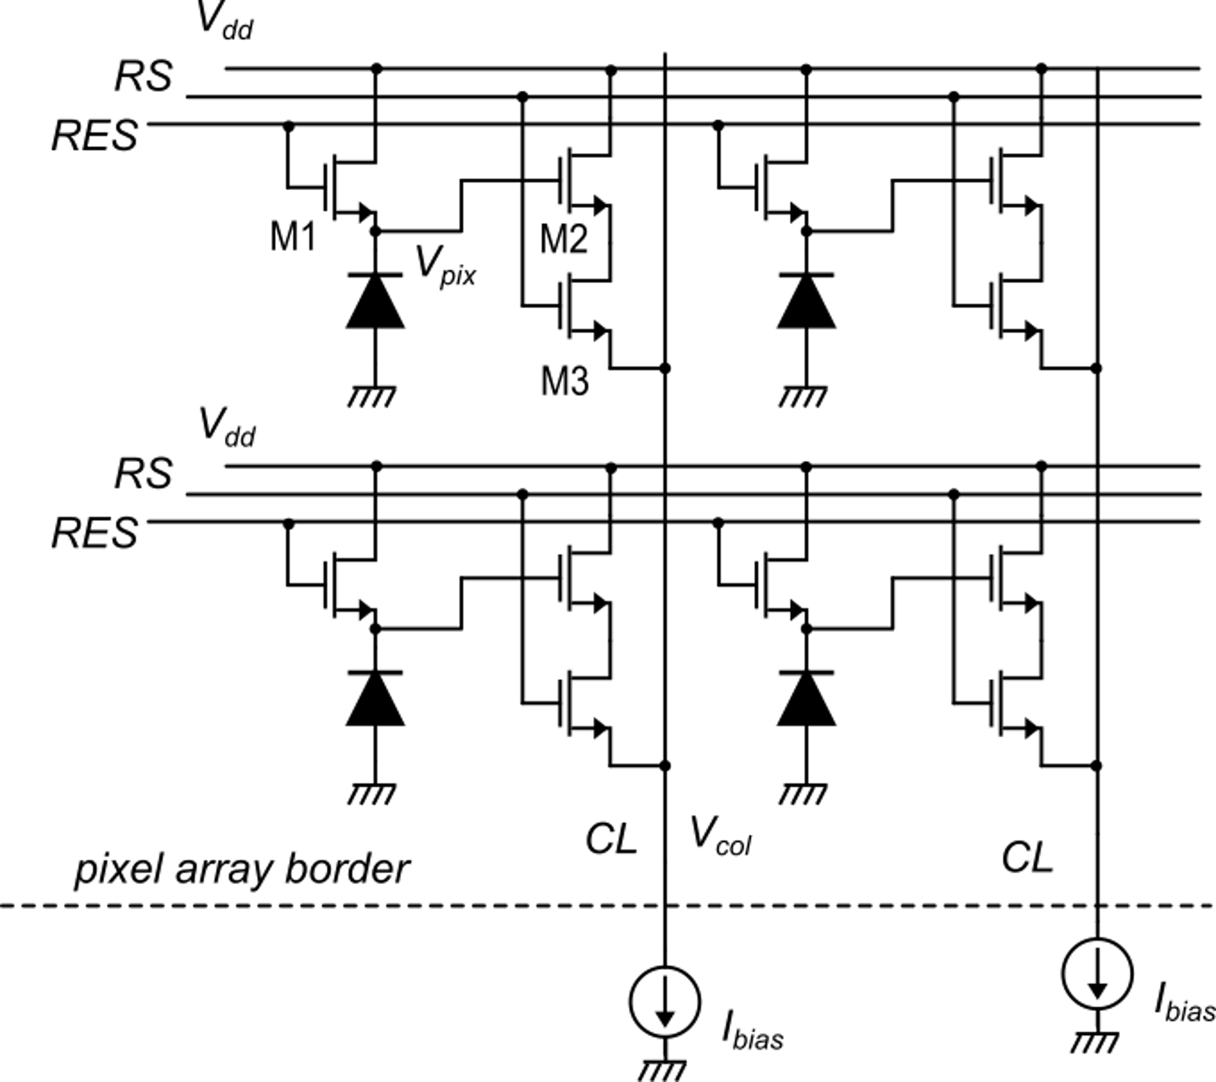
Structure of a standard CMOS Imager
To avoid charge sharing with the CL capacitance, the pixel voltage is buffered by a source follower (M2)
All the pixels in a row are read at the same time
The pixel is initially charged by M1 to the reset voltage V_{res}
When RES goes low, the integration phase begins
At the end of the integration time (t_{int}) (exposure time), the difference between the initial value and the final value is calculated.

Slide 10
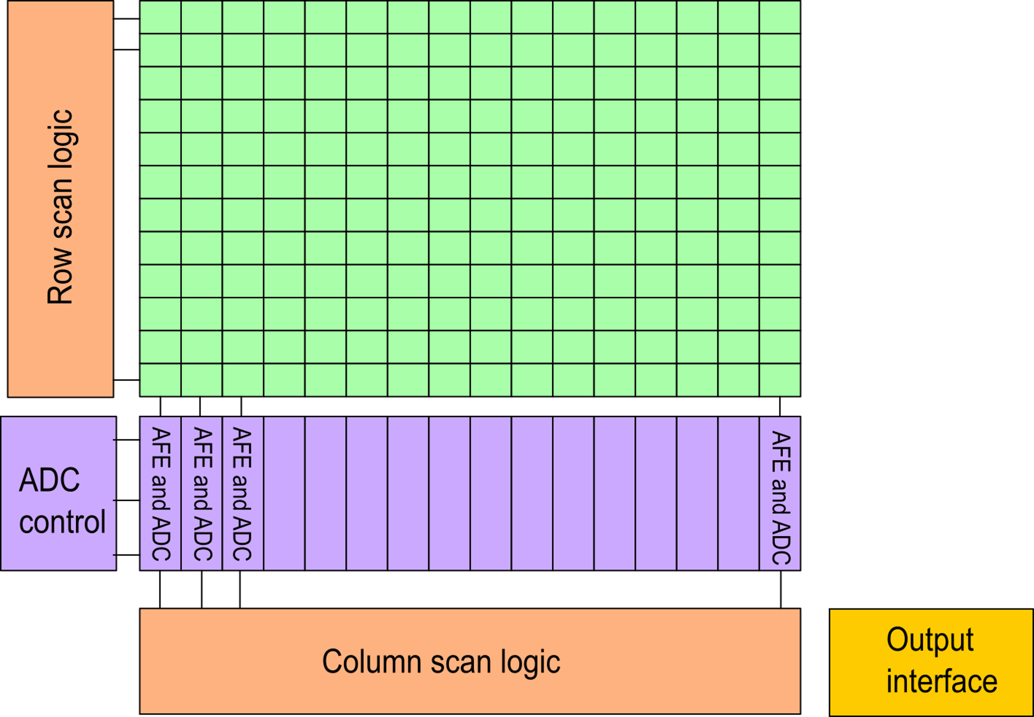
Structure of a standard CMOS imager with column-parallel ADCs
We have an AFE and an ADC for each column
The AFE is very simple, including only a current source to bias the pixel source followers and an SC circuit that calculate the difference between the pixel voltages at the beginning and at the end of the exposure time

Slide 11
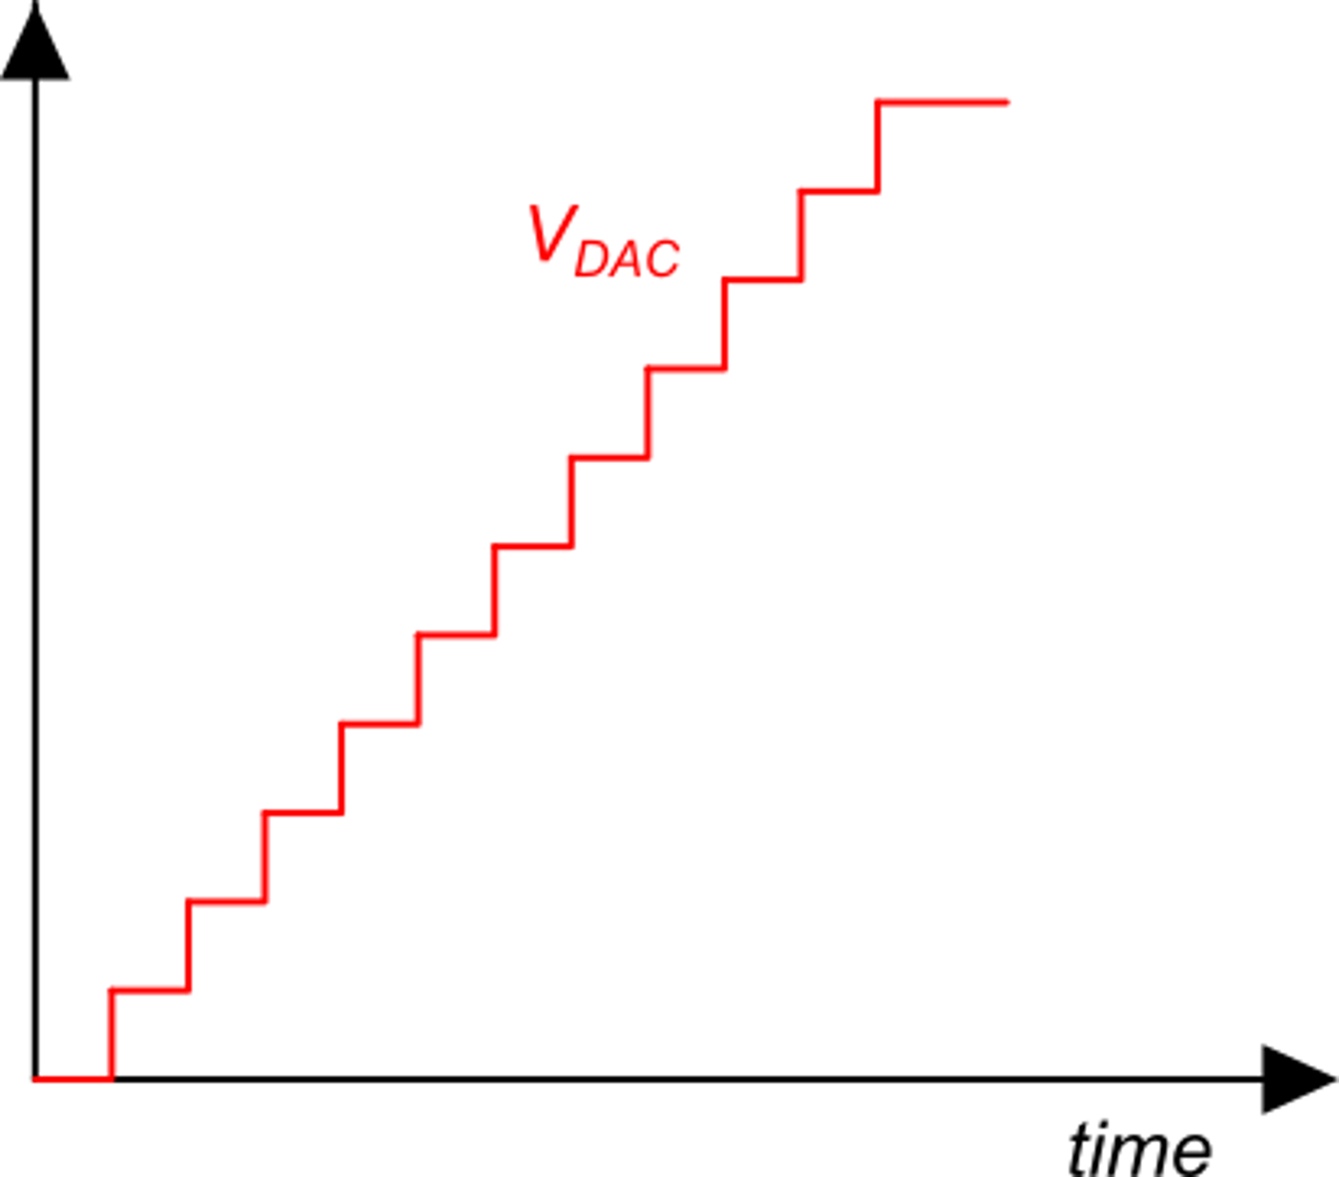
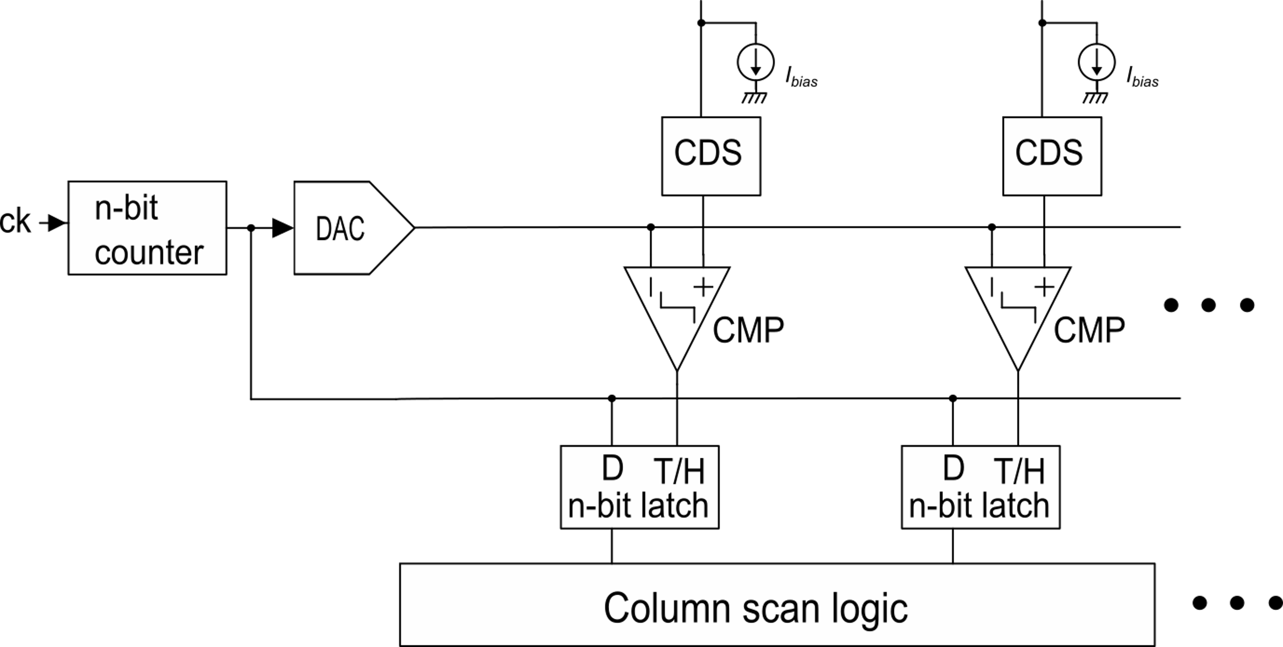
Column-parallel ADCs
The CDS block is a switched capacitor circuit that subtracts the two samples of the pixel voltage (at the beginning and at the end of the exposure)
AFE and ADC
V_{dac}
A counter ADC is used, where only a single DAC is necessary, while each column requires only a comparator and an n-bit latch.
n
ADC control: generation of the digital and analog ramp.

Slide 12
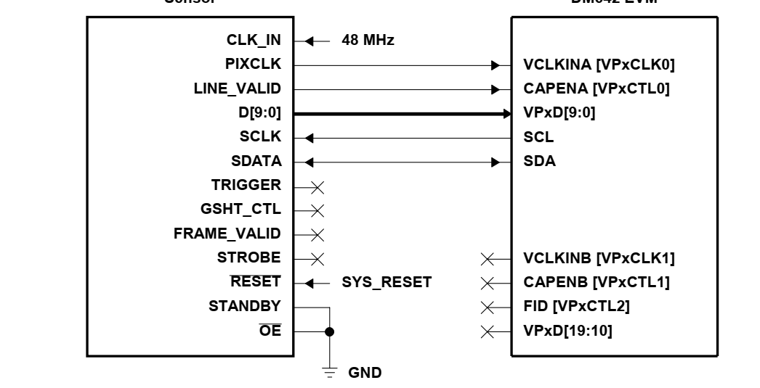
Example of CIS connection to a DSP chip
CMOS Image sensor:
Aptina MT9T001
DSP processor
TI-TMS320DM642
Parallel line (10 bit parallel data out + synchronization signals) for pixel data streaming
Bayer pattern
I2C interface: for set-up of the imager
(writing to internal registers)

