Slide 1
Back to the sensor types
Hall sensors:
Advantages:
Wide linearity range, inexpensive, highly integrable.
Drawbacks:
Relatively large detection limit (not suitable for B < 1μT)
Other popular or promising Magnetic sensors:
Anisotropic Magneto-Resistance (AMR sensors)
Giant Magneto-Resistance (GMR) - Tunnel Magneto Resistance (TMR)
Flux Gates

Slide 2
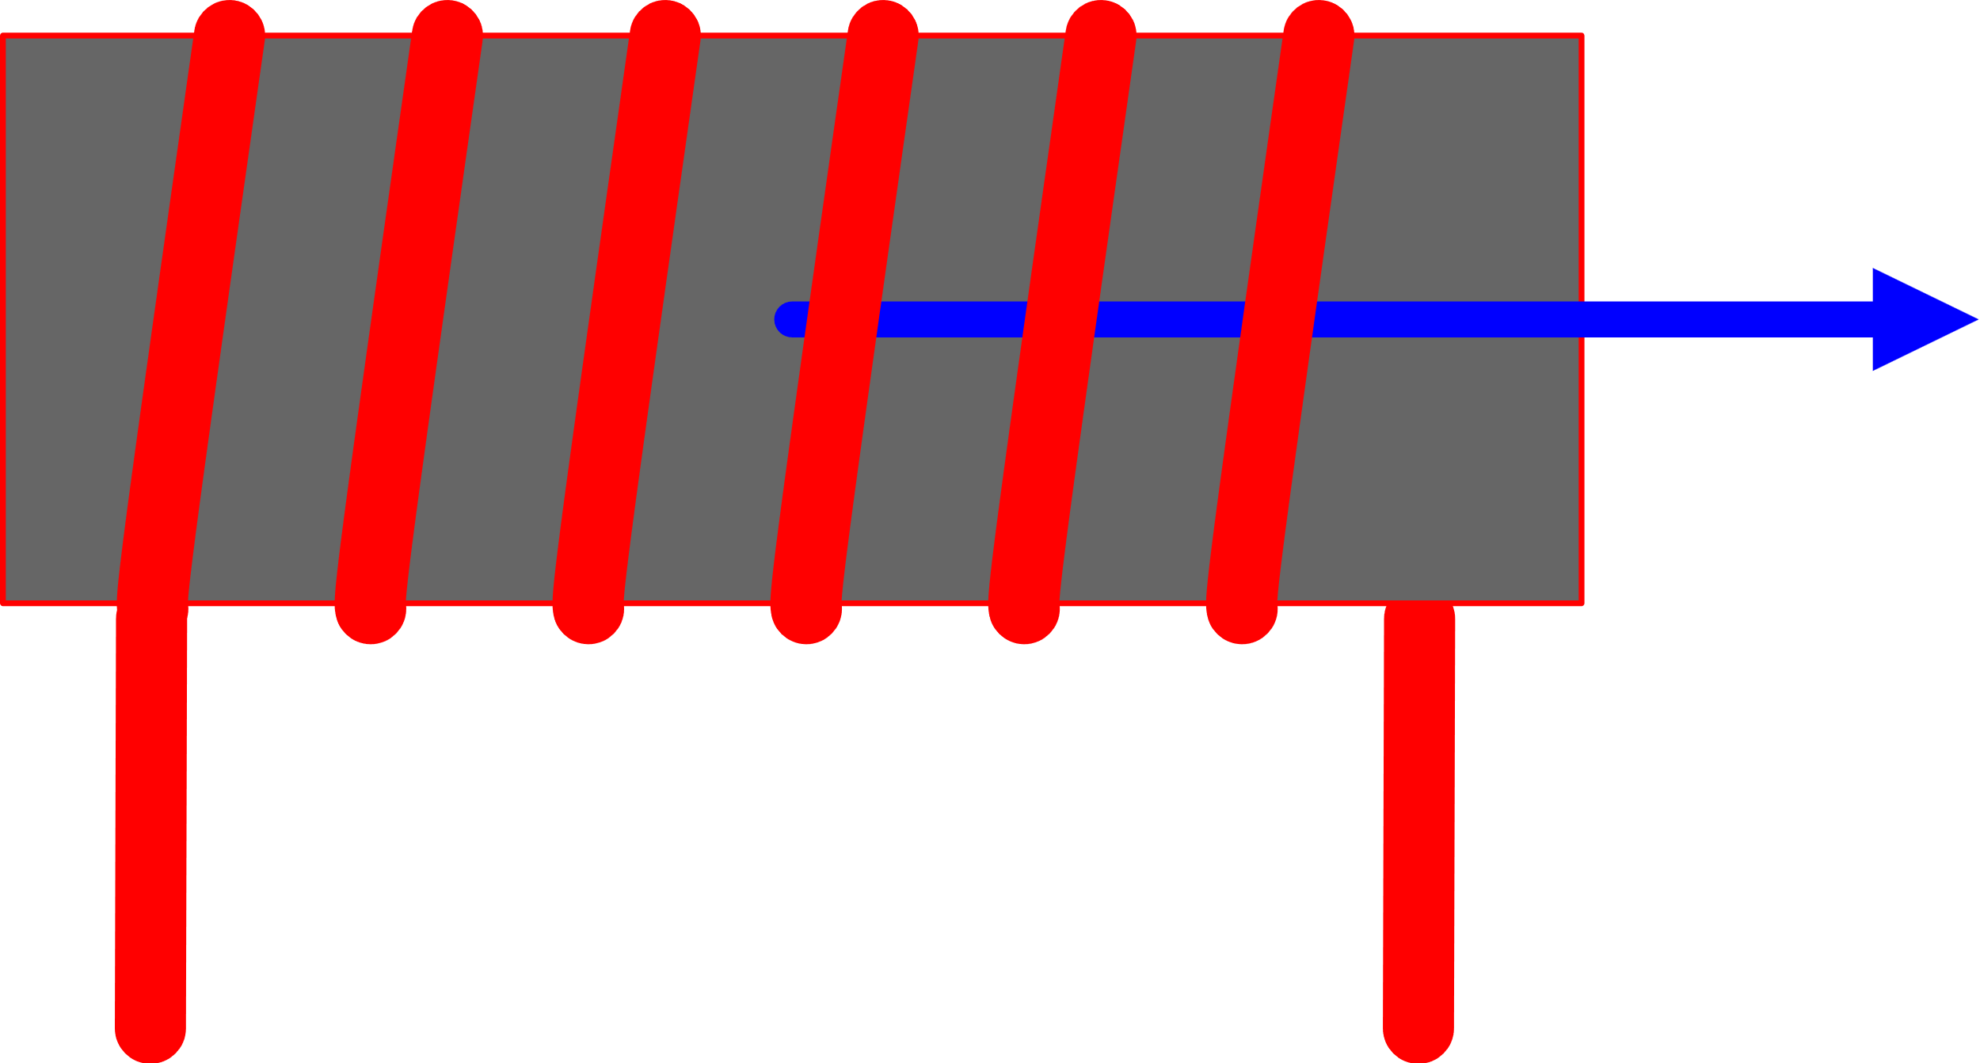
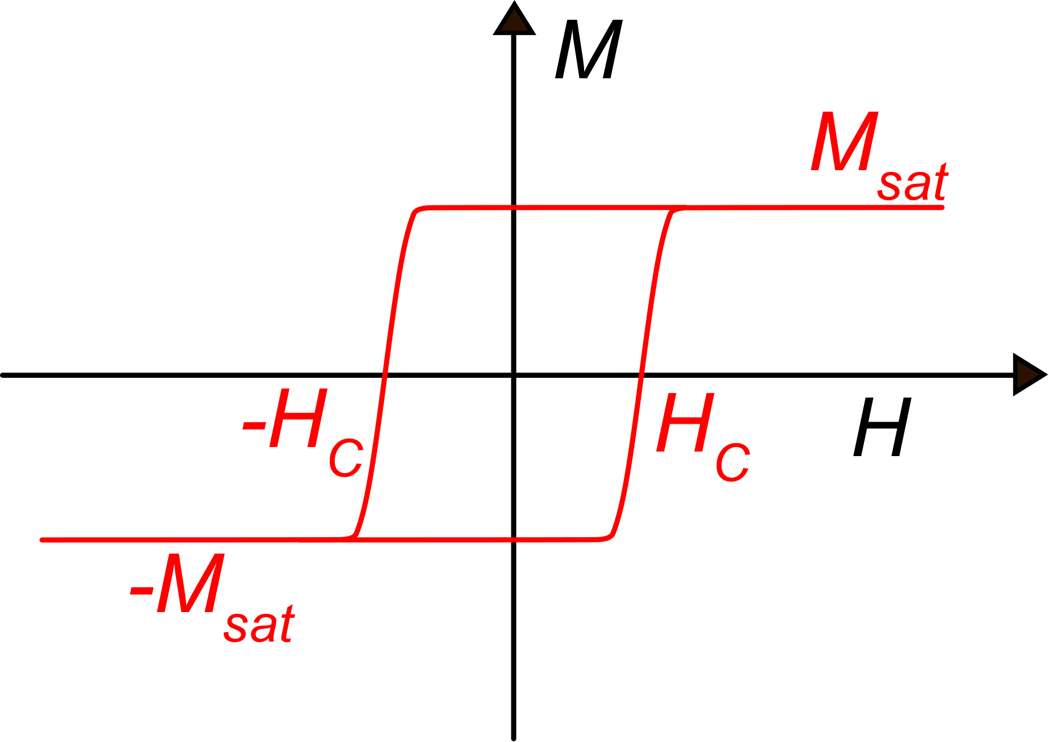
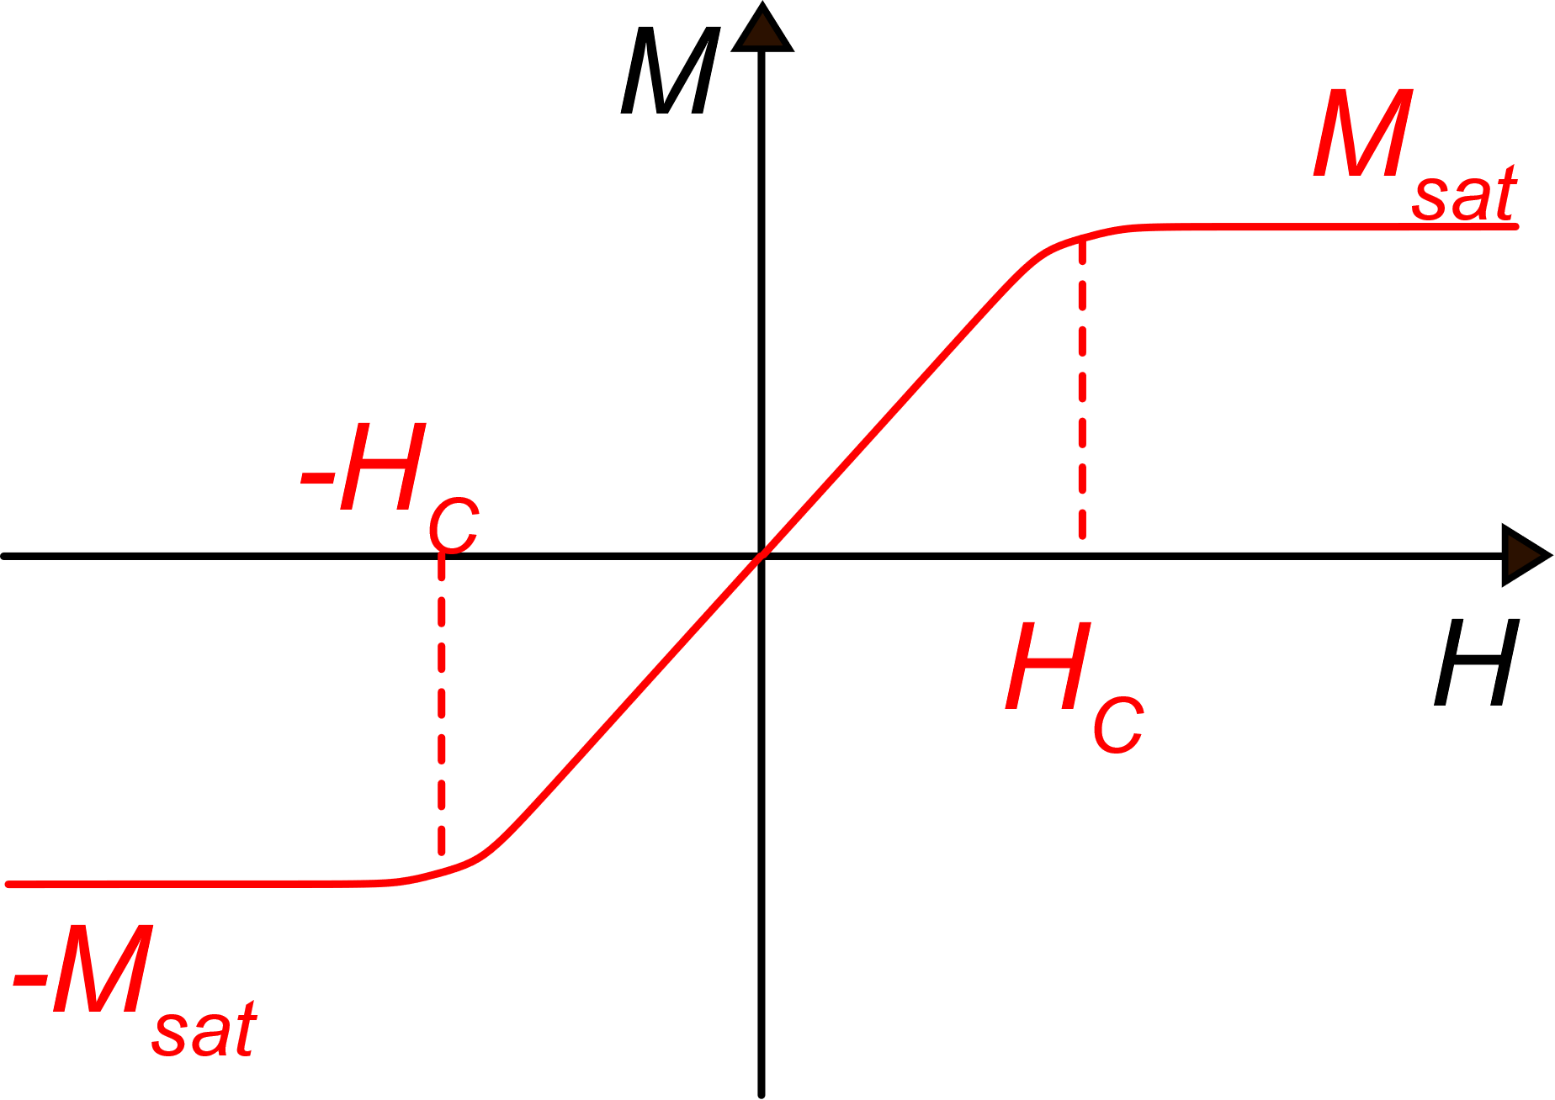
Anisotropic Magneto Resistance
A premise on magnetization: ferromagnetic materials
In ferromagnetic materials M>>H
H and M has different scales in these figures
H, B
Hard ferromagnetic
I_{M}
I_{M}
N=number of turns
H: Excitation, proportional to NI_{M}
Soft ferromagnetic
(idealized)
B: Response to the excitation B=μ₀(H+M)
M: Due to the material.

Slide 3
Anisotropic ferromagnetic materials
Hard axis
Magnetic material (film)
Easy axis
Materials that present this characteristic are, for example Iron-Nickel (Ni_{x}Fe_{y}) alloys, properly deposited grown under a magnetic field

Slide 4
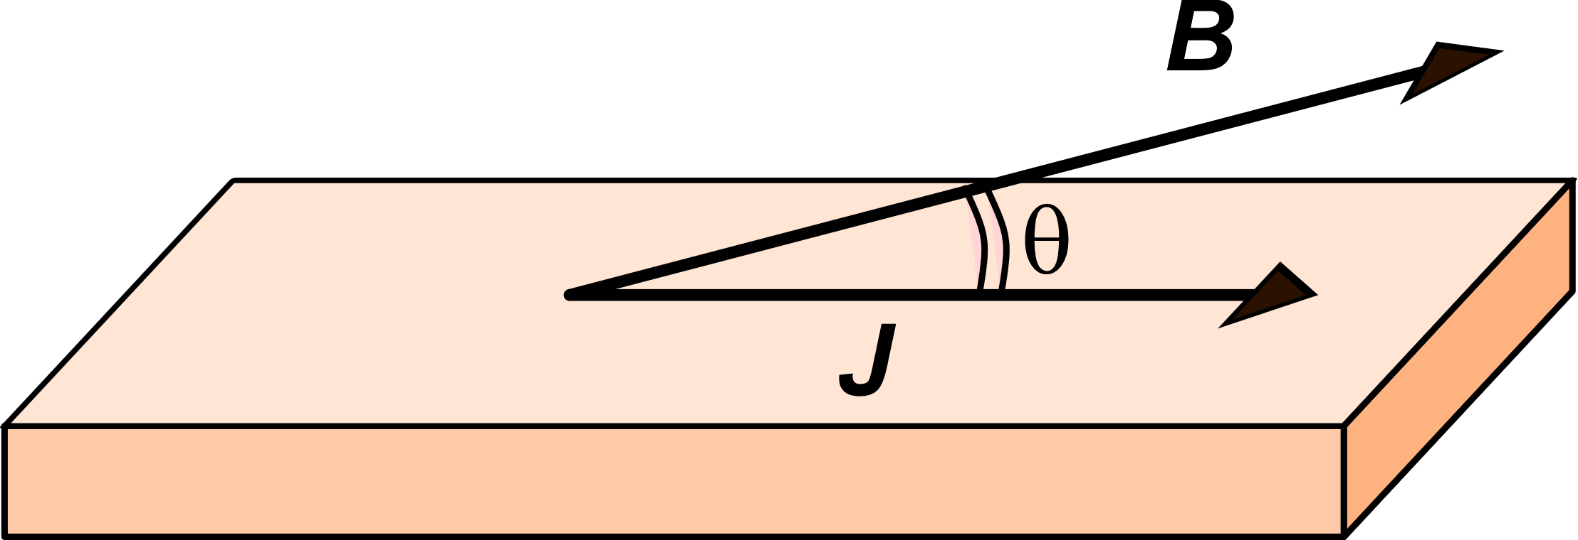
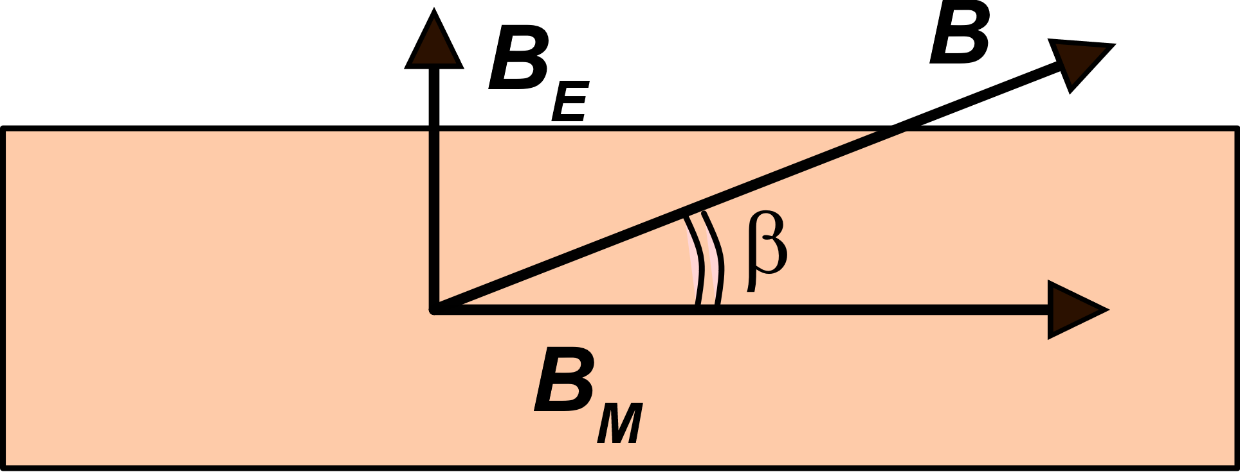
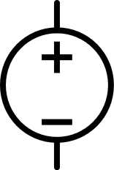
Anisotropic Magneto Resistance (AMR)
Hard axis
Easy axis
I
V
B_{M}: permanent magnetization (saturated)
B_{E}: due to external field (to be measured)<<B_{M}
Material:
Ferromagnetic conductors such as
Fe / Ni alloys (Permalloy)
Discovered: 1856 (Lord Kelvin)

Slide 5
Resistance vs external magnetic field
R
R
R
0
90°
180°
θ
B_{E}
The derivative is around zero in this region, meaning that the sensitivity to external fields is extremely small

Slide 6
"Barber Pole" approach:
A thin metal film of a ferromagnetic conductor is deposited and magnetized along the easy axis
B_{M}
B_{M}
Highly conductive (e.g. Al), are deposited on top and patterned in order to form a series of 45 - degrees oriented stripes
J
Barber pole
45°
The fact that the Al layer is much more conductive than the underlying magnetic one, forces the current to cross the gaps between the Al stripes along the direction of minimum distance, which is perpendicular to the aluminum stripe edges. Then the current density in the ferroelectric materials between the conducting stripes form a 45° angle with permanent magnetization.

Slide 7
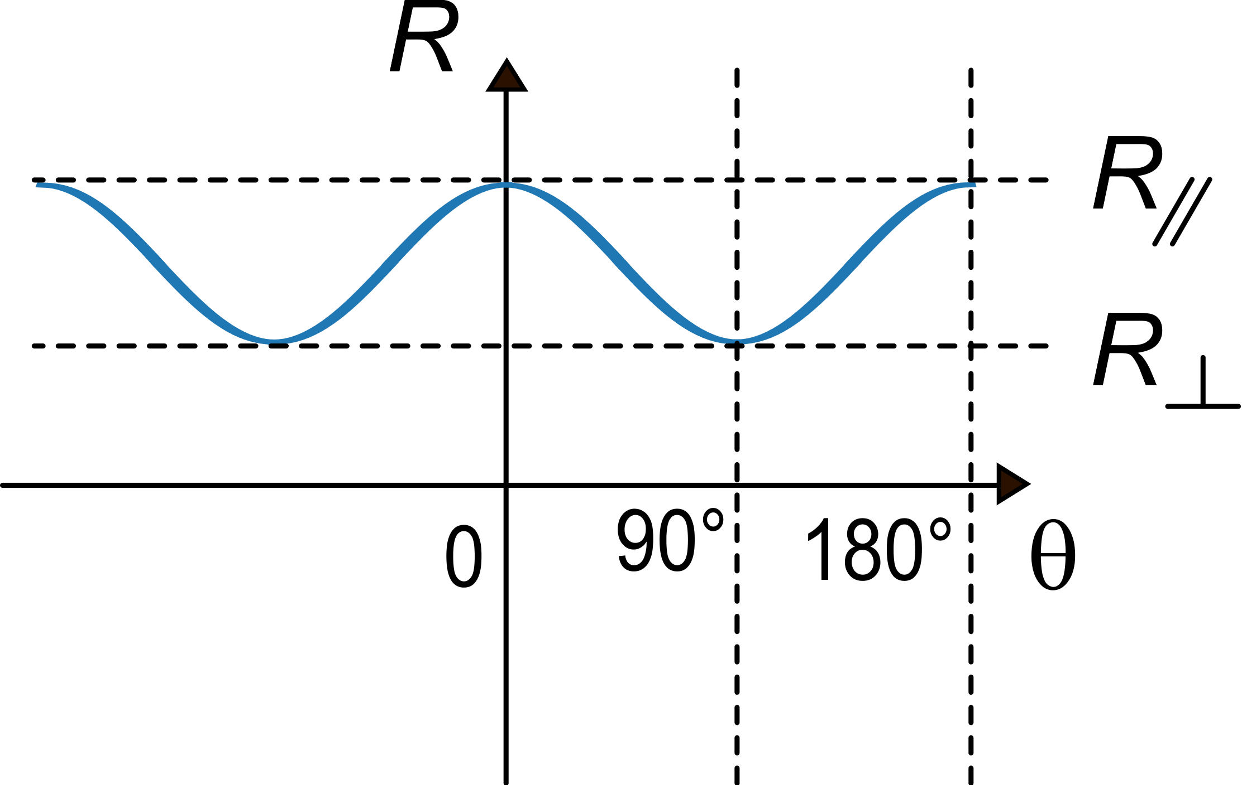
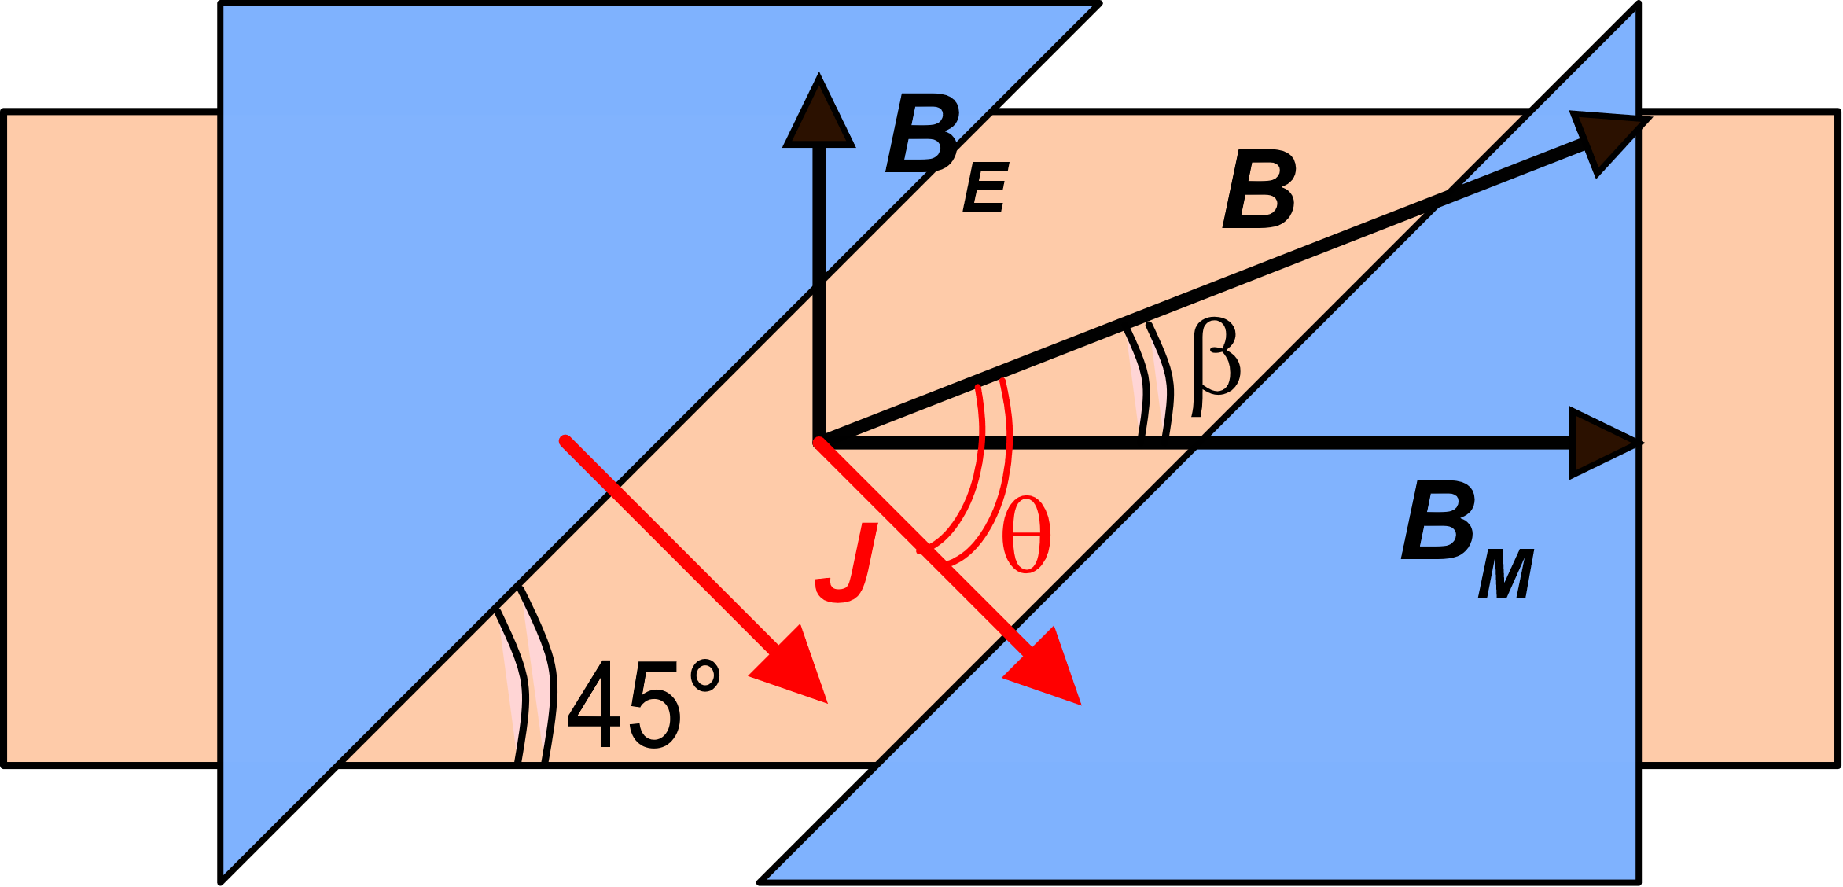
Magnetic field sensor based on AMR
Aluminum
stripes
Ferromagnetic
material
For B_{E}=0 θ=45°
B_{E}
Maximum slope
45°
Produced by the external magnetic field H_{E} oriented along the hard axis
Maximum sensitivity

Slide 8
Magnetic field sensor based on AMR

Slide 9
Effect of reversing the permanent magnetization
B
B_{E}
J
β
J
B_{M}
θ
3
π
4

Slide 10
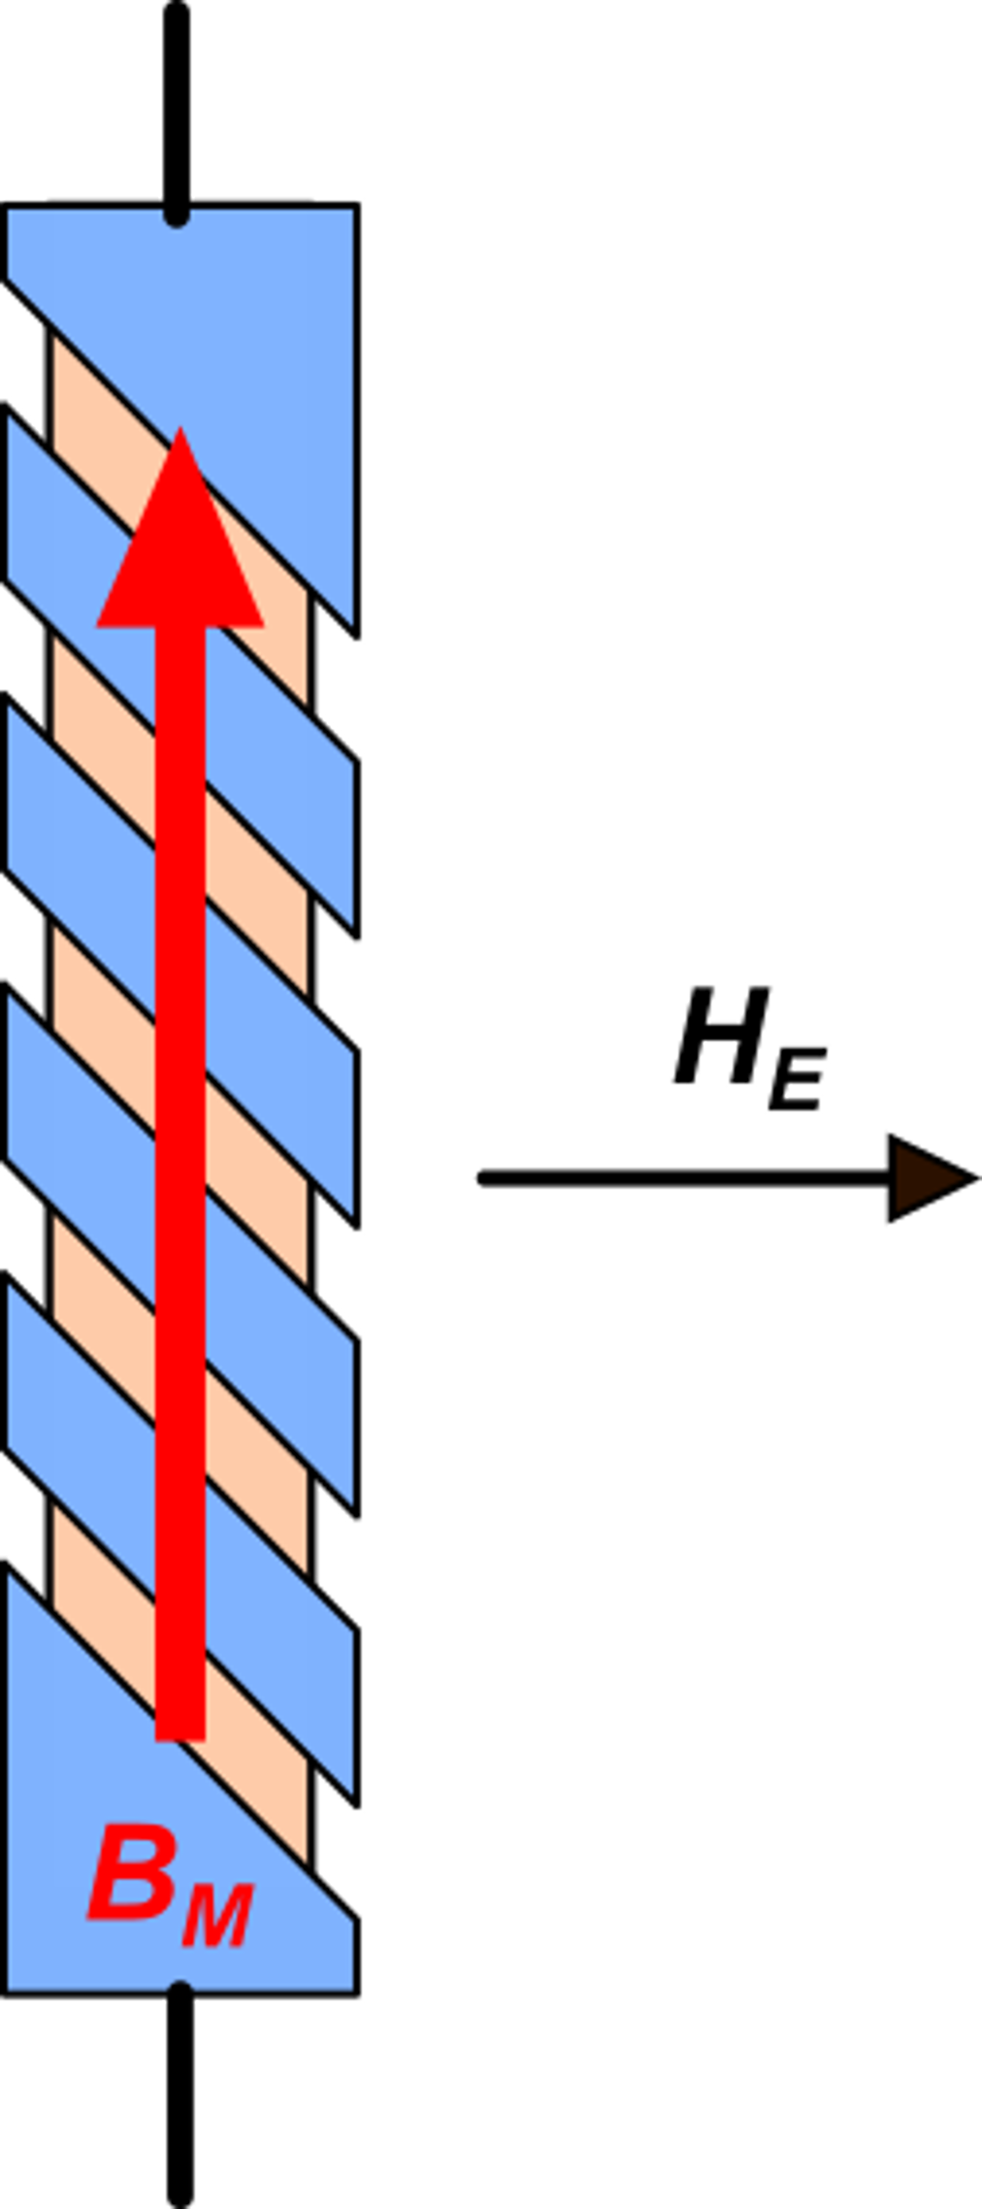
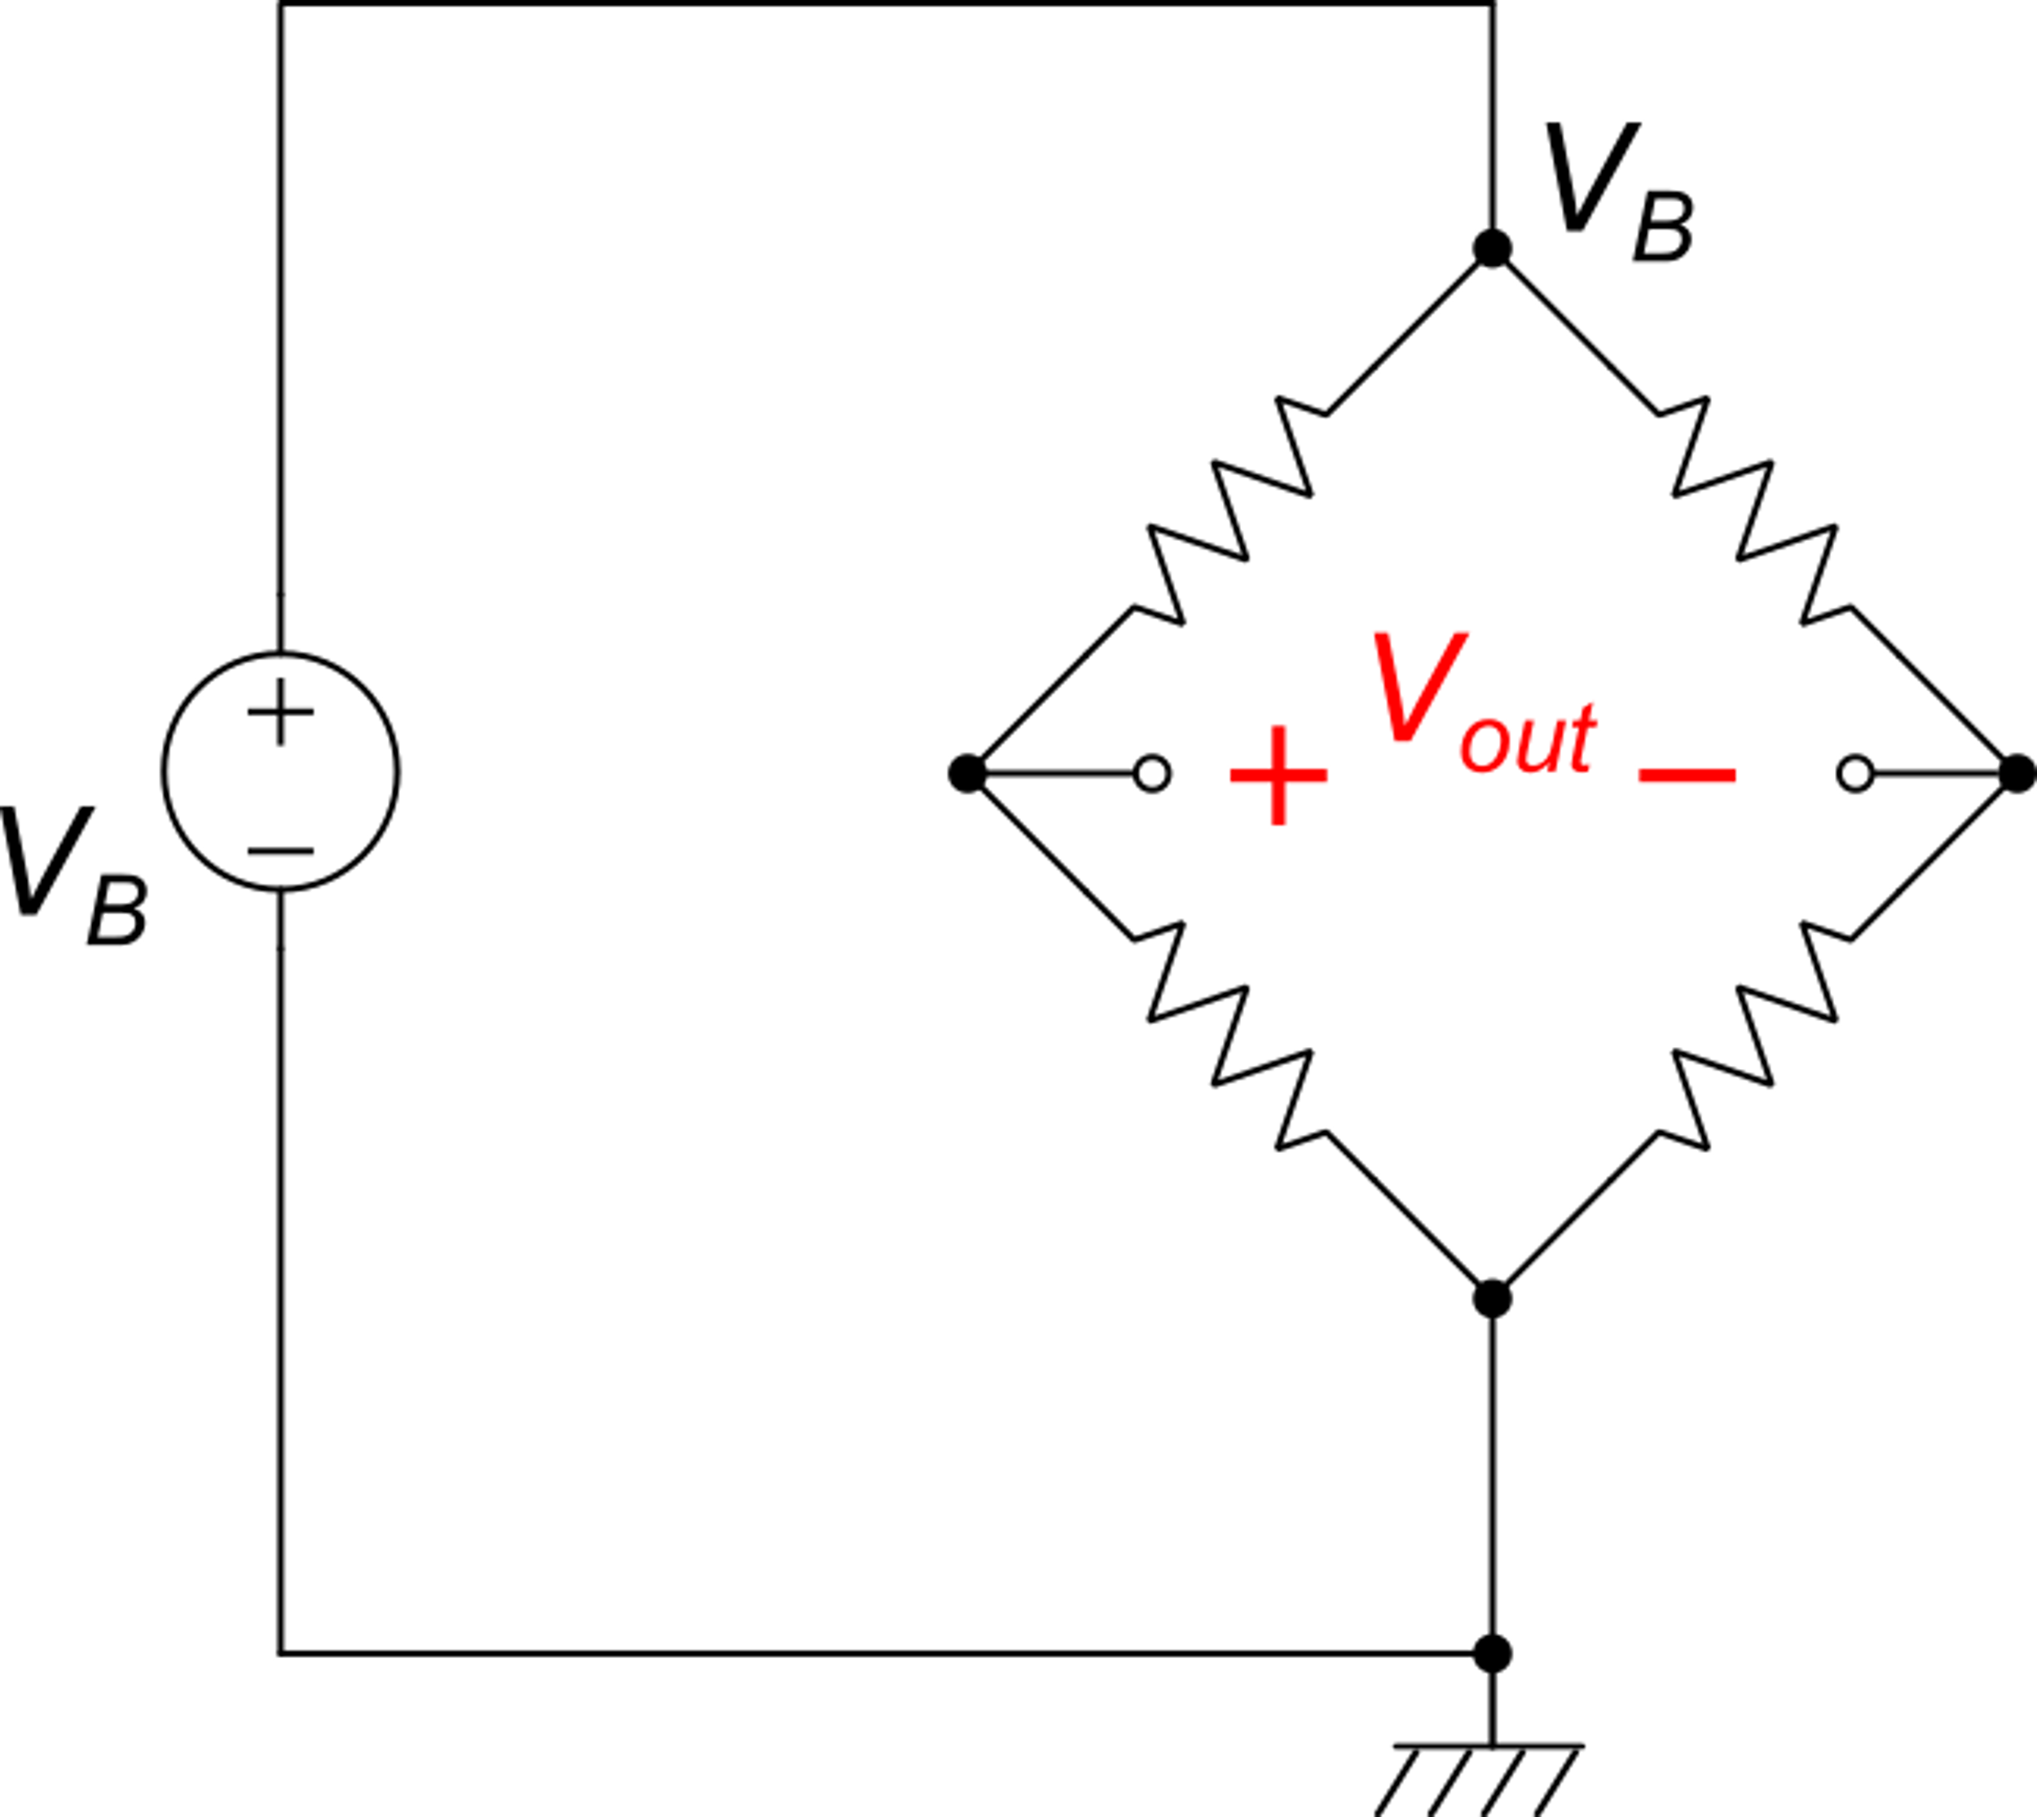
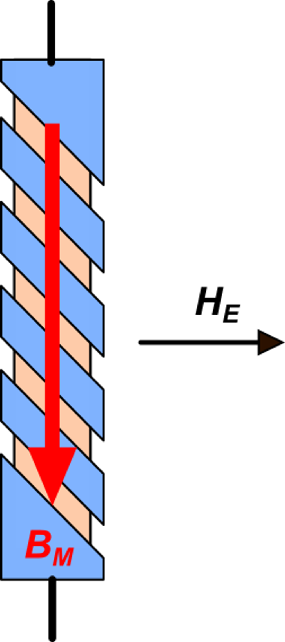
Wheatstone bridge of AMR resistors
R₁
R₃
R₁
R₄
R₂
R₄
R₂
R₃

Slide 11
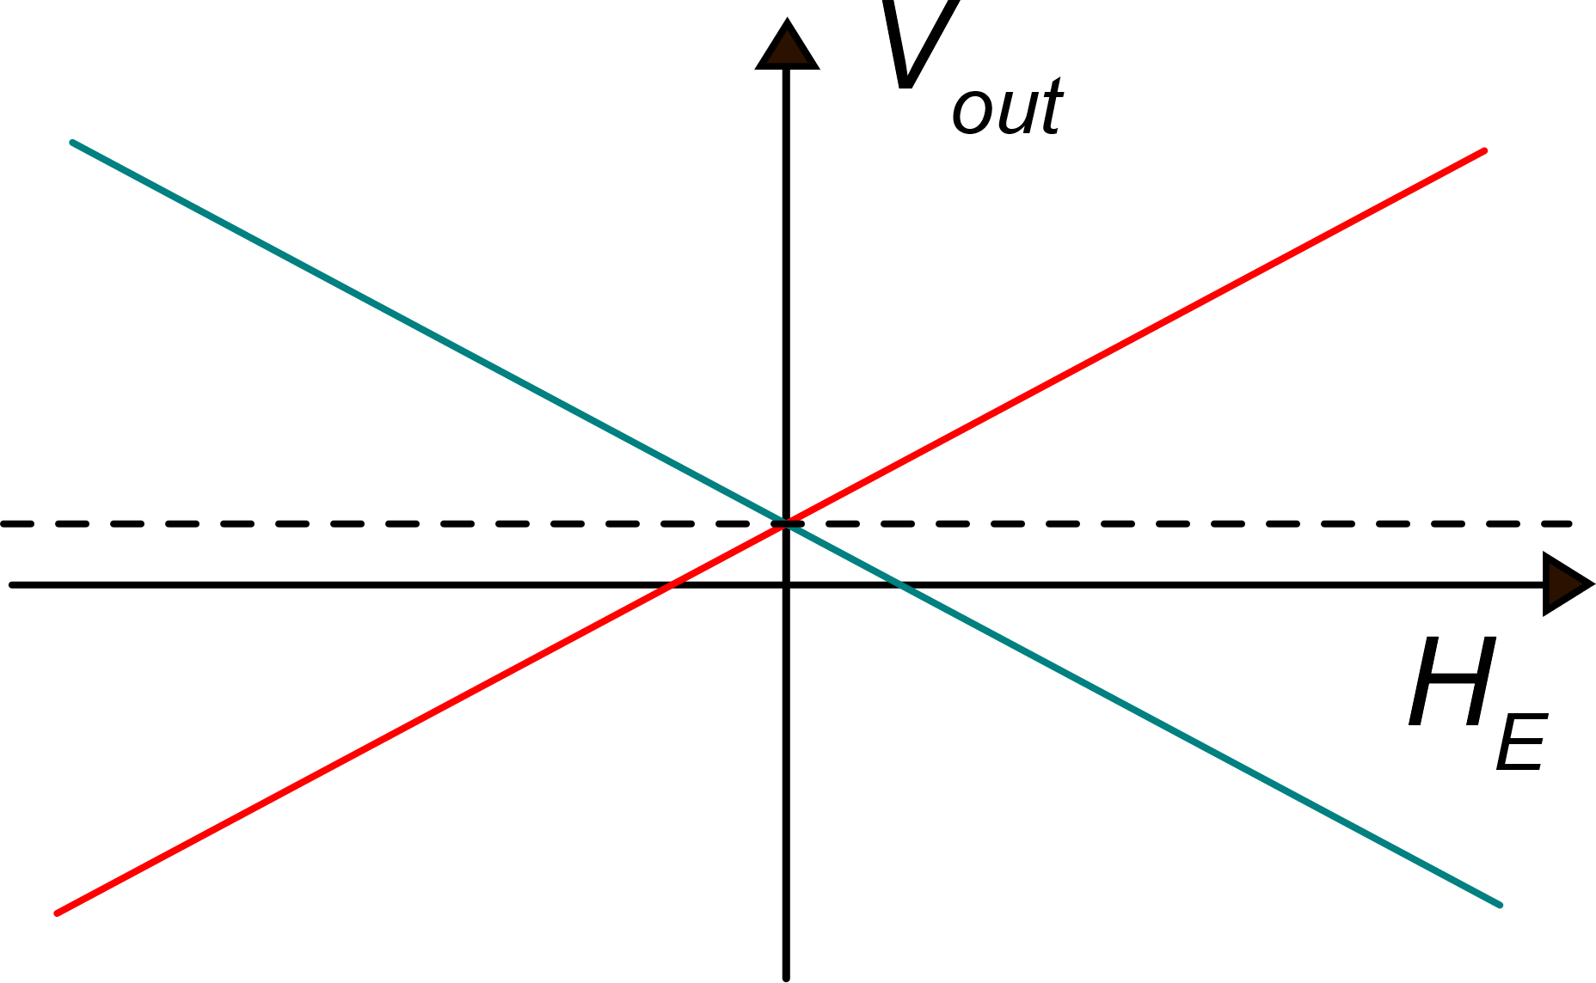
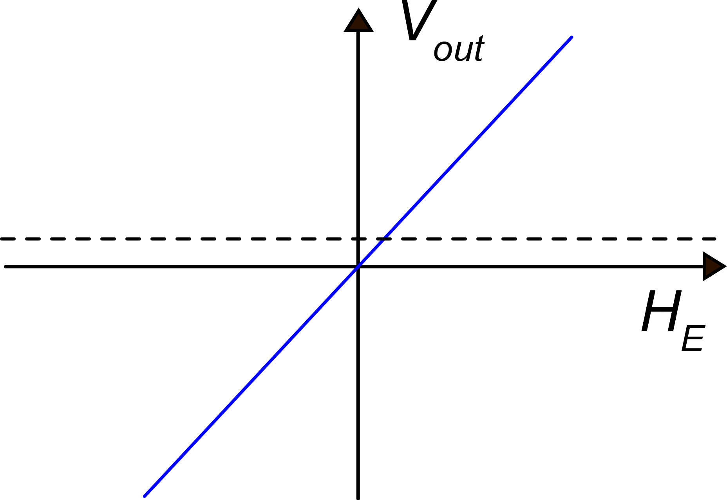
Offset free read cycle
The offset is due to mismatch of the zero-field resistors (R₀) of the Wheatstone bridge
Phase 2
Phase 1
Offset
Inverting the magnetization of all AMR resistors change the sign of the output voltage but leaves the offset unchanged
Phase 1
Phase 2
phase 1 - phase 2
(no offset)

Slide 12
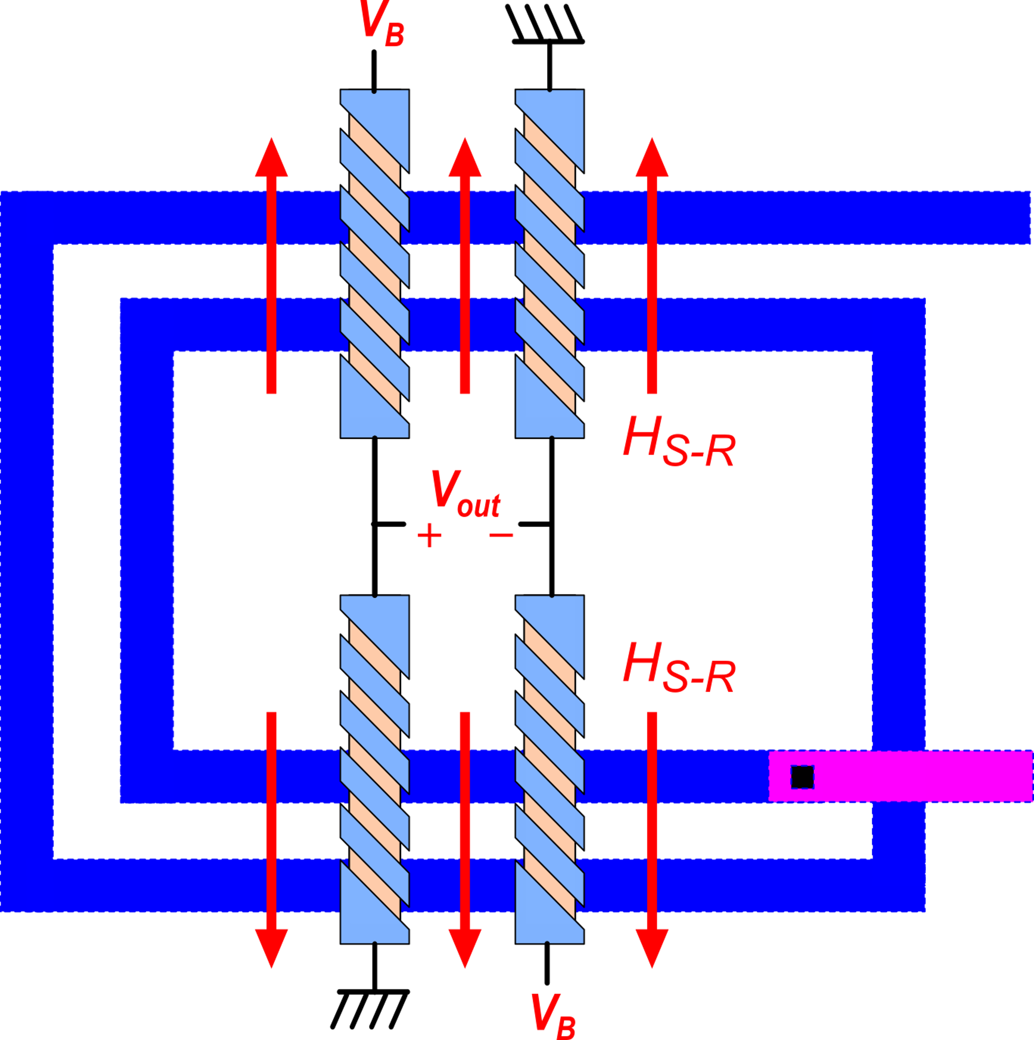
Integrated AMR sensor with magnetization coil (set-reset coil)
I_{set-reset}
order of 1 A for 1μs
Sensitivity axis

Slide 13
Giant Magneto Resistance (GMR) Sensors
Ferro Magnetic (FM) Layers (medium conductivity)
Layer thickness:
a few monolayers
Non-FM, high conductivity layer (e.g. Cu)
R
With no external field, magnetization tends to be opposite in adjacent layers
High surface scattering in the conductive layers.
High resistance

Slide 14
Effect of an external field
Resistance variations can be much larger than in AMR sensors (up to 100 %), but this is not a linear effect (it is rather a threshold effect).
H_{E}
An external field of sufficient strength force all the layers to have parallel magnetization
Low scattering
Low resistance

Slide 15
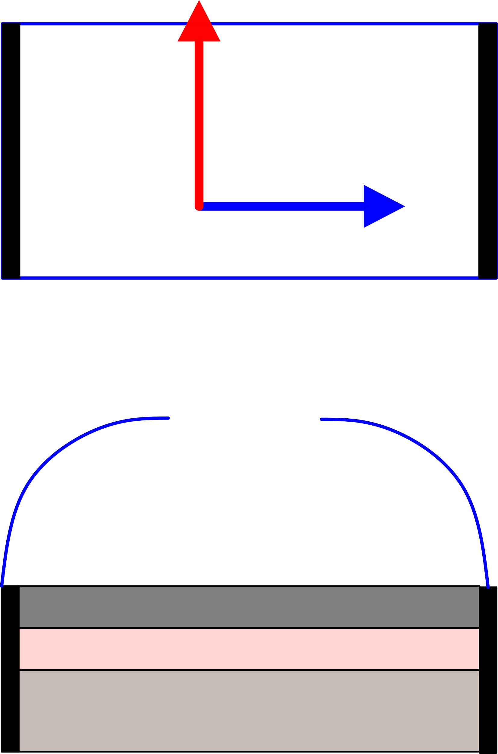
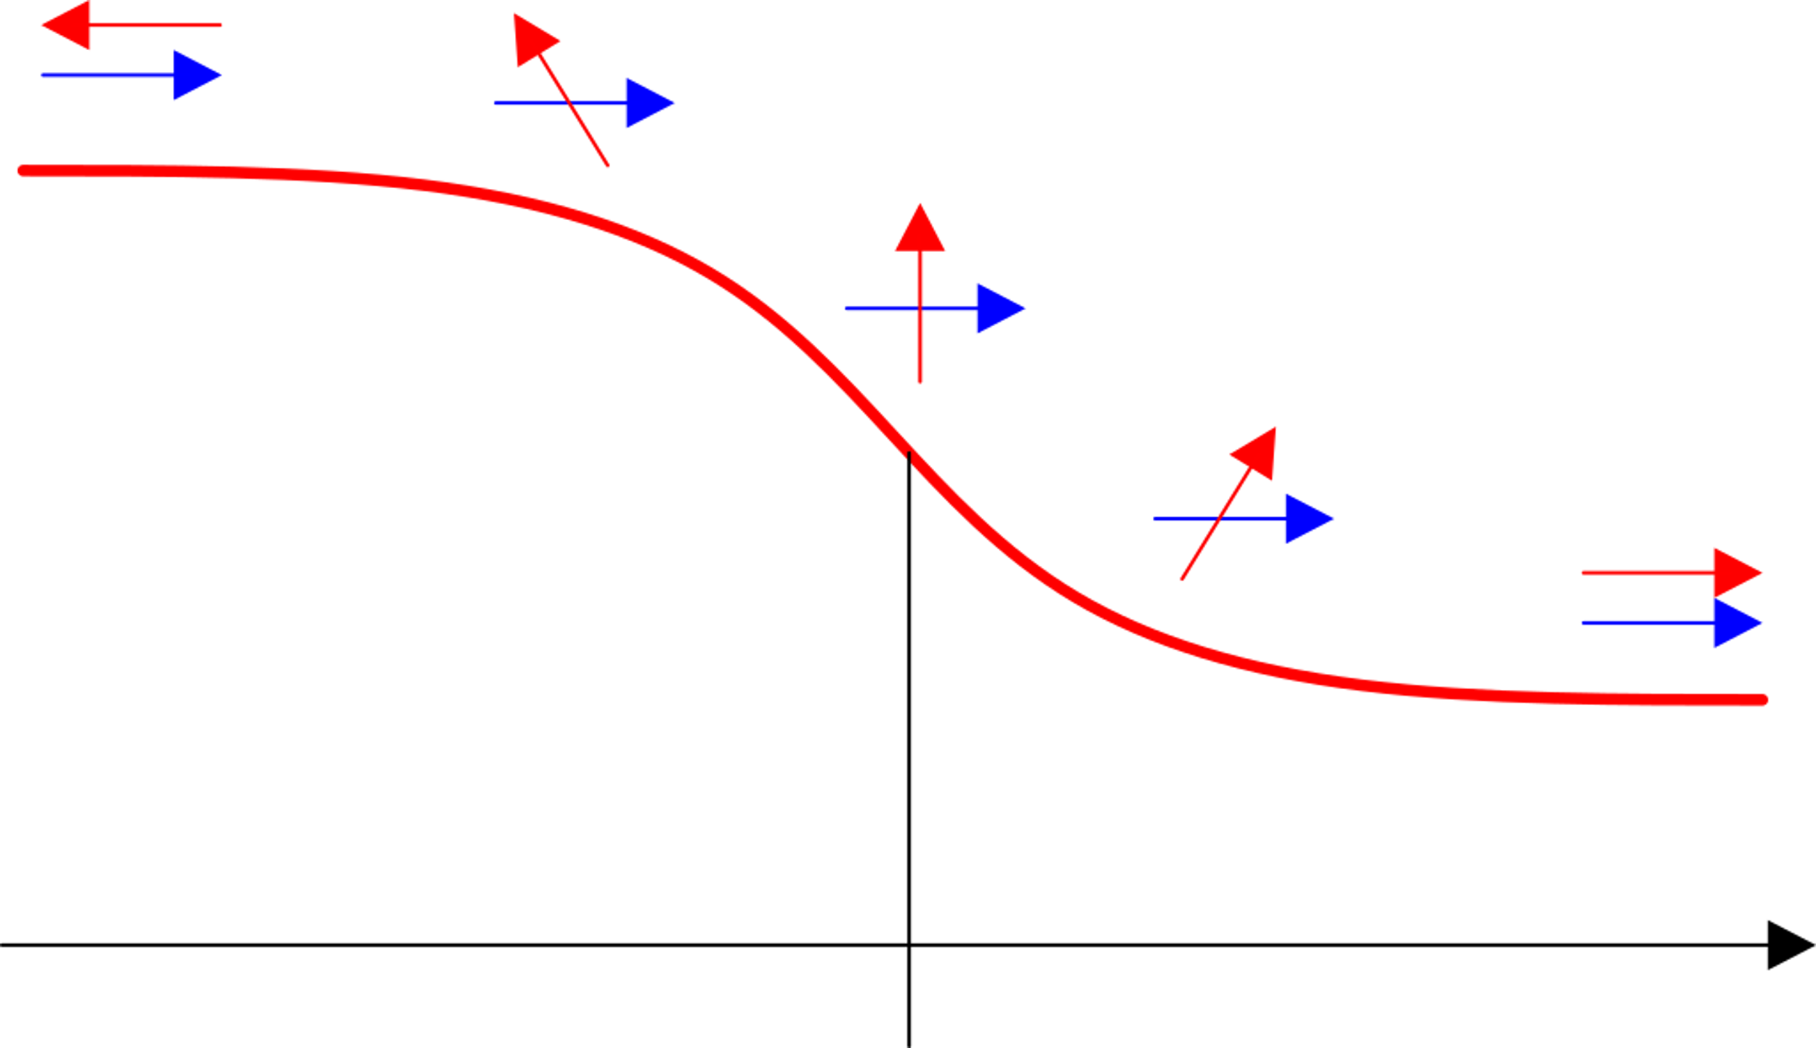
GMR Spin Valve
H_{E}
Top view
For null external fields, magnetization
in the two layers are orthogonal
The external field make the two magnetization tend to a parallel or anti-parallel orientation
Top FM layer
(the magnetization is affected by
the external field)
R
R
Linear behavior
around the origin
FM layer with pinned magnetization (does not change with external field)
0
H_{E}

Slide 16
TMR (Tunneling Magneto Resistance)
Free Magnetization Layer
Insulating (tunnel) Layer
Tunnel current
0
H_{E}
Pinned Magnetization Layer
The resistance curve is similar to that of GMR, but variations are even larger

Slide 17
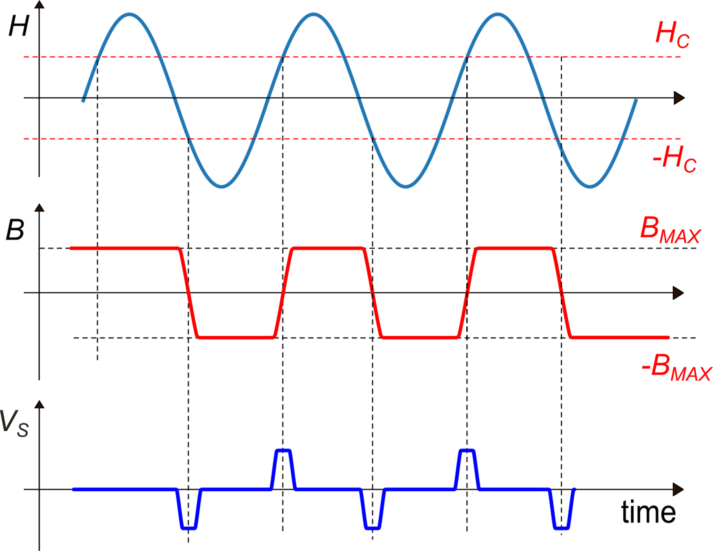
Flux-Gates Magnetometer : Principle
H
H_{IM}: the excitation field, proportional to I_{M}
H_{ext}: is the external field, that we want to sense
V_{S}
I_{M}
For H_{ext}=0
Excitation coil
Sensing coil
I_{M} is a sinusoidal current
The fluxgate principle is effective also with soft magnetic materials. What is essential is the presence of saturation.
In the case of Hext=0, the sensed voltage V_{S} has the property of half-wave symmetry. Then it has no even harmonics

Slide 18
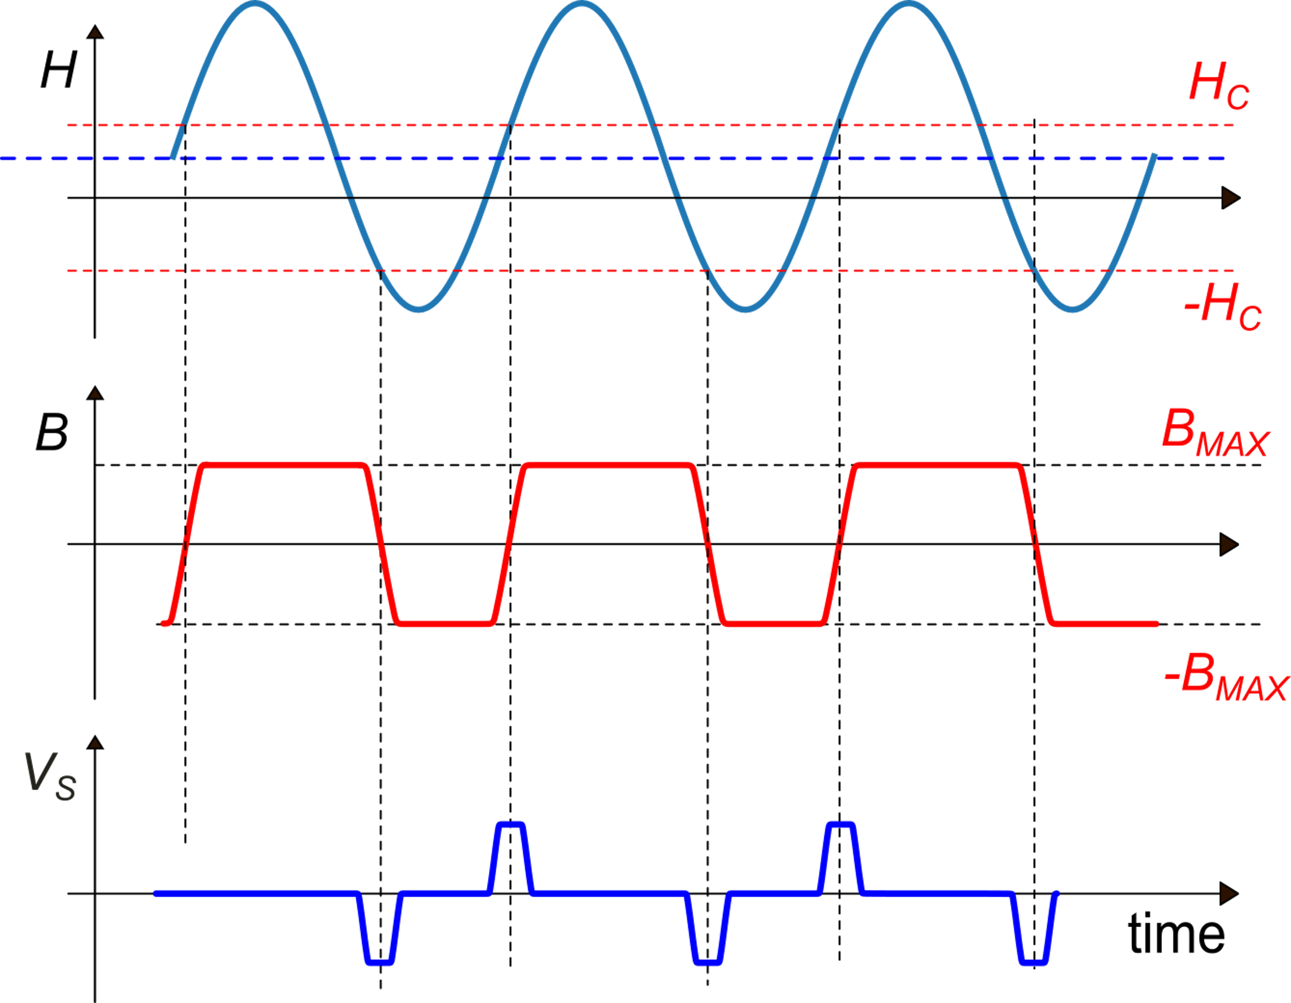
Flux-Gates Magnetometer : Principle
H
V_{S}
I_{M}
Excitation coil
Sensing coil
The external field H_{ext}, shifts the excitation field H (in the example H is shifted up). As a result, magnetic induction B spends more time in the positive saturation value (B_{MAX}) than in the negative one (.-B_{MAX}).
This introduce an asymmetry that results in the presence of a second harmonic component.
The relationship between the magnitude of the second harmonics and H_{ext} is linear for small values of the field. The sign of H_{ext} is represented by the phase of the second harmonics that can be detected by means of a synchronous demodulator.

