Slide 1
Magnetic sensors
H : Magnetic field strength. Unit: A/m)
Magnetic field:
B : Magnetic flux density (magnetic induction) Unit: Tesla (T)
Non-SI unit, still commonly used: Gauss: 1 Gauss = 100 μT
In a medium of magnetic permeability μ:
Vacuum permeability μ₀=$4π×{10}^{−7}$ H/m (H=Henry).

Slide 2
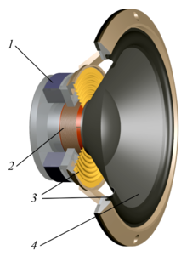
Example of electric field magnitude
Earth's magnetic field: 25 to 65 μT
Magnetic field produced by a current
I_{M}
Example:
μ=μ₀ (air, vacuum ...)
I_{M}=1 A, r=10 cm
r
H
B=20 μT
Refrigerator
magnets
General purpose permanent magnets (e.g. "refrigerator magnets")
B=5-20 mT
Inside the gap of loudspeaker magnets: ∼ 1 T

Slide 3
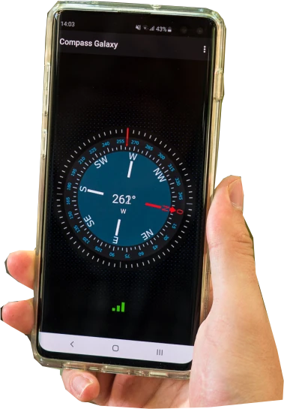
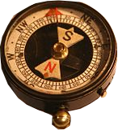
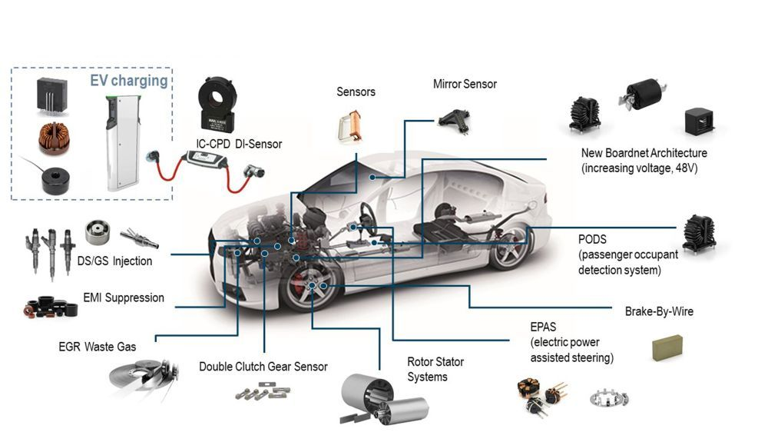
Applications of magnetic sensors
Aid to navigation
Orientation finding
Accuracy improvement of IMUs (inertial measurement units)
Magnetic compass:
Proximity sensors
Angular position sensors
Contactless current measurements

Slide 4
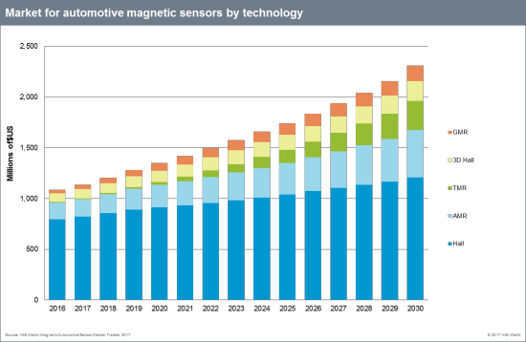
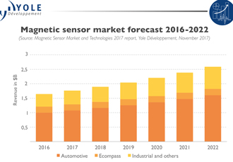
Magnetic sensors: market
By Type (in automotive)
By Application
3-D Hall
GMR
TMR
AMR
Hall

Slide 5
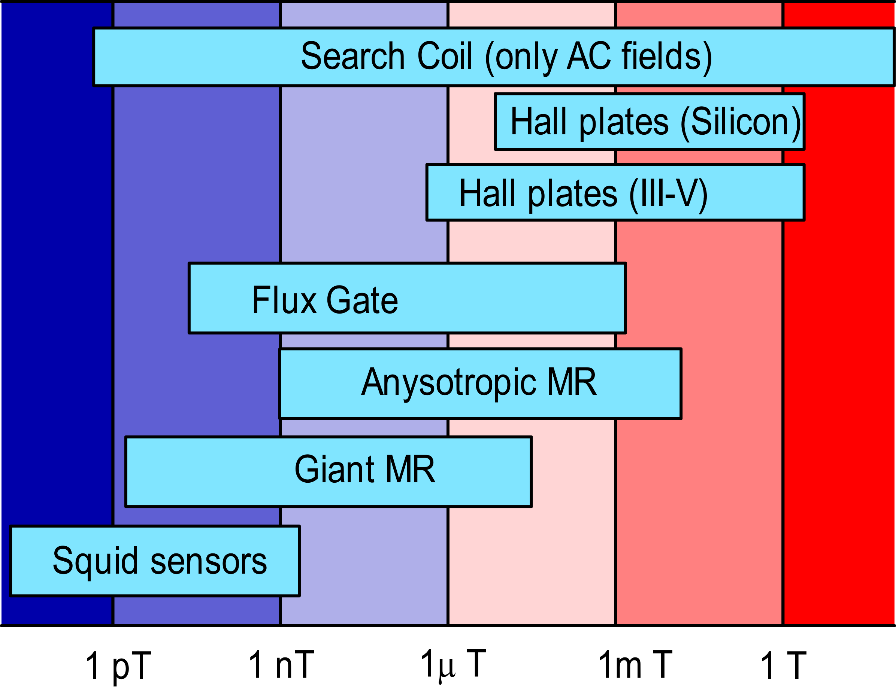
Types of magnetic sensors
Heart and Brain
magnetic field
Earth's magnetic field
Detection Limit

Slide 6
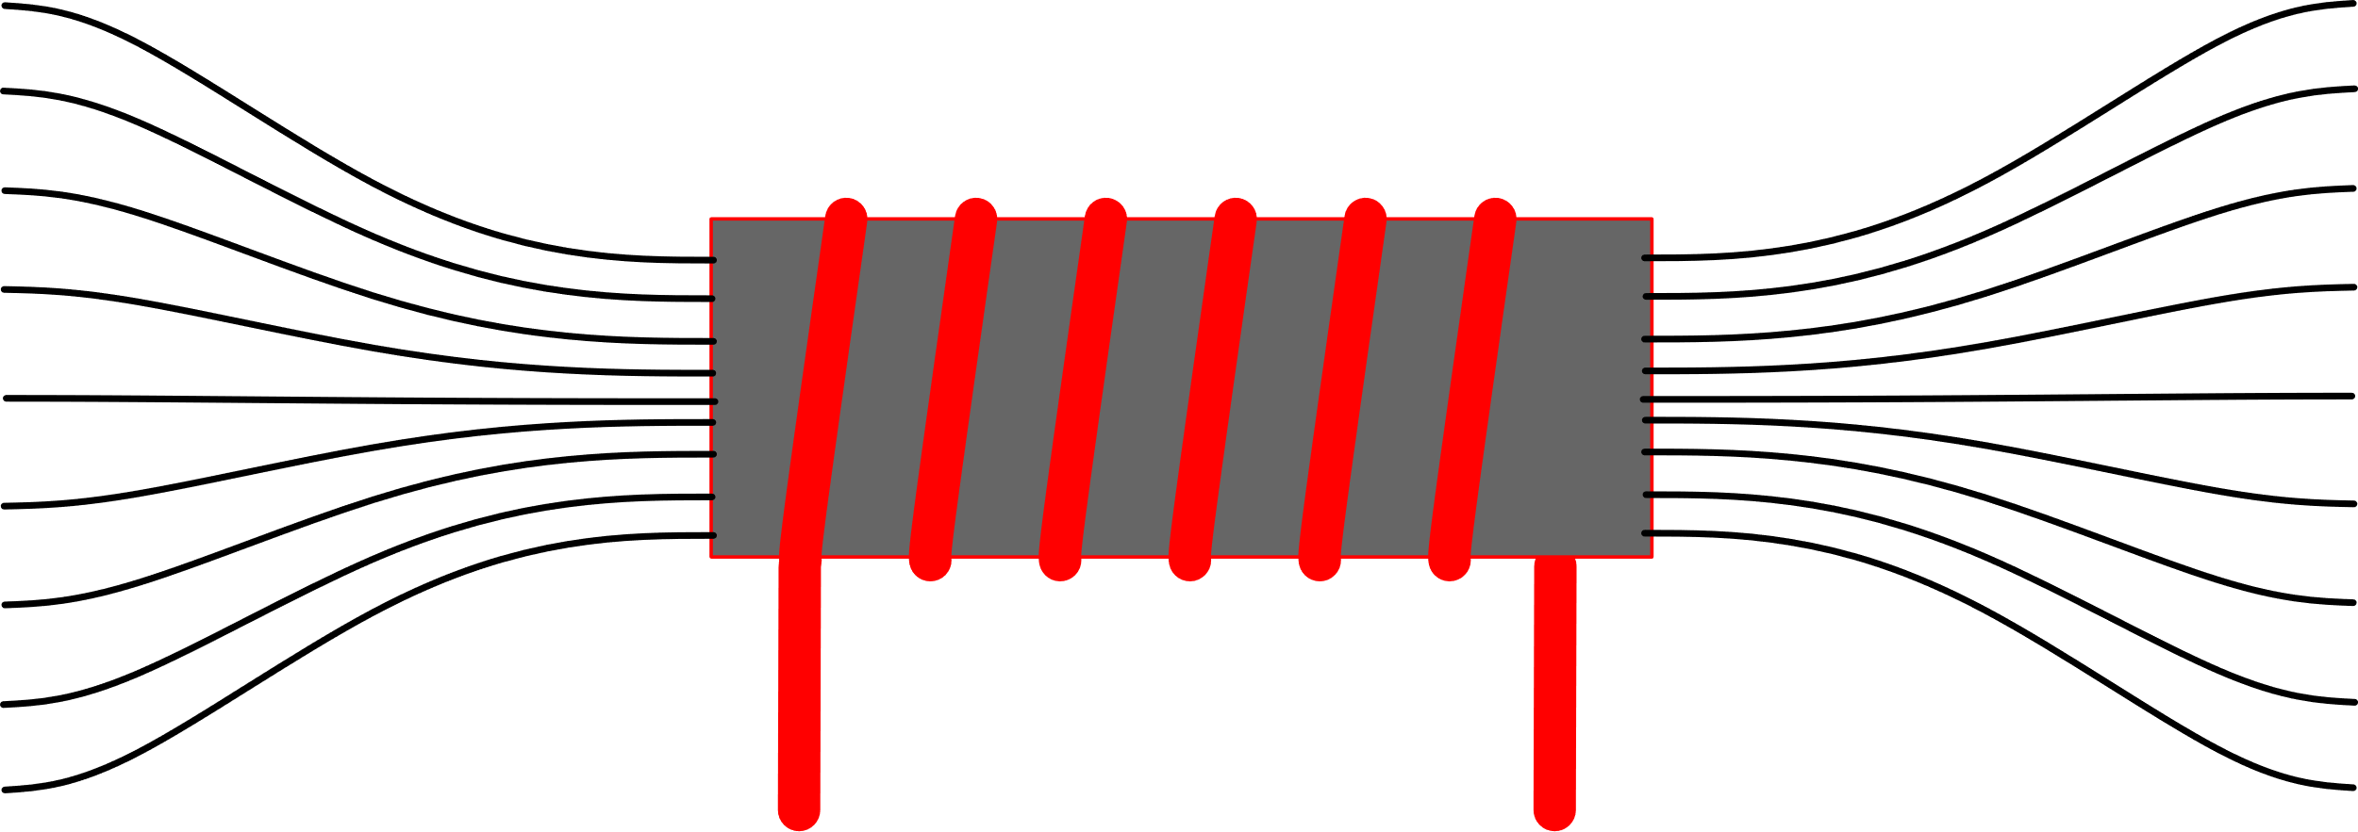
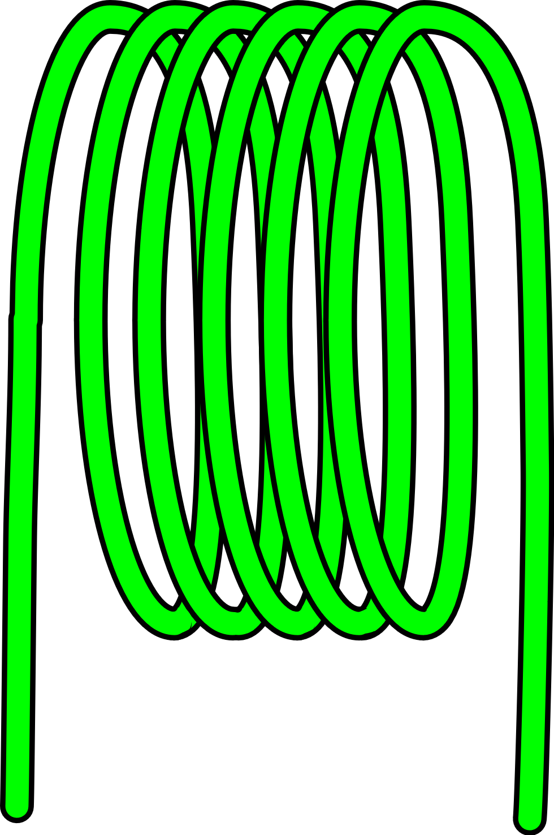
Search Coil
B
A ferromagnetic nucleus can be used to concentrate the field lines, increasing the sensitivity
The search coil needs the magnetic flux to be variable.
Constant magnetic fields can be measured only mechanically rotating or vibrating the coil.
AC Fields only!

Slide 7
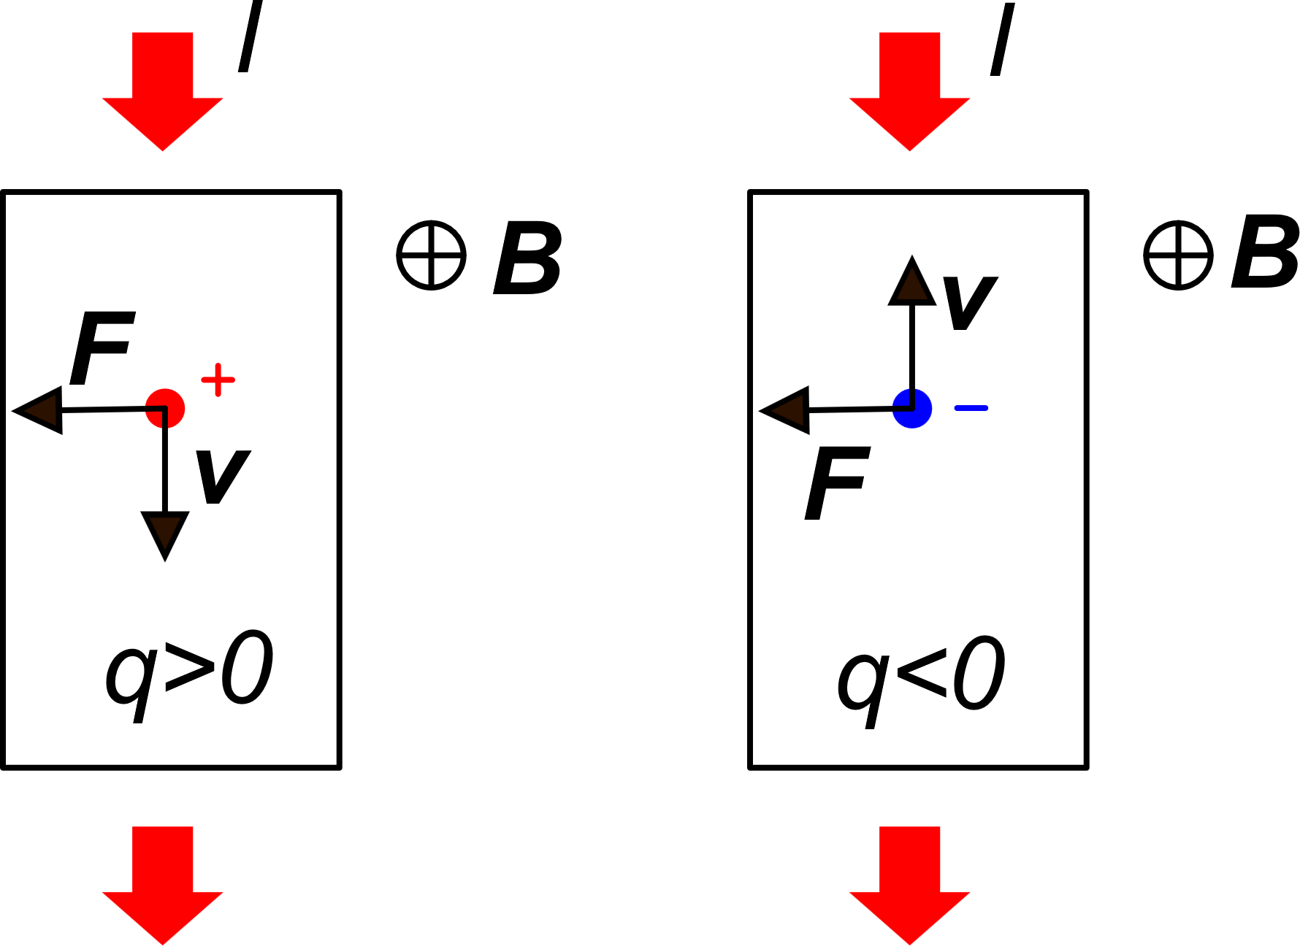
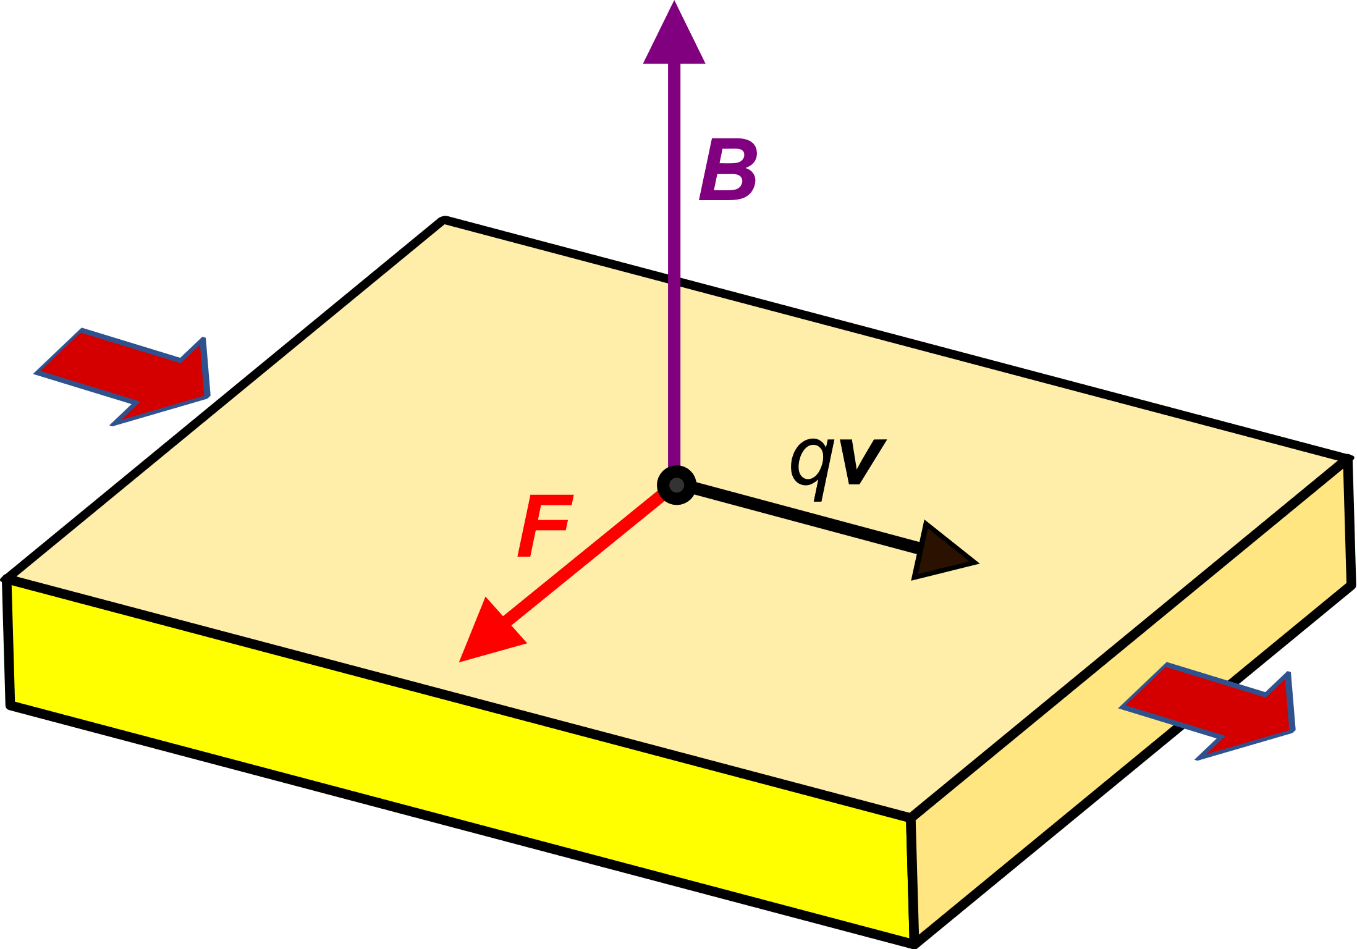
Hall sensors
Positive
charge
carriers
Negative
charge
carriers
Basic Hall effect:
Discovered by Edwin Hall in 1879
Conductor or
semiconductor plate
Electrical
current
F: Lorentz Force
I
q: charge of the charge carrier (can be positive or negative)
v: charge carrier velocity
B: Magnetic induction field
The force has the same direction

Slide 8
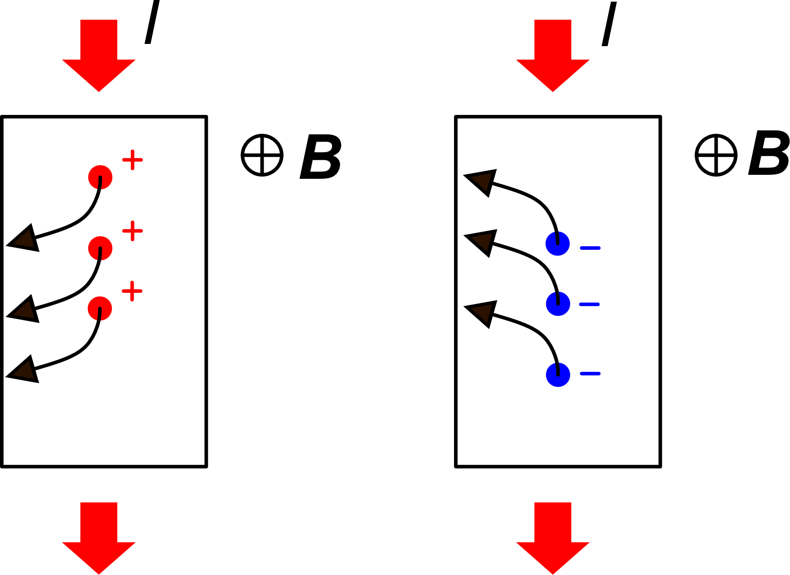
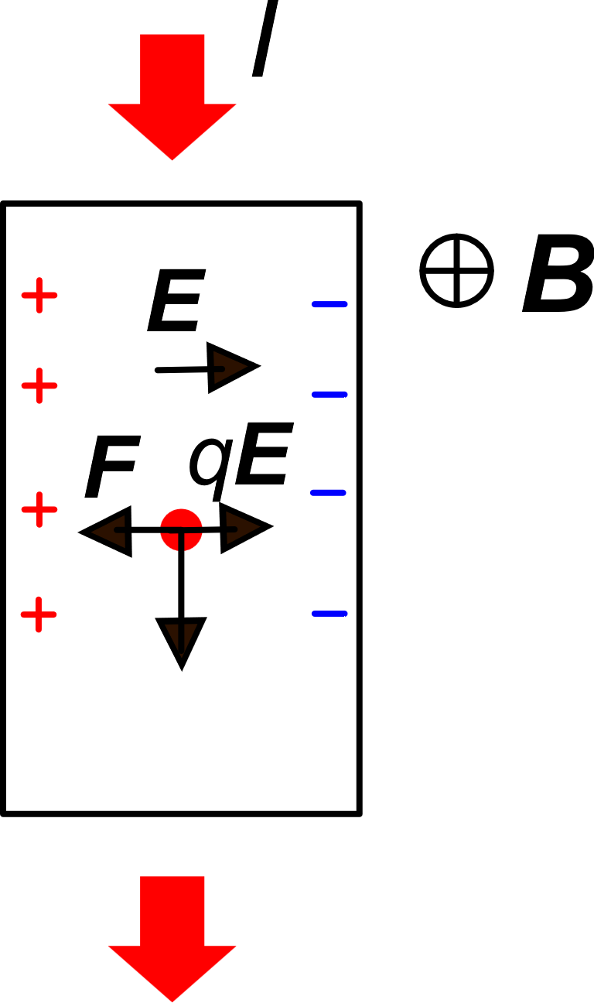
Hall effect: formation of the Hall voltage
y
x
Stationary conditions:
W

Slide 9
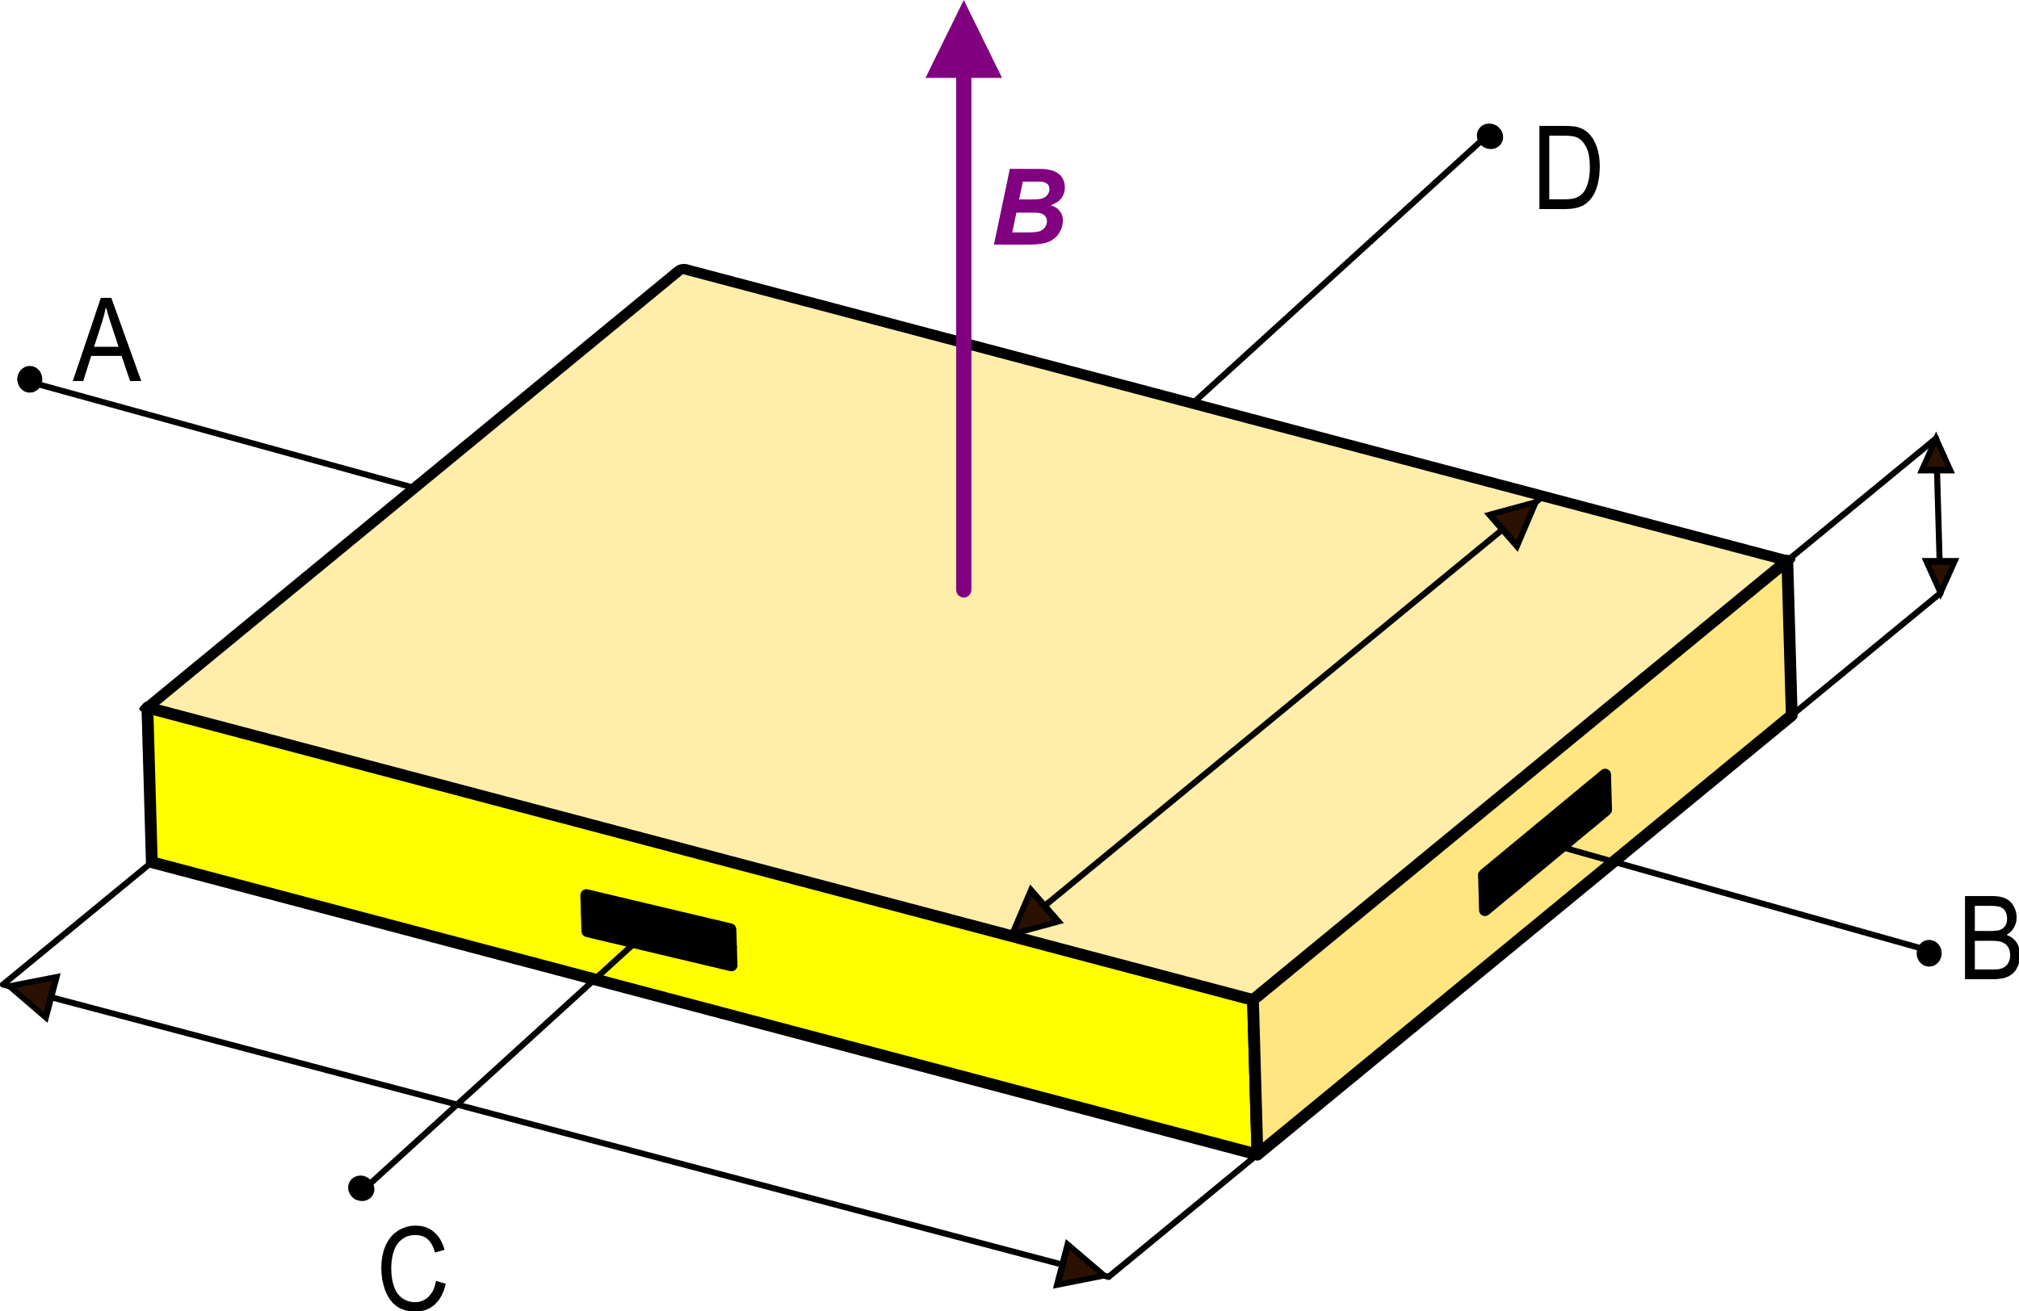
Hall Voltage
d
W
z
L
y
x
The Hall effect can be used to determine the carrier mobility μ

Slide 10
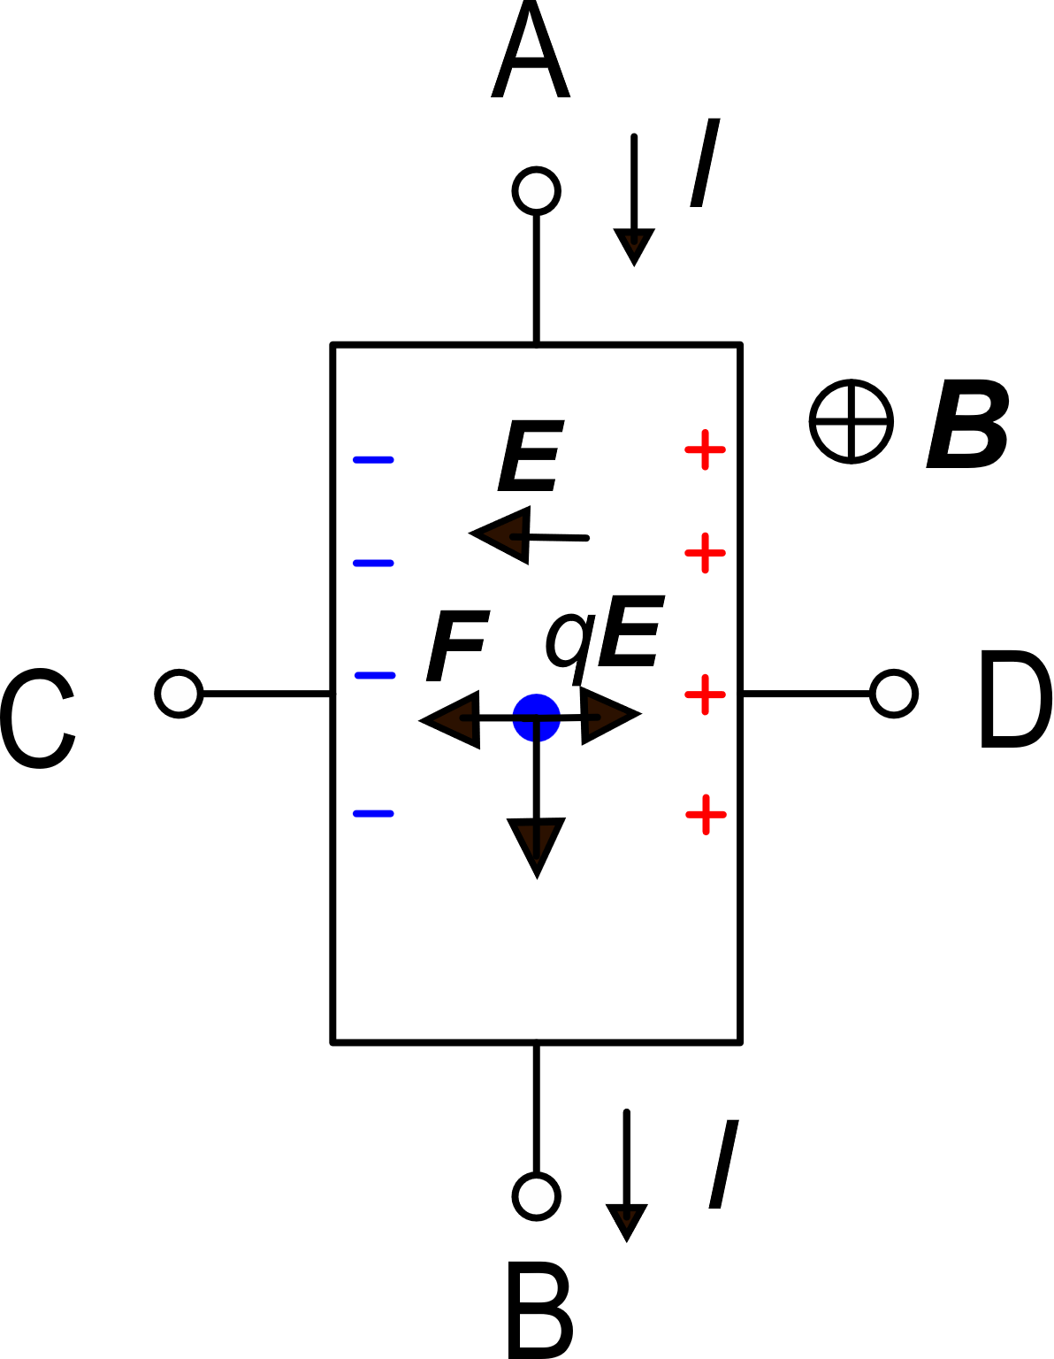
Case of negative charges:
The Hall voltage change sign if the sign of the charge charrier is changed
The Hall effect can be used to determine if the main charge carries are holes or electrons

Slide 11
Hall Voltage: a more practical expression
d
W
z
L
y
x
The Hall voltage is proportional to both the magnetic field (B) and the bias current (I)
For this reason, the sensitivity is generally expressed in:
V / (A T)
"Volt per Ampere Tesla"

Slide 12
Examples of Hall voltage magnitude
(possible thickness of an interconnection
layer in an Integrated circuit)
d=1 μm
d
W
L
Copper: $n\sim 8×{10}^{22} cm^{−3}=8×{10}^{28} m^{−3}$
n-Si with N_{D}=10⁻¹⁶ cm⁻³ : n$=N_{D}=1×{10}^{22} m^{−3}$

