Slide 1
Importance of detecting biopotentials
Diagnostic purposes: Detecting a possible disease (e.g. heart and neural pathologies, etc.)
Implantable, wearable biomedical devices:
Cardiac pacemakers (on demand stimulation)
Control of limb prostheses (smart prostheses)
Advanced human-machine interfaces
Early detection of pathological situations (e.g. , automatic defibrillator, migraine attacks) for on-demand drug delivery or electrical stimulation)
Research: understanding the functioning of human or animal body, with particular interest in functioning of the brain

Slide 2
Type of biopotentials and related challenges
Main biopotentials, according to the source
ECG: Electrocardiogram, produced by the electrical activity of the cardiac muscle
EEG: Electroencephalogram, produced by the neurons in the brain
EMG: Electromyogram, produced by the contraction and relaxation of muscles
ERG: Electroretinogram, produced by the activity of the retina.

Slide 3
Biopotential acquisition system
Electrodes
AFE
Isolation
Processing
Number and position of the electrodes
Type of electrodes
Differential input
High CMRR
Specifications of:
Bandwidth
Noise
Input bias currents
Artefact correction capability
Impedance measurement (quality of contact)

Slide 4
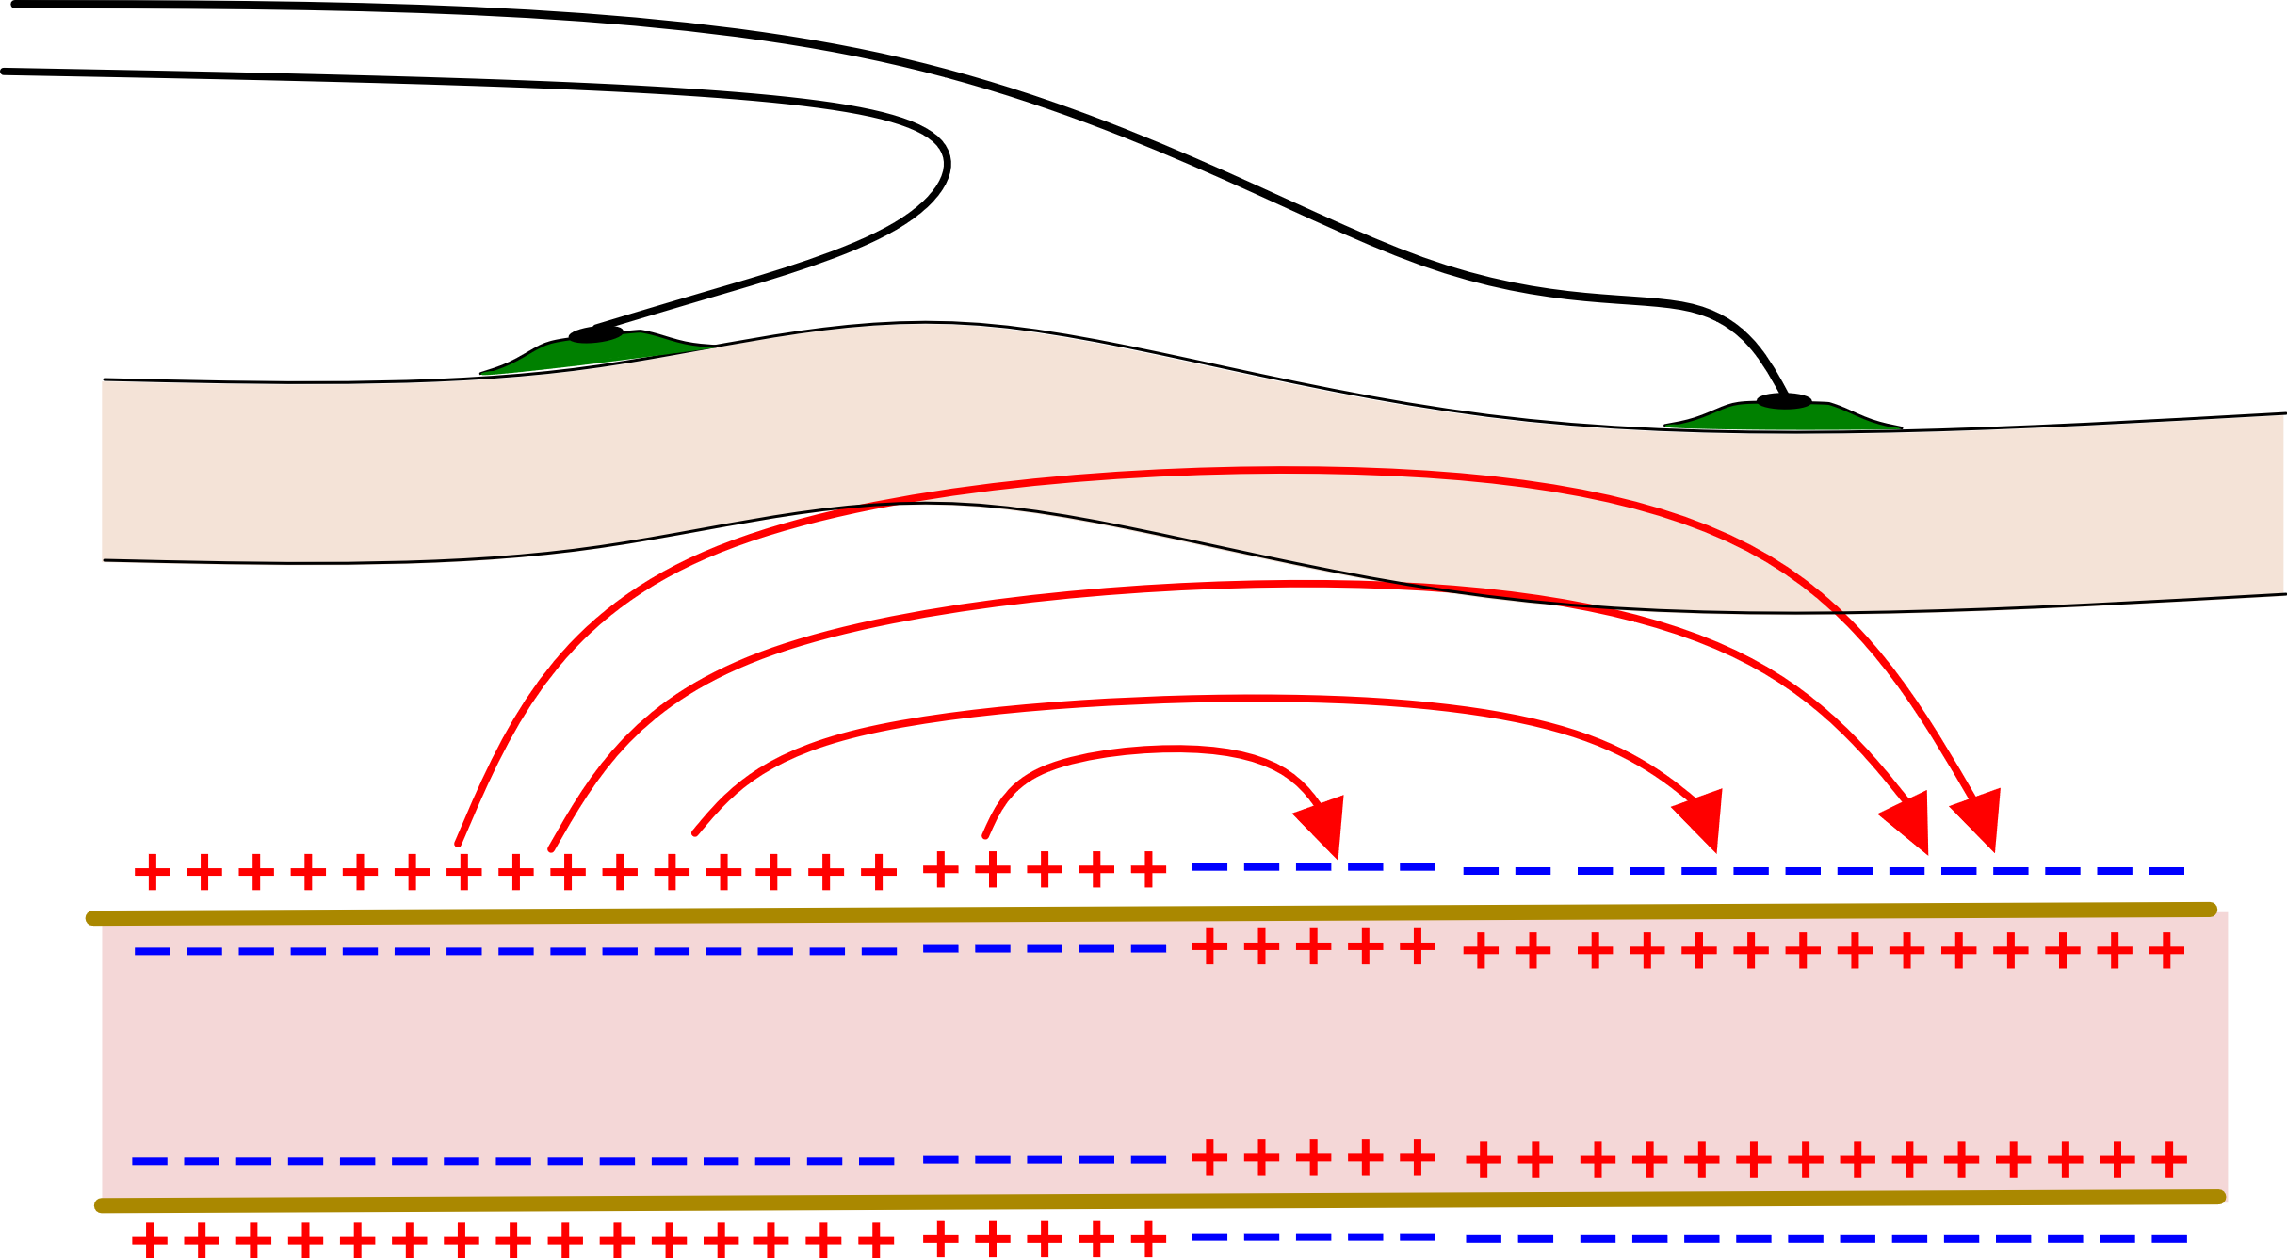
Detection of biopotential through non-invasive electrodes
Principle: electrodes are placed on the skin
To the electronic interface
electrodes
skin
Electrically excited nerve or muscle fibers induce currents in the tissues that produce potential differences across different points of the body
currents
fiber

Slide 5
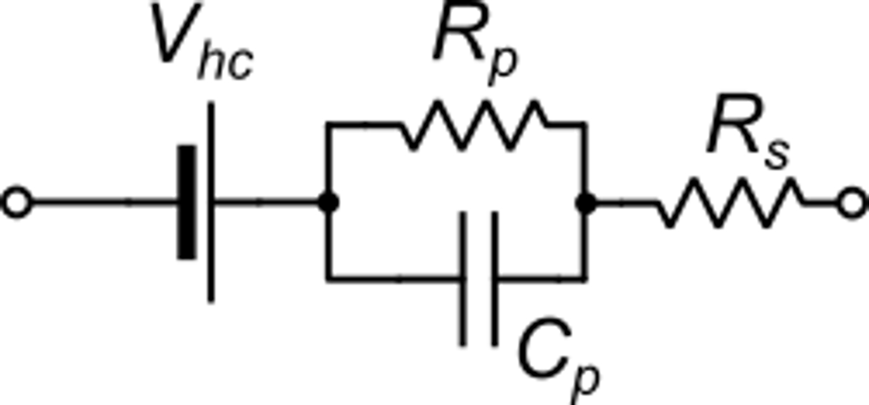
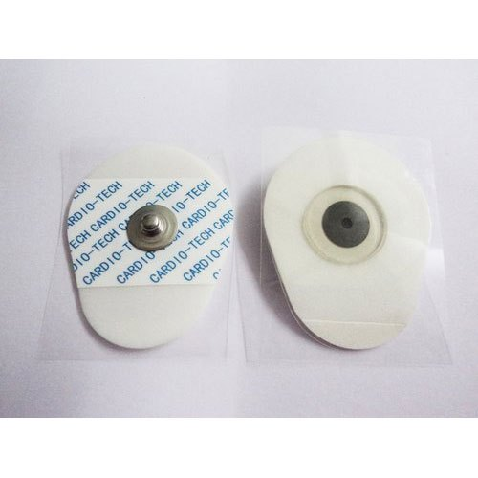
Electrodes for biopotential detection: the Ag / AgCl electrode
adhesive layer
out
Plastic cup
Silver (Ag)
Electrode equivalent circuit
Silver chloride (AgCl)
Skin
Electrolyte gel
Terminal
(electron currents)
Tissues
Skin / tissues
(ionic currents)
The Ag/AgCl electrode is one of the best option, Can be disposable or reusable.
V_{hc} is the half-cell potential. It introduces a dc offset that can be critical for the AFE

Slide 6
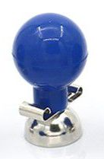
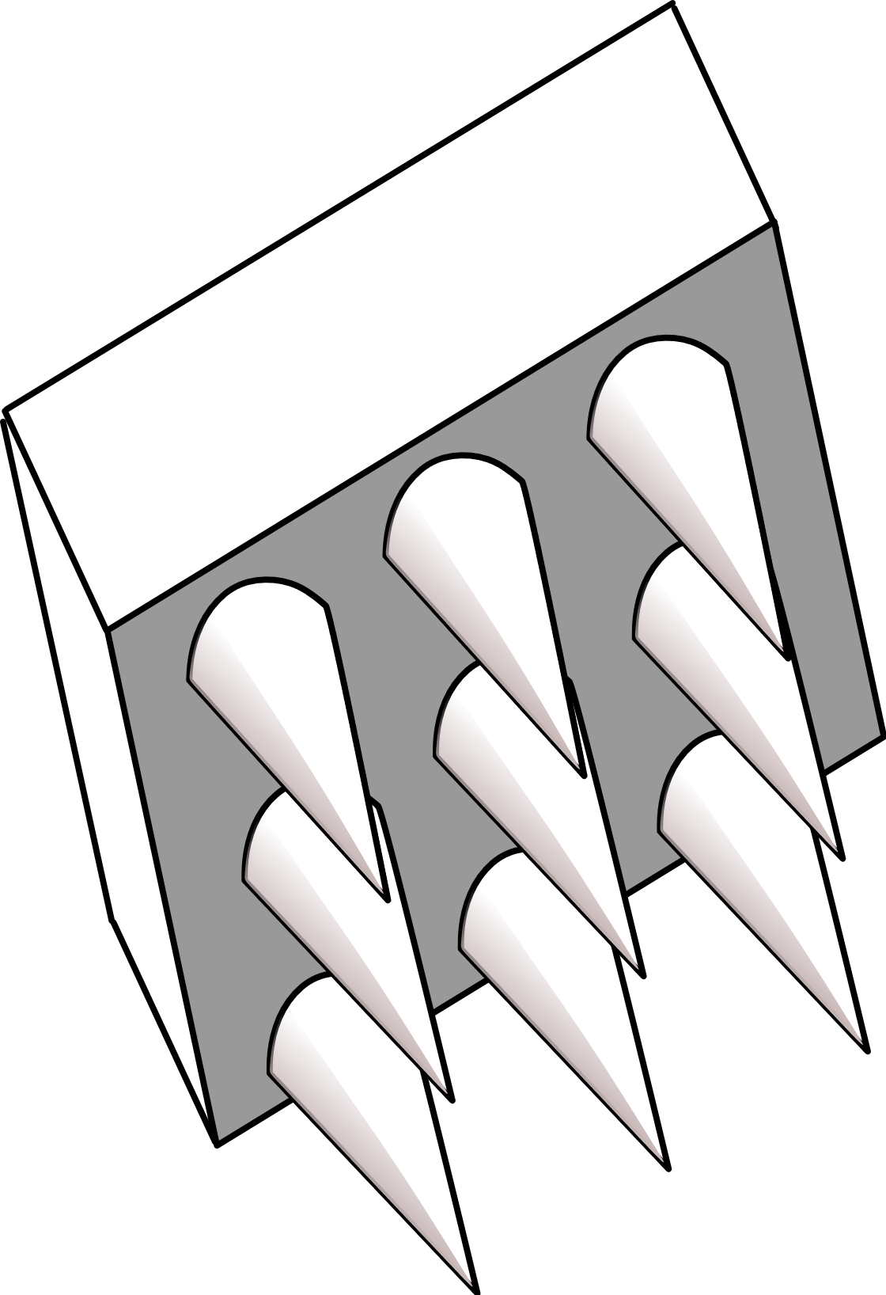
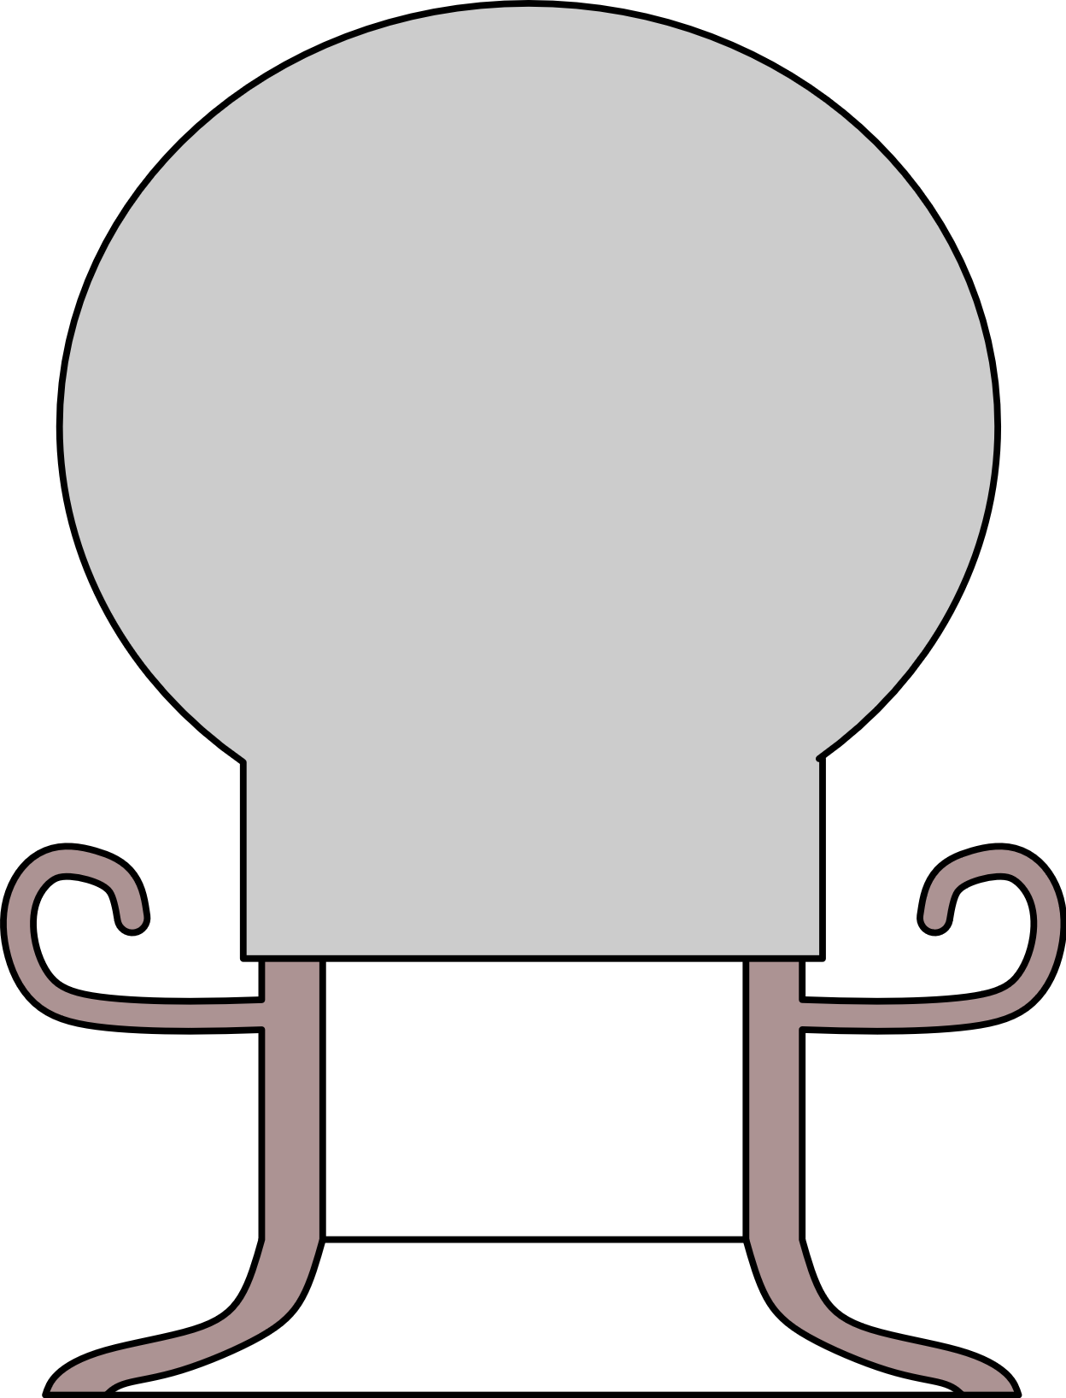
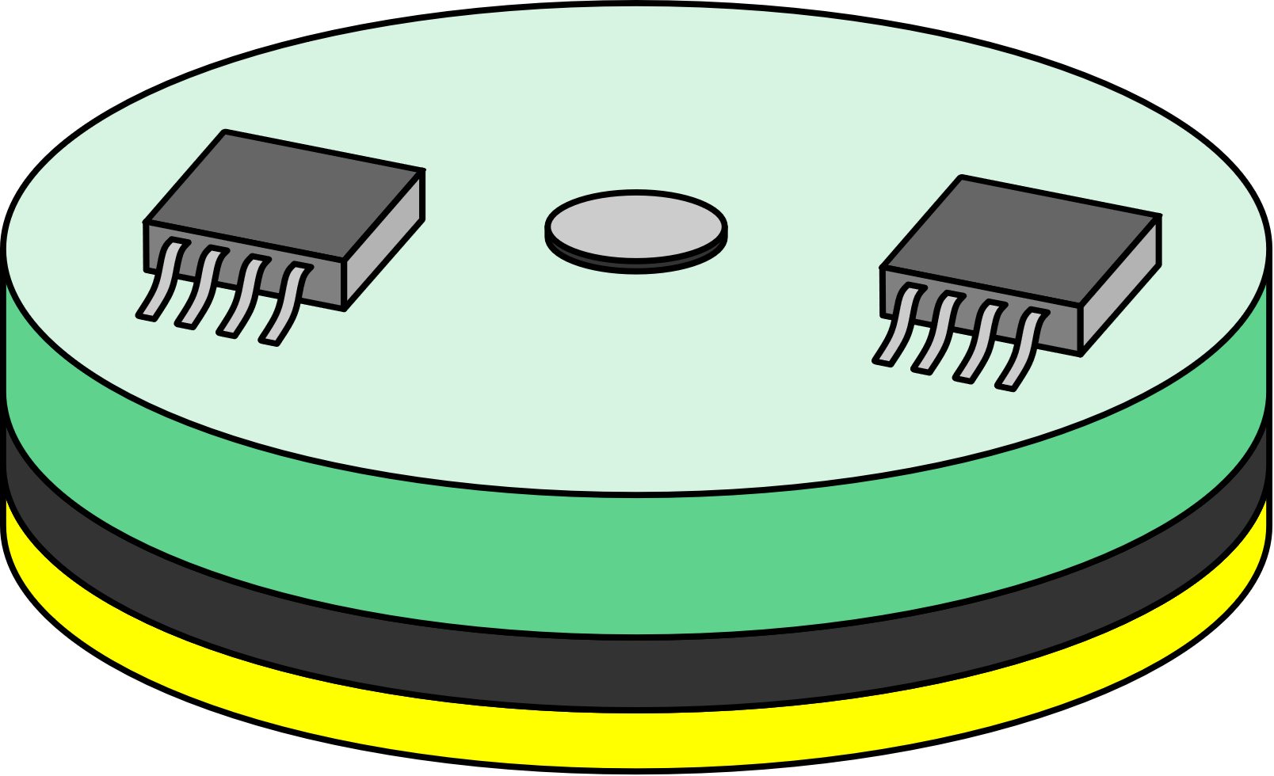
Other types of electrodes
Metal electrodes:
Can be advantageous when the electrode must be reused, or the electrode position must be changed frequently. Need application of electrolyte gel.
Dry electrodes
Do not need application of electrolyte gel.
Capacitive electrodes
Microneedle arrays
Conductive silicone electrodes
Active electrode
rubber cuff
metal
electrode
Insulator (touchless) or conductive silicone rubber
Microneedles
Example: cuff electrode

Slide 7
Electrodes for in-depth biopotential monitoring
Sometimes, it is necessary to detect the biopotential in a position very close to the organ that is generating it. In this case, invasive catheter or needle electrodes are required. They do not need gel, since internal tissues are wet
insulator (flexible)
Examples:
Metal electrodes
conductor
Catheter: used to pick up potential differences within organs (e.g. the heart).
Can be brought in place through veins or arteries
insulator
Needle (used to contact muscle fibers directly)

Slide 8
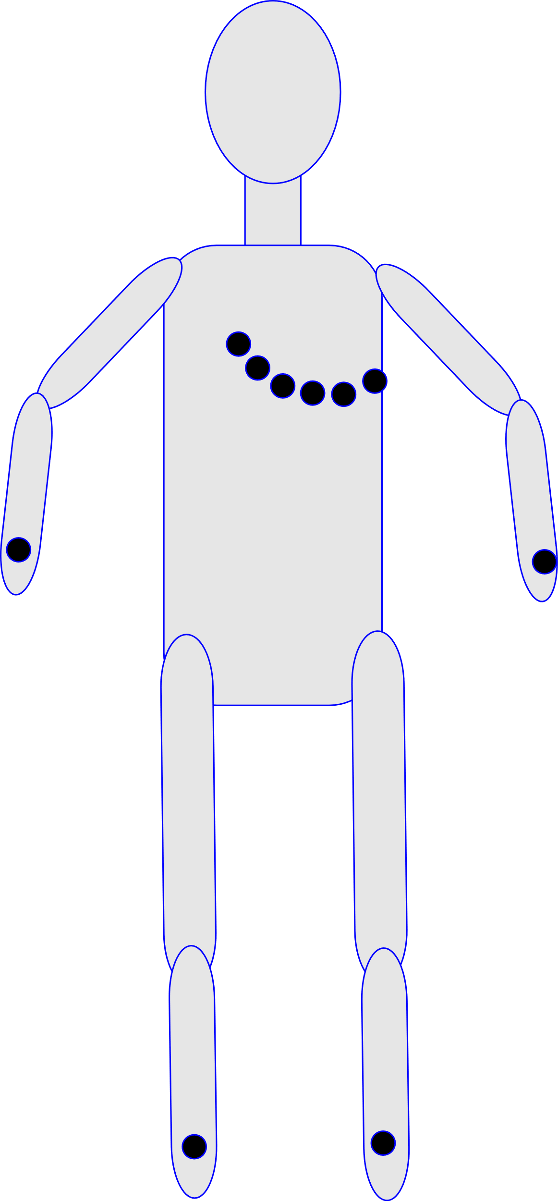
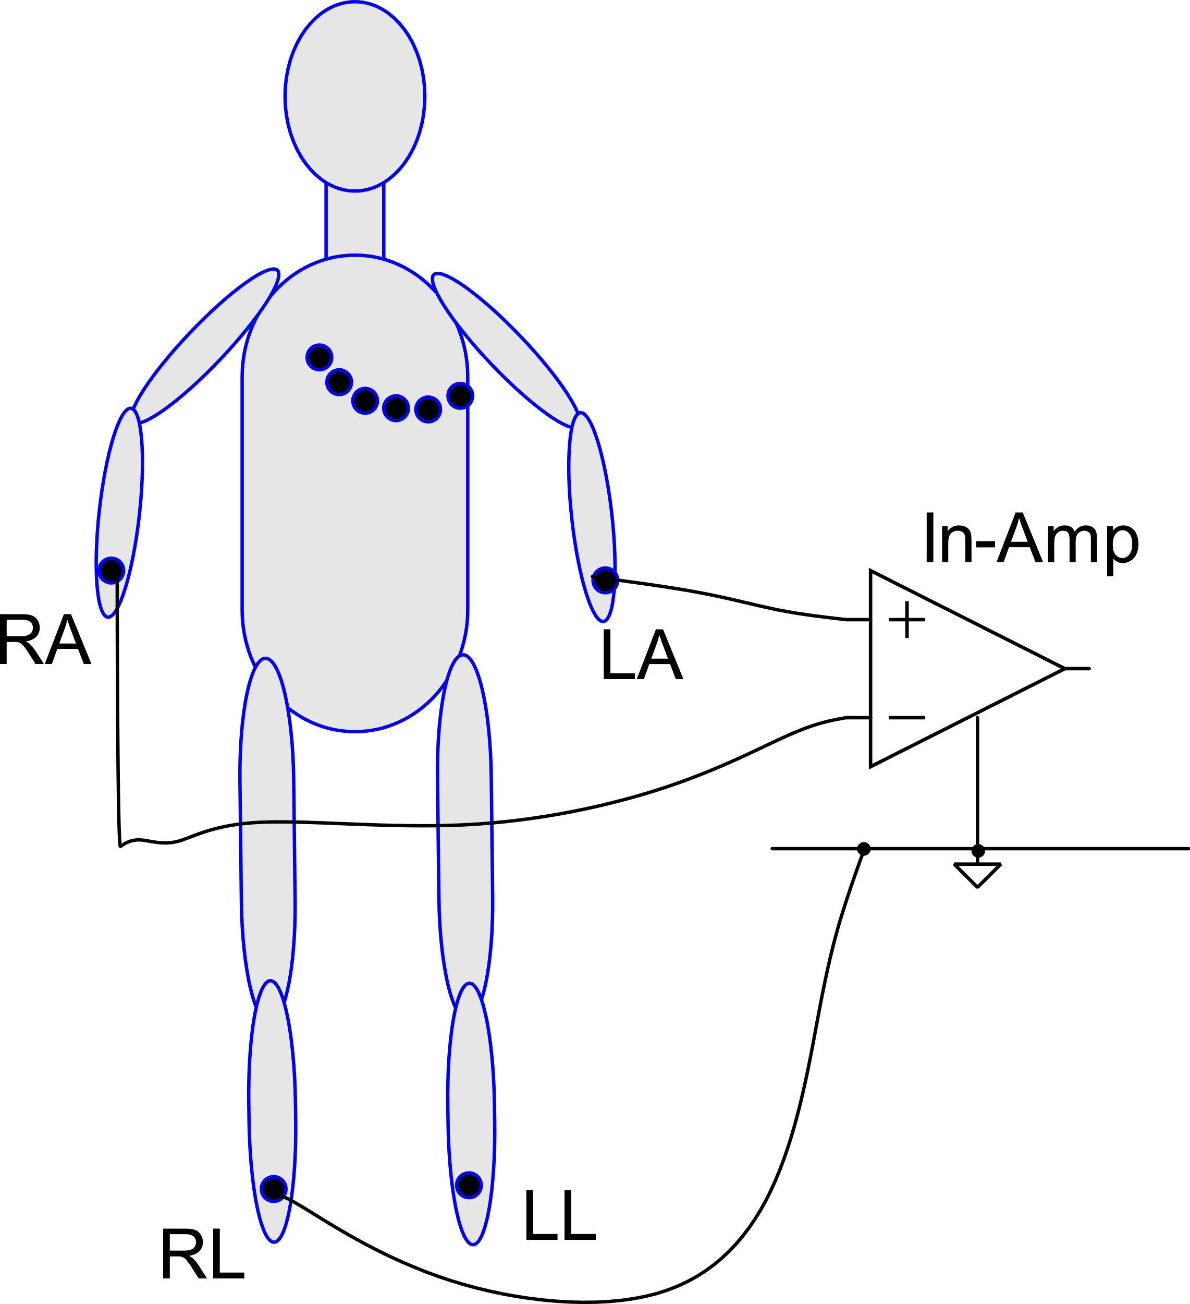
Electrode position and number: ECG
C; chest (typically 6 positions, V1-V6)
RL: Right Leg
LL: Left Leg
RA: Right Arm
LA: Right Arm
The reading is differential with the right-leg always used as gnd (necessary to set the input common mode voltage)
C
LA
RA
This is an example of connection
("Lead I")
RL
LL

Slide 9
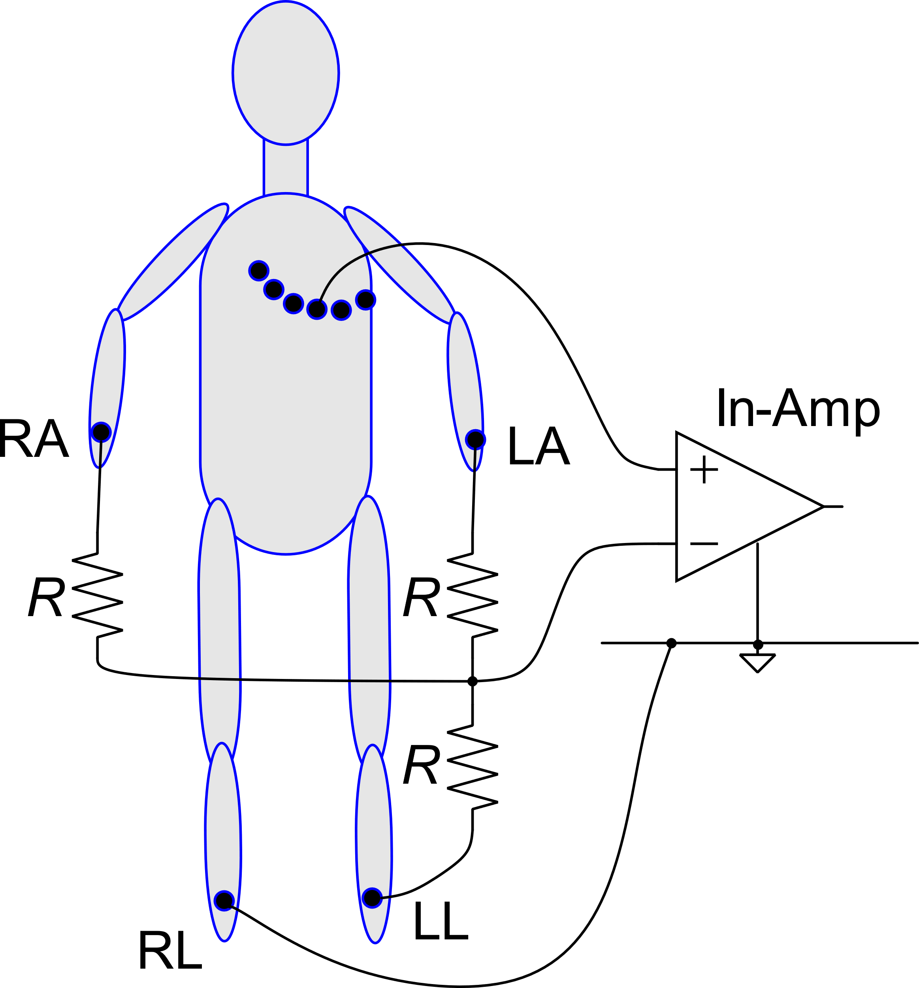
ECG example of leads
Lead I : LA-RA
Lead II : LL-RA
Lead III : LL-LA
Different leads give different diagnostic information.
For monitoring purposes, a single lead is generally used
Chest V₄
Augmented:
aVR
Resistors (placed inside the ECG instrument, are used to average the voltage of two or three electrodes

Slide 10
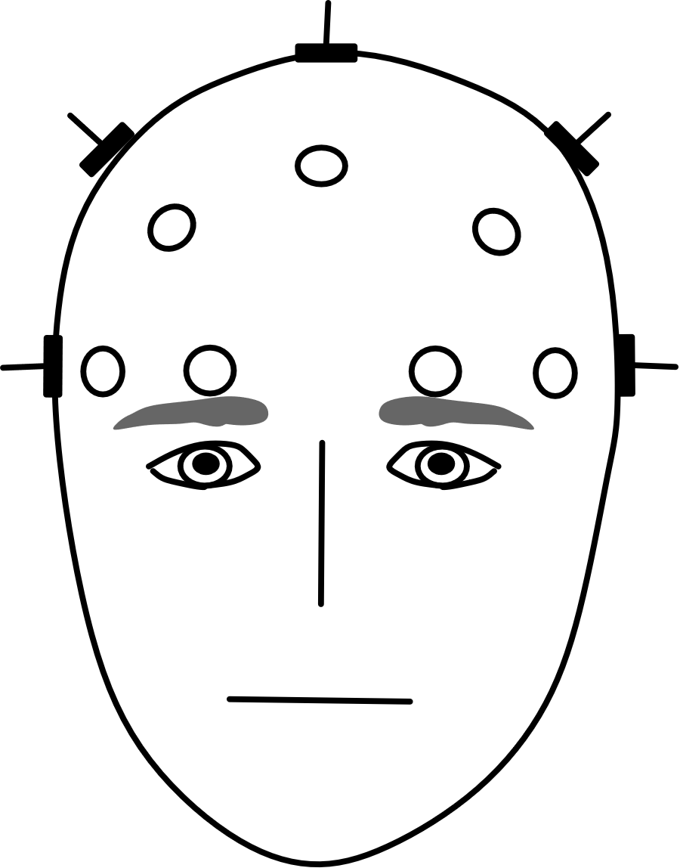
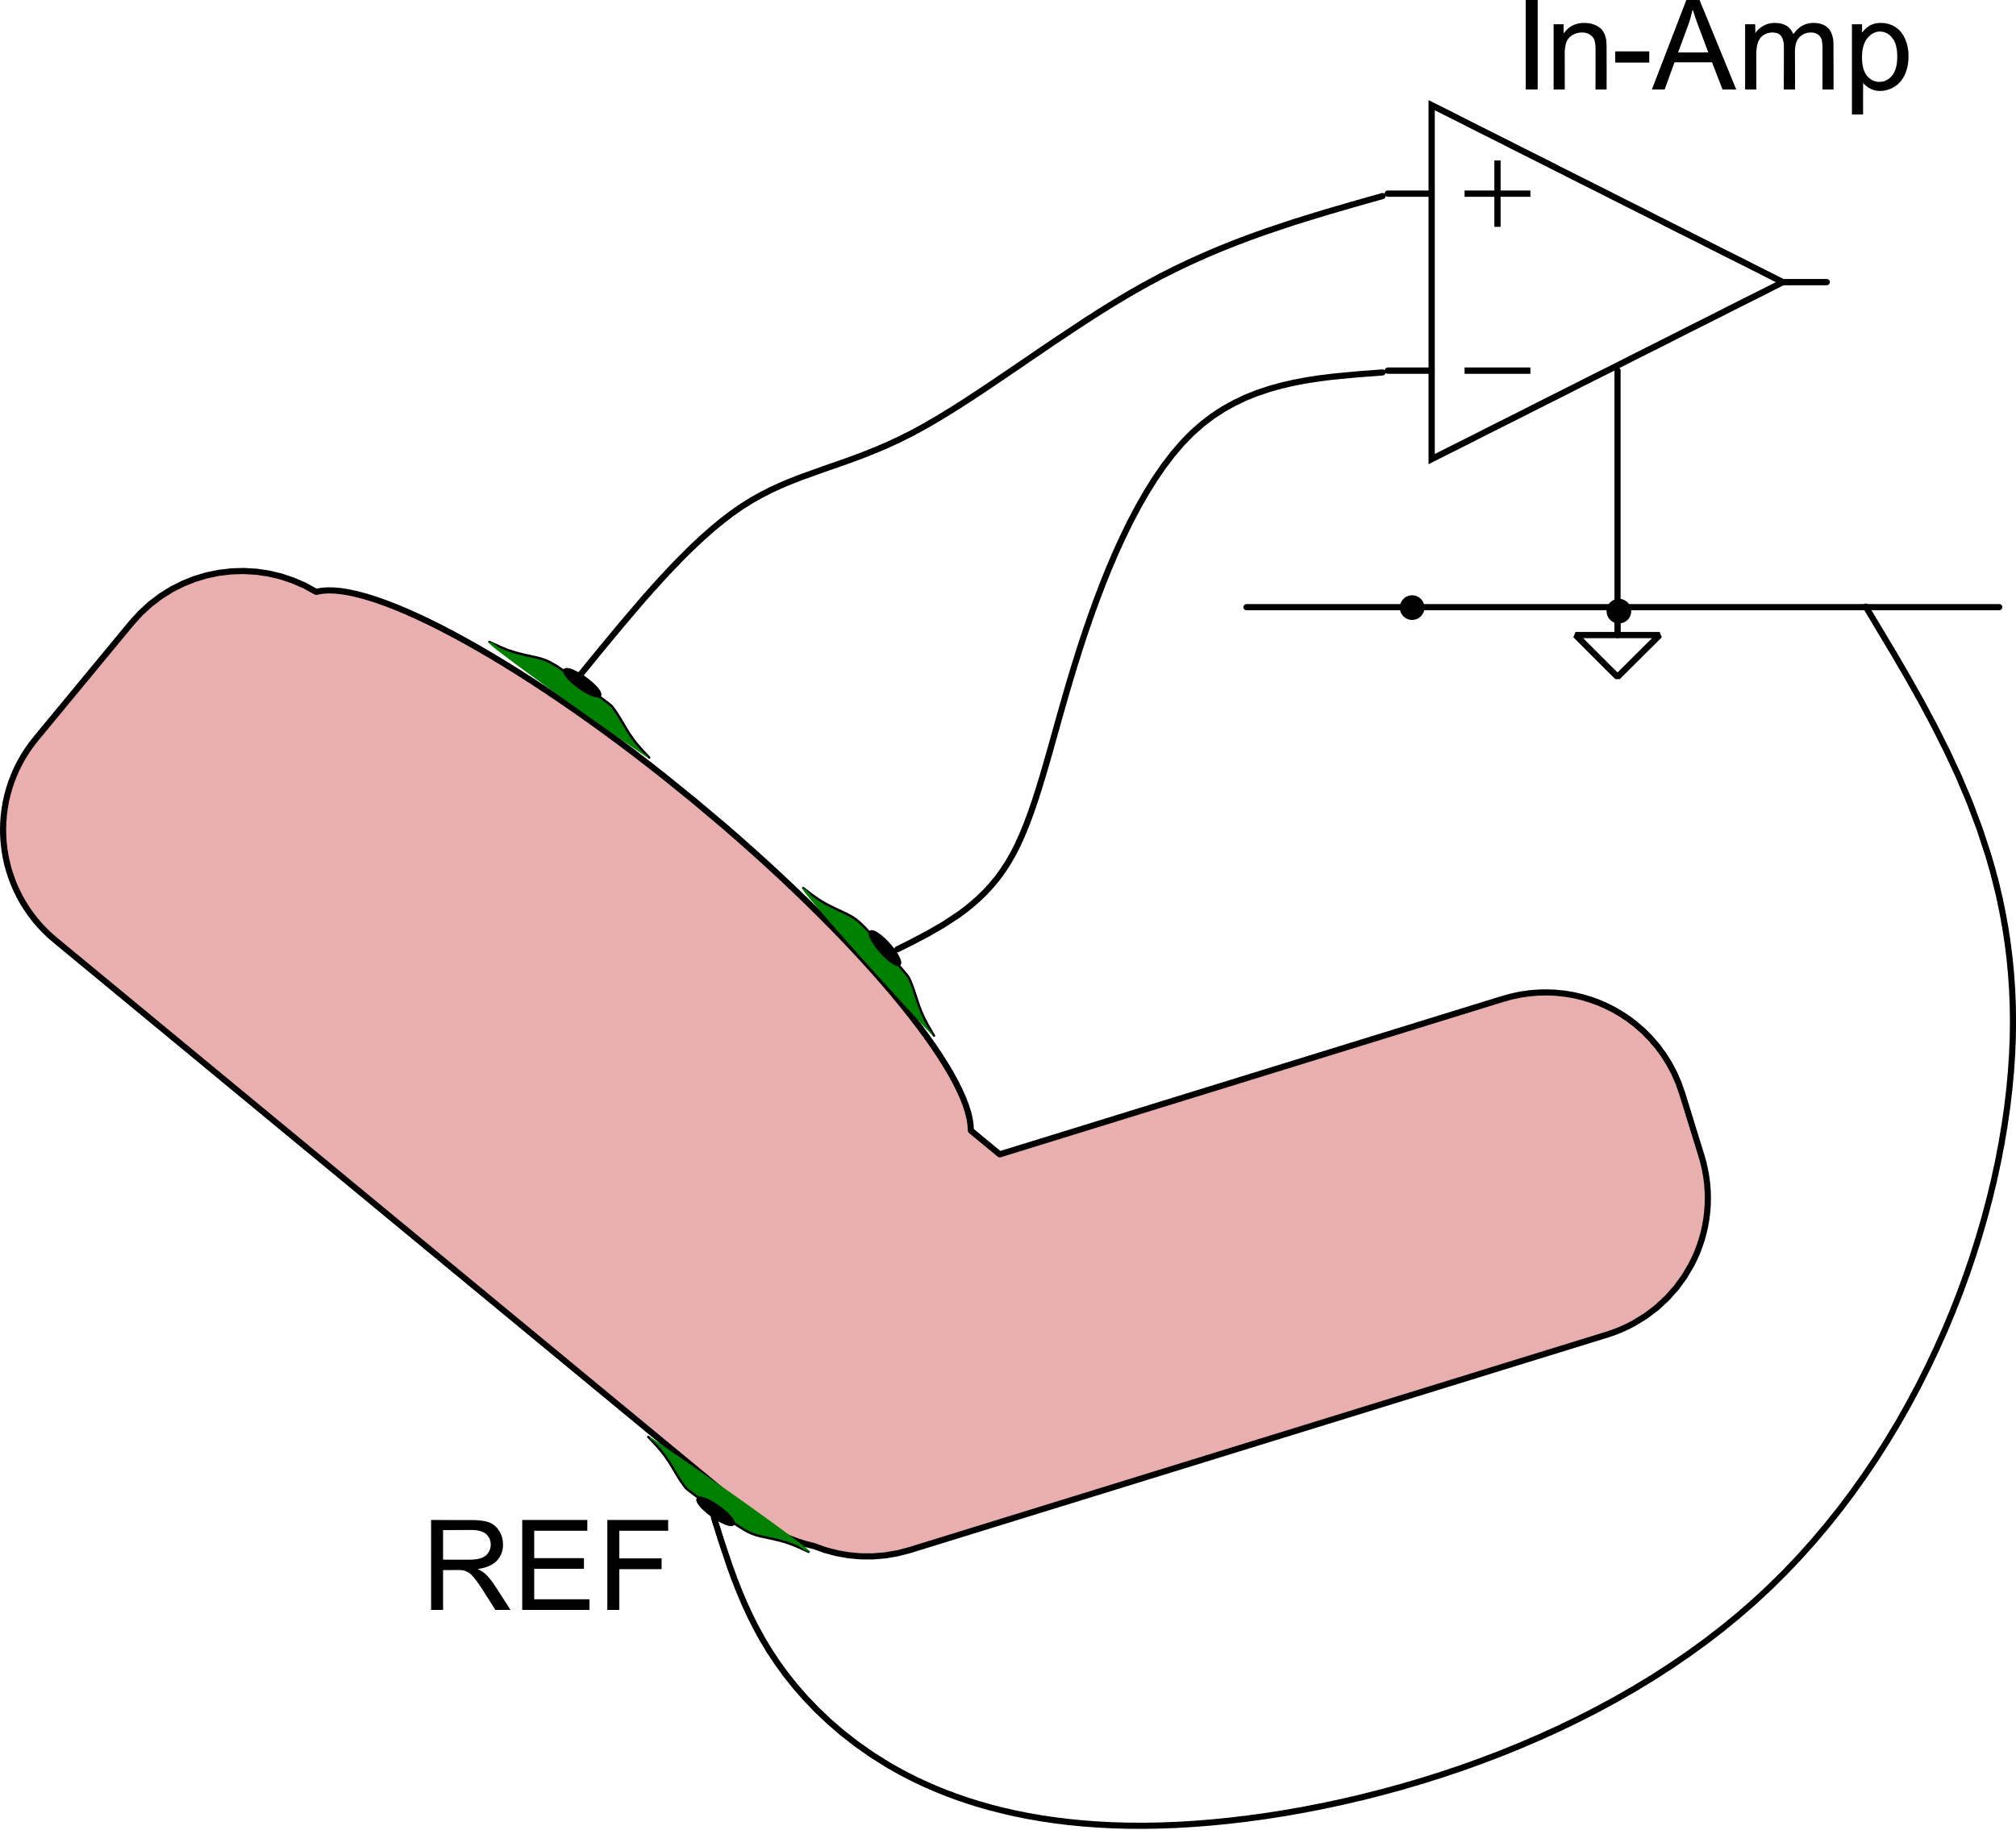
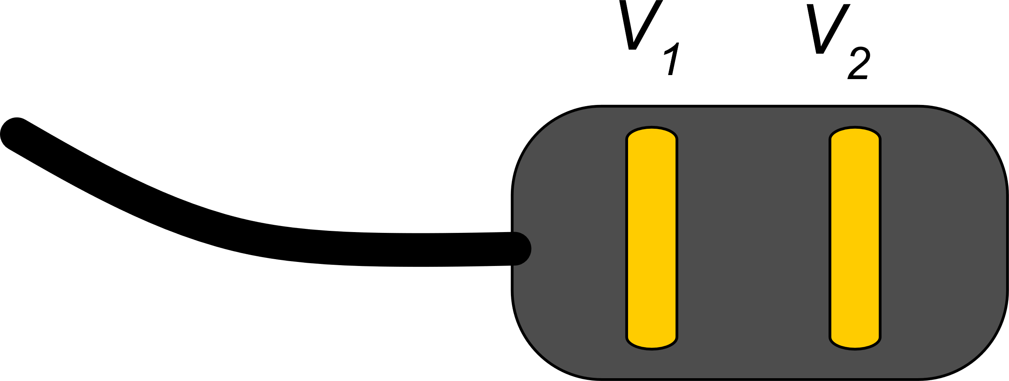
EEG and EMG electrode placement
EMG
EEG
middle sagittal plane
Surface EMG:
10-20 electrode system: refers to the spacing between electrodes in terms of percentage, 10 % 20 %
(8 - 128 electrodes)
Each electrode position has a code. Electrodes in the "middle sagittal plane" are generally used as gnd.
Compact bipolar
electrode for EMG

Slide 11
Biopotentials characteristics
Type of biopotential | Bandwidth | Typical level
ECG | 0.05 Hz - 100 Hz | 1 mV -5 mV
EEG | 0.5 Hz - 40 Hz | 10 μV - 100 μV
EMG | 20 Hz -2 kHz | 1 mV - 10 mV
ERG | 1 Hz - 1 kHz | 10 μV - 100 μV
Range includes 50/60 Hz: prone to interference from power line
Very small low frequency:
high pass filter is critical and exhibits long settling times (due to poles at very low frequency)
Very small magnitude. Requires very-low noise amplifiers and careful rejection of interferences

Slide 12
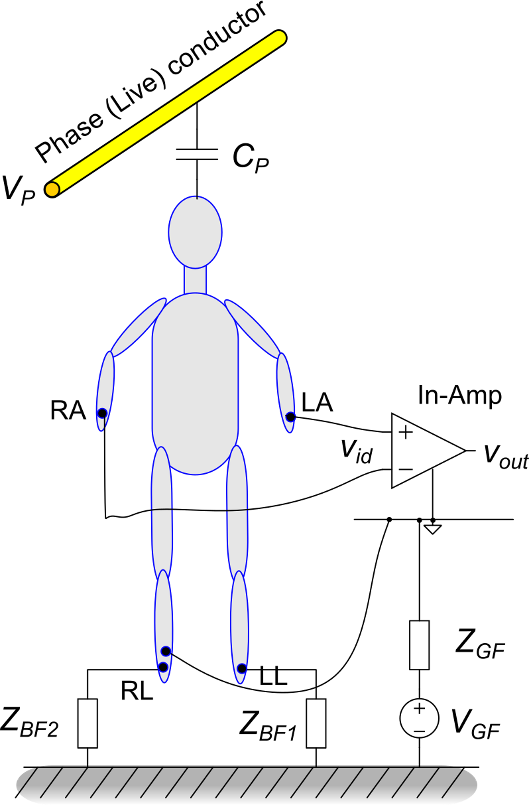
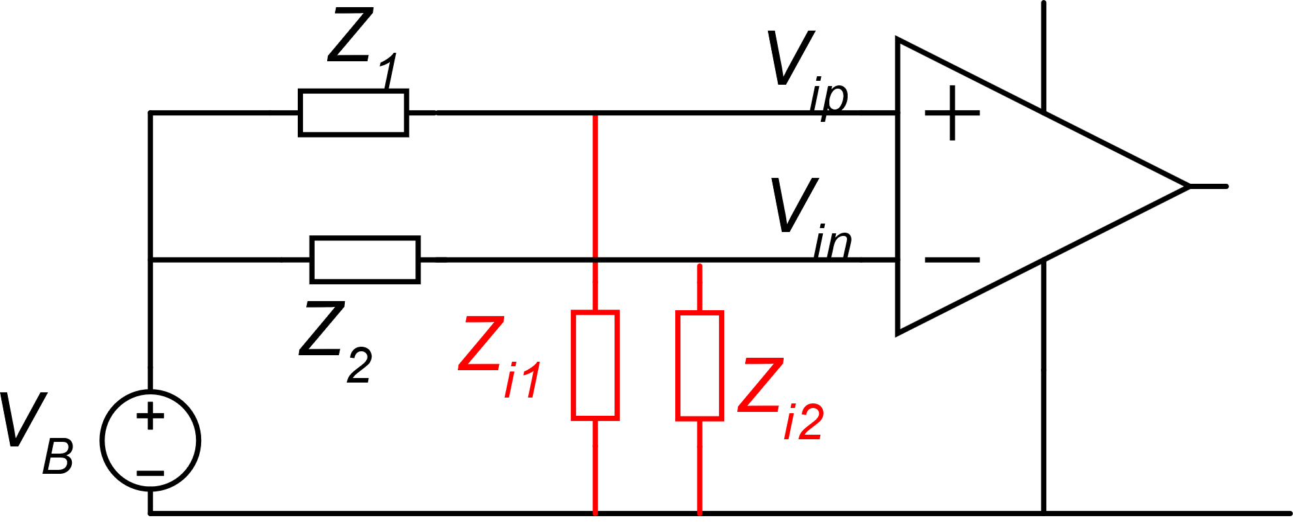
Power line interference
Electrode
impedance
Z3 may be large enough to produce a V_{B} of hundred mV
Z₂
Z₁
i_{G}
Due to mismatch of electrode impedance (Z₁,Z₂), α₁≠α₂ and V_{B} produces a differential input
Z₃

Slide 13
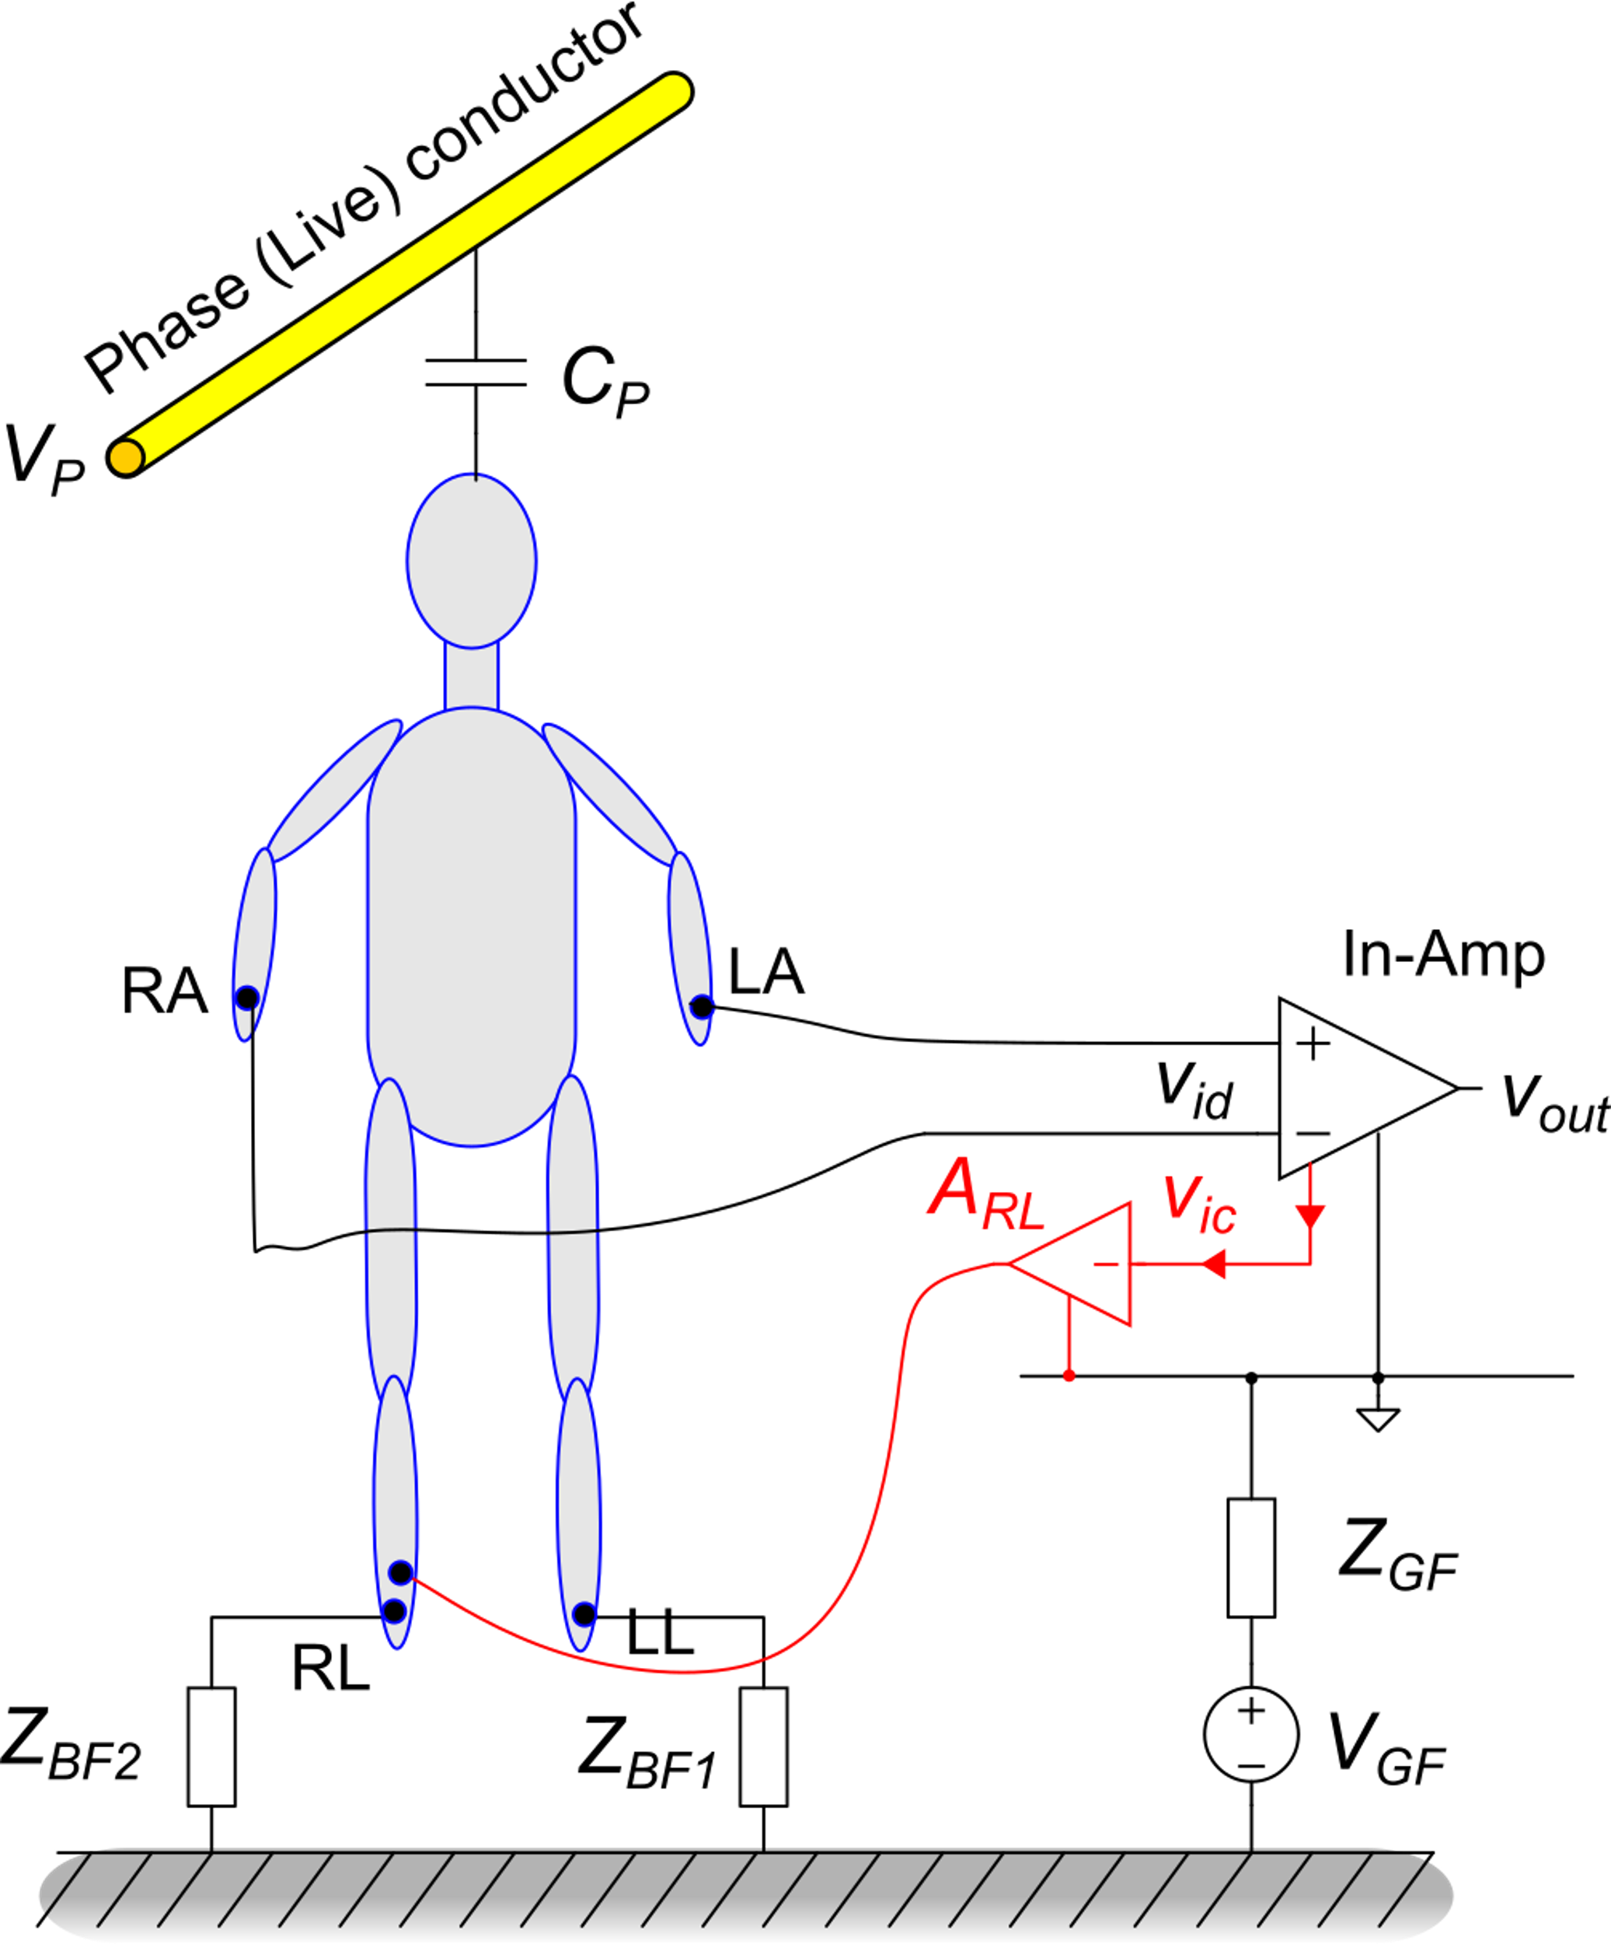
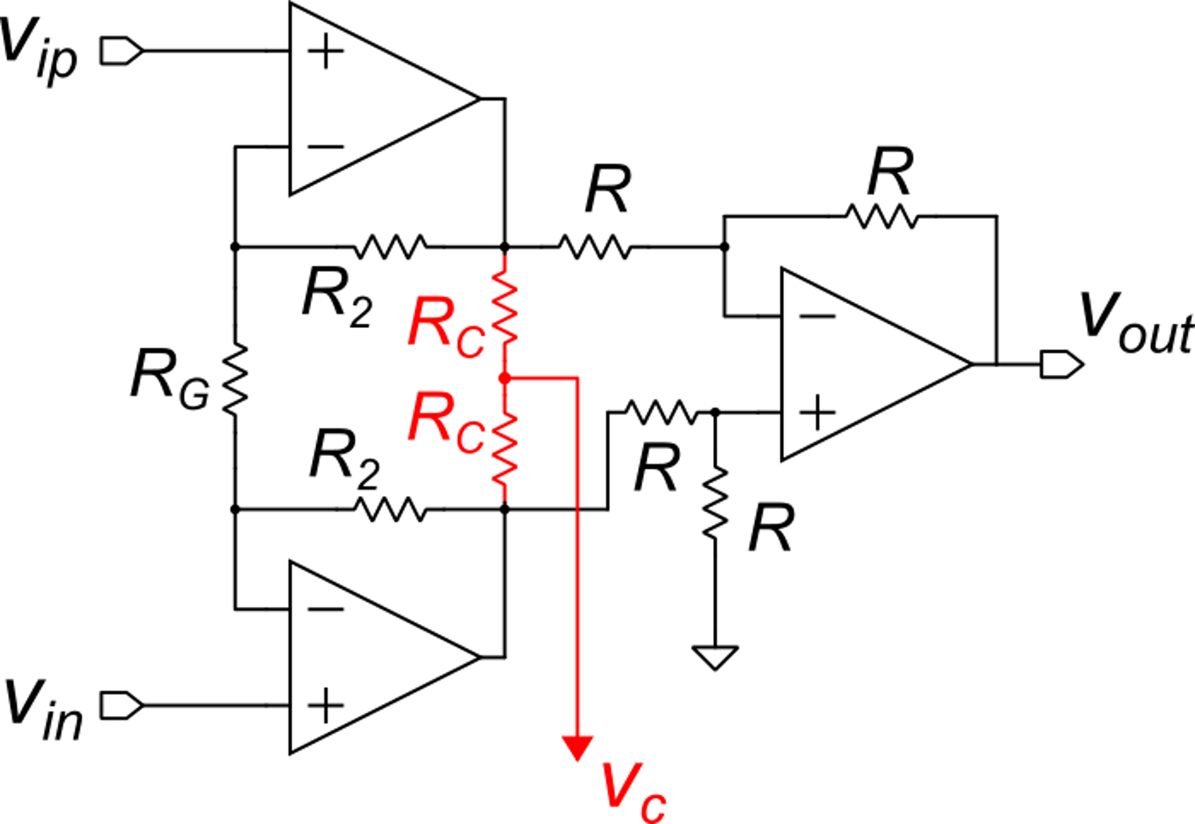
Right Leg Drive (RLD) Method
The common mode voltage of the in-amp input terminals is extracted and amplified with a high-gain inverting amplifier (A_{RL})
Thanks to the high loop gain, virtual ground is established at the input of A_{RL}, meaning that V_{ic} is strongly attenuated.
Extraction of the common mode voltage from an in-amp

Slide 14
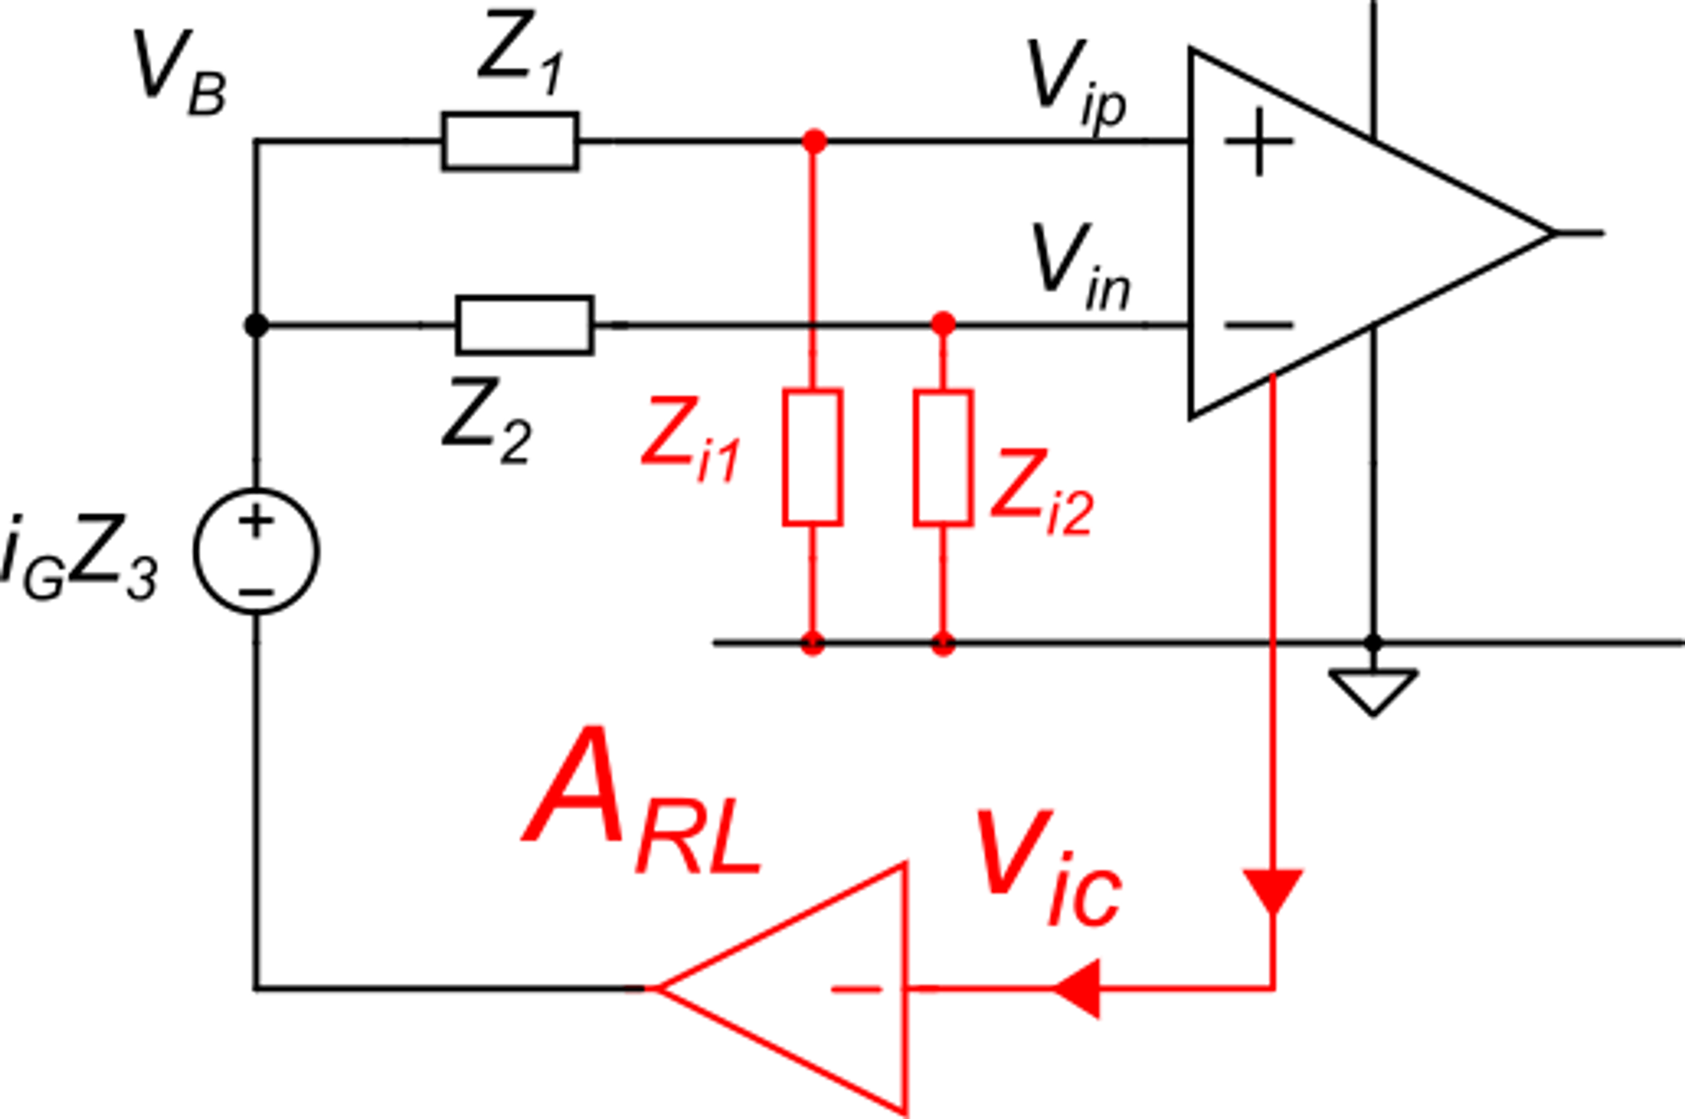
Right Leg Drive (RLD) Method
Then, the strong reduction of the input common mode voltage results in a corresponding reduction of the differential mode disturbance voltage caused by the common mode.

Slide 15
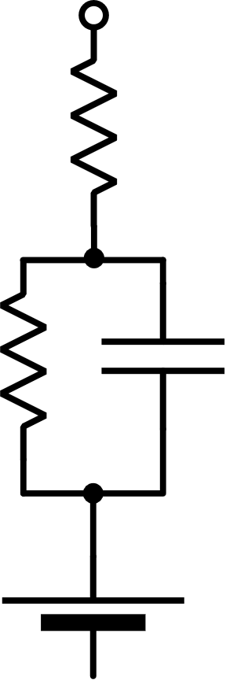
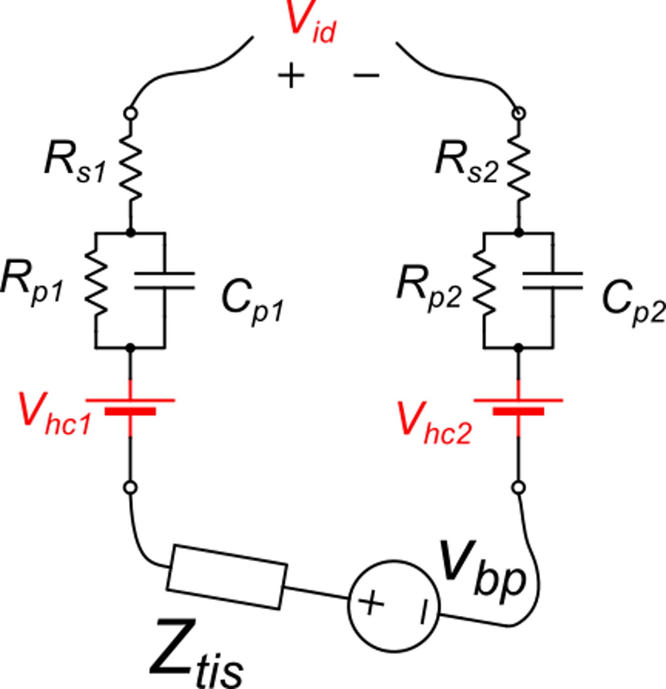
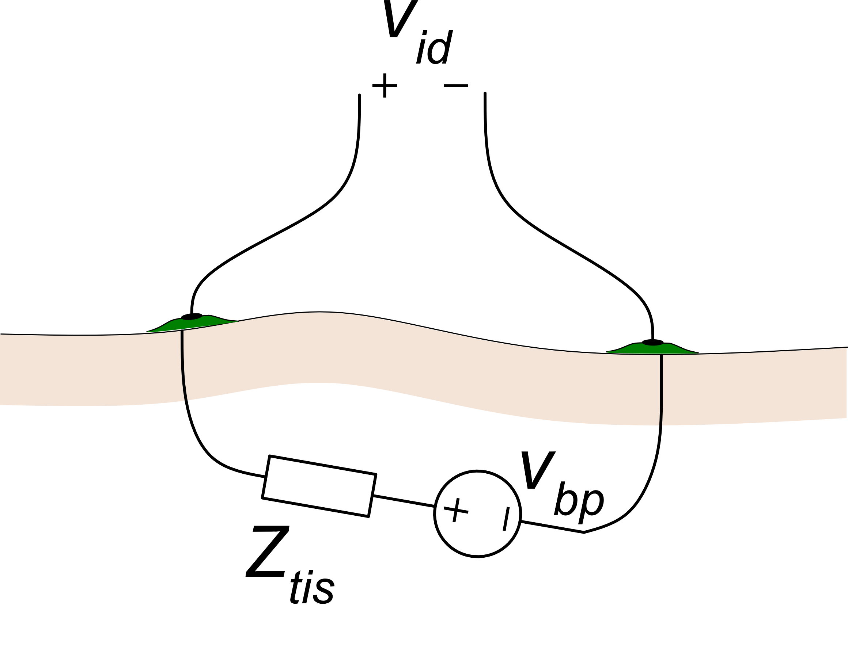
Electrode offset
Electrodes
Tissue
Due to mismatch in the electrodes, their degradation with time, or to local differences in the electrolyte composition, the half-cell potentials can be different. DC voltage up to tens mV may appear

Slide 16
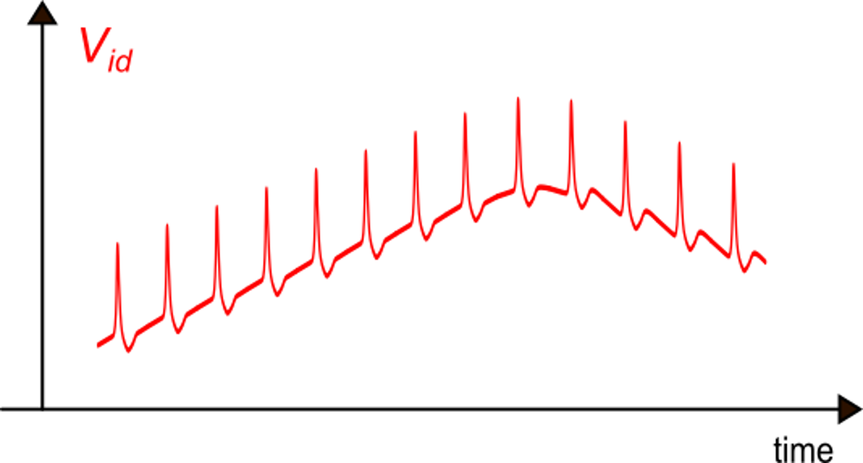
Electrode offset
The DC offset slowly varies with time, producing the so-called "baseline-drift"
This phenomenon can be very important, distorting the useful signal and causing saturation of the amplifier.
The DC component must be removed with a high pass filter.
ECG | 0.05 Hz - 100 Hz
For example, ECG recording would require a filter with a lower cut-off frequency og 0.05 Hz

Slide 17
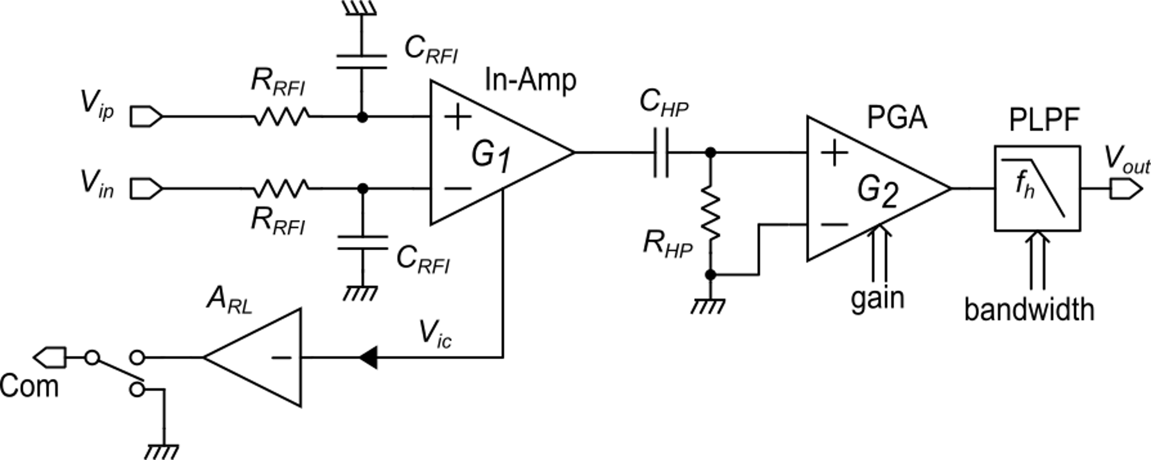
Versatile AFE schematic
Programmable Gain Amplifier
Programmable Low Pass Filter
Three electrode scheme
For f_{L}=0.05 Hz, τ=3.18 5 τ ≅ 16 s
Such a long settling time can lead to long period of unavailability

Slide 18
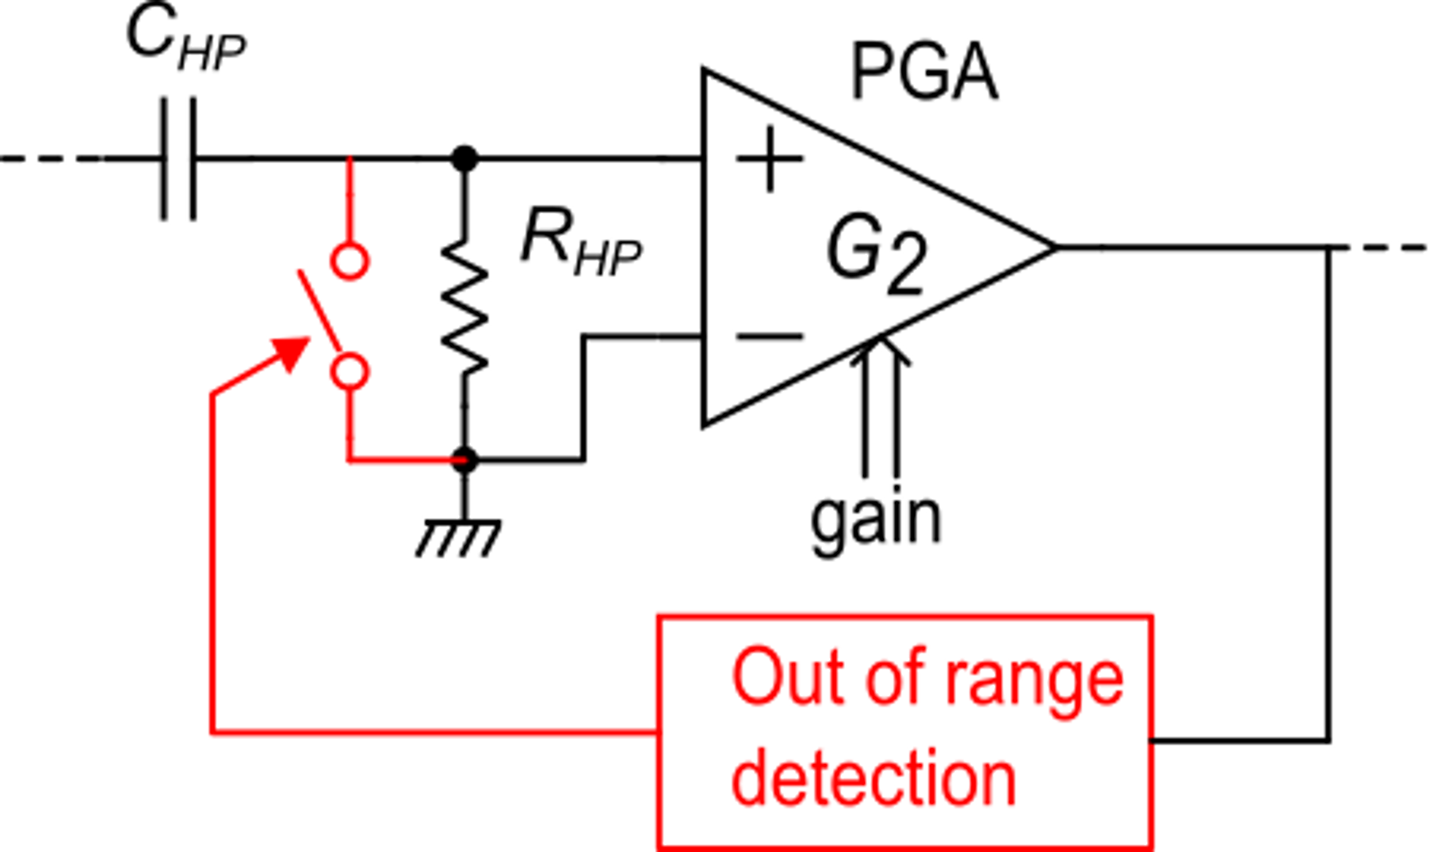
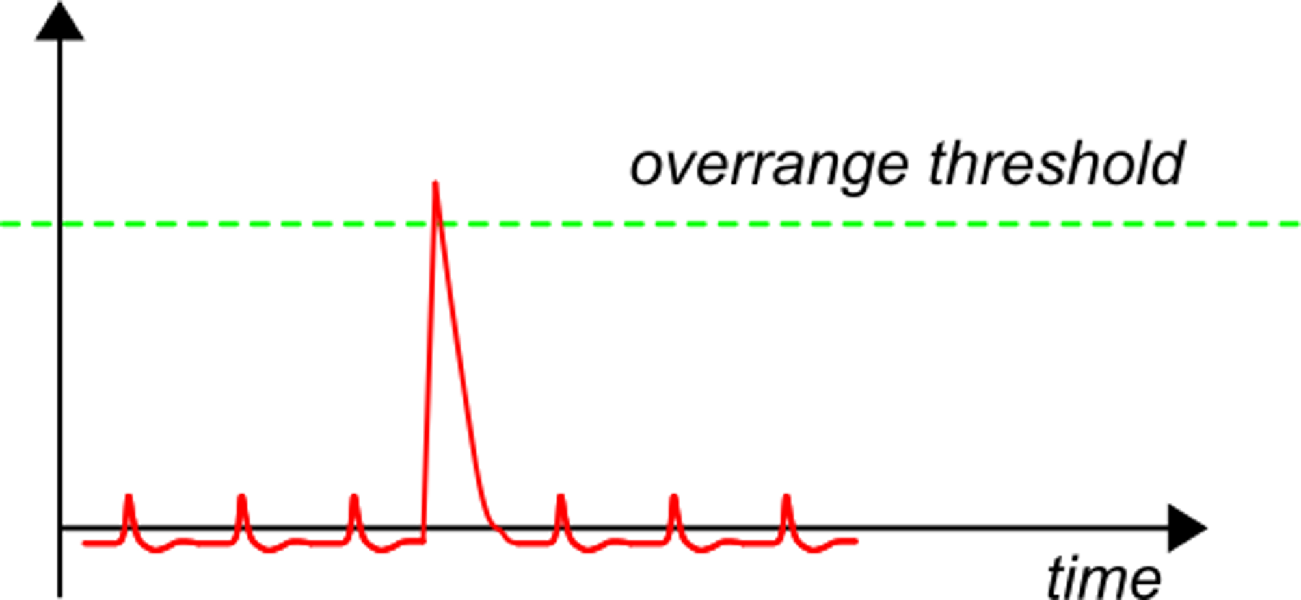
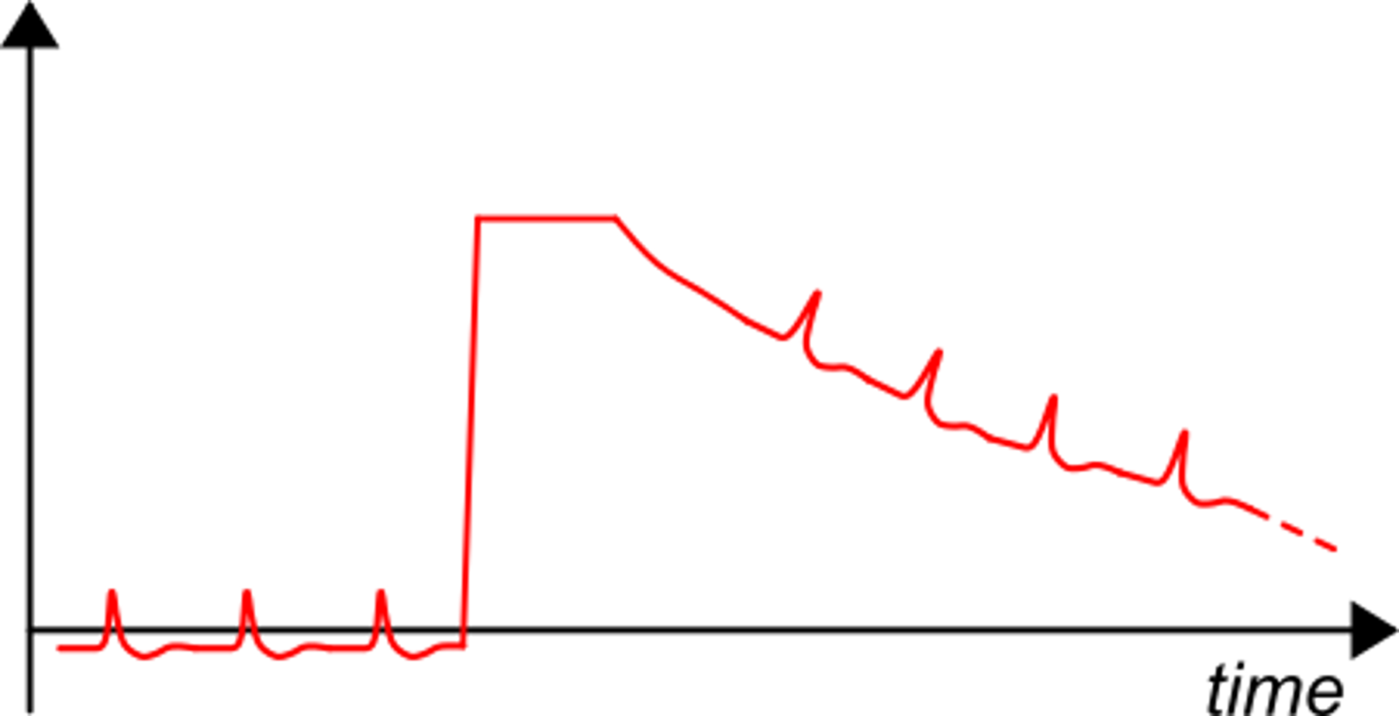
Baseline fast recovery circuit
Switch S1 is activated for a fixed time
S1
Without recovery circuit
Amplifier saturation caused by a disturbance

Slide 19
Bibliography
[1] Khan University, "Signal propagation: The movement of signals between neurons", https://www.khanacademy.org/test-prep/mcat/organ-systems/neural-synapses/a/signal-propagation-the-movement-of-signals-between-neurons
[2] University of Texas, Neuroscience Online, https://nba.uth.tmc.edu/neuroscience/m/s1/index.htm
[2] Lumen, Anatomy and Psychology: Neuromuscular Junctions and Muscle Contractions, https://courses.lumenlearning.com/cuny-csi-ap-1/chapter/neuromuscular-junctions-and-muscle-contractions/
[3] Analog Devices, " Biopotential Electrode Sensors in ECG/EEG/EMG Systems" https://www.analog.com/en/technical-articles/biopotential-electrode-sensors-ecg-eeg-emg.html#:~:text=A%20biopotential%20electrode%20is%20a,ion%20current%20to%20electron%20current.

