Slide 1
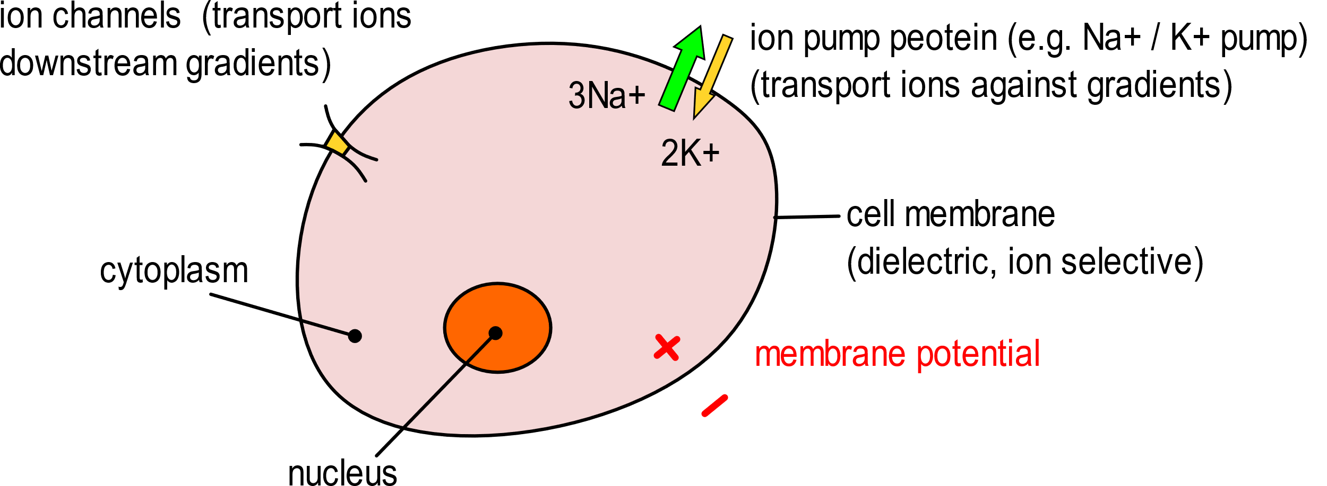
Biopotentials
Biopotential: An electric signal (voltage) that is:
measured across distinct points of living cells or tissues
generated by biochemical processes examples: transmission of neural stimuli, contraction of muscle cells
Generation of a biopotential in a cell (simplified view)
Due to protein pumps, Na+ concentration is much higher outside the cell.
The cell internal gets a negative potential:
from –100 mV to –50 mV.
(lipid-protein complex, 7-15 nm)

Slide 2
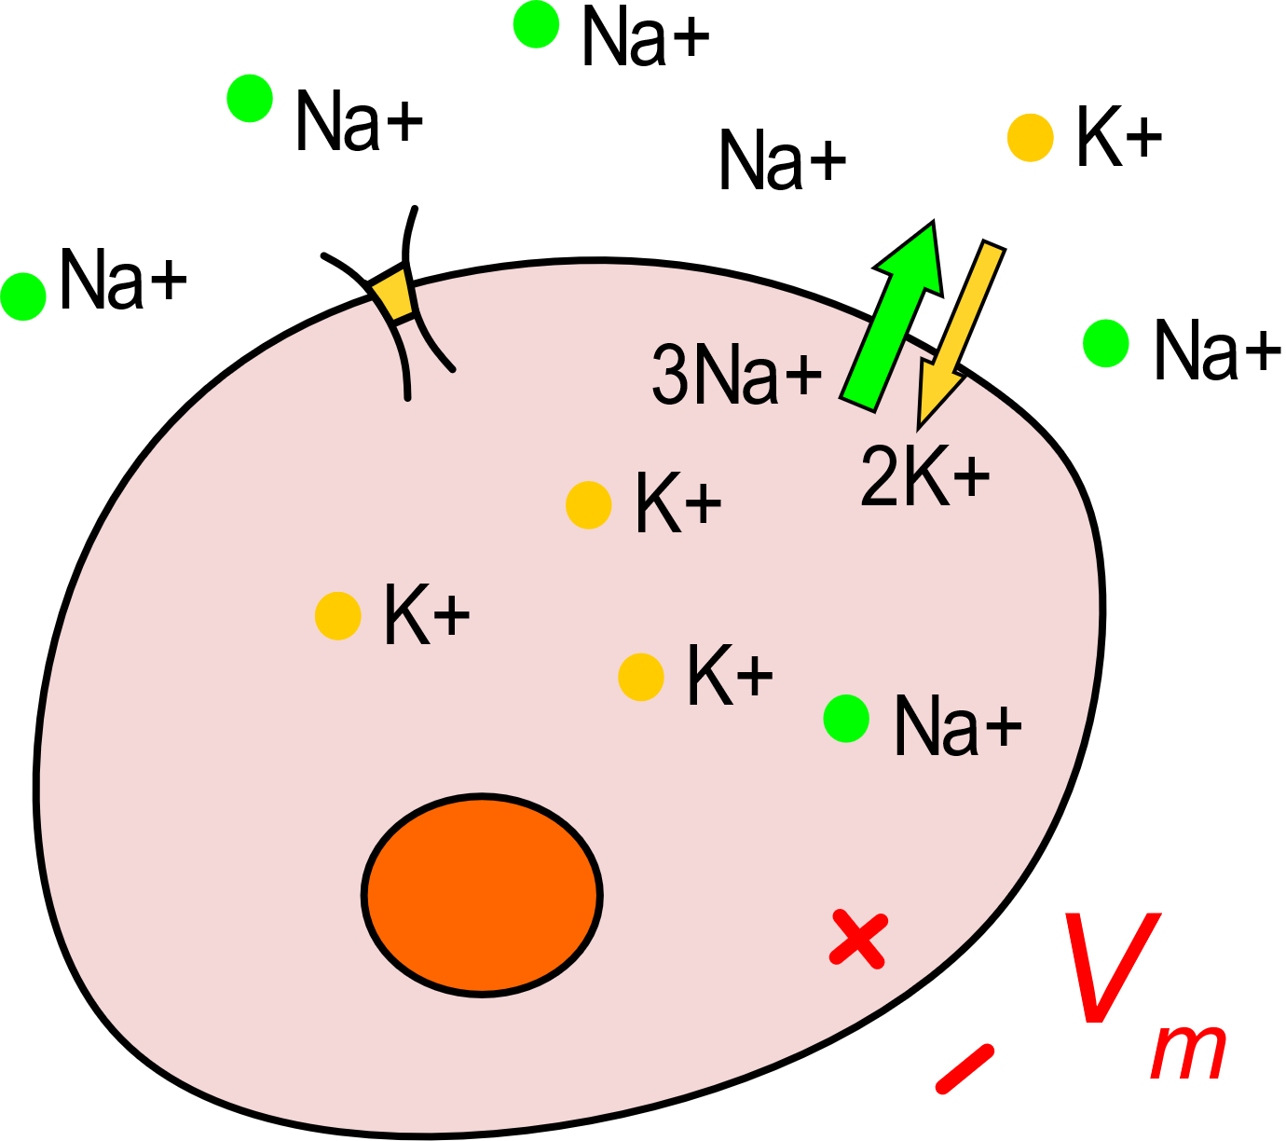
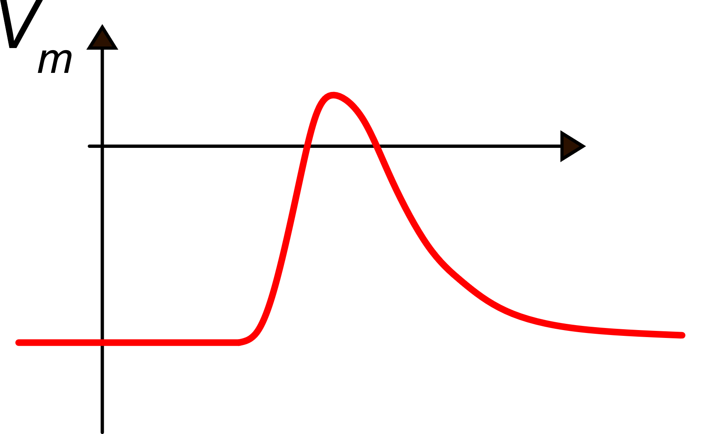
Electrically excitable cells
When potential gets positive, the ion-channel closes, and the ion pump allow the potential to recover
0
time
Electrically excitable cells are marked by ion channels that are controlled by local potential:
(voltage-gated ion channels).
Arrival of an electrical stimulus
If the stimulus overcome
a threshold, the ion-channel opens and let sodium (Na+) get into the cell increasing the membrane potential

Slide 3
Phases of cell excitation
time
Threshold
Time-scale:
a few ms
resting potential
( -100 to -50 mV )
Depolarization
Ripolarization

Slide 4
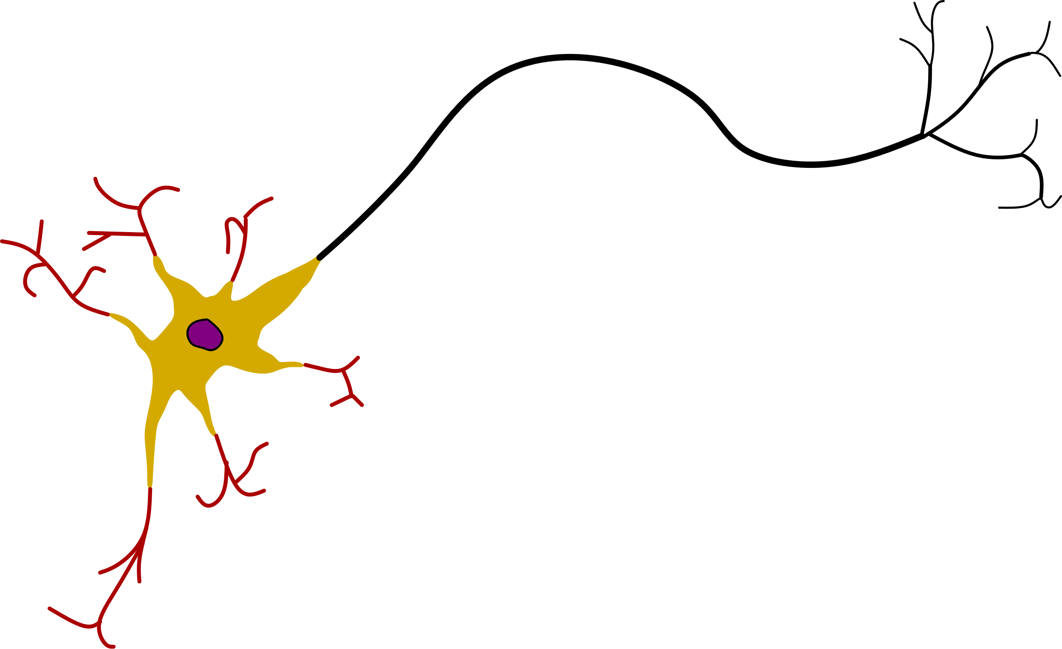
Nerve cells (neurons)
output stimulus
dendrites
(carry input signals
to the neuron)
nucleus
axon
(carry output signals
out of the neuron)
synaptic terminals
(connect to other neuros or
muscle cells )
soma
(typical metabolic
cell functions)
Note: cable-like bundles of axons constitute nerves. Axons can be longer than 1 m
input stimuli

Slide 5
Propagation of a stimulus along the axon or dendrites
resting condition V_{m}<0
uniform polarization
cell membrane
a stimulus causes
local depolarization
electrical field lines
and ion displacement
the adjacent portion of fiber
is depolarized
the previously excited segment is repolarized
propagation of action potential

Slide 6
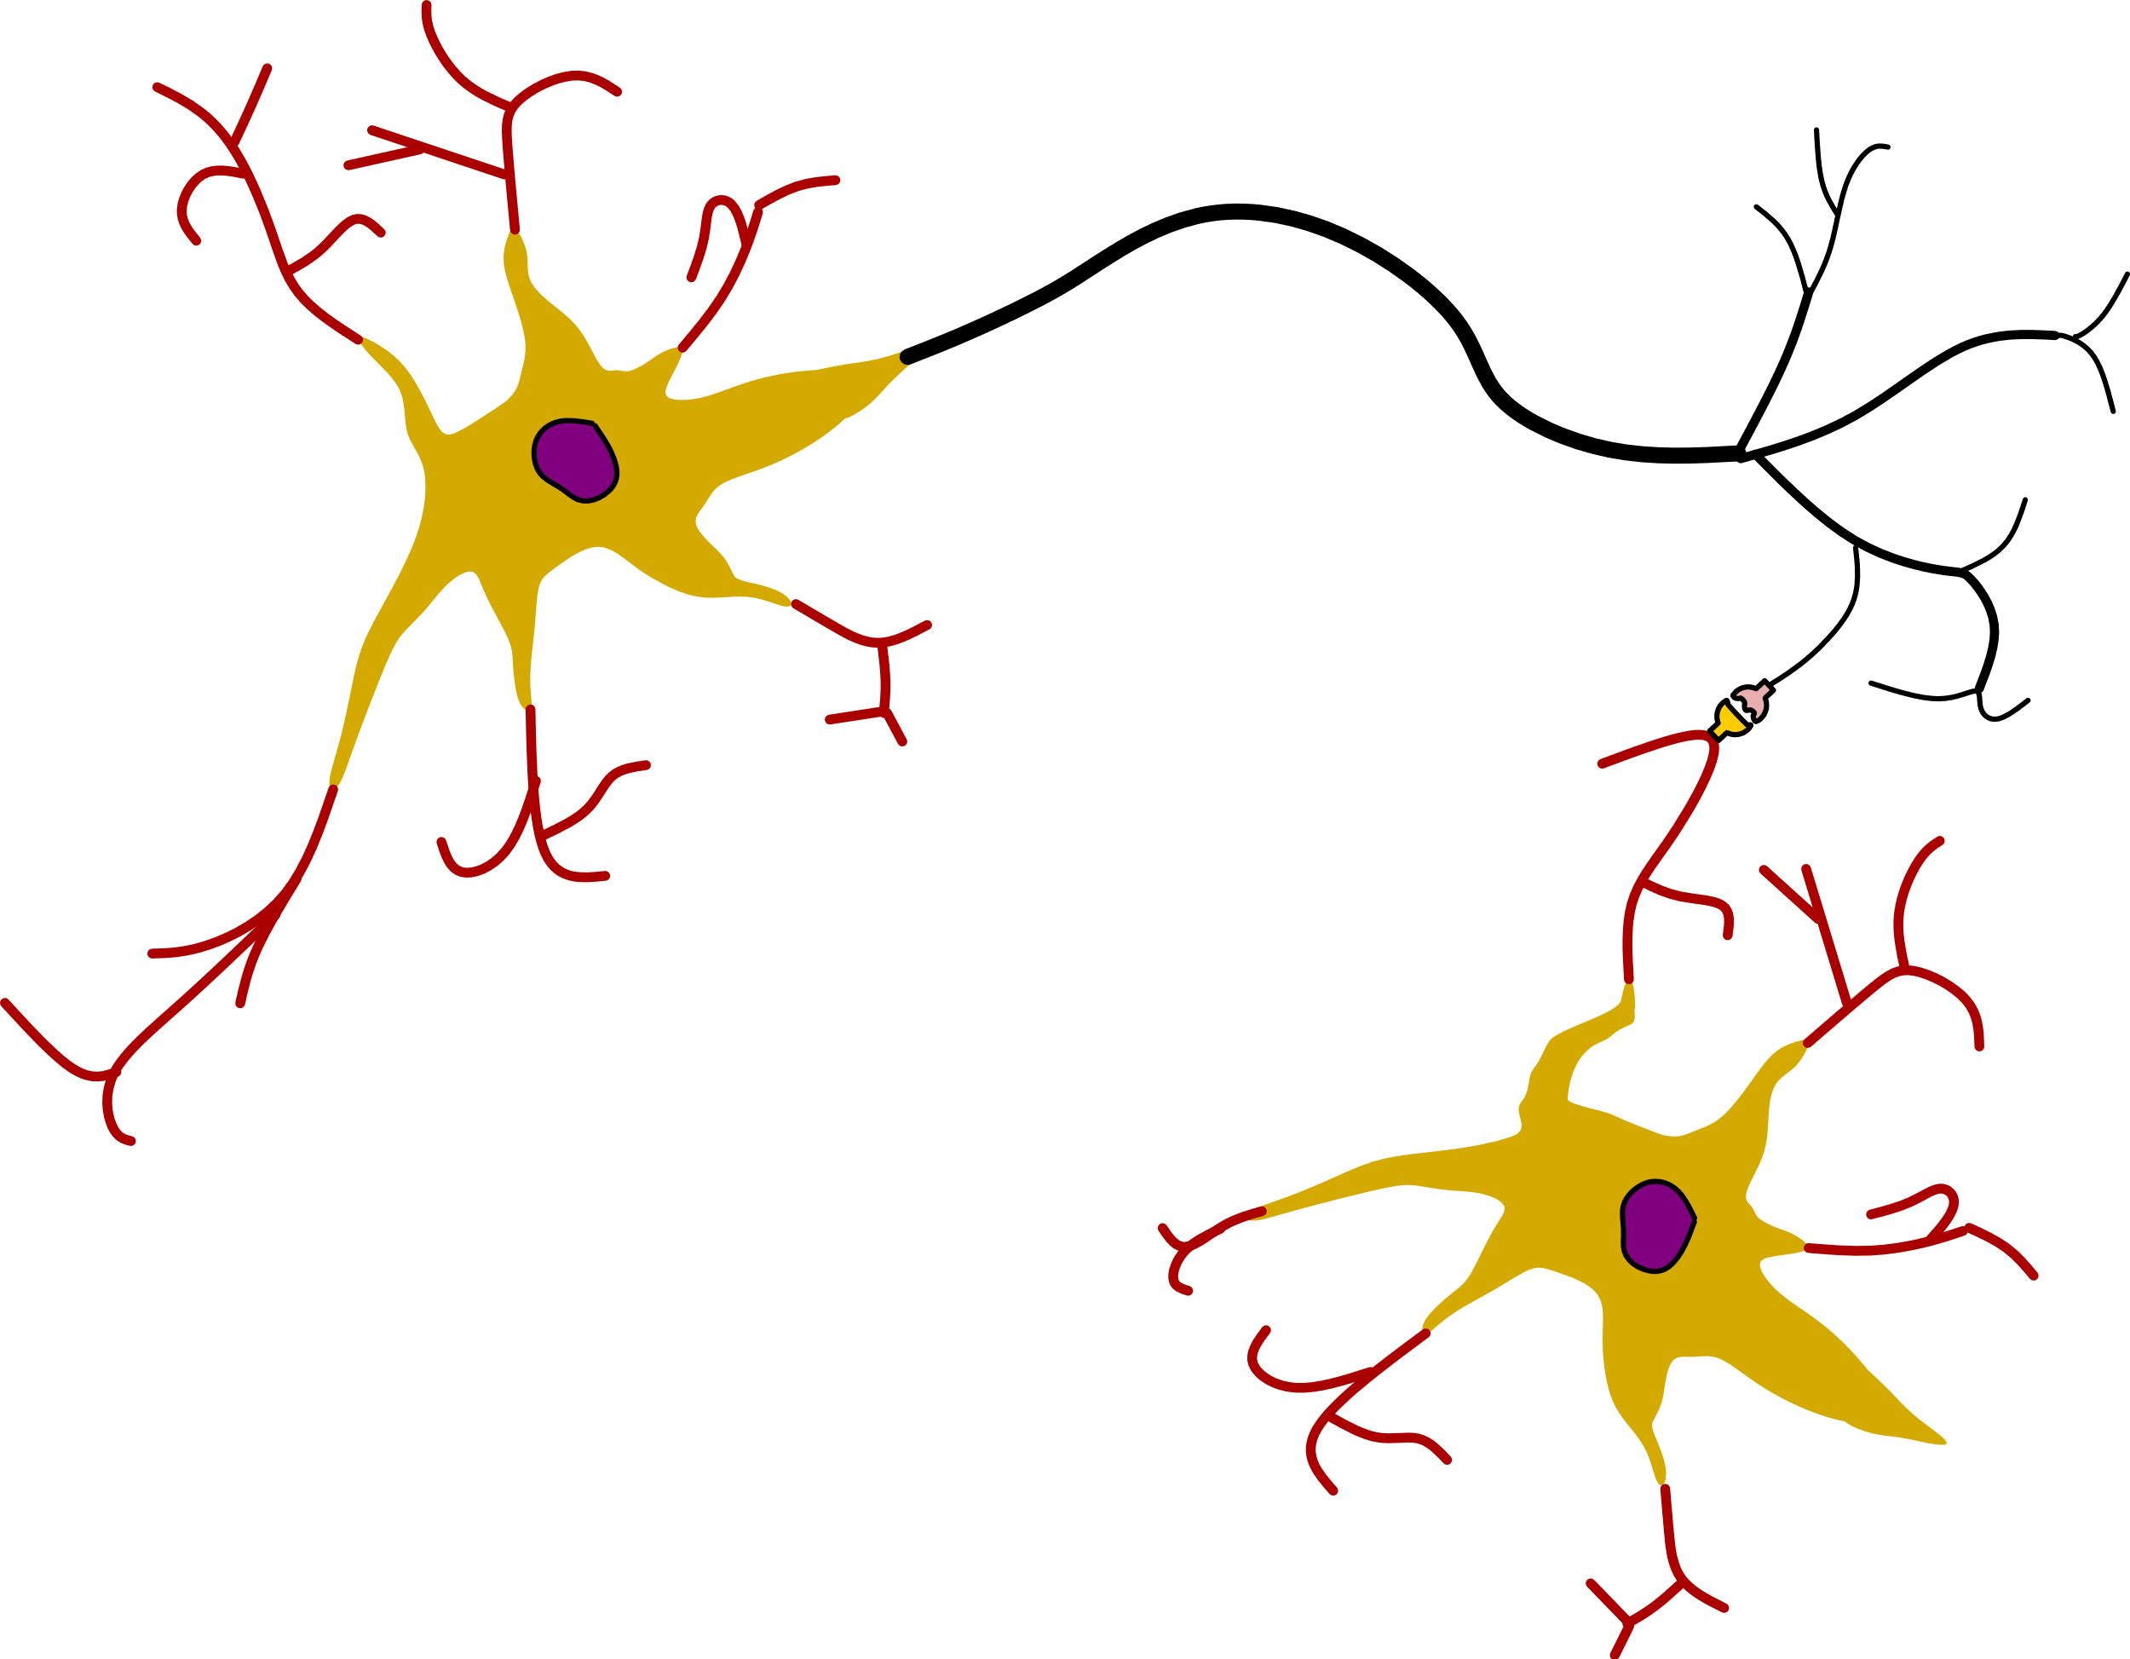
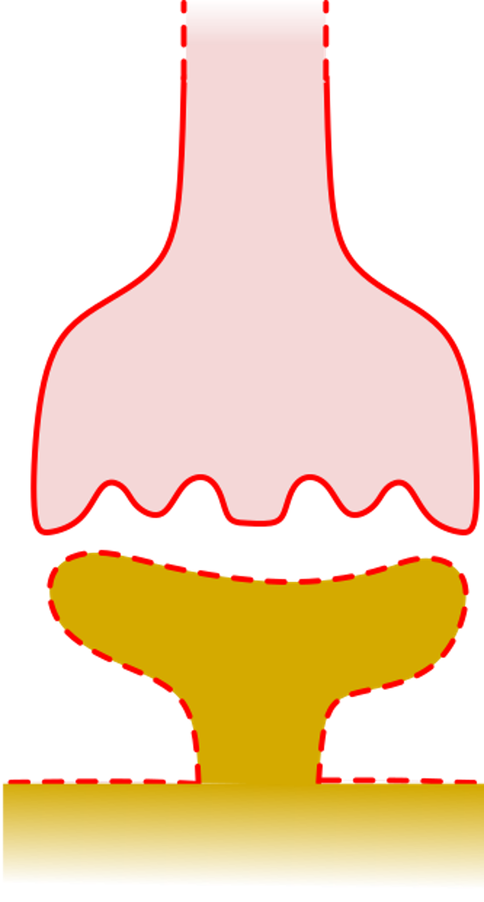
Propagation of stimuli between neurons (1)
Propagation of
action potential
Axon terminal
Neurotransmitter
release (chemical
molecules)
Synapse
(chemical
synapse)
gap (20 nm)
Receptors
neuron 1
(transmitting)
Dendrite or
neuron soma
neuron 2
(receiving)
Synapse "propagation time": 0.5-1 ms

Slide 7
Propagation of stimuli between neurons (2)
Receptors
Receptors are specialized ion channels that, once activated by the specific neurotransmitter, let ions get into the receiving neuron:
Positive ions (e.g. Na+): excitatory
Negative ions (e.g. Cl-): inhibitory
V_{m}
If the threshold is overcome, a depolarization event is triggered
time
Neuron membrane potential
(soma end dendrites). The evolution of the potential is the result of the action of multiple synapses
threshold
excitatory
inhibitory

Slide 8
Propagation of stimuli between neurons (3)
To other neurons: action can be excitatory or inhibitory, depending on the type of synapse
action potential
From other neurons:
excitatory and inhibitory
signals
When the threshold is overcome, depolarization (action potential) begins generally at the point the axon starts (AIS=Axon Initial Segment, or Axon Hillock)
The action potential travels along the axon up to 100 m/s and reaches all the synapses that are present at the end of the axon, stimulating other neuros or other electrically excitable cells.

Slide 9
Neuron "firing"
FIRE !
"spikes" (single firing events)
Recording of neural activity

Slide 10
Recap on the neuron function (highly simplified view)
A neuron receives inputs through its dendrites and transmit it output (action potential) through the axon
Connection between the axon and the dendrites is actuated by the synapses
Reception of one input produces a variation of the cell potential: an inhibitory input reduces the cell potential, an excitatory input increases the cell potential
The cell potential continuously varies up and down fo the effect of a large number of successive or simultaneous stimuli from a large number of neurons. Then, the cell potential is the sum of different inputs that can be different in terms of magnitude and sign.
When the potential overcome a certain threshold (that depends on the type of neuron ) the neuron emits an action potential along the axon.

Slide 11
Types of Neurons
Motor neurons (transmit signals from the brain or spinal cord to muscles)
Sensory neurons (generate action potentials from physical /chemical stimuli and transmit it to the brain / spinal cord)
Interneurons: connect neurons to other neurons
Muscle Cells
Muscle cells are another important type of electrically excitable cells
There are three main types of muscle cells:
Skeletal muscle cells, or muscle fibers (voluntary movements)
Smooth muscle cells (involuntary movements, i.e. peristalsis )
Cardiac muscle cells
Striated muscles

Slide 12
Skeletal muscle cells
axon (from a motor neuron)
neuro-muscular
junction (synapse)
Depolarization proceeds along the fiber
and towards the inner fibrils
nuclei
myofibrils
myosin
actin
myosin and actin slide one over the other
membrane
(sarcolemma)
Depolarization triggers a chemical reaction chain that causes the fibrils to contract. This mechanism consumes ATP, which should be replaced by energy-consuming reactions
Muscle cell (fiber). Can be several cm long a 100-200 μm wide.

Slide 13
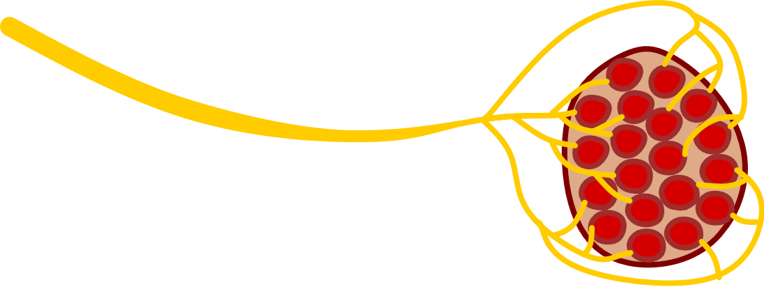
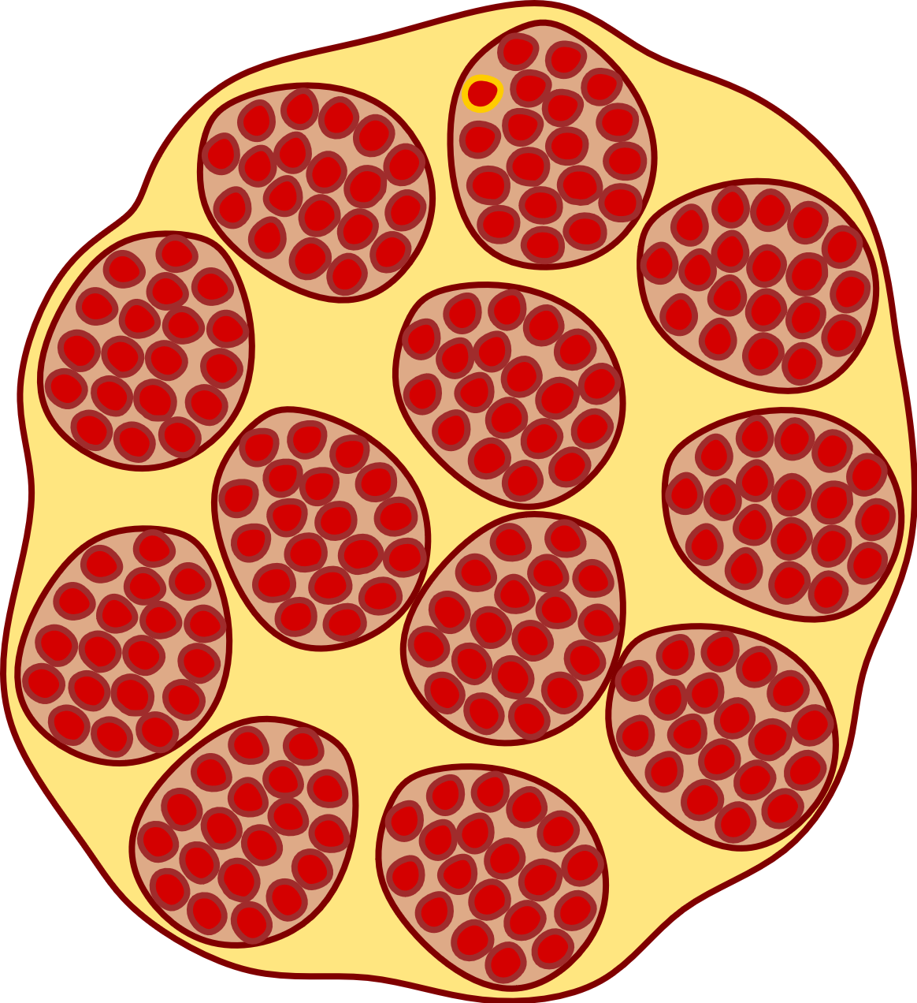
Muscle motor units
muscle
The fibers forming a single motor unit contract all together
Different motor units can contract independently form each other.
The higher the number of motor units that are activated, the greater the strength produced by the muscle
From the motor neuron
fibers = muscle cells
Motor unit: Bundle of fibers connected to a single motor neuron
Muscle cross-section

Slide 14
Muscle stimulation
electrical
stimulus
The strength of muscle contractions depends on the frequency of arriving action potentials and the number of motor neuros that are firing.
tension (force)
time
Effect of a train of many action potentials occurring at high frequency: constant maximum tension or "complete tetanus".
Single contraction
"twitch"
Effect of two
action potentials
(summation)

Slide 15
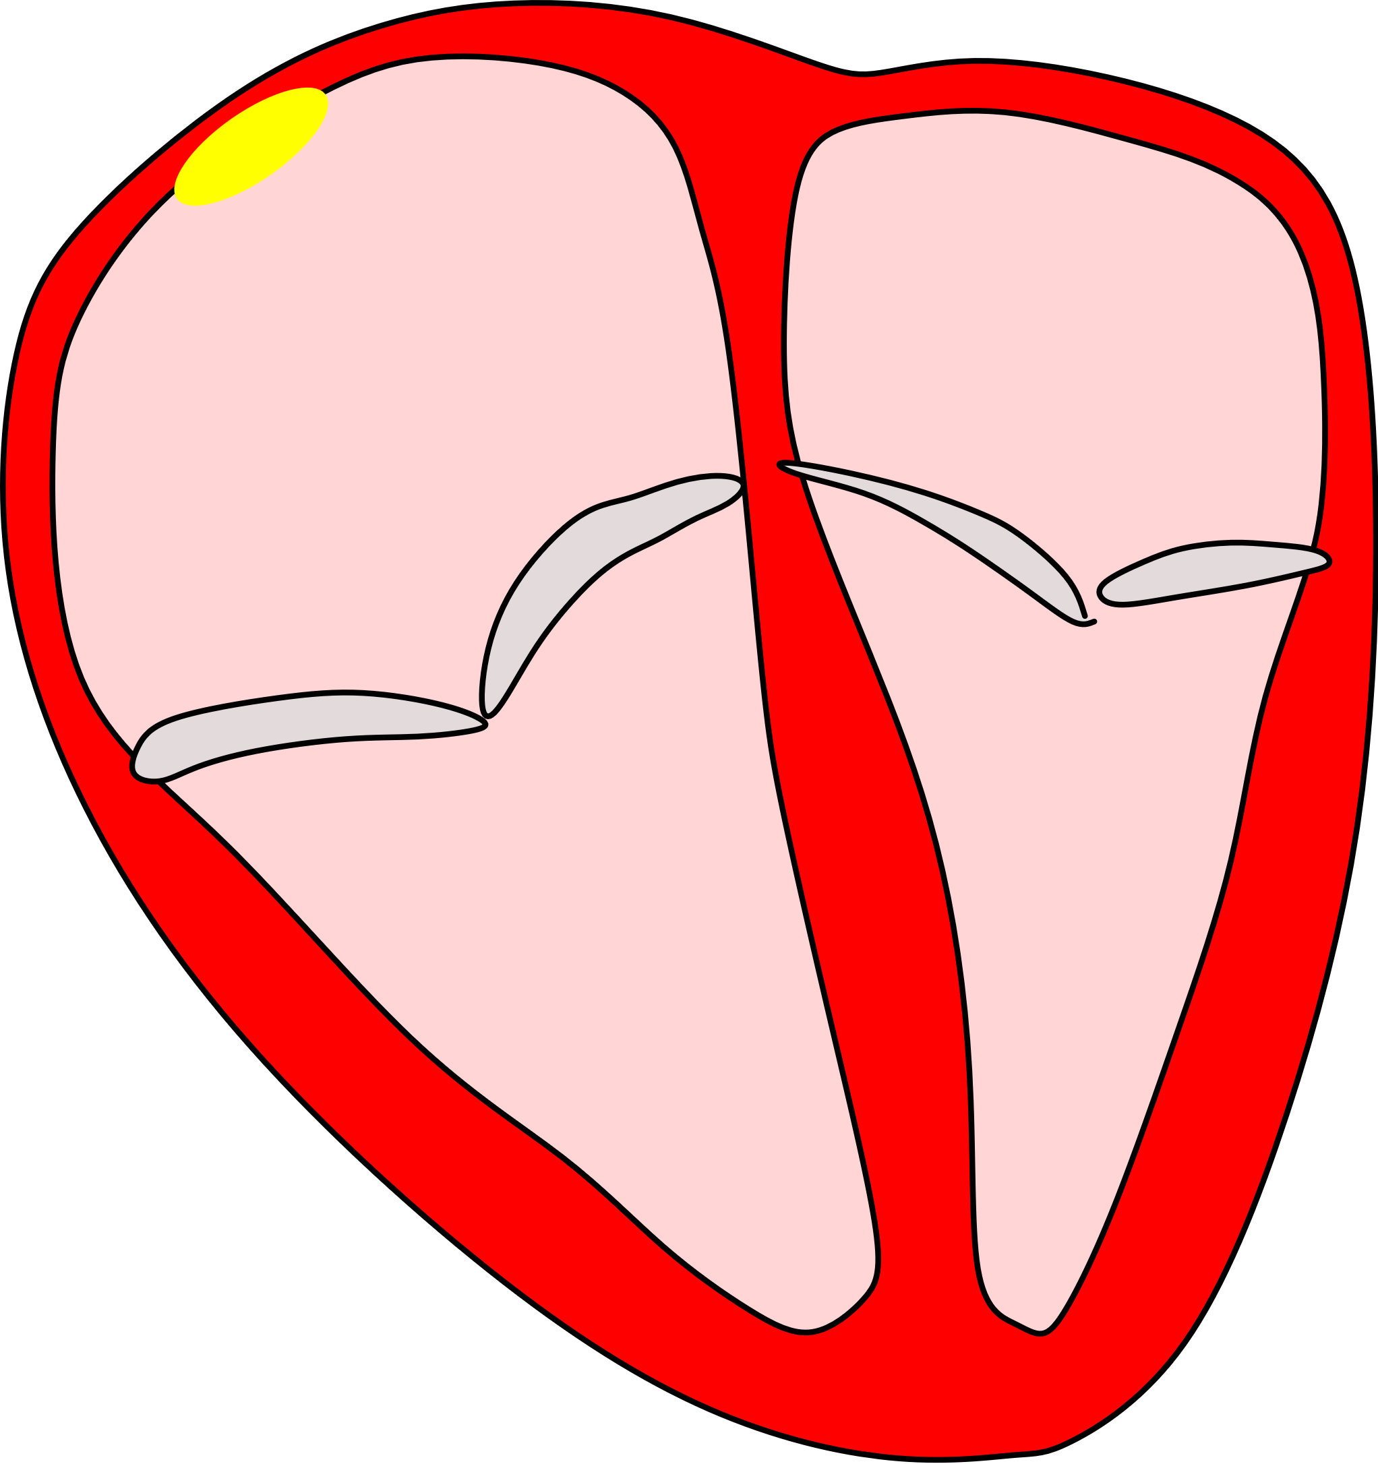
Cardiac muscle
Myocardium contraction is initiated by an action potential generated by specialized cardiac cells forming the sinoatrial (SA) node
SA
Left
Atrium
myocardium
Cells (striated: formed by myofibril)
Right
Atrium
Short cells, highly interconnected
Action potential is easily transmitted
from a cell to another at high speed
Right
Ventricle
Left
Ventricle

Slide 16
Electrical events during a cardiac cycle
Atrioventricular (AV) node
The SA node is a muscle cell that has not a stable resting potential: it continuously goes through depolarization and repolarization, operating like an oscillator
The action potential generated by the SA, rapidly spread across the atrii, through specialized conduction tissues (same type as the SA) causing contraction of the atrii
Network of conduction Tissue
The stimulus is received by an intermediate node (AV) that introduces a delay of nearly 100 ms, and then propagate it to the ventricles, causing their strong and fast contraction

Slide 17
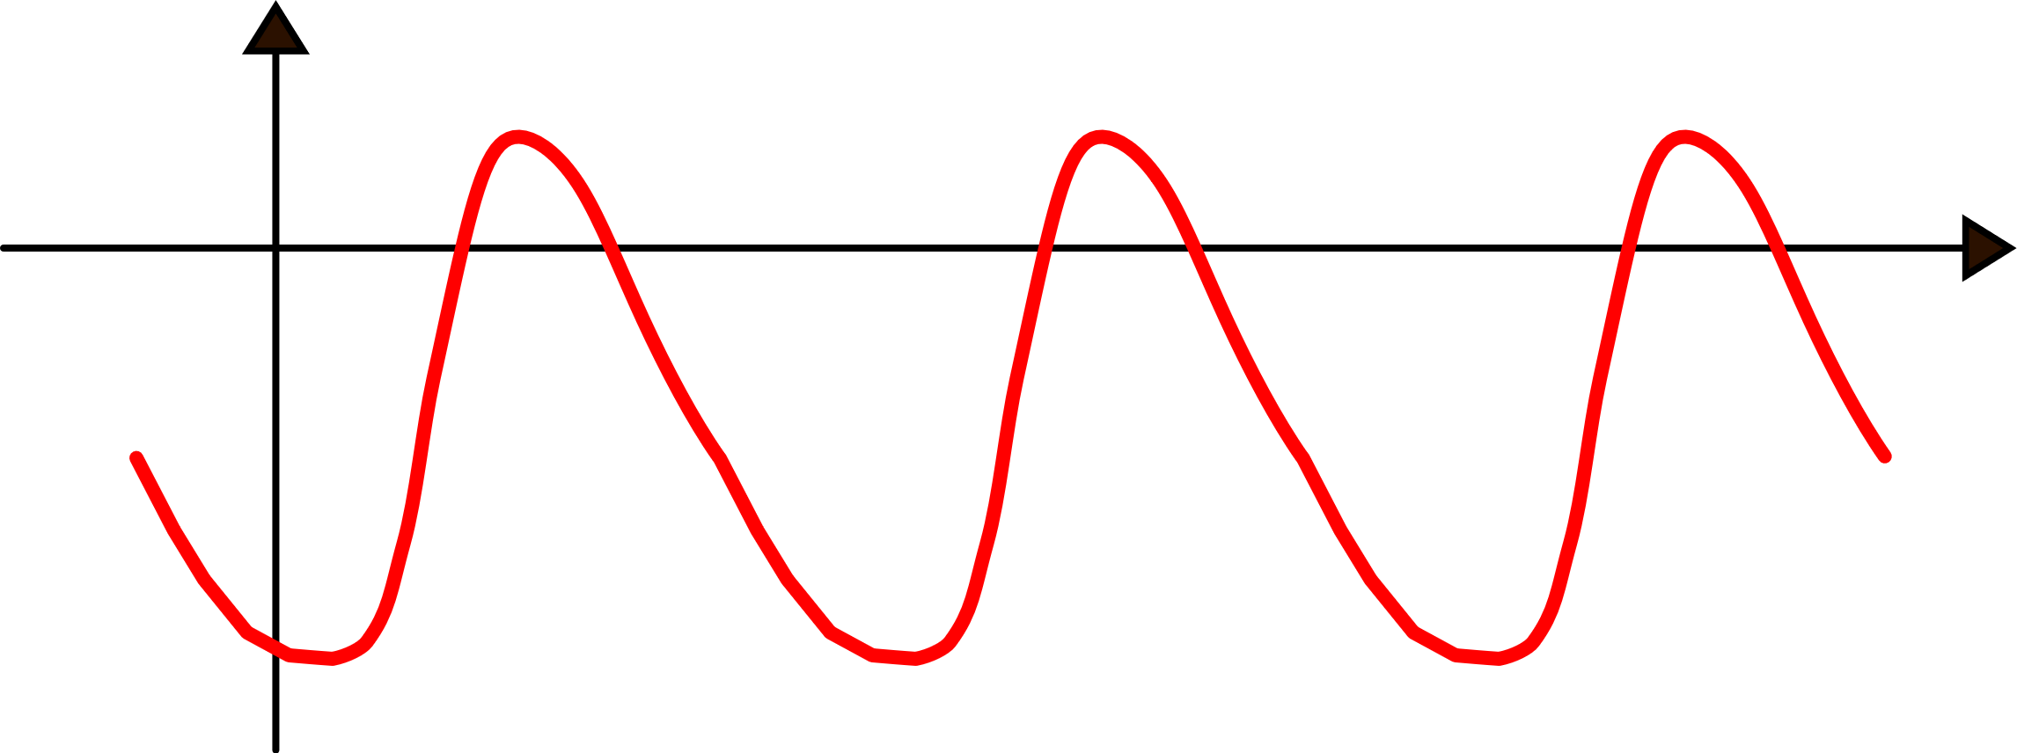
Neurostimulation of the heart
The oscillation frequency of the SA node sets the heart beating rate (BR). The SA is perfectly autonomous and does not require stimulations from nerves.
However, the BR is affected by neurotransmitters released by nerves connected to the heart and by other molecules released in the blood stream by endocrine glands

Slide 18
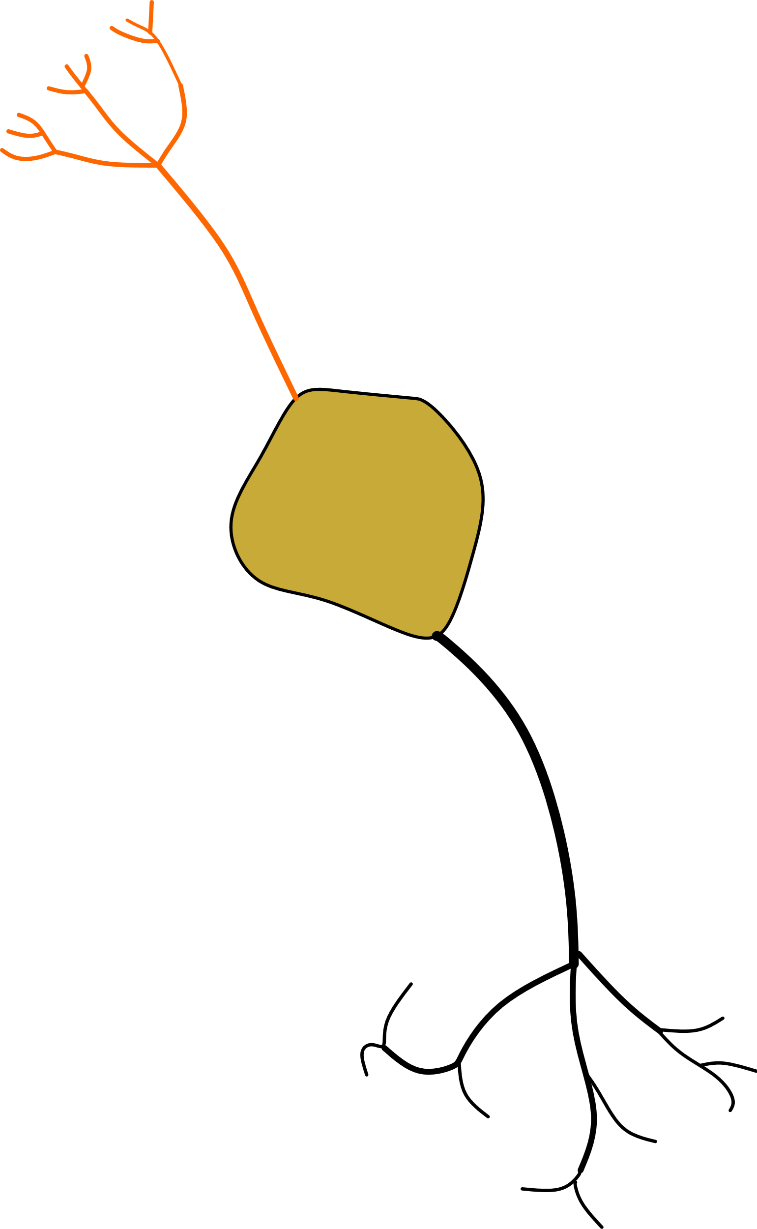
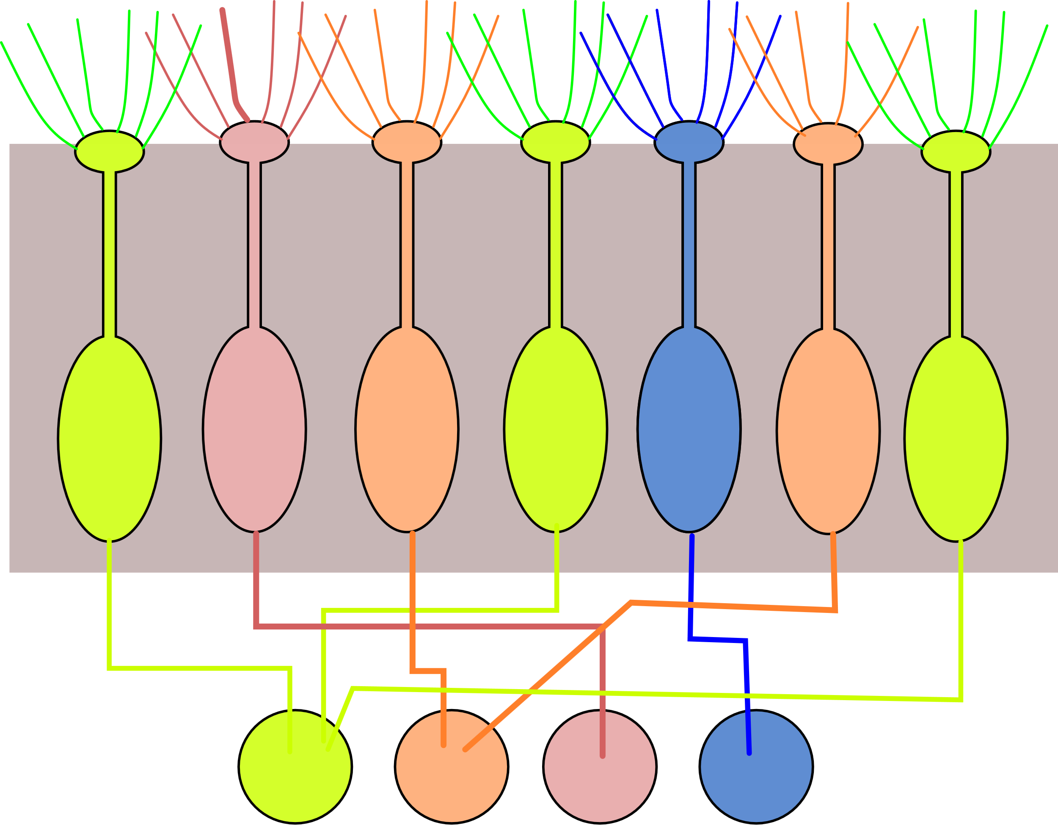
Sensory neurons
Quantity to be sensed
(light, temperature, molecules)
Example: Olfactory Sensory Neurons (OSN)
Odorant molecule
Cilia with receptors
for different odorants
Dendrite-like
sensitive structures
Receptor
OSN: different colors represent different receptors
soma
axons
axon
The frequency of firing is proportional to the odour intensity
Glomeruli (each glomerolus is connected to OSNs of the same type)

Slide 19
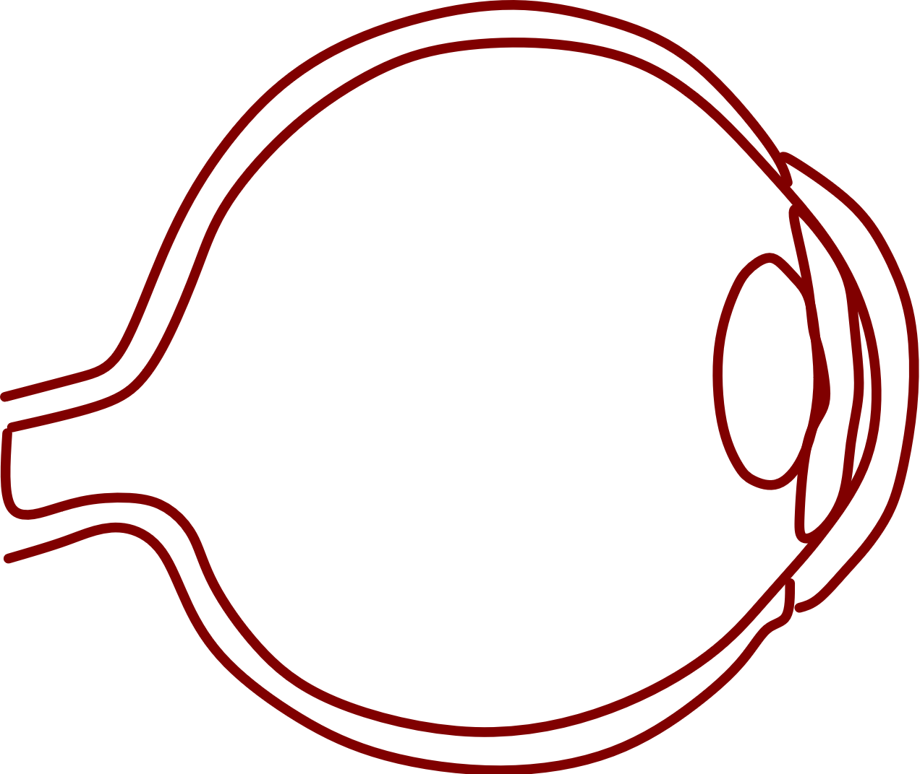
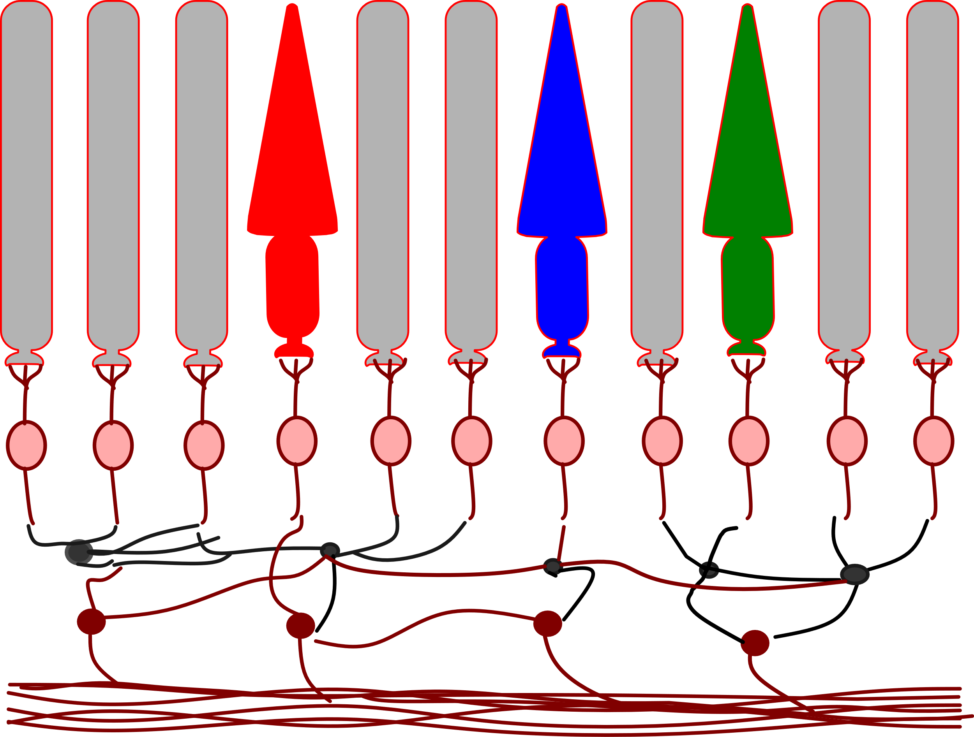
Natural photoreceptors: the retina
cones (7 millions)
rods 150 millions
retina
light
optical nerve
(1 million fibers)
Interneurons
(simple feature extraction)
light
to optical nerve

