Slide 1
Common inter-chip digital communication protocols
I2C (Inter Integrated Circuit) 2-wires (SDA, SCL) support addressing: can be used to build small busses require pull-up resistors up to 5 Mbit/s
SPI (serial peripheral interface) Simpler and faster than I2C Up to 100 Mbit/s Does not support addressing 4-wires
RS232 (UART) Asynchronous, needs matched clocks 2-wires full-duplex Slow: 115200 bit/s max Does not support addressing
Sensor Module
Sensor Module
Sensor node
(MCU)
Sensor Module
Non-specialized protocols

Slide 2
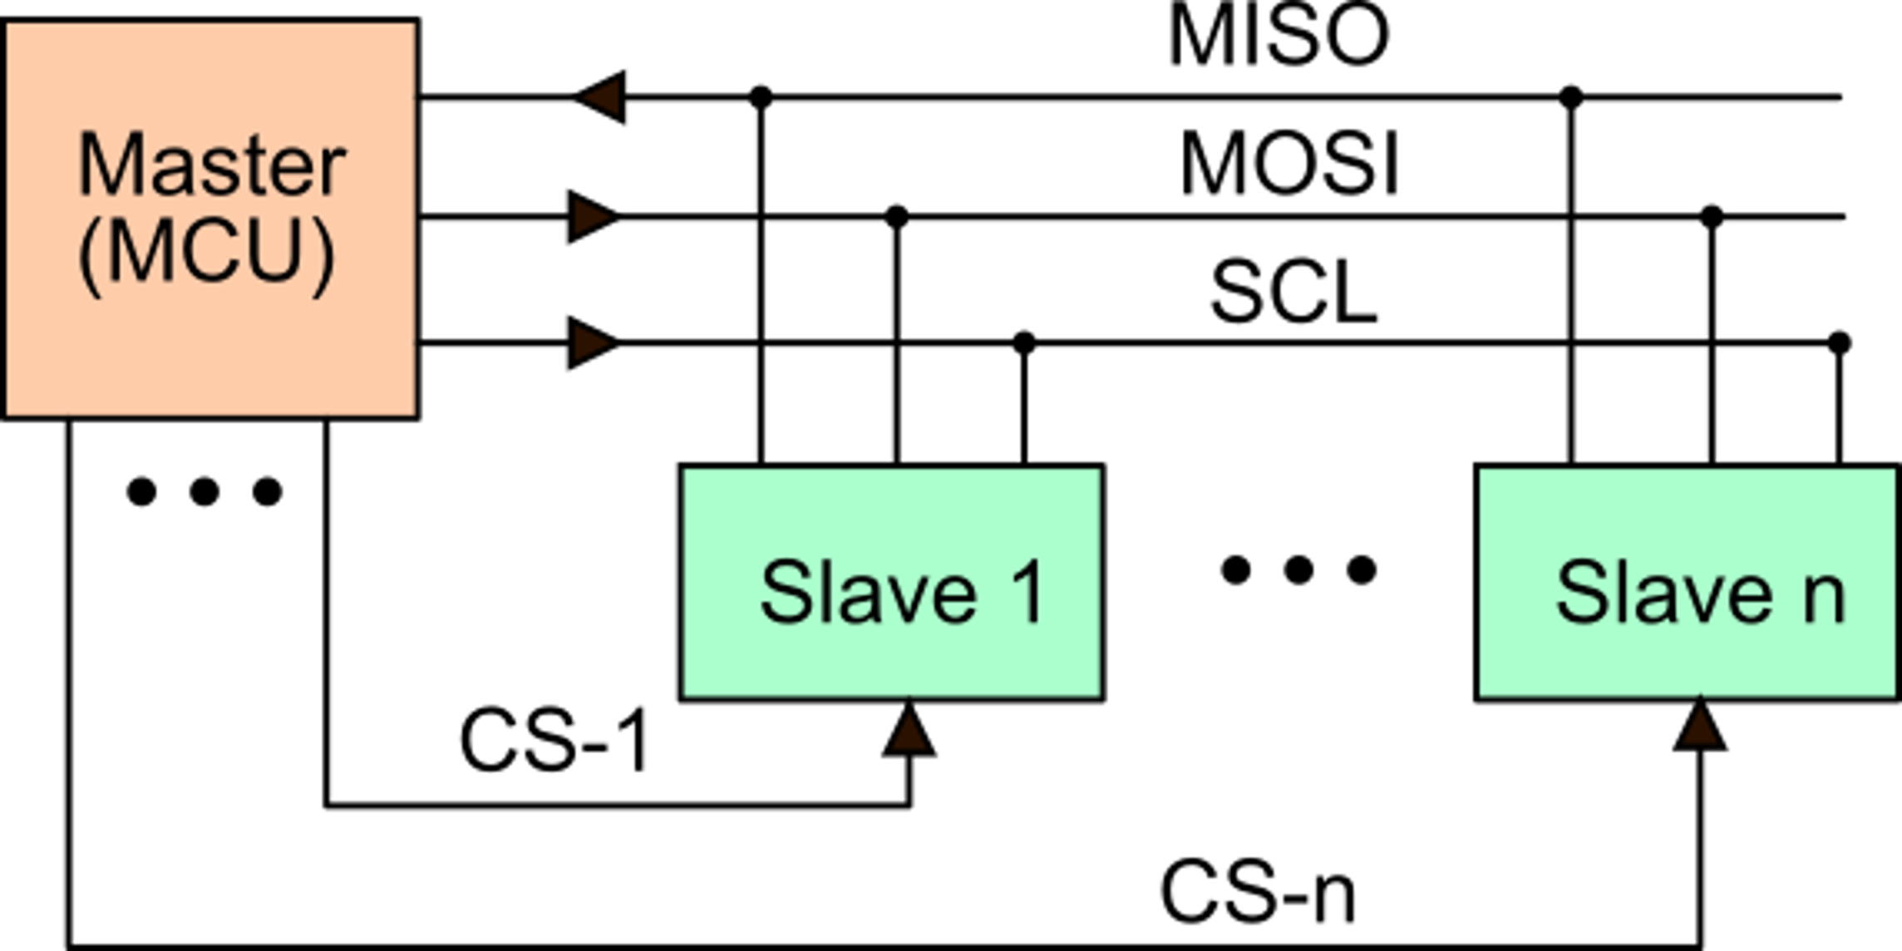
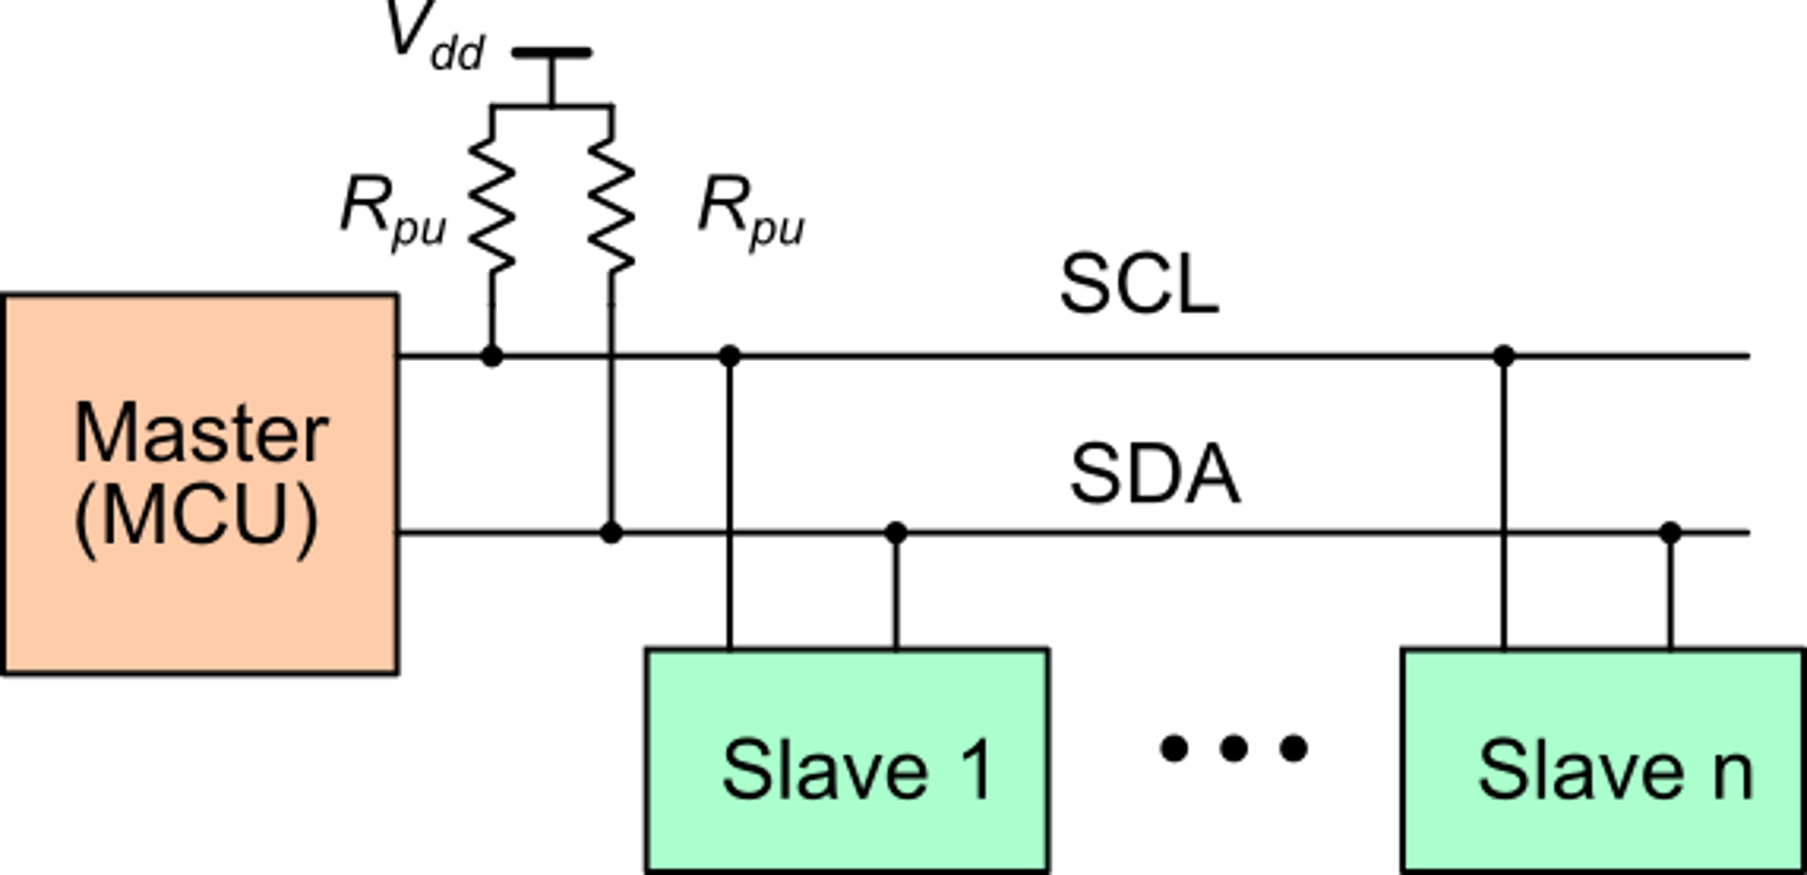
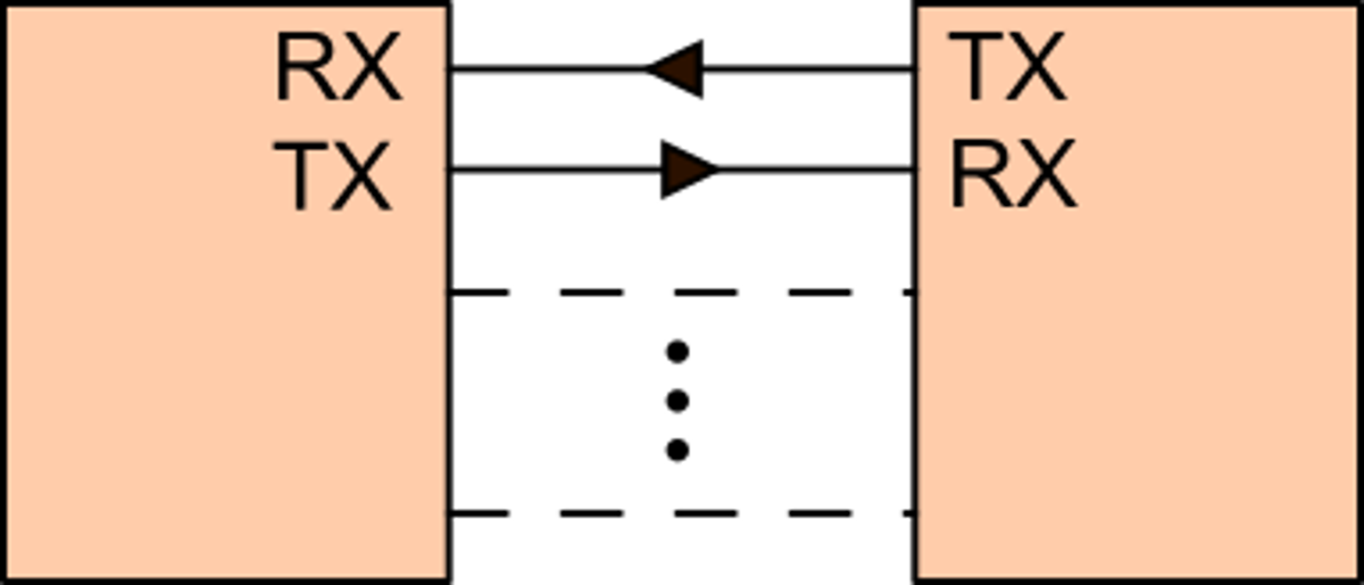
I2C, SPI, UART
SPI
I2C
One CS line for each slave
I2C Base: 7-bit addressing (up to 128 slaves)
UART
Pull-up resistors are necessary. Their value is chosen as a trade-off between power and speed
Optional lines for handshaking
Only connection between two devices

Slide 3
Possible wired links between a sensor node (MCU) and a high-level computer
I2C
SPI
UART
Operating system driver: Virtual COM
Sensor modules
MCU
USB
to RS232
USB
COM API
I2C
SPI
MCU with embedded USB
High level program (Python, C/C++, Java
USB
Sensor modules

Slide 4
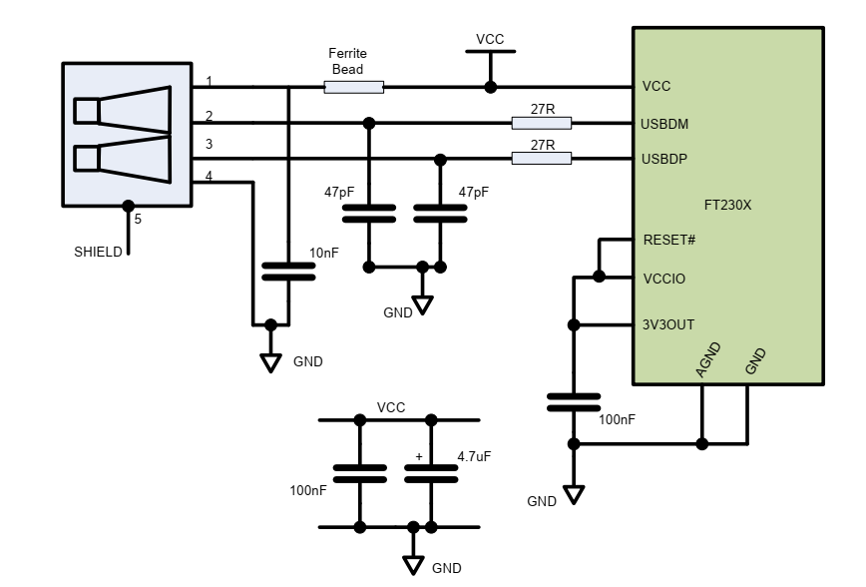
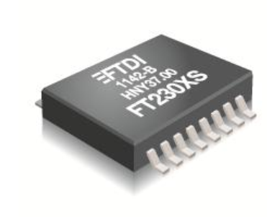
Example of USB to RS232 converter
FT230X

Slide 5
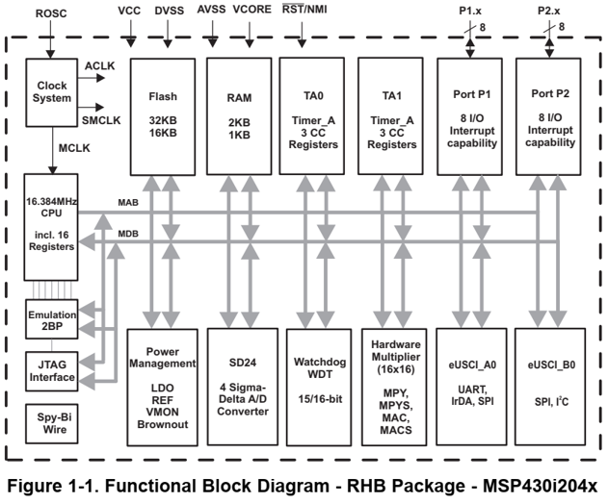
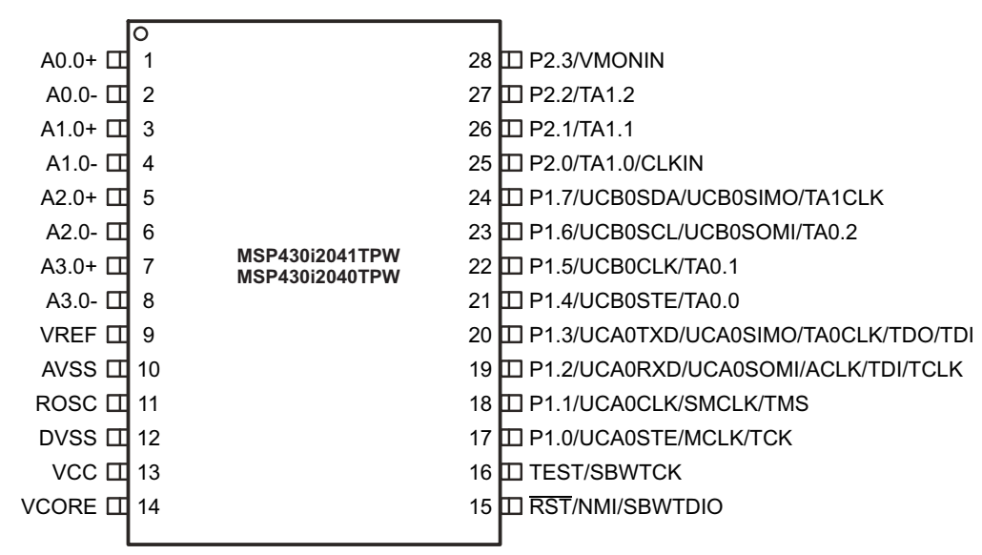
Example of MCU with SPI/I2C and RS232
I2C
SDA
SCL
TXD
UART
RXD
Versatile peripherals that can be configured to implement different communication protocols

Slide 6
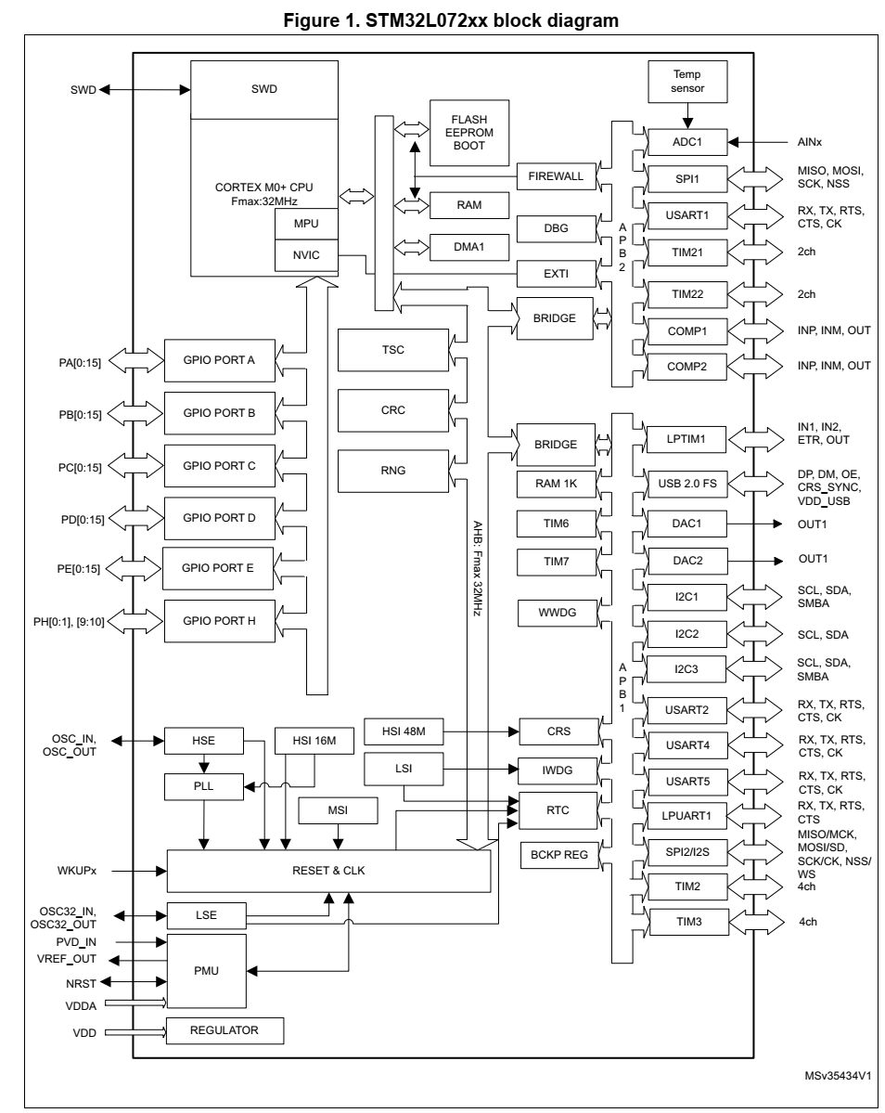
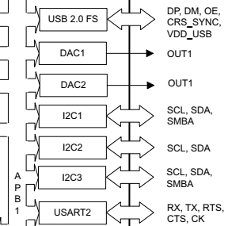
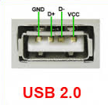
Example of MCU with embedded USB
DP
DM

Slide 7
Simple slave program (user firmware) on the MCU
RX interrupt from UART
EOI= End Of Instruction
(example, CR character
Read ch from RX-register
Low Power (Sleep) mode or infinite loop
USB
cable
byte
sequence
yes
interpret rx-buf and execute
ch=EOI?
USB to UART
MCU
no
reset rx-buf a
put ch in rx-buf

Slide 8
On the PC side: Windows OS - VCP (Virtual COM port)
The COM port was originally the way a real RS232 port was accessible from programs in IBM PCs running the MSDOS.
The RS232 defined logic levels that nowadays no more convenient (i.e. -12 V, +12 V). The communication protocol (UART Universal Asynchronous Receiver-Transmitter) has survived with voltage levels compatible with current integrated circuit supply voltages (e.g. 3.3 V, 5 V).
A Virtual COM Port is a software object that simulate the presence of a physical RS232 port, and allows communication with a device that supports data transmission and reception as stream of bytes

Slide 9
Virtual COM port
PC
Medium
(cable, EM waves, IR ..)
MCU
User Program
Device driver
Peripheral
(module or embedded in MCU)
User firmware
Peripheral
UART
peripheral
COMxx
PHY
PHY
bytes
bytes
User program:
opens the COM port, specifying the baud rate (e.g. 9600 b/s. This must be the same as the target device)
Write and/or read from the port sequence of bytes.
Closes the port at the end of the communication.
Device driver:
When the device is installed for the first time, one or more virtual COM ports are created. For example:
COM8

Slide 10
Equivalent of COM ports in non-Windows operative systems
The advantage of Windows VCP is that this standard is used for a large variety of communication devices, not limited to USB but including also Bluetooth (BT). Many program can be adapted to switch from USB and BT by simply changing the number of the virtual COM.
In Linux OS, COM ports are called "tty". Popular USB to UART conversion modules (e.g. FTDI modules) comes with a driver that installs a tty port that can be opened and used as a VCP. There is not an equivalent VCP for Bluetooth and special libraries has to be used with a syntax for sending bytes that is somewhat different from VCP one
In Android systems, special Java classes have to be used to open a connection over a BT or USB link. To enable connection from the USB connector of a smartphone to a slave module, the USB must be OTG (on-the-go) enabled.

Slide 11
Possible wiress links between a sensor node (MCU) and a high-level computer
Embedded in most fixed or mobile computers
Protocols: Bluetooth
WiFi
Zigbebee (IEEE 802.15.4)
LoRaWAN
Need a Bridge to a wireless or wired (USB, Ethernet) standard
I2C
SPI
I2C
SPI
MCU
UART
Radio
Module
MCU with embedded Radio Module
Sensor modules
Sensor modules

Slide 12
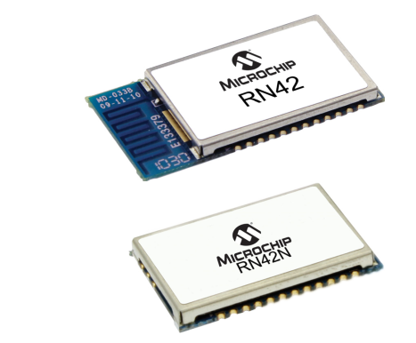
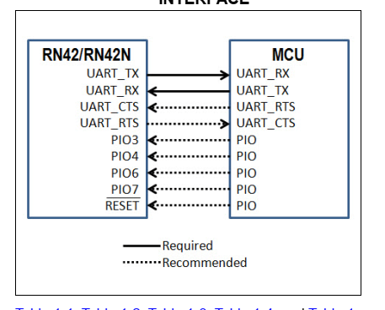
Example of Bluetooth module
Connection of the module to an MCU

Slide 13
Stable and intermittent mode in a wireless link
Stable link: allows the sensor node and the data collector (e.g. the high-level computing machine) to initiate a data transfer at any time and in any direction (uplink or downlink).
Examples: BT or Zigbee modules in "Cable Replacement Mode"
WiFi connection.
Intermittent link: the sensor and the data collector can talk each other only in short time intervals.
The stable link is more adequate when the data collector must send data to the sensor node in frequent and random fashion.
Unfortunately, this mode is extremely inefficient in terms of power

Slide 14
Power consumption in Wireless Modules
Important: in low power wireless modules, keeping the receiver on requires as much the power as transmitting data.
In a stable link, the sensor node must keep his receiver on, even when it is not communicating, since the data collector may send data / command at any time. Keeping the receiver on imply a power consumption generally in the range 10-40 mA for commercially available modules.
For battery operated modules, a steady power consumption of mA is often not acceptable
Different methods for intermittent link have been developed. Their details depend on the type of wireless protocol.

Slide 15
Intermittent link mode: a possible uplink-based approach
Used by LoRaWAN
This is an AC powered device, and its radio is always on
TX
LP Module 1
RX
Gateway
or
Data Collector
power
LP Module 2
A sensor node that needs to communicate with the server, turns the radio-on and transmit a brief message ("uplink") to the gateway
Then, keeps the receiver on for a short period. Waiting for the server answer. If no answer is received, the radio is turned off.
Server
LP Module n
These nodes are battery powered and cannot keep their radio on all the time

Slide 16
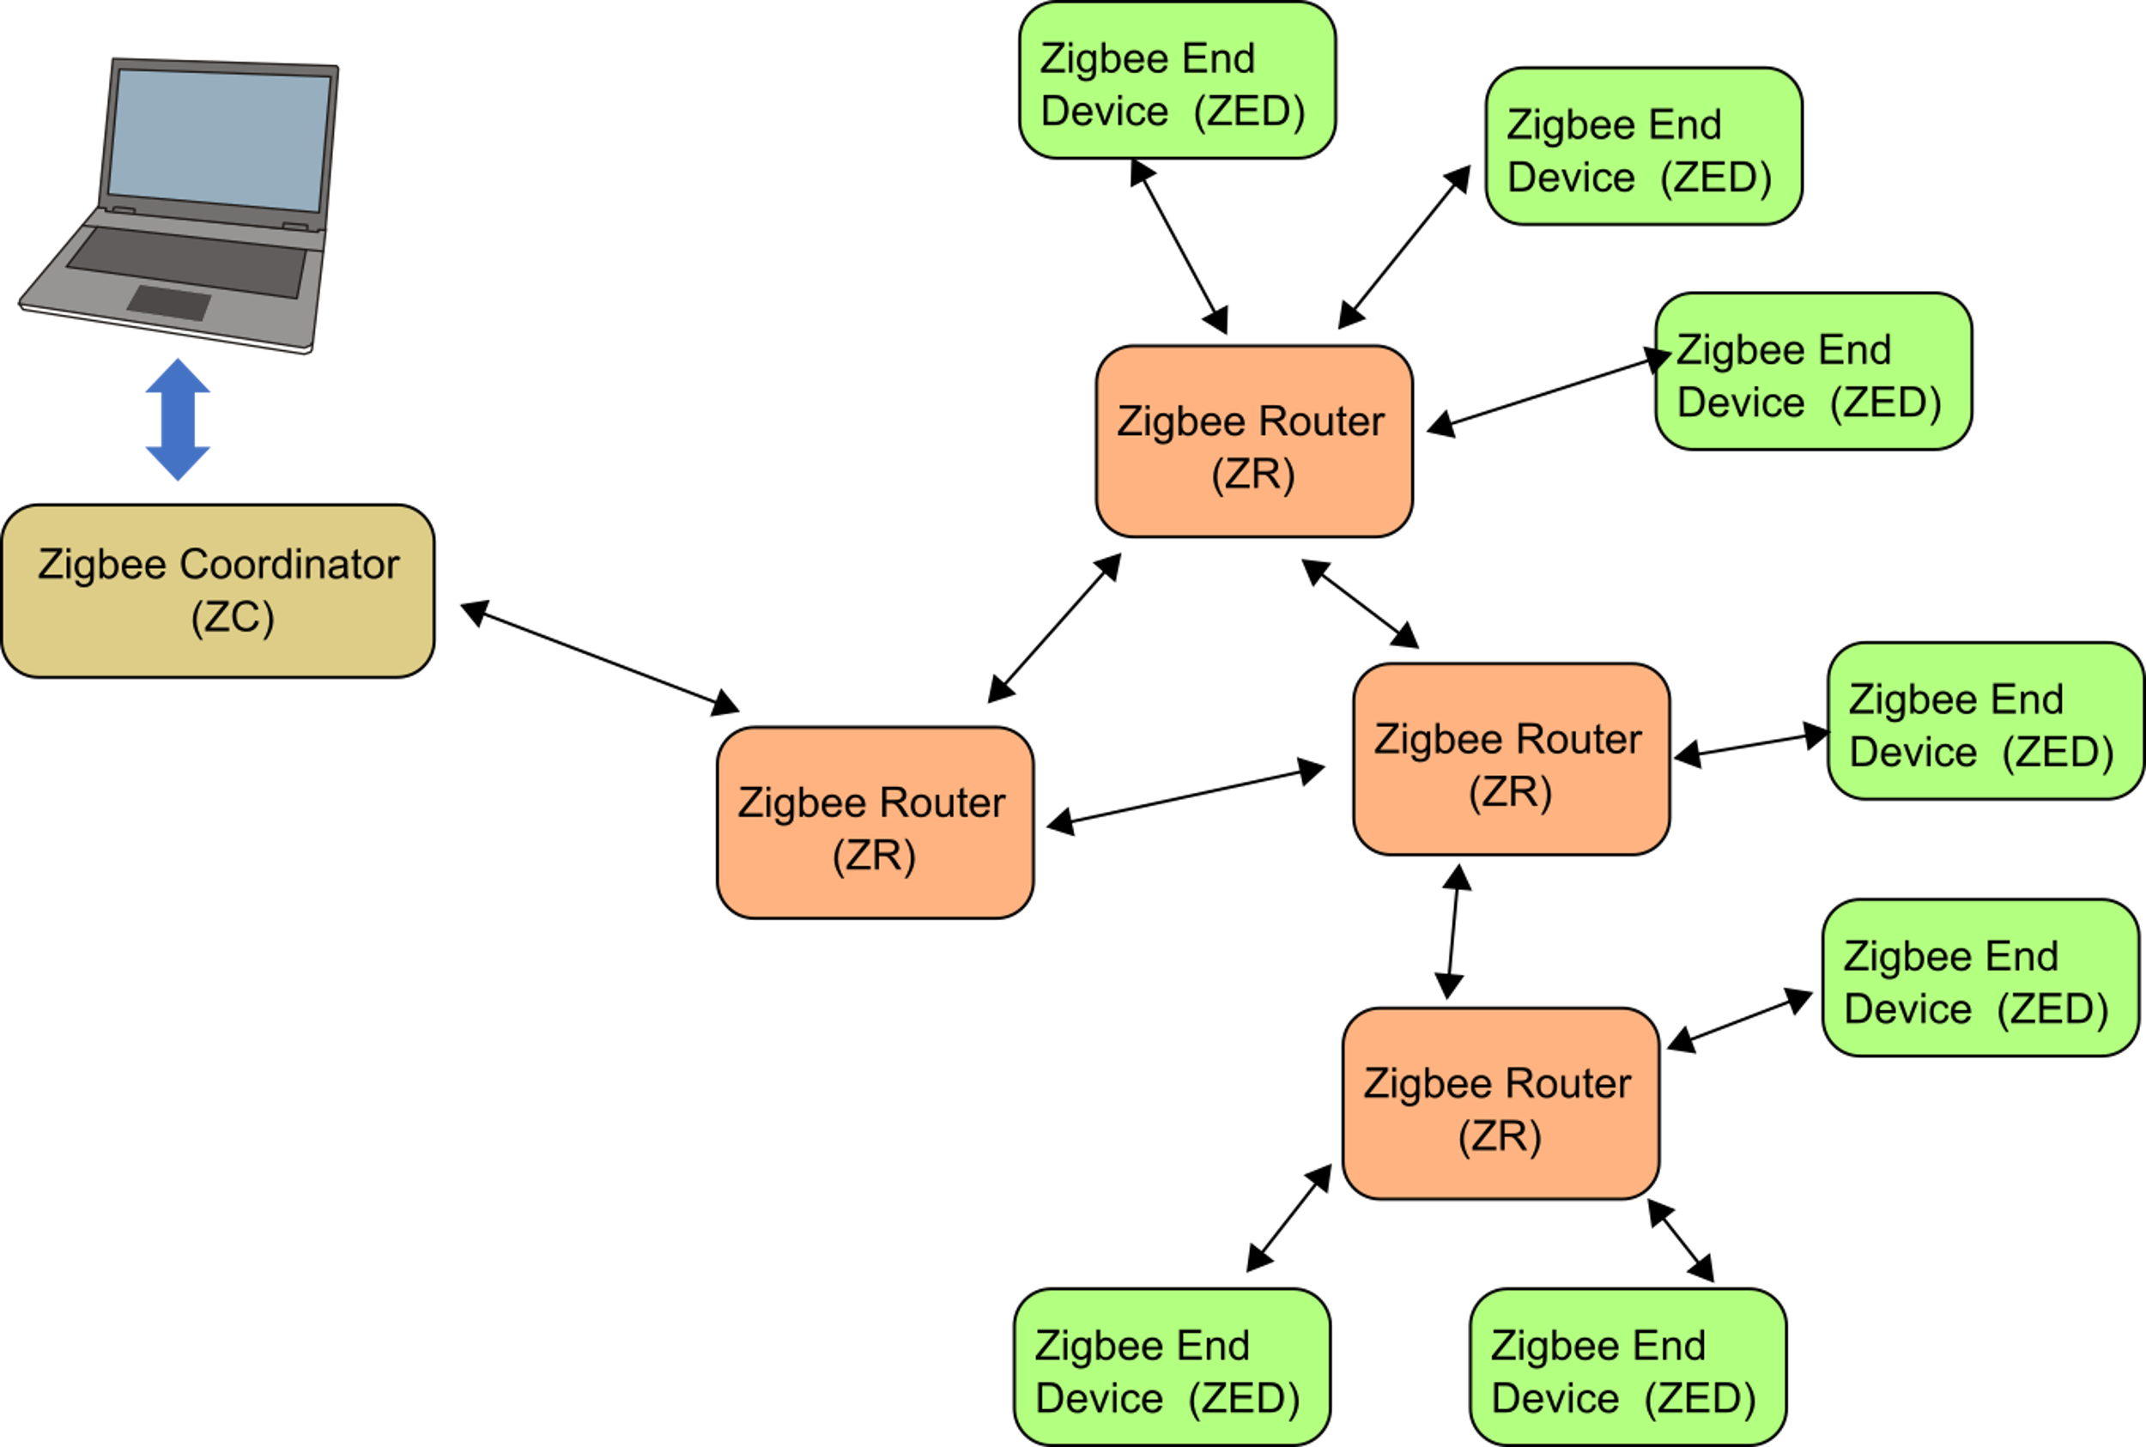
A MESH Wireless Sensor Network based on ZigBee
ZEDs are battery powered and perform sensing operations.
They communicate with a routing node (ZR) periodically. A ZR node (parent) can communicate with several ZEDs
ZR nodes can be continuously kept in "on" state or follow a "beacon-enabled" intermittent operation to save power.
Frequencies (Europe): 868 MHz and 2.4 GHz

Slide 17
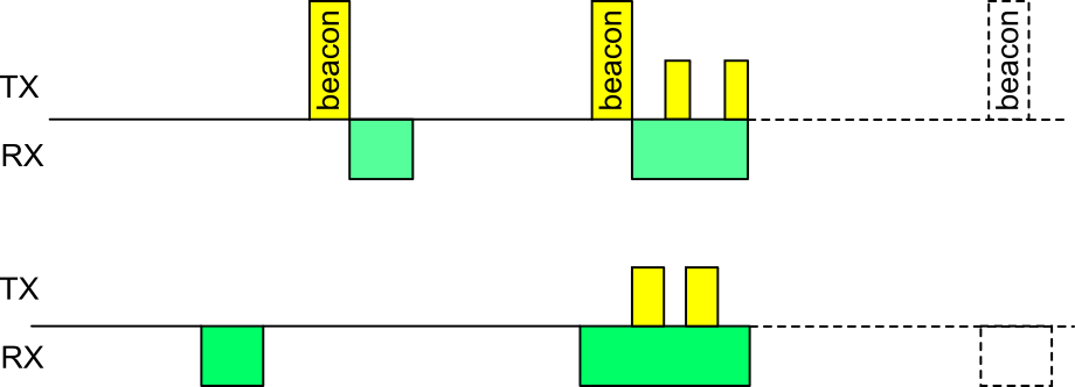
Beacon-enabled intermittent mode
Beacons are special transmissions used to indicate that a wireless node is alive and ready to communicate. If the receiver gets the beacon, then communication can start between the two nodes.
Beacons are used also in low power, WiFi intermittent links and in many other wireless network protocols.
At the endo of the communication, the two nodes synchronize their clocks, so that Node 2 can reliably wake-up its radio when it expects the beacon is sent
Node 1
Node 2
Node 1 send the beacon and open its receiver to get replies. Node 2 cannot respond because it turns on RX in a wrong time interval
Node 2 has its RX on when the beacon is sent. It respond to Node 1 and communication is performed.

Slide 18
The LoRaWan Star Sensor Network
LoRA RF links
LoRa
End Node
Cable or Wireless connections
Gateway
LoRa
End Node
Gateway
LoRa
End Node
Batteries of End-Nodes can last 5-10 years
End node can implement different power saving strategies
Non-GPS localization is possible through comparison of data received by different gateways
3-15 km
Frequencies 867-869 MHz (Europe)

Slide 19
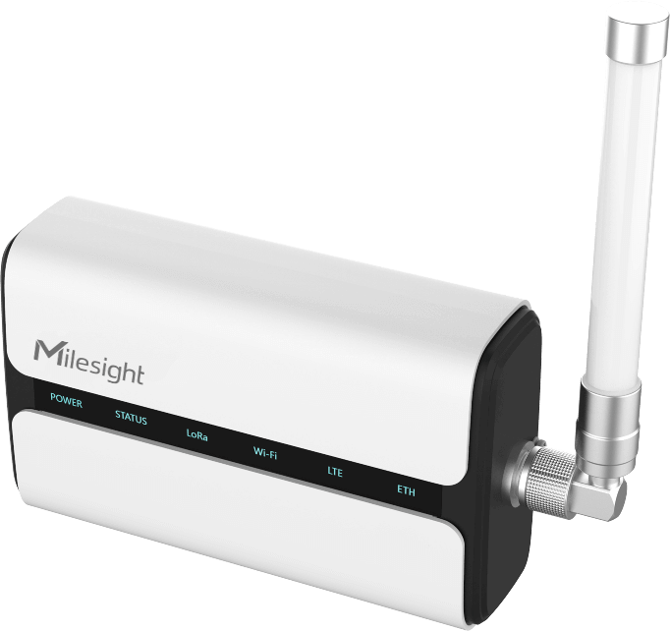
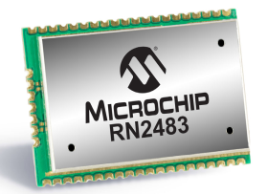
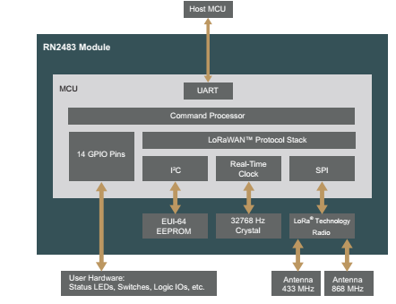
Examples of commercial products: LoraWan

