Slide 1
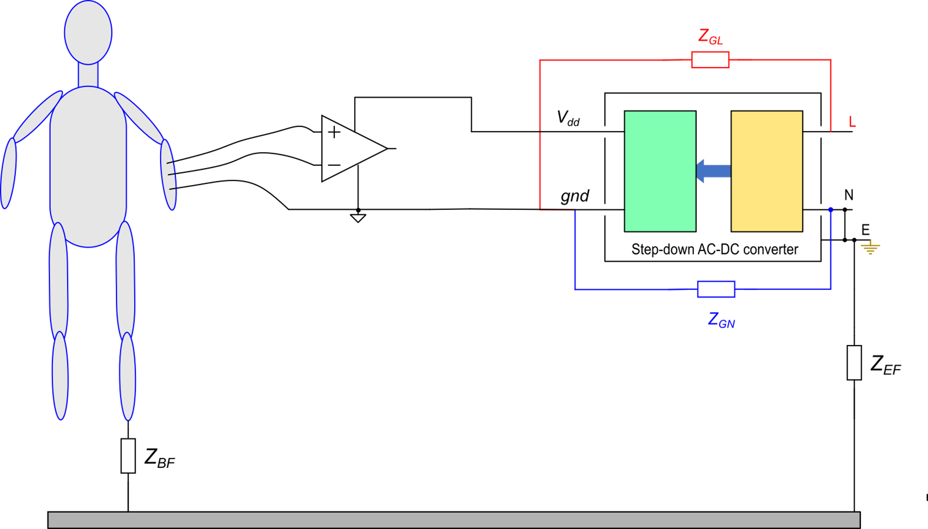
Hazards due to lack of isolation
Case 1: AC powered biomedical apparatus, electrically connected to the patient.
Let us suppose that this impedance gets much smaller due to a failure in the transformer insulation.
Depending on Z_{BF}, a large current may pass through the body. A current that passes through the heart is potentially fatal.

Slide 2
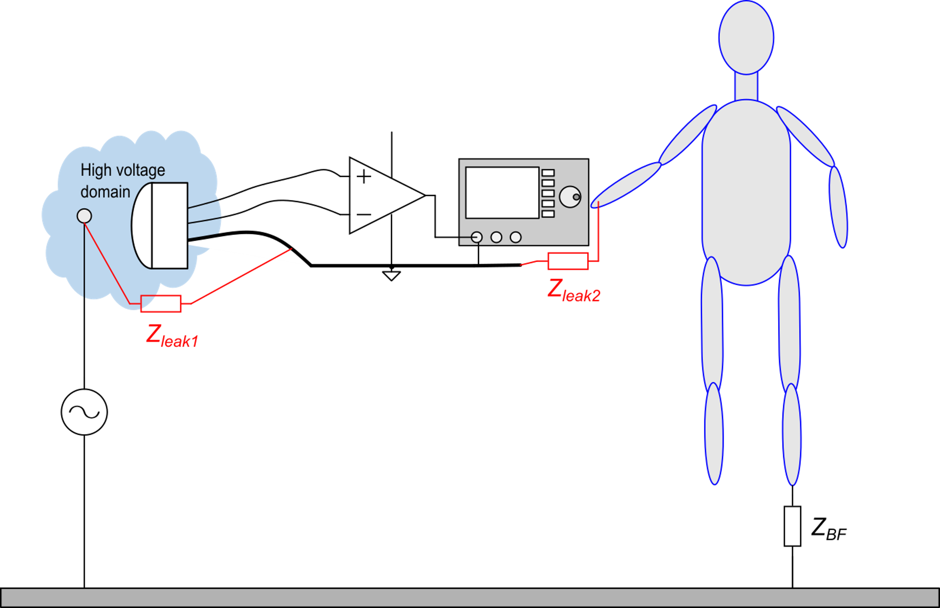
Hazards due to lack of isolation
Case 2: Sensing systems with possible continuity with a high voltage domain.
The sensor is isolated from conductors of the high voltage domain, but a leakage impedance may originate from dielectric failure or an unwanted contact (Z_{leak1}).
From the operator side, the front panel control may lose insulation due to wearing or presence of moisture / accidental liquid pouring

Slide 3
Isolation approach 1: Isolation Amplifier
Isolation amplifier
Probe (electrode)
or sensor
Double protection concept: this is a strict requisite in biomedical instrumentation

Slide 4
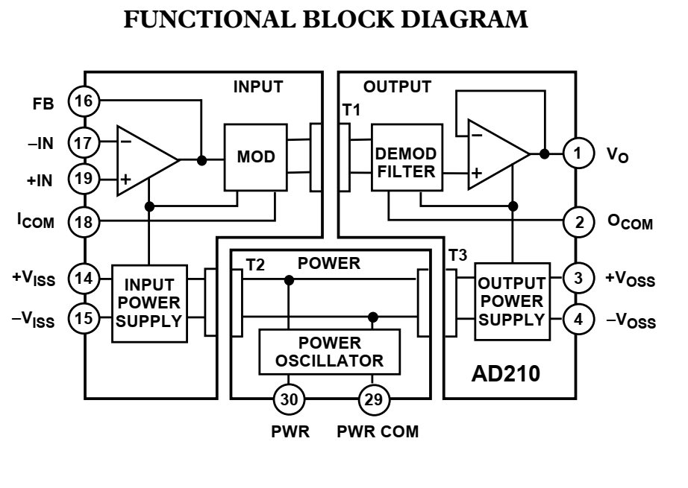
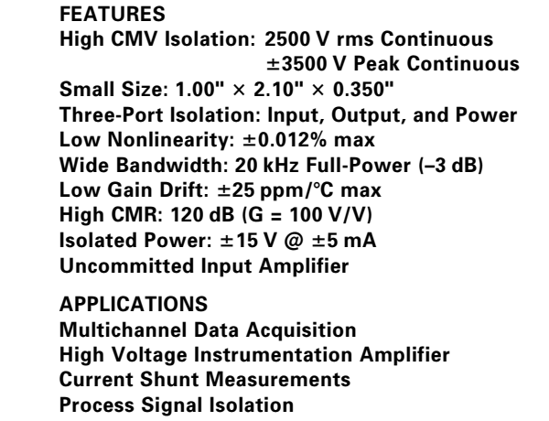
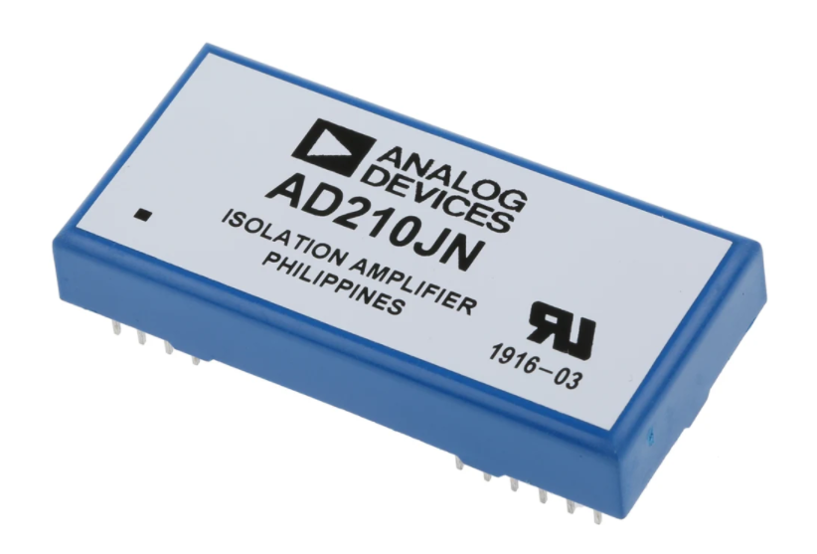
Techniques for analog signal insulation
Transformer coupling
Optical Coupling
Capacitive Coupling
Example of transformer coupling: the AD210

Slide 5
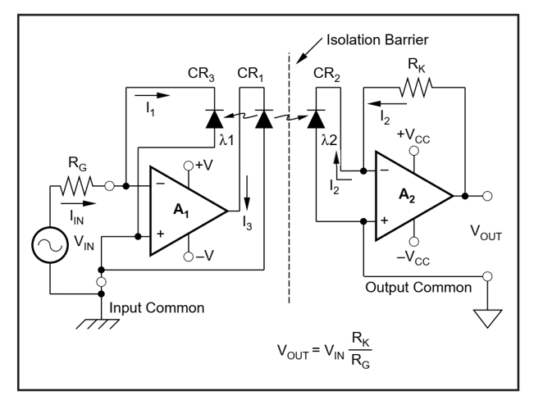
Principle of analog optical coupling
Example: Broadcom ACNT-H79A
An optical link is marked by strong non-linearity. It can be used in an open-loop scheme only to transmit digital signals.
For analog signals, a feedback scheme can be used, as in the figure. The LED CR₁ is coupled in a symmetrical way to photodetectors CR₃ and CR₂, thus:
(photocurrents)
virtual short circuit due to optical feedback at A₁.

Slide 6
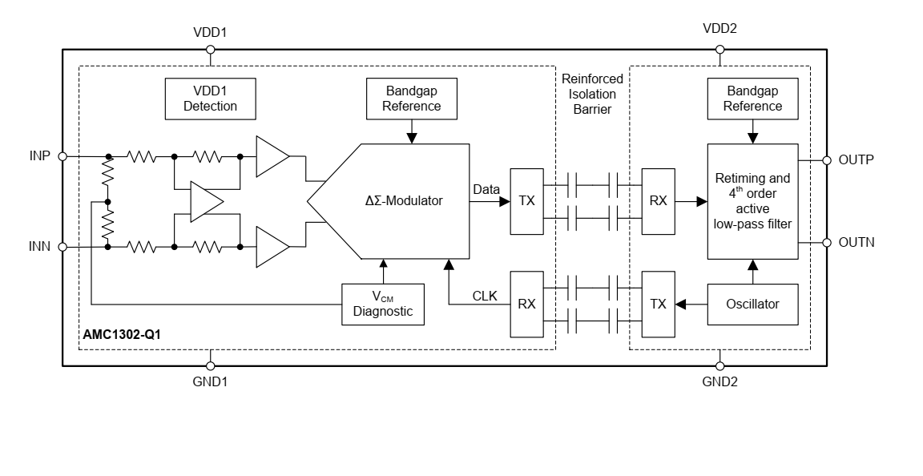
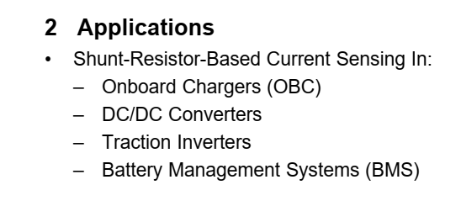
Isolation amplifier with capacitive coupling
Data that cross the barrier are digital (bitstream). Differential data links are used
Data are converted back to analog by filtering.

Slide 7
Isolation approach 2: Isolated Digital Link
Digital Data Isolator
Advantages of digital isolation
Does not affect accuracy
Cost is generally lower than analog
Size is also generally smaller
Digital isolators are based on two principles:
(1) Optical (photocouplers) (2) Capacitive

Slide 8
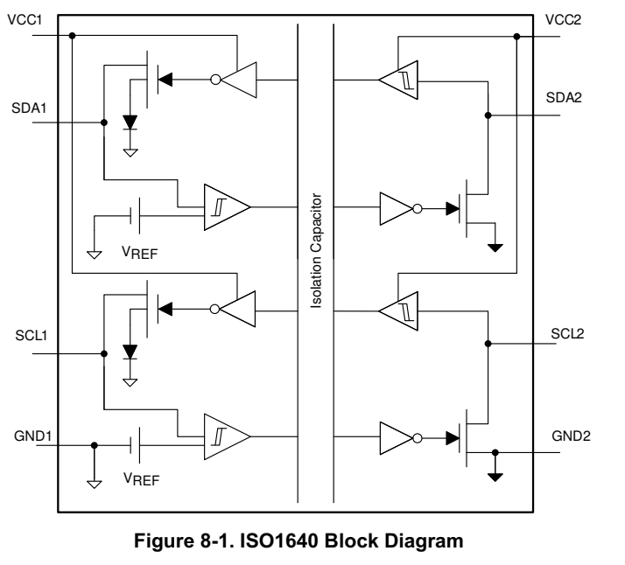
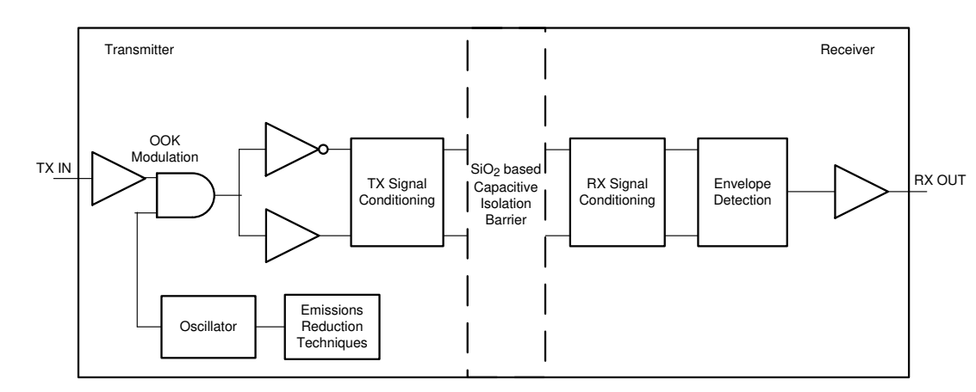
Example of digital data isolator: I2C isolator
4 channels are necessary because each one of the two I2C lines is bidirectional
Texas Instrument
Digital data are modulated by a high frequency carrier (on-off modulation (on-off keying, OOK) and transmitted across the barrier through a capacitive barrier.

Slide 9
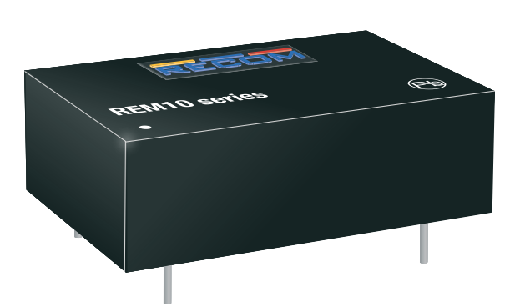
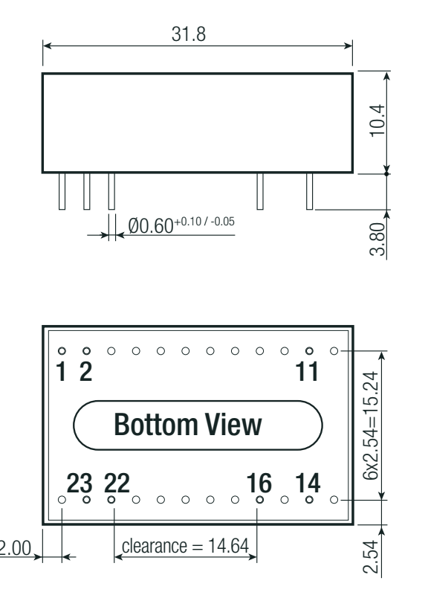
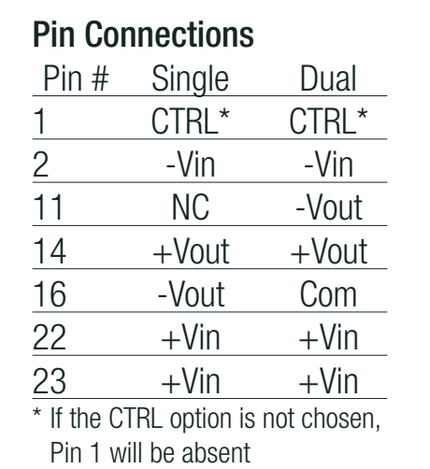
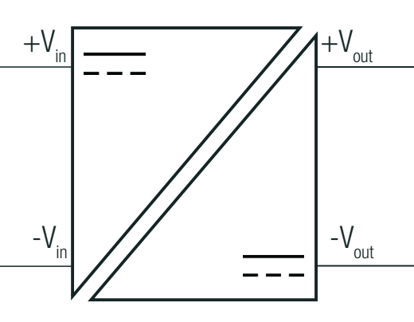
Example of isolated power supply
RECOM REM10 (10 W)
Medical compliant
Isolation voltage: 5 kV
Simbolo
For standby mode

