Slide 1
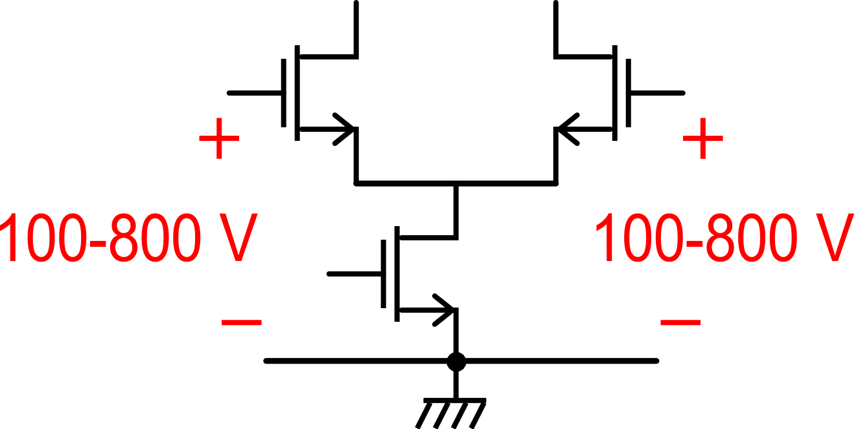
A particular case: voltage or current sensing in battery packs
"High-side current sensing": commonly used in batteries
and power supplies.
∼ 100-800 V
V_{H}=NV_{B}
R_{sense}
I_{charge}
I_{motor}
V_{I}
Conversion
3.7 V
Processing
Display ....
Such a high common mode voltage at the input damage the amplifiers!
V_{B}
V_{V}
Goal: monitor the current through the battery and the voltage of individual cells for State-of-Charge estimation.

Slide 2
Possible solution: isolation components
The isolation amplifier is capable of amplifying and transmitting the analog signal across an insulation barrier
In this way, the output signal can be referred to a ground which is independent on the ground of the input section.
Signal transmission across the barrier may occur through magnetic (transformer), optical or capacitive coupling.
R_{sense}
V_{H}=NV_{B}
I_{charge}
I_{motor}
Isolation barrier
Isolation amplifier
Conversion
Processing
V_{B}
Display ....

Slide 3
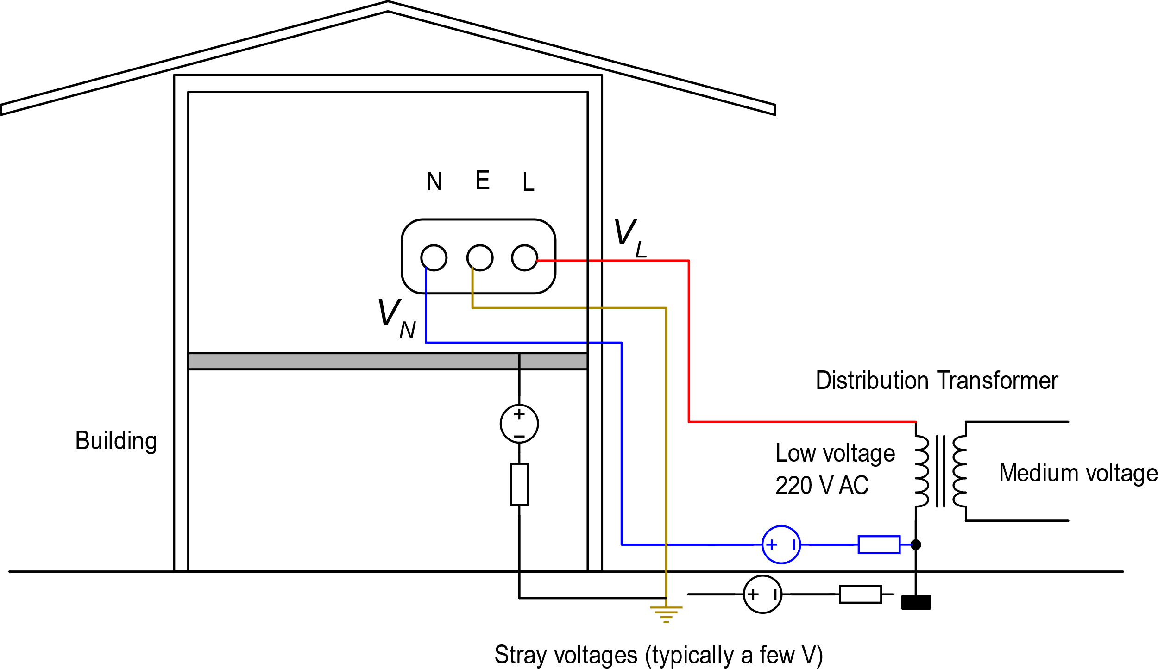
Voltages due to mains inside a building
N= Neutral
E= Earth
L= Live (or "phase")
power wall socket
The neutral is connected to the earth at the distribution transformer

Slide 4
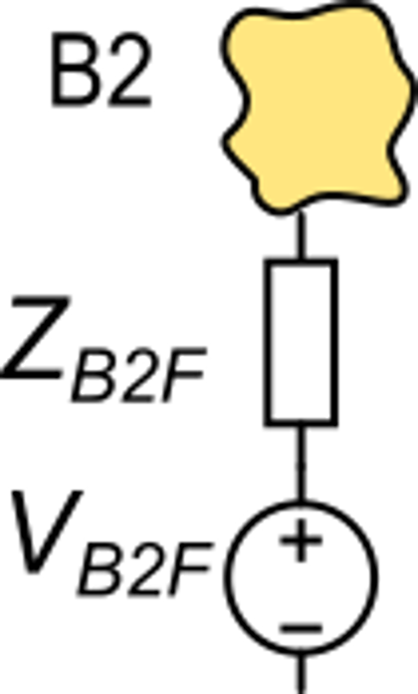
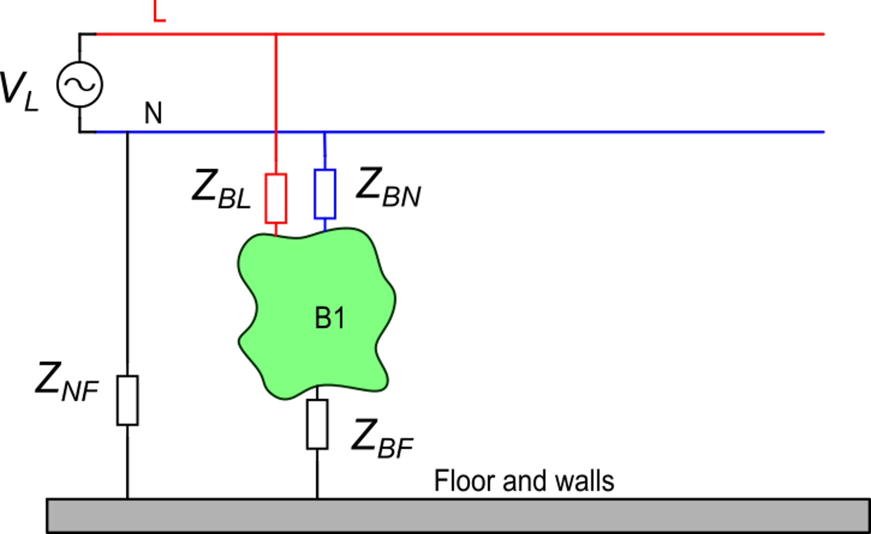
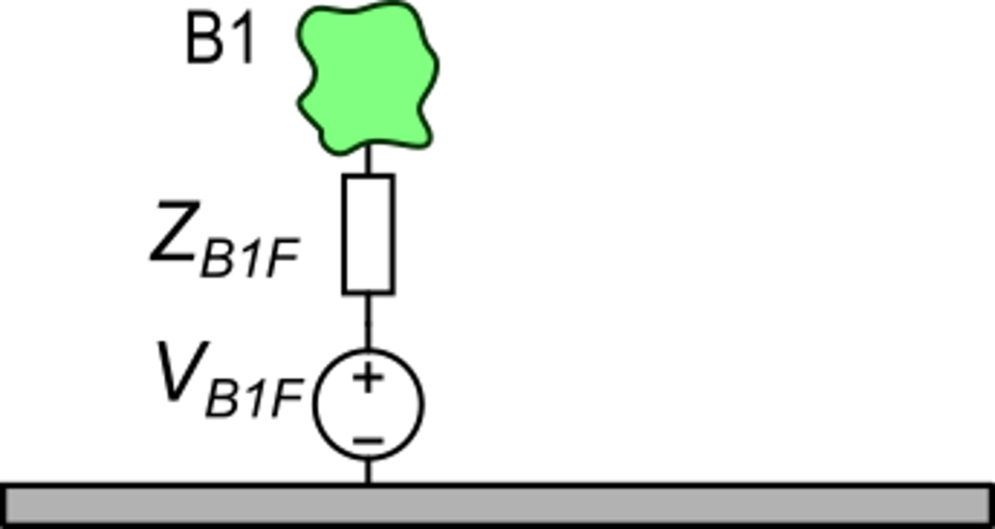
Consequences of the presence of AC power distribution
B1: conducting body
Generally:

Slide 5
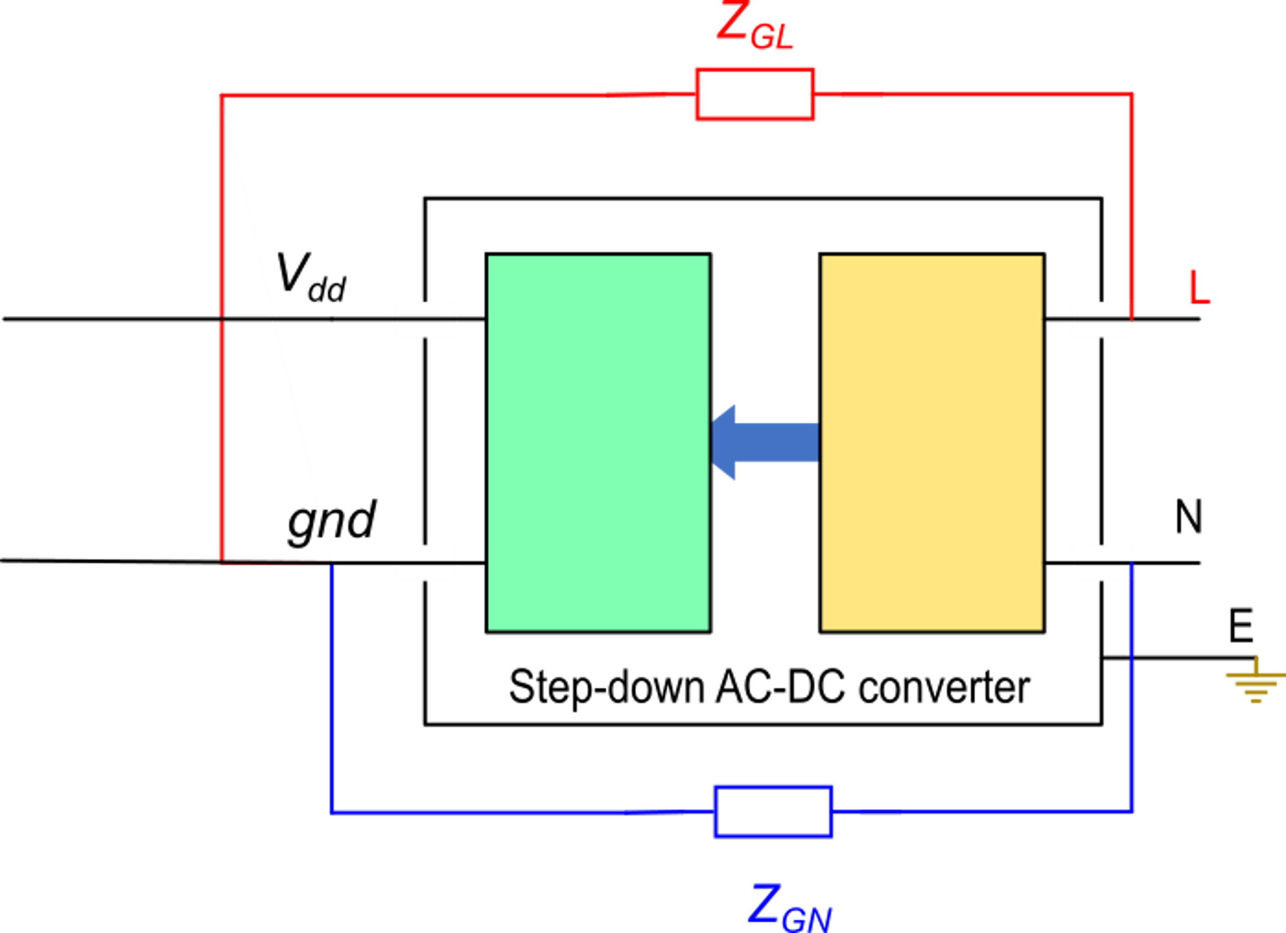
Particular case: the power supply
Isolation barrier
V_{dd}
gnd
Z_{GF}
V_{GF}
Power
This is the actual equivalent circuit that takes into account also the connection towards the floor and the relative voltage.
In any power supply it is impossible to avoid leakage impedances (Z_{GL}, Z_{GN}) between the input output terminals

Slide 6
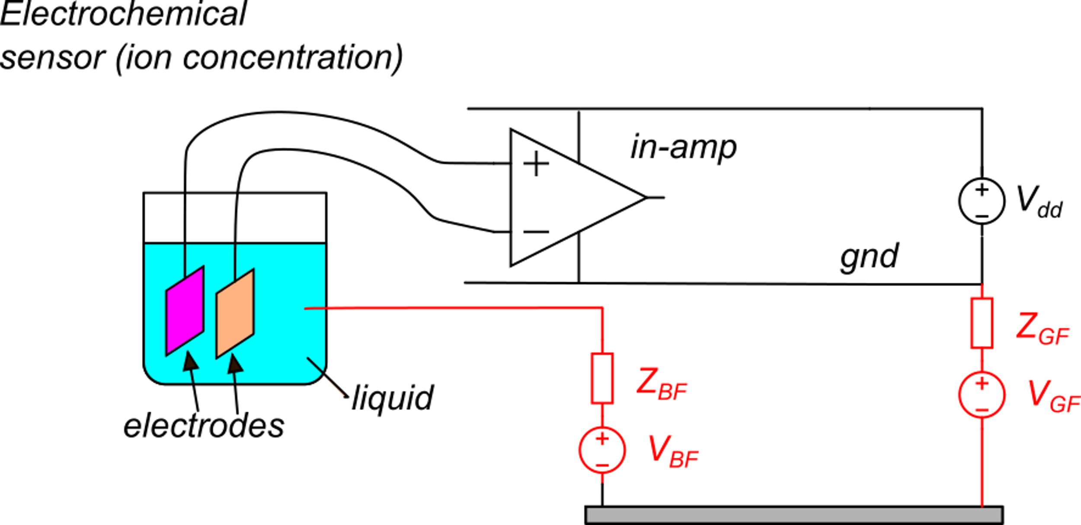
A few significant cases
Presence of electrical continuity between a conductive physical object and the sensor terminals.
Example
Suppose that: 1) the input impedance is infinite
2) the voltages between the electrodes and the liquid are negligible
With this simplified model, the input common mode voltage of the in-amp is:
Since V_{BF} and V_{GF} are important fraction of the mains voltage (220 V r.m.s):
The amplifier will be damaged or the protection at the input terminals activate, making the measurement meaningless

Slide 7
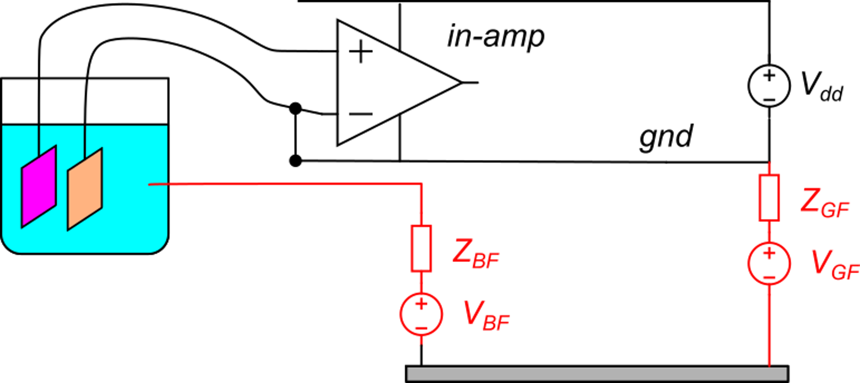
Two possible solutions:
Connect one of the two terminals to gnd. In this way, the input common mode voltage is close to zero.
The problem with solution is that a current flows trough one of electrodes. Since the series resistance between the electrode and the solution can be relatively high, the current can cause an important error in the measurement.
I_{G}
connection of one input to gnd

Slide 8
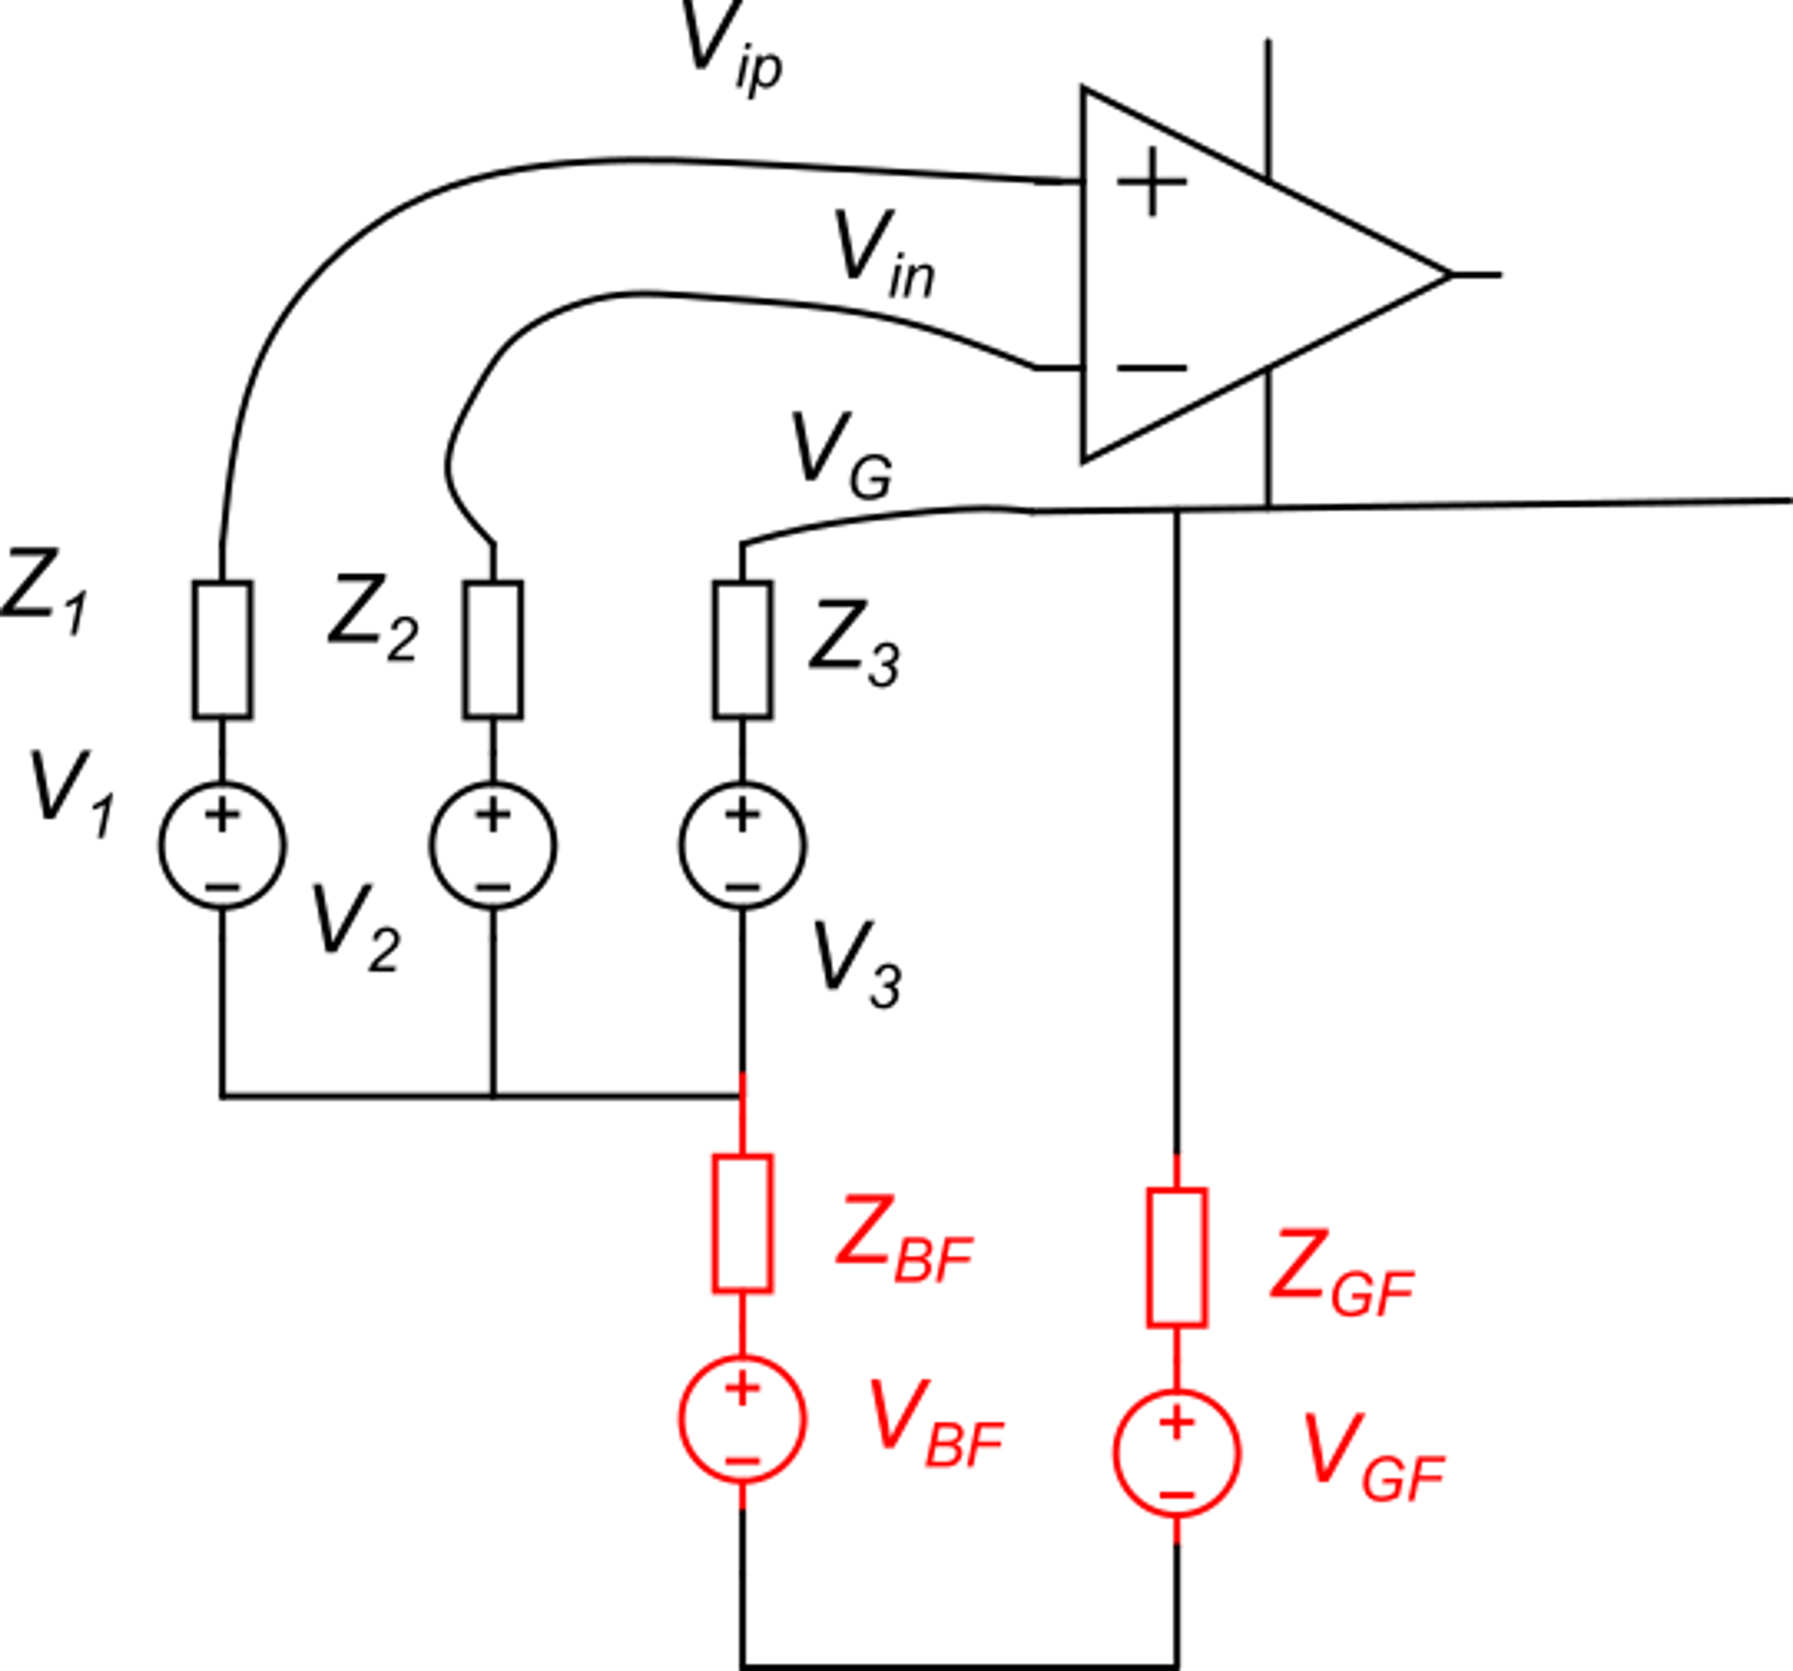
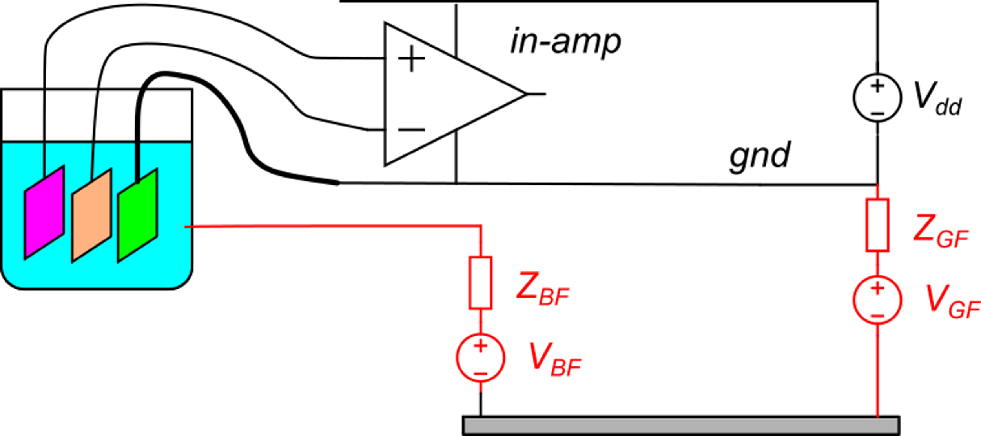
Second solution
Use a third electrode to connect the gnd of the amplifier to the fluid
("Three electrode measurement")
I_{G}
I_{G}
V_{B}
V_{B}

Slide 9
Second solution
Such a small V_{C} can be tolerated by the amplifier
V_{B}
V_{B}
If the input amplifier impedance is >> Z_{1,}Z₂:
If Z₃ << Z_{BF}+Z_{GF}, the effect of voltages V_{BF} and V_{GF} on V_{C} can be as small as a few hundred mv
The differential voltage is not affected by V_{BF} and V_{GF}

Slide 10
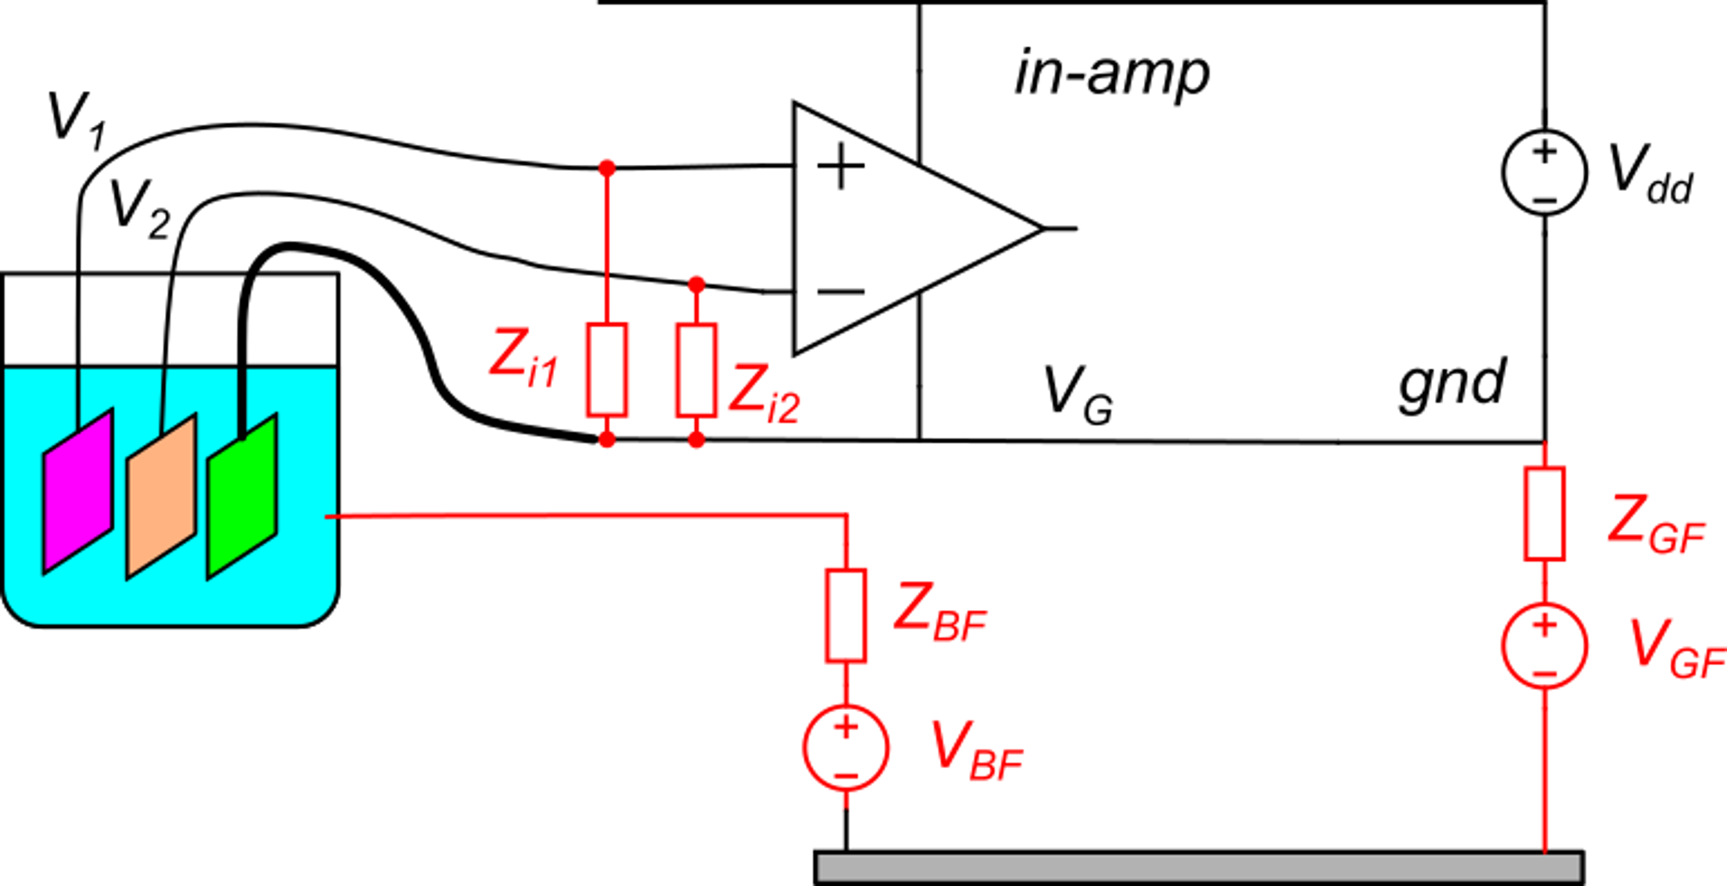
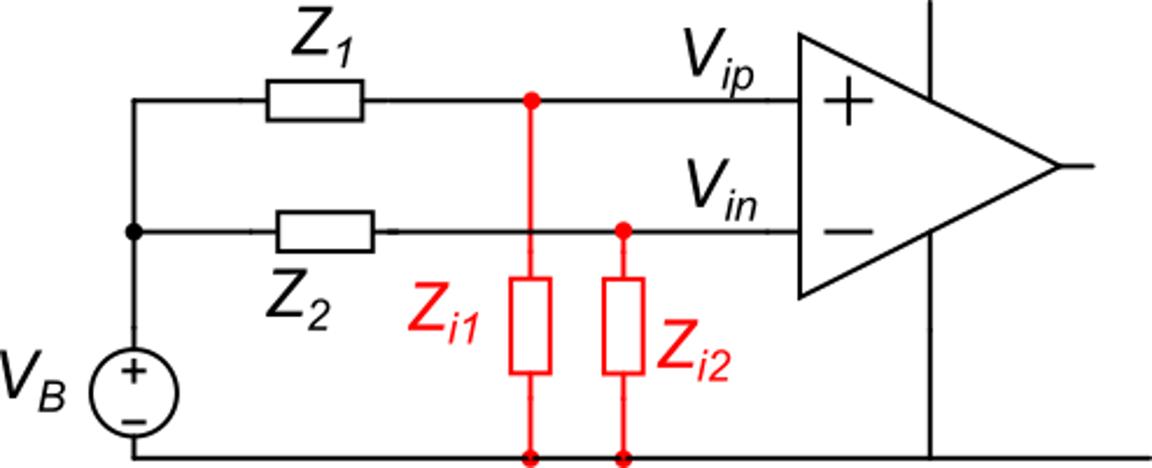
Effect of the finite input impedances of the amplifier
(this is an AC
disturbance voltage)
α₁
α₂
Due to unavoidable impedance mismatch, the two impedance ratios α₁ and α₂ are not equal and a common mode disturbance voltages generate a differential voltage.

Slide 11
Effect of the finite input impedances of the amplifier
V_{B} can include the fundamental component of the AC power line (50 or 60 Hz, depending on country) but also harmonics at higher frequency and other disturbance signals from motors, DC-DC converters, etc,
The amplifier input impedances Z_{i1} and Z_{i2} are mainly capacitive, while Z₁ and Z₂ may include both capacitive and resistive components.
Clearly, in the case that Z_{i1},Z_{i2} >> Z₁,Z₂, the impedance ratios α₁ and α₂ are very close to 1 and their difference is close to zero. This is the case of infinite input amplifier that we have analyzed before, where the effect of V_{B} on V_{id} was null.

Slide 12
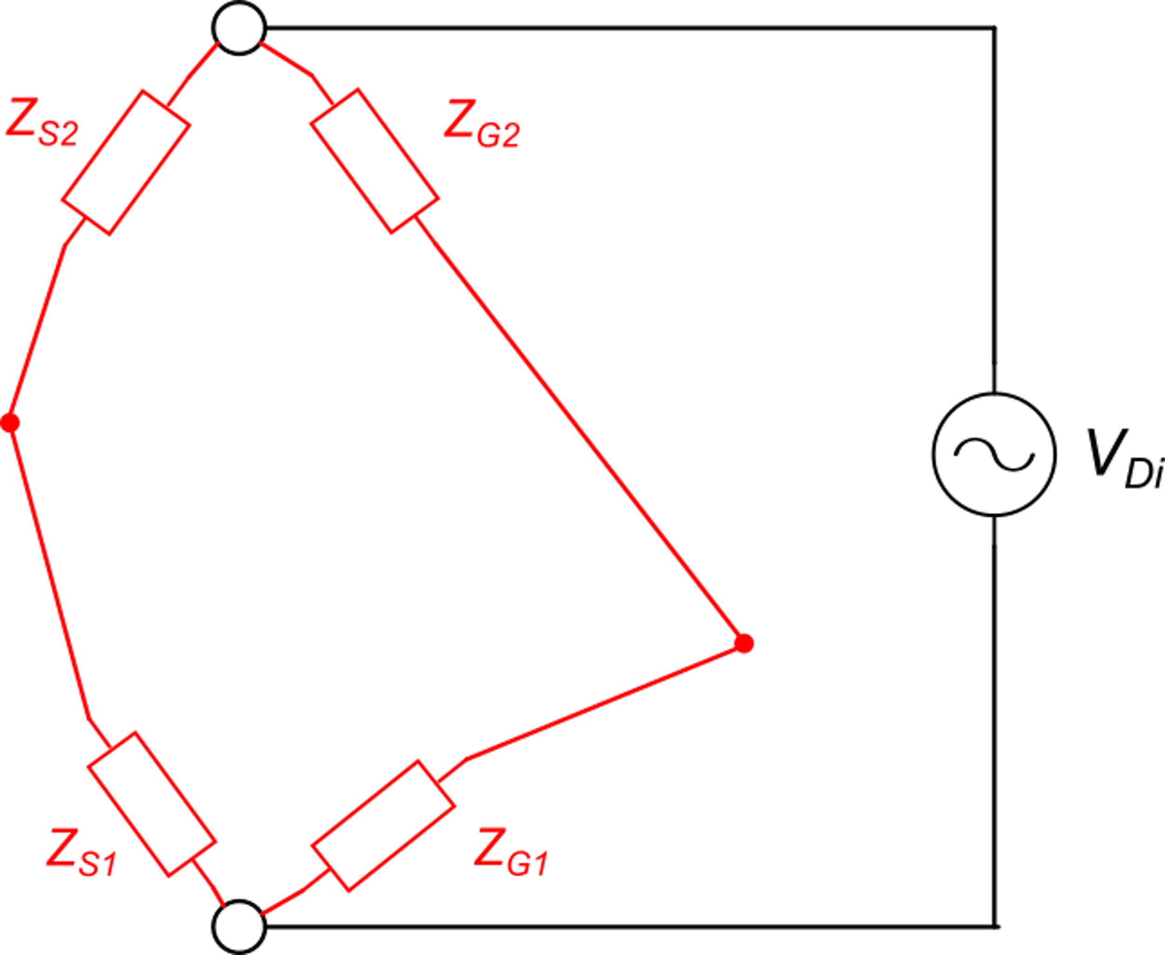
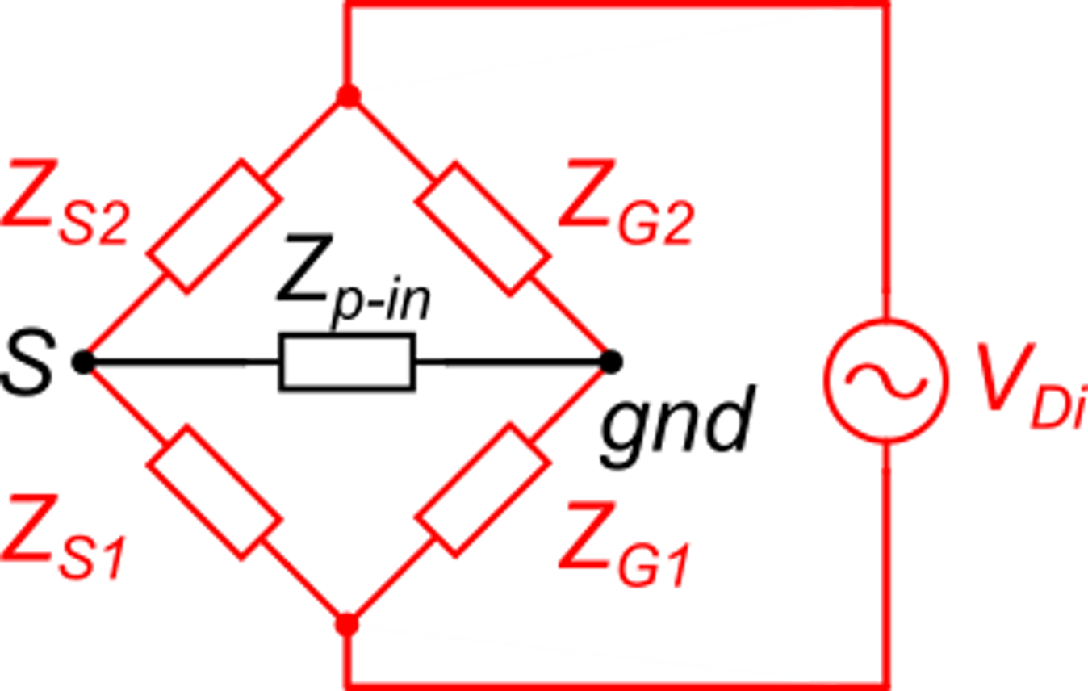
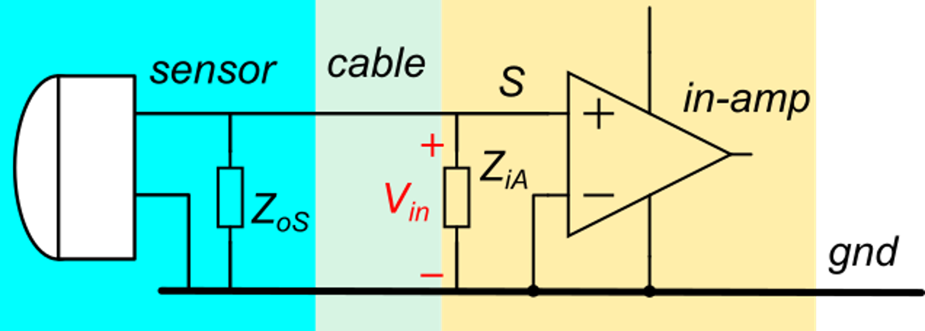
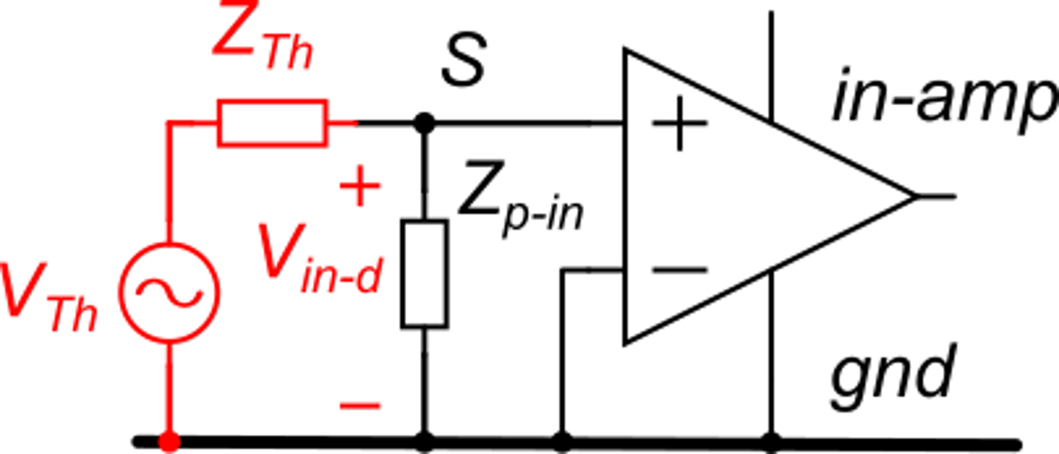
General case of no electrical continuity
These impedances are usually capacitances
Circuit for calculation of the disturbance at the amplifier input
That can be further simplified, applying the Thevenin theorem at the bridge diagonal where Zp-in is placed. The Thevenin equivalent does not include Zp-in
Here, we represent a typical connection between amplifier and sensor ...
... and we add a disturbance voltage applied between two conductors. This disturbance can be the AC power line, but also have a different origin

Slide 13
General case of no electrical continuity
V_{TH} is zero only for:
which generally does not occur.
With a careful design:
For a given Z_{p-in} (sensor and amplifier), the higher Z_{th}, the smaller the input disturbance

Slide 14
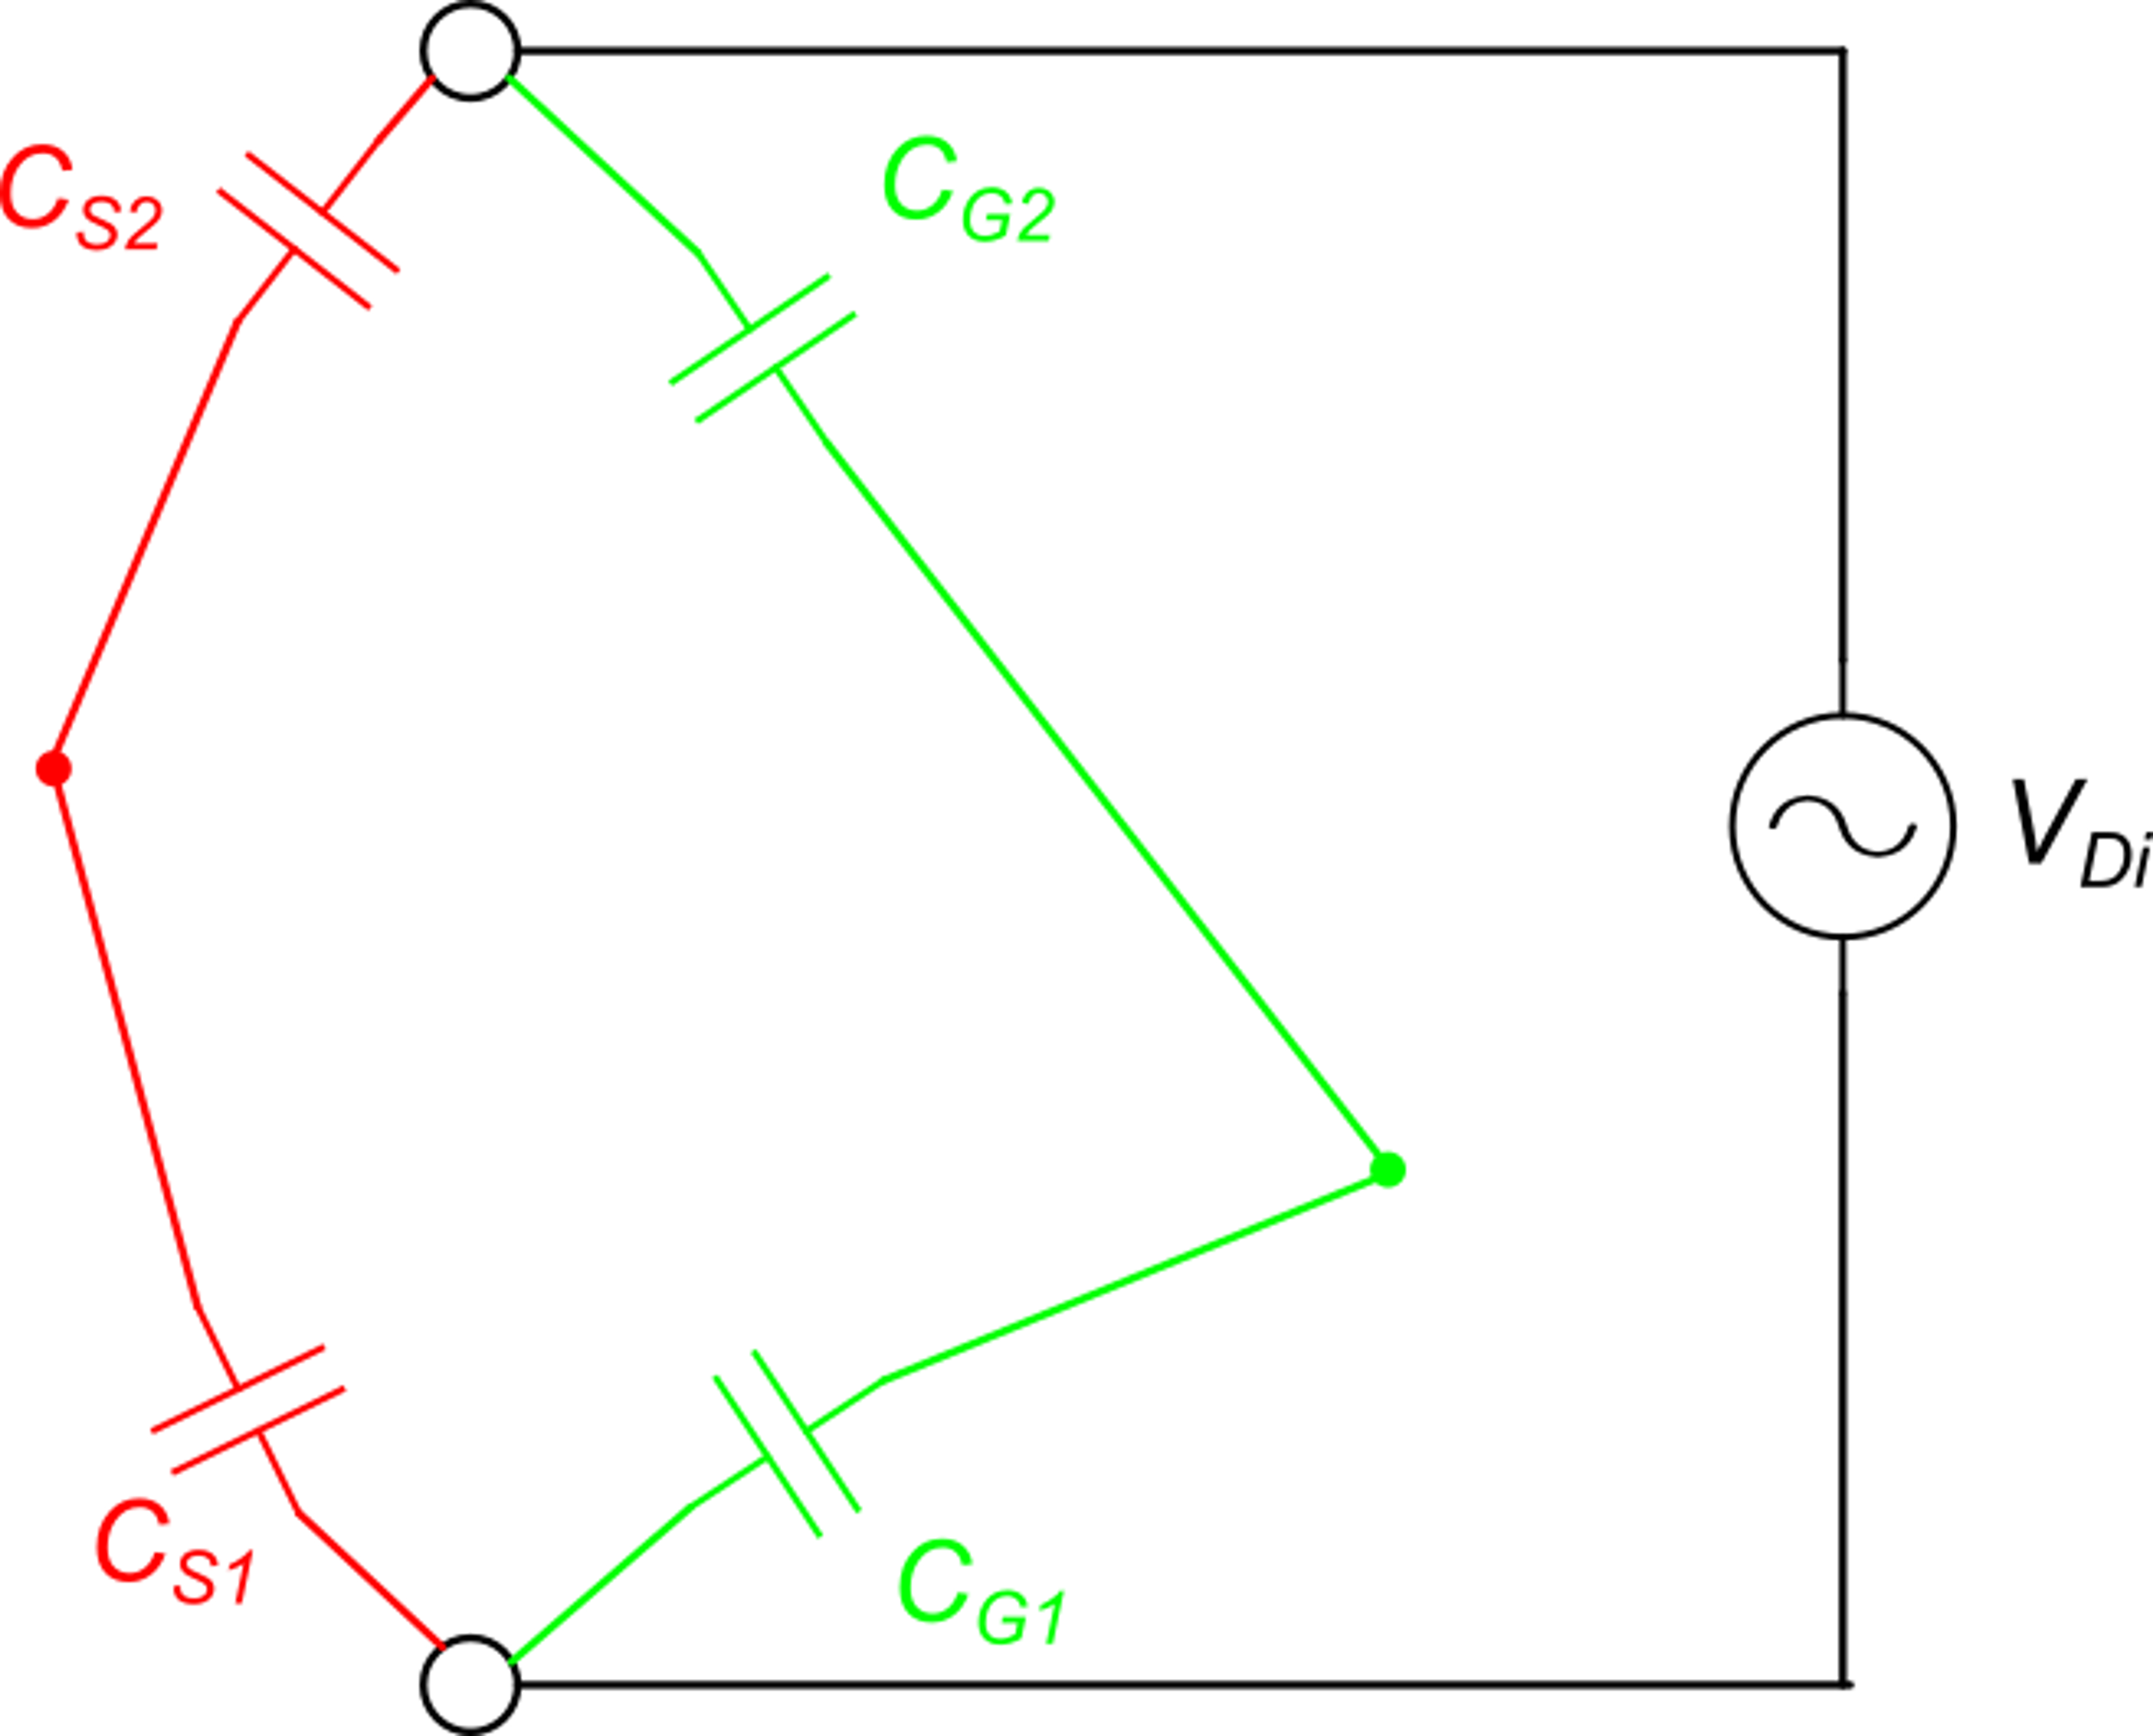
Disturbance minimization: capacitive (electrostatic) coupling
The magnitude of this component, due to the "hot" terminal, is much higher than the other, because capacitances that involve the gnd node (and all other nodes connected to it) are much larger.
In order to minimize the interference, we can maximize the impedance between the "hot terminal" and the disturbance conductors. This means reducing the related capacitances C_{S1} and C_{S2}.

Slide 15
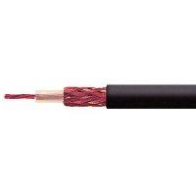
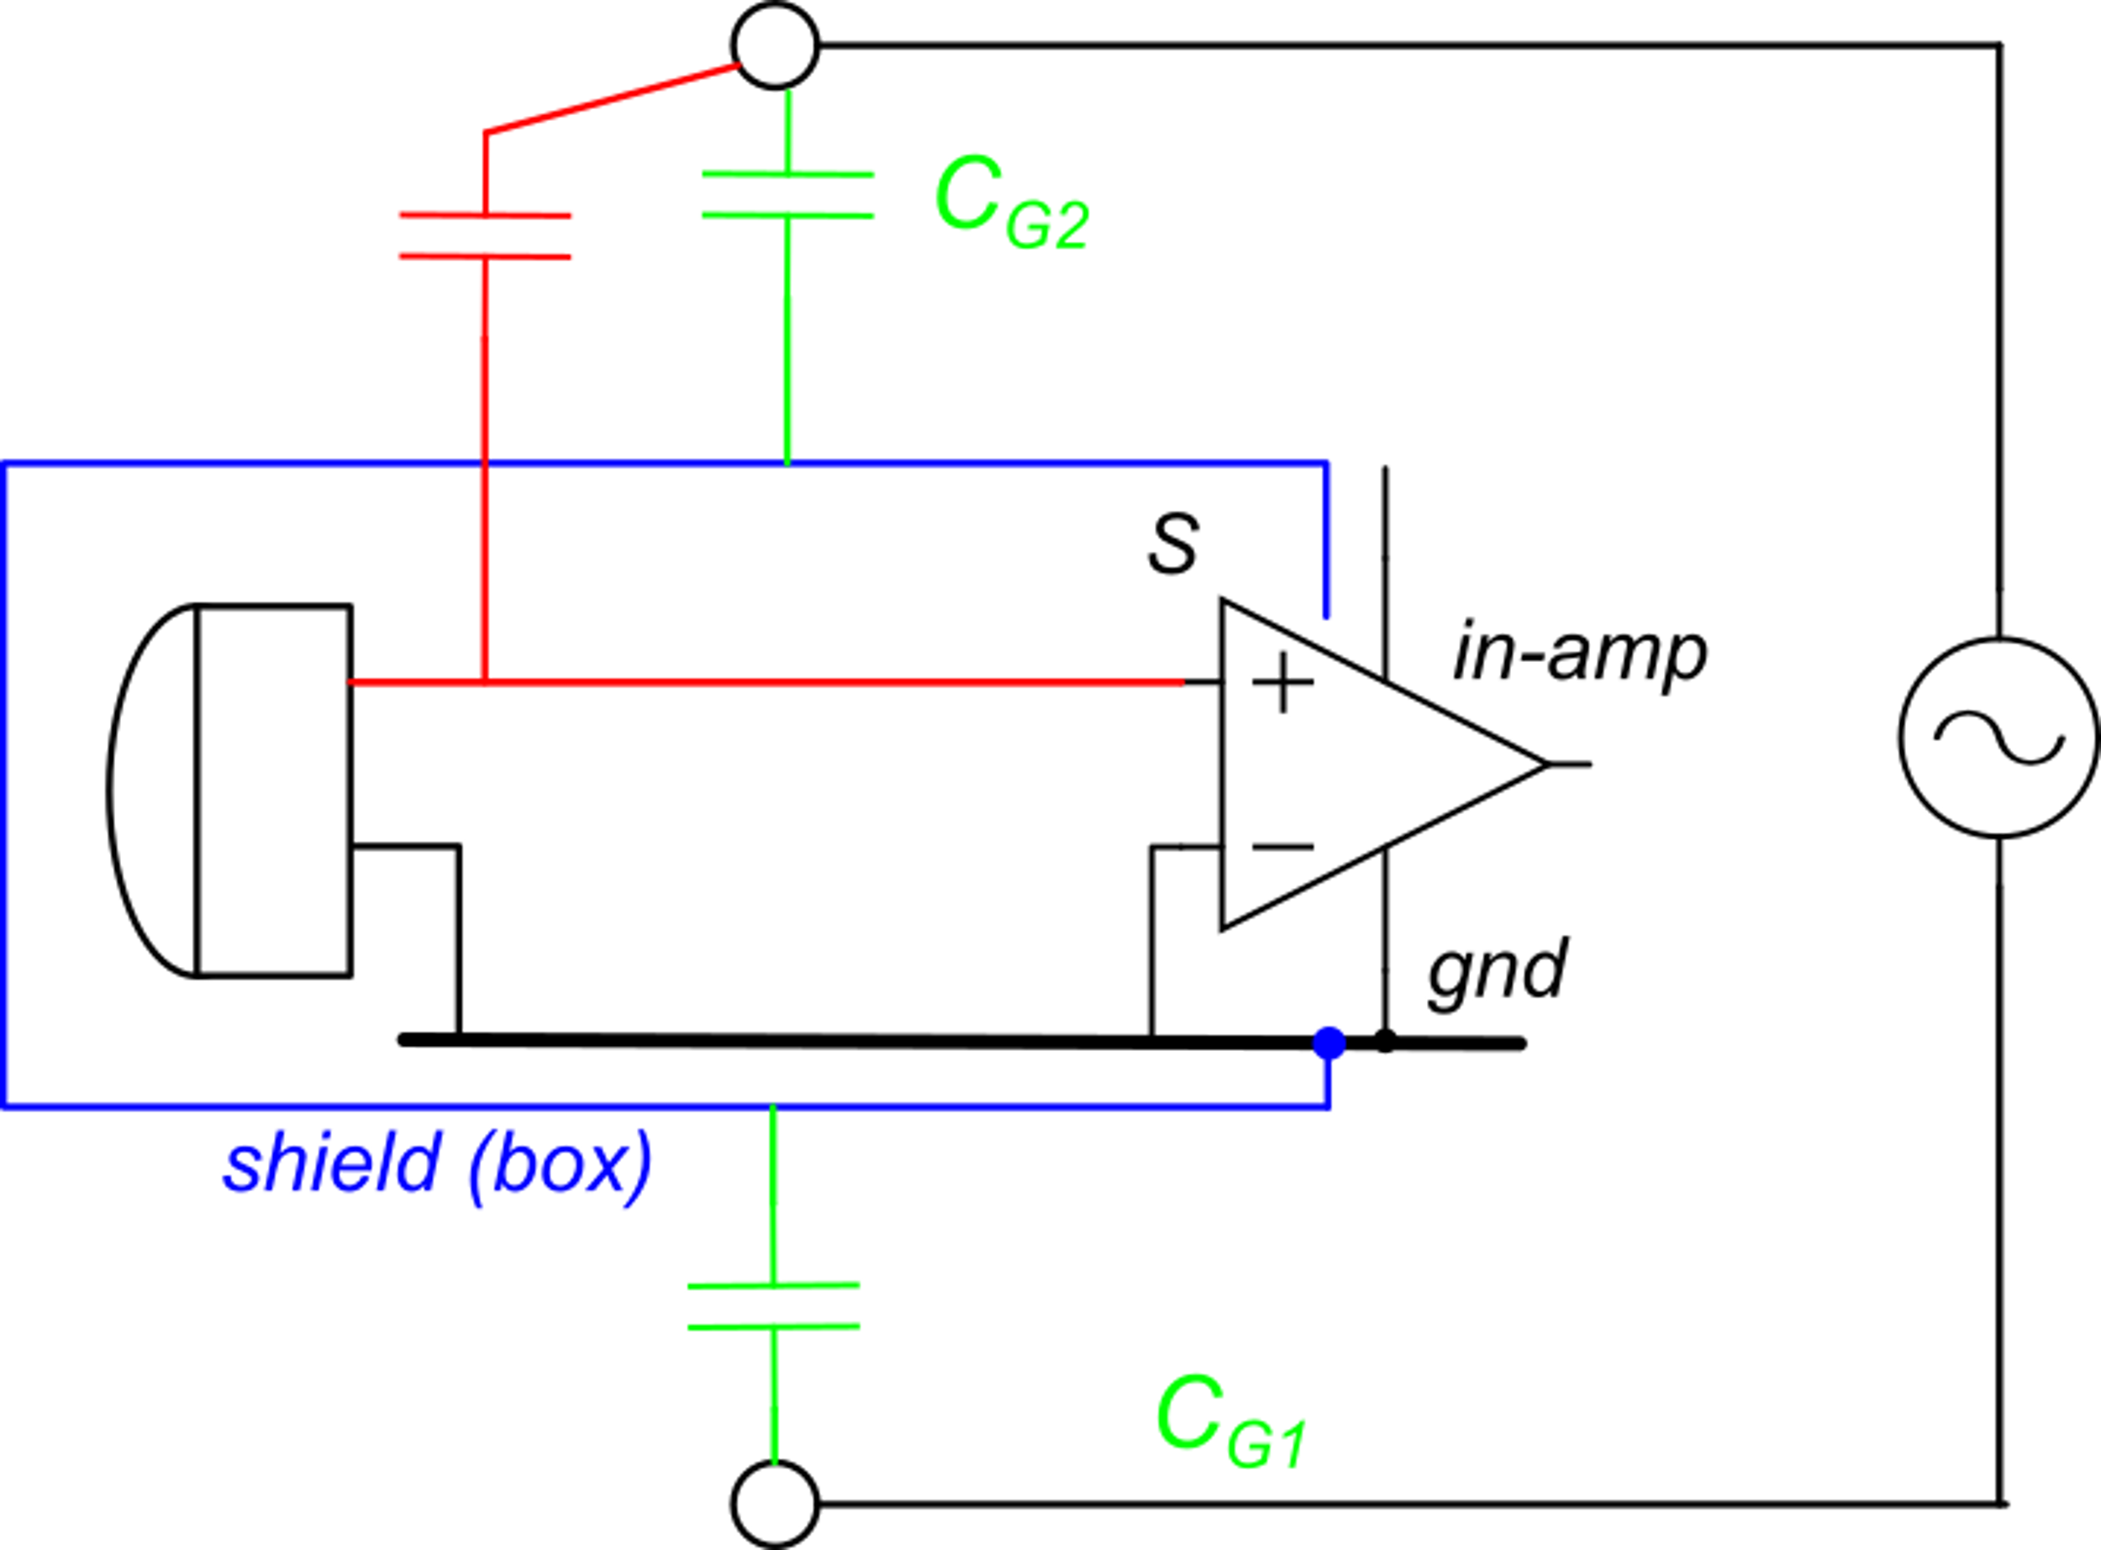
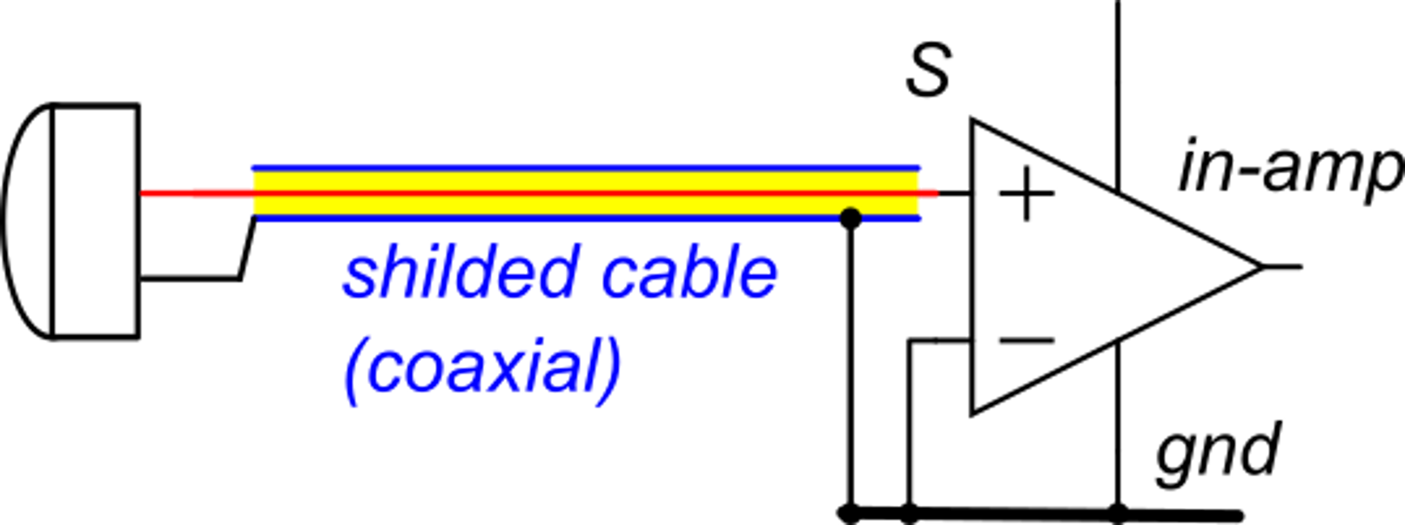
Mutual capacitance reduction: shielding
External conductors cannot produce fields inside the shield ("faraday cage")
For relatively long connections between the sensor and the amplifier, a shielded coaxial cable can be used to protect the internal "hot" terminal from interaction with disturbance conductors.
We add a conductive shield that wraps around the sensitive input node (and other sensitive nodes, if any)

Slide 16
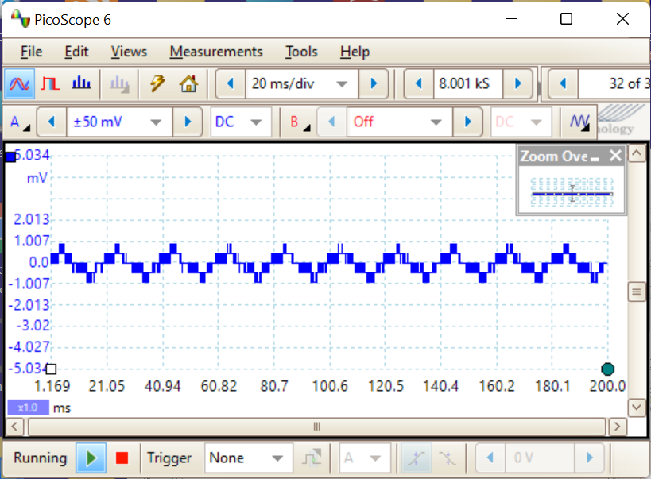
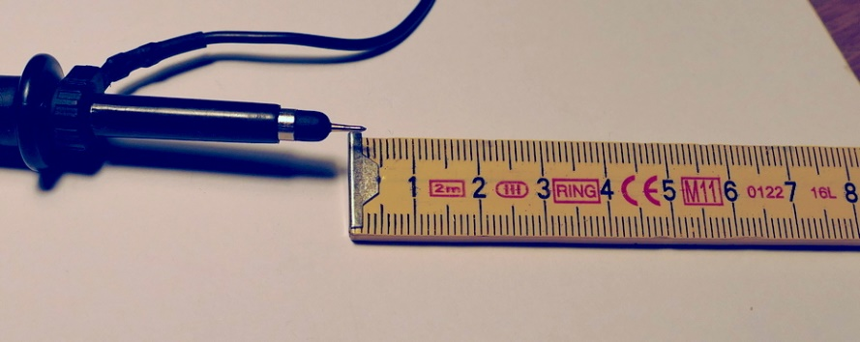
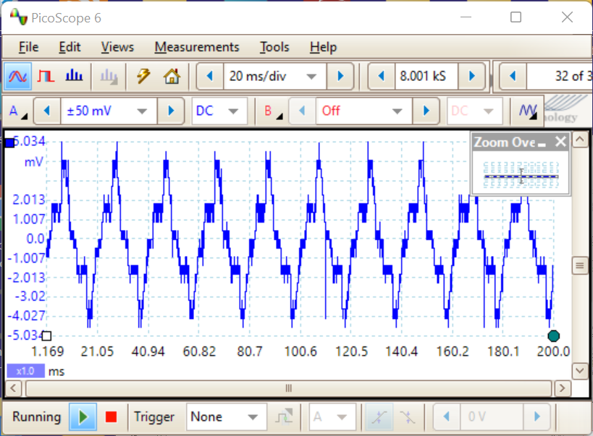
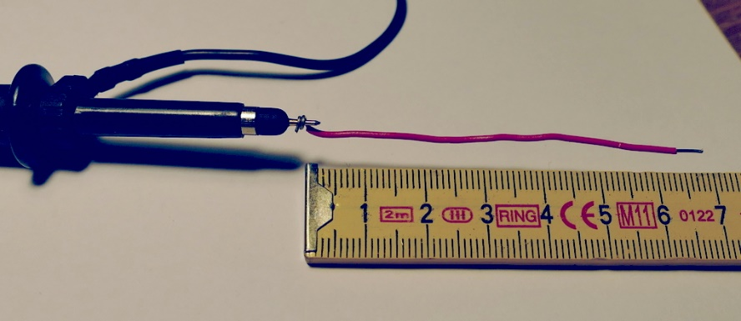
Example
Oscilloscope probe. The input "hot" terminal is shielded.
The exposed conductor is less than 1 cm long
Just adding 6 cm of unshielded conductor ...
~10 mV p-p
50 Hz with strong harmonics

Slide 17
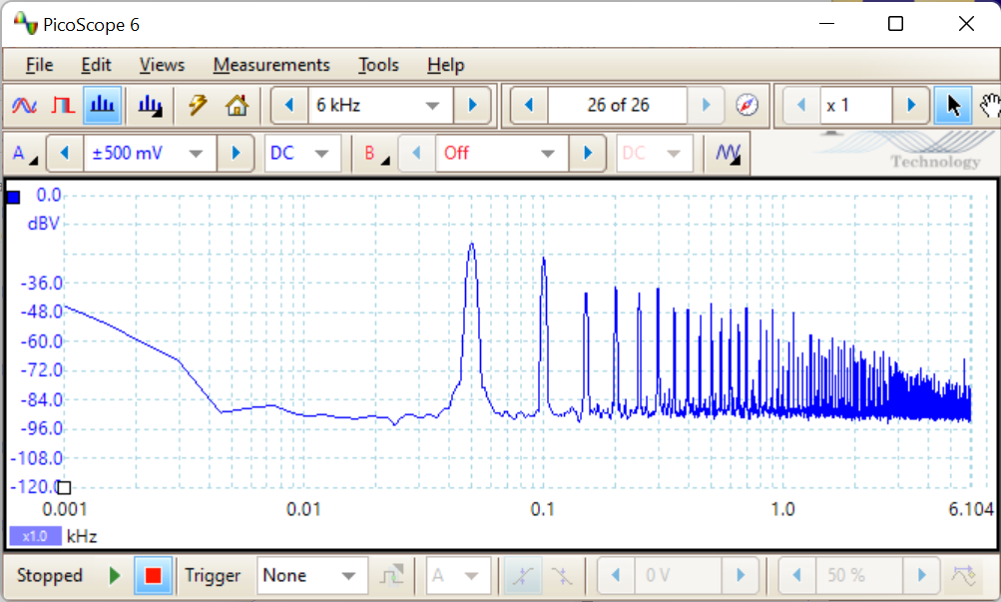
Spectral content of the disturbance voltage
The voltage picked up from the AC power line by capacitive coupling is much more distorted than the original voltage, since high order harmonics find much less attenuation:
At low frequencies the resistive component dominates
50 Hz
horizontal scale: kHz

Slide 18
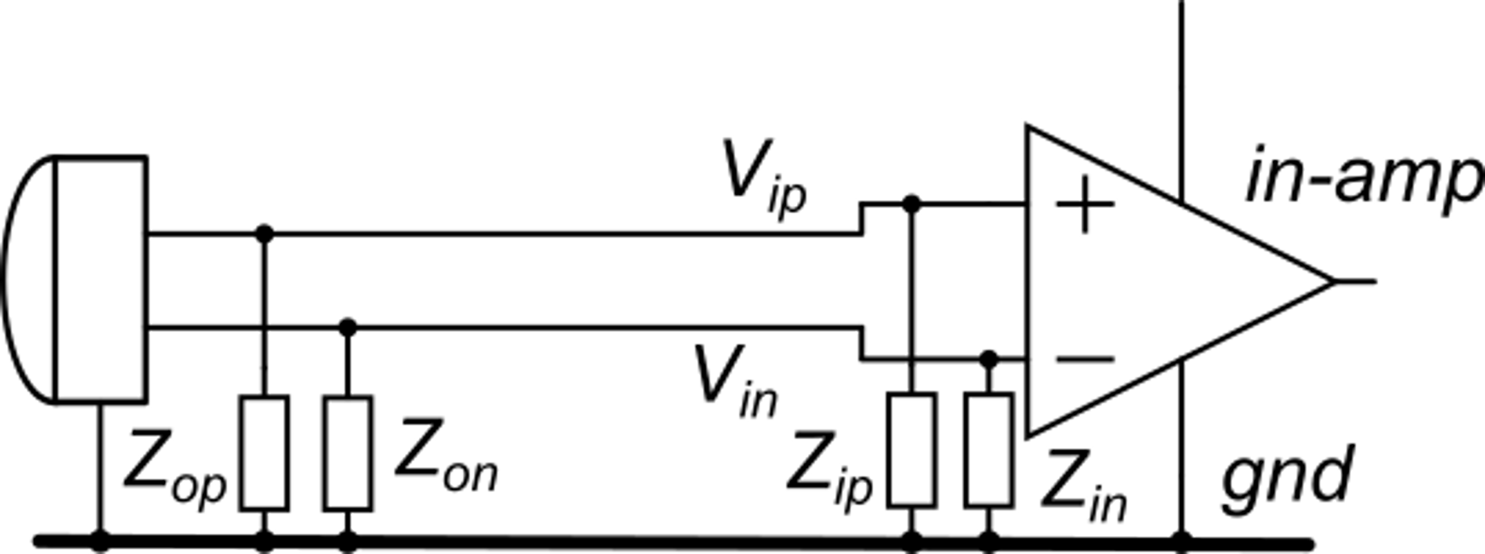
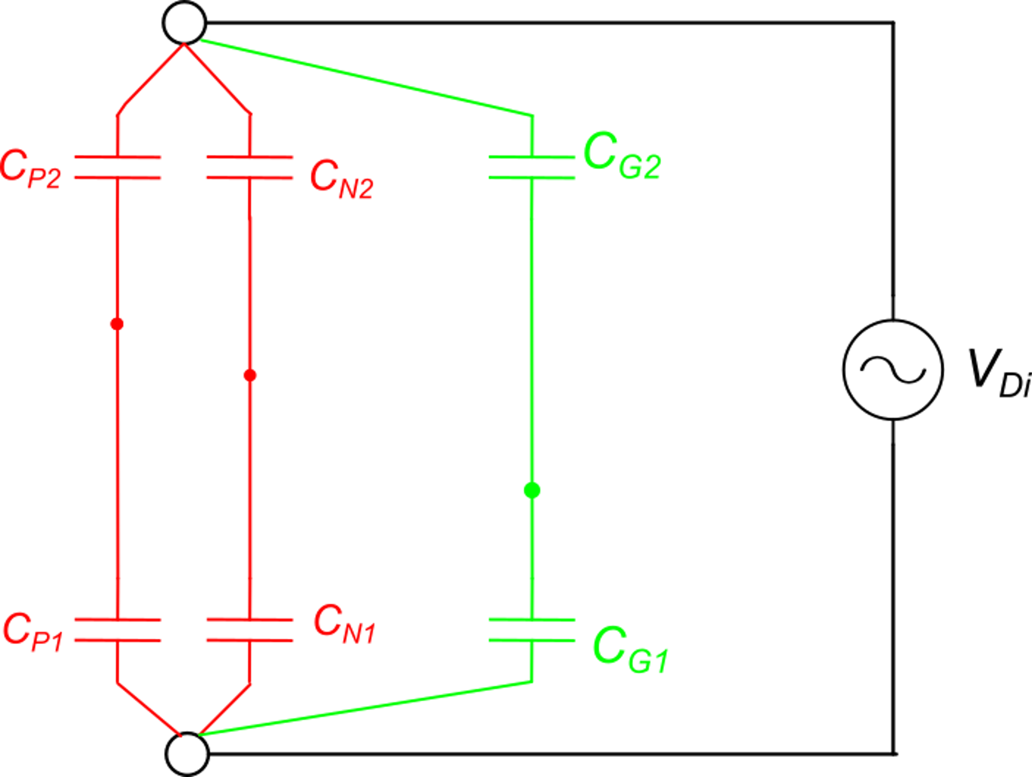
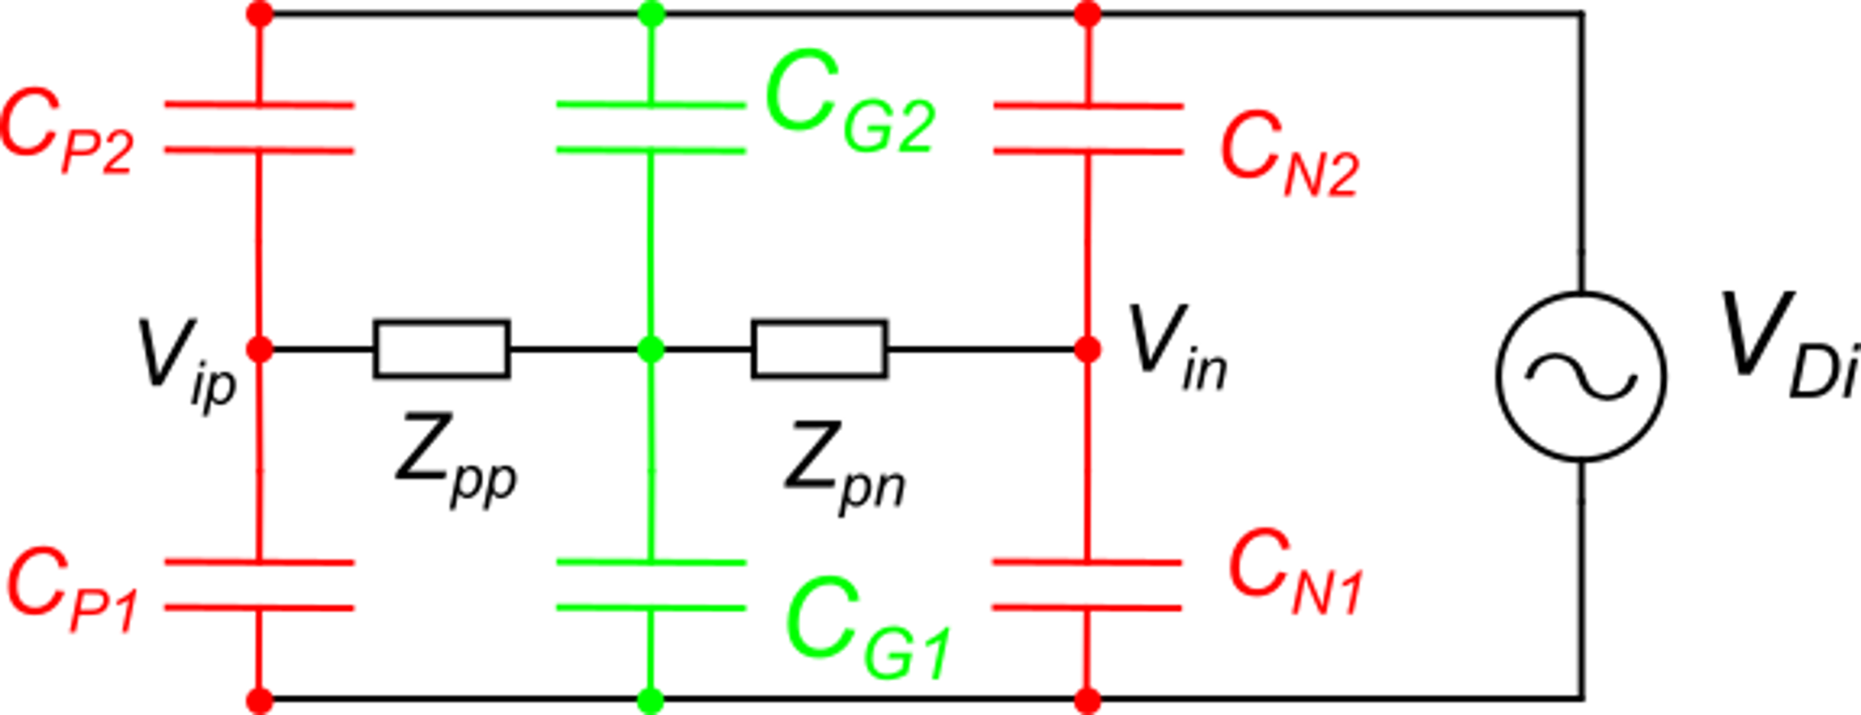
Advantage and limit of differential reading.
In a differential connection, the signal is the voltage difference between two wires, none of which is gnd.
The sensor has three terminals.
With a symmetrical routing of V_{ip} and V_{in}, we can obtain: C_{P1}=C_{N1}, C_{P2}=C_{N2}

Slide 19
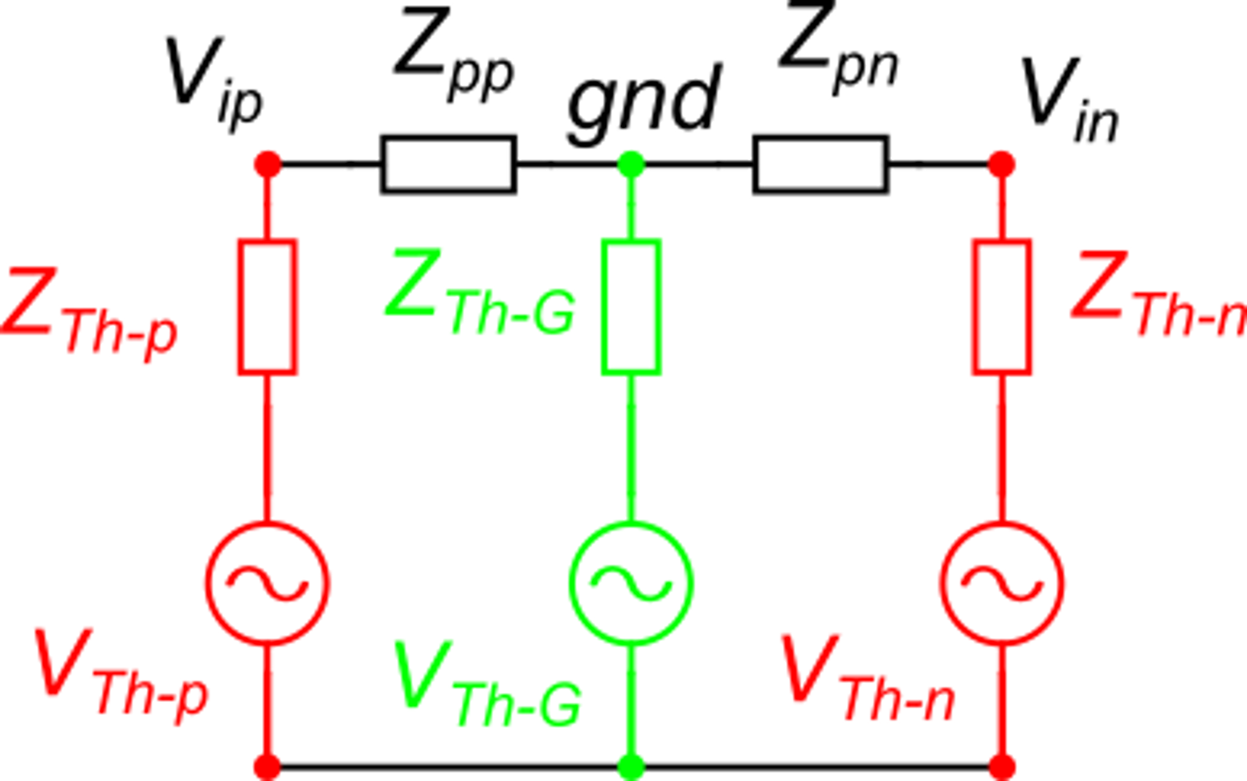
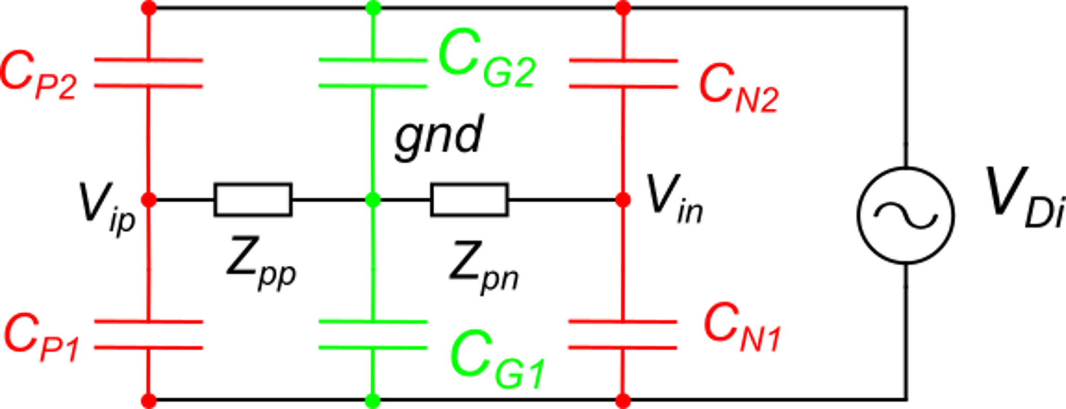
Advantage and limit of differential reading.
equal
Thanks to the symmetry:
N_{d1}
N_{d1}
equal
We apply three times the Thevenin equivalent between Nd1 and:
V_{ip}, gnd, V_{in}, respectively.
Then, to obtain V_{id}=V_{ip}−V_{in} = 0 we need a balanced source and balanced amplifier:
There are critical cases where it is not possible to have a balanced source.
A pseudo-differential configuration is not effective:

Slide 20
Interference from variable magnetic fields
The loop formed by the mesh that includes the sensor output port and amplifier input port is subjected by an electromotive force given by:
For a sinusoidal magnetic field:
The current in the loop is given by:
The voltage at the amplifier input is then:
If |Z_{iA}|>>|Z_{oS}|
In order to reduce the disturbance, it is necessary to reduce the area of all critical loops. Twisting the cables reduces the equivalent area of connection cables. Note that magnetic shield are much less effcetive than electrical ones.

Slide 21
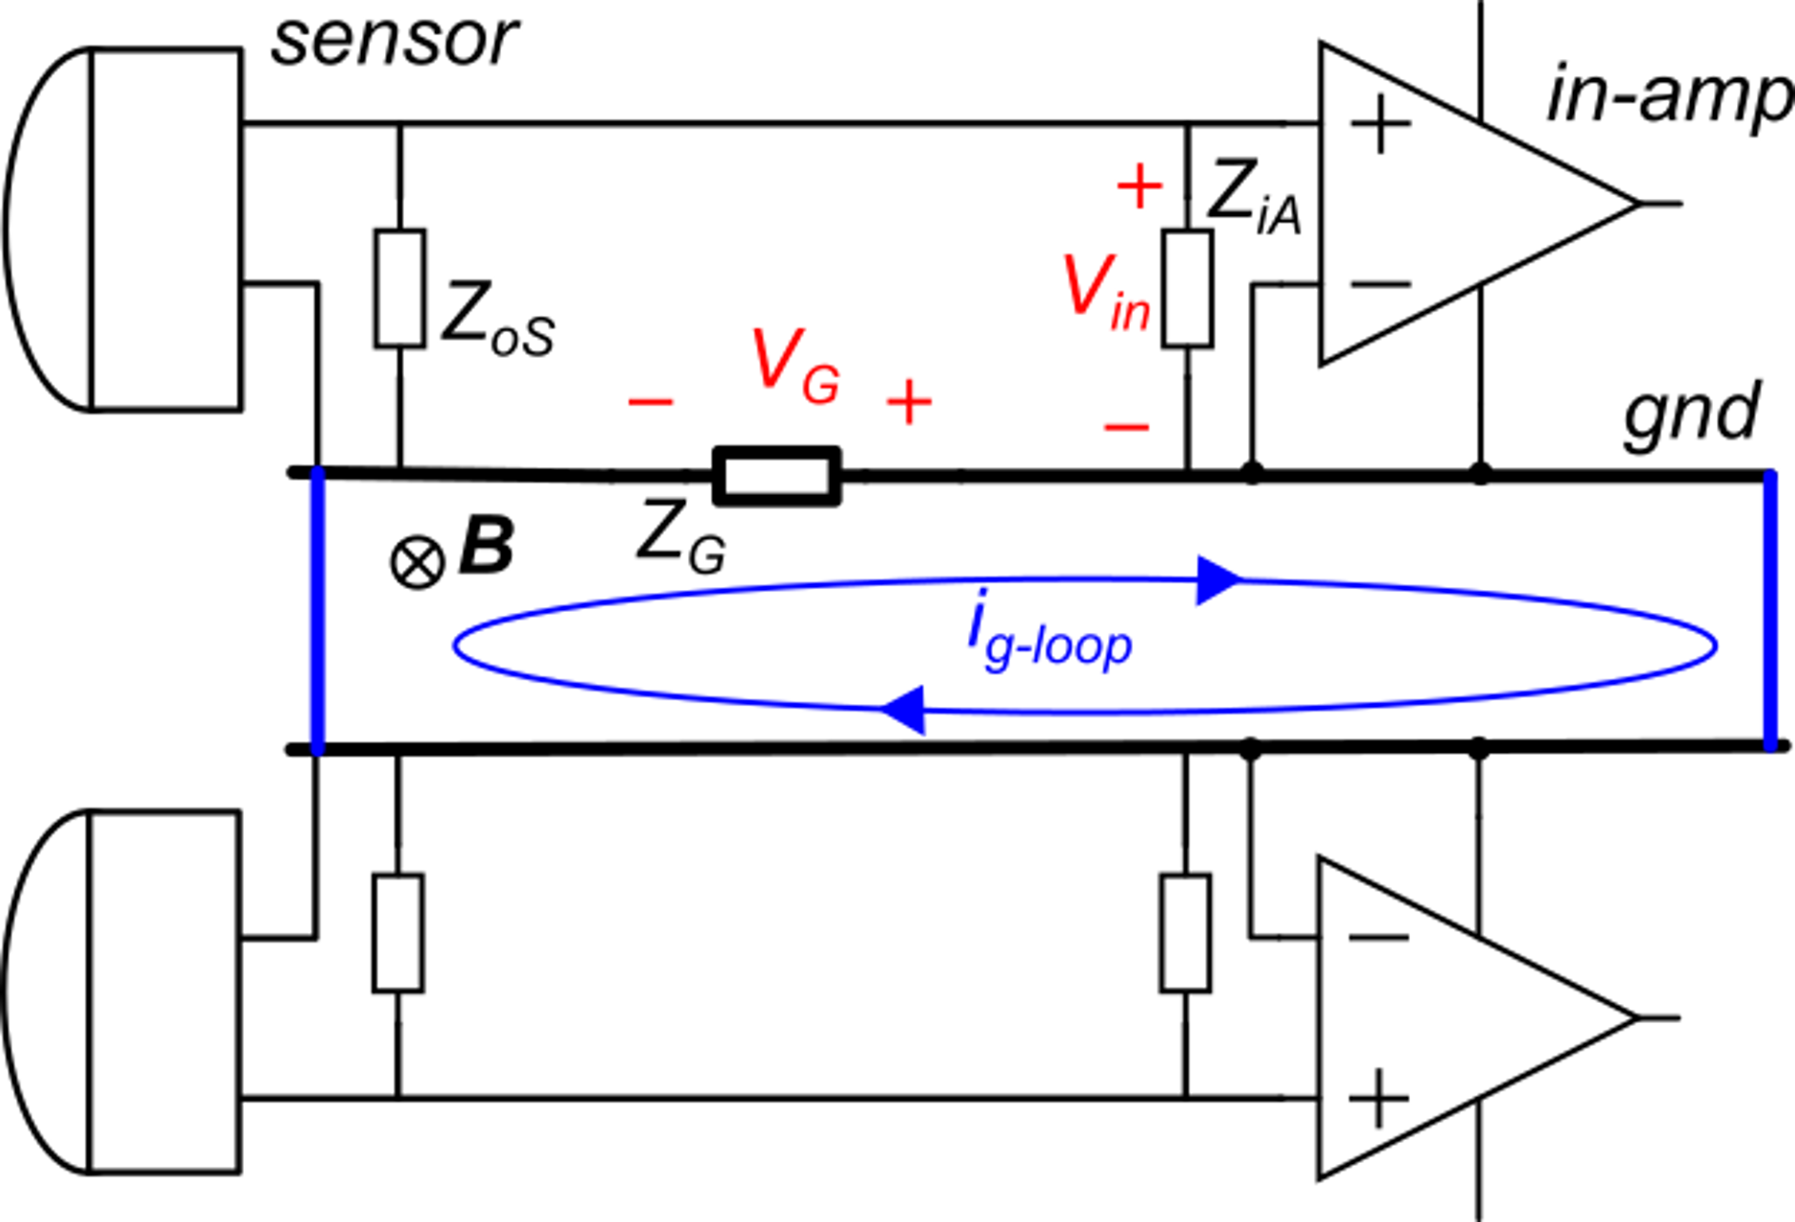
Ground loops
The picture below depicts two reaout channels (two sensors). The ground of the two channels must be connected together in a single point. Connecting the grounds in two spatially separated points, creates a loop that can sustain considerably large currents.
Z_{loop} is the series impedance of the whole loop.
Ground connection 1
Ground connection 2
Since Z_{G} can be a large fraction of Z_{loop}, an important portion of the electromotive force falls across Z_{G}. The voltage V_{G} gets added to the output signal of the sensor.

