Slide 1
Sensor systems: general definitions (1)
What is the input of a sensor system?
Non-electrical quantities ( e.g. temperature, pressure, acceleration, flow ... )
but also:
Electrical quantities that characterize a device or a process: impedance, current, etc.
Biopotentials (ECG, EEG , etc)

Slide 2
Sensor systems: general definitions (2)
Information flow in a sensor system
Analog domain
Digital Domain
Digital Processing
Linear Filtering
Data Interpretation
Data compression
Non-electrical
sensor(s)
AFE
Analog Front-End
ADCs
Electrical
probe(s)
Display
Communication
Environment
Storage

Slide 3
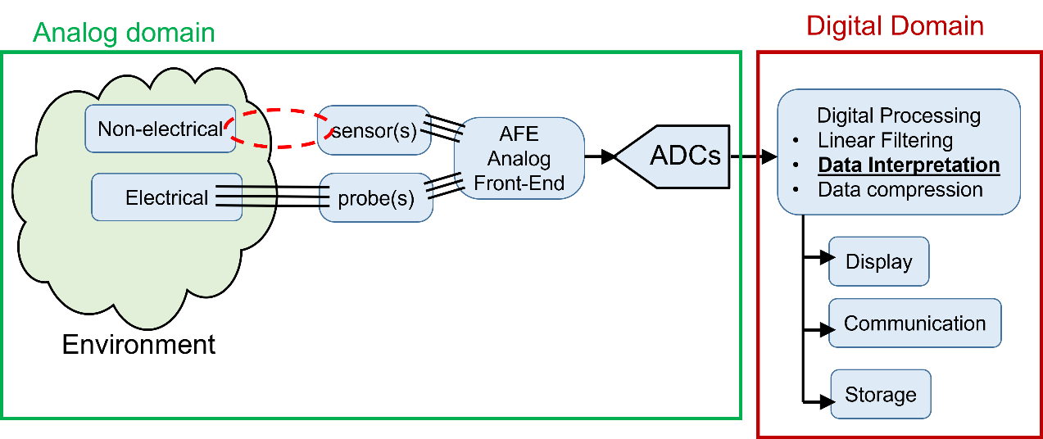
System partitioning
A complex sensor system can be formed by a large number of different partially independent components. In some cases the sensor system can be distrubuted in a large volume and include tens or hundreds of sensors.
In other cases the system can be relatively simple and small in size.
For this reason, in the system level design phase, it is important to organize the sensor system in a hyerarchical way, deciding at which level the above depicted operations must be performed

Slide 4
Sensor systems: a possible hierarchy
Sensor nodes
Sensor modules
High performance digital processing unit
Sensors / Probes
Embedded System
(e.g. MCU)
AFE + ADC
Complex Human - Machine Interface
Digital preprocessing
Communication
(wired or wireless)
High-capacity data storage
Communication
(wired)
Simplified Human-Machine Interface
Sensor module
Data logging
World-scale
communication
MCU-based Sensor nodes
High level computing machine

Slide 5
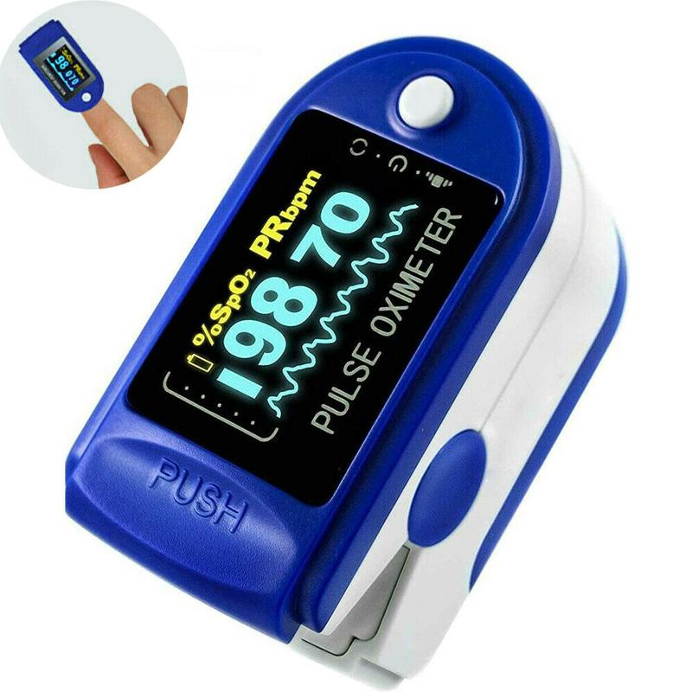
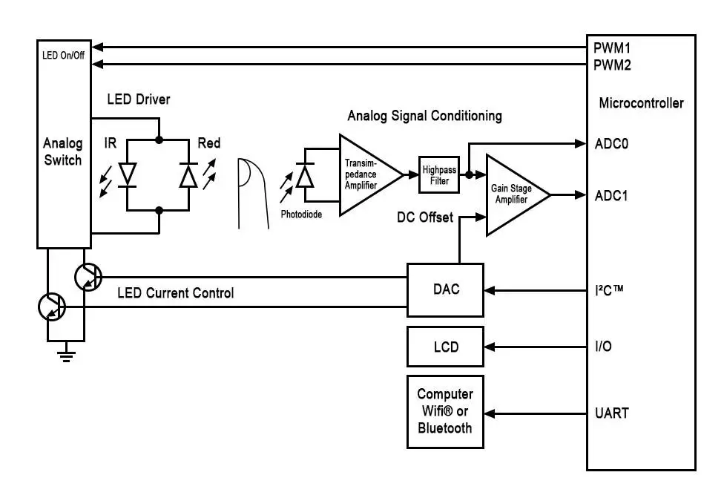
Example 1: Pulse oximeter A simple, complete sensor system
Sensor probe, AFE, ADC = Sensor module
Digital Processing
Human Interface (simplified)
Communication
Performs the functions of sensor node

Slide 6
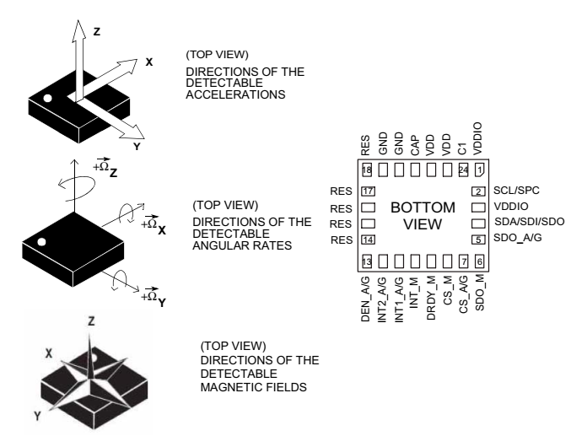
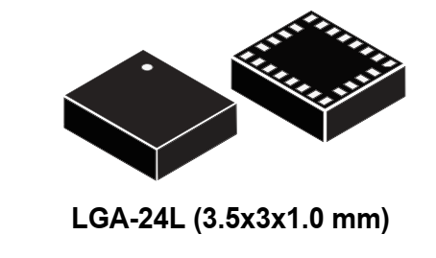
Example 2: Integrated 9 axis inertial sensor (sensor module or smart sensor)
3-axis accelerometer
3-axis gyroscope
3-axis magnetometer
SPI -I2C communication lines

Slide 7
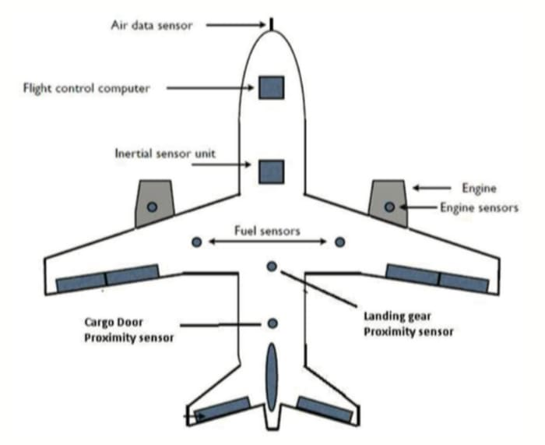
Example 3, a complex case: sensor system in an airplane
Sensor node
Includes different sensor modules
(air speed, air temperature, angle of attack) and implements complex communication protocols.
To reduce wiring, there is a tendency towards wireless comunication between sensor nodes (WSN= wireless sensor network)
High level computing machine

Slide 8
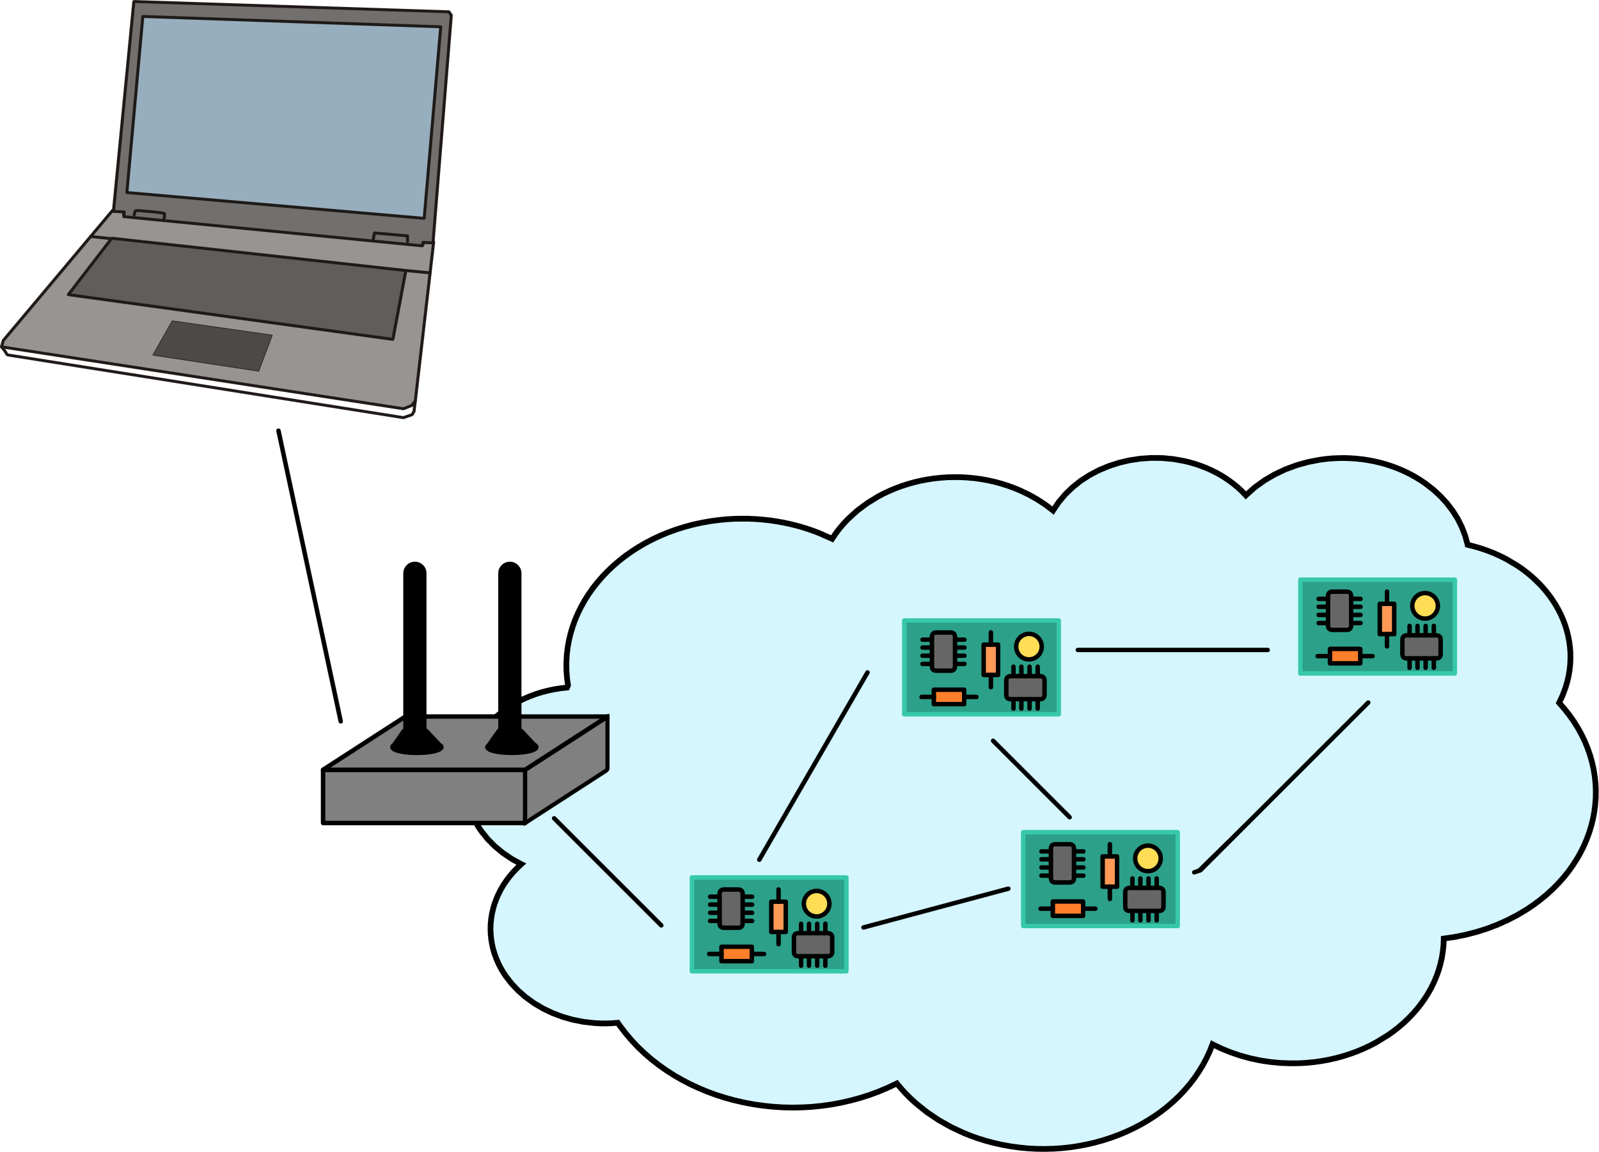
Example 4: Wireless Sensor Network
High level computing machine: PC, smartphone, emebedded computer
Sensor Nodes
Can be equipped with different sensor types or simply replicate the same sensor set in different locations (distributed sensing)
Sink
Network: Multi-hop communication protocol

Slide 9
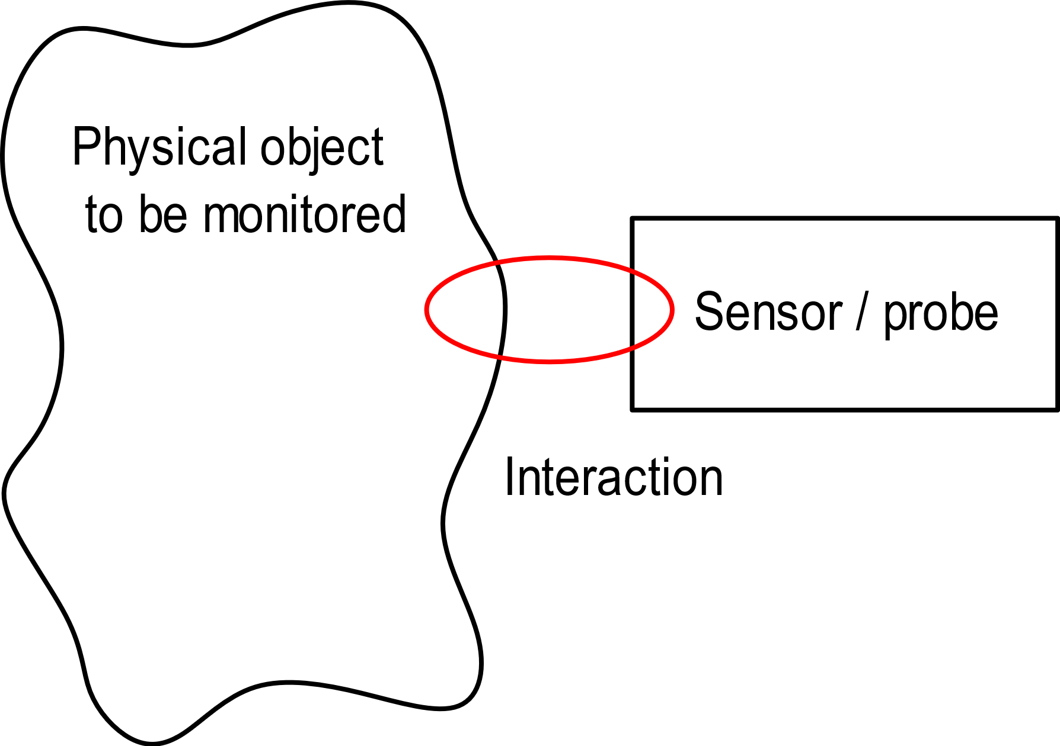
Sensor / object interaction
The physical object is a solid, liquid or gaseous to which the quantity to be measured belongs
It can be a very simple object (e.g. a single-piece mechanical part) or a complex object, like the human body or a chemical reactor
The sensing operation requires the sensor / probe to interact with the physical object.
The sensor package (housing) must be designed to enable the required interaction and, at the same time, protect the sensors

Slide 10
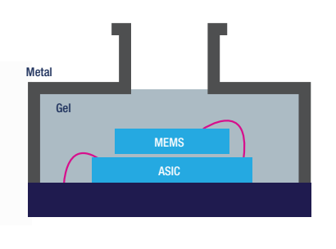
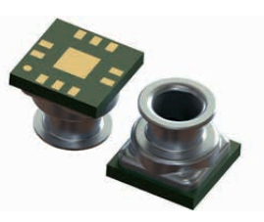
Sensor - object interaction
The interaction can be contactless (e.g. IR thermometer) or with contact (e.g. a thermocouple temperature probe).
Protection of the sensing elements is particularly important, for example, when the physical object is in liquid phase (liquid flow sensors, ion concentration sensors) or it is a corrosive gas.
Example: a liquid pressure sensor (10-bar resistant, usable for depth meters)
Insulating gel:
Avoid direct contact with the liquid but ….
LPS33HW
2) Transmit pressure from the liquid to the MEMS chip

Slide 11
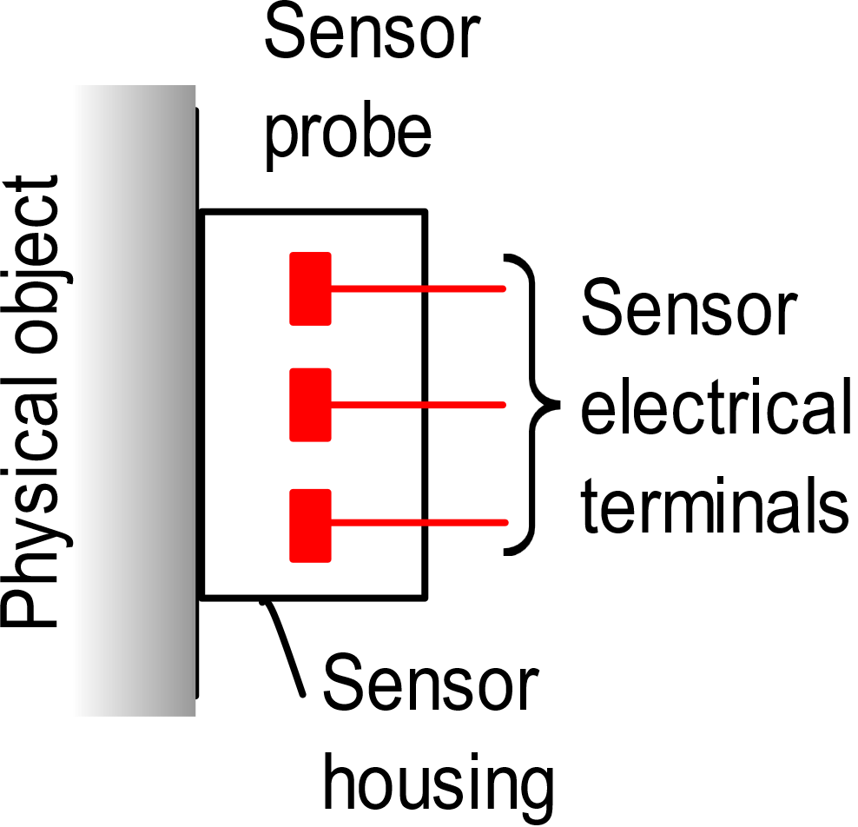
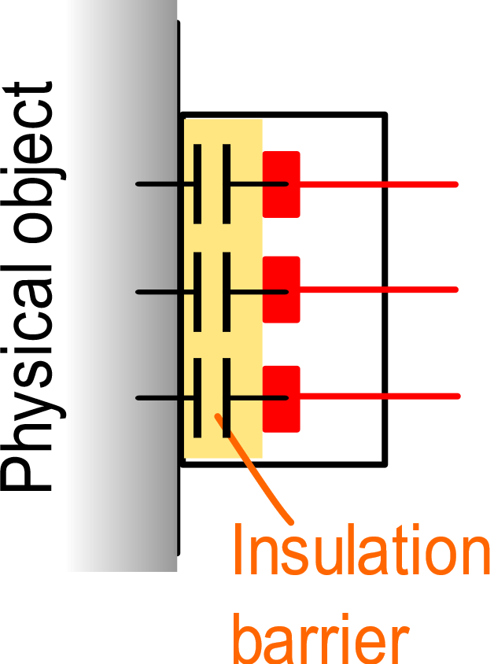
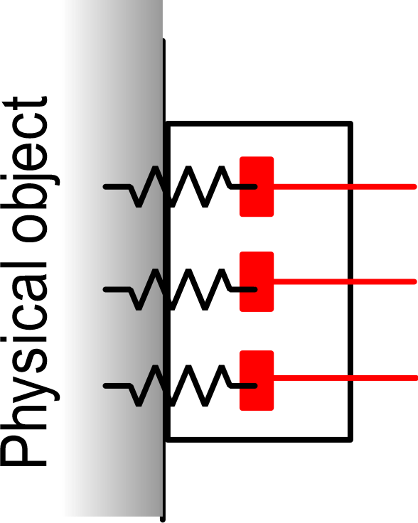
Electrical connection and continuity
A particular aspect that have to be assessed is the degree of electrical contact between the sensor terminals and the physical object
Only capacitive coupling
(AC coupling)
Only resistive coupling
The presence of a dc path can be unwanted (defective insulation) or necessary
C: order of pF
V_{ISO} (maximum that the barrier can withstand)

Slide 12
Examples
thermocouple
terminals
(or thermistor)
ceramic or plastic
conductivity probe
insulator
metal case
H₂O
Probe for the measurement of the water conductivity
(used to monitor the quality of water supplies)
liquid
Temperature probe
Electrical continuity is not necessary, but a leakage conductance between the sensor terminal and the liquid can develop when the insultaor properties degrade with time
In this case, electrical continuity is necessary to perform the measurement

