Slide 1
Artificial Intellingence (AI) and Machine Learning (ML)
AI: Computer programs that mimic human intelligence to perform complex tasks
ML: adaptable algorithms that trains their parameters from data
Artificial Intelligence
DL (Deep Learning): ANNs formed by several layers of artificial neurons
Machine Learning
ANN (Artificial Neural Networks): ML algorithm based on a structure that resemble the neuron connections in the brain
Neural Networks
Deep Learning

Slide 2
Very short introduction to Machine Learning
Definition
Machine Learning (ML) indicates all kinds of strategies and methods that allow tuning an artificial system ("the machine") to make predictions about future data the basis of past data.
ML is all about "self-learning" algorithms.
ML is subfield of Artificial Intelligence (AI).
Machine
In a ML system, the correct values of the parameters to obtain the desired response is autonomously determined by the machine after a "training" phase
Model
(algorithm)
Input data
(x)
Output data
(y)
Parameters
(a,b,c ...)

Slide 3
Example of Applications of Machine Learning
Every kind of feature recognition in images (faces, objects, hazards, etc.)
Voice recognition (form sounds to words)
Text interpretation (spam filters, web-search tasks, document selection ...)
Pattern recognition from homogeneous or heterogeneous sensor data (chemical component recognition, medical diagnosis, food quality ...)
Advanced application in sensor systems

Slide 4
The three different cases of Machine Learning
1) Supervised learning
Frequently used in sensor applications
2) Unsupervised learning
3) Reinforcement learning

Slide 5
Supervised Learning
Single input data "example"
Training:
A large number of examples (labelled data) is proposed to the machine that learns to associate different labels (y) to different properties of the feature vector (x).
Label y
Goal:
Tune the algorithm (i.e. its parameters) is such a way that it gets able to predict the label of all new x feature vector that are proposed to it after training.
Set of "features", or "predictors" that can be arranged into a row or column vector x
Data in this format
are called "labeled data"

Slide 6
Supervised Learning
There are three main cases of supervised learning, depending on the type of label
Binary (only two values, e.g. "yes / not")
Binary classification
Label
Discrete (only a set of n possible values)
Multi-class classification
Continuous (e.g. a real number)
Regression
These categories are independent of the type of input data (i.e. type of features), which can be continuous even in the case of binary or discrete label

Slide 7
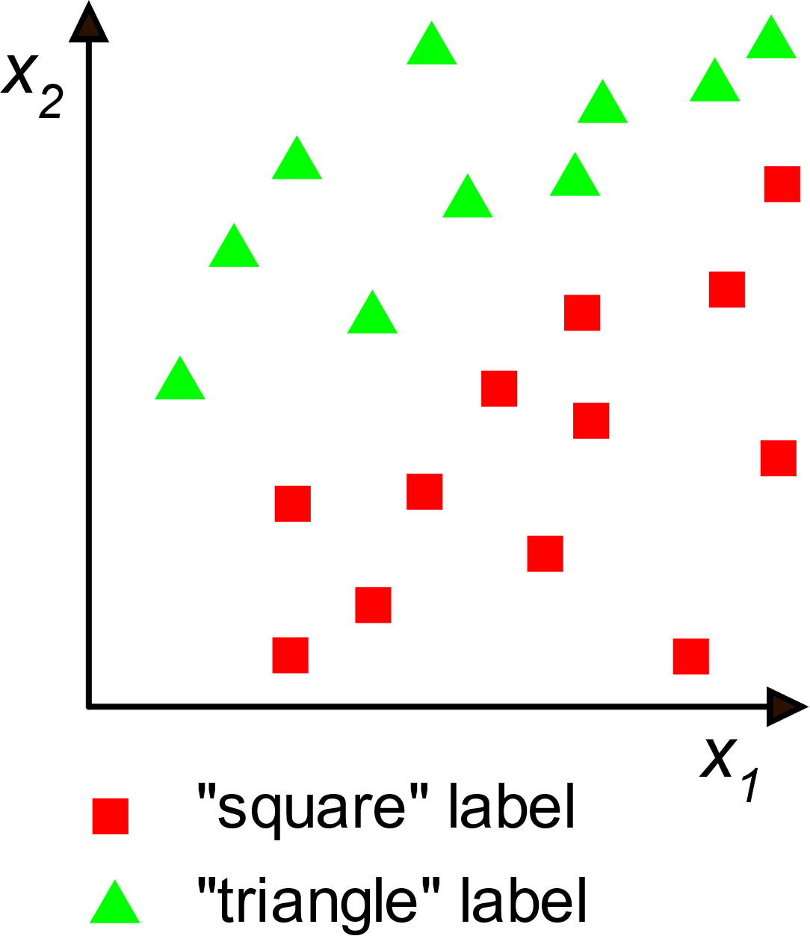
More on classification
Non-probabilistic classification: the membership to a given class is predicted
Probabilistic classification: the probability of belonging to a class is predicted
Linear and non-linear classification
Linear
The decision boundary is non-linear
linear "decision boundary"
In more than 2 dimensions the linear boundary is a hyperplane
x₂
Feature vector
x₁
Non-linear
Graphical representation of the training set

Slide 8
Unsupervised learning
The goal of the training is finding hidden characteristics that can be used to find a criterion to classify the data (data clustering) or to eliminate useless information (dimensionality reduction)
Single input data "example"
To illustrate the typical goals of unsupervised learning it is better to show a few examples.
Data are "unlabeled"

Slide 9
Example of Data Clustering
The clustering algorithm understands that data can be grouped into three "clusters".
After clustering, a label can be created to signify belonging to a given cluster.
x₂
x₂
In this example the label can assume three values (red, green, blue)
Feature vector
x₁
Graphical representation of the training set (27 examples)
x₁
Once we have learnt this property of the data (that we did not know before) we still have to give an interpretation to it and if it is useful, use this information to simplify classification algorithms.

Slide 10
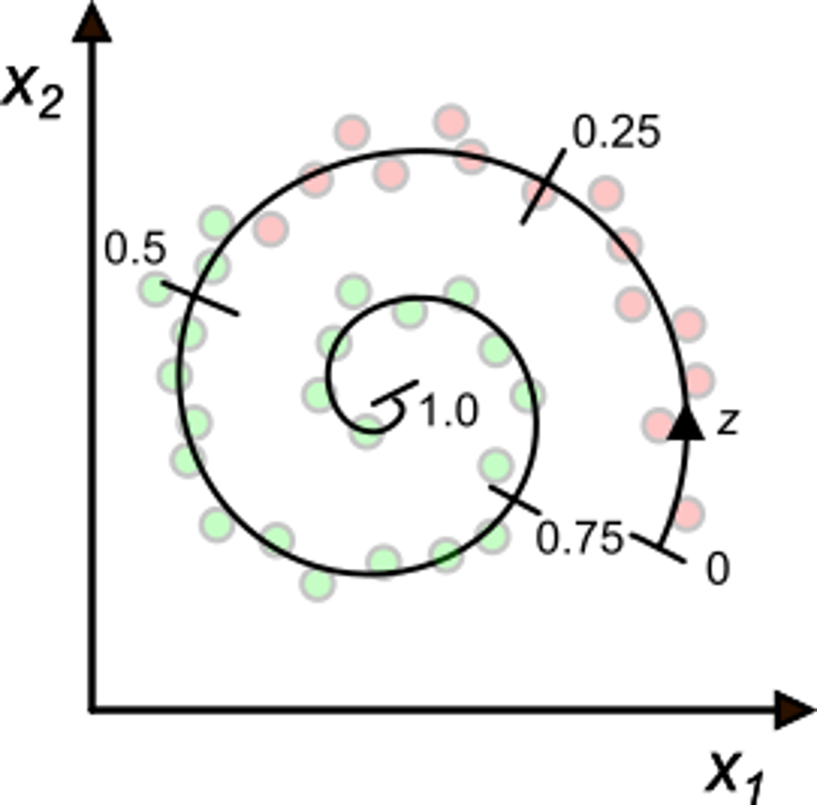
Example of dimensionality reduction
The dimensionality reduction task consists in finding coordinate transformation that allow reducing the number of significant features
x₂
x₂
x₁
x₁
With this transformation, classification is much easier
It is clearly possible to arrange data according their position in the spiral (coordinate z).
For this operation, the algorithm do not use the label
We have a set of labelled data (green / red) with a 2-D vector. Depending on the algorithm, classification can be difficult with data arranged in this way.

Slide 11
Reinforcement learning
Reinforcement algorithms learn how to perform actions in response to particular situations with the goal to obtain a certain result.
Examples of goals are maximizing the profit of a company, winning a chess match etc ..
Environment
(set of states)
Reward
The algorithm learns which actions are convenient on the basis of the reward, which is a function of the state. The reward can be positive (win) or negative (loose).
Training
Agent
(algorithm)
action

Slide 12
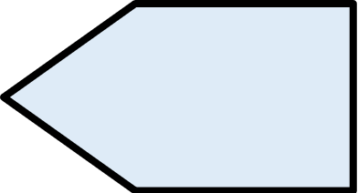
Machine learning in sensor applications
Machine learning can be used at this stage
Analog domain
Digital Domain
Digital Processing
Linear Filtering
Data Interpretation
Data compression
Non-electrical
sensor(s)
AFE
Analog Front-End
ADCs
Electrical
probe(s)
Display
Communication
Environment
Storage

Slide 13
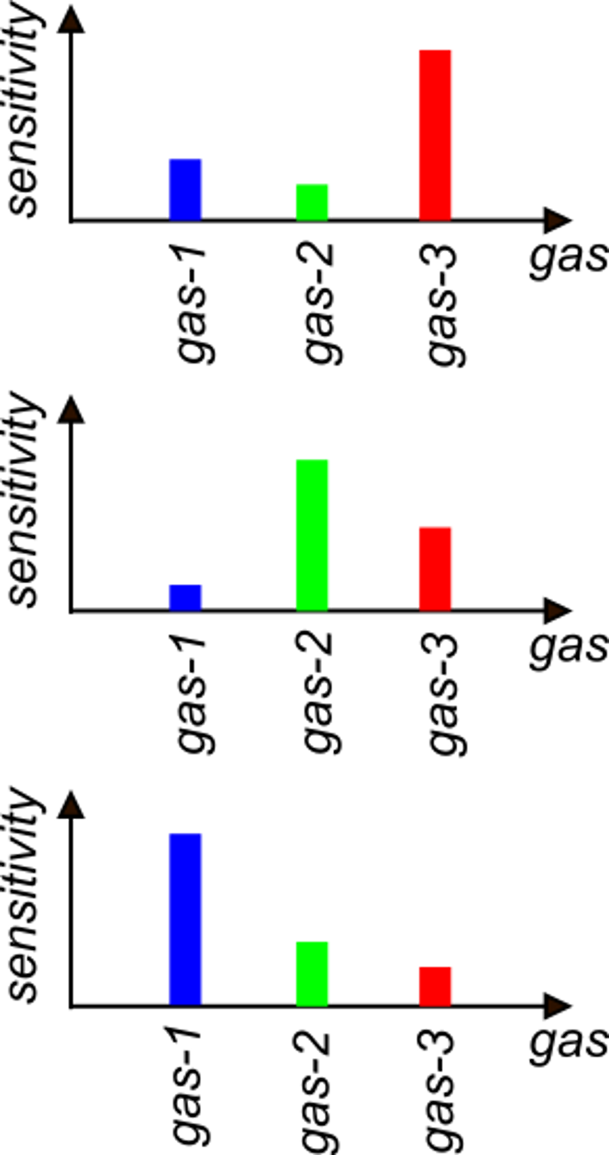
Machine learning in sensor applications
Example: gas classification and/or concentration measurement
y: concentration of the three gases (regression)
Machine Learning algorithm
Sensor 1
Sensor 2
y
Sensor 3
y: type of gas or type of mixture
(multi-class classification)
Building of the feature vector

Slide 14
When is ML useful for data interpretation in sensors
A priori model tuning
No Machine learning
Data interpretation can be accomplished in two ways:
1. Model-driven: we know the deterministic relationship between the quantities that we want to sense and the sensor outputs ("features"). If the inverse relationship (from the features to the quantities) can be easily found, then it is directly implemented in the algorithm.
2. Data-driven: if the relationship between from the quantities to the sensor outputs is difficult-to-model, due to a large number of features, presence of strong non-linearities, unreliable properties, complicated dependencies, then its better to use a generic model and let the data tune it to perform the required data interpretation.
Machine learning (= statistical learning)

Slide 15
General characteristics of the training process
Hyperparameters: these are not set by the learning process but have to be chosen before the training begins-. Hyperparameters affect:
a) The structure of the model
b) The way the training process is performed
For example, in a polynomial regression process, an hyperparameter can be the degree of the polynomial.
Cost or loss function: measure the difference between the desired outputs and the predicted values
Example of loss function
:predicted by the model
In all phases, proper cost functions are used to assess the degree of accuracy.

Slide 16
Data used in the training process
Training data
Used to really train the algorithm
(i.e. set the model parameters)
Development data
Used to choose the hyperparameters
Test data
Used at the end of the learning process to test the accuracy of the model

Slide 17
Effectiveness metrics: the confusion matrix
The confusion matrix is used to represent the accuracy of a classification algorithm
Predicted labels
Example with 4 classes A,B,C,D
Number of examples that have label A and the algorithm classified ad D
A
B
C
D
A
R_{A}
W_{AB}
W_{AC}
W_{AD}
In the ideal case, there are non-zero elements only in the diagonal.
B
W_{BA}
R_{B}
W_{BC}
W_{BD}
Actual
labels
C
W_{CA}
W_{CB}
R_{C}
W_{DC}
Non-zero values in non-diagonal elements represent errors, i.e. "confusion".
D
W_{DA}
W_{DB}
W_{CD}
R_{D}

Slide 18
The training phase
Every batch is formed by N / M examples
The model parameters are updated at the end of each batch
Batch 1
Batch 2
Batch M
The accuracy increases with the number of epochs but tends to saturate
Training set (N examples)
Generally, the same training set is passed through the learning algorithm several times. A single pass of the whole training set is called epoch
accuracy
epochs

Slide 19
Types of ML algorithms
Decision trees (classification)
Regression Analysis (regression, continuous target y)
K-Nearest-Neighbors (k-NN) (classification)
Logistic Regression (classification)
Principal Component Analysis (PCA) (clustering)
Support Vector Machine (SVM): classification
Artificial Neural Networks (ANN) (classification and /or regression)

Slide 20
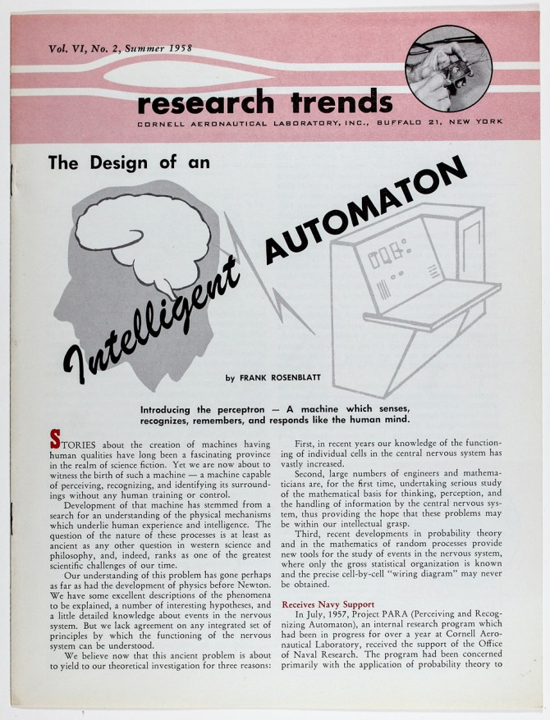
Artificial Neural Networks: the origins
The predecessor: The Perceptron
(Ronsenblatt, Cornell Aerounautical Lab.1958)
Originally implemented on a IBM 704 computer and connected to an array of photodetector to obtain a visual classifier.
Inspired by:
1943: First models of the natural neuron (McCulloch-Pitt)
Followed by:
1960: Adaline (ADAptive LInear NEuron)
(B. Widraw et al., Stanford)

Slide 21
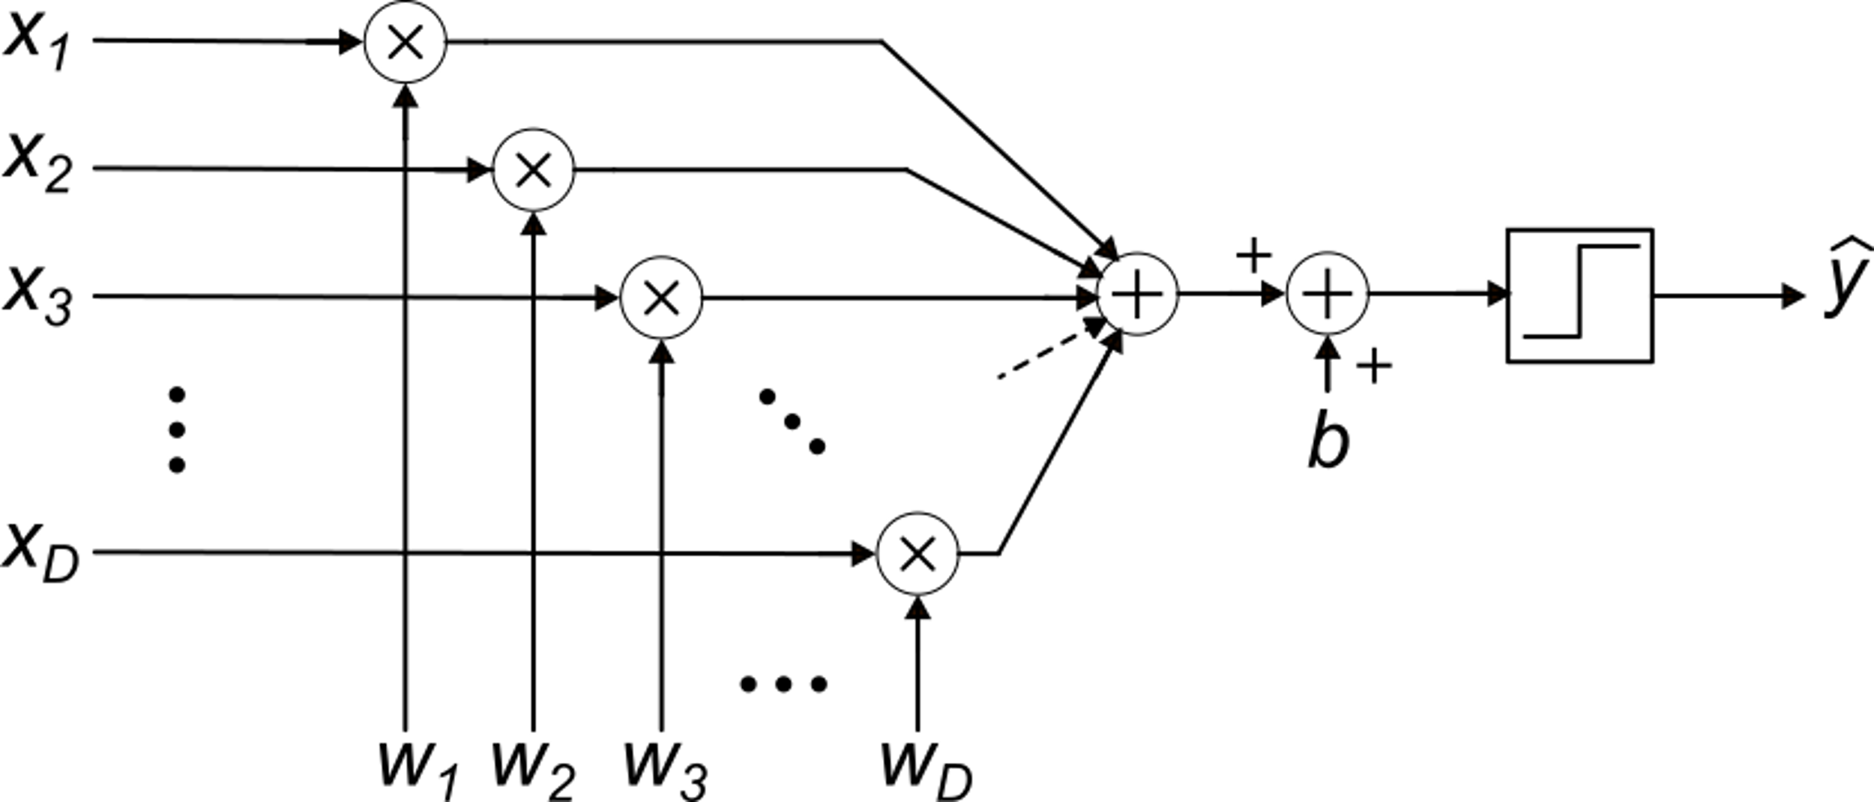
The perceptron classifier
Inputs (features)
bias
Parameters (weigths)

Slide 22
The perceptron operation: 2D case
x₂
x₂
y=1
w
w
x
x₁
x₁
y
=-1

Slide 23
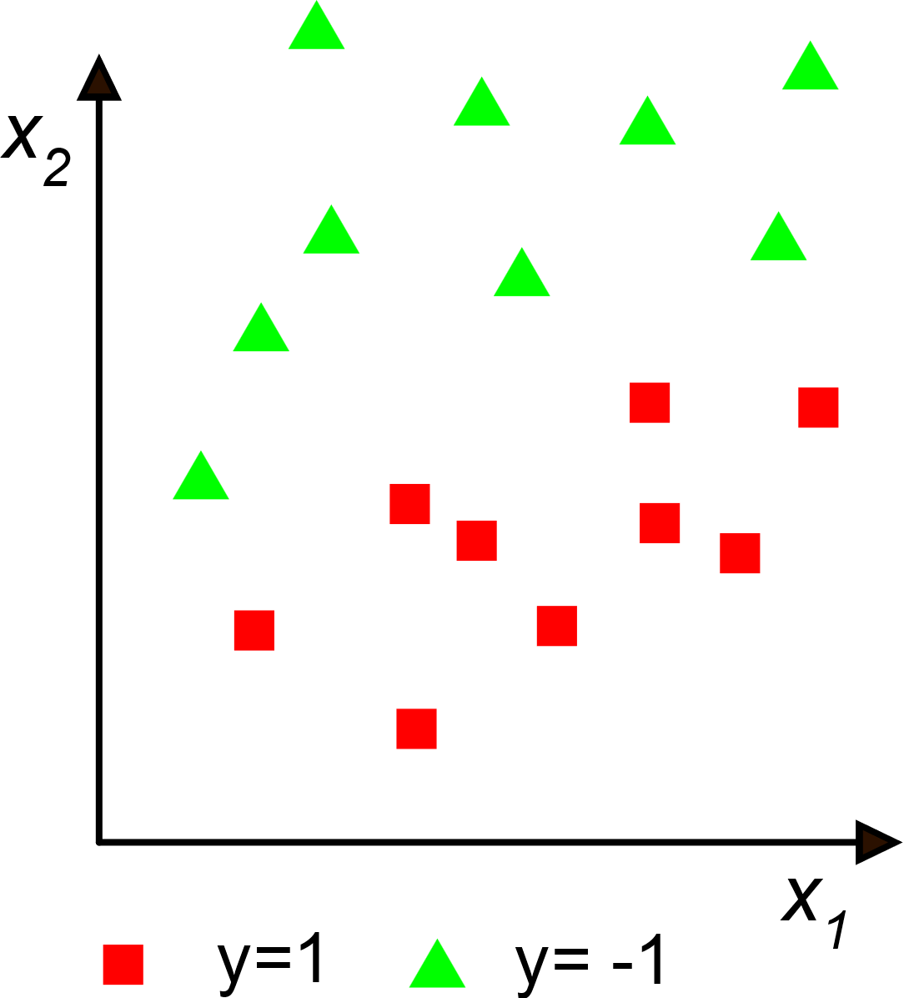
Perceptron classifier
Labels y (0 or 1)
Training data
Target: find the correct weight set (w₁, w₂) and bias b that allow the perceptron to predict the label on a new data. In the case shown above, the data are "linearly separable", i.e. a line exists that divide the x₁,x₂ plane into two regions where points with homogeneous label are present
Since the plane exists, this classification problem can be solved by a perceptron
The problem is: how to make the perceptron set the weights and the bias autonomously.

Slide 24
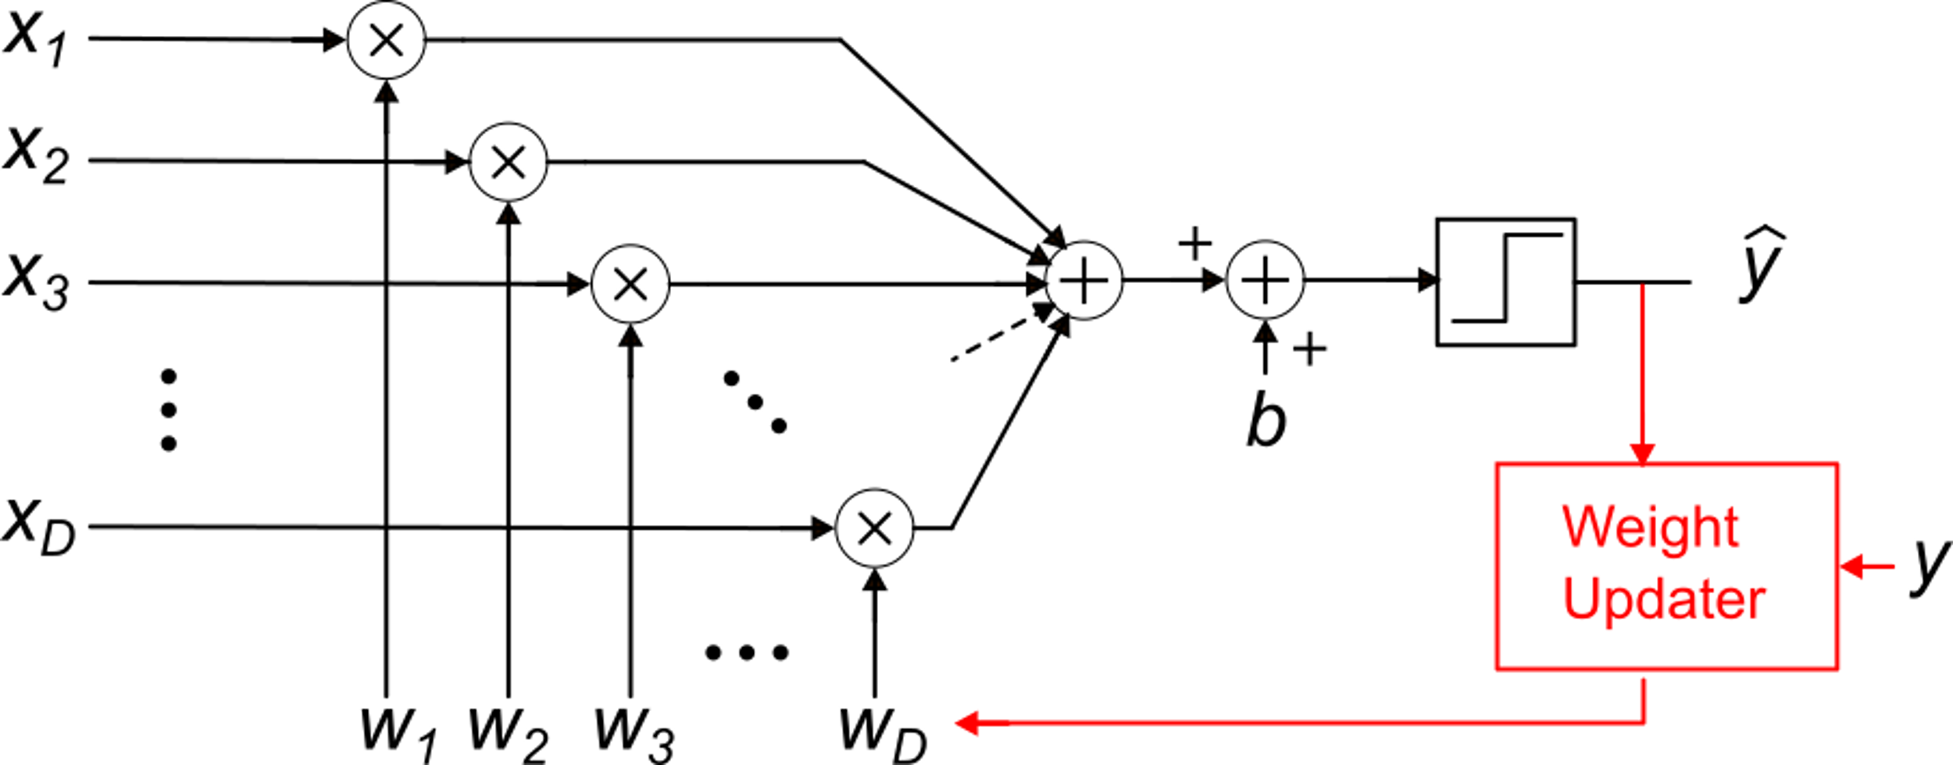
Setting the weights from the training data = learning
Update algorithm
z
i: 1, .... D
η : learning rate
i: 0, .... D

Slide 25
Artificial Neural Networks
The perceptron implements a "single layer" ANN and can solve only binary classification problems for linearly separable data
An ANN uses more perceptrons (modified to produce a continuous output) to solve a much wider variety of problems

