Slide 1
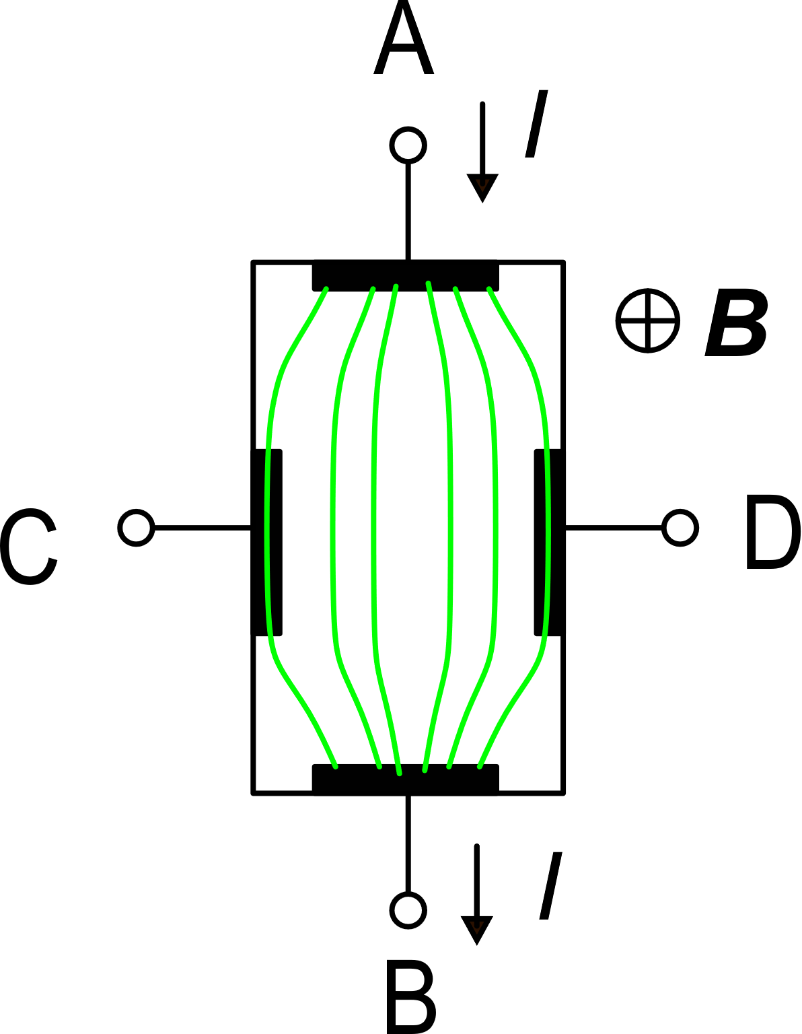
Hall sensors: a more accurate expression
Biasing
contacts
Geometrical effects:
The sensing contacts "short" the Hall voltage in their proximity (shorting effect). The full V_{H} develops only far from the sensing contacts
Scattering factor: it takes into account the real complexity of the charge carrier scattering (random thermal velocity and drift velocity, etc)
Sensing
contacts
Current lines are not straight and parallel, due to the effect of both the sensing and biasing contacts
Shorting effect
G<1
μ_{H}="Hall mobility"

Slide 2
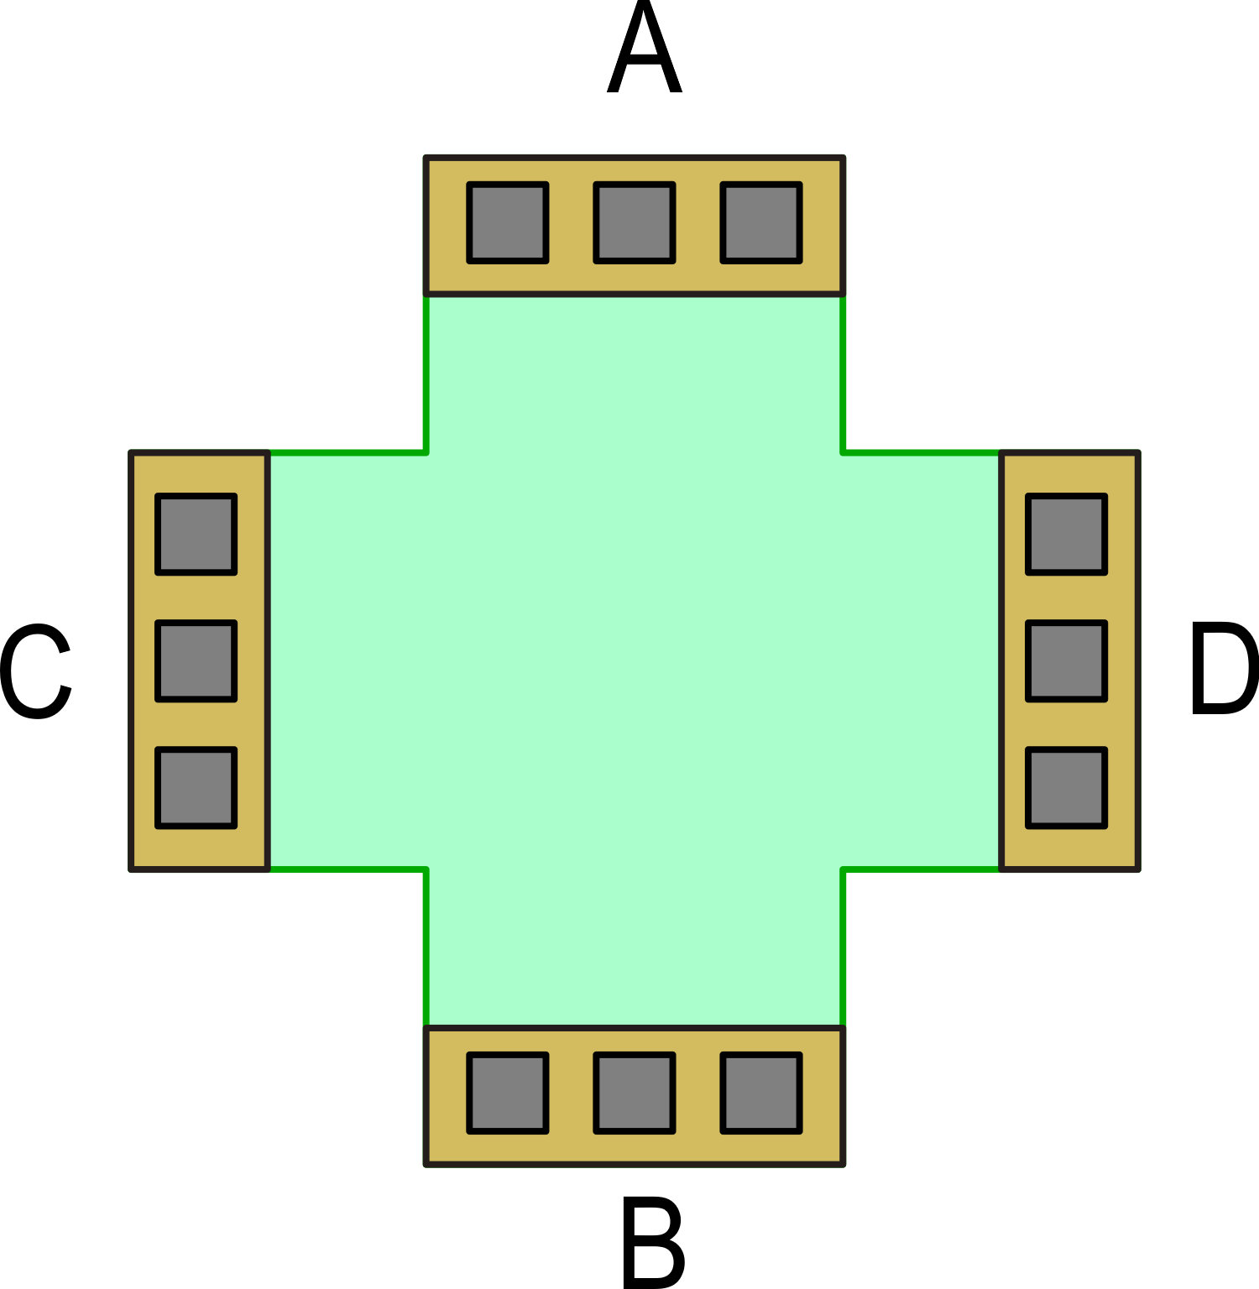
Absolute sensitivity
Example of layout: symmetric cross
G ≅ 0.9 (0.85-0.95)
r_{H} (Si) ~ 1.15
Absolute sensitivity:
Possible implementation
in a CMOS process
Advantages:
Symmetry (bias and sensing contact can be swapped)
Minimum perturbation caused by sensing contacts

Slide 3
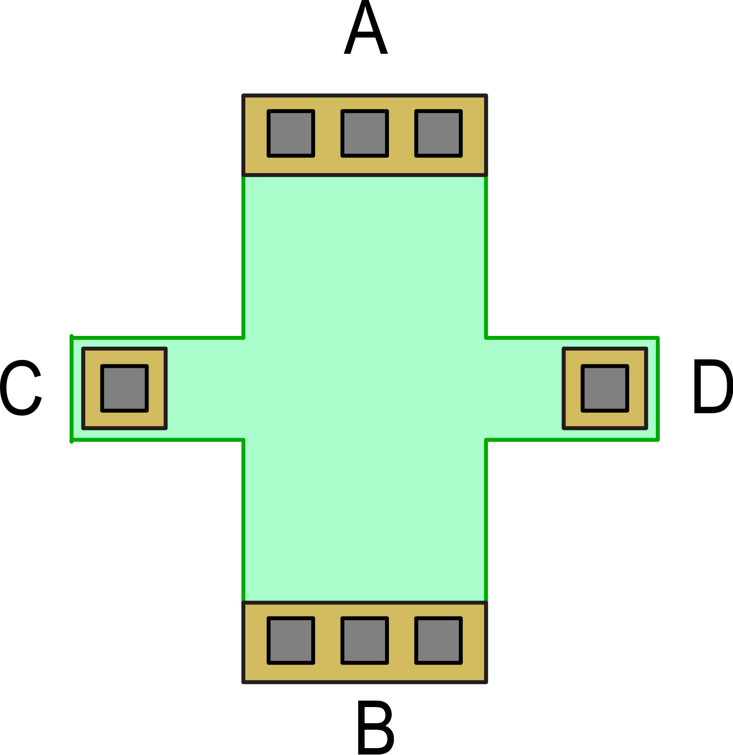
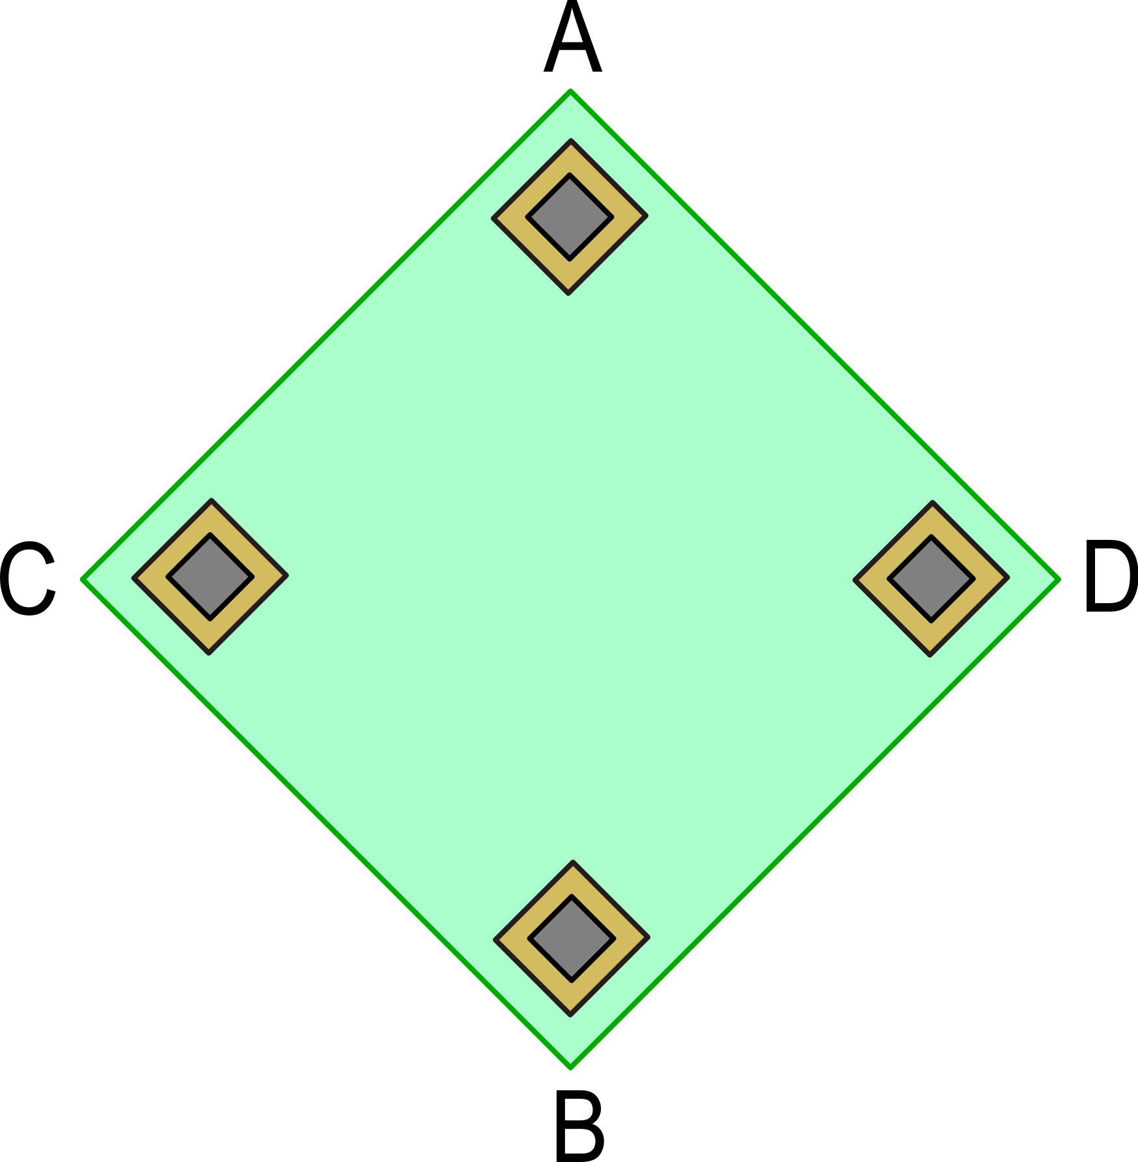
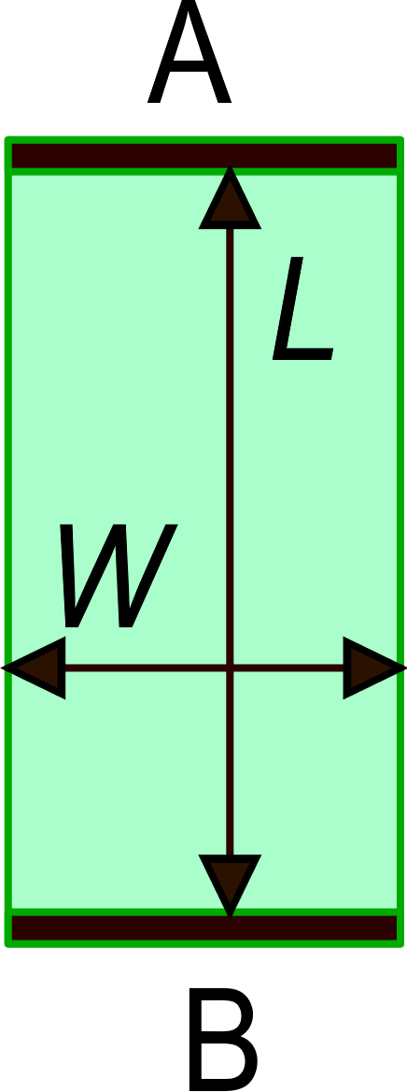
More on sensitivity:
G and F_{S} are dimensionless factors depending on the shape
The larger the bias current I, the larger the sensitivity. However, increasing the current causes V_{AB} and the dissipated power P_{D} to increase as well.
Example of shapes
For a rectangular
conductor: F_{S}=L/W
Dissipated power:

Slide 4
Power vs sensitivity efficiency
I
For the same power dissipation, the sensitivity is higher for materials with:
Highest mobility (μ)
Lowest charge carrier density (n)

Slide 5
Materials used for Hall sensors
Material | E_{g} (eV) | μ_{n} cm⁻²V⁻¹s⁻¹
Si | 1.12 | ∼ 1000
GaAs | 1.42 | ∼ 8000
InAs | 0.36 | ∼ 33000
InSb | 0.17 | ∼ 80000
Despite having the smallest sensitivity, Silicon is by far the preferred material for fabrication of Hall Sensors, for the following reasons:
Cost (sensors can be fabricated with standard CMOS processes)
Allows integration with complex readout interfaces on the same chip (miniaturization, cost, robustness, electromagnetic immunity)

Slide 6
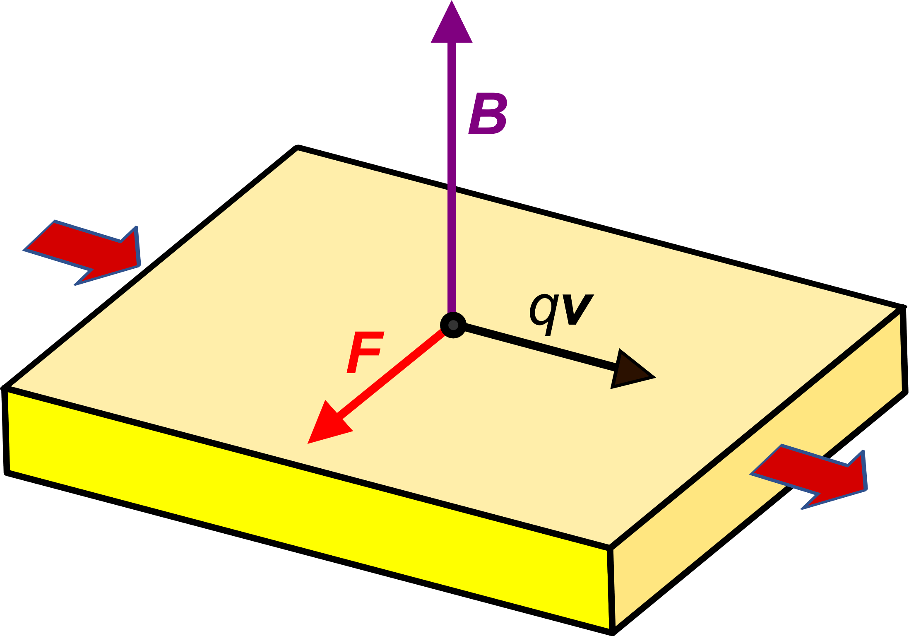
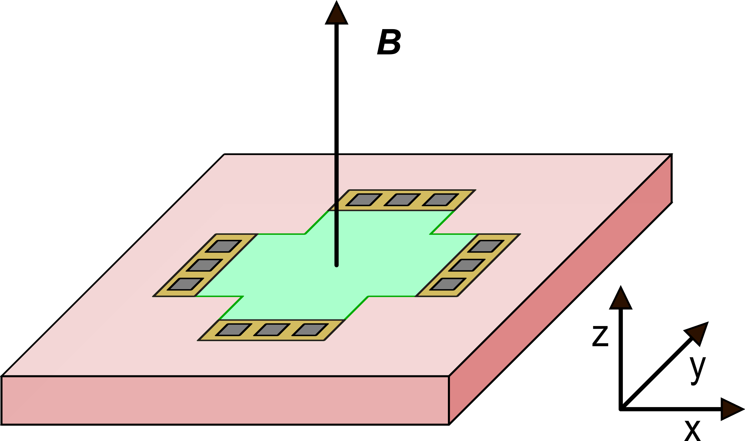
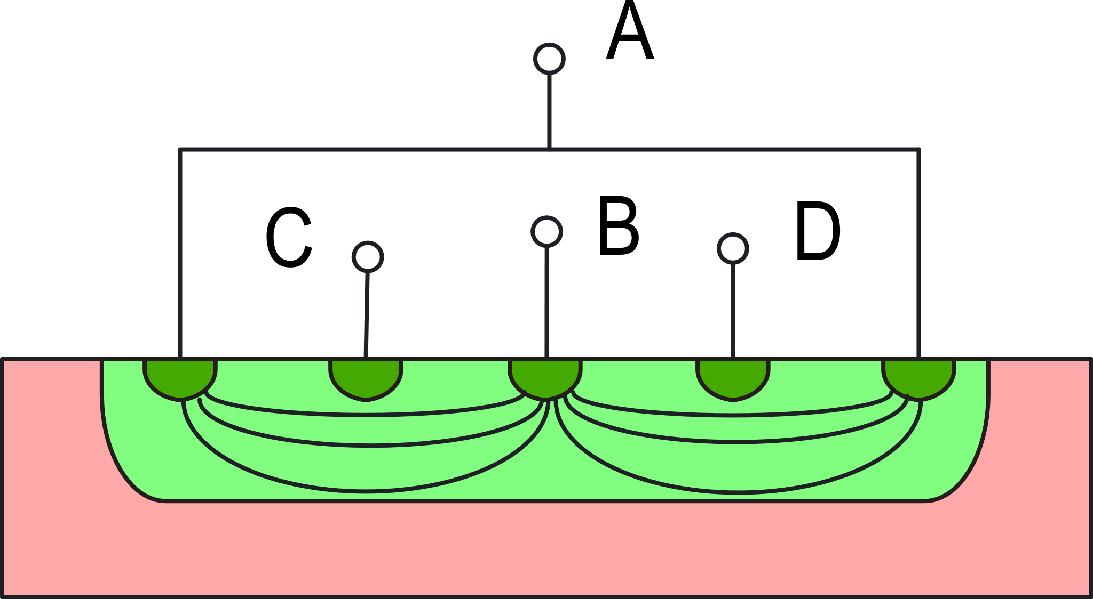
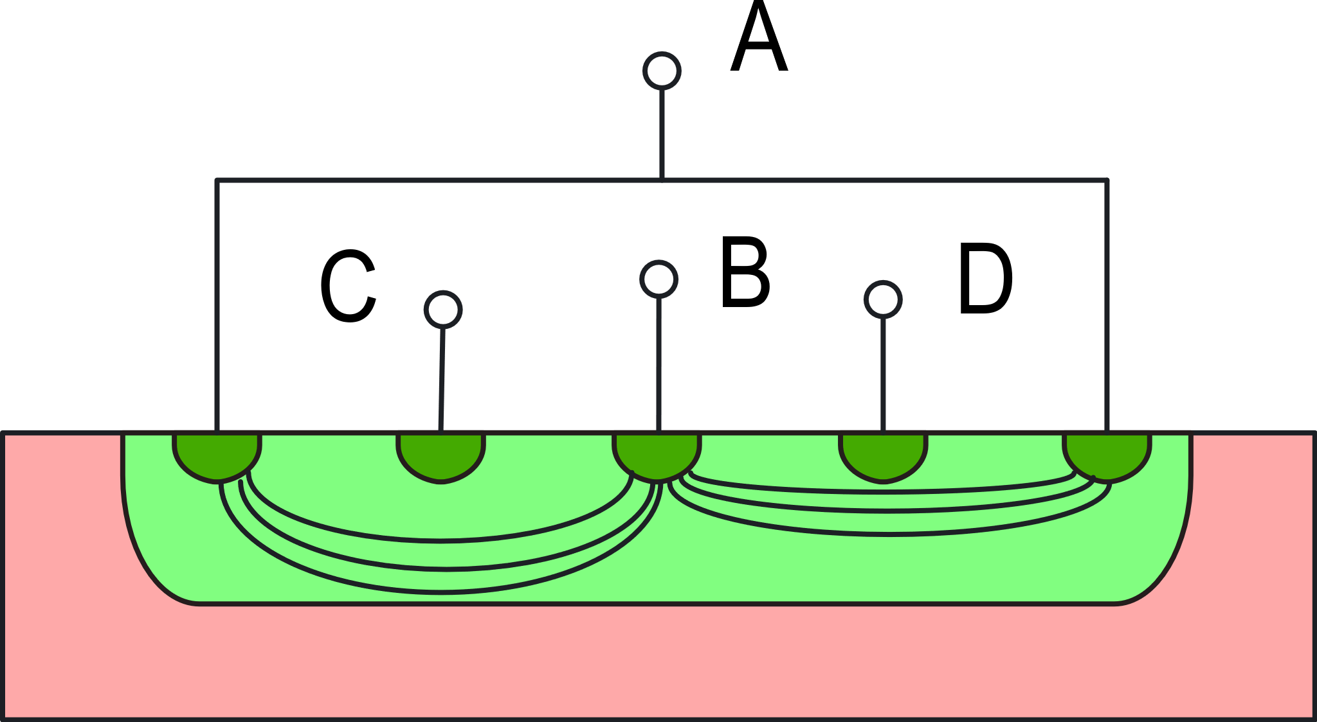
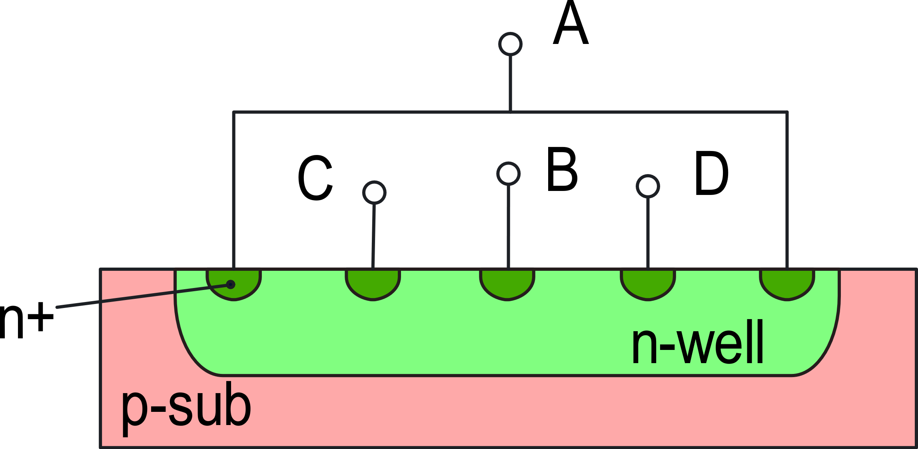
Integrated 3-axis Hall magnetometers.
Horizontal (planar) Hall plates are sensitive only to the component of B orthogonal to the substrate surface (B_{z})
Vertical component
B_{y}=0
B_{y}≠0
(symmetry, V_{H}=V_{CD}=0)
(asymmetry, V_{H}=V_{CD} ≠ 0)
Vertical Hall Sensor (VHS)

Slide 7
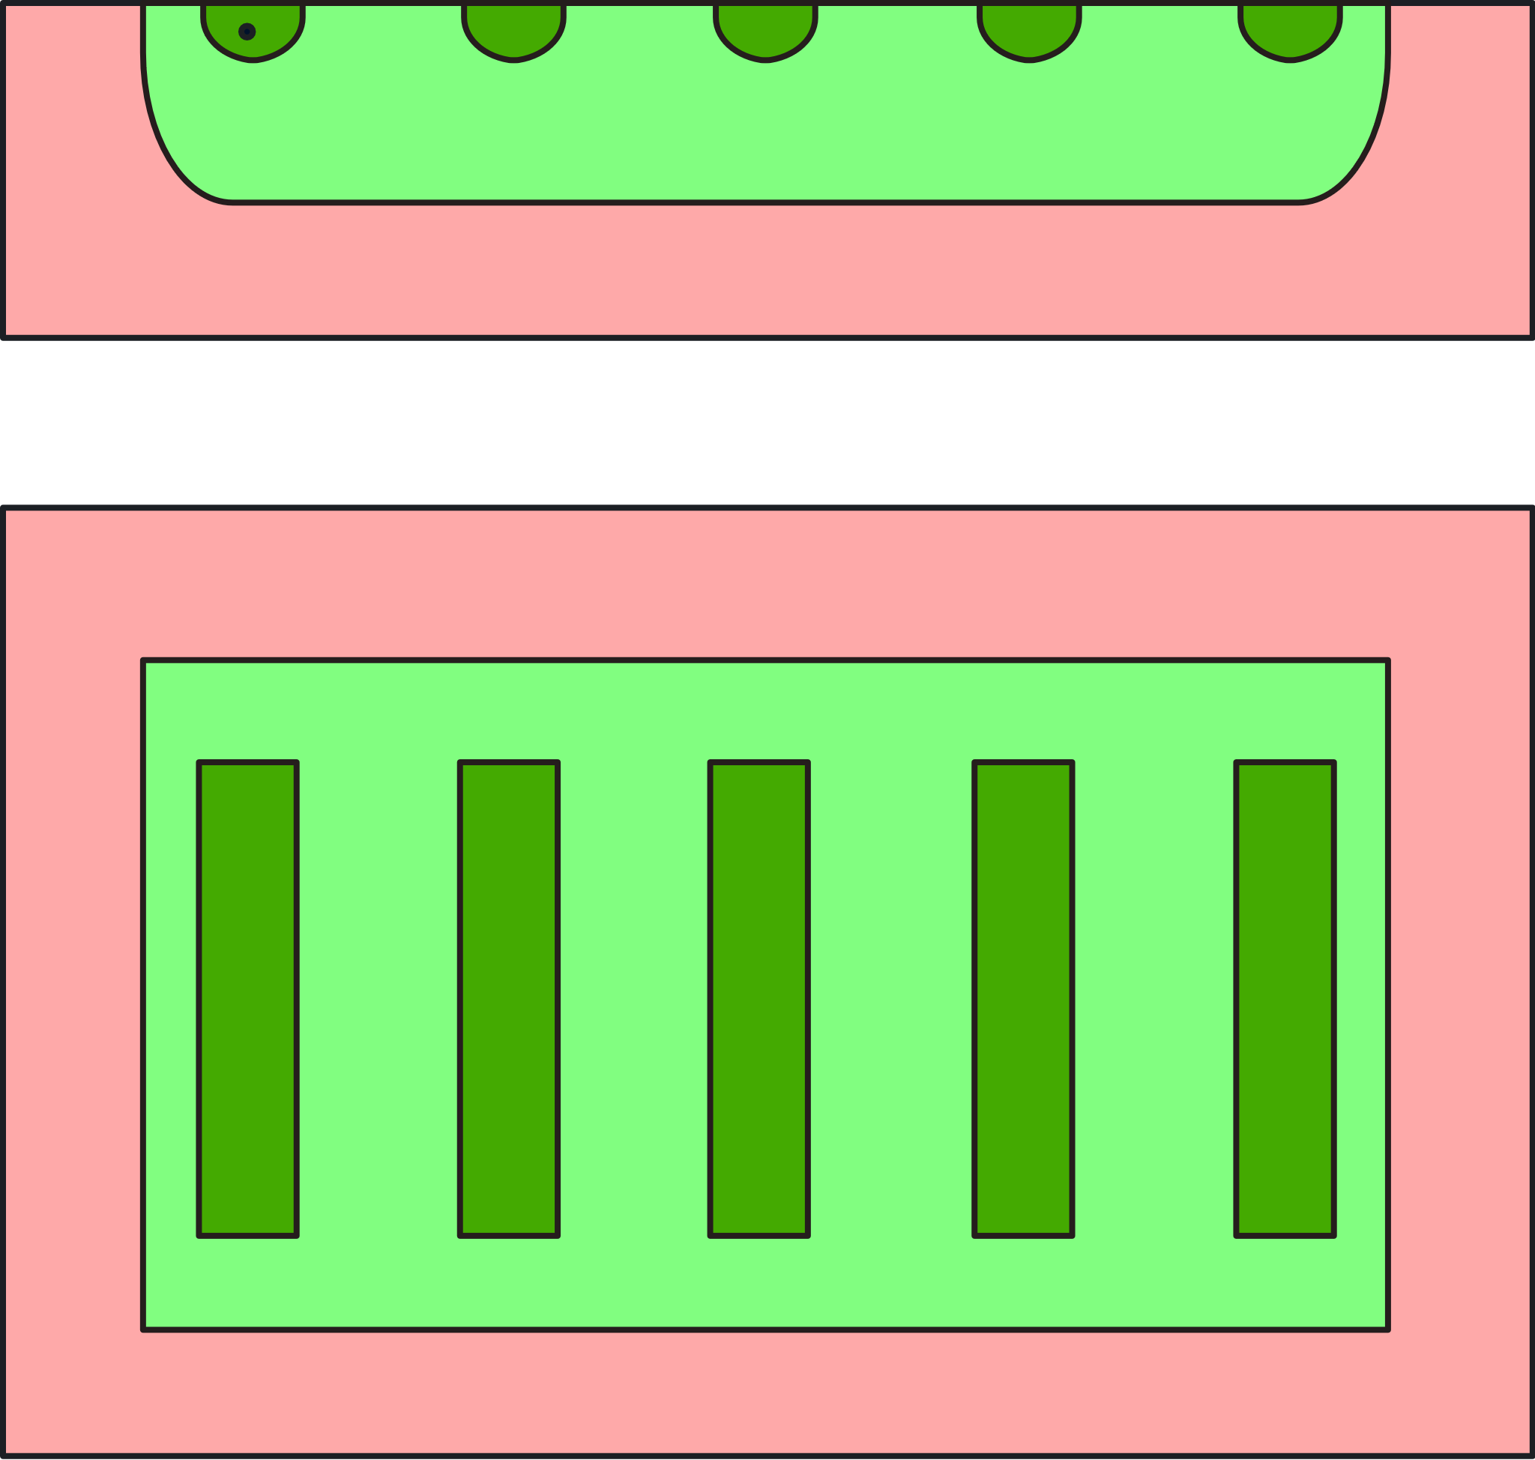
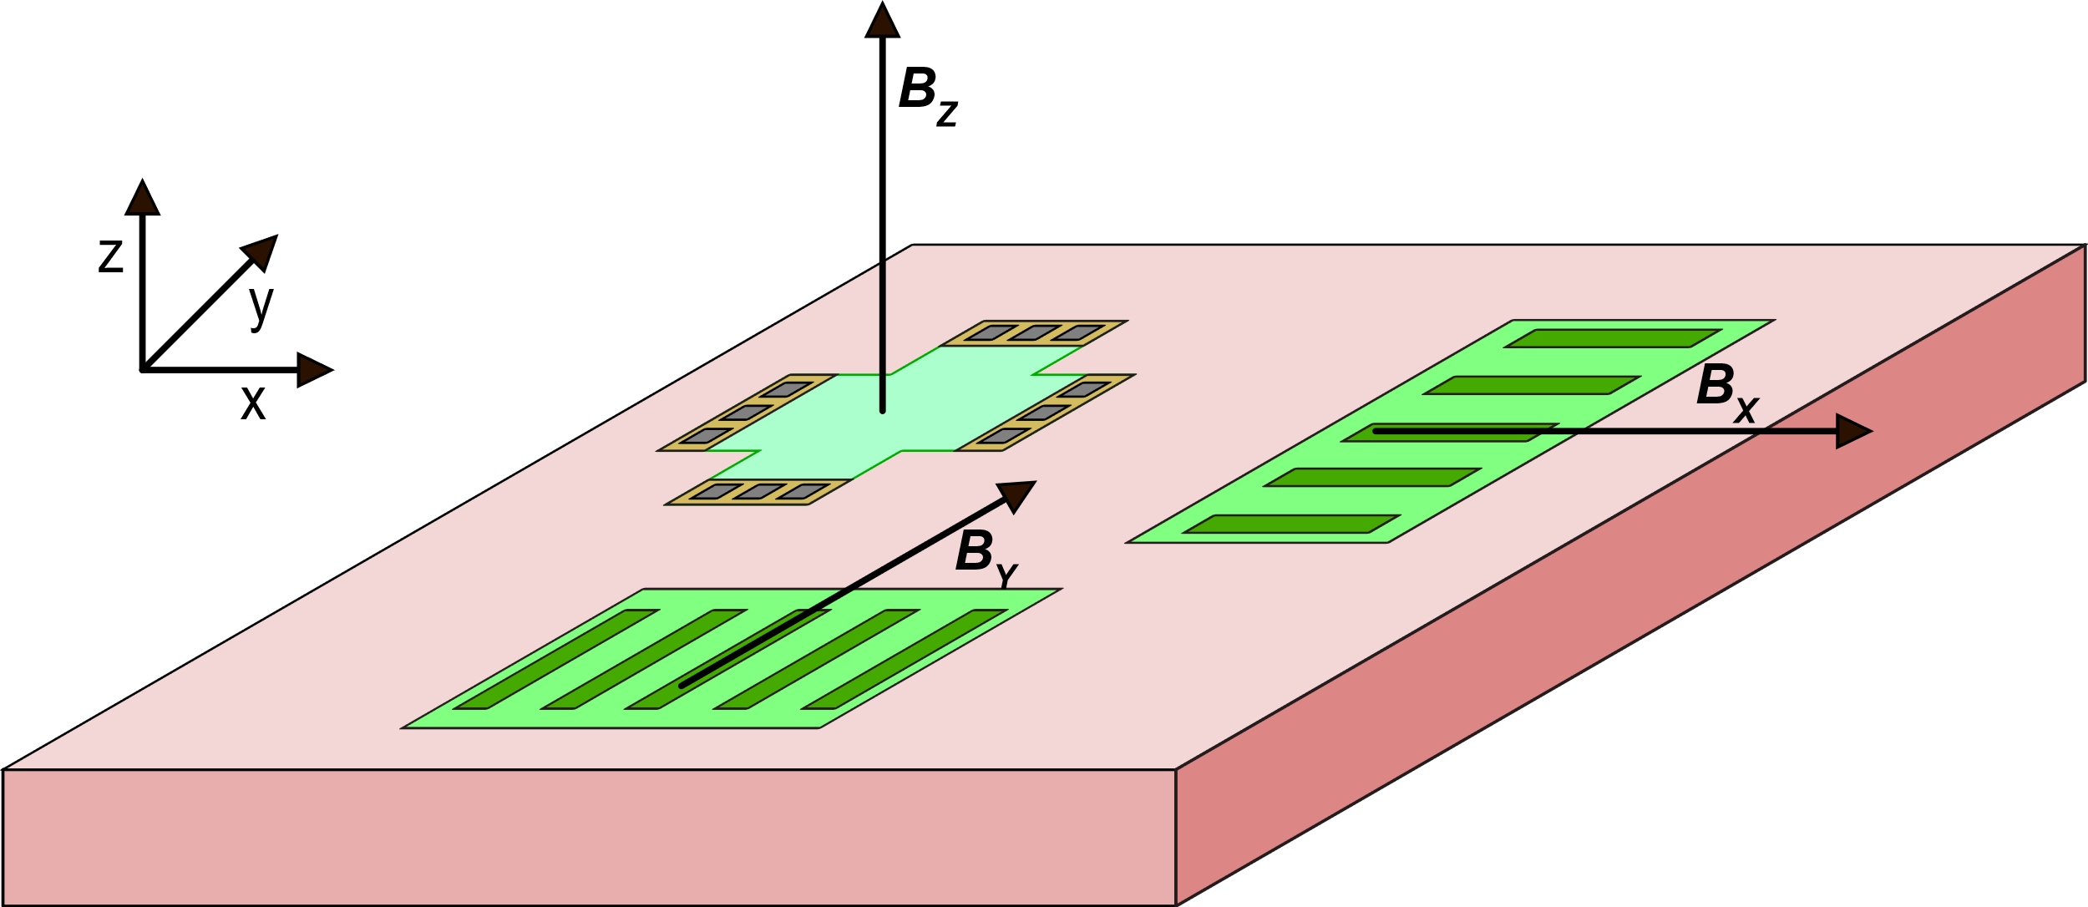
Single-chip, 3-D magnetometer
Horizontal (or planar) Hall Sensor (HHS)
orthogonal vertical Hall sensors
Top view of a VHS
A single-chip, CMOS compatible 3-D magnetometer can be obtained by combining an HHS and two orthogonal VHS

Slide 8
Main non-idealities of Hall Sensors
Offset voltage
Temperature dependence of the sensitivity
Non-linearity
Noise
The offset is by far the problem that limit the performances of the Hall sensors. We will focus mainly on this aspect.
Temperature dependence is reduced by driving the sensor with a constant current and applying temperature compensation in the estimation process.
Non-linearity occurs at very large fields and can be compensated in the digital domain by a proper non-linear estimator.
Thermal noise is generally not an issue, due to the small output resistance of the sensor (typically of the order of 1 kΩ in integrated sensor). Flicker noise can be more important.

Slide 9
Just a mention to current vs voltage biasing
I_{bias}
I_{bias}
Current-related
sensitivity
(V_{bias}=V_{AB})
Voltage-related
sensitivity

Slide 10
Just a mention to current vs voltage biasing
Temperature affects only the carrier concentration n, which, in a doped semiconductor is practically constant
Temperature affects only mobility, which has a strong temperature dependence
Constant current biasing is generally the preferred choice

Slide 11
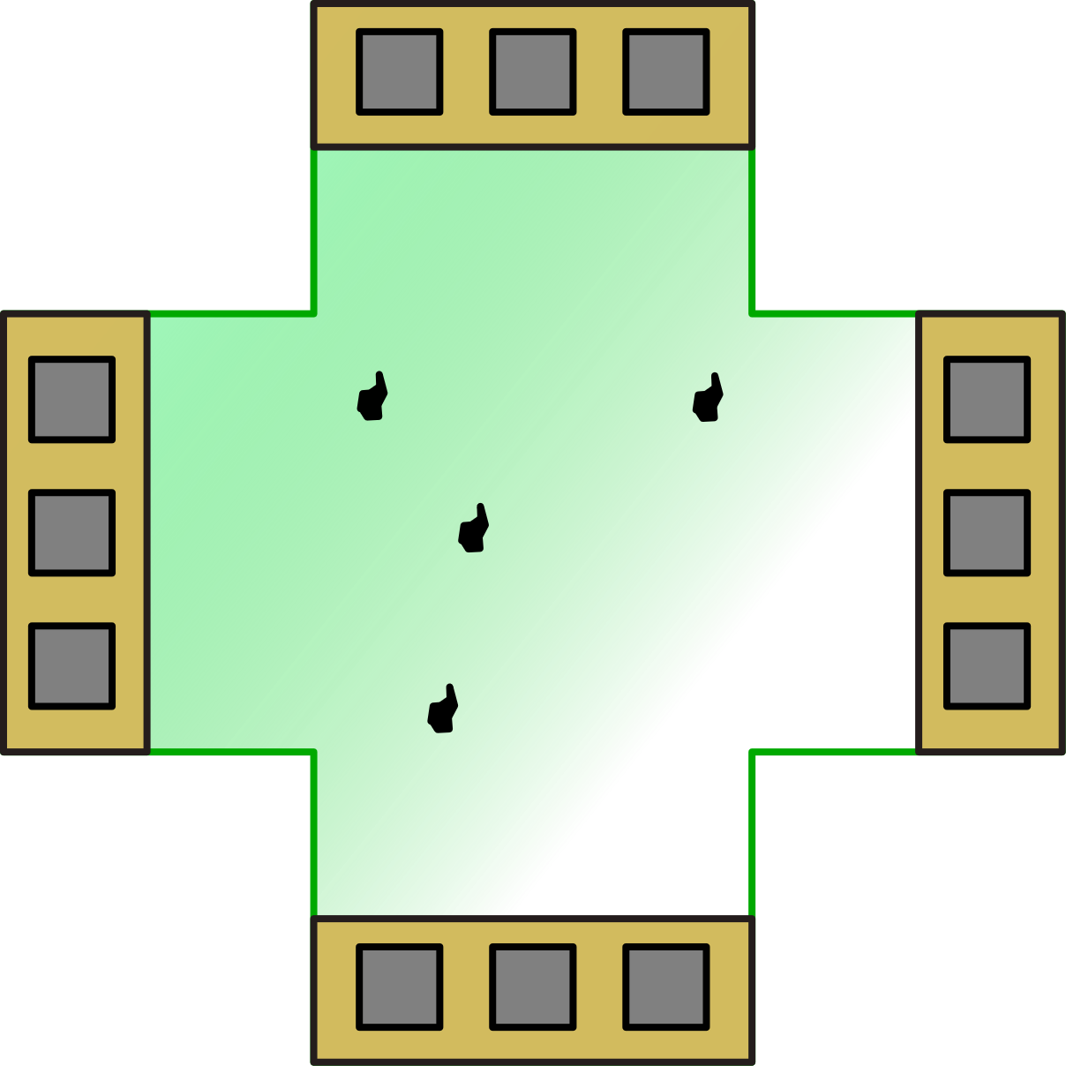
Offset voltage and equivalent magnetic field offset
I_{bias}
Equivalent offset magnetic field
Origin of the offset voltage V_{offset}:
I_{bias}
Non uniform resistivity due to:
Parameter gradients
Local non homogeneity (defects, etc)
Mechanical stress associated with material piezoresistivity

Slide 12
Simple offset model
A
I_{bias}
C
D
B
A
R₄
R₁
C
D
Balanced
bridge
V_{out}
I_{bias}
R₃
R₂
B
Due to unavoidable asymmetries the bridge is unbalanced, and a significant offset appears

Slide 13
Offset magnetic field
Typical offset voltage that are observed in silicon integrated planar Hall sensors are of the order of 10 mV
Current related sensitivities, S_{I}, are of the order of 400 V/A/T
With bias currents of the order of 1 mA , the absolute sensitivity, S_{A}, is of the order of 0.4 V /T.
This offset value is often larger than the field to be measured!
The offset of Hall sensors is also marked by important temperature drift, so that standard offset cancellation techniques (e.g. zero calibration) generally leave a large residual offset.

Slide 14
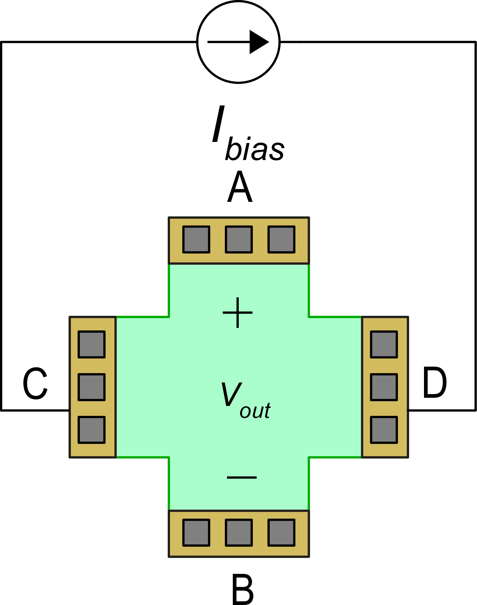
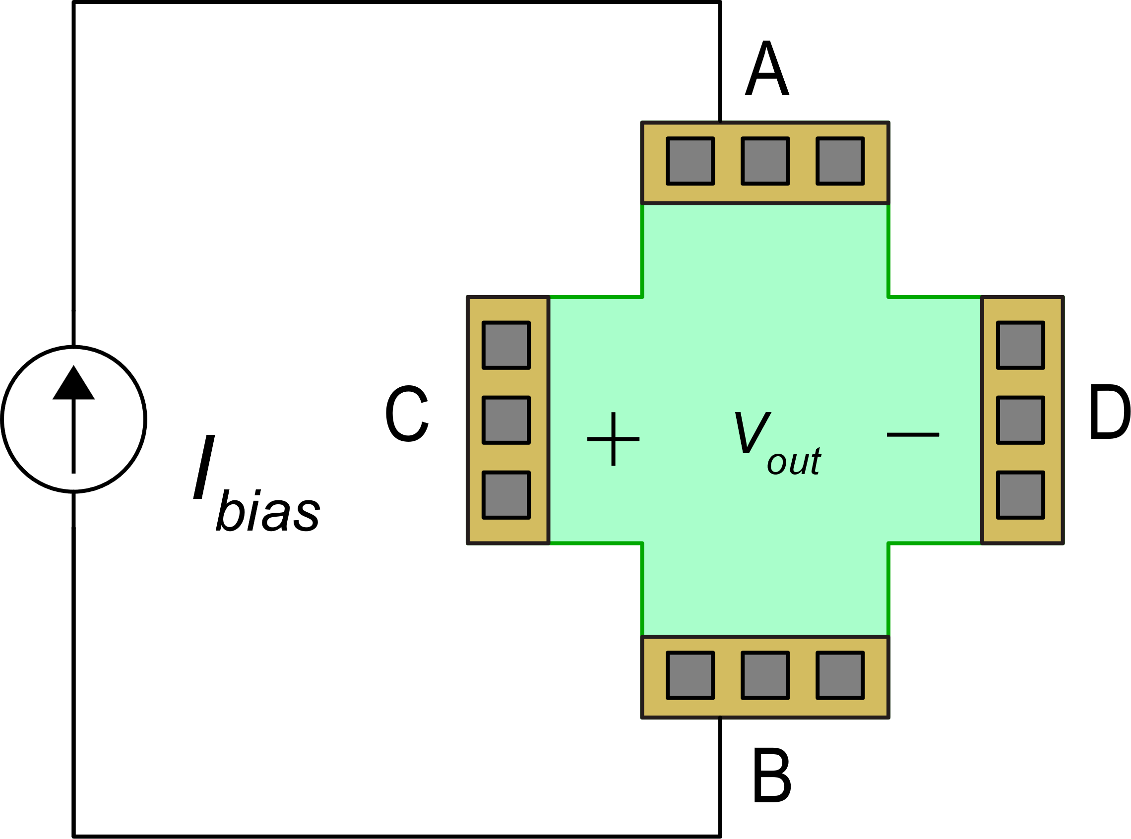
Principle of current spinning approach to offset cancellation
rotation
phase 1
phase 2: 90° rotation of both the bias and sensing axis.
Thanks to the symmetry of the layout, the voltage induced by the field B does not change after the rotation.

Slide 15
Effect of the terminal rotation on the offset voltage
phase 1
A
R₄
R₁
I_{bias}
C
D
A
The rotation simply changes the terminals in such a way:
V_{out}
R₄
R₁
I_{bias}
R₃
R₂
C
D
V_{out}
B
R₃
R₂
phase 1
phase 2
B
Making all resistor transformations:
The useful signal, S_{A}B_{Z}, remain the same, the offset undergoes sign reversal

Slide 16
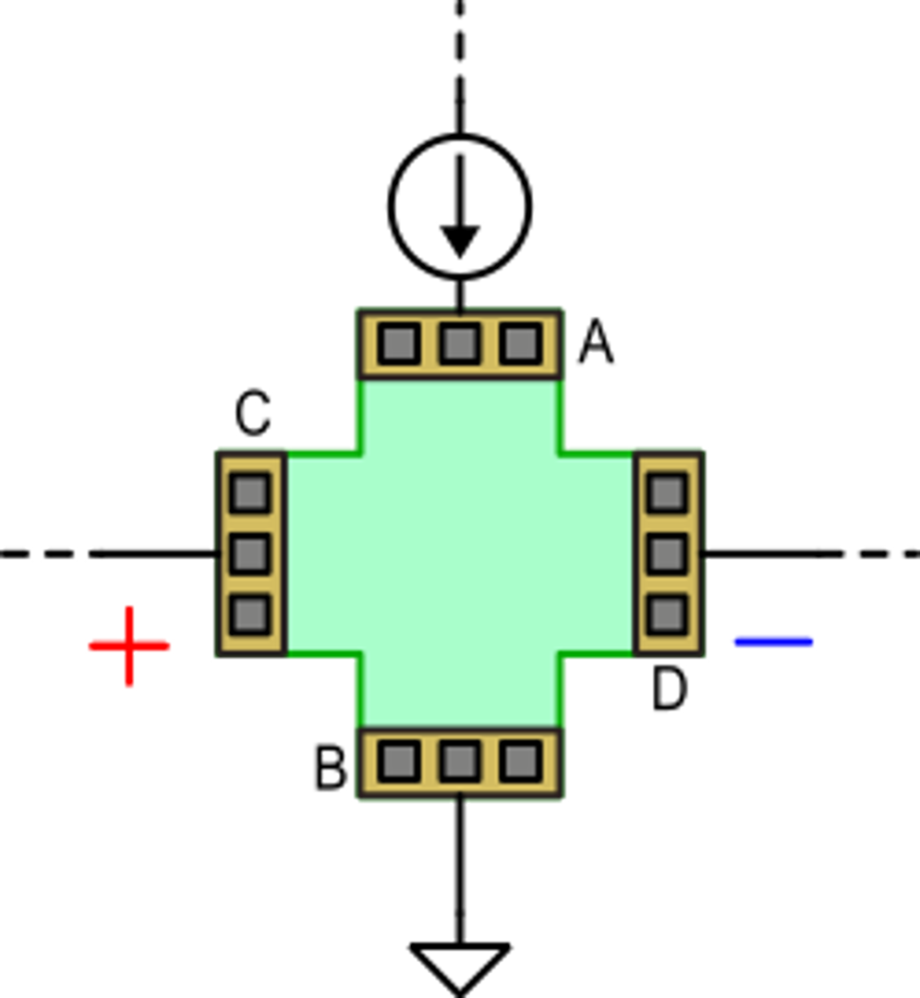
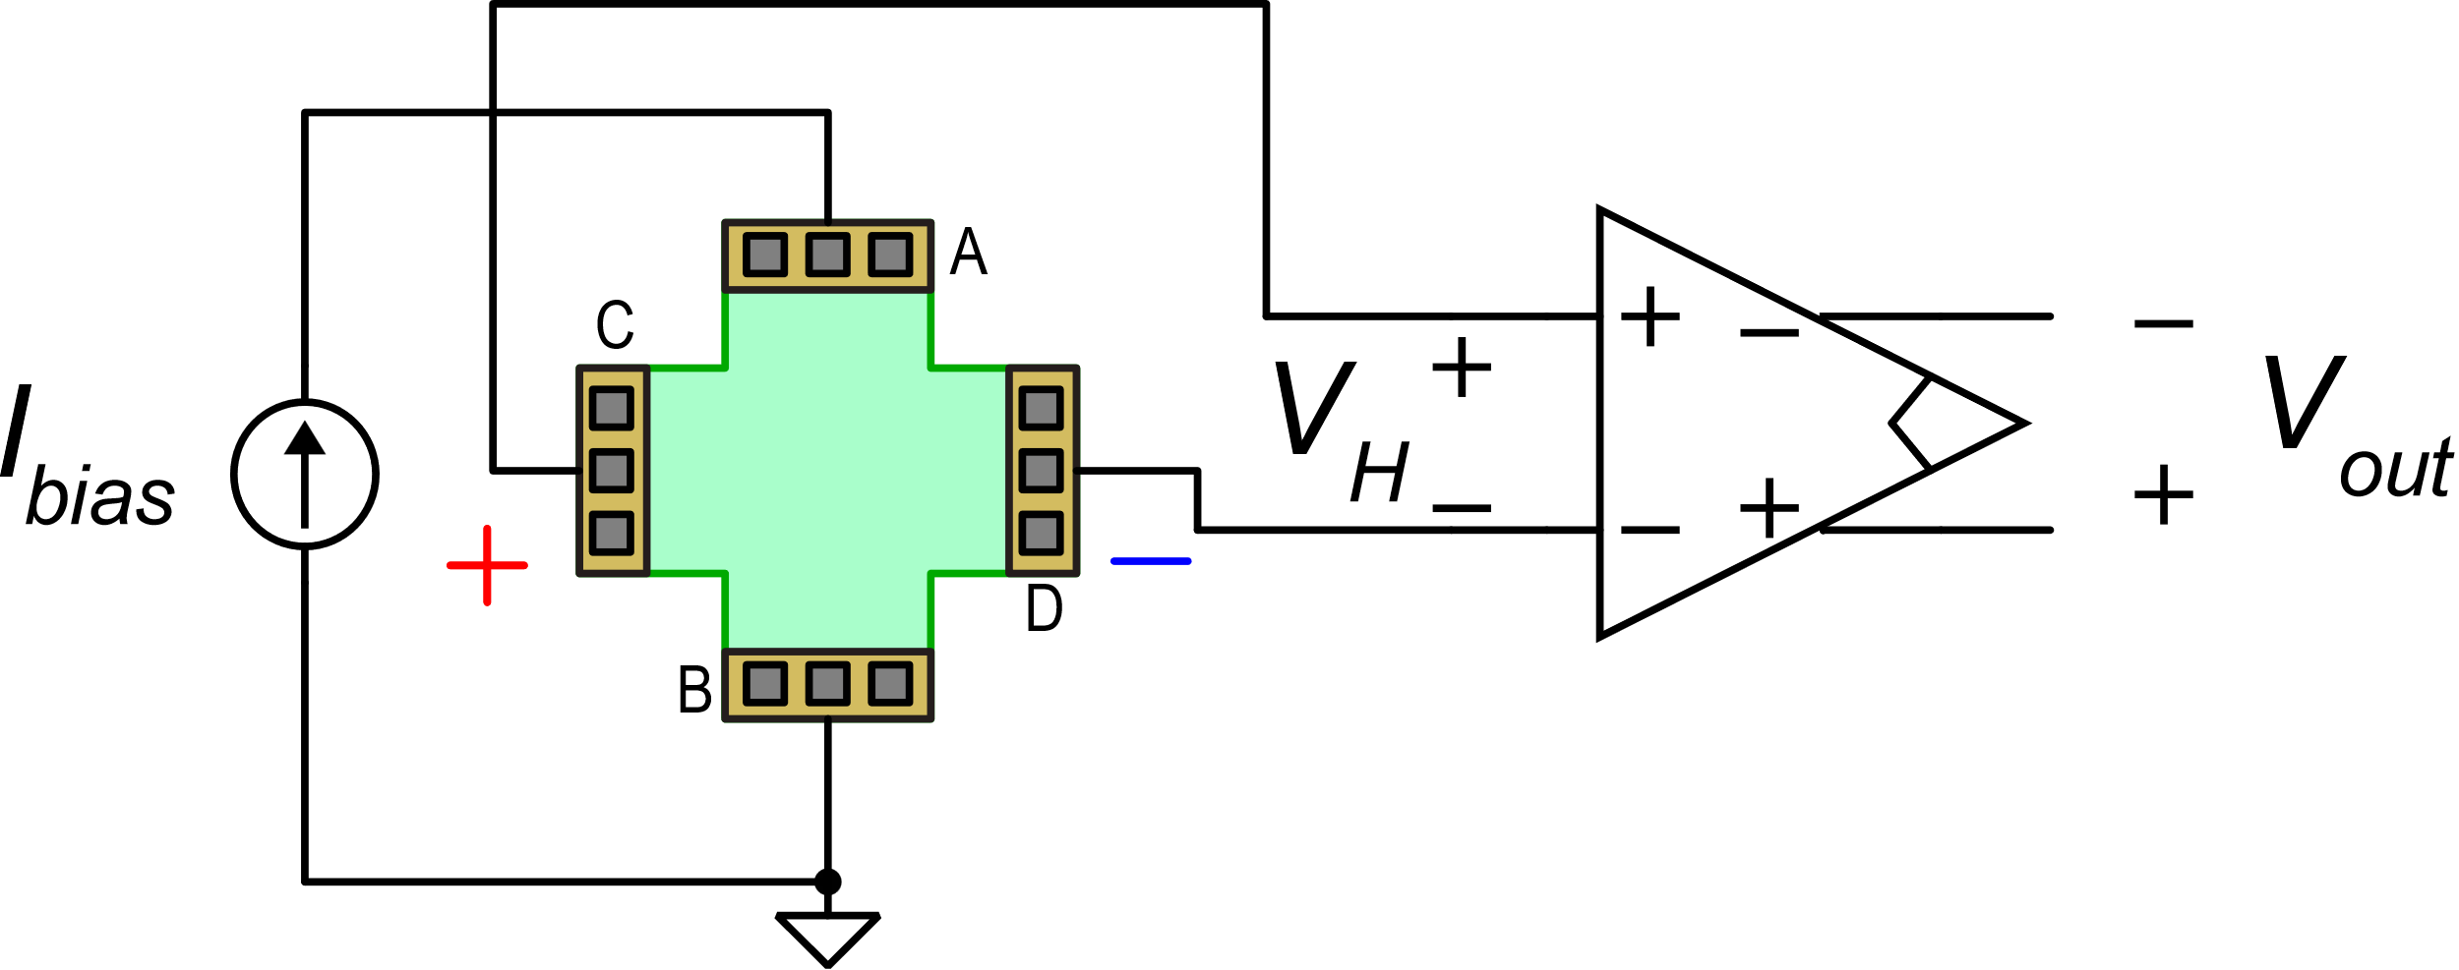
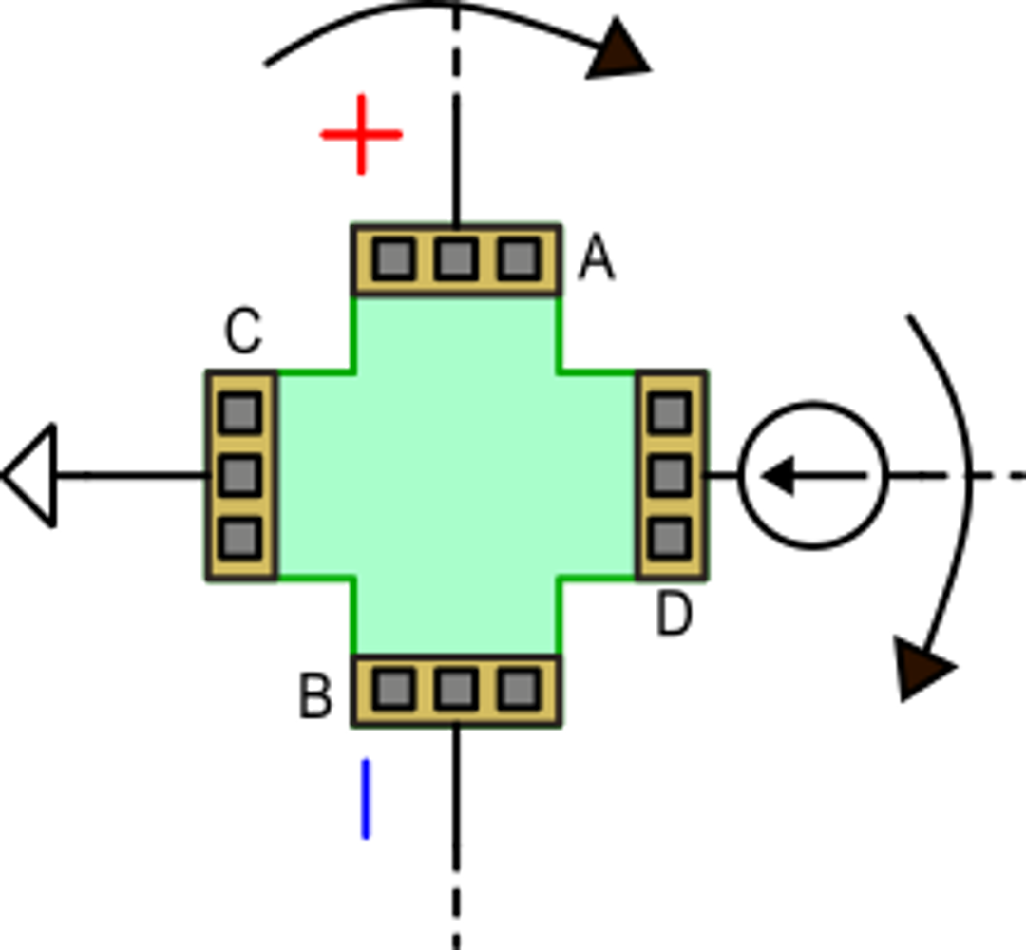
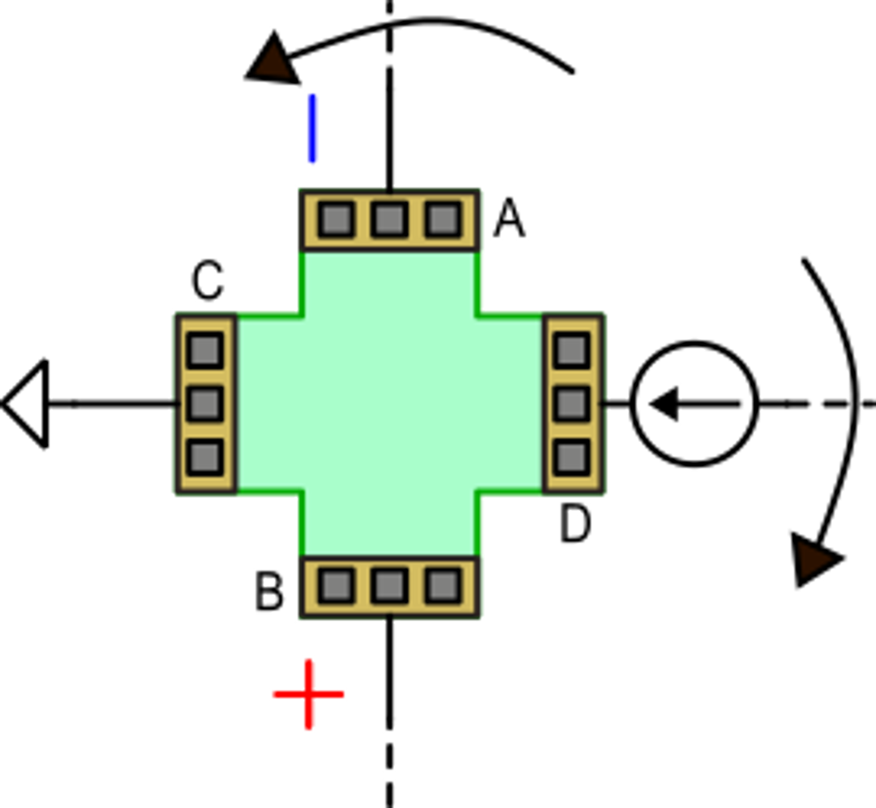
Current spinning
Let us start from this connection
... that can be represented in this way
Turning the bias and sensing terminals in the same direction:
Turning the bias and sensing terminals in opposite directions:

Slide 17
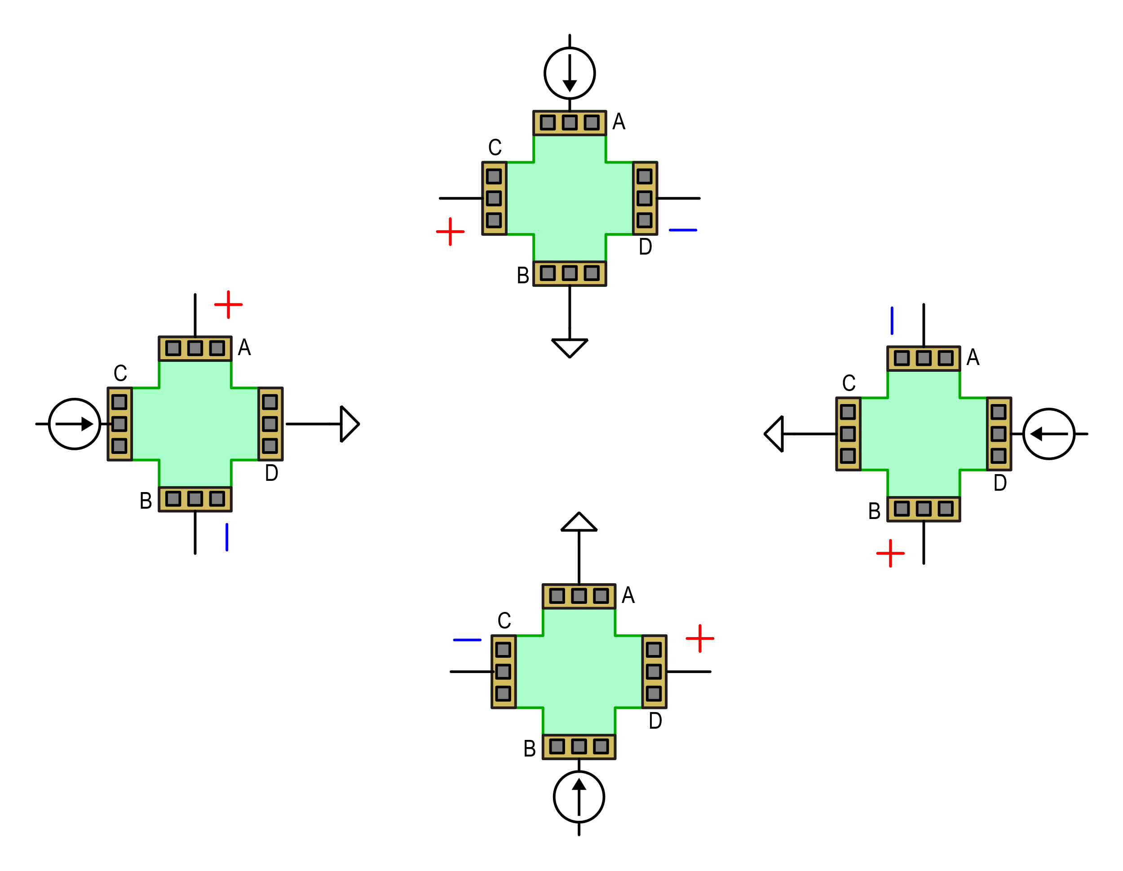
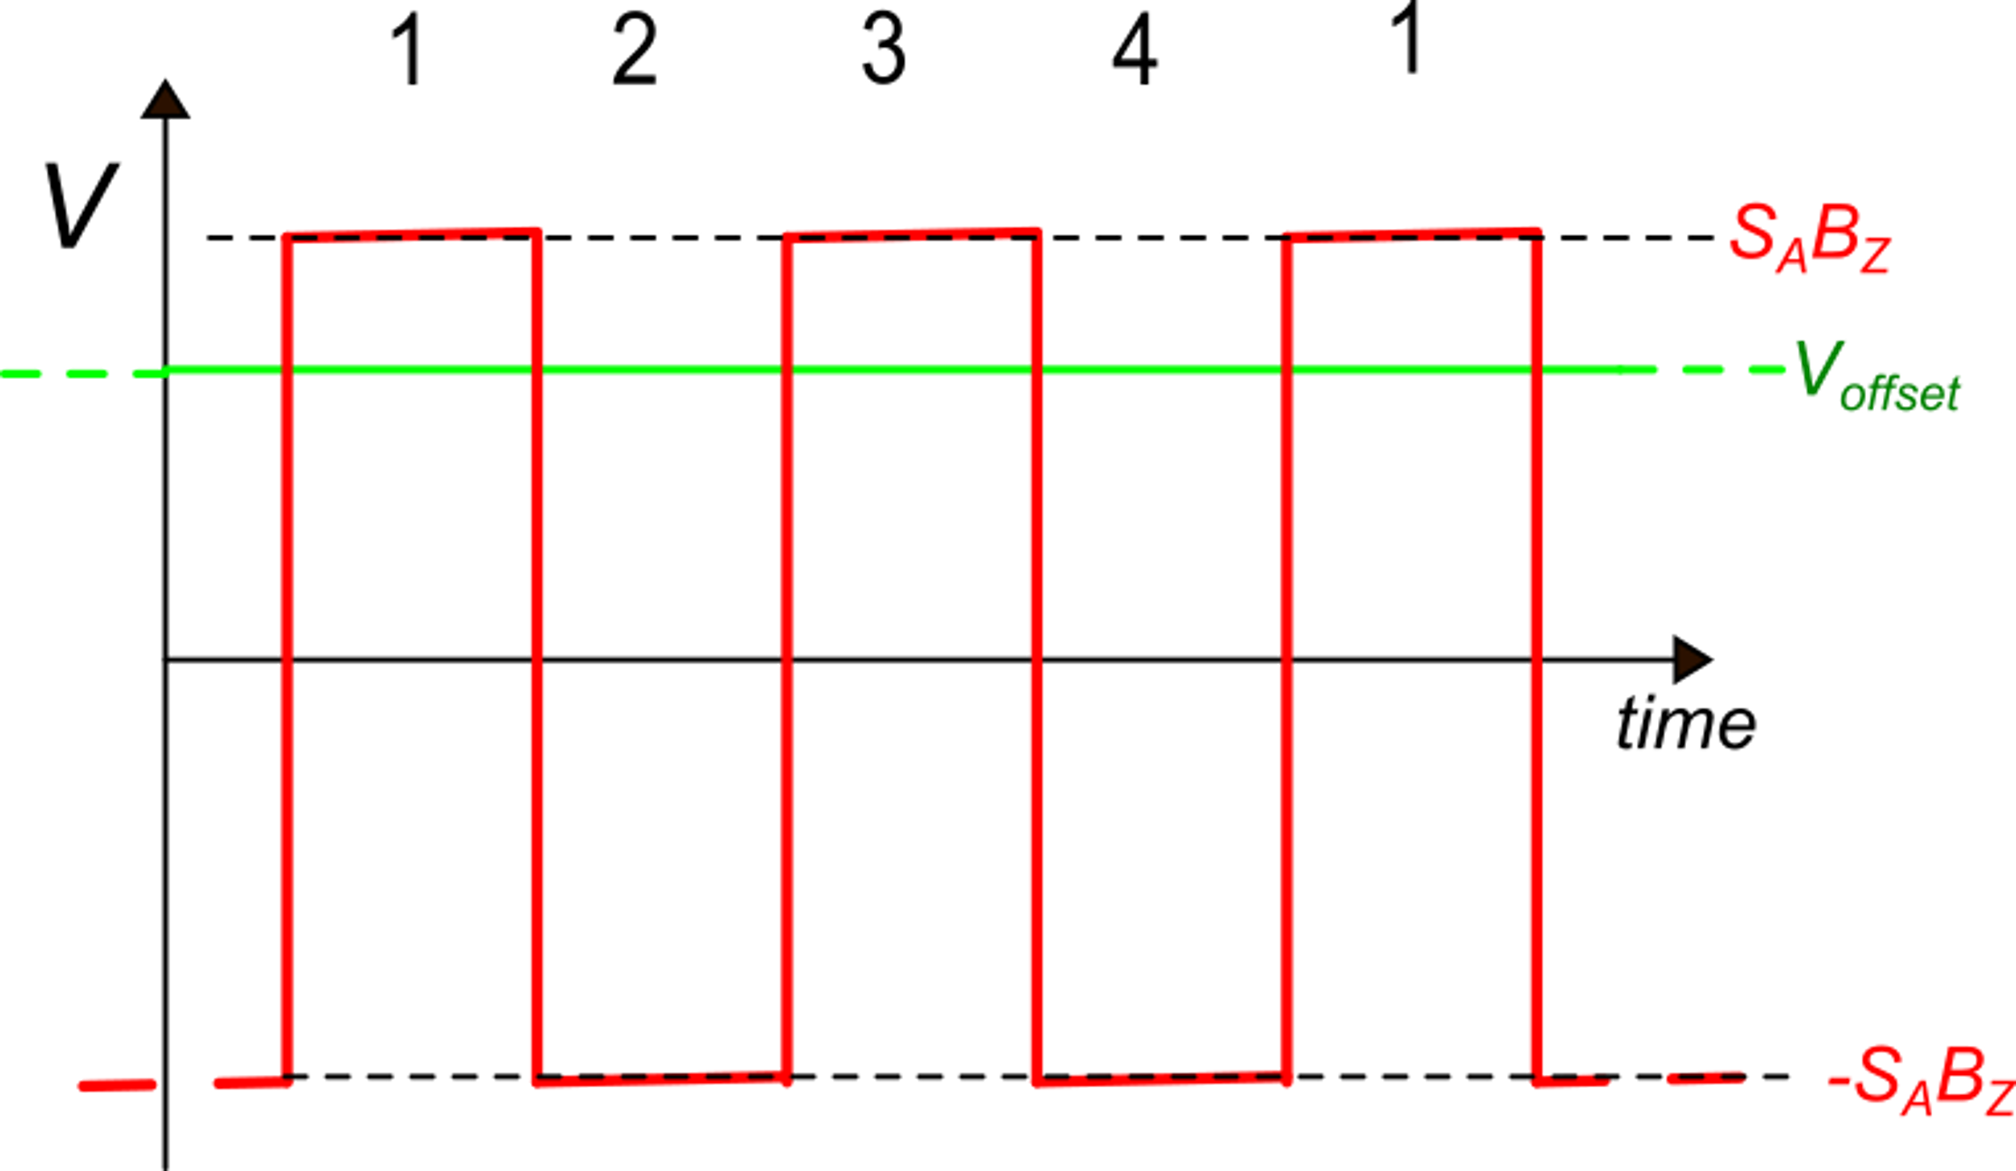
Current spinning
1
4
2
Current spinning applied by rotating the biasing and sensing axis in opposite directions leaves the offset in DC, while modulates the useful signal (S_{A}B_{Z})
3

Slide 18
Possible interface circuit for Hall sensors
This high-pass filter (HPF) stops the DC offset voltage, preventing the following stages from saturating
First stage
Second stage
The demodulator brings the useful signal back to baseband and shifts the DC offset and flicker noise of the second stage to high frequencies, where it is rejected by the low-pass filter (LPF)

Slide 19
Magnetometer based on Hall sensors: open problems
Performance with small fields
The spinning approach can reduce the offset field (B_{io}) by more than a factor of 100, but a residual offset in the order of 10-100 mT typically remains. This is comparable with the Earth's magnetic field and is not compatible with fabrication of an accurate magnetic compass.
Reduced performance of vertical Hall Sensors: These sensors have typically a smaller sensitivity than planar hall sensors: Furthermore, they do not present symmetry between biasing and sensing contacts, and this makes the spinning approach less effective.
Classical Silicon-based Hall sensors are not suitable for fabrication of e-compasses

Slide 20
Possible solution for 3D sensors: application of magnetic concentrators
Ring of ferromagnetic
material (e.g. permalloy)
The ferromagnetic ring produces two effects:
Locally transform an in-plane field into a vertical field
Amplify the magnetic field by a factor 3-8
B_{X}
Planar Hall plates

Slide 21
Commercial product: a single-chip, three axis e-compass
The magnetic field amplification is maximum at the gaps between the ferromagnetic rings
Each axis is read by four hall plates whose output signals are summed at the amplifier input: this boost the sensitivity and reduce the offset.
The Z axis does not benefit from the magnetic field amplification caused by the concentrators.
Y
Z
X
X
Y
Requires deposition of a thick (20 μm) ferromagnetic layer.
The ferromagnetic layer can acquire permanent magnetization
Melexis MLX90333

