Slide 1
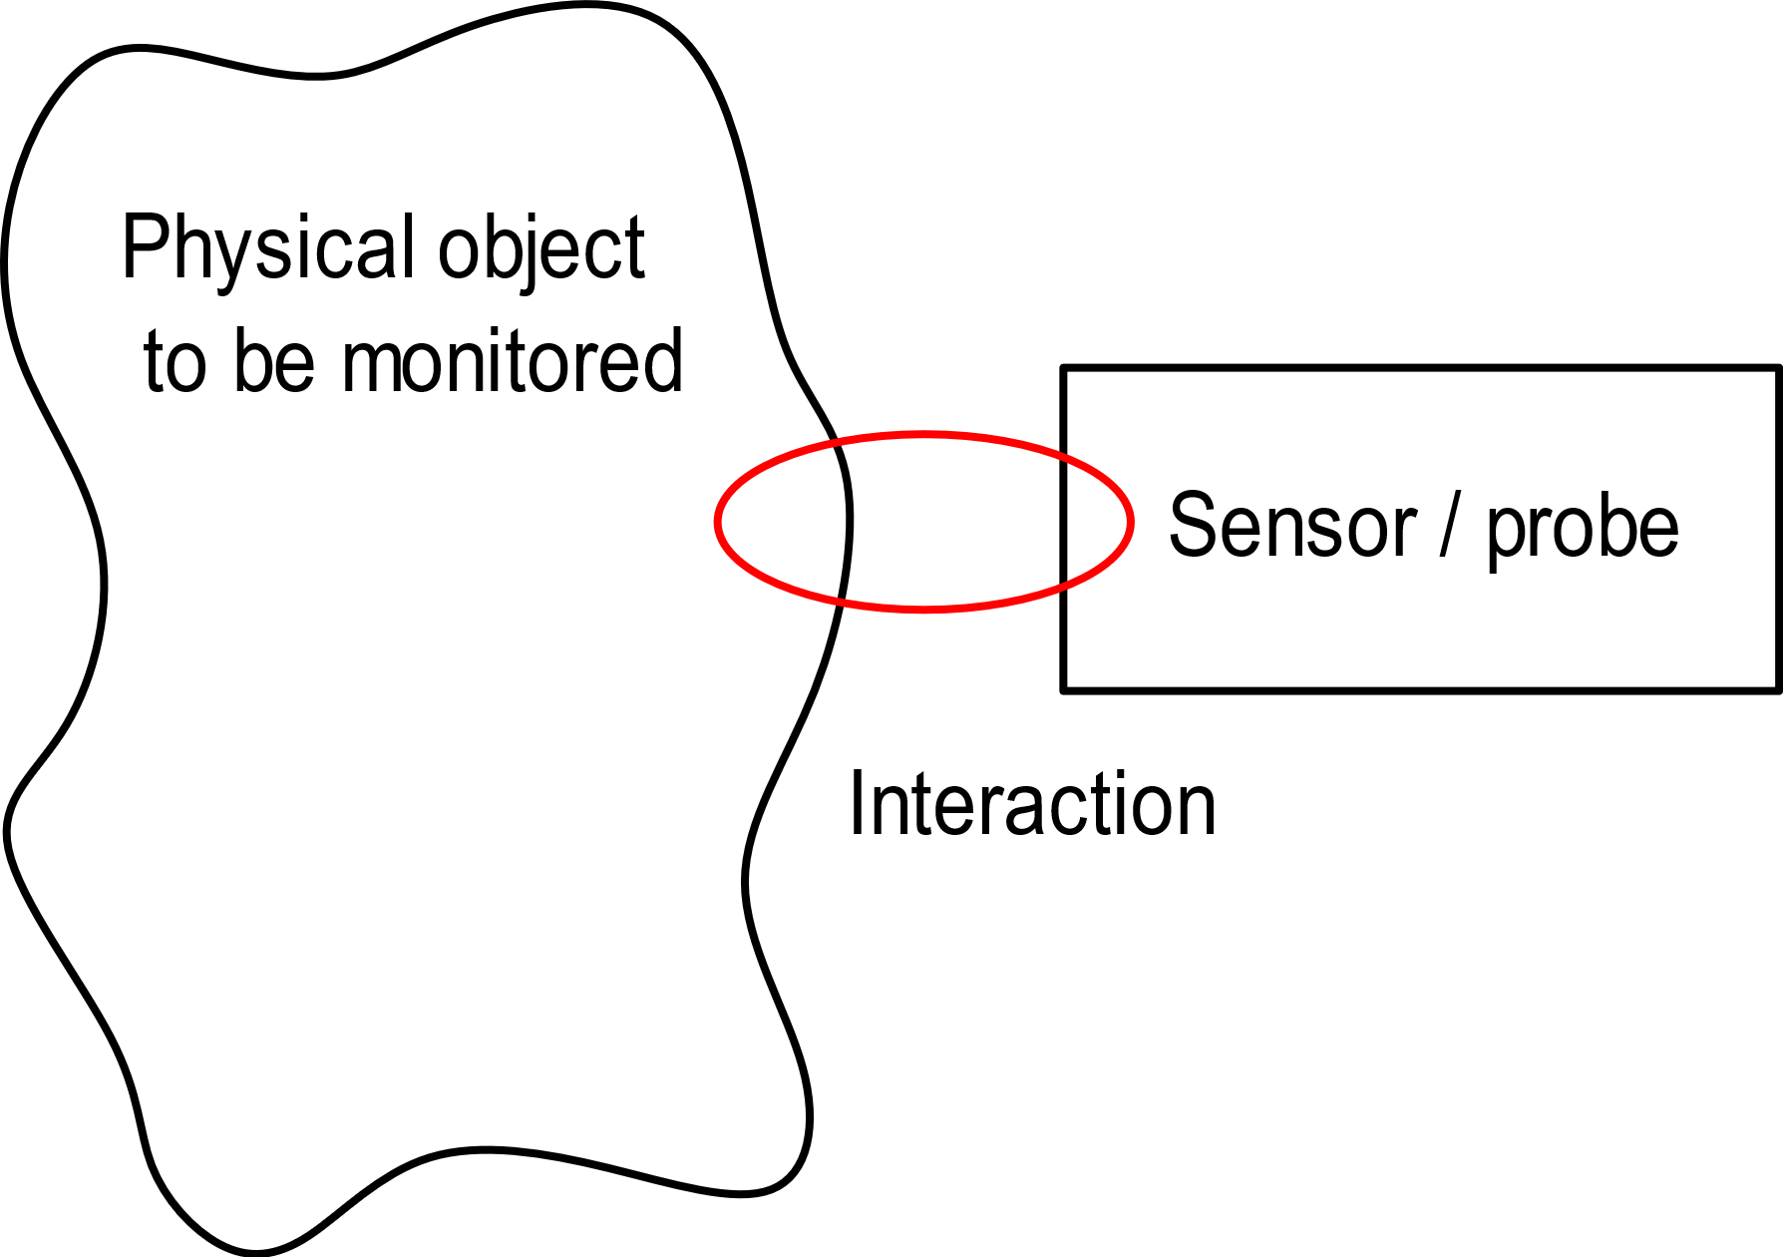
Sensor / object electrical coupling
The physical object is a solid, liquid or gaseous to which the quantity to be measured belongs
It can be a very simple object (e.g. a single-piece mechanical part) or a complex object, like the human body or a chemical reactor
The sensing operation requires the sensor / probe to interact with the physical object.
The sensor package (housing) must be designed to enable the required interaction and, at the same time, protect the sensors

Slide 2
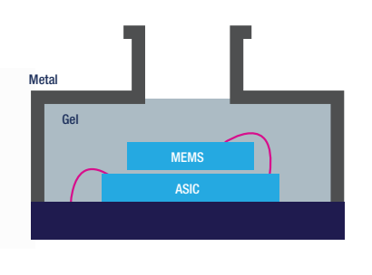
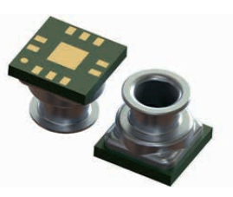
Sensor - object interaction
The interaction can be contactless (e.g. IR thermometer) or with contact (e.g. a thermocouple temperature probe).
Protection of the sensing elements is particularly important, for example, when the physical object is in liquid phase (liquid flow sensors, ion concentration sensors) or it is a corrosive gas.
Example: a liquid pressure sensor (10-bar resistant, usable for depth meters)
Insulating gel:
Avoid direct contact with the liquid but ….
LPS33HW
2) Transmit pressure from the liquid to the MEMS chip

Slide 3
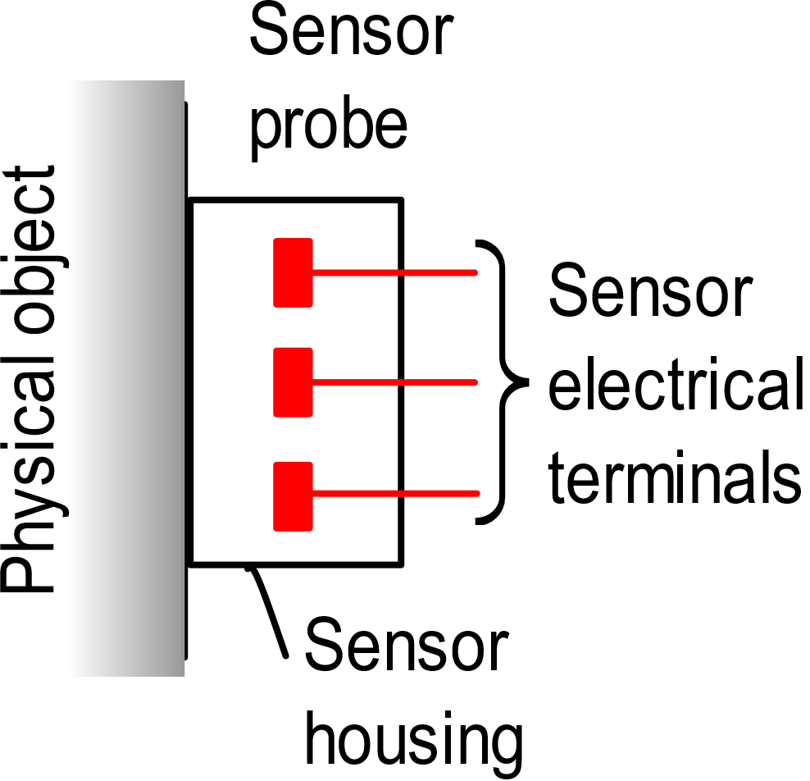
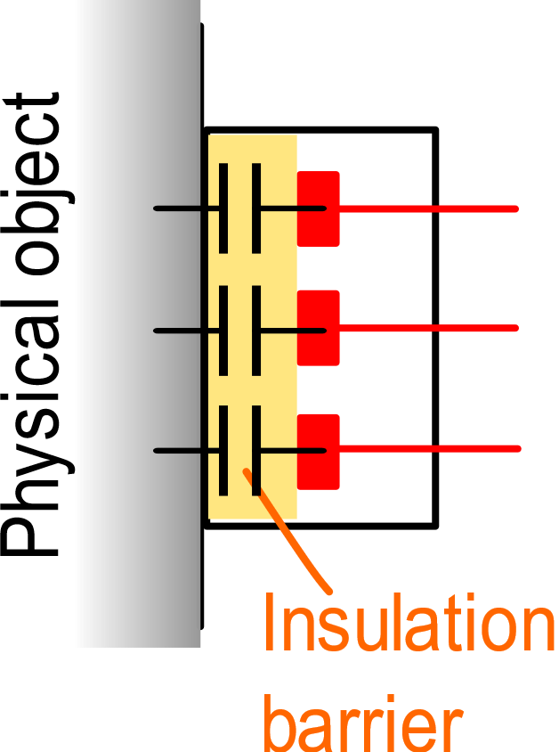
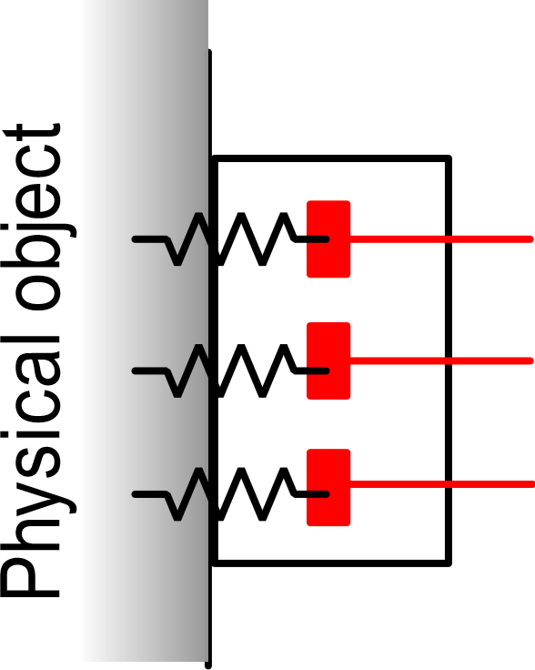
Electrical connection and continuity
A particular aspect that have to be assessed is the degree of electrical contact between the sensor terminals and the physical object
Only capacitive coupling
(AC coupling)
Only resistive coupling
The presence of a dc path can be unwanted (defective insulation) or necessary
C: order of pF
V_{ISO} (maximum that the barrier can withstand)

Slide 4
Examples
thermocouple
terminals
(or thermistor)
ceramic or plastic
conductivity probe
insulator
metal case
H₂O
Probe for the measurement of the water conductivity
(used to monitor the quality of water supplies)
liquid
Temperature probe
Electrical continuity is not necessary, but a leakage conductance between the sensor terminal and the liquid can develop when the insultaor properties degrade with time
In this case, electrical continuity is necessary to perform the measurement

Slide 5
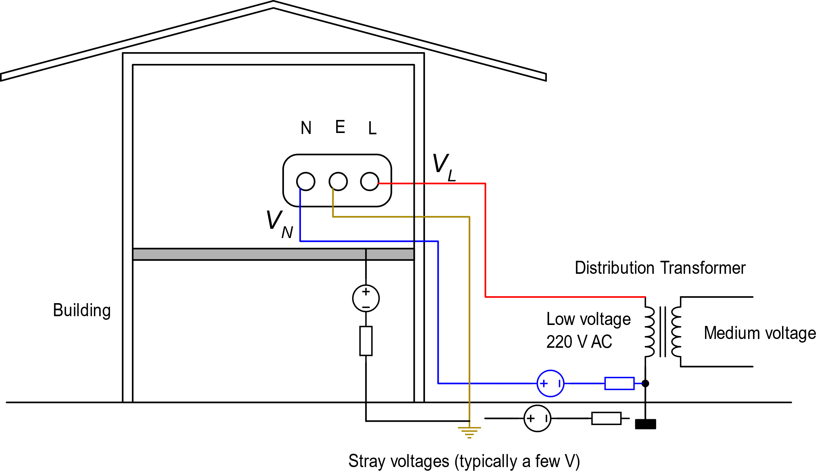
Voltages due to mains inside a building
N= Neutral
E= Earth
L= Live (or "phase")
power wall socket
The neutral is connected to the earth at the distribution transformer

Slide 6
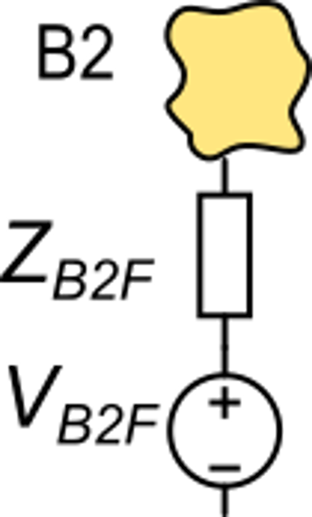
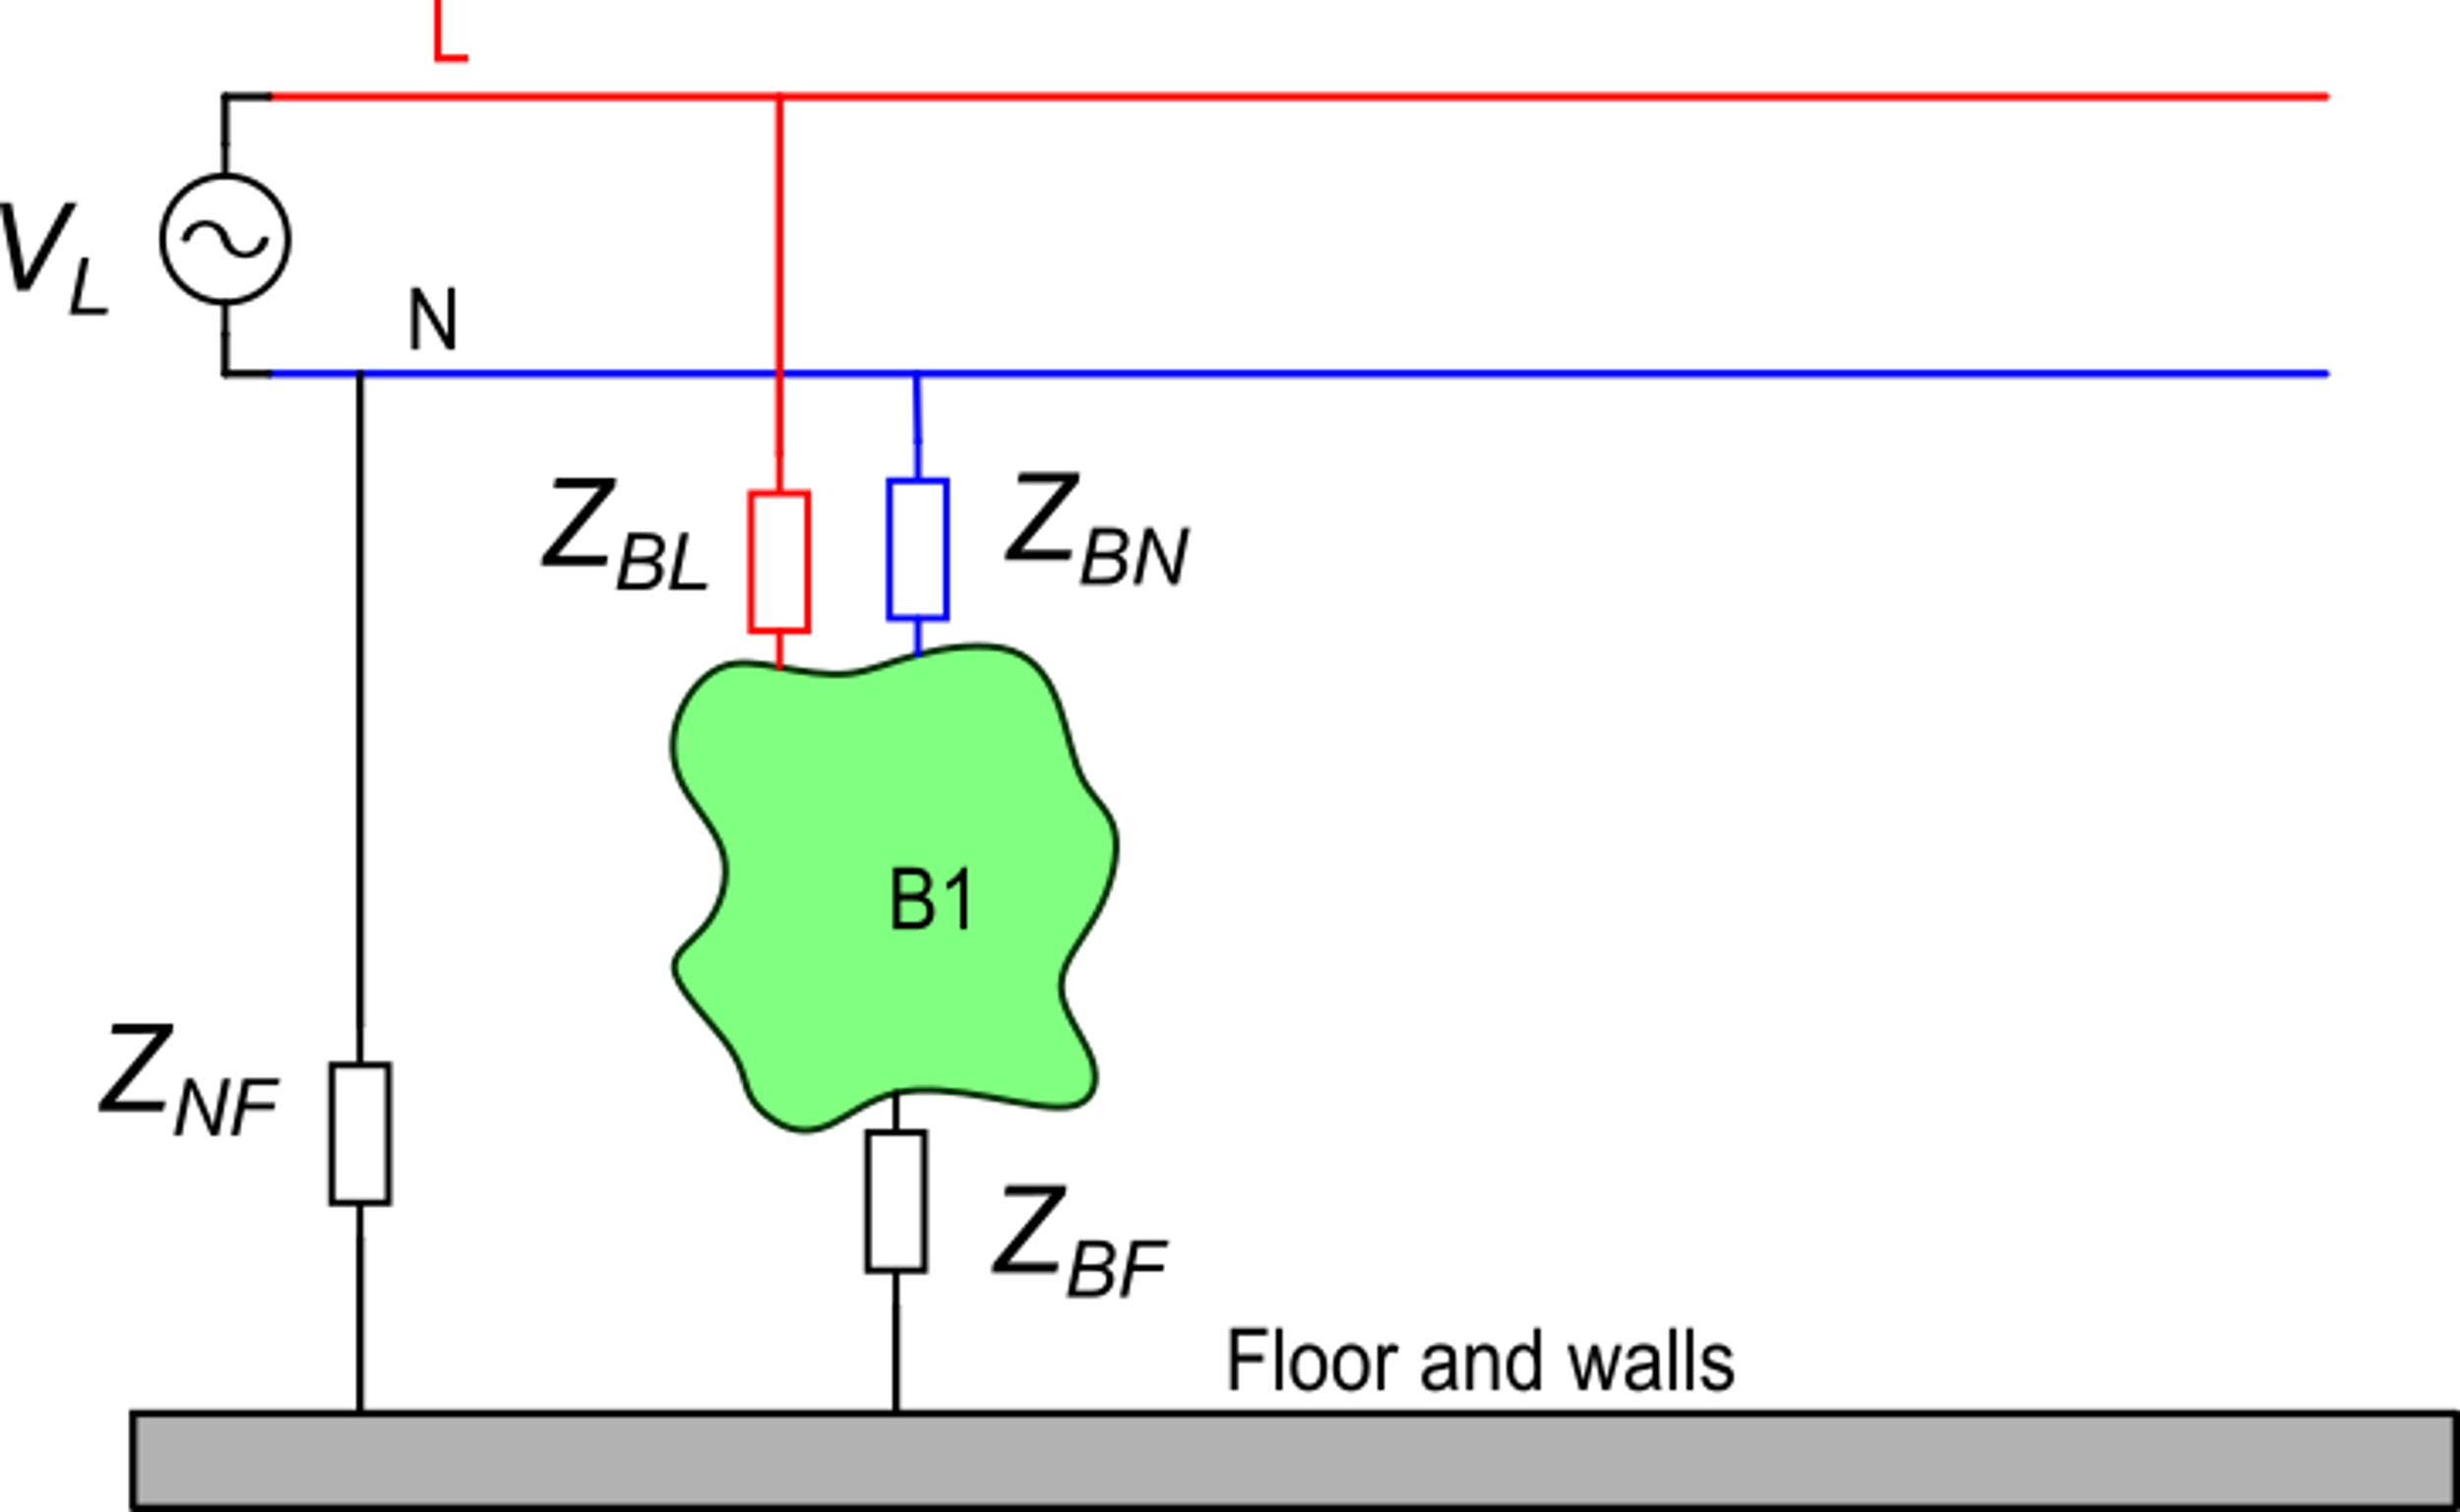
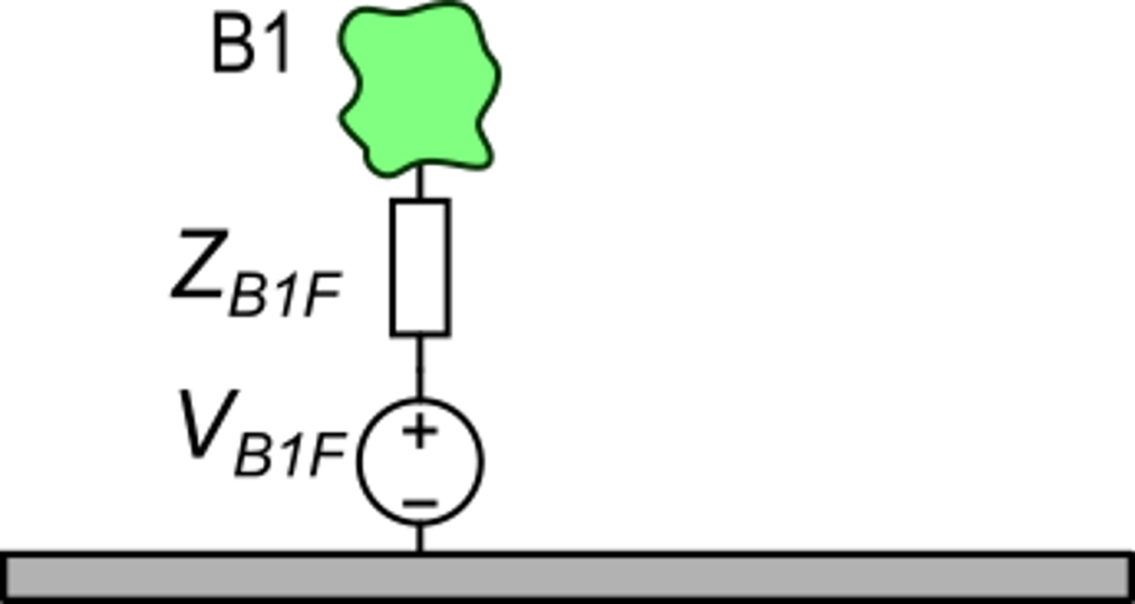
Consequences of the presence of AC power distribution
B1: conducting body
Generally:

Slide 7
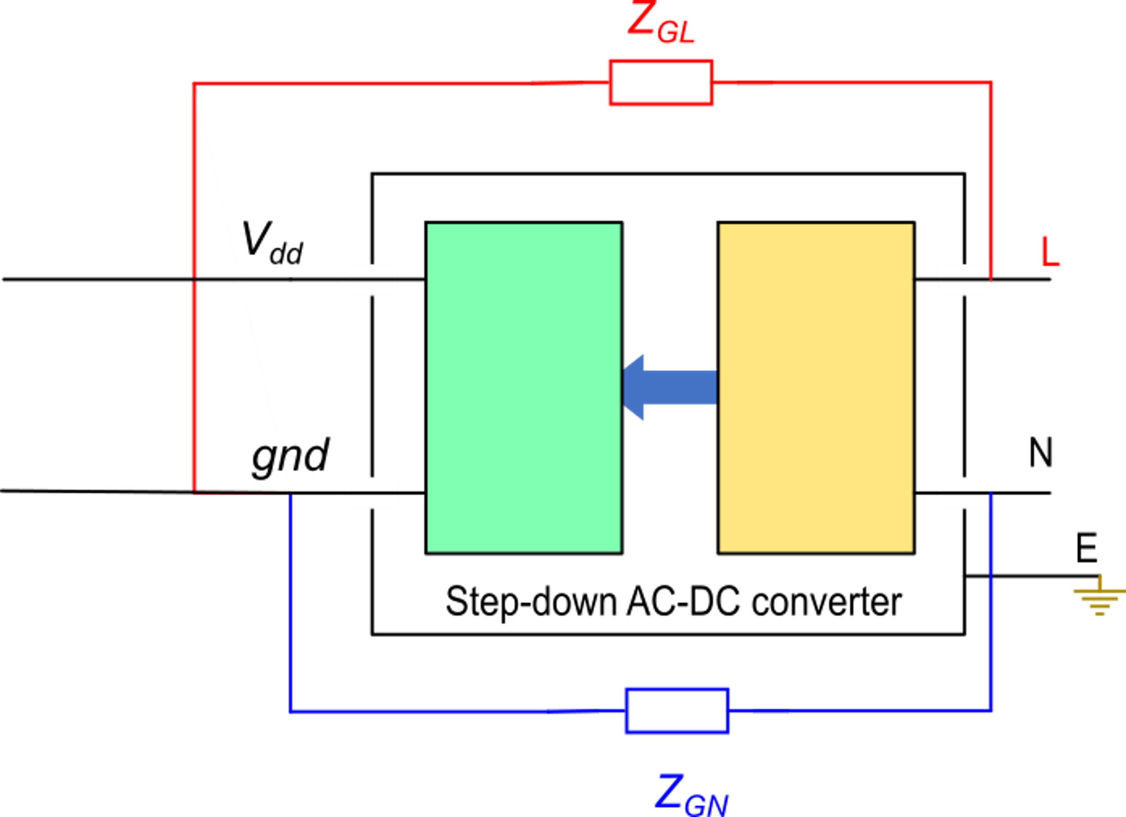
Particular case: the power supply
Isolation barrier
V_{dd}
gnd
Z_{GF}
V_{GF}
Power
This is the actual equivalent circuit that takes into account also the connection towards the floor and the relative voltage.
In any power supply it is impossible to avoid leakage impedances (Z_{GL}, Z_{GN}) between the input output terminals

Slide 8
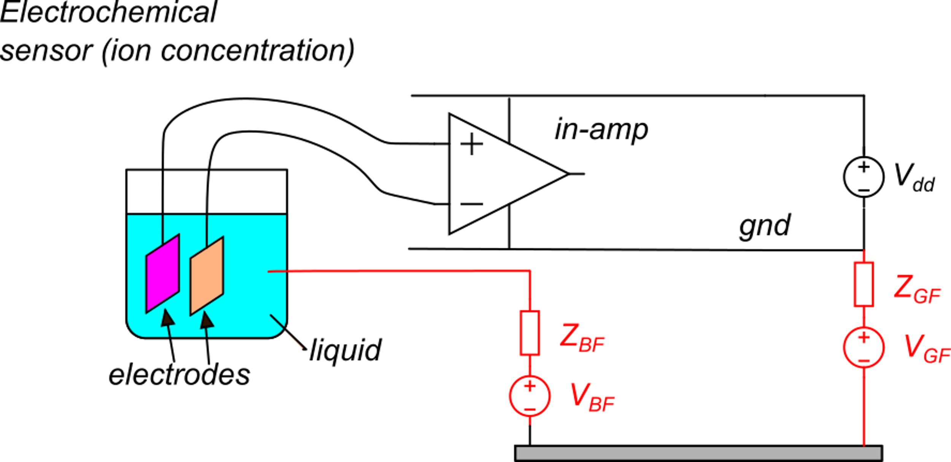
A few significant cases
Presence of electrical continuity between a conductive physical object and the sensor terminals.
Example
Suppose that: 1) the input impedance is infinite
2) the voltages between the electrodes and the liquid are negligible
With this simplified model, the input common mode voltage of the in-amp is:
Since V_{BF} and V_{GF} are important fraction of the mains voltage (220 V r.m.s):
The amplifier will be damaged or the protection at the input terminals activate, making the measurement meaningless

Slide 9
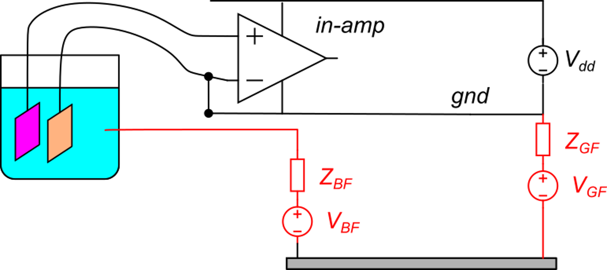
Two possible solutions:
Connect one of the two terminals to gnd. In this way, the input common mode voltage is close to zero.
The problem with solution is that a current flows trough one of electrodes. Since the series resistance between the electrode and the solution can be relatively high, the current can cause an important error in the measurement.
I_{G}
connection of one input to gnd

Slide 10
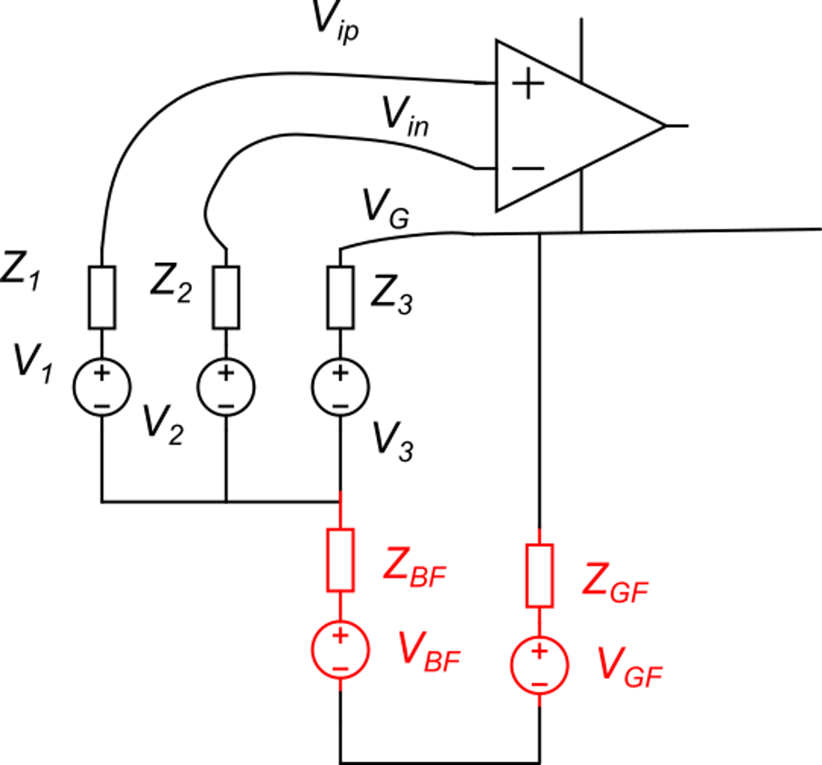
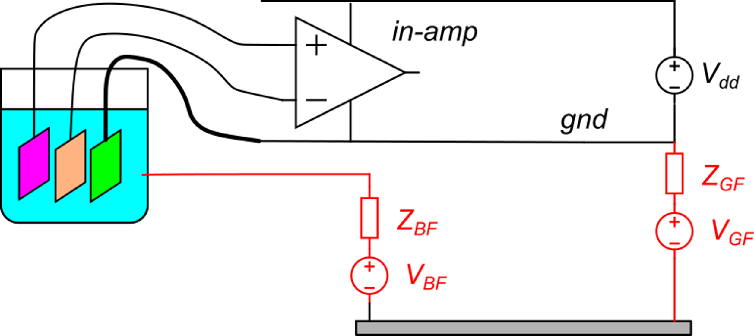
Second solution
Use a third electrode to connect the gnd of the amplifier to the fluid
("Three electrode measurement")
I_{G}
I_{G}
V_{B}
V_{B}

Slide 11
Second solution
Such a small V_{C} can be tolerated by the amplifier
V_{B}
V_{B}
If the input amplifier impedance is >> Z_{1,}Z₂:
If Z₃ << Z_{BF}+Z_{GF}, the effect of voltages V_{BF} and V_{GF} on V_{C} can be as small as a few hundred mv
The differential voltage is not affected by V_{BF} and V_{GF}

Slide 12
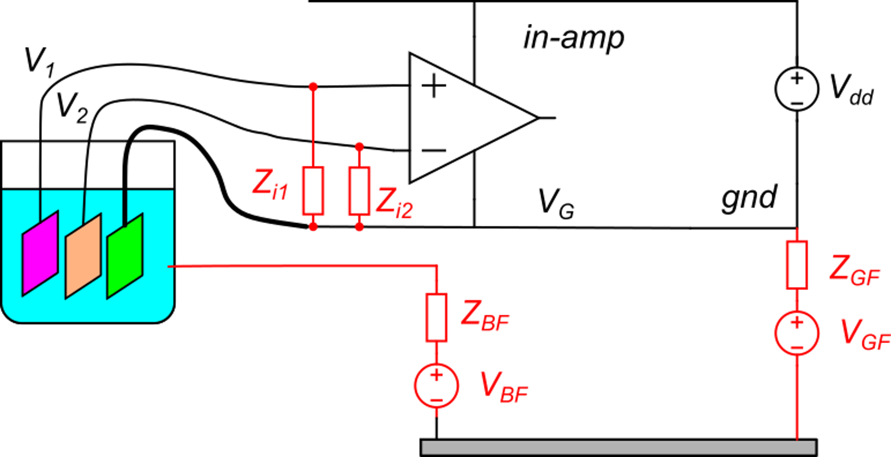
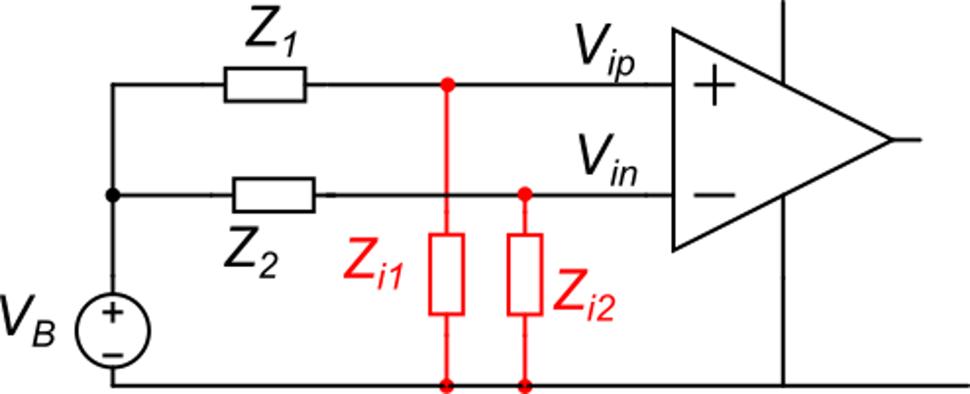
Effect of the finite input impedances of the amplifier
(this is an AC
disturbance voltage)
α₁
α₂
Due to unavoidable impedance mismatch, the two impedance ratios α₁ and α₂ are not equal and a common mode disturbance voltages generate a differential voltage.

Slide 13
Effect of the finite input impedances of the amplifier
V_{B} can include the fundamental component of the AC power line (50 or 60 Hz, depending on country) but also harmonics at higher frequency and other disturbance signals from motors, DC-DC converters, etc,
The amplifier input impedances Z_{i1} and Z_{i2} are mainly capacitive, while Z₁ and Z₂ may include both capacitive and resistive components.
Clearly, in the case that Z_{i1},Z_{i2} >> Z₁,Z₂, the impedance ratios α₁ and α₂ are very close to 1 and their difference is close to zero. This is the case of infinite input amplifier that we have analyzed before, where the effect of V_{B} on V_{id} was null.

Slide 14
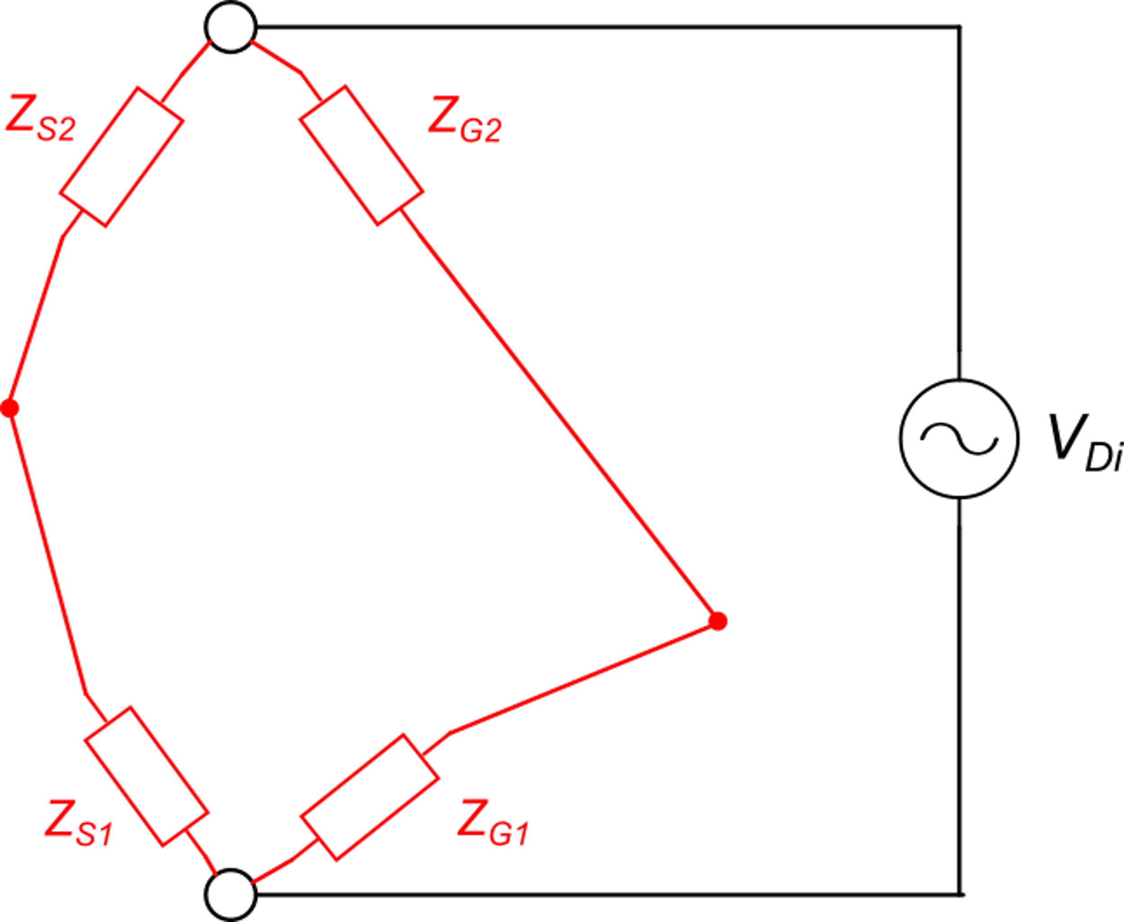
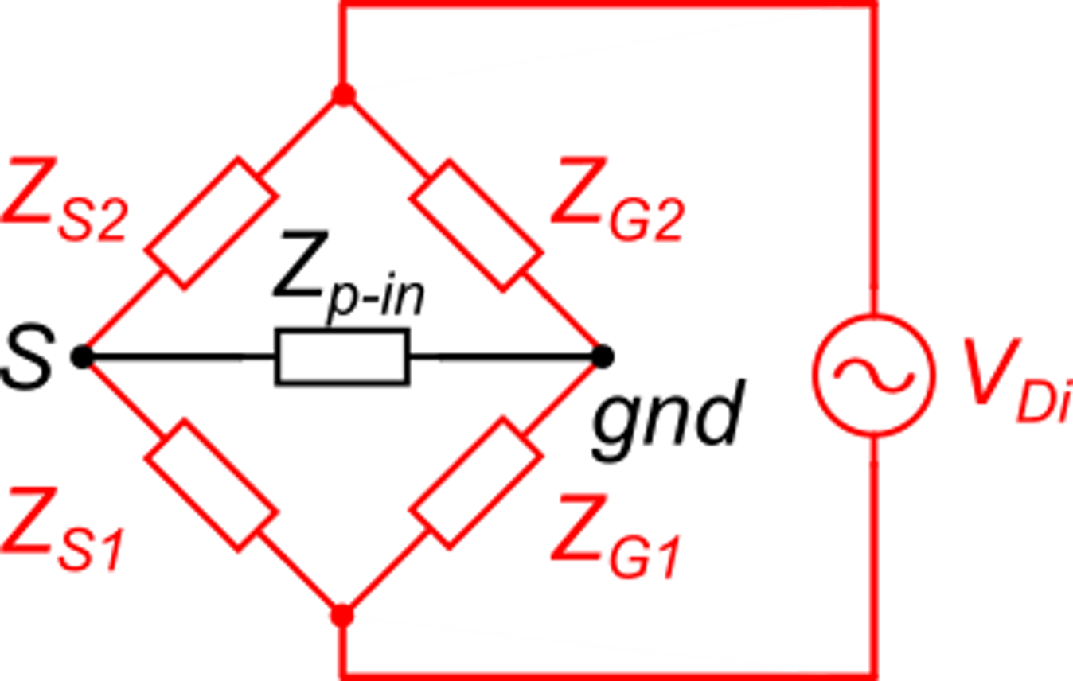
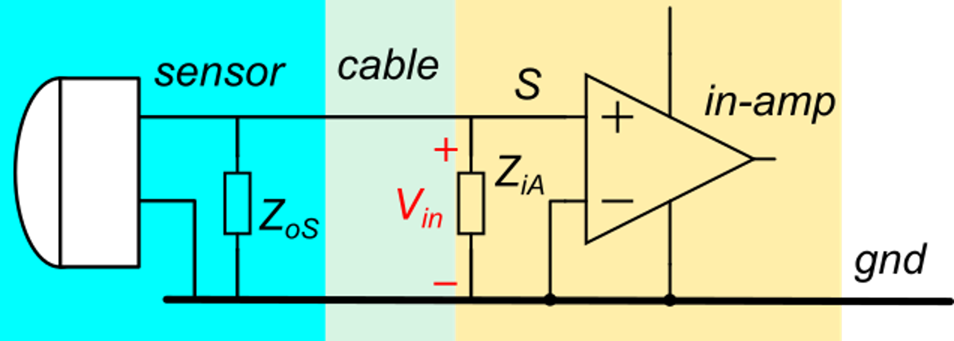
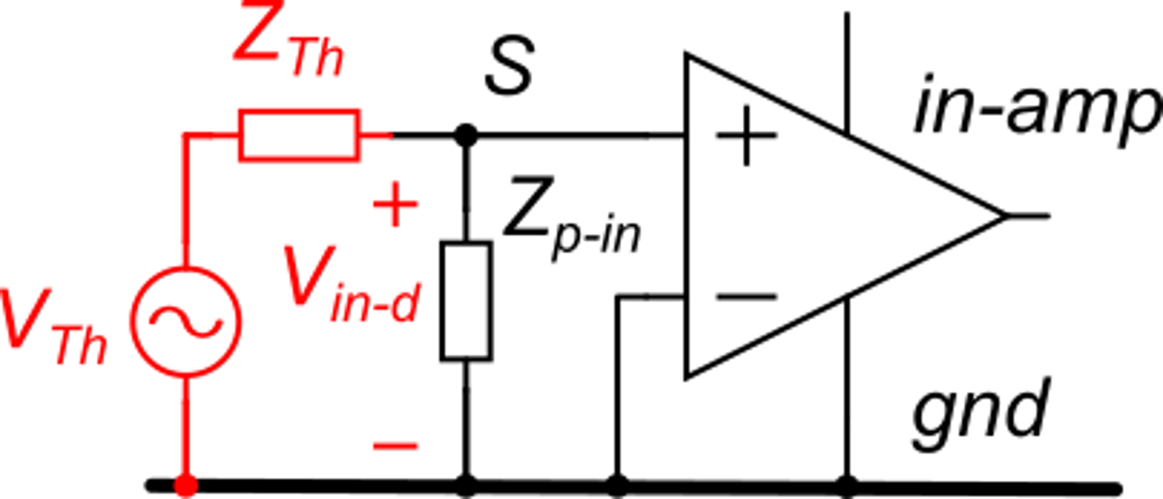
General case of no electrical continuity
These impedances are usually capacitances
Circuit for calculation of the disturbance at the amplifier input
That can be further simplified, applying the Thevenin theorem at the bridge diagonal where Zp-in is placed. The Thevenin equivalent does not include Zp-in
Here, we represent a typical connection between amplifier and sensor ...
... and we add a disturbance voltage applied between two conductors. This disturbance can be the AC power line, but also have a different origin

Slide 15
General case of no electrical continuity
V_{TH} is zero only for:
which generally does not occur.
With a careful design:
For a given Z_{p-in} (sensor and amplifier), the higher Z_{th}, the smaller the input disturbance

Slide 16
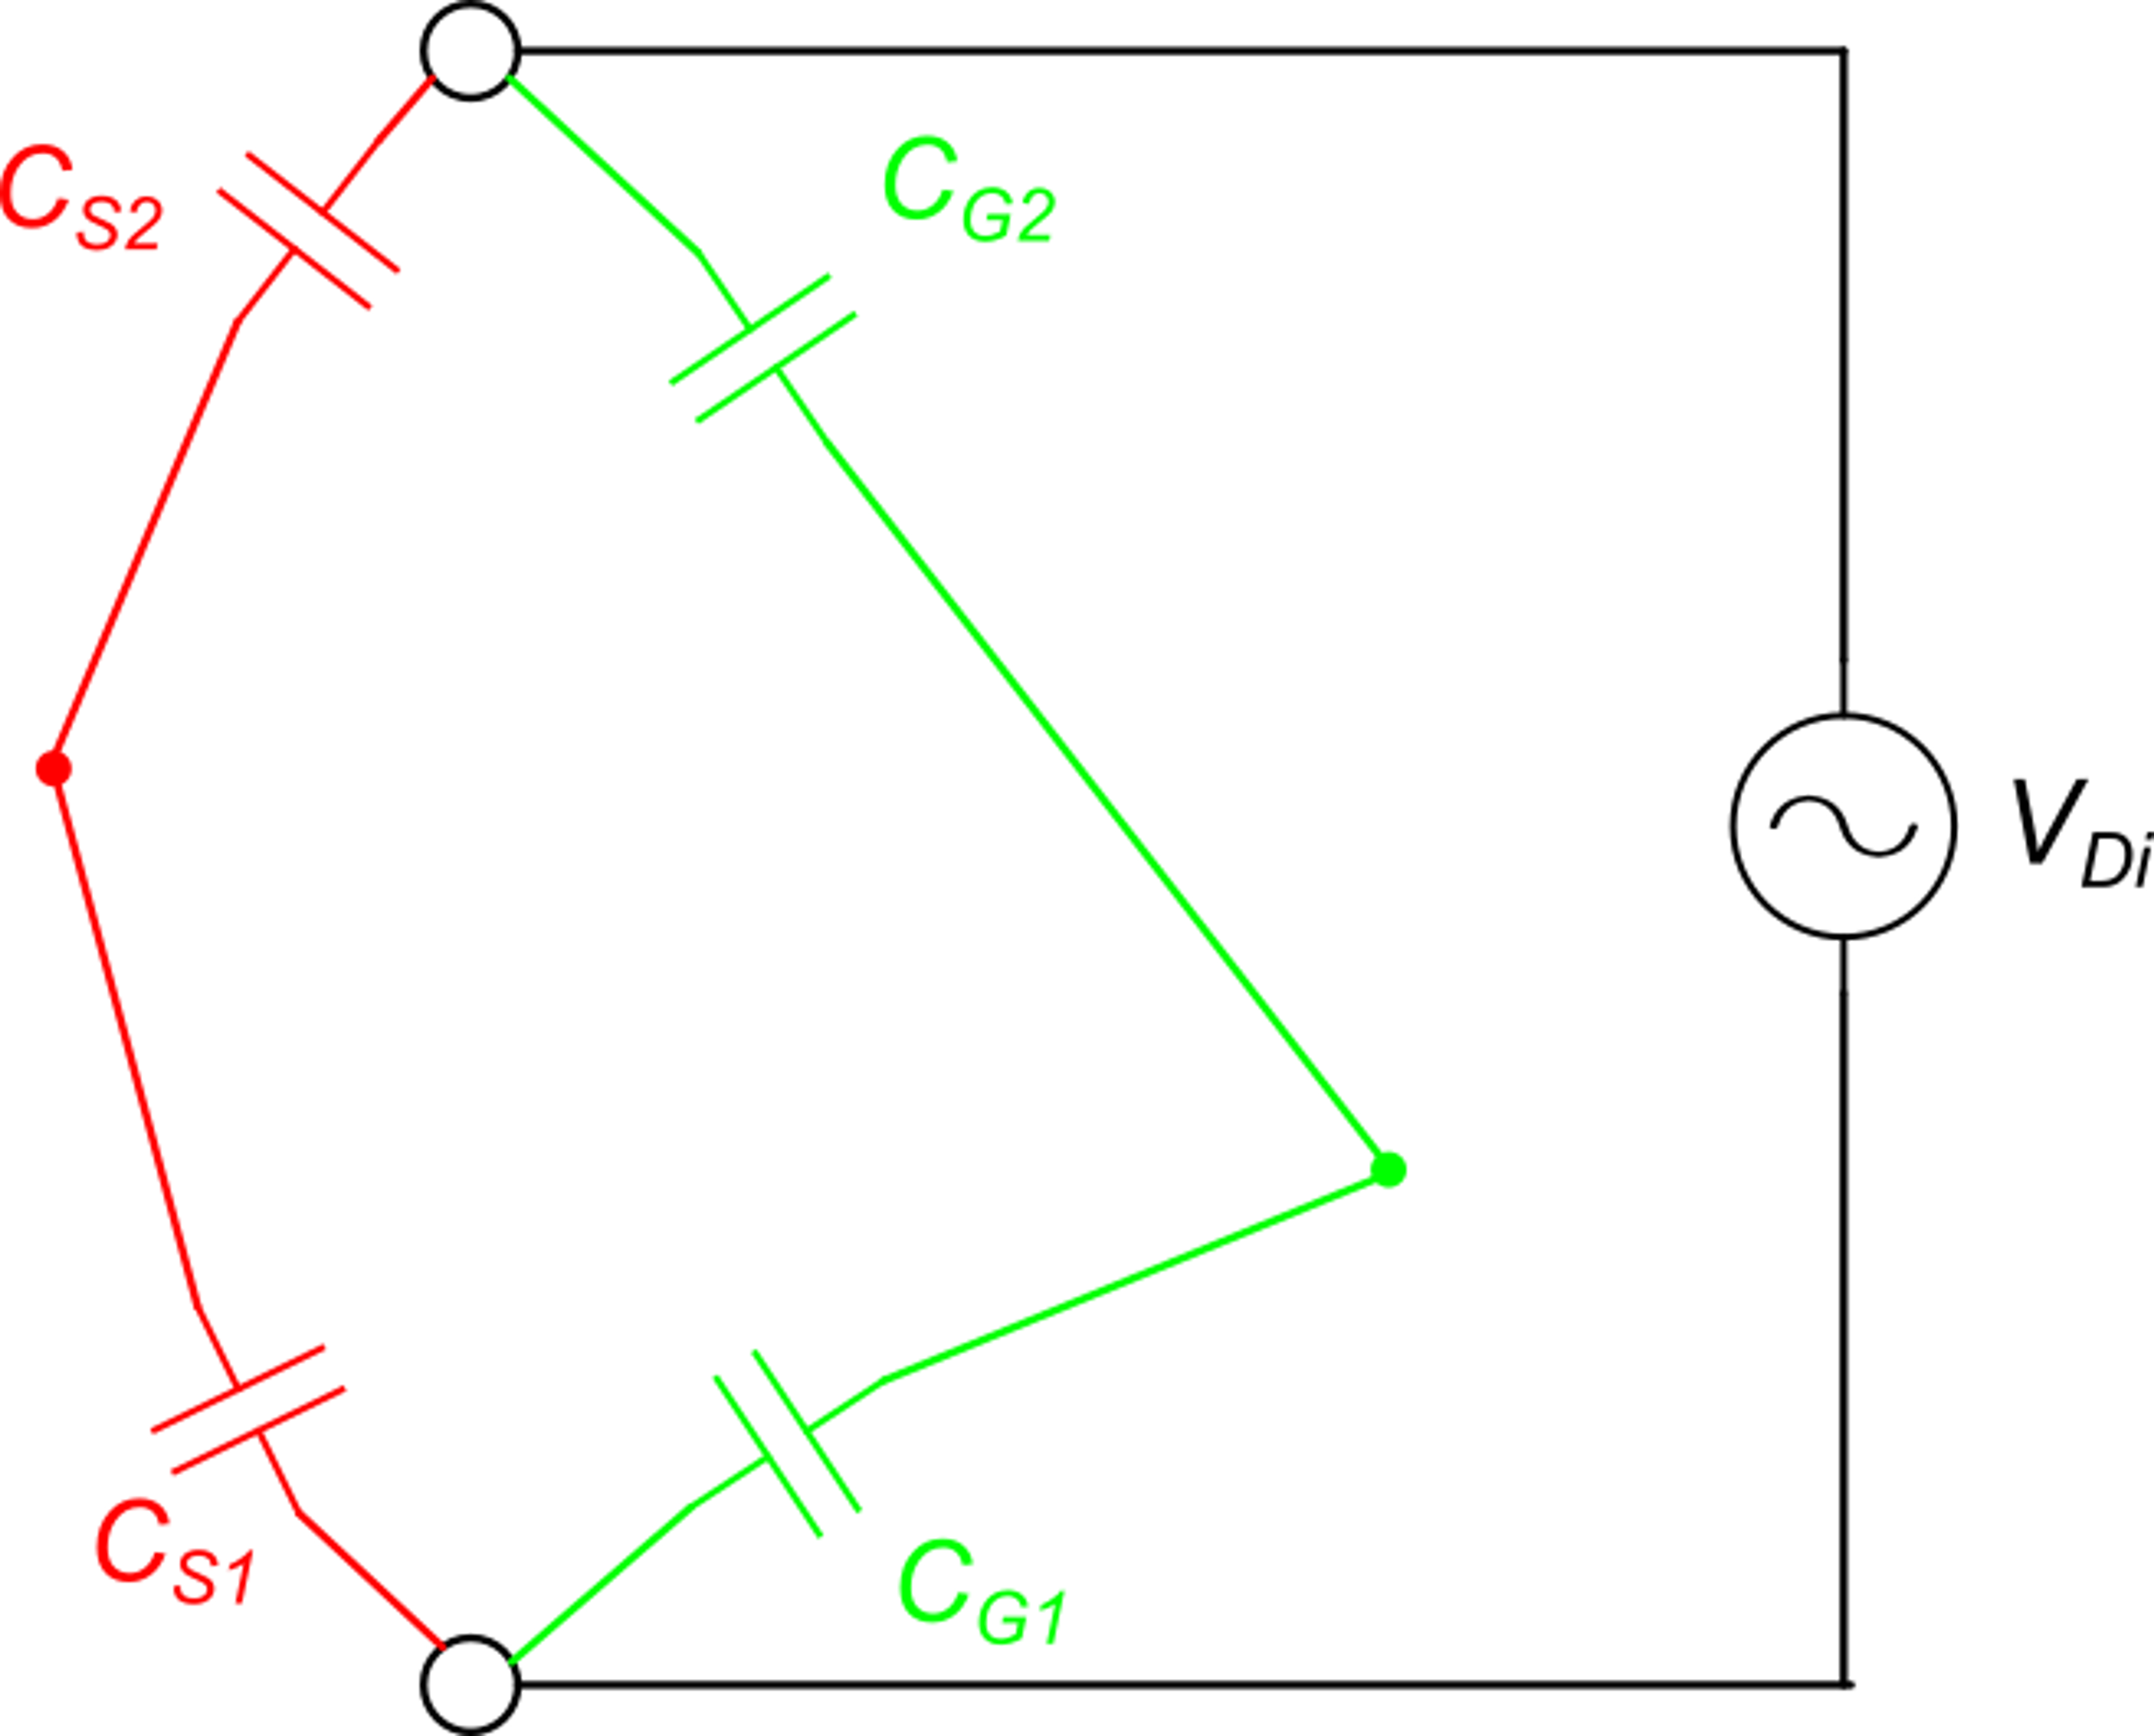
Disturbance minimization: capacitive (electrostatic) coupling
The magnitude of this component, due to the "hot" terminal, is much higher than the other, because capacitances that involve the gnd node (and all other nodes connected to it) are much larger.
In order to minimize the interference, we can maximize the impedance between the "hot terminal" and the disturbance conductors. This means reducing the related capacitances C_{S1} and C_{S2}.

Slide 17
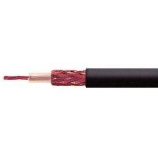
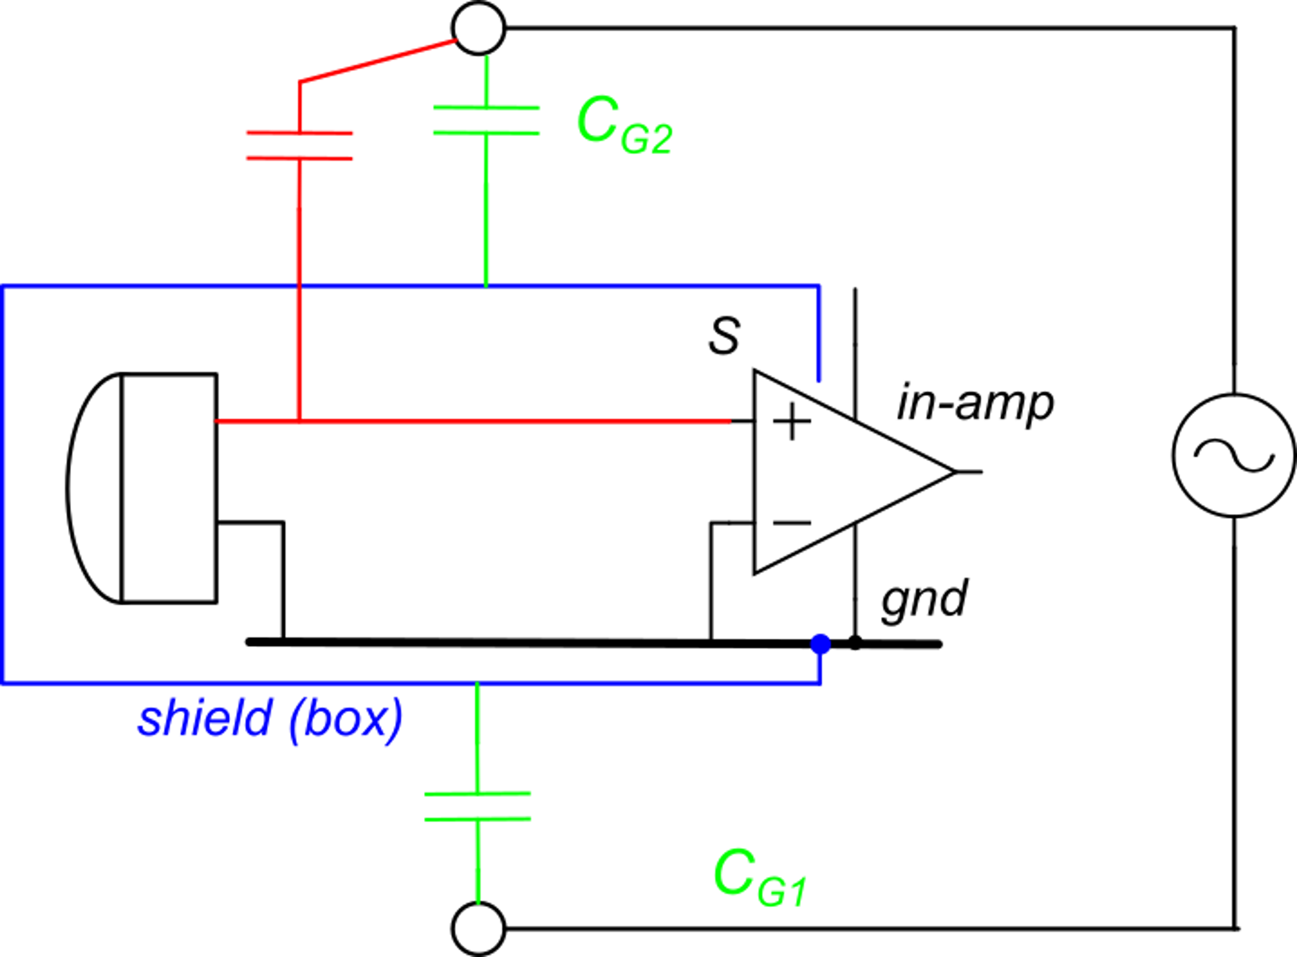
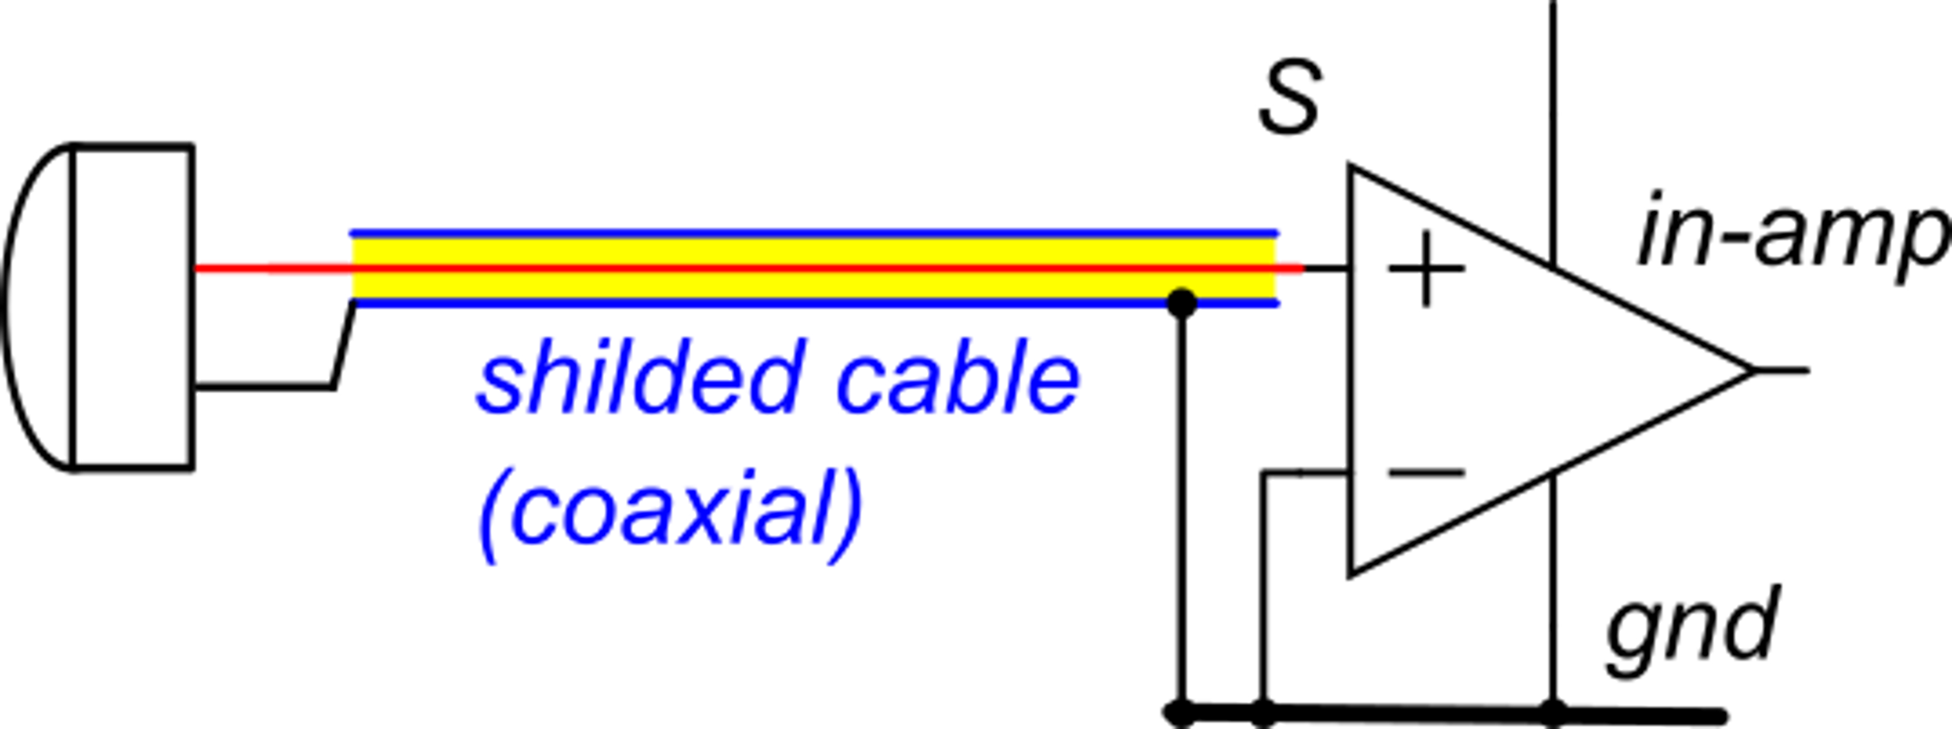
Mutual capacitance reduction: shielding
External conductors cannot produce fields inside the shield ("faraday cage")
For relatively long connections between the sensor and the amplifier, a shielded coaxial cable can be used to protect the internal "hot" terminal from interaction with disturbance conductors.
We add a conductive shield that wraps around the sensitive input node (and other sensitive nodes, if any)

Slide 18
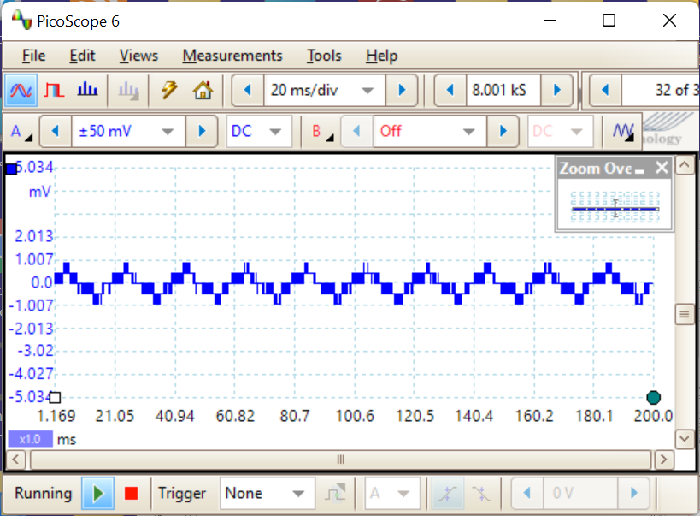
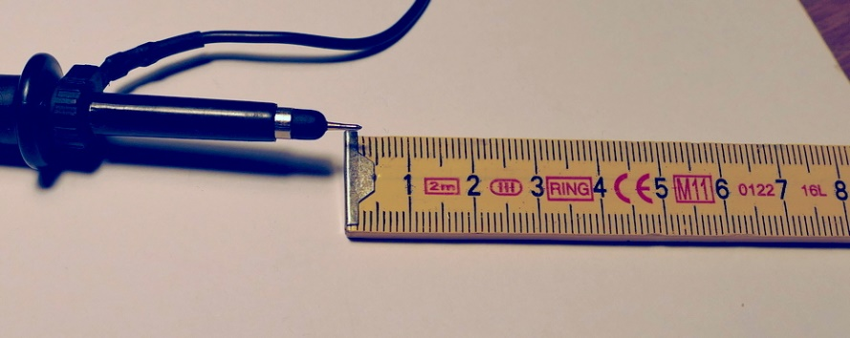
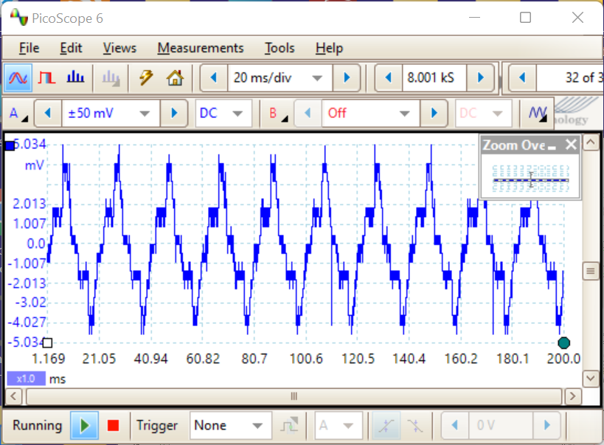
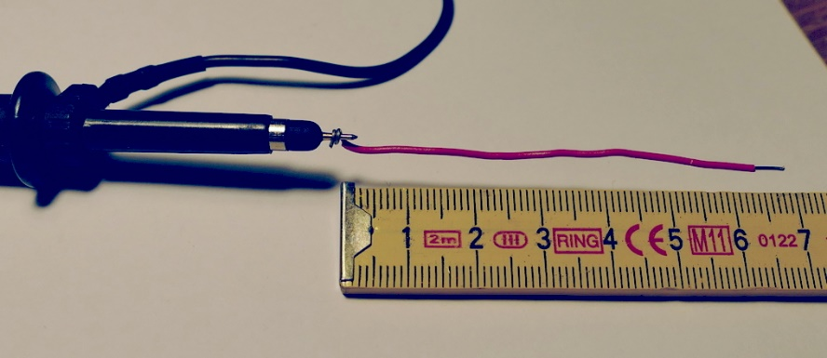
Example
Oscilloscope probe. The input "hot" terminal is shielded.
The exposed conductor is less than 1 cm long
Just adding 6 cm of unshielded conductor ...
~10 mV p-p
50 Hz with strong harmonics

Slide 19
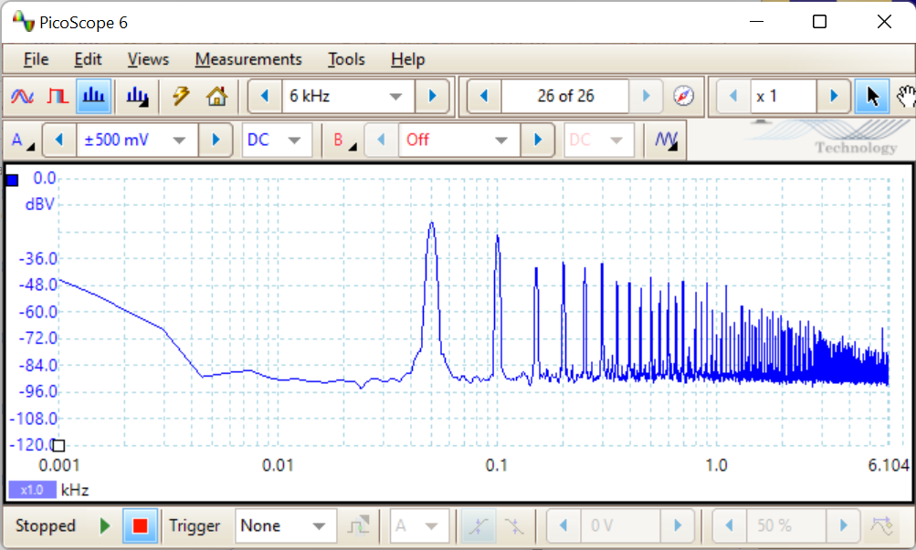
Spectral content of the disturbance voltage
The voltage picked up from the AC power line by capacitive coupling is much more distorted than the original voltage, since high order harmonics find much less attenuation:
At low frequencies the resistive component dominates
50 Hz
horizontal scale: kHz

Slide 20
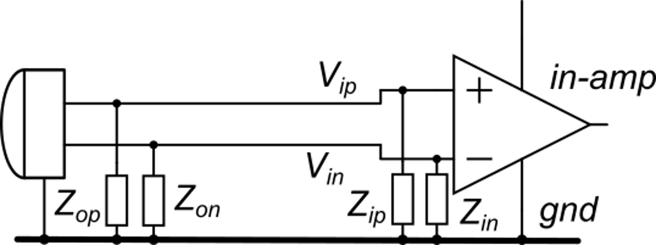
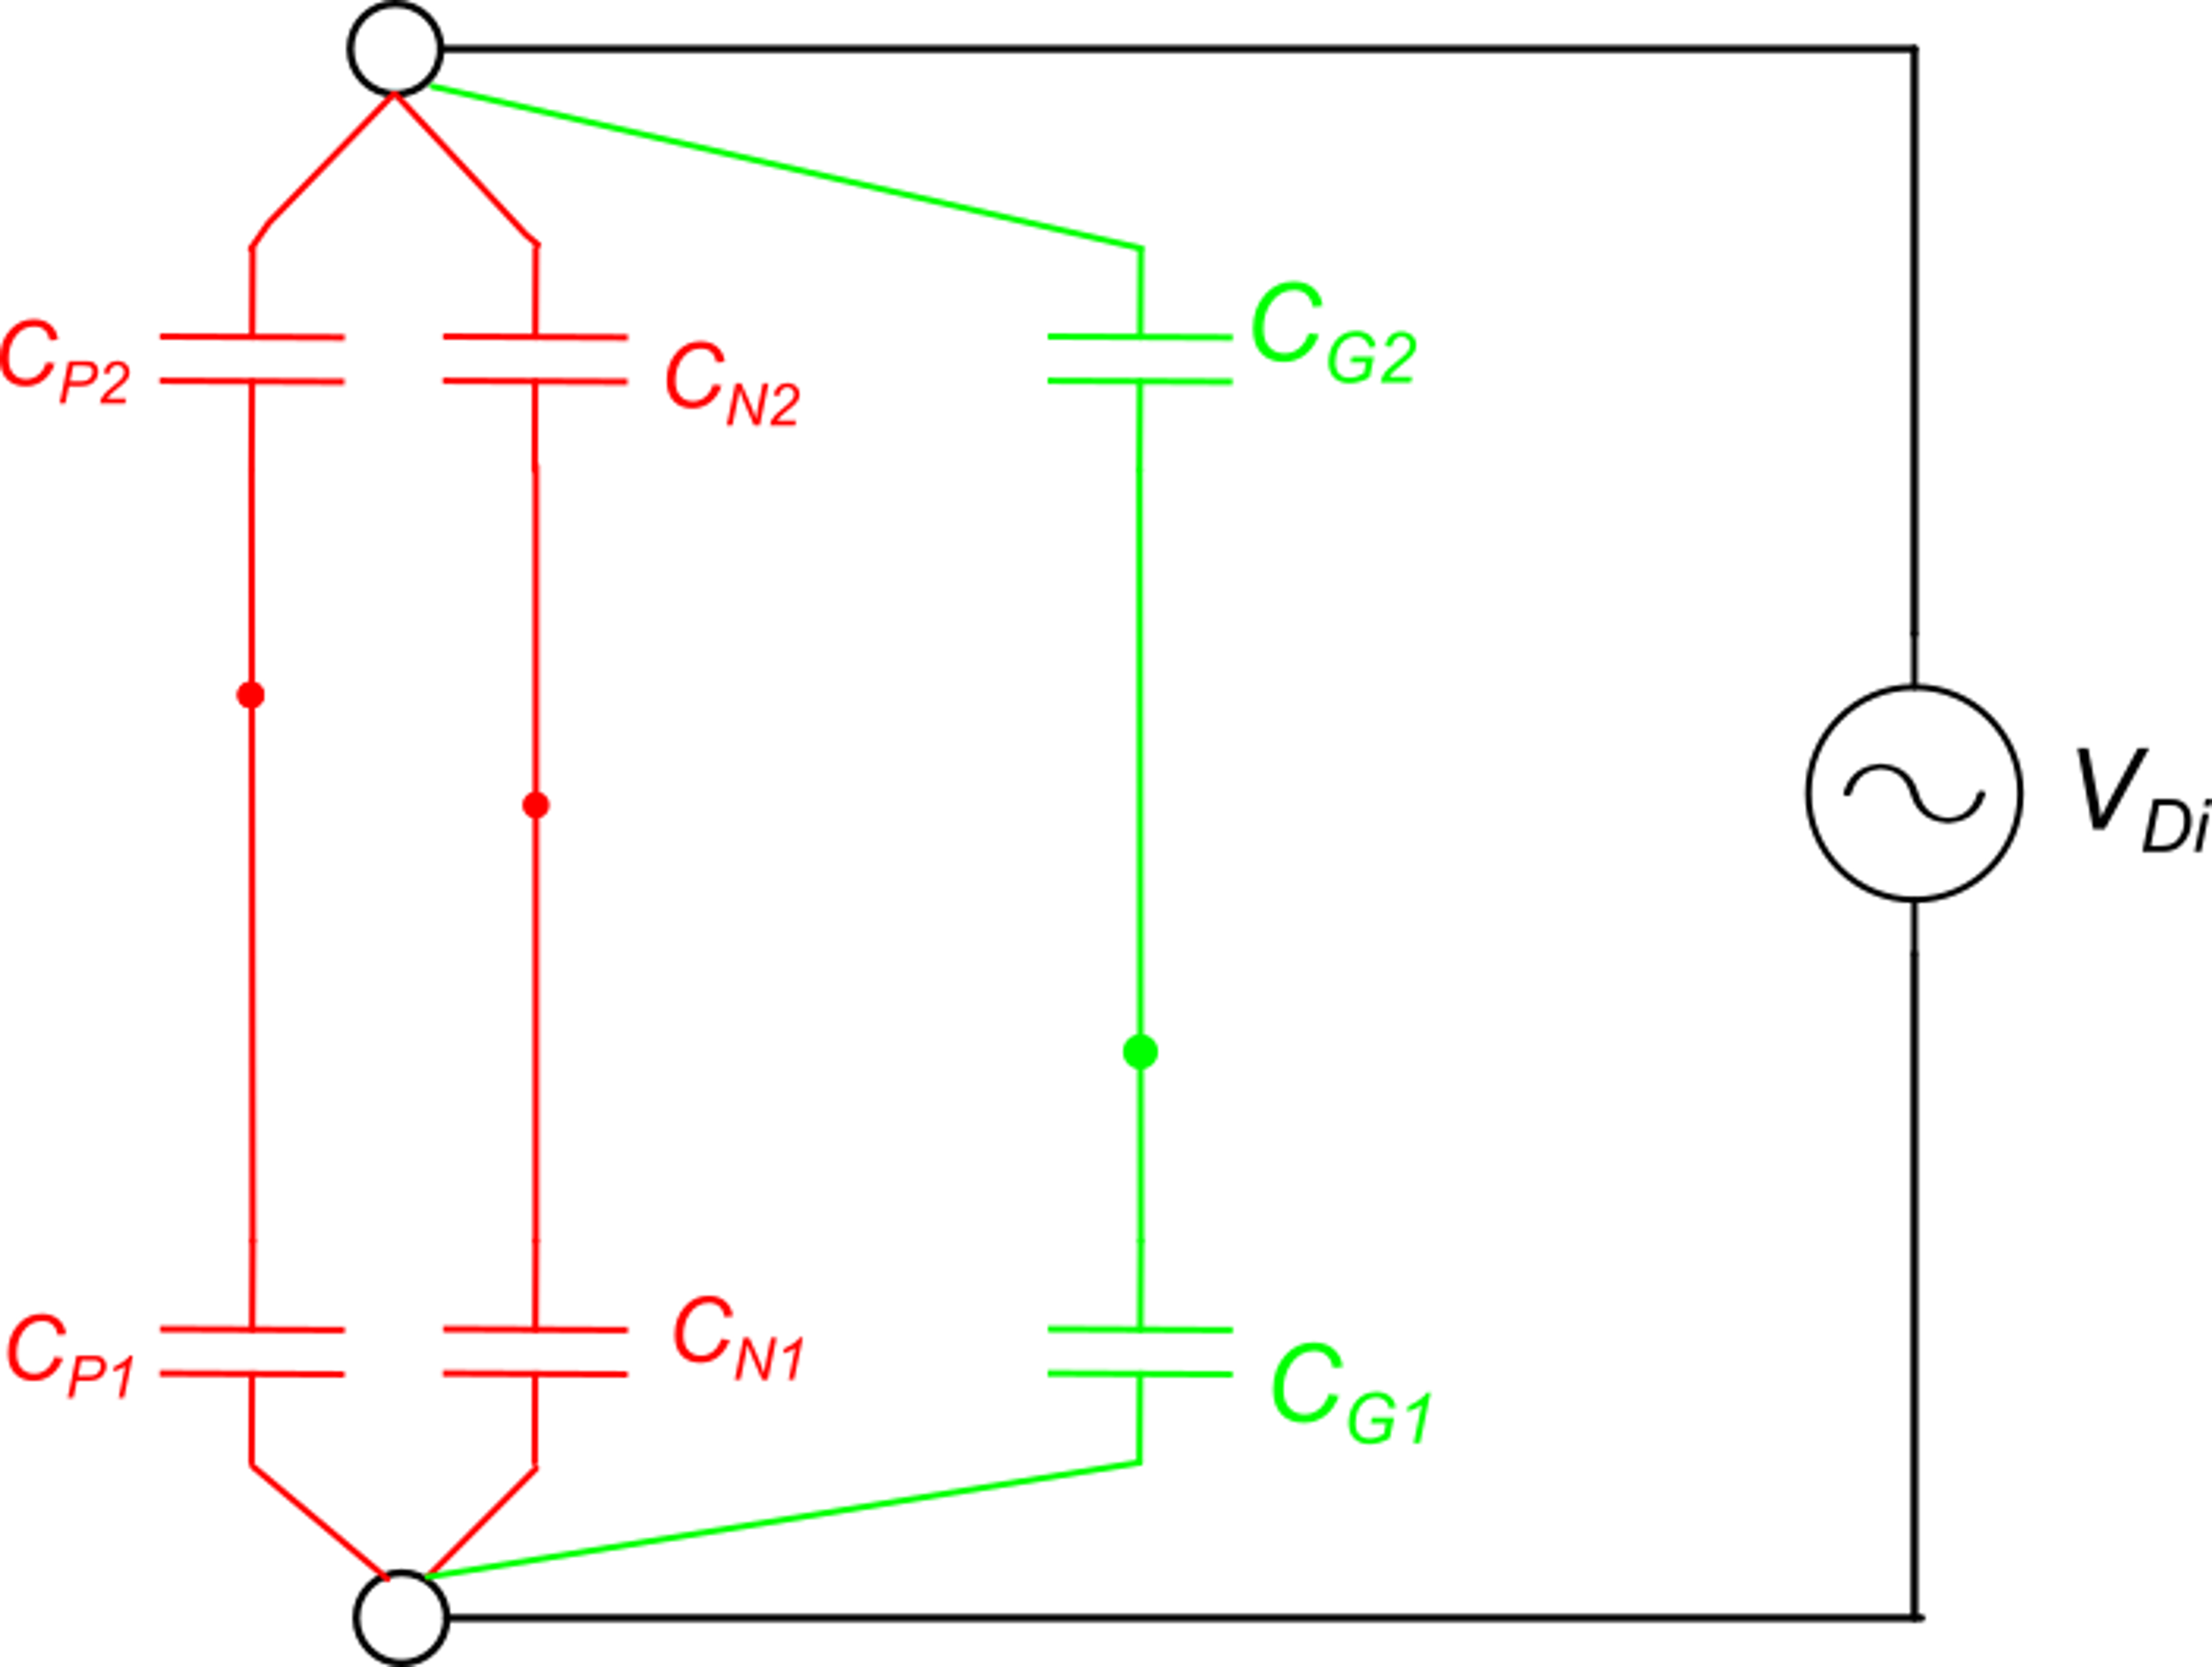
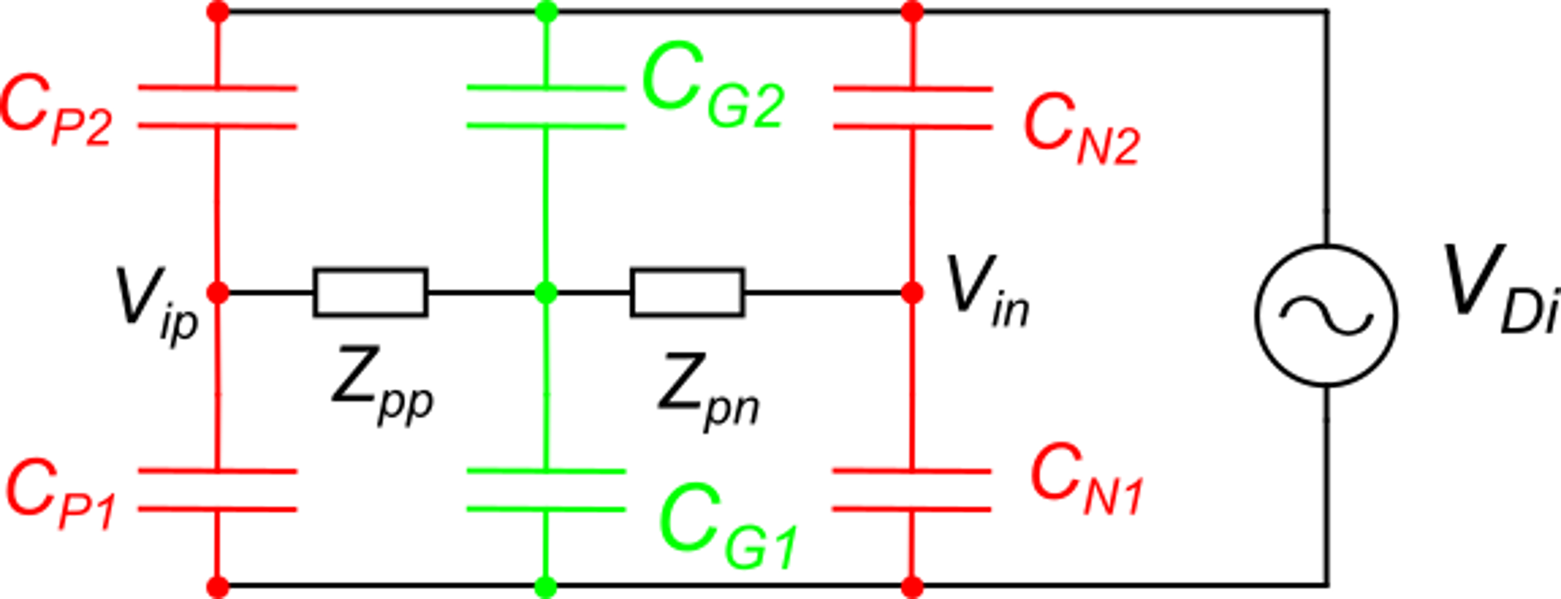
Advantage and limit of differential reading.
In a differential connection, the signal is the voltage difference between two wires, none of which is gnd.
The sensor has three terminals.
With a symmetrical routing of V_{ip} and V_{in}, we can obtain: C_{P1}=C_{N1}, C_{P2}=C_{N2}

Slide 21
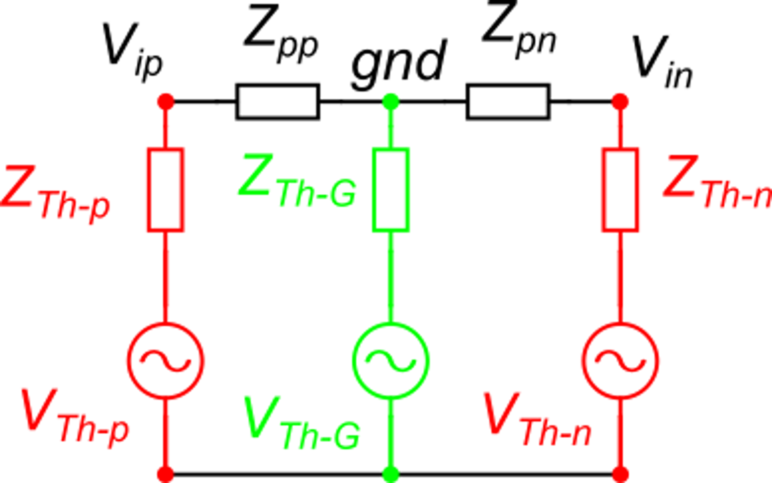
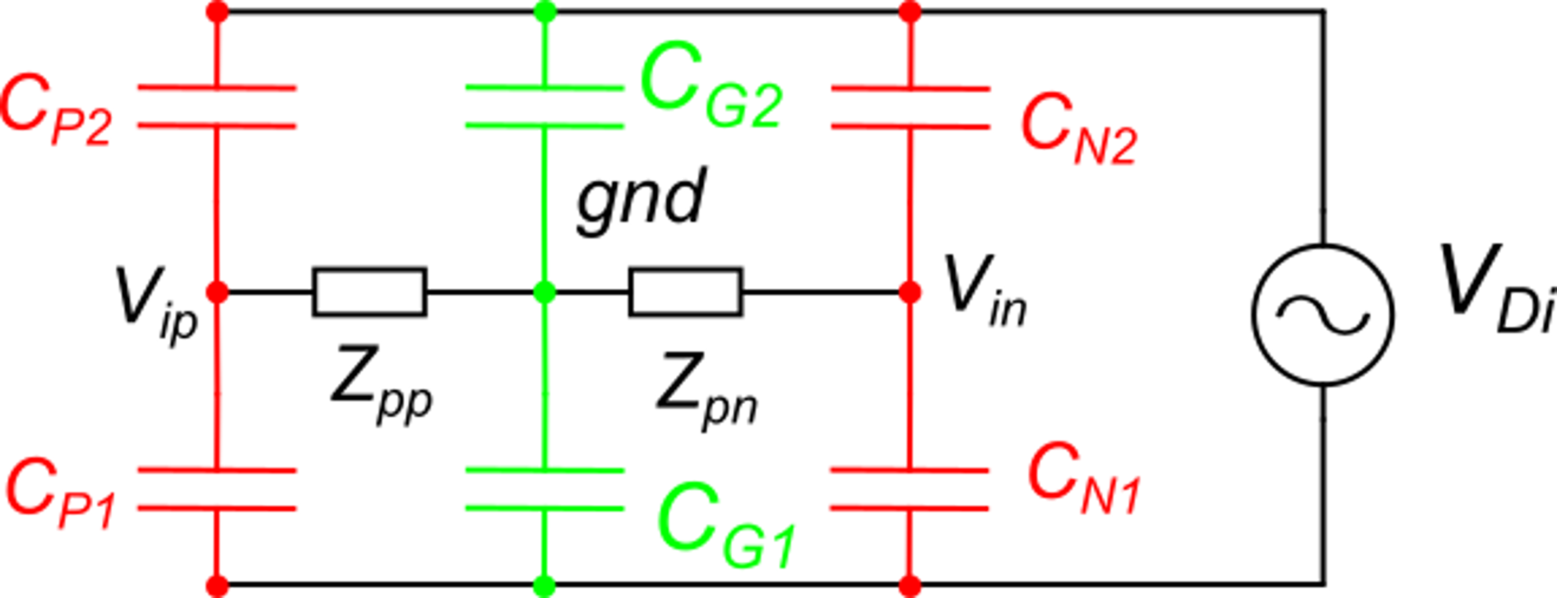
Advantage and limit of differential reading.
equal
Thanks to the symmetry:
N_{d1}
N_{d1}
equal
We apply three times the Thevenin equivalent between Nd1 and:
V_{ip}, gnd, V_{in}, respectively.
Then, to obtain V_{id}=V_{ip}−V_{in} = 0 we need a balanced source and balanced amplifier:
There are critical cases where it is not possible to have a balanced source.
A pseudo-differential configuration is not effective:

Slide 22
Interference from variable magnetic fields
The loop formed by the mesh that includes the sensor output port and amplifier input port is subjected by an electromotive force given by:
For a sinusoidal magnetic field:
The current in the loop is given by:
The voltage at the amplifier input is then:
If |Z_{iA}|>>|Z_{oS}|
In order to reduce the disturbance, it is necessary to reduce the area of all critical loops. Twisting the cables reduces the equivalent area of connection cables. Note that magnetic shield are much less effcetive than electrical ones.

Slide 23
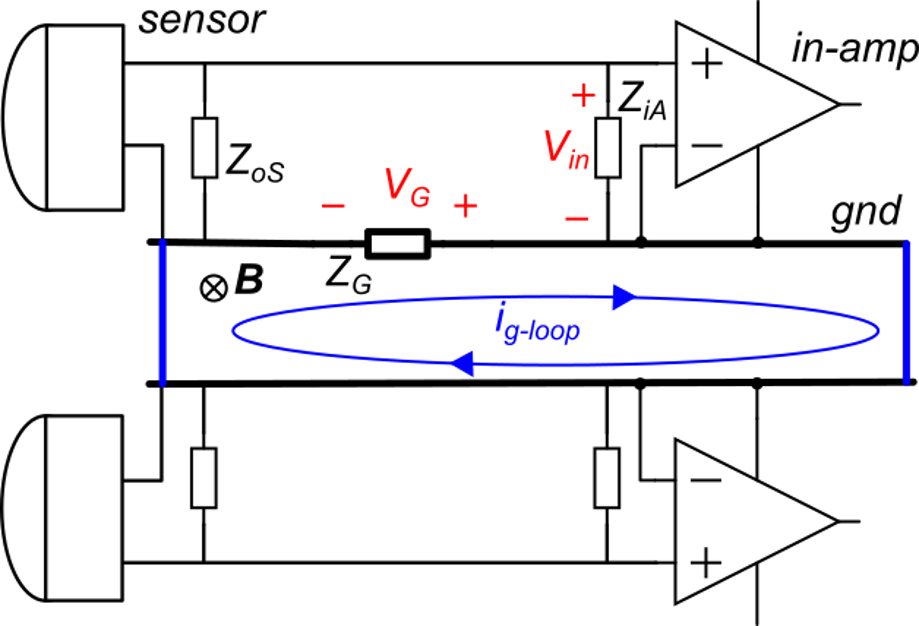
Ground loops
The picture below depicts two reaout channels (two sensors). The ground of the two channels must be connected together in a single point. Connecting the grounds in two spatially separated points, creates a loop that can sustain considerably large currents.
Z_{loop} is the series impedance of the whole loop.
Ground connection 1
Ground connection 2
Since Z_{G} can be a large fraction of Z_{loop}, an important portion of the electromotive force falls across Z_{G}. The voltage V_{G} gets added to the output signal of the sensor.

