Slide 1
Sensor systems: general considerations (2)
What is the input of a sensor system?
Non-electrical quantities ( e.g. temperature, pressure, acceleration, flow, concentration of chemical species... )
but also:
Electrical quantities that characterize a device or a process: impedance, current, charge ...
Biopotentials (ECG, EEG , etc)

Slide 2
Sensor systems: general considerations (2)
End users
What does a sensor system do?
Information flow
Representation of x
(a voltage, a number ...)
Sensor system
quantity of
interest: x
human
comprehension
Environment
Examples: a house, a vehicle, air or water in open spaces, the soil, a living body ....
machine (for automation tasks)

Slide 3
Sensor systems: general definitions (3)
Information flow in a sensor system
Analog domain
Digital Domain
Digital Processing
Linear Filtering
Data Interpretation
Data compression
Non-electrical
sensor(s)
AFE
Analog Front-End
ADCs
Electrical
probe(s)
Display
Communication
Environment
Storage

Slide 4
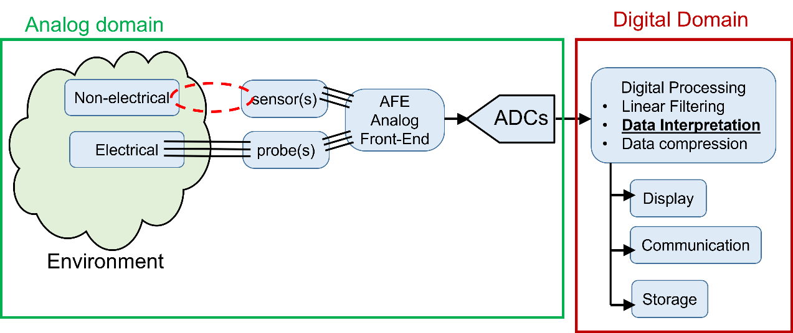
System partitioning
A complex sensor system can be formed by a large number of different partially independent components. In some cases the sensor system can be distrubuted in a large volume and include tens or hundreds of sensors.
In other cases the system can be relatively simple and small in size.
For this reason, in the system level design phase, it is important to organize the sensor system in a hyerarchical way, deciding at which level the above depicted operations must be performed

Slide 5
Sensor systems: a possible hierarchy
Sensor nodes
Sensor modules
High performance digital processing unit
Sensors / Probes
Embedded System
(e.g. MCU)
AFE + ADC
Complex Human - Machine Interface
Digital preprocessing
Communication
(wired or wireless)
High-capacity data storage
Communication
(wired)
Simplified Human-Machine Interface
Sensor module
Data logging
World-scale
communication
Sensor nodes
High level sensor system

Slide 6
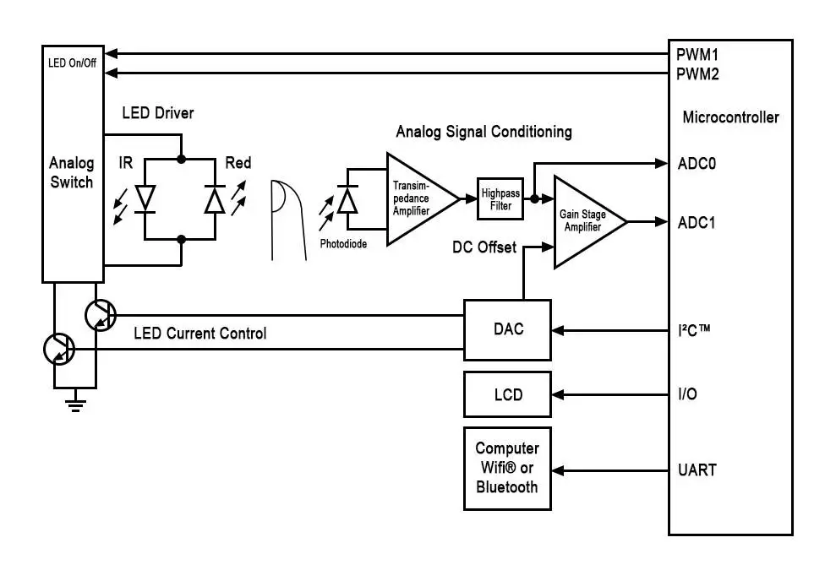
Example 1: Pulse oximeter A simple, complete sensor system
Sensor probe, AFE, ADC = Sensor module
Digital Processing
Human Interface (simplified)
Communication
Performs the functions of sensor node

Slide 7
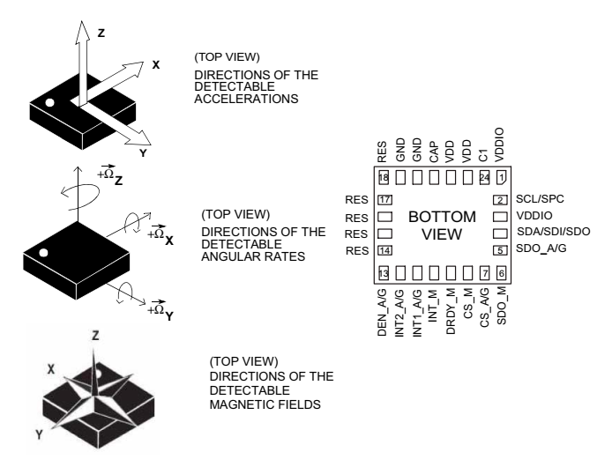
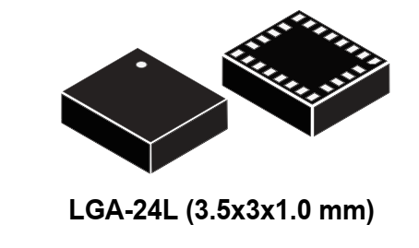
Example 2: Integrated 9 axis inertial sensor (sensor module or smart sensor)
3-axis accelerometer
3-axis gyroscope
3-axis magnetometer
SPI -I2C communication lines

Slide 8
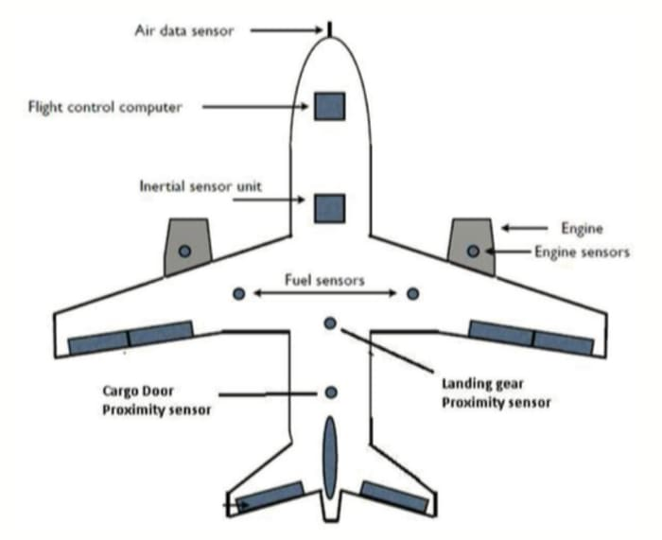
Example 3, a complex case: sensor system in an airplane
Sensor node
Includes different sensor modules
(air speed, air temperature, angle of attack) and implements complex communication protocols.
To reduce wiring, there is a tendency towards wireless comunication between sensor nodes
High level computing machine

Slide 9
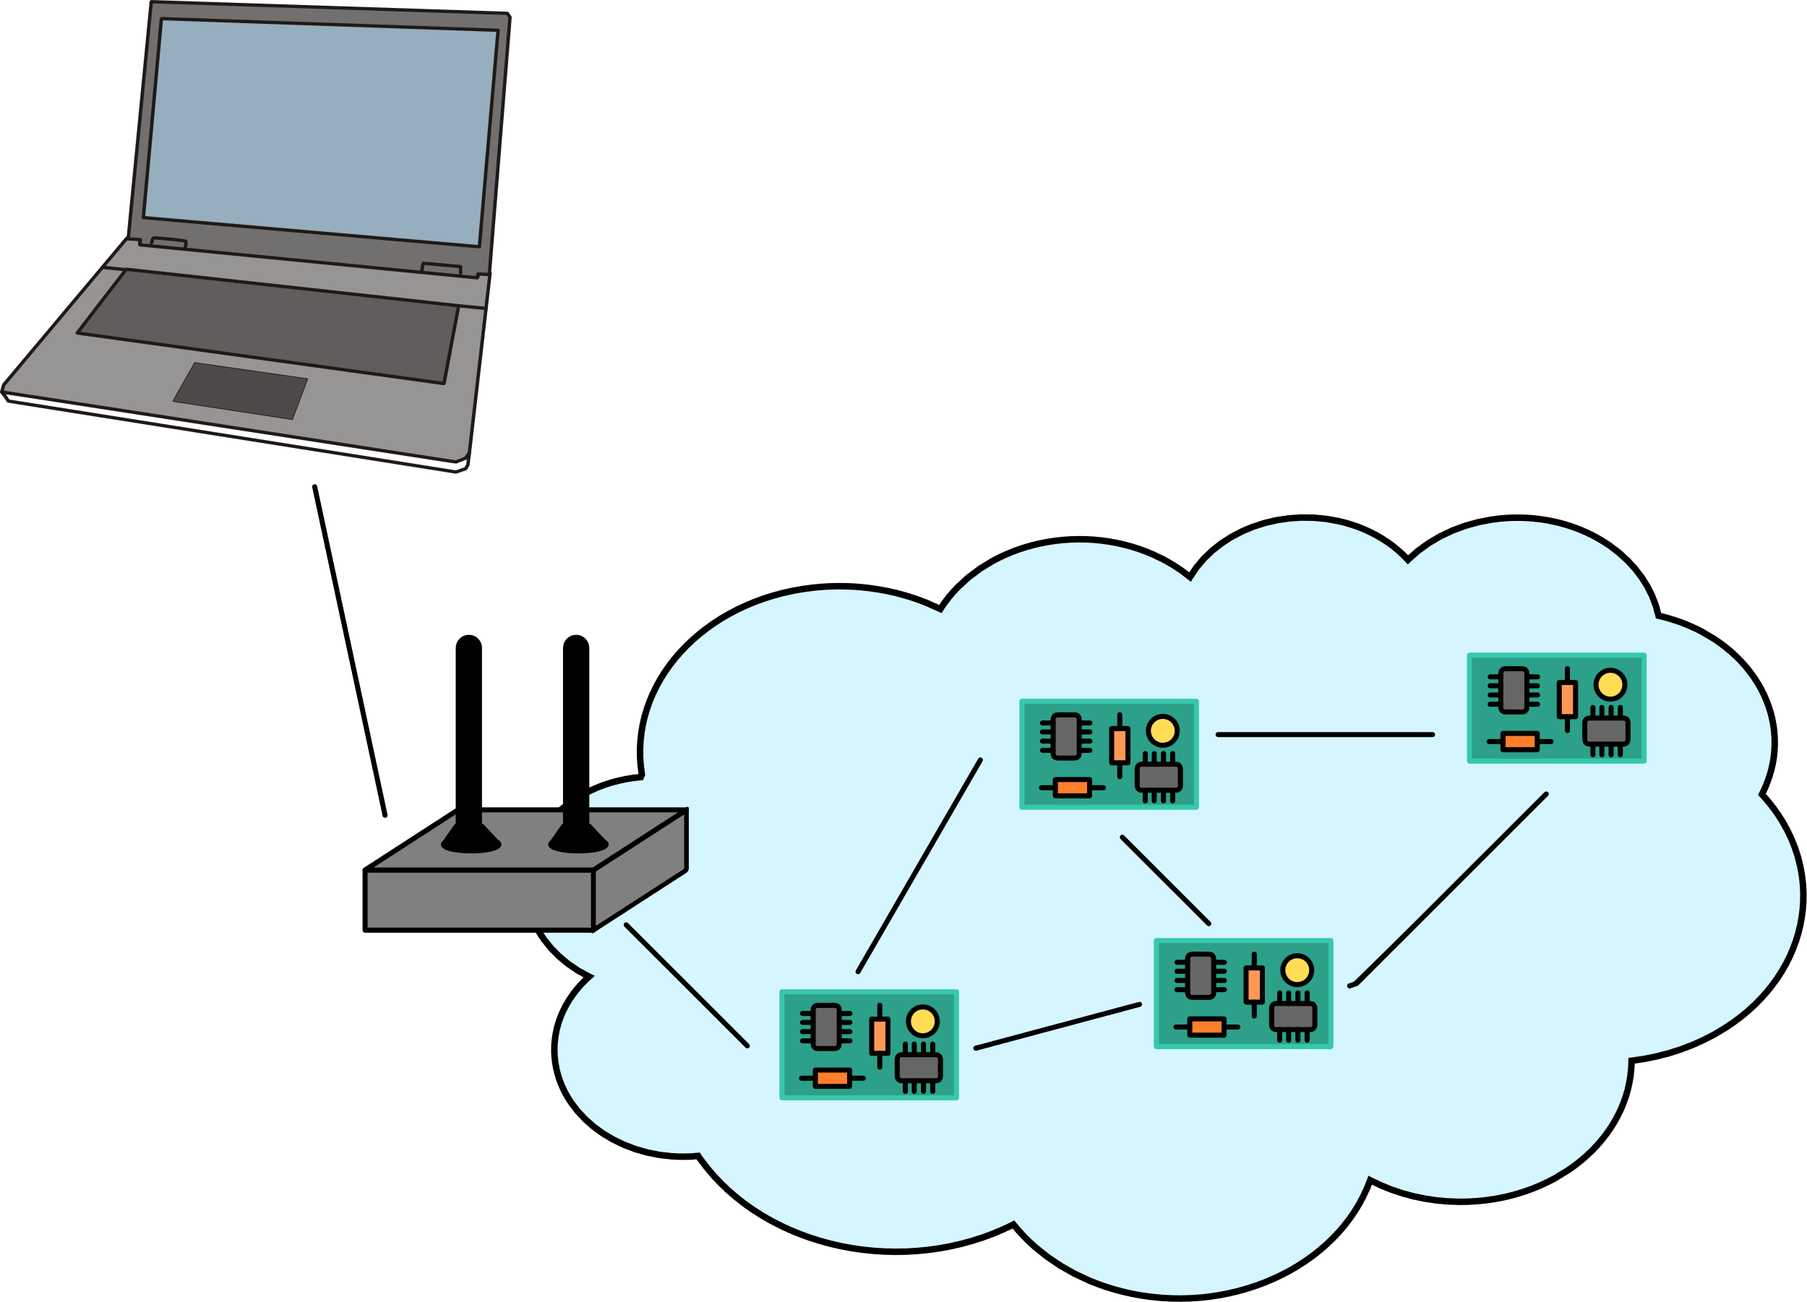
Example 4: Wireless Sensor Network
High level computing machine: PC, smartphone, emebedded computer
Sensor Nodes
Can be equipped with different sensor types or simply replicate the same sensor set in different locations (distributed sensing)
Sink
Network: Multi-hop communication protocol

Slide 10
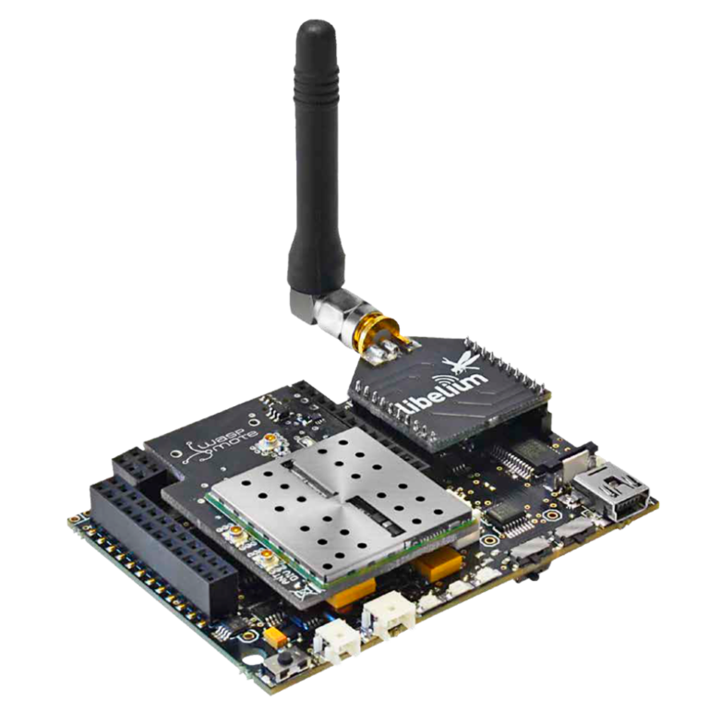
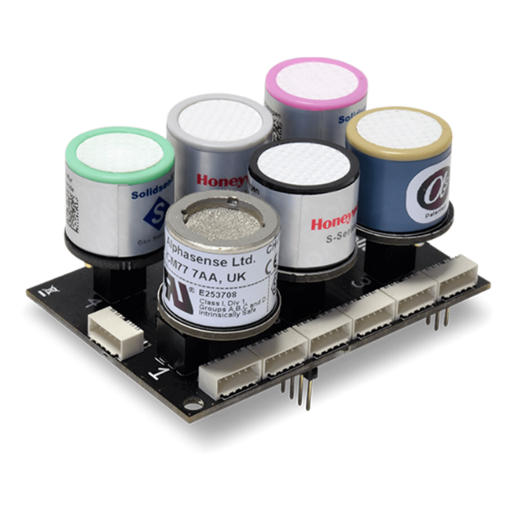
Example of a sensor node for WSN
Sensor module
(air quality)
Libellium wasp-mote
Multi-protocol wireless communication
https://www.libelium.com/iot-products/waspmote/

