Slide 1
Graphical User Interfaces (GUIs) in Python
Python offers different possibilities to create GUIs.
Most of these are derived from GUI creation approaches introduced for other pre-existent languages. A few popular choices are:
Tkinter : Derived from TCL scripting language - comes with the standard python installation
wxPython (Derived ftom the wxWidgets C++ library)
pyQt : derived from the Qt C++ tools. It comes by default with anaconda and has been ported to Android (QPython, pyqtdeploy)
PySide : another porting Qf qt to Python (mostly compatible with pyQt
Kiwy : A recent platform natively built for Python

Slide 2
Qt and pyQt
Qt (https://www.qt.io/) is a series of multi-platform tools, basically aimed at the creation of GUIs with C++. It is free and consists of a series of libraries and a preprocessor (the code is an extension of C++).
First version by TrollTech (Oslo) in 1995.
At present, Qt is being developed by the Qt group (Helsinki)
PyQt maintains the same classes of Qt and the way they are organized in modules. Differently from the original C++ version, the Python syntax is completely respected, and no preprocessing is required
PyQt latest version, pyQt6, but latest version in Anaconda is still pyQt5 (April 2023)
The complete documentation refer to the original Qt (C++):
https://doc.qt.io/qt.html (Focused on Qt6, mostly compatible with Qt5)

Slide 3
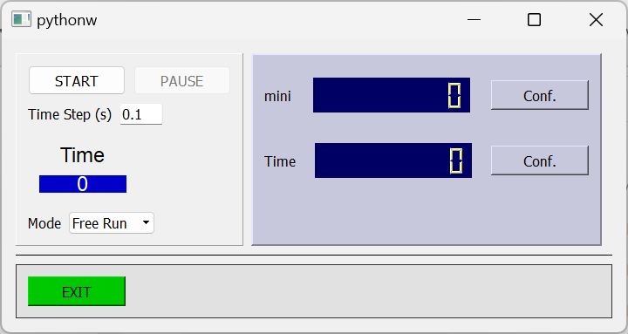
Structure of a GUI: widgets
The GUI is a "widget"
Widget is an English word that indicates a small mechanical device.
Any smaller object that forms the GUI is a widget
The widget that is not included into other widgets is called "window" (it is the top widget (or "parent widget")
x
y
window
window coordinate system (units: screen pixels)

Slide 4
pyQt principle of operation
In order to allow access to the graphical APIs of the operating system, it is necessary to load a resident program ("QApplication") at any execution of the Python code.
from PyQt5 import QtWidgets
import sys
app = QtWidgets.QApplication(sys.argv)
In order to allow the GUI to intercept actions from the user (e.g. mouse clicks), it is necessary to execute the loaded program (the GUIs "loop").
sys.exit(app.exec_())
This program will be terminated when all the GUI's windows are closed

Slide 5
PyQt (Qt) modules for GUIs
QtWidgets: includes most high level built-in widgets and prototype classes for creation of simple GUIs
QtGui: low level painting (e.g. QPainter and its primitives) and classes for bitmap import.
QtCore: Includes non-graphical classes (e.g. QTimer) Includes also support for mutli-threading, constant values definitions, support for animation and more.

Slide 6
PyQt principle of operation: signals and slots
Events are detected by the loop and proper signals are emitted
Signals may be connected to slots
Events
signal
Mouse clicks
slot 1
signal
Keyboard hits
slot 2
signal
Touch operations
Timer overflow
signal
slot 3
signal
slot 4
other events

Slide 7
Events, signals and slots in a GUI
A simple GUI consists in a custom class that inherits from a proper PyQt class
The GUI may include objects (instances of classes) that are capable of detecting an event and generating a signal
Built-in pyQt objects are capable of generating different signals. For example, a push button can generate different signals when it is clicked or simply pressed or released.
Using a proper and simple construct, the user can connect these signals to slots.
A slot can be any member function of the GUI class

Slide 8
Syntax
class my_gui(QtWidgets.QWidget):
def __init__(self)
super().__init__()
Inherits from QWidget (prototype for simple guis.)
Inizitializes the parent class
bt1=QtWidgets.QPushButton("Exit")
bt1.clicked.connect(self.fine)
def fine(self):
...
...
Create an instance of a button with label "Exit"
Connects the signal emitted when the button is clicked to a member function

Slide 9
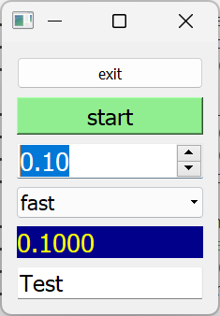
A few useful built-in widgets
Buttons: QPushButton()
Up-down numerical fields: QDoubleSpinBox()
Multiple choice selector: QComboBox()
Label used as a display: QPushButton()
Text Input: QLineEdit()

Slide 10
Layouts
Layouts help placing objects (widgets) into the main widget space. The layout create the space required by each widget and align them automatically.
widget
widget
widget
widget
widget
Horizontal layout: QVBoxLayout()
widget
widget
widget
widget
widget
widget
Two horizontal layout arranged into a vertical layout
Vertical layout:
QVBoxLayout()
widget
widget

Slide 11
Layouts: including elements into a layout
vlay=QtWidgets.QVBoxLayout()
A Layout starts as an empty container
vlay.addWidget(wid1)
vlay.addWidget(wid2)
wid1
Widgets are added at the bottom of the layout
wid2
hlay=QtWidgets.QHBoxLayout()
hlay.addWidget(wid3)
hlay.addWidget(wid4)
Creating a horizontal layout and populating it with two widgets
wid1
Inserting the h-layout at the bottom of the v-layout
wid2
vlay.addLayout(hlay)
wid3
wid4
vlay.addStretch(hlay)
Add a stretchable space
self.setLayout(vlay)
Apply Vlay to the main widget
wid4

Slide 12
Changing the apparence of the widgets: StyleSheets
wid.setStyleSheet("color : red; font-size : 12pt")
Most frequently used properties:
background-color
color
font-size ( pt or px)
font-style (normal, italic)
font-weight (normal bold)
font-family (es. Times New Roman
text-align (left,right,center, ...)
properties
values
colors, values:
rgb(r,g,b)
or a color name:
red, black, white, blue, yellow, green ...

Slide 13
Timing events: QTimer
Creates the timer
from PyQt5 import QtCore
self.tm=QtCore.QTimer()
self.tm.timeout.connect(self.acquire)
self.tm.setInterval(500)
self.tm.start()
self.tm.stop()
Connects timer overflows to a slot
Sets the time interval between overflows
Starts the timer
Stops the timer

