Slide 1
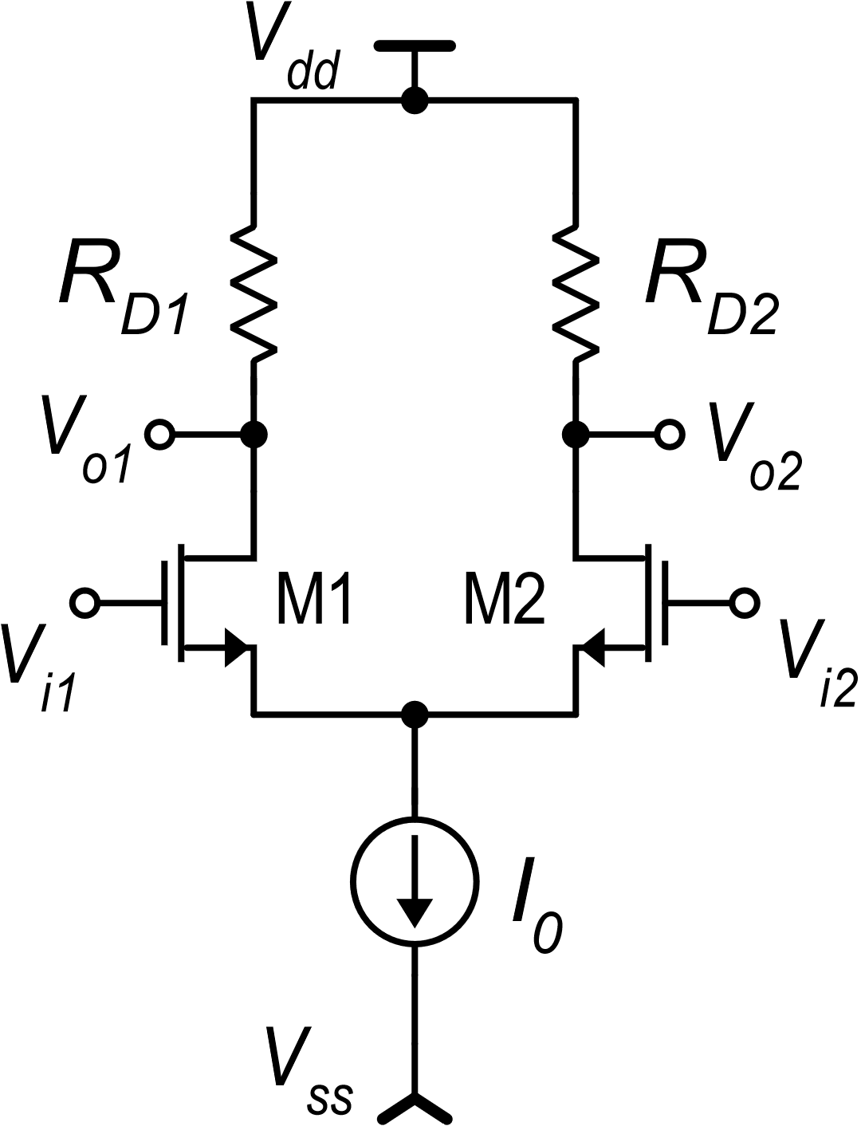
CMOS differential amplifier with resistive load: limitations
The S/E version has a poor CMRR (large A_{c}) and large input offset voltage
Both the S/E and fully-diff. versions reach low voltage gains at small supply voltage
Problem 1: Consider the output voltage in the fully-differential case with no resistor mismatch:
The drain current difference appears:
This reduces A_{c} (I_{D1} and I_{D2} tend to be equal for only common mode applied) and the output voltage for V_{D}=0 is affected only by matching errors.
Solution for a S/E amplifier: produce the current difference (I_{D1}-I_{D2}) and then put it into a single resistor. Problem 2: Do not use a passive component for the resistor

Slide 2
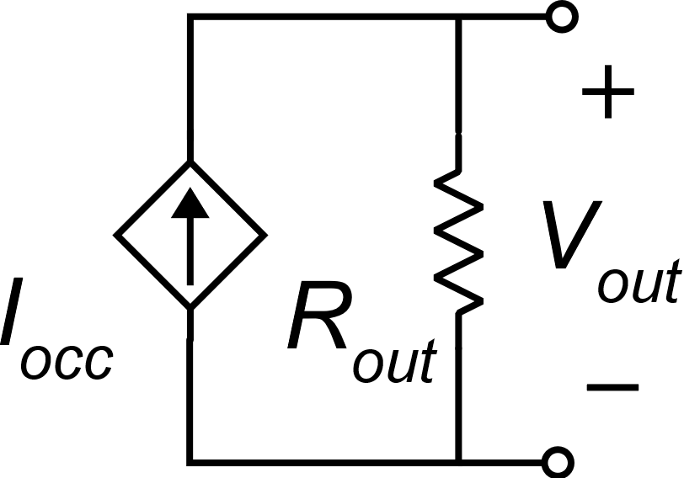
CMOS differential amplifier with current mirror load
V_{dd}
Specifications
I_{D1}
I_{D1}
We need a S/E output port
High CMRR (> 80 dB)
High gain (~ 40 dB) even at low supply voltages (V_{dd}−V_{ss}).
I_{D1}+I_{D2}
M3
M4
I_{occ} =I_{D1}−I_{D2} $≅g_{m1}v_{id}$
V_{out}
I_{D1}
I_{D2}
M1
M2
V_{i1}
V_{i2}
I₀
V_{ss}

Slide 3
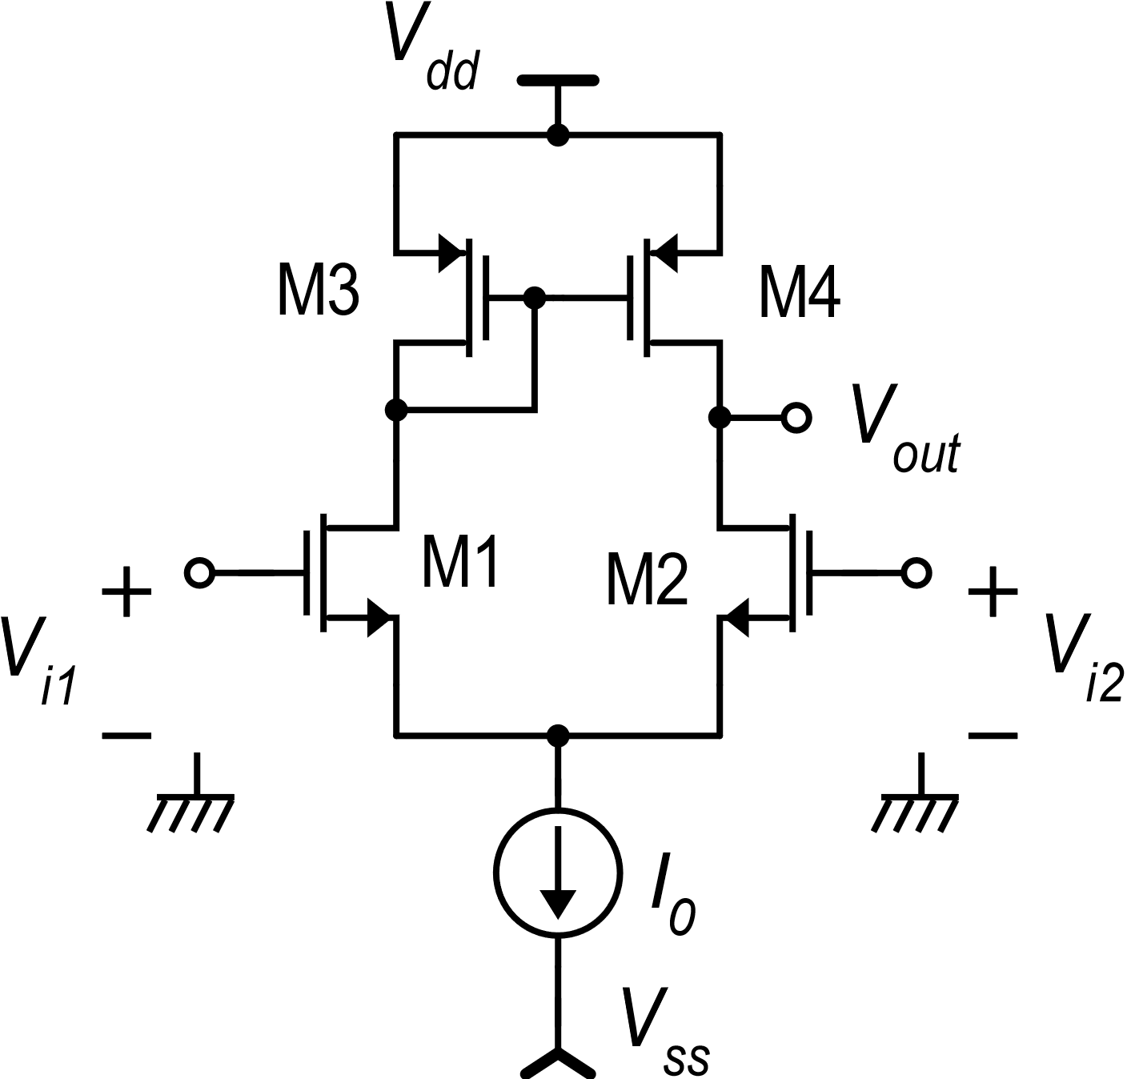
Subunits of the amplifier with mirror load
I₁
R_{out}
V_{in}
I_{occ}
I₂
V-to-I
I-to-I
I₁
I₂

Slide 4
Operating point : V_{id}=0
Symmetrical stimulus, but ….
The circuit is not symmetrical

Slide 5
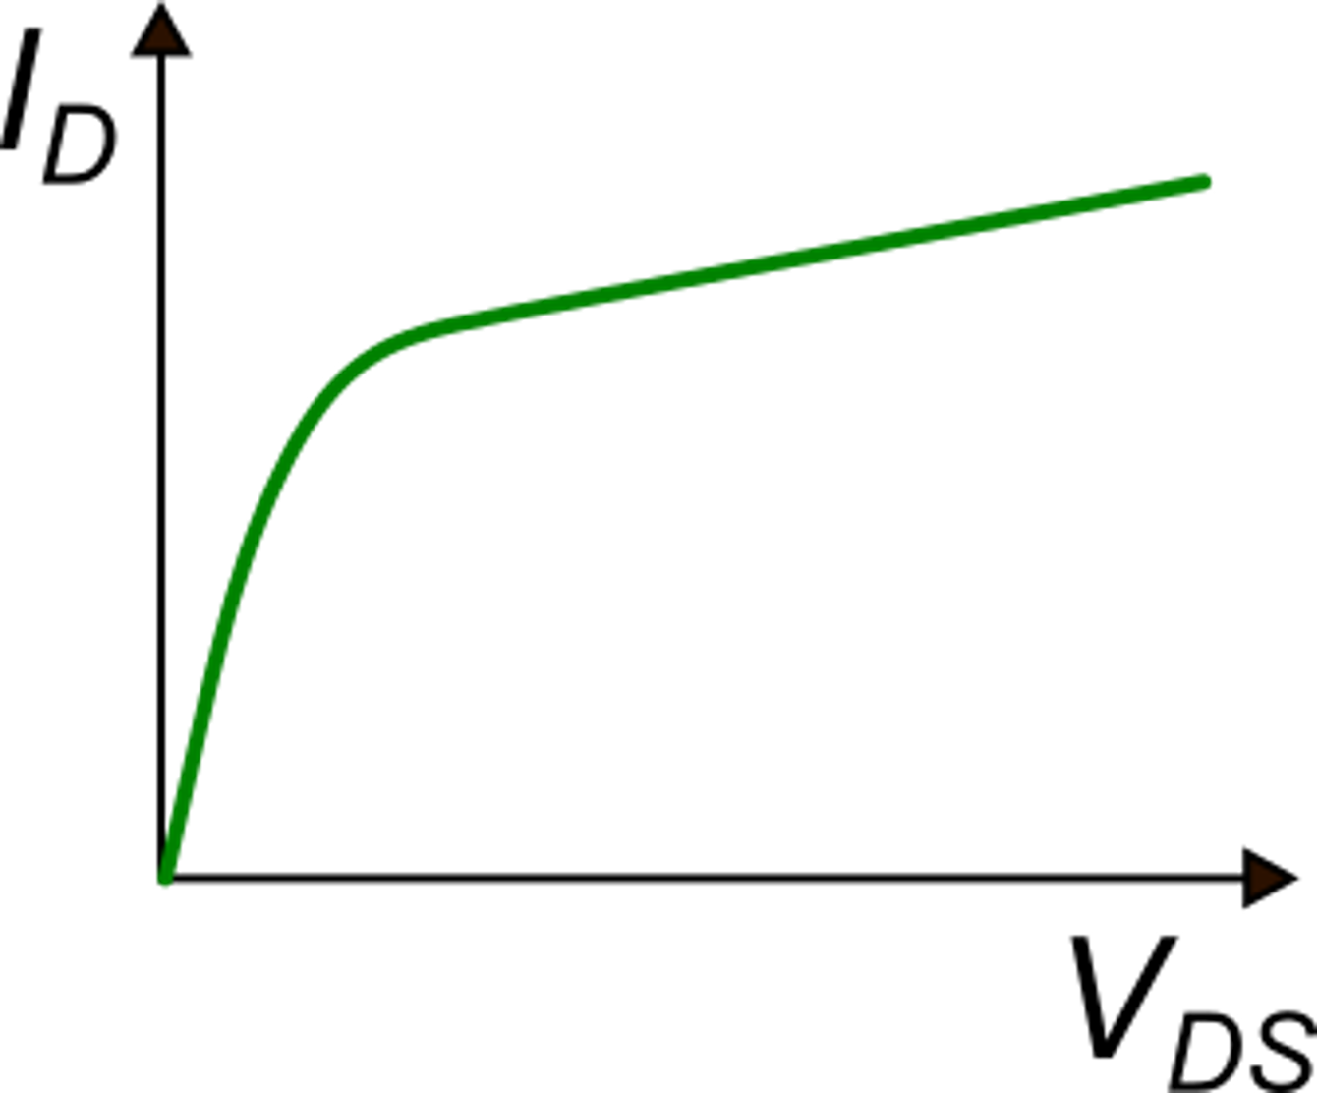
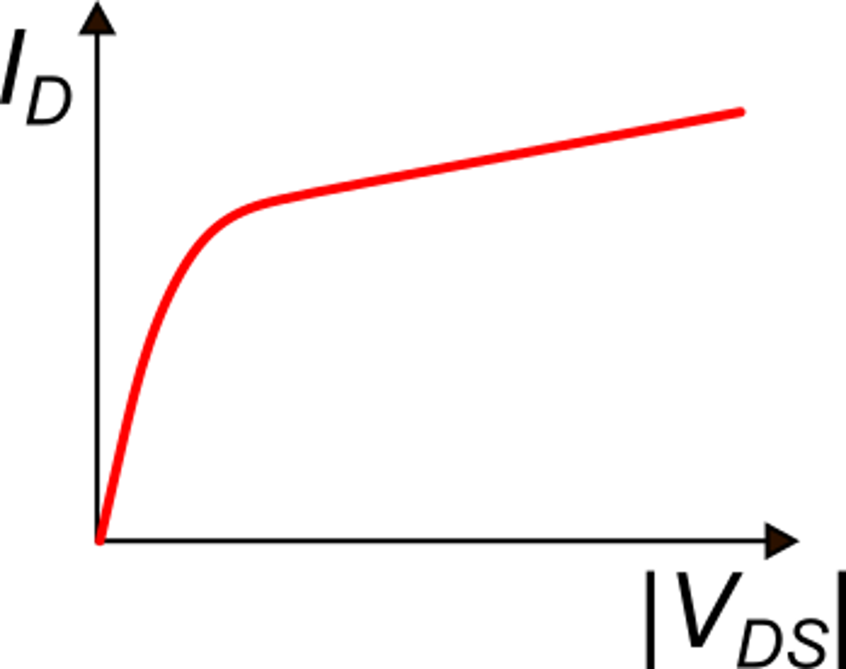
Demonstration of the exact symmetry of the electrical solution for V_{id}=0
With fixed V_{GS} and V_{BS}, I_{D} is a monotone function of V_{DS} (or |V_{DS}| for a p-MOS.
M1 and M2
M3 and M4

Slide 6
Demonstration of the exact symmetry of the electrical solution for V_{id}=0
From Kirchhoff #2:
We want to demonstrate that:
Proof by contradiction:
Let us suppose:
Contradiction

Slide 7
Demonstration of the exact symmetry of the electrical solution for V_{id}=0
Repeating the procedure for I_{D1}<I_{D2} we get another contradiction; thus, the only possible solution is:
K
For V_{id}=0, the electrical solution is perfectly symmetrical

Slide 8
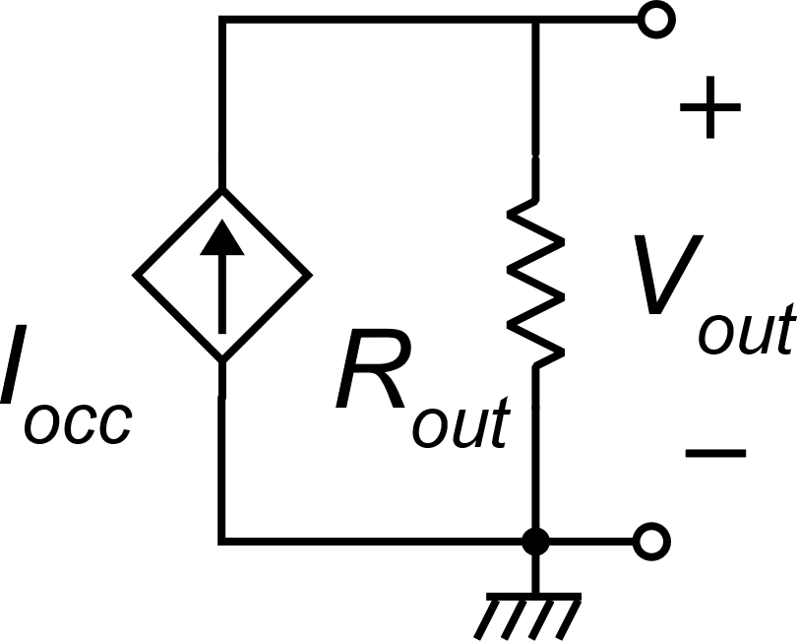
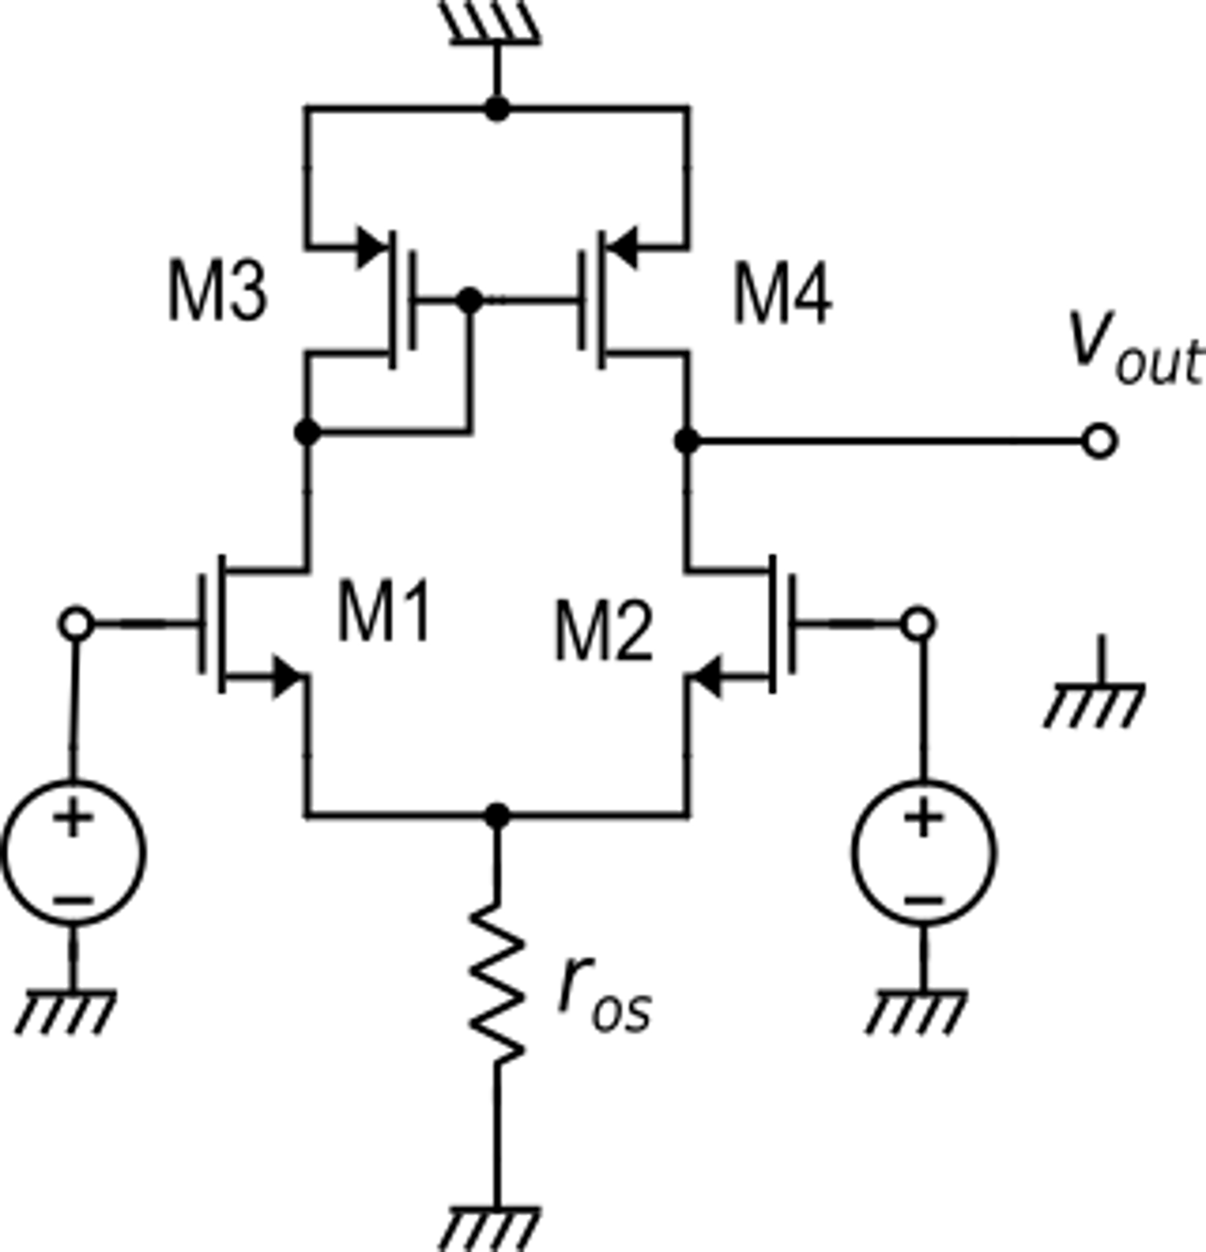
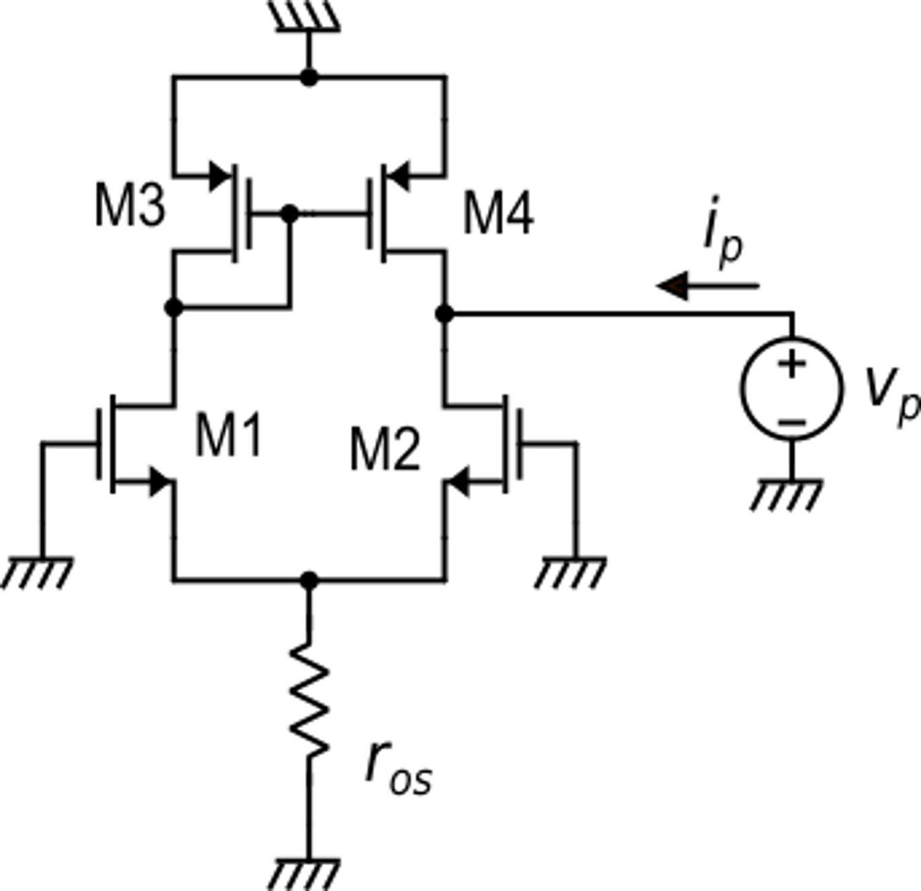
Differential mode gain
Norton equivalent circuit
of the output port
i_{ric}
Small-signal equivalent circuit
Circuit for R_{out} calculation

Slide 9
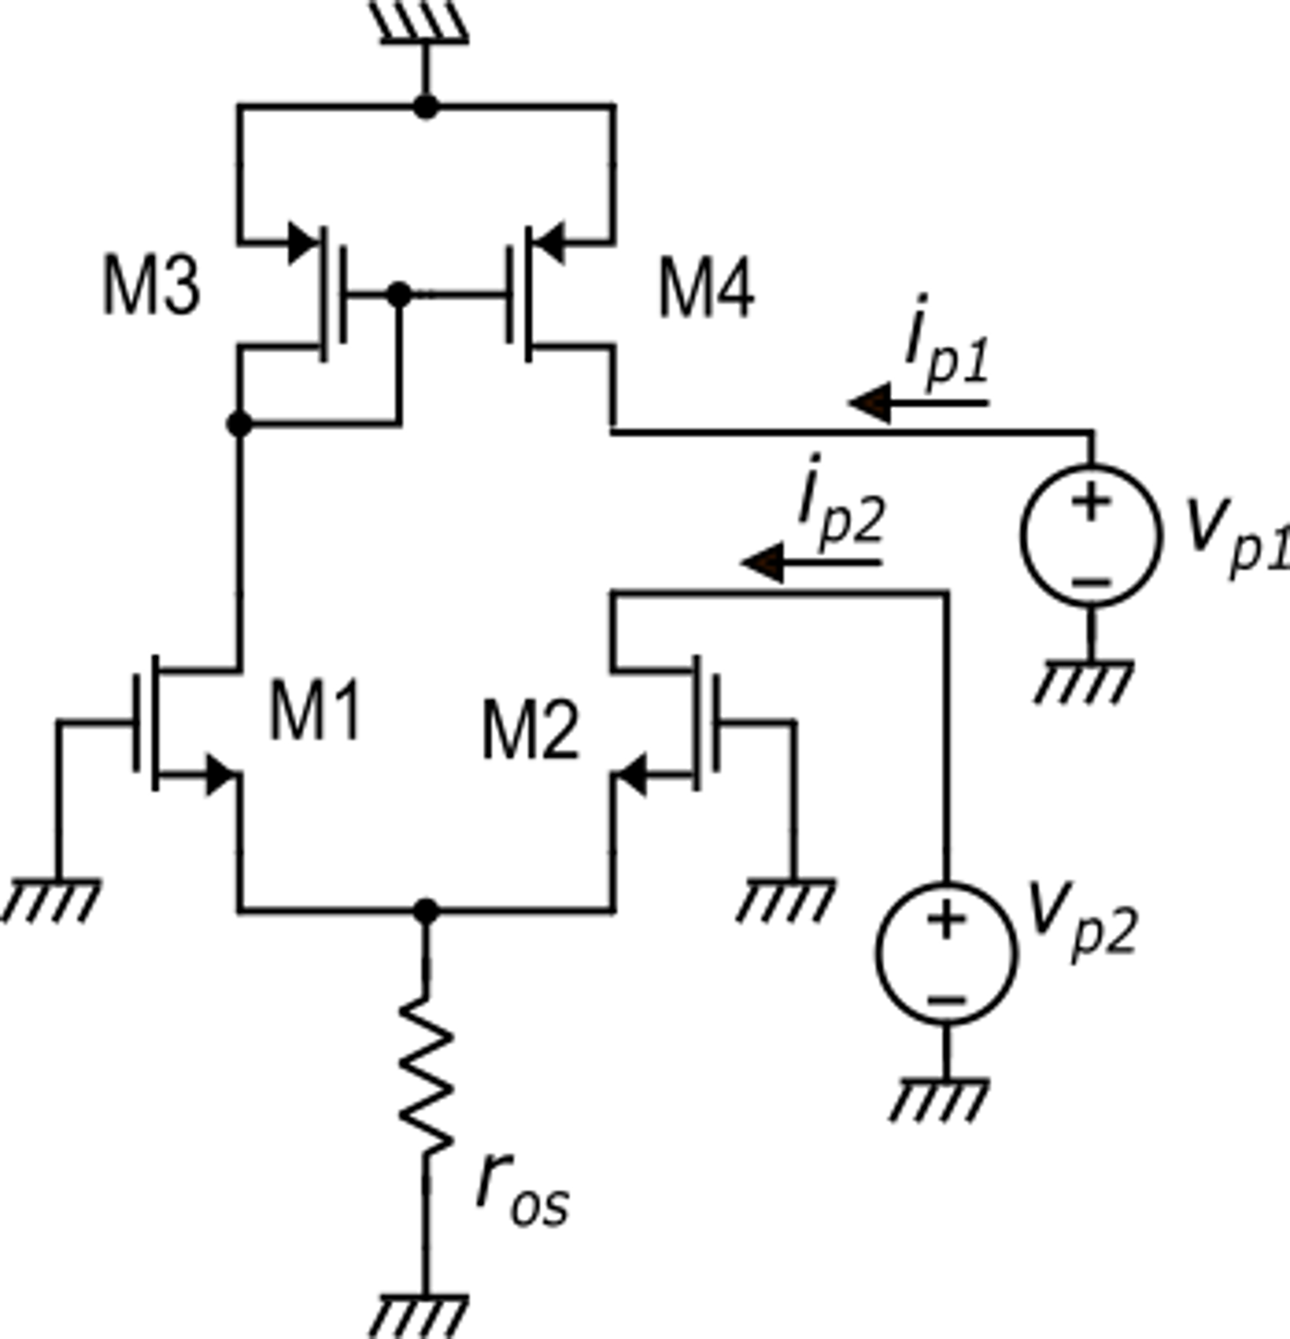
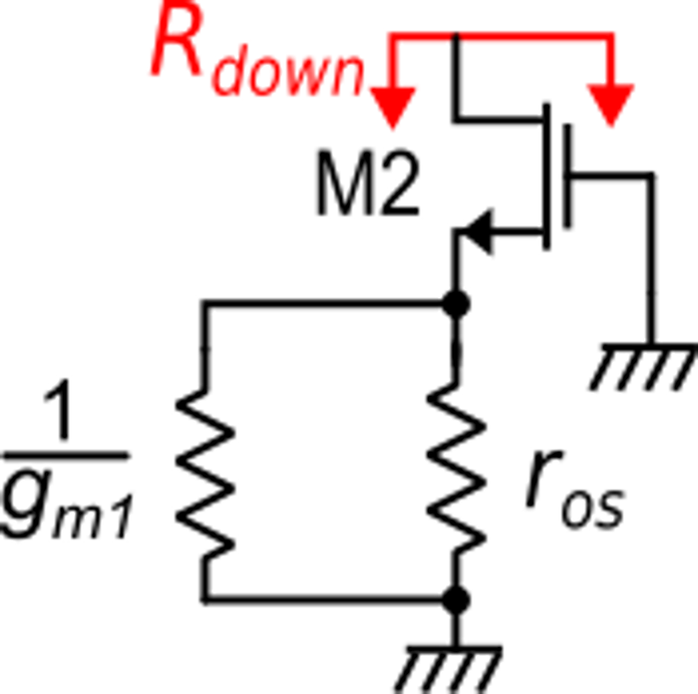
Differential mode gain: R_{out} calculation.
Case 1:
Case 2:
For the superposition theorem:
Case 1:
Case 2:

Slide 10
Differential mode gain
The gain is of the order of$\frac{g_{m}r_{d}}{2}$
Independently from the supply voltage

Slide 11
Differential mode gain
In strong inversion. Minimum V_{TE}=50 mV
In weak inversion.
V_{TE} $≅$35-40 mV
In order to obtain a large differential-mode gain it is necessary to:
Set V_{TE} to a small value
Use long MOSFETs (small λ)

Slide 12
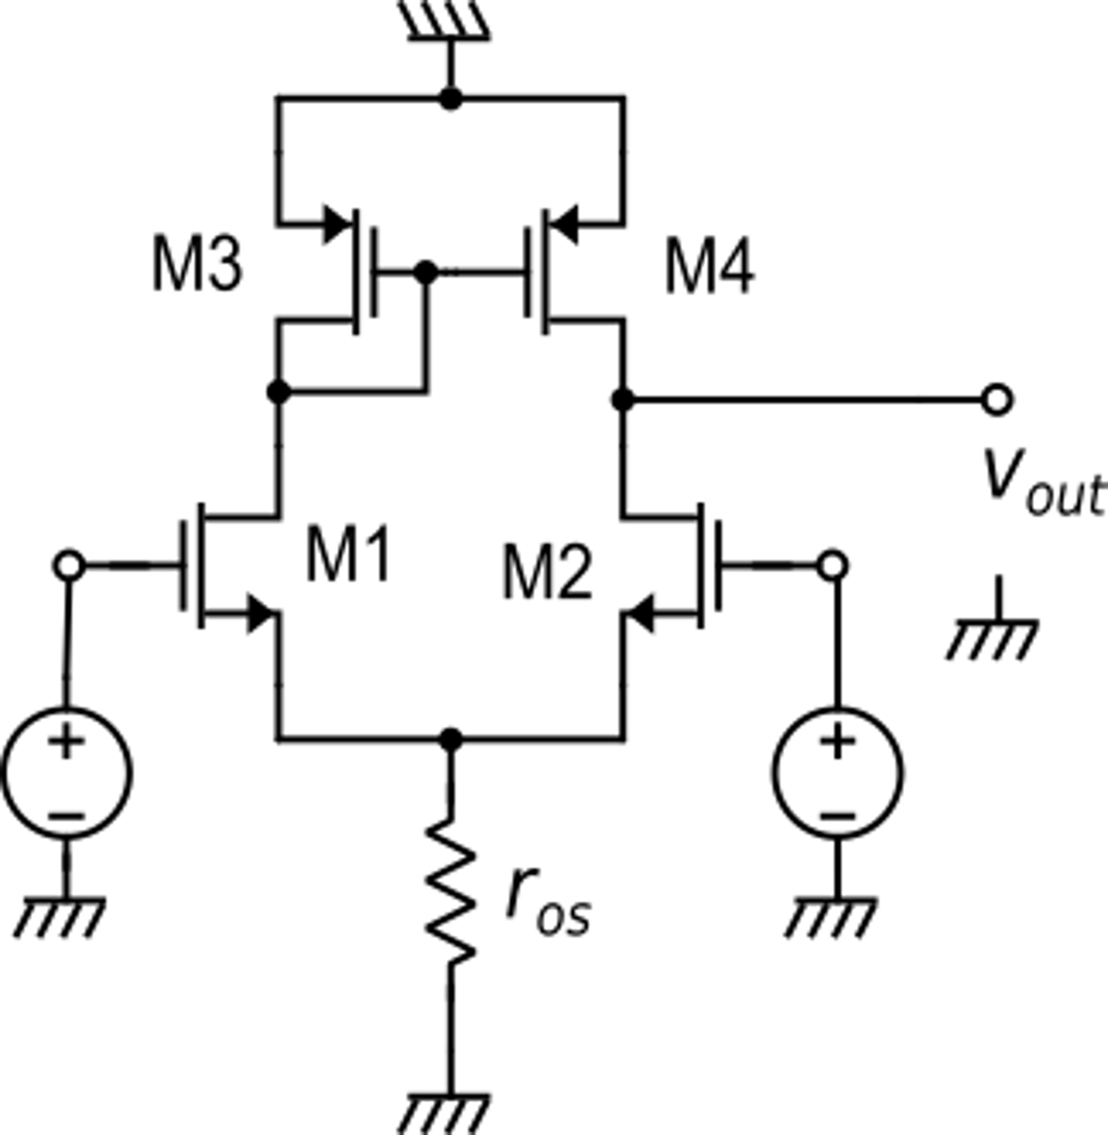
Common mode gain
As in the case of differential input voltage, we can try to use the Norton equivalent circuit of the output port.
v_{c}
v_{c}
Is it possible??

Slide 13
Common mode gain
The problem occurs when we calculate i_{occ}. Placing a short circuit across the output port, disrupts the symmetry:
v_{c}
v_{c}

Slide 14
Common mode gain
It is possible to exactly calculate i_{occ}, taking into account the actual i_{d1}/i_{d2} ratio and i_{d4}/i_{d3} ratio ….
v_{k}
… but this is a very tedious approach
There is a much simpler way:
Let us remove the short circuit and directly calculate v_{out}. Now , for v_{id}=0, the circuit is symmetric again and, in particular: v_{k}=v_{out}
v_{c}
v_{c}

Slide 15
Common mode gain
v_{k}
for r_{os}=r_{d}
(worst case: the tail is the output branch of a simple current mirror)
and considering all g_{m}'s and r_{d}'s equal for simplicity
v_{c}
v_{c}
A CMRR of 80 dB can be easily reached

Slide 16
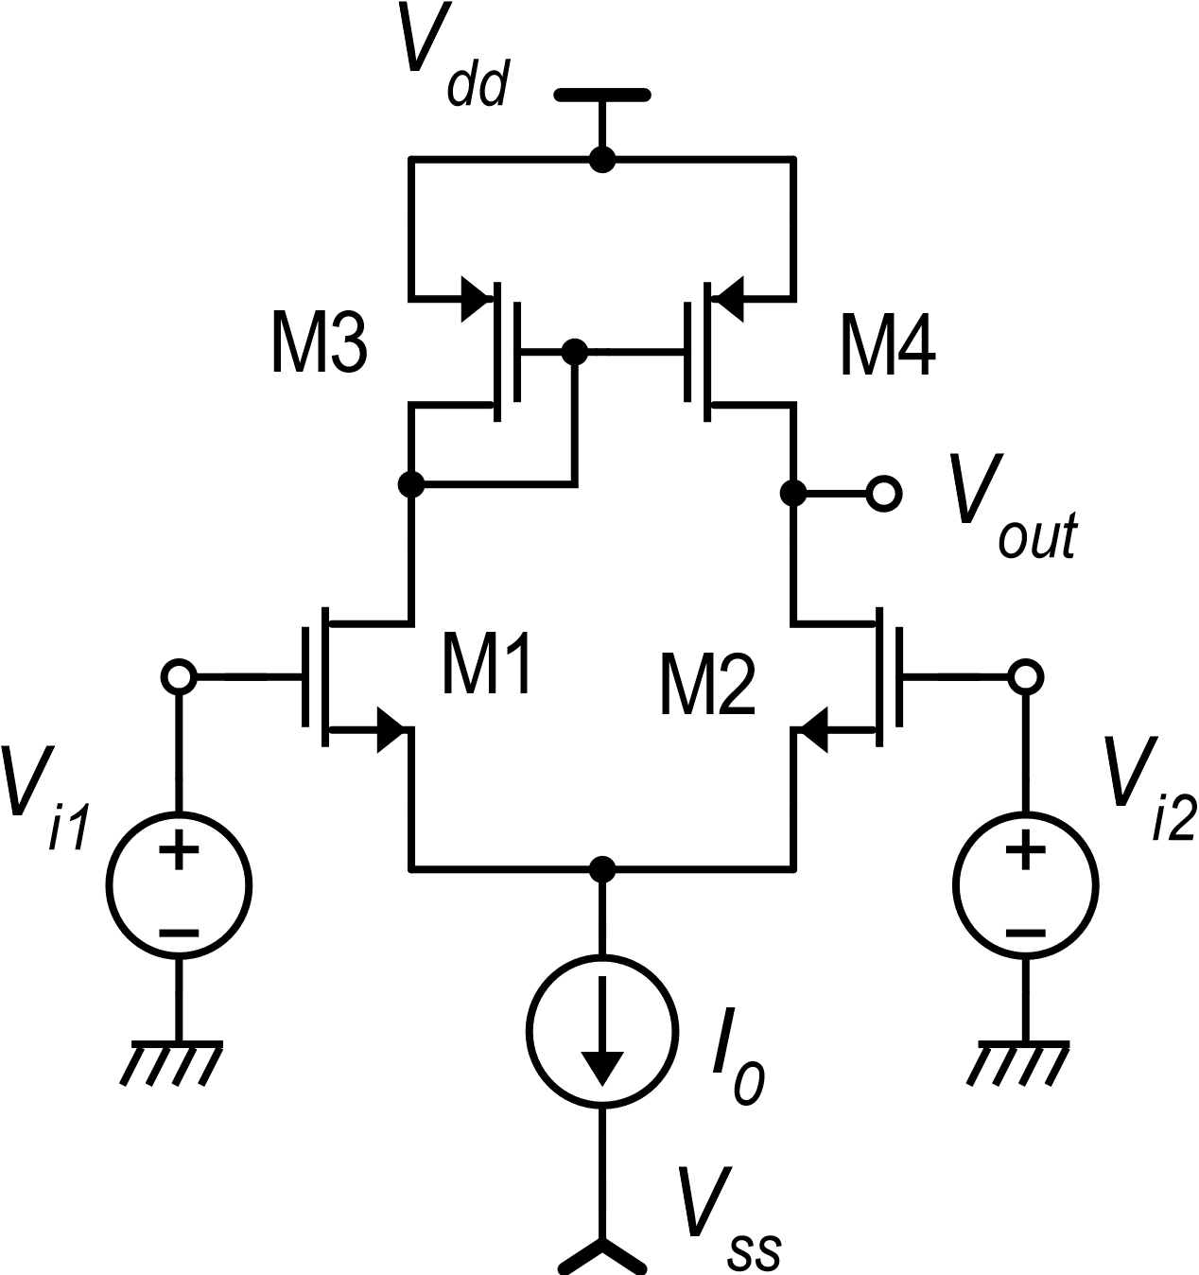
Large-signal dc transfer function
For V_{D}=0:
In strong inversion

Slide 17
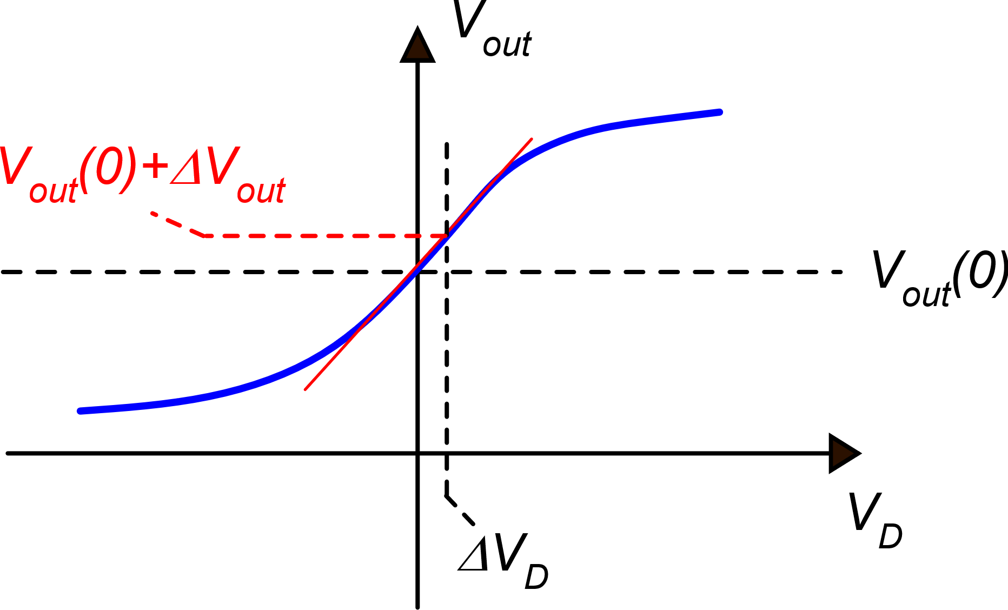
Large-signal dc transfer function
V_{out} variations for small V_{D} variations around the origin
g_{m1}

Slide 18
Moving away from the origin, step by step
In the first step, Vout moves along the tangent calculated in the origin
When V_{D} and V_{out} get far from the operating point, the parameters of the small signal models change and the slope of the tangent change as well

Slide 19
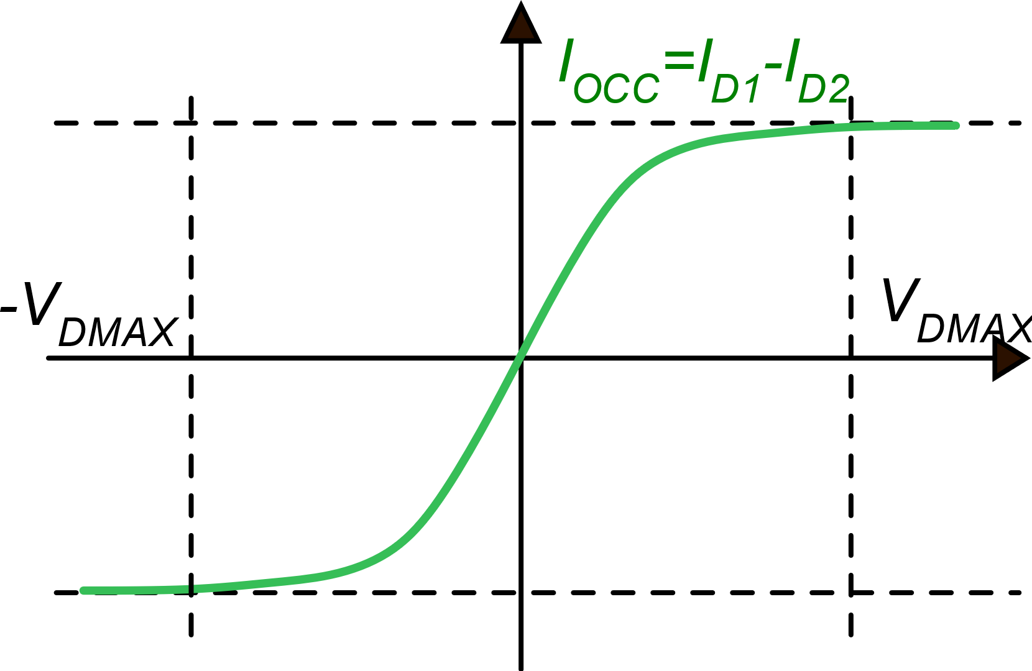
Large-signal dc transfer function
V_{out}
V_{out}(V_{DQ})+ΔV_{out}
V_{out}(V_{DQ})
V_{out}(0)
V_{D}
V_{DQ}
V_{DQ}+ΔV_{D}
V_{DQ}
V_{DQ}+ΔV_{D}

Slide 20
Approximate dc transfer characteristic
V_{out}
V_{dd}
V_{out}(0)
-V_{DMAX}
V_{DMAX}
V_{D}
V_{ss}
Example: A_{d}=100, V_{dd}-V_{ss}=5V ΔV_{D}<50 mV

Slide 21
Practically constant and equal to g_{m1}
V_{out}
V_{dd}
V_{out}(0)
M4 enters triode region and r_{d4} drops down
V_{D}
M2 enters triode region and r_{d2} drops down
V_{ss}

Slide 22
Minimum output voltage
V_{D} in the linear zone is at most
a few tens mV
V_{C} varies between V_{SS} and V_{DD}
We can neglect V_{D}/2 with respect to V_{C}

Slide 23
Minimum output voltage
Weak inversion
Strong inversion

Slide 24
Complete dc transfer characteristic
V_{out} approaches V_{dd} when I_{D2} approaches zero and M4 gets in deep triode region
V_{dd}
V_{out}
max(V_{out})=V_{dd}-|V_{DSAT4}|
V_{out}(0)=V_{dd}−|V_{GS3}|
Slope=A_{d}
V_{D}
min(V_{out})=V_{C} −V_{GS2}+V_{DSAT2}
V_{C} −V_{GS2}
=V_{S2}
V_{out} gets close to M1,M2 source voltage when V_{DS2} approaches zero (M2 is in deep triode region)
V_{ss}

Slide 25
Minimum supply voltage V_{dd}-V_{ss}
|V_{DS3}|
V_{DS1}
Example: V_{MIN}=100 mV
V_{DSAT2}=100 mV
|V_{GS3}|=0.5 V
V_{outS}

Slide 26
Input common mode range
Lower limit
As V_{C} is progressively decreased, also V_{S} decreases at the same pace and eventually the voltage across the current source I₀ will get smaller than the minimum value V_{MIN}. From that point on, I₀ will rapidly decrease, turning off the stage.

Slide 27
Input common mode range
Upper limit
As V_{C} is progressively increased, also V_{S} increases at the same pace. Since V_{out}=V_{K} =V_{D2} = V_{D1} is fixed, eventually V_{DS1} and V_{DS2} will drop below the saturation voltage.
V_{k}

Slide 28
Input common mode range
These overdrive voltages can be made equal by design, so they cancel each other
This difference can be >0 because:
(V_{t1} is affected by body effect
if M1 and M2 body is at V_{SS})
The input common mode voltage can get even slightly higher than V_{dd}

