Slide 1
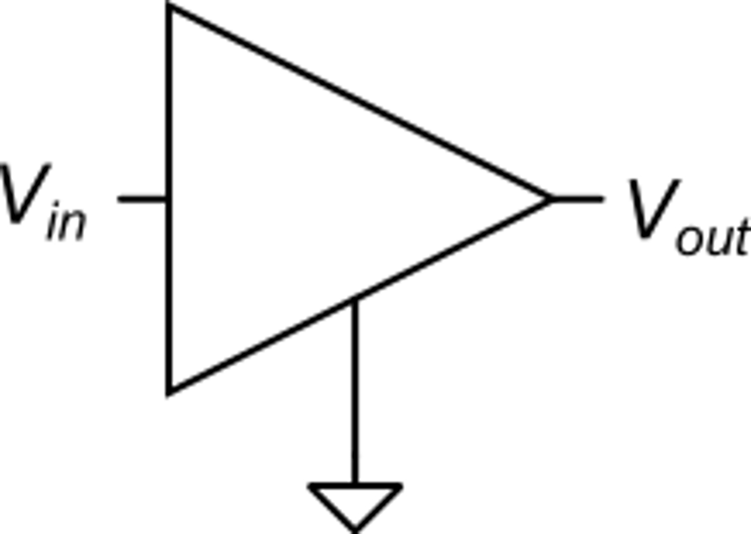
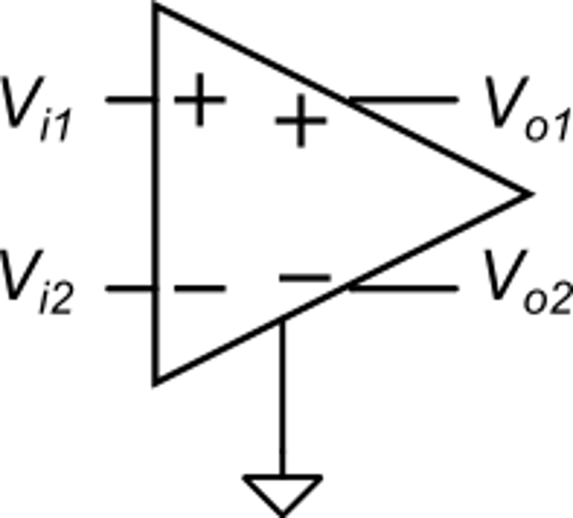
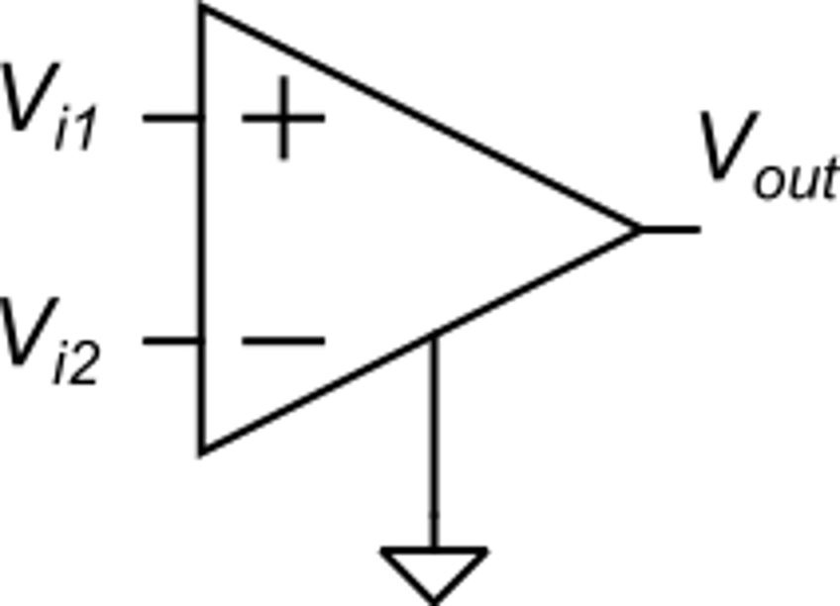
Voltage amplifiers: number of inputs and outputs
Unipolar:
single input
single output (single-ended, S/E)
Fully Differential:
differential input,
differential output
Differential:
differential input,
single output (single-ended, S/E)

Slide 2
Voltage Amplifiers: gains

Slide 3
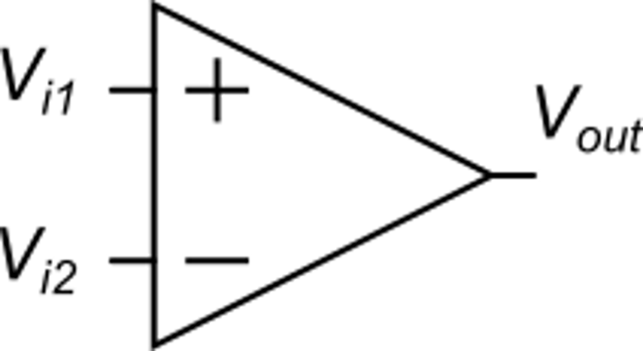
Differential amplifiers: parameters
Input voltage ranges:
Output voltage range
(Output voltage swing)
Input differential range (maximum V_{ID} (V_{D}) to maintain an acceptable input-output linearity
Outside the output range the amplifier stop working correctly (e.g. the output voltage tends to saturate)
Linear response
(with input offset voltage)
Input common-mode range:
Interval of VC values where the amplifier behaves as designed

Slide 4
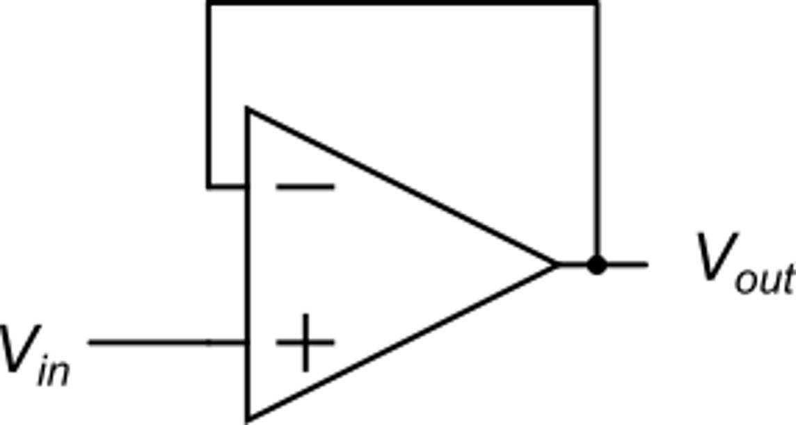
Differential amplifiers: role of the input common mode range
Example: voltage follower (buffer amplifier)
Another condition is clearly that V_{out} is within the output range
Then the conditions for correct operation are:
In the ideal case:
We have:
The voltage follower operates correctly only for V_{in} within the CM range

Slide 5
Single Stage Voltage Amplifiers
I₁
R_{out}
The processed currents are finally conveyed to an output resistance (R_{out}) and converted back to a voltage (V_{out}). In most cases, Rout is not a physical resistor, but is the output differential resistance of the I-to-I network.
For this reason, one of the function of the I-to-I network is increasing the output resistance to increase gain
V_{in}
I_{occ}
V_{out}
I₂
V-to-I
I-to-I
small-signal output voltage
The first component converts the input voltage (single or differential) into a current (single or differential)
example
The second component is a current processing network, that takes the input currents and applies simple linear operations such as:
Addition and subtraction
Addition of constant currents
Multiplication by a constant gain factor
example

Slide 6
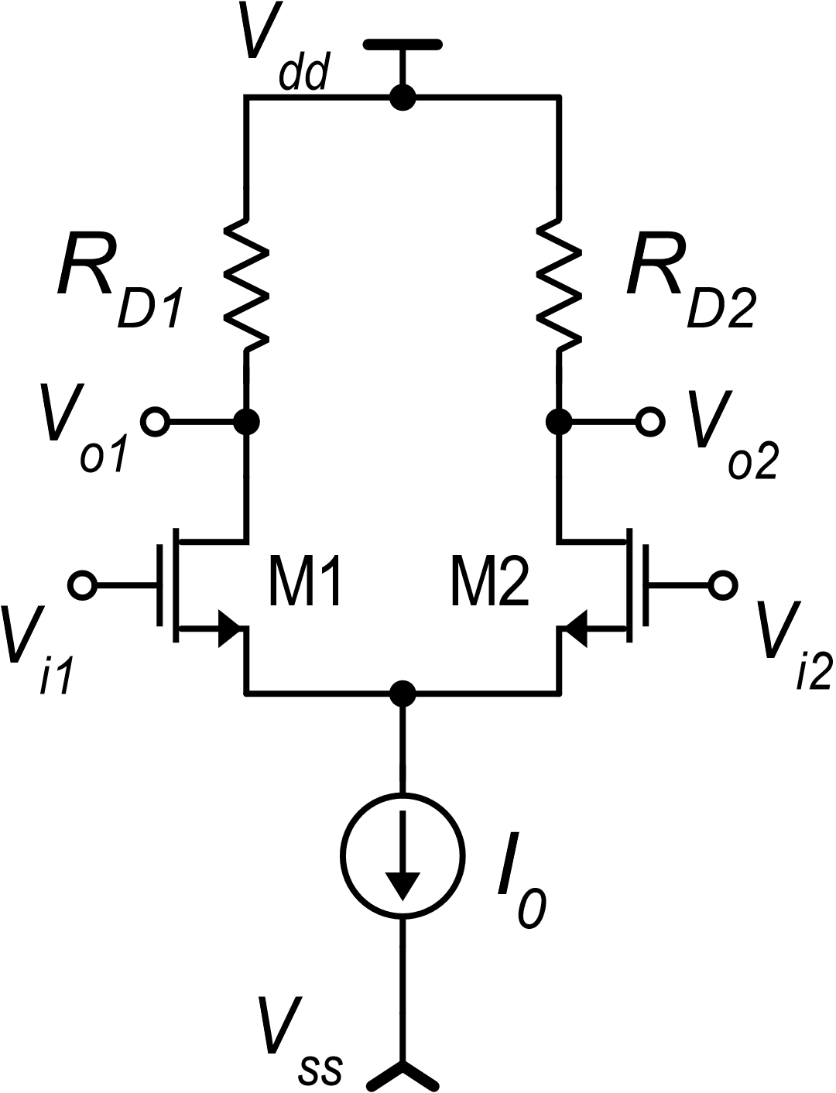
Differential amplifier with resistive loads
Small signal analysis
Differential mode:
Single-ended case:
Fully-differential case:

Slide 7
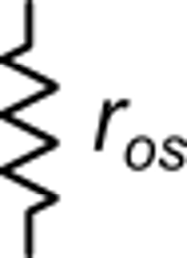
Common mode Analysis
This, actually, is not an ideal current source.
It has a finite output resistance = r_{os} If it is implemented by a simple current mirror, r_{os}= r_{d} otherwise it can be even higher
The source voltage practically follows the common mode variations. V_{S} is V_{C} shifted by V_{GS}

Slide 8
Common mode gain and CMRR
output voltages
Single-ended case
Considering that generally I₀ is produced by a simple current mirror, r_{os}=r_{d}, then CMRR~40 dB,
This CMRR is not sufficient for many applications

Slide 9
Common mode gain and CMRR
Fully differential case
is a relative matching error ~ 0.01
Adequate for most applications

Slide 10
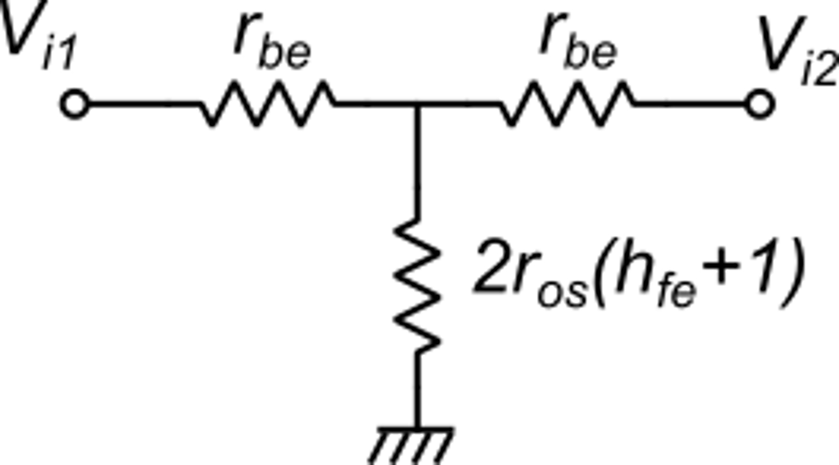
BJT case
In the case of a BJT differential amplifier, the expressions are exactly the same as for the MOSFET case.
The only important difference is the presence of a base current that is drawn from the voltage sources that provide V_{i1} and V_{i2}. In terms of small signal analysis, this base current is the cause of a finite input resistance that may result in an input attenuation if the signal voltage sources (V_{i1}, V_{i2}) have a significant internal resistance.
I_{B1}
I_{B2}
Equivalent circuit of
the input terminals

Slide 11
Maximum gain for a given supply voltage
single ended
nominal case:
R_{D1}=R_{D2}=R_{D}
fully-differential
R_{D}I_{D} is the static voltage drop across resistors R_{D}. It cannot exceed the total supply voltage V_{DD}−V_{SS}
|A_{dd} | < 60
Example: V_{TE}=50 mV, V_{DD}-V_{SS}=3 V:
|A_{dd} | < 120
With a BJT: V_{TE}=V_{T}=25 mV:
To get the highest gain for a given supply voltage it is convenient to bias the MOSFETS with the smallest V_{TE}.

Slide 12
Offset voltage of differential amplifiers with resistive load
MOSFET case - fully-differential - Strong inversion
We can consider the difference of V_{GS} as the matching error between two nominally identical circuits: M1,R_{D1} and M2,R_{D2}
posynomial
form
Nominally identical
circuits

Slide 13
Offset voltage of differential amplifiers with resistive load
B
MOSFET case - fully-differential
A
This is a generic expression of V_{D}, corresponding to a given value of $\frac{ΔI_{D}}{I_{D}}$
This expression gives V_{io} for the particular $\frac{ΔI_{D}}{I_{D}}$ value that results in V_{out}=0

Slide 14
Offset voltage of differential amplifiers with resistive load
MOSFET case - fully-differential
Imposing V_{out}=0 is the same as imposing ΔZ=0
defining:
R_{D}I_{D} is the average value and cannot be zero

Slide 15
Offset voltage of differential amplifiers with resistive load
MOSFET case - fully-differential

Slide 16
Role of the design parameters
W_{R}
L_{R}
To be made as small as possible, to reduce σ_{Vio}
W
L
Small offset means large silicon area

Slide 17
Offset voltage of a BJT differential amplifier with resistor load

Slide 18
Offset voltage of a BJT differential amplifier with resistor load
Minimum size BJT (elemental BJT) of the process
Small offset means large silicon area

Slide 19
Temperature drift of the input offset voltage: BJT case
These terms are practically temperature independent (ratios of homogeneous quantities)

Slide 20
A method to reduce the offset voltage and its drift
Example: v_{io}=1 mV
T=300 K
By trimming the resistors, I can null the offset. In this way, also the temperature drift is nulled.
This is an advantage of the BJT amplifier. Trimming the offset of a MOSFET differential amplifier does not null the drift.

Slide 21
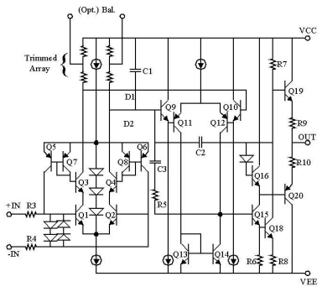
Example: the OP07
Resistors are varied by laser trimming to null the offset
In this way, also the offset drift is strongly reduced
The base currents of the input devices (Q1,Q2) are reproduced by Q3 and Q4 and than fed back to the input terminals by mirrors Q8,Q6 and Q7,Q5. This approach allows to reduce the input bias currents.

Slide 22
OP07 vs μA741
OP07
μA741

Slide 23
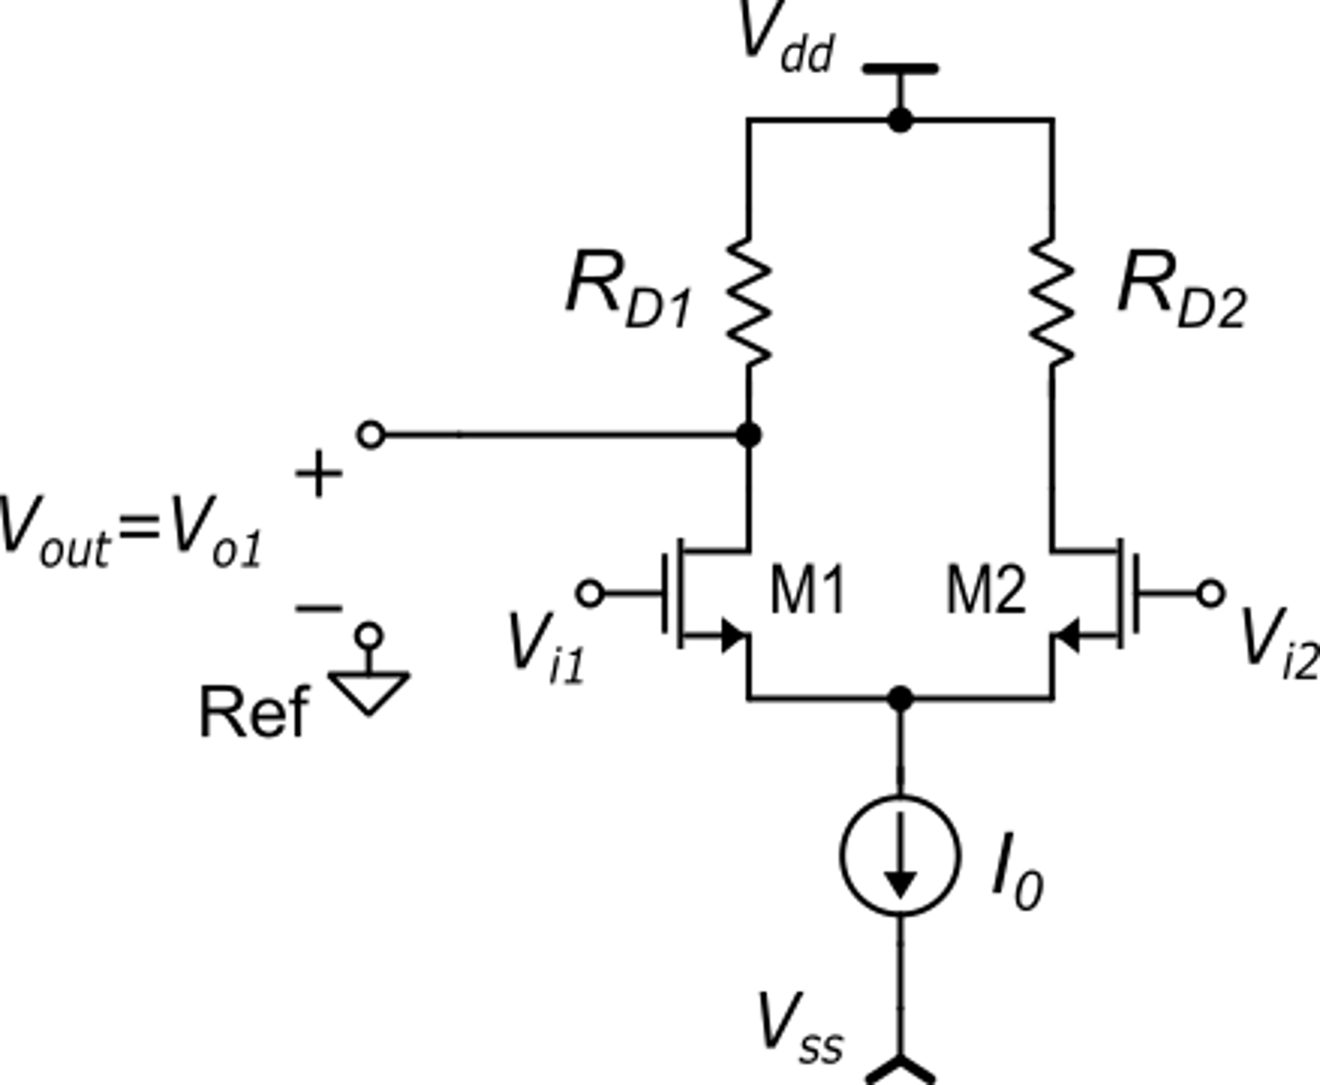
How is the amplifier offset when the single ended option is chosen?
Single ended (S/E): device parameters do not appear as differences: the output voltage is affected mainly by global errors
The single ended case is subjected to a much larger offset!
Compare with the fully-differential case: the output voltage depends only on matching differences

