Slide 1
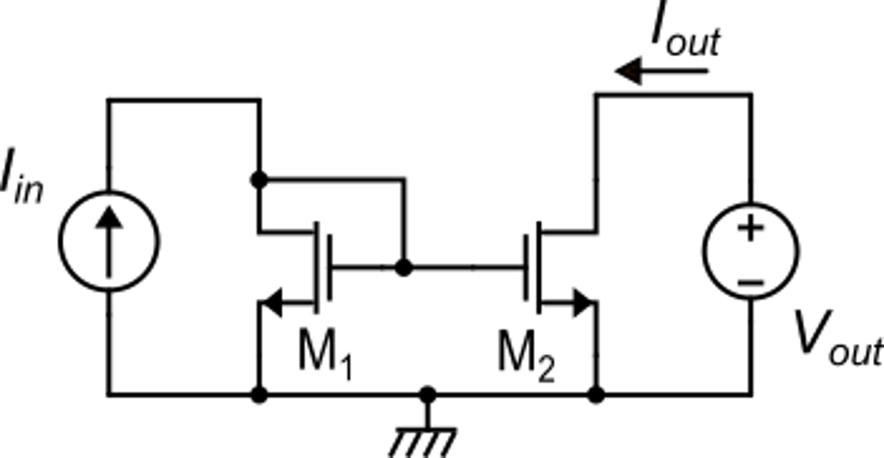
Effect of matching errors in current mirrors
CMOS simple current mirror
with k_{M}=1
M1 is nominally identical to M2

Slide 2
Standard deviations

Slide 3
Examples
Case 1: L=W=1μm
V_{GS}-V_{t} =100 mV
Case 1: L=W=1μm
V_{GS}-V_{t} =500 mV
Case 1: L=W=10 μm
V_{GS}-V_{t} =500 mV

Slide 4
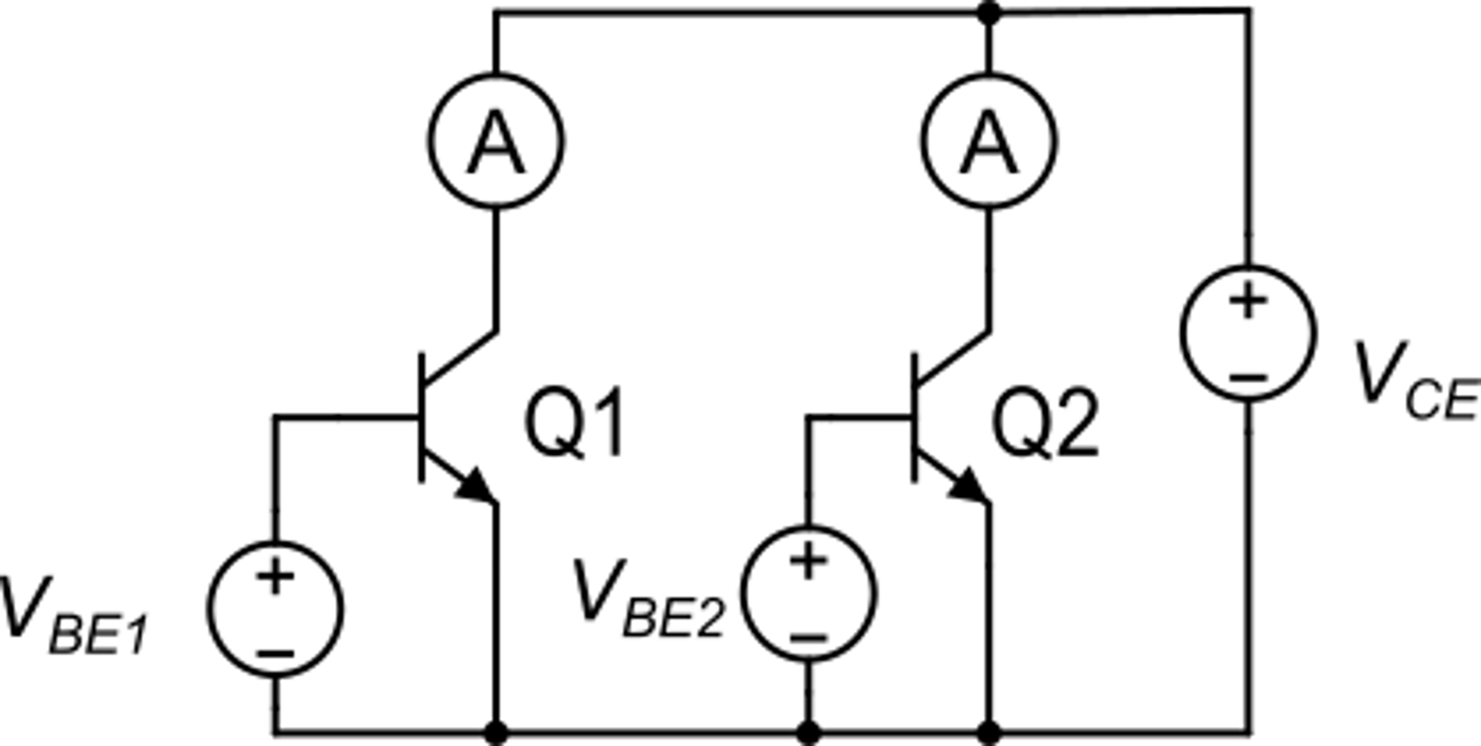
Matching in BJT: process parameters
amperometers
Q1 and Q2 are nominally identical and placed in the same chip. They are affected by matching errors
Q1 and Q2 are biased with identical V_{CE}>> V_{CESAT} and individual V_{BE} voltage such that Q1 and Q2 carry the same collector current
generically
The foundry provides (of the minimum size BJT)

Slide 5
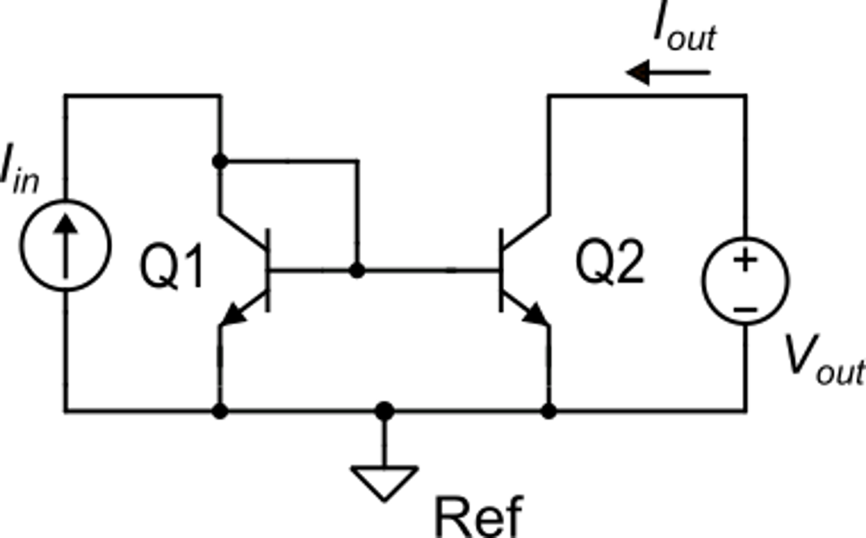
Matching errors in BJT current mirrors
typical values:
Note:

