Slide 1
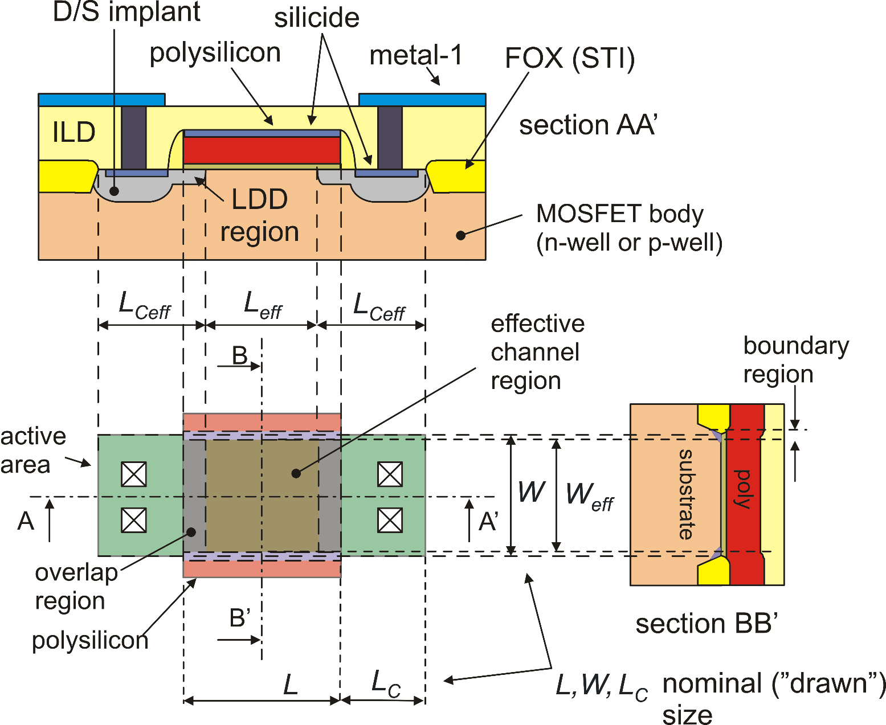
Planar n-MOSFET cross-section and layout
The designer introduces ideal geometrical values (L,W ..), while the electrical properties are determined by "effective" values:

Slide 2
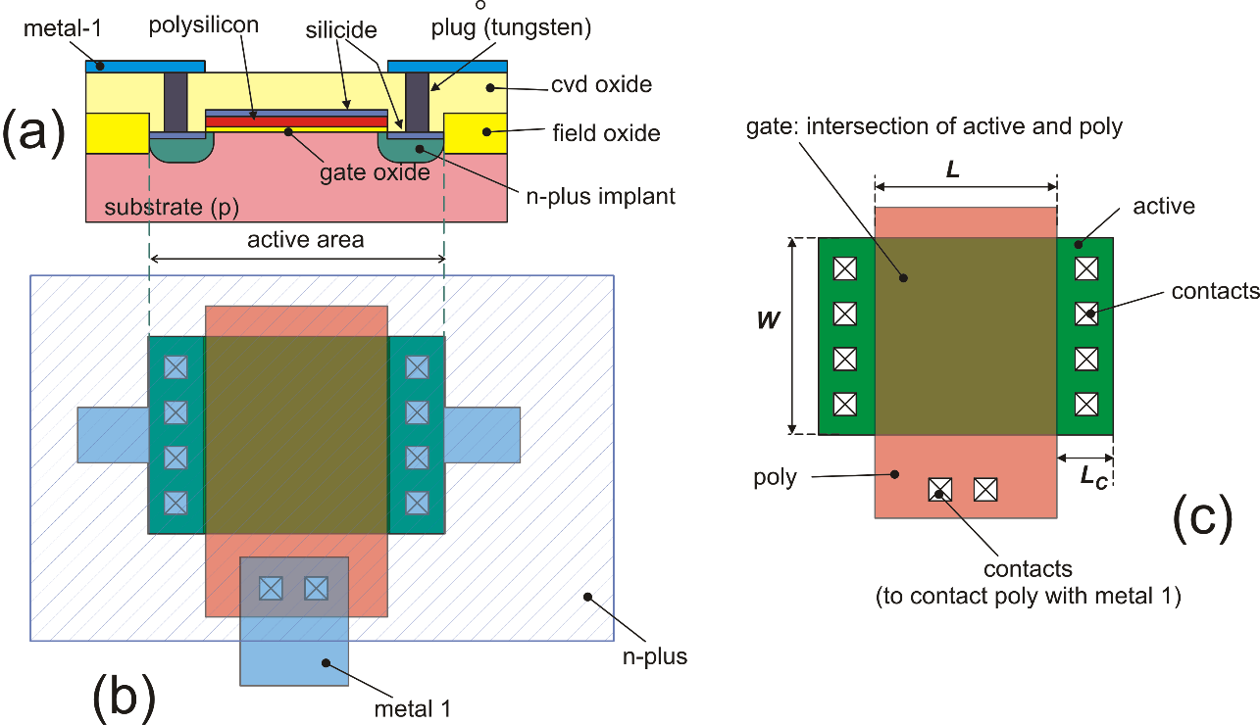
Simplified layout and cross-section ("designer view")

Slide 3
MOSFET models
Models for accurate electrical simulations: BSIM models (Berkeley Short-channel IGFET Model), EKV (Enz, Krummenacher, Vittoz) ...
Models for "hand calculations": square law (strong inversion)
exponential laws (weak inversion)
It is of primary importance to be able to manually perform first order device sizing and first order performance estimation.
Only very simple and intuitive model enable the designer to create cells that need only a final refinement and verification in the simulation phase
The simulator is useless if we do not know how to produce a circuit on scrap-paper. The simulator obeys to the law:
garbage in – garbage out

Slide 4
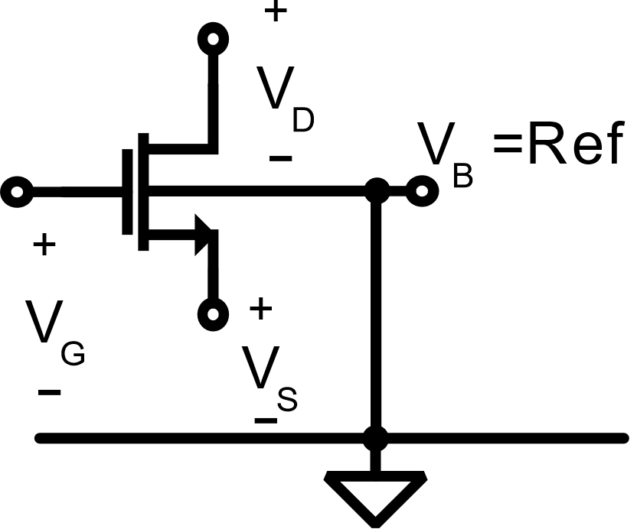
EKV Model
Fully-analytical, physics based model focused on weak-inversion behaviour
All terminal voltages are referred to the bulk terminal voltage, exploiting the simmetry of the source and drain terminals
Supported by Spice simulators, requires only 18 DC parameters
Drawback: simplified expressions of short channel effects
* “An analytical MOS transistor model valid in all regions of operation and dedicated to low-voltage and low-current applications” – Enz, C. C., Krummenacher, F., Vittoz, E. A. - 1995

Slide 5
BSIM Models
Highly empirical models (BSIM3 DC models requires almost 100 parameters)
Standards for integrated circuit design, with accurate modeling of transistor’s behaviour (e.g.: channel length modulation and DIBL)
Currently maintained models: BSIM3 (until sub-100 nm nodes), BISM4 (from 0.13 um to 20 nm), BSIM-SOI, BSIM-CMG (Common Multi-Gate, for FinFET and 3-D transistors)…
* “BSIM: Berkeley Short-Channel IGFET Model for MOS transistor” – B.J. Sheu et al. - 1987

Slide 6

MOSFET models: The n-MOSFET
From this point on, we will consider the behavior of the
n-MOSFET, unless otherwise specified. In the end, we will suggest a simple way to transfer all the considerations made for the n-MOSFET to the p-MOSFET
In integrated circuits, the MOSFET is a four terminal devices: Drain, Source, Gate and Body. In discrete MOSFETs, the body is generally connected to the source internally.
D
G
B
S

Slide 7
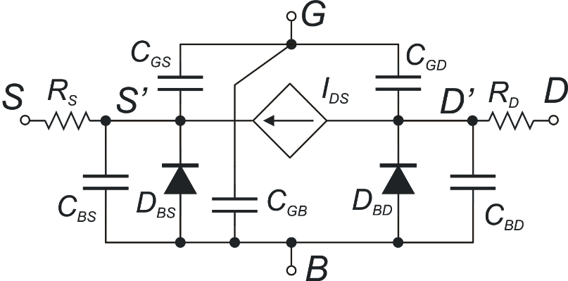
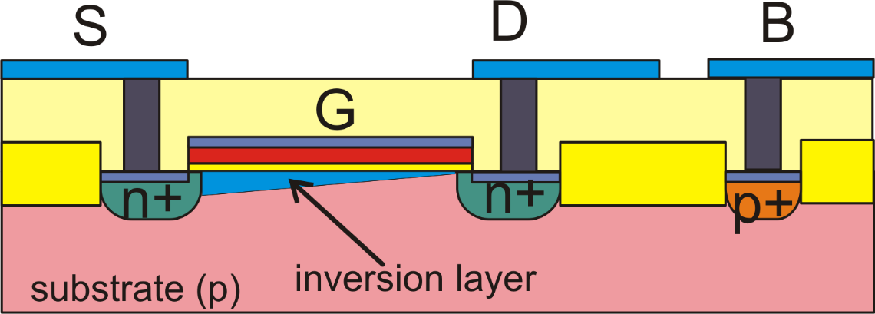
Large signal MOSFET model (n-MOSFET)
G
S
D
B
In DC, we will always assume:

Slide 8
Source and Drain Symmetry (1)
The planar MOSFET is symmetric so that drain and source can be swapped with no consequences in the electrical characteristics.
Equations that use the source as a reference terminal for all relevant voltages can be applied only after finding which terminal is actually playing the role of the source.
In an n-MOSFET, the effective source is the terminal that has the lower voltage; the other one of the two, is the actual drain
In a p-MOSFET, the effective source is the terminal that has the higher voltage; the other one of the two, is the actual drain

Slide 9
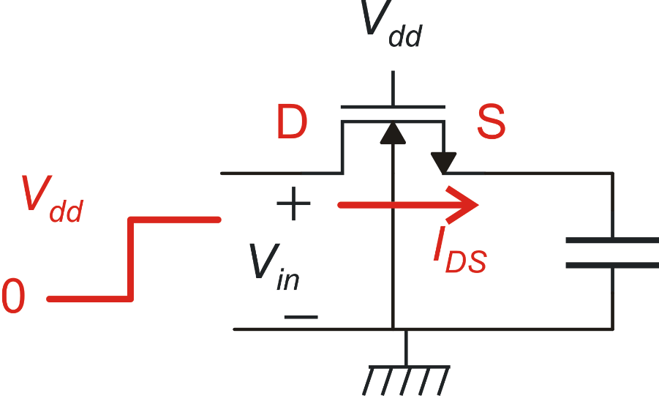
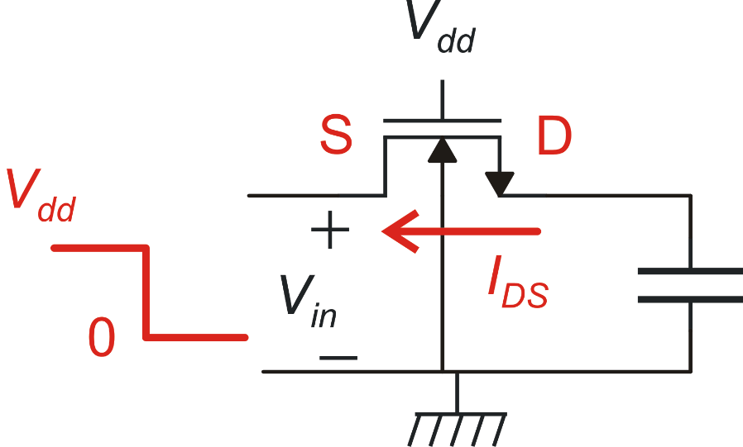
Source and Drain Symmetry (2)
With this definition, it is clear that in transient situations, the effective drain and source can swap, depending on the voltage assumed by the terminals.
Example
In a schematic editor it is necessary to indicate which terminal is the drain and the source. These "conventional" terminals are used to mark all voltages for printing and plotting purposes. This choice do not affect the circuit behavior during the simulations.

Slide 10
Source and Drain Symmetry (3)
If the circuit has a clear static operating point (like most analog circuits), it is convenient to mark as source the terminal that in the operating point is actually working as the source. This will facilitate reading device voltages produced as textual or graphical outputs by the simulator.
Models like the EKV use the body as the reference for all voltages. In this way drain and sources are perfectly symmetrical also in the equations and there is no need to decide which one is actually working as the source.
Maintaining the distinction between source and drain is more intuitive and most models oriented to hand calculations are actually based on this choice.

Slide 11
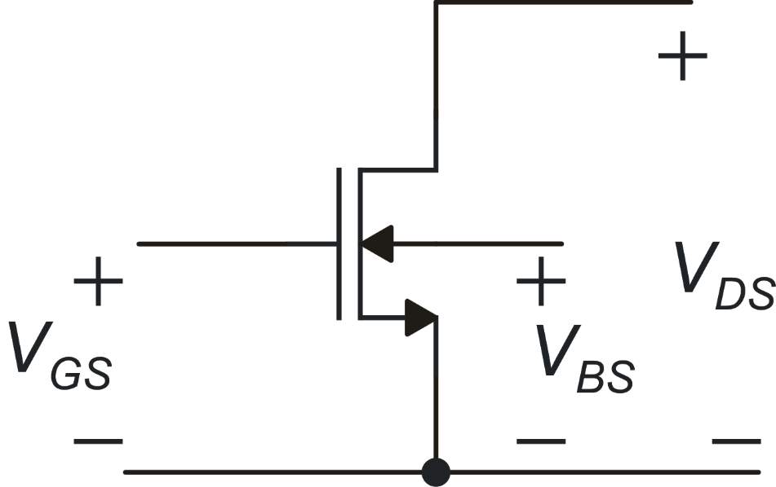
The I_{DS} model: control voltages
secondary effects:
generally they are unwanted
primary effect
it is the wanted current control

Slide 12
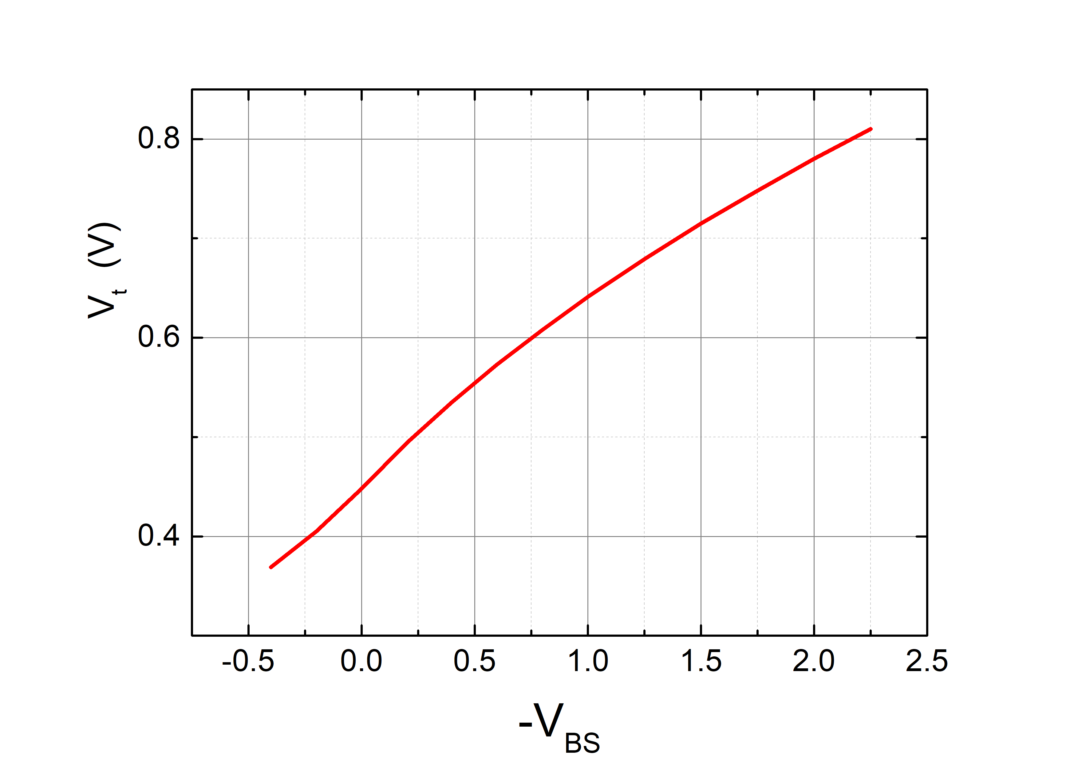
V_{GS}, V_{BS} and "overdrive voltage"
The voltage that really affects the current is the "useful" part of the V_{GS},
often called "overdrive voltage".
Body effect
γ: body effect coefficient φ_{S}: surface potential

Slide 13
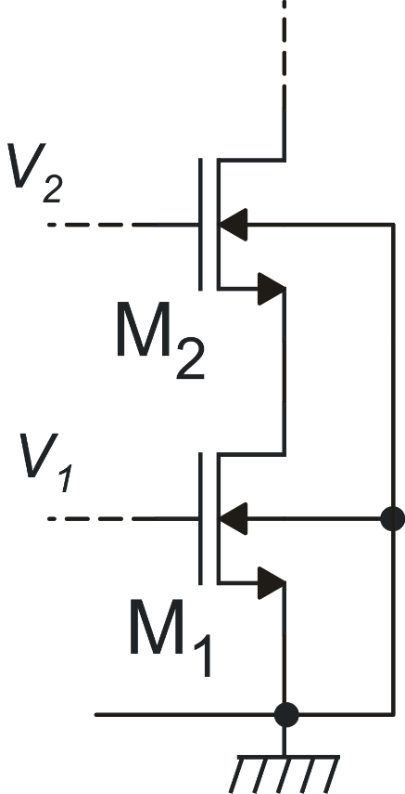
More on body effect: example

Slide 14
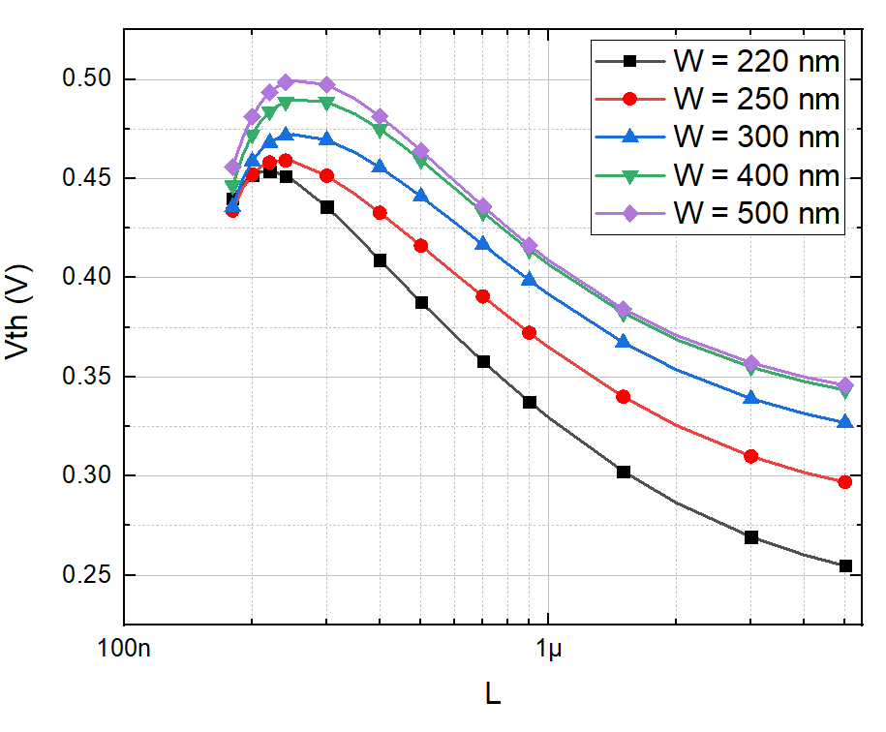
RSCE and RNCE
Reverse Short Channel Effect (RSCE): reduction of Vth with increasing channel length L
Reverse Narrow Channel Effect (RNCE): increasing of Vth with increasing channel width W

Slide 15
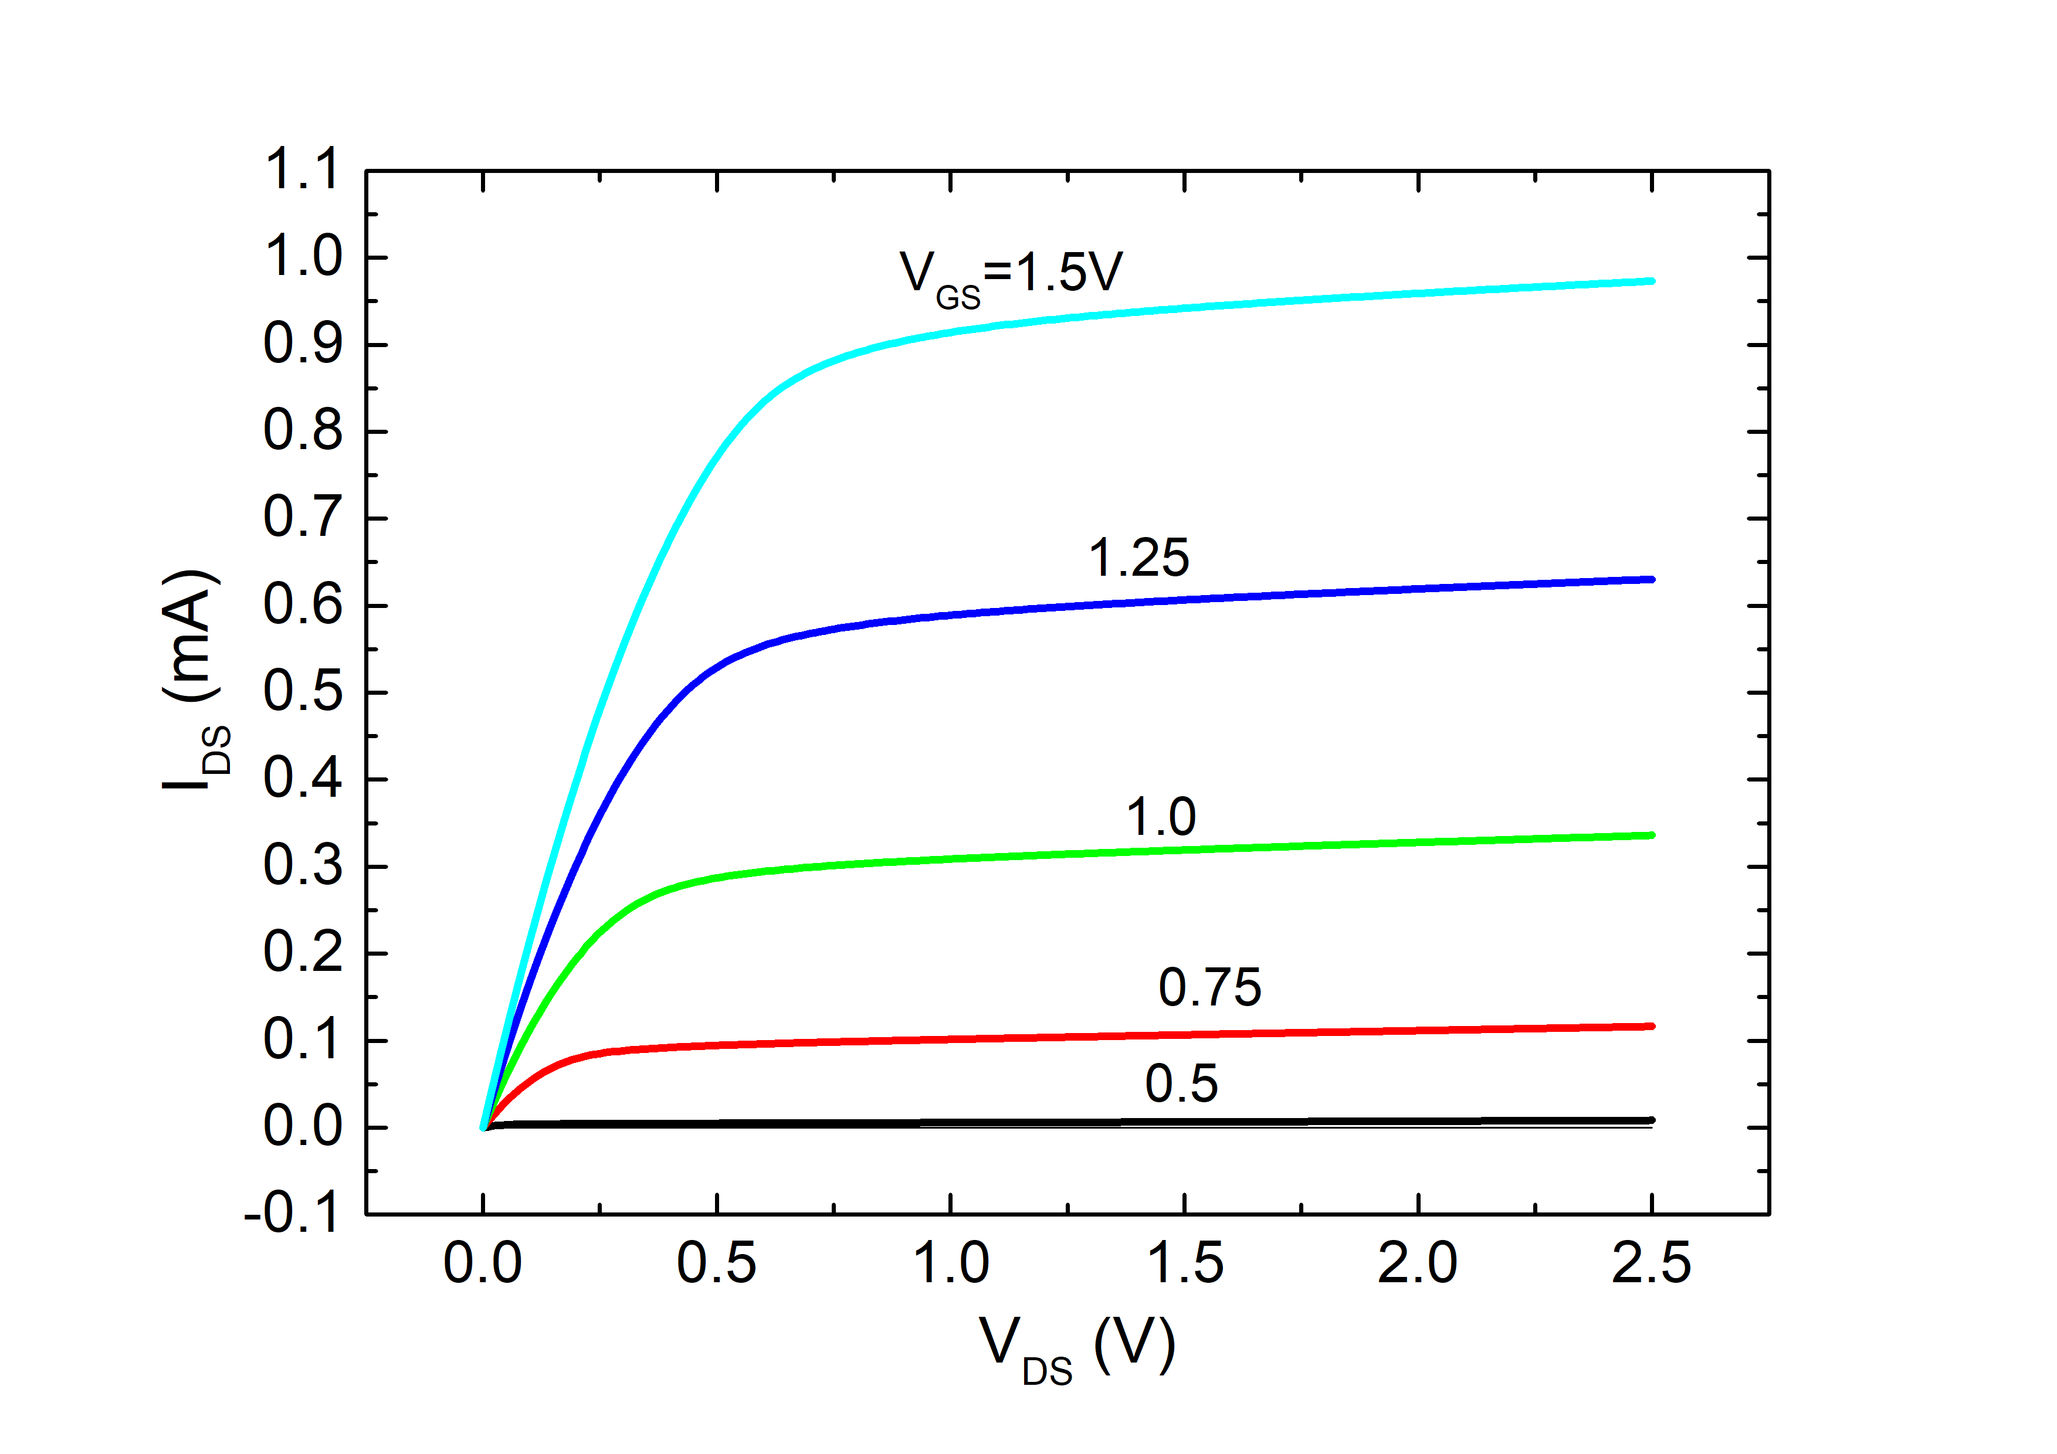
I_{DS} : operating zones on the basis of V_{DS}
Triode: I_{DS} is strongly dependent on V_{DS}
triode
saturation
Saturation: I_{DS} shows a weak and almost linear dependence on V_{DS}
V_{DSAT} is a function of V_{GS}-V_{t}
V_{DSAT}

Slide 16
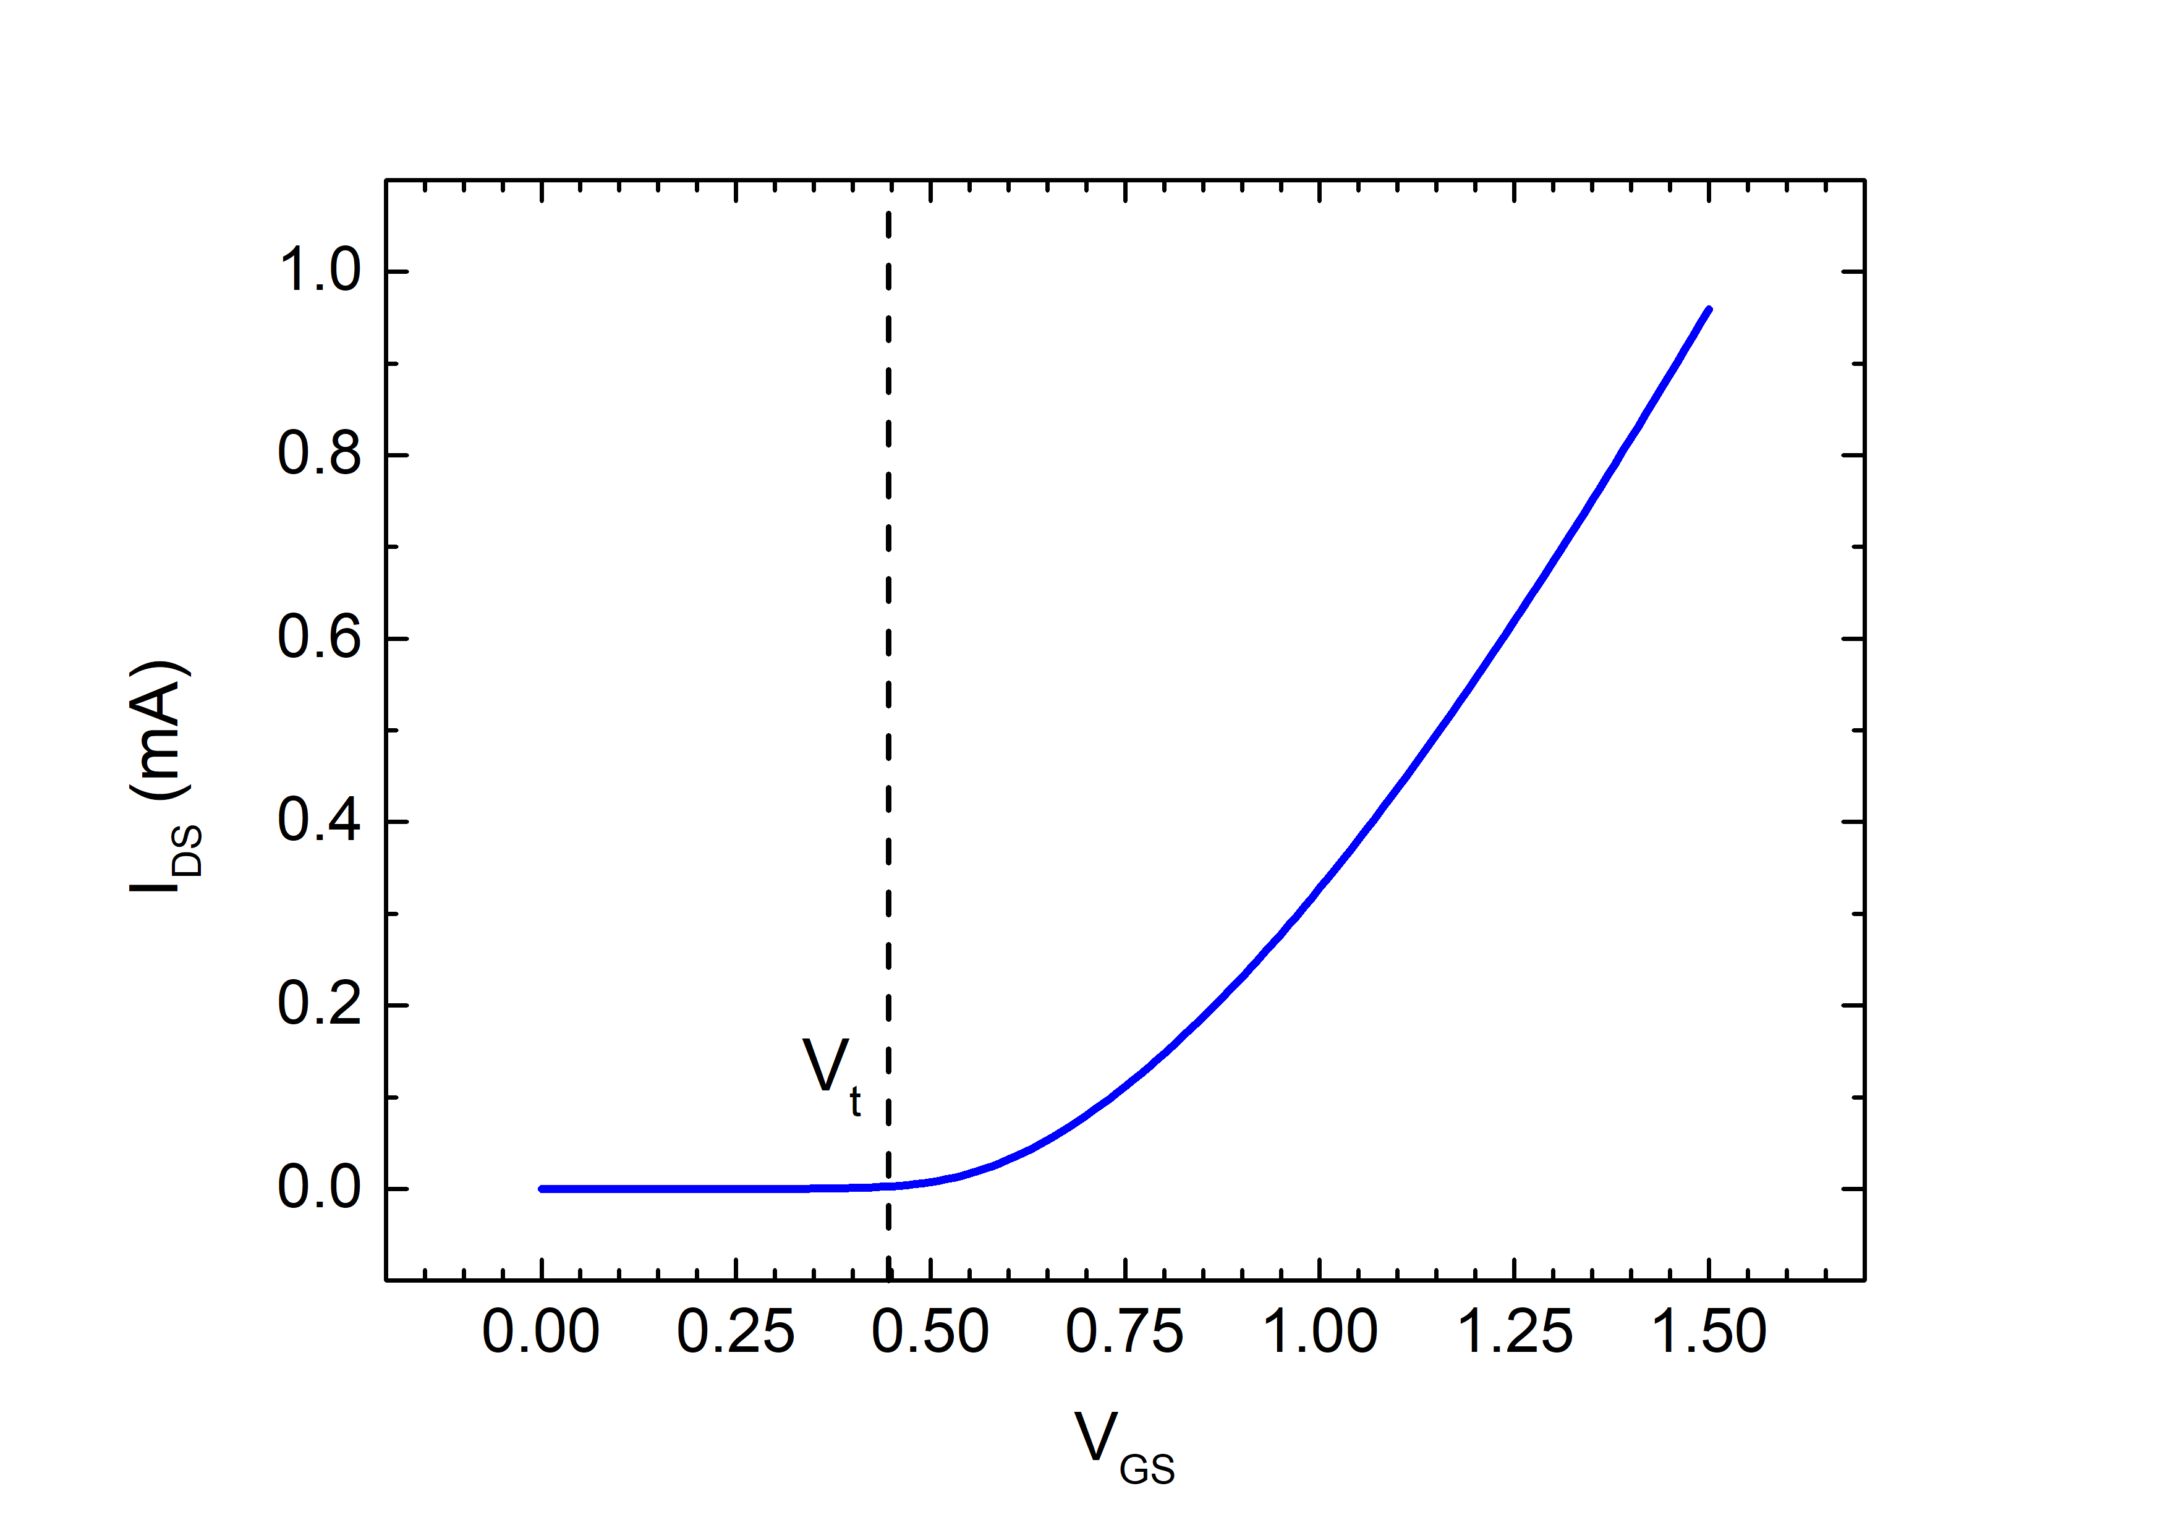
Operating zones on the basis of V_{GS}-V_{t}
A rough picture:
V_{DS}>V_{DSAT}
V_{GS}<V_{t}
V_{GS}>V_{t}
off
on

Slide 17
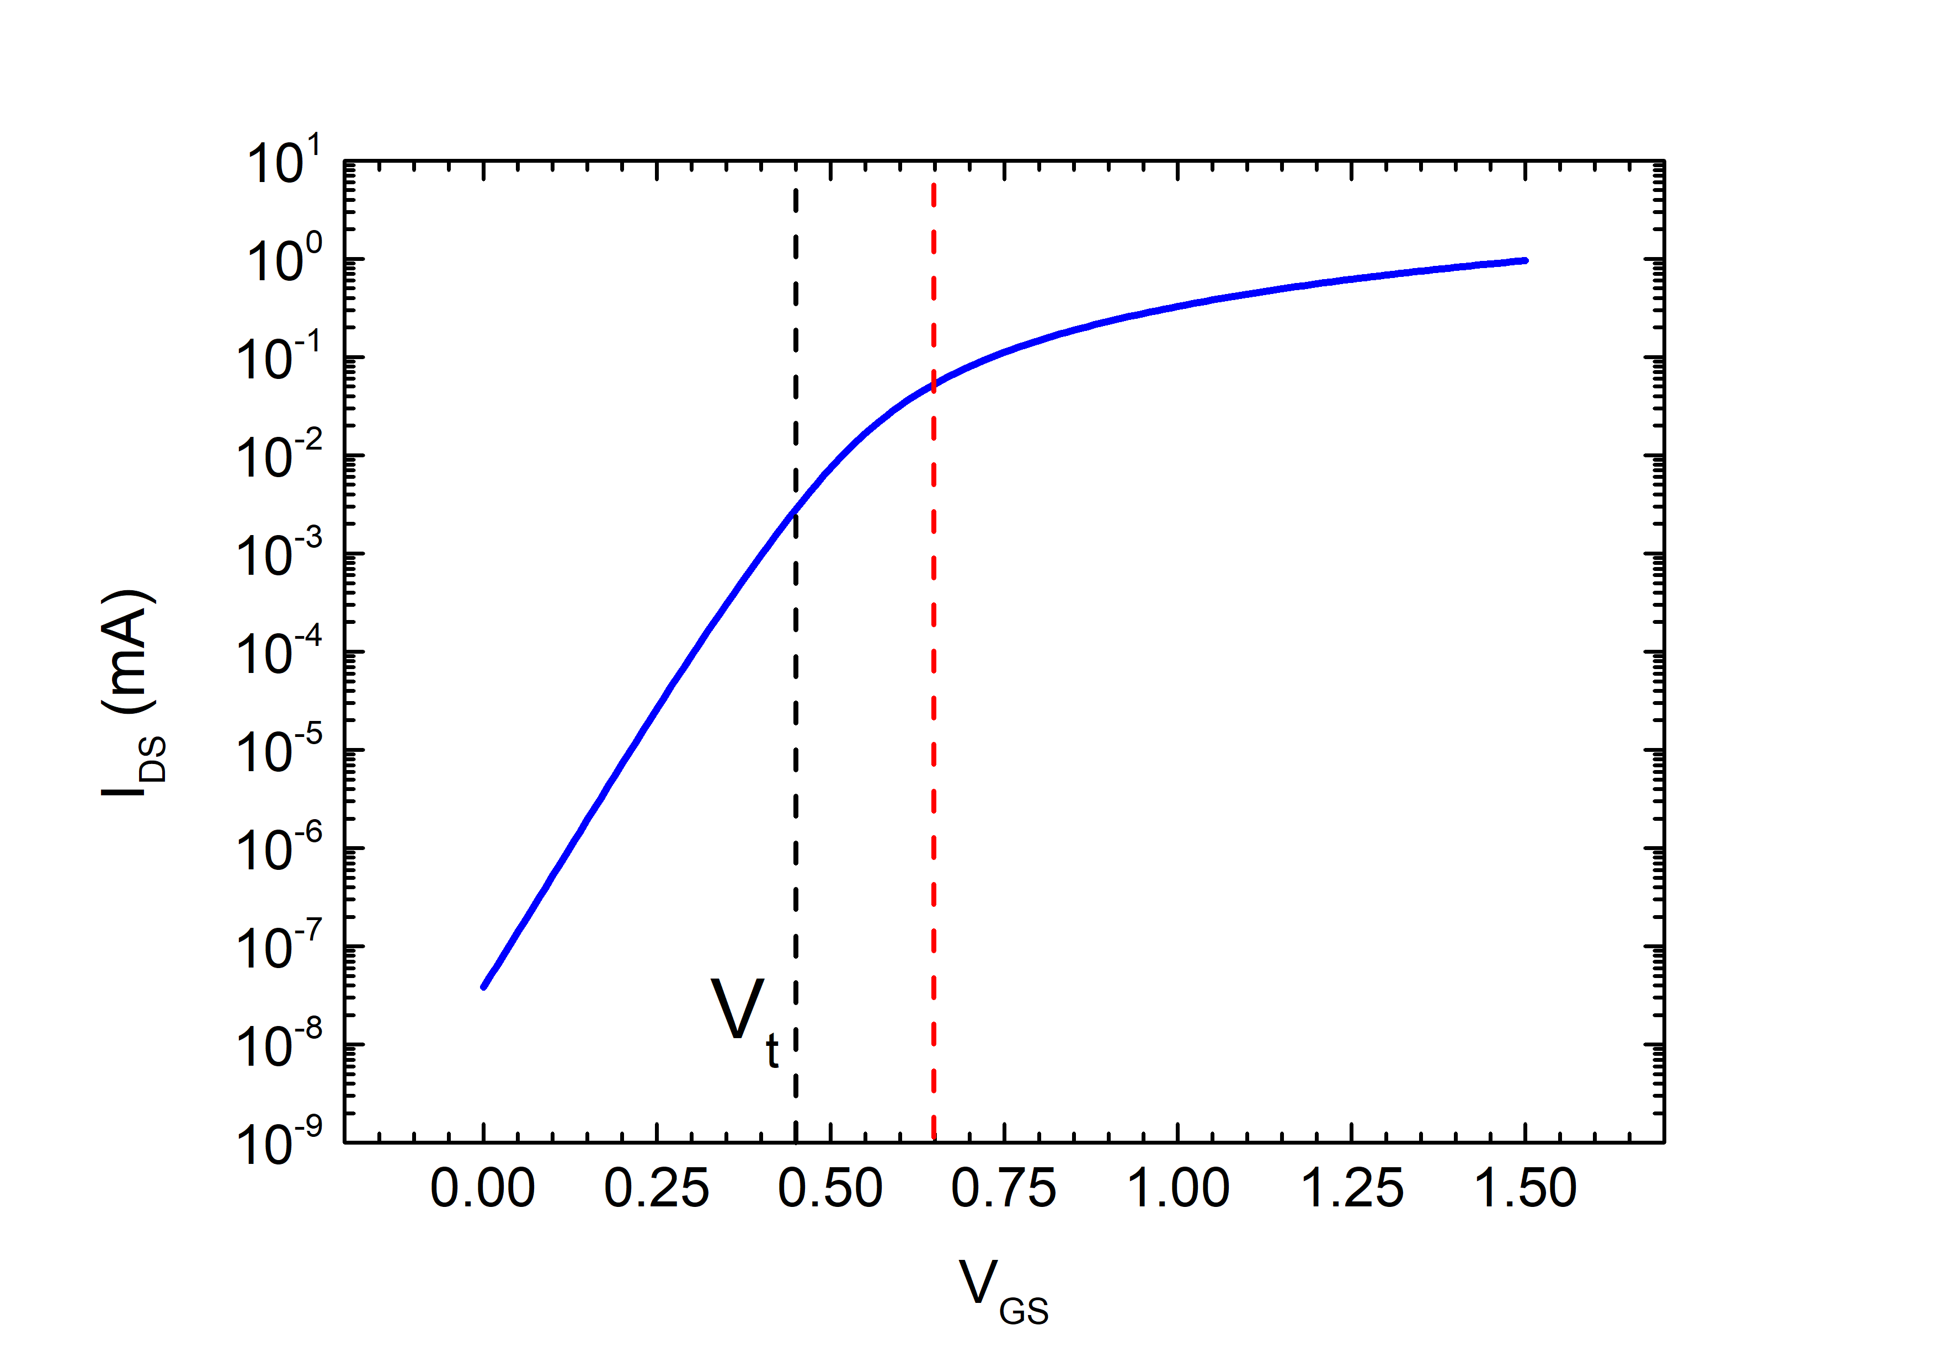
A more gradual picture: same characteristic with logarithmic y-axis
weak inversion
(sub-threshold)
moderate inversion
stong
inversion
V_{T}=kT/q
V_{t}+4V_{T}

Slide 18
I_{DS}: operating zones
 | V_{GS} -V_{t} ≤ 0 | 0 ≤ V_{GS} -V_{t} ≤ 4V_{T} | V_{GS} -V_{t} ≥ 4V_{T}
V_{DS} ≤ V_{DSAT} | Triode – Weak Inversion | Triode – Moderate Inversion | Triode – Strong Inversion
V_{DS} ≥ V_{DSAT} | Saturation – Weak Inversion | Saturation – Moderate Inversion | Saturation – Strong Inversion

Slide 19
V_{GS}-V_{t}>4V_{T} Strong inversion: I_{DS} equations
V_{DS} ≤ V_{DSAT} (Triode)
V_{DS} ≥ V_{DSAT} (Saturation)
In some textbooks this term is omitted (V_{DSAT}) for simplicity, but this cause a discontinuity between the triode and saturation region

Slide 20
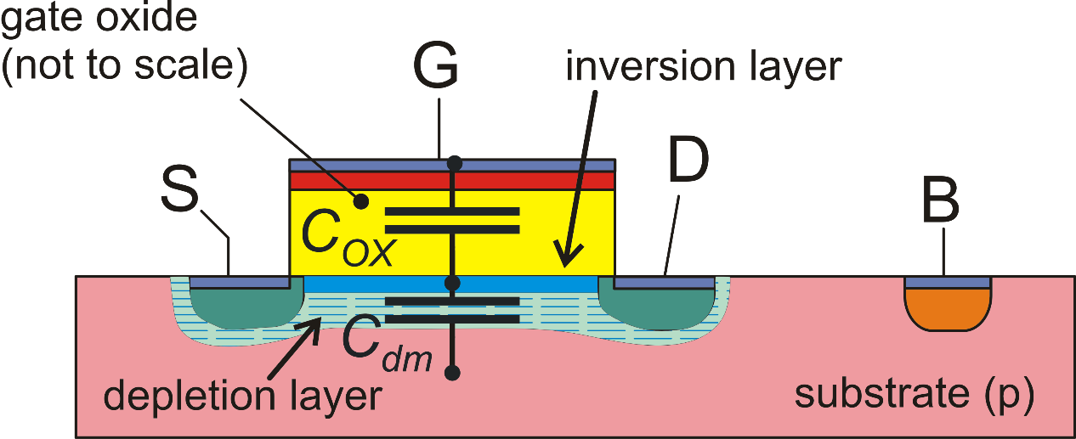
EKV model in weak inversion
EKV model for w.i.
κ: channel divider
m: subthreshold slope factor

Slide 21
EKV model in weak inversion
EKV model for w.i.
κ: channel divider
m: subthreshold slope factor
Body effect
Body effect coefficient

Slide 22
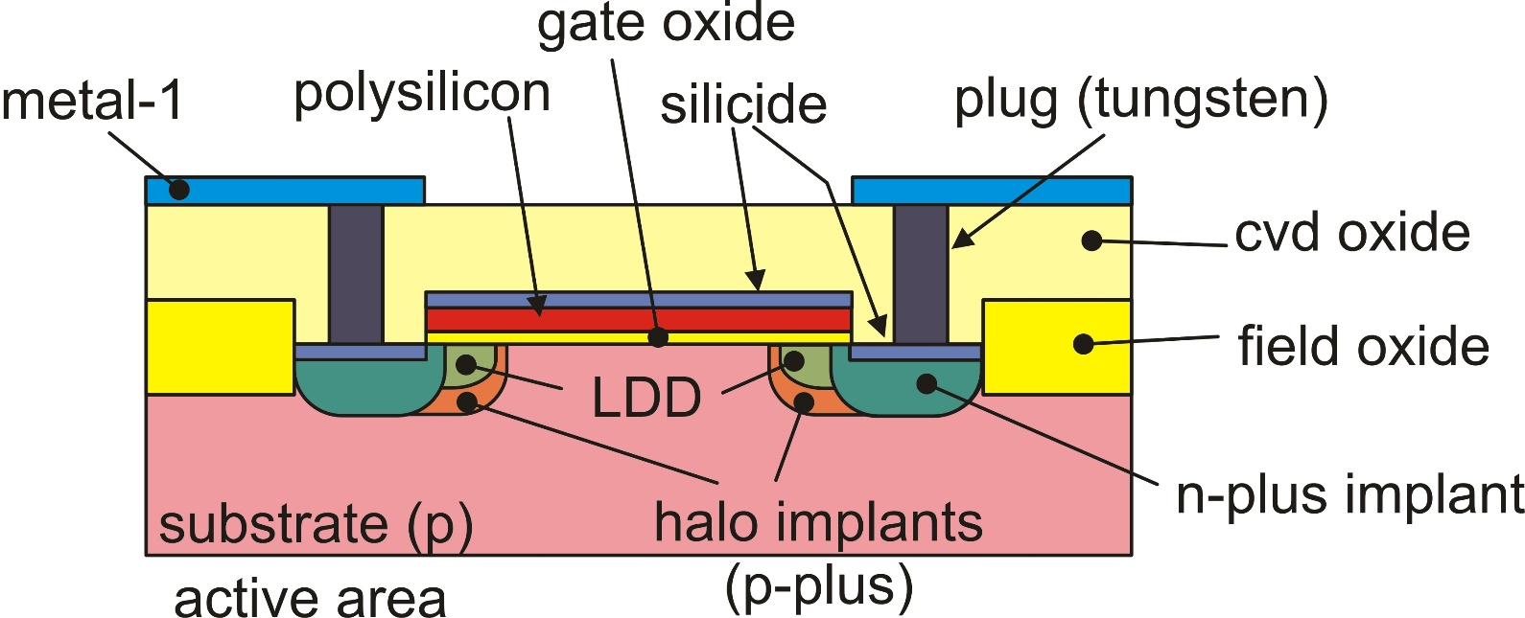
Drain-Induced Barrier Lowering (DIBL) Effect
Short-channel effect that reflects into a reduction of the threshold voltage with a larger drain-source voltage, due to the drain-body depletion region
Lower DIBL effect with longer channel length L
Halo implants reduce DIBL effects (but cause RSCE)

Slide 23
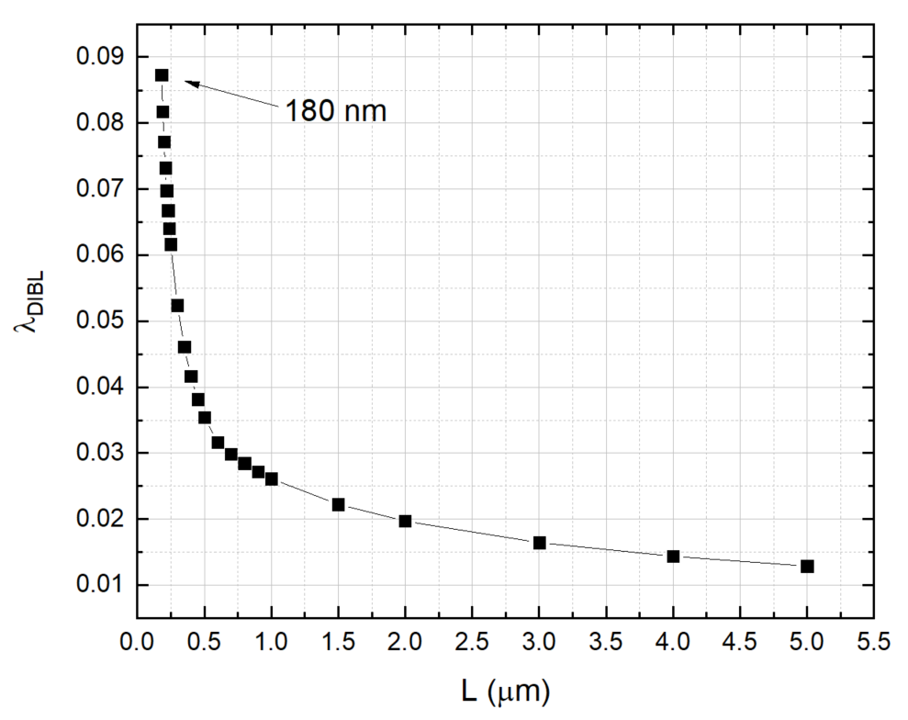
DIBL Effect
λ_{DIBL}: DIBL coefficient (inversely proportional to L), typically 0.01 – 0.1
DIBL
effect

Slide 24
I_{DS} simplified model in weak inversion
Weak Inversion
(V_{GS} < Vt)
Triode region
V_{DS} < V_{DSAT} ≈ 4V_{T}
Saturation region
V_{DS} > V_{DSAT} ≈ 4V_{T}

Slide 25
I_{DS} operating regions
 | Weak Inversion (V_{GS} -V_{t} ≤ 0) | Moderate Inversion (0 ≤ V_{GS} -V_{t} ≤ 4V_{T}) | Strong Inversion (V_{GS} -V_{t} ≥ 4V_{T})
Current in Triode Region V_{DS} ≤ V_{DSAT}
Current in Saturation Region V_{DS} ≥ V_{DSAT}
Saturation Voltage V_{DSAT}

Slide 26
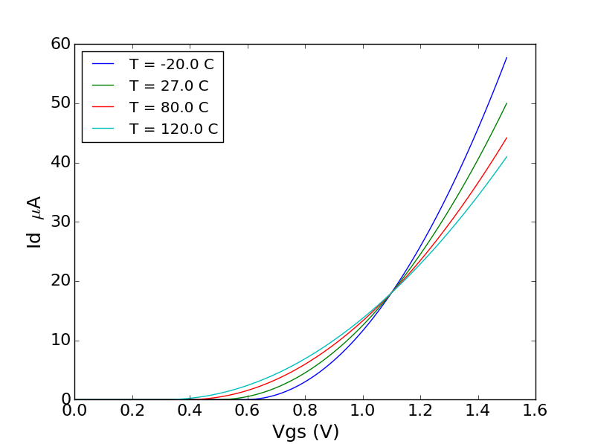
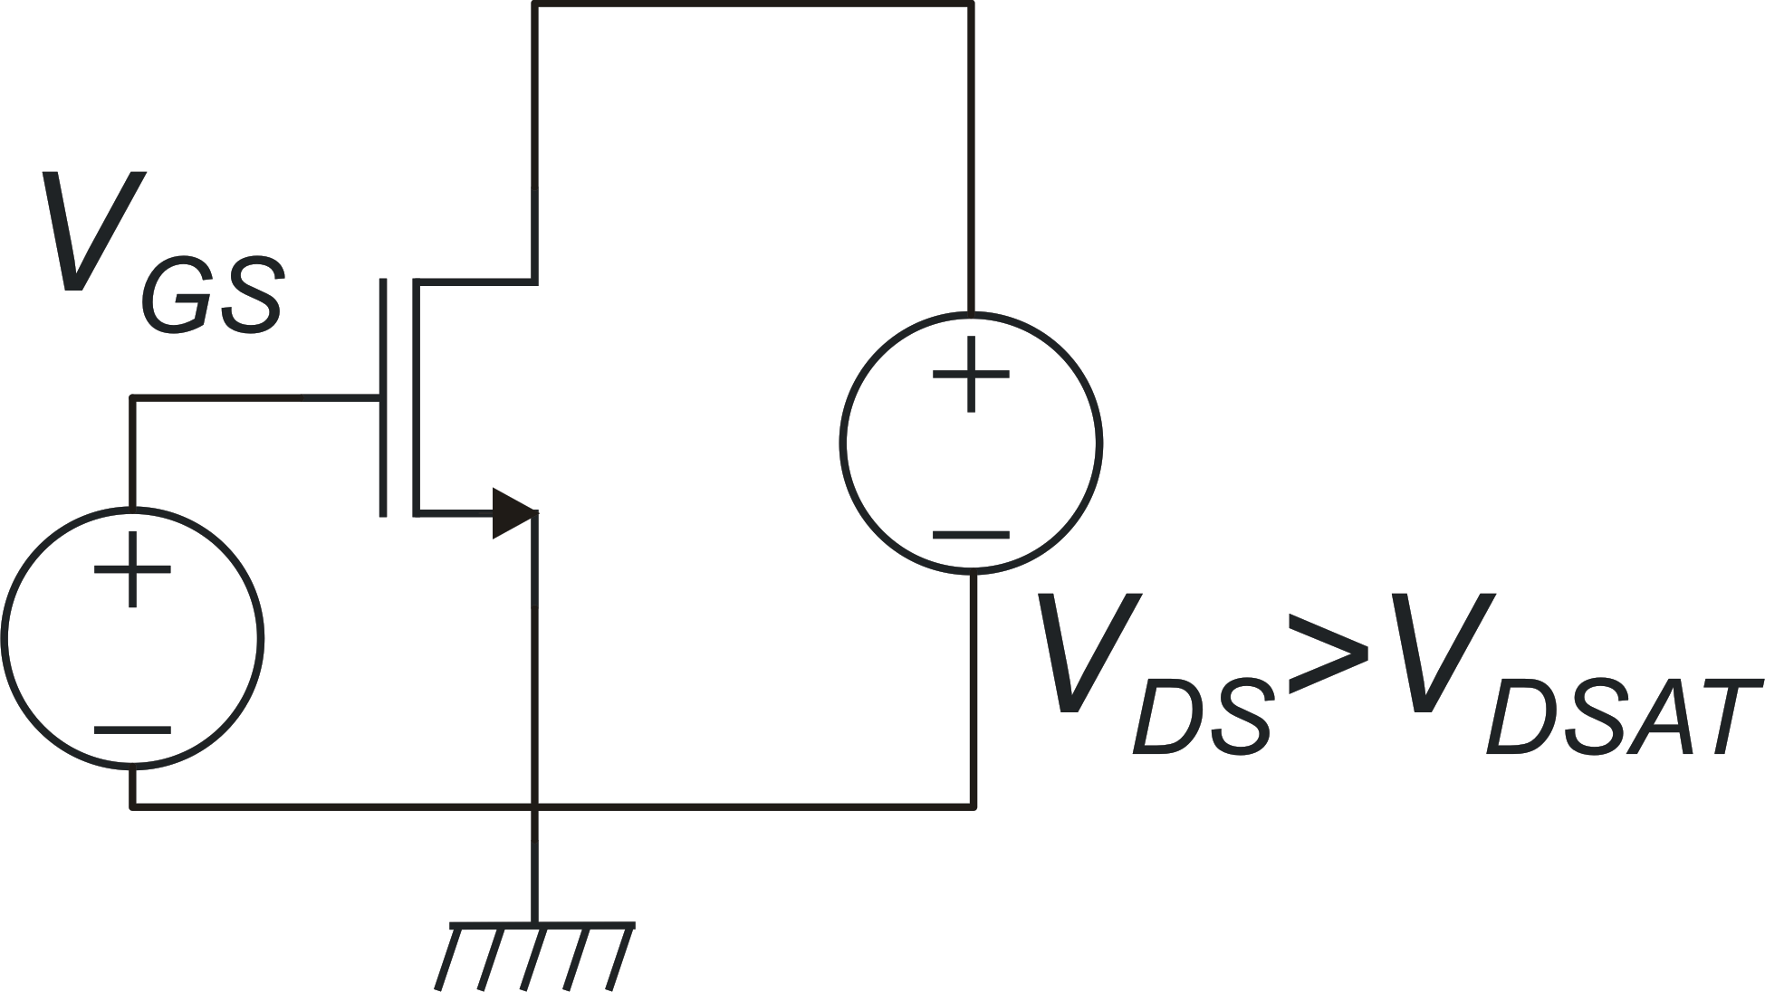
Temperature effects on MOSFET characteristics
Vt dominates
(I_{D} increases with T)
ZTC point
β dominates
(I_{D} decreases with T)

Slide 27
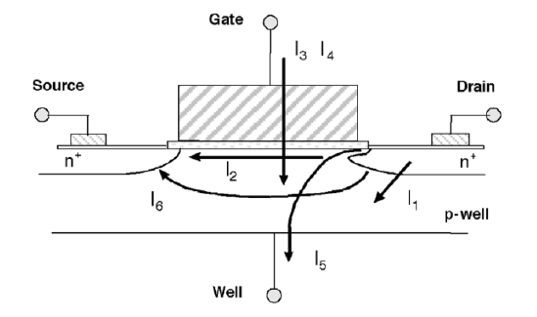
MOSFET Leakage current
I₁: pn Junction Reverse-Bias Current
I₂: Subthreshold Leakage
I₃: Tunneling into and through Gate Oxide
I₄: Injection of Hot Carriers from Substrate to Gate Oxide
I₅: Gate-Induced Drain Leakage
I₆: Punchthrough
* Leakage Current Mechanisms and Leakage Reduction Techniques in Deep-Submicrometer CMOS Circuits – K.Roy et al. - 2003

Slide 28
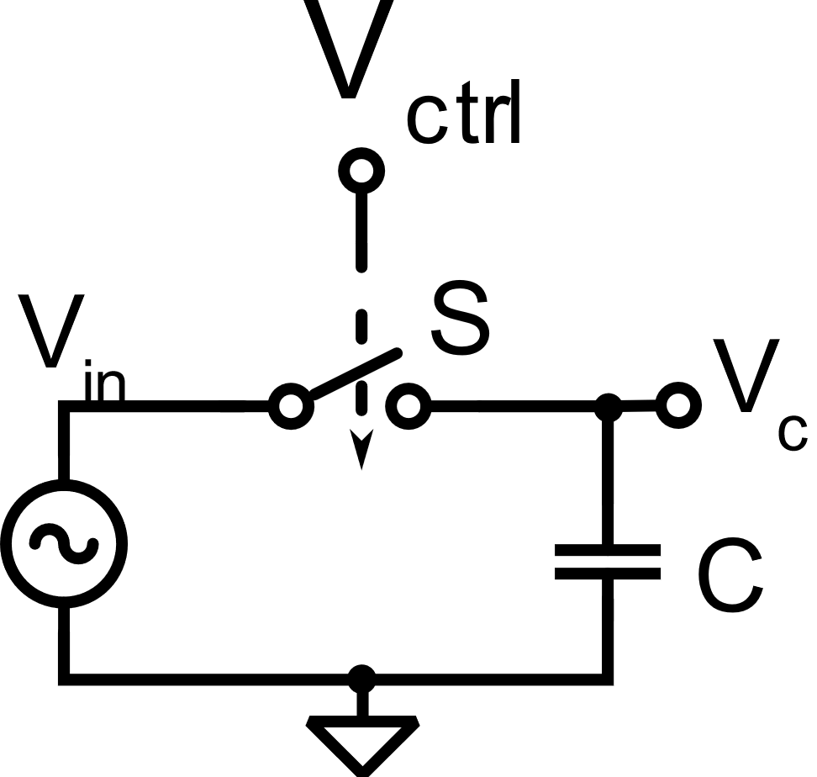
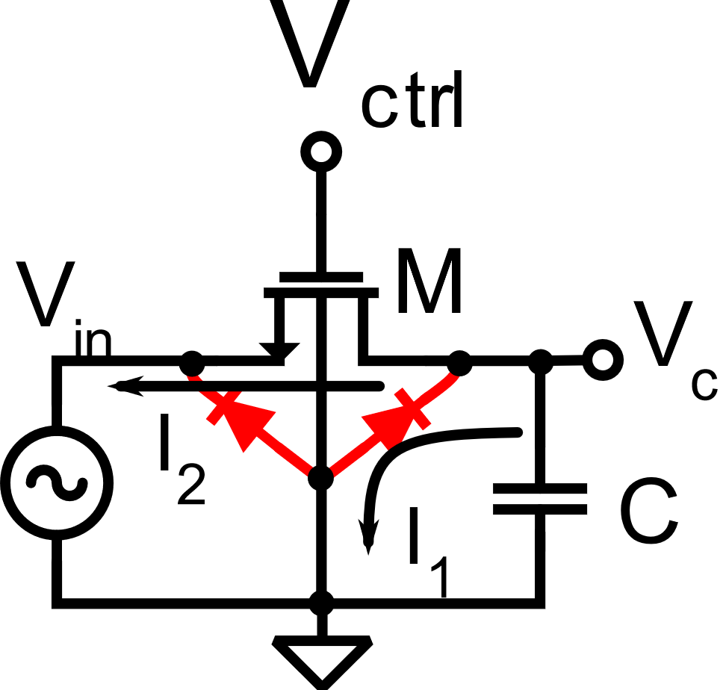
MOSFET Leakage current
Example: Sample-and-Hold
V_{ctrl} = 0 V → S is open
V_{ctrl} = 0 V → M is off (weak inversion)

Slide 29
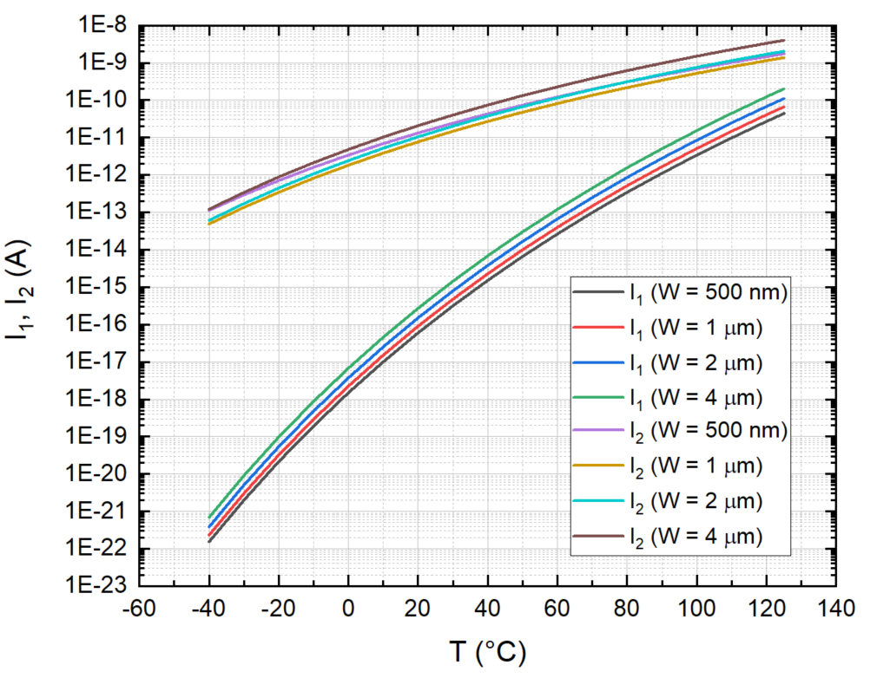
MOSFET Leakage current
L=180 nm, V_{GS} = 0 V, V_{DS} = 1.8 V

Slide 30
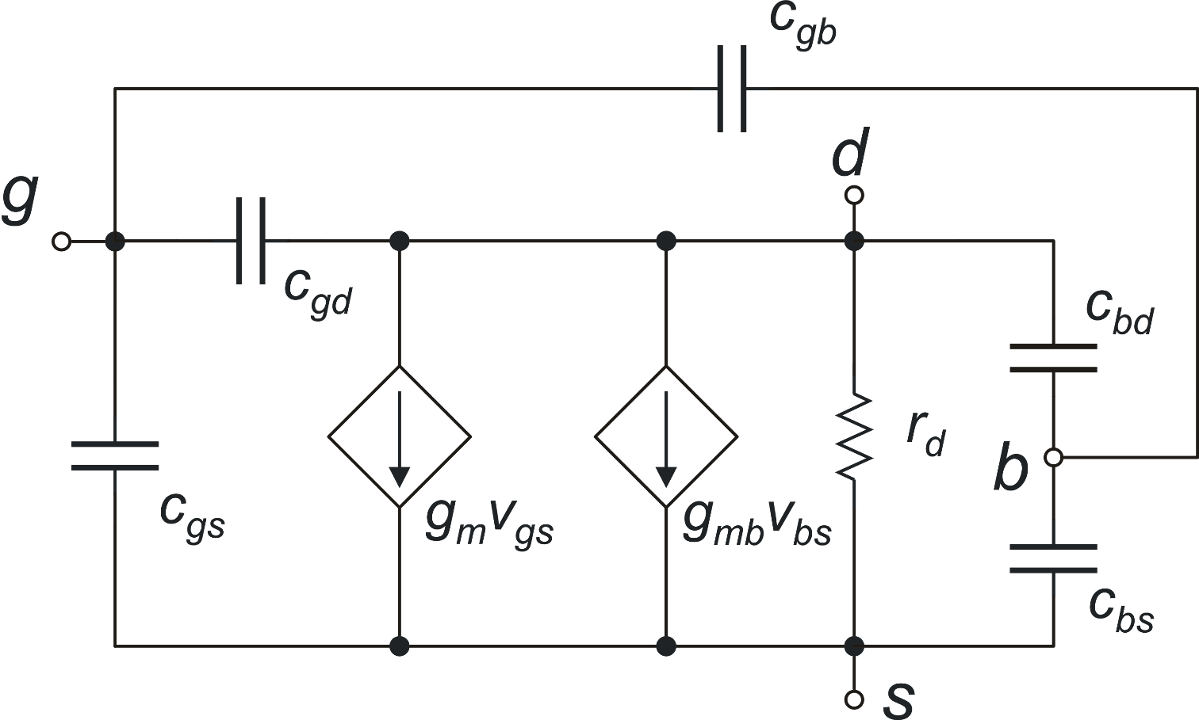
MOSFET Small Signal model
c_{gs}, c_{gd}, c_{gb}, c_{bd}, c_{bs} : small signal capacitances
Let's start from the dc model (capacitances are removed)
effect of v_{bs}

Slide 31
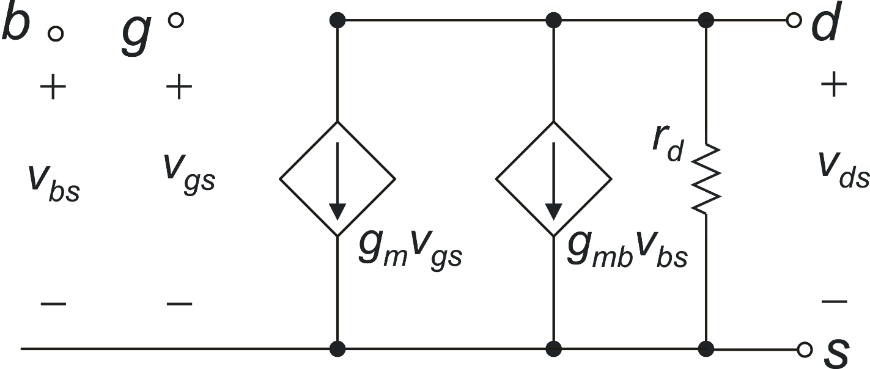
MOSFET small signal model: dc limit
small signal

Slide 32
Body transconductance: g_{mb}
_{let's recall the gm definition}
1
g_{m}
g_{mb}

Slide 33
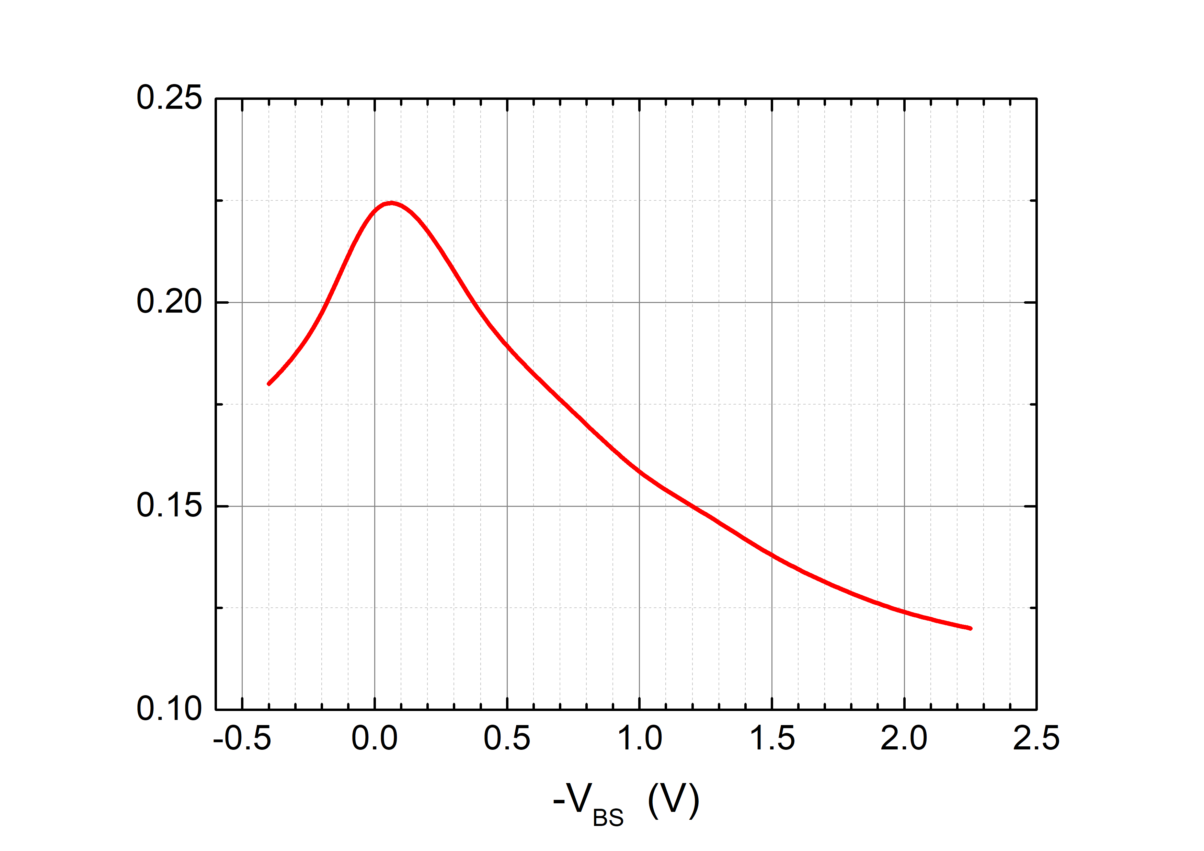
Body transconductance: g_{mb}
Example from simulation
m ~ 1.2 g_{mb} ~ 0.2g_{m}

Slide 34
g_{m}, g_{d} in strong inversion
Triode region
g_{m}
g_{d}

Slide 35
g_{m}, g_{d} in strong inversion
Saturation region
neglecting the dependence of V_{DSAT} on V_{GS}

Slide 36
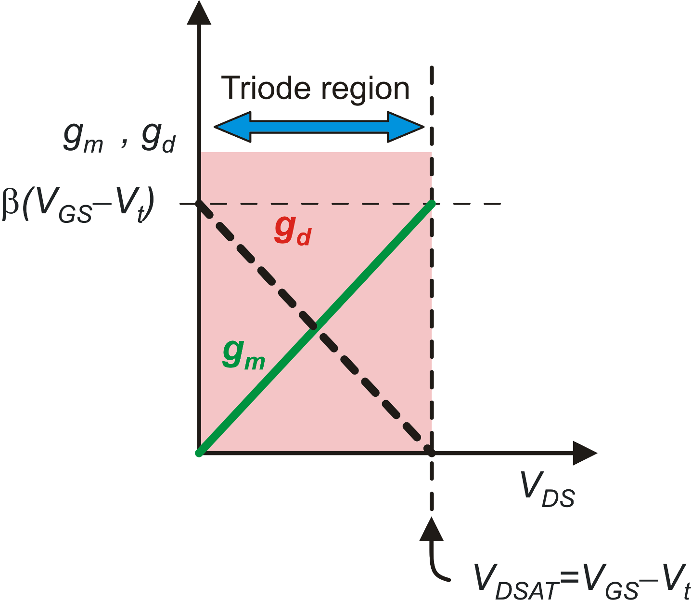
g_{m}, g_{d} in strong inversion

Slide 37
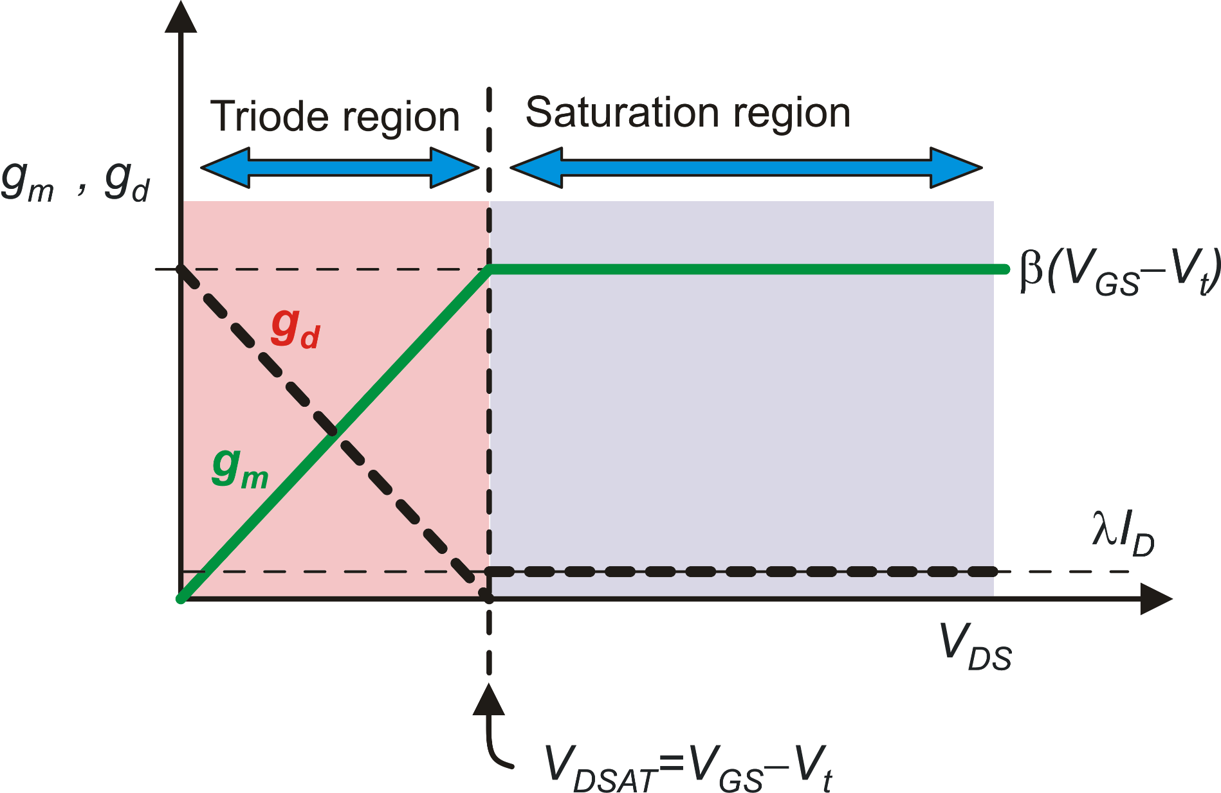
g_{m}, g_{d} in strong inversion
Important parameter
for MOSFETs:
MOSFET
Self-gain

Slide 38
Transconductance models in saturation
acceptable approximation, because we are studying gm, i.e the effect of V_{GS}
In strong Inversion:
only a few %
!!!

Slide 39
g_{m},g_{d} in weak inversion
Exact result
Exact result

Slide 40
g_{m},g_{d} in weak inversion
In saturation:
In triode:
I_{D}
g_{m}
g_{d}
g_{m}
g_{d}
V_{DSAT}
V_{D}
V_{DSAT}
V_{D}

Slide 41
g_{m}, g_{d} everywhere: simulations
Strong inversion
V_{GS}-V_{t}= −100 mV
V_{GS}-V_{t}= 200 mV
V_{GS}-V_{t}=0

Slide 42
g_{m}, g_{d} everywhere
Strong inversion
 | Triode (V_{DS} ≤ V_{DSAT} = V_{GS}-Vt) | Saturation (V_{DS} ≥ V_{DSAT} = V_{GS}-V_{T})
g_{m}
g_{d}

Slide 43
g_{m}, g_{d} everywhere
Weak inversion
 | Triode (V_{DS} ≤ V_{DSAT} = 4V_{T}) | Saturation (V_{DS} ≥ V_{DSAT} = 4V_{T})
g_{m}
g_{d}

Slide 44
g_{m}/g_{d} everywhere
Saturation (V_{DS} > V_{DSAT})
 | Strong Inversion | Weak Inversion
g_{m}/g_{d}

Slide 45
Unified model for transconductance in saturation
Strong Inversion
Important parameter for analog circuit design
Weak Inversion
Strong inversion
with
Weak inversion
BJT
Definition of V_{TE}
BJT

Slide 46
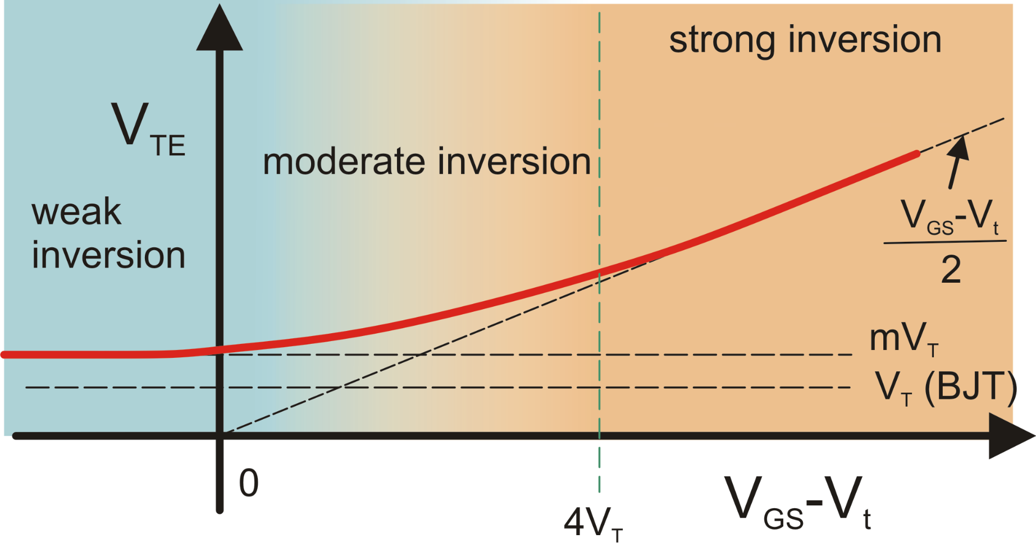
Effective Thermal Voltage: V_{TE}
The smaller the V_{TE}, the higher the g_{m} that can be obtained with a given I_{D}

Slide 47

MOSFET Capacitance Model: gate related capacitances
estrinsic cap.
intrinsic cap..

Slide 48
Estrinsic Capacitances
S
D
W
Localization of extrinsic
capacitances: along the
borders of the gate
G
L

Slide 49
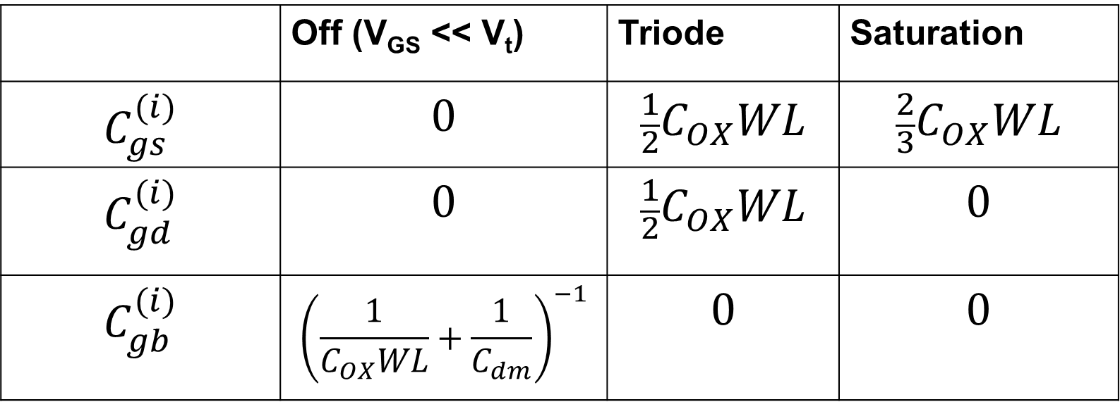
Intrinsic capacitances: The Meyer Model
 | Off (V_{GS} << V_{t}) | Triode | Saturation
$$C_{gs}^{(i)}$$ | $$0$$ | $${\frac{1}{2}C}_{OX}WL$$ | $${\frac{2}{3}C}_{OX}WL$$
$$C_{gd}^{(i)}$$ | $$0$$ | $${\frac{1}{2}C}_{OX}WL$$ | $$0$$
$$C_{gb}^{(i)}$$ | $${\left(\frac{1}{C_{OX}WL}+\frac{1}{C_{dm}}\right)}^{−1}$$ | $$0$$ | $$0$$
Series of the oxide and depletion layer capacitances. Can be approximated with only the oxide cap C_{OX}WL

Slide 50

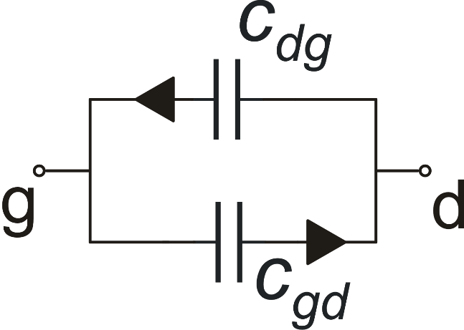
Charge oriented models (Dutton and Ward model)
Limits of the Meyer Model:
Does not guarantee charge conservation
Capacitances are reciprocal
Important errors in circuits
using MOSFETs as
switches.
Dutt and Ward model
Array of 9 capacitances
Cij are < 0 for i≠j (trans-capacitances)
Cij are > 0 for i=j (self capacitances)
Generally: Cij ≠ Cji
V_{G}
Q_{G}
Q_{S}
Q_{D}
V_{S}
V_{D}
V_{B}=0

Slide 51
Junction capacitances
W
S
D
G
L_{C}

Slide 52
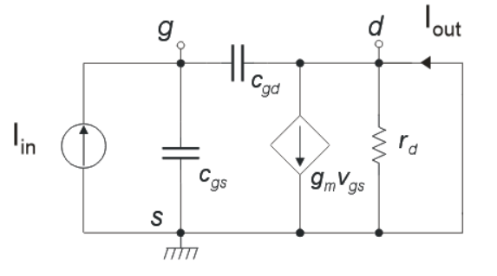
MOSFET Transition Frequency
Ex.: S.I., Saturation

Slide 53
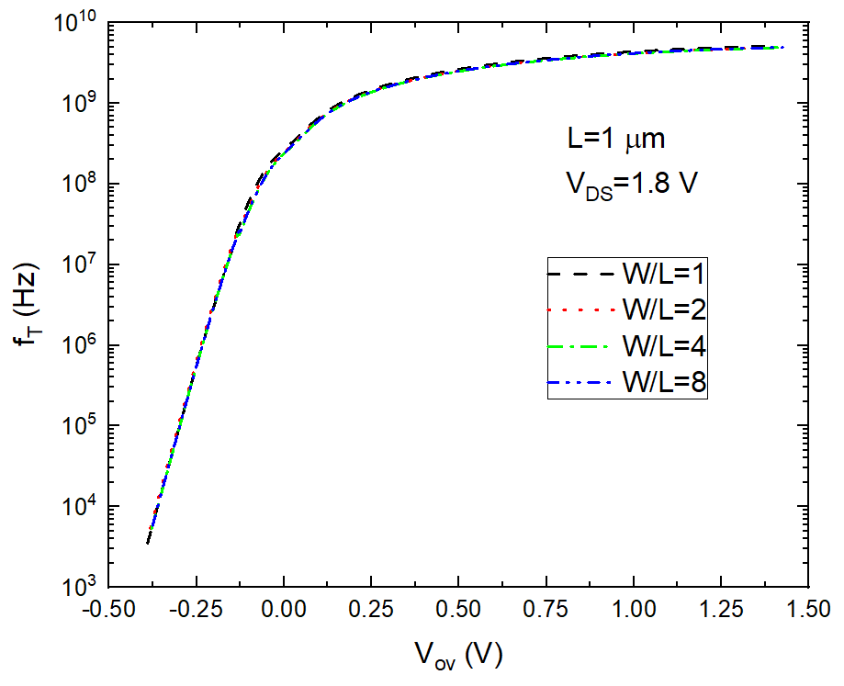
MOSFET Transition Frequency in W.I, M.I. and S.I.
M.I.
W.I.
S.I.
UMC 180 nm CMOS Process

Slide 54
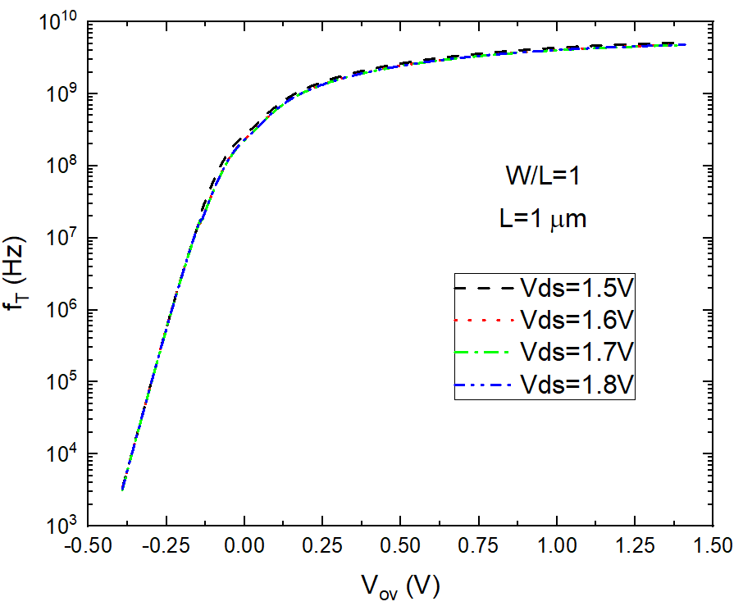
MOSFET Transition Frequency in W.I, M.I. and S.I.
M.I.
W.I.
S.I.
UMC 180 nm CMOS Process

Slide 55
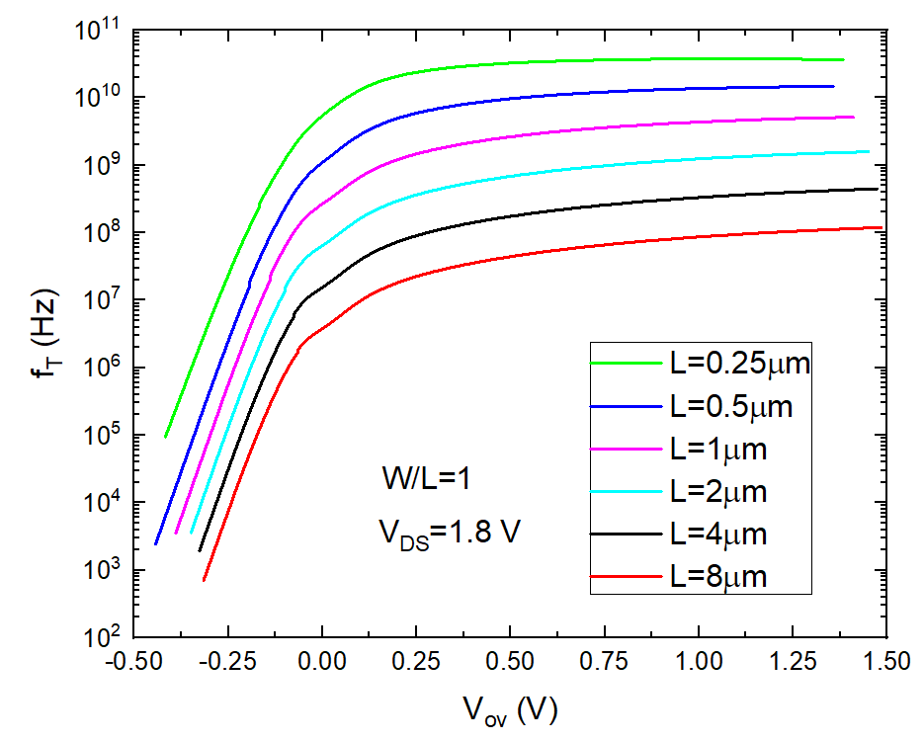
MOSFET Transition Frequency in W.I, M.I. and S.I.
UMC 180 nm CMOS Process

Slide 56
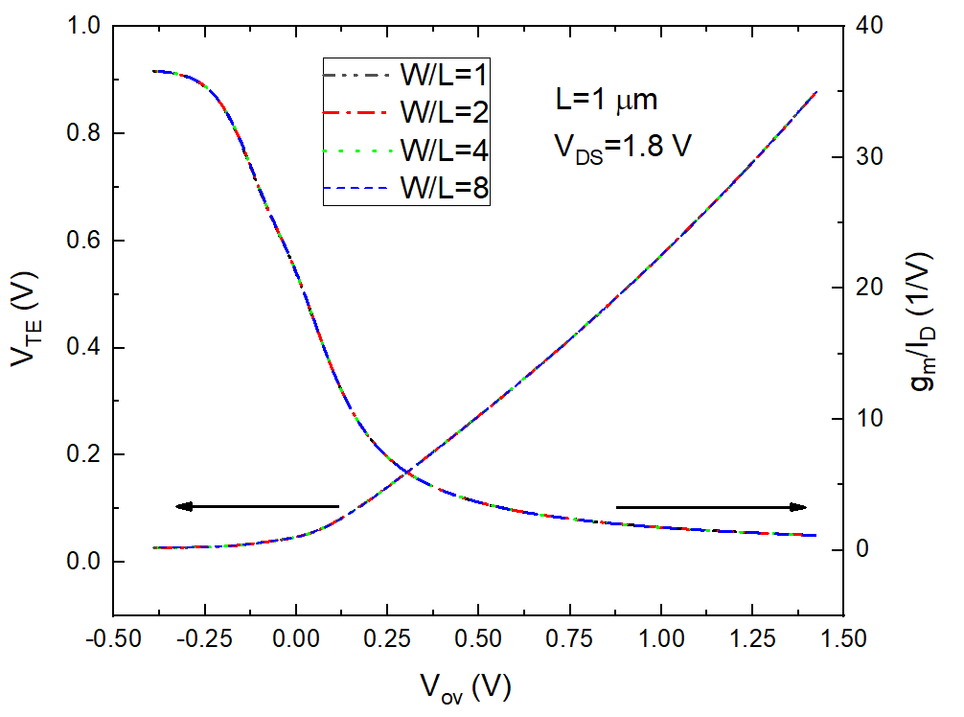
V_{TE} and g_{m}/I_{D} in W.I, M.I. and S.I.
M.I.
S.I.
W.I.
W.I.
S.I.
UMC 180 nm CMOS Process
27.4 mV

Slide 57
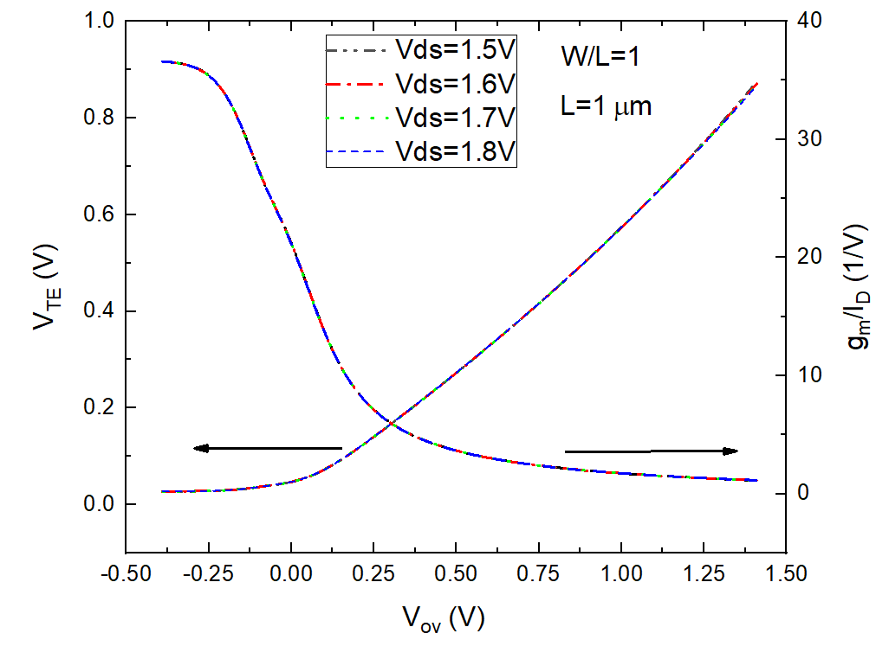
V_{TE} and g_{m}/I_{D} in W.I, M.I. and S.I.
M.I.
S.I.
W.I.
W.I.
S.I.
UMC 180 nm CMOS Process

Slide 58
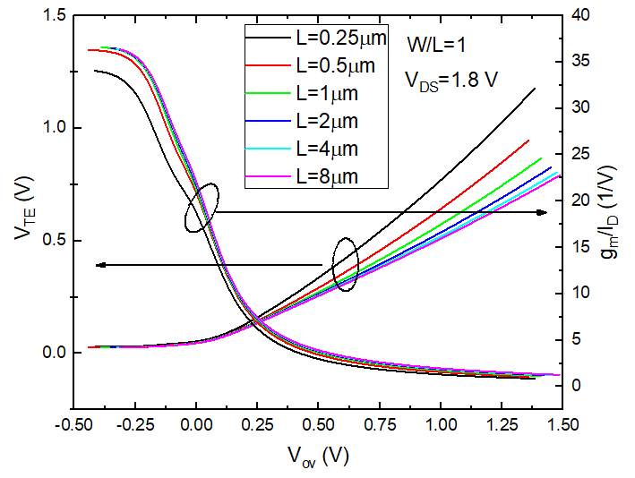
V_{TE} and g_{m}/I_{D} in W.I, M.I. and S.I.
S.I.
W.I.
UMC 180 nm CMOS Process

Slide 59
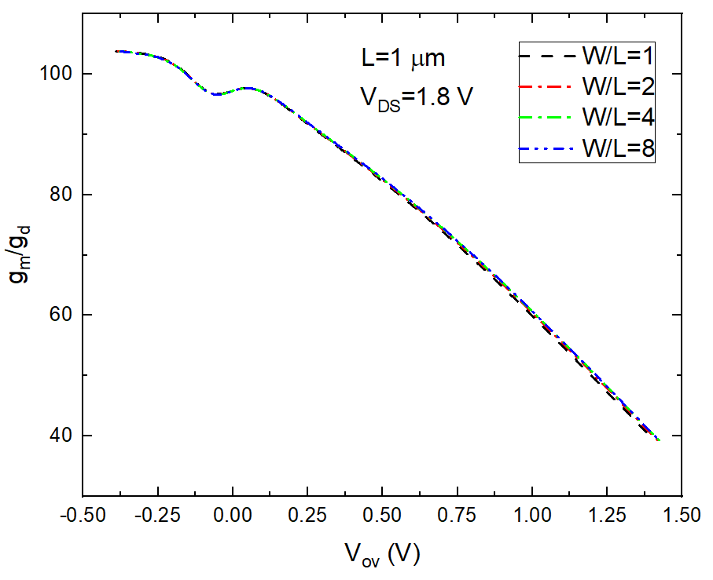
g_{m}/g_{d} in W.I, M.I. and S.I.
M.I.
S.I.
W.I.
W.I.
S.I.
UMC 180 nm CMOS Process

Slide 60
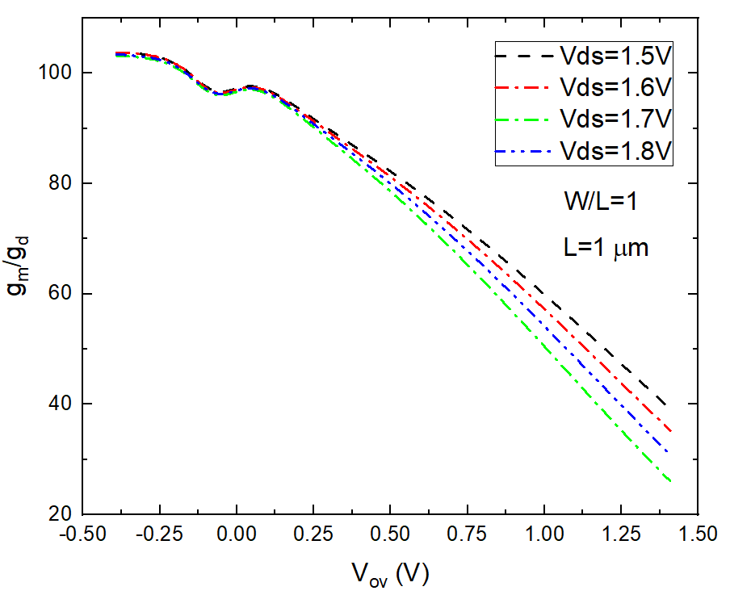
g_{m}/g_{d} in W.I, M.I. and S.I.
M.I.
S.I.
W.I.
W.I.
S.I.
UMC 180 nm CMOS Process

Slide 61
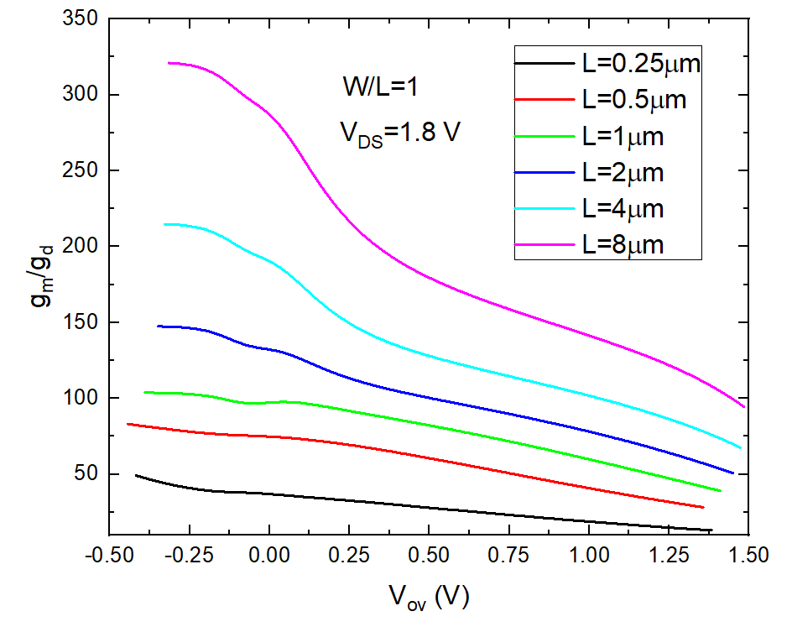
g_{m}/g_{d} in W.I, M.I. and S.I.
S.I.
W.I.
UMC 180 nm CMOS Process

Slide 62
Other non-idealities of the MOSFET behaviour
Gate-bias dependent mobility
μC_{ox} depends on V_{GS} (decreases at high V_{GS})
(all devices)
Carrier velocity saturation
I_{D} dependence on V_{GS} in strong inversion
tends to become linear (instead of quadratic)
(Short channel devices). Again, appears as
a reduction of the μC_{ox} at high V_{GS}
RSCE and RNCE
Vth depends on MOSFET dimension (W and L)
(Short channel devices).
Gate current
May be due to tunneling (all devices)
or hot electrons - hot holes (Short channel devices)

Slide 63
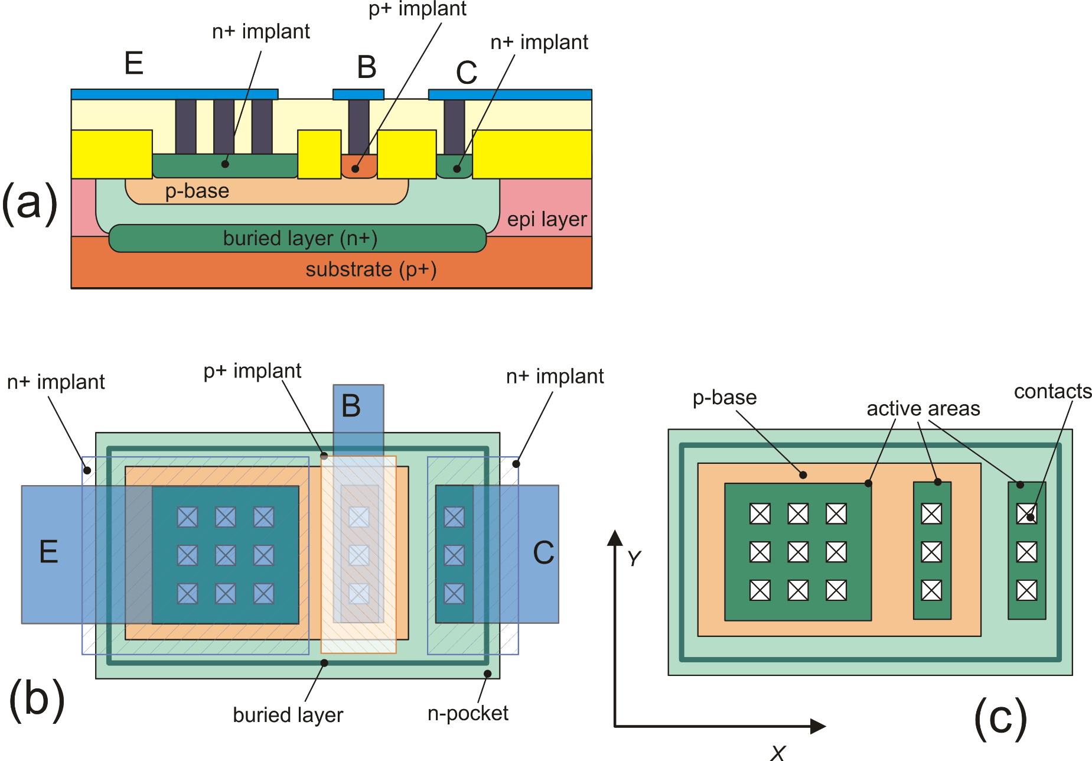
BJTs in integrated circuits: Vertical NPN
buried-L
p-base
BiCMOS: CMOS + p-base and buried-layer
The n-pocket can be an n-well
The buried-layer a buried-well of a triple-well CMOS
A diode between collector and
substrate is present capacitance
p-base
buried-L
Same as (b) but with the
Metal 1 removed

Slide 64
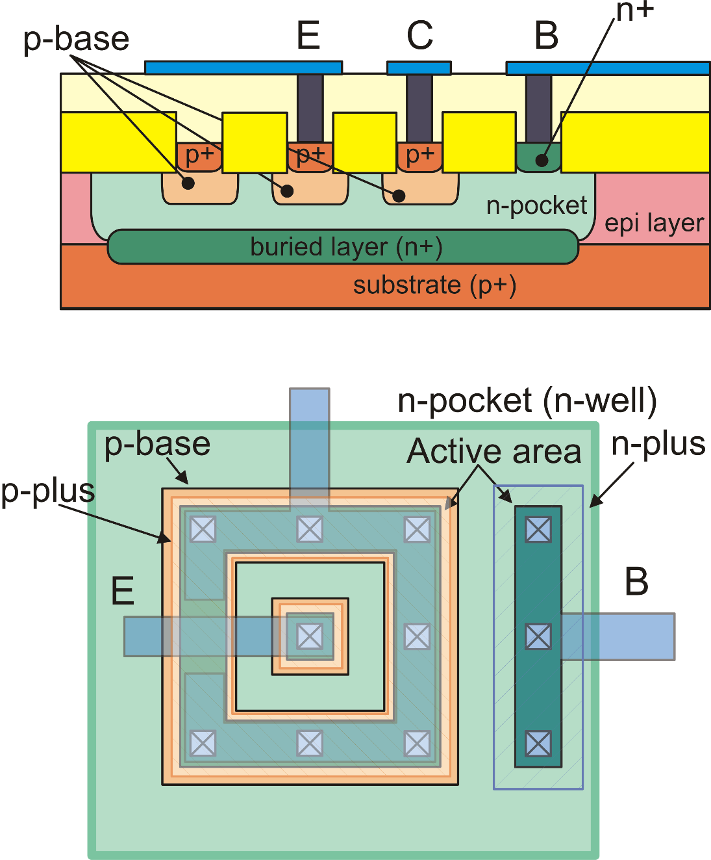
The lateral PNP
Slower than vertical devices due to
large base series resistance (r_{bb'})
and base-to substrate capacitance
Lower early voltage (V_{A}), due to
non-optimal collector doping.
Larger than vertical devices for the same
current capability

Slide 65
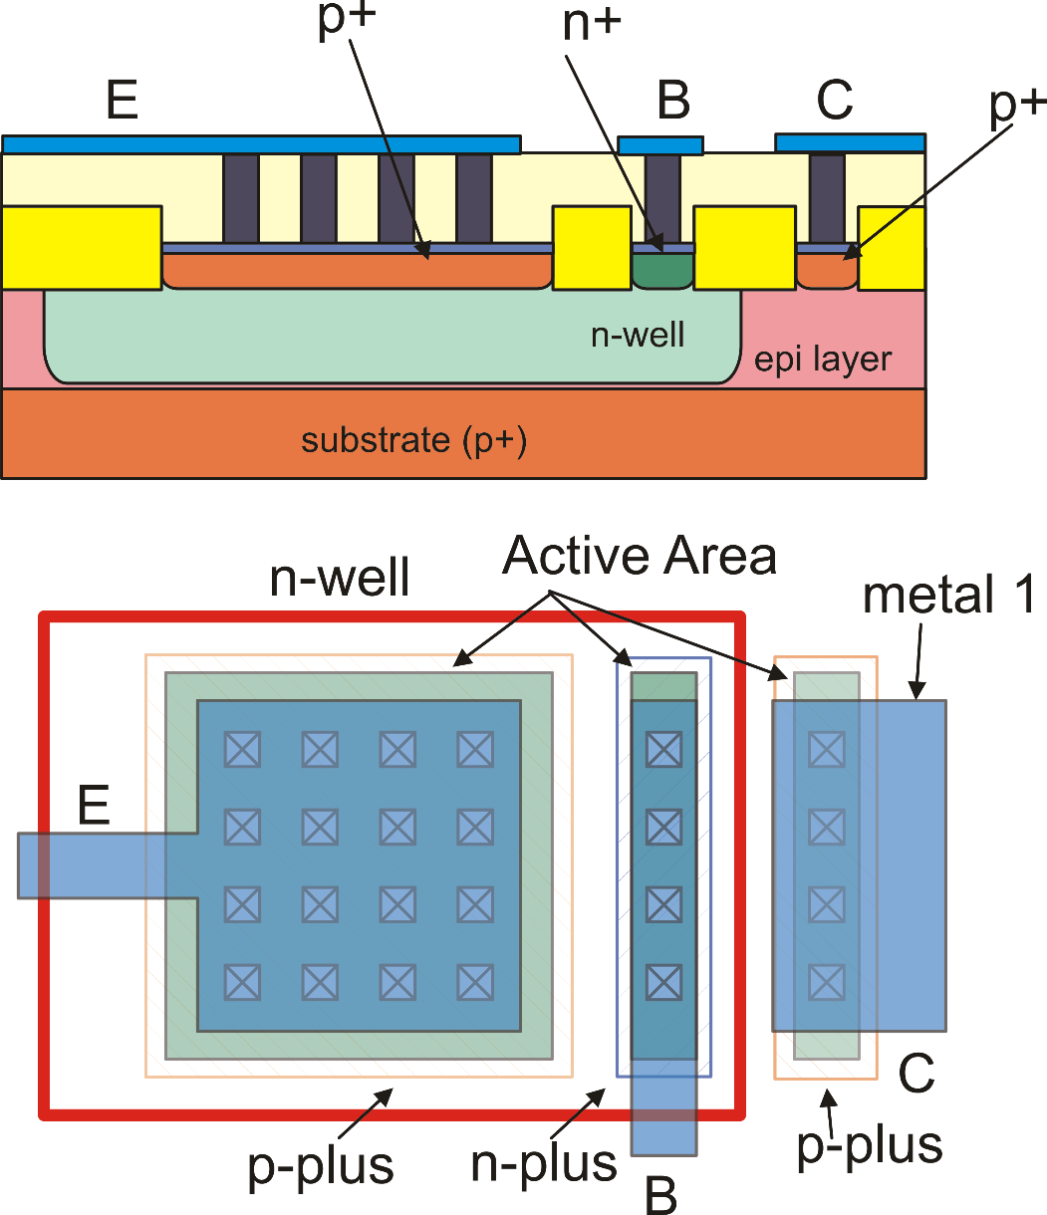
The substrate PNP: compatible with standard CMOS n-well processes
Limitation: The collector is
committed to the substrate,
(forced to V_{SS})

Slide 66
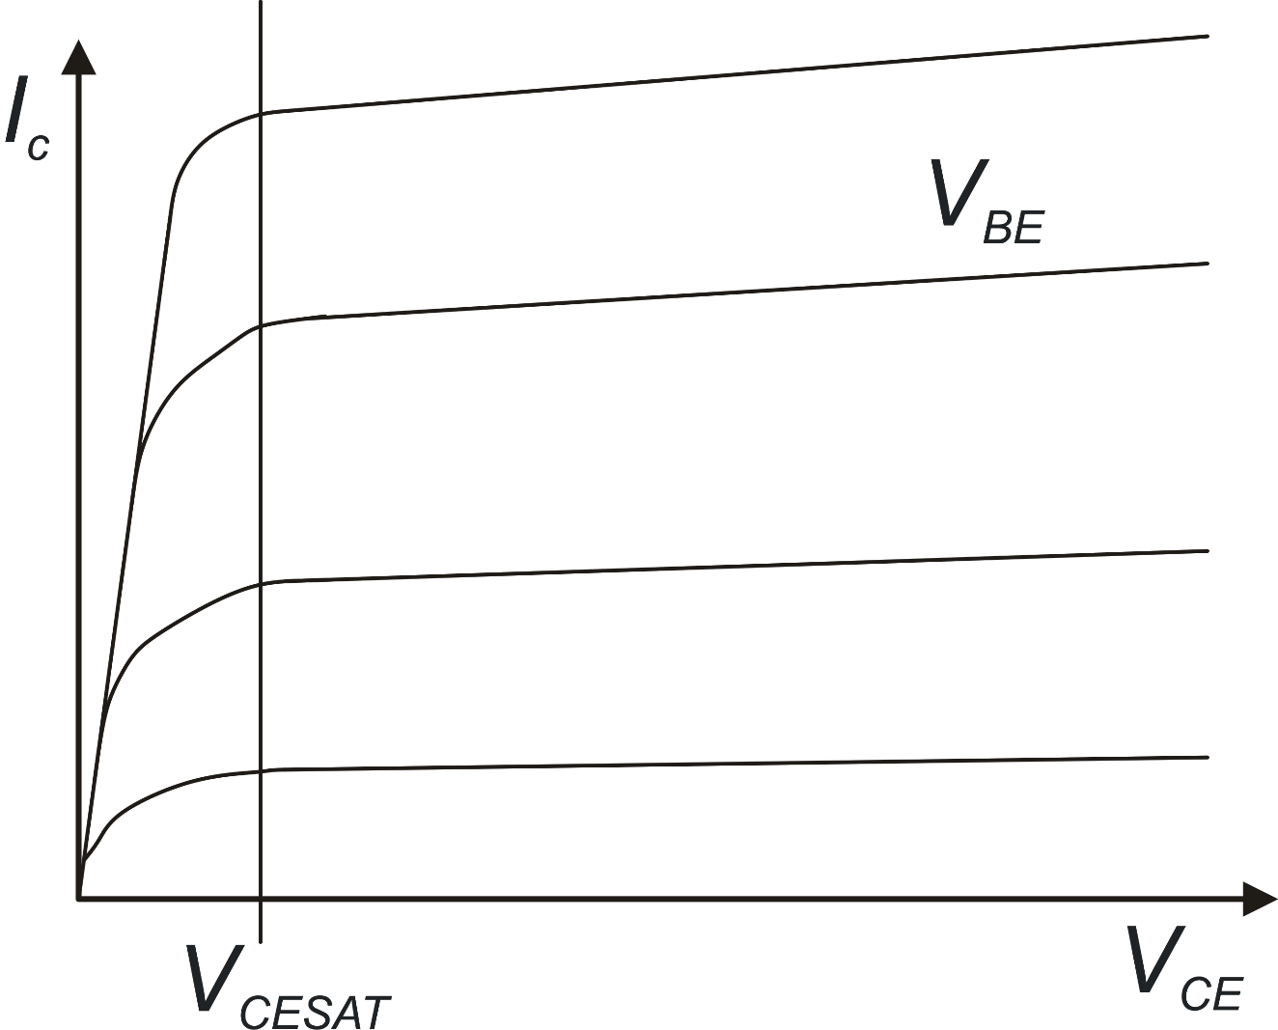
BJT output characteristics
Saturation
Forward Active Region
V_{BE}, V_{CE} : control
voltages
I_{C}, I_{B}: dependent
currents

Slide 67
BJT model in the forward active zone
Sometimes this expression is used
in order to refer to V_{BE} and V_{CE} as
control voltages:
For calculation of I_{C} and I_{B} in all operating zones (saturation, cut-off,
forward active, reverse active) the Ebers-Moll model should be used.

Slide 68
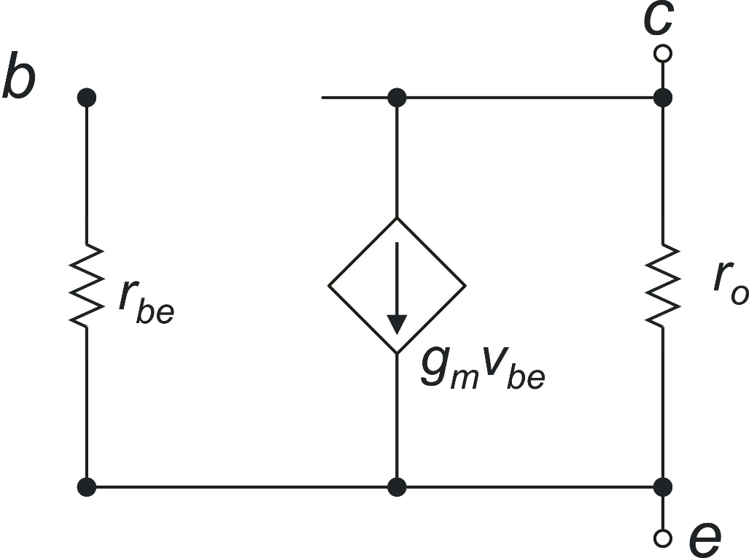
BJT: small signal model
Small signal dc model
Equivalence with the MOSFET parameters
BJT
MOSFET

Slide 69
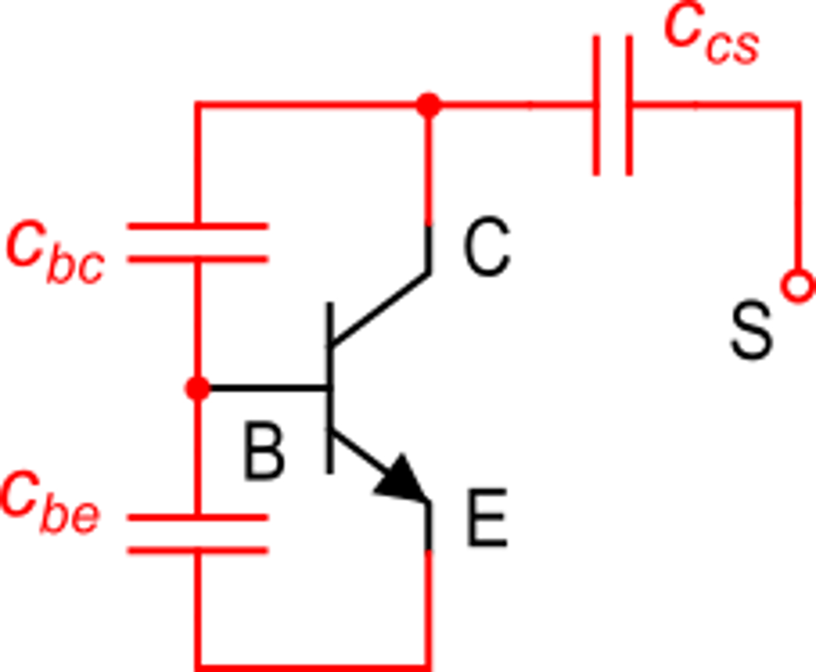
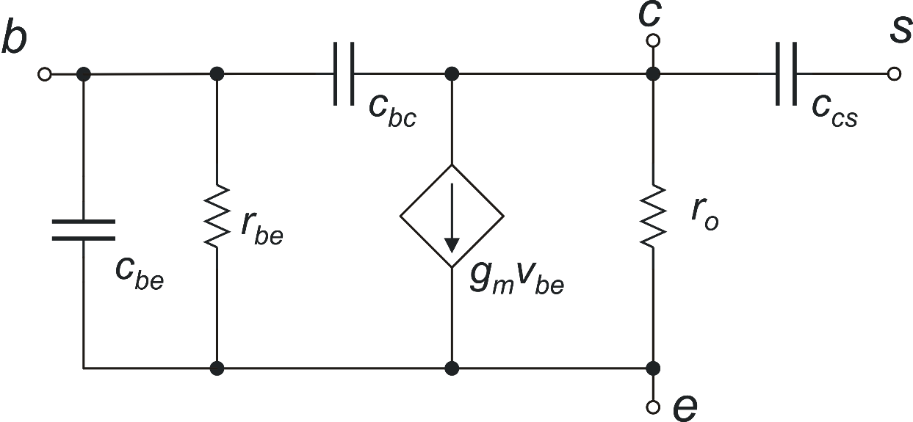
BJT capacitances in forward active region (vertical npn)
Transition frequency

Slide 70
BJTs in Integrated Circuit: instance parameters
area
area
minimum size BJT
("elemental" BJT)
area=1.5
area may not be an
integer (not all PDKs
allow this)
parameter "area"
(dimensionless)
area=2 (,3, 4 ….)
area = integer

Slide 71
BJT sizing: Effect of the area parameter on the electrical parameters
Electrical effects of area parameter:
elemental BJT
elemental BJT with area
specified as an instance parameter
I_{S}
V_{A}
β
C_{JE}
…..
area × I_{S}
V_{A}
β
area × C_{JE}
…..

Slide 72
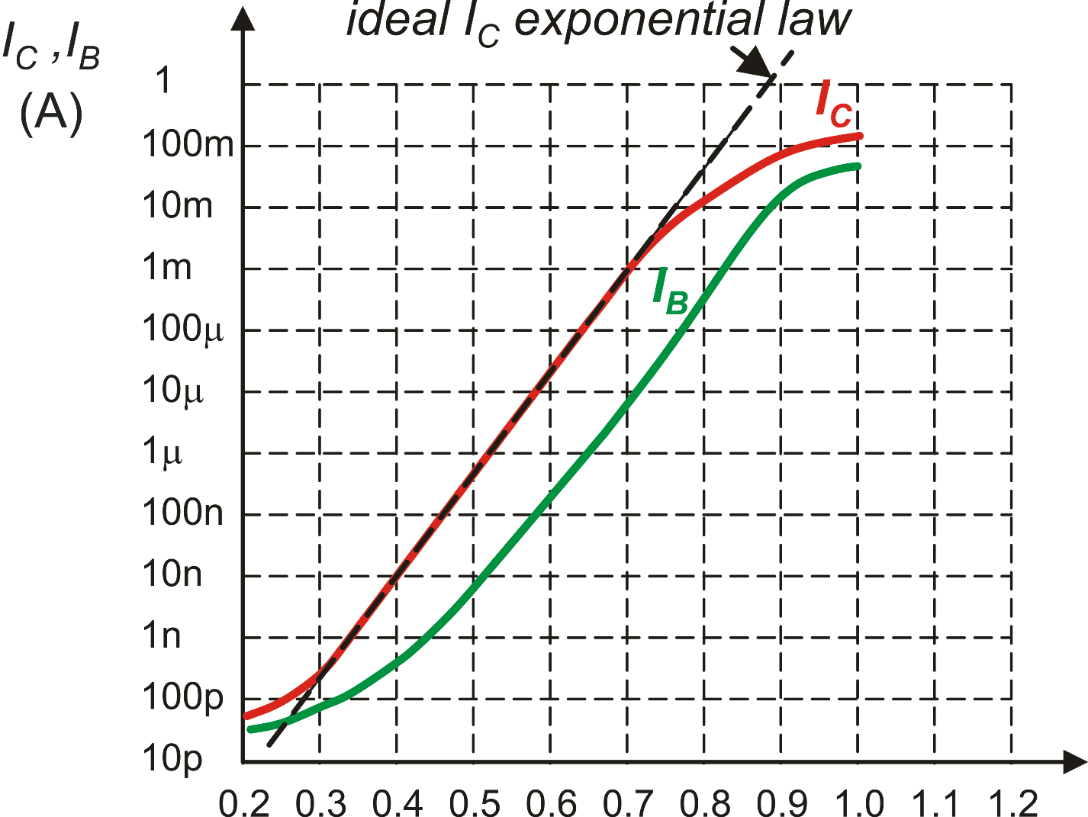
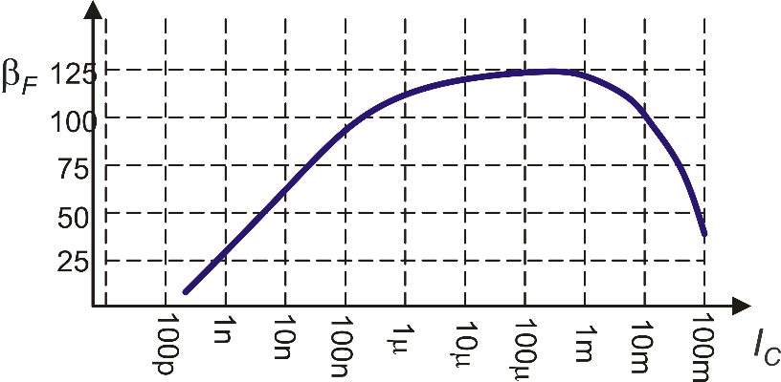
BJT sizing: Gummel plot and beta plot
My BJT has to carry this current
(200 mA). The elemental BJT would
be damaged
Using a BJT with area=100 would be
equivalent to make the elemental BJT
work with a current 100 times smaller.
This corresponds to the operating point
given by the blue line
β
β
This refers to the
elemental BJT (area=1)
I_{C}
V_{BE}
Gummel Plot
Beta Plot

