Slide 1
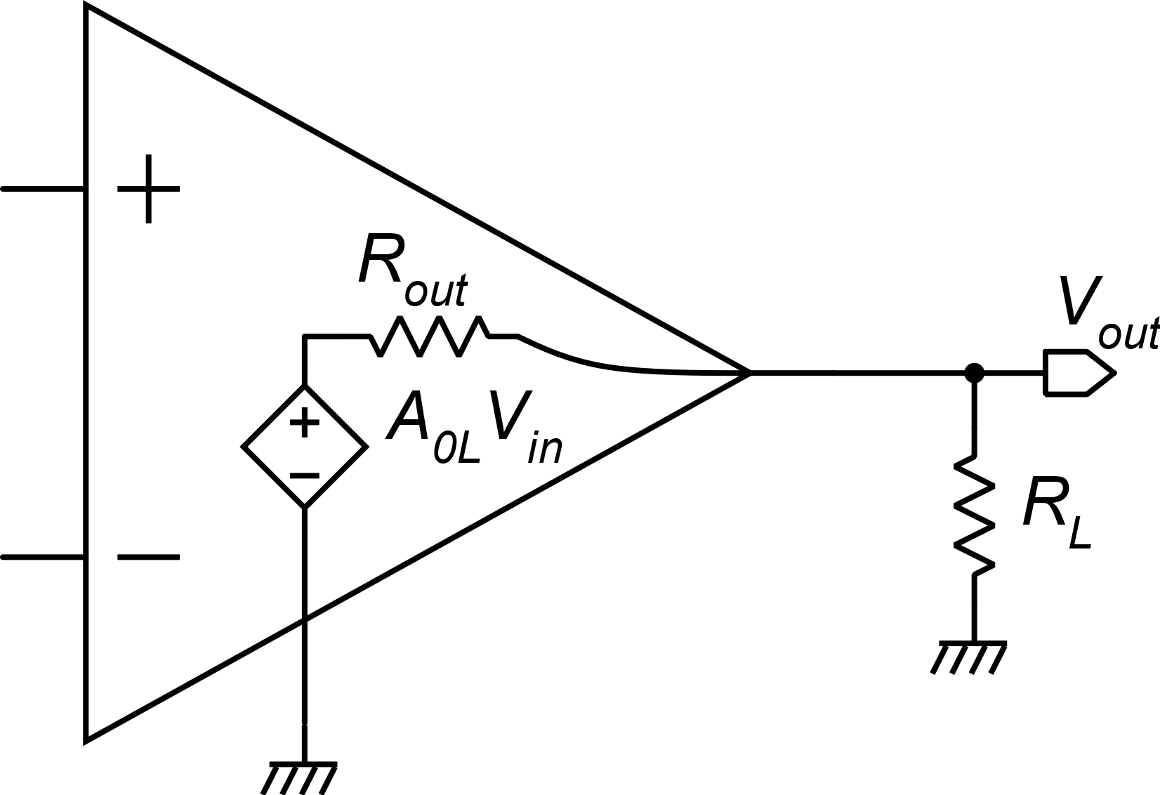
Output stages
Output stages for operational amplifier
Gain reduction due to loading:
output attenuation α_{out}
The only requirement on R_{out} is that A is still >> 1 even with the lowest value of R_{L}
A particularly low R_{out} is not a necessary specification for op-amps

Slide 2
Example of commercial op-amp with high output resistance
R_{L}=500 kΩ
R_{L}=10 kΩ

Slide 3
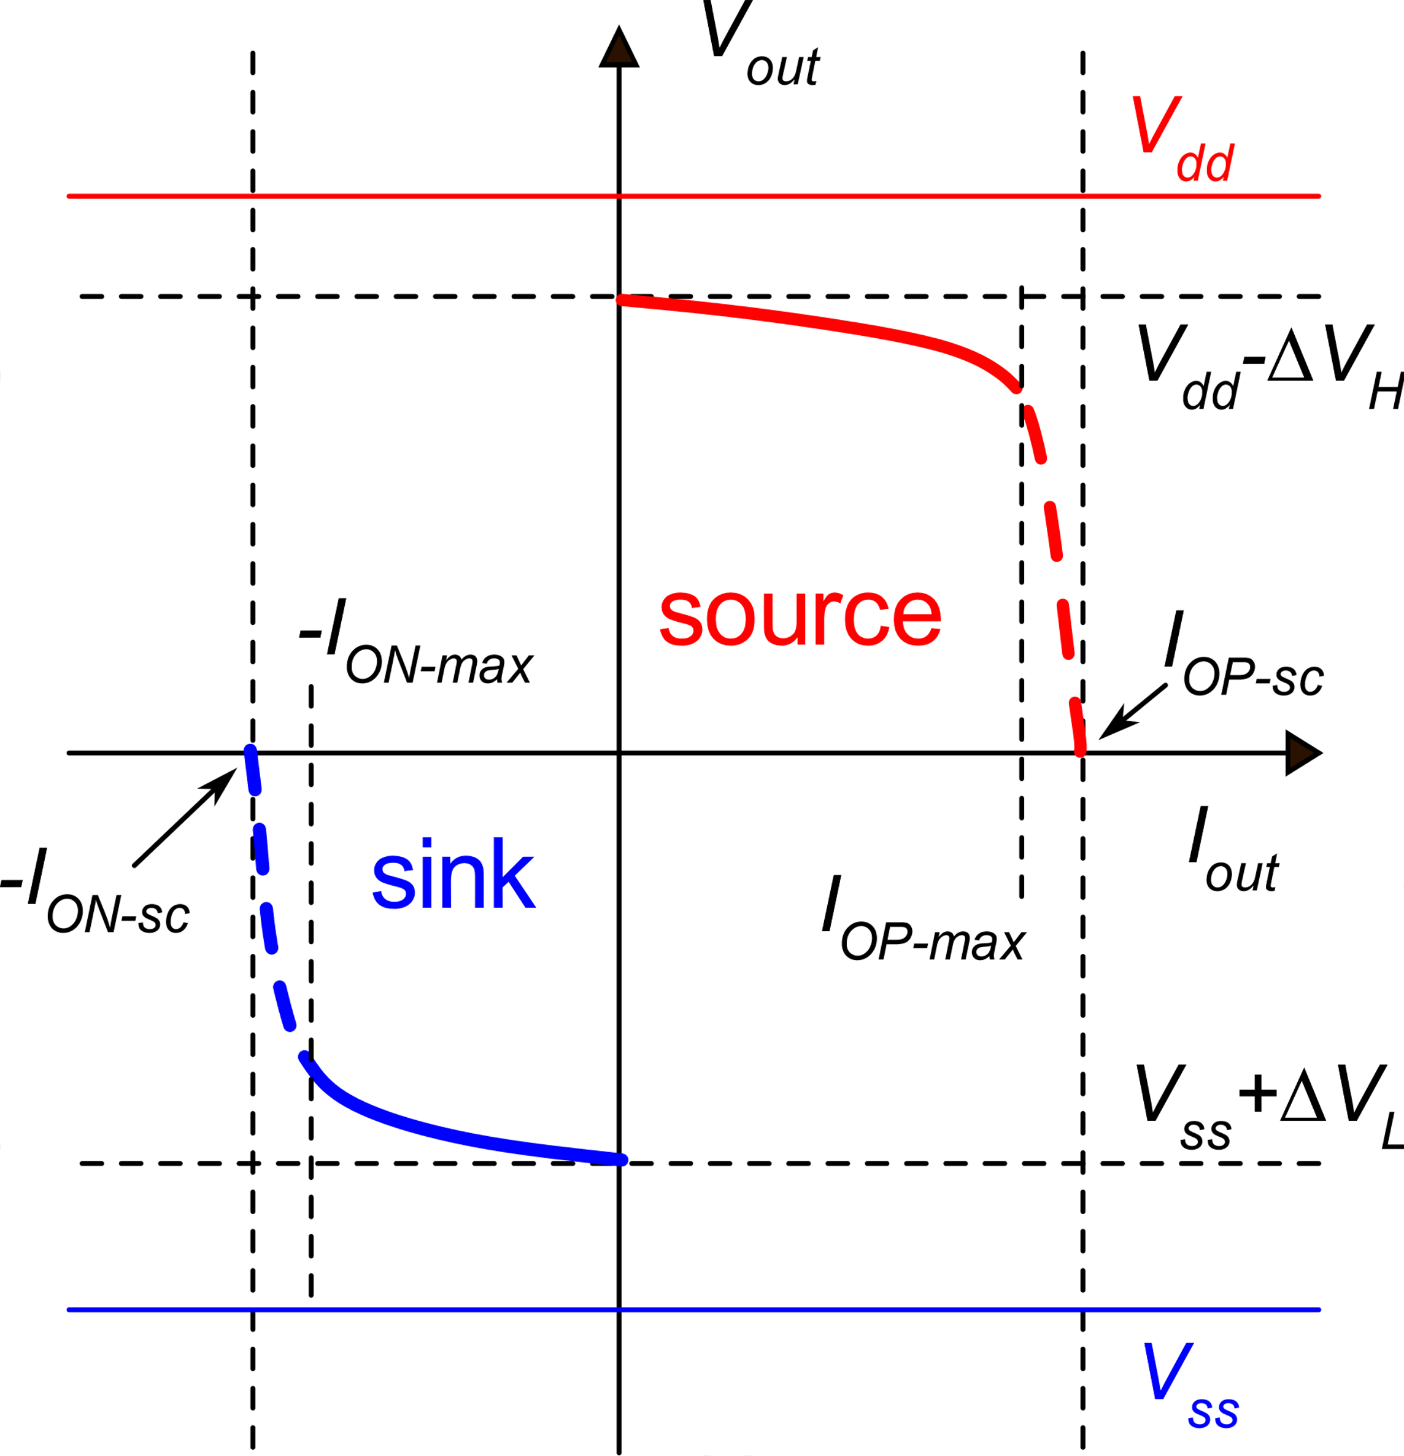
Specifications for an output stage
Currents (sink and source)
Sink
Source
V_{out-max}
Voltages (swing)
V_{out-min}
The output swing depends on the currents the stage has to feed to the load

Slide 4
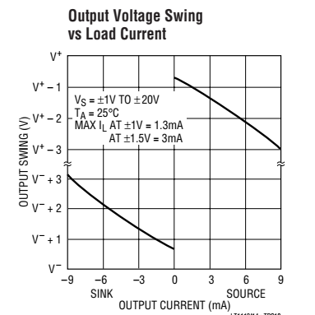
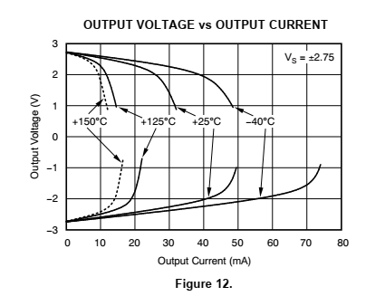
Examples
OPA 377 (Analog Devices)
Linear Tech.

Slide 5
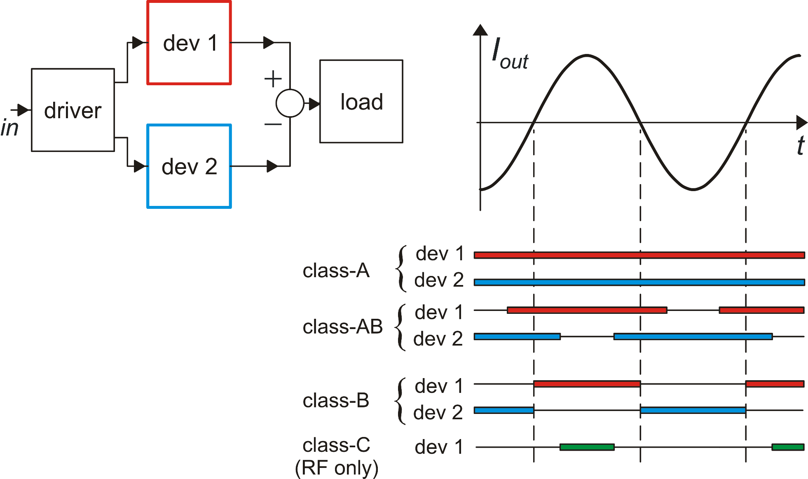
Output stage classes
Simple model of an output stage
constant I_{dev2}
By subtracting two unipolar
currents, we obtain a bi-directional output current

Slide 6
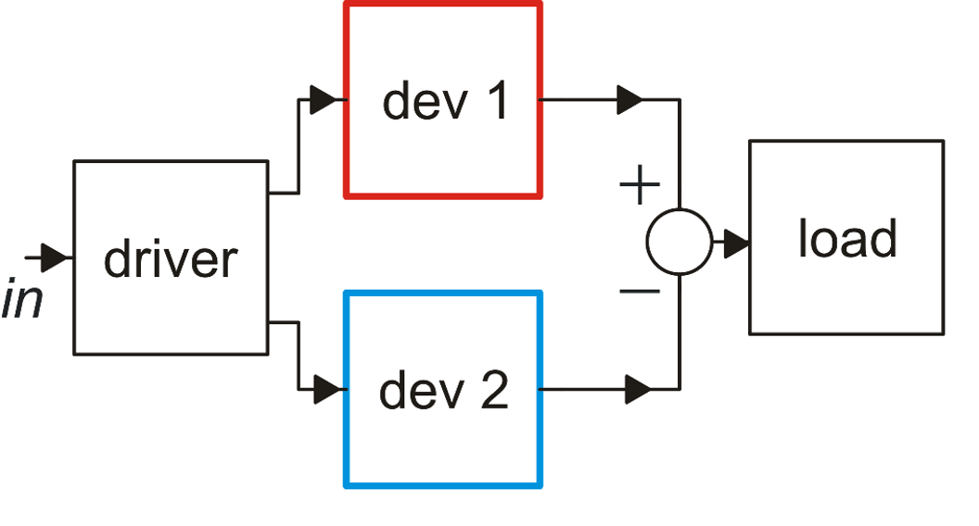
Typical class A case: low power efficiency
In a class-A stage, one of the two output devices operates at constant current
The maximum symmetrical current coincides with I_{dev 2}, which is a constant bias current.
Therefore, the maximum (symmetrical) output current is smaller than the quiescent current absorption.

Slide 7
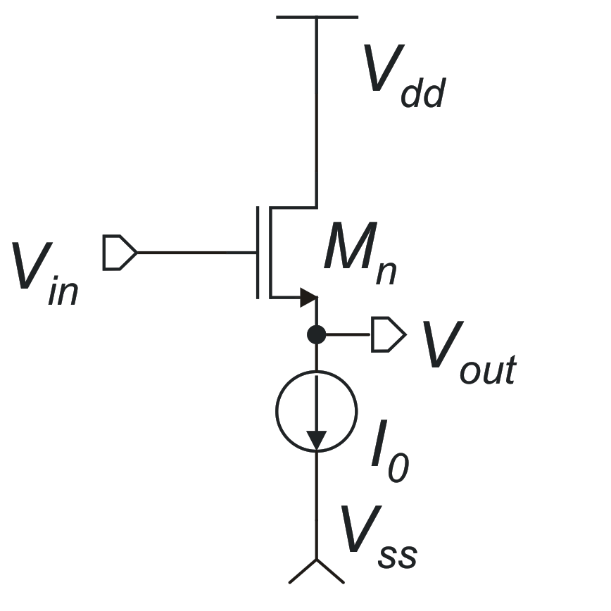
Class – A source followers
The n-MOS source follower can be used as a negative voltage-shifter
Because the circuit that produces V_{in} (driver) uses the same V_{dd}
The large margin to to V_{dd} makes it not suitable for rail-to-rail output stages (practically mandatory in modern, low voltrage applications)

Slide 8
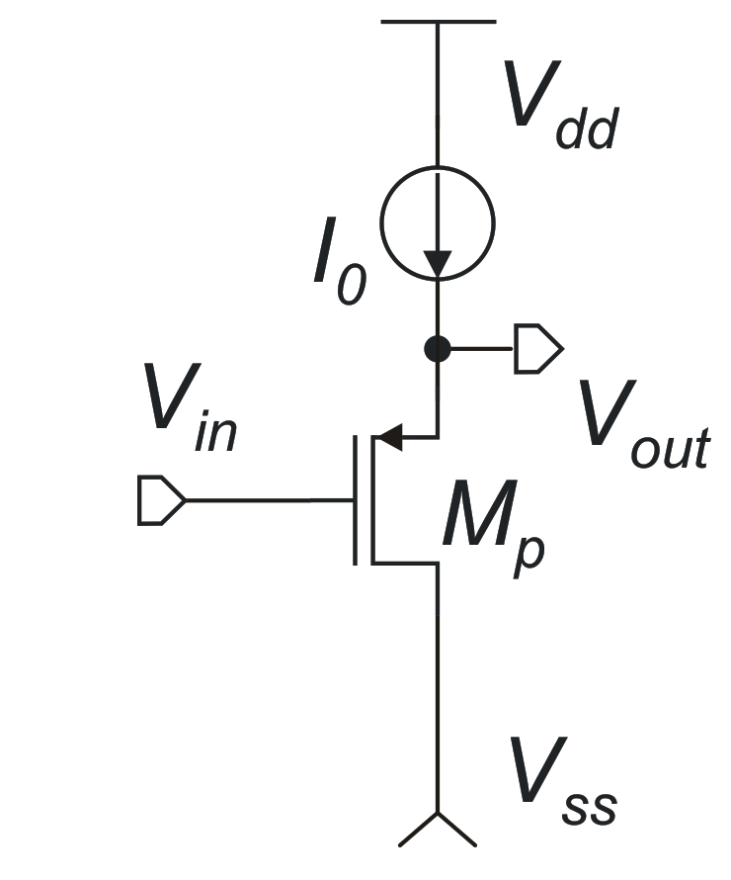
P-type Source follower
The p-MOS source follower can be used as a positive voltage shifter.
Margin to V_{ss}
(too large for typical supply voltages used in modern CMOS processes)

Slide 9
Class-A source followers: output current limits
The positive output current (I_{OP}) is limited only by the MOSFET size
The negative output current (I_{ON}) is limited by I₀, which is the quiescent supply current
opposite condition: it is the positive current to be limited by I₀,
n source follower
p source follower

Slide 10
Source followers: summary
N-type: Large margin with respect to Vdd
Sink current limited by bias current
P-type: Large margin with respect to Vss
Source current limited by bias current
Class AB source followers (push-pull stages) remove the limitation on the output current but impose a large margin with respect to both rails (Vdd, Vss)
Source followers are avoided in amplifiers designed for low supply voltages and for large output swing

Slide 11
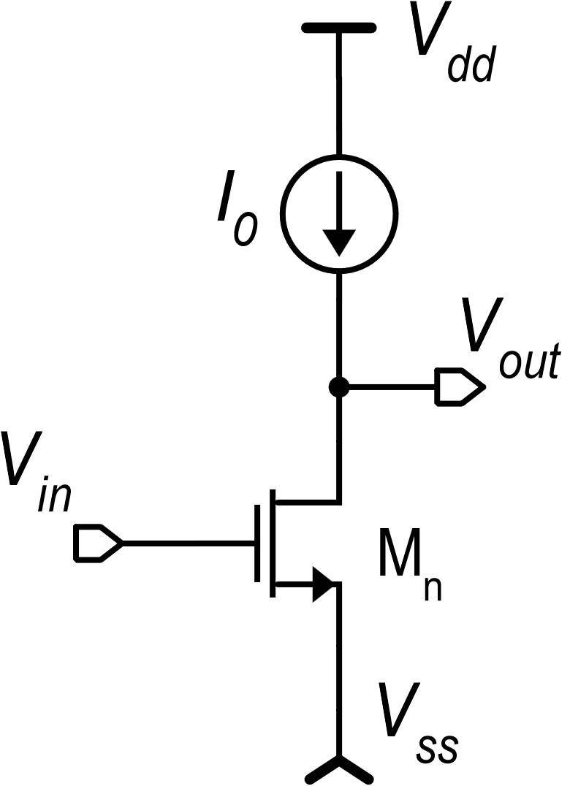
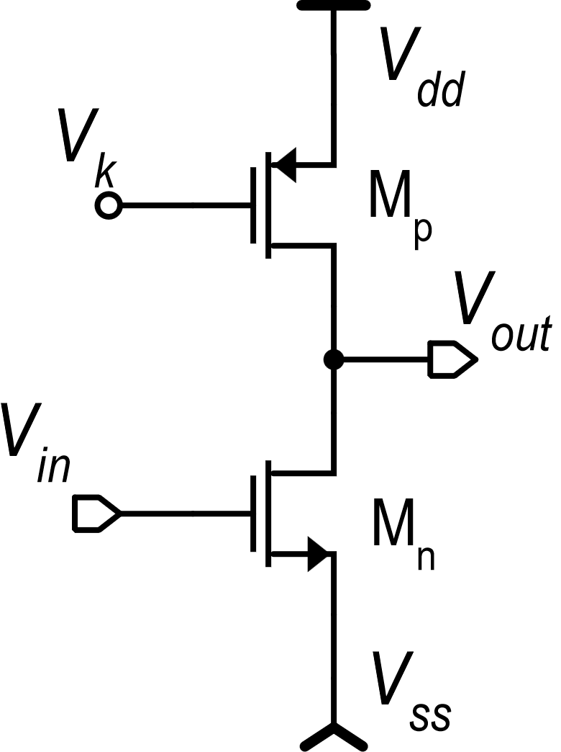
Common source output stages: class-A case
Margins to the rails are now only a V_{DSAT}, which is much smaller than a V_{GS}.
The common source output stage has a practically rail-to-rail output swing
P. Bruschi – Microelectronic System Design
11

Slide 12
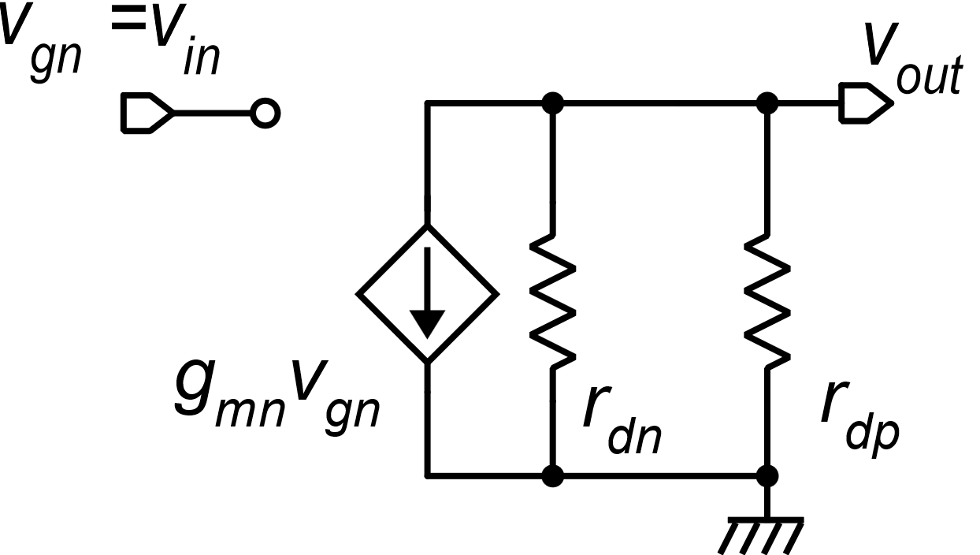
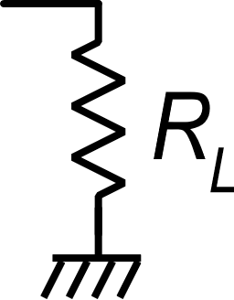
Small signal properties of the class-A common source stage
The unipolar common source is a gain stage (inverting) that can be used also as output stage
P. Bruschi – Microelectronic System Design
12

Slide 13
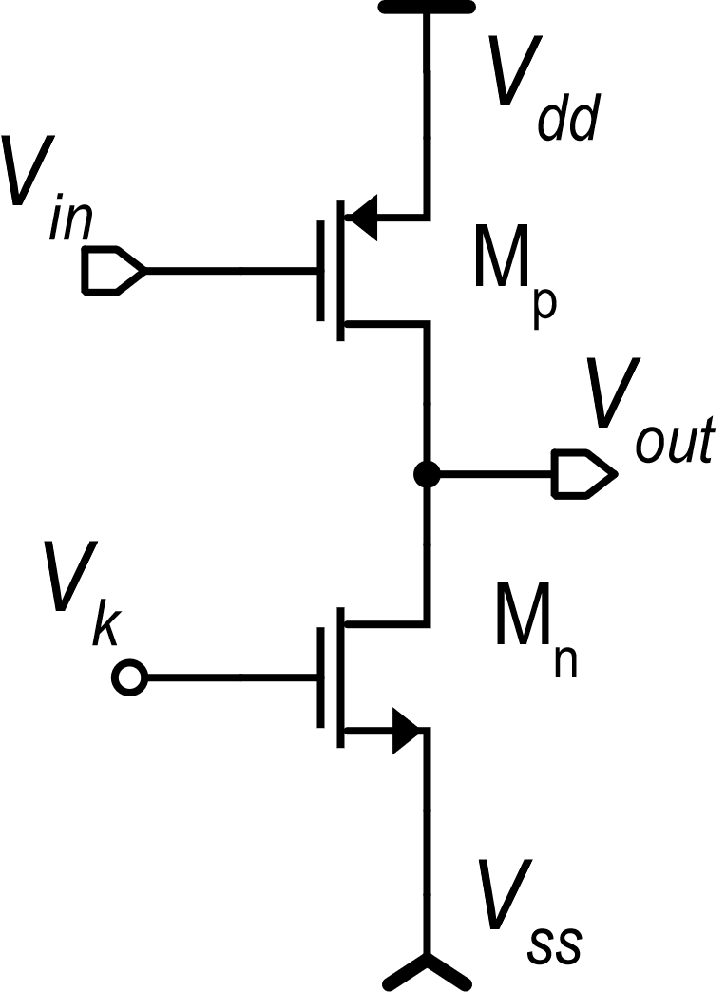
Class-A common source: maximum output current
n-version
-V_{GSp}
I₀
I₀
V_{GSn}
class-A
class-A
p-version:
(the input signal is invariant when referred to V_{dd})
The input voltage is invariant to the supply voltages when it is referred to V_{ss}: the preceding stage should provide an output with the same property

Slide 14
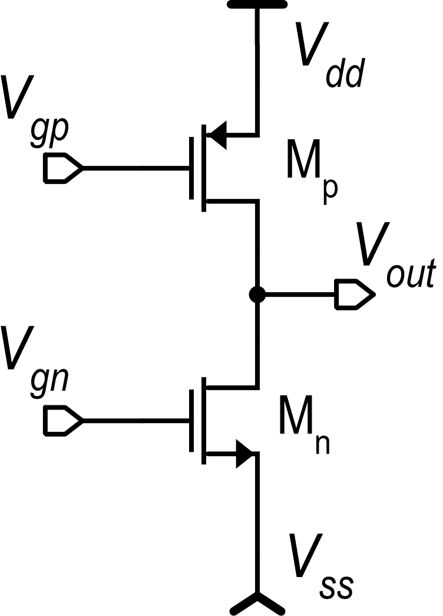
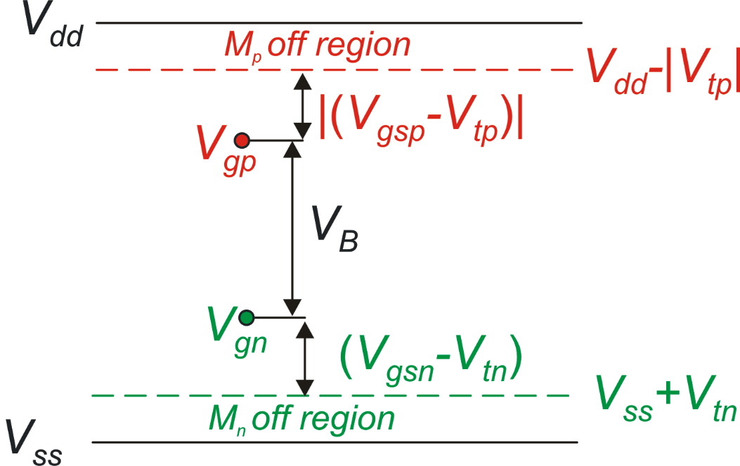
Class-AB common source: principle of operation
push
class-AB control
(driver)
operating
point
M_{p} turns off
pull
M_{n} turns off
14

Slide 15
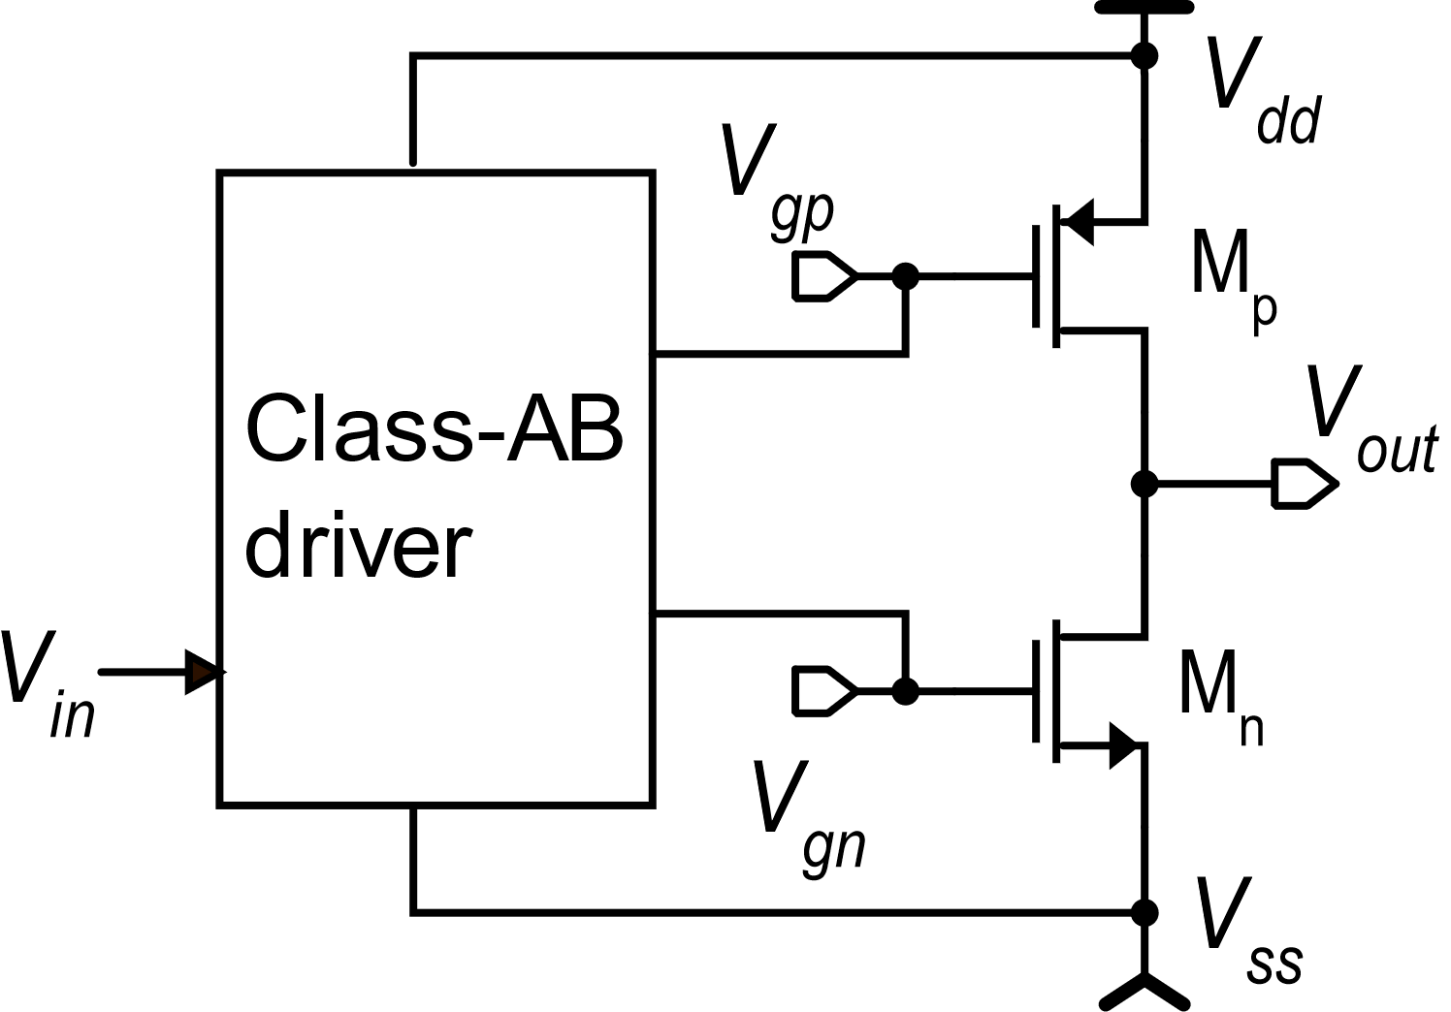
Class-AB common-source output stages: maximum output currents
Driver
β_{p} , β_{n}
Different topologies are available for the class-AB driver. They differ for the maximum V_{GS} that can be delivered to M_{p} and M_{n} and for the minimum supply voltage
15

Slide 16
Class-AB common-source output stages: equivalent voltage source
V_{dd}
V_{gp}
M_{p}
V_{B}
V_{out}
V_{gn}
M_{n}
This is equivalent to have a voltage source (battery) across the two gates.
V_{ss}
For small signals:

Slide 17
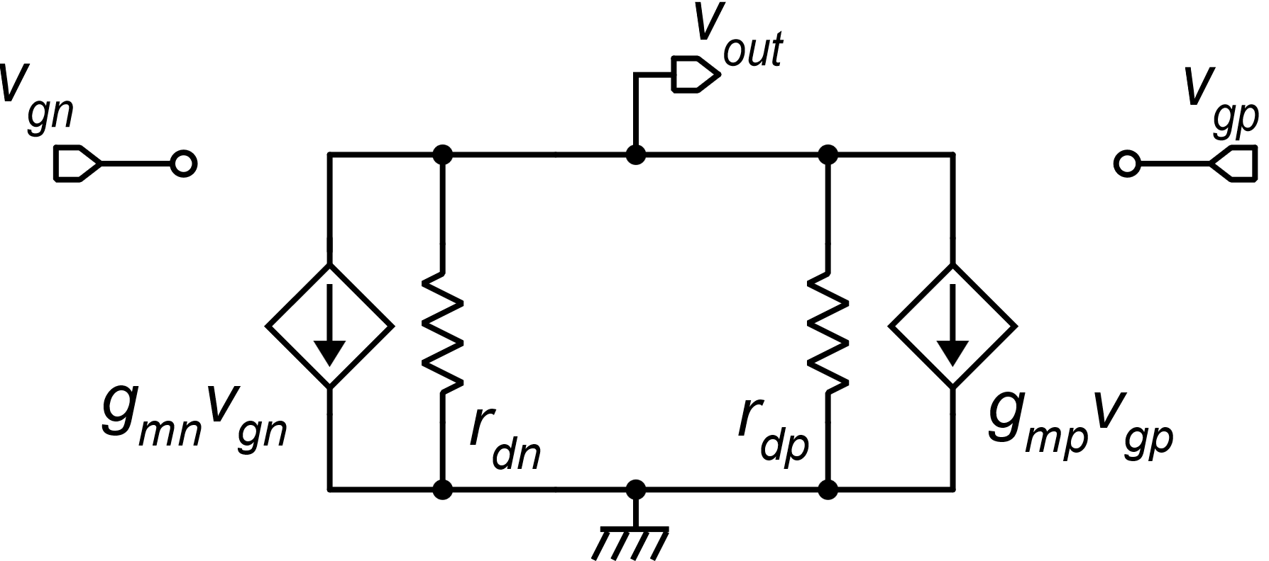
Class-AB common-source output stages: small signal gain
v_{gn} and v_{gp} must have the same sign to produce in-phase effects on v_{out}
For:

Slide 18
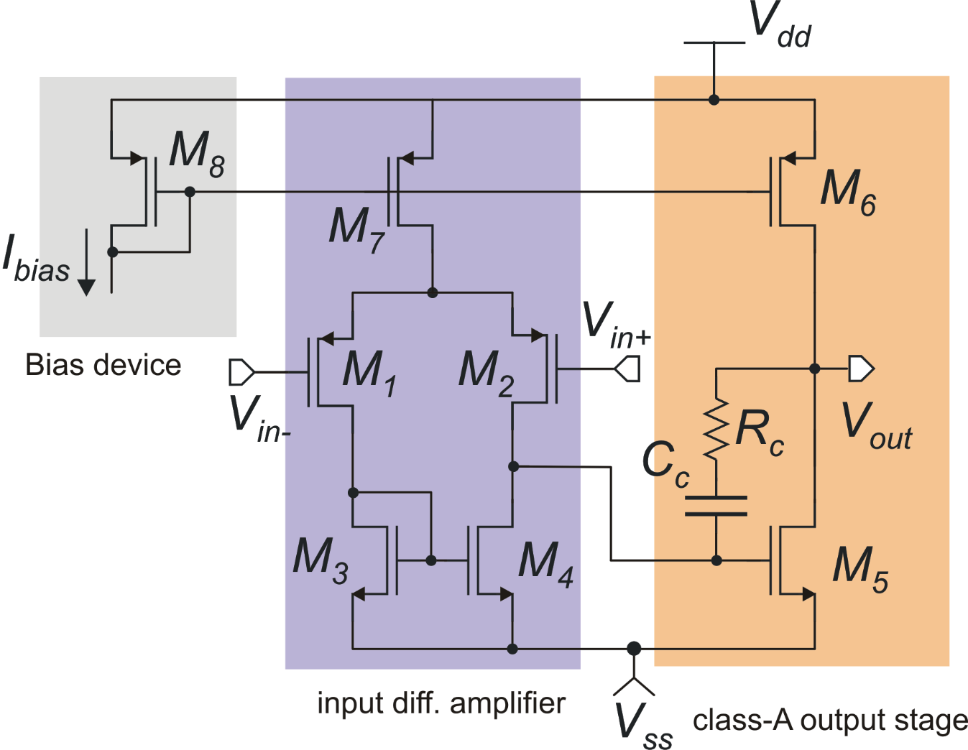
Two-stage operational amplifiers: examples

Slide 19
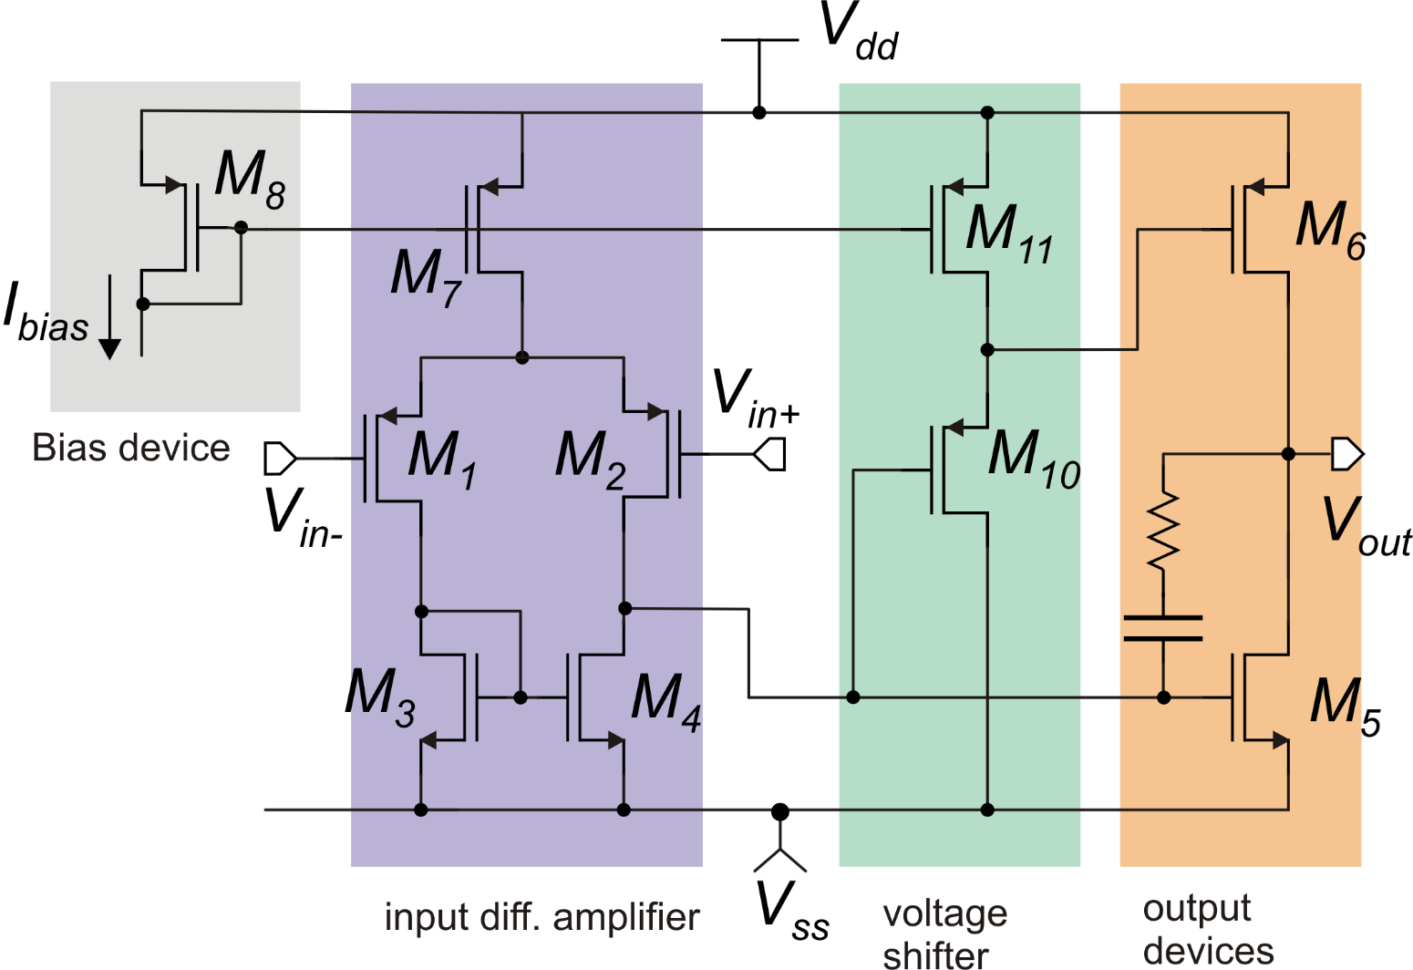
Two-stage operational amplifier with class-AB output stage
V_{gp}
V_{gn}

