Slide 1
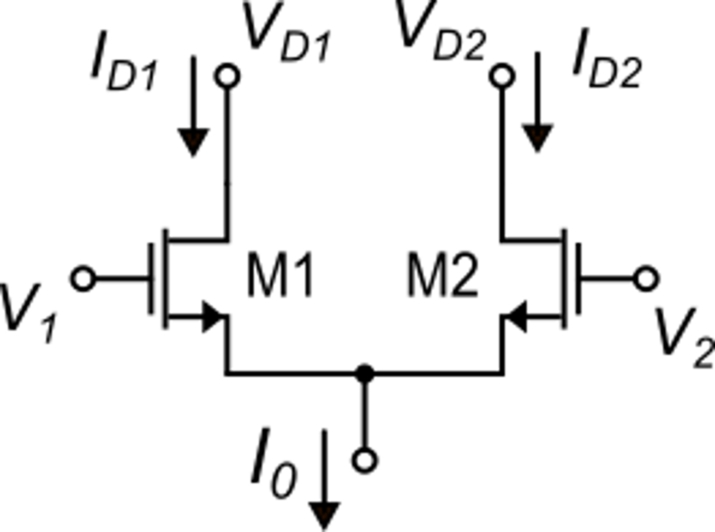
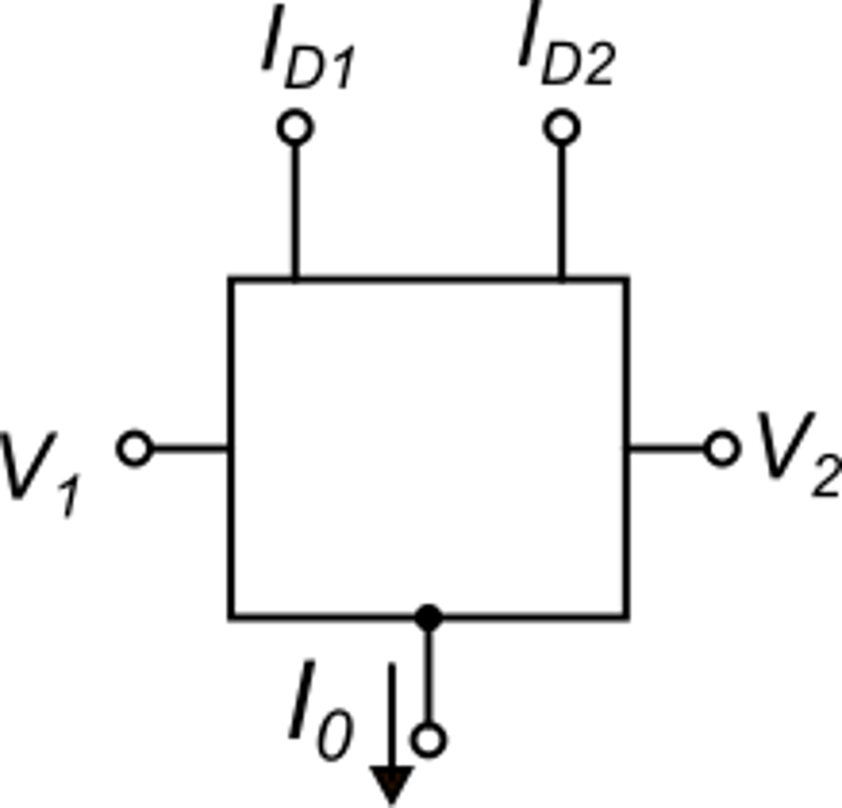
Source coupled MOSFET pair (differential MOSFET pair)
Inputs: V₁, V₂ (effective input signal: V_{D}=V₁−V₂)
I₀ ("Tail current")
Outputs: I_{D1}, I_{D2} (I_{D1}−I_{D2})
Function
The input current I₀ is split into I_{D1} and I_{D2}, according to fractions x and (1-x)
x depends on V_{D} (x=0.5 for V_{D}=0)

Slide 2
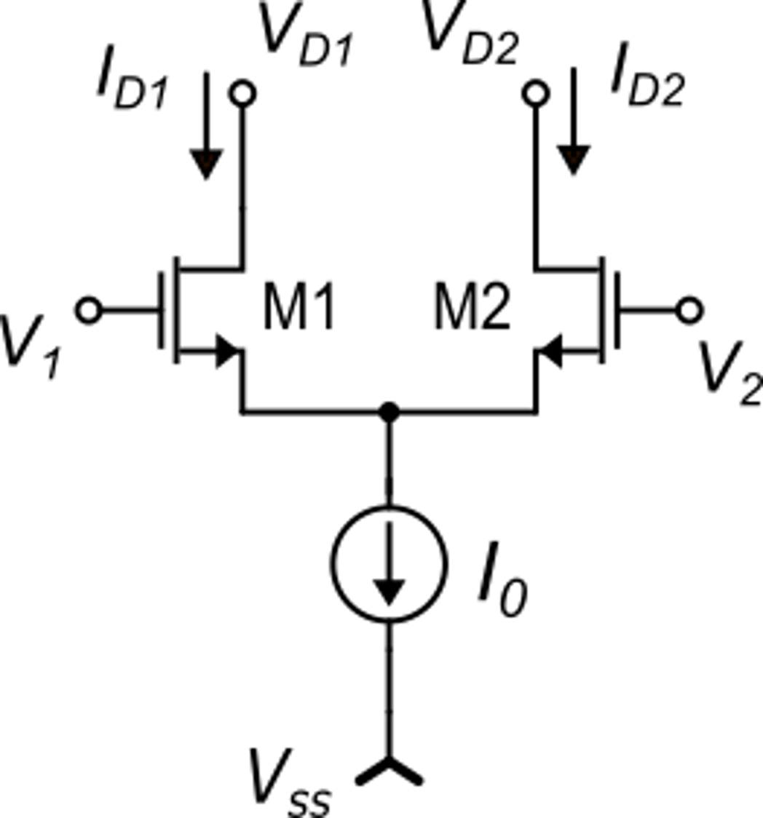
Analysis of the source coupled MOSFET pair (differential MOSFET pair)
Target: obtain the relationship between the ratio x and the input differential voltage V_{D}
Hypotheses
M1 and M2 work in saturation and the effect of V_{DS} can be neglected
Strong inversion equation can be applied
I₀ does not depend on V₁, V₂
I₀ has been represented as an ideal current source placed between M1,M2 sources and V_{SS}: this is just an example.

Slide 3
Analysis of the source coupled MOSFET pair (differential MOSFET pair)
Nominal conditions: M1=M2: β₁=β₂=β and V_{t1}=V_{t2} (V_{BS1}=V_{BS2}).

Slide 4
Analysis of the source coupled MOSFET pair (differential MOSFET pair)

Slide 5
Analysis of the source coupled MOSFET pair (differential MOSFET pair)
To solve this equation, we have to square both hands.
In this way we add new solutions that are not valid.
Before squaring, we have to note that:
condition 1

Slide 6
Analysis of the source coupled MOSFET pair (differential MOSFET pair)
condition 1
We have to square this equation again.
This time, the condition is:
condition 2

Slide 7
Analysis of the source coupled MOSFET pair (differential MOSFET pair)
condition 1
condition 2

Slide 8
Analysis of the source coupled MOSFET pair (differential MOSFET pair)
+
condition 1

Slide 9
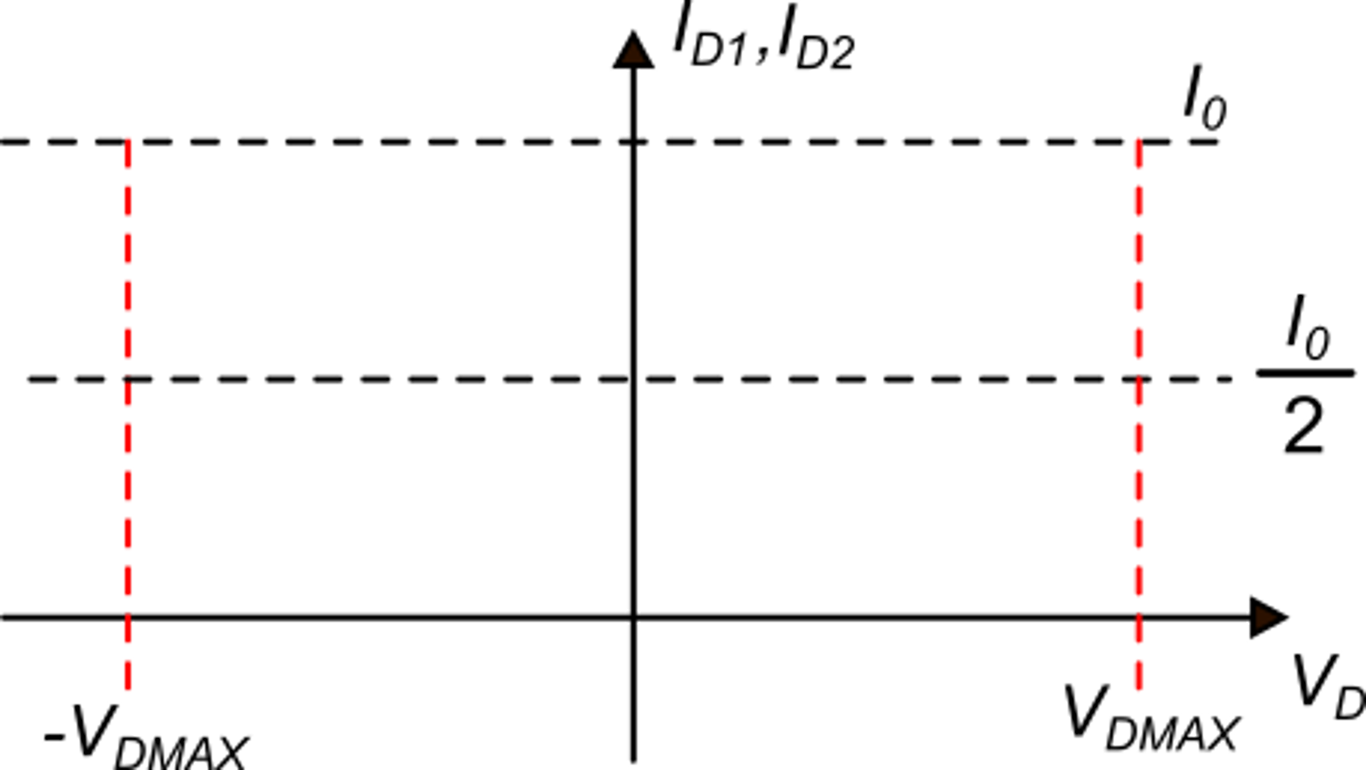
condition 2
The analysis is applicable only between -V_{DMAX} and +V_{DMAX}

Slide 10
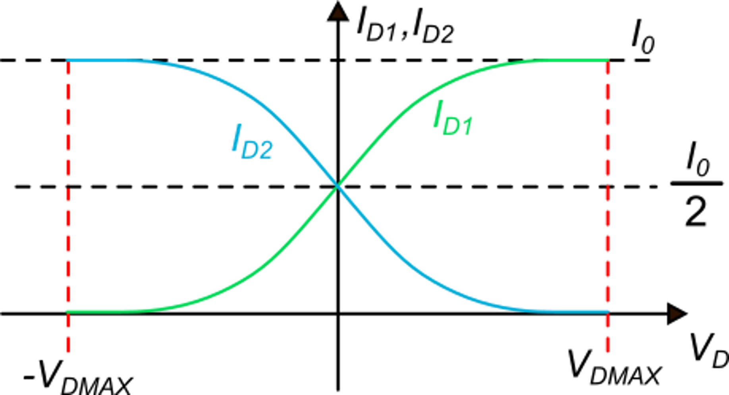
Derivative of the differential pair input-output curves (optional)

Slide 11
Extrapolation outside the -V_{DMAX}≤V_{D} ≤V_{DMAX} region
Considering the boundary:
V_{DMAX}
If V_{D} increases over V_{DMAX} :
V_{GS1} cannot increase because I_{D1} would become > I₀, which is impossible.
Then V_{GS2} gets smaller than V_{t} I_{D2} keeps being =0
I_{D1} keeps being = I₀
The opposite occurs when V_{D} decreases below V_{DMAX} :

Slide 12
Mosfet differential pair: parameters
For V_{D}=0 (typical operating point):

Slide 13
Small signal behavior
For small variations (v_{d}) of V_{D} around 0:
Check that this is consistent with other expressions of gm

Slide 14
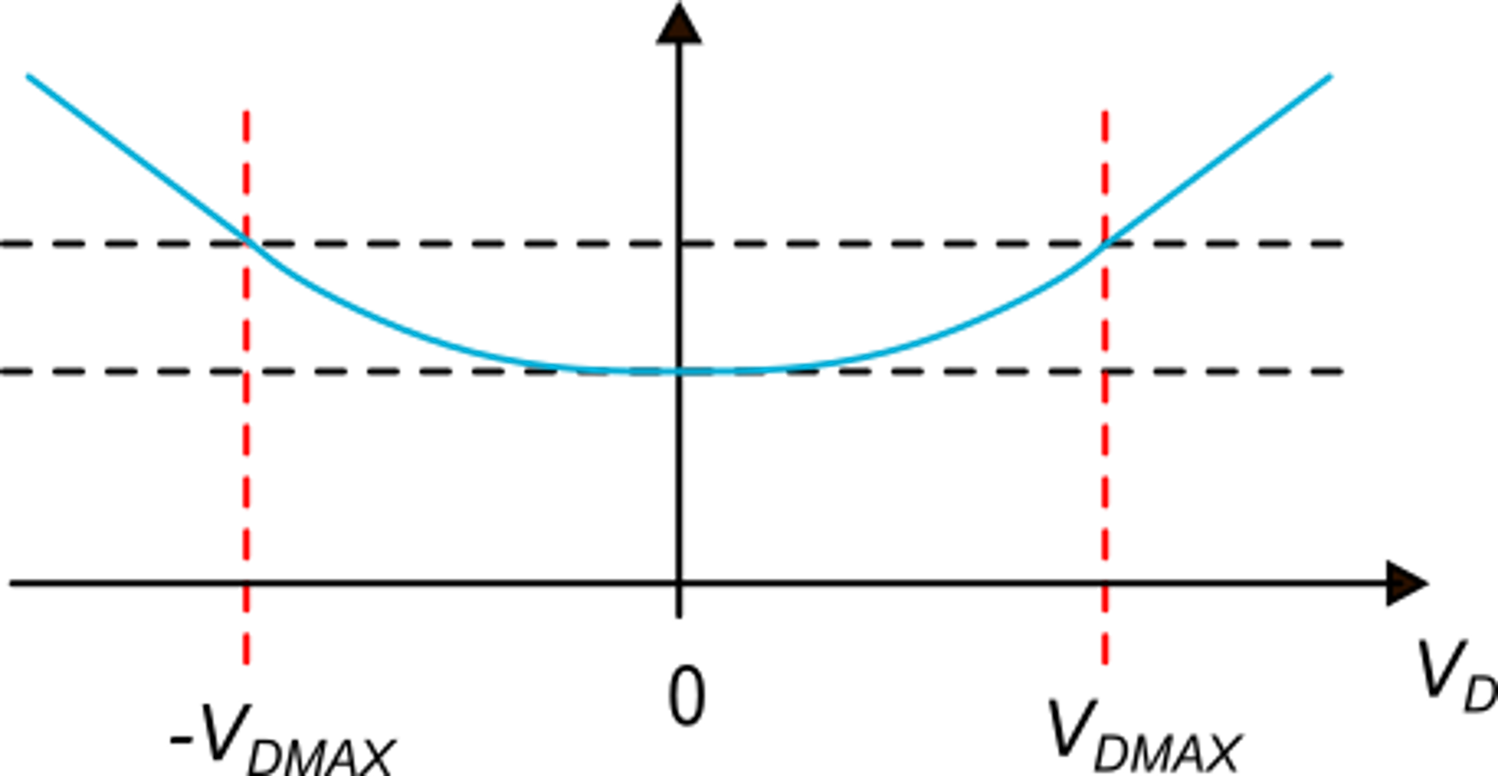
Large-signal dependence of the source voltage on V_{D}
V_{C}: common mode voltage=constant
<
V_{S}
for V_{D}> V_{DMAX}
constant

Slide 15
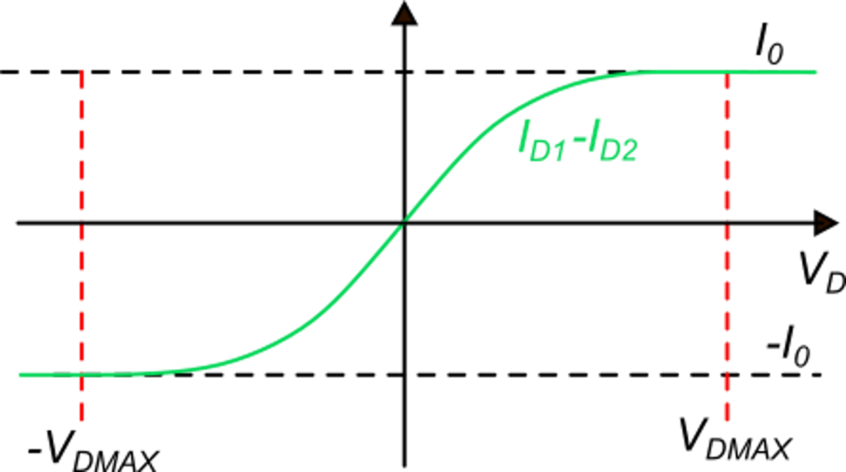
Differential output current

Slide 16
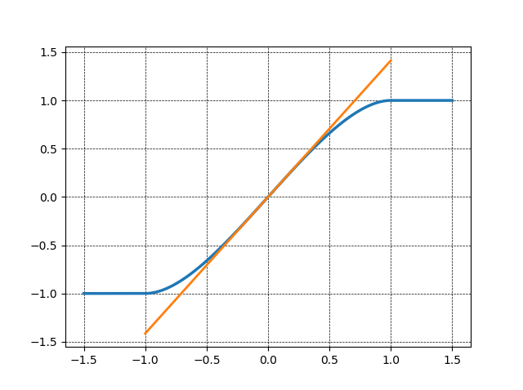
Mosfet differential pair: real curves (calculated) and linearity
linear approximation
calculated around origin
Non-linearity error:

Slide 17
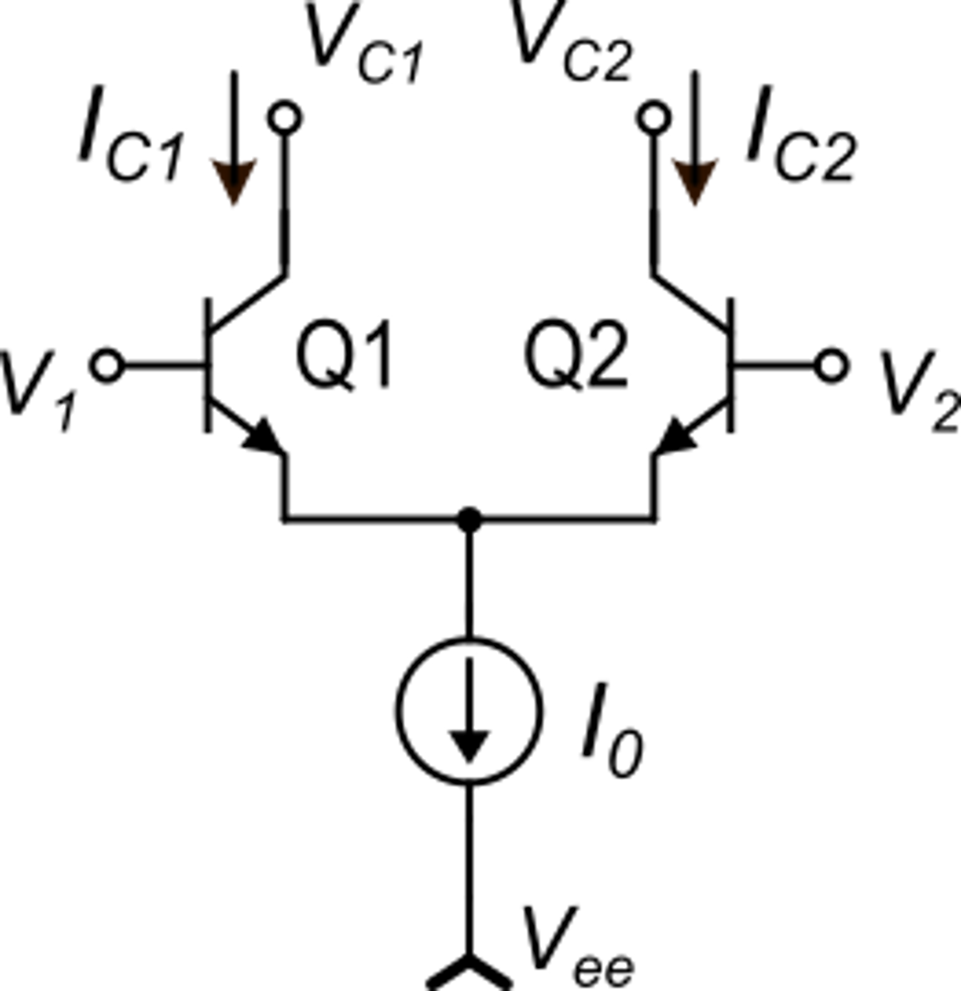
BJT differential pair

Slide 18
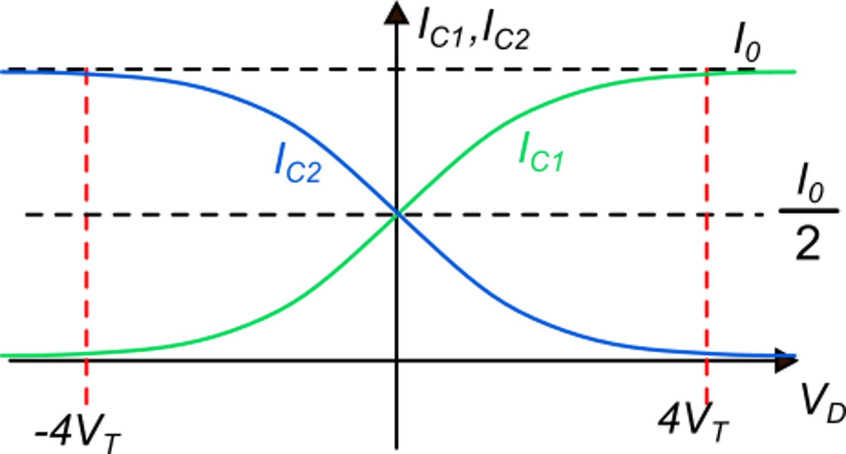
BJT differential pair
0.982 I₀

Slide 19
BJT differential pair - small signal currents

Slide 20
MOSFET and BJT differential pairs compared
(I_{C1}-I_{C2})
In the mosfet pair, V_{DMAX} can be varied by modifying β and I₀
In the BJT pair, V_{DMAX} is fixed to around 4V_{T}
Note: a mosfet pair in subthreshold region behaves like a BJT pair with the substitution:
Paremeter g_{m} depends on both I₀ and β:
Paremeter g_{m} depends only on I₀

Slide 21
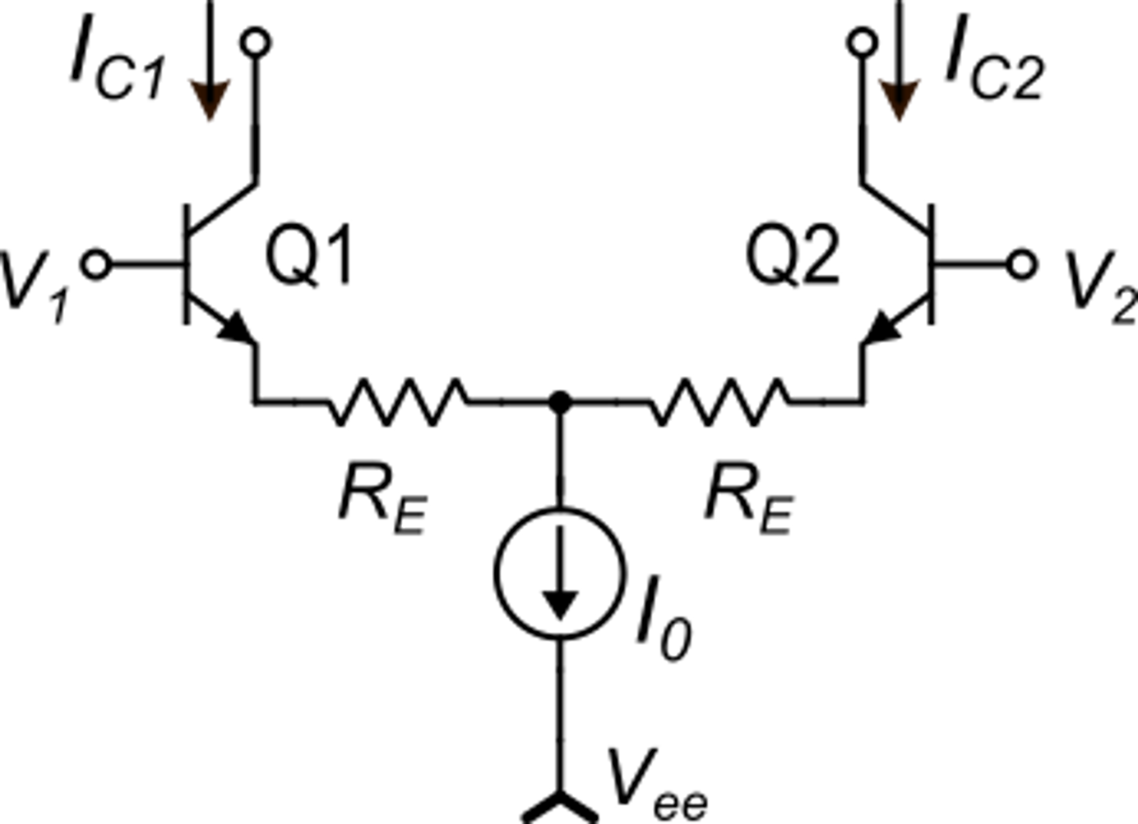
How to increase the V_{DMAX} of a BJT pair
To demonstrate this, let us write V_{D}:
Source degeneration
0.964 I₀

