Slide 1
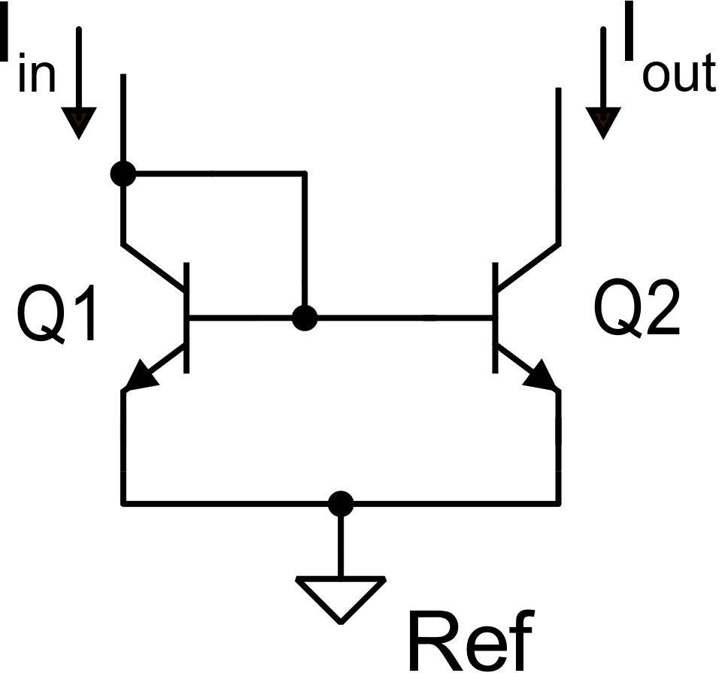
BJT current mirrors
BJT simple current mirror
V_{out}=V_{in}

Slide 2
BJT simple current mirror: parameters

Slide 3
BJT simple mirror: impact of base currents

Slide 4
BJT simple mirror: impact of base currents

Slide 5
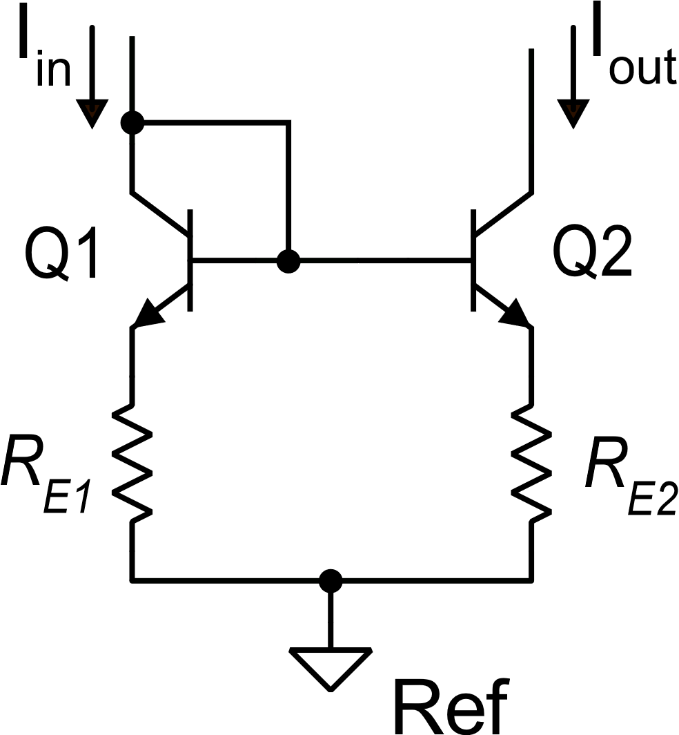
Simple mirror with emitter degeneration to increase the output resistance
for V_{in}=V_{out} , only if:
The voltage drop across R_{E1} (R_{E2}) makes V_{IN} and V_{MIN} worse than in the simple mirror

Slide 6
BJT current mirror with emitter degeneration: parameters
The voltage drop across R_{E1} (R_{E2}) makes V_{IN} and V_{MIN} worse than in the simple mirror
Example: with I_{C2}R_{E2} =225 mV, and V_{T}=25 mV, R_{out}=10r_{o2}
The error due to the base currents is the same as in the simple mirror

Slide 7
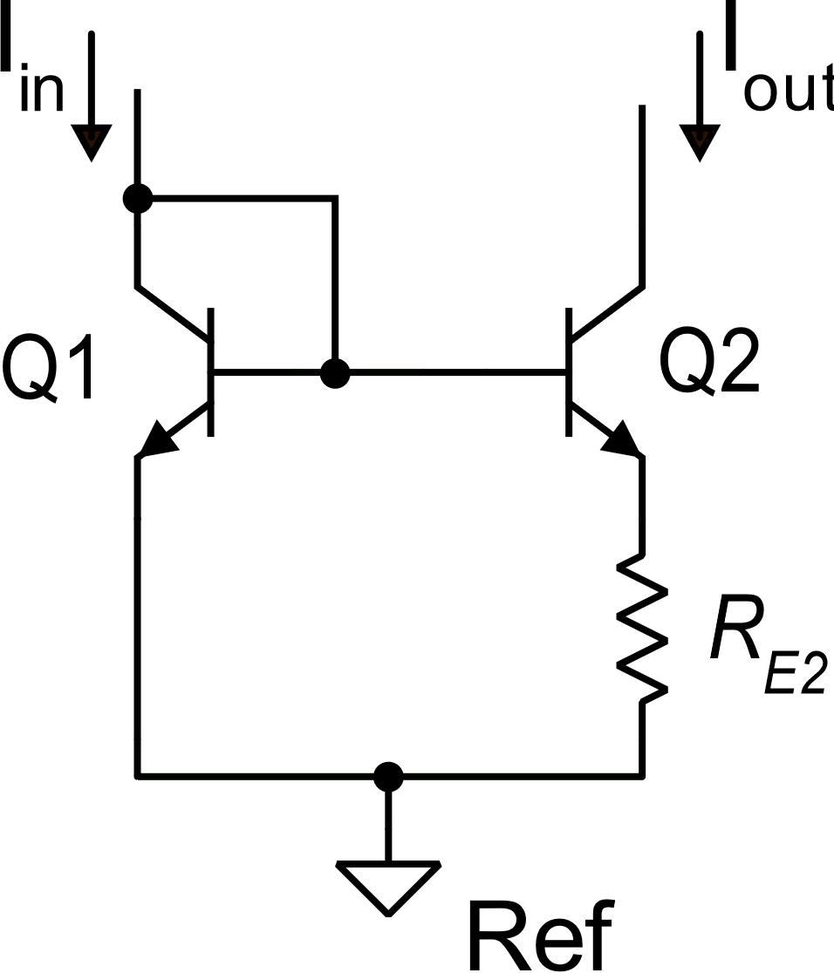
The Widlar current source
A non-linear current mirror
If Q1=Q2 (I_{S1}=I_{S2})

Slide 8
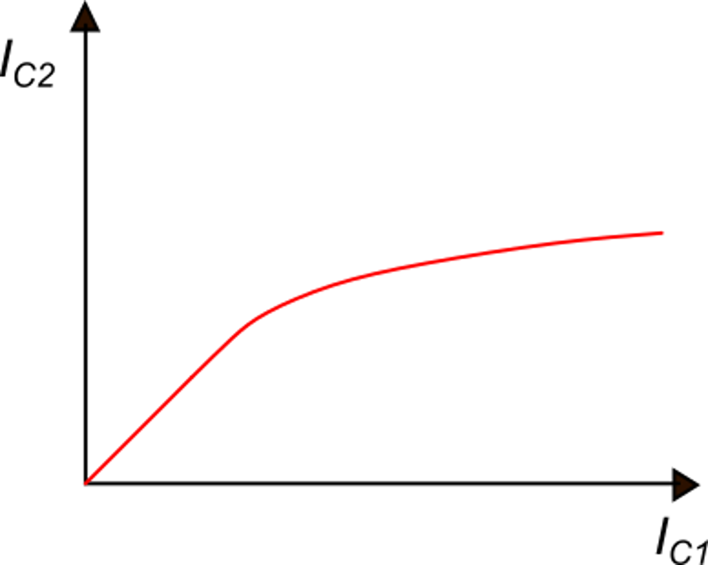
The Widlar current source
Since the I_{C2}/I_{C1} ratio is not constant, but depends on I_{C2} (and then on the input current), the behavior is non-linear
I_{out} is much less sensitive to I_{in} variations then for a linar mirror producing the same output current.
gain=1
gain<1
It was used to produce an almost constant current (I_{out}) from a variable current I_{in}

Slide 9
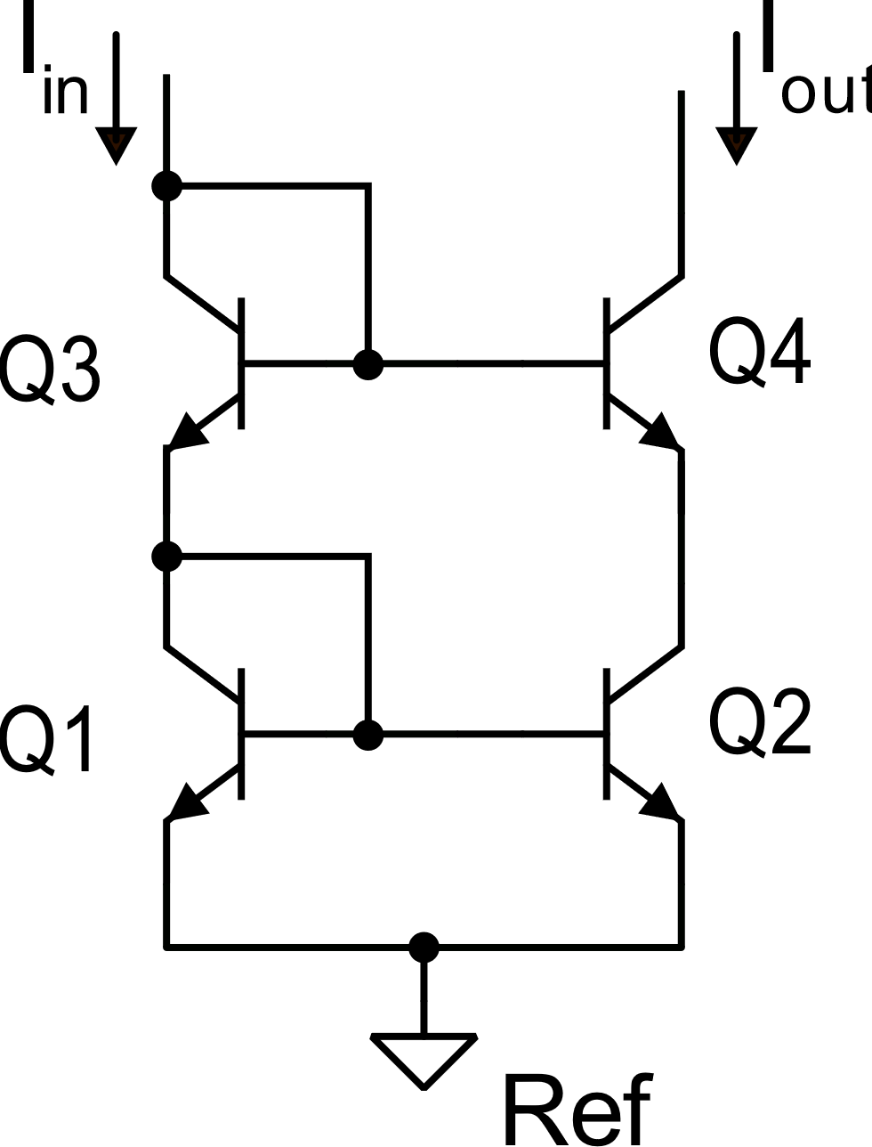
BJT cascode current mirror
If we make:
then:
almost independently of V_{out}
Design rule

Slide 10
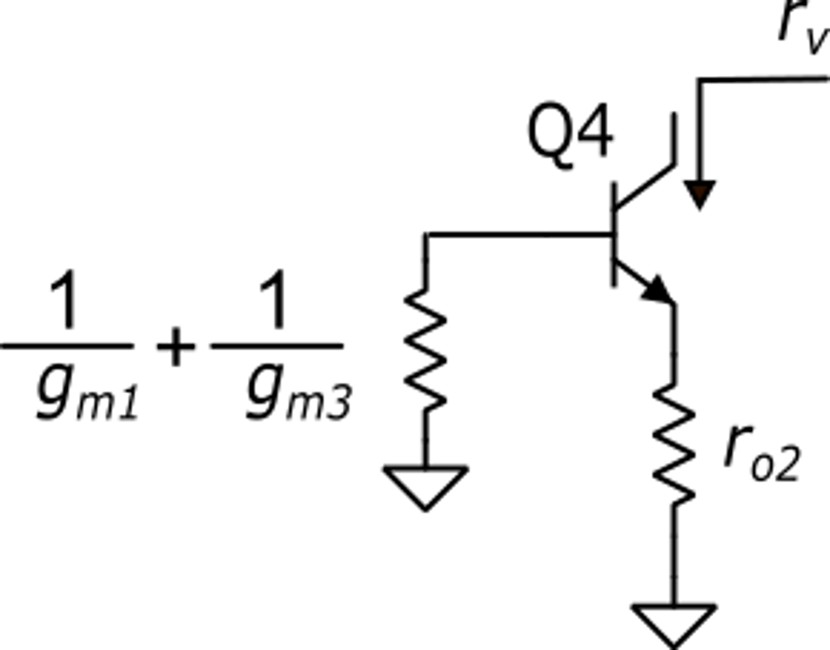
BJT cascode current mirror: R_{out}
It can be shown that:
There is interaction of the output branch (Q2,Q4) with the input one (Q3,Q4) caused by the base currents. This interaction is not present in the cascode MOSFET

Slide 11
BJT cascode current mirror: effect of base currents
using the approximation:

Slide 12
BJT cascode current mirror: summary of parameters
The output resistance is increased by a factor around h_{fe}/2, which is paid with an increase of both V_{IN} and V_{MIN}. The relative error due to the base current is doubled with respect of the simple mirror.
Due to the mentioned drawbacks of the BJT cascode current mirror, other solutions, such as the emitter degenerated mirror and Wilson mirror are often preferred.

Slide 13
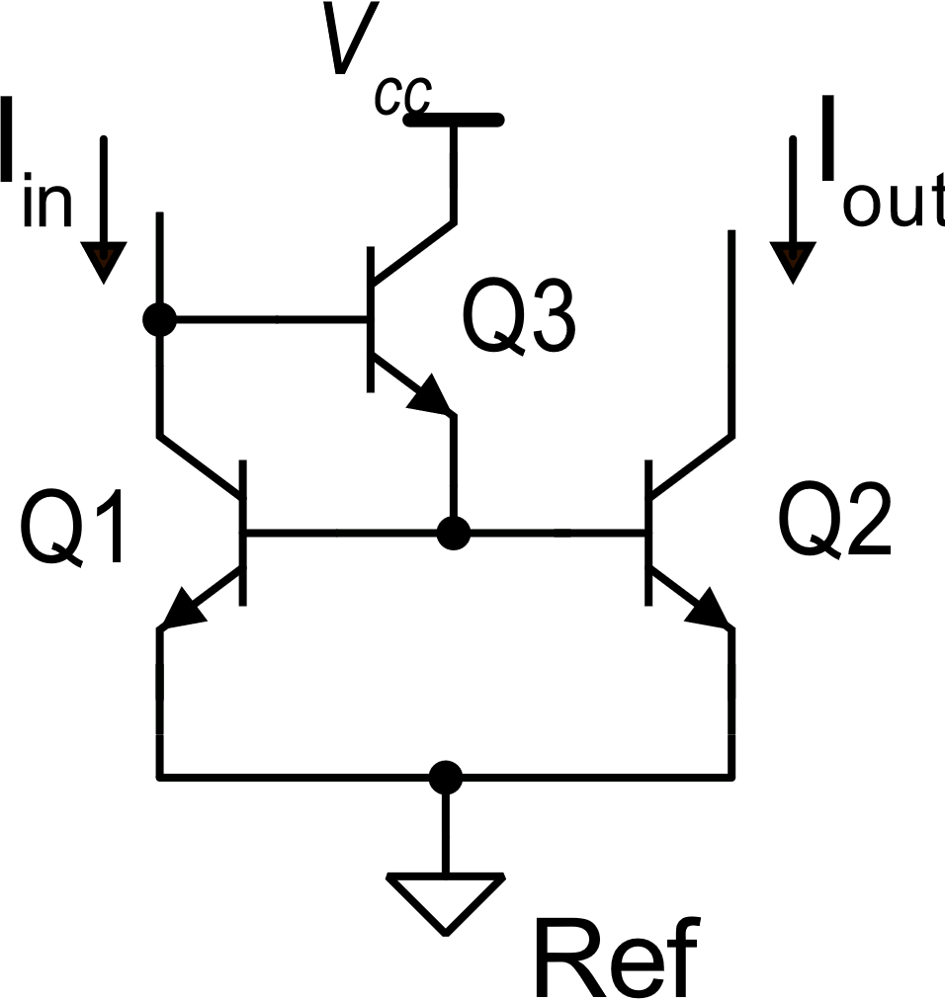
Methods to reduce the impact of the base currents: the "beta helper"
beta helper

Slide 14
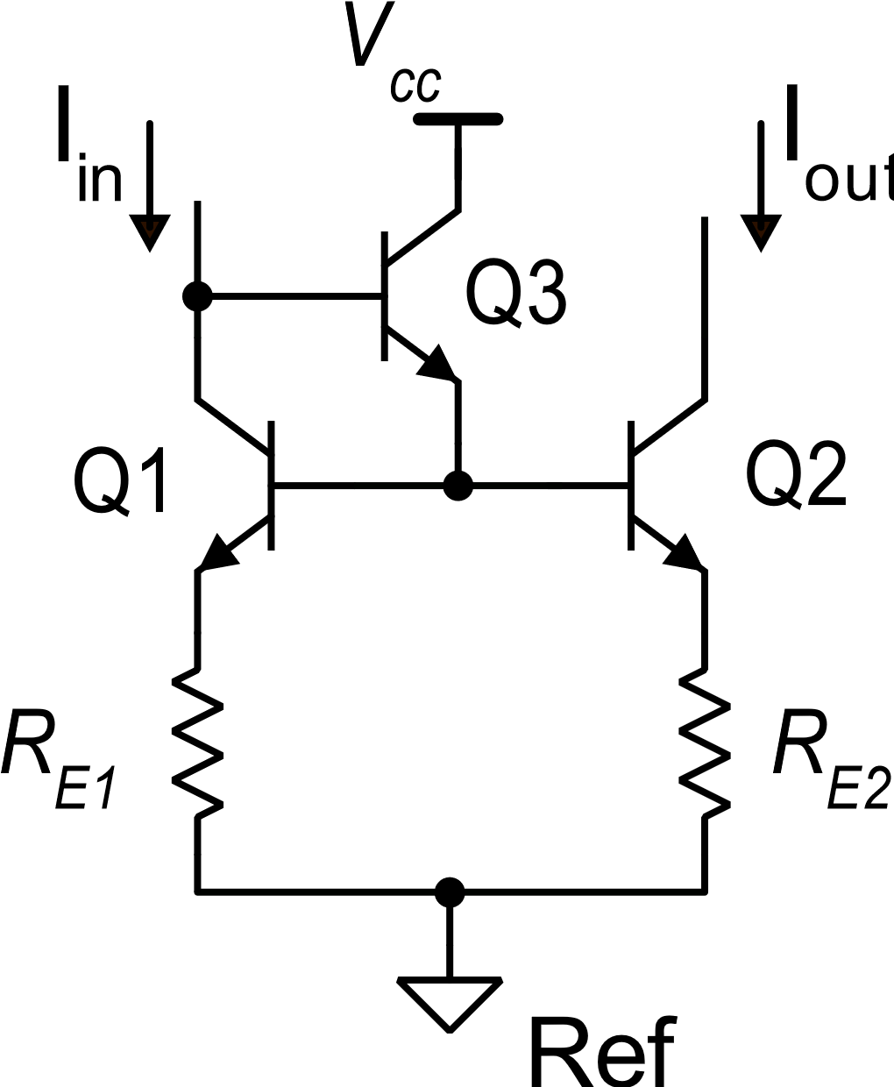
Simple mirror with emiter degeneration and beta helper
This mirror offers a good output resistance and small base-current related error.
This made it a popular choice for the design of BJT op-amps.
Its large V_{IN} prevents its use in low supply voltage circuits

Slide 15
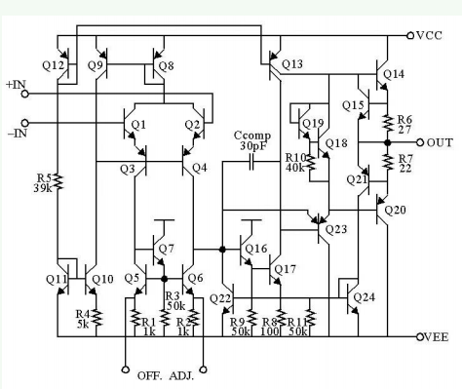
Mirrors in the 741
Widlar
Current source:
Bias current
Beta helper +
Emitter deg: accurate current inverter

Slide 16
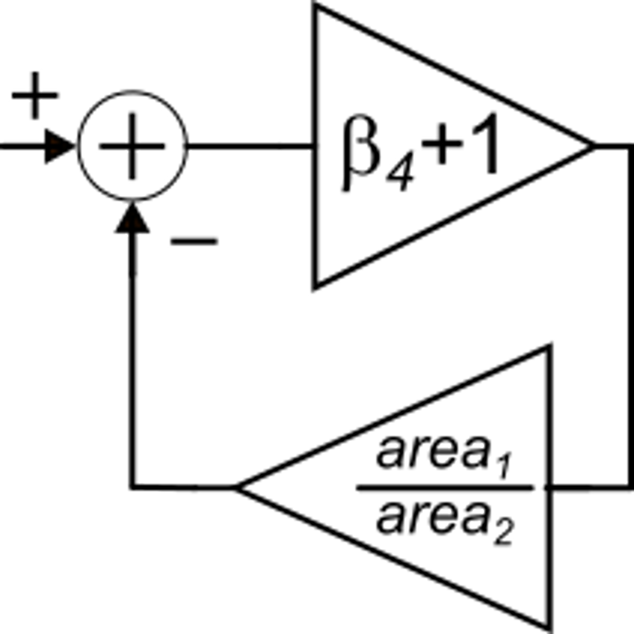
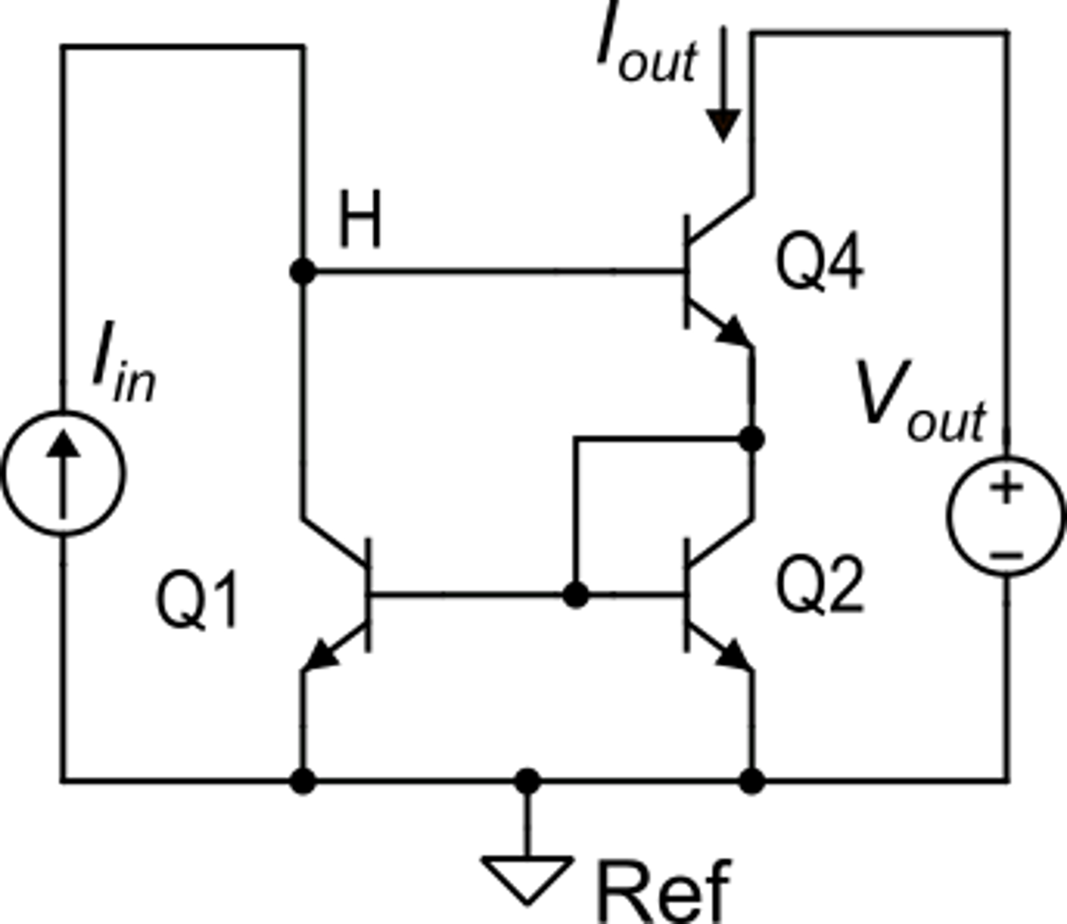
Wilson current mirror
Target: to obtain the same output resistance of a cascode mirror, but with smaller impact of base currents on the current gain accuracy.
Operating principle
Note: the Q2-Q1 mirror transmits the output current (I_{out}) back to the input branch

Slide 17
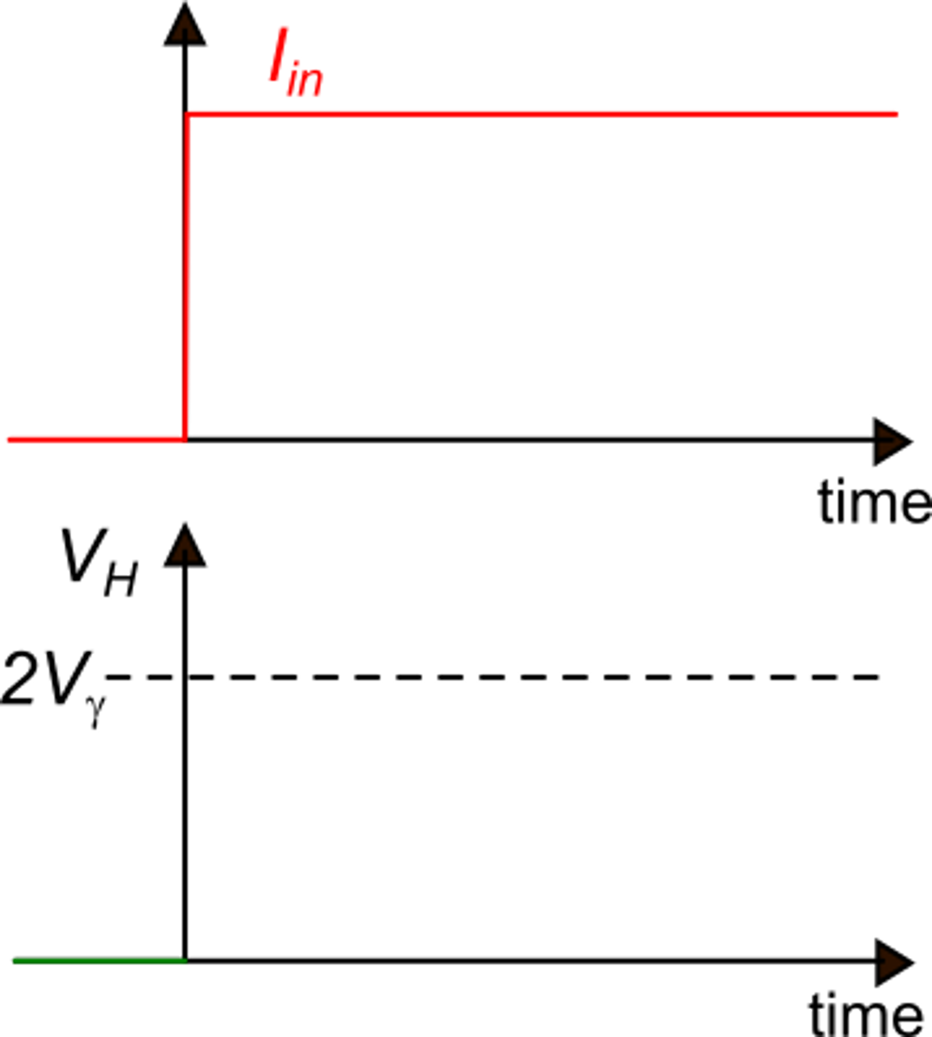
Wilson current mirror: start-up transient
until:
Q2, Q4: off
0
As V_{H} approaches 2Vγ, Q4 and Q2 turn on and the Q2 current is mirrored to M1

Slide 18
Wilson current mirror
I_{C1} starts increasing and taking part of I_{in}, away from C_{p}
Due to the exponential law, small V_{H} increments produce large I_{C2} (and then I_{C1}) increases
Equilibrium is reached when:

Slide 19
Wilson Current Mirror: effect of base currents

Slide 20
Wilson current mirror
Only if: k_{M}=1

Slide 21
Wilson current mirror
In the Wilson current mirror the relative error due to the base current is of the order of 1/β² only when it is designed for k_{M}=1. For current gains different from one, the relative error becomes of the order of 1/β.
Other characteristics:
(same as
the cascode
mirror)
due to feedback from I_{out} to node H
There is a large systematic error between I_{C2} and I_{C1}

Slide 22
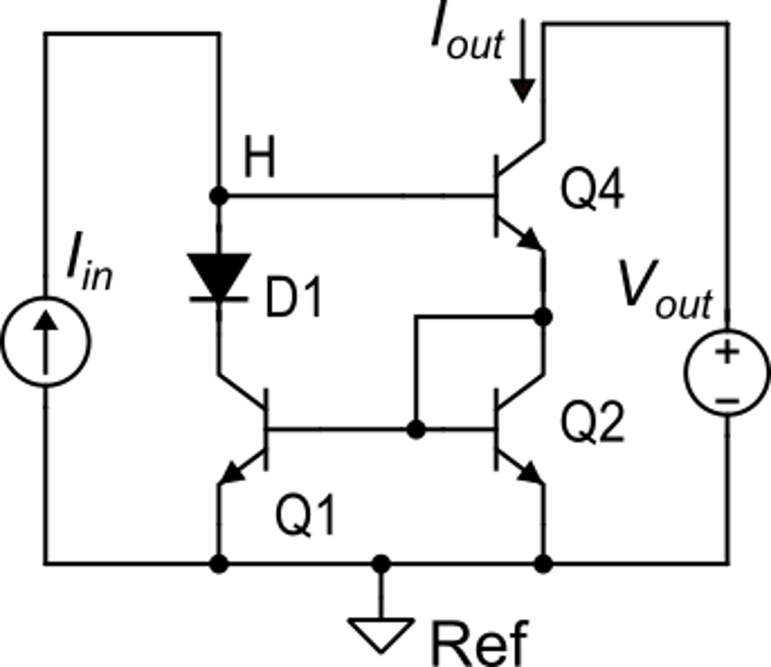
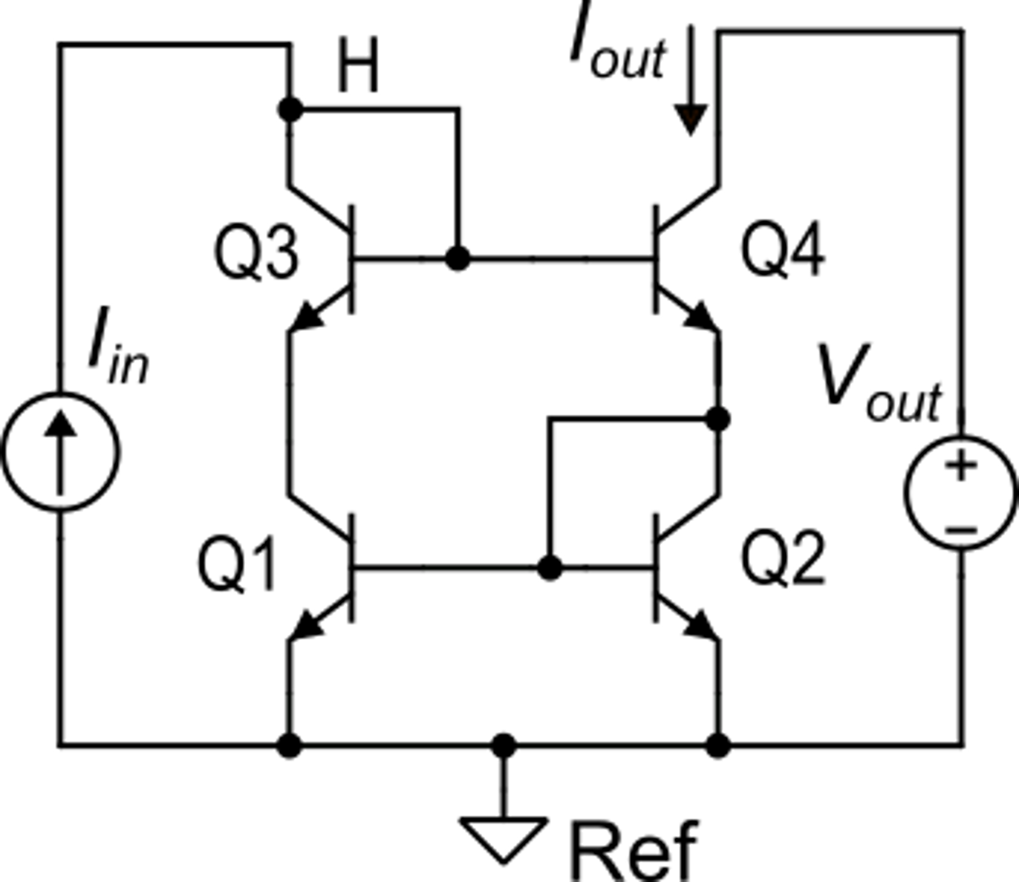
4-transistor Wilson current mirror
The 4-transistor Wilson Mirror is the optimal choice when an accurate mirror with k_{M}=1 is required.
Implementing D1 with a diode-connected BJT (Q3)

