Slide 1
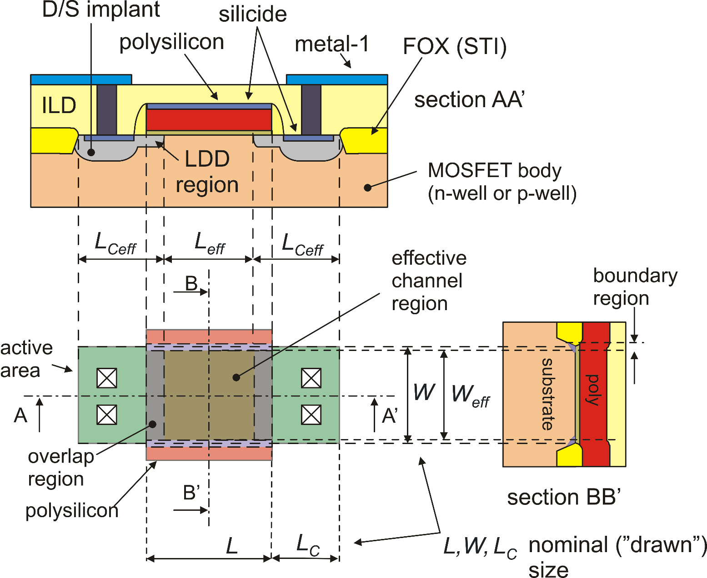
Planar n-MOSFET cross-section and layout
The designer introduces ideal geometrical values (L,W ..), while the electrical properties are determined by "effective" values:

Slide 2
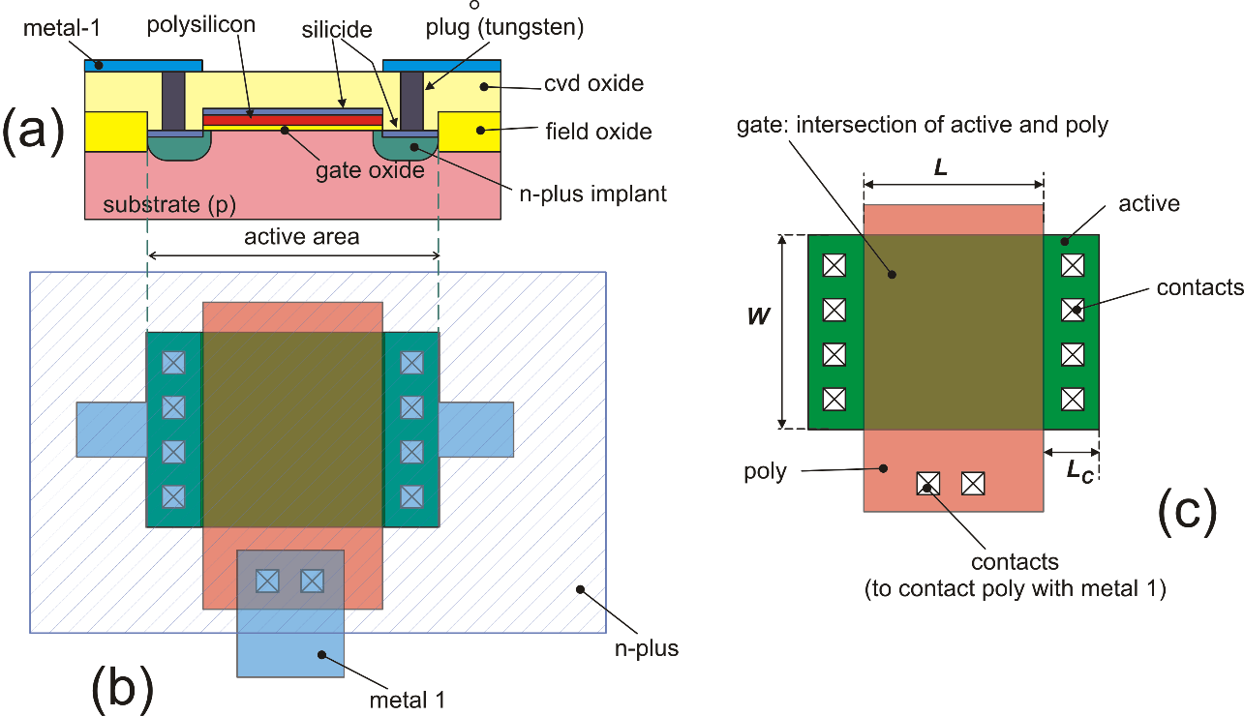
Simplified layout and cross-section ("designer view")

Slide 3
MOSFET models
Models for accurate electrical simulations: BSIM models (Berkeley Short-channel IGFET Model), EKV (Enz, Krummenacher, Vittoz) ...
Models for "hand calculations": square law (strong inversion)
exponential laws (weak inversion)
It is of primary importance to be able to manually perform first order device sizing and first order performance estimation.
Only very simple and intuitive model enable the designer to create cells that need only a final refinement and verification in the simulation phase
The simulator is useless if we do not know how to produce a circuit on scrap-paper. The simulator obeys to the law:
garbage in – garbage out

Slide 4

MOSFET models: The n-MOSFET
From this point on, we will consider the behavior of the
n-MOSFET, unless otherwise specified. In the end, we will suggest a simple way to transfer all the considerations made for the n-MOSFET to the p-MOSFET
In integrated circuits, the MOSFET is a four terminal devices: Drain, Source, Gate and Body. In discrete MOSFETs, the body is generally connected to the source internally.
D
G
B
S

Slide 5
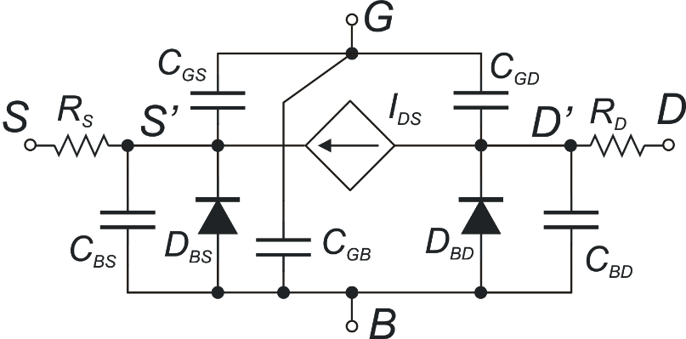
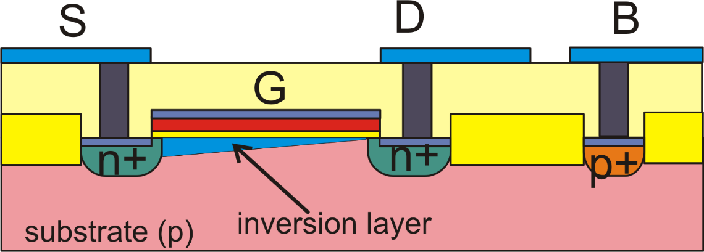
Large signal MOSFET model (n-MOSFET)
G
S
D
B
In DC, we will always assume:

Slide 6
Source and Drain Symmetry (1)
The planar MOSFET is symmetric so that drain and source can be swapped with no consequences in the electrical characteristics.
Equations that use the source as a reference terminal for all relevant voltages can be applied only after finding which terminal is actually playing the role of the source.
In an n-MOSFET, the effective source is the terminal that has the lower voltage; the other one of the two, is the actual drain
In a p-MOSFET, the effective source is the terminal that has the higher voltage; the other one of the two, is the actual drain

Slide 7
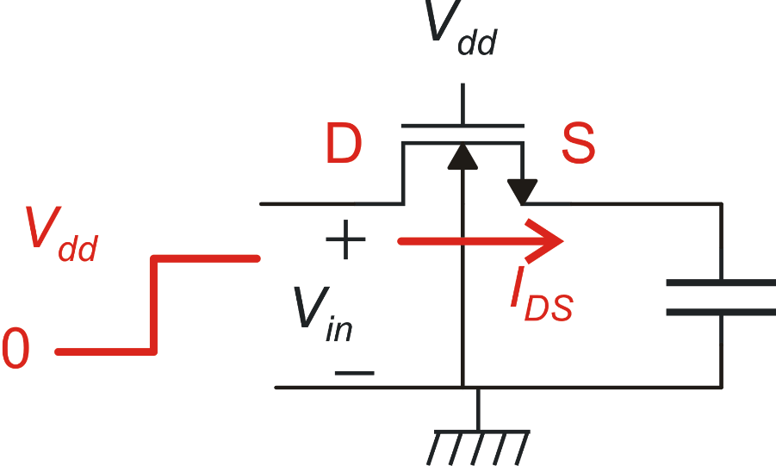
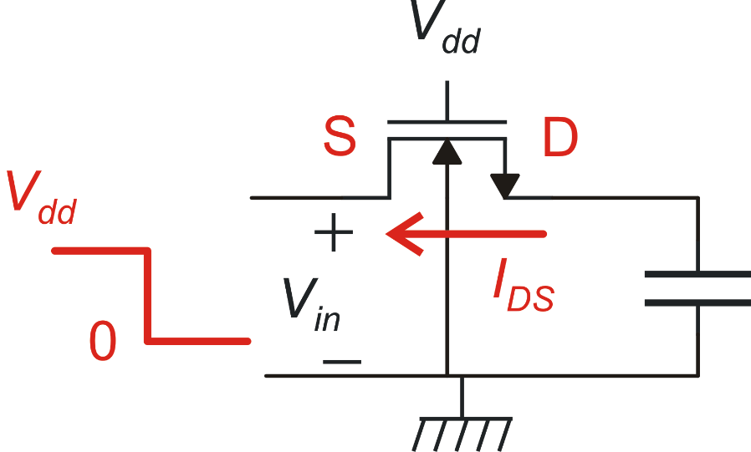
Source and Drain Symmetry (2)
With this definition, it is clear that in transient situations, the effective drain and source can swap, depending on the voltage assumed by the terminals.
Example
In a schematic editor it is necessary to indicate which terminal is the drain and the source. These "conventional" terminals are used to mark all voltages for printing and plotting purposes. This choice do not affect the circuit behavior during the simulations.

Slide 8
Source and Drain Symmetry (3)
If the circuit has a clear static operating point (like most analog circuits), it is convenient to mark as source the terminal that in the operating point is actually working as the source. This will facilitate reading device voltages produced as textual or graphical outputs by the simulator.
Models like the EKV use the body as the reference for all voltages. In this way drain and sources are perfectly symmetrical also in the equations and there is no need to decide which one is actually working as the source.
Maintaining the distinction between source and drain is more intuitive and most models oriented to hand calculations are actually based on this choice.

Slide 9
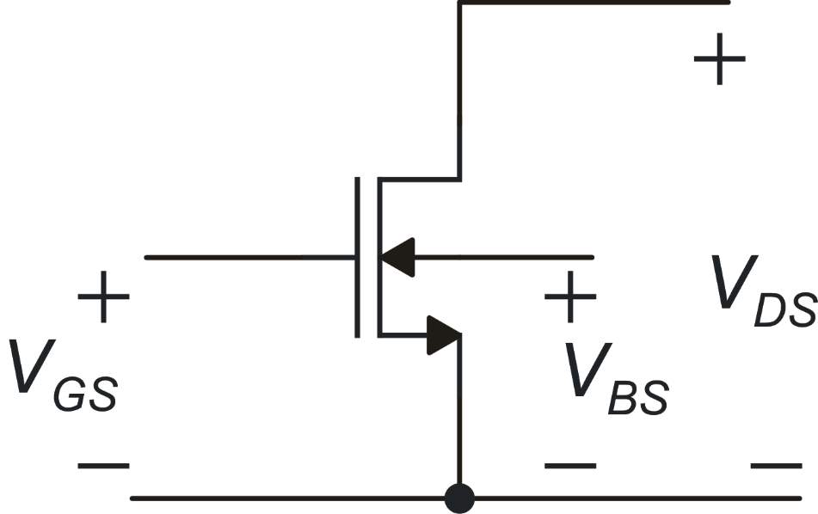
The I_{DS} model: control voltages
secondary effects:
generally they are unwanted
primary effect
it is the wanted current control

Slide 10
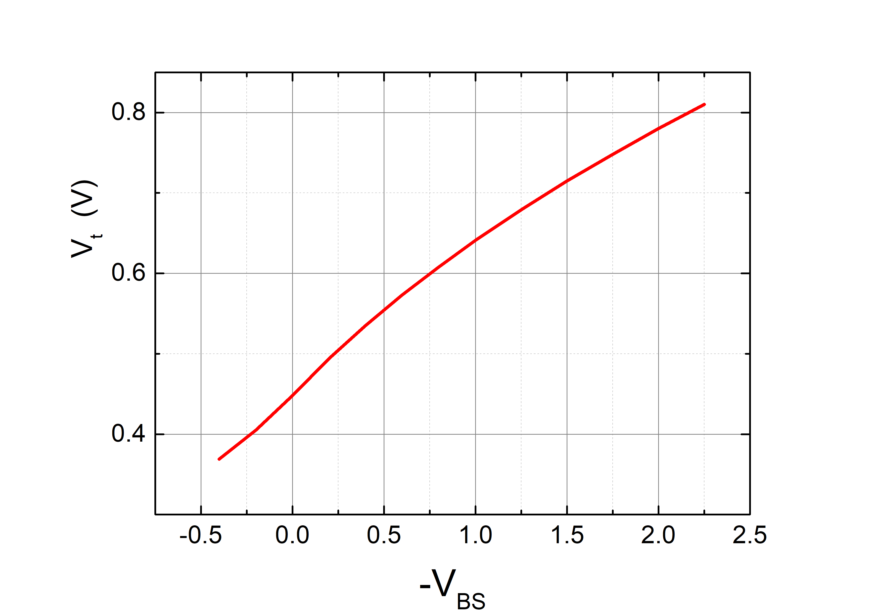
V_{GS}, V_{BS} and "overdrive voltage"
The voltage that really affects the current is the "useful" part of the V_{GS},
often called "overdrive voltage".
Body effect
γ: body effect coefficient φ_{S}: surface potential

Slide 11
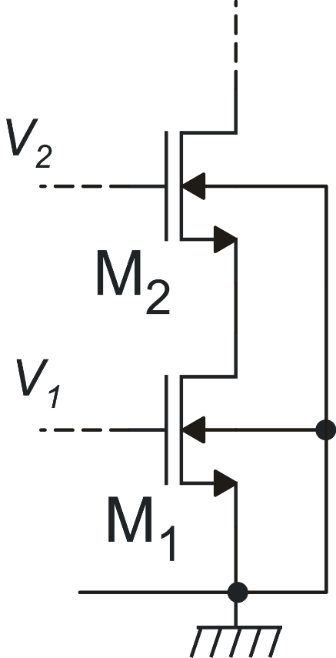
More on body effect: example

Slide 12
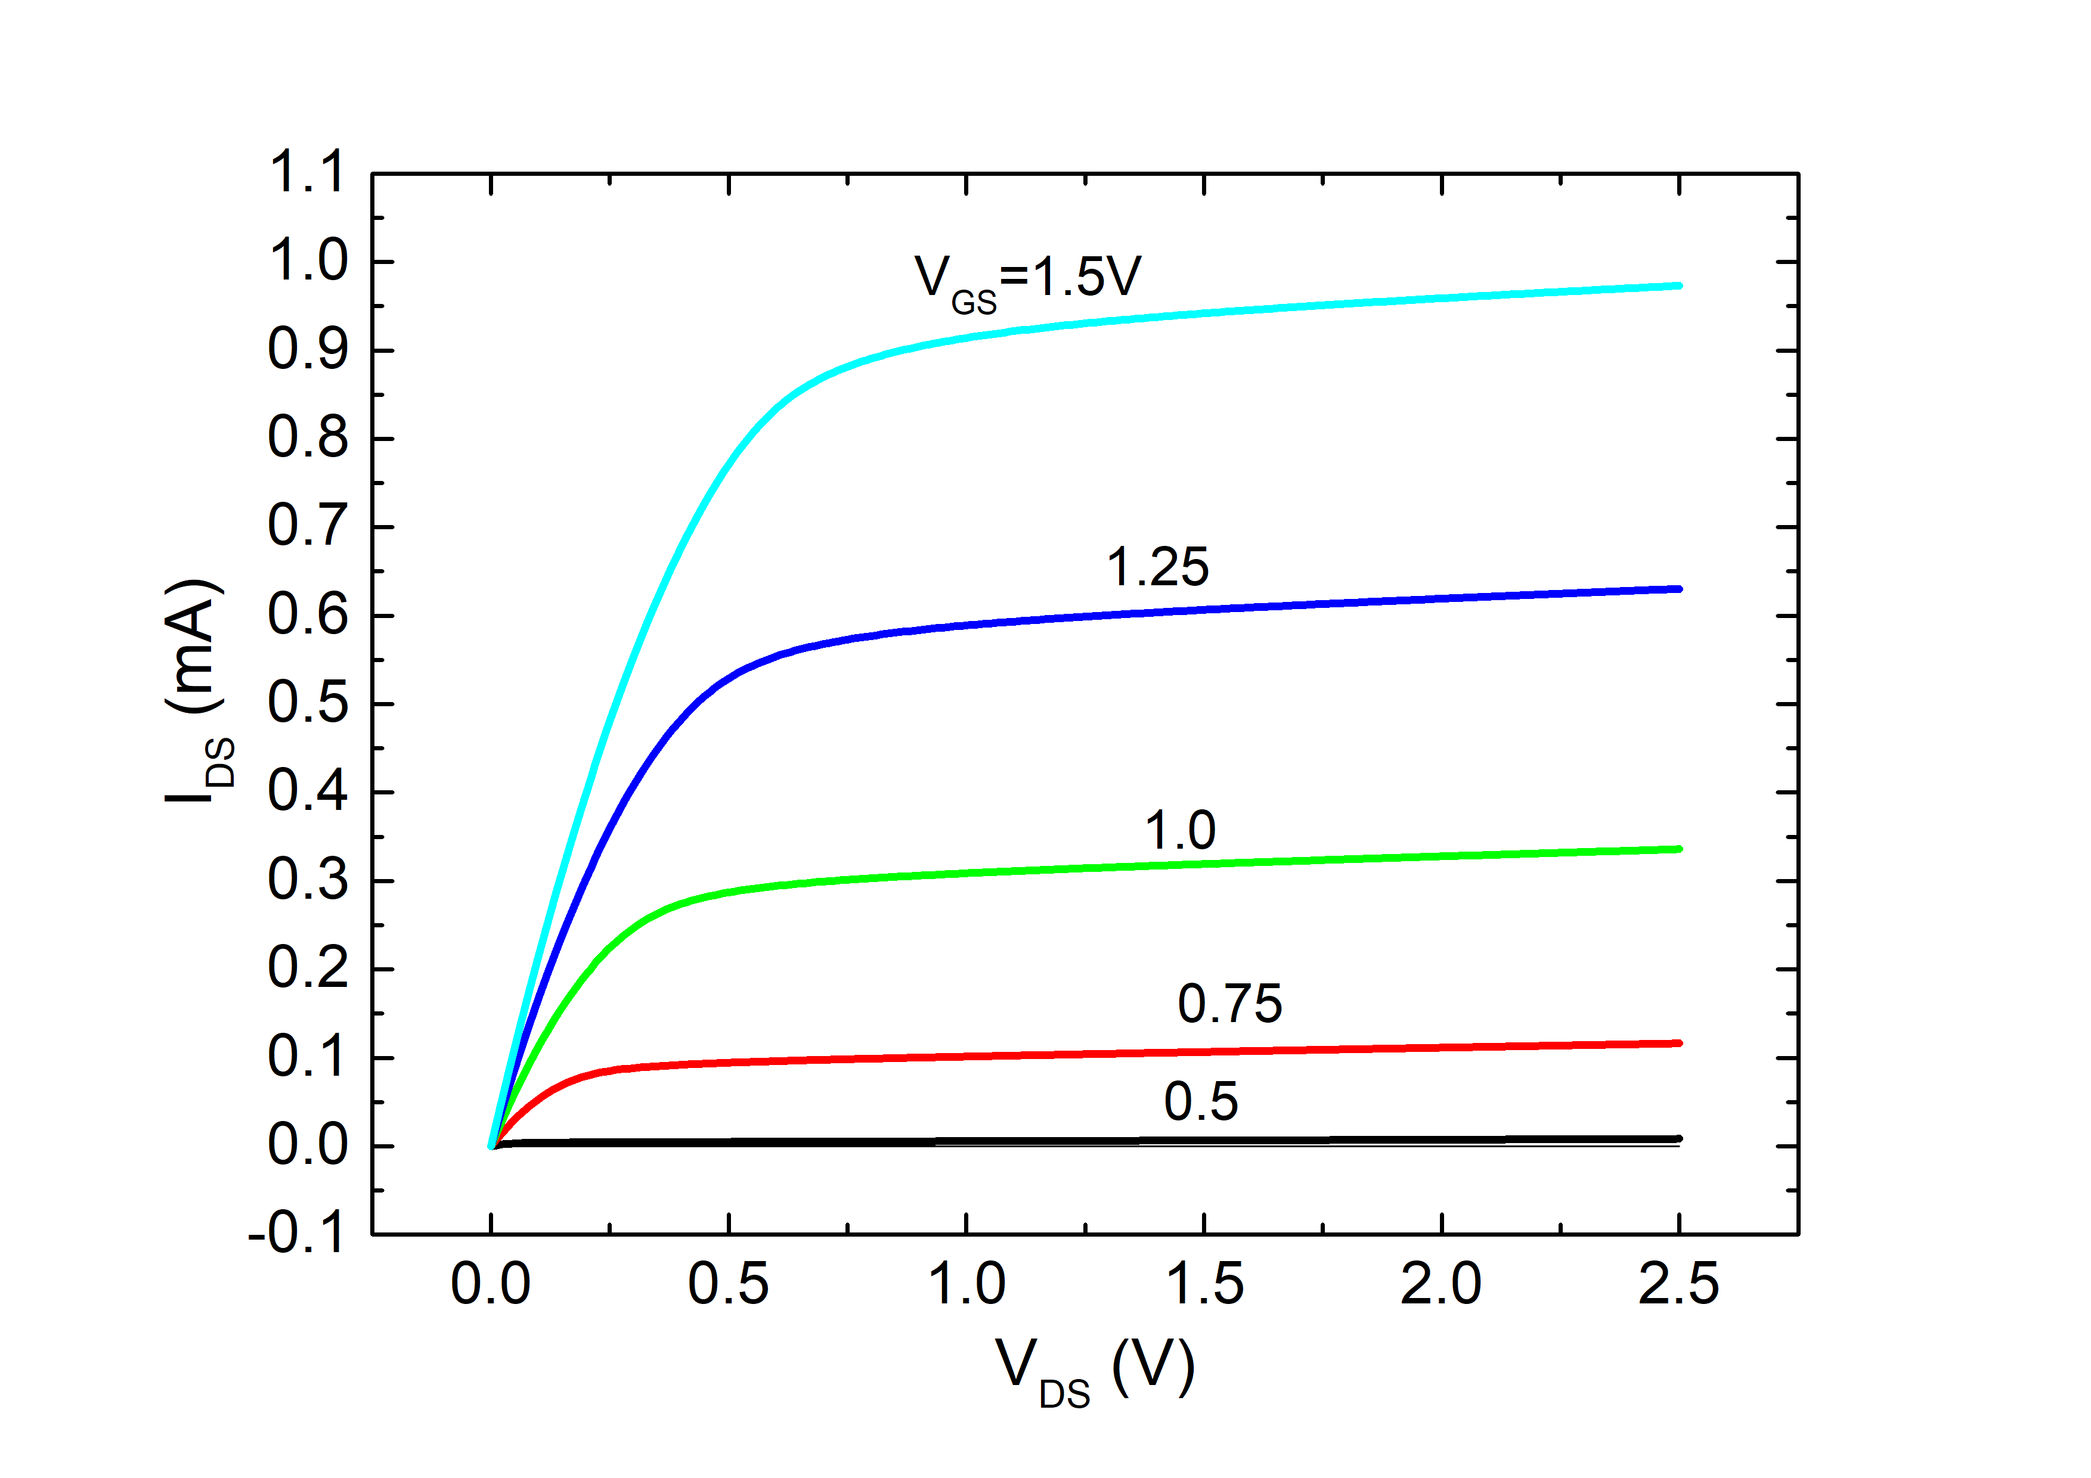
I_{DS} : operating zones on the basis of V_{DS}
Triode: I_{DS} is strongly dependent on V_{DS}
triode
saturation
Saturation: I_{DS} shows a weak and almost linear dependence on V_{DS}
V_{DSAT} is a function of V_{GS}-V_{t}
V_{DSAT}

Slide 13
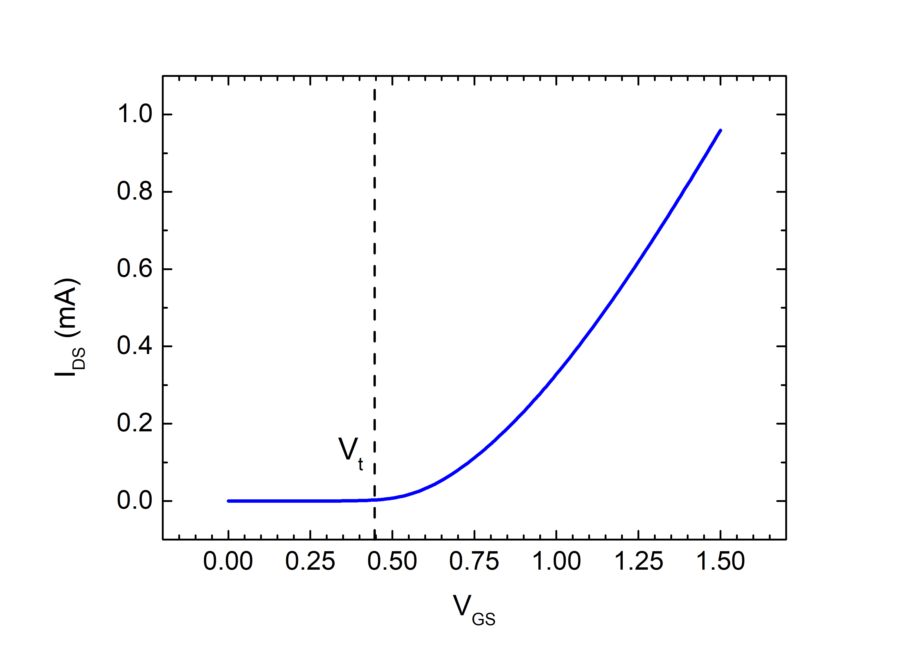
Operating zones on the basis of V_{GS}-V_{t}
A rough picture:
V_{DS}>V_{DSAT}
V_{GS}<V_{t}
V_{GS}>V_{t}
off
on

Slide 14
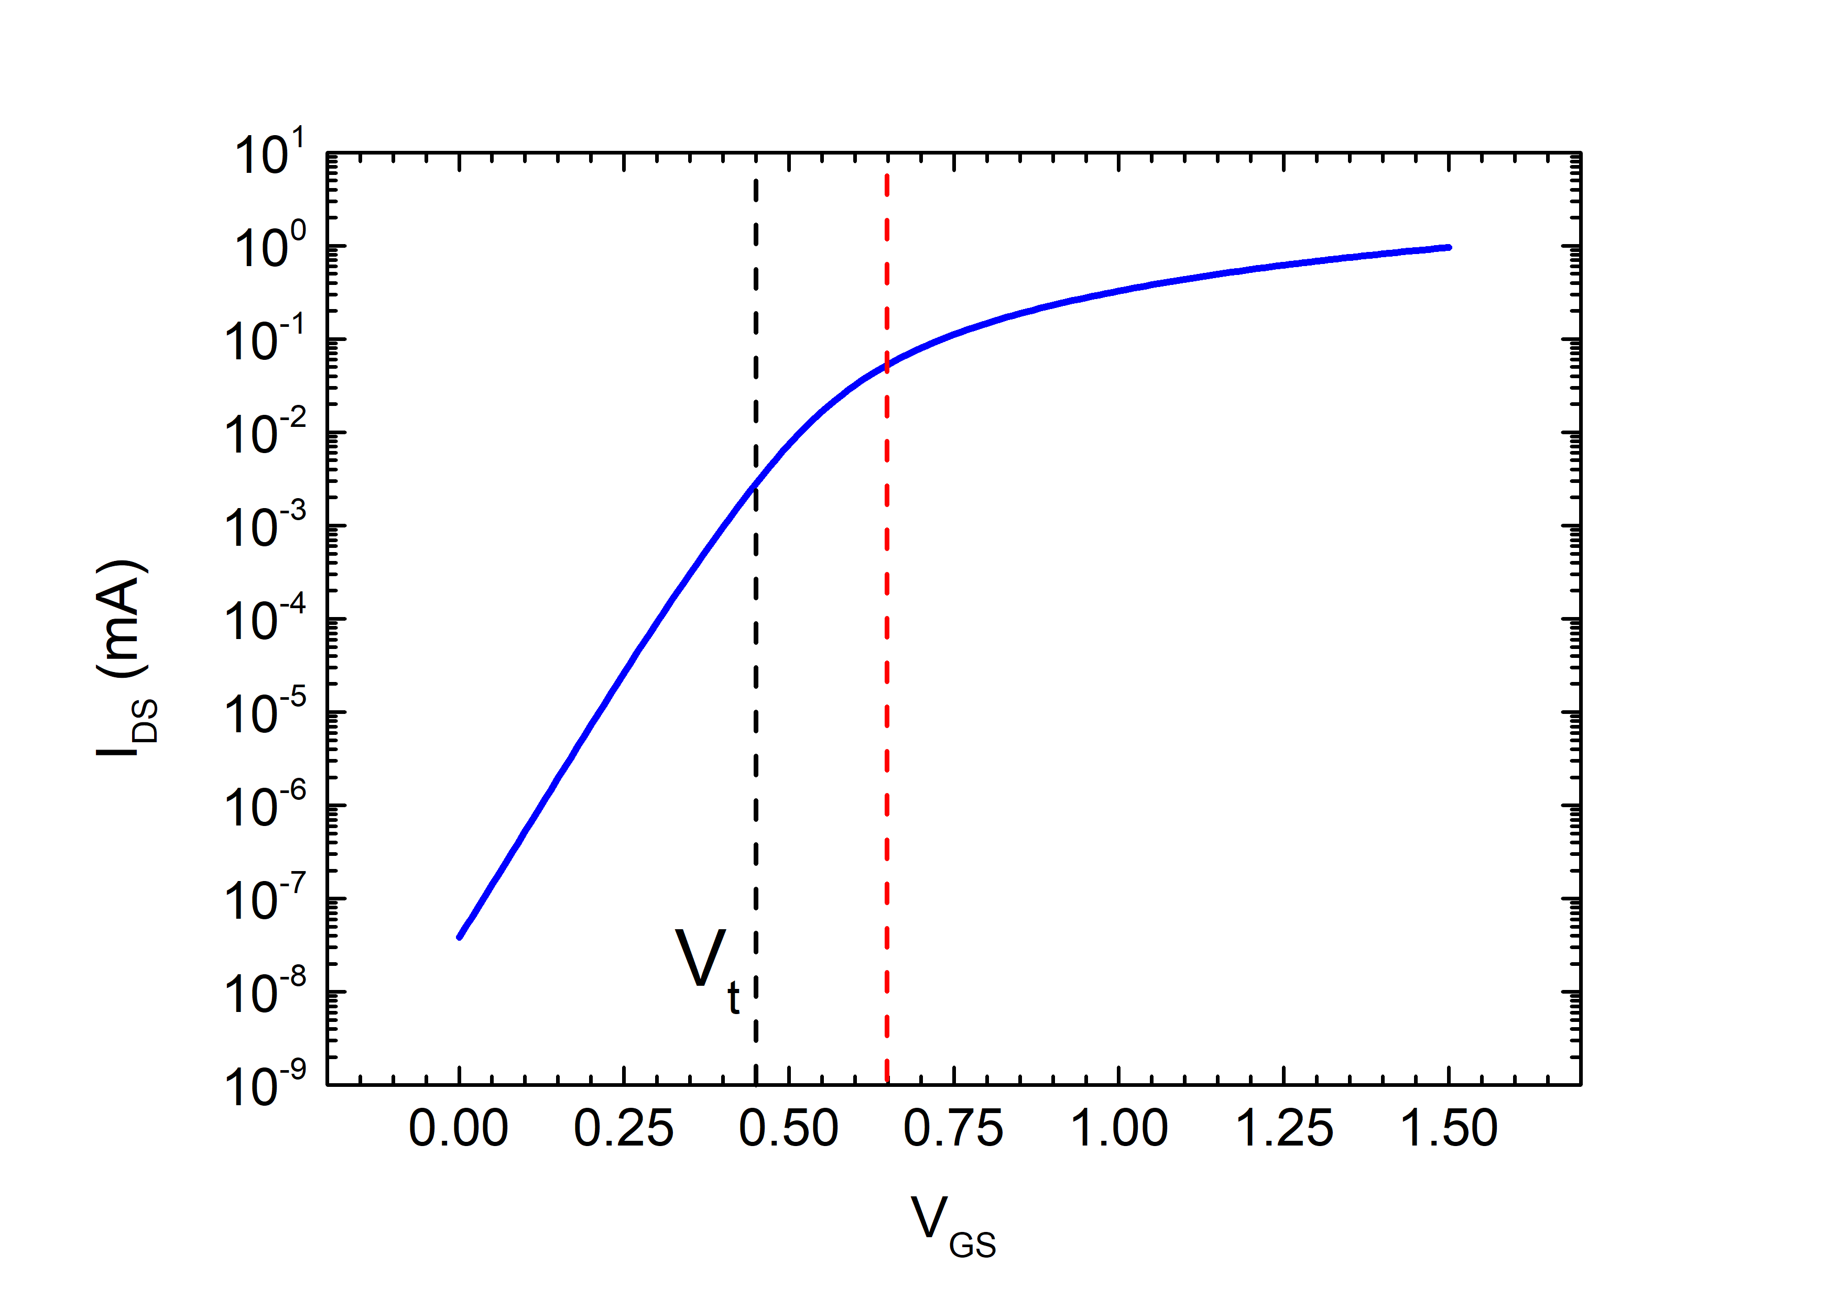
A more gradual picture: same characteristic with logarithmic y-axis
weak inversion
(sub-threshold)
moderate inversion
stong
inversion
V_{T}=kT/q
V_{t}+4V_{T}

Slide 15
I_{DS}: operating zones
 | V_{GS} -V_{t} ≤ 0 | 0 ≤ V_{GS} -V_{t} ≤ 4V_{T} | V_{GS} -V_{t} ≥ 4V_{T}
V_{DS} ≤ V_{DSAT} | Triode – Weak Inversion | Triode – Moderate Inversion | Triode – Strong Inversion
V_{DS} ≥ V_{DSAT} | Saturation – Weak Inversion | Saturation – Moderate Inversion | Saturation – Strong Inversion

Slide 16
V_{GS}-V_{t}>4V_{T} Strong inversion: I_{DS} equations
V_{DS} ≤ V_{DSAT} (Triode)
V_{DS} ≥ V_{DSAT} (Saturation)
In some textbooks this term is omitted (V_{DSAT}) for simplicity, but this cause a discontinuity between the triode and saturation region

Slide 17
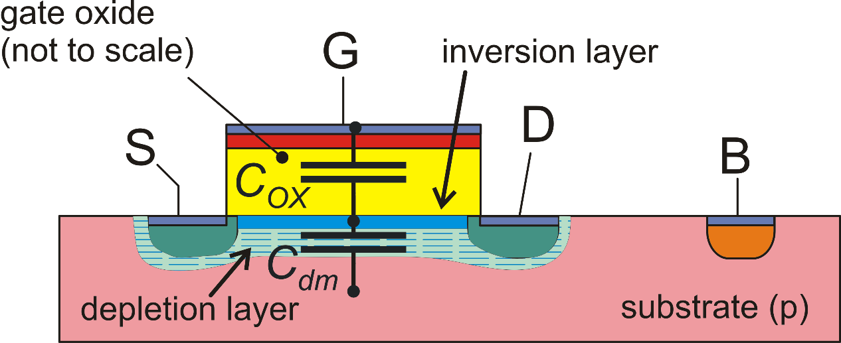
I_{DS} simplified model in weak inversion
m: subthreshold slope factor

Slide 18
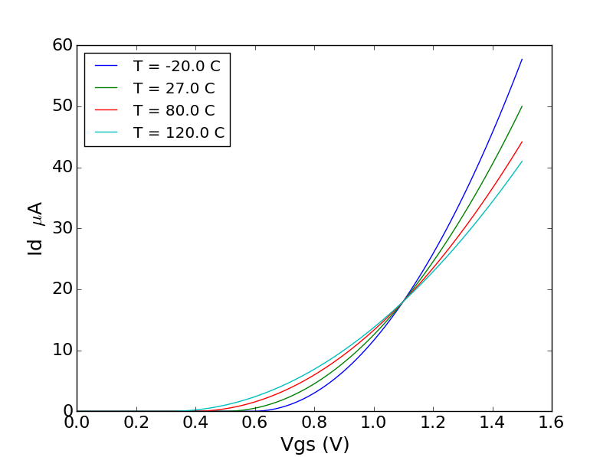
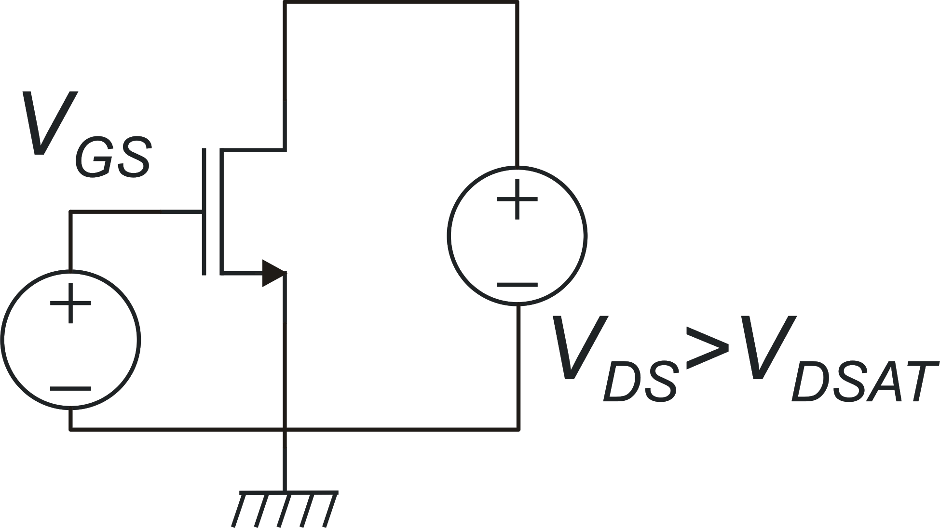
Temperature effects on MOSFET characteristics
Vt dominates
(I_{D} increases with T)
ZTC point
β dominates
(I_{D} decreases with T)

Slide 19
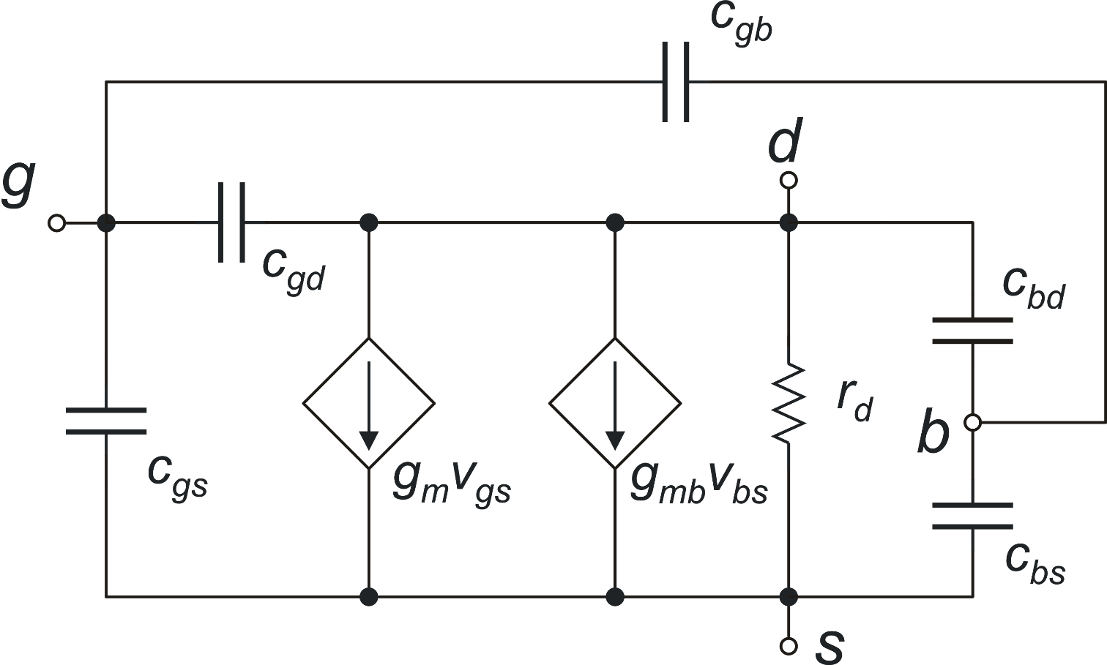
MOSFET Small Signal model
c_{gs}, c_{gd}, c_{gb}, c_{bd}, c_{bs} : small signal capacitances
Let's start from the dc model (capacitances are removed)
effect of v_{bs}

Slide 20
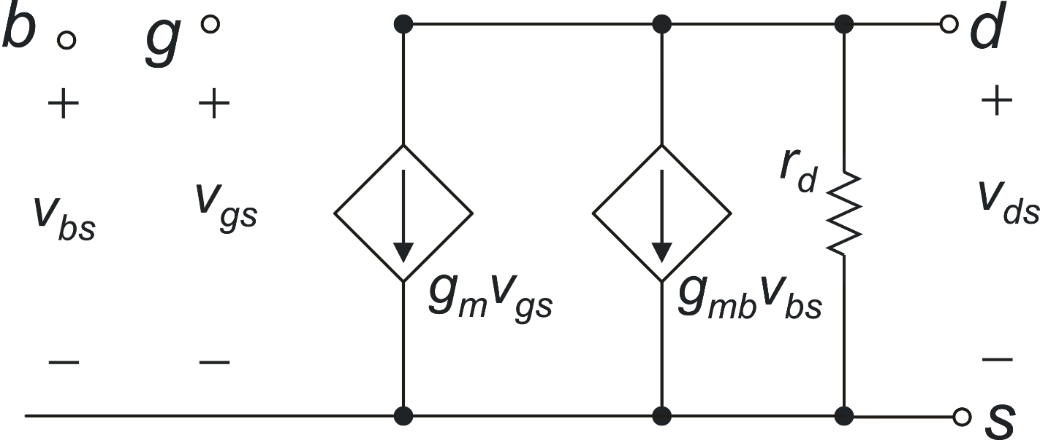
MOSFET small signal model: dc limit
small signal

Slide 21
Body transconductance: g_{mb}
_{let's recall the gm definition}
1
g_{m}
g_{mb}

Slide 22
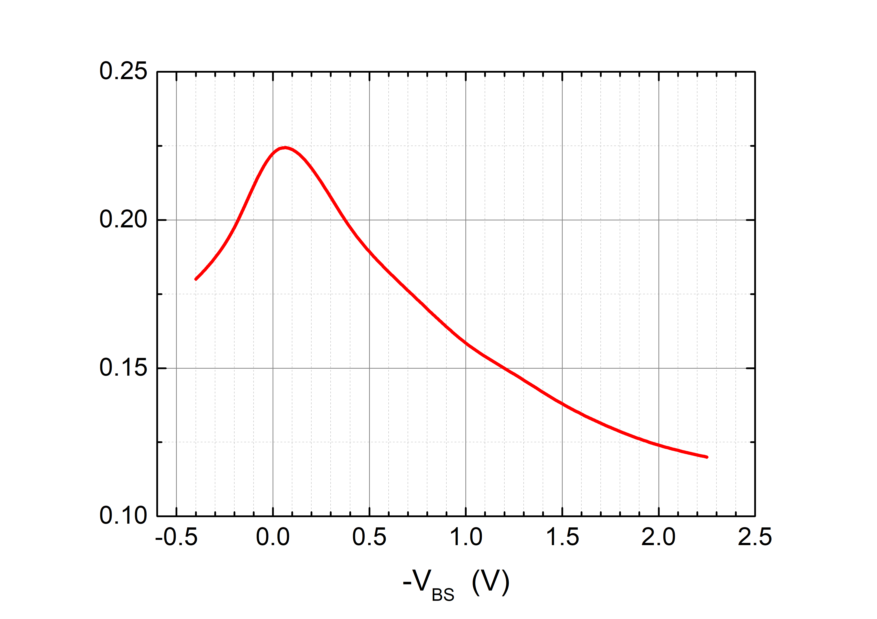
Body transconductance: g_{mb}
Example from simulation
m ~ 1.2 g_{mb} ~ 0.2g_{m}

Slide 23
g_{m}, g_{d} in strong inversion
Triode region
g_{m}
g_{d}

Slide 24
g_{m}, g_{d} in strong inversion
Saturation region
neglecting the dependence of V_{DSAT} on V_{GS}

Slide 25
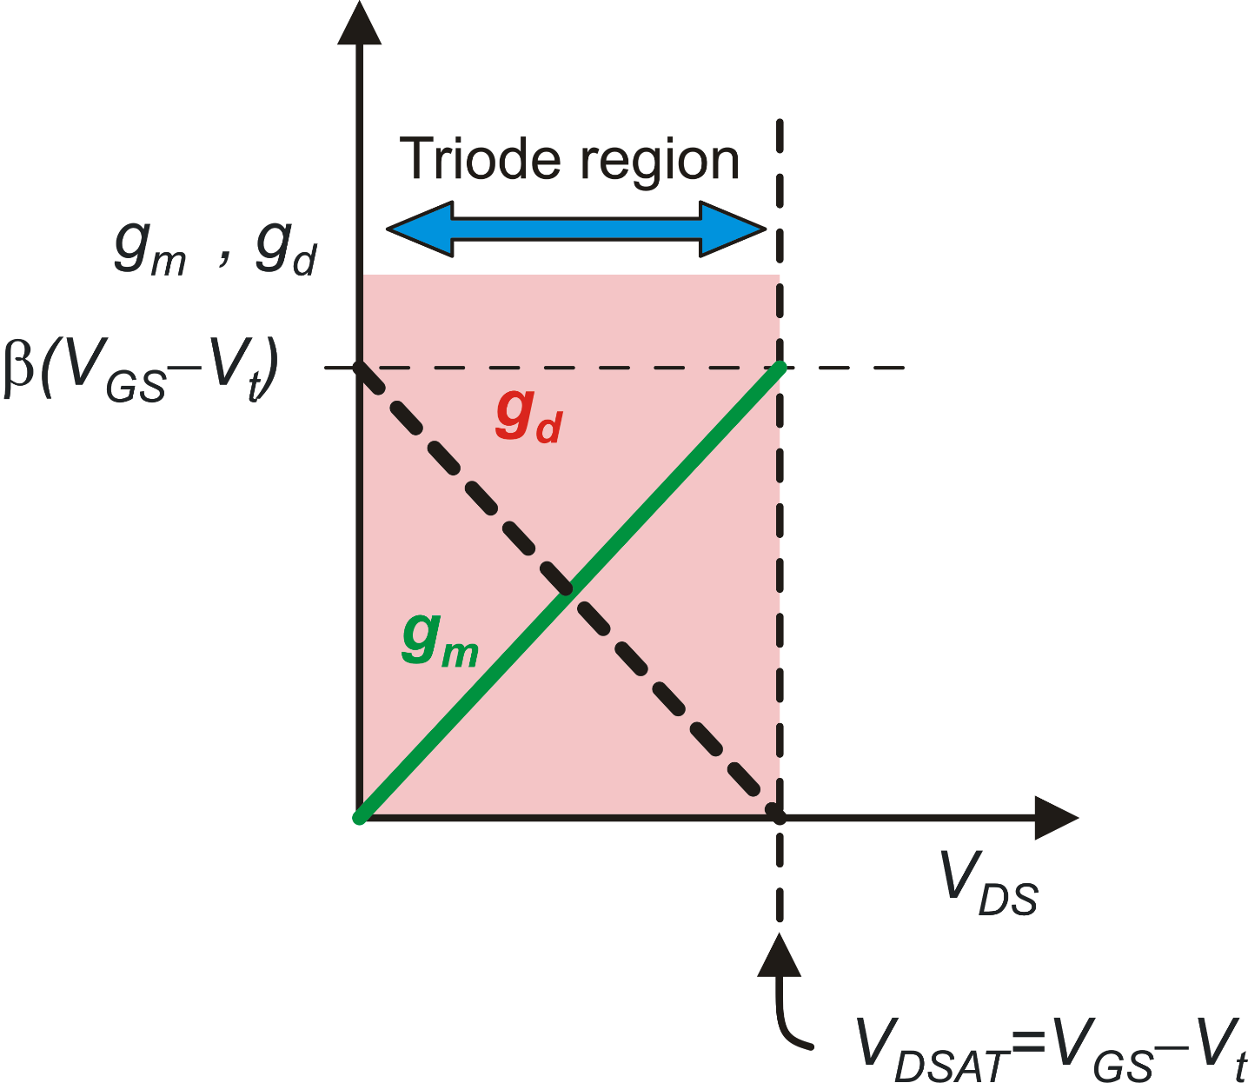
g_{m}, g_{d} in strong inversion

Slide 26
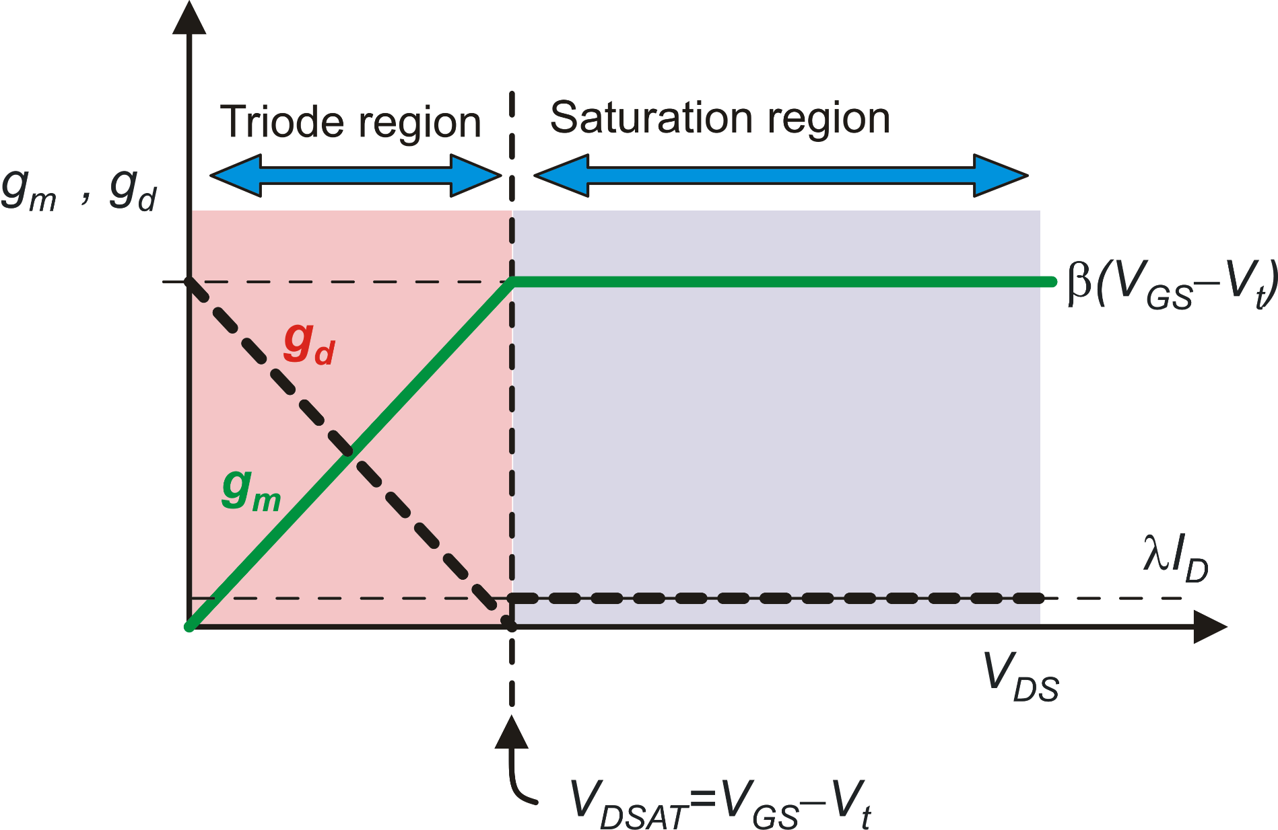
g_{m}, g_{d} in strong inversion
Important parameter
for MOSFETs:

Slide 27
Transconductance models in saturation
acceptable approximation, because we are studying gm, i.e the effect of V_{GS}
In strong Inversion:
only a few %
!!!

Slide 28
g_{m},g_{d} in weak inversion
Exact result

Slide 29
g_{m},g_{d} in weak inversion
I_{D}
g_{m}
g_{d}
g_{m}
In saturation:
g_{d}
V_{DSAT}
V_{D}
V_{DSAT}
V_{D}

Slide 30
g_{m}, g_{d} everywhere: simulations
Strong inversion
V_{GS}-V_{t}= −100 mV
V_{GS}-V_{t}= 200 mV
V_{GS}-V_{t}=0

Slide 31
Unified model for transconductance in saturation
Strong Inversion
Important parameter for analog circuit design
Weak Inversion
Strong inversion
with
Weak inversion
BJT
Definition of V_{TE}
BJT

Slide 32
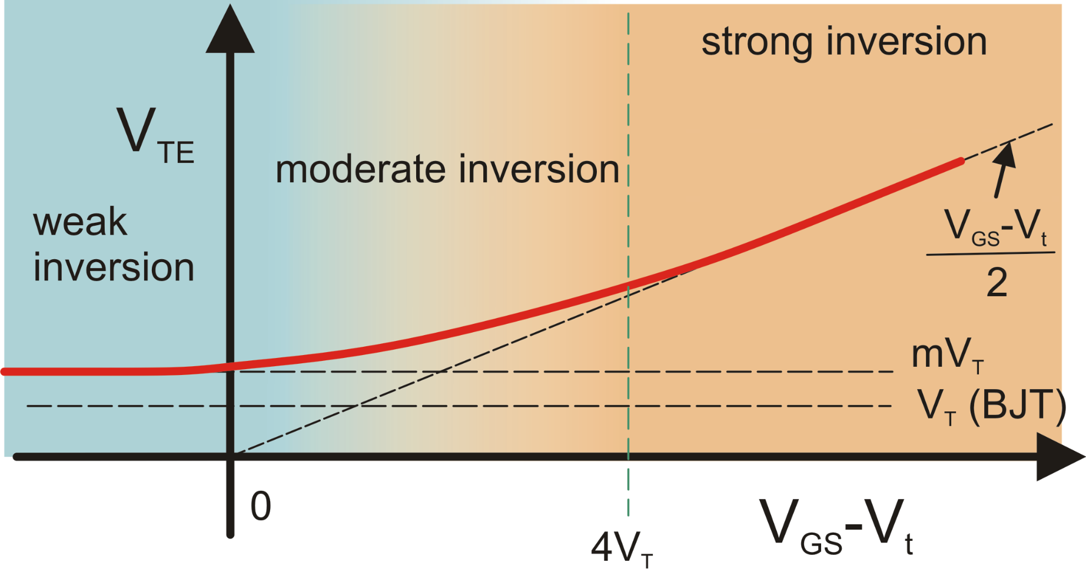
Effective Thermal Voltage: V_{TE}
The smaller the V_{TE}, the higher the g_{m} that can be obtained with a given I_{D}

Slide 33

MOSFET Capacitance Model: gate related capacitances
estrinsic cap.
intrinsic cap..

Slide 34
Estrinsic Capacitances
S
D
W
Localization of extrinsic
capacitances: along the
borders of the gate
G
L

Slide 35
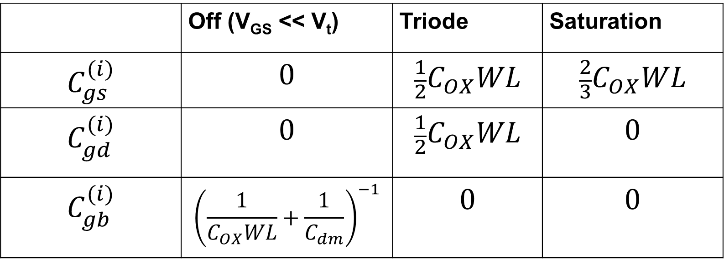
Intrinsic capacitances: The Meyer Model
 | Off (V_{GS} << V_{t}) | Triode | Saturation
$$C_{gs}^{(i)}$$ | $$0$$ | $${\frac{1}{2}C}_{OX}WL$$ | $${\frac{2}{3}C}_{OX}WL$$
$$C_{gd}^{(i)}$$ | $$0$$ | $${\frac{1}{2}C}_{OX}WL$$ | $$0$$
$$C_{gb}^{(i)}$$ | $${\left(\frac{1}{C_{OX}WL}+\frac{1}{C_{dm}}\right)}^{−1}$$ | $$0$$ | $$0$$
Series of the oxide and depletion layer capacitances. Can be approximated with only the oxide cap C_{OX}WL

Slide 36

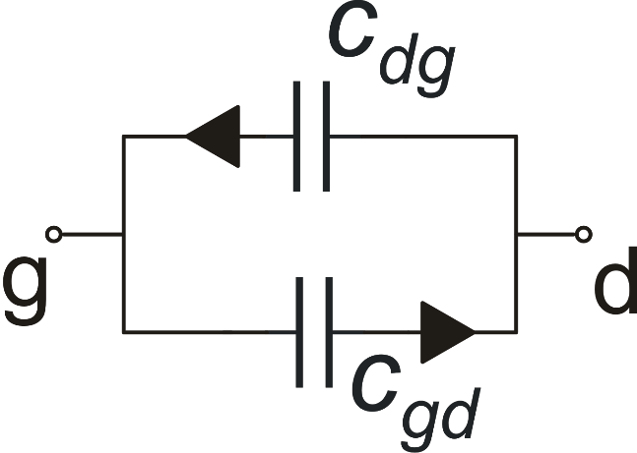
Charge oriented models (Dutton and Ward model)
Limits of the Meyer Model:
Does not guarantee charge conservation
Capacitances are reciprocal
Important errors in circuits
using MOSFETs as
switches.
Dutt and Ward model
Array of 9 capacitances
Cij are < 0 for i≠j (trans-capacitances)
Cij are > 0 for i=j (self capacitances)
Generally: Cij ≠ Cji
V_{G}
Q_{G}
Q_{S}
Q_{D}
V_{S}
V_{D}
V_{B}=0

Slide 37
Junction capacitances
W
S
D
G
L_{C}

Slide 38
Other non-idealities of the MOSFET behaviour
Gate-bias dependent mobility
μC_{ox} depends on V_{GS} (decreases at high V_{GS})
(all devices)
Carrier velocity saturation
I_{D} dependence on V_{GS} in strong inversion
tends to become linear (instead of quadratic)
(Short channel devices). Again, appears as
a reduction of the μC_{ox} at high V_{GS}
Gate current
May be due to tunneling (all devices)
or hot electrons - hot holes (Short channel devices)

Slide 39
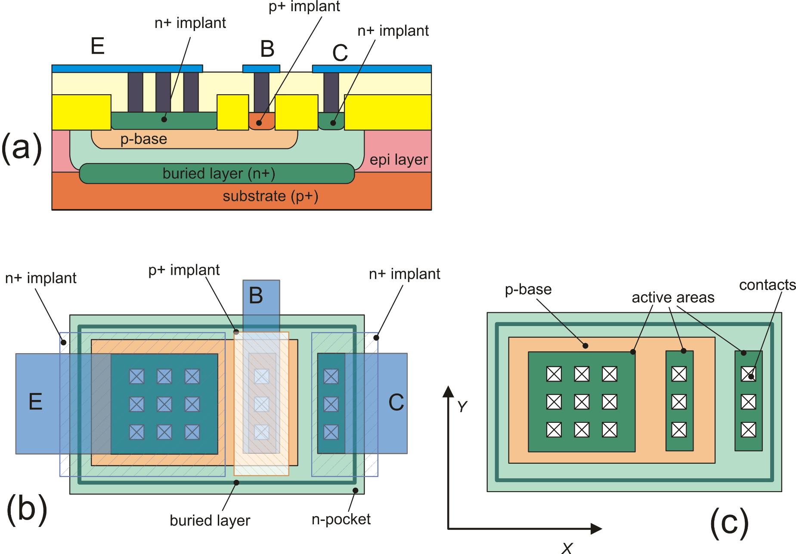
BJTs in integrated circuits: Vertical NPN
buried-L
p-base
BiCMOS: CMOS + p-base and buried-layer
The n-pocket can be an n-well
The buried-layer a buried-well of a triple-well CMOS
A diode between collector and
substrate is present capacitance
p-base
buried-L
Same as (b) but with the
Metal 1 removed

Slide 40
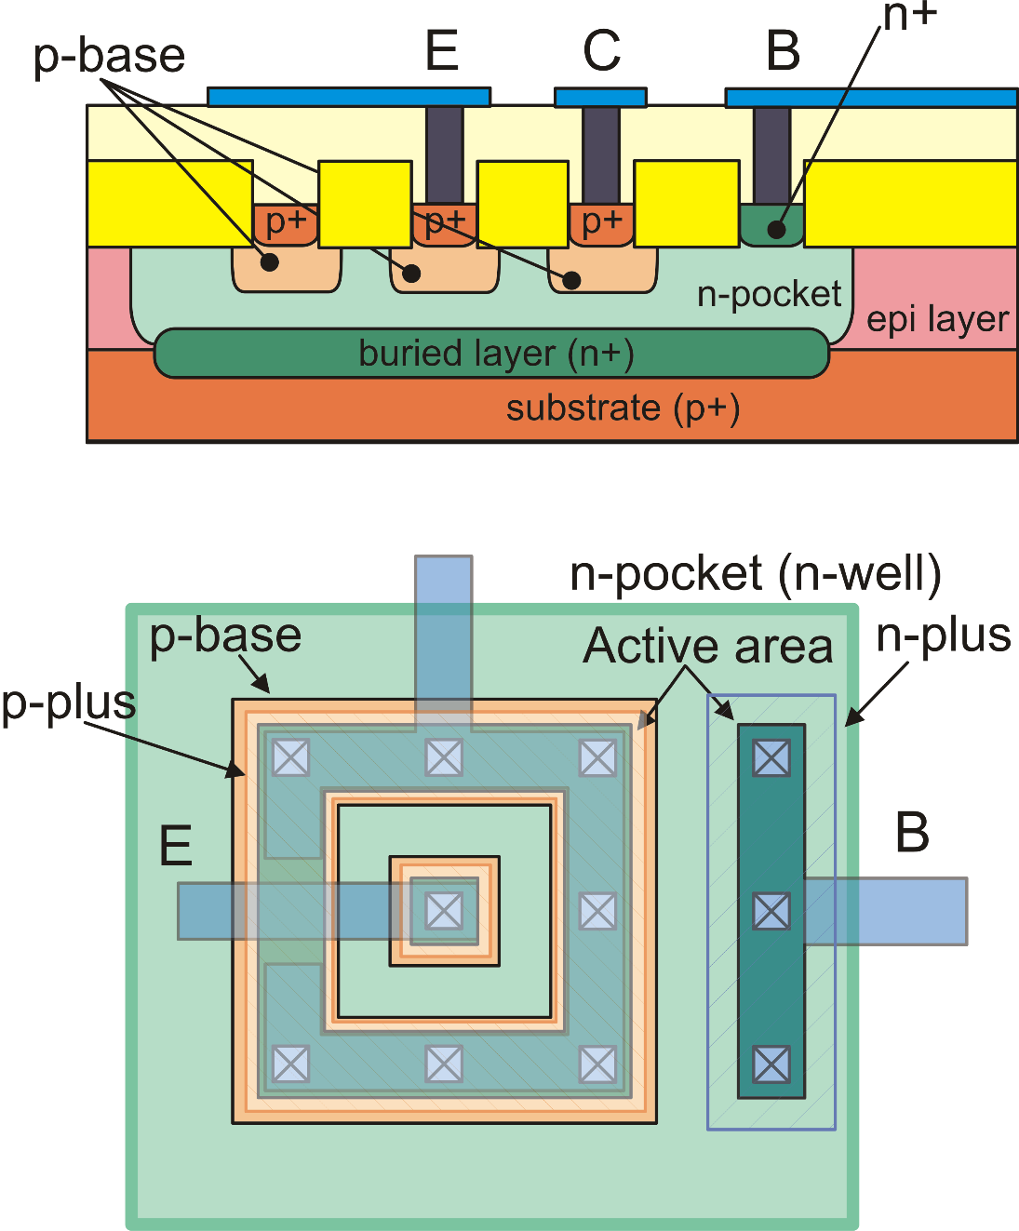
The lateral PNP
Slower than vertical devices due to
large base series resistance (r_{bb'})
and base-to substrate capacitance
Lower early voltage (V_{A}), due to
non-optimal collector doping.
Larger than vertical devices for the same
current capability

Slide 41
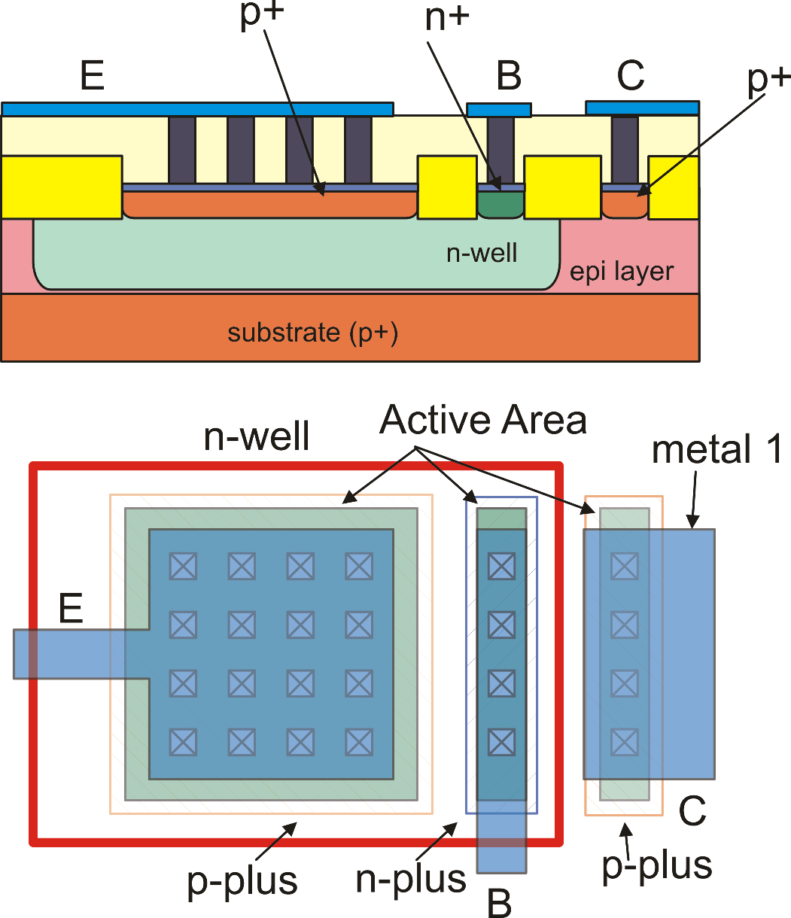
The substrate PNP: compatible with standard CMOS n-well processes
Limitation: The collector is
committed to the substrate,
(forced to V_{SS})

Slide 42
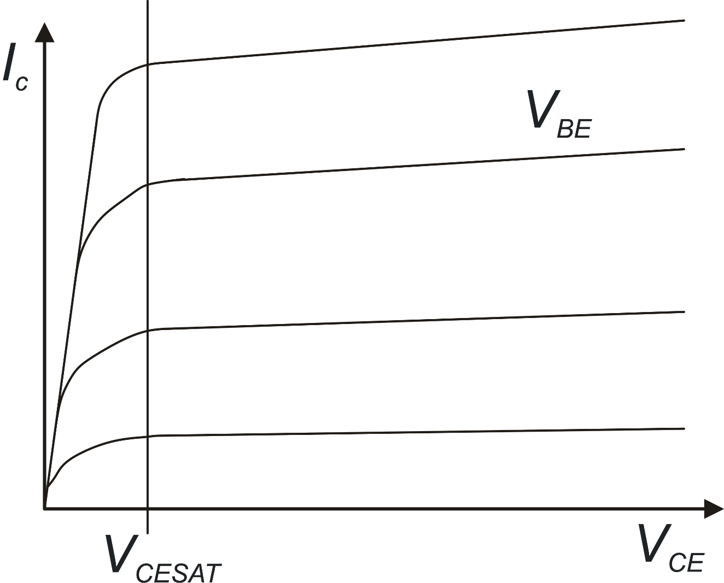
BJT output characteristics
Saturation
Forward Active Region
V_{BE}, V_{CE} : control
voltages
I_{C}, I_{B}: dependent
currents

Slide 43
BJT model in the forward active zone
Sometimes this expression is used
in order to refer to V_{BE} and V_{CE} as
control voltages:
For calculation of I_{C} and I_{B} in all operating zones (saturation, cut-off,
forward active, reverse active) the Ebers-Moll model should be used.

Slide 44
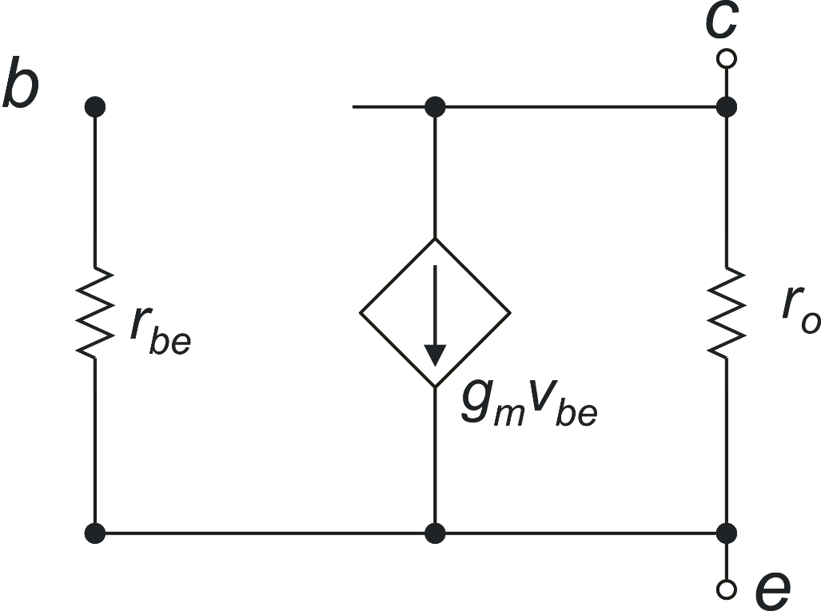
BJT: small signal model
Small signal dc model
Equivalence with the MOSFET parameters
BJT
MOSFET

Slide 45
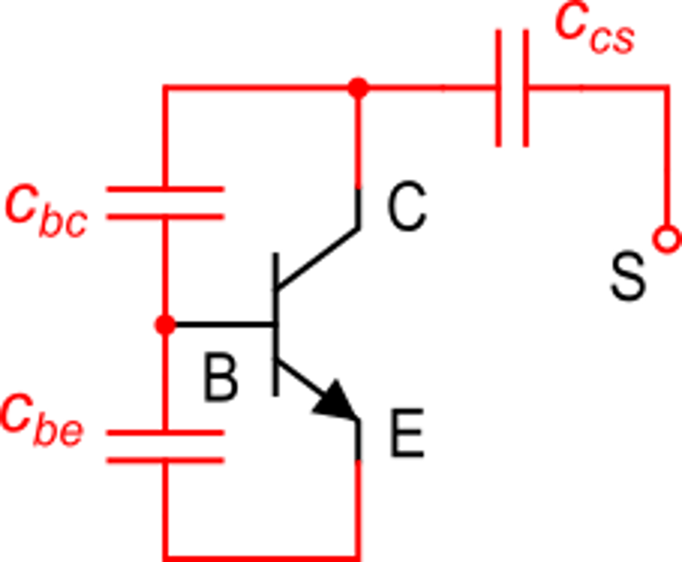
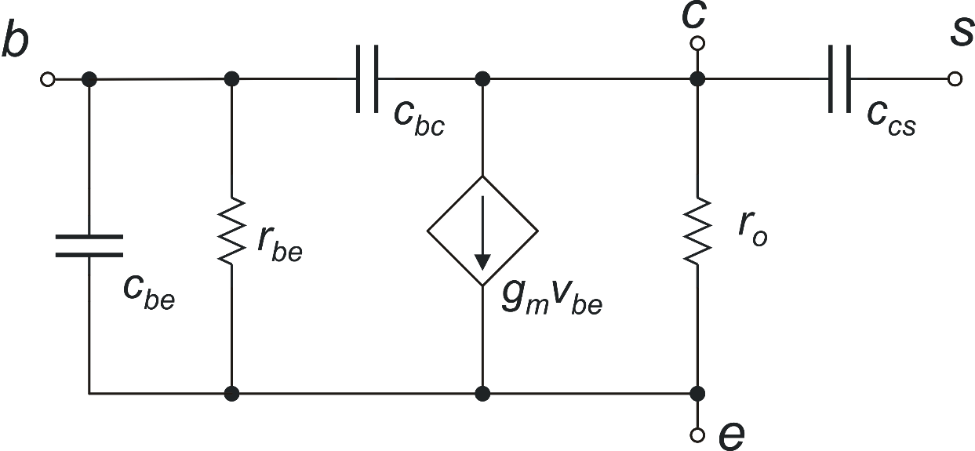
BJT capacitances in forward active region (vertical npn)
Transition frequency

Slide 46
BJTs in Integrated Circuit: instance parameters
area
area
minimum size BJT
("elemental" BJT)
area=1.5
area may not be an
integer (not all PDKs
allow this)
parameter "area"
(dimensionless)
area=2 (,3, 4 ….)
area = integer

Slide 47
BJT sizing: Effect of the area parameter on the electrical parameters
Electrical effects of area parameter:
elemental BJT
elemental BJT with area
specified as an instance parameter
I_{S}
V_{A}
β
C_{JE}
…..
area × I_{S}
V_{A}
β
area × C_{JE}
…..

Slide 48
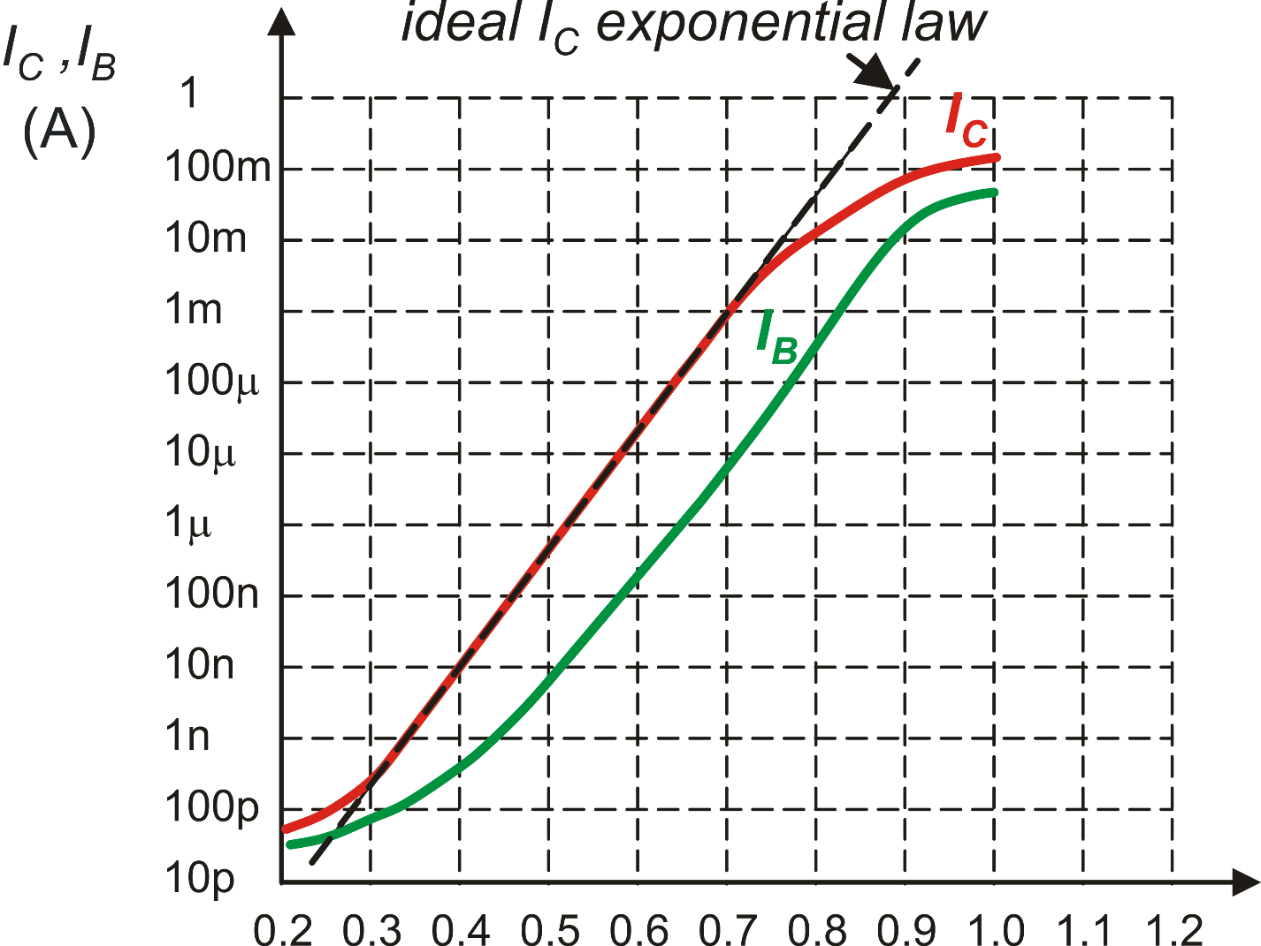
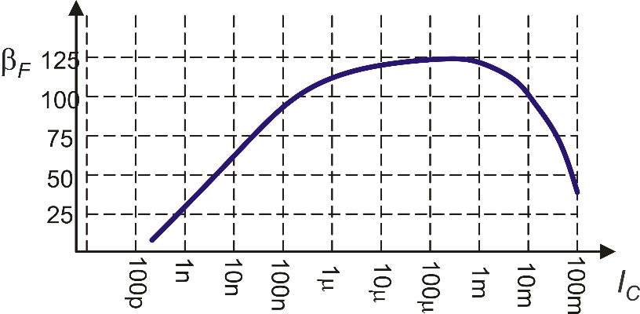
BJT sizing: Gummel plot and beta plot
My BJT has to carry this current
(200 mA). The elemental BJT would
be damaged
Using a BJT with area=100 would be
equivalent to make the elemental BJT
work with a current 100 times smaller.
This corresponds to the operating point
given by the blue line
β
β
This refers to the
elemental BJT (area=1)
I_{C}
V_{BE}
Gummel Plot
Beta Plot

