Slide 1
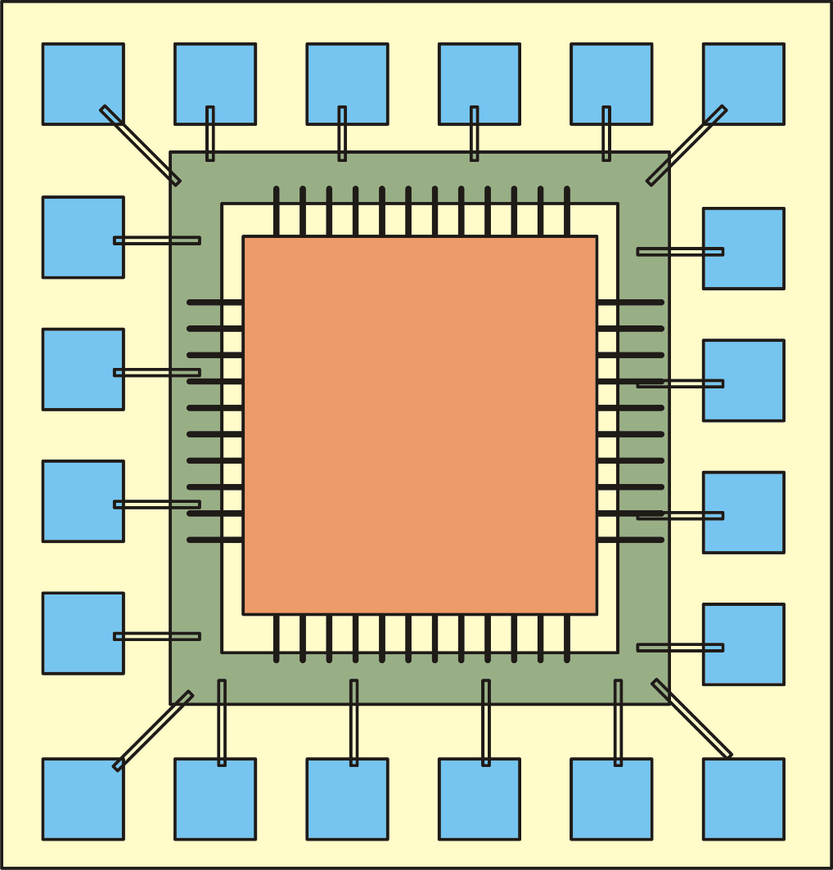
Typical structure of a digital chip
Pad Frame
I/O circuits
Core (o internal) logic

Slide 2
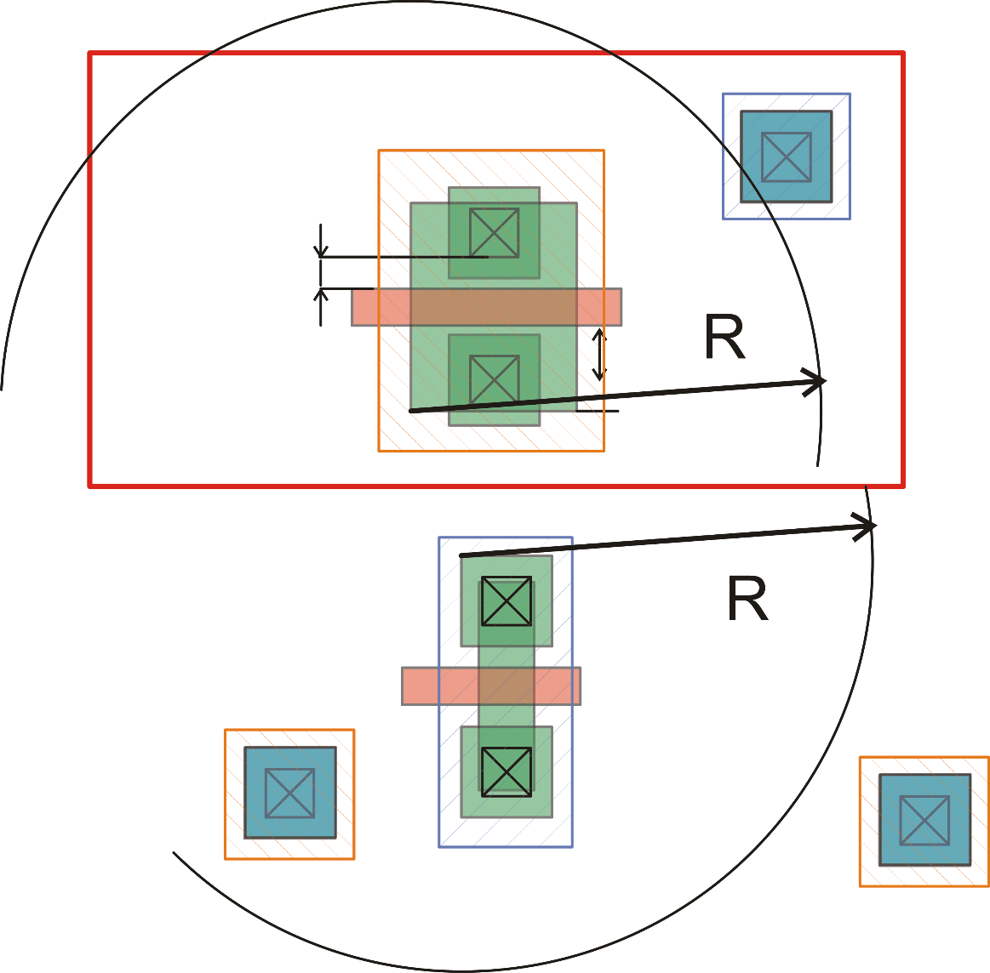
Latch-up layout rules: core logic
Every part of a p-active area in an n-well must "see" at least one well-tap with a maximum distance R
Every part of an n-active area in the substrate (p-well) must "see" at least one substrate-tap with a maximum distance R

Slide 3
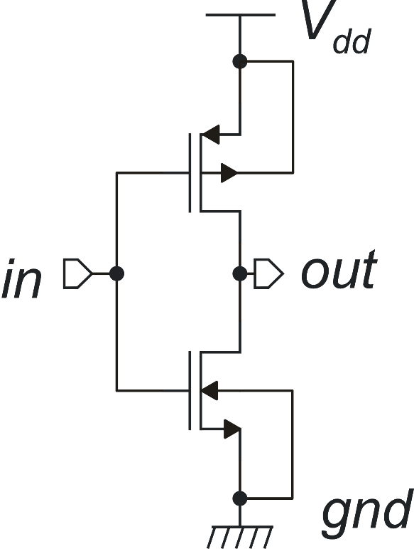
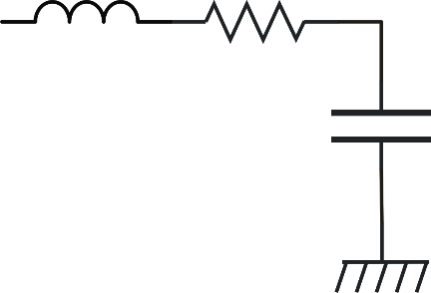
I/O circuits: over-voltage risk
Real case
possible load / transmission
line equivalent circuit
Ideal case
Vout
Vdd
I/O pad
gnd
In I/O circuits, the output termination can exceed the Vdd or
gnd rails. This introduces additional risk of latch-up

Slide 4
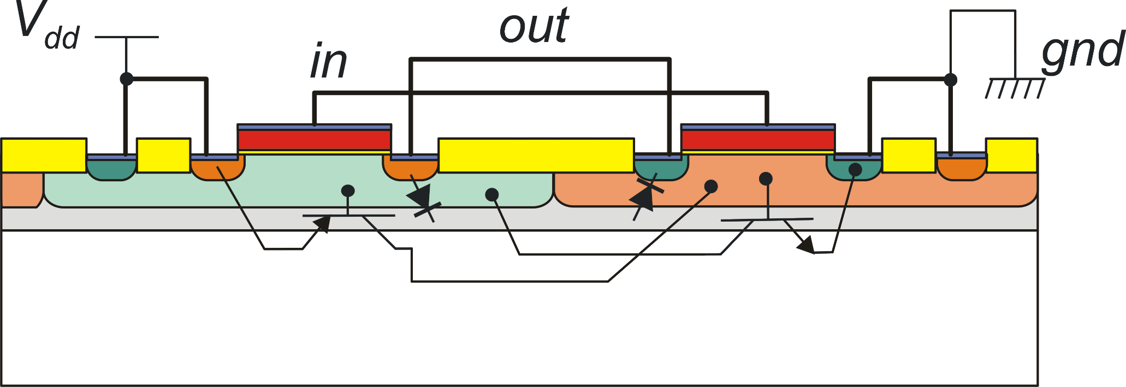
Injection of minority carriers
when Vout exceeds Vdd,
this diode is turned on
when Vout drops below gnd,
this diode is turned on
Well: bases of the pnp BJT (collector of npn BJT)
Substrate: bases of the npn BJT (collector of pnp BJT)

Slide 5
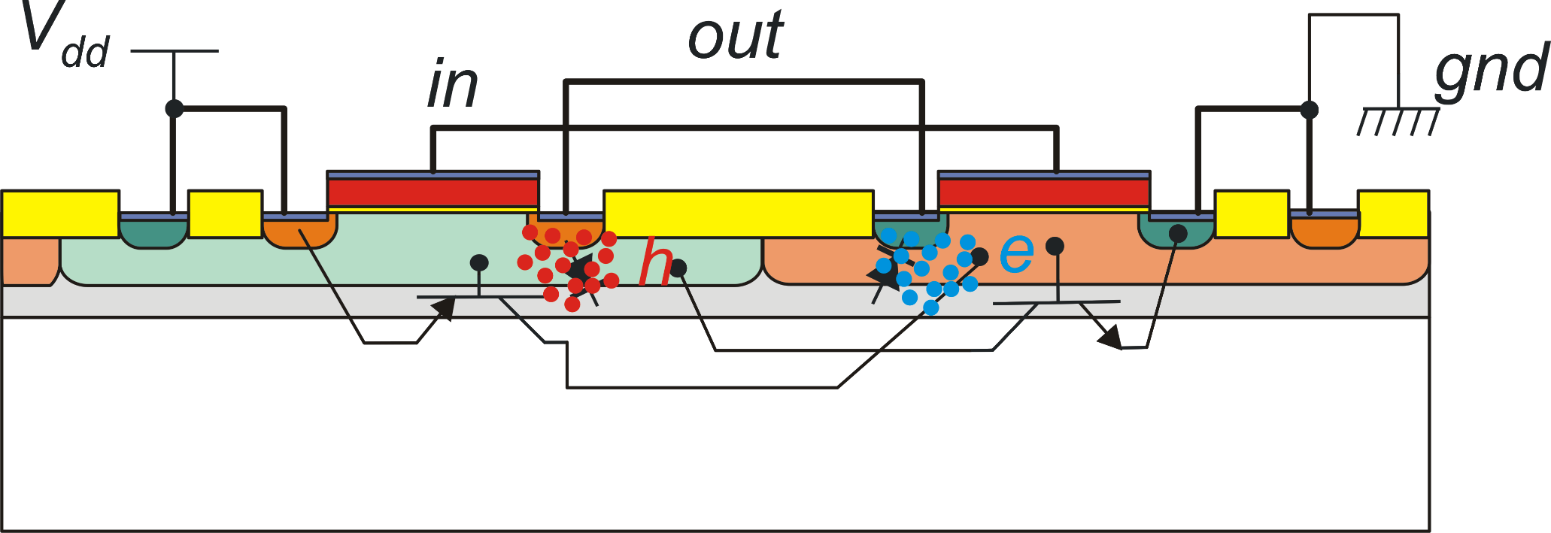
Injection of minority carriers
Injection of minority charge carriers into the parasitic BJTs bases may trigger the latch-up phenomenon
Hole injection into the n-well
when V_{out} > V_{dd}
Electron injection into the substrate when V_{out}< 0

Slide 6
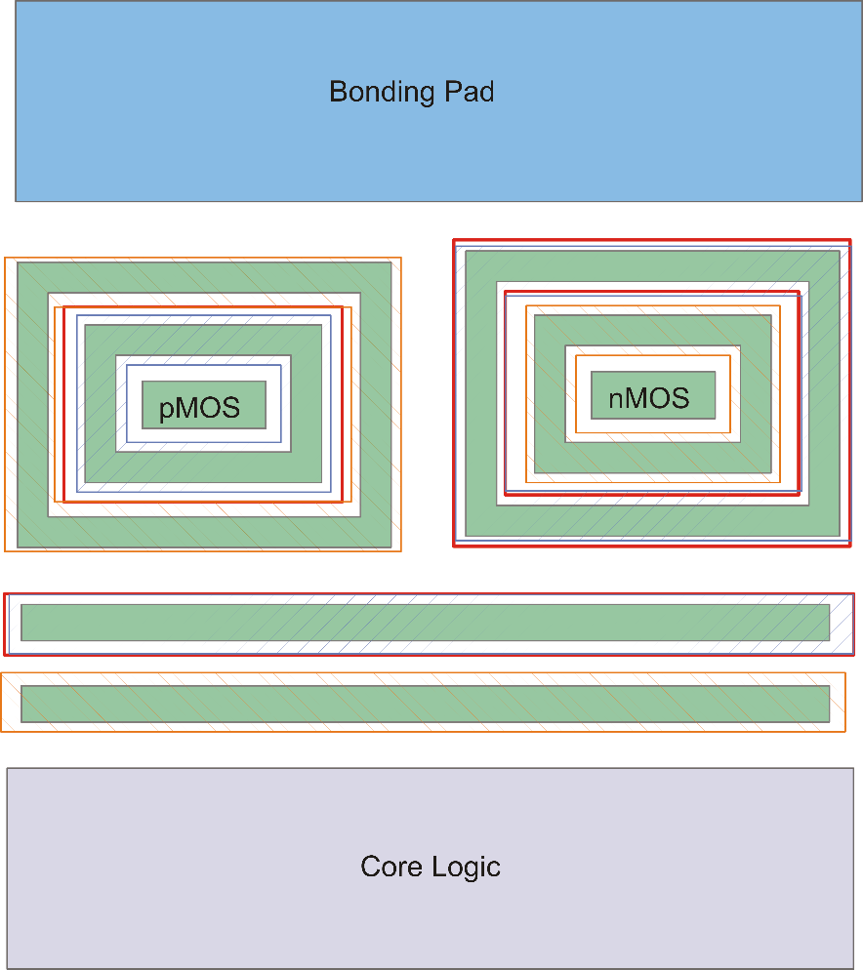
I/O devices: Guard Rings
I/O circuits require additional protection against latch-up
Guard rings are placed around the I/O devices in order to:
Reduce the resistance between drain/body diffusions to gnd (nMOS) or Vdd (pMOS)
Collect most of the minority carriers injected by one device before they reach neighboring devices
p+ (sub-tap)
n-well
I/O devices
n+ (well tap)
p+ (sub. tap)
vdd
gnd
gnd
vdd
vdd
n-well
These guard rings further reduce the
effects of the I/O devices on the core
logic
gnd
p+ (sub. tap)

Slide 7
Analog and mixed signal chips
For the analog section of a System on a Chip, it is not convenient or even impossible to divide the circuit into a core section and an I/O section.
However, the same rules illustrated for digital chips apply to the output devices of the analog cells (for example, operational amplifiers), which are connected to output pads. High density of substrate / well contacts, guard-rings and particular layout configurations are common practice for the output devices of analog circuits.

