Slide 1
Voltage references
Voltage references are used for:
Provide an absolute reference voltage for ADCs and DACs
Provide an absolute reference voltage for stimulating sensors
Create constant bias voltages (and currents) when required

Slide 2
Possible reference voltage sources
Zener Diodes
Problems:
Require additional process steps, but only a small number of components are required for each chip (not convenient)
Available voltages are > 3 V
Temperature stability is poor for V_{Z} ≠ 5-6 V
The reference voltage generated by Zener diodes is noisy
Band-gap circuits

Slide 3
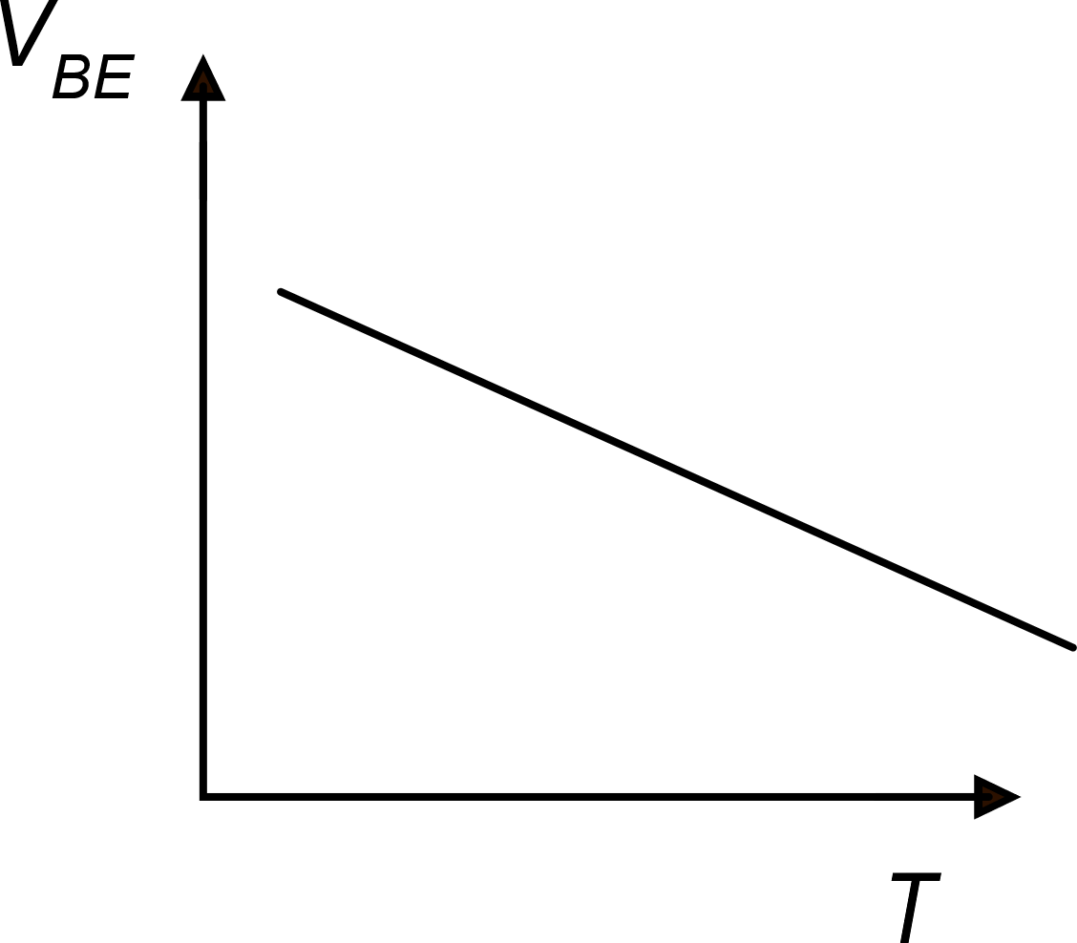
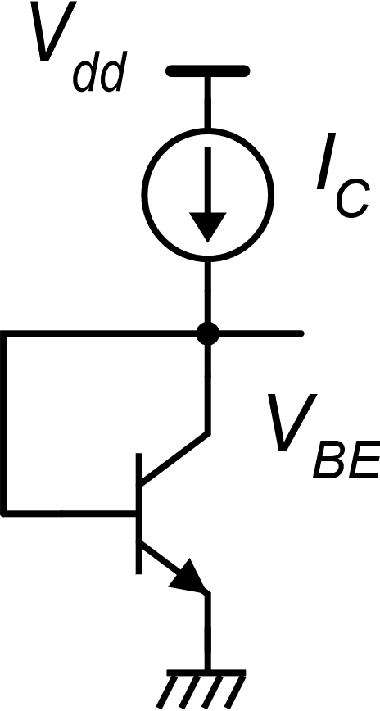
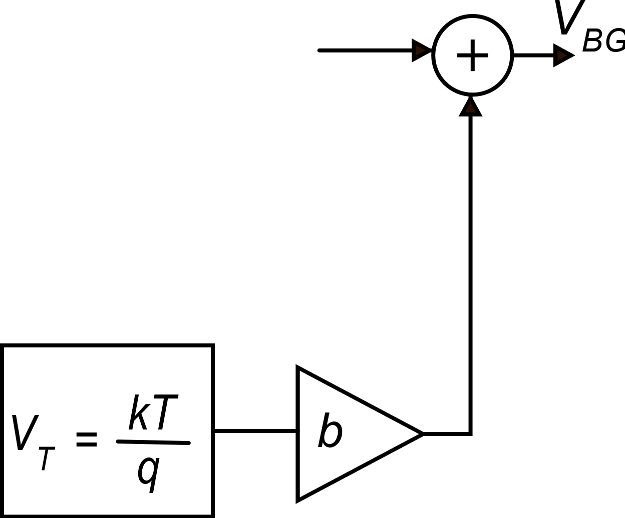
Band-gap voltage reference: principle of operation
V_{BG}
PTAT
CTAT
Complementary To Absolute Temperature
Proportional To Absolute Temperature

Slide 5
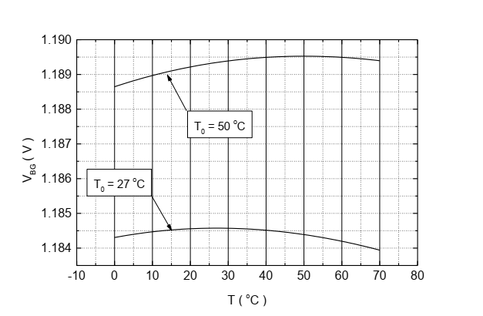

Slide 6
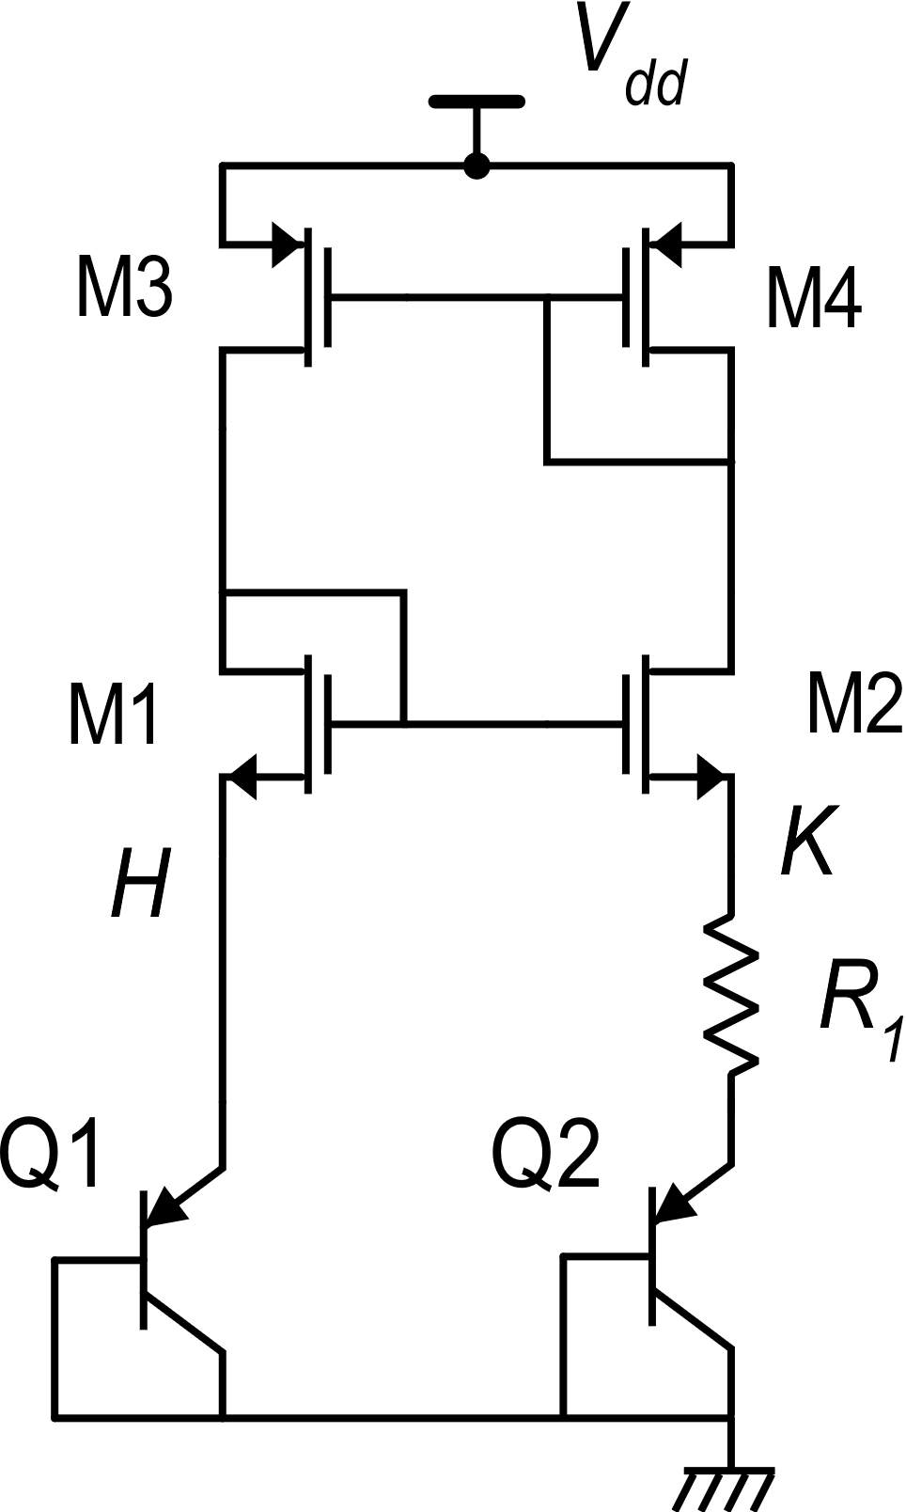
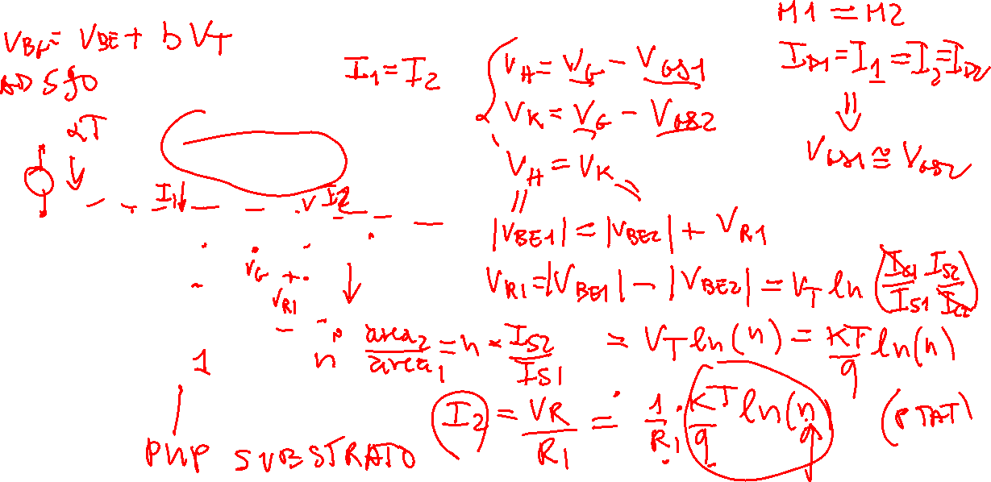
Band-Gap voltage: a Circuit

Slide 7
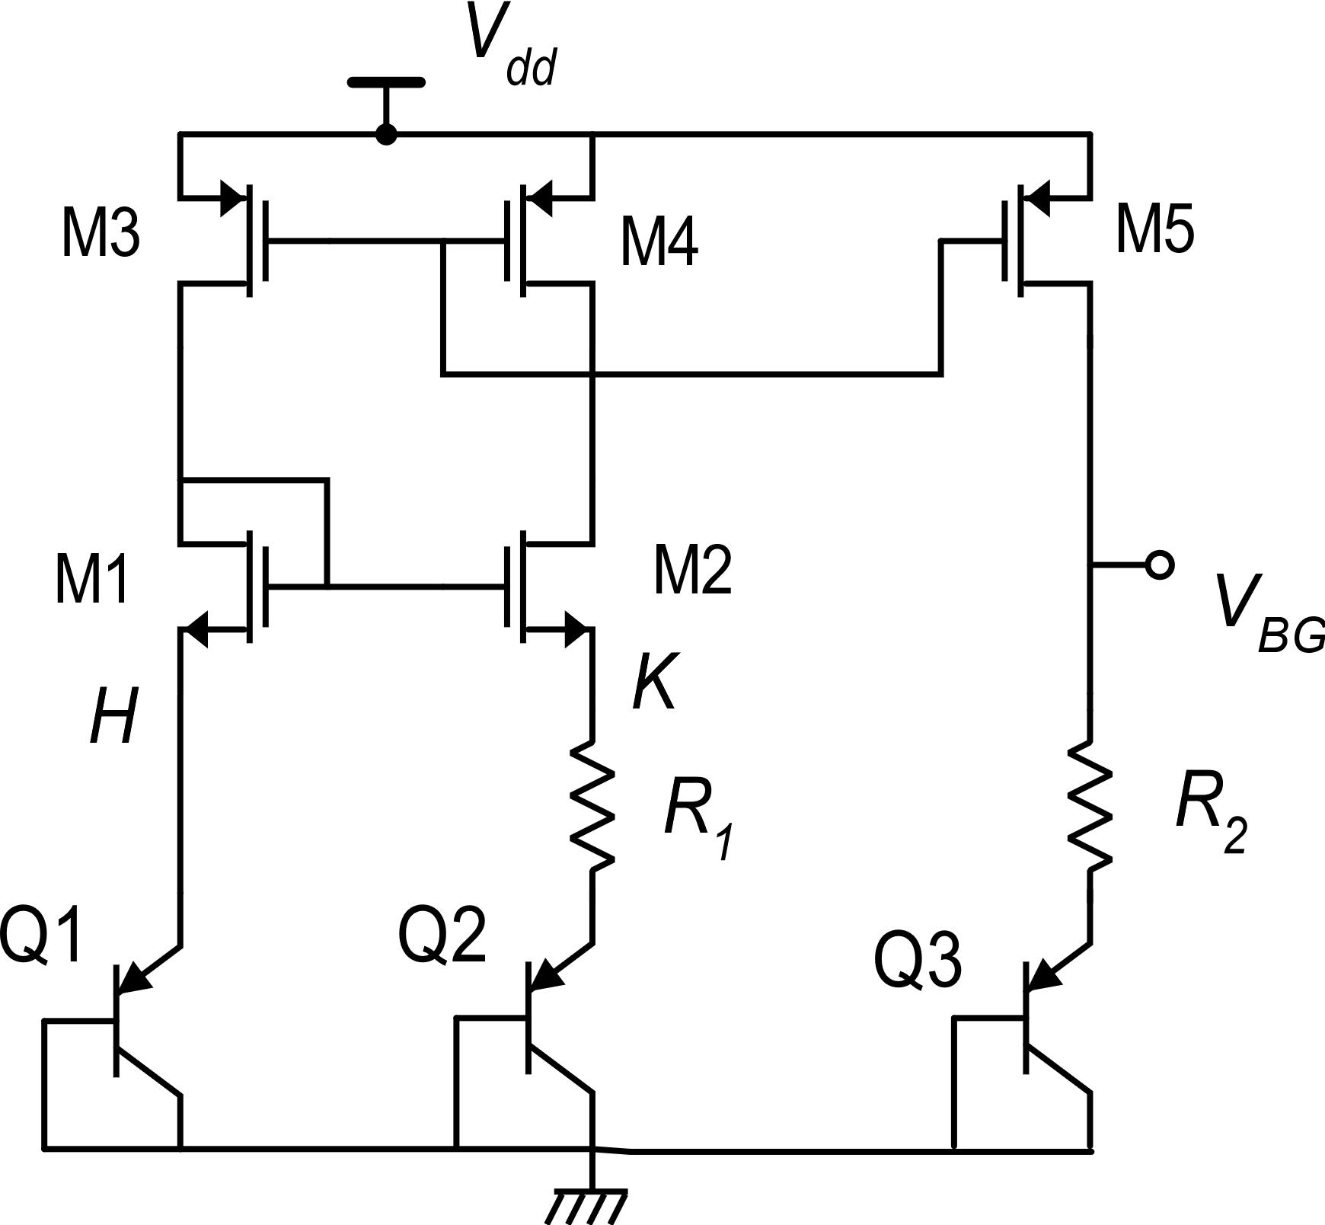
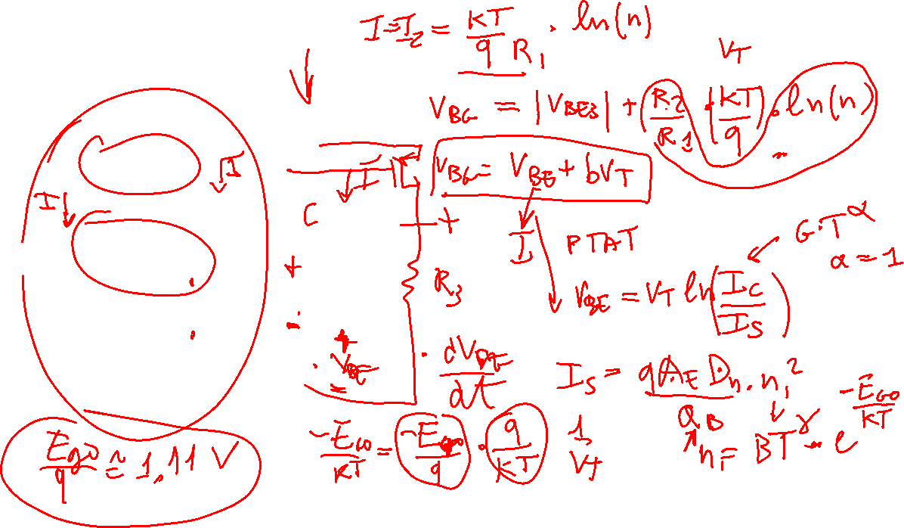

Slide 8
