Slide 1
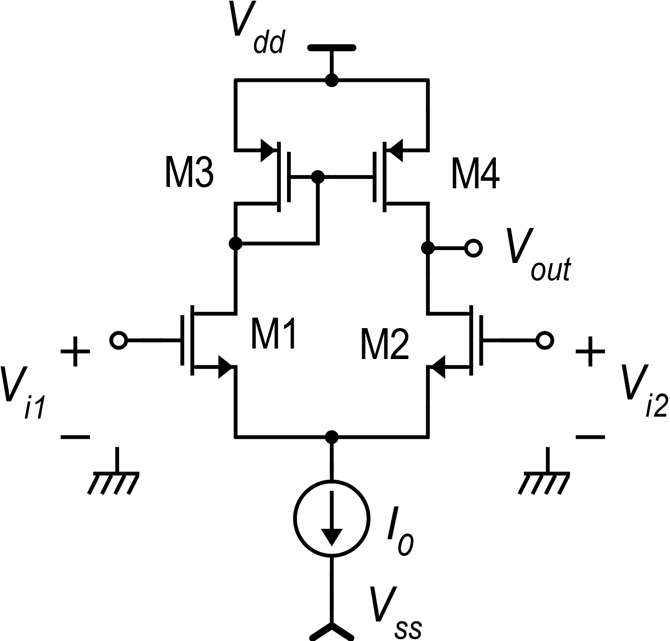
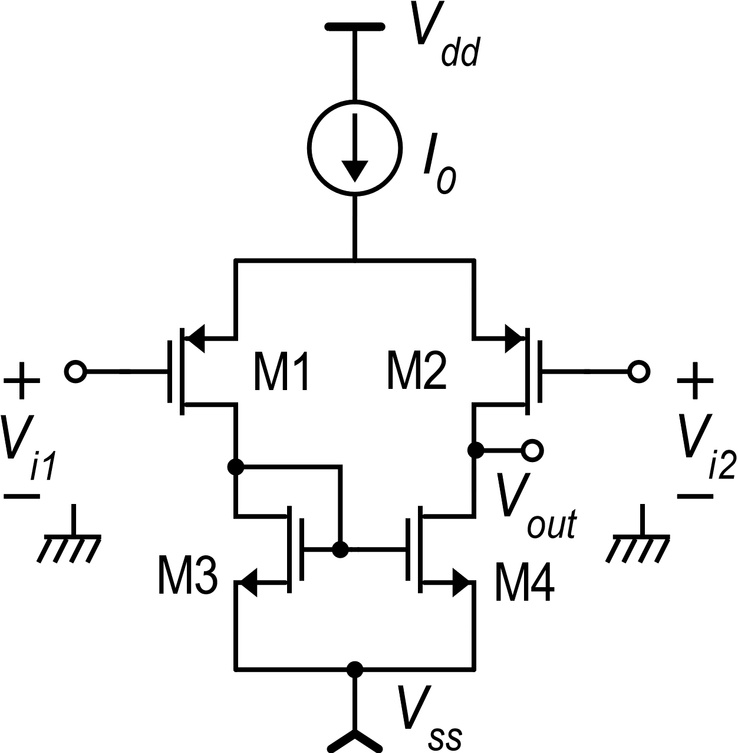
Dual versions of CMOS circuits
Simple differential amplifier with mirror load
Dual (complementary) versions
“n” version
“p” version

Slide 2
Ranges of the «p» version

Slide 3
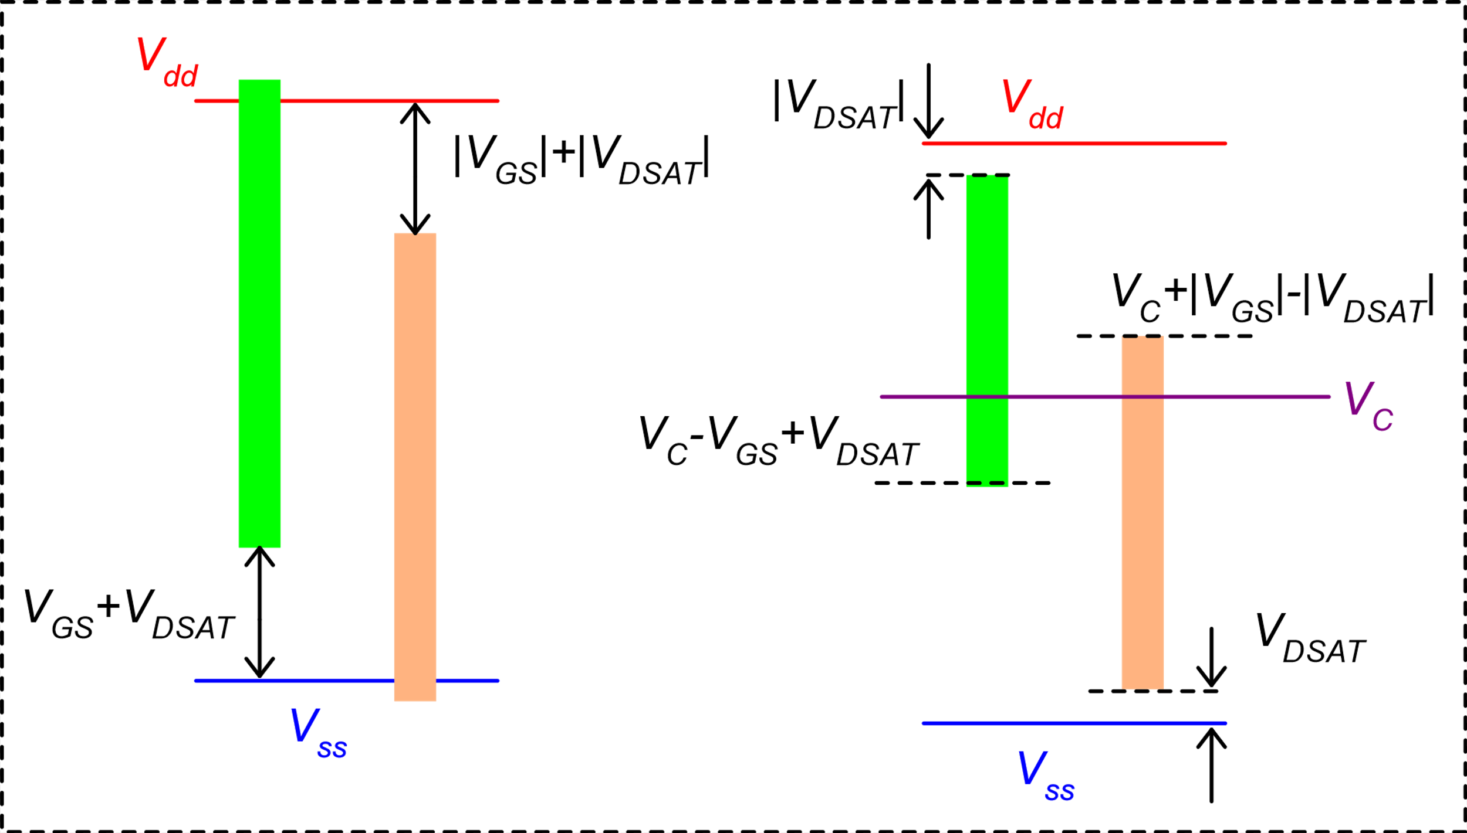
Ranges: graphical representation
Input CM range
Output swing
n-type
n-type
p-type
p-type

Slide 4
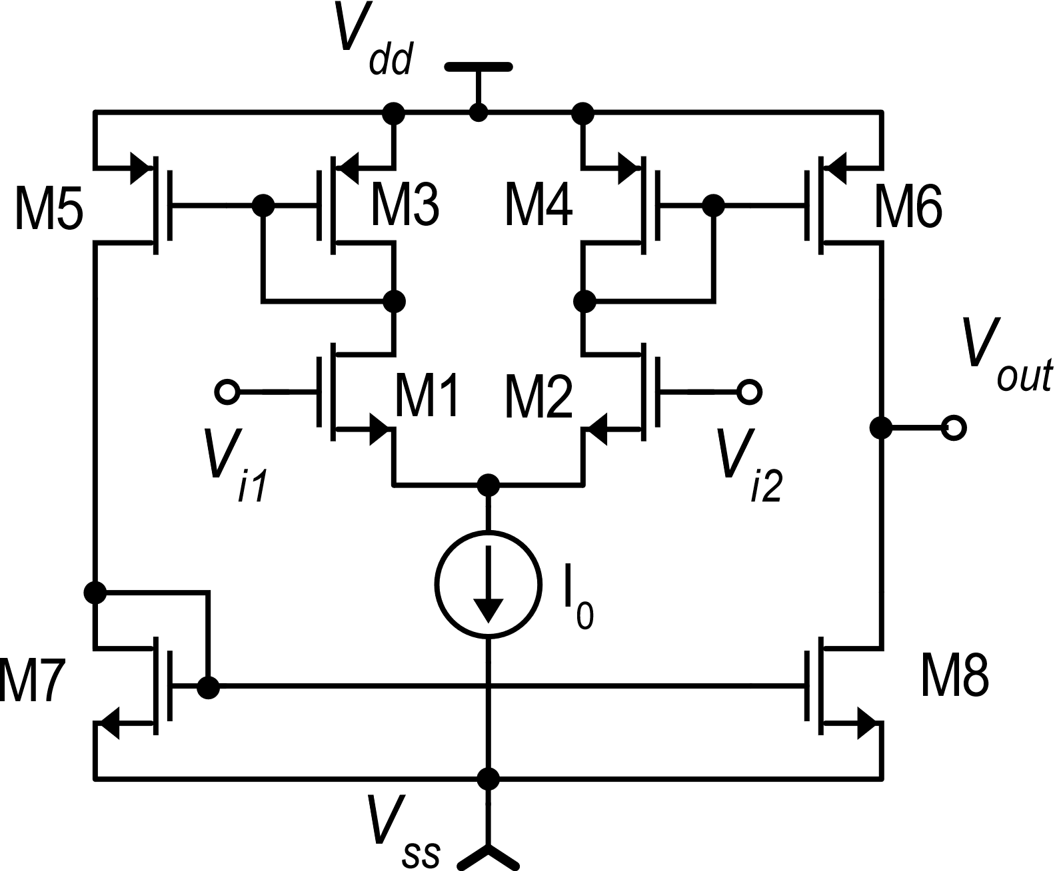
Improving the output swing: the OTA
OTA: Operational Transconductance Amplifier
The term OTA generally indicates all single-stage amplifiers with high output resistance. The folded cascode amplifier is often classified as an OTA.
Historically, the term OTA has been used to indicate the topology shown in this slide

Slide 5
OTA: simple analysis
k : 1
1 : k
kI_{D2}
kI_{D1}
I_{OCC}
kI_{D1}
1 : 1

Slide 6
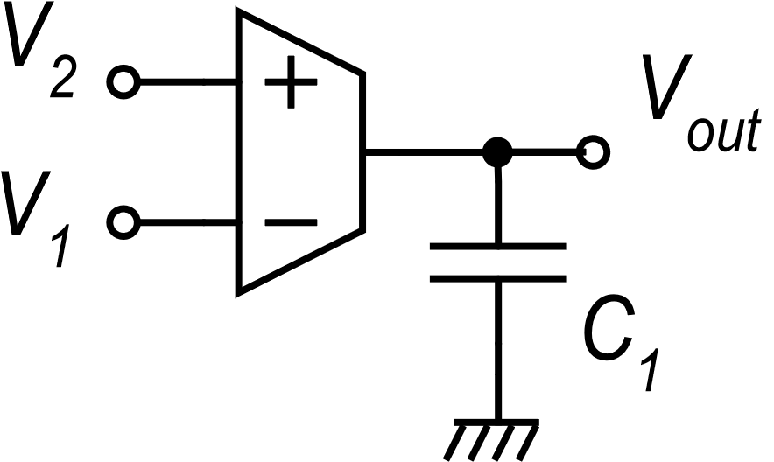
Usage of the OTA as a transconductance amplifier
« Gm-C Integrator »
i_{C}
OTA symbol

Slide 7
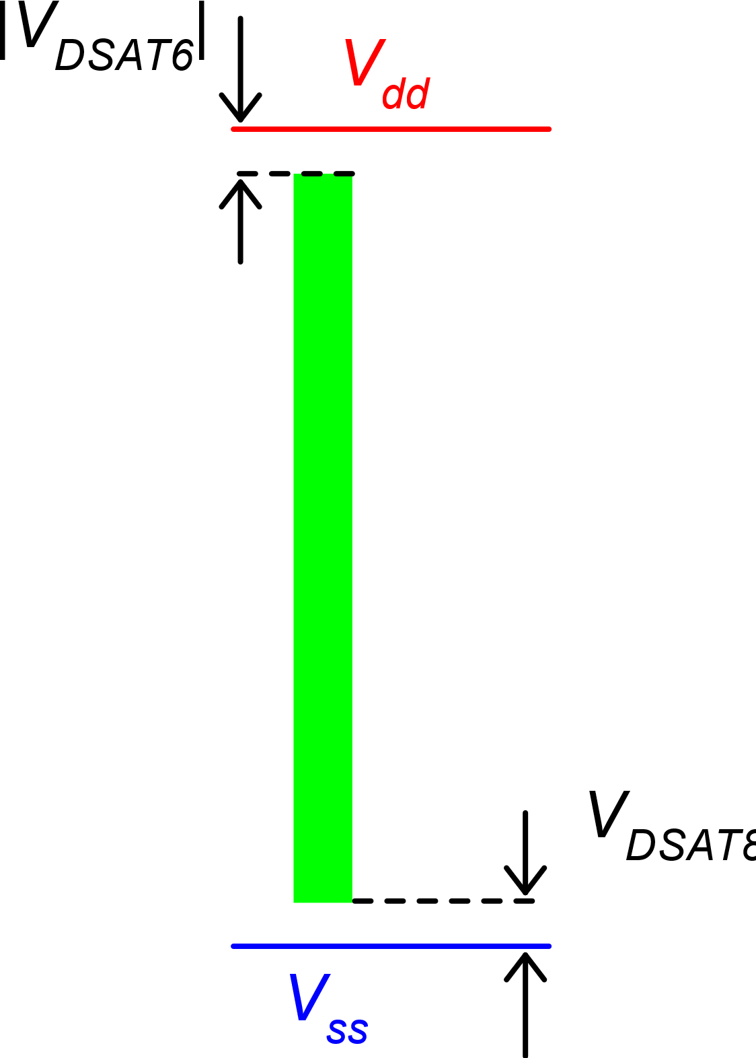
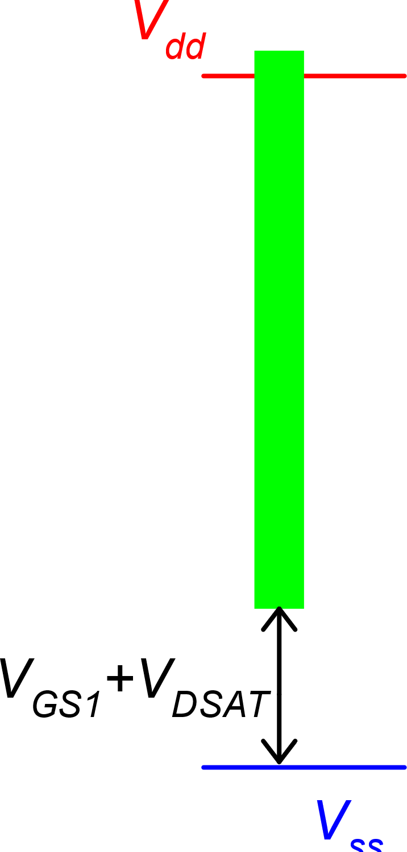
OTA output swing
Output swing
Input CM range

Slide 8
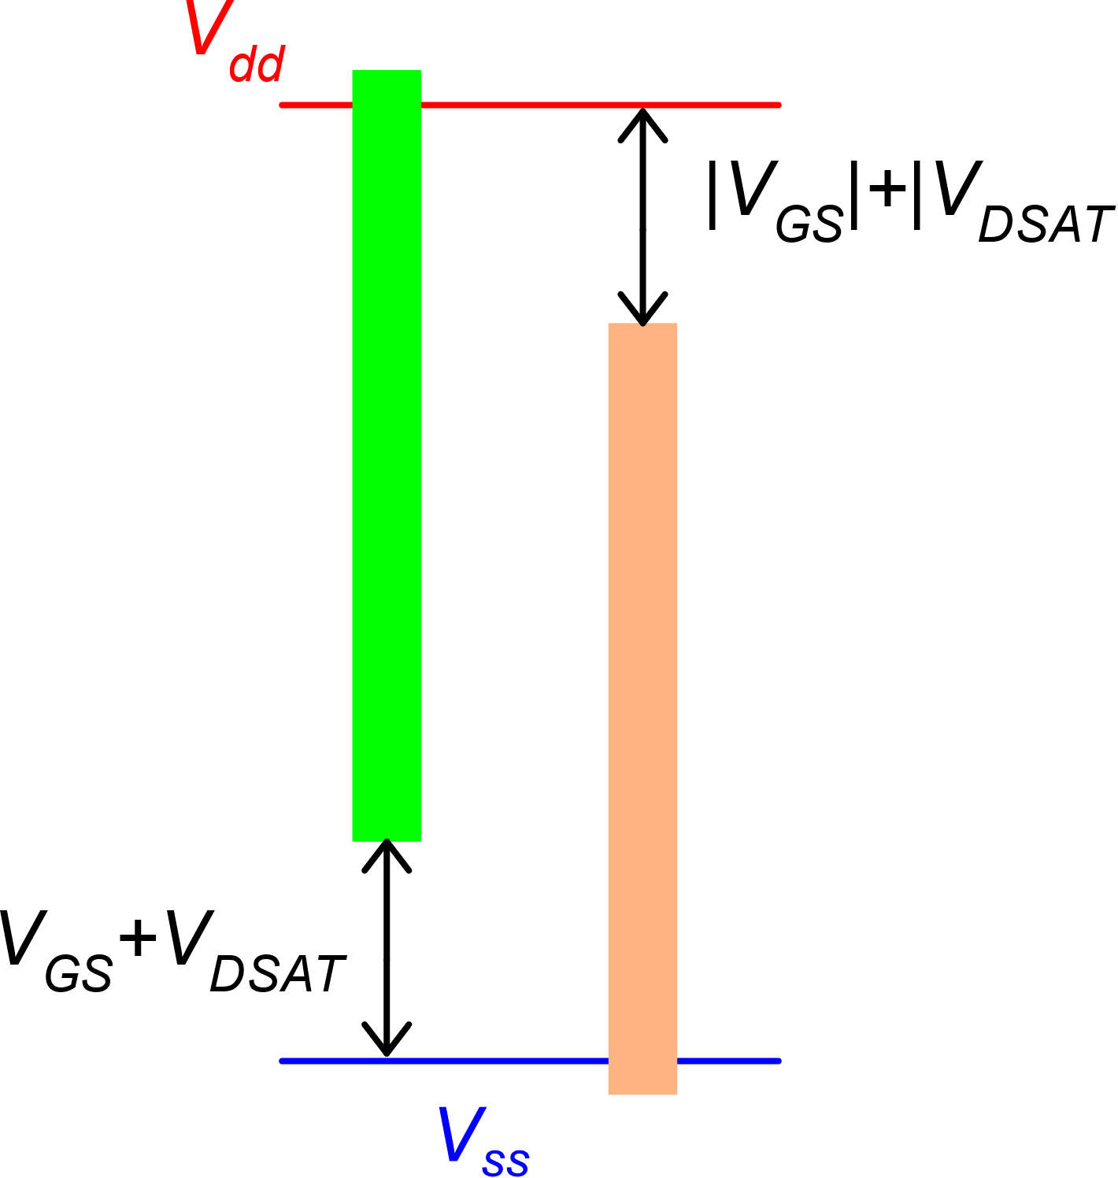
OTA with rail-to-rail input CM range
Input CM range
The idea is to make an n-type and p-type OTAs work together,
In this way, for any value of the input common mode range, there is at least one OTA that operates correctly
n-type
p-type

Slide 9
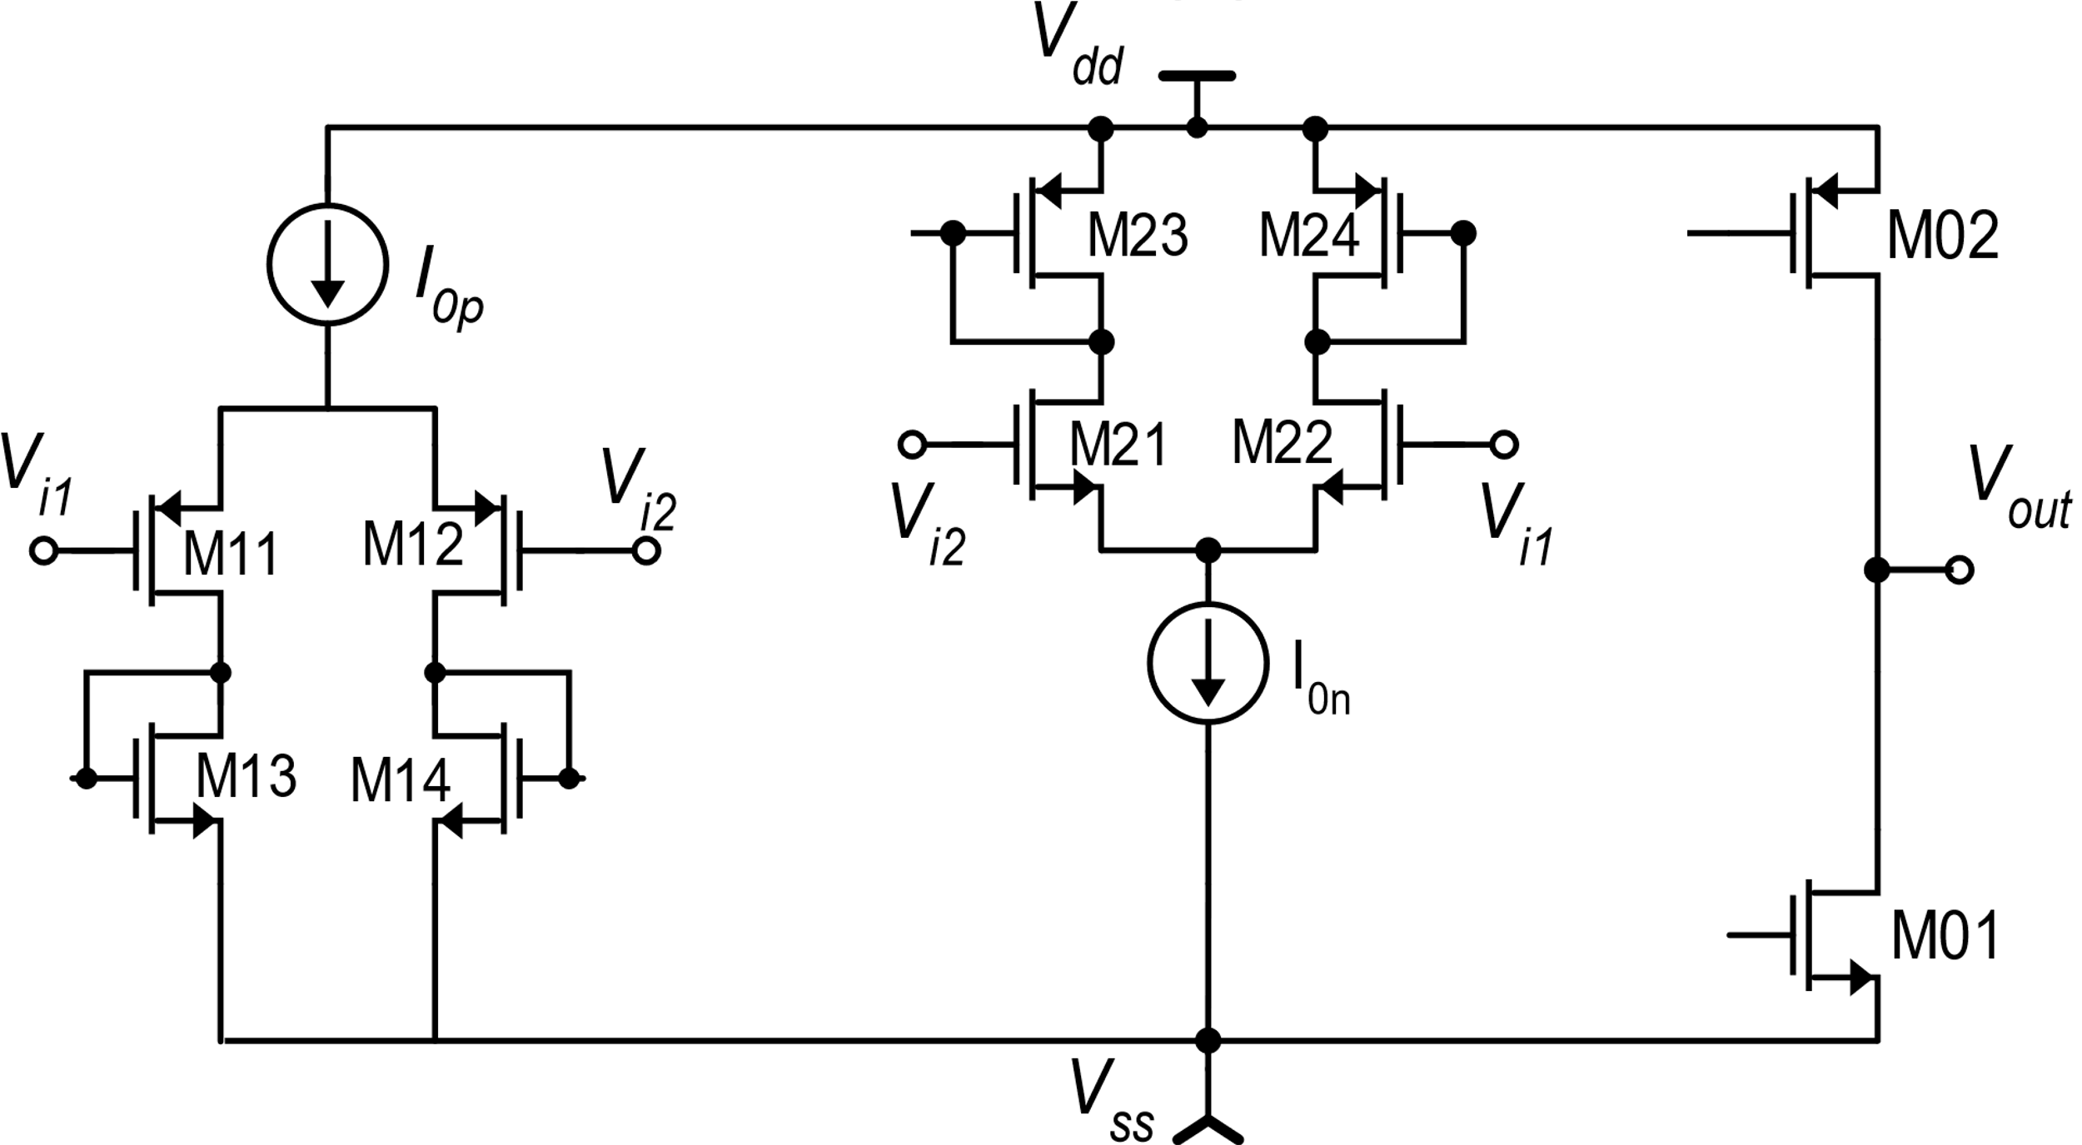
OTA with rail-to-rail input CM range

Slide 10
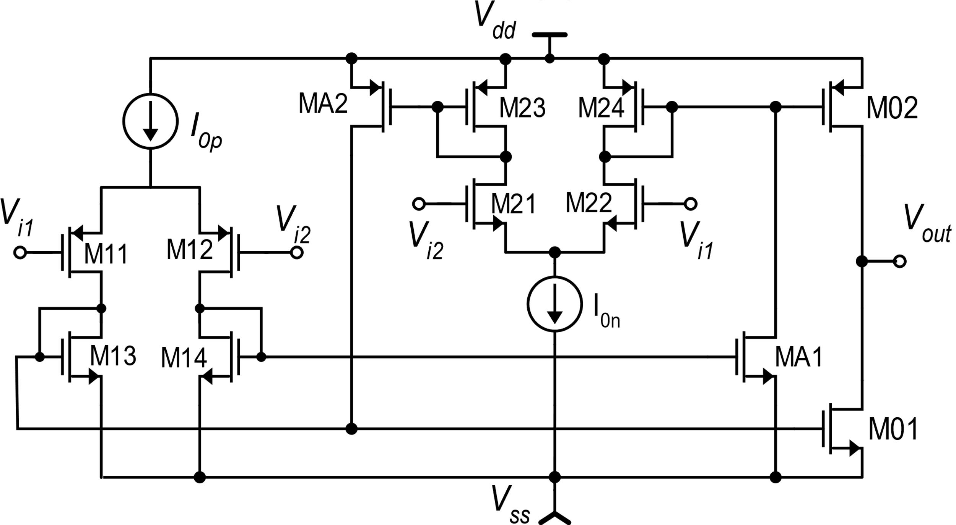
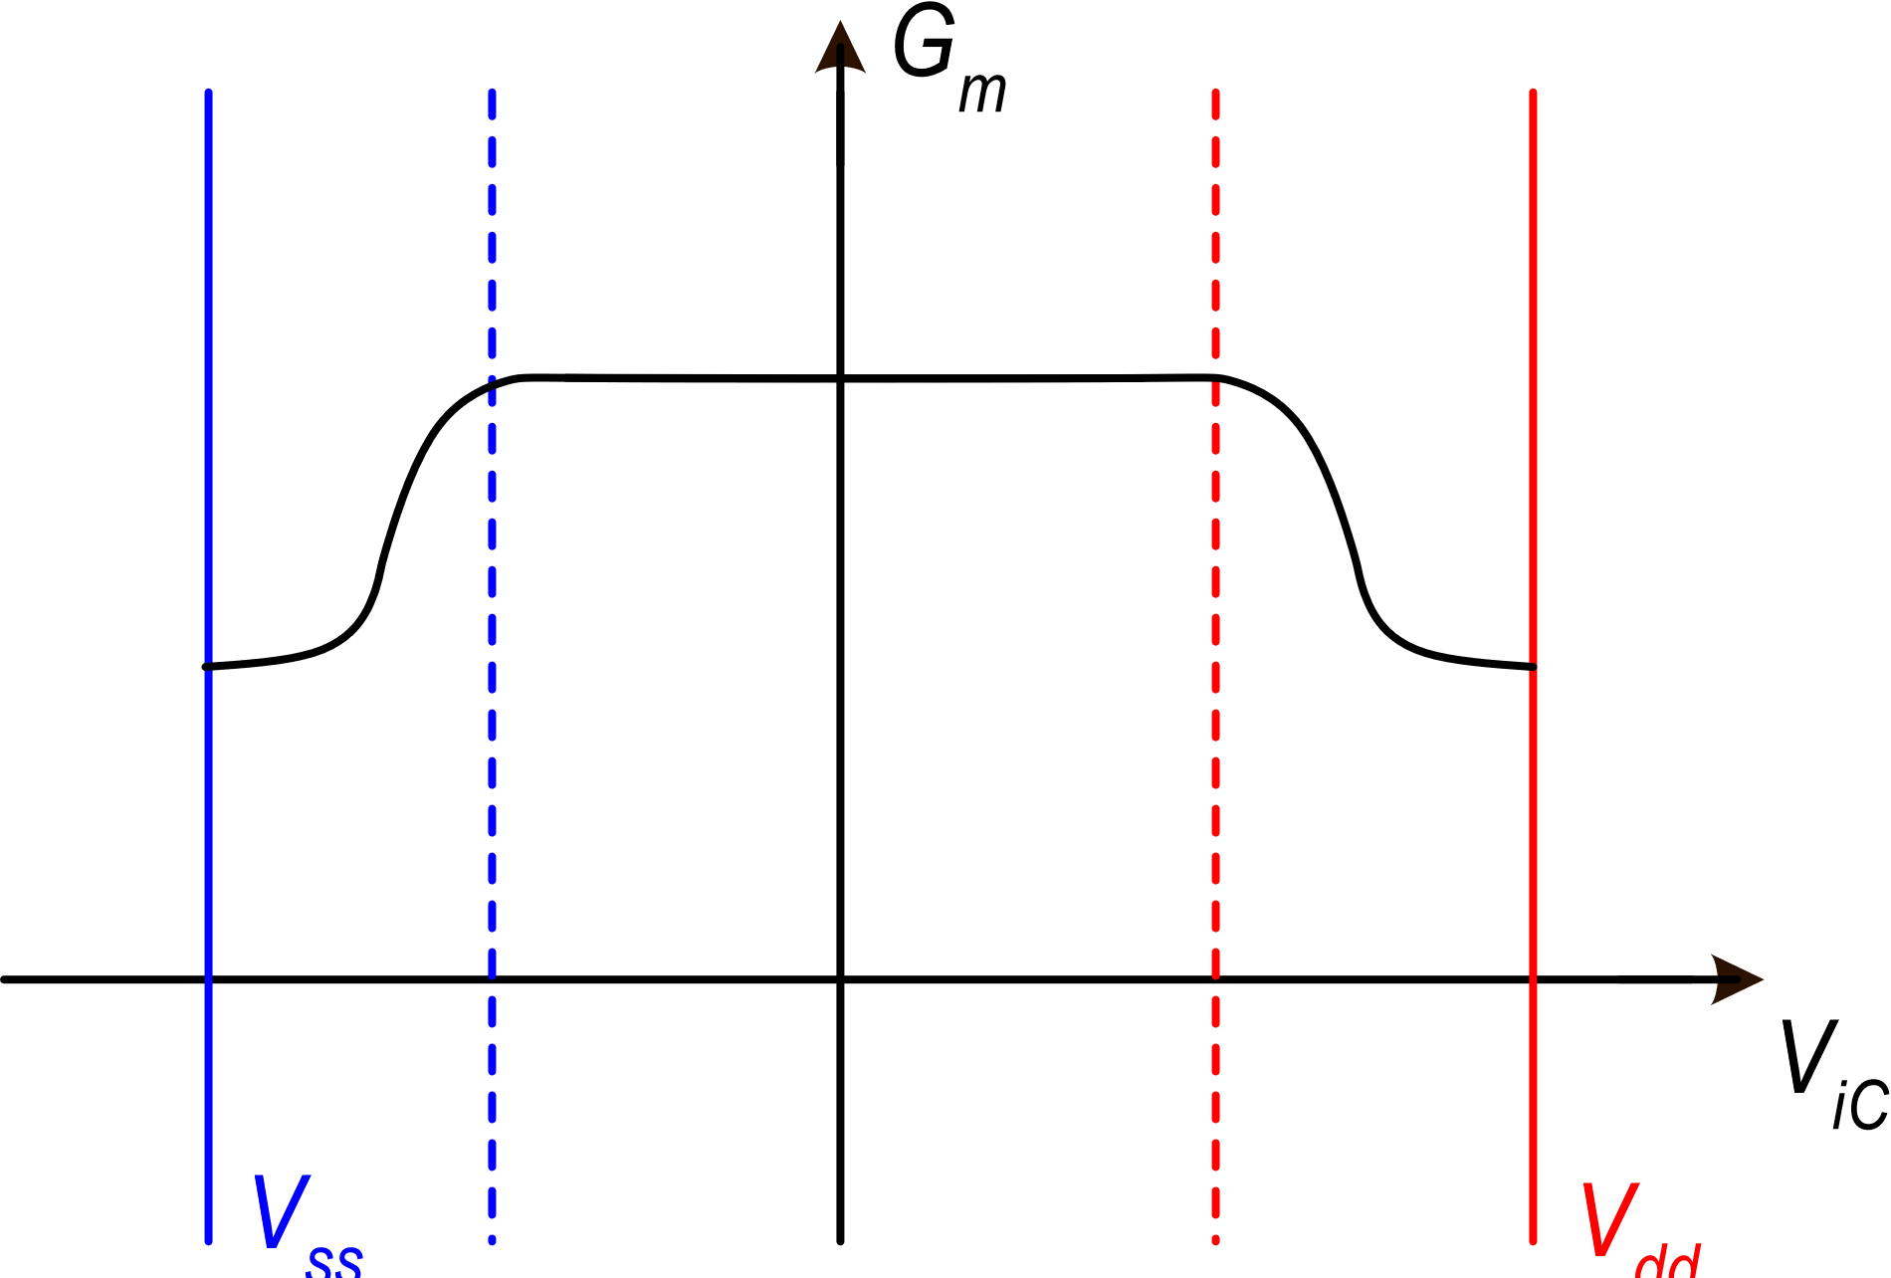
OTA rail-to-rail: equivalent Gm and dc gain

