Slide 1
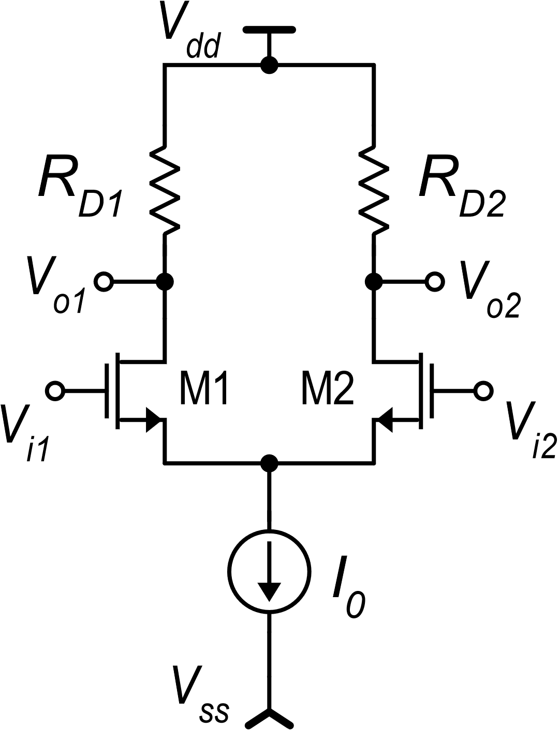
CMOS differential amplifier with current mirror load
Differential to S/E conversion
High CMRR (> 80 dB)
High gain (~ 40 dB) at low supply voltages (V_{dd}-V_{ss}).
High CMRR: we start from here:
The low Ac shown for the fully-differential case is due
Small value of Id common mode variations
The output voltage is proportional to i_{d1}-i_{d2}

Slide 2
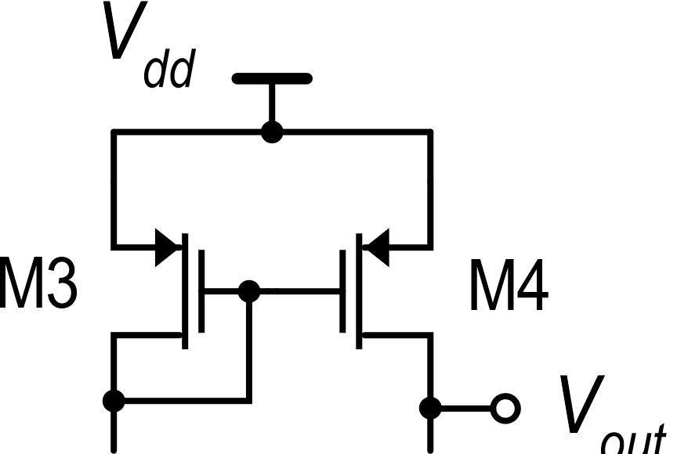
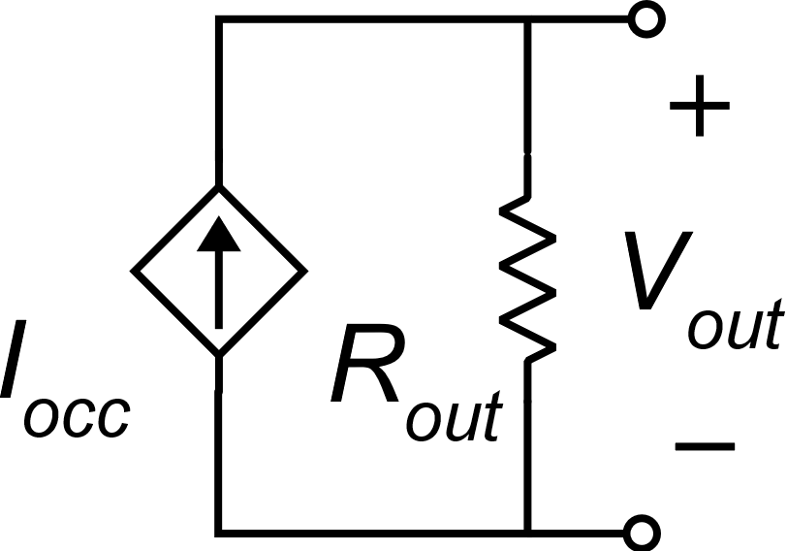
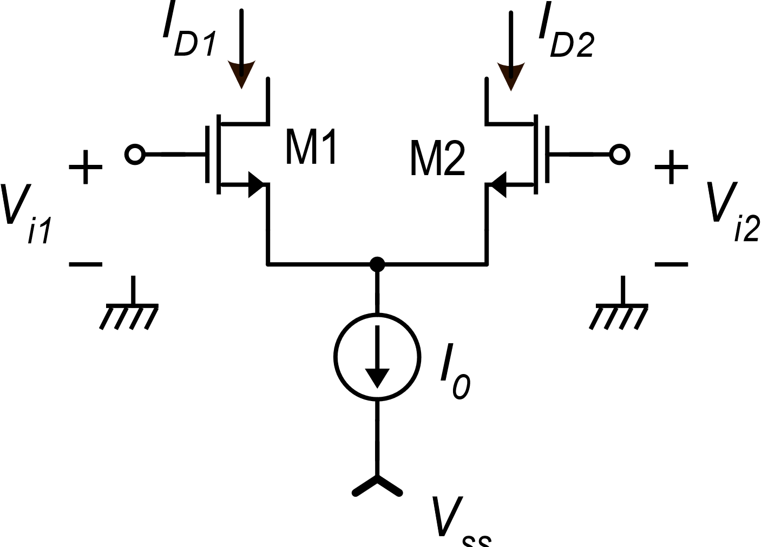
CMOS differential amplifier with current mirror load
I_{D1}
I_{D1}
I_{D1}+I_{D2}
I_{occ} =I_{D1}−I_{D2} $≅g_{m1}v_{id}$

Slide 3
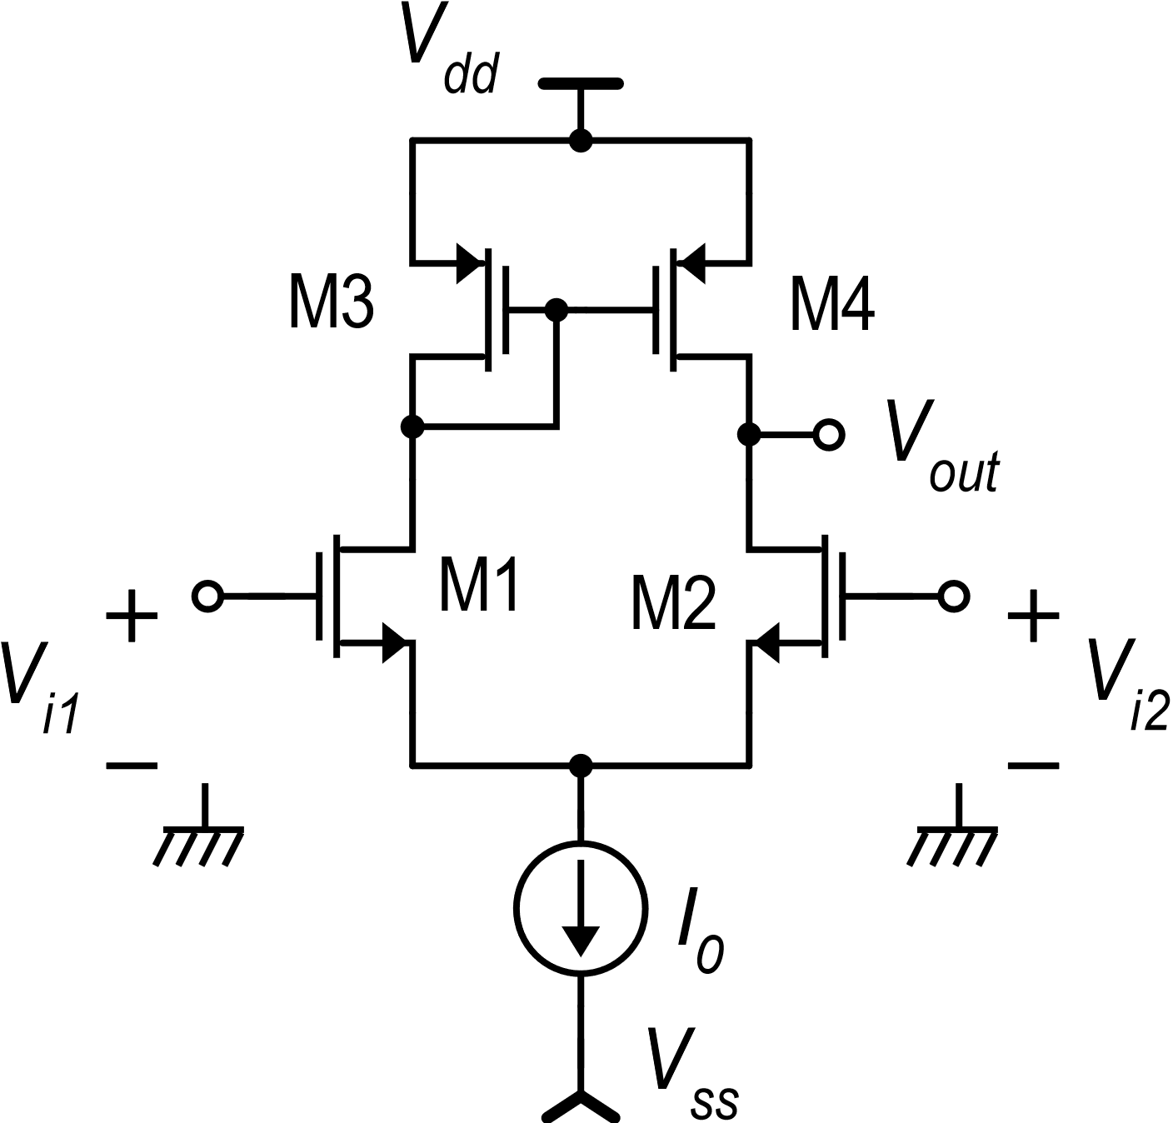
Operating point : V_{id}=0
Symmetrical stimulus, but ….
The circuit is not symmetrical

Slide 4
Demonstration of the exact symmetry of the electrical solution for V_{id}=0
M1 and M2
M3 and M4

Slide 5
Proof by contradiction (reductio ad absurdum)
Contradiction

Slide 6
Solution valid everytime Vd=0
K

Slide 7
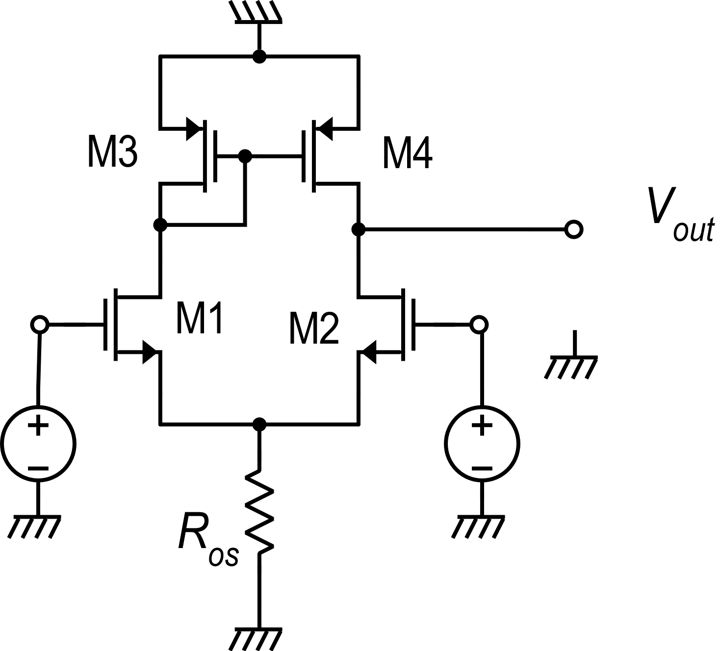
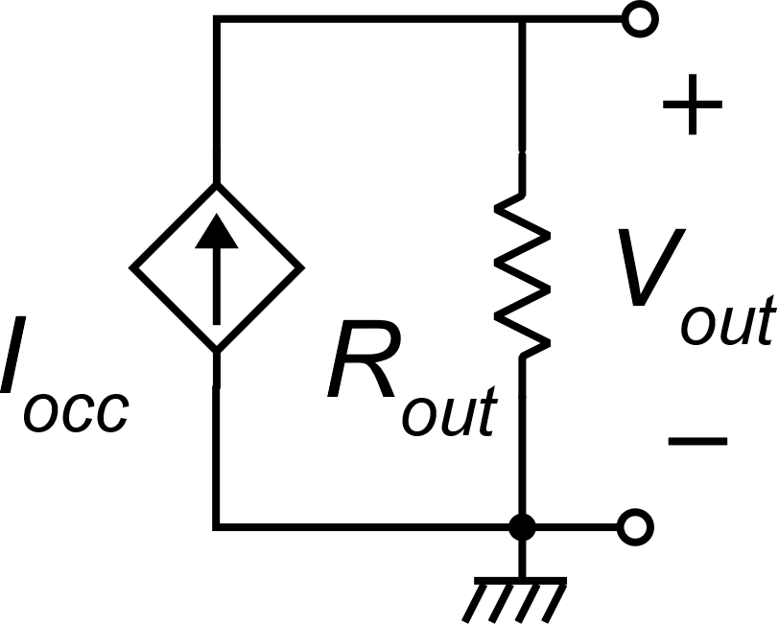
Differential mode gain

Slide 9
Differential mode gain
The gain is of the order of$\frac{g_{m}r_{d}}{2}$
Independently from the supply voltage

Slide 10
Differential mode gain
In order to obtain a large differential-mode gain it is necessary to:
Set V_{TE} to a small value
Use long mosfets (small λ)
In strong inversion. Minimum V_{TE}=50 mV
In weak inversion.
V_{TE} $≅$35-40 mV

Slide 11
Common mode gain
v_{c}
v_{c}
Is it possible??

Slide 12
Common mode gain
The problem occurs when we calculate i_{occ}. Placing a short circuit across the output port, disrupts the symmetry:
v_{c}
v_{c}

Slide 13
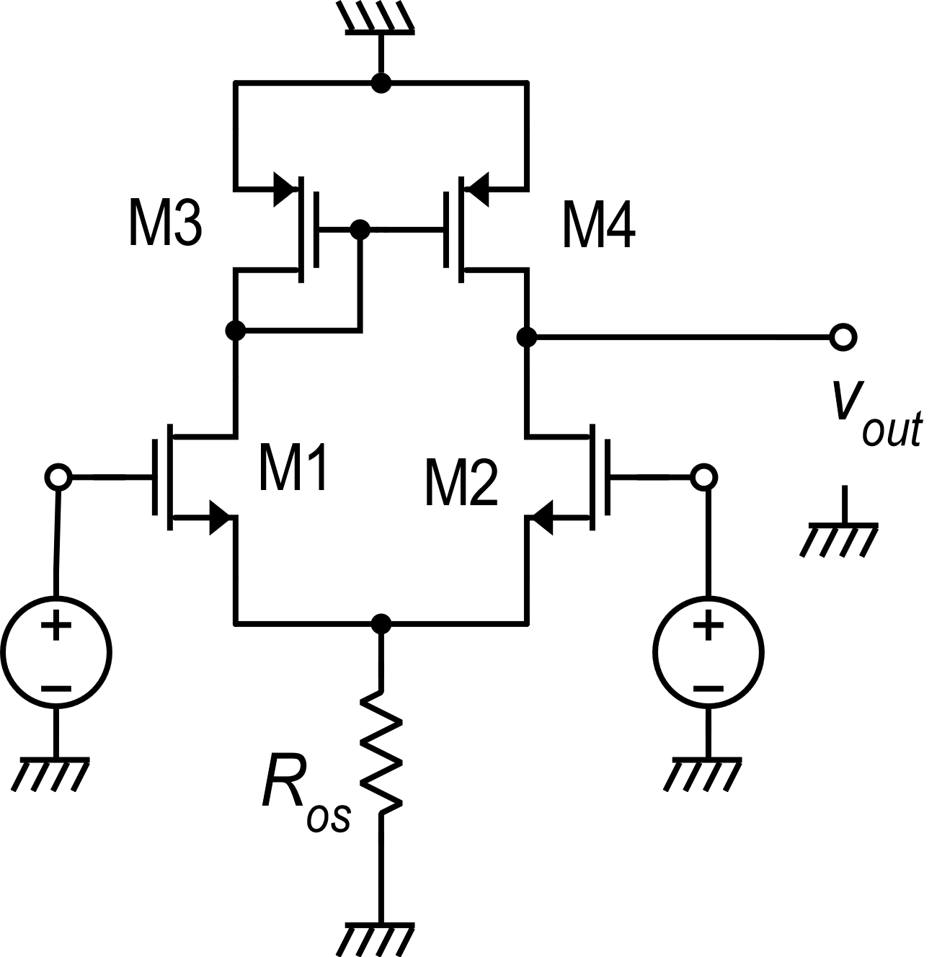
Common mode gain
It is possible to exactly calculate i_{occ}, taking into accout the actual i_{d1}/i_{d2} ratio and i_{d4}/i_{d3} ratio ….
v_{k}
… but this is a very tedious approach
There is a much simpler way:
Let us remove the short circuit and directly calculate v_{out}. Now , for v_{id}=0, the circuit is symmetric again and, in particular: v_{k}=v_{out}
v_{c}
v_{c}

Slide 14
Common mode gain
v_{k}
for R_{os}=r_{d} (worst case)
v_{c}
v_{c}
A CMRR of 80 dB can be easily reached

Slide 15
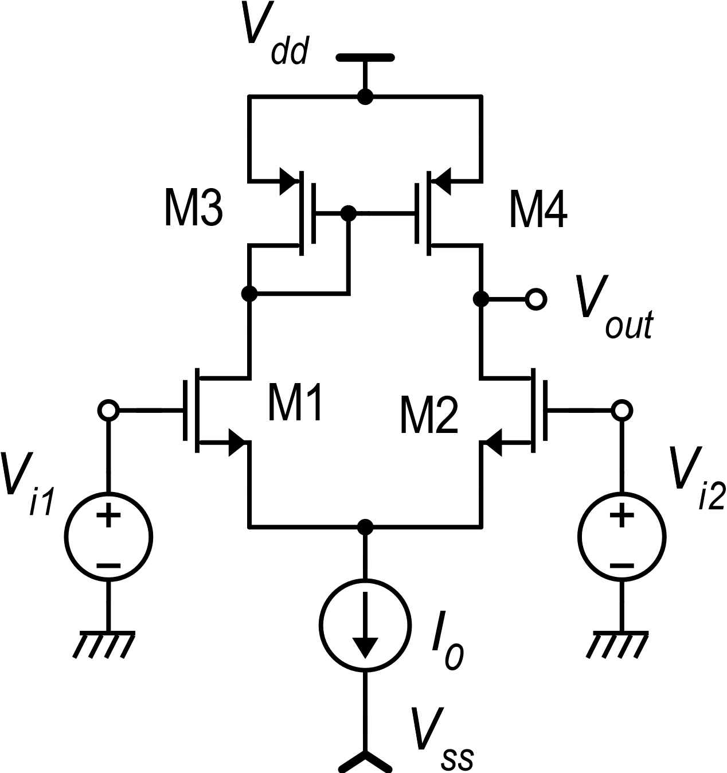
Large-signal dc transfer function
In strong inversion

Slide 16
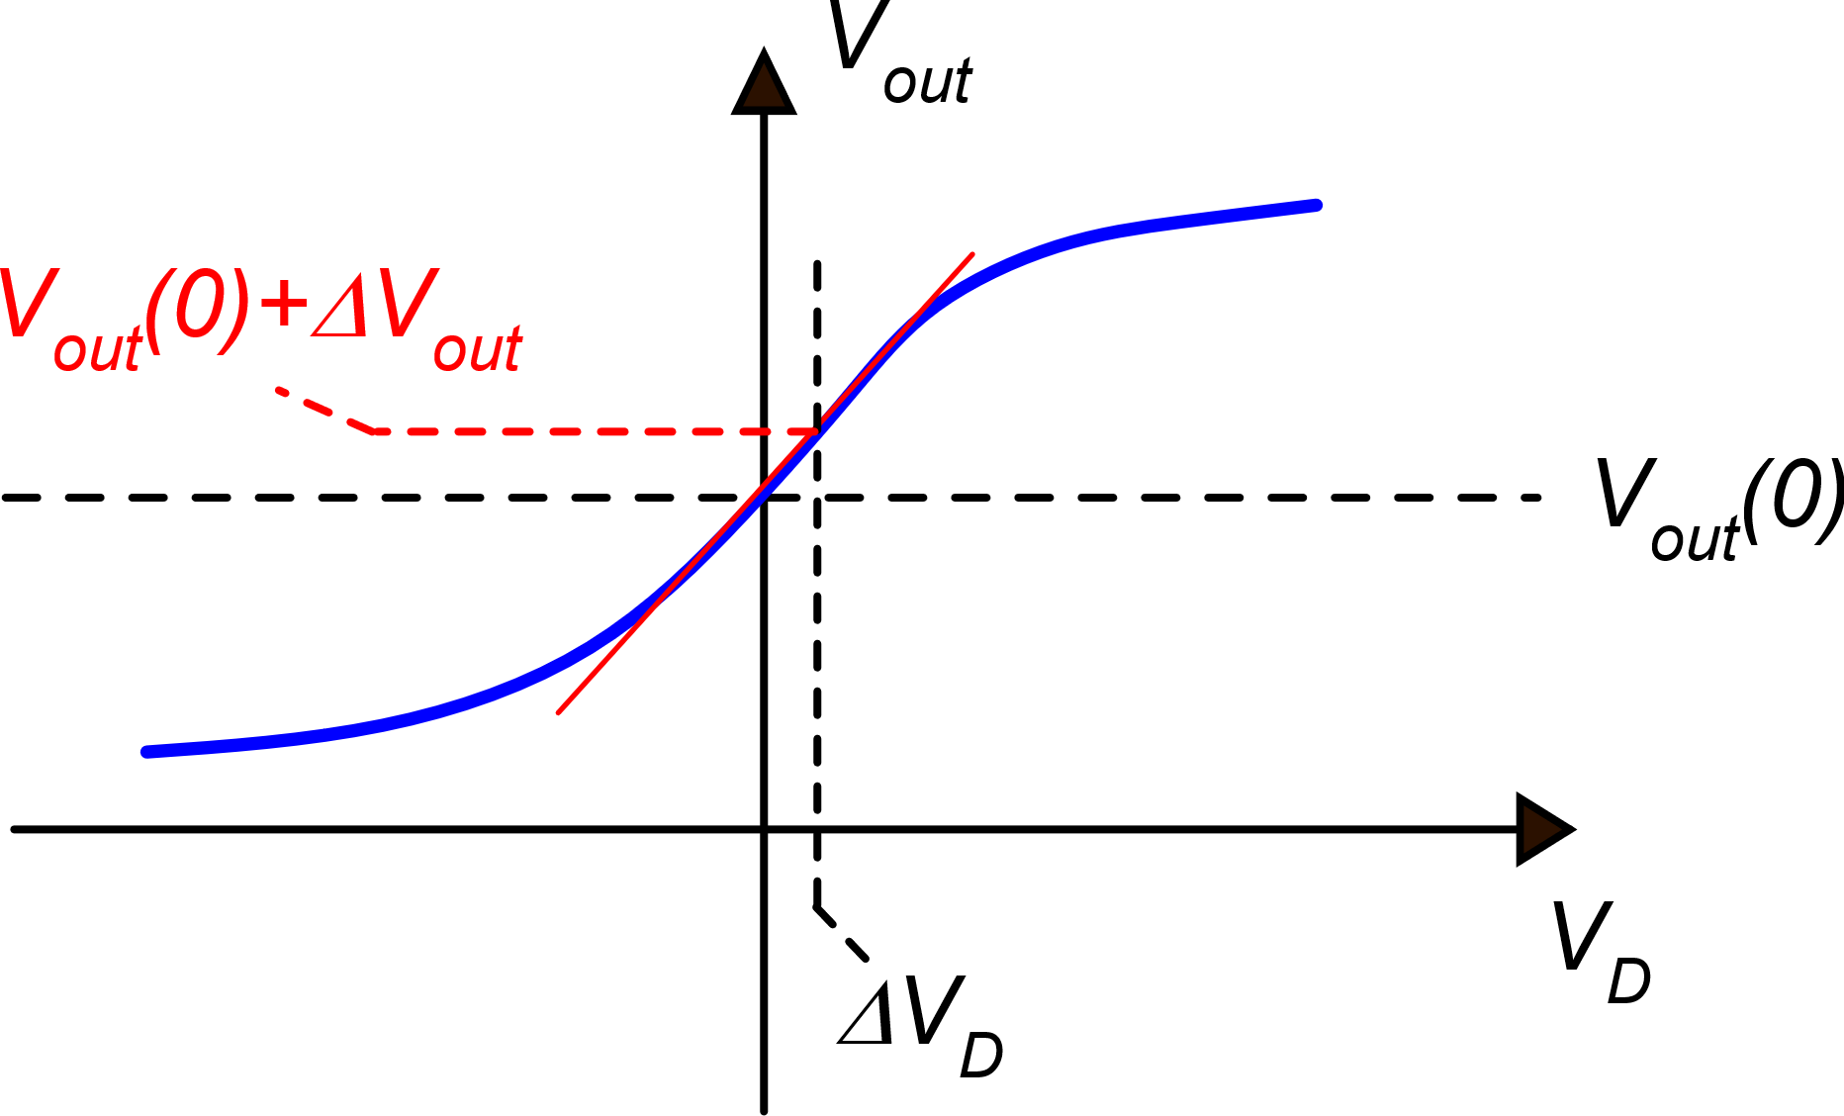
Large-signal dc transfer function
V_{out} variations for small V_{D} variations around the origin
g_{m1}

Slide 17
Moving away from the origin, step by step

Slide 18
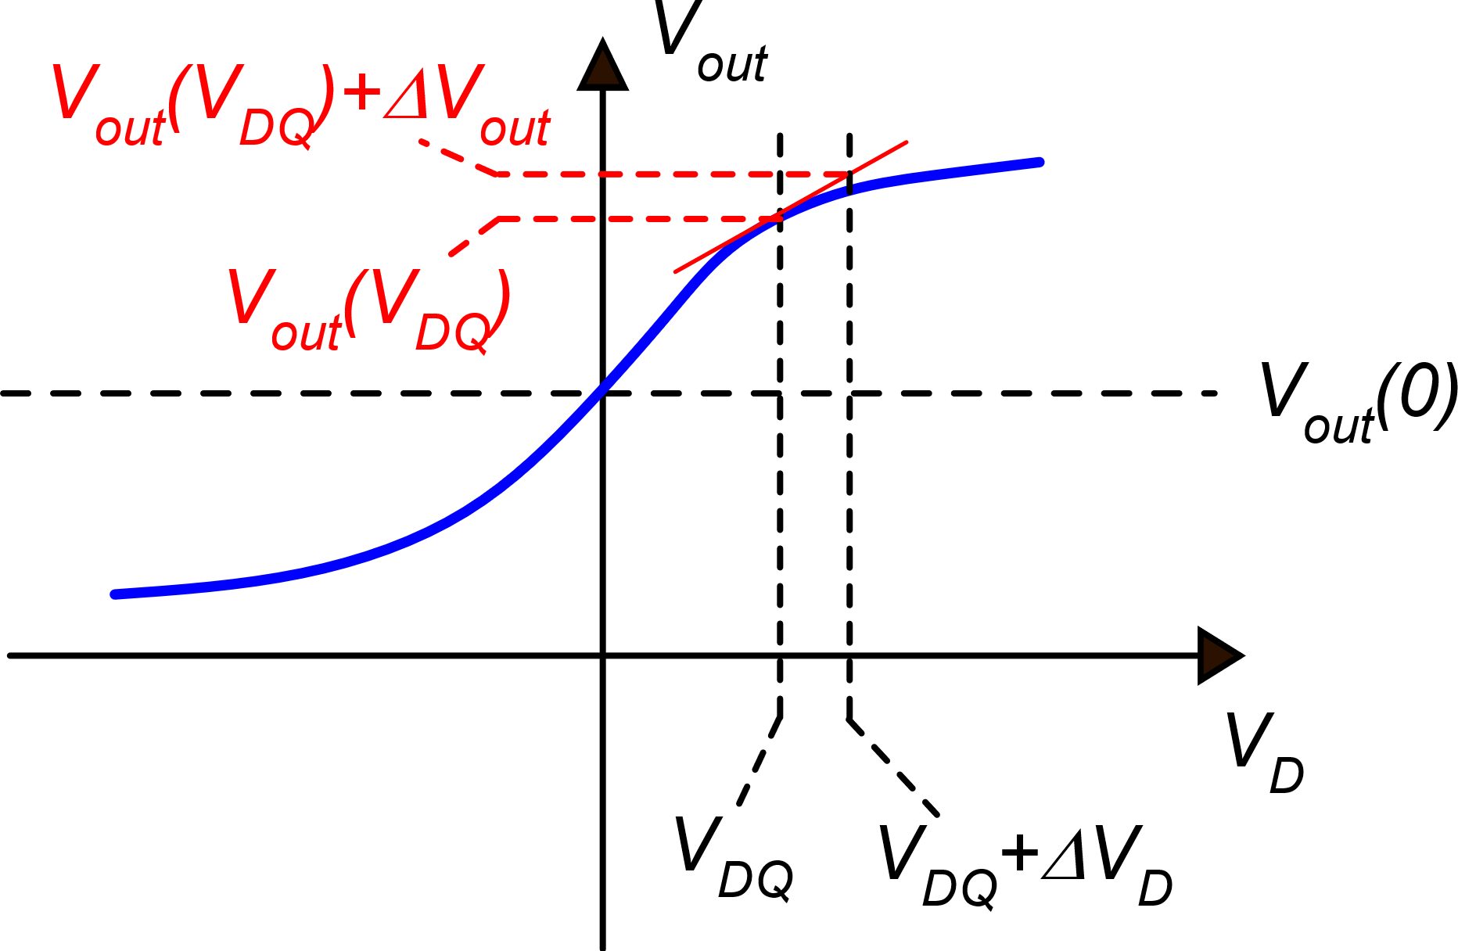
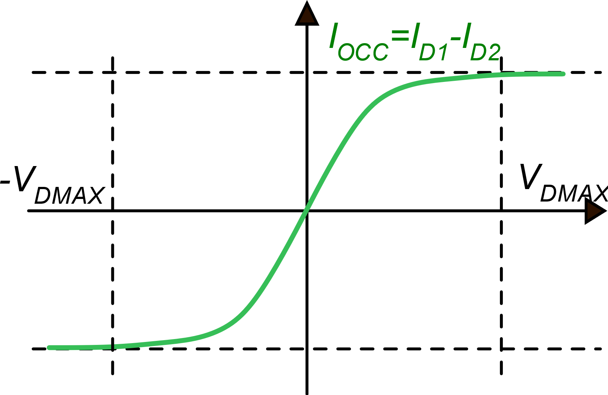
Large-signal dc transfer function

Slide 19
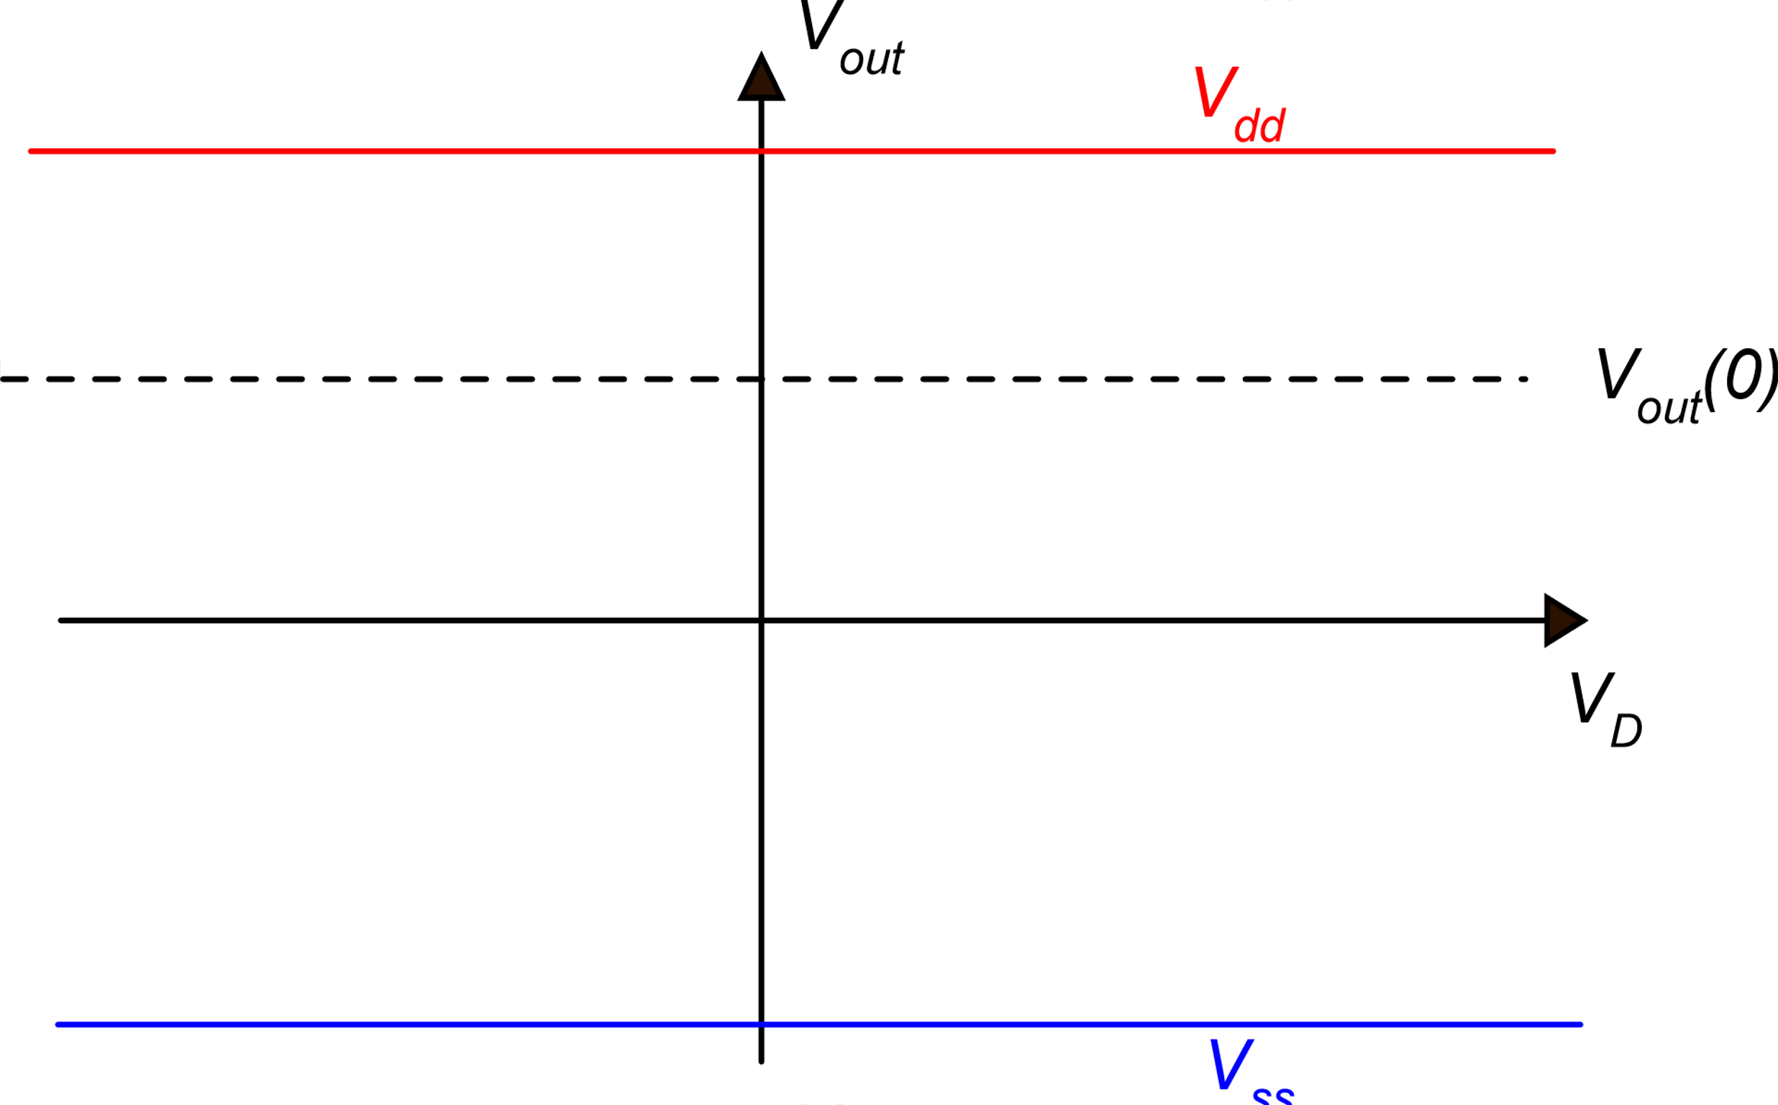
Approximate dc transfer characteristic
-V_{DMAX}
V_{DMAX}
Example: A_{d}=100, V_{dd}-V_{ss}=5V ΔV_{D}<50 mV

Slide 20
Practically constant and equal to g_{m1}
M4 enters triode region and r_{d4} drops down
M2 enters triode region and r_{d2} drops down

Slide 21
Minimum output voltage
V_{D} in the linear zone is at most
a few tens mV
V_{C} varies between V_{SS} and V_{DD}

Slide 22
Minimum output voltage
Weak inversion
Strong inversion

Slide 23
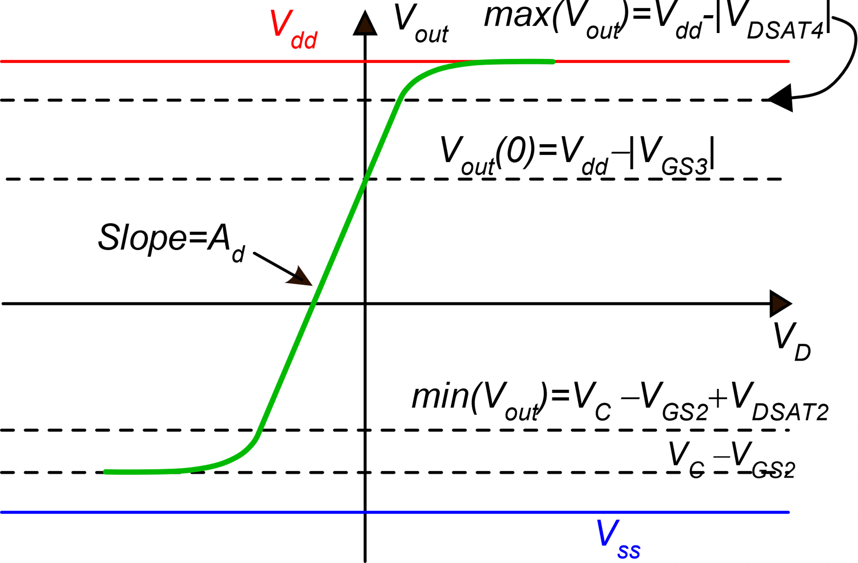
Complete dc transfer characteristic

Slide 24
Minimum V_{dd}-V_{ss}
|V_{DS3}|
V_{DS1}
Example: V_{MIN}=100 mV
V_{DSAT2}=100 mV
|V_{GS3}|=0.5 V
V_{outS}

Slide 25
Input common mode range
Lower limit
As V_{C} is progressively decreased, also V_{S} decreases at the same pace and eventually the voltage across the current source I₀ will get smaller than the minimum value V_{MIN}. From that point on, I₀ will rapidly decrease, turning off the stage.

Slide 26
Input common mode range
Upper limit
As V_{C} is progressively increased, also V_{S} increases at the same pace. Since V_{out}=V_{K} =V_{D2} = V_{D1} is fixed, eventually V_{DS1} and V_{DS2} will drop below the saturation voltage.
v_{k}

Slide 27
Input common mode range
The input common mode voltage can get even slightly higher than Vdd

