Slide 1
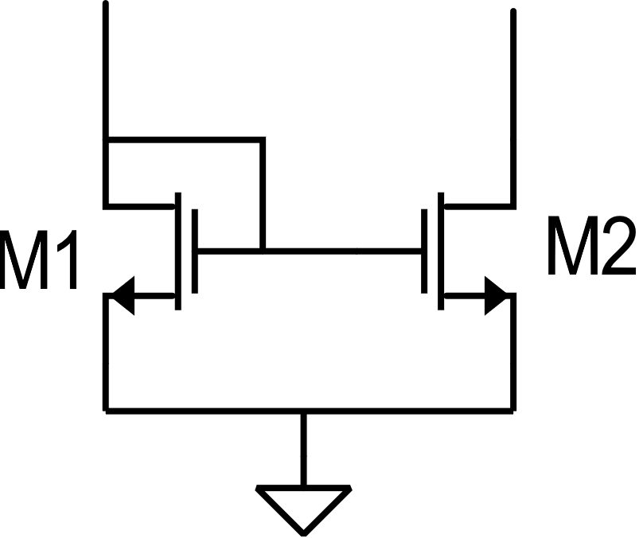
Matching errors in current mirrors
CMOS current mirror

Slide 2
Standard deviations

Slide 3
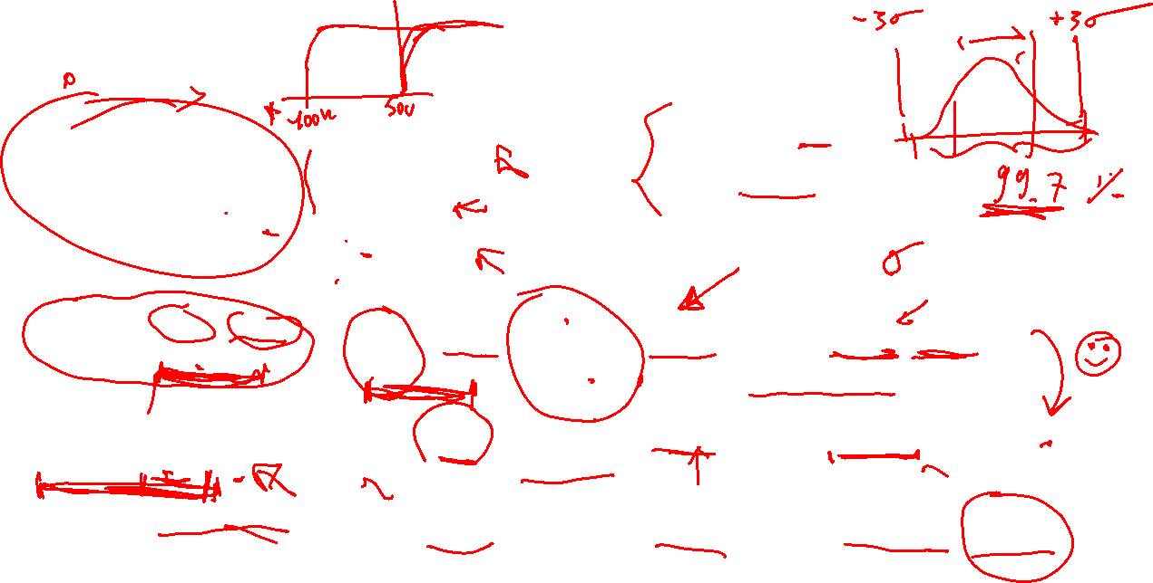
Examples
Case 1: L=W=1μm
V_{GS}-V_{t} =100 mV
Case 1: L=W=1μm
V_{GS}-V_{t} =500 mV
Case 1: L=W=10 μm
V_{GS}-V_{t} =500 mV

Slide 4
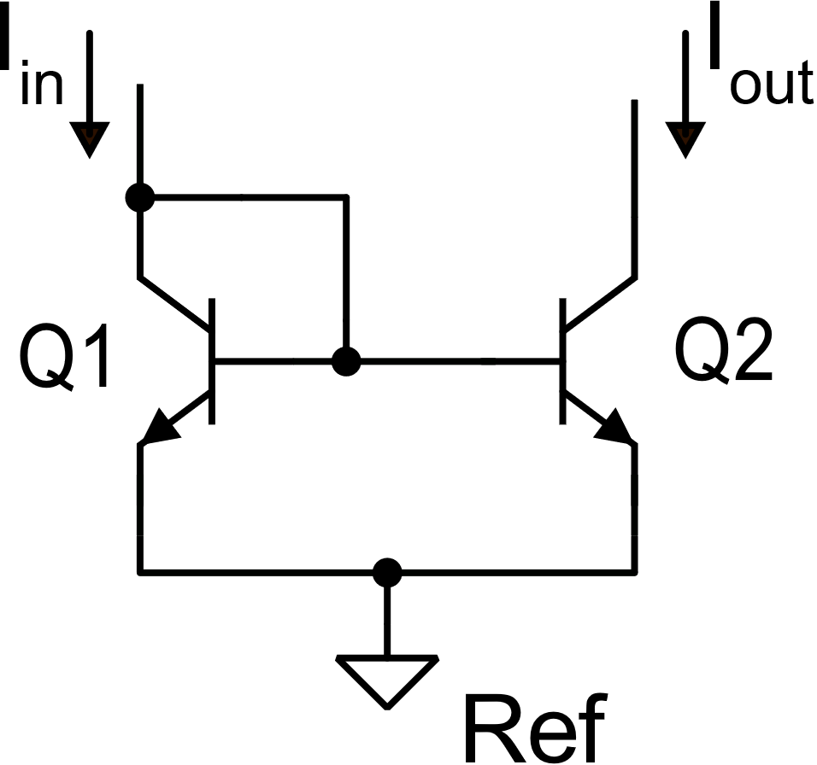
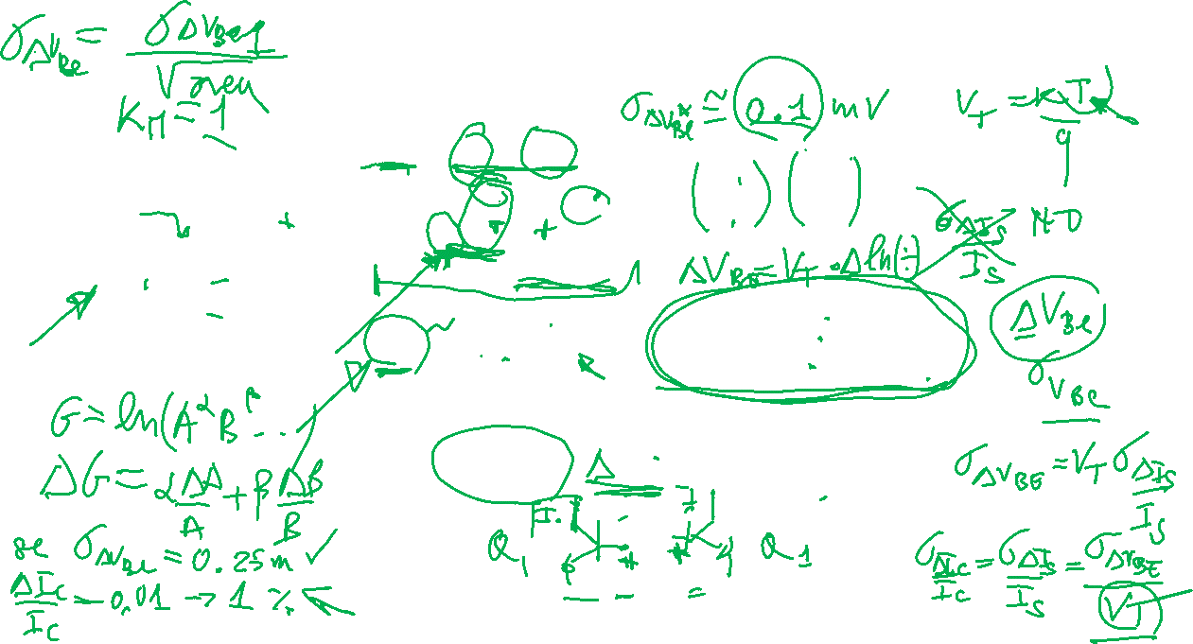
Matching errors in BJT current mirrors

