Slide 1
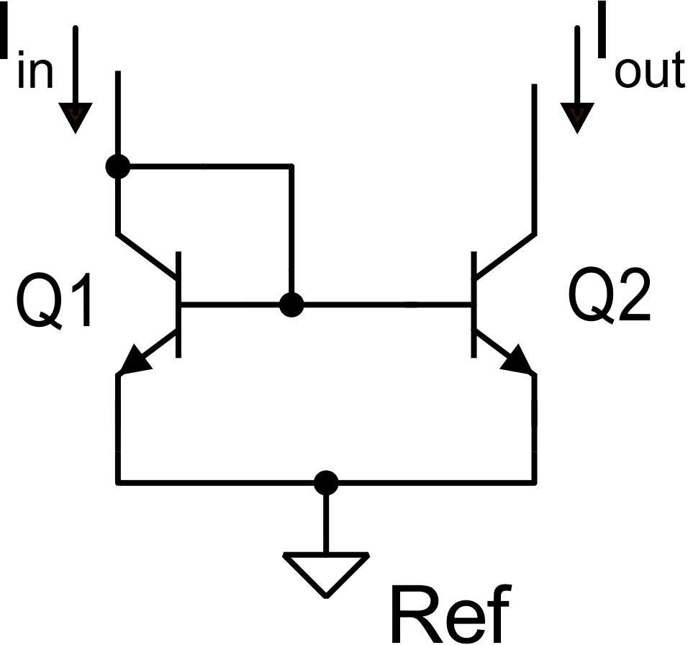
BJT current mirrors
BJT simple current mirror
V_{out}=V_{in}

Slide 2
BJT simple current mirror

Slide 3
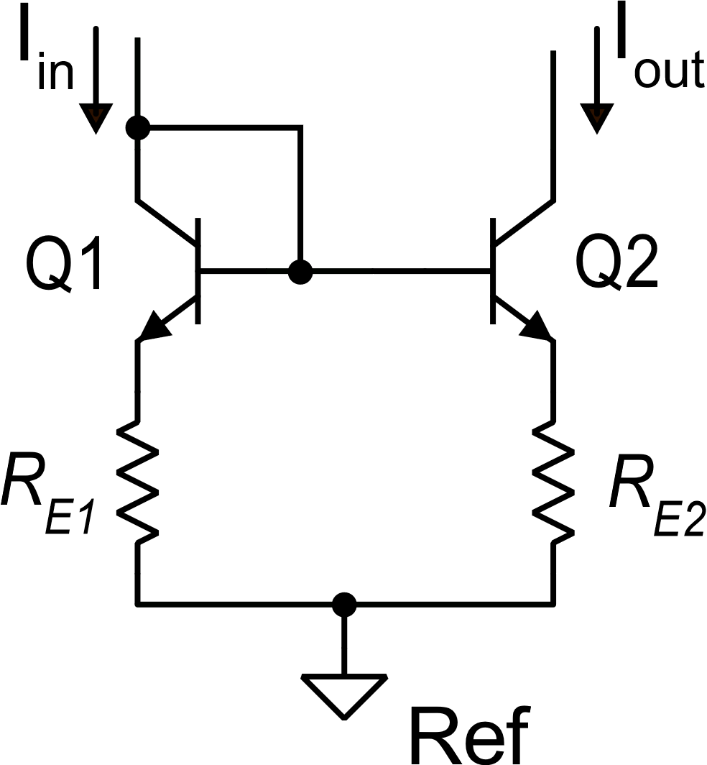
Simple mirror with emitter degeneration

Slide 4
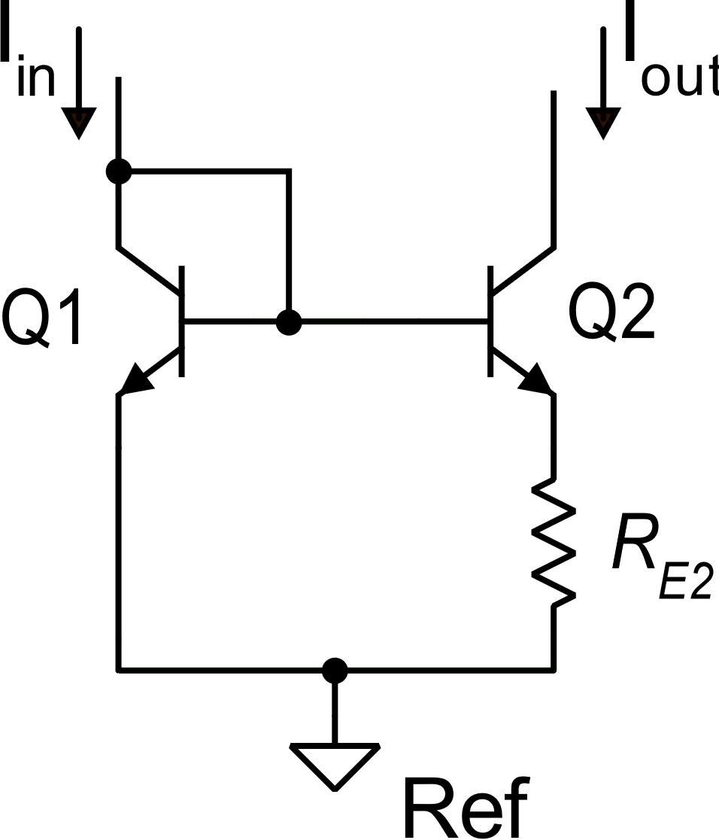
The Widlar current source
A non-linear current mirror

Slide 5
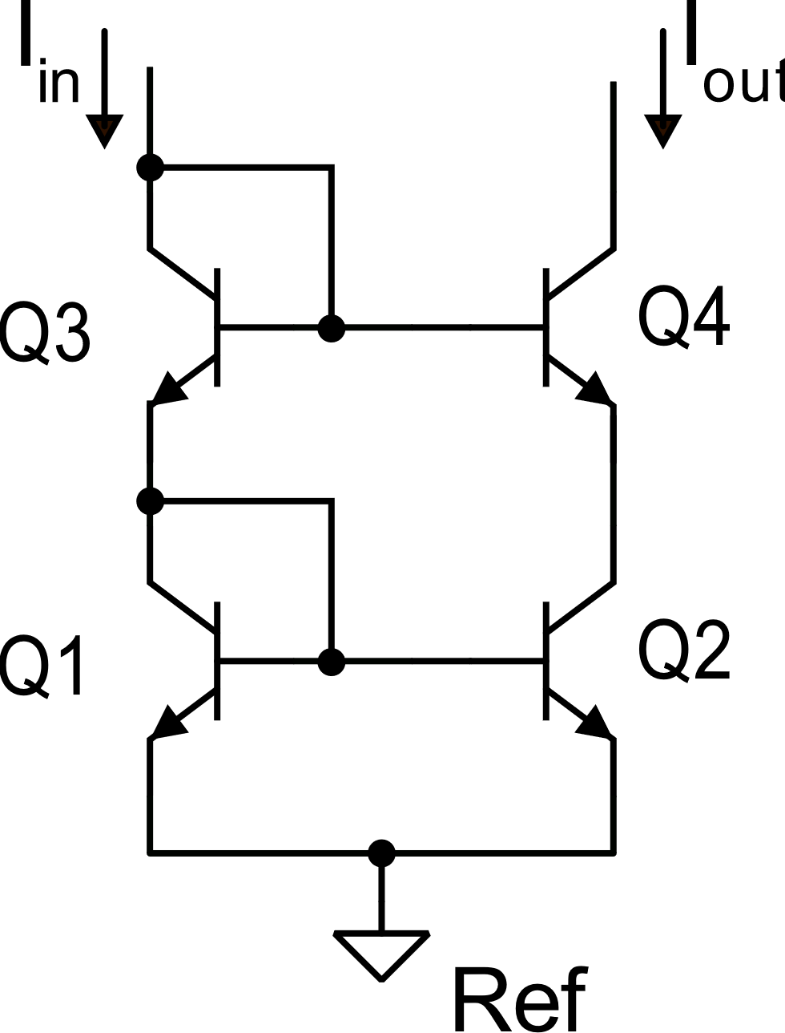
BJT cascode mirror

Slide 6
BJT cascode current mirror

Slide 7
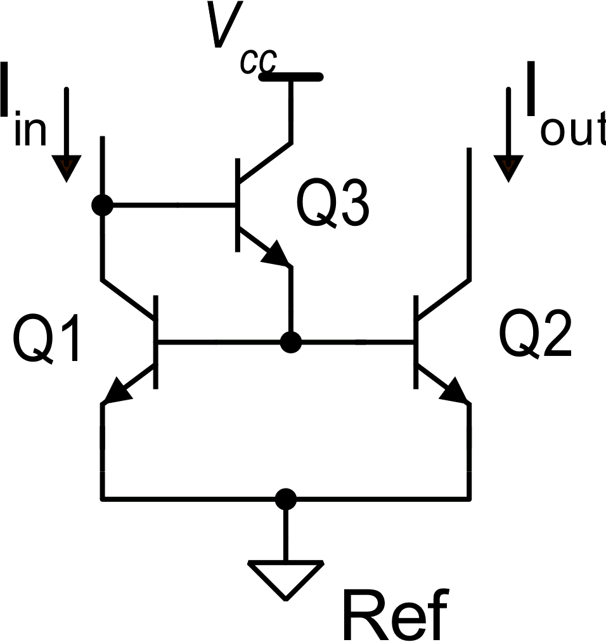
Current mirrors with «beta-helper»

Slide 8
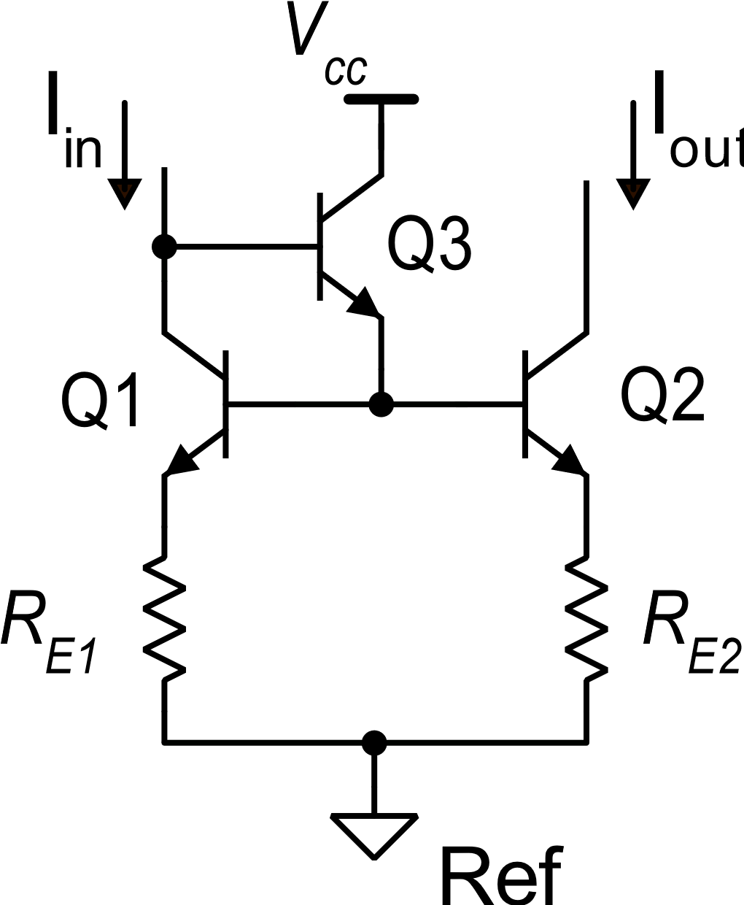
Beta helper + emitter degeneration

Slide 9
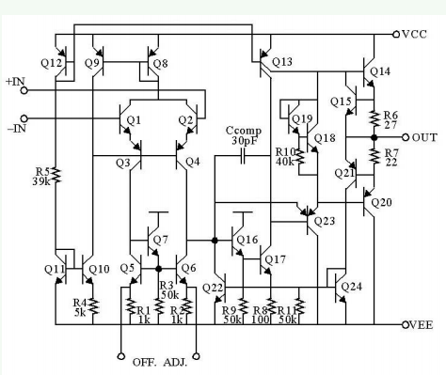
Mirrors in the 741
Widlar
Current source
Beta helper +
Emitter deg.

Slide 10
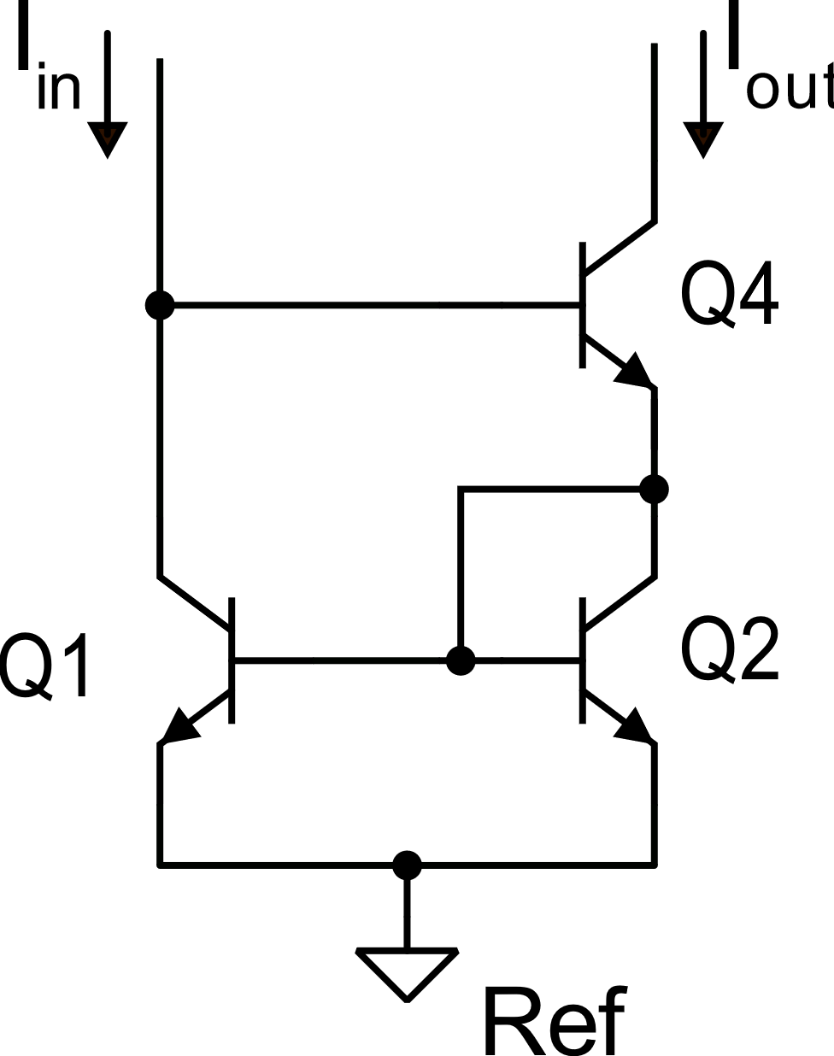
Wilson current mirror
3-transistor version
H

Slide 11
Wilson Current Mirror

Slide 12
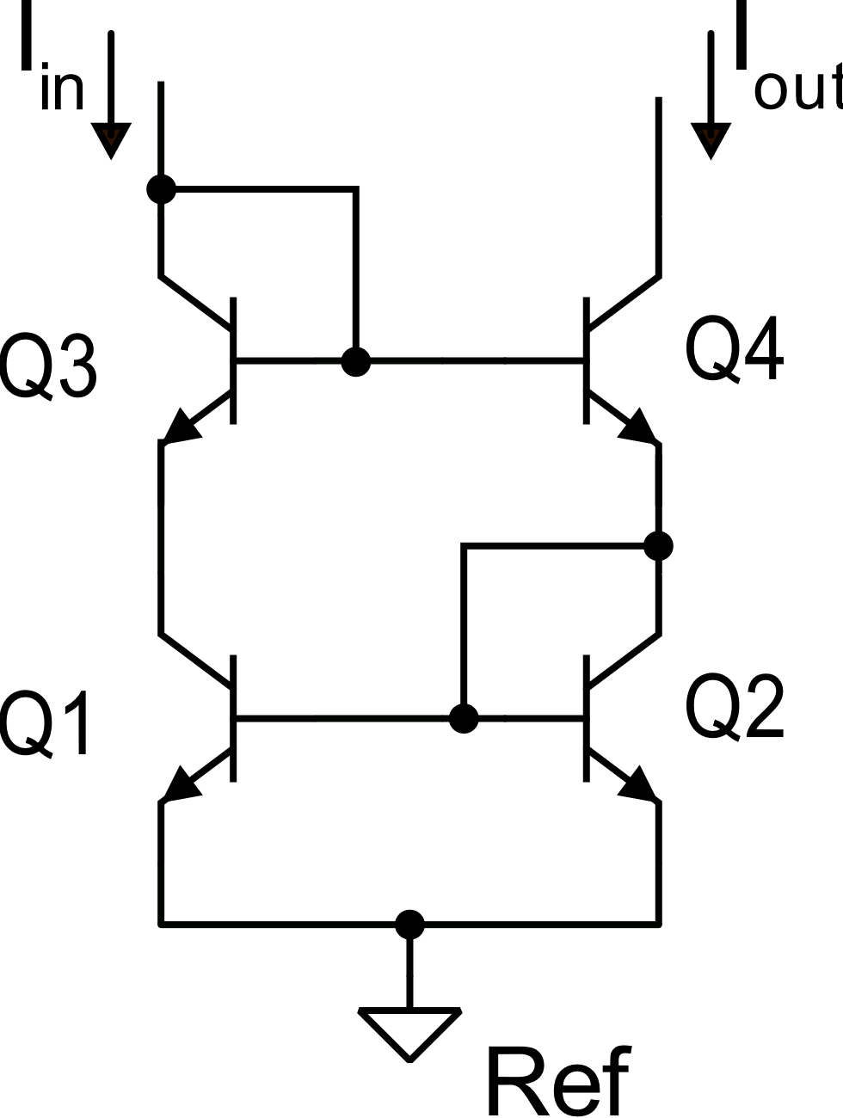
4-transistor Wilson current mirror

