Slide 1
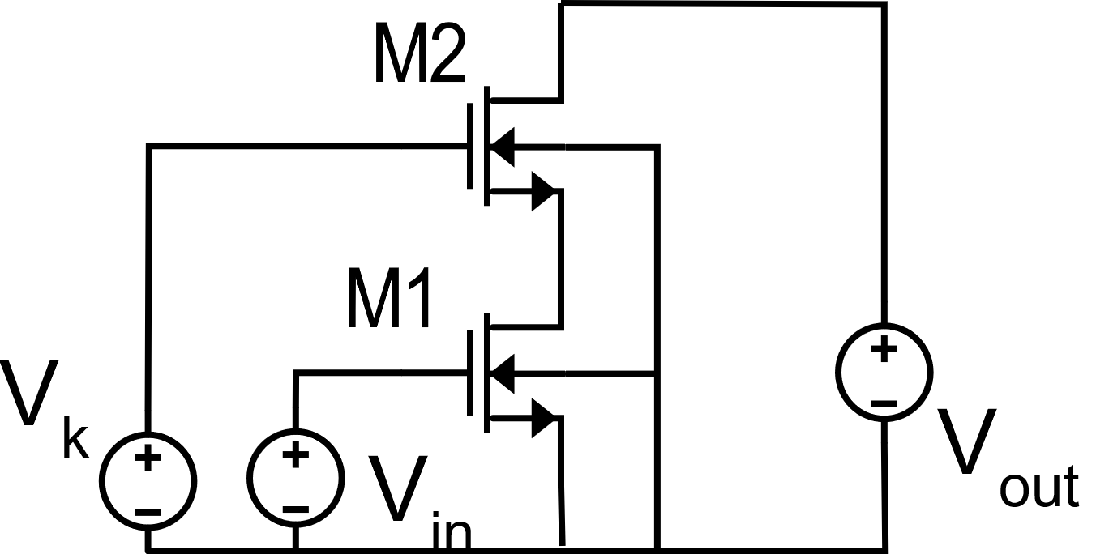

Slide 3
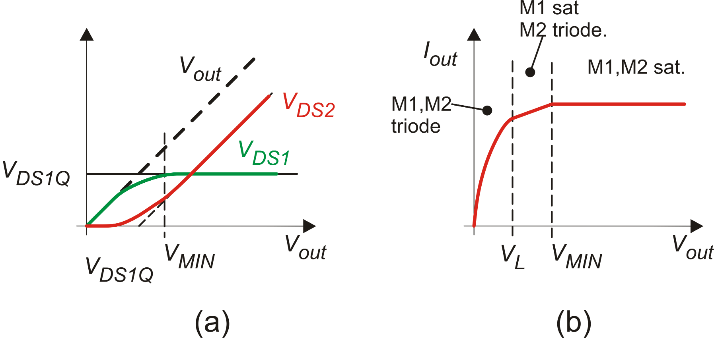

Slide 4
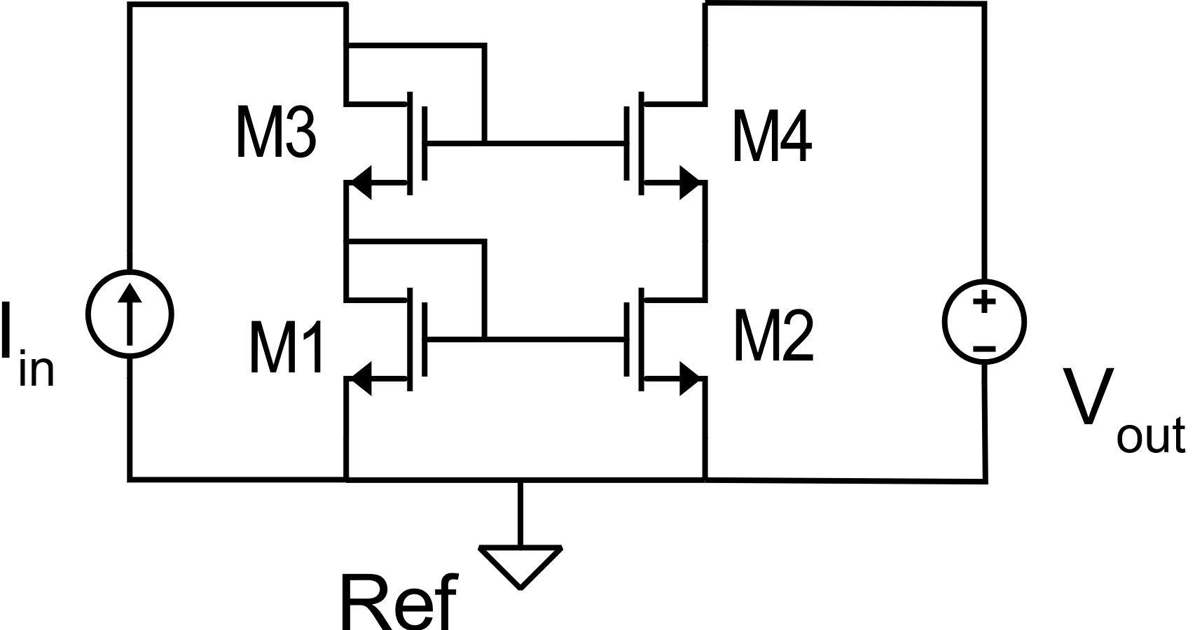
CMOS cascode current mirror (classic topology)
V_{B1}=V_{B2}=V_{B3}=V_{B4}=Vss (lowest supply rail)
V_{BS2}=V_{BS1}
V_{BS3} generally ≠ V_{BS4}

Slide 5
CMOS cascode current mirror (classic topology)

Slide 6
CMOS cascode current mirror (classic topology)
Parameters

Slide 7
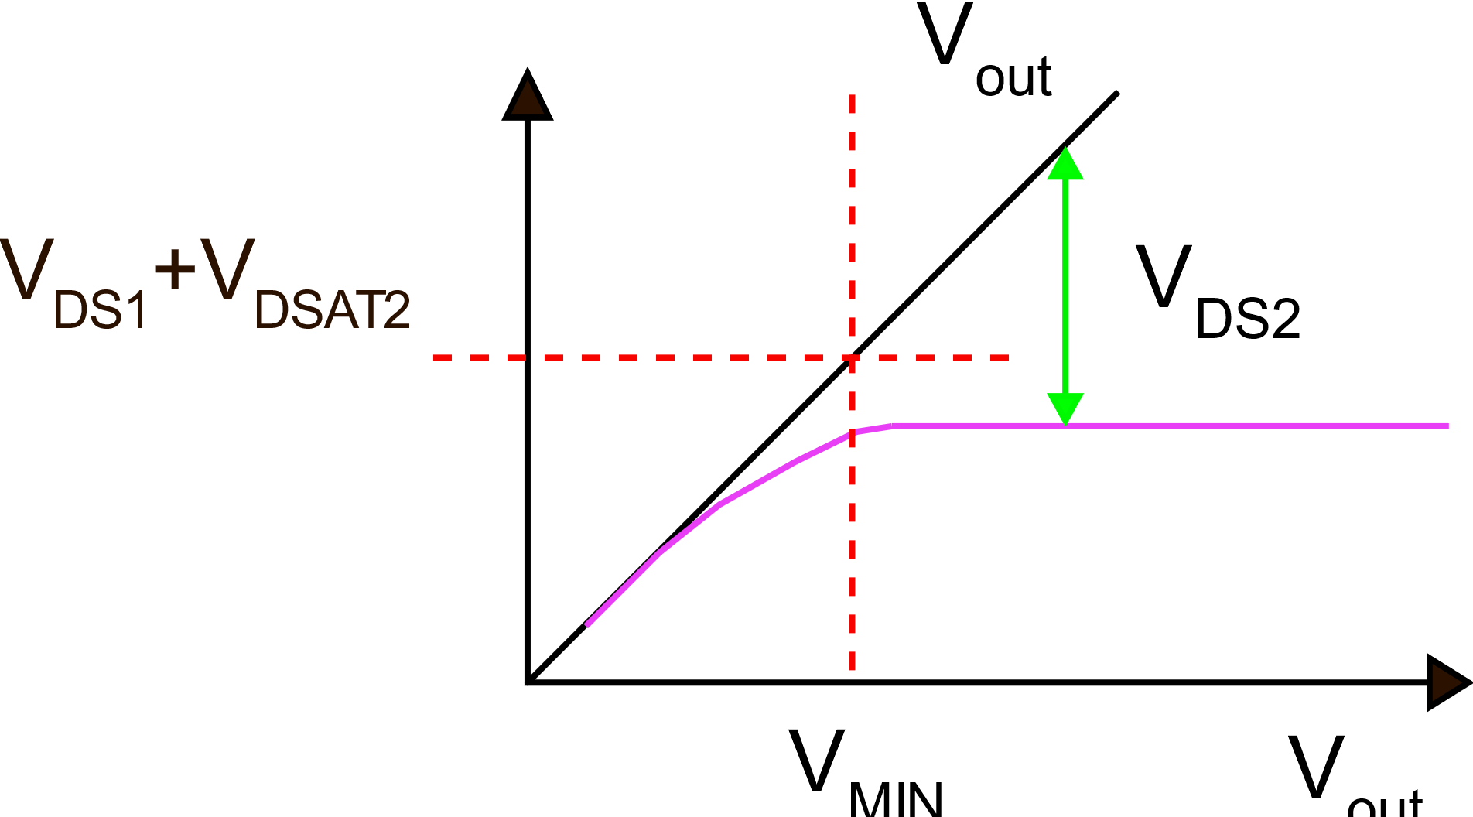
Cascode current mirror: non-optimal V_{MIN}

Slide 8
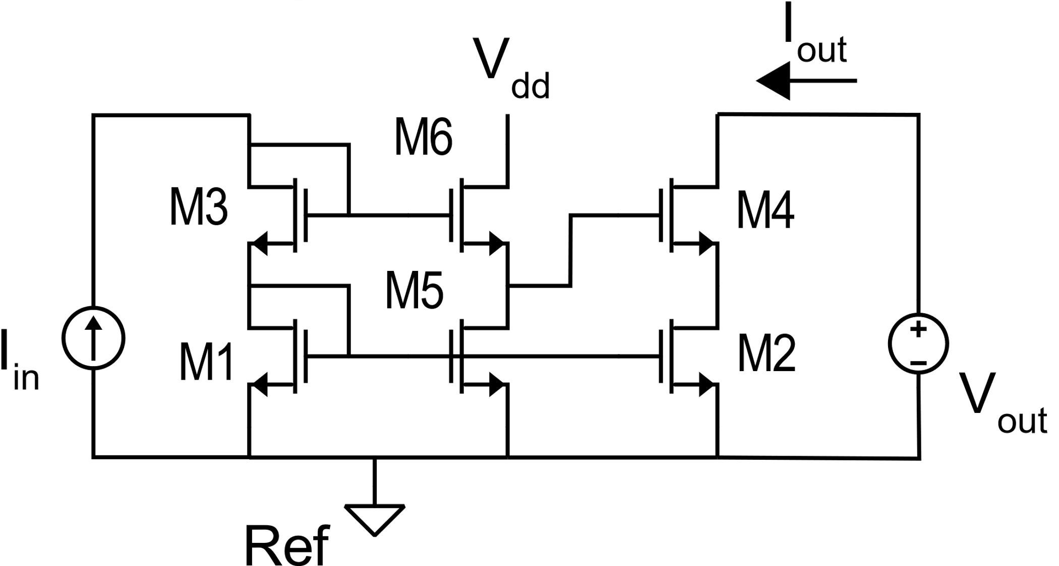
Wide swing cascode mirror: 6 MOSFET mirror
Voltage shifter

Slide 9
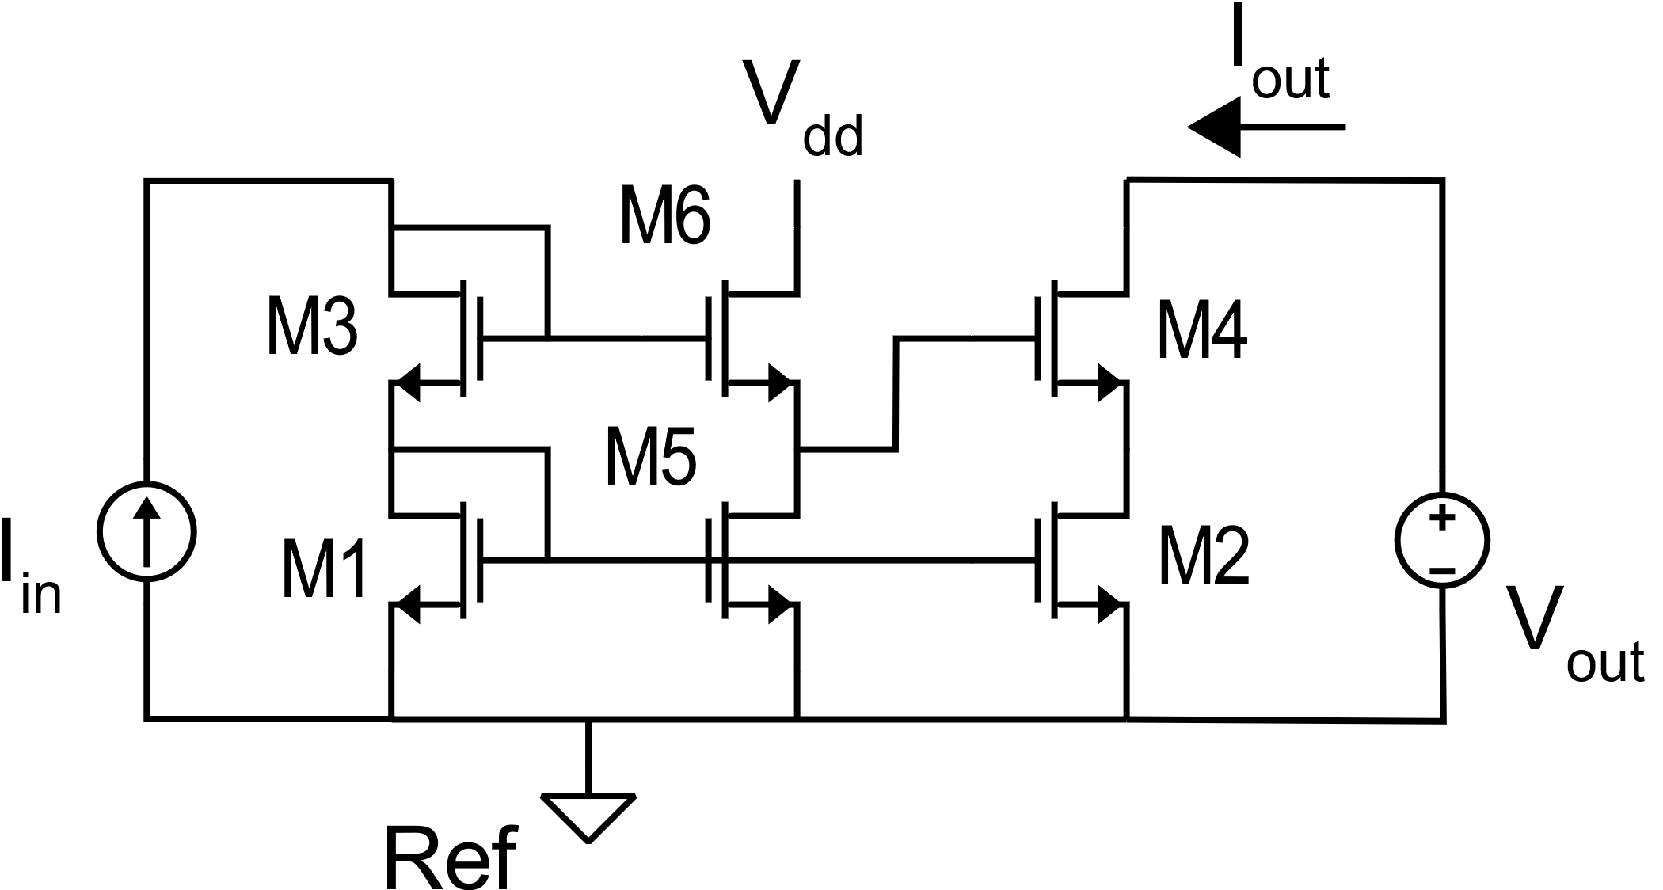
Wide swing cascode mirror: 6 MOSFET mirror
(neglecting the body effect)
In strong inversion:
Choices:
I_{D5}=I_{D1} (=I_{D6})
β₆=β₁
β₄=k_{M}β₁
β₃=β₁/4

Slide 10
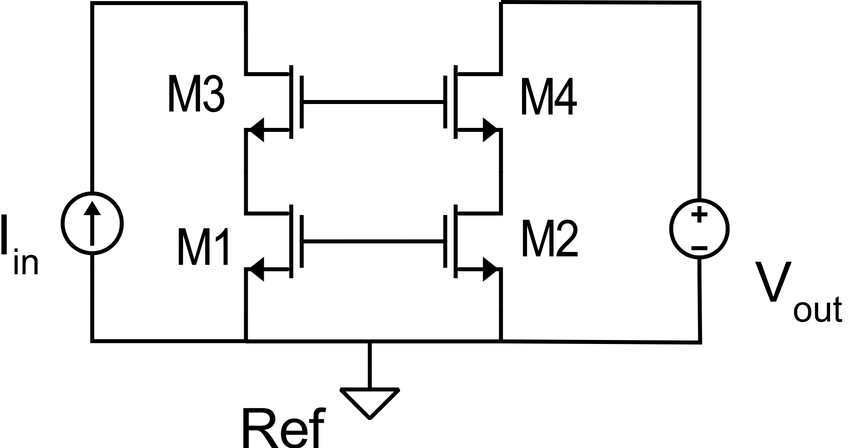
High precision – wide swing cascode mirror

Slide 11
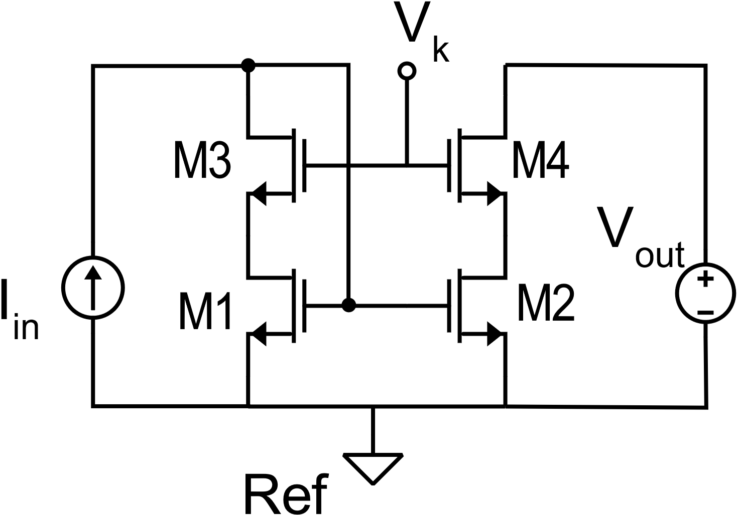

Slide 12
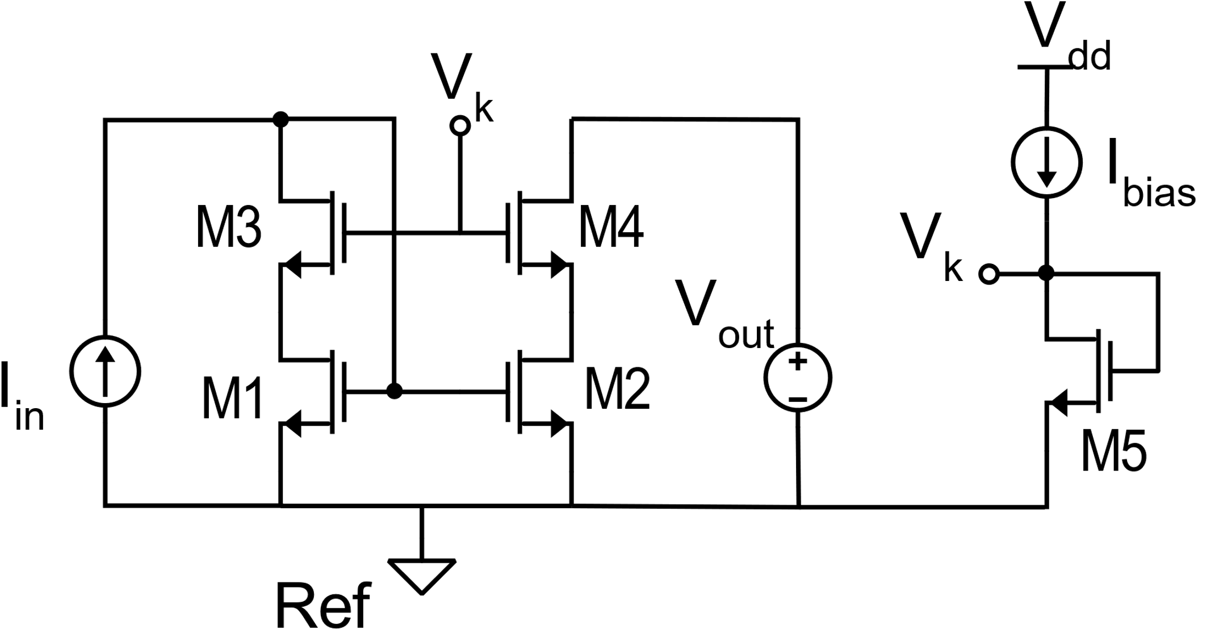
Bias of a wide-swing cascode structure

Slide 13
To reach maximum swing:
In strong inversion

Slide 14
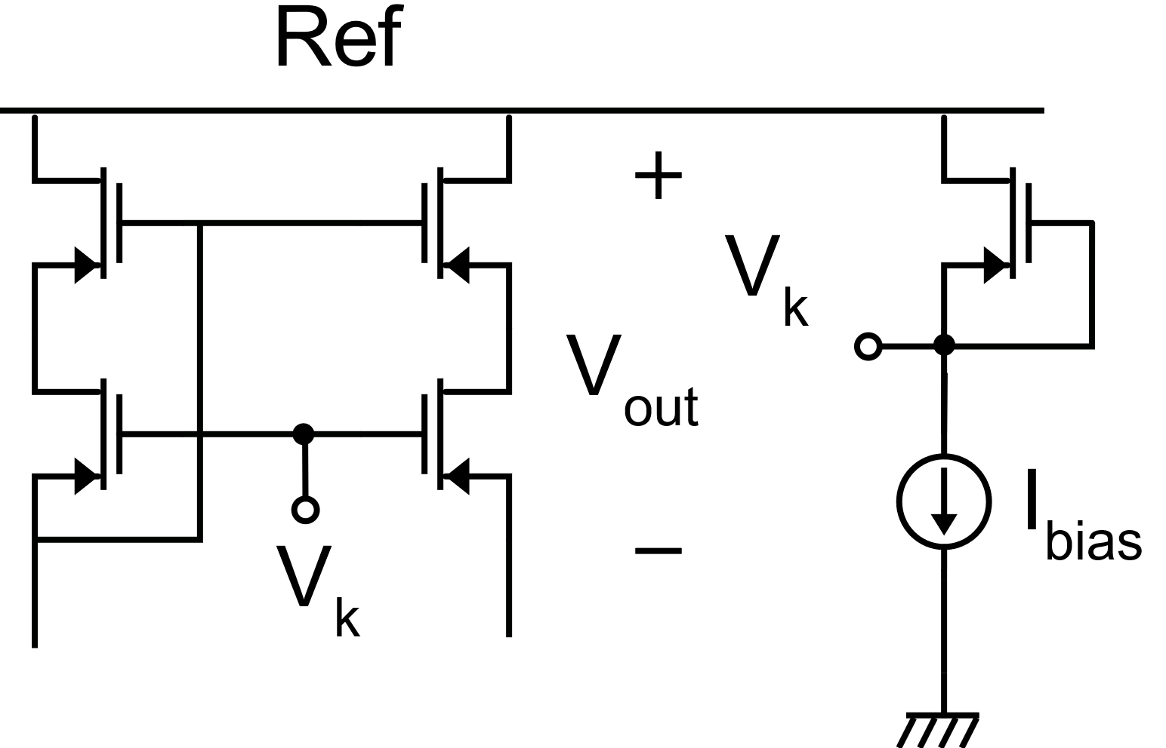
P-version of the wide swing high precision cascode mirror
Very important rule:
Voltage Vk must be invariant against Vdd variations when measured using Ref as the reference voltage. (i.e. Vk should be referred to node Ref.) The circuit shown in the picture satisfies this requirement.

