Slide 1
Very basic rules to facilitate analysis / synthesis of integrated analog circuits
In these slides:
How to obtain the large signal equation of p-type transistors from n-type ones and a few intuitive views about both.
Basic expressions for the resistances seen from each terminal in notable single-transistor configurations.
The g_{m}r_{d} (g_{m}r_{o} in BJTs) product
Power rails, floating rails and reference nodes

Slide 2
From n-type transistors to p-type ones
We will start from MOSFETs and, at last, will briefly cite the case of BJTs. These considerations apply to the large signal behavior, since the small-signal equivalent circuits of n-type and p-type transistors are identical.

Slide 3
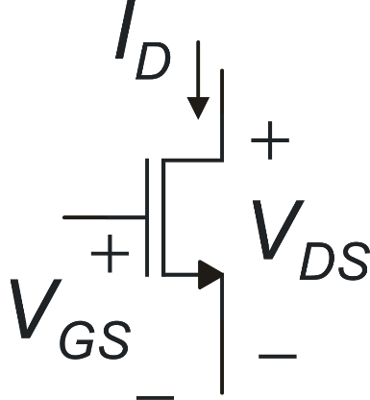
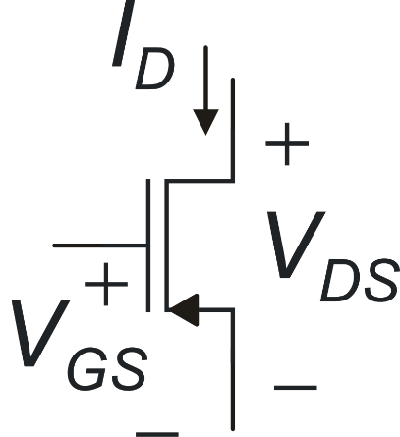
From n-MOSFETs to p-MOSFETS
Apply this transformation:
And put it into the n-MOS equations:
Obtain the correct p-MOS equations!

Slide 4
Useful examples: transition between triode and saturation region
N-MOS
Applying the transformation (considering also V_{DSAT} − V_{DSAT}
P-MOS

Slide 5
Again on the triode-saturation transition: Strong Inversion
N-MOSFET in Strong Inversion
Condition to keep the MOSFET in saturation
Practical Rule
In order to keep an N-MOSFET in saturation V_{D} cannot descend below the gate voltage (V_{G}) reduced by V_{tn}
V_{D}
saturation
V_{G}
V_{G}-V_{tn}
This picture represents a drain voltage that progressively decreases while the gate voltage is constant
triode

Slide 6
Again on the triode-saturation transition: Strong Inversion
P-MOSFET in Strong Inversion
Condition to keep the MOSFET in saturation
Enhancement P-MOSFET
triode
V_{G}+|V_{tp}|
In order to keep a P-MOSFET in saturation V_{D} cannot rise over the gate voltage (V_{G}) increased by |V_{tp}|
V_{G}
saturation
V_{D}

Slide 7
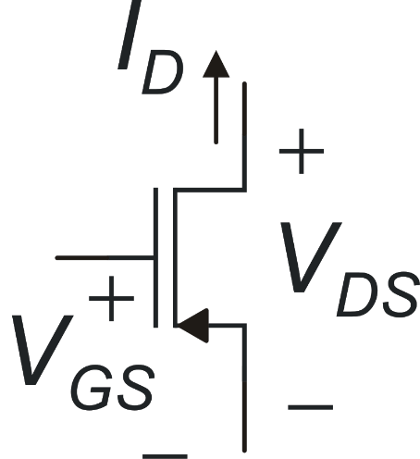
The "natural" direction of the current in P-type transistors
This is equivalent to reverse the
conventional direction of the
drain current for P.MOSFETs
By this convention, the
drain current is positive
also in P-MOSFETs

Slide 8
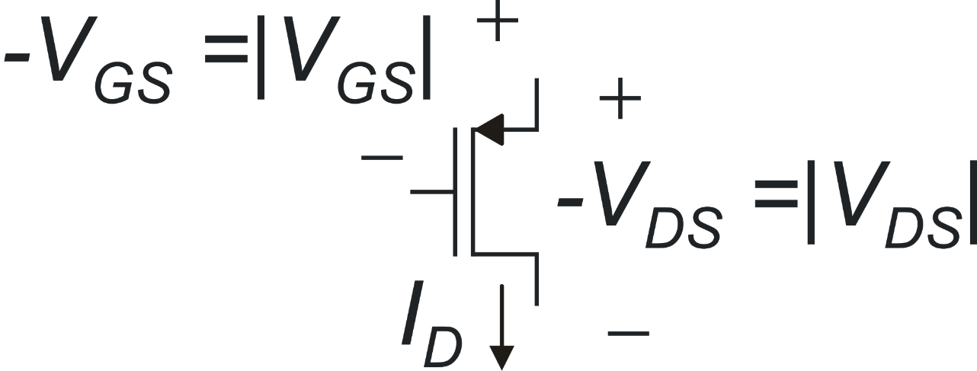
An intuitive view to deal with p-MOSFETs
always
in strong and moderate inversion
The voltage drop across
the mosfet, measured along the natural direction of ID is |V_{DS}|
in strong inversion
for enhancement
p-MOSFETs
Passing from the gate to the source the voltage is increased by |V_{GS}|

Slide 9
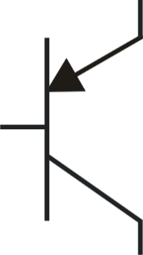
From NPN BJTs to PNP ones
Transformations
These two can be
avoided if the opposite
convention for the current
direction is used
I_{B}
I_{C}

Slide 10
Notable case of small signal resistances
In order to simplify the analysis of circuits including a large number of devices, it is important to keep in mind simple expressions of the resistances that are seen from one terminal of a transistor to gnd in different configurations.
In the next slides, cases of great importance for the synthesis of electronic circuits are recalled. The expressions may be complicated and it is important to remember only the simplified forms and the broad conditions for which the approximations hold true

Slide 11
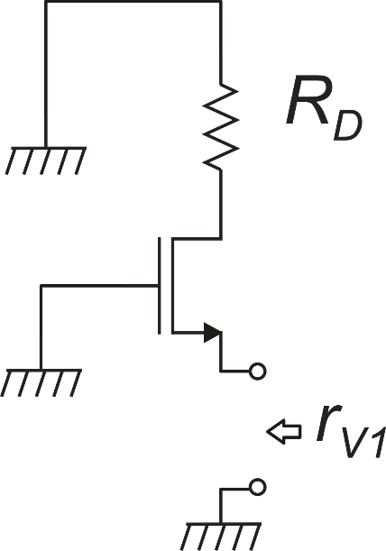
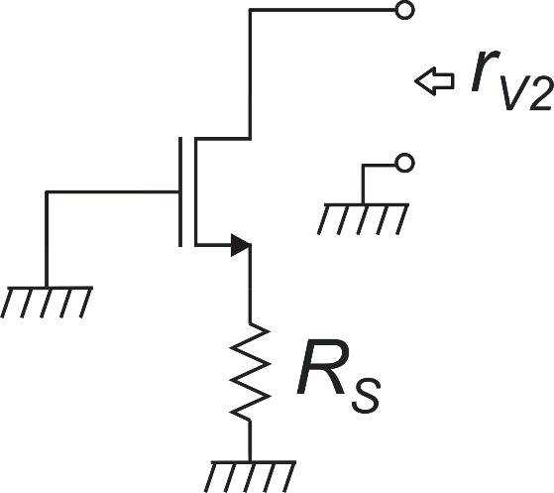
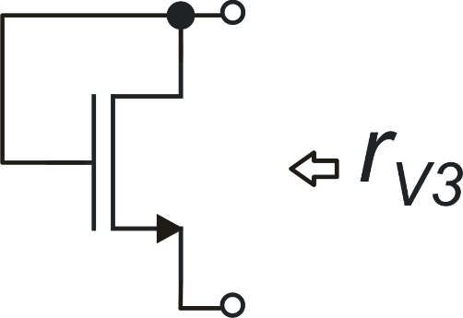
The six basic (small signal) resistances: MOSFETS
exact result
Conditions for approximation
Diode-connected MOSFET

Slide 12
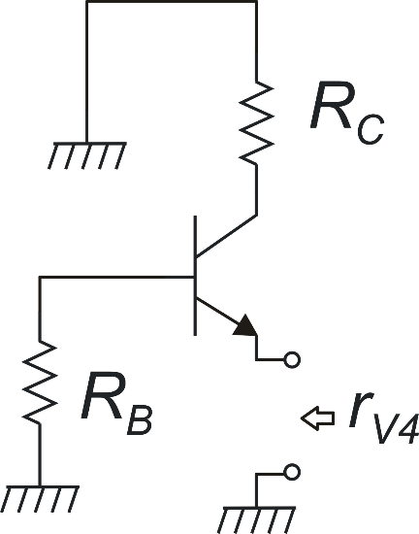
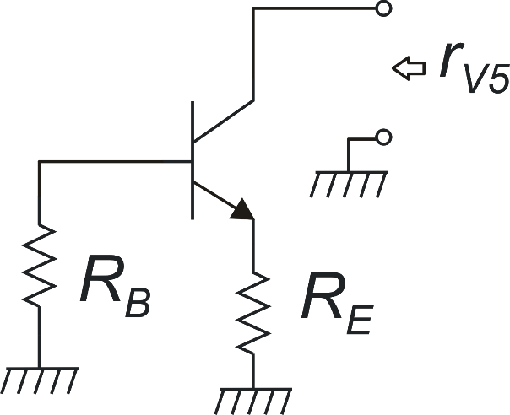
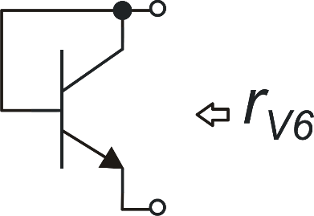
The six basic (small signal) resistances: BJTs
exact result
exact result
approximations
Conditions for approximation

Slide 13
Classification of resistances in analog circuits
 | Small | Medium-large | Large | Very large
MOSFETs | 1/g_{m} | - | r_{d} | (g_{m}r_{d})r_{d}
BJTs | 1/g_{m} | h_{ie} (r_{be}) | r₀ | h_{fe}r_{o}

Slide 14
The g_{m}r_{d} (g_{m}r_{o}) product
The g_{m}r_{d} product in MOSFETs and JFETs, or the equivalent g_{m}r_{o} product in BJT, plays an important role in many circuit configurations.
For example, this product appears in the voltage gain expression of most topologies used to design high-gain amplifier stages. A large g_{m}r_{d} product is also beneficial for the output resistance of high-performance current sources.
In the next slides we will consider which are the factors that affect the g_{m}r_{d} (g_{m}r_{o}) product.

Slide 15
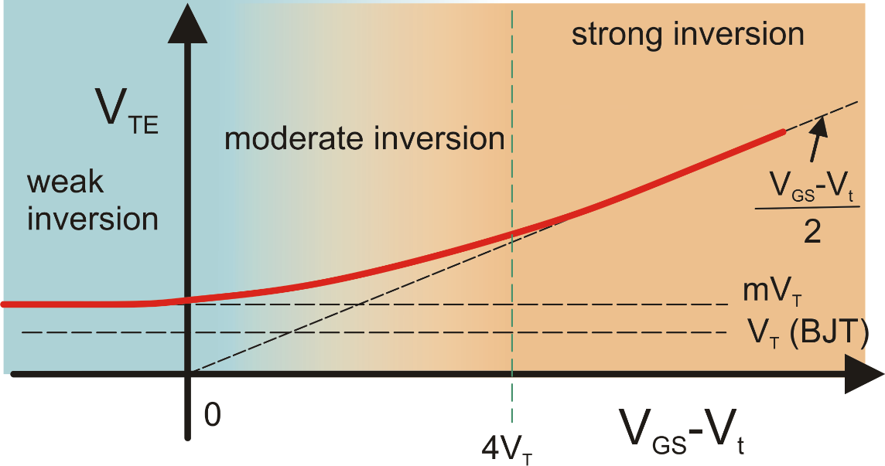
The g_{m}r_{d} product (in saturation region)
Large g_{m}r_{d} products are obtained for small V_{GS}-V_{t} and large L
As a broad estimate, g_{m}r_{d} can be considered to be of the order of 100

Slide 16
g_{m}r₀ for BJTs in active zone
This result is correct in the I_{C} region where the exponential I_{C} vs. V_{BE} dependence holds
(see the Gummel Plot)
g_{m}r₀ may easily reach 1000 (e.g. for V_{A}=25 V)
g_{m}r₀ does not depend on the BJT operating point
(this is an important difference between BJT and MOSFETS)
In general, the performance of BJT integrated circuits is affected by less degrees of freedom (DOFs) than CMOS ones. One of the reason is that, for a given temperature the g_{m}/I_{C} ratio is a constant (=1/V_{T}). If there is the need to change this ratio, emitter degeneration is the simplest choice.

Slide 17
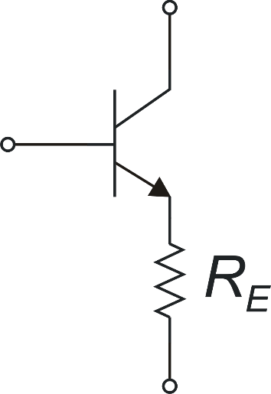
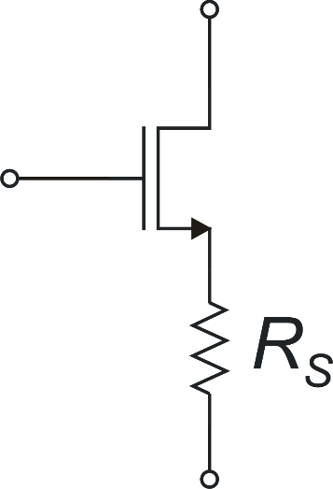
Emitter degeneration (source degeneration)
Lower effective g_{m} for the same I_{D} (I_{C})
Higher equivalent r_{o}
Higher input resistance (BJT)
reduced g_{m}

Slide 18
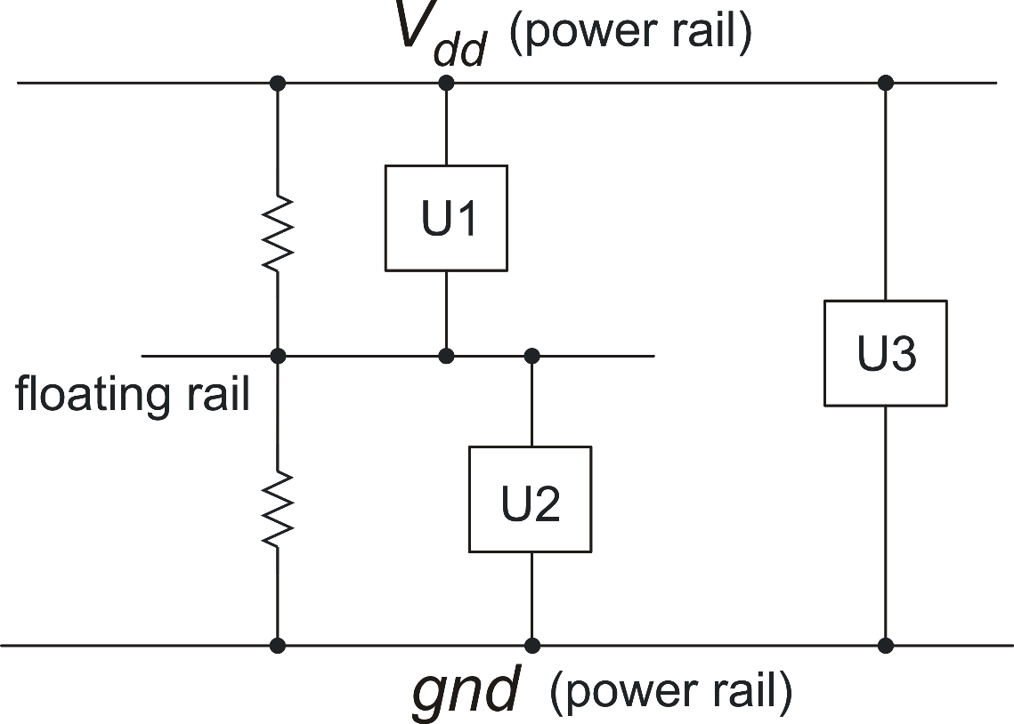
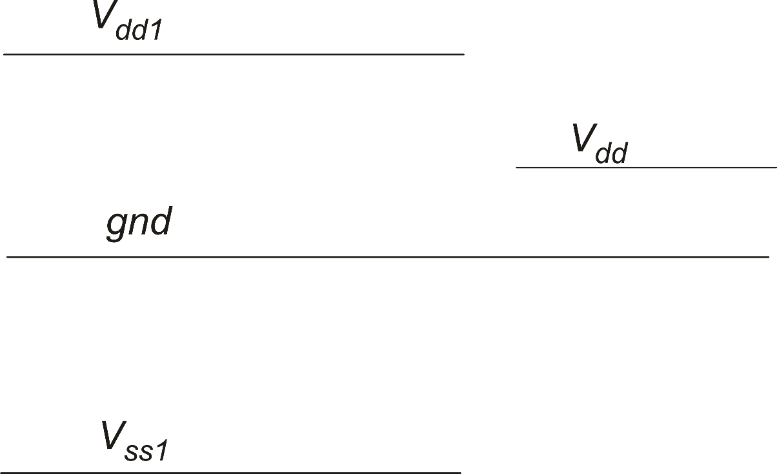
4. Power rails and floating rails
16 V
High voltage
domain
3.3 V
0 V
Low voltage
domain
-16 V
Each power rail is connected to one of terminal od the power supply. Power rails carry the supply currents to all blocks of the IC
If the currents that the floating rail provides to the circuits connected to it (U1 and U2) are too large, the voltage of the floating rail can be altered. In that case it is necessary to use an active circuit (e.g a voltage buffer) to create the floating rail.

Slide 19
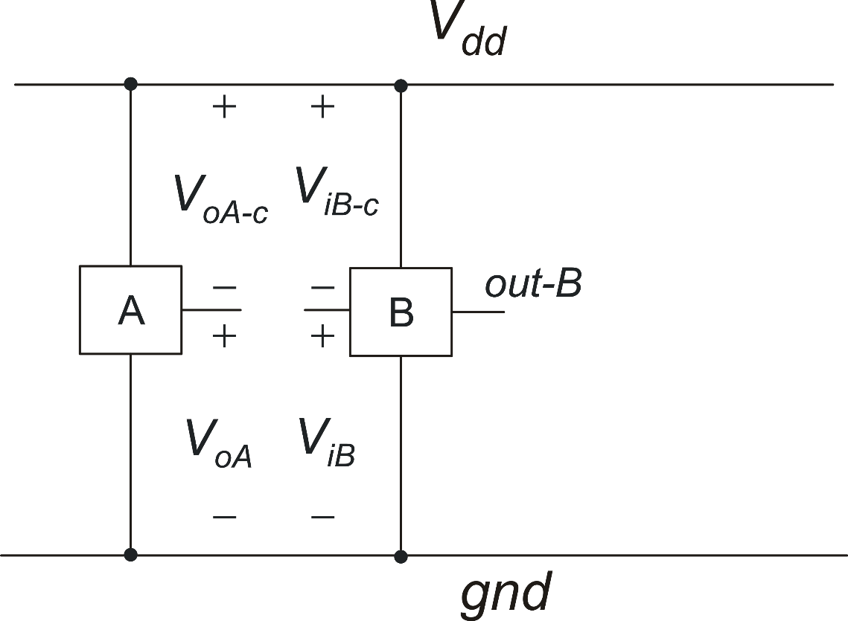
Reference node for voltages: power supply invariance
Output voltage of circuit A, referred to Vdd (complementary to VoA)
Input voltage of circuit B, referred to Vdd
Depending on the topology of circuits A and B:
Either V_{oA} or V_{oA-c} may be invariant with respect to _{Vdd}
Out-B does not depend to V_{dd} if either V_{iB} or V_{iB-c} is independent to V_{dd}
Output voltage of circuit A, referred to gnd
Input voltage of circuit B, referred to gnd

Slide 20
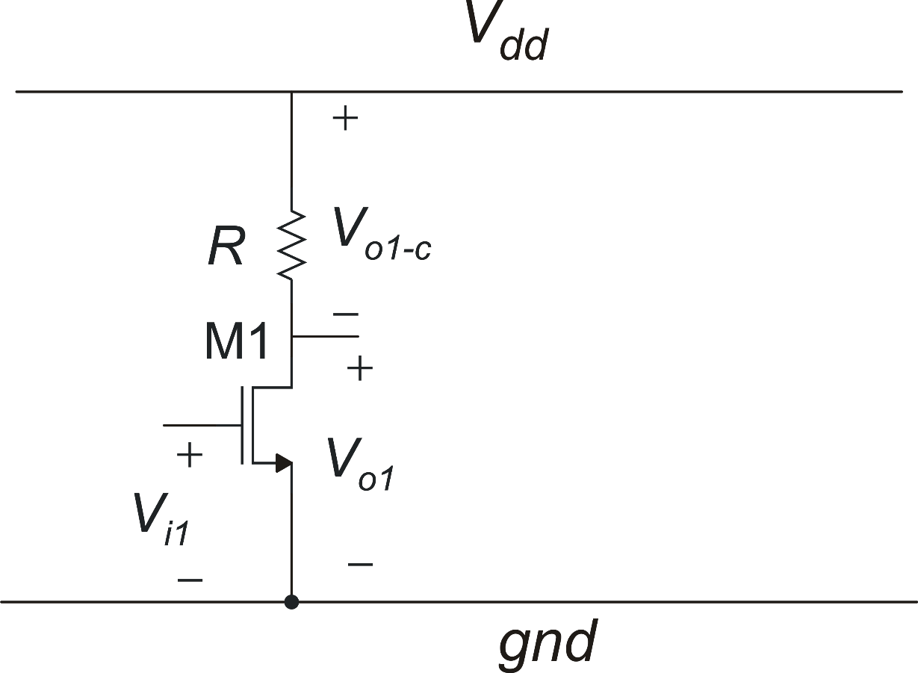
Example: n-MOS common source amplifier with resistive load (unipolar)
Invariant
When referred to the gnd rail, the output voltage of this amplifier is not invariant with respect to the the power supply voltage (V_{dd}).
Non-Invariant
On the other hand, the complementary voltage
V_{o1-c} is invariant with respect to the supply voltage.

Slide 21
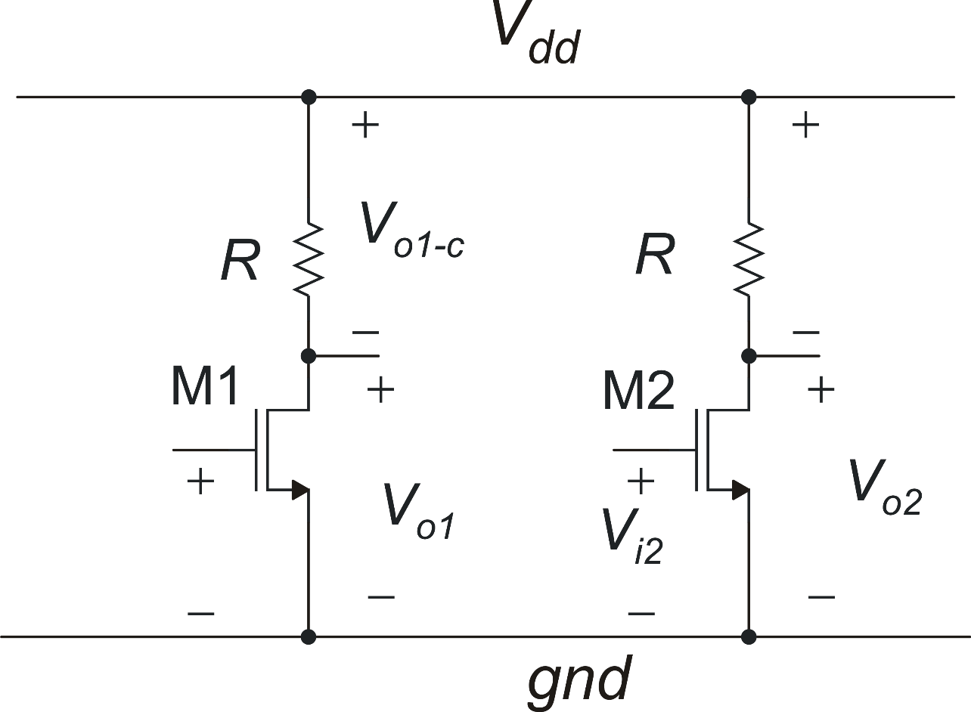
Example: cascade of two n-mos common source stages
V_{out}
I_{D2} (and then V_{out}) is strongly dependent on V_{dd}. This means a very low PSSR. For large V_{dd} variations, the operating point of M2 can be altered in an not acceptable extent.
wrong configuration!

Slide 22
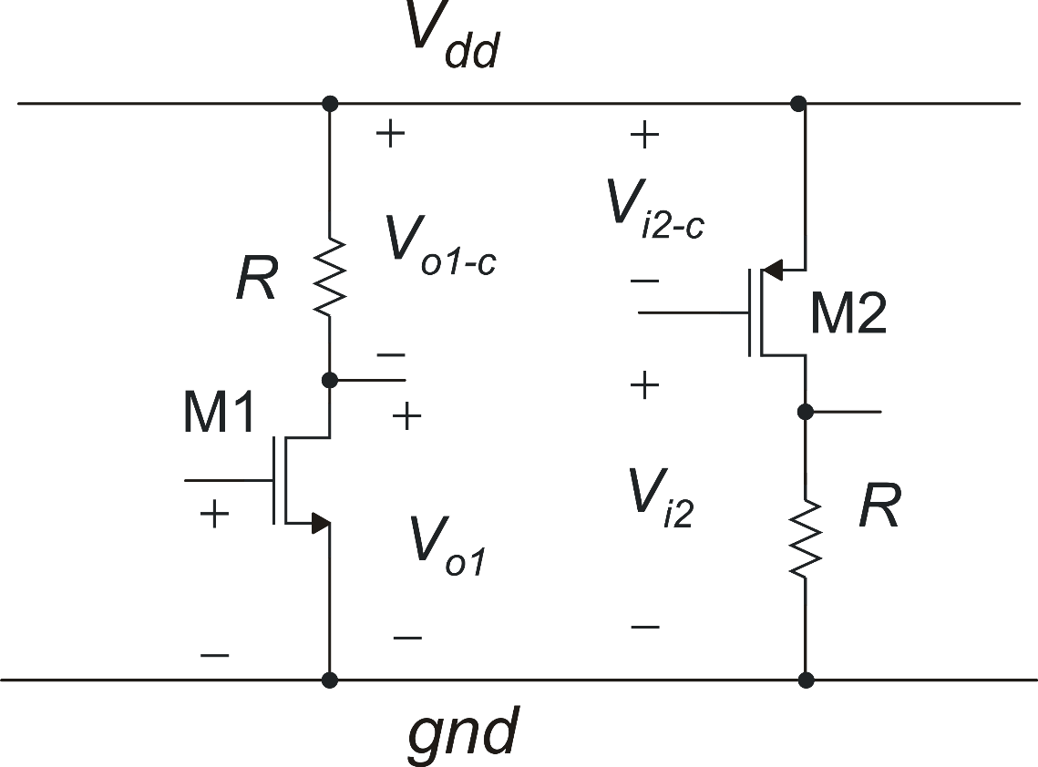
Example: cascade of two complementary common source amplifiers
N-stage
P-stage
The N-stage:
requires an input voltage (Vi1) that is invariant when referred to gnd.
Produces a voltage that is invariant when referred to Vdd
The P-stage:
requires an input voltage (Vi1) that is invariant when referred to Vdd.
Produces a voltage that is invariant when referred to gnd
correct configuration!
P-type and N-stages can be cascaded with low sensitivity to Vdd (high PSSR)

