Slide 1
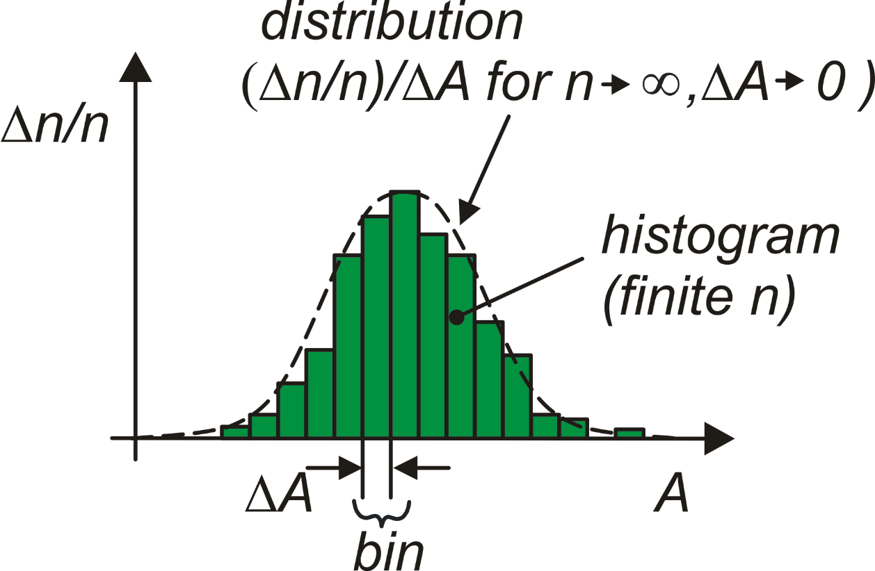
Process Errors in Integrated Circuits
component
(e.g. resistor, transistor, …)
Design phase
quantity A (e.g.
resistance, β_{n}, V_{t} etc)
chip
A_{N} (nominal value)
Production phase

Slide 2
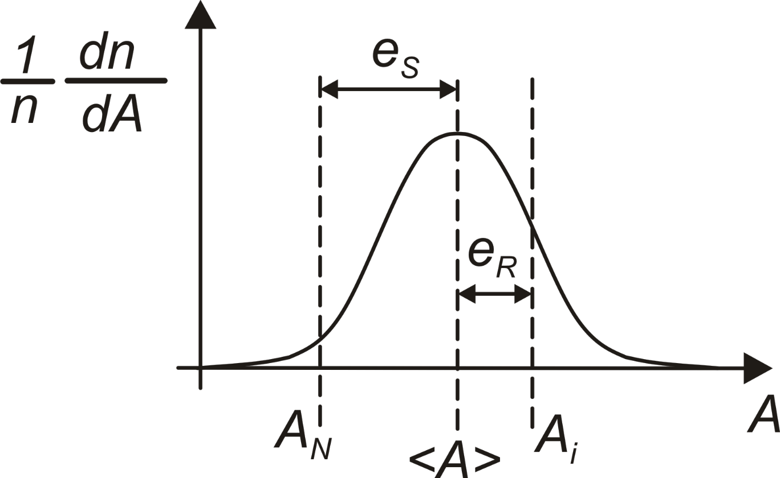
Components of the error and statistical representation
A_{N}: nominal value
A_{i:} A for a generic i-th component.
<A>: the mean of the distribution.
e_{S}: Systematic error = <A>-A_{N}
e_{R}: Random error for the i-th component e_{R} =A_{i}-<A>.
σ_{A}
Random error: standard deviation

Slide 3
Confidence intervals
Max deviation from the mean | ± σ | ± 2σ | ± 3σ | ± 4σ
Fraction of data within the interval | 68.3 % | 95.4 % | 99.7 % | 99.994 %
Fraction of data outside the interval | 31.7 % | 4.6 % | 0.3 % | 0.006 %

Slide 4
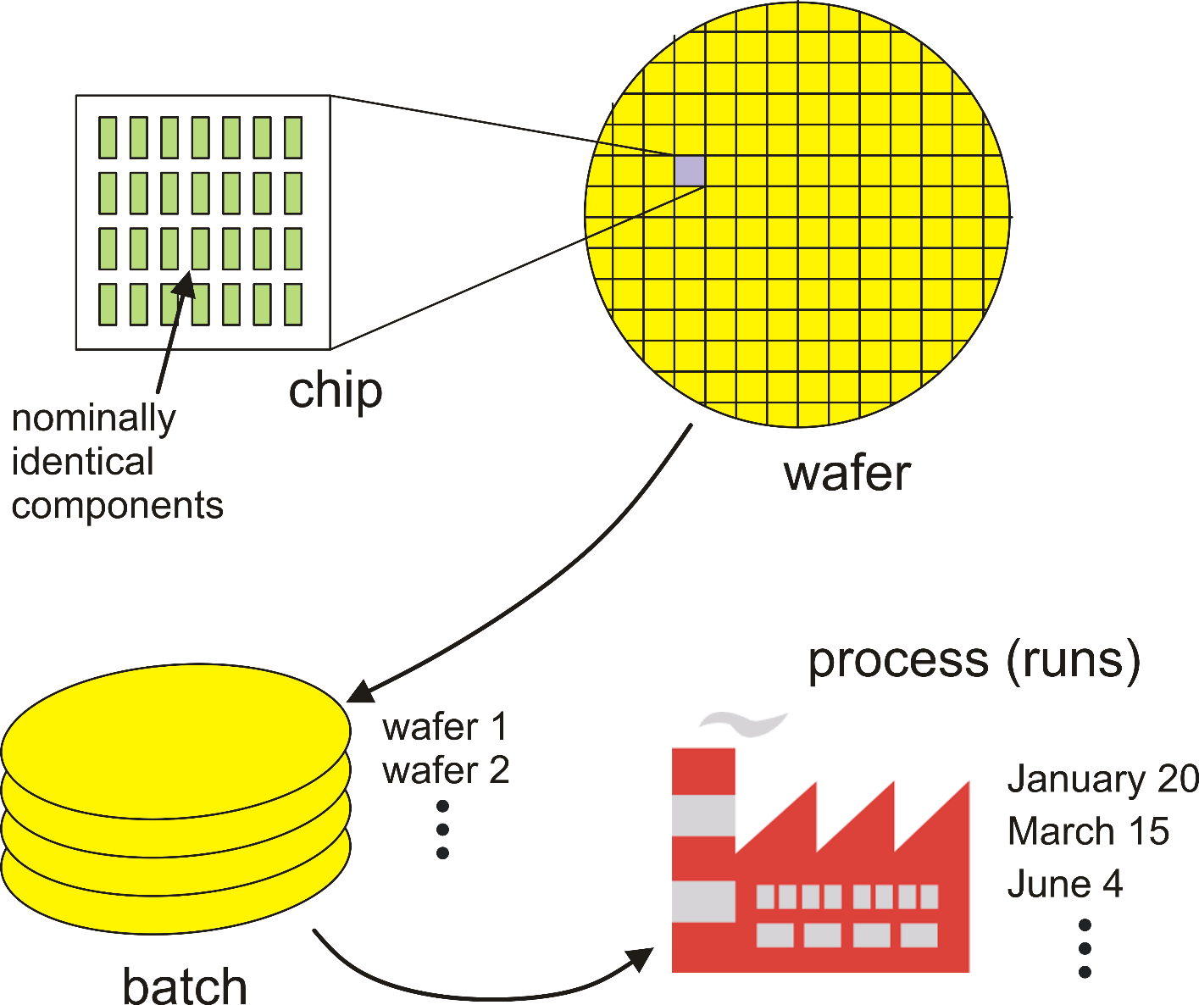
Errors in Integrated Circuits: Levels
chip level
wafer level
batch level
run level

Slide 5
Local and global errors: means
i-th chip
nominally identical components
<A>_{chip}
varies from chip to chip (local mean)
<A>_{process}
property of the whole
process
(global mean)

Slide 6
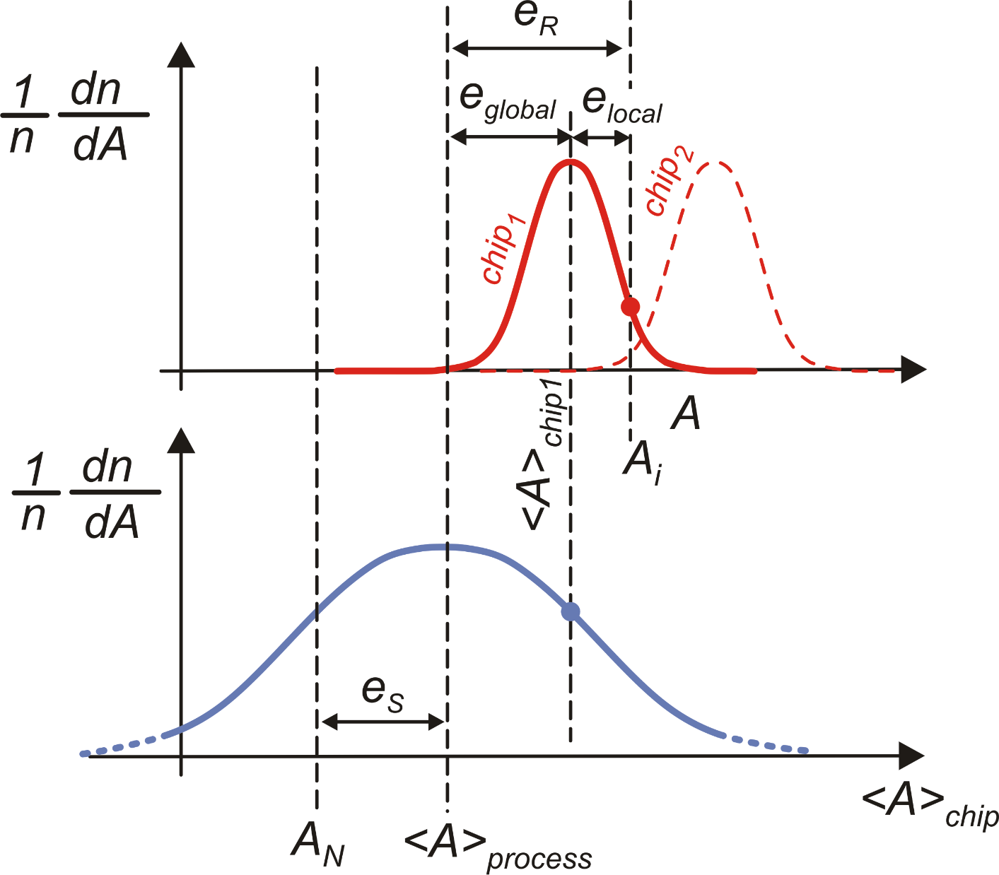
Local and global errors
Random errors local and global
In practice, the distribution of local errors is much narrower than shown here
process corners
"min"
process corners
"max"
process corners
"typical"

Slide 7
Matching errors: definition
Matching error (or mismatch)
A₁
A₂
Nominally
identical
Component 1
Random Matching errors: Main causes
Component 2
Microscopic irregularities (local granularity)
Parameter gradients

Slide 8
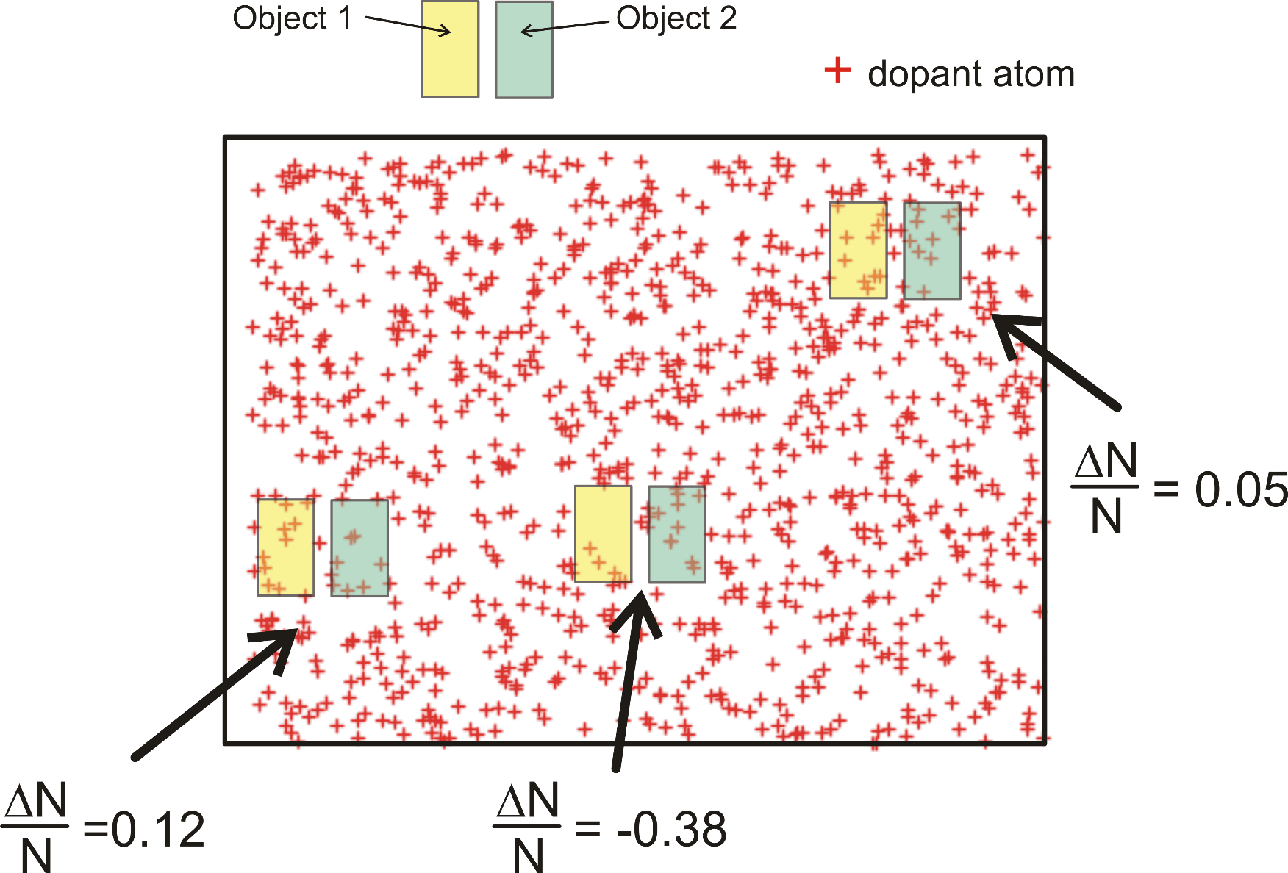
Matching errors: Microscopic irregularities
N= number of dopants
atoms within the
component area
ΔN= N₁-N₂
matching error
Depending on the position
ΔN is subjected to large
variations.
Relative matching error:
$$\frac{ΔN}{N}$$
$$\frac{N_{1}+N_{2}}{2}$$

Slide 9
Matching errors: Microscopic irregularities
The number of dopants atoms affects several properties such as effective sheet resistance and MOSFET threshold voltage
The example can be replicated for other quantities, such as oxide thickness, where the crosses in the figure may represent local maxima or minima
The large fluctuation of ΔN/N can be ascribed to the small area of the devices shown in the example. For even smaller devices its is likely that one of the two devices does not include any dopant atom : ΔN/N may exceed unity (100 % error).

Slide 10
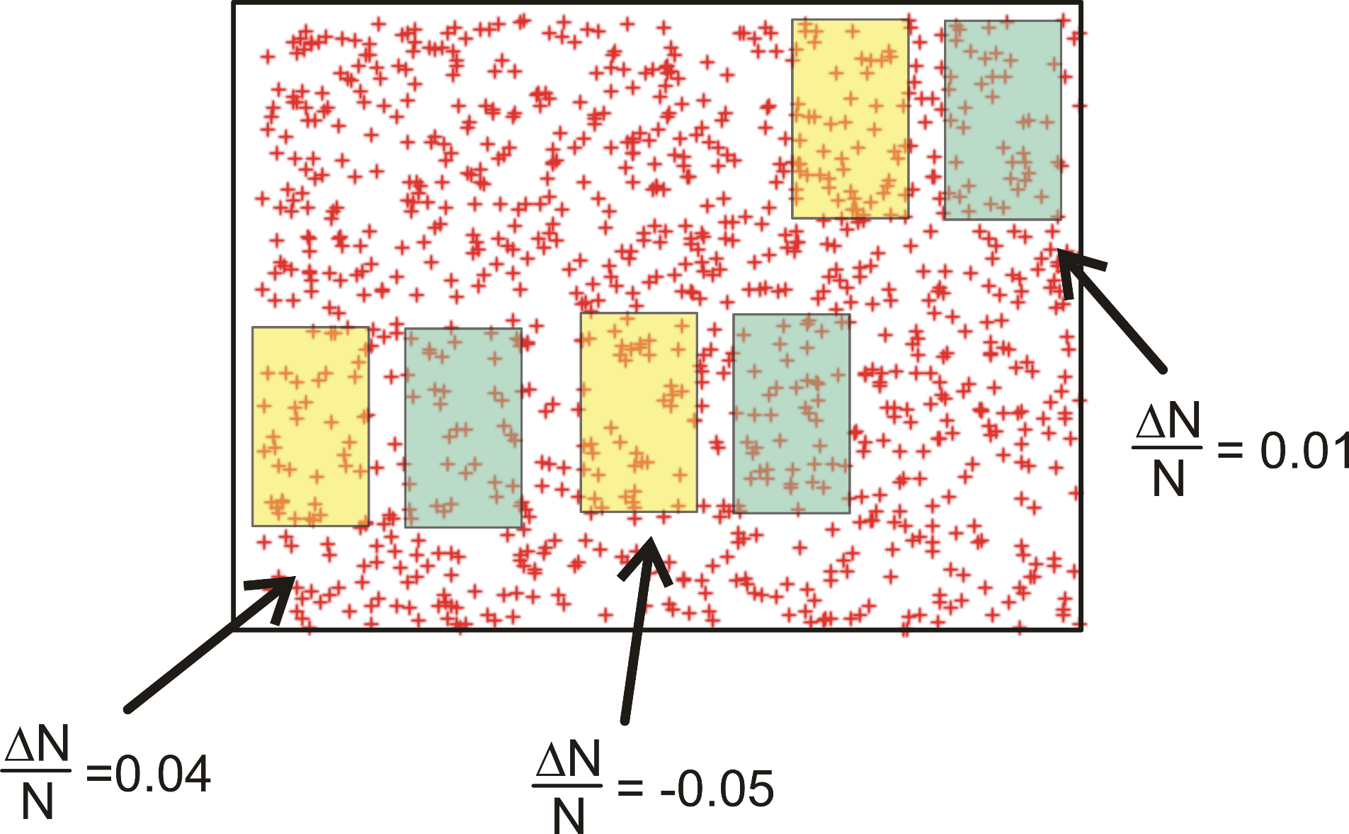
Microscopic irregularities: effect of device area
Larger device areas result in smaller relative matching errors

Slide 11
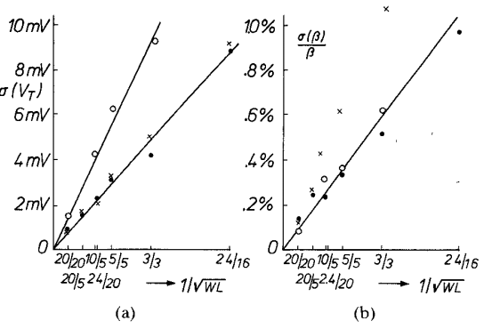
Microscopic irregularities: the Pelgrom model
Resistor
Mosfet
C_{vt}, C_{β} and C_{R} are constant parameters of the process Their values are given in the Design Rule Manual, with names that depend on the foundry (there is no general convention).
C_{vt} units are generally V·μm, while C_{β} and C_{R} ones are μm.
From: Pelgrom et a IEEE J. of Solid State Circuits, 1989l

Slide 12
Matching Errors: Gradients
Gradients indicate that important quantities that affect the device properties are not uniformly distributed on a macroscopic scale. This means that these quantities gradually varies across the chip area.
Quantities of interest can be, for example: -) Dopant density -) Oxide thickness
-) Geometrical process biases (e.g. etching undercut) -) Temperature (e.g. due to power devices present on the chip)
-) Mechanical stress (mainly due to the packaging process)

Slide 13
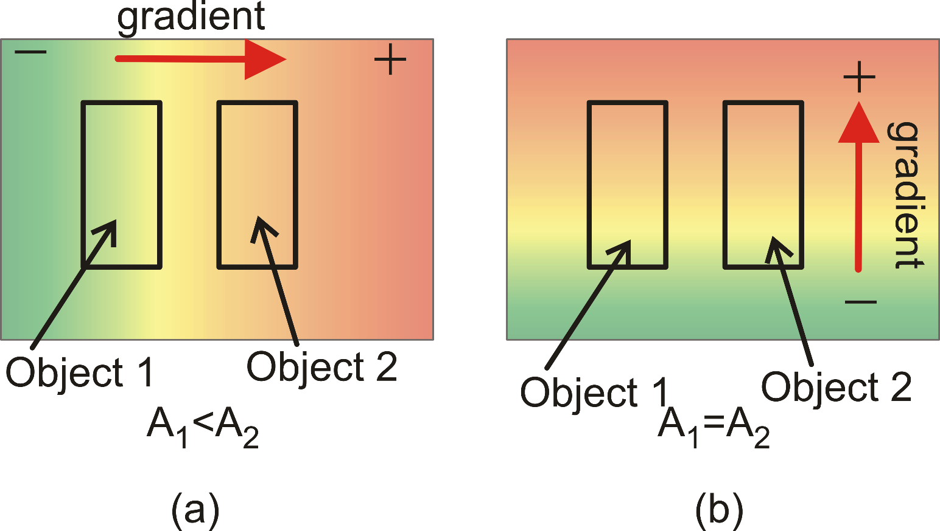
Effect of gradients on device matching
Gradient causes matching error
Gradient does not causes matching error
We consider a generic quantity "A"
Unfortunately, in most cases, the direction of gradients is not predictable!

Slide 14
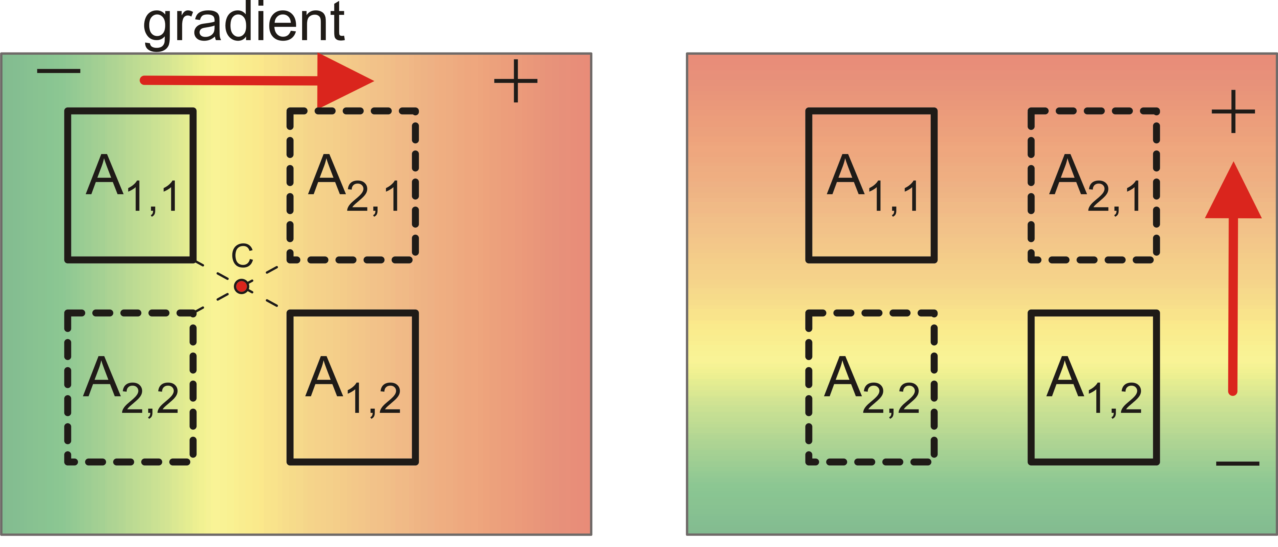
Layout rules that prevent device mismatch caused by gradients
Rule 1 (obvious): Take the distance between objects as close as possible. (This rule is less effective for large devices)
Rule 2: Use common centroid configurations.
A_{1,1}
A₁
A_{1,2}
A_{2,1}
A₂
A_{2,2}
Centroid of both A₁ and A₂ objects

Slide 15
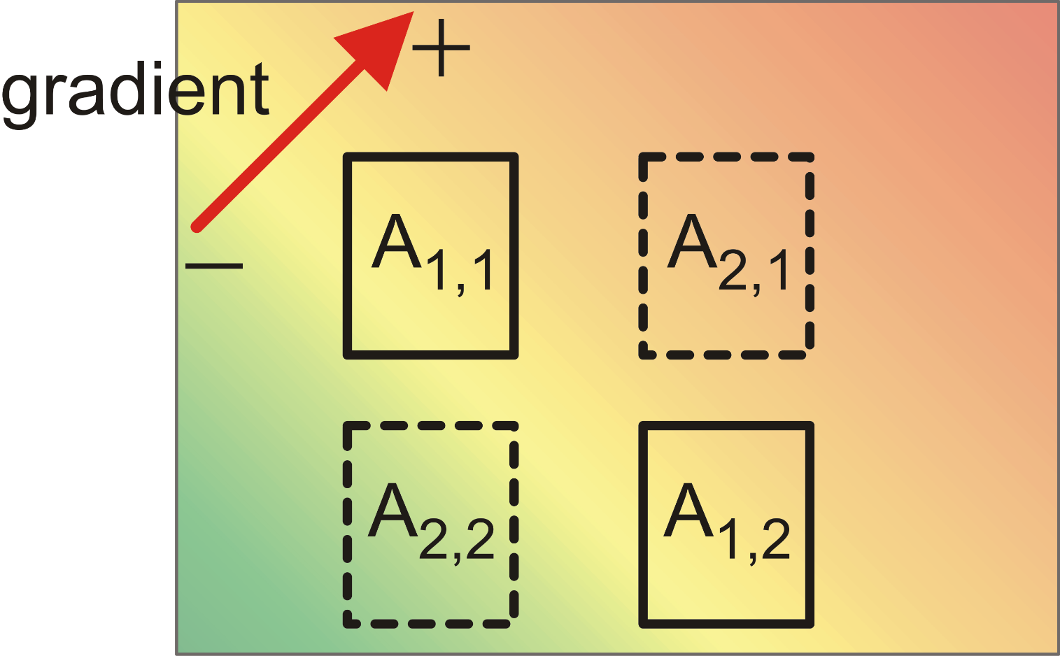
Common centroid configuration: Oblique gradients
component
part
level
A_{1,1}
average
A₁
A_{1,2}
average
A_{2,1}
high
A₂
A_{2,2}
low
The common centroid configuration is effective also against oblique gradients..

Slide 16
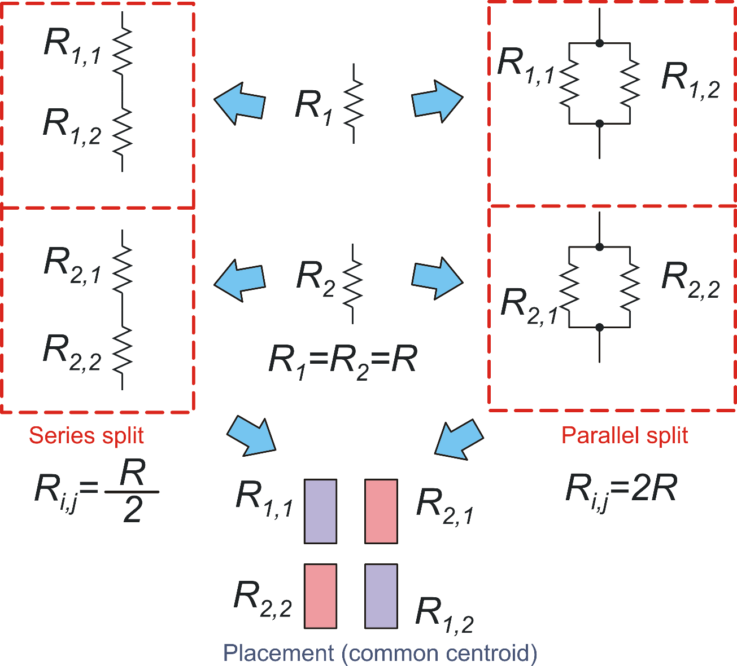
Split and connect components in common centroid configurations
Case 1::Resistors
Series are preferred
when resistors R₁ and R₂
are large
Parallels have to be preferred
for small resistances

Slide 17
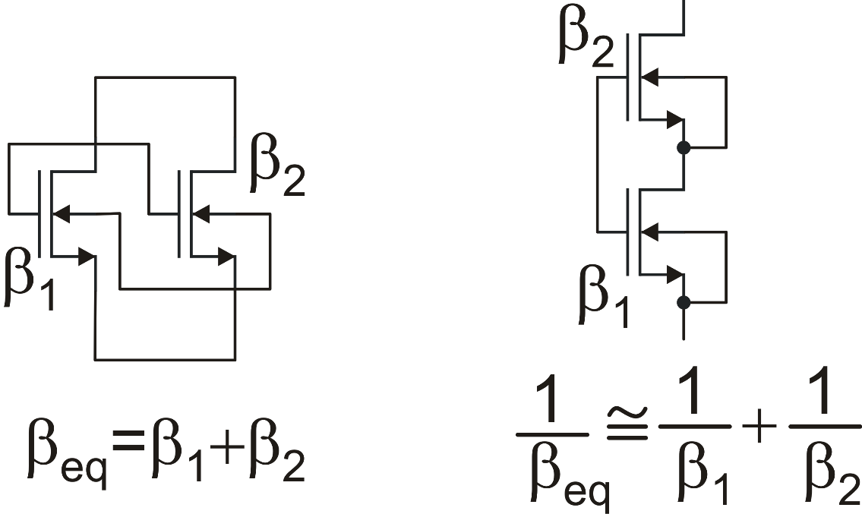
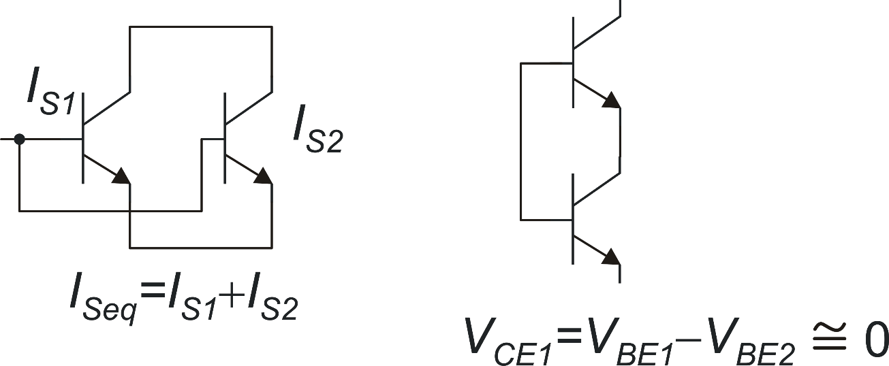
Split and connect components in common centroid configurations
Other devices -Properties of series and parallels
not allowed in
standard
n-well CMOS
Not accurate
Don't use!
Accurate: Can be used in common centroid configurations

Slide 18
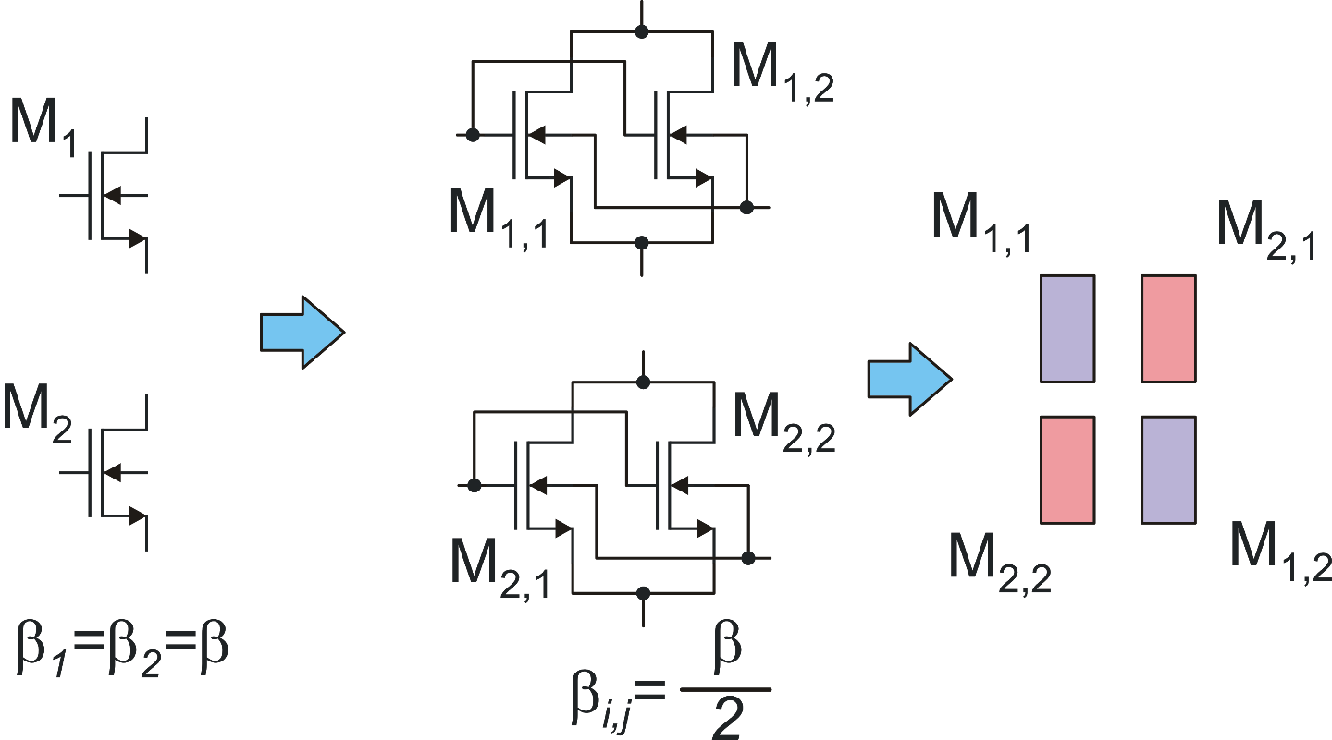
Split and connect components in common centroid configurations
Case 2: MOSFETS
Floating node (no dc path)
Series connections of capacitors have to be avoided as much as possible unless dc paths are provided for the floating node
BJTs: Same as Mosfets (parallels only)
Capacitors: Parallel connections are preferred (no floating nodes)

Slide 19
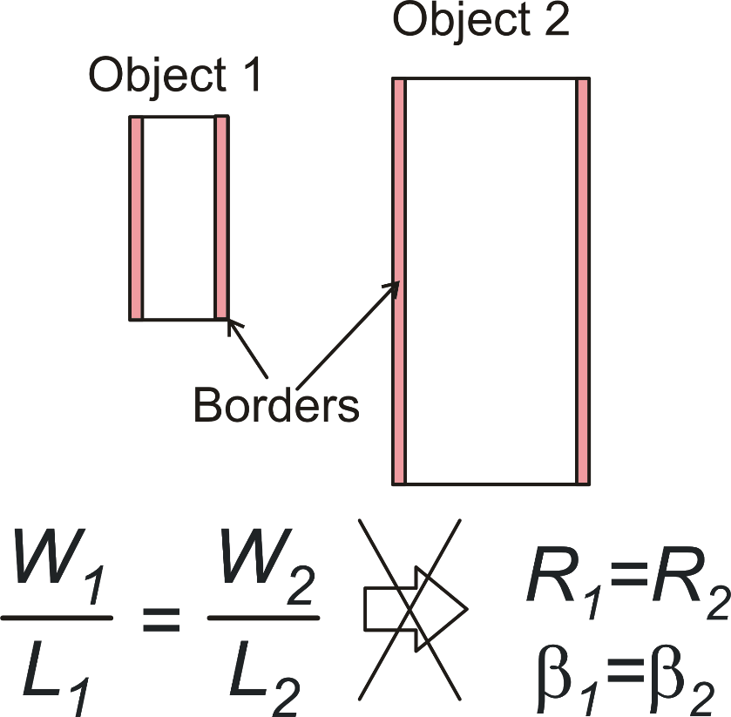
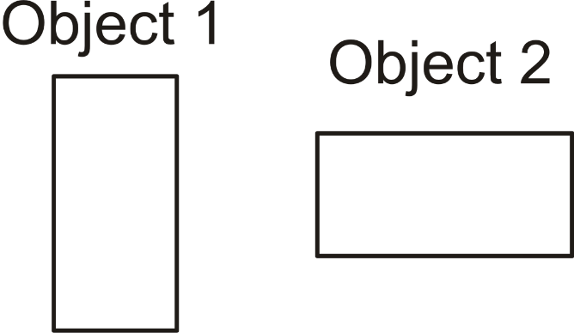
Other Layout rules for improving device matching
Wrong solutions
mechanical stress
Different orientation:
poor matching
resistors
mosfets
Different size: poor matching

Slide 20
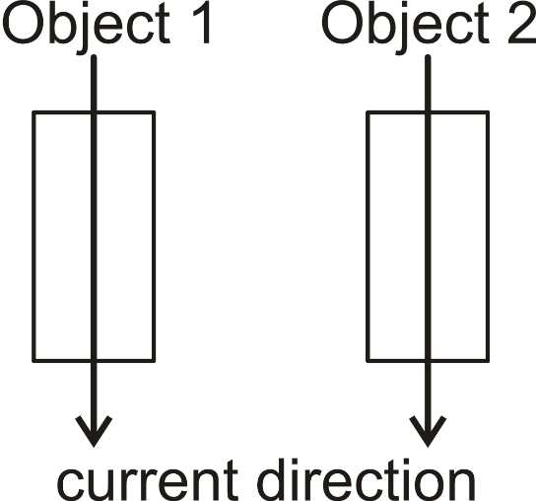
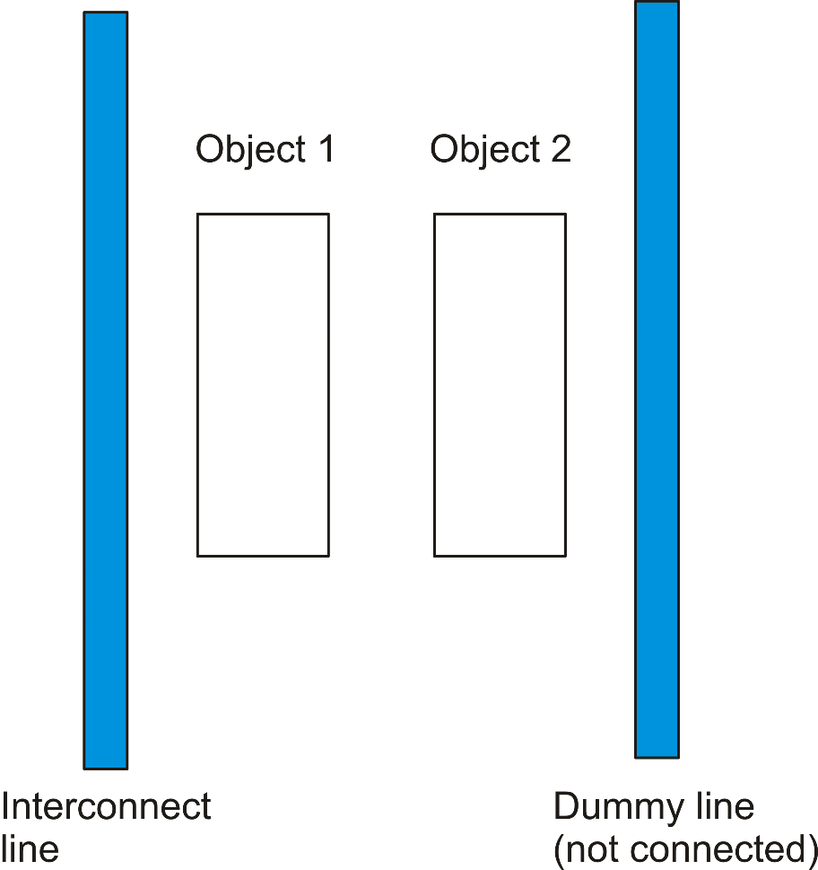
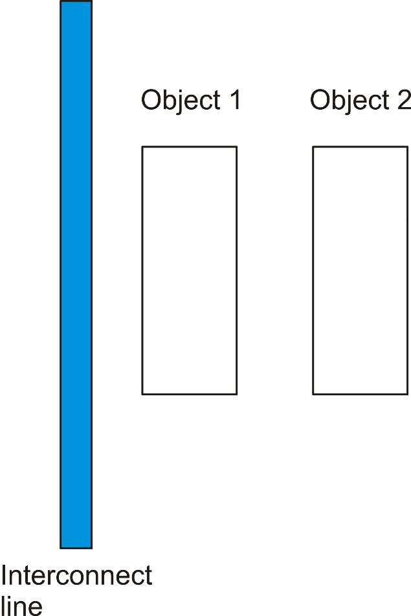
Other Layout rules for improving device matching
Same direction
(to match thermoelectric effects)
Same surroundings
Temperature gradients develop extra voltage differences that depend on the current direction
(up to several hundred μVs

Slide 21
Summary of rules for a good device matching
Devices must be nominally identical (same dimensions, same orientation)
Device areas should be as large as possible (Pelgrom model)
Place devices as close as possible
Use common centroid configurations
Same current direction for the two devices
The devices should "see" the same surroundings

Slide 22
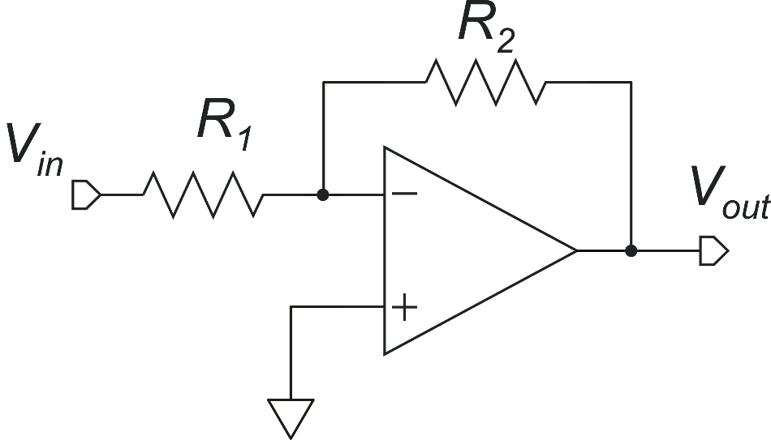
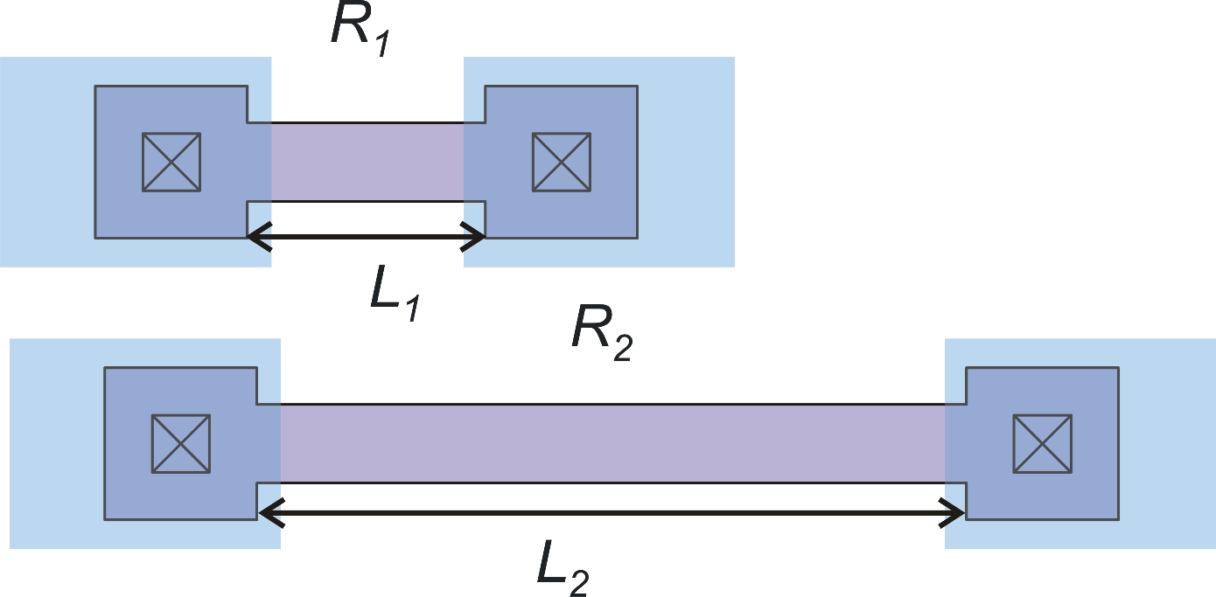
Rules to obtain accurate ratios
Example: accurate inverting amplifier with gain magnitude =3
(e.g. with x=0.1, er=11%)
(systematic error)

Slide 23
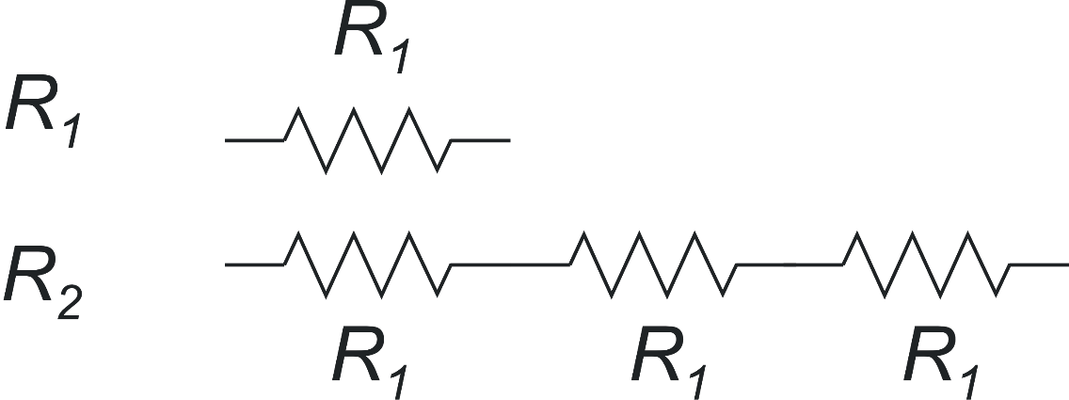
Accurate ratios: modular components
Both components R₁ and R₂ are obtained by adding different numbers of a single module.
Generalization to
Fractional ratios
module

Slide 24
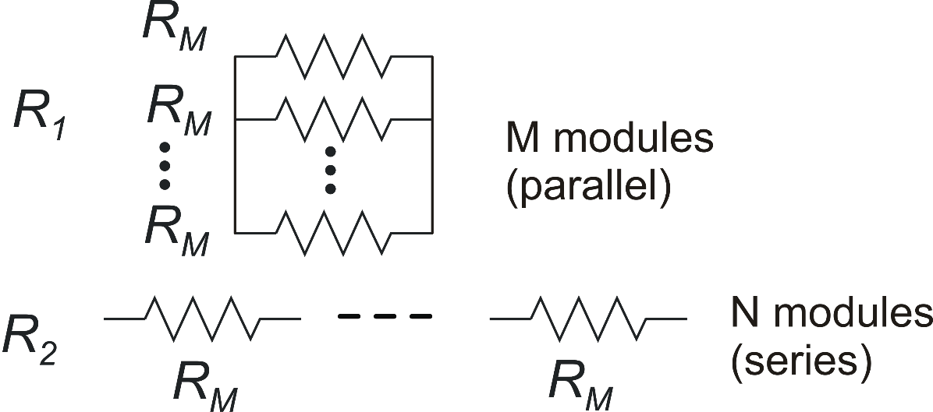
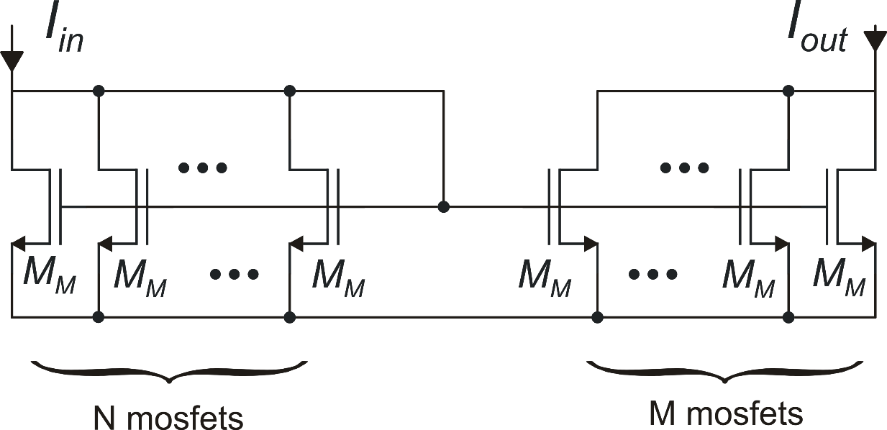
Accurate ratios: modular components
Parallel / series
combination
Current mirror with accurate gain
M_{M} = Module
Large ratios with less components

Slide 25
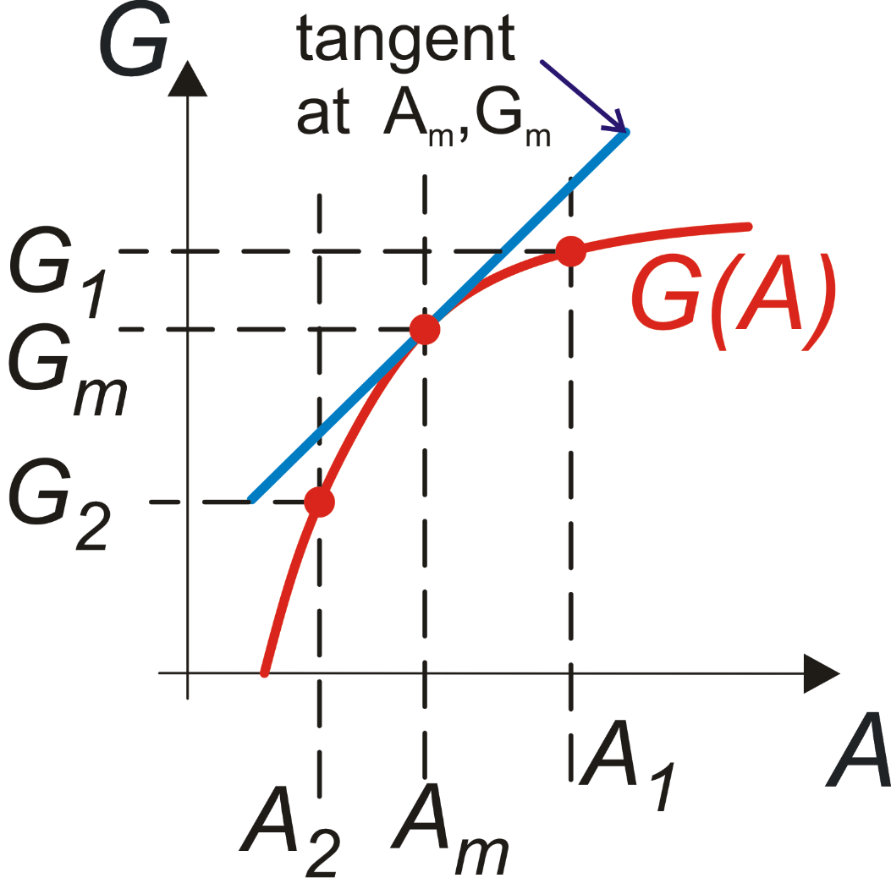
Elements of error propagation theory

Slide 26
For multiple independent variables - general case
(A₁,B₁,C₁)
(A₂,B₂,C₂)
G₁
G₂

Slide 27
Error propagation: particular case 1
posynomial expression
α,β,γ : real exponents
A,B,C real positive variables
Using:

Slide 28
Error propagation: particular case 1
Relative variation (or relative error)
Sum of the single relative errors, weighted by the respective exponents

Slide 29
Error propagation: particular case 2
logarithm of a posinomial
Here we have the absolute error, not the relative one.

Slide 30
Application to matching errors
Generally, when dealing with matching errors: $A_{m}=\overline{A }$ (mean value)
Matching errors has also the following basic property: Linearity: G=A+B ΔG=ΔA+ΔB G=kA, where k is a constant : ΔG=kΔA
In the case of relative error: G=kA: $\frac{ΔG}{G}=\frac{ΔA}{A}$

Slide 31
Matching errors: statistical independence
Matching errors of different quantities (e.g., quantities A,B,C) can be often considered independent from each other since they are mostly affected by microscopic irregularities, that do not show significant correlations when pairs of quantities are considered.
In addition matching errors of different device pairs can be also considered independent, or, at least, uncorrelated.

