Slide 1
Passive components in Integrated Circuits
Resistors: DAC - Time-continuous amplifiers, sensor interfaces, voltage references …
Capacitors: Analog filters, Switched-Capacitors circuits (discrete-time)
Inductors: Very High frequency (GHz ) RF circuits
Passive components:
Precise resistors and capacitors are necessary for high accuracy analog applications.

Slide 2
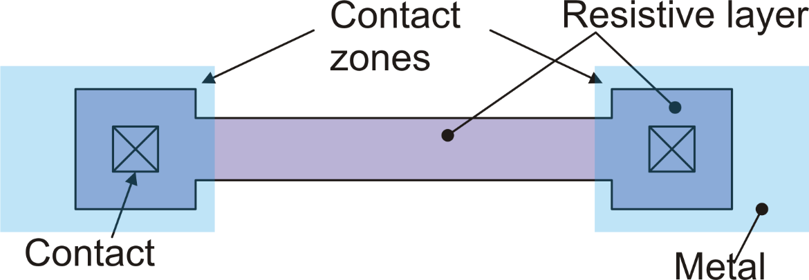
Integrated resistors: general layout
W
L

Slide 3
Resistor layout for W>>W_{min}
In some cases, we need to draw a resistor body with a width much larger than the minimum value dictated by the technology. This may occur when we need a resistor of low value that must carry relatively large currents.
In this case, the resistor body width is already as large as to allow correct surround of contacts. If there is enough space, we add as many as possible contacts along the resistor width.

Slide 4
Resistors: quality parameters
Sheet resistance (R_{S}): Large R_{S} means that large resistance values can be obtained using less area
Voltage dependence: In integrated resistors, the resistance often depends on the voltage applied to the terminals
Temperature dependence:
TCR: temperature coefficient of resistance:

Slide 5
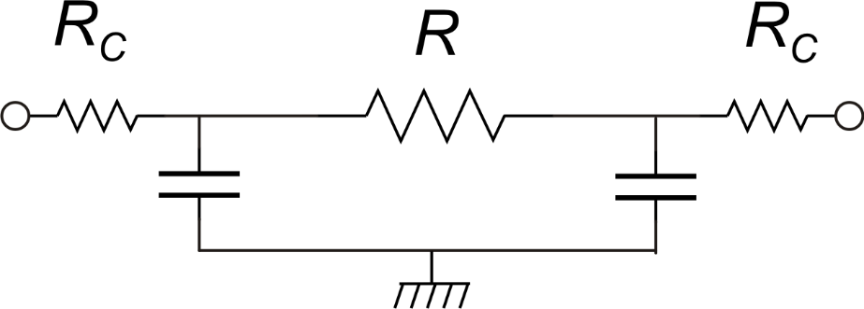
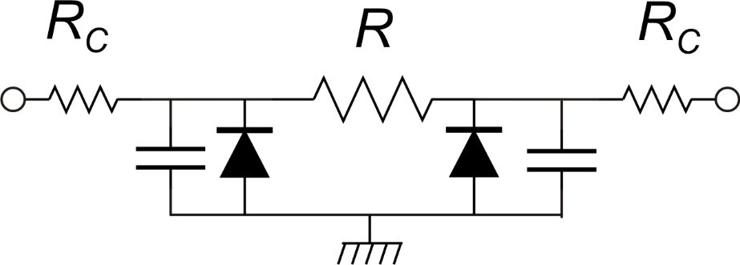
Integrated resistors: Parasitic Components
Unavoidable
parasitics
Needs Care!

Slide 6
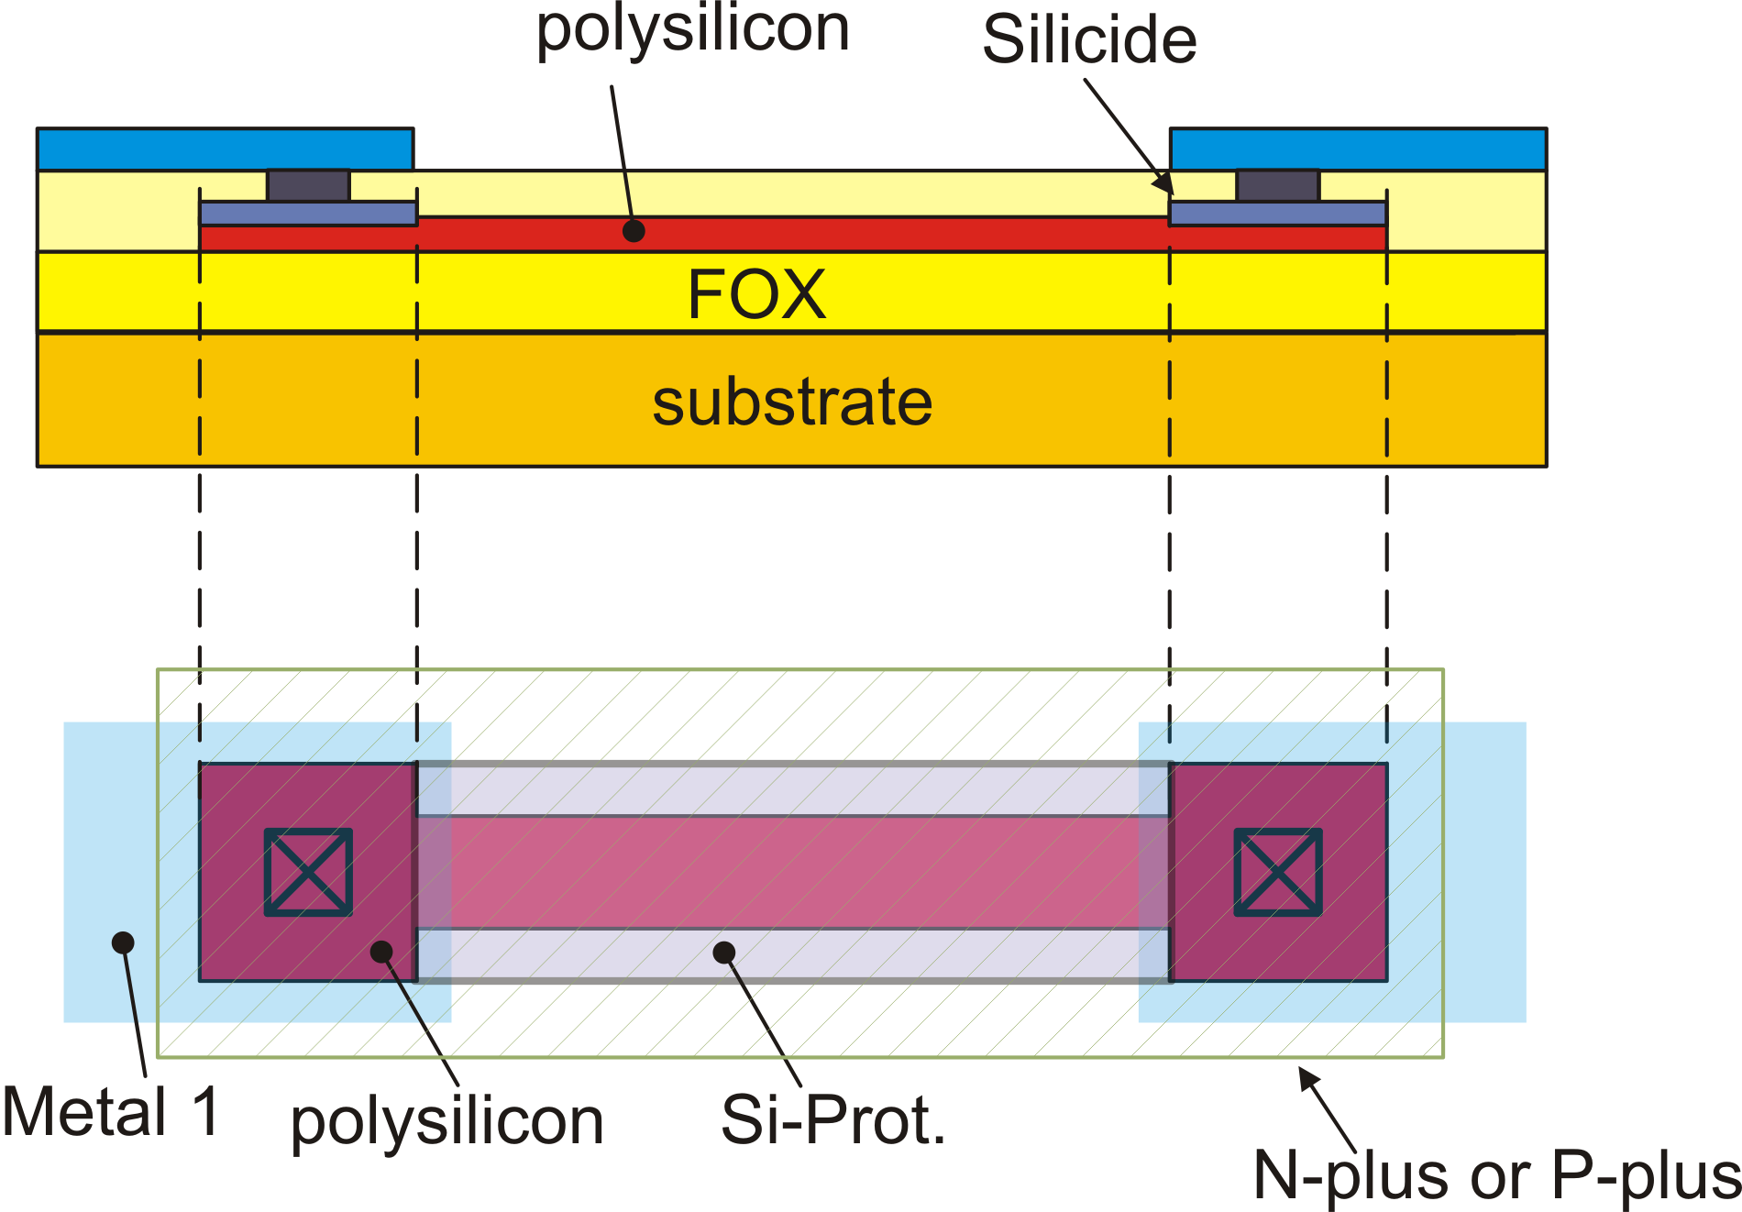
Polysilicon resistors

Slide 7
Typical characteristics of polysilicon resistors
Resistor Type | Sheet resistance | TCR | Non linearity (a_{V1})
n-plus polysilicon | 30-150 Ω | 100-500 ppm/°C | 50 ppm / V
p-plus polysilicon | 50-400 Ω | 250-1000 ppm/°C | -50 ppm / V
high-res polysilicon | 400-4000 Ω | -1000 ppm/°C, -3000 ppm/°C | 100 ppm / V
Salicided polysilicon | 5-10 Ω | 2500-3500 ppm/C | -

Slide 8
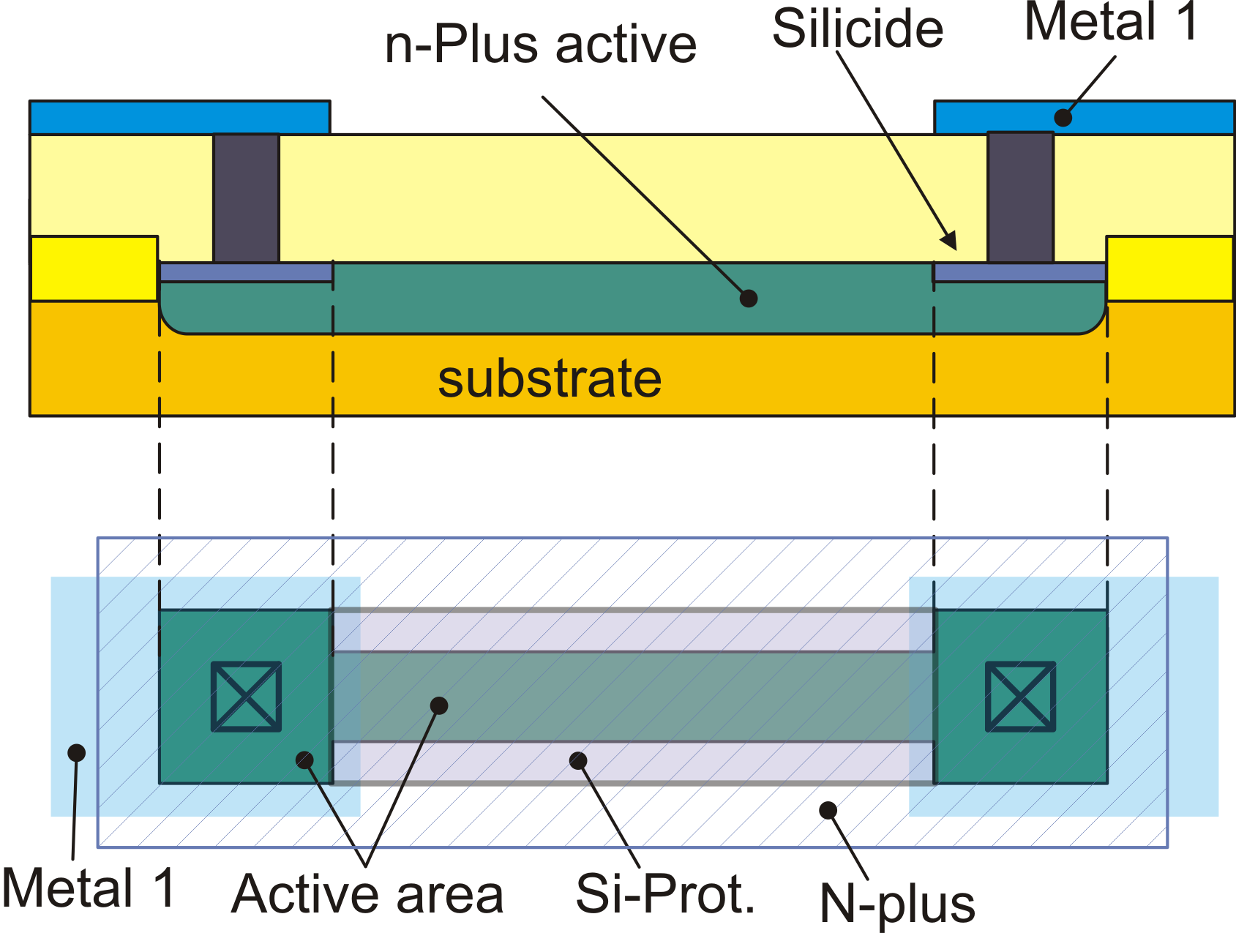
Diffusion Resistors

Slide 9
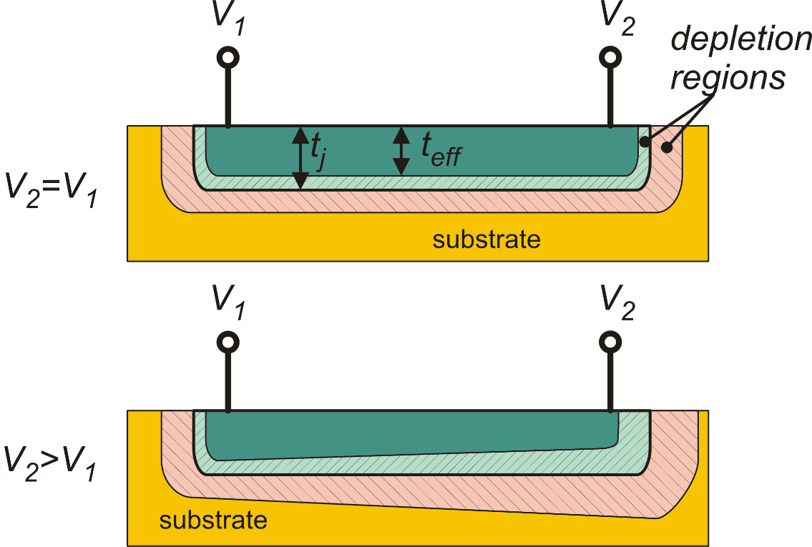
Voltage dependence in diffused resistors

Slide 10
Properties of diffused resistors
Resistor Type | Sheet resistance | TCR | Non linearity (a_{V1})
n-plus on substrate | 30-80 Ω | 1000-1500 ppm/°C | 400 ppm / V
p-plus on n-well | 50-150 Ω | 1000-1500 ppm/°C | 400 ppm / V
n-Well on substrate | 400-4000 Ω | 2000 -3000 ppm/°C | 3000 ppm / V

Slide 11
Integrated capacitors: quality parameters
Capacitance per unit area: critical when large capacitors have to be integrated into the chip. Typical values : 1 fF/μm² to 8 fF/μm².
Linearity: A linear capacitance should be voltage independent. In some cases, the fact that a capacitance depends on voltage can be exploited to obtain tunable resonant circuits.
Temperature dependence. Integrated capacitors exhibit a very low temperature dependence (a few tens of ppm/°C. Thus, this is seldom a critical point.
Parasitic components: as for resistors, capacitors may be affected by parasitic components, typically capacitances to the substrate and parasitic diodes, when insulation is obtained by means of reverse-biased junctions.

Slide 12
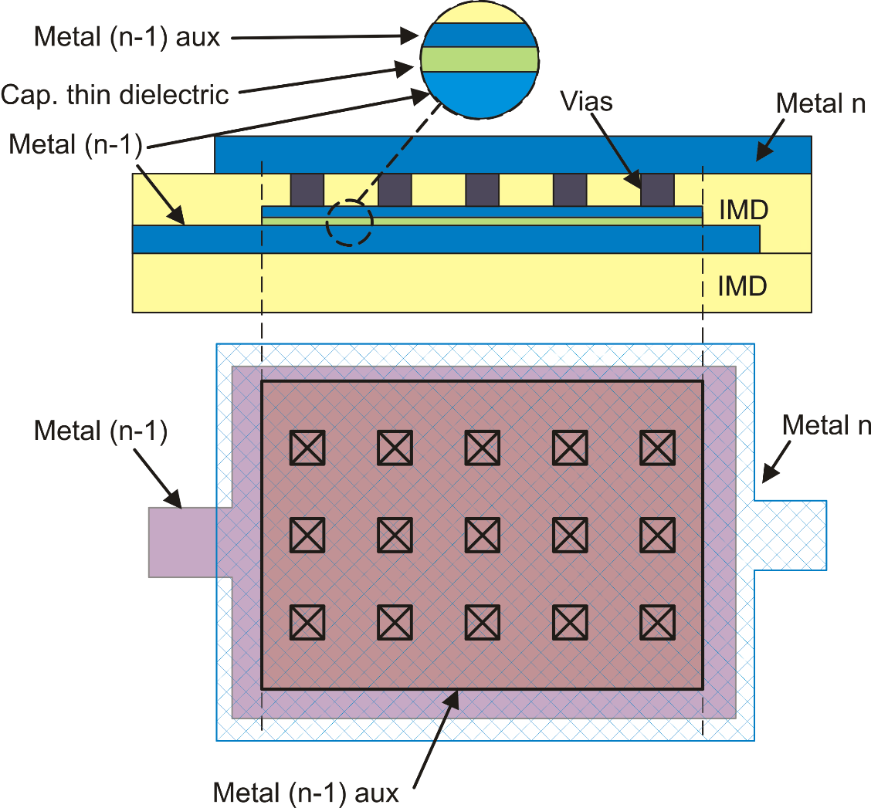
Integrated Capacitors: MIM capacitors
Typical capacitance density: 1fF/μm²
33 μm
= 1 pF
33 μm
Need additional process steps
Relatively low density
Possible leakage
Withstand low voltages ( a few V)

Slide 13
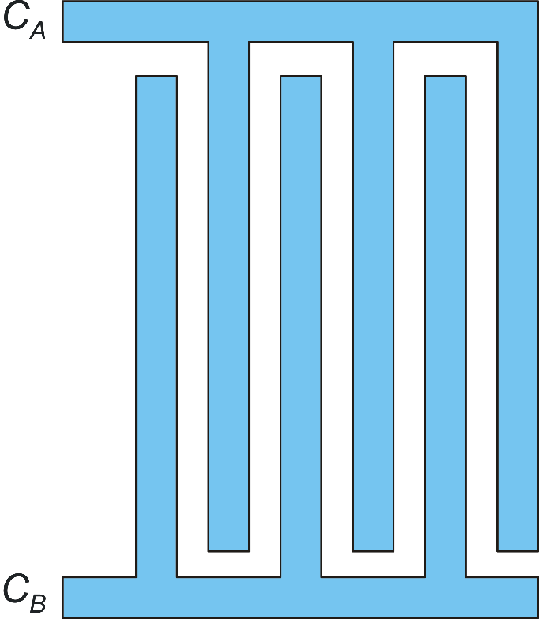
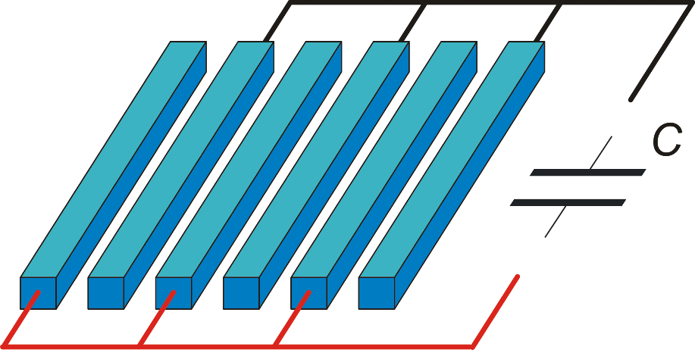
Integrated capacitors: MOM capacitors
Single layer MOM capacitor
Layout of a 6-finger Single-layer MOM
Standard metal interconnection layer

Slide 14
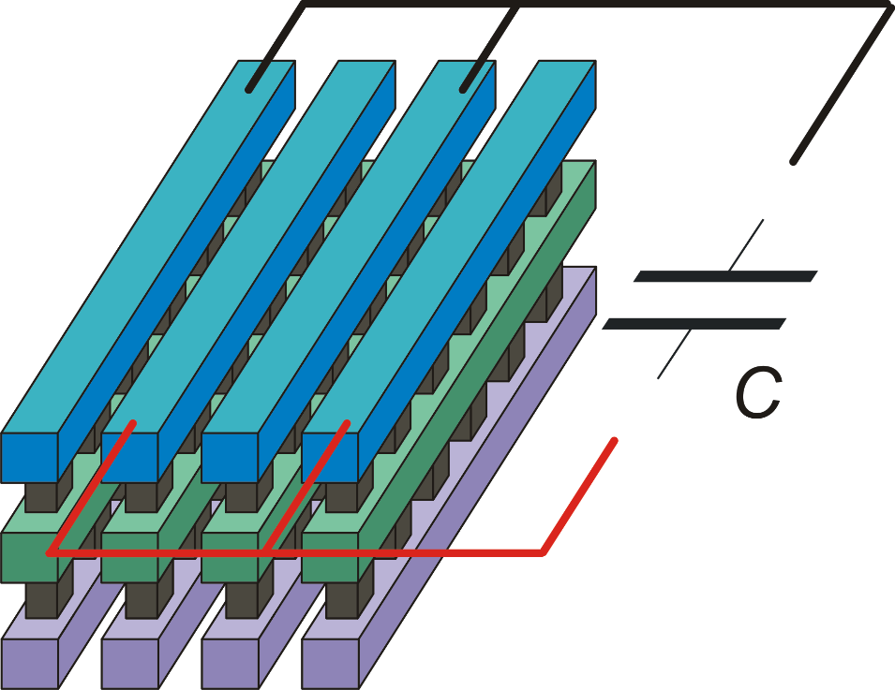
Multi-layer MOM capacitors
Multi-layer MOMs are required to obtain capacitance density comparable with MIMs
No additional process steps are required to fabricate MOMs
They withstand relatively high voltages (tens of V or more)
Multi-layer MOMs are "walls" that cannot be crossed by other interconnection layers
Standard metal layers
Vias

Slide 15
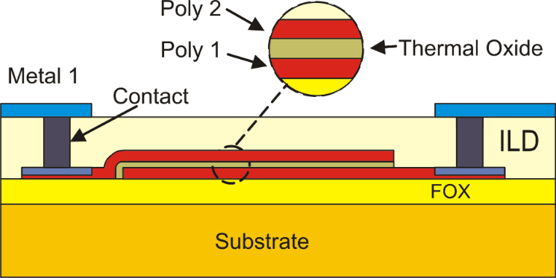
Poly-Poly Capacitors
Poly-poly capacitors can be integrated only when two polysilicon layers are available
Maximum capacitance density among integrated capacitors (up to 8 fF/μm²)
Higher non-linearity (voltage dependence) with respect to MIM and MOM cap.
Only low voltages can be safely applied
The non-linearity derives from the much greater (and non linear) penetration of the electric field into the polysilicon plates with respect to metal ones.

Slide 16
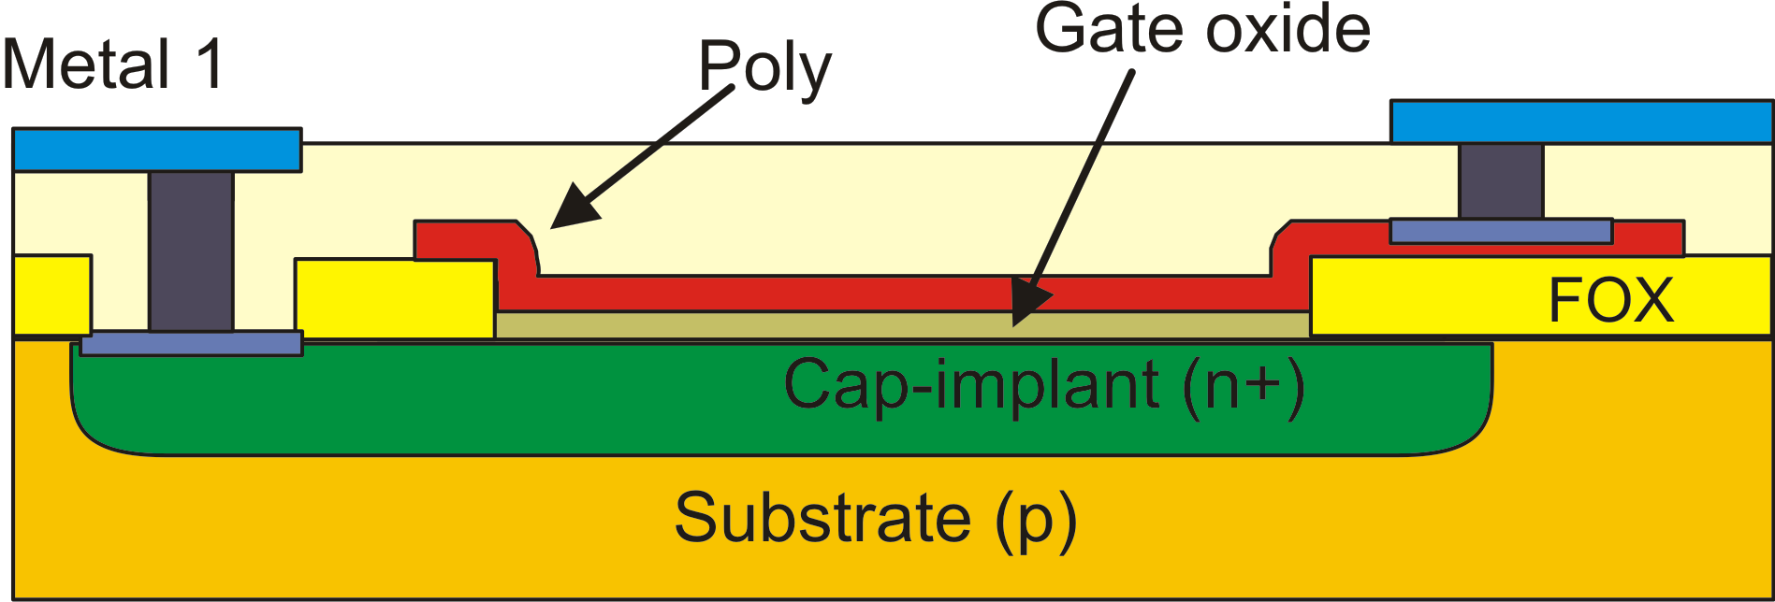
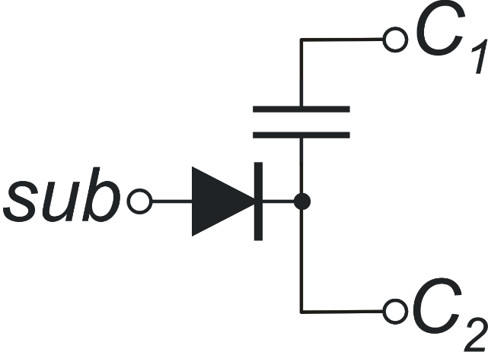
Poly-implant capacitor
C₁
C₂
sub
Some properties as poly-poly capacitors but presence of a parasitic junction between the lower terminal and the substrate.

Slide 17
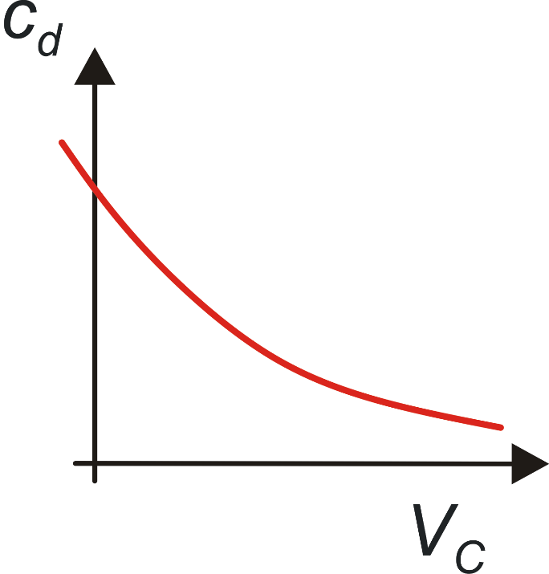
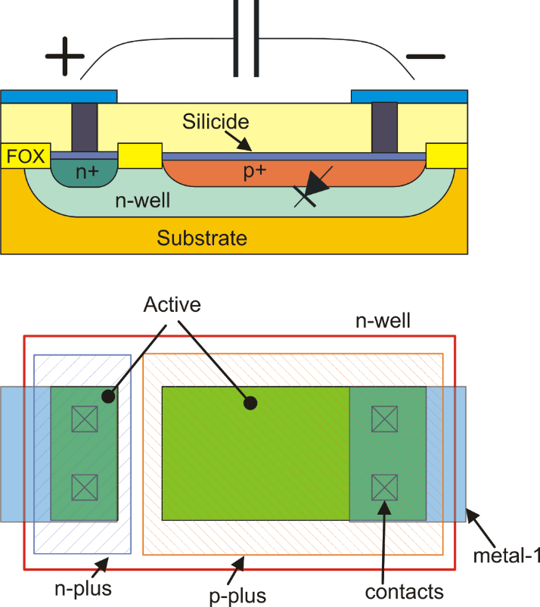
Junction Capacitors
+ V_{C} -
Due to the strong dependence on voltage, junction capacitances are used only for frequency compensation purposes or as bypass capacitors.
The dependence on voltage can be used in RF applications to implement varactors for tuning of LC resonators.

Slide 18
Properties of Integrated Capacitors
Capacitor Type | Capacitance per unit area | Linearity (voltage dependence) | Parasitic components
MIM | 1 fF /μm² | < 100 ppm/ V | Capacitance to substrate (bottom plate only)
MOM (flux) 1 metal layer | 0.1 fF /μm² | < 100 ppm/ V | Capacitance to substrate (both terminals only)
MOM (flux) 6 metal layer | 1 fF /μm² | < 100 ppm/ V | Capacitance to substrate (both terminals only)
poly-poly | 6 fF /μm² | 100 - 1000 ppm/V | Capacitance to substrate (bottom plate only)
poly-diffusion | 6 fF /μm² | 100 - 1000 ppm/V | Diode to Substrate (bottom plate only)
junction | 1 fF /μm² | very –high (up to 30 % / V) | Diode to Substrate (bottom plate). Diode between terminals.

