Slide 1
The CMOS Process
Planar CMOS process is used up to the 28 nm technology node.
For later technology nodes, 3D CMOS MOSFETs (FinFETs) are used.
Planar CMOS processes are still extensively used for analog and mixed-signal ICs.
Classification of planar CMOS processes: example
CMOS n-well 0.18 μm 1P6M
Number of metal layers
Minimum channel length
Number of poly layers
Type of Well (n-well, p-well, triple-well)

Slide 2
Simplified designer's view of a CMOS Process
We are considering a simple n-well (twin-Tub) 1P2M process
The starting substrate is p-type: all p-wells are shorted together since there are no insulation junctions with the substrate.
N-wells are insulated from the substrate if the latter is biased at the lowest voltage in the circuit.
A very lightly doped epitaxial layer is often present on top of a strongly doped wafer. P-wells are necessary to obtain the optimal doping for n-MOSFETS.

Slide 3
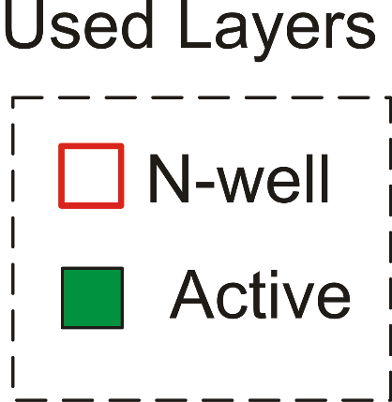
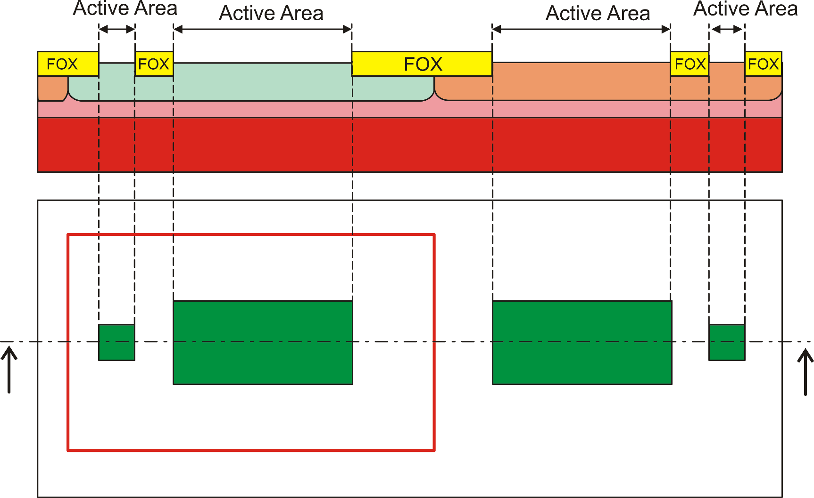
The active areas
Active areas are all of the same type.
They are specialized by other layers (e.g. n-well).
p-wells are often drawn automatically as not(n-well)
n-well
Top view

Slide 4
Polysilicon and gate oxide
poly over active area
MOSFET gate
poly out of active area
inteconnection
The gate (thin) oxide is grown on all active areas.
After that, it is covered by the polysilicon layer
When the poly is patterned, the gate oxide remains only where polysilicon remains, forming the gate.
Only one layer (poly) is required to control the final result of this step.

Slide 5
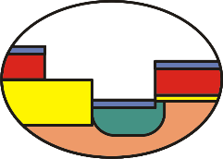
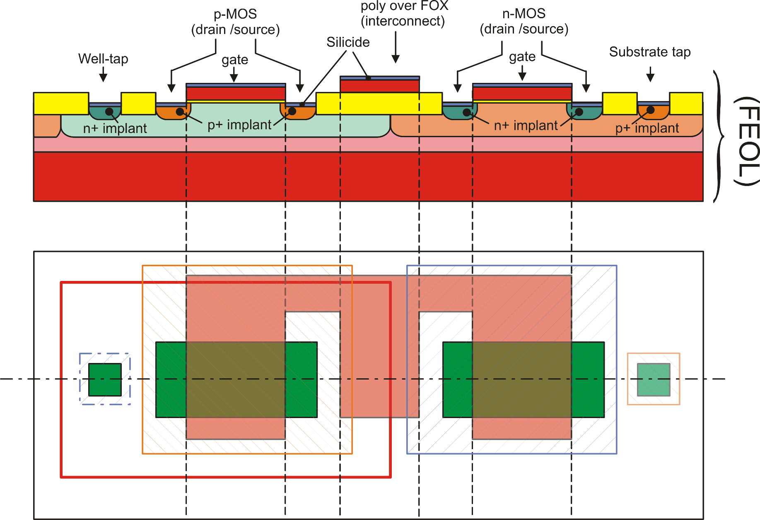
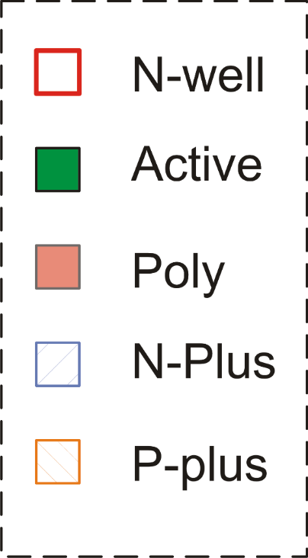
FEOL (Front-End Of the Line)

Slide 6
BEOL (Back End Of the Line) - Contacts
All devices created in the FEOL are covered by an insulating layer and holes are opened only where we want to contact them. These opening are the CONTACTS
Contacts can reach active areas (p+ or n+ doped portions of the substrate) or polysilicon (over the FOX).
Direct contact of polysilicon over the gates is not allowed
Contacts
Insulating
Layer
Thungsten
Plugs

Slide 7
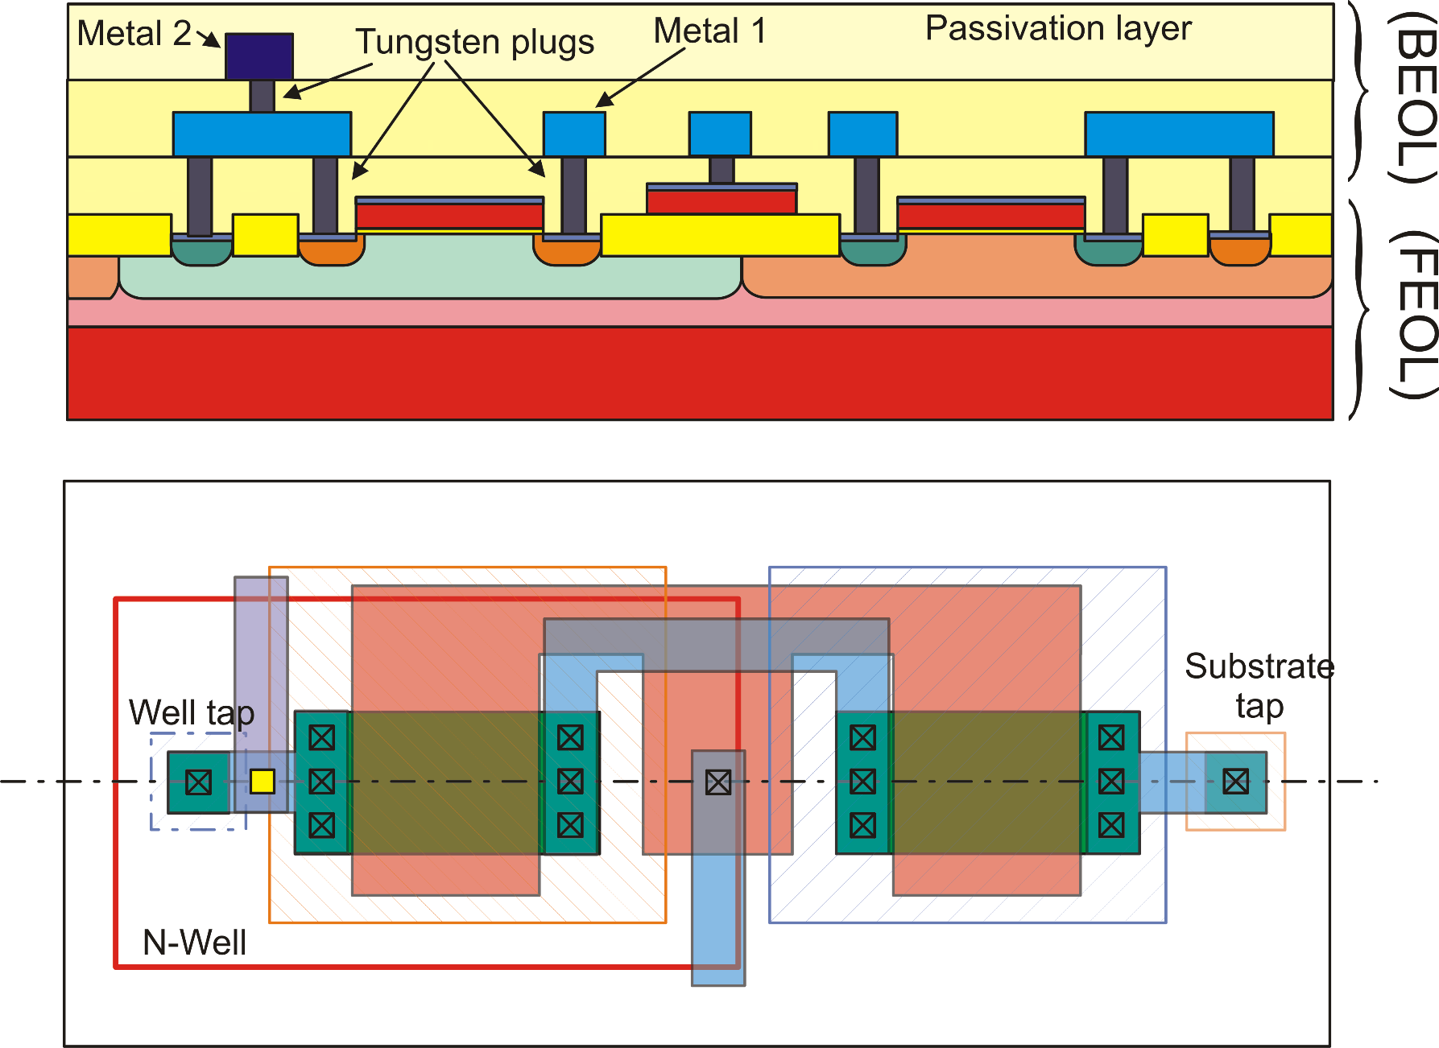
BEOL: The interconnections

Slide 8
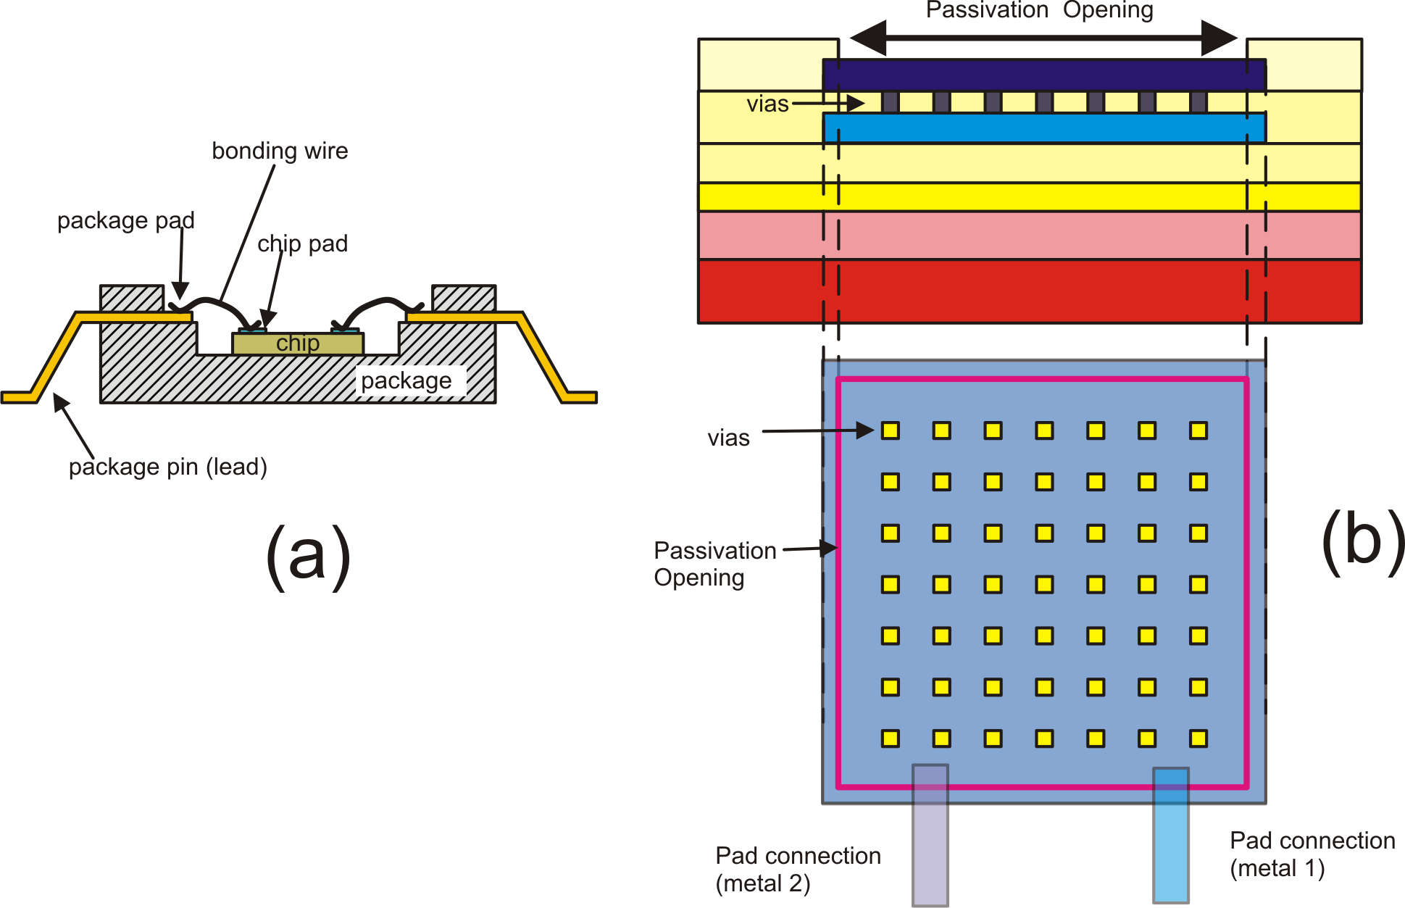
Bonding Pads
Layer: Passivation Opening

Slide 9
The Triple Well
n-well twin tub
n-well
n-well
buried well o buried layer

Slide 10
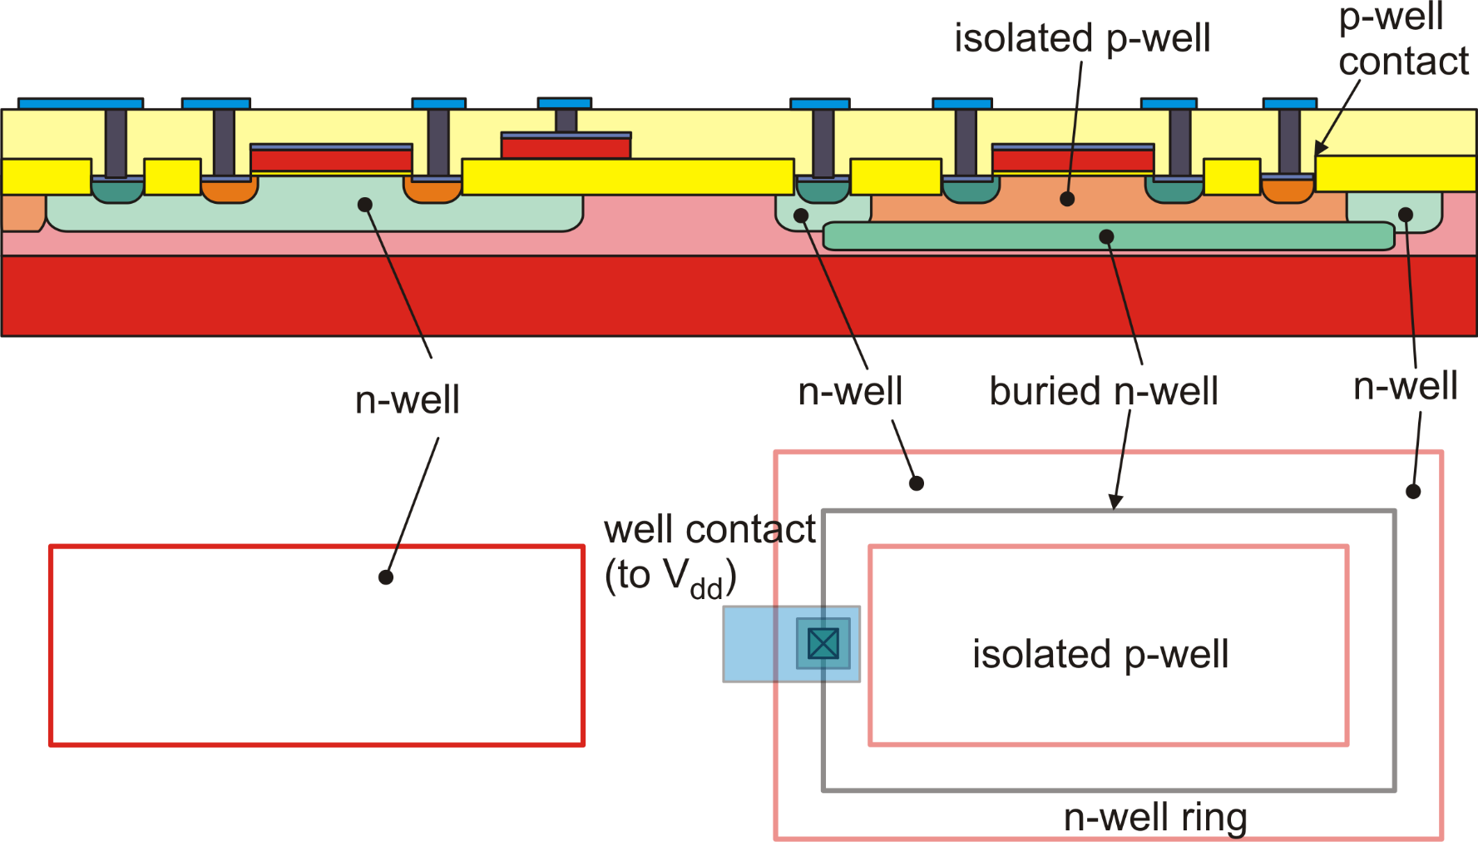
Triple Well: Multiple PWells and NWells at independent voltages

Slide 11
Bipolar processes
Technology | Available Devices | Notes
Bipolar | Vertical NPN, Lateral PNP | Used for precision and/or fast amplifier. Si-Ge versions for RF applications
Complementary Bipolar | Vertical NPN, Vertical PNP
BiFet | BJTs and JFETs | Used for precision / low bias current amplifiers

Slide 12
BiCMOS, BCD, SOI
Technology | Available Devices | Notes
BiCMOS | CMOS + BJTs | Mixed Signal ICs High speed digital line drivers
BCD | Bipolar, CMOS, DMOS | Smart Power
SOI Silicon on Insulator. | As CMOS, BiCMOS or BCD | High Voltage and Rad Hard (e.g. space applications)

Slide 13
Resistances in planar ICs
Direction of the current
Ω / square
Number of
squares
W

Slide 14
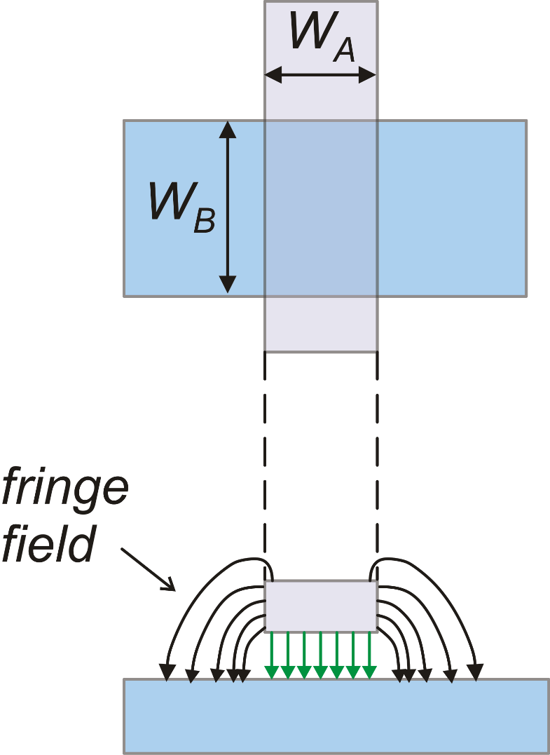
Vertical and lateral capacitances
Area
Perimeter
Capacitance per unit area
Capacitance per unit perimeter
(Fringe capacitance)

Slide 15
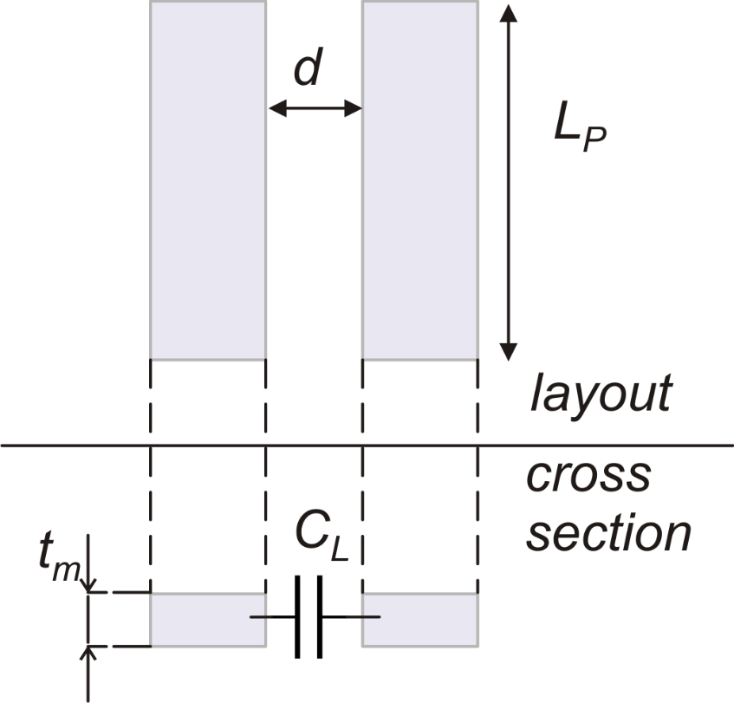
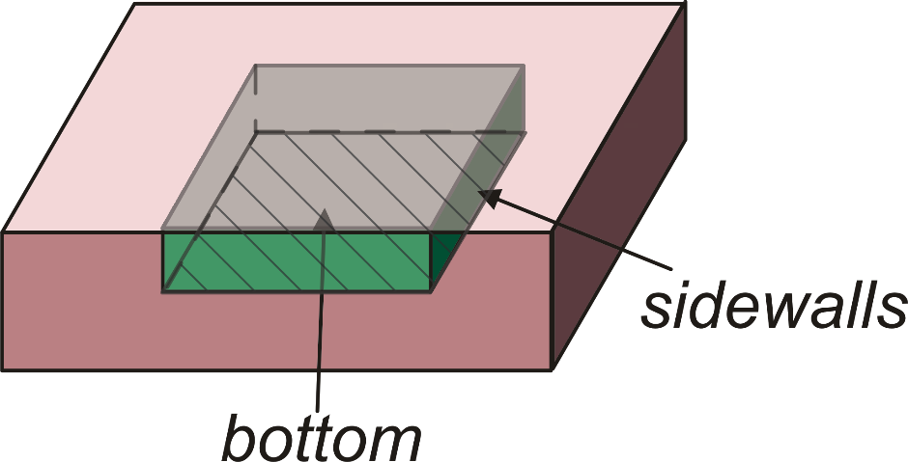
Lateral and Junction Capacitances
n (or p)
p (or n)
Lateral
Junction

