Slide 1
Voltage references
Voltage references are blocks that produce an output voltage that is independent of PVT variations:
V: Supply voltage
T: Temperature
P: Process errors
Voltage references are used for:
Providing an absolute reference voltage for ADCs and DACs
Providing an absolute reference voltage for stimulating sensors or other external devices that require precise control voltages and/or currents.
Creating constant bias voltages (and currents) when required

Slide 2
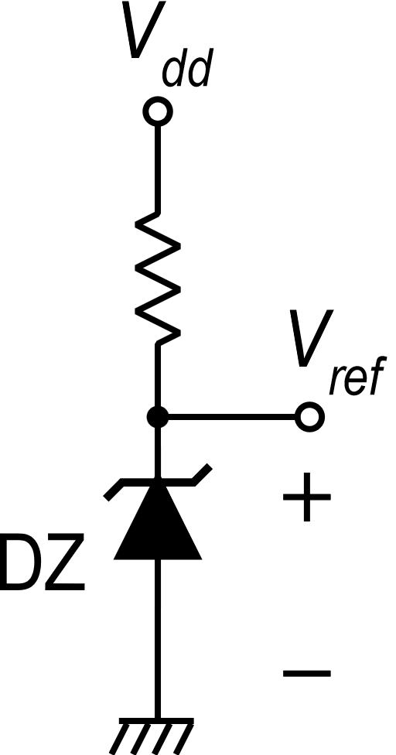
Possible reference voltage sources
Zener Diodes
Problems:
Require additional process steps, but only a small number of components are required for each chip (not convenient)
Available voltages are > 3 V
Temperature stability is poor for V_{Z} ≠ 5-6 V
The reference voltage generated by a Zener diode is noisy (very wide band noise)
In present days, zener diodes are available only in high voltage processes and are used more for protection than for voltage references
Band-gap circuits
solution

Slide 3
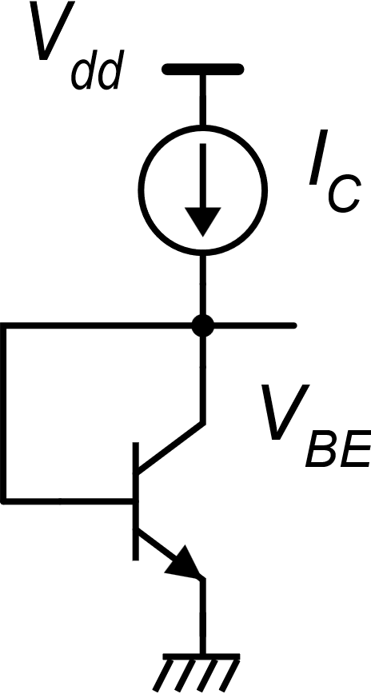
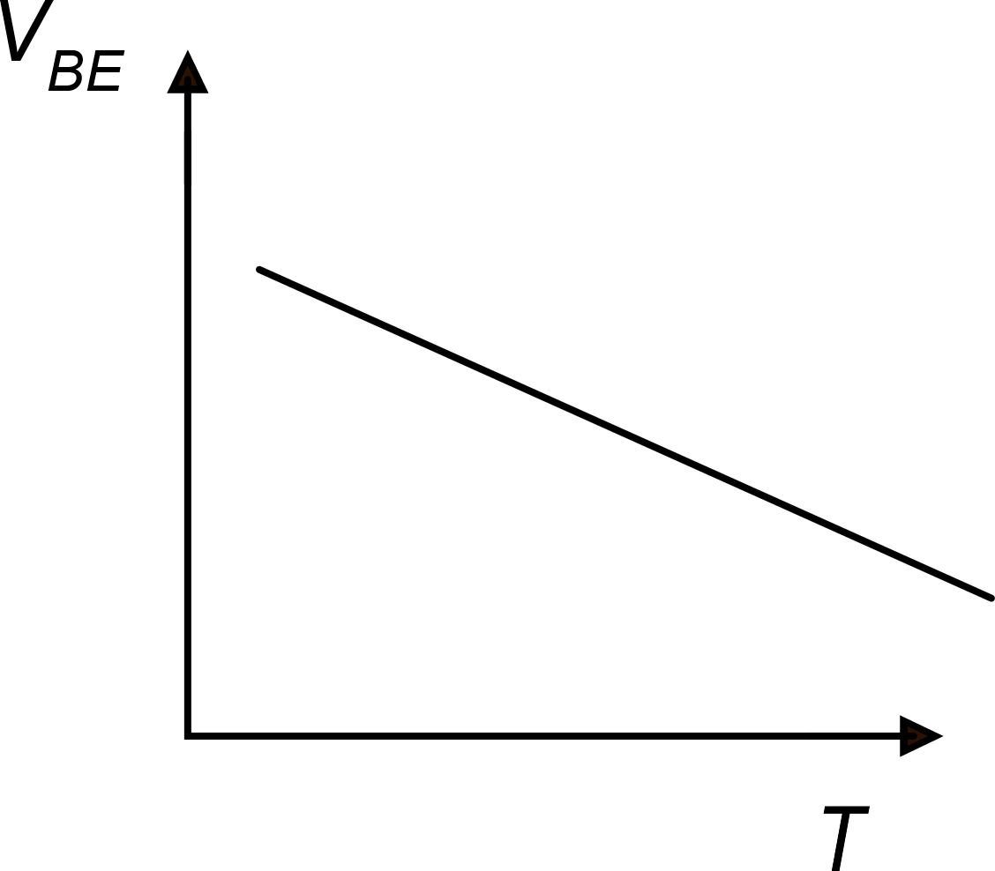
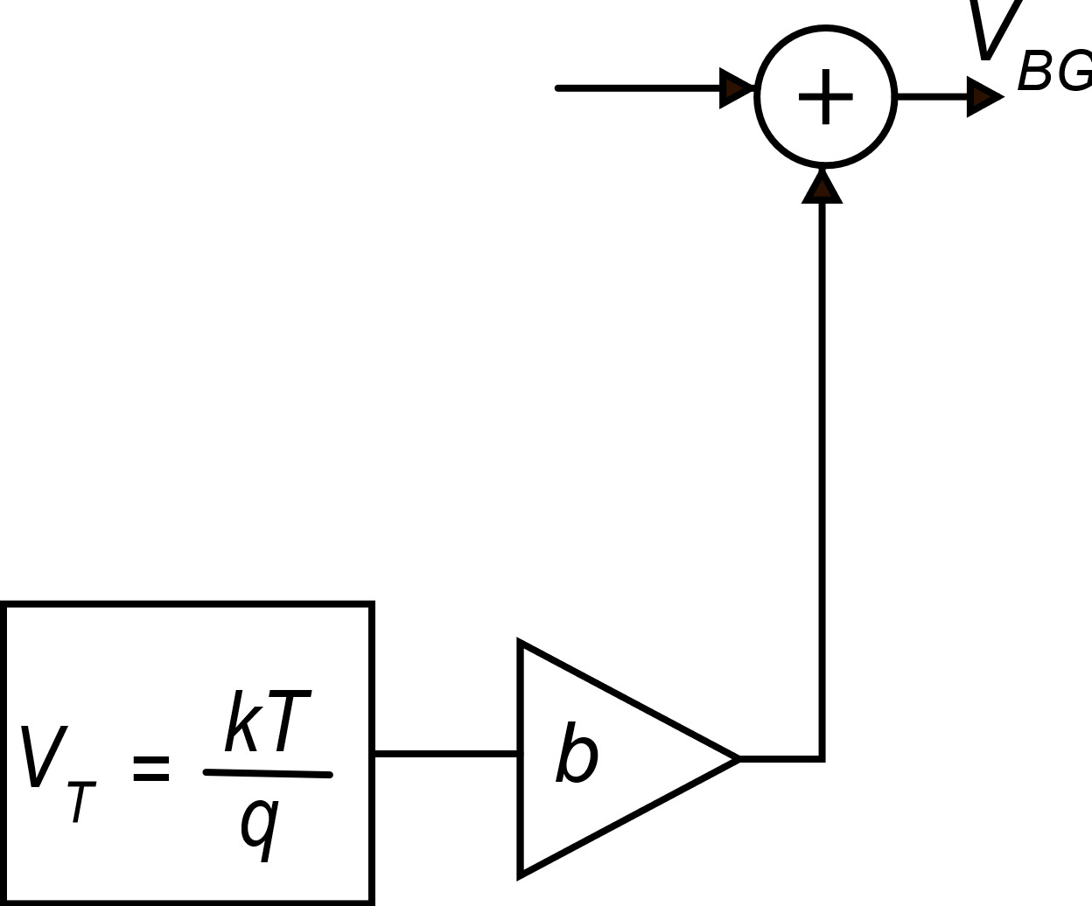
Band-gap voltage reference: principle of operation
We start with a DIODE (BJT) biased with
a current I_{C}
V_{BG}
PTAT
V_{PTAT}
CTAT
CTAT: Complementary To Absolute Temperature
PTAT: Proportional To Absolute Temperature

Slide 4
Band-gap voltage reference: determination of parameter b and estimate of the output voltage
We have to determine the value of b, for which:
Good news!
This voltage is compatible with low-supply voltage circuits
Example:

Slide 5
Band-Gap voltage reference: theory
constant
V_{G0}
constant
constant
It is not necessary that I_{C} is temperature-independent
Gray, Hurst, Lewis, Meyer, "Analysis and design of analog integrated circuits" 4th edition, 2001 J.Wiley & Sons

Slide 6
Band-Gap voltage reference: theory
V_{GO} is numerically equivalent to E_{g0} measured in eV
The name "band-gap" of this reference voltage comes from V_{GO}, which is the dominant part
Let us calculate the derivative of V_{BG} with respect to temperature
The derivative of V_{BG} depends on temperature

Slide 7
Band-Gap voltage reference: theory
We impose that the derivative of V_{BG} is zero at a given temperature T₀
This is possible, since b is a free parameter that can be chosen to obtain this result.
Typically: α=1

Slide 8
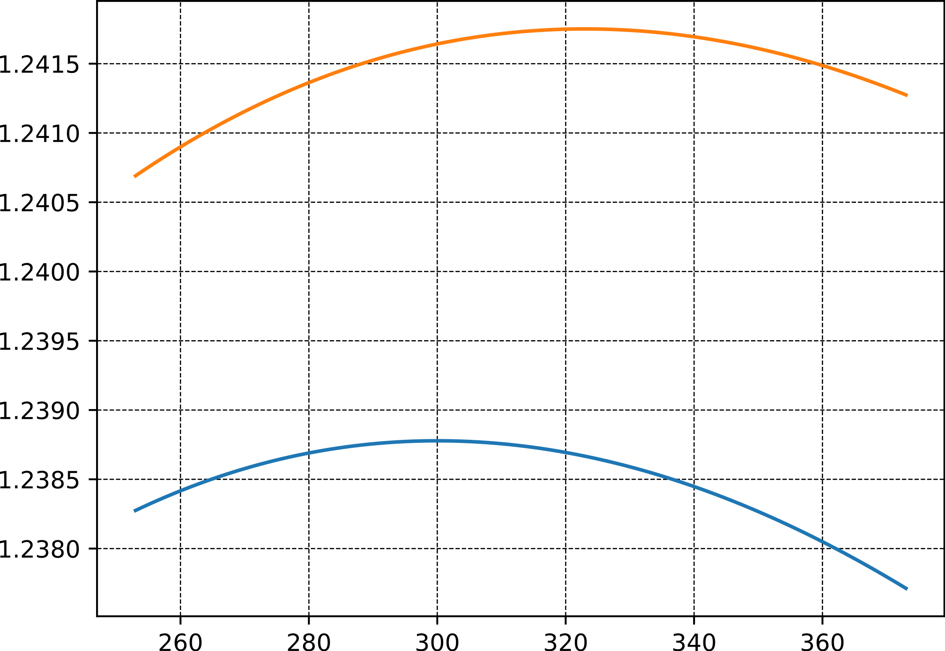
Band-gap voltage reference: calculation result
V_{BG} (V)
T₀=323 K
Even if the derivative is zero only at T₀, the total voltage variation is only a few mV for a wide range
1 mV
T₀=300 K
T (Kelvin)
A bandgap voltage reference designed for a higher T₀, will also have a higher output voltage.
-20 °C
+100 °C

Slide 9
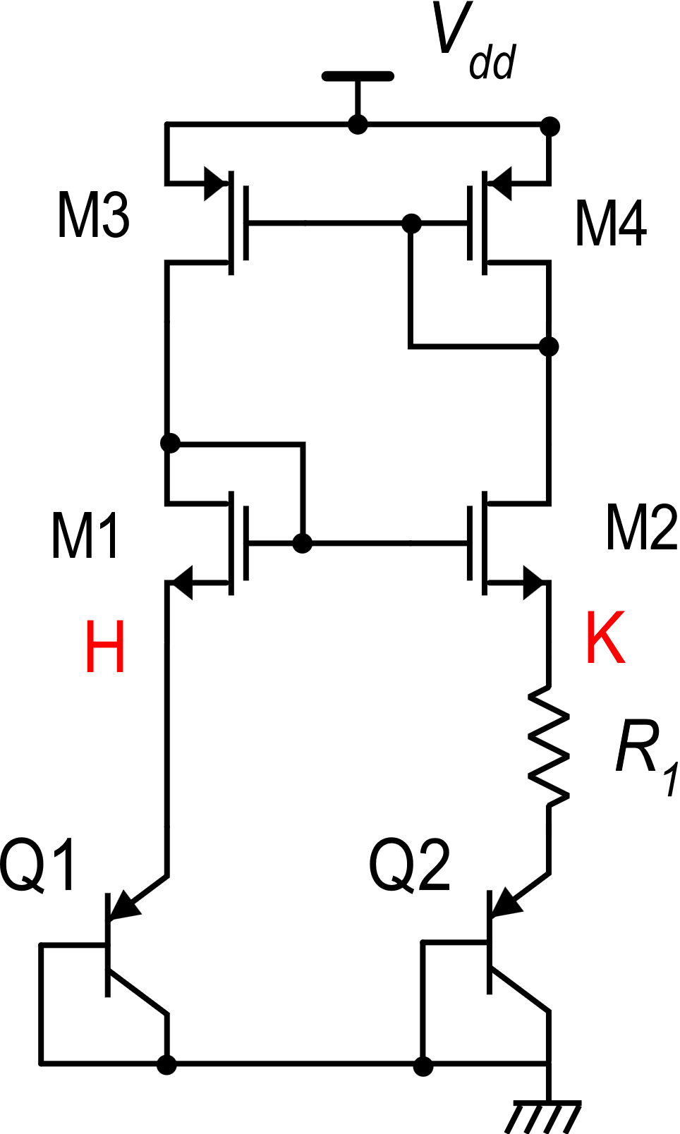
Band-Gap voltage reference: a CMOS compatible Circuit
Q2
Q2
Q2
Q2
Q1
Q2
Q2
Q2
Q2
Part 1: PTAT current generator
Common centroid
layout
For n=8
neglecting the effects
of V_{DS} on I_{D} :
I₁
I₂
I is proportional to T (PTAT) and independent of V_{dd}.
Substrate PNPs

Slide 10
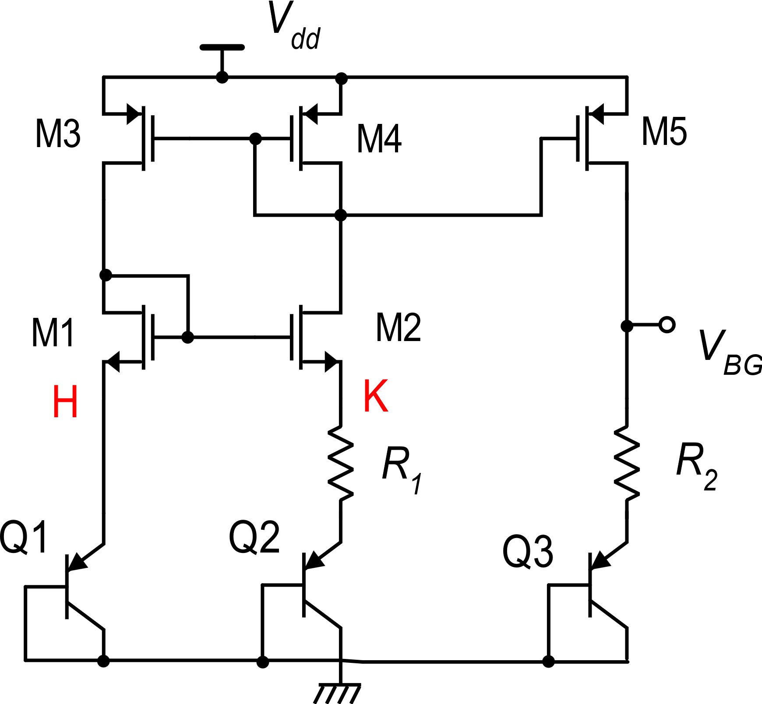
Band-Gap voltage: a CMOS compatible Circuit
Biased with I
α=1
I
I
I

Slide 11
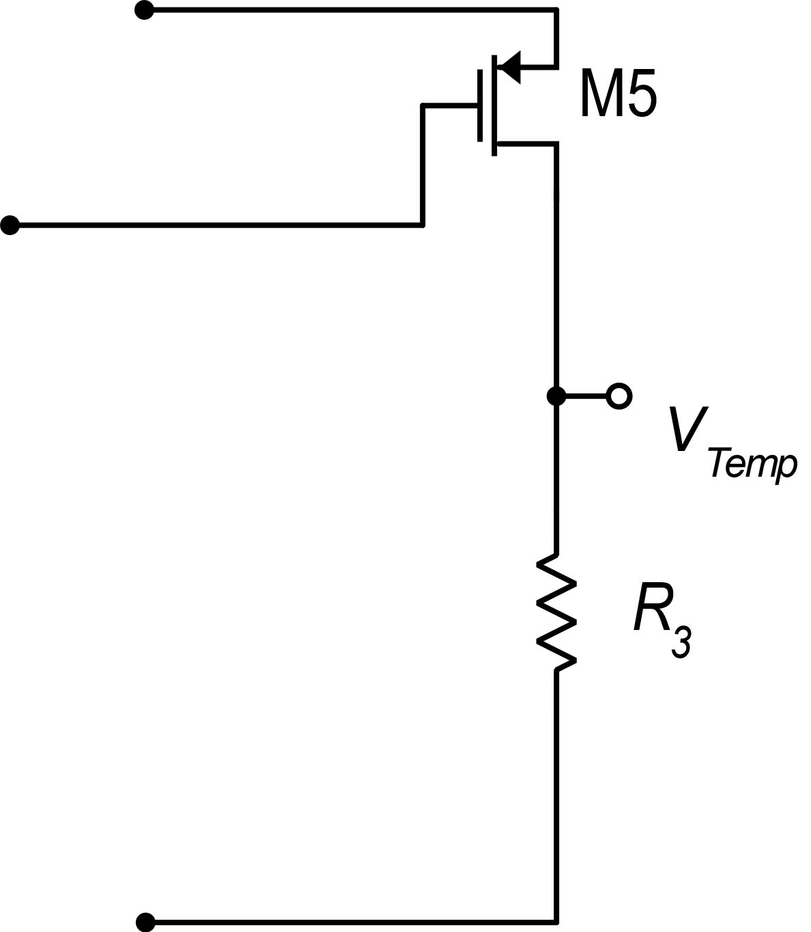
Deriving a temperature sensor from the Band-Gap circuit
Adding this branch, we can obtain a voltage proportional to the absolute temperature, which can be conveniently used to monitor the chip temperature.
I
I
I
I

Slide 12
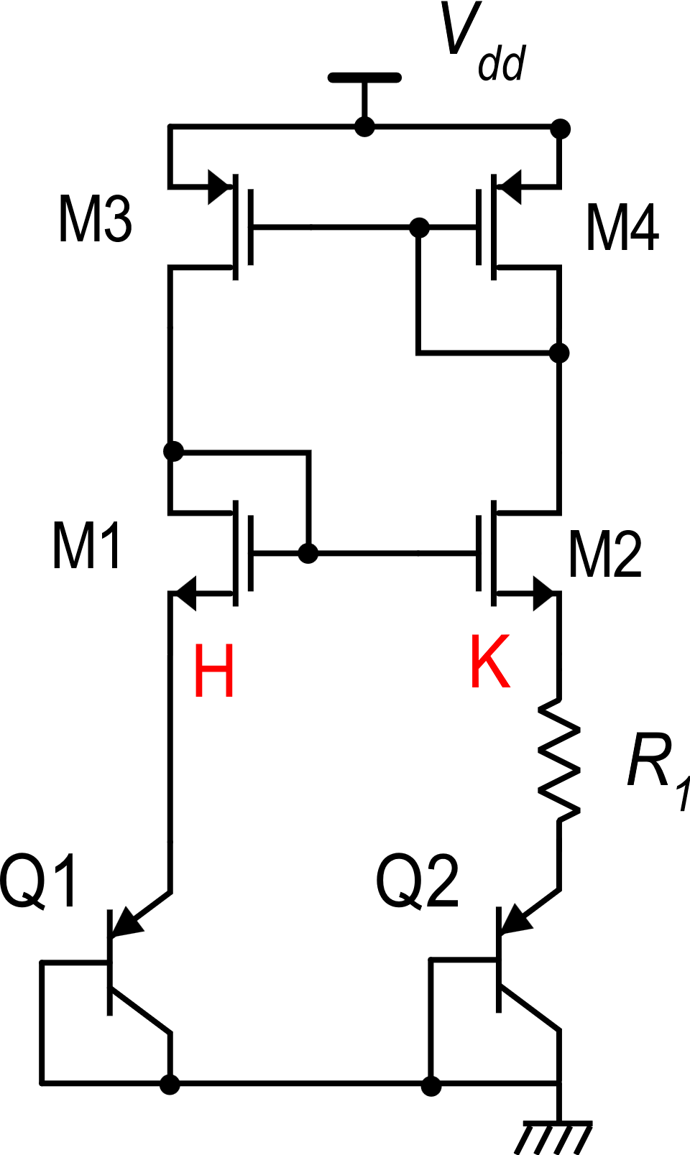
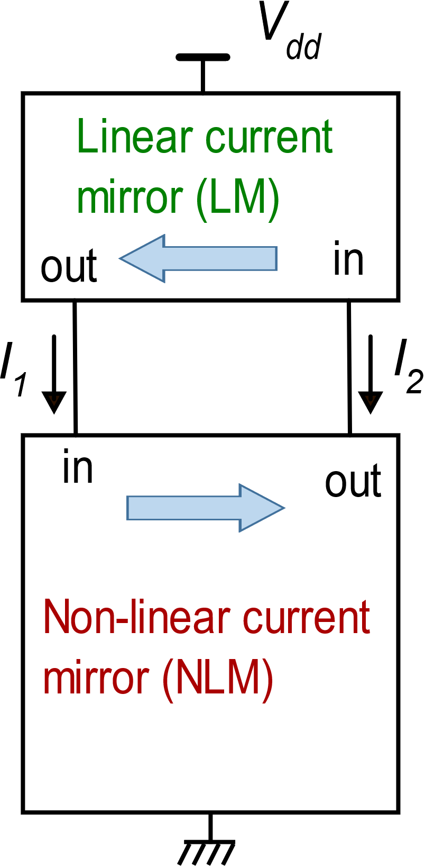
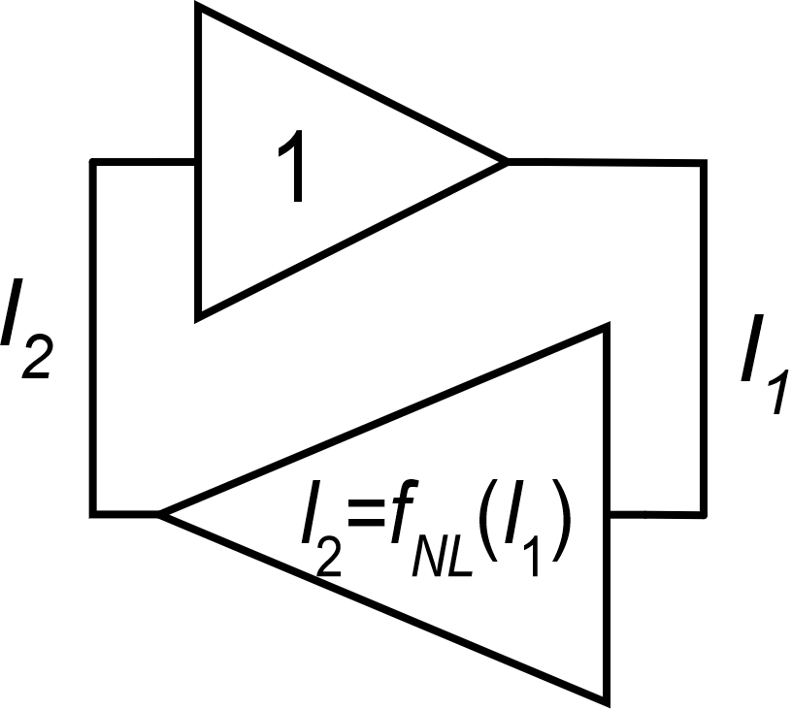
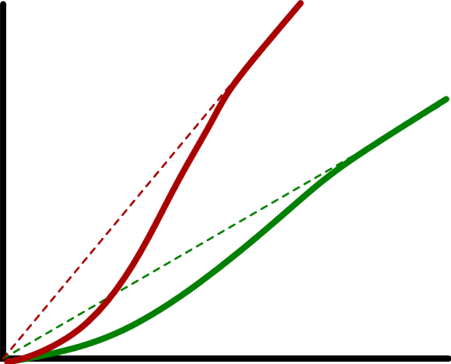
PTAT current generator: multiple stable states
Positive feedback loop
P1
f_{NL}
I₂
I₂=I₁
P2
P1 is the correct operating point. P2 (null currents) is stable because the two mirrors have very small gains around the origin.
I₁
A start-up circuit is necessary to prevent the circuit from being trapped into P2

Slide 13
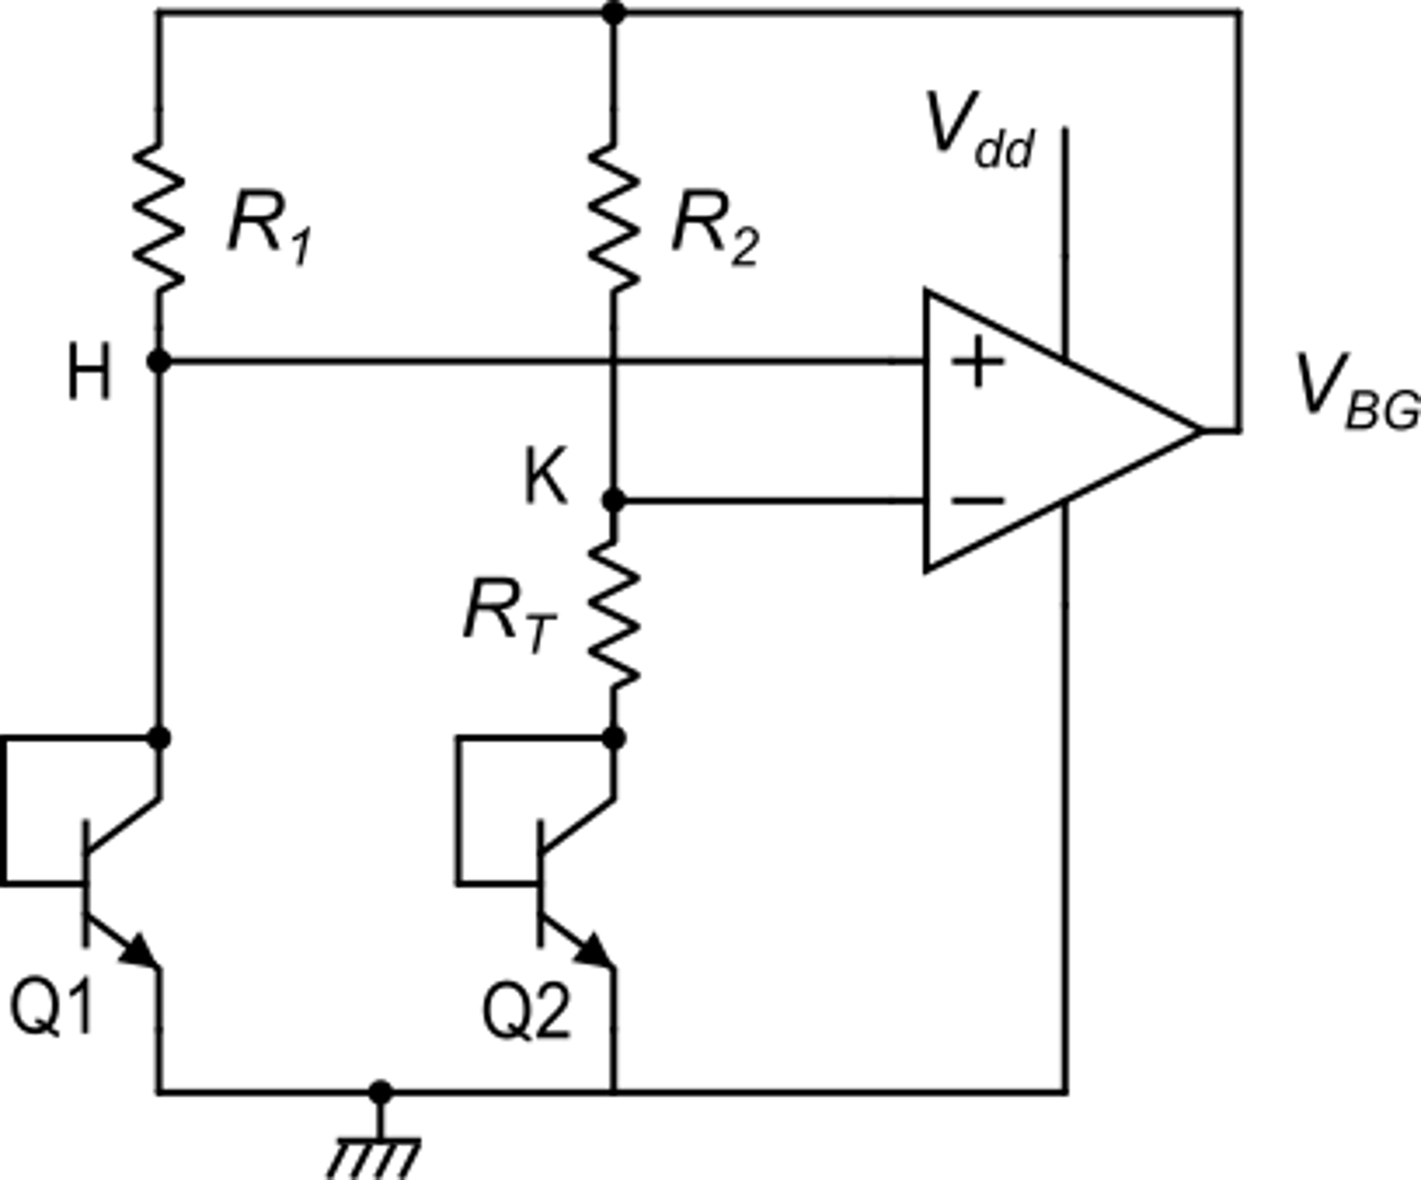
Mention to another very popular bandgap circuit
Due to virtual short circuit:
I₁
I₂
(voltages across R₁ and R₂)
We choose R₁=R₂
op-amp
b

Slide 14
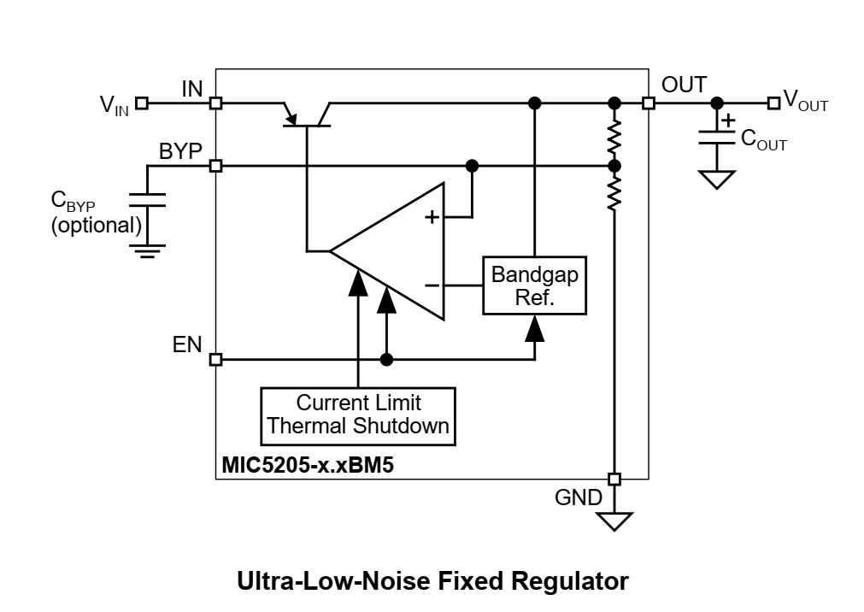
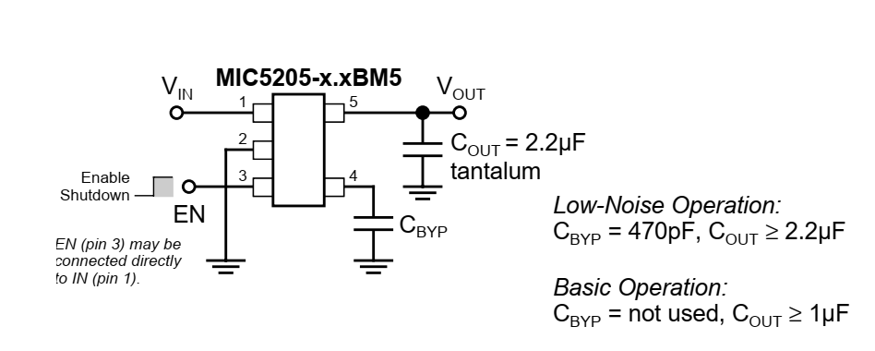
The bandgap voltage reference in voltage regulators

