Slide 1
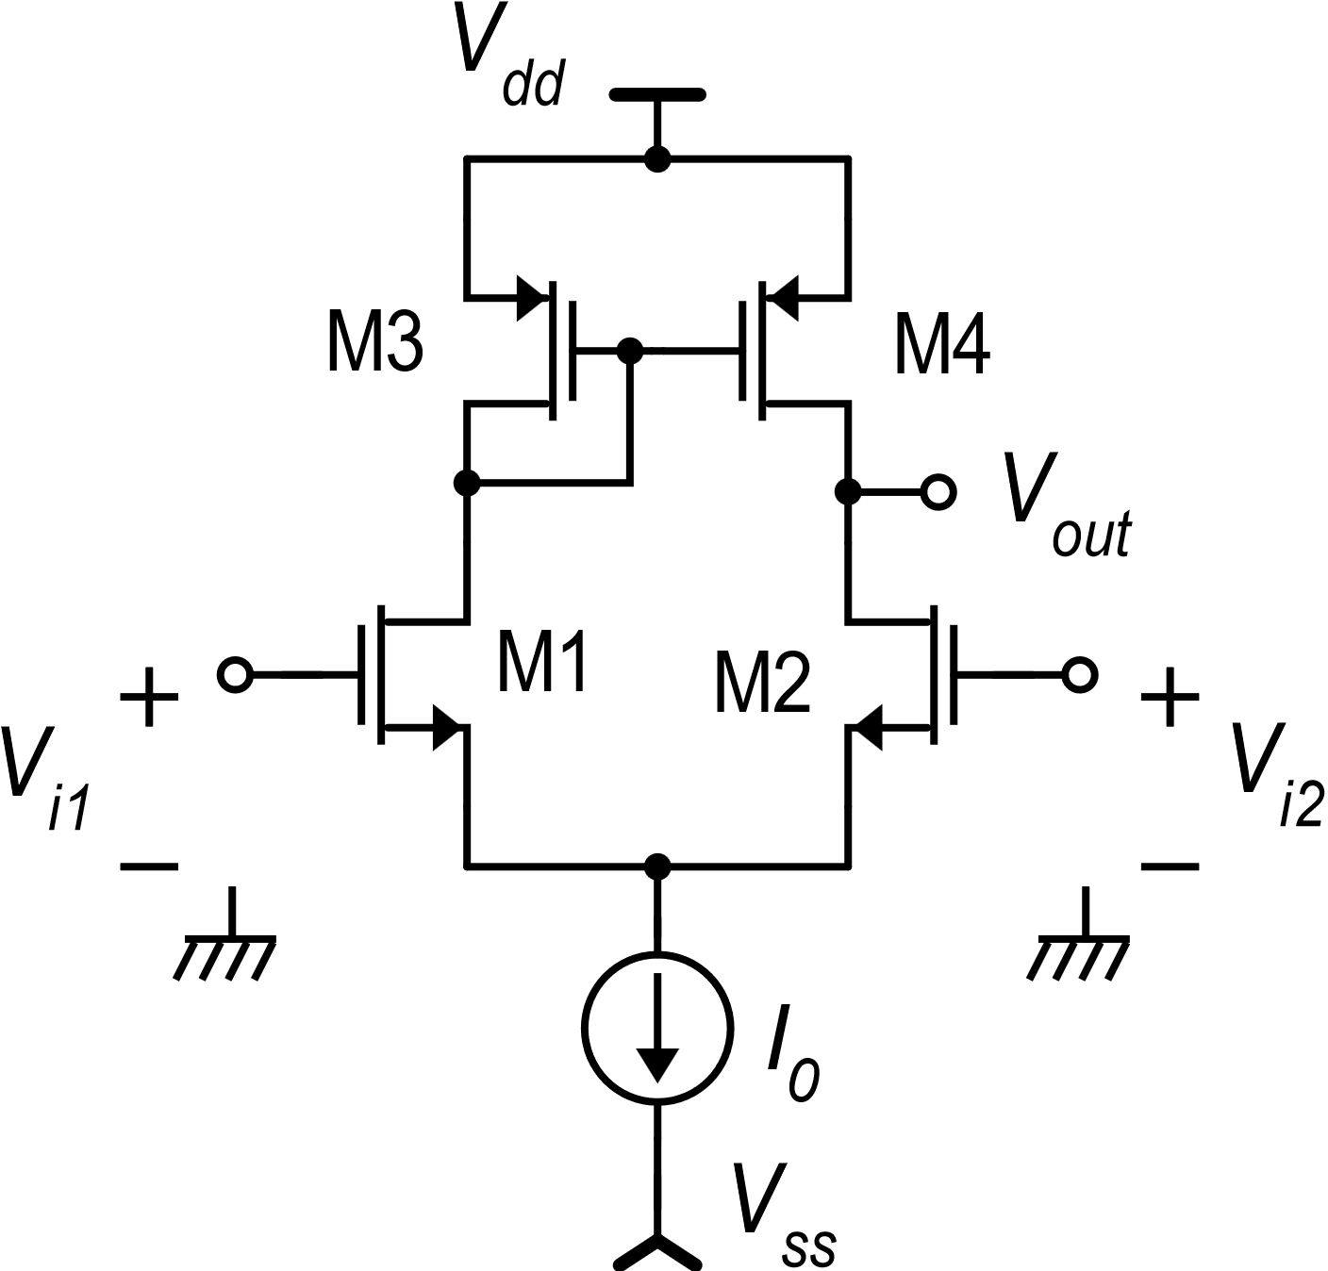
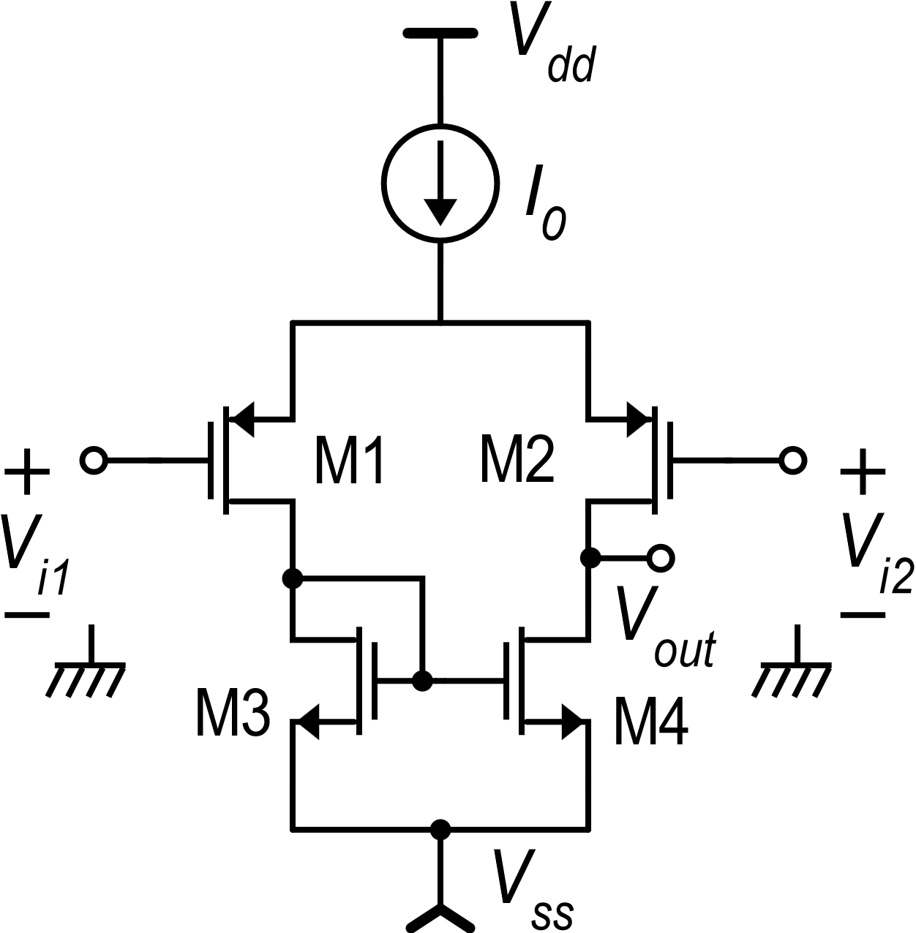
Dual versions of CMOS circuits
Simple differential amplifier with mirror load
Dual (complementary) versions
“n” version
“p” version

Slide 2
Ranges of the «p» version

Slide 3
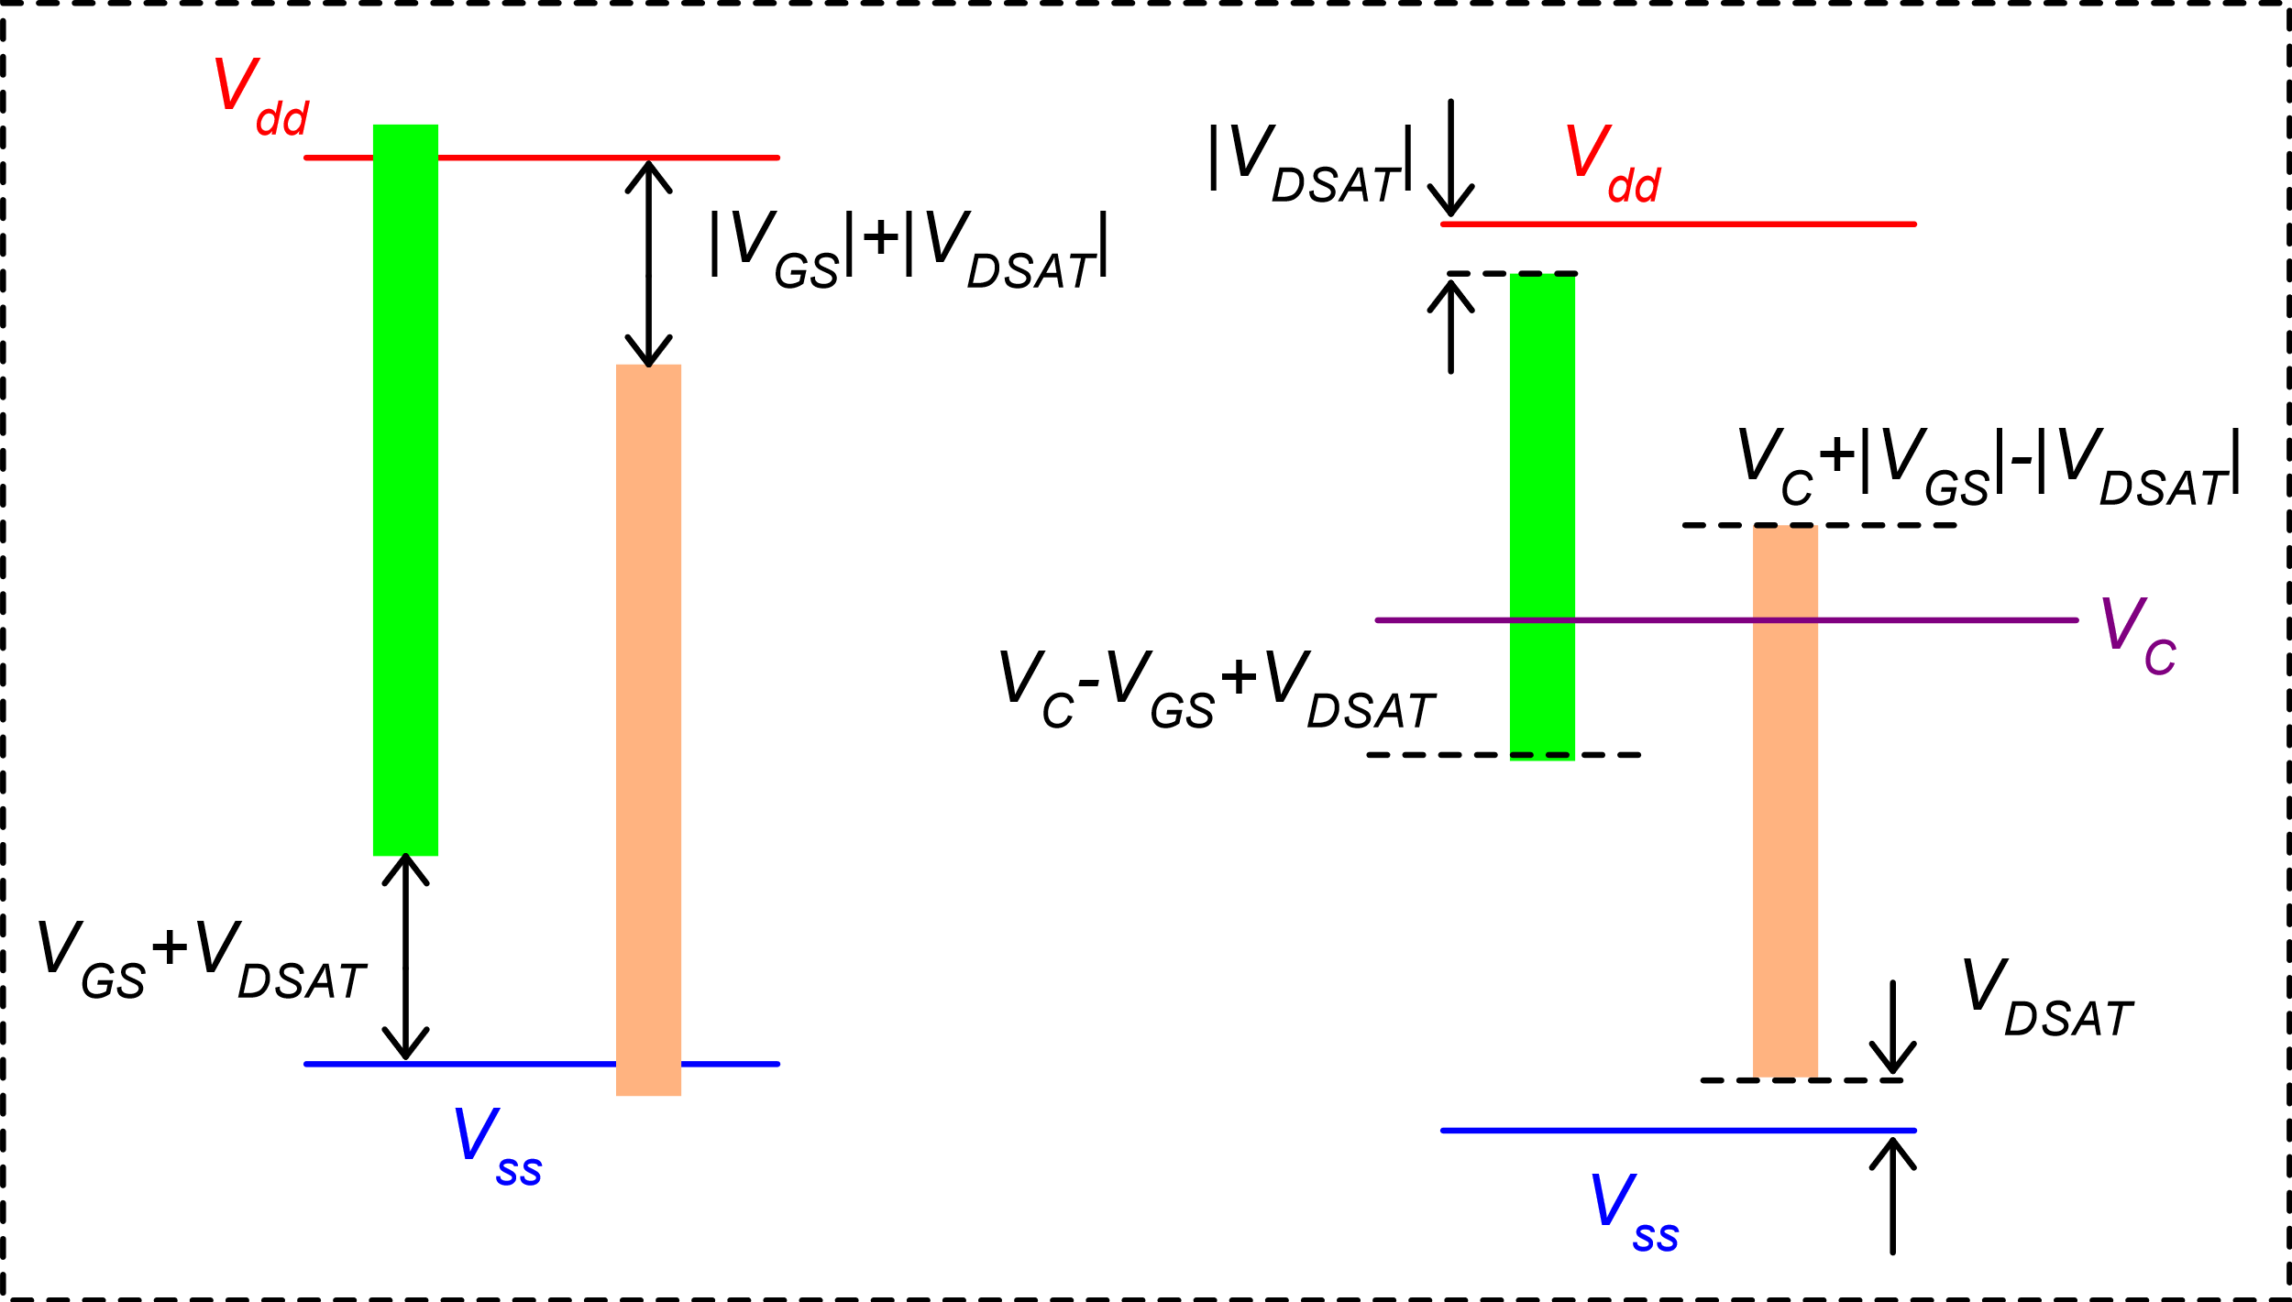
Ranges: graphical representation
Input CM range
Output swing
n-type
n-type
p-type
p-type

Slide 4
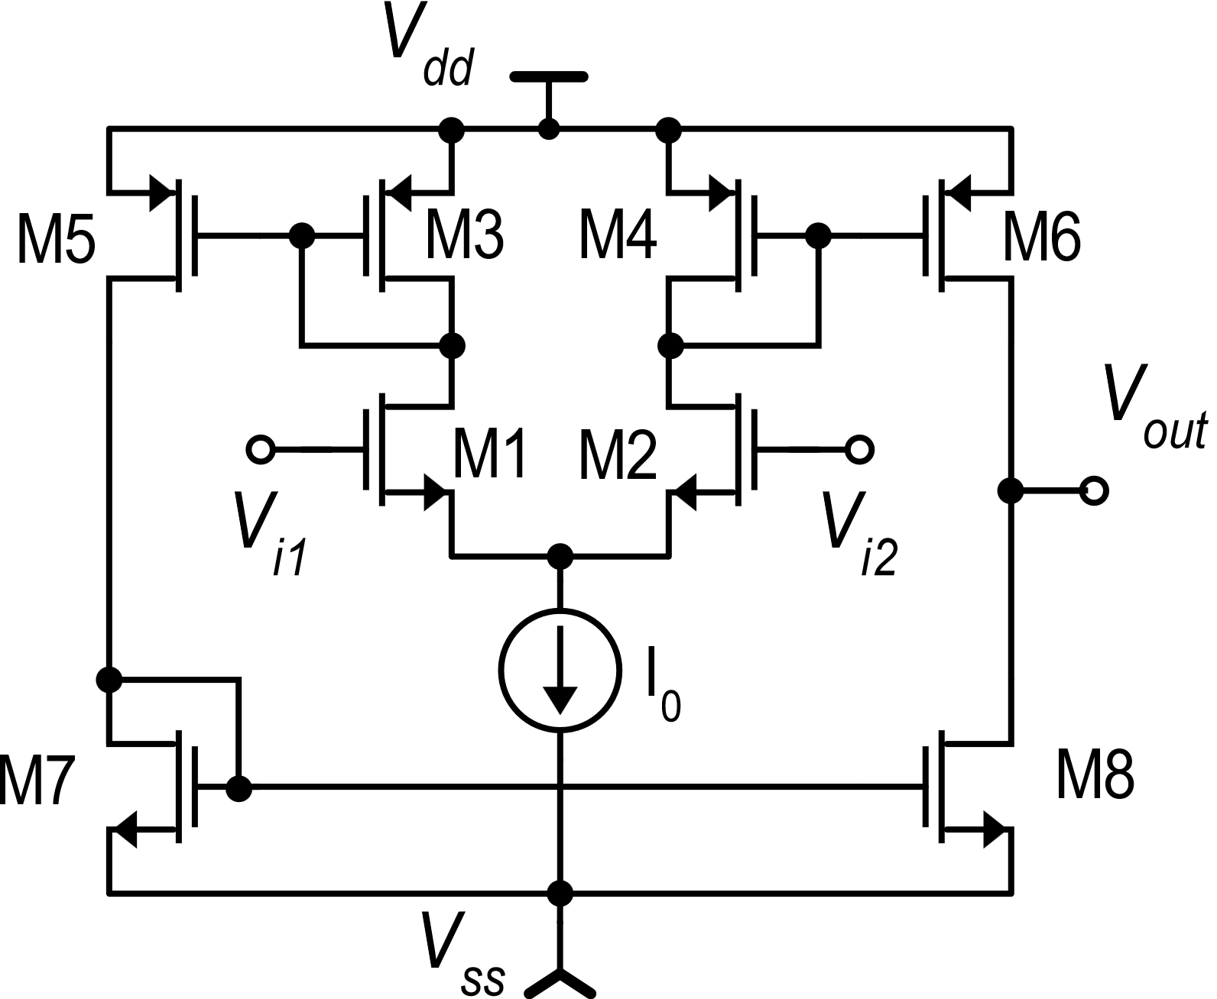
Improving the output swing: the OTA
OTA: Operational Transconductance Amplifier
The term OTA generally indicates all single-stage amplifiers with high output resistance. The folded cascode amplifier is often classified as an OTA.
Historically, the term OTA has been used to indicate the topology shown in this slide

Slide 5
OTA: simple analysis
k : 1
1 : k
kI_{D2}
kI_{D1}
I_{OCC}
kI_{D1}
1 : 1

Slide 6
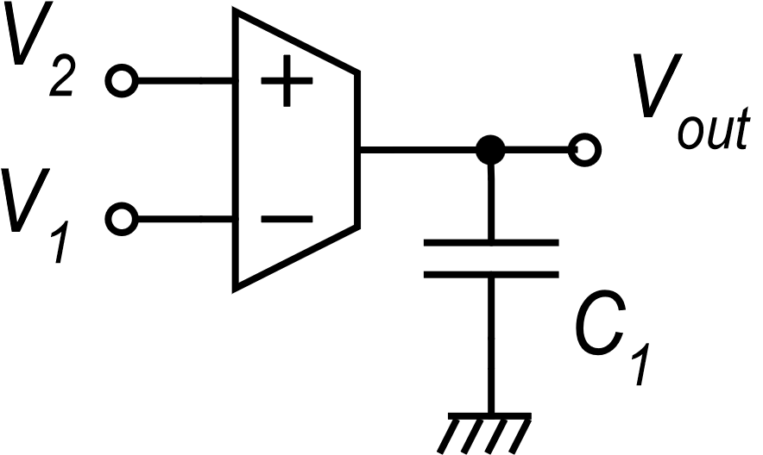
Usage of the OTA as a transconductance amplifier
« Gm-C Integrator »
i_{C}
The Gm-C integrator is the basis of the Gm-C analog filters
OTA symbol
Differential Integrator

Slide 7
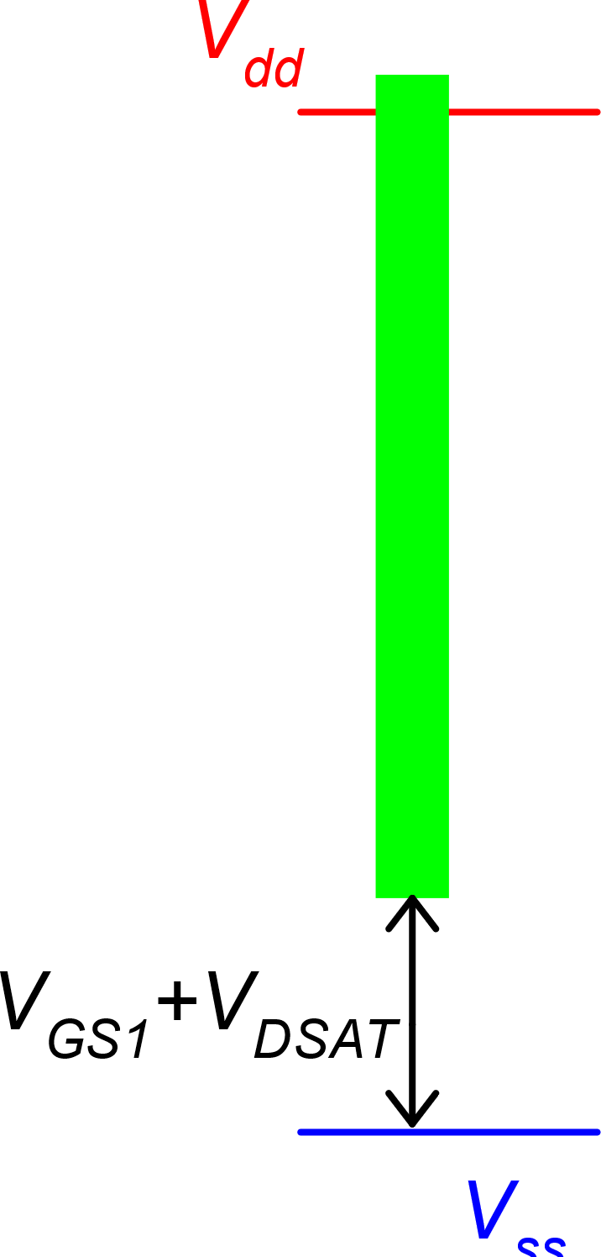
OTA output swing
|V_{DSAT6}|
V_{dd}
V_{DSAT8}
V_{ss}
Output swing
Input CM range

Slide 8
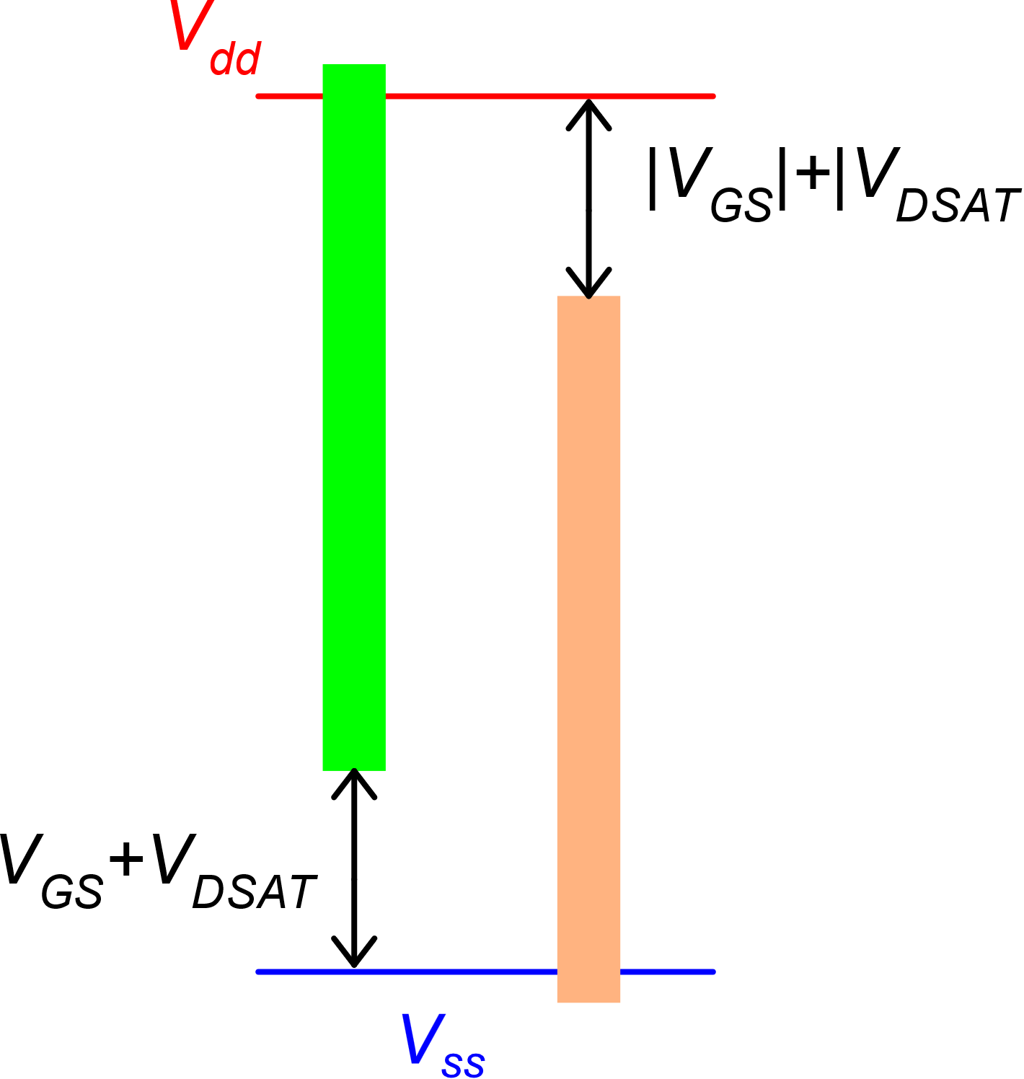
OTA with rail-to-rail input CM range
Input CM range
The idea is to make an n-type and p-type OTAs work together,
In this way, for any value of the input common mode range, there is at least one OTA that operates correctly
n-type
p-type

Slide 9
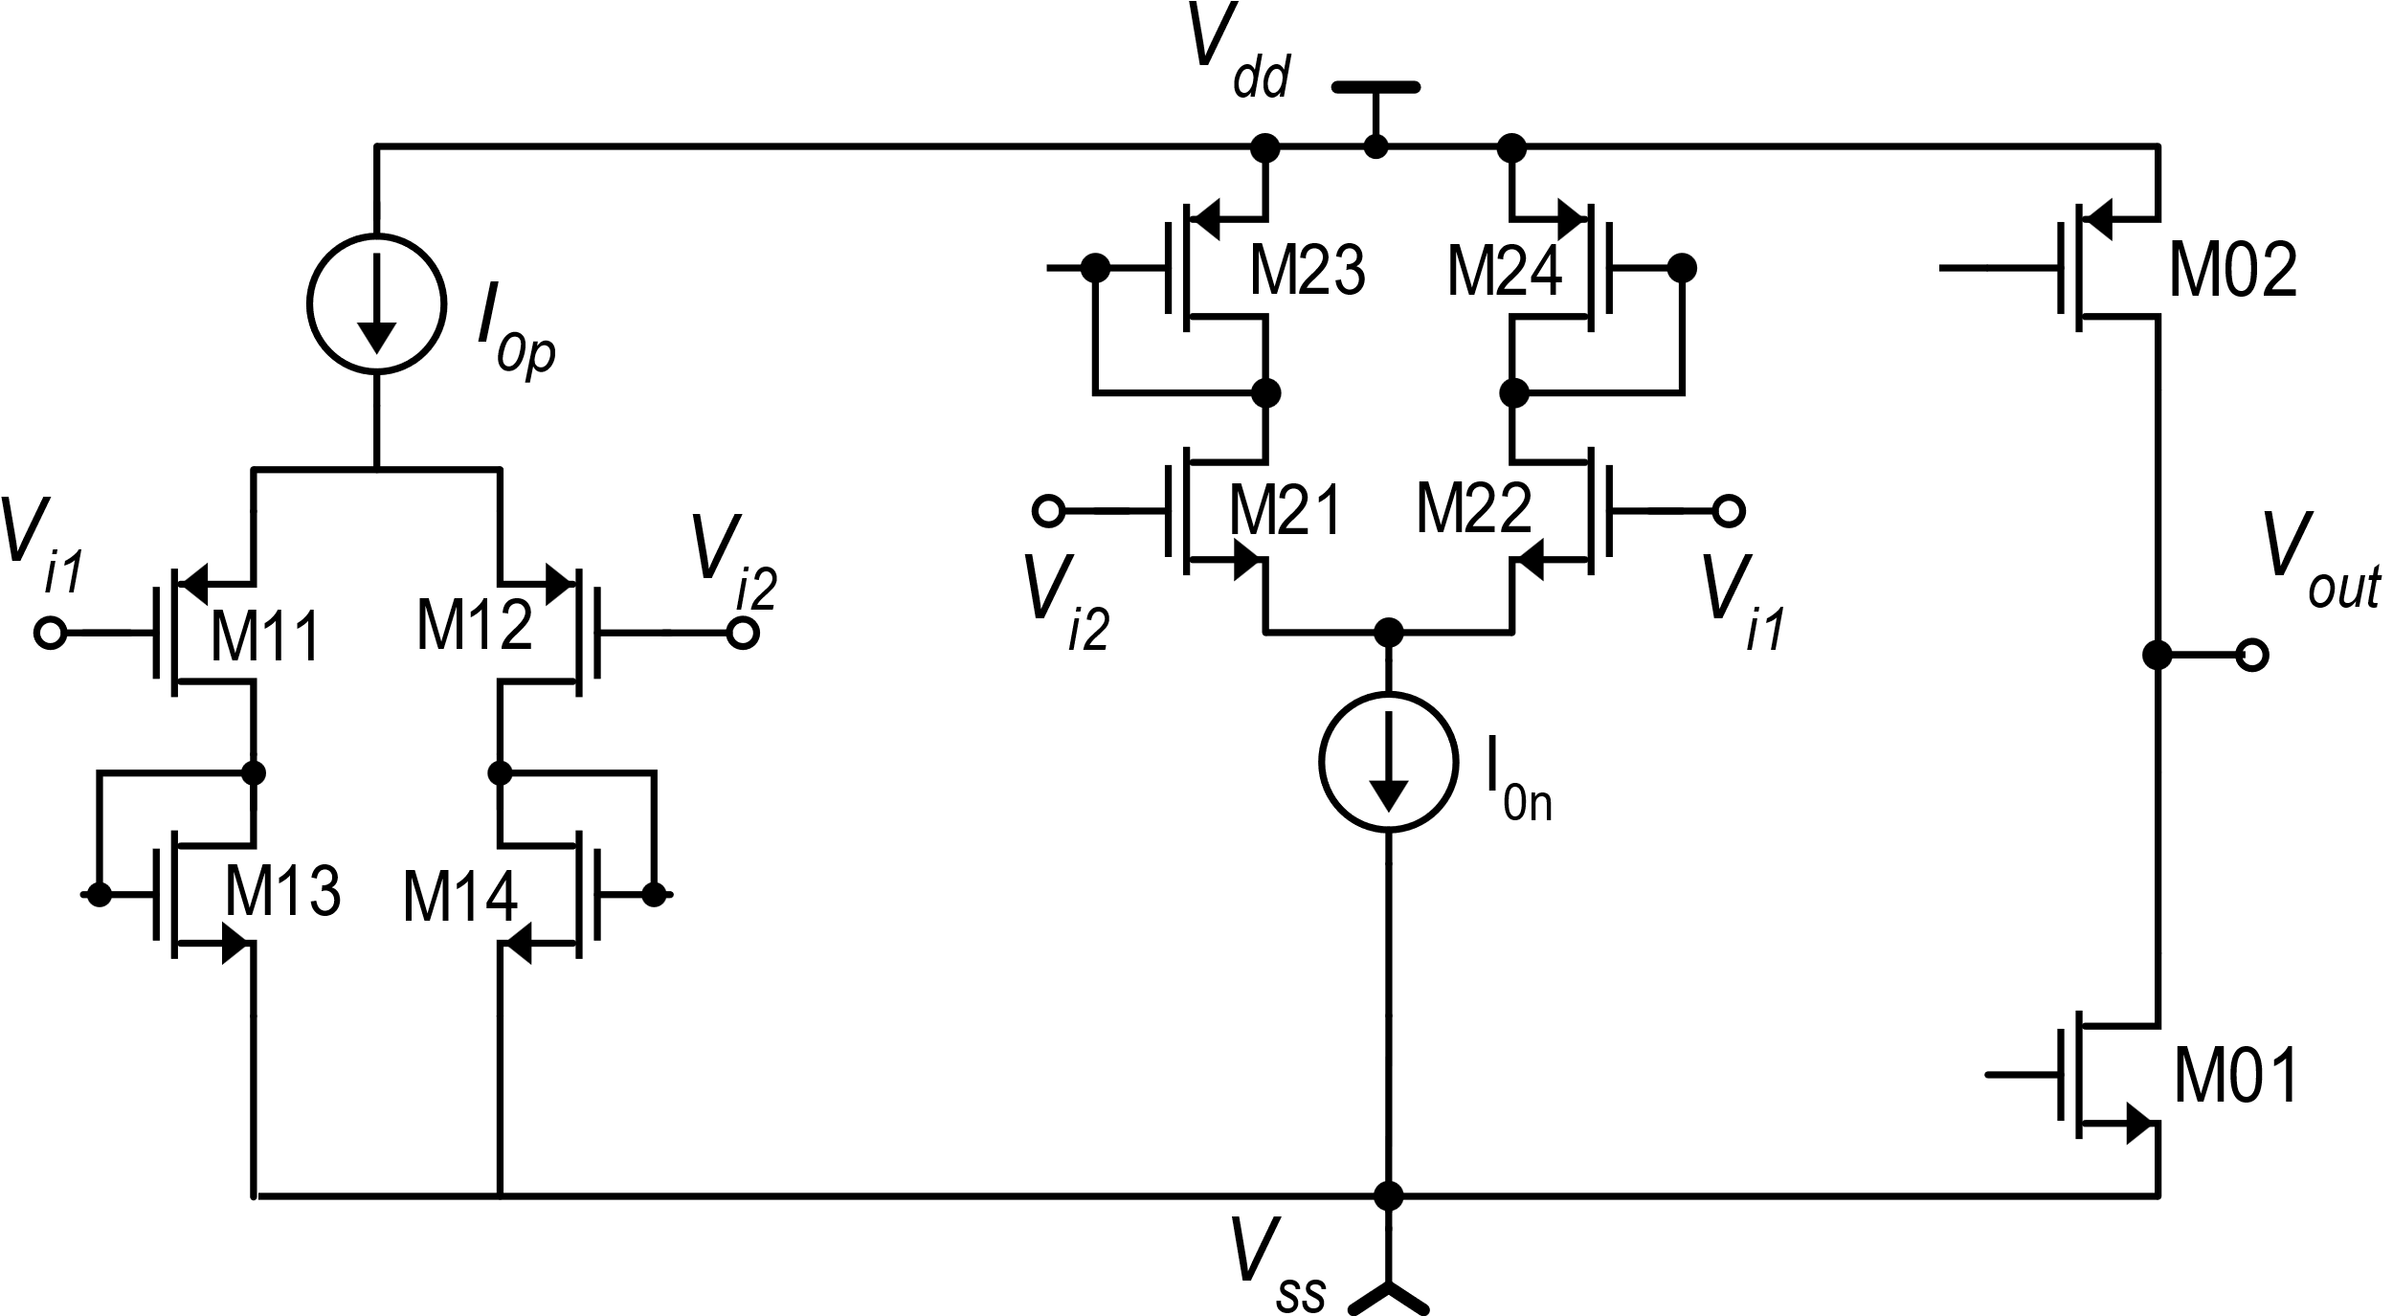
OTA with rail-to-rail input CM range

Slide 10
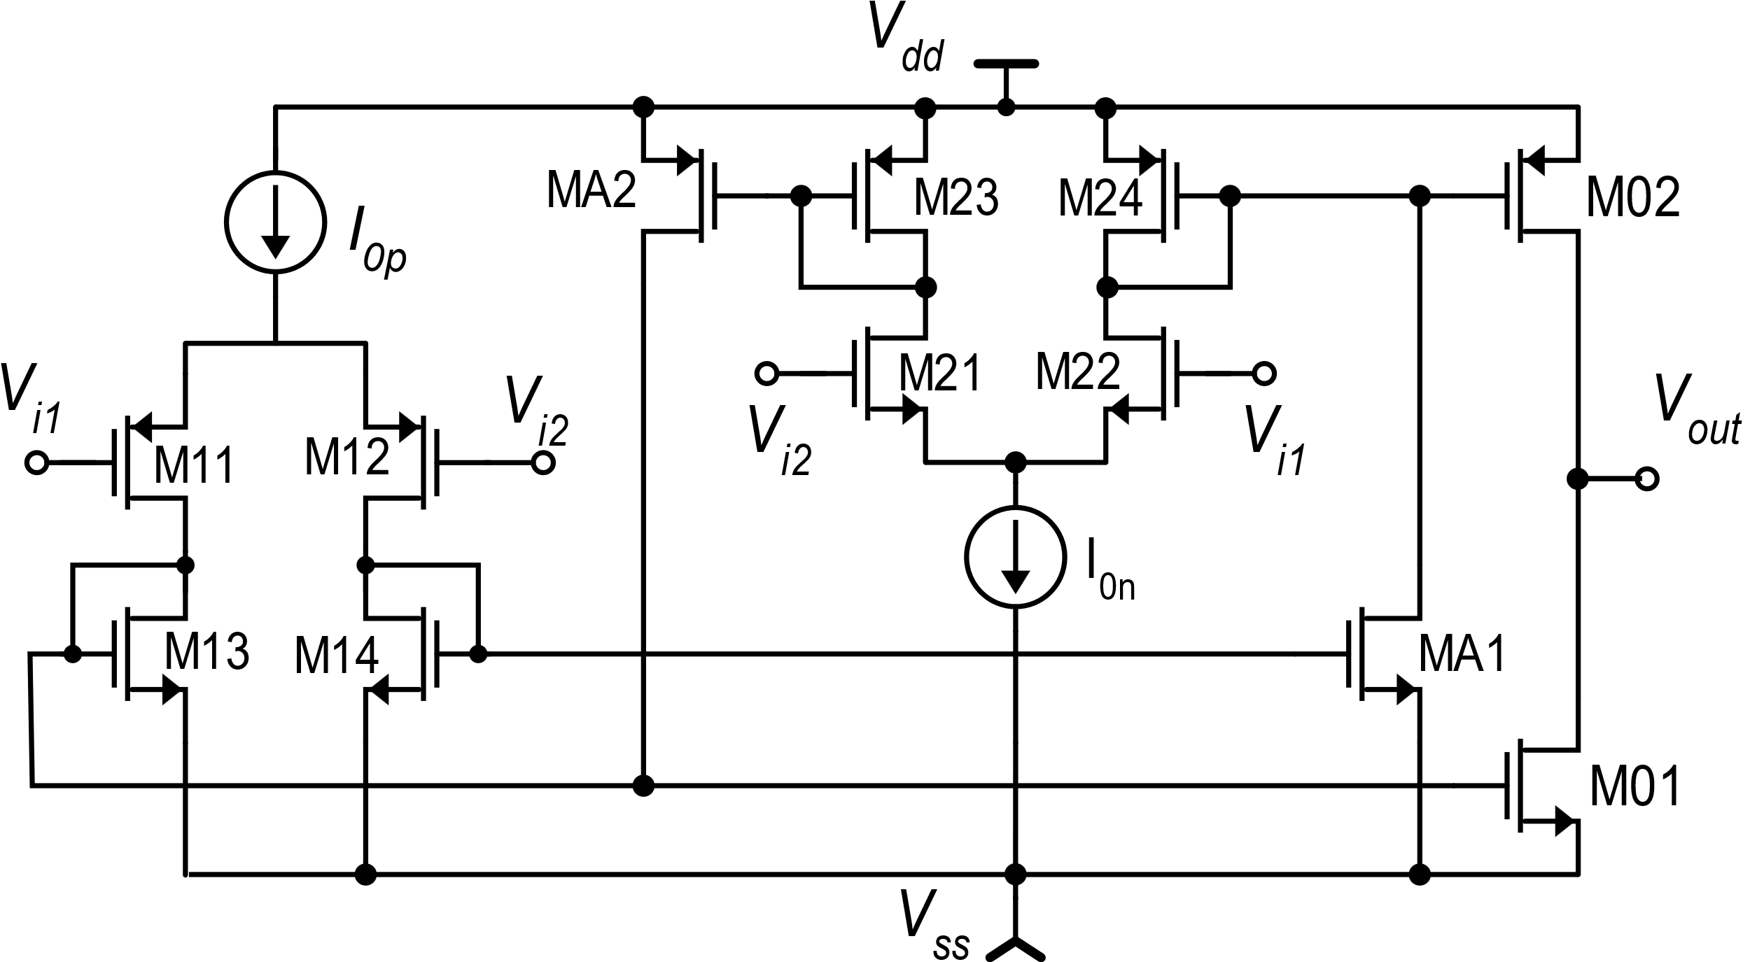
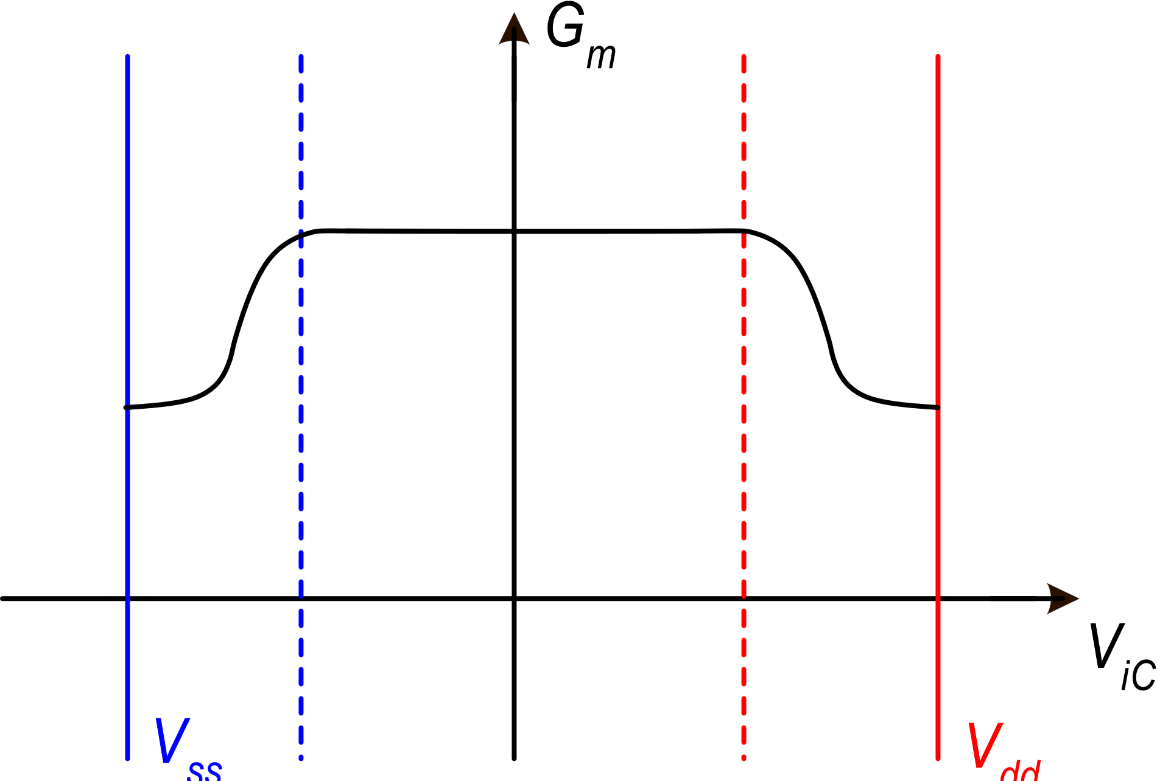
OTA rail-to-rail: equivalent Gm and dc gain

Slide 11
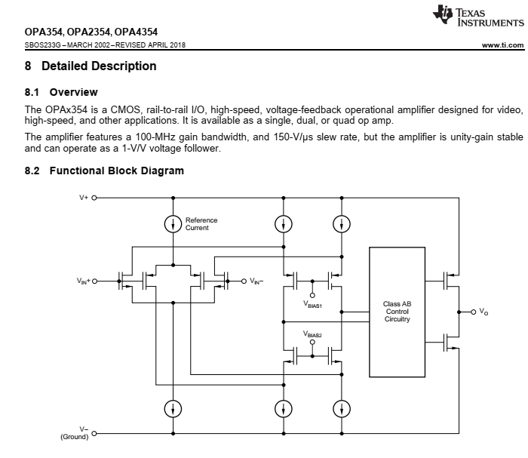
Example of CMOS Op-Amp RRIO using a folded cascode input stage and a complementary p-n input pair

Slide 12
The source follower
V_{dd}
V_{in}
M1
V_{out}
(small)
I₀
The source follower can be used as an output stage to be placed, for example after an high gain stage as the folded cascode.
V_{ss}

Slide 13
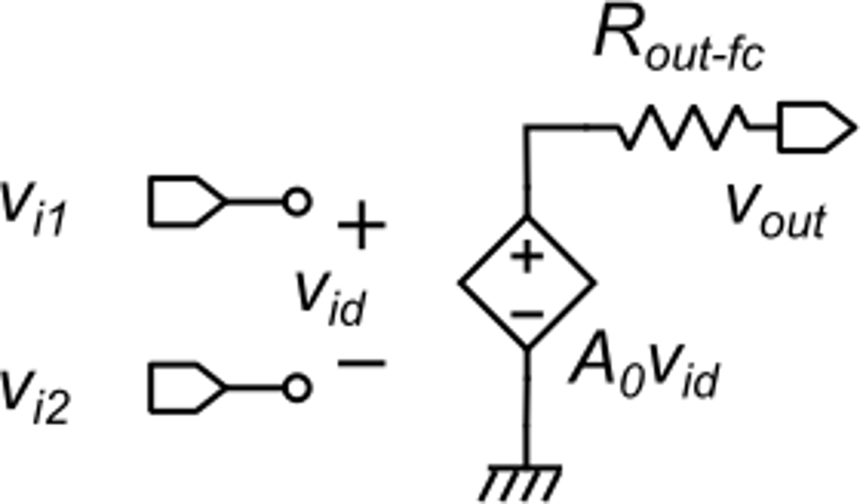
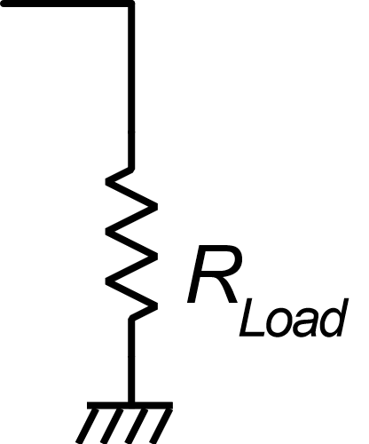
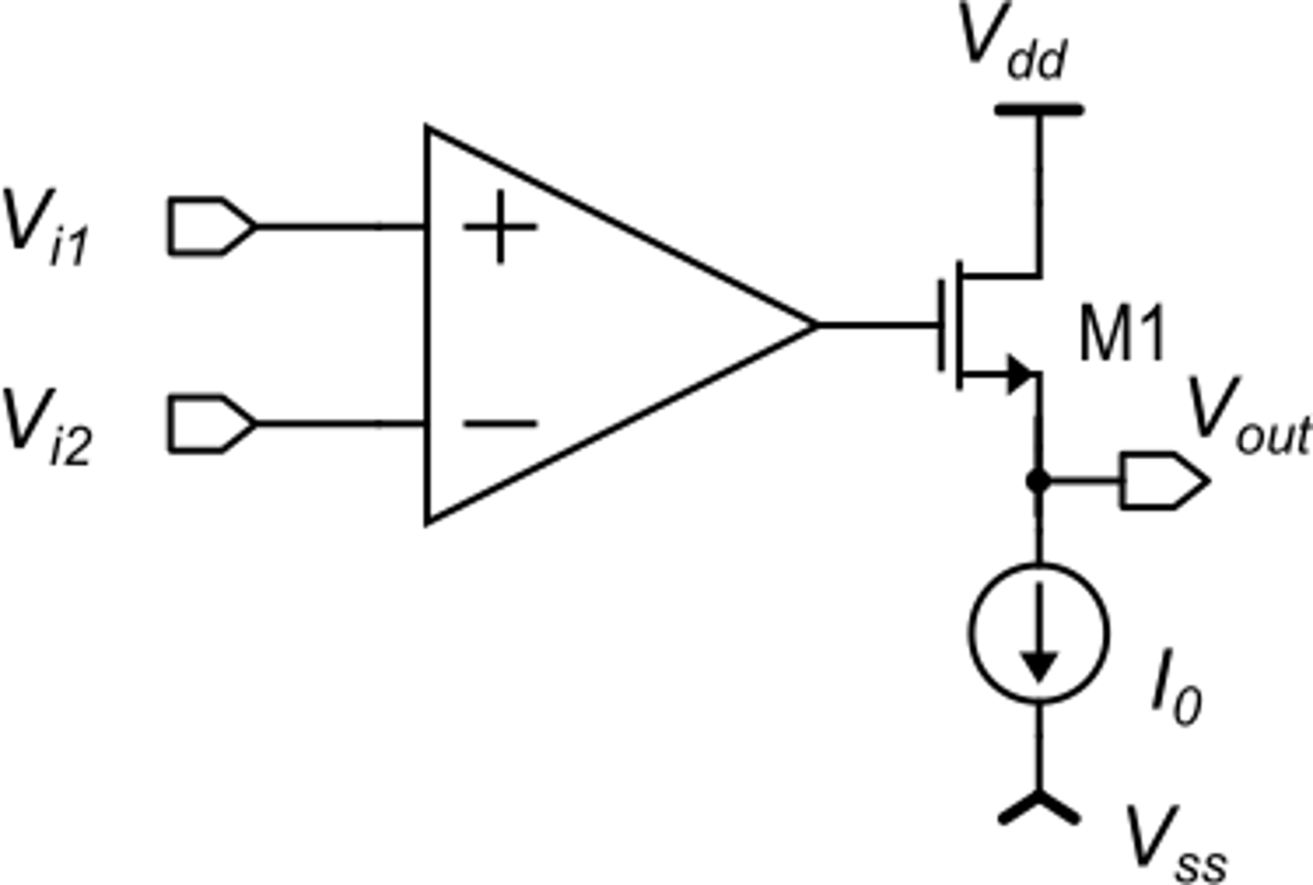
The source follower as an output stage: advantage
Folded cascode amplifier
If we have to drive a resistive load
V_{i1}
V_{out}
For R_{out}>>R_{Load}, this coefficient can be <<1 reducing the available gain
V_{i2}
Adding a source follower at the output we have the same gain A₀ with a much lower output resistance
Equivalent circuit

Slide 14
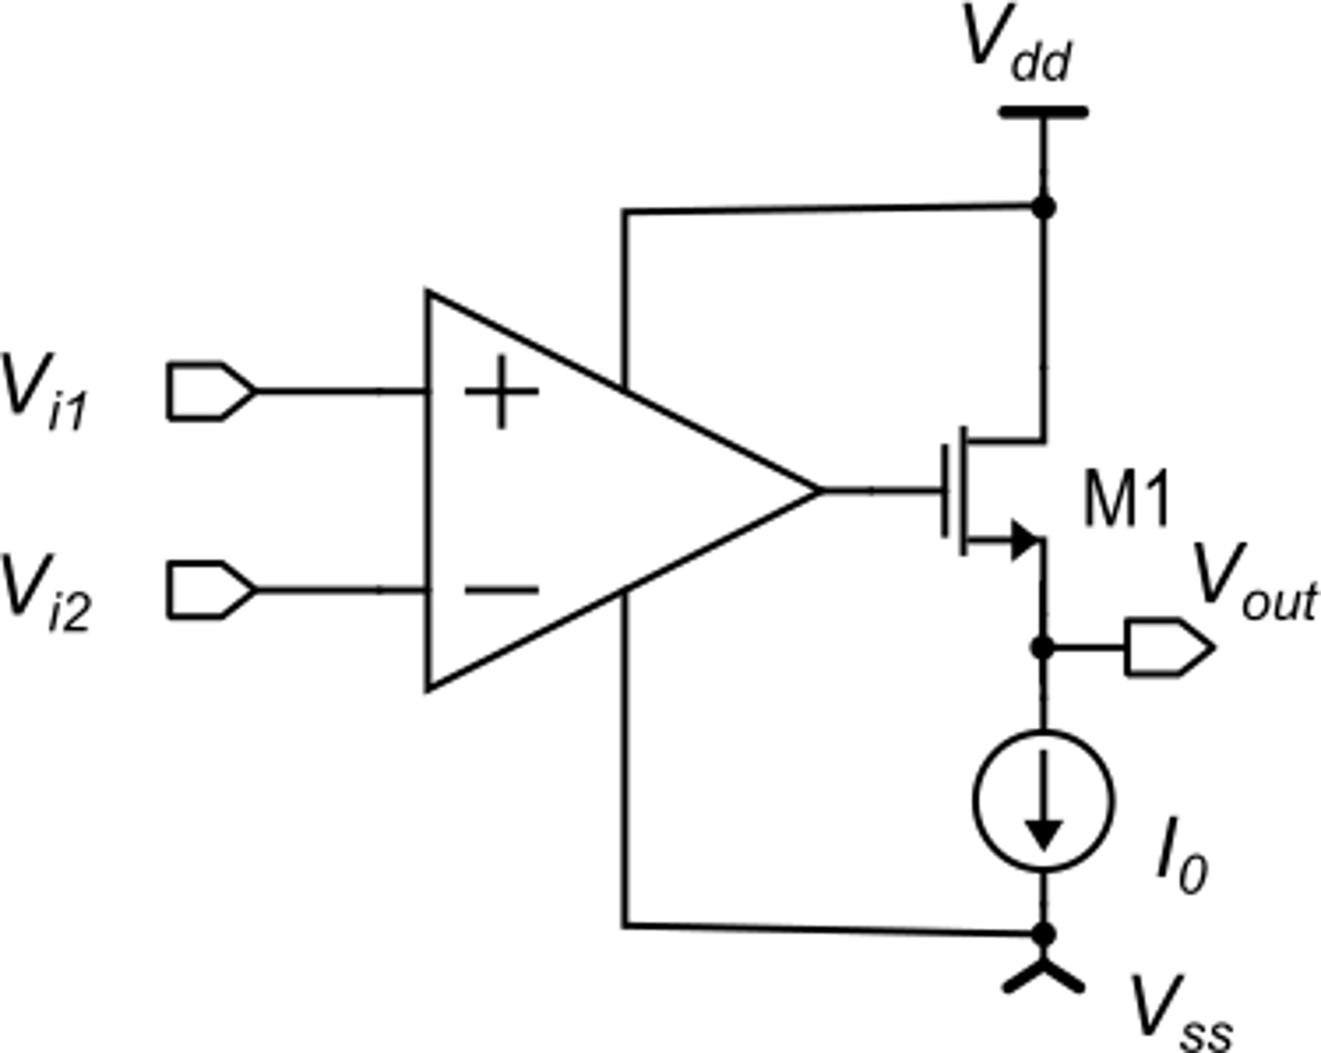
The source follower as an output stage: drawback
The input voltage of the source follower cannot be larger than V_{dd}
The output swing looses a VGS margin with respect to the higher power rail (V_{dd})
This drawback strongly limits the usage of the source follower as an output stage in modern integrated circuits. It can be used only if a rail-to-rail output swing is not required.

Slide 15
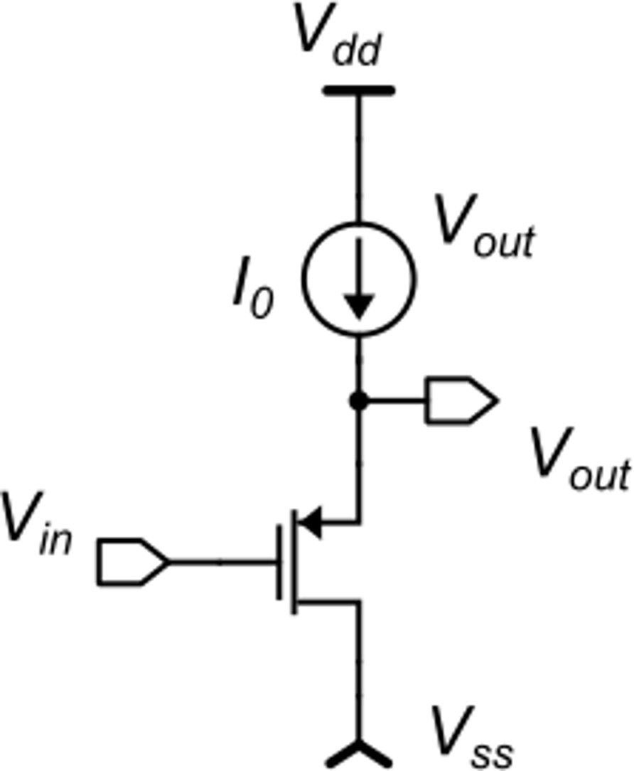
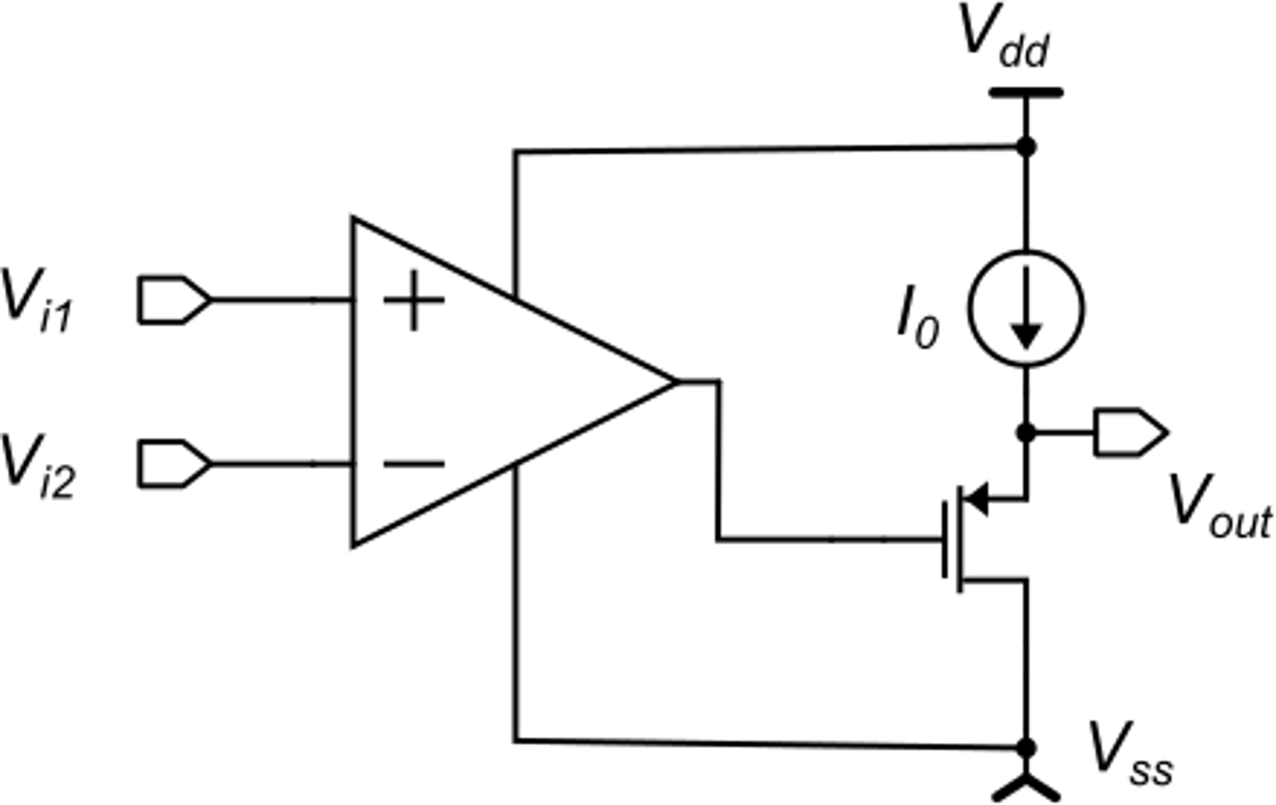
P-type source follower
With the p-type source follower we loose a |V_{GS}| margin to V_{ss}.
This is equally not compatible for rail-to-rail applications

Slide 16
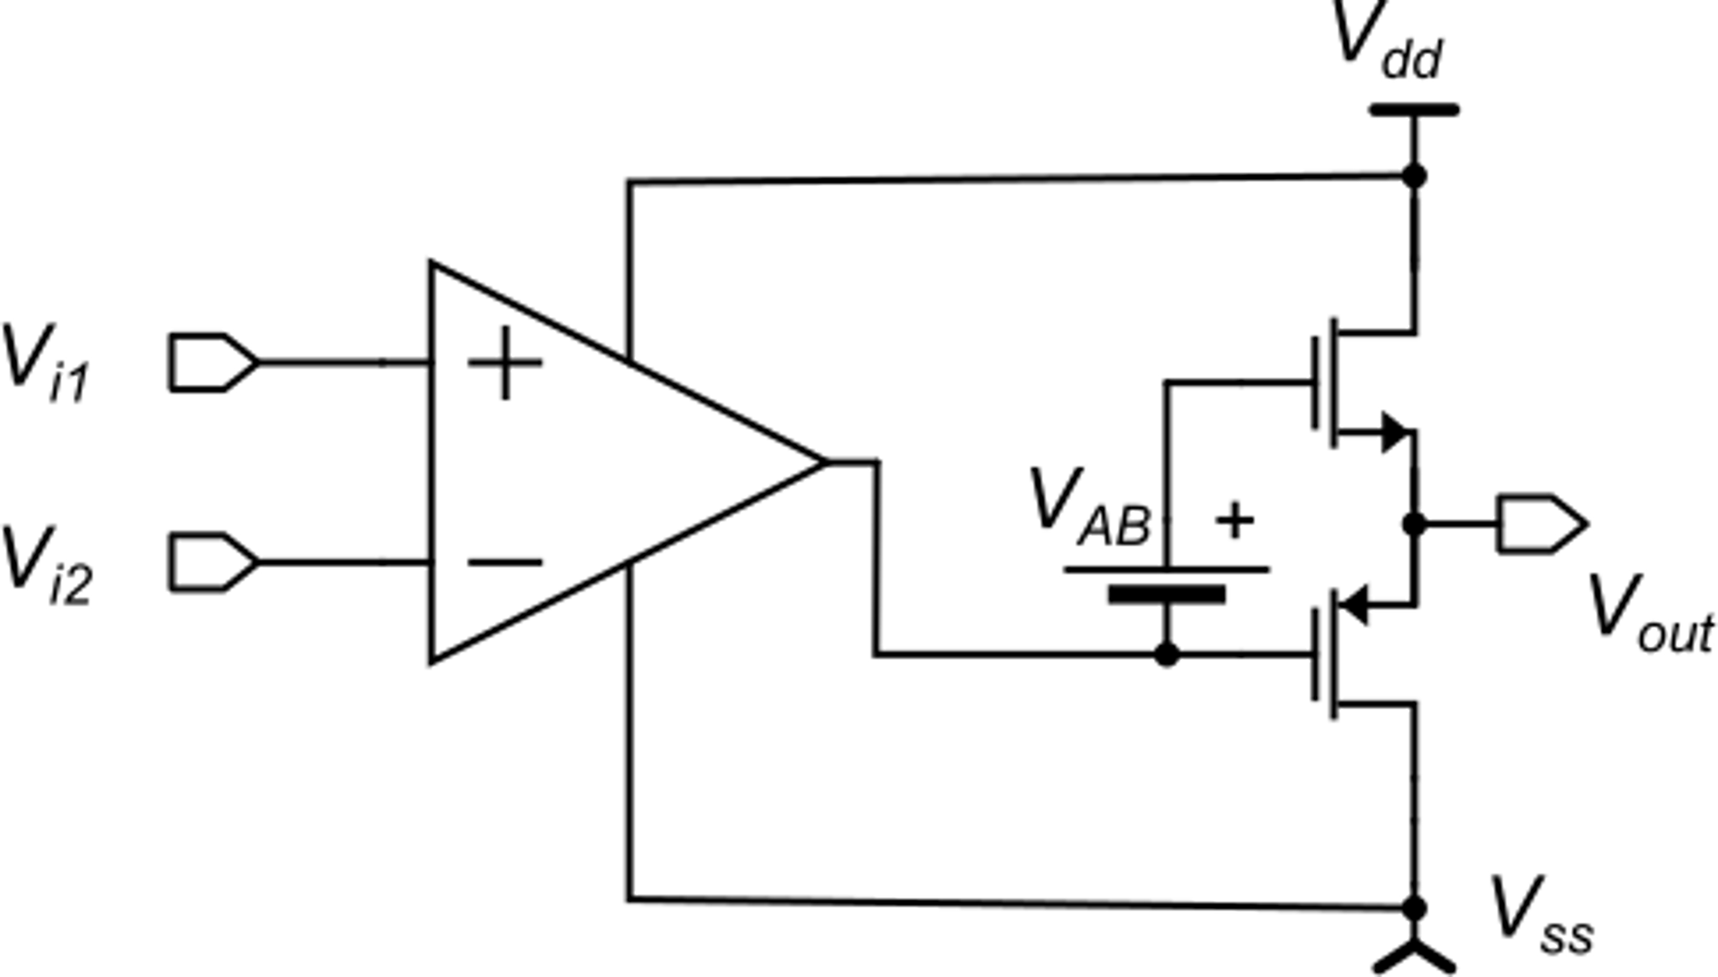
Class AB source follower
This stage looses a VGS margin to both rails. It is used only for amplifiers that can count on high supply voltage. Not used in general purposes operational amplifiers

Slide 17
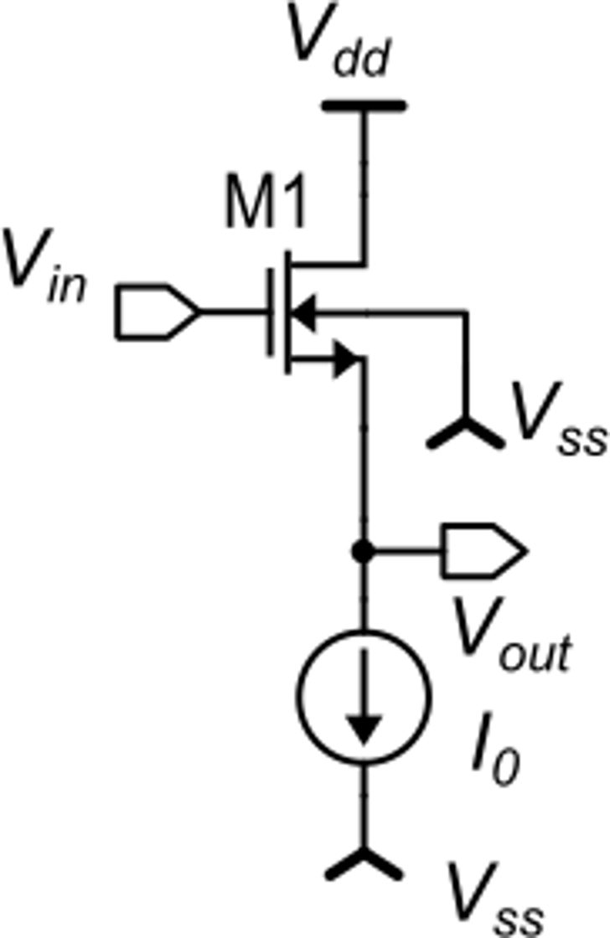
Source follower as voltage shifter
In strong inversion:
V_{out} is shifted down by V_{GS}.
Unfortunately the voltage shift (VGS) is not constant, but depends on the output signal:
This causes distortion for wide input signals
The problem can be solved by connecting the source to the body (tot possible in standard n-well CMOS processes)

Slide 18
P-type voltage shifter
The p-type source follower acts as a positive voltage shifter.
In standard n-well CMOS processes it is possible to connect the source to the body (n-well) obtaining a constant voltage shift (|V_{GS}|)

