Slide 1
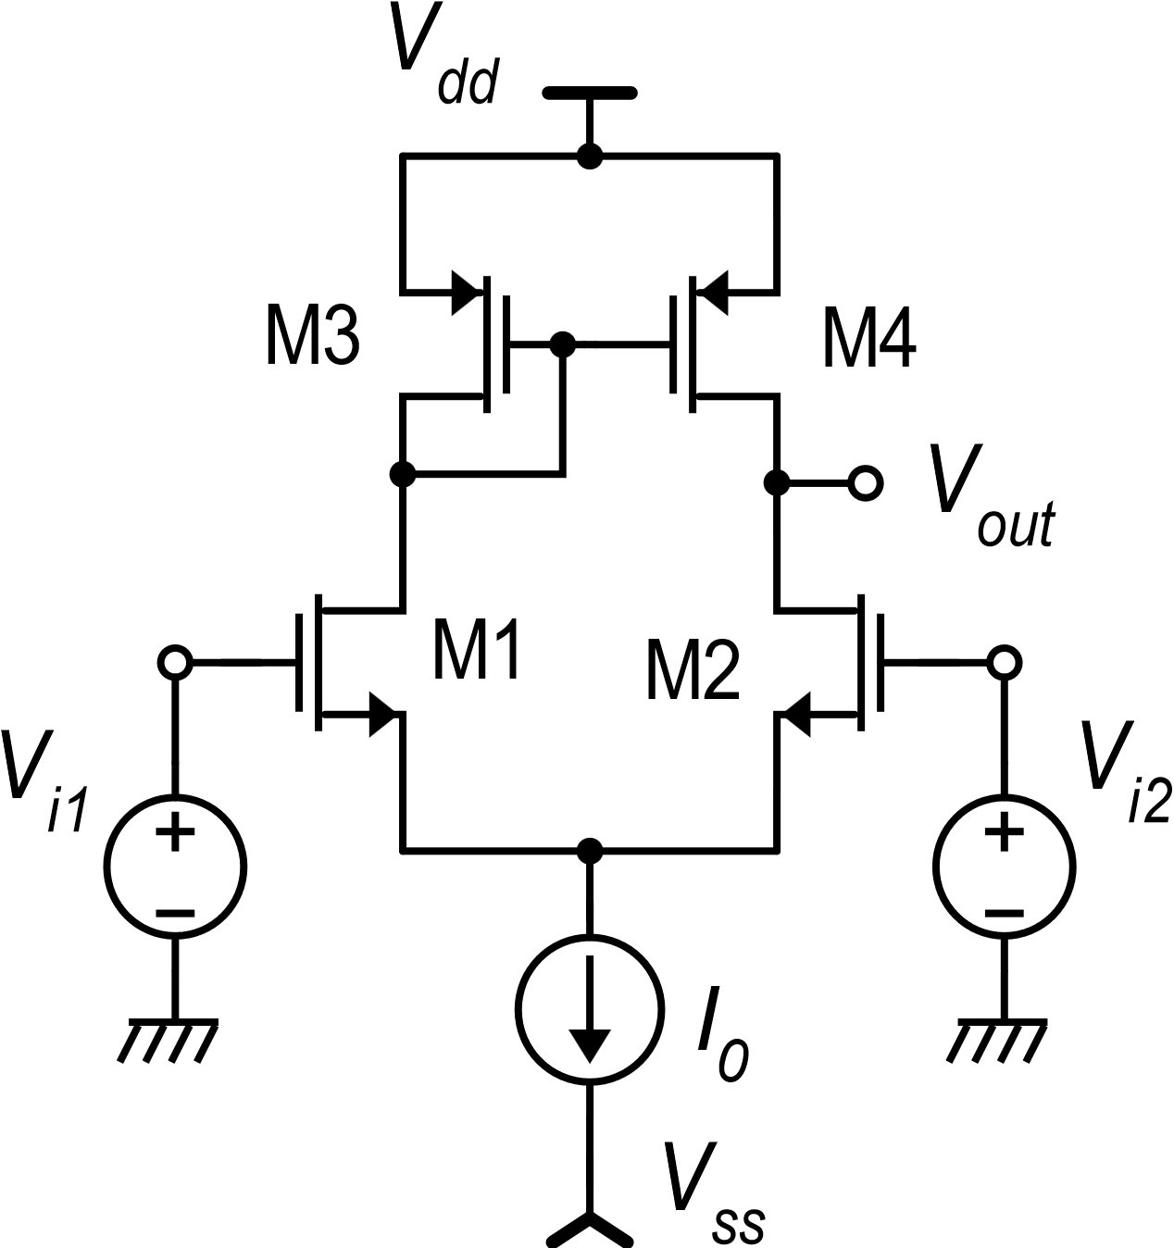
Increasing the gain of the simple differential amplifier with mirror load
For many applications, the gain of the simple CMOS differential is not sufficient
Trying to increase g_{m1} by increasing I_{D1} produces a corresponding decrease of R_{out}.
The gain is not improved
We can increase R_{out} by reducing the lambdas, but this means very long MOSFETs, resulting in large area occupation and parasitic capacitances.
We need to increase R_{out} in a different way!

Slide 2
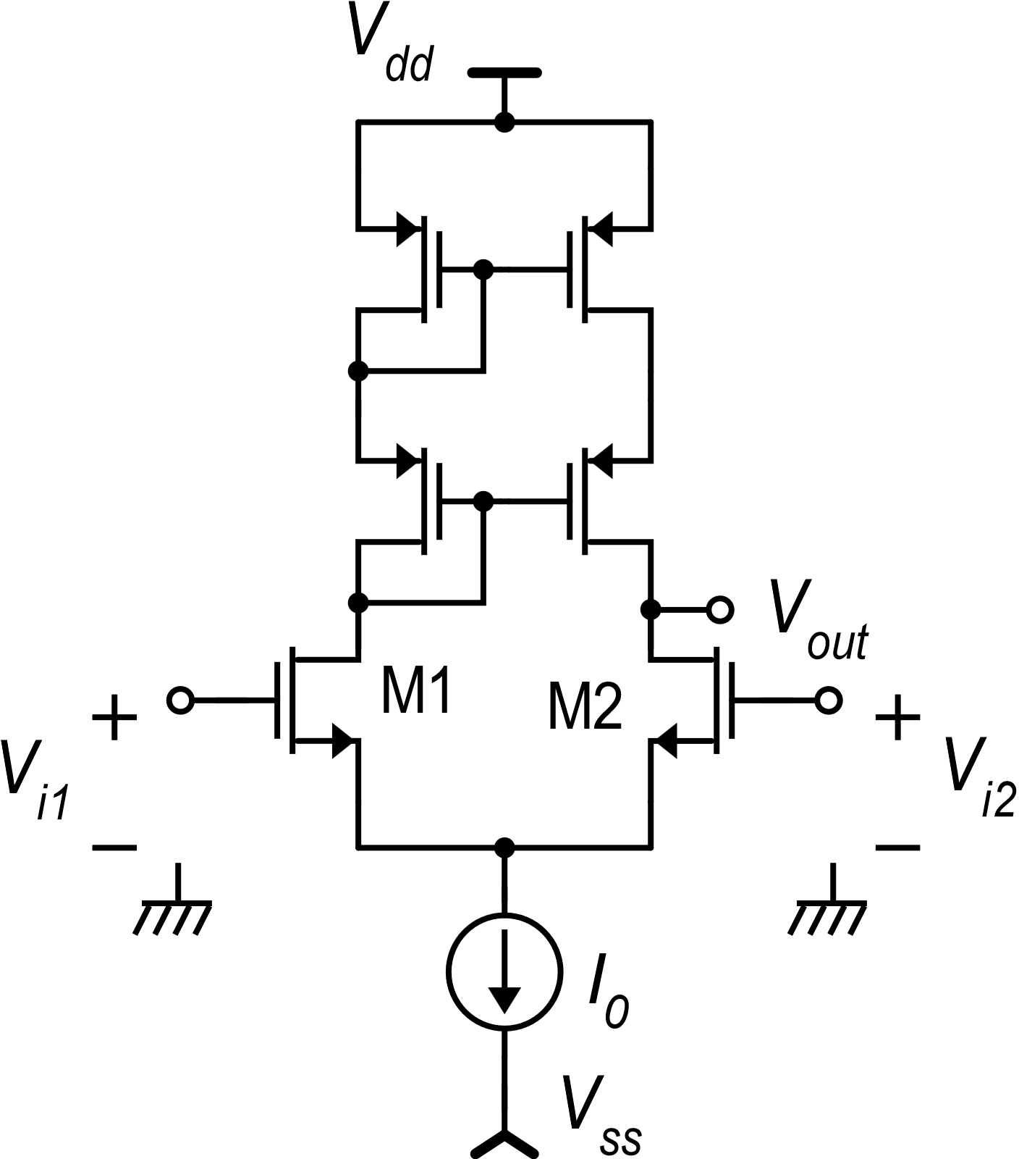
Fist step: replace the simple current mirror with a cascode mirror
This increases R_{up} …
… but R_{down} is not changed
R_{out} passes from r_{d}/2 to r_{d} and the gain is only doubled

Slide 3
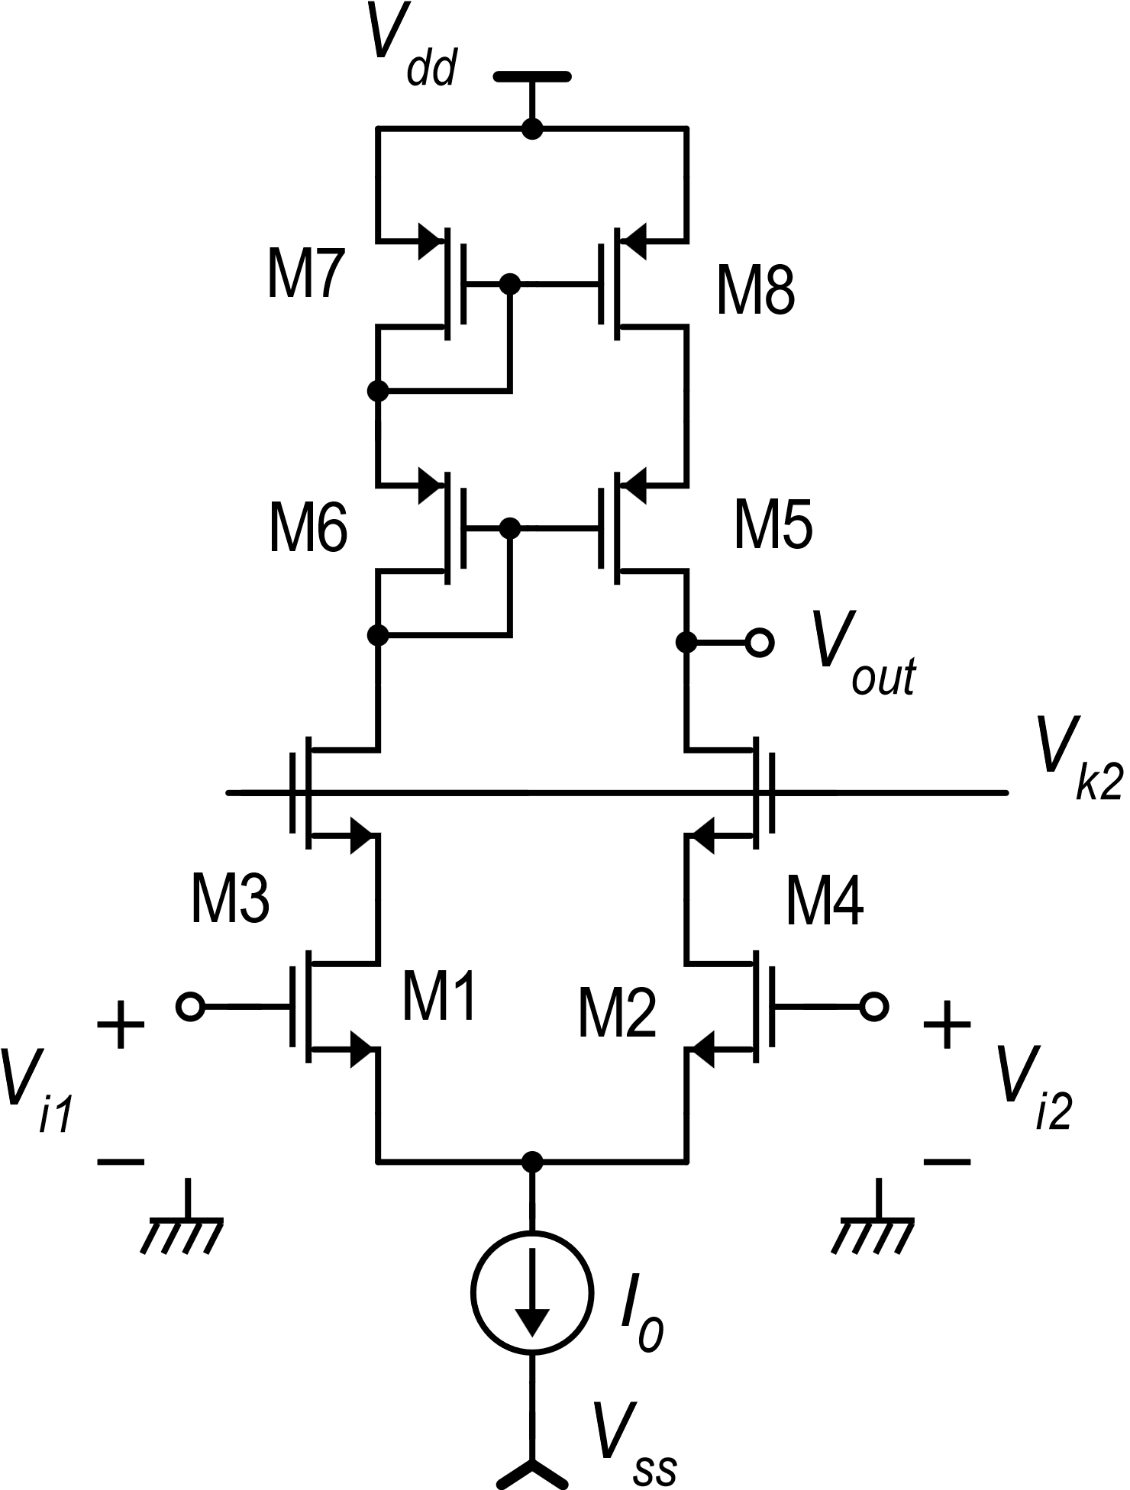
Second step: add a common-gate also to the differential pair: The cascode differential amplifier
2r_{d2}
We add a differential common gate stage (M3,M4) to the differential pair: forming a differential cascode stage

Slide 4
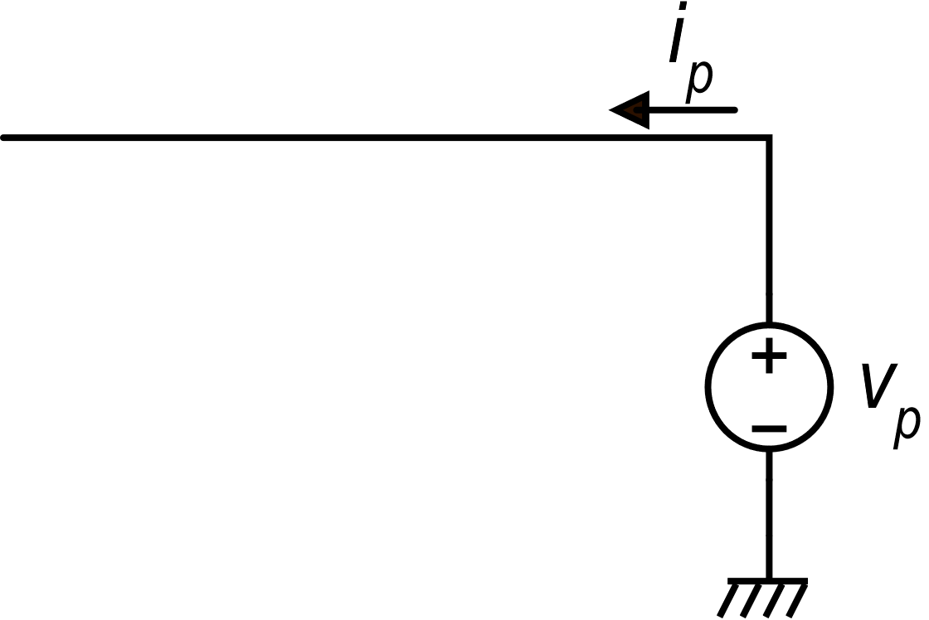
Cascode differential amplifier: R_{out}
Also in this amplifier, the current into R_{down} is brought back to the output
The current into R_{down} is doubled

Slide 5
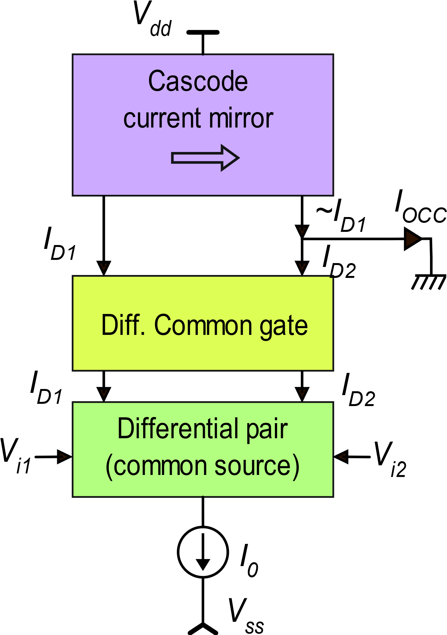
Cascode differential amplifier
I-to-I network
If all devices have the same r_{d} and g_{m}:
Cascode
Differential
stage
V-to-I network

Slide 6
CMOS cascode amplifier: output range
Upper limit
|V_{out-mirror} |
As V_{out} gets higher than max(V_{out}), R_{up} decreases making the gain decrease

Slide 7
CMOS cascode amplifier: output range
Lower limit
In strong inversion:
For an approximation of min(V_{out}) in weak inversion just add 100 mV

Slide 8
Input common mode range
V_{C}
V_{C}

Slide 9
Cascode amplifier: all ranges
V_{dd}
V_{dd}
V_{out}
max(V_{out})=V_{dd}−|V_{MIN-cascode}|
max(V_{iC})=V_{k2} −V_{DSAT1}
V_{out}
V_{k2}
V_{ic}
min(V_{out})=V_{k2} −V_{GS4}+V_{DSAT4}
V_{k2} determines a trade-off between the input common mode range and the output swing
min(V_{iC})=V_{SS} +V_{MIN-tail}+V_{GS1}
V_{ss}
V_{ss}

Slide 10
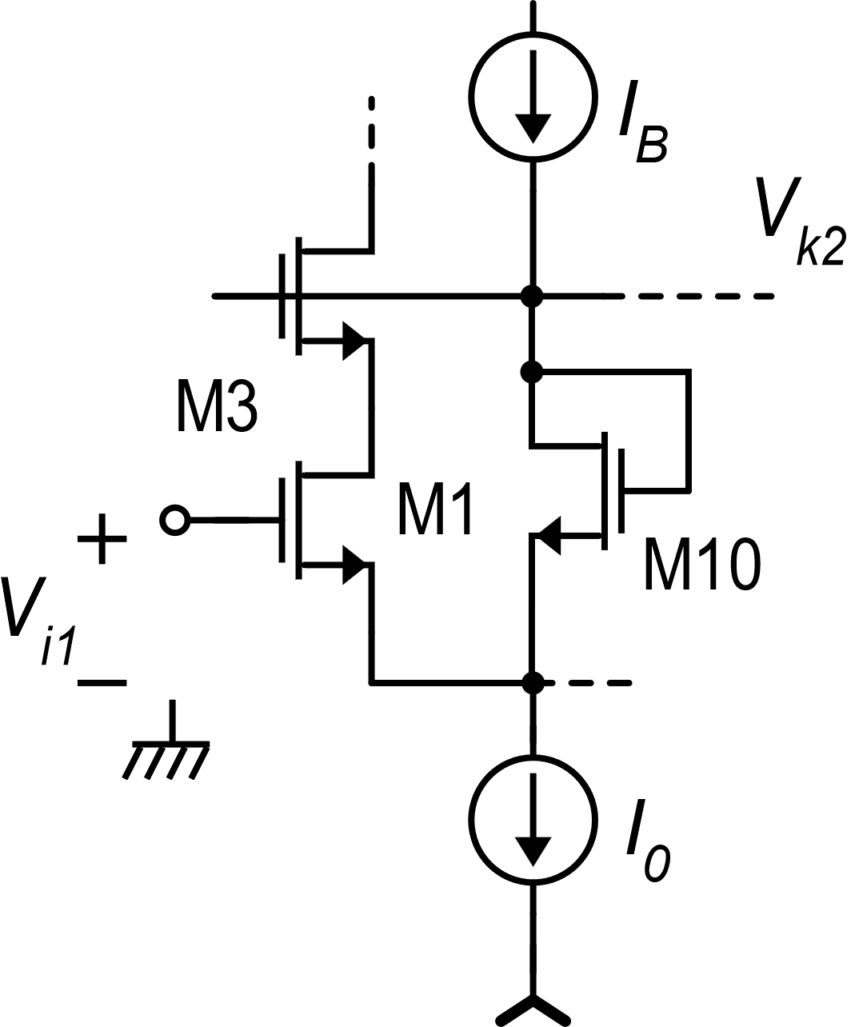
Adaptive V_{k2}

Slide 11
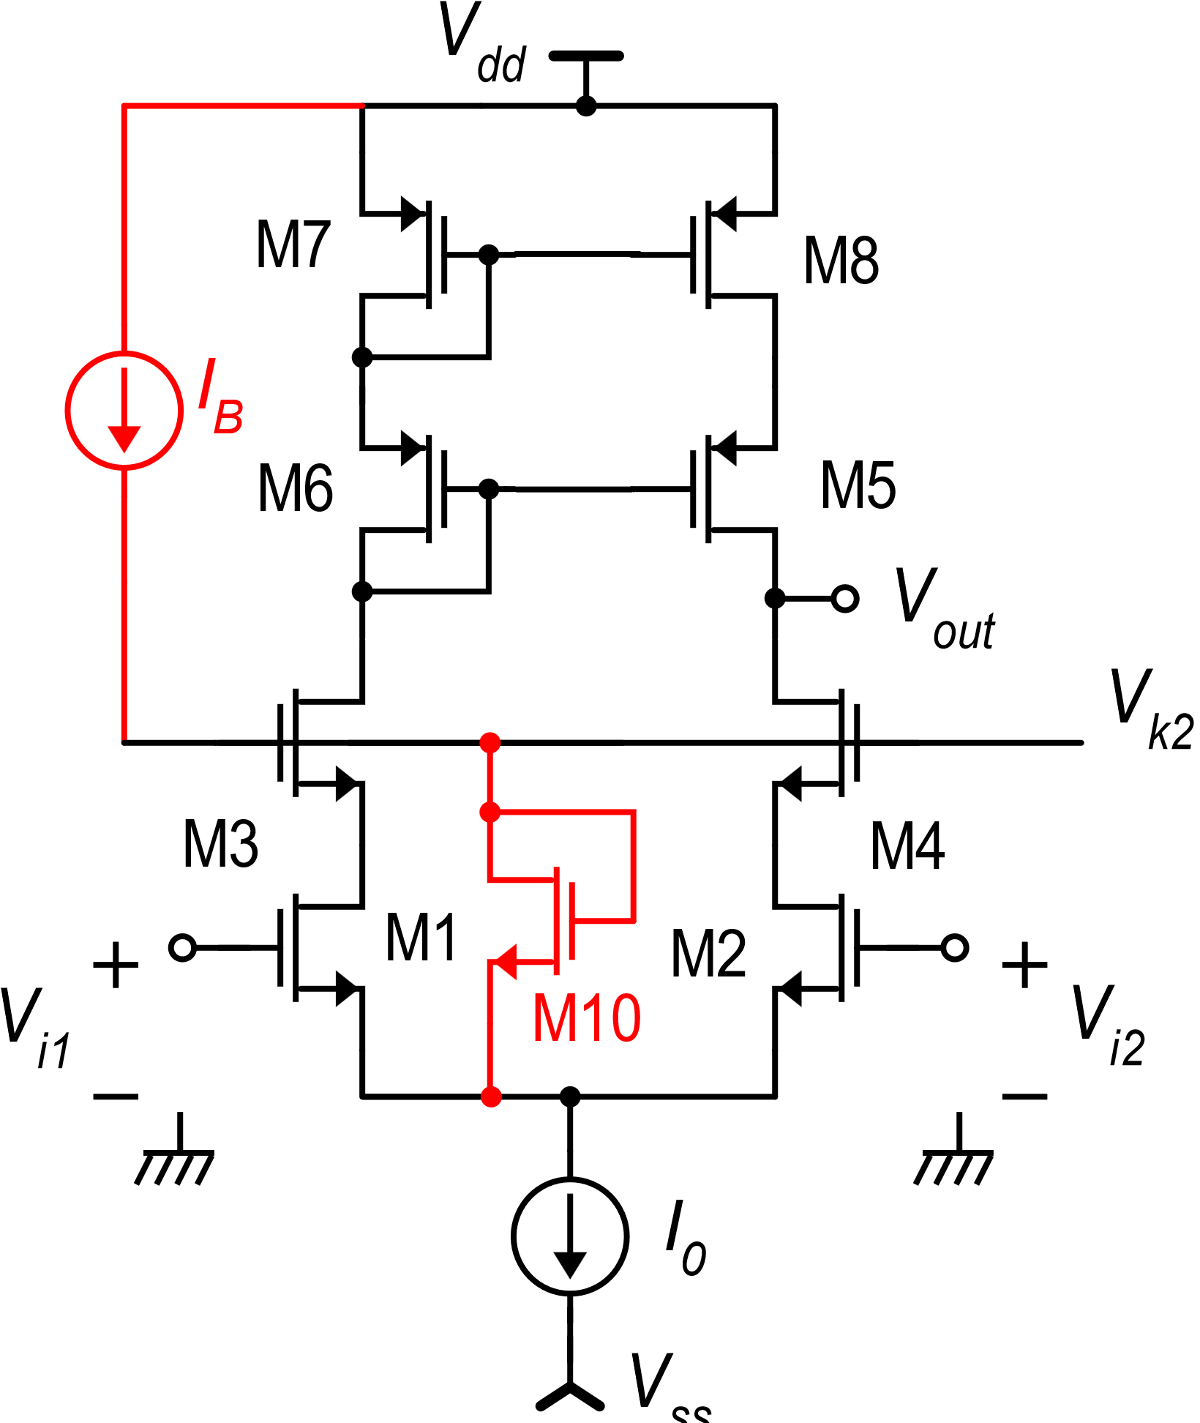
Adaptive V_{k2}
Same as in the case of a general cascode structure
The adaptive V_{k2} does not solve the problem that, as V_{iC} increases, the output swing gets smaller. The advantage is that the amplifier is more flexible and no trade-off on V_{K2} should be made in the design phase.
“Telescopic” amplifier

Slide 12
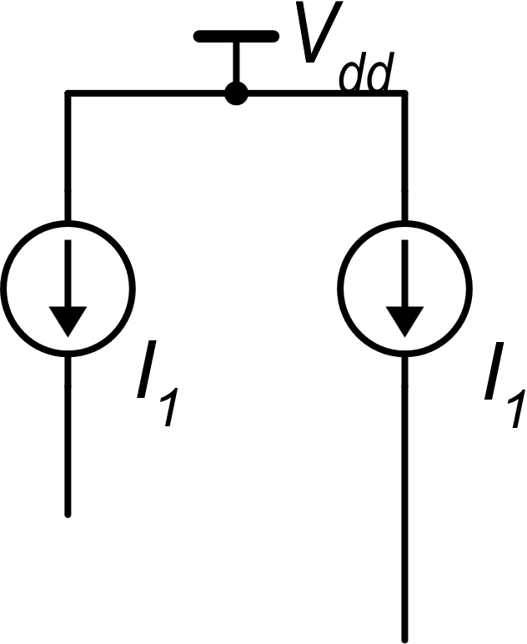
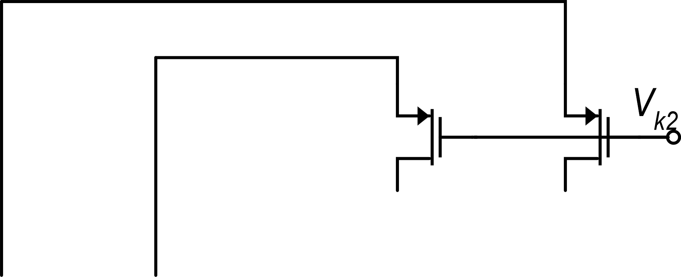
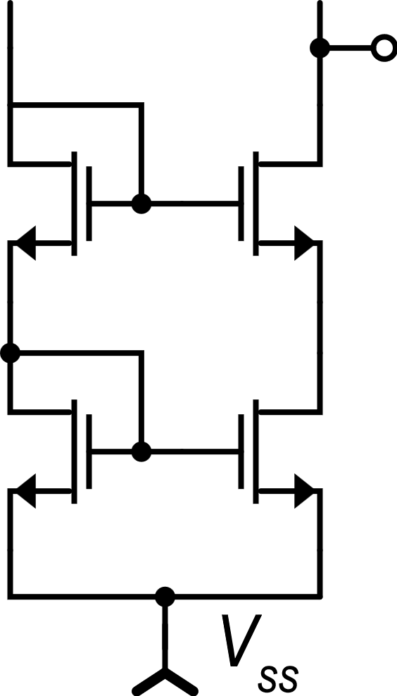
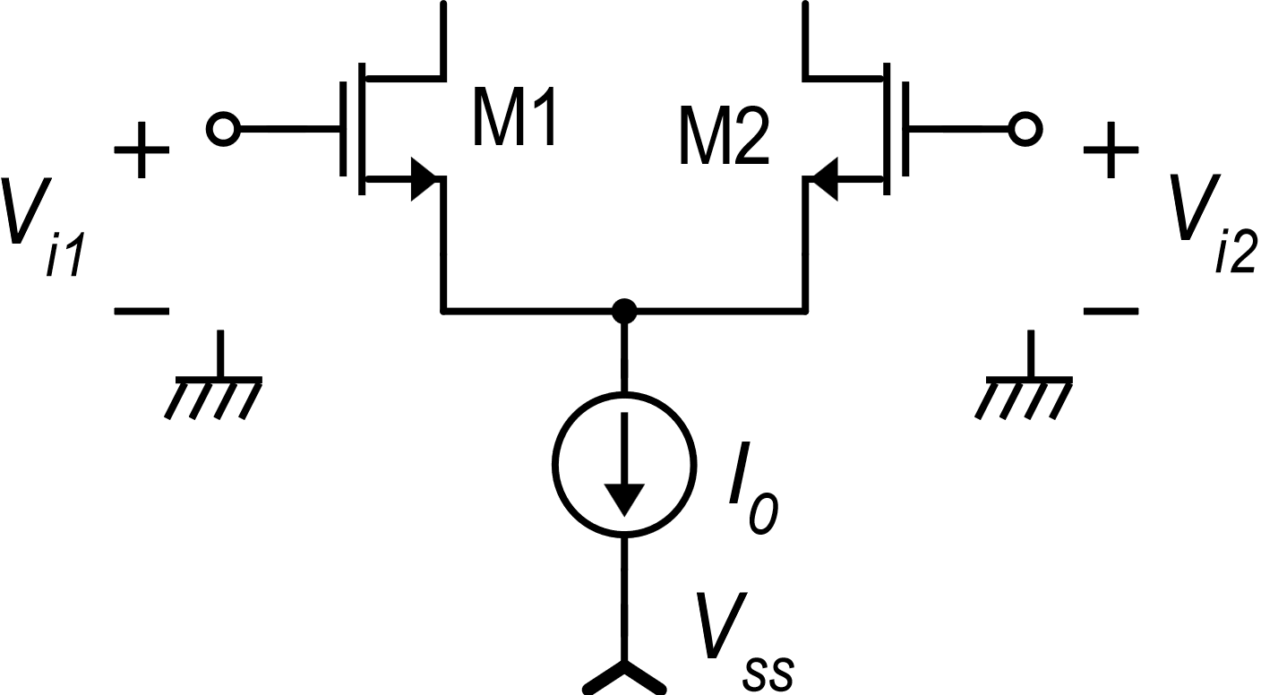
Removing the interaction between input and output range: The Folded Cascode
Two current sources are required to bias the common source and common gate
Folding
Let us introduce a type-p common gate stage
out
According to the folding mechanism, the signal (variations) initially travels from one rail to the other and then invert direction and goes back to the initial rail
Use an n-type current mirror to subtract the currents

Slide 13
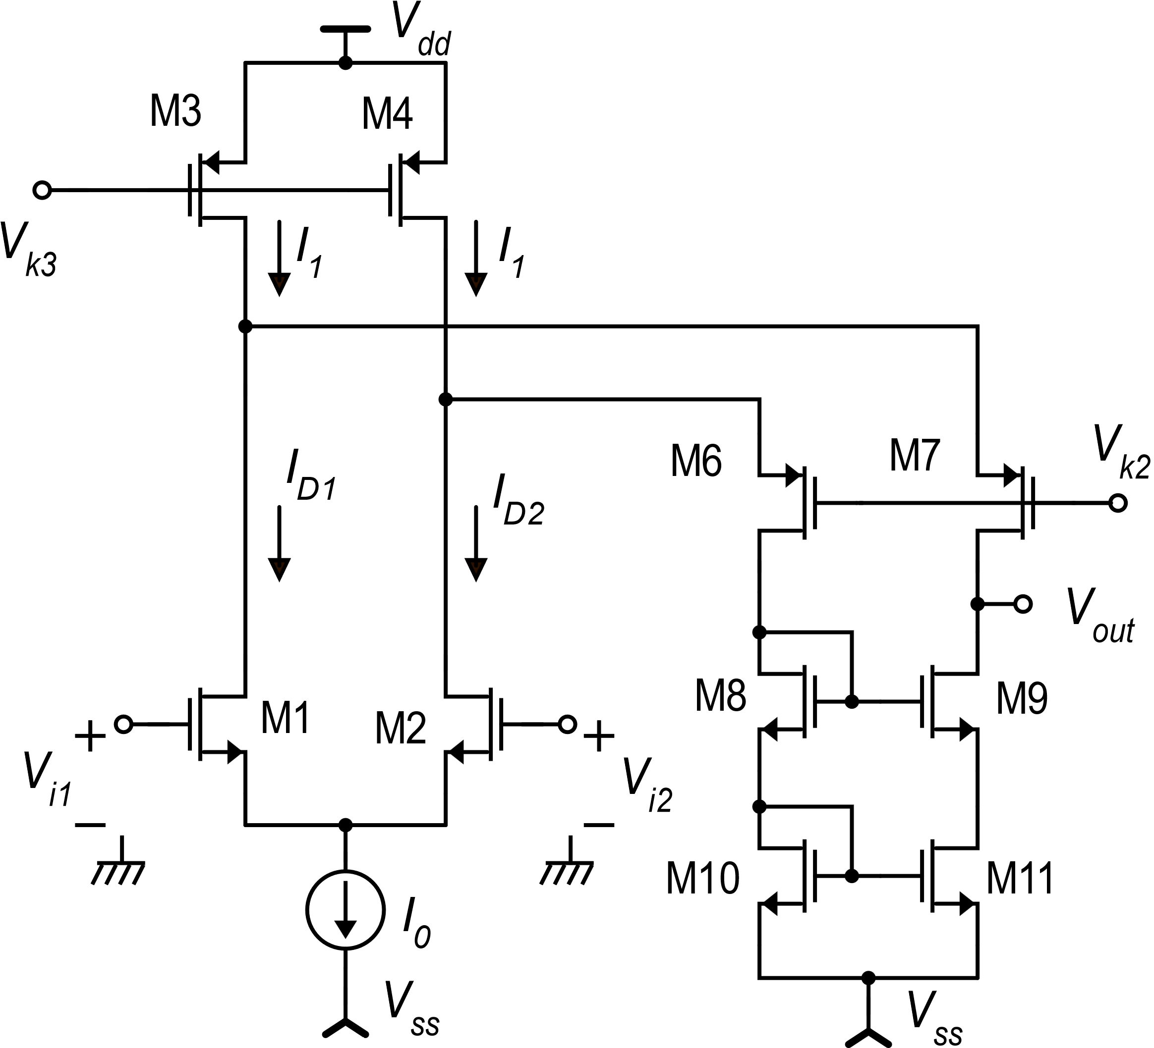
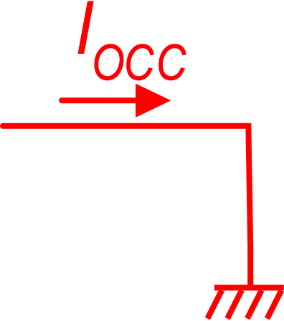
Folded cascode amplifier: device currents
Condition:

Slide 14
Folded cascode: setting the correct I₁ value
Quiescent point:
With a large input signal (|V_{id}|> V_{DMAX}):

Slide 15
Folded cascode: differential mode gain
Using a Norton equivalent circuit of the output port
r_{d3}
r_{d4}
M6
M7
V_{k2}
i_{p}
M1
M8
M9
v_{p}
M2
r_{os}
M10
M11

Slide 16
Folded cascode: output resistance (2)
r_{d3}
r_{d4}
M6
M7
V_{k2}
i_{p1}
i_{p2}
v_{p1}
M1
M8
v_{p2}
M2
M9
M10
M11
r_{os}

Slide 17
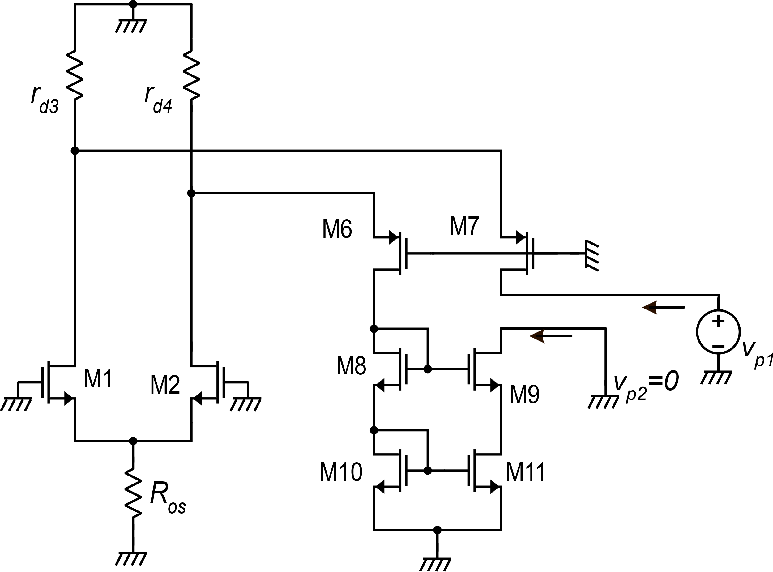
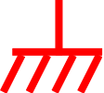
Folded cascode: output resistance (2)
R_{S7}
2r_{d1}
R_{up}
r_{os}

Slide 18
Folded cascode: output resistance (2)
R_{dw}
r_{os}

Slide 19
Folded cascode: output resistance (3)
If r_{d2}=r_{d3}=r_{d7}=r_{d9}=r_{d11} =r_{d}
g_{m7}=g_{m9}=g_{m}

Slide 20
Folded cascode: differential mode gain
If r_{d2}=r_{d3}=r_{d7}=r_{d9}=r_{d11} =r_{d}
g_{m7}=g_{m9}= g_{m1}= g_{m}
Compare with the “Telescopic” amplifier
… and with the simple amplifier with mirror load (non-cascode)

Slide 21
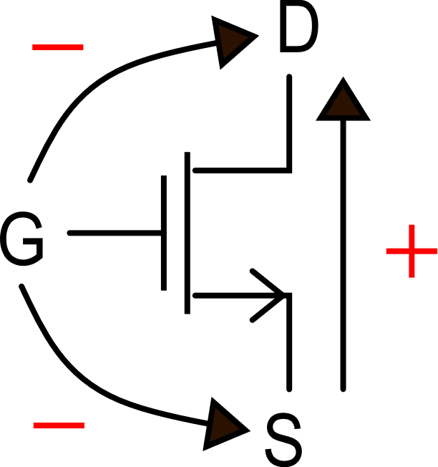
Simple method to find if a terminal is inverting / non-inverting
Signal paths:
From G to D: inversion
From G to S: no inversion
From S to D: no inversion

Slide 22
Ac, CMRR
It is possible to demonstrate that, for V_{D}=0, voltage and currents in the amplifiers are symmetrical.
Then:
v_{C}
v_{C}
r_{os}

Slide 23
Folded cascode: output range
Lower limit
Upper limit
V_{out-mirror}
In strong inversion:

Slide 24
Maximum V_{k2}
|V_{DS3}|
V_{k2} sets the voltage of M1-M3 and M2-M4 drains

Slide 25
Input common mode range
Minimum V_{iC}: M1,M2 pair
Maximum V_{iC}:
M1 (M2) has the drain at a fixed voltage. If the gate voltage increases, M1 (M2) will eventually leave saturation

Slide 26
The folded cascode as a single stage amplifier
I-to-I network (K_{I}=1)
V-to-I network
(G_{m1}=g_{m1})

Slide 27
Folded cascode: summary of properties
DC Gain: Slightly smaller than the telescopic amplifier (non-folded cascode) gain. May reach several thousands or even 10⁴ (80 dB) with long mosfets. Larger than the gain of the cascade of two common source stages.
Ranges: In the the Folded cascode, the output range is not affected by the input common mode voltage. As a result, the input CM range and output range are much wider than in the telescopic amplifier.
Approaches the V_{dd} rail
Output range:
(swing)
May approach the V_{ss} rail if a wide swing mirror is used
The only critical limit
Input CM range:
Goes over the V_{dd} rail

Slide 28
The only true advantage of the telescopic amplifier
Current consumption (I_{supply})
common-source
supply current
common-gate
supply current
CG
CG
Current re-use
The telescopic amplifier needs less current
CS
CS

Slide 29
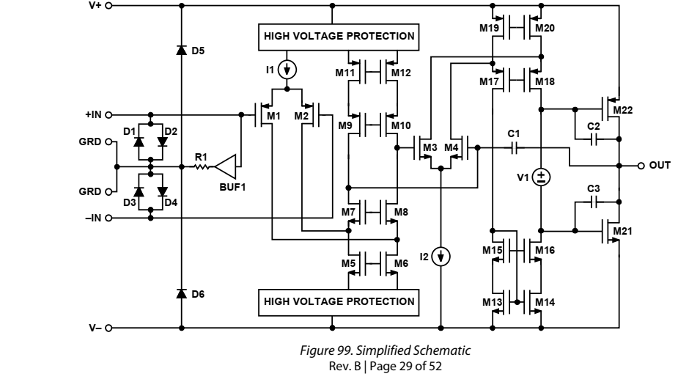
Example: Analog Devices ADA4530
Folded cascode with wide-swing current mirror (gate bias voltages are not indicated for simplicity)

Slide 30
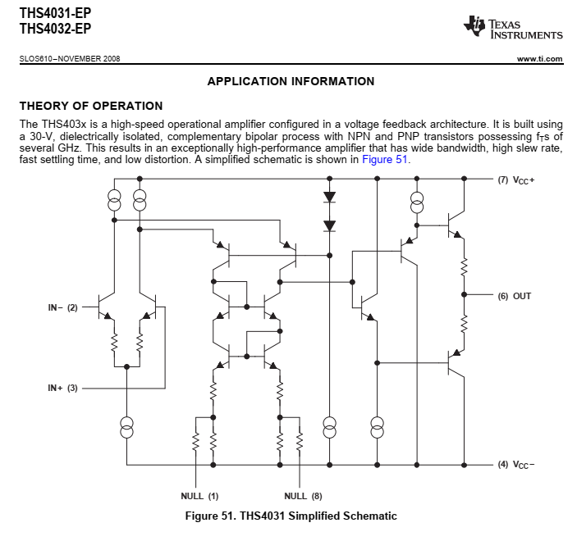
Example of BJT Op-Amp with a single folded cascode gain stage
Emitter-degenerated input pair
(improves input differential range, with benefits in terms of Slew-Rate
Wilson current mirror with emitter degeneration.
Class-AB emitter follower (gain ≅ 1)

