Slide 1
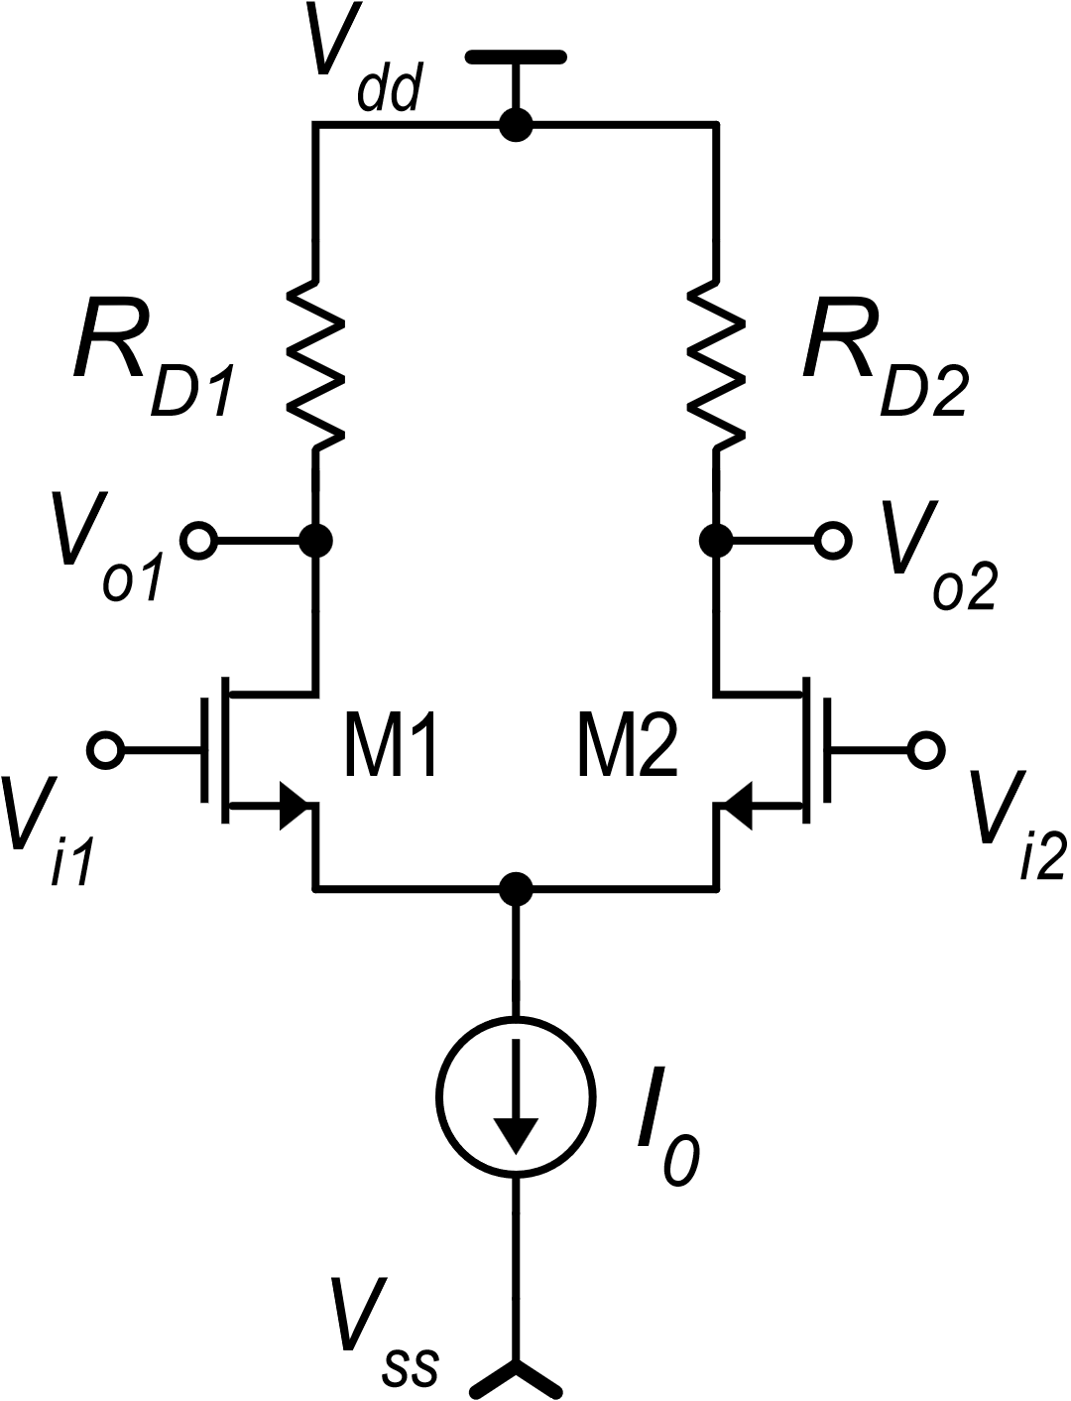
CMOS differential amplifier with resistive load: limitations
The S/E version has a poor CMRR (large A_{c}) and large input offset voltage
Both the S/E and fully-diff. versions reach low voltage gains at small supply voltage
Suggestion for problem 1: Consider the output voltage in the fully-differential case with no resistor mismatch:
The drain current difference appears:
This reduces A_{c} (I_{D1} and I_{D2} tend to be equal for only common mode applied) and the output voltage for V_{D}=0 is affected only by matching errors.
Solution for a S/E amplifier: produce the current difference (I_{D1}-I_{D2}) and then put it into a single resistor. Problem 2: Do not use a passive component for the resistor

Slide 2
A more general case: single-stage voltage amplifiers
I₁
R_{out}
The processed currents are finally conveyed to an output resistance (R_{out}) and converted back to a voltage (V_{out}). In most cases, R_{out} is not a physical resistor, but it is the output differential resistance of the I-to-I network.
For this reason, one of the function of the I-to-I network is increasing the output resistance to increase gain
V_{in}
I_{o-sc}
V_{out}
I₂
V-to-I
I-to-I
The second component is a current processing network, that takes the input currents and applies simple linear operations such as:
Addition and subtraction
Addition of constant currents
Multiplication by a constant gain factor
The first component converts the input voltage (single or differential) into a current (single or differential)
example:
(Linear Model)
example:
Output short circuit current

Slide 3
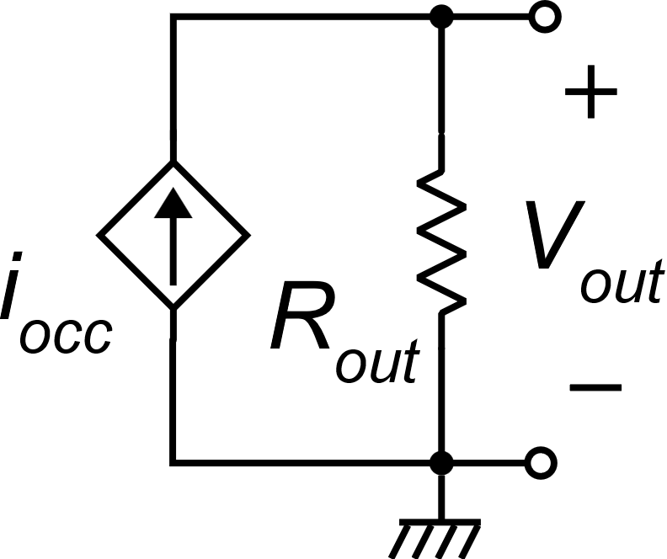
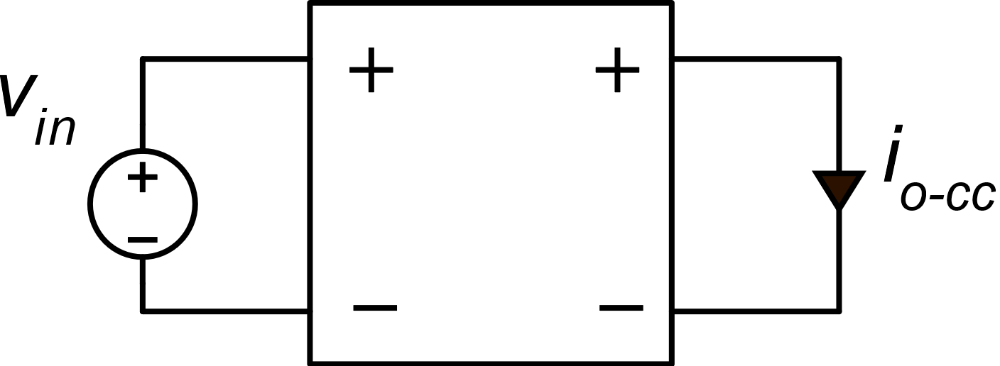
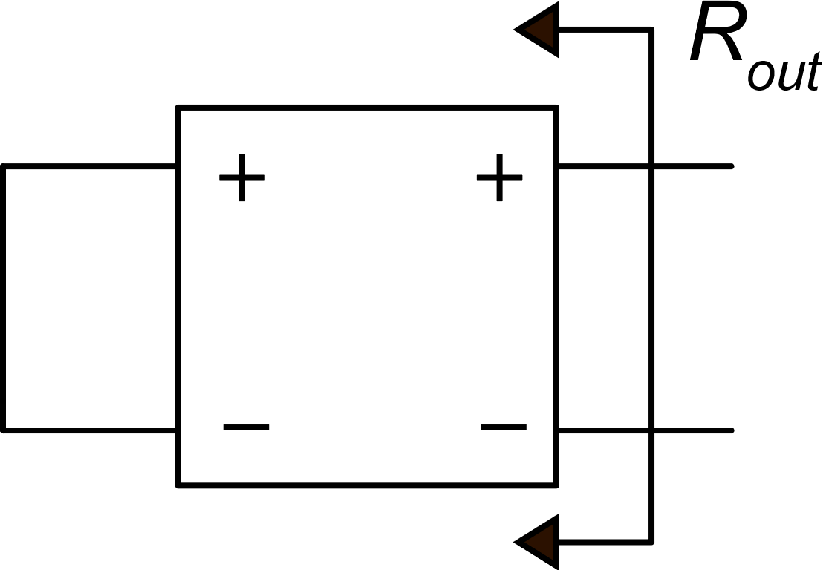
A general method for calculation of the gain in single-stage amplifiers
I₁
R_{out}
In a single-stage amplifier it is generally simple to calculate the output short-circuit current i_{o-sc}
V_{in}
V_{out}
V-to-I
I₂
I-to-I
Then, we can easily obtain a Norton equivalent circuit:

Slide 4
CMOS differential amplifier with current mirror load
V_{dd}
Specifications
I_{D1}
I_{D1}
We need a S/E amplifier
High CMRR (> 80 dB)
High gain (~ 40 dB) even at low supply voltages (V_{dd}−V_{ss}).
I_{D1}+I_{D2}
M3
M4
I_{occ} =I_{D1}−I_{D2}
V_{out}
I_{D1}
I_{D2}
M1
M2
V_{i1}
V_{i2}
I₀
V_{ss}

Slide 5
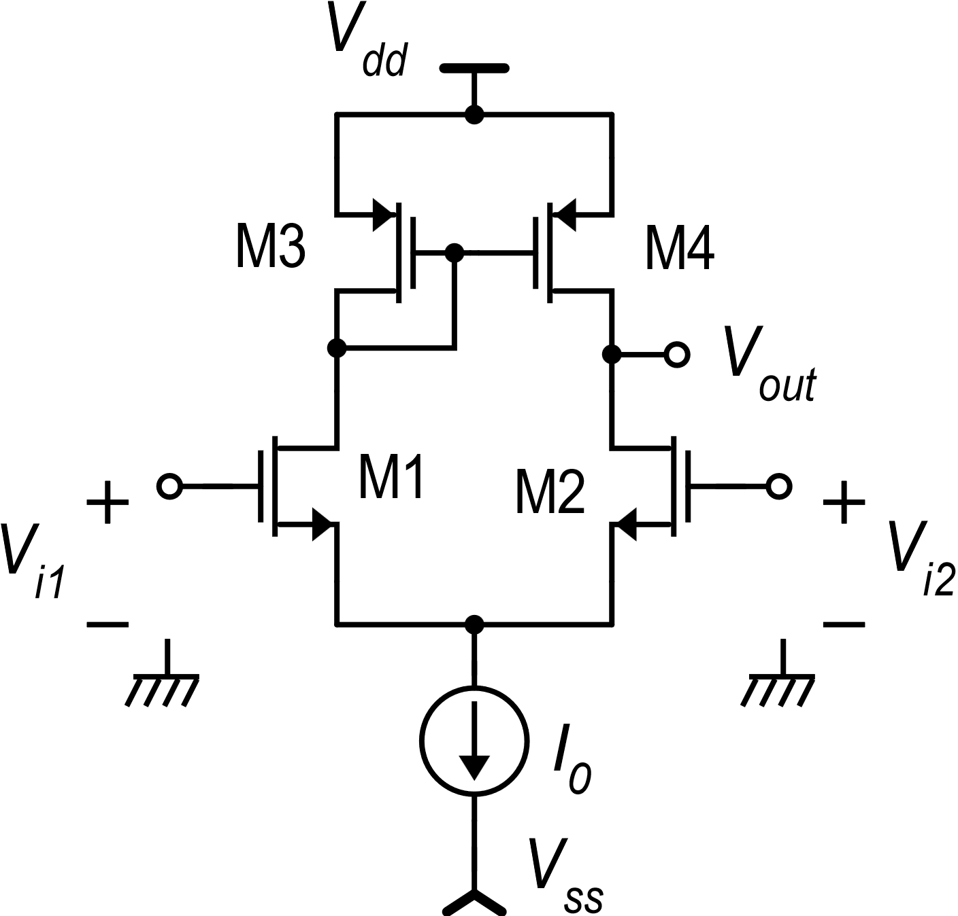
Subunits of the amplifier with mirror load
I₁
R_{out}
V_{in}
V_{out}
V-to-I
I₂
I-to-I
I₁
I₂

Slide 6
Operating point : V_{id}=0
Symmetrical stimulus, but ….
The circuit is not symmetrical

Slide 7
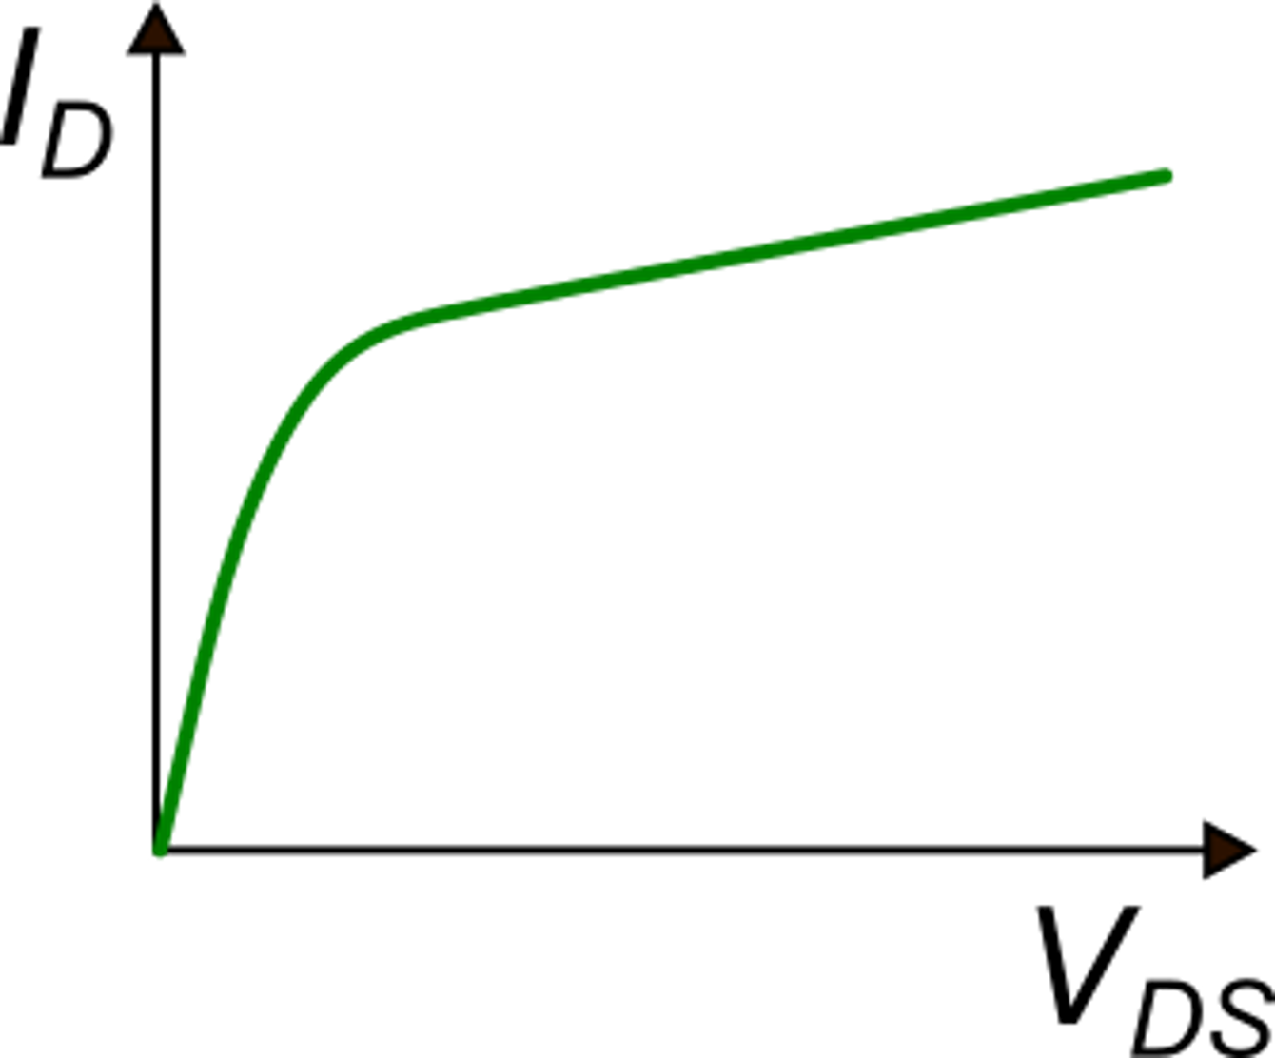
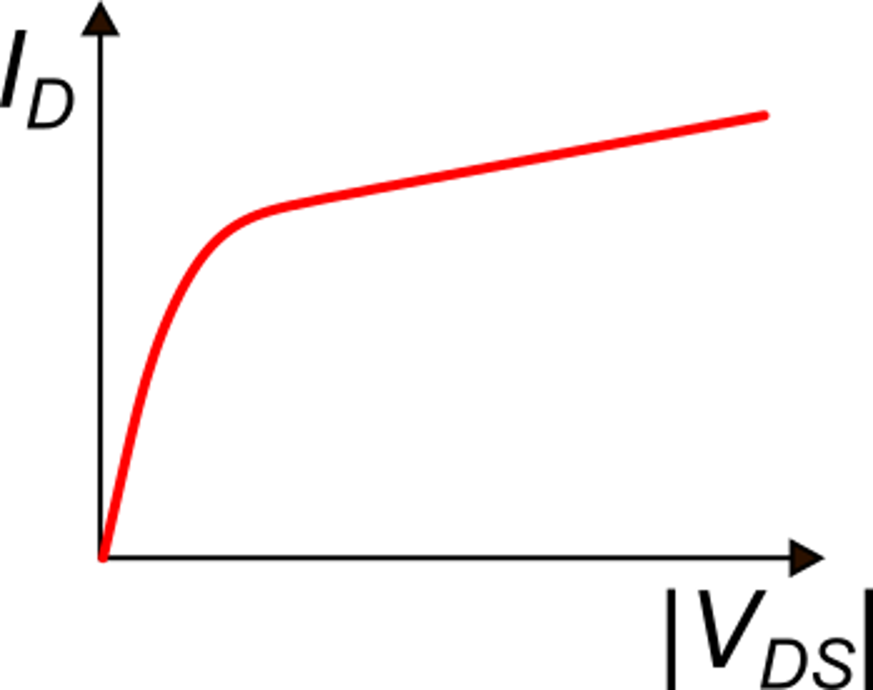
Demonstration of the exact symmetry of the electrical solution for V_{id}=0
With fixed V_{GS} and V_{BS}, I_{D} is a monotone function of V_{DS} (or |V_{DS}| for a p-MOS.
M1 and M2
M3 and M4

Slide 8
Demonstration of the exact symmetry of the electrical solution for V_{id}=0
From Kirchhoff #2:
We want to demonstrate that:
Proof by contradiction:
Let us suppose:
Contradiction

Slide 9
Demonstration of the exact symmetry of the electrical solution for V_{id}=0
Repeating the procedure for I_{D1}<I_{D2} we get another contradiction; thus, the only possible solution is:
K
For V_{id}=0, the electrical solution is perfectly symmetrical

Slide 10
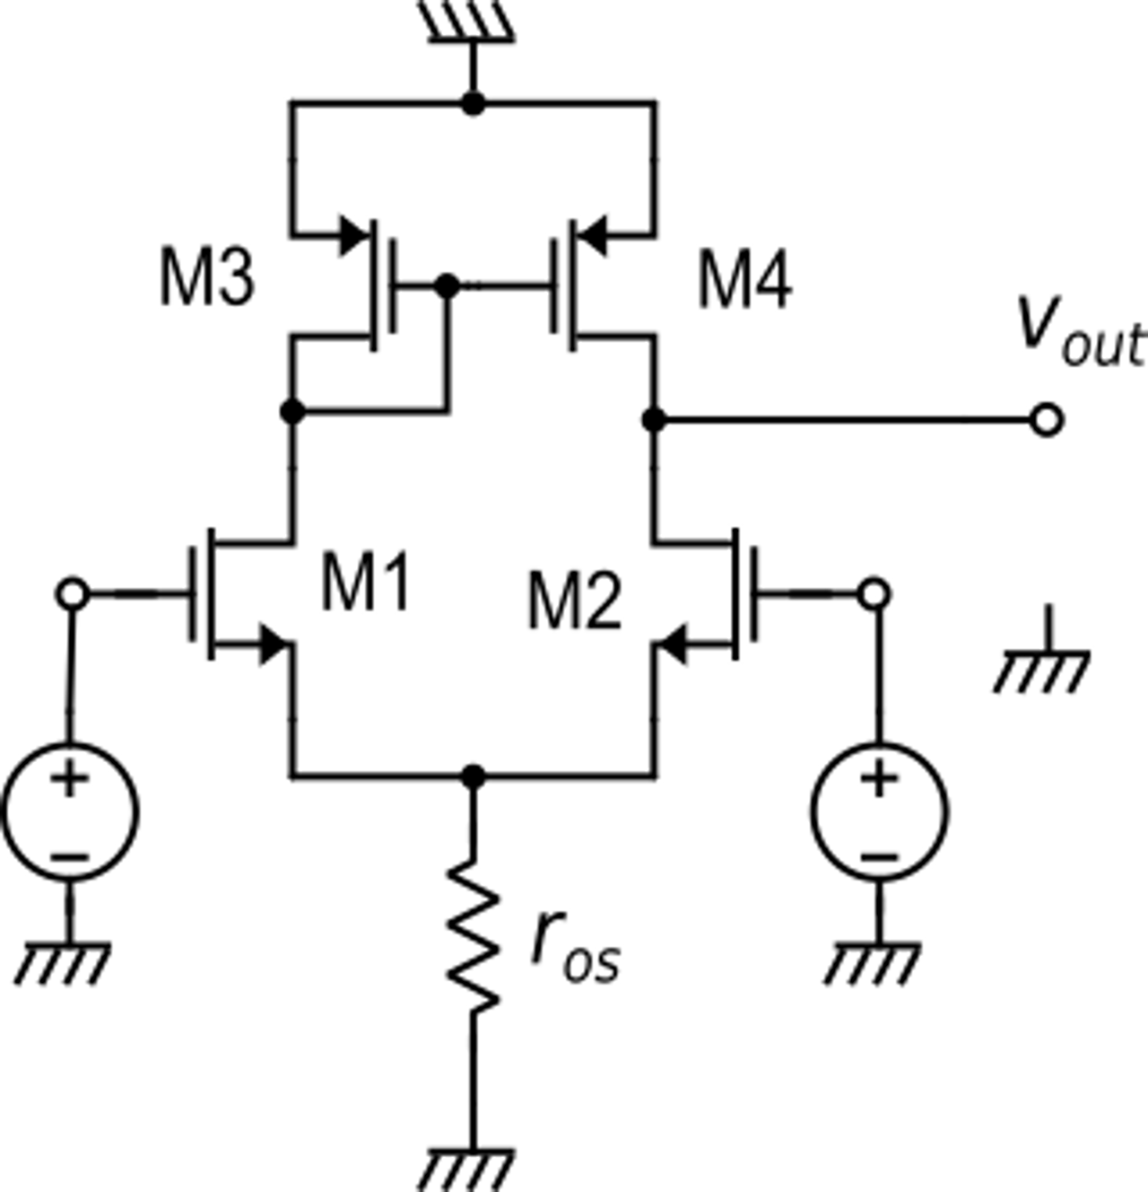
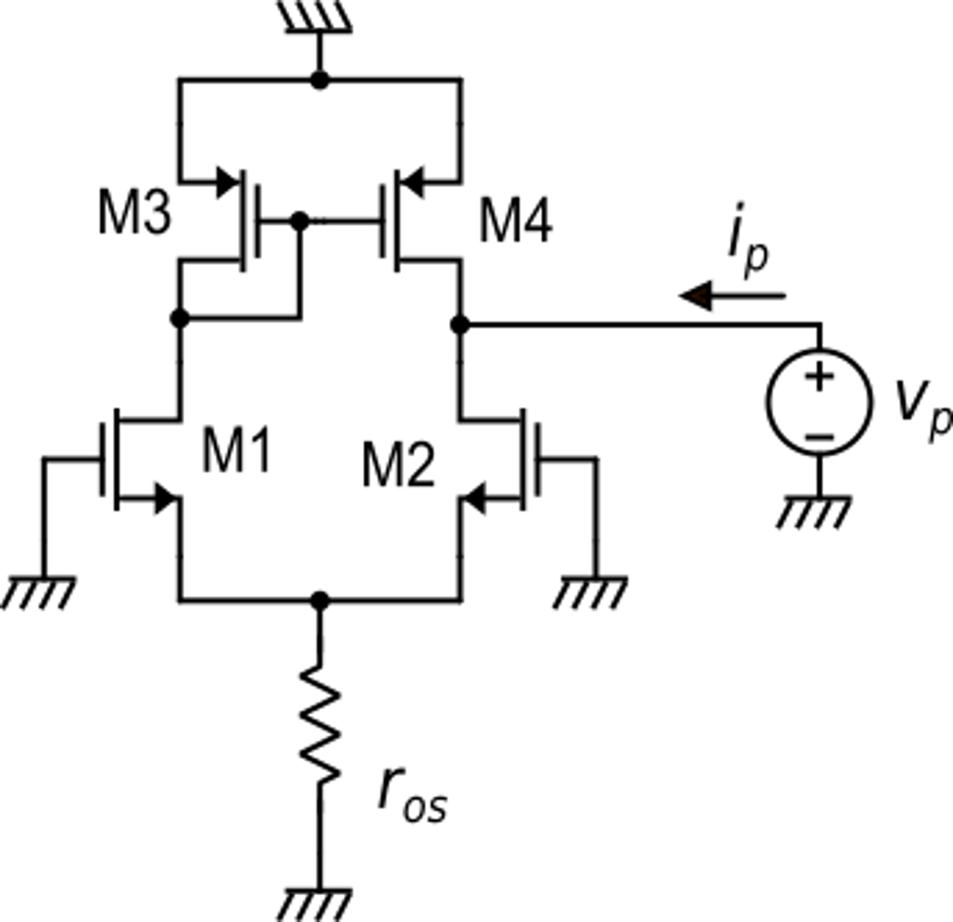
Differential mode gain
V_{out}
i_{occ}
R_{out}
Norton equivalent circuit
of the output port
i_{ric}
Small-signal equivalent circuit
Circuit for R_{out} calculation

Slide 11
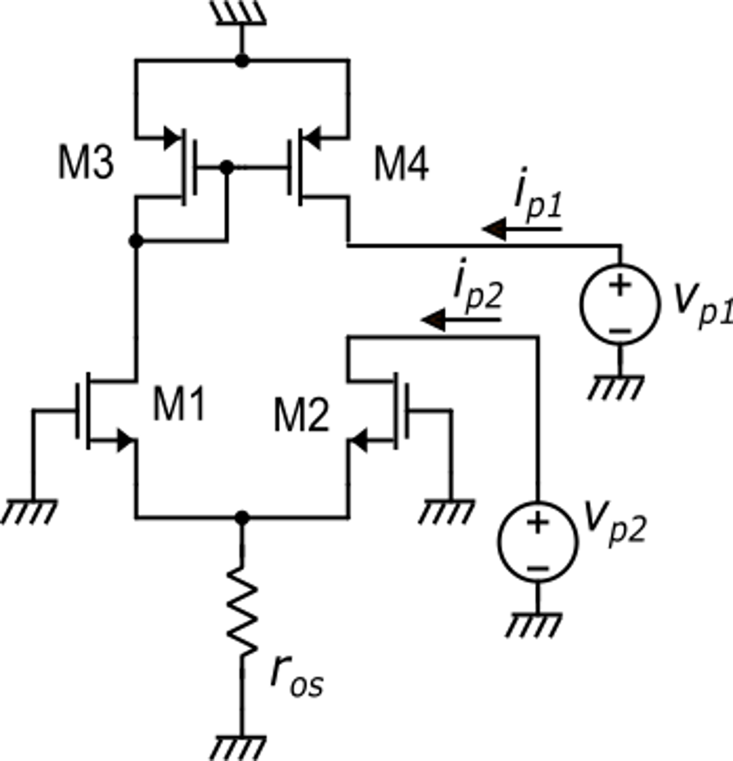
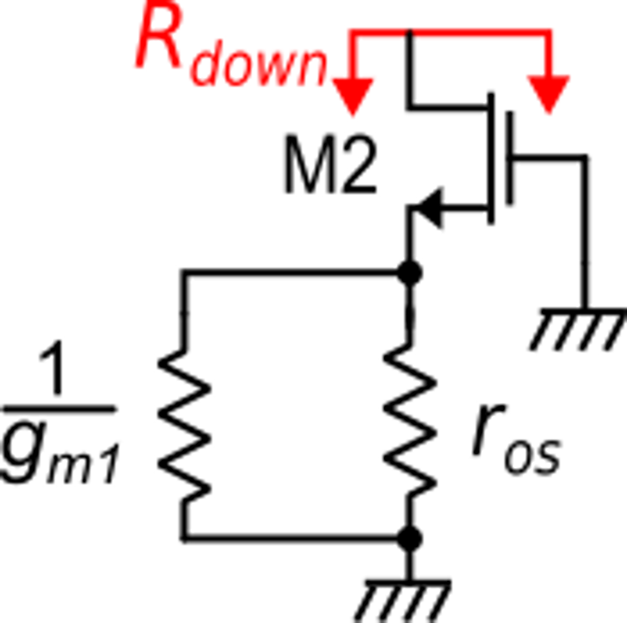
Differential mode gain: R_{out} calculation.
Case 1:
Case 2:
For the superposition theorem:
Case 1:
Case 2:

Slide 12
Differential mode gain
Just to find the order of magnitude we can assume:
Independently from the supply voltage

Slide 13
Differential mode gain
In strong inversion. Minimum V_{TE}=50 mV
In weak inversion.
V_{TE} $≅$35-40 mV
In order to obtain a large differential-mode gain it is necessary to:
Set V_{TE} to a small value
Use long MOSFETs (small λ)

Slide 14
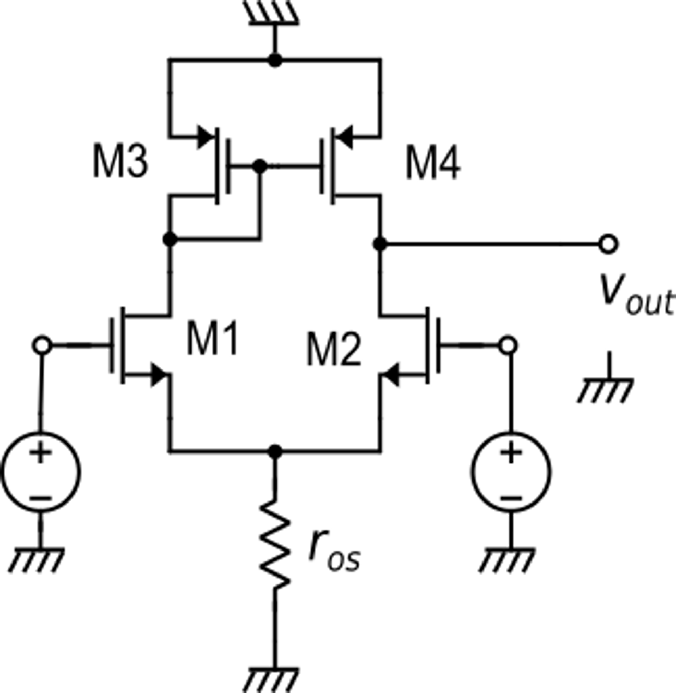
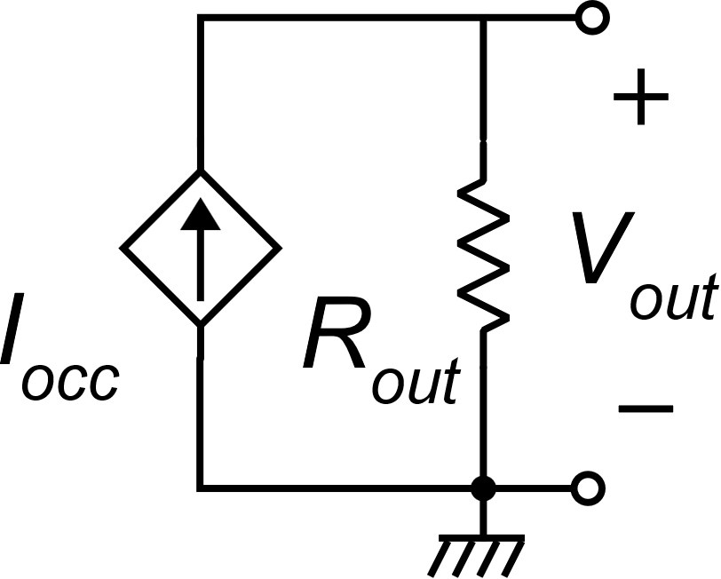
Common mode gain
As in the case of differential input voltage, we can try to use the Norton equivalent circuit of the output port.
v_{c}
v_{c}
Is it possible??

Slide 15
Common mode gain
The problem occurs when we calculate i_{occ}. Placing a short circuit across the output port, disrupts the symmetry:
v_{c}
v_{c}

Slide 16
Common mode gain
It is possible to exactly calculate i_{occ}, taking into account the actual i_{d1}/i_{d2} ratio and i_{d4}/i_{d3} ratio ….
v_{k}
… but this is a very tedious approach
There is a much simpler way:
Let us remove the short circuit and directly calculate v_{out}. Now , for v_{id}=0, the circuit is symmetric again and, in particular: v_{k}=v_{out}
v_{c}
v_{c}

Slide 17
Common mode gain
v_{k}
for r_{os}=r_{d}
(worst case: the tail is the output branch of a simple current mirror)
and considering all g_{m}'s and r_{d}'s equal for simplicity
v_{c}
v_{c}
A CMRR of 80 dB can be easily reached

Slide 18
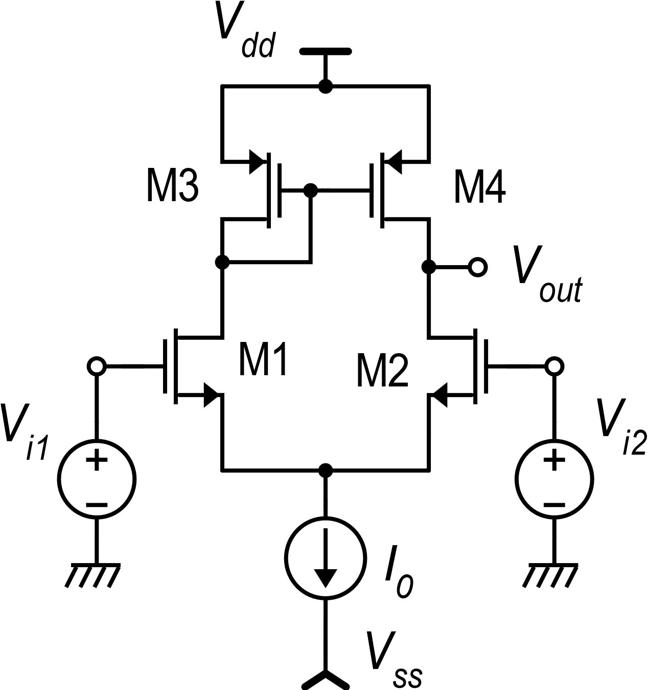
Large-signal dc transfer function
Let us try to determine:
V_{K}
For V_{D}=0:
In strong inversion
It is possible to set the
rest value of V_{out}(0)

Slide 19
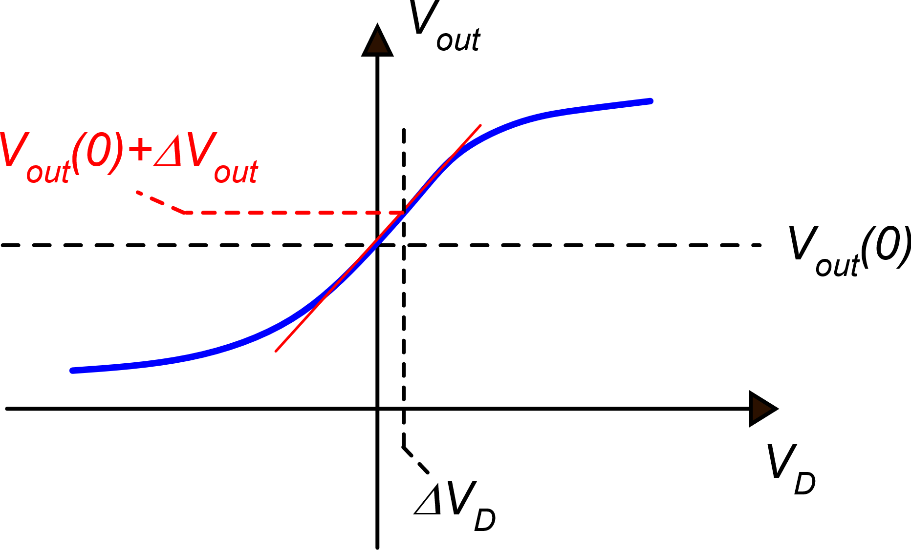
Large-signal dc transfer function
V_{out} variations for small V_{D} variations around the origin
Linear approximation:
g_{m1}

Slide 20
Moving away from the origin, step by step
In the first step, Vout moves along the tangent calculated in the origin
When V_{D} and V_{out} get far from the operating point, the parameters of the small signal models change and the slope of the tangent change as well

Slide 21
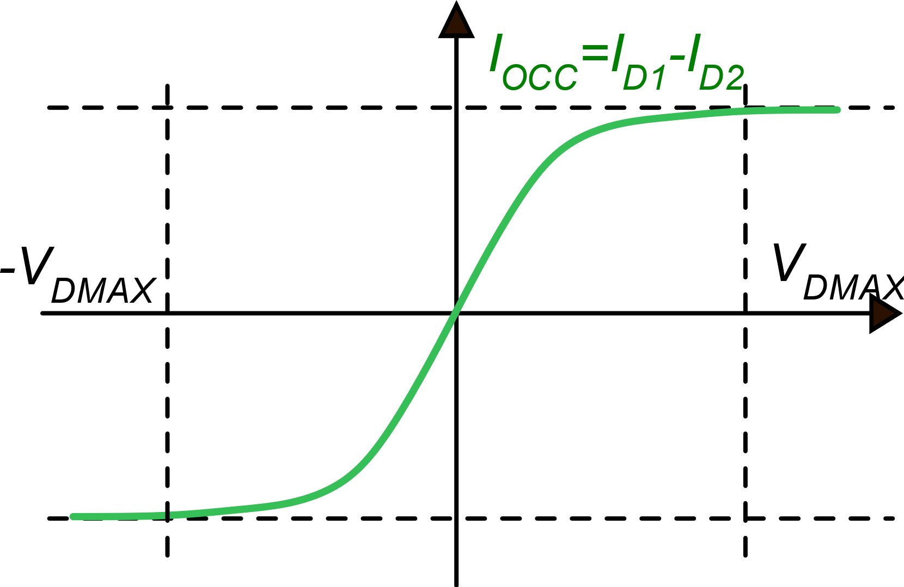
Large-signal dc transfer function
V_{out}
V_{out}(V_{DQ})+ΔV_{out}
V_{out}(V_{DQ})
V_{out}(0)
V_{D}
V_{DQ}
V_{DQ}+ΔV_{D}
V_{DQ}
V_{DQ}+ΔV_{D}

Slide 22
Approximate dc transfer characteristic
V_{out}
V_{dd}
V_{out}(0)
-V_{DMAX}
V_{DMAX}
V_{D}
V_{ss}
V_{DMAX}
Example: A_{d}=100, V_{dd}-V_{ss}=5V ΔV_{D}<50 mV

Slide 23
Practically constant and equal to g_{m1}
V_{out}
V_{dd}
V_{out}(0)
M4 enters triode region and r_{d4} drops down
V_{D}
M2 enters triode region and r_{d2} drops down
V_{ss}

Slide 24
Minimum output voltage
V_{D} in the linear zone is at most
a few tens mV
V_{C} varies between V_{SS} and V_{DD}
We can neglect V_{D}/2 with respect to V_{C}

Slide 25
Minimum output voltage
Weak inversion
Strong inversion

Slide 26
Complete dc transfer characteristic
V_{out} approaches V_{dd} when I_{D2} approaches zero and M4 gets in deep triode region
V_{dd}
V_{out}
max(V_{out})=V_{dd}-|V_{DSAT4}|
V_{out}(0)=V_{dd}−|V_{GS3}|
Slope=A_{d}
V_{D}
min(V_{out})=V_{C} −V_{GS2}+V_{DSAT2}
V_{C} −V_{GS2}
=V_{S2}
V_{out} gets close to M1,M2 source voltage when V_{DS2} approaches zero (M2 is in deep triode region)
V_{ss}

Slide 27
Minimum supply voltage V_{dd}-V_{ss}
|V_{DS3}|
V_{DS1}
Example: V_{MIN}=100 mV
V_{DSAT2}=100 mV
|V_{GS3}|=0.5 V
V_{outS}

Slide 28
Input common mode range
Lower limit
As V_{C} is progressively decreased, also V_{S} decreases at the same pace and eventually the voltage across the current source I₀ will get smaller than the minimum value V_{MIN}. From that point on, I₀ will rapidly decrease, turning off the stage.
Note: when the output voltage of the current source I₀ gets below V_{MIN}, its output resistance (r_{os}) gets small, degrading the CMRR.

Slide 29
Input common mode range
Upper limit
As V_{C} is progressively increased, also V_{S} increases at the same pace. Since V_{out}=V_{K} =V_{D2} = V_{D1} is fixed, eventually V_{DS1} and V_{DS2} will drop below the saturation voltage.
V_{k}

Slide 30
Input common mode range: upper limit
These overdrive voltages can be made equal by design, so they cancel each other
This difference can be >0
because it is likely that:
(V_{t1} is affected by body effect
if M1 and M2 body is at V_{SS})
The input common mode voltage can get even slightly higher than V_{dd}

