Slide 1
Main building blocks in analog ICs
Current Mirrors
Differential pairs
Obviously combined with the three basic single-transistor configurations:
Common source (emitter)
Source (emitter) follower
Common gate (base)
Differential Cascode amp.
Cascode Mirrors
Cascode Amplifier

Slide 2
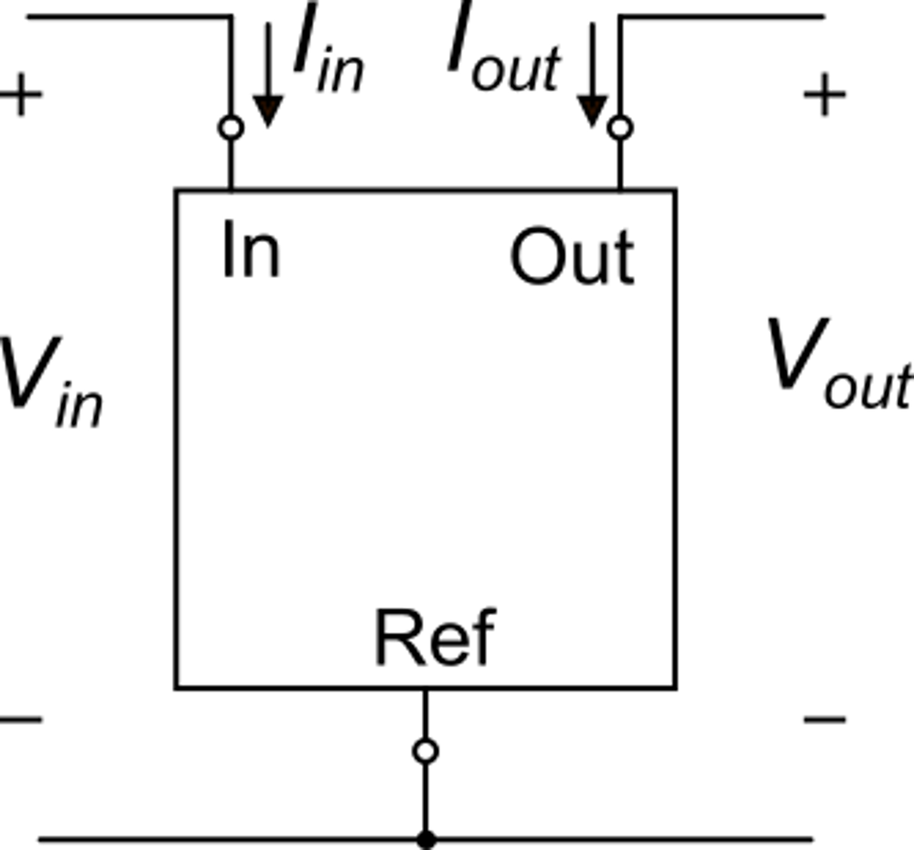
Current Mirrors: general definitions and properties
Ideal characteristics
for:
Voltages and
currents
As a building block, the current mirror must have a simple topology
These characteristics are generally non feasible with simple elementary circuits. They can be obtained with complex architectures (current amplifiers) that cannot be considered current mirrors anymore.

Slide 3
Current mirrors: n-type and p-type mirrors
n-type:
formed mainly by n-type transistors
p-type:
formed mainly by p-type transistors

Slide 4
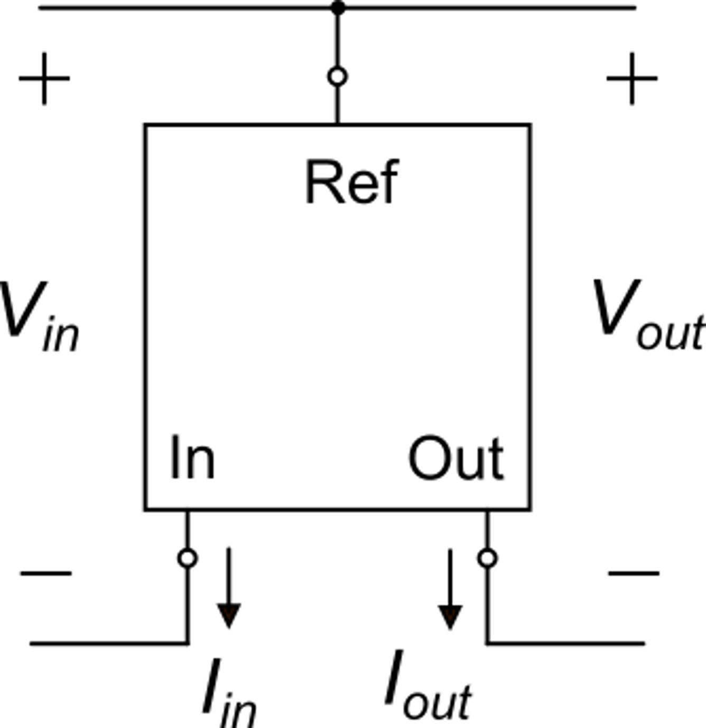
Conventions on voltage and current signs used to obtain positive values also for p-type mirrors
With this convention all quantities are positive also for the p-type mirror
The mirror is drawn upside-down because the voltage of the Ref terminal is greater than the voltage of In and Out ones
Convention for an n-type current mirror
Alternative convention for a p-type current mirror

Slide 5
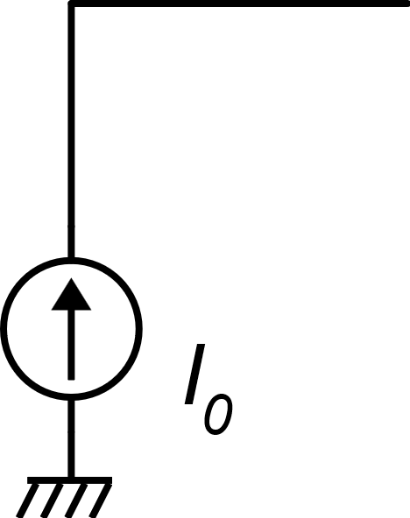
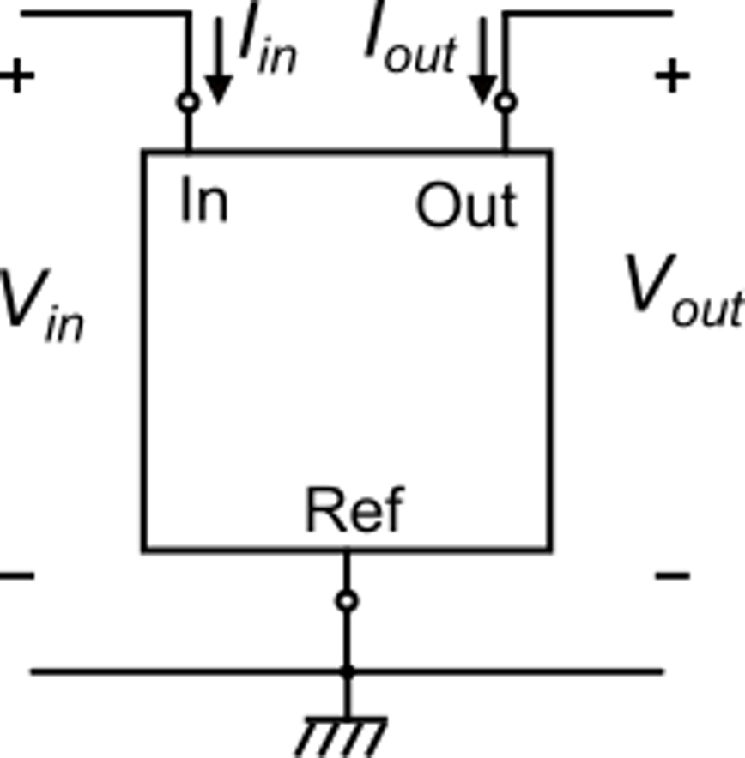
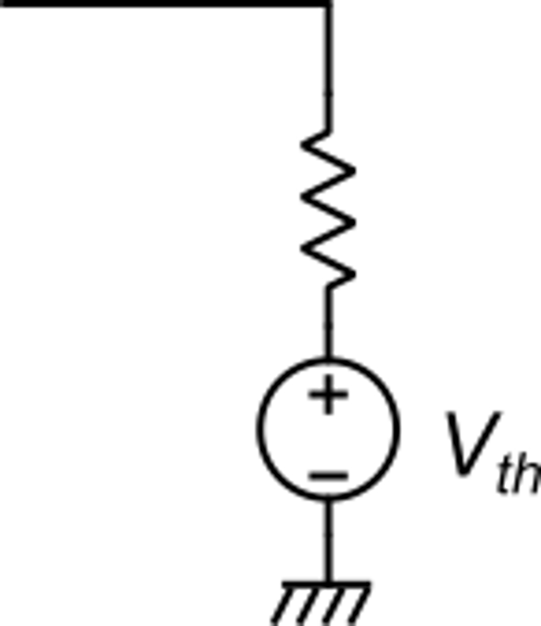
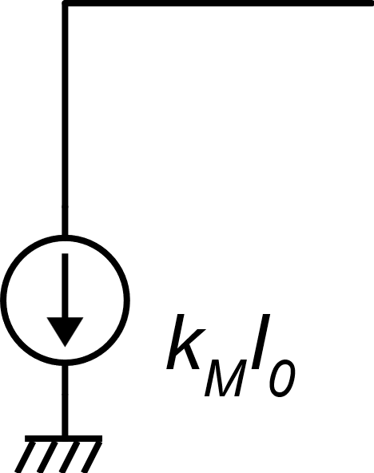
Current reversing function of a current mirror
Equivalent circuit seen from the mirror output terminal
This is a current source
(the current exits from the generator)
The circuit connected to the output port must be able to provide a positive V_{out}
The mirror is seen by the output circuit as a an equivalent current source. Note that now the current enters the source (it is a sink)
n-type mirror is required
(the input current enters the mirror)

Slide 6
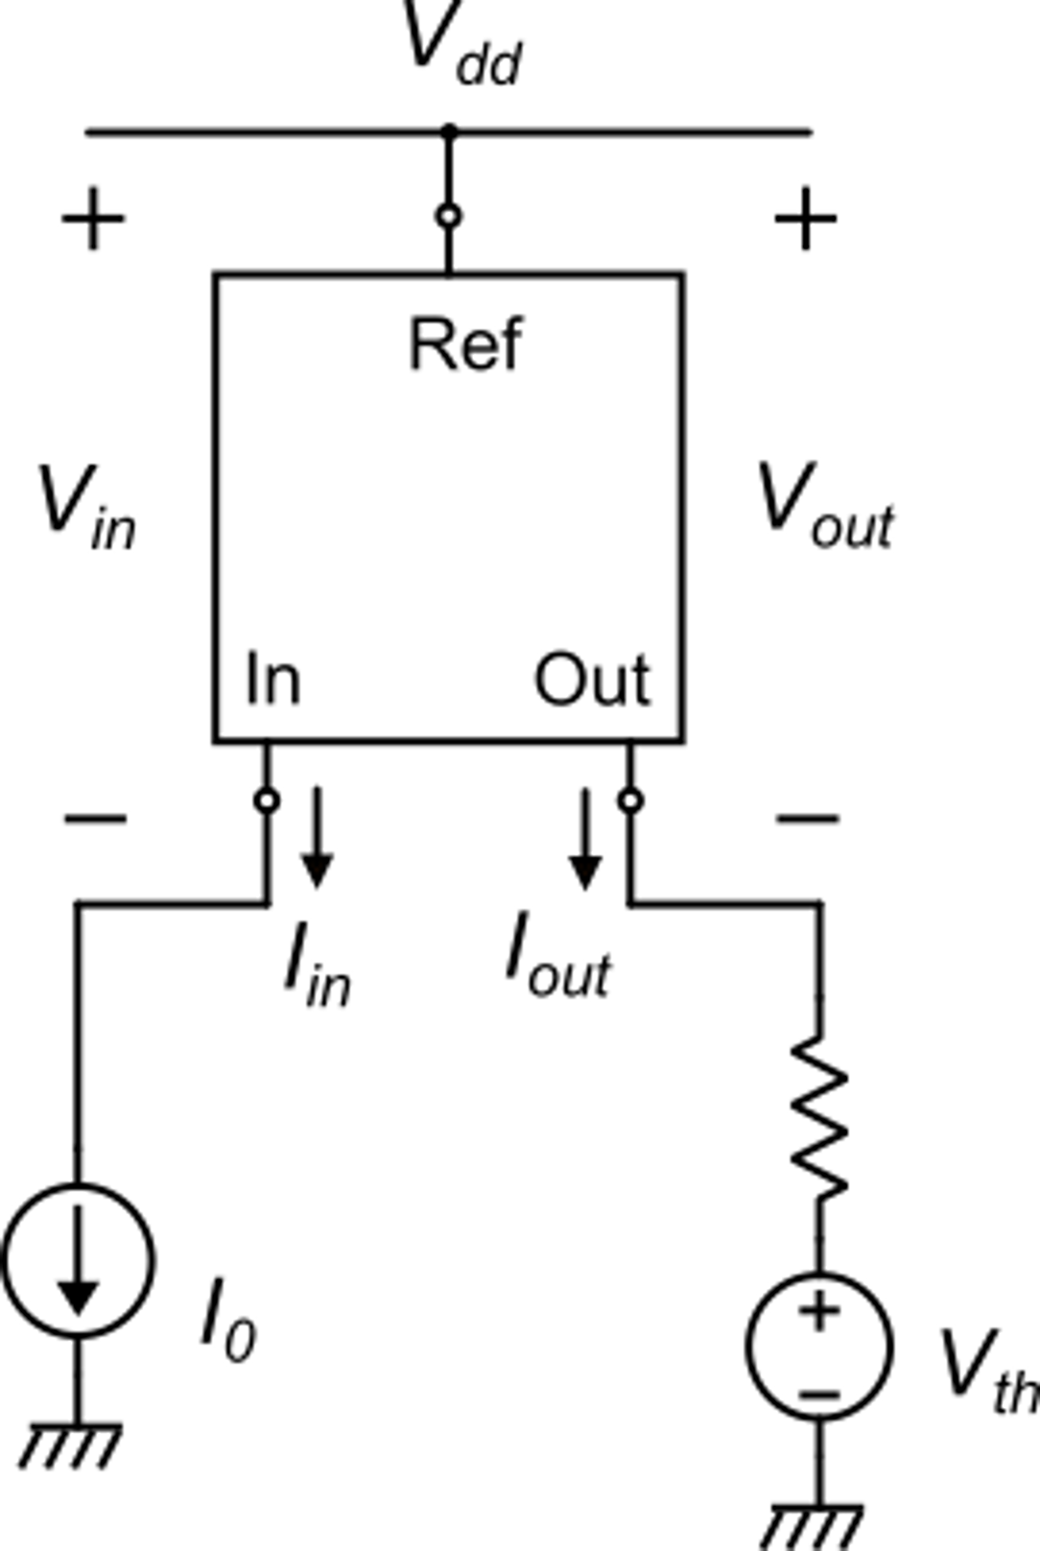
Current reversing function of a current mirror
An n-type current mirror transforms a current source ( the current exit from the source) into a current sink ( the current enter the source)
p-type
A p-type current mirror transforms a current sink into a current source
The generator connected to the input is "sinking" a current
The mirror is "sourcing" a current towards the output circuit

Slide 7
Parameters of merit for a current mirror
Ideal function:
General conditions
K_{lM} is a nominal value (gain) that should depend only on simple geometrical ratios.
V_{in} should be almost constant and be as small as possible
The ideal function should be maintained down to very small V_{out} values. The smallest V_{out} value is indicated with V_{MIN}
For V_{out}>V_{MIN}, the dependence of I_{out} on V_{out} must be the smallest as possible.
V_{in}
V_{MIN}
R_{out}
V_{Th}

Slide 8
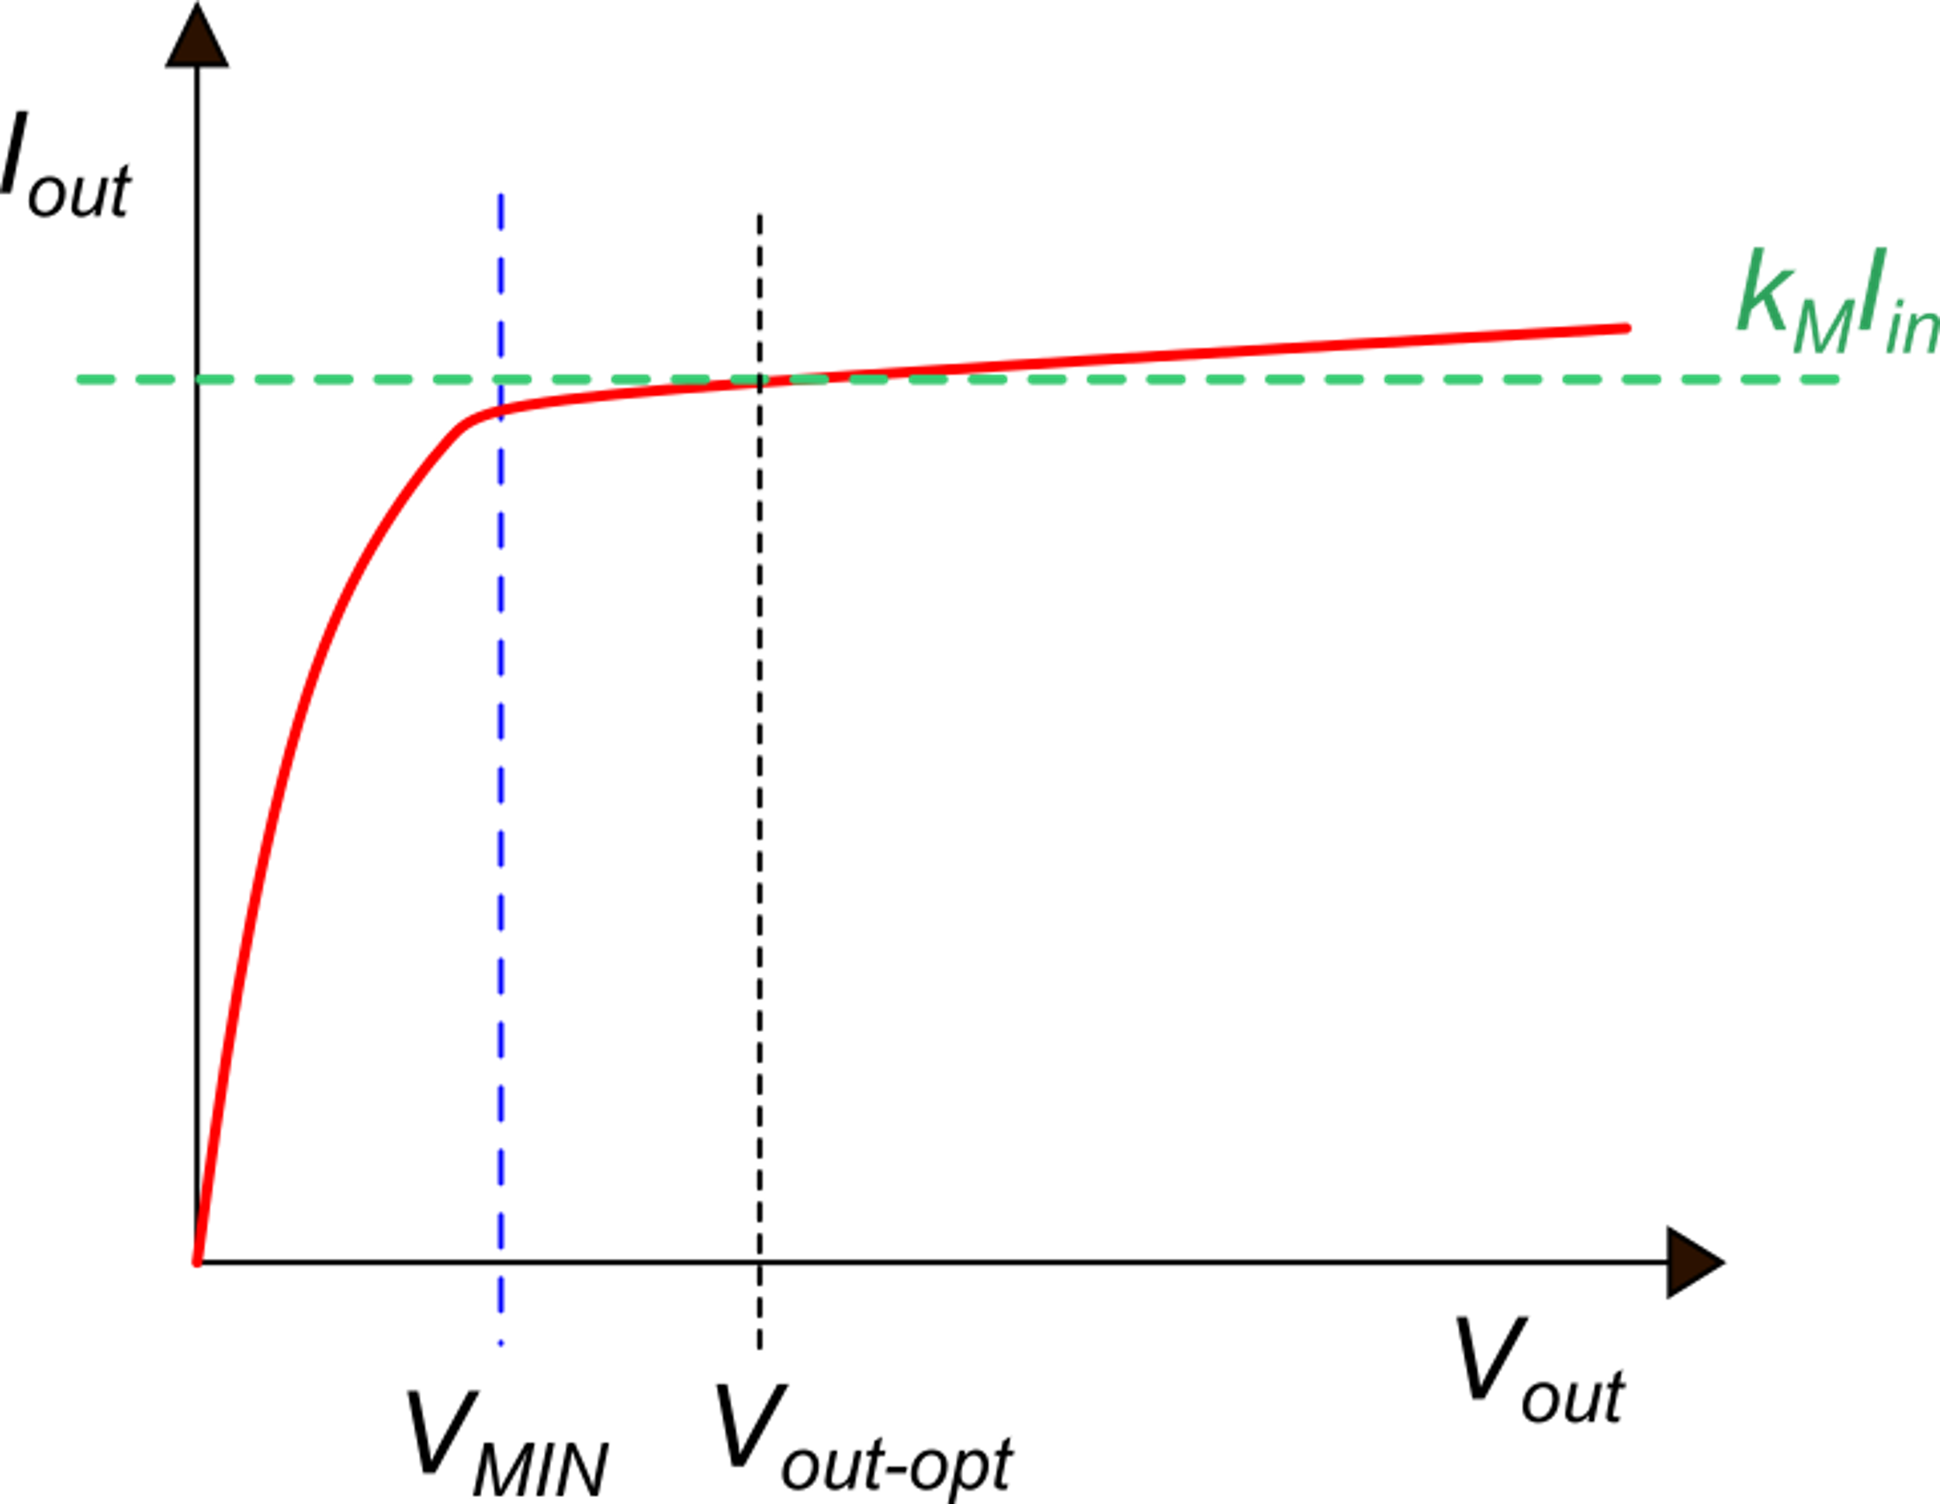
The typical I_{out} vs V_{out} characteristic of a current mirror
correct operation zone
slope
R_{out}, which is the reciprocal of the slope in the correct operation zone, must be as large as possible
The V_{out-opt} voltage is the output voltage at which the output current coincides with the ideal value k_{M}I_{in}.

Slide 9
The mirror "Thevenin" voltage, V_{th}
Definition:
Current variation:
Relative current variation:
The Thevenin equivalent voltage allows comparing current mirrors regardless of the current magnitude they are designed for. The higher the Thevenin voltage, the more ideal the current mirror.

Slide 10
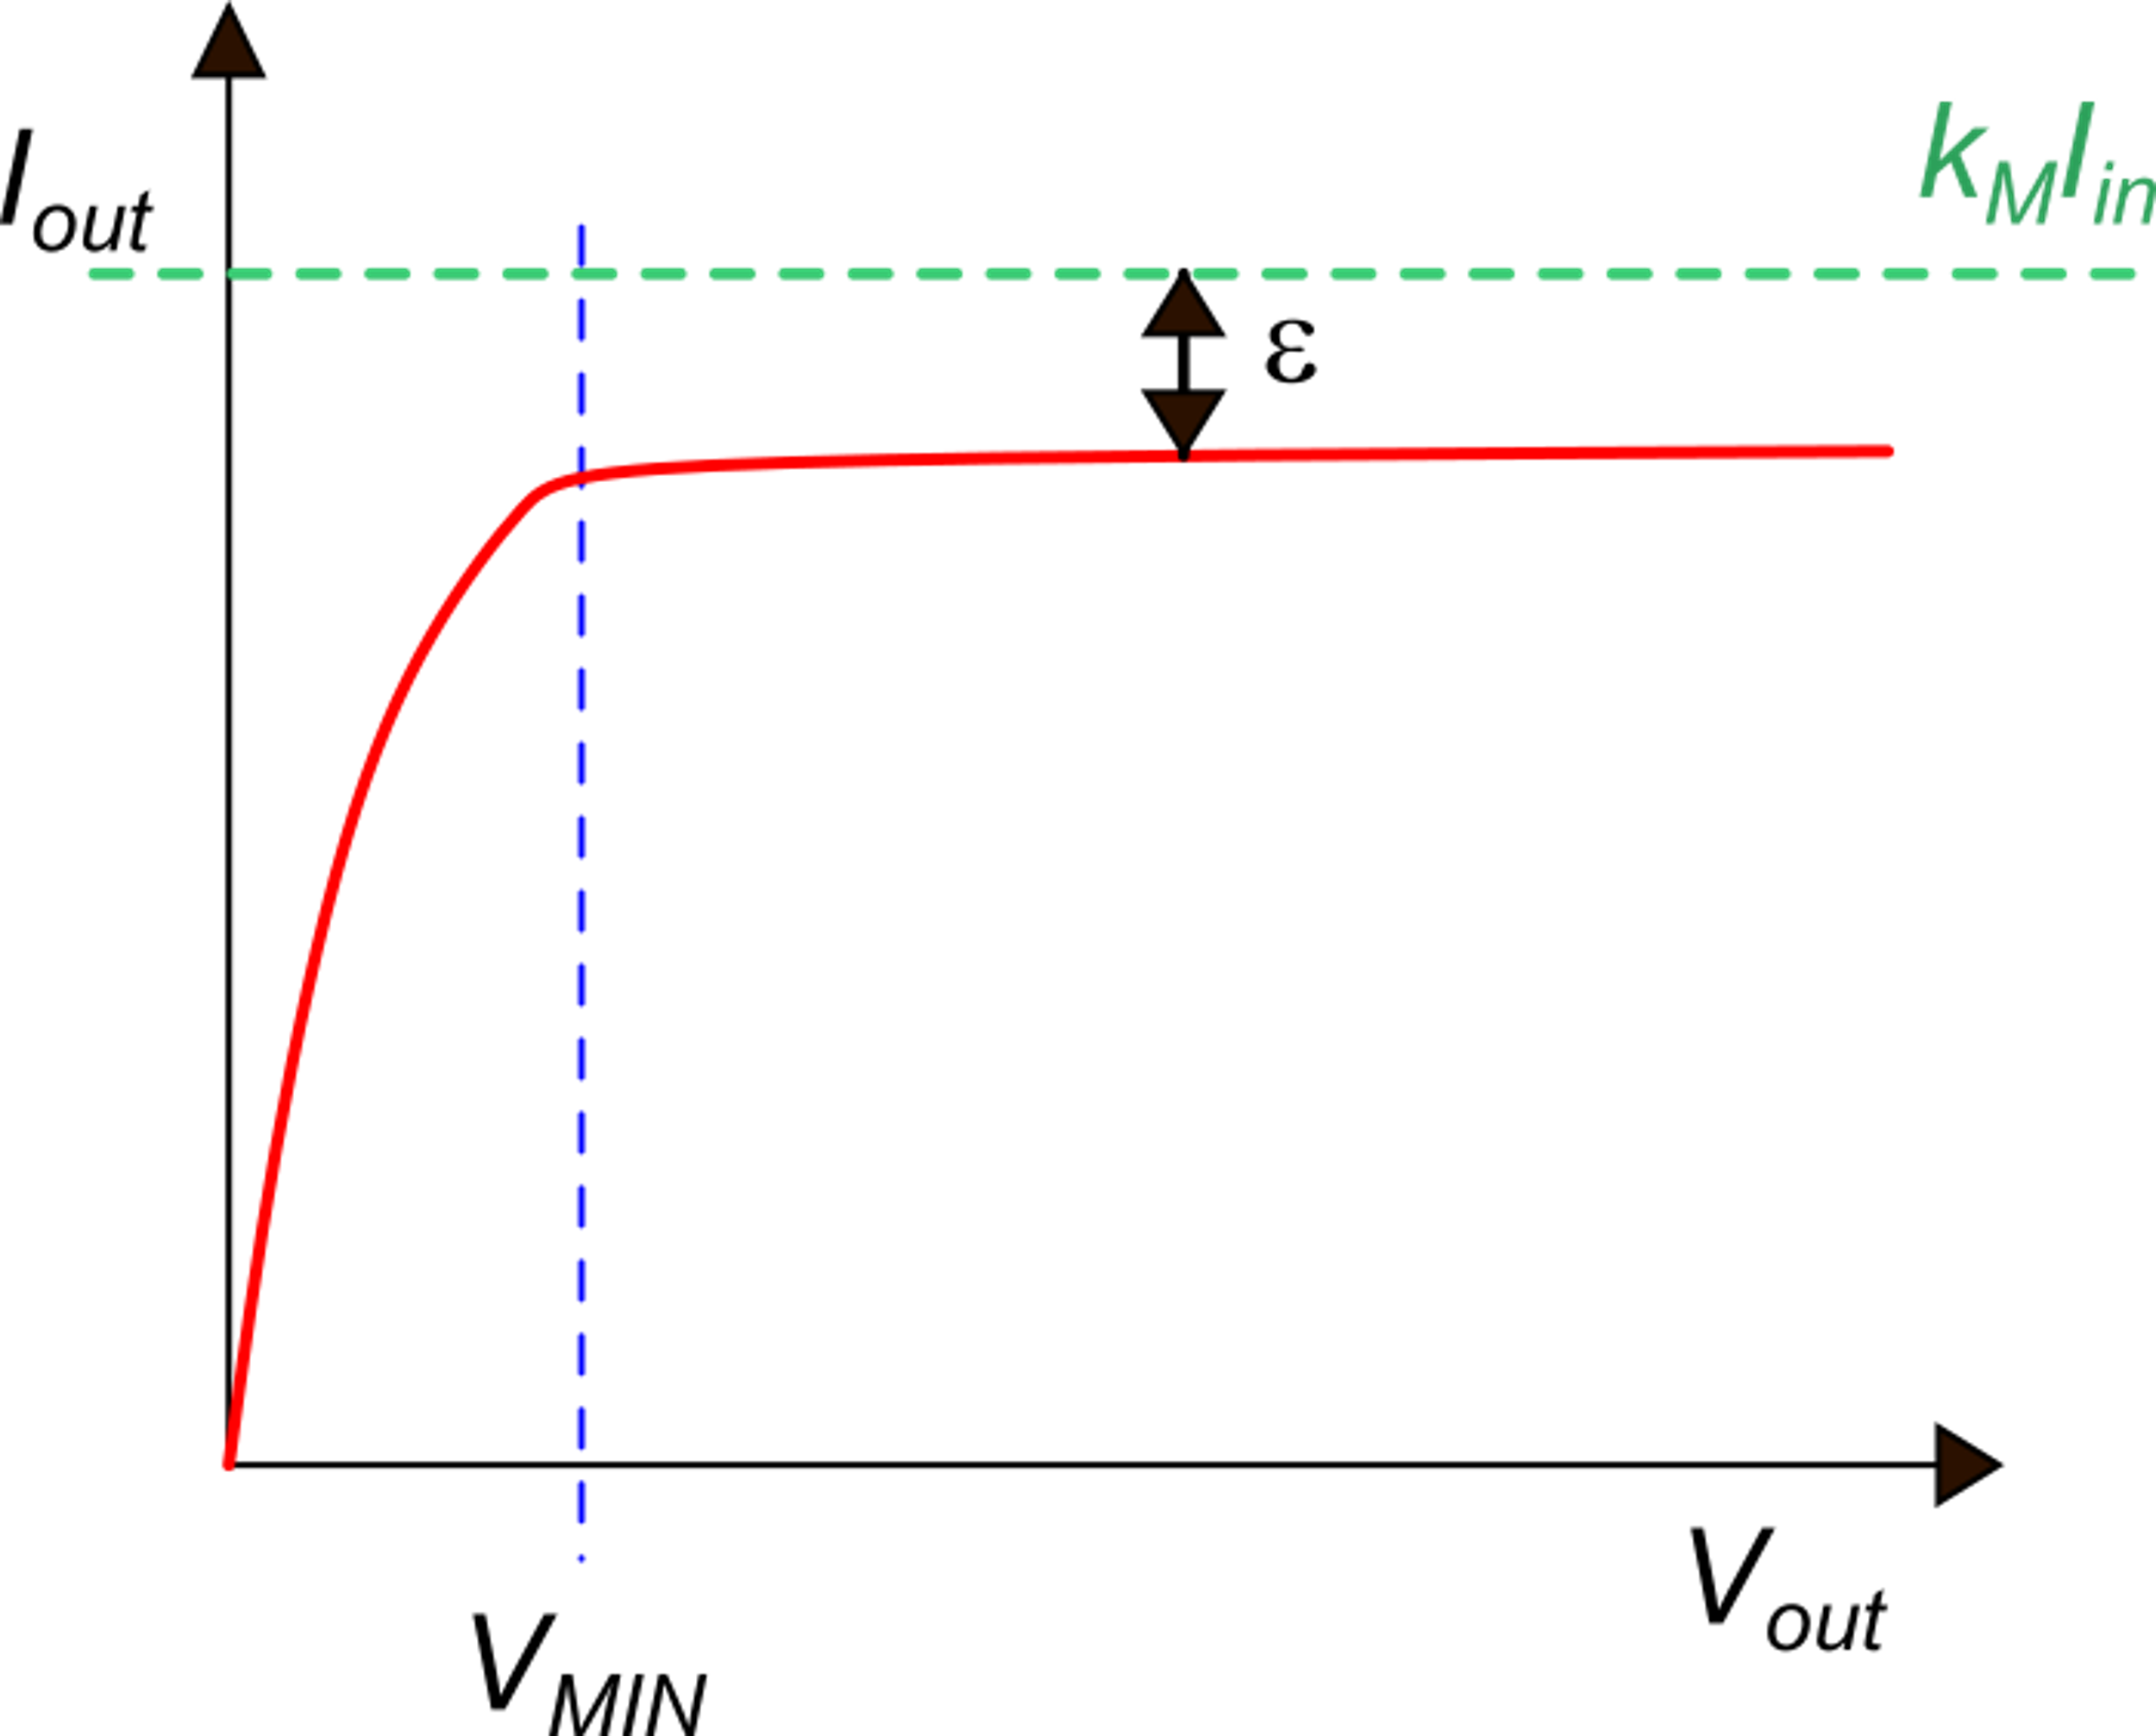
Presence of systematic errors
In this example, there is not an optimum voltage in the correct operating area (V_{out}>V_{MIN}) at which the output current is equal to the ideal value
Note: k_{M} must be a parameter that can be easily set by design. It is generally a ratio of simple device parameters: W/L ratios in MOSFETs area ratios in BJTs.

Slide 11
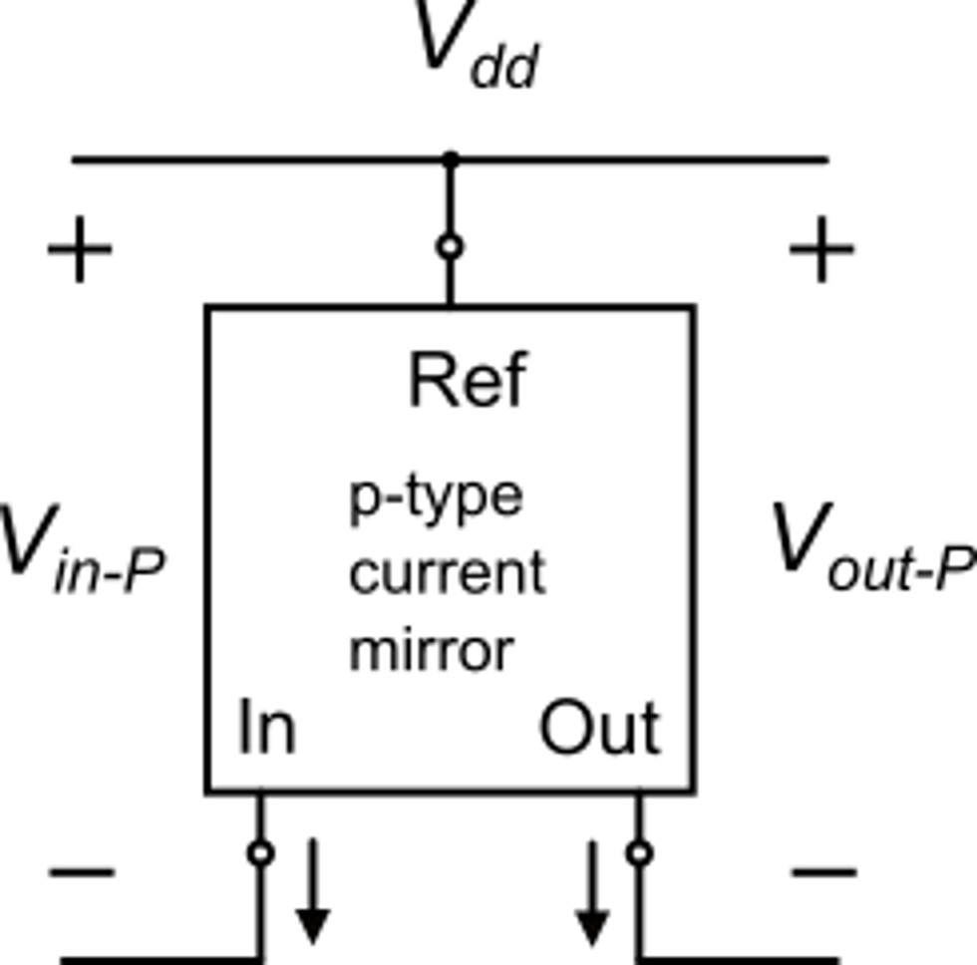
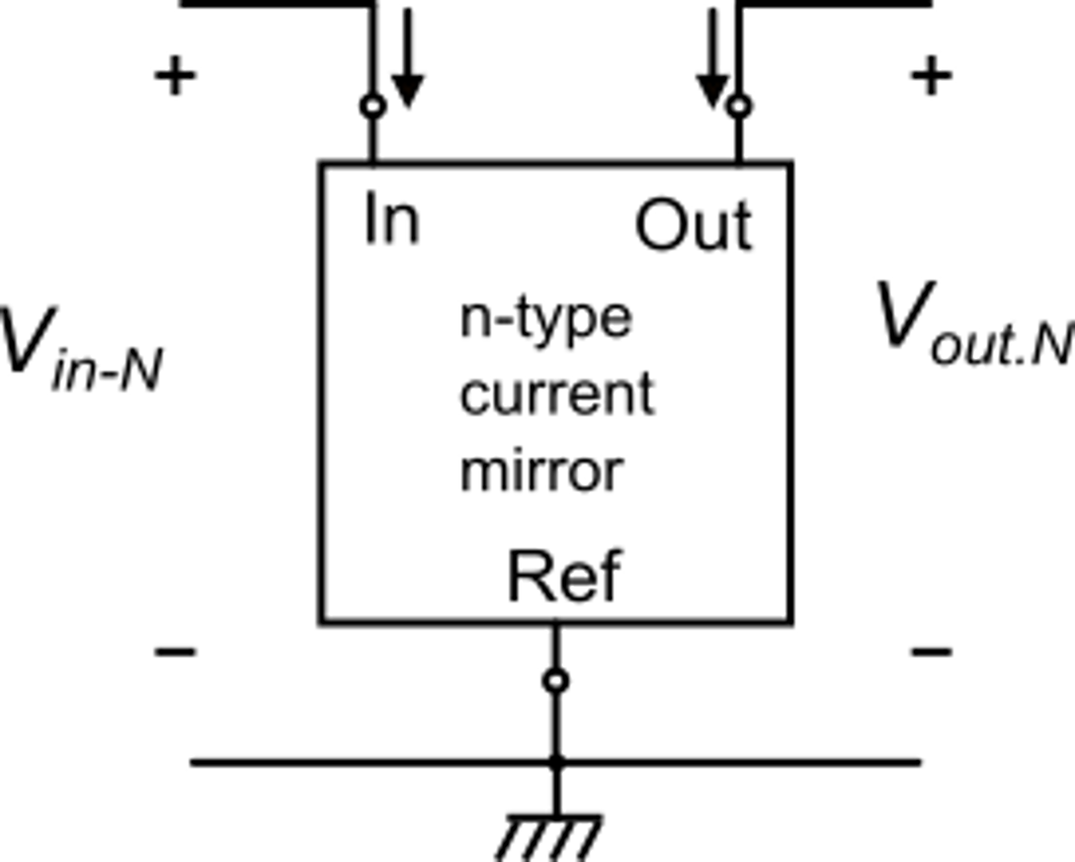
Role of V_{in}, V_{MIN}: an example
We need to obtain a copy of
current I₀, scaled up by a factor M
We add a p-type mirror to reverse the
current source type
A single n-mirror does the job, but transforms the
a source into a sink
K_{M-P}
K_{M-N}

Slide 12
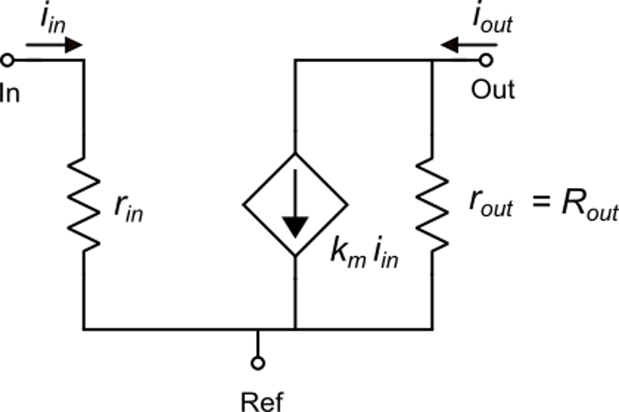
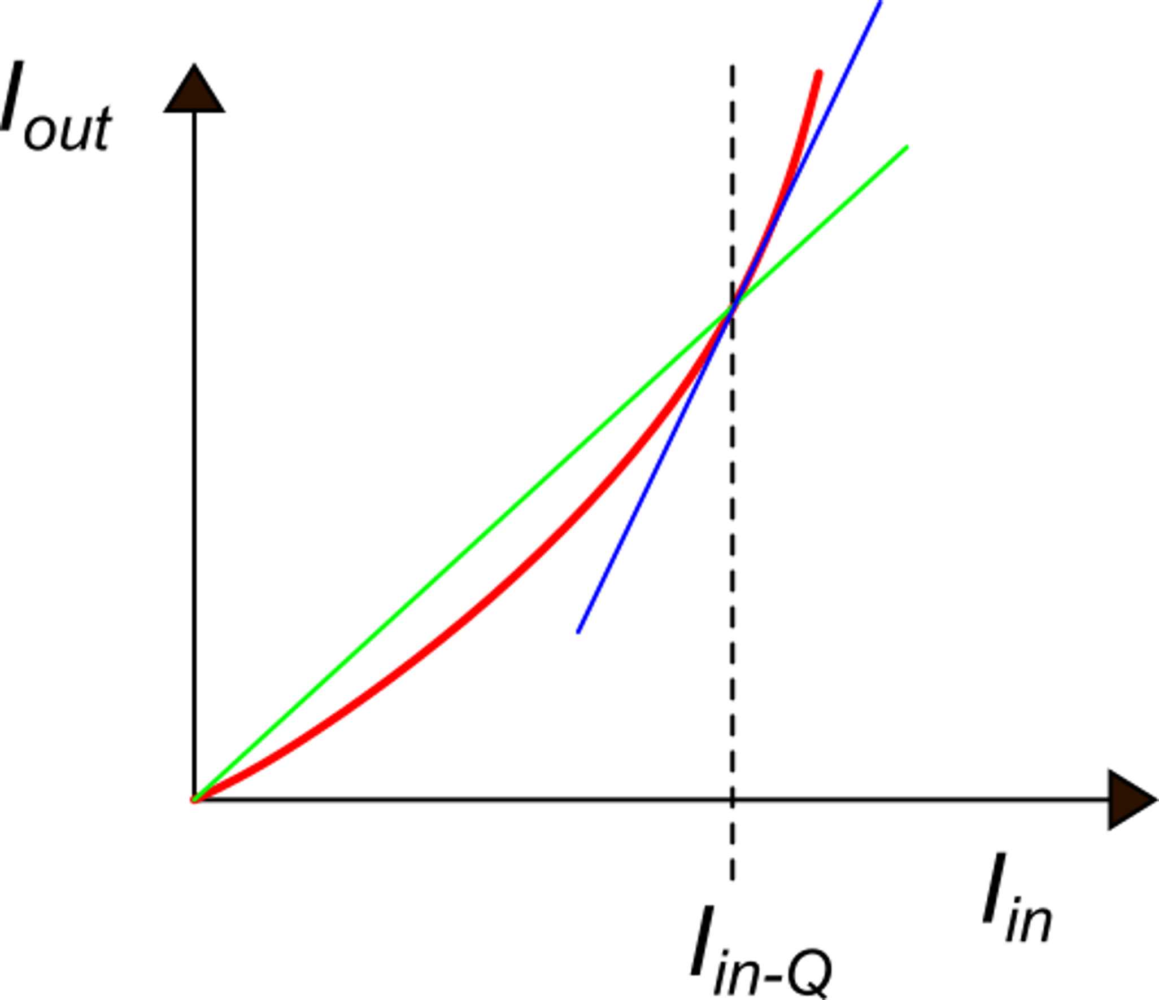
Small signal equivalent circuit of a current mirror
slope: k_{M}
Notice: the linearity of a real current mirror is much better than in this figure
tangent: slope: k_{m}
Note: generally
operating point

Slide 13
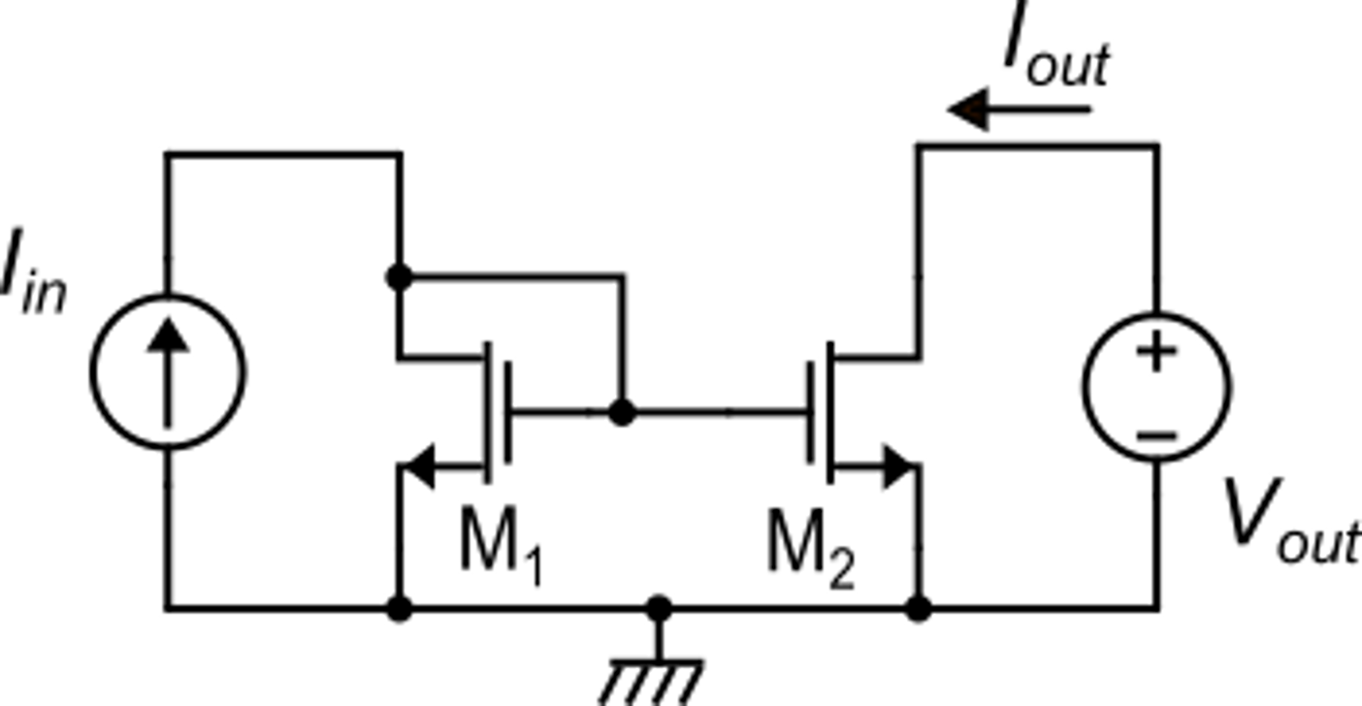
MOSFET current mirrors: the simple mirror
strong inversion
weak inversion

Slide 14
Simple MOSFET current mirror
For V_{out}=V_{in}

Slide 15
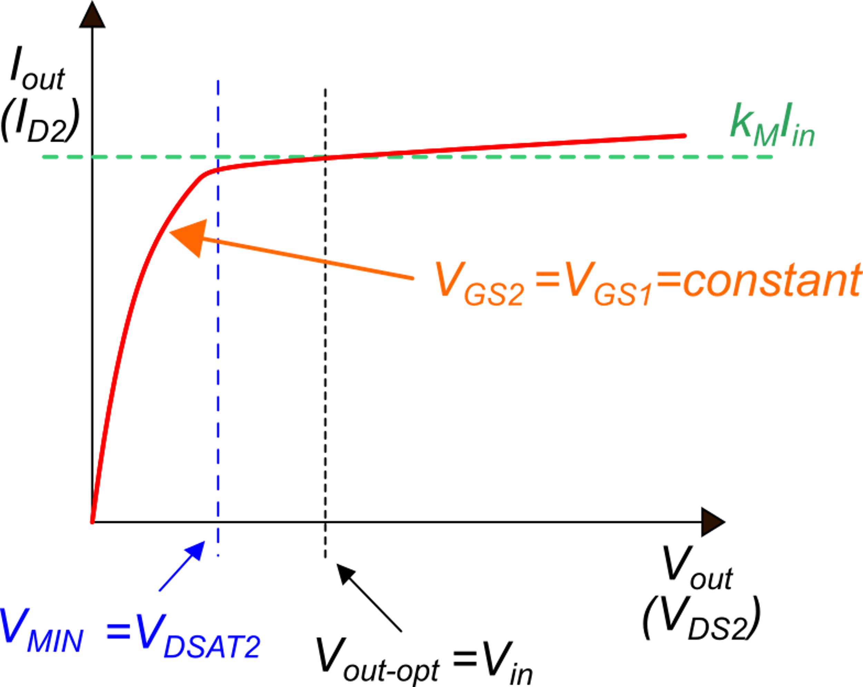
Parameters of the simple MOSFET current mirror
In strong inversion

Slide 16
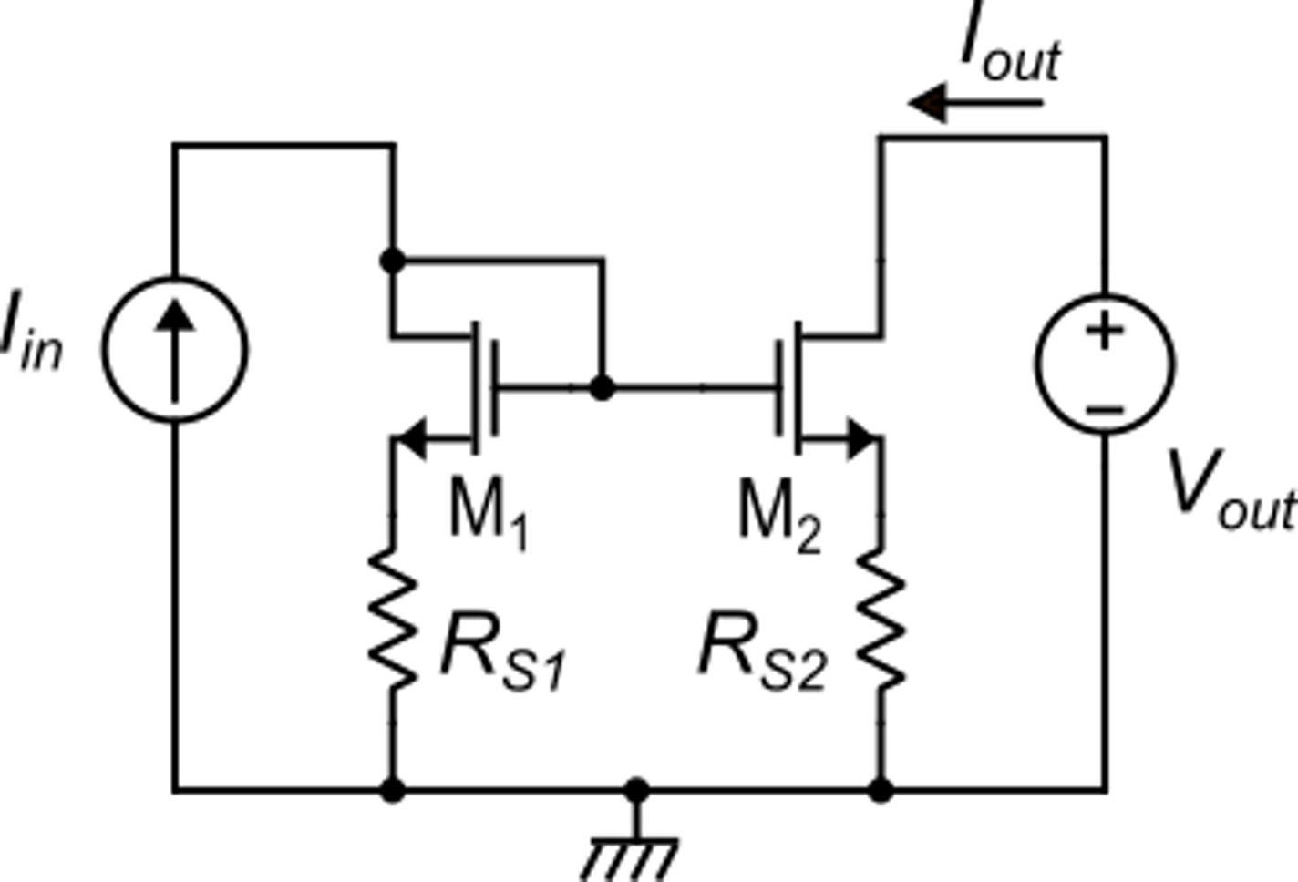
Increasing R_{out}: source degeneration
The output resistance is increased by a factor (1+g_{m2}R_{S2}) with respect to the simple current mirror
In order to have a linear behavior, so that I_{out}=k_{M}I_{in}, we need that:
Notice:
design rule
In this way, we can apply the same formulas of the simple mirror for I_{D1} and I_{D2} that give:

Slide 17
Increasing R_{out}: source degeneration
Unfortunately, V_{MIN} and V_{in} are larger in this mirror:
when V_{out} reduces, Iout is nearly constant, then this term is almost constant and it is V_{DS2} to dimmish.
The mirror starts to fail at a V_{out} value that make M₂ enter triode region
To get a large output resistance boosting factor (1+g_{m2}R_{D2}, it is necessary to make R_{D2}I_{out} >> V_{TE}
Notice:
But:
In practice, R_{D2}I_{out} (=R_{D1}I_{in}) cannot be too large to avoid increasing V_{in} and V_{MIN} too much

