Slide 1
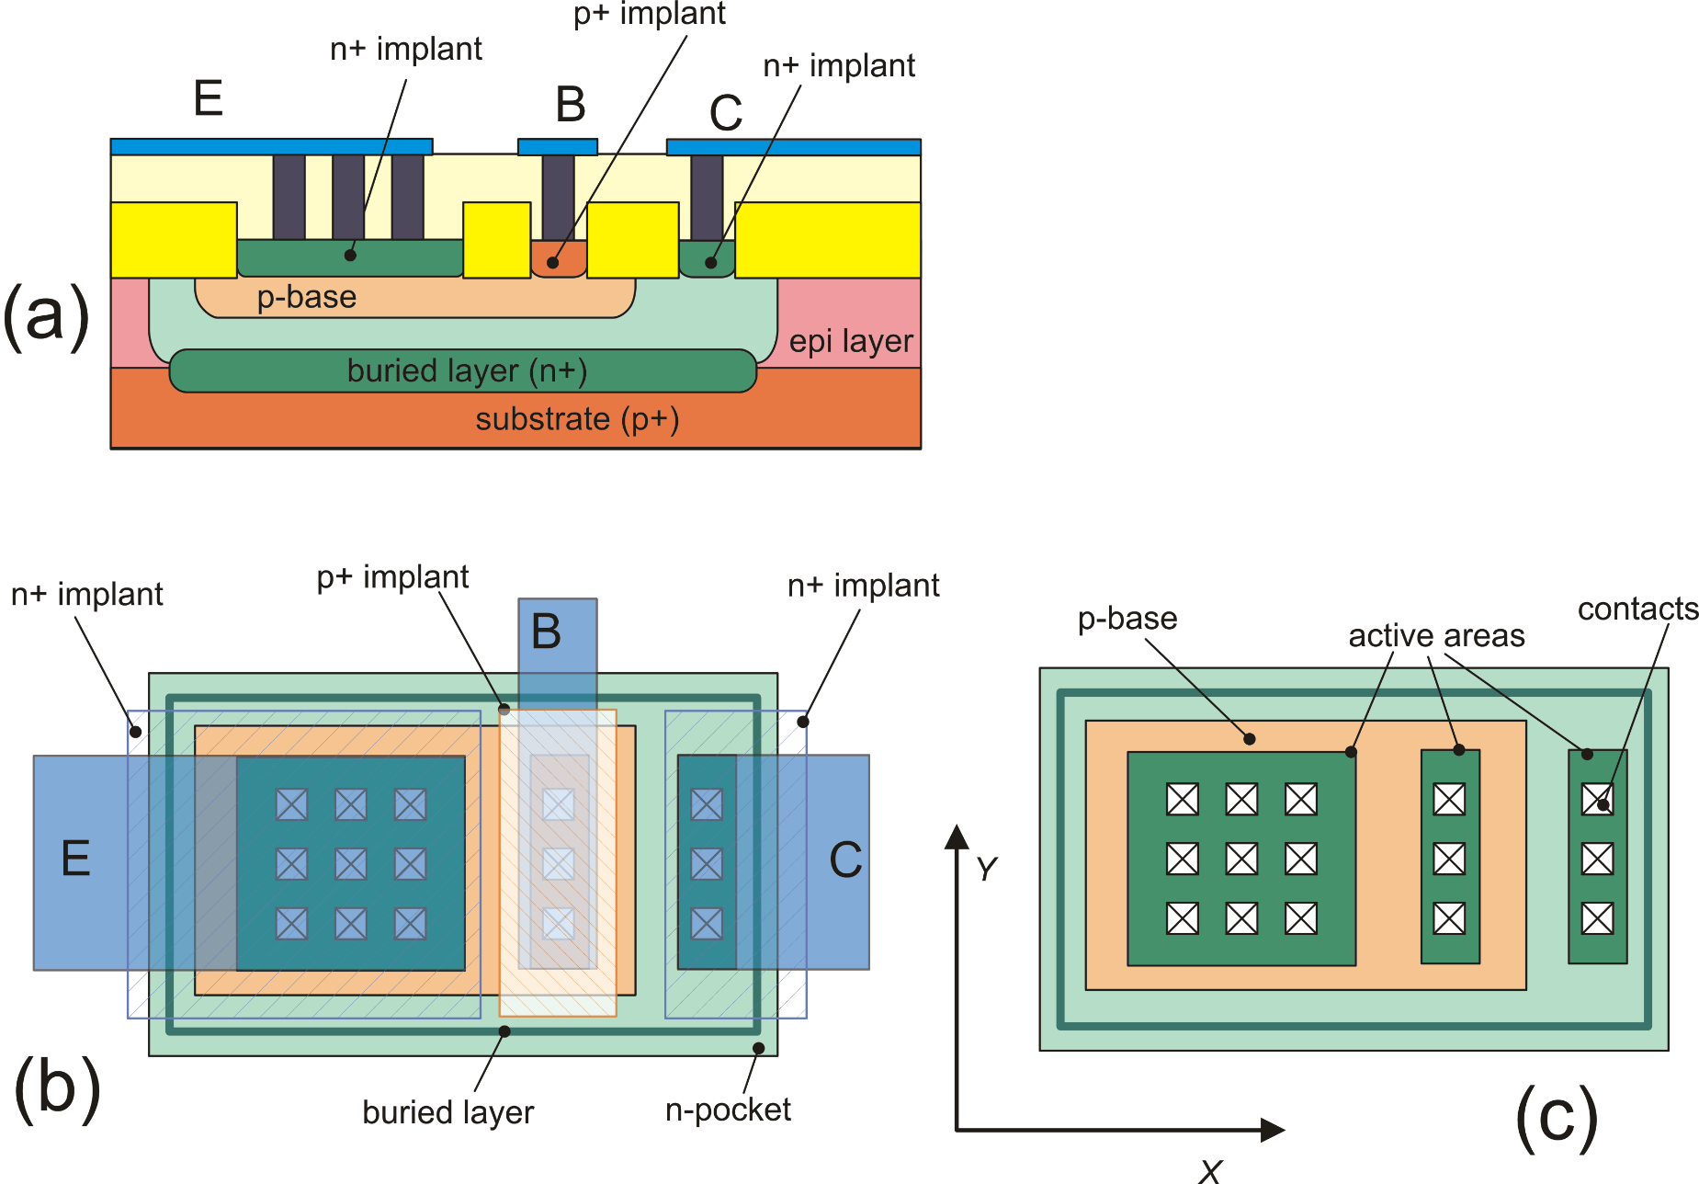
BJTs in integrated circuits: Vertical NPN
buried-L
p-base
BiCMOS: CMOS + p-base and buried-layer
The n-pocket can be an n-well
The buried-layer a buried-well of a triple-well CMOS
A diode between collector and
substrate is present capacitance
p-base
buried-L
Same as (b) but with the
Metal 1 removed

Slide 2
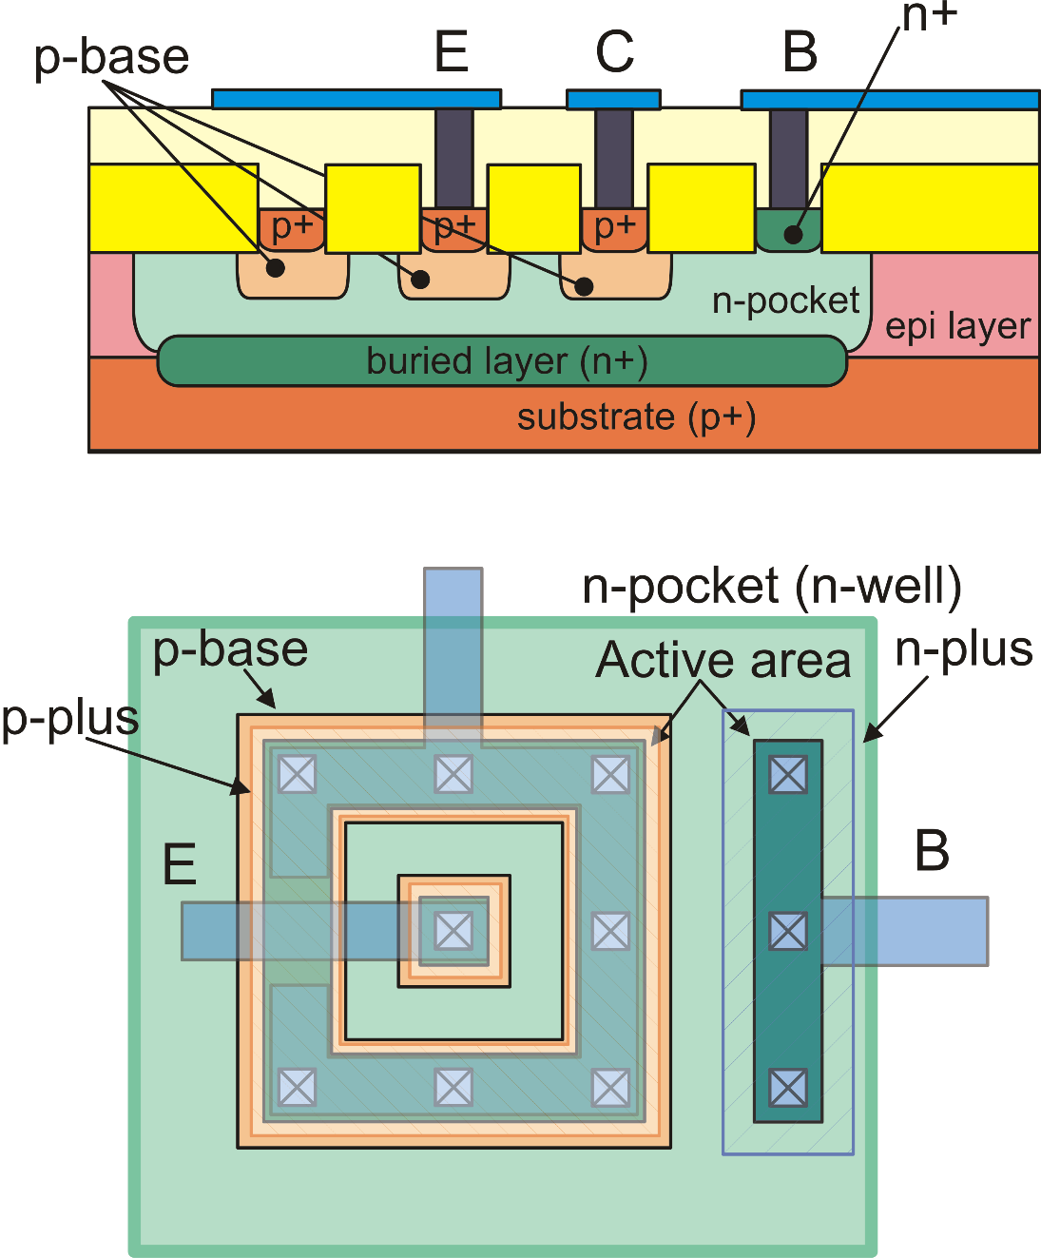
The lateral PNP
Slower than vertical devices due to
large base series resistance (r_{bb'})
and base-to substrate capacitance
Lower early voltage (V_{A}), due to
non-optimal collector doping.
Larger than vertical devices for the same
current capability

Slide 3
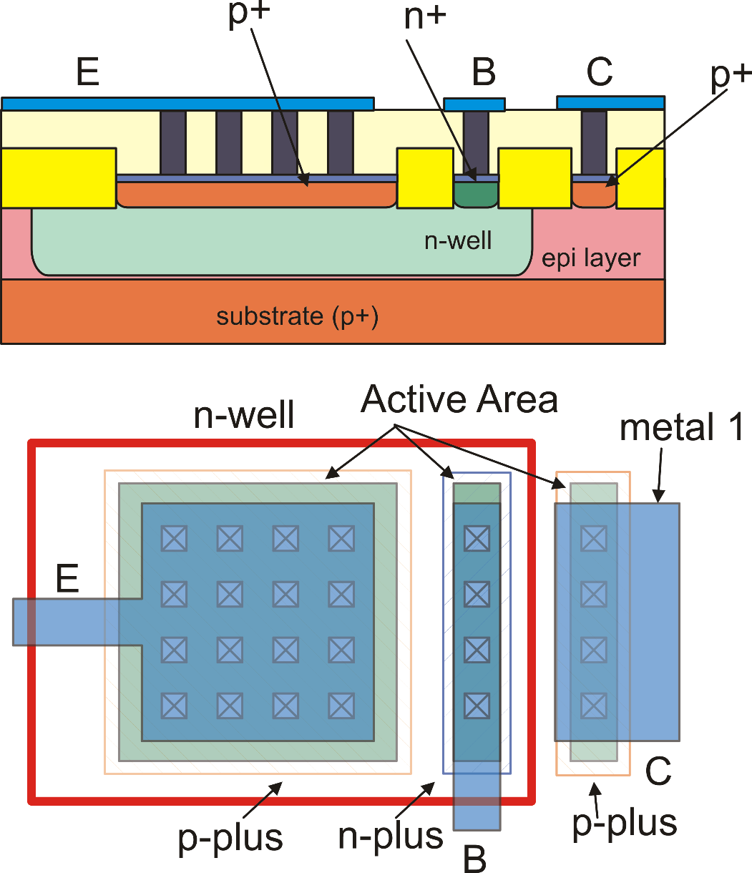
The substrate PNP: compatible with standard CMOS n-well processes
Limitation: The collector is
committed to the substrate,
(forced to V_{SS})

Slide 4
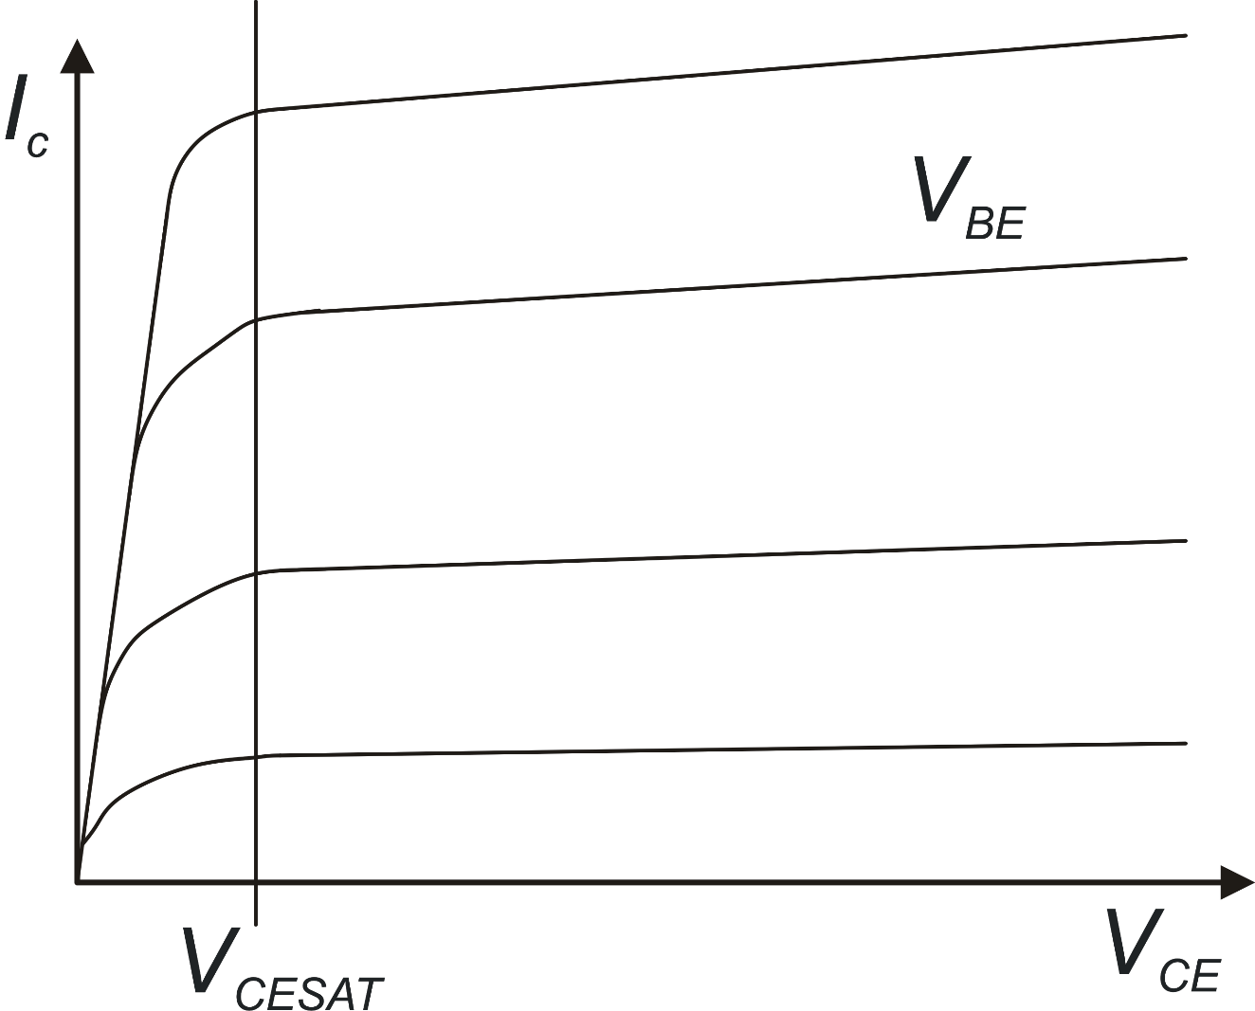
BJT output characteristics
Saturation
Forward Active Region
V_{BE}, V_{CE} : control
voltages
I_{C}, I_{B}: dependent
currents

Slide 5
BJT model in the forward active zone
Sometimes this expression is used
in order to refer to V_{BE} and V_{CE} as
control voltages:
For calculation of I_{C} and I_{B} in all operating zones (saturation, cut-off,
forward active, reverse active) the Ebers-Moll model should be used.

Slide 6
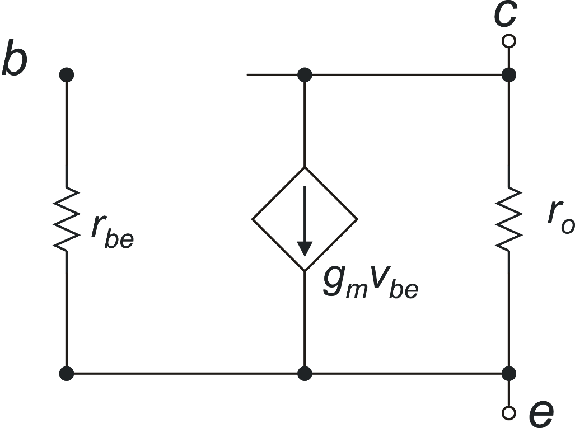
BJT: small signal model
Small signal dc model
Equivalence with the MOSFET parameters
BJT
MOSFET

Slide 7
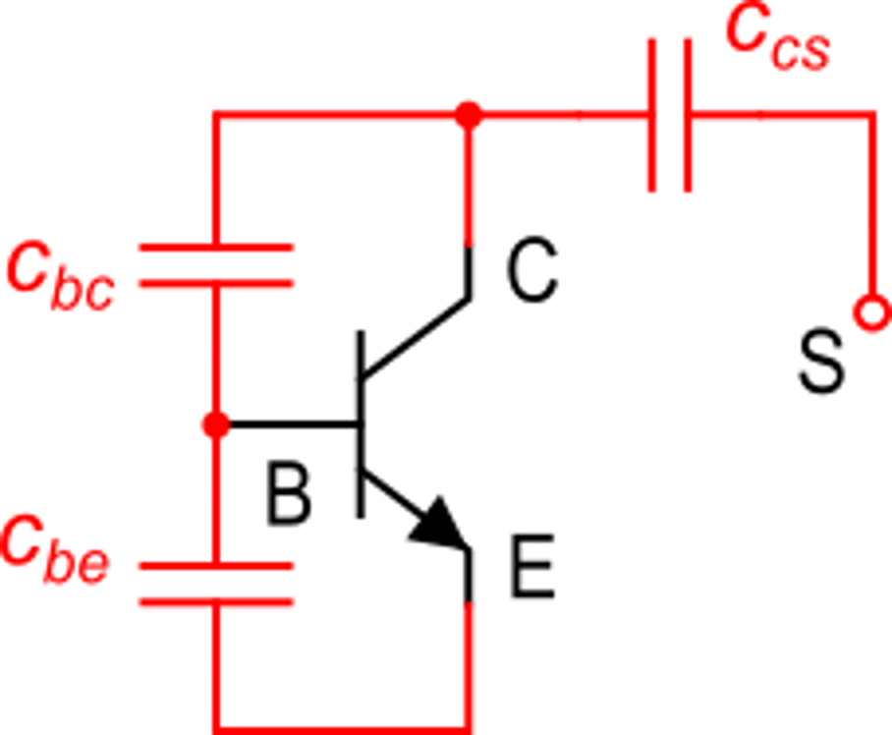
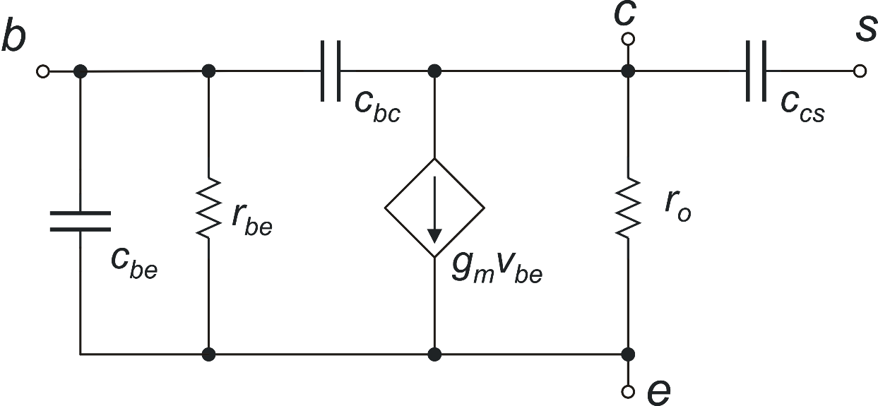
BJT capacitances in forward active region (vertical npn)
Transition frequency

Slide 8
BJTs in Integrated Circuit: instance parameters
area
area
minimum size BJT
("elemental" BJT)
area=1.5
area may not be an
integer (not all PDKs
allow this)
parameter "area"
(dimensionless)
area=2 (,3, 4 ….)
area = integer

Slide 9
BJT sizing: Effect of the area parameter on the electrical parameters
Electrical effects of area parameter:
elemental BJT
elemental BJT with area
specified as an instance parameter
I_{S}
V_{A}
β
C_{JE}
…..
area × I_{S}
V_{A}
β
area × C_{JE}
…..

Slide 10
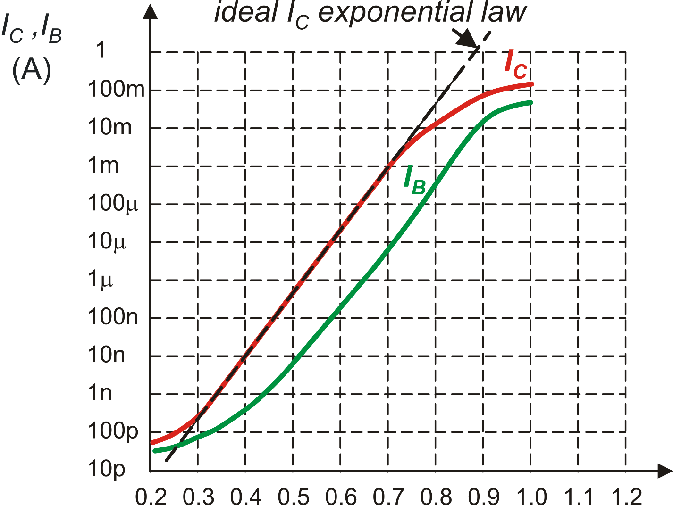
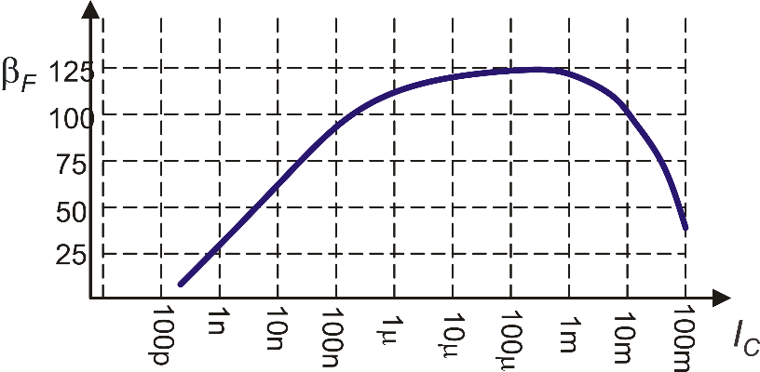
BJT sizing: Gummel plot and beta plot
My BJT has to carry this current
(200 mA). The elemental BJT would
be damaged
Using a BJT with area=100 would be
equivalent to make the elemental BJT
work with a current 100 times smaller.
This corresponds to the operating point
given by the blue line
β
β
This refers to the
elemental BJT (area=1)
I_{C}
V_{BE}
Gummel Plot
Beta Plot

