Slide 1
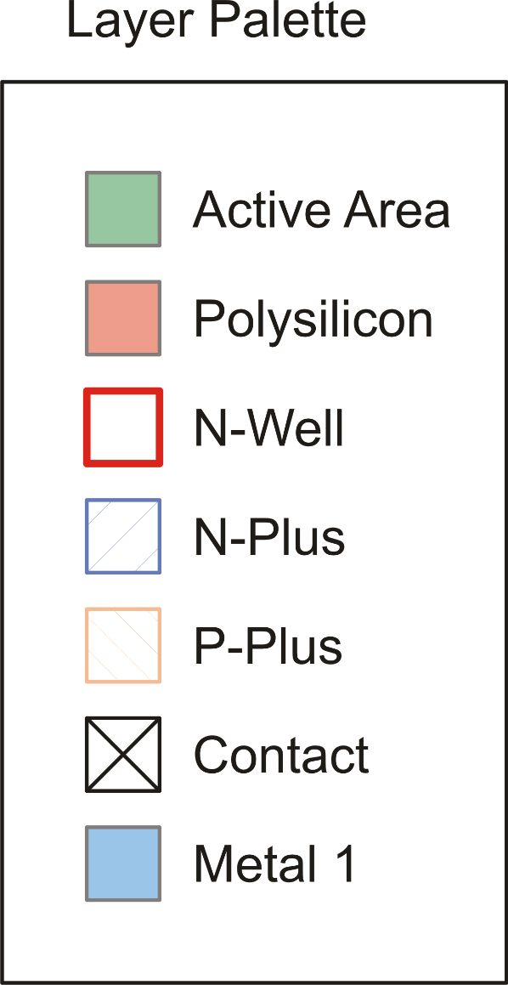
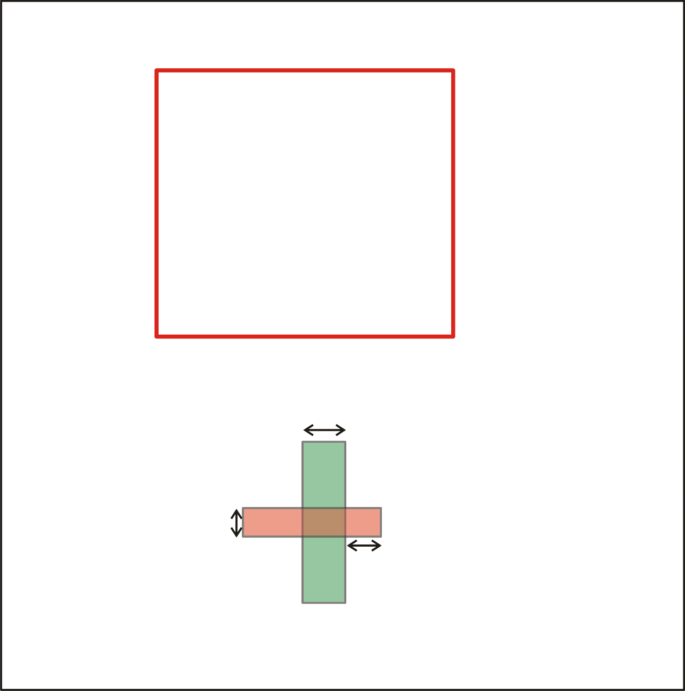
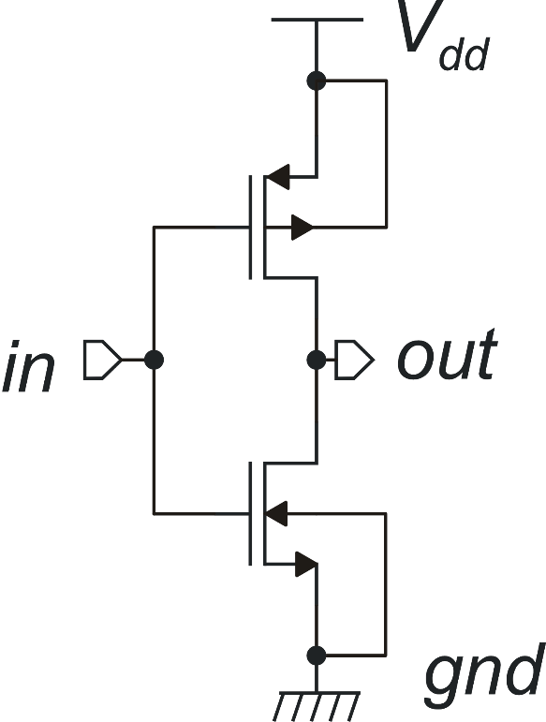
Example: CMOS Inverter
W_{P}, L_{P}
W_{N}
W_{N}, L_{N}
L_{N}
Minimum Extension

Slide 2
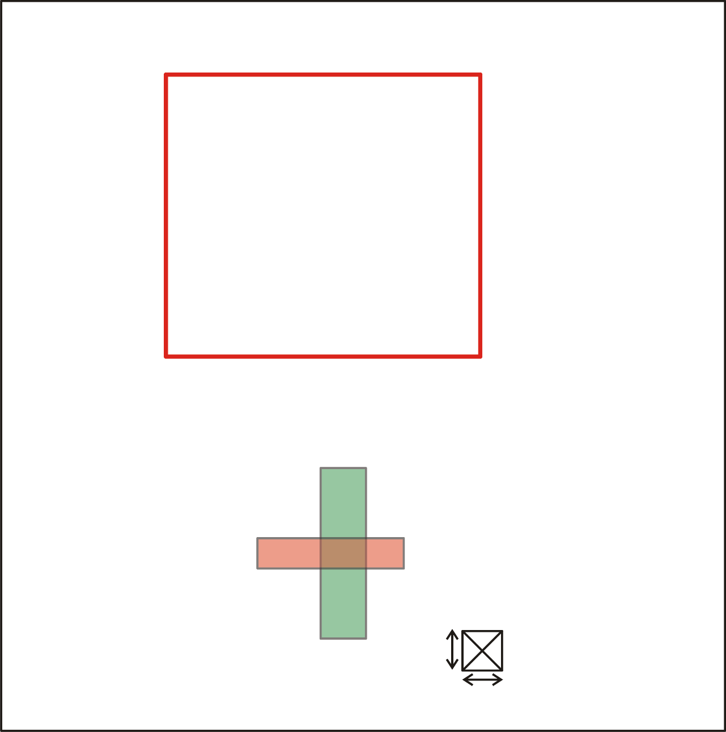
Let's introduce a contact
W_{P}, L_{P}
W_{N}, L_{N}
Contact Exact width

Slide 3
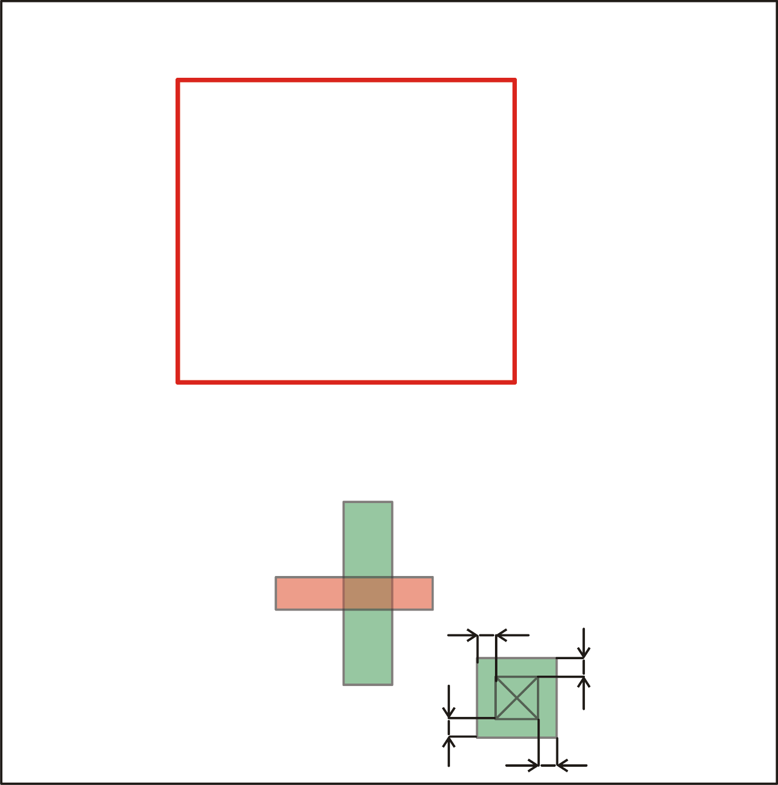
Then, we provide enough active surround to the contact
W_{P}, L_{P}
W_{N}, L_{N}
Contact to active margin

Slide 4
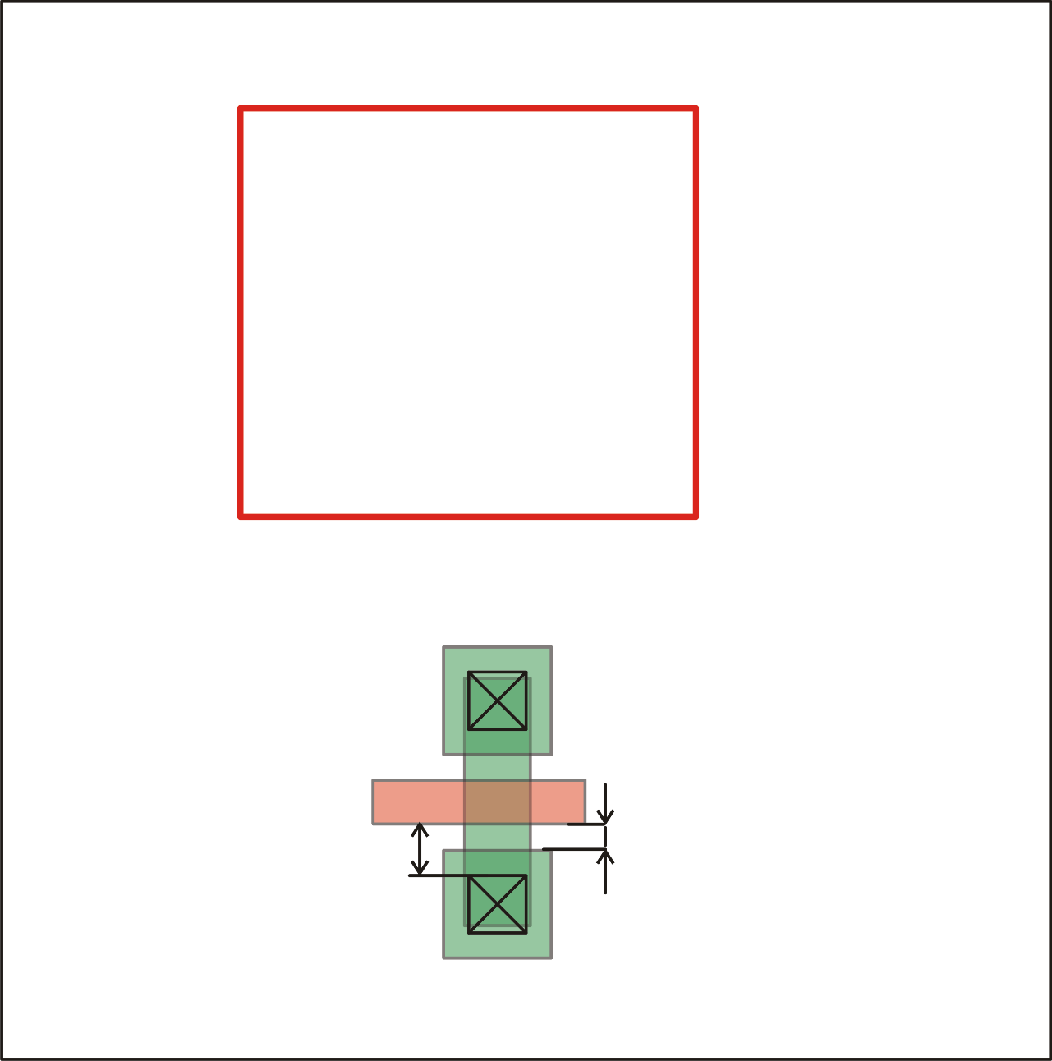
Then, we provide enough active surround to the contact
W_{P}, L_{P}
W_{N}, L_{N}
Poly-Active spacing
Contact to poly-gate
minum spacing

Slide 5
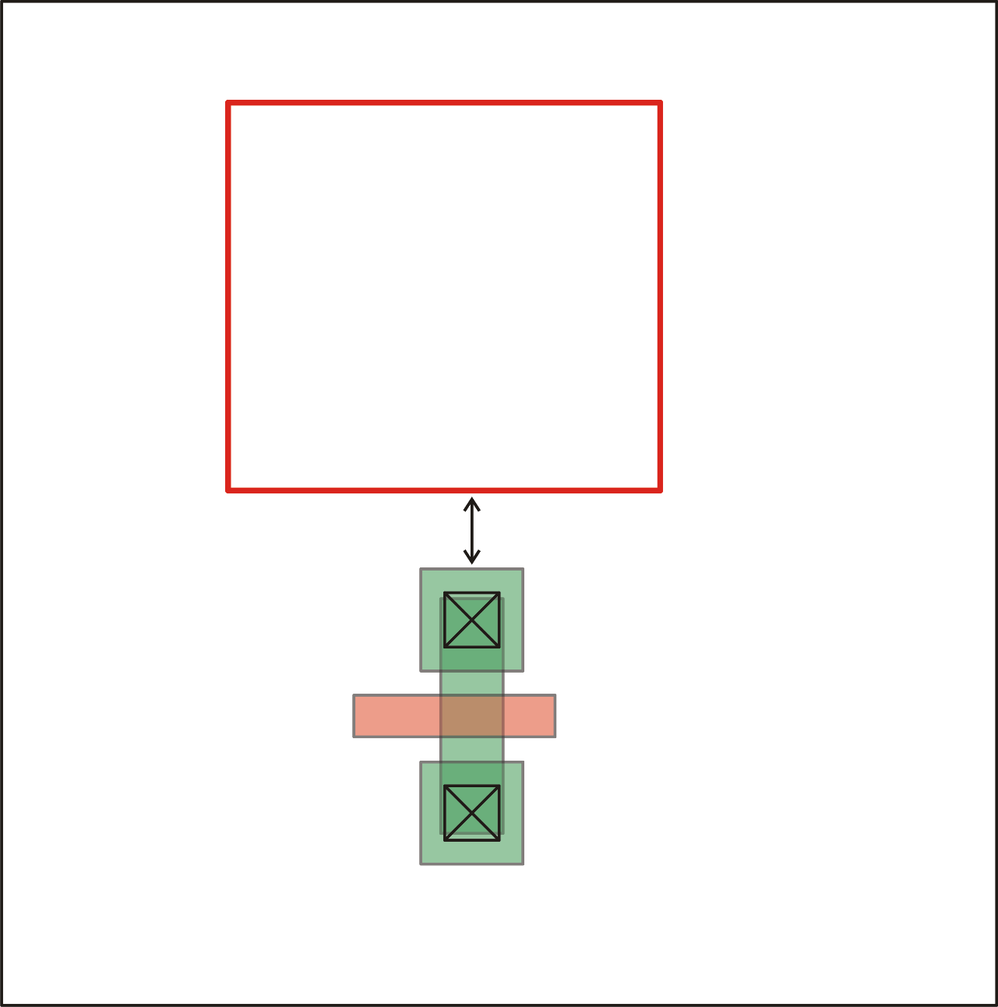
Place the n-MOS as close as possible to the n-well
W_{P}, L_{P}
Minimum active to well spacing
W_{N}, L_{N}

Slide 6
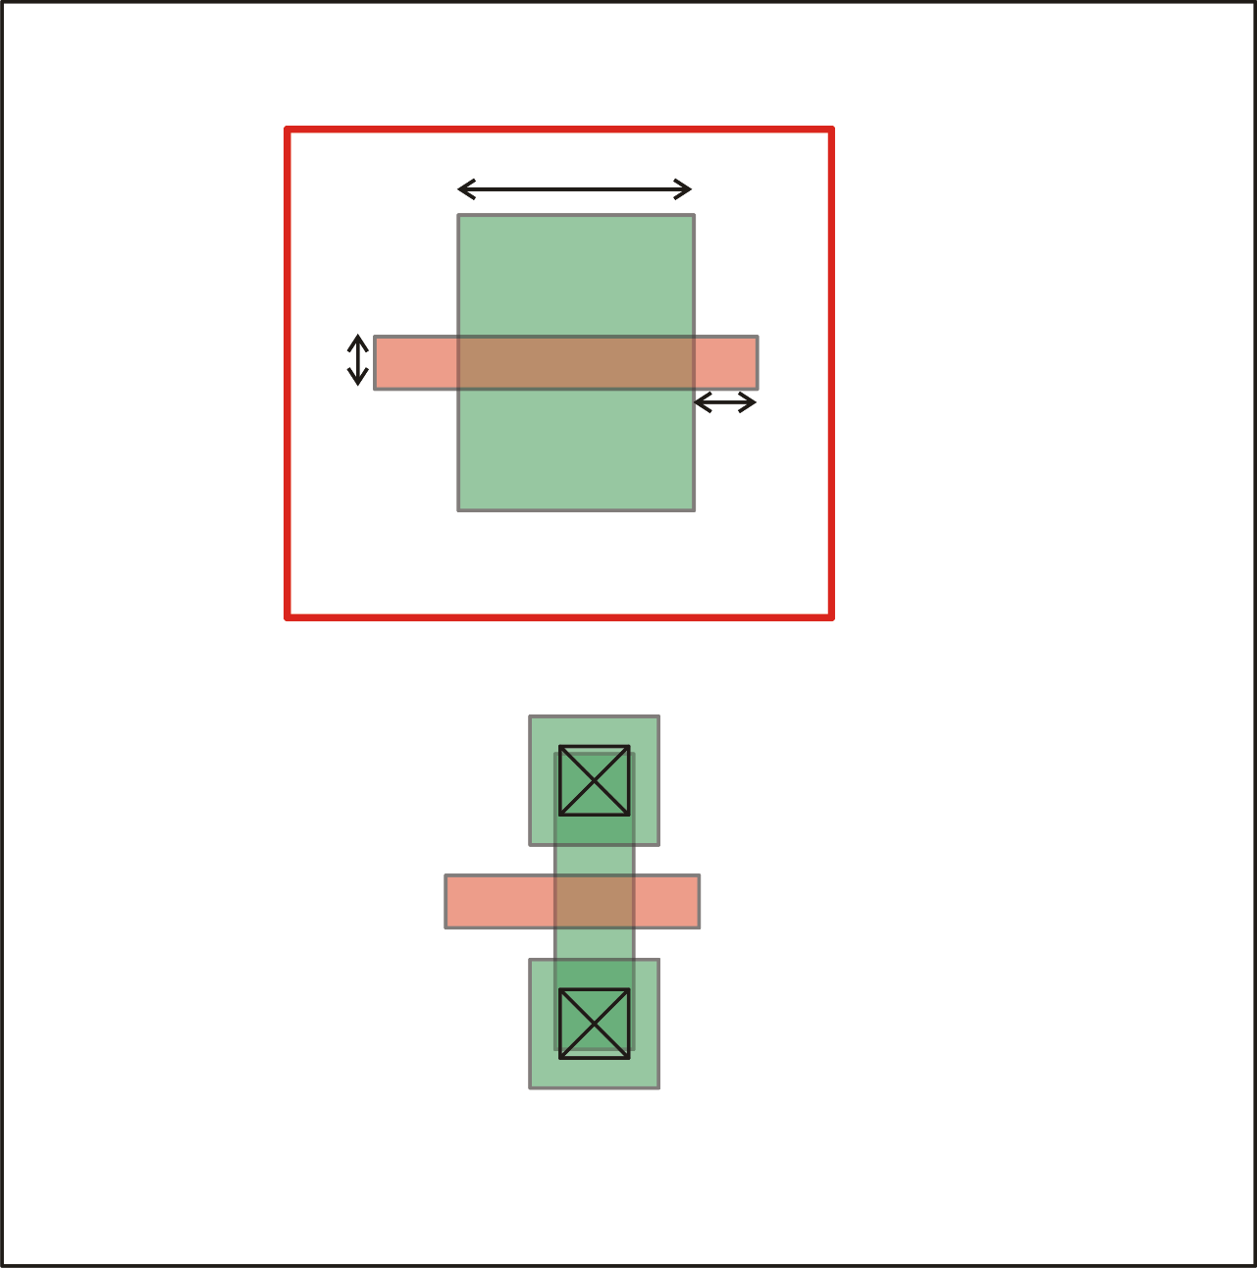
Now draw the p-MOS inside the n-well
W_{P}
W_{P}, L_{P}
L_{P}
Extension poly of active
W_{N}, L_{N}

Slide 7
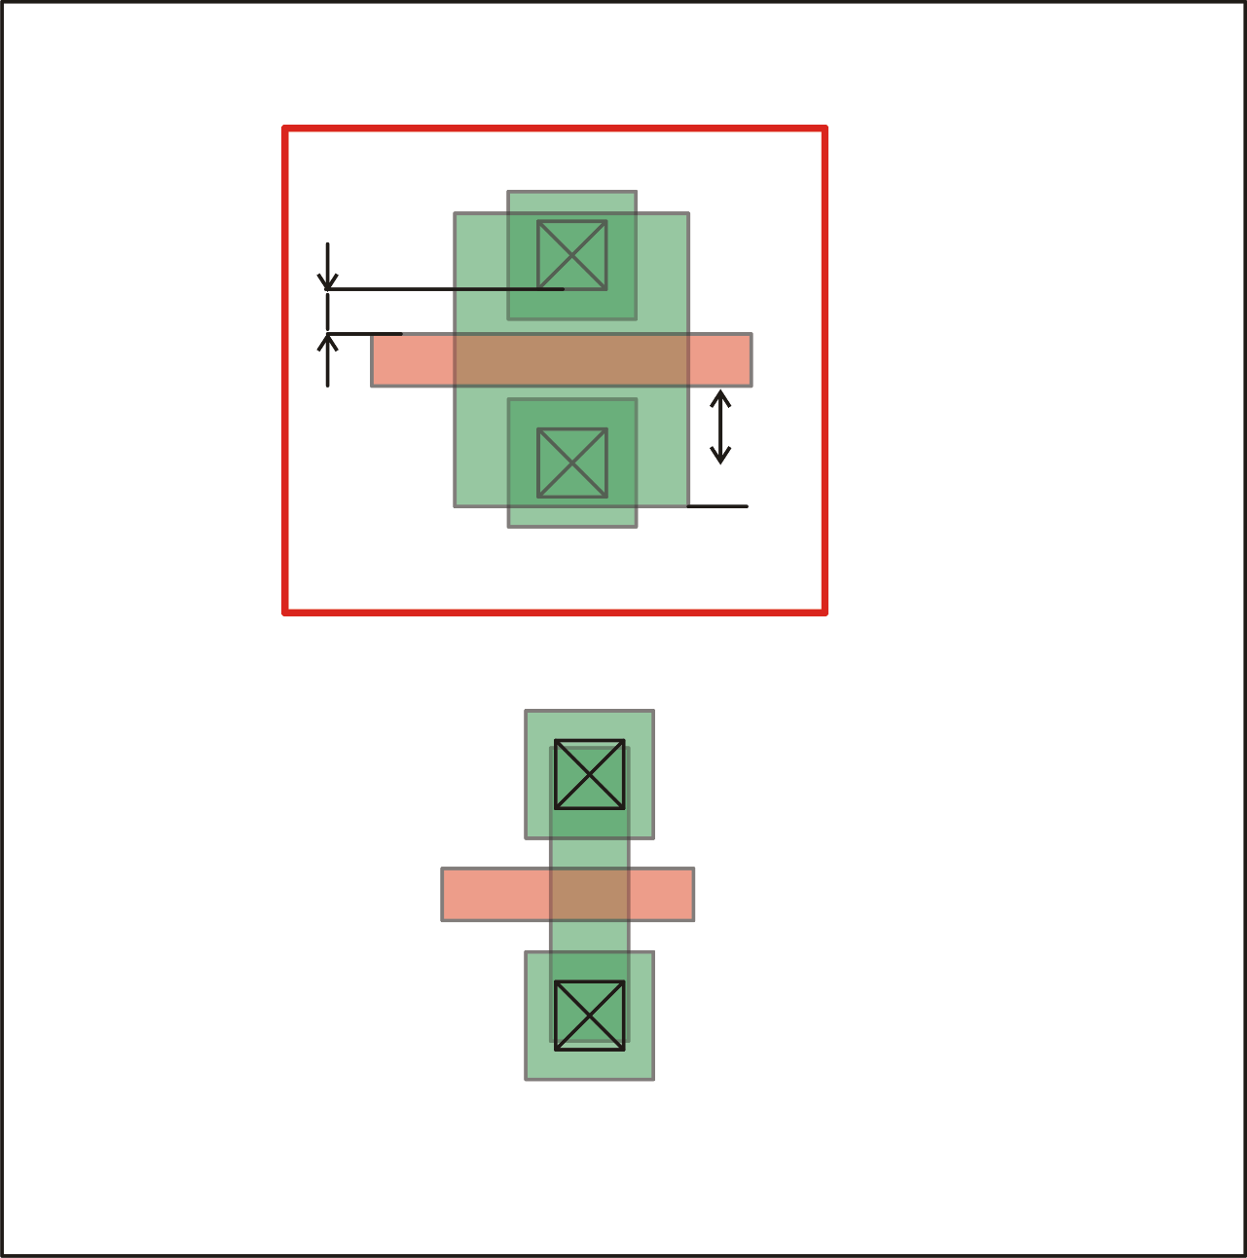
Place the source/drain contact of the
W_{P}, L_{P}
Extension active of poly
Contact to
poly-gate spacing
W_{N}, L_{N}

Slide 8
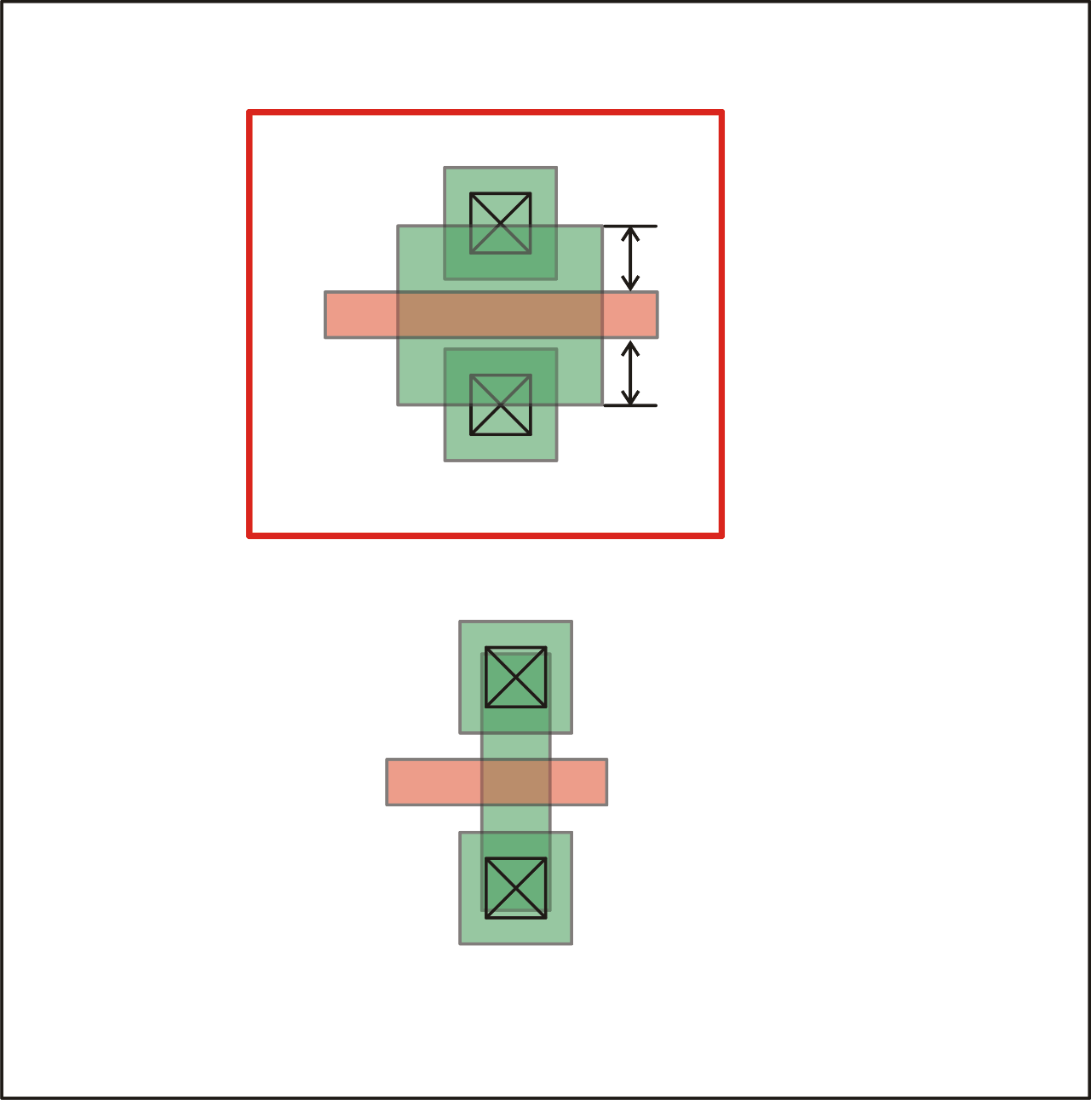
Reduce the active extension to the minimum
W_{P}, L_{P}
Extension active of poly
(minimum)
W_{N}, L_{N}

Slide 9
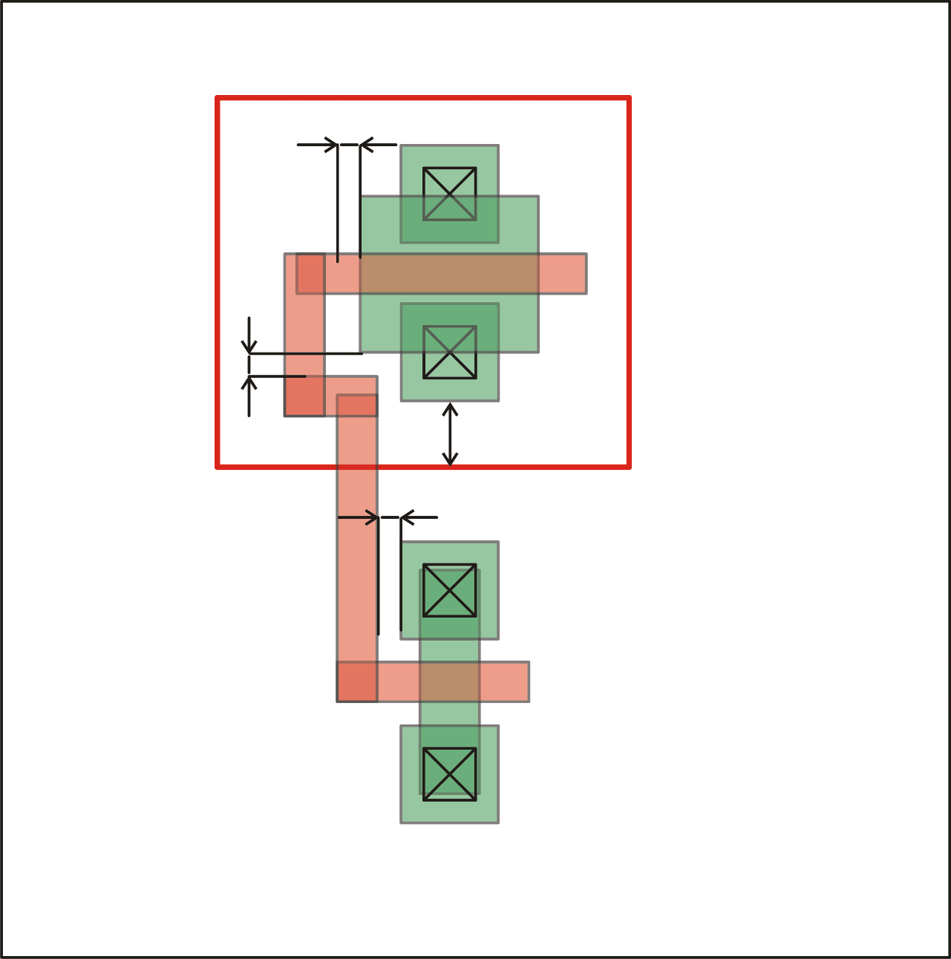
Connect the gates of the n-MOS and p-MOS
W_{P}, L_{P}
Minimum Active to n-well margin
W_{N}, L_{N}
Minimum poly
to active spacing
Minimum poly width

Slide 10
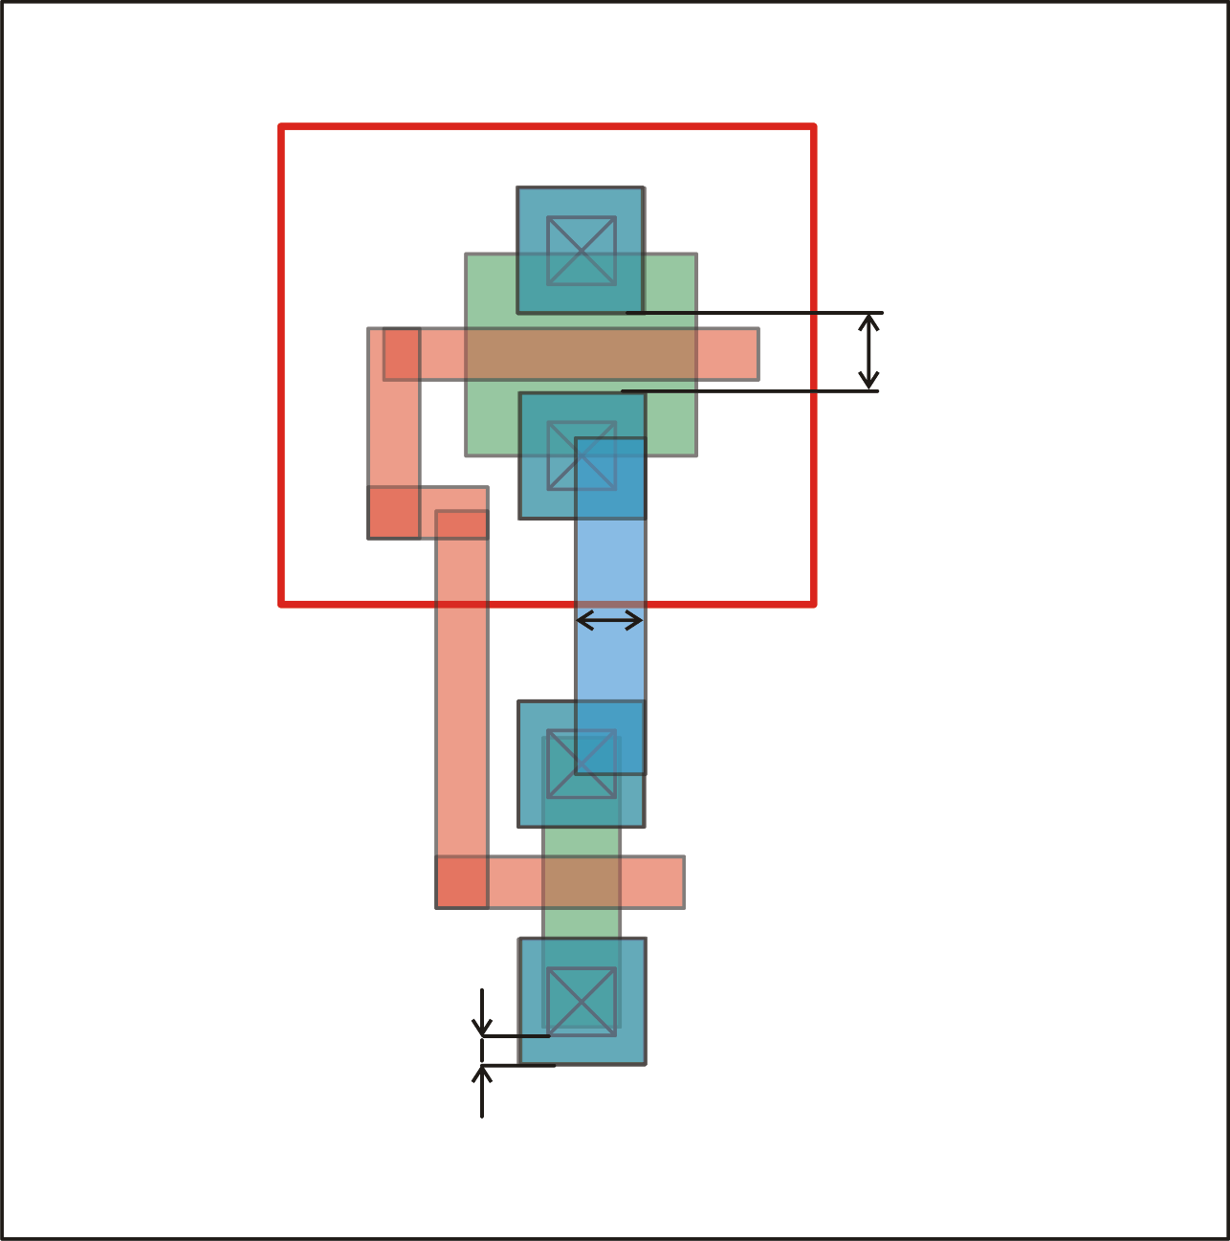
Introduce the metal-1 connections
W_{P}, L_{P}
Minimum metal1 to metal1
spacing
W_{N}, L_{N}
Minimum metal1 width
Metal 1 to contact overlap

Slide 11
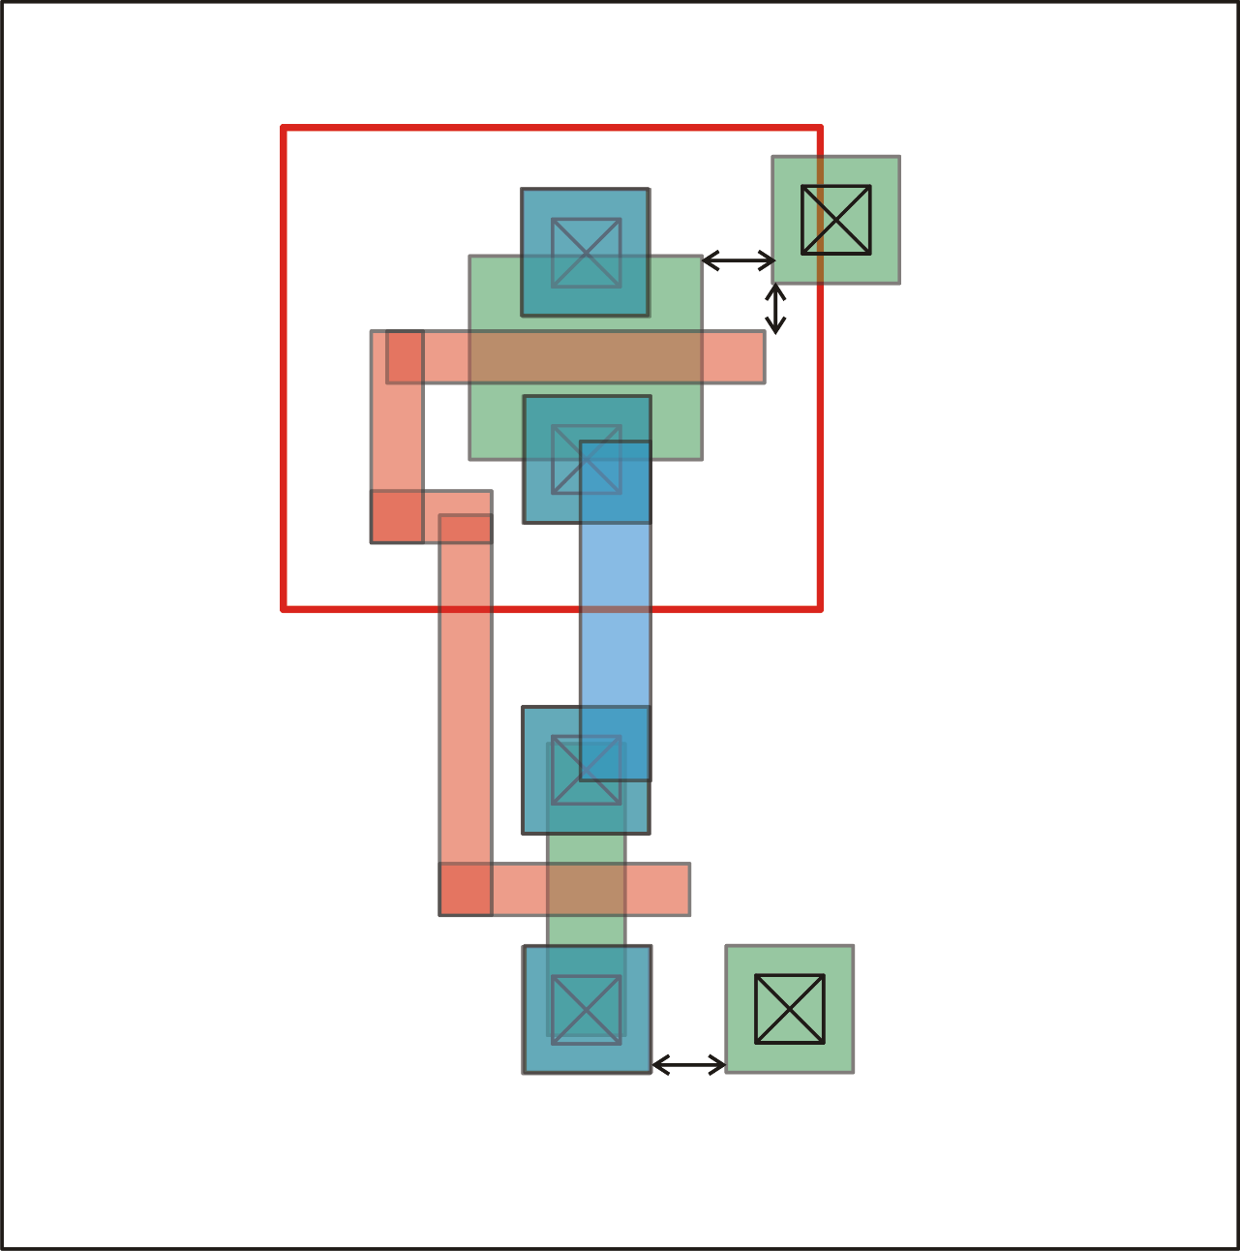
Introduce the substrate and n-well contacts
Minimum active
to active spacing
W_{P}, L_{P}
Minimum poly to active
spacing
W_{N}, L_{N}
Minimum active
to active spacing

Slide 12
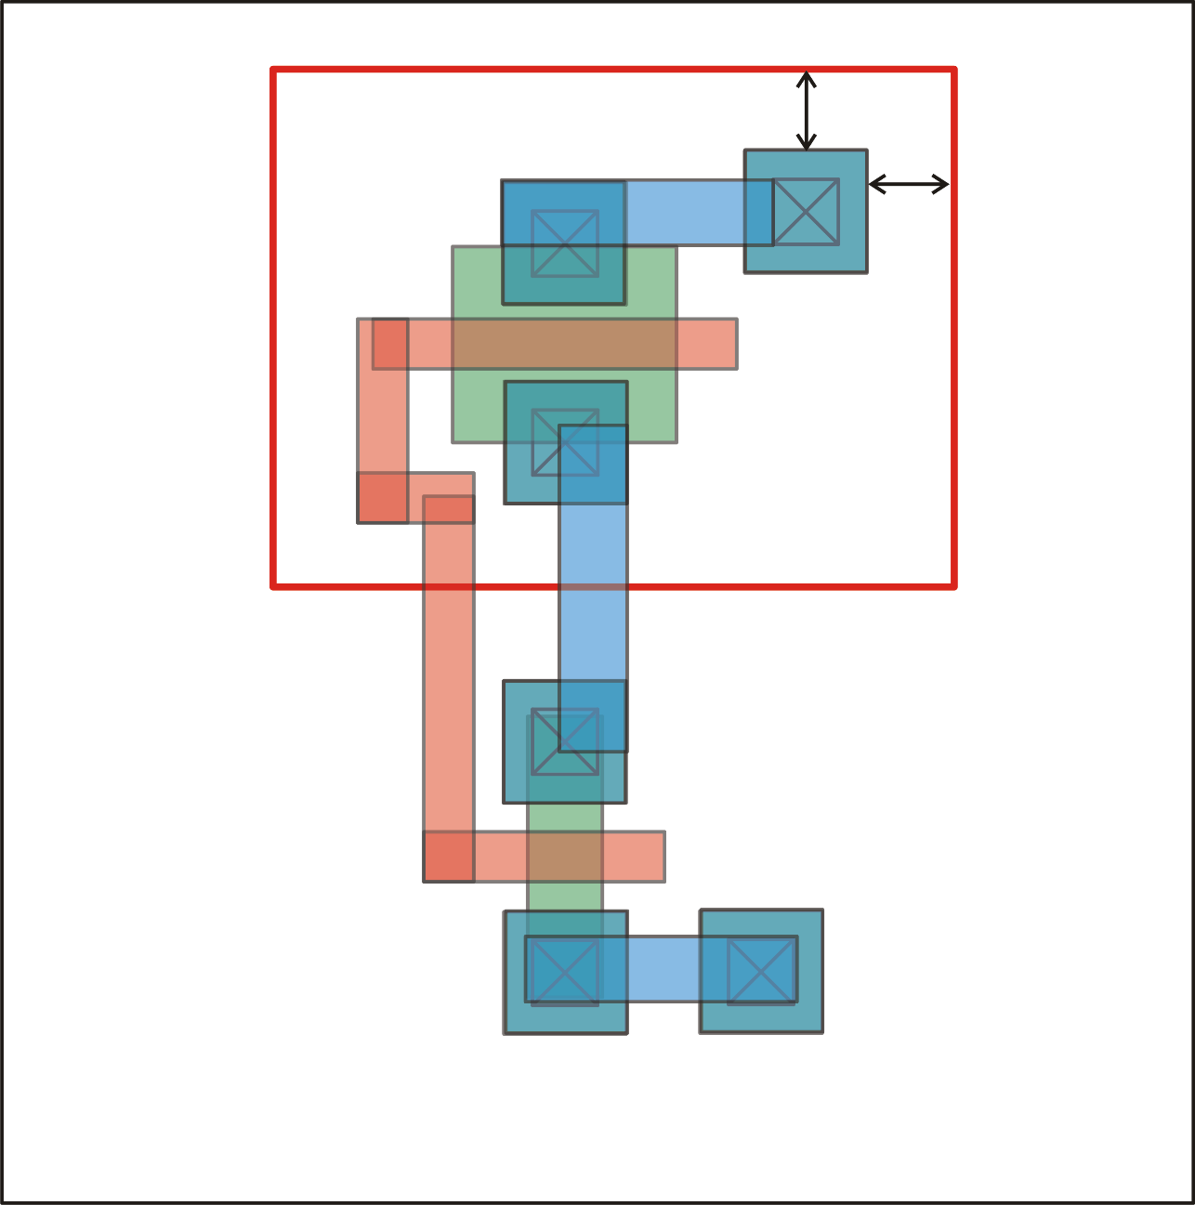
Resize the n-well to comply with all active margins. Connect sources to bodies
W_{P}, L_{P}
Minimum active to
well margin
W_{N}, L_{N}

Slide 13
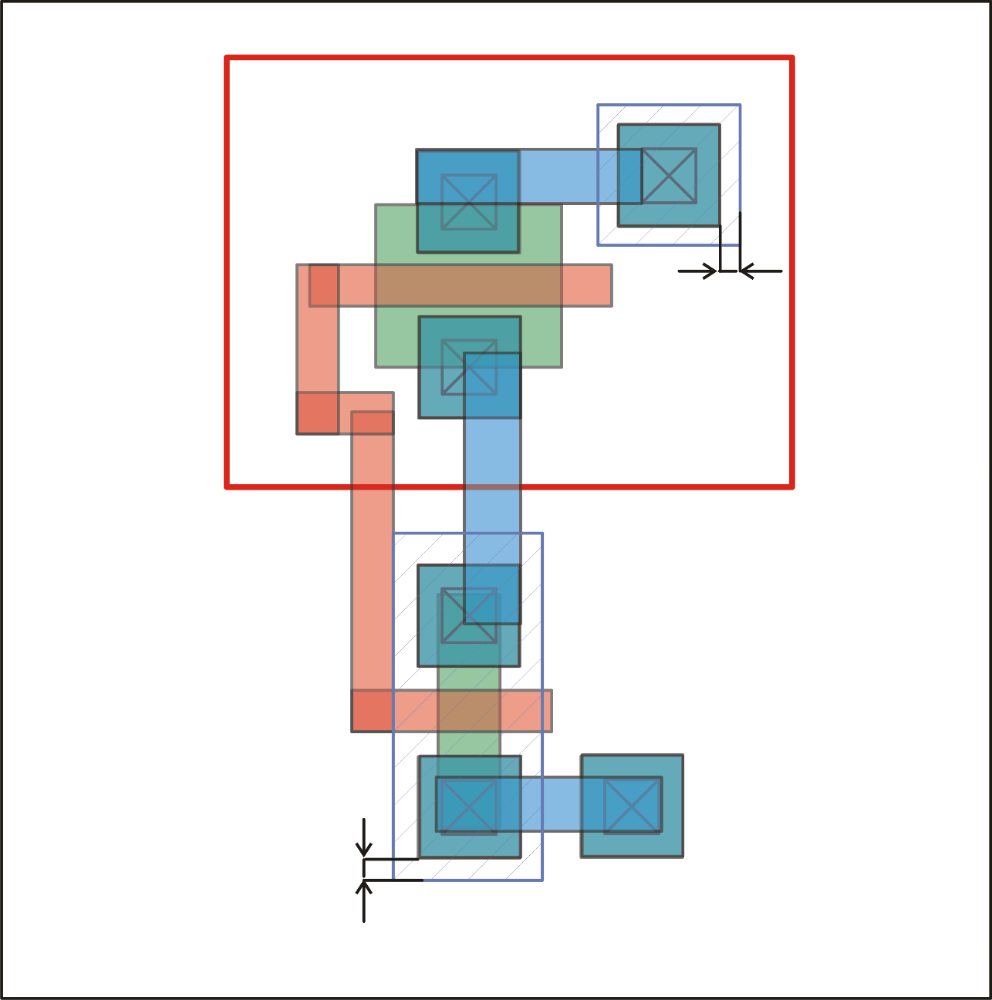
Cover all n-plus active areas with n-plus implant
well contact
W_{P}, L_{P}
well contact
drain/source
implants
Minimum n-plus overlap of
active areas
W_{N}, L_{N}

Slide 14
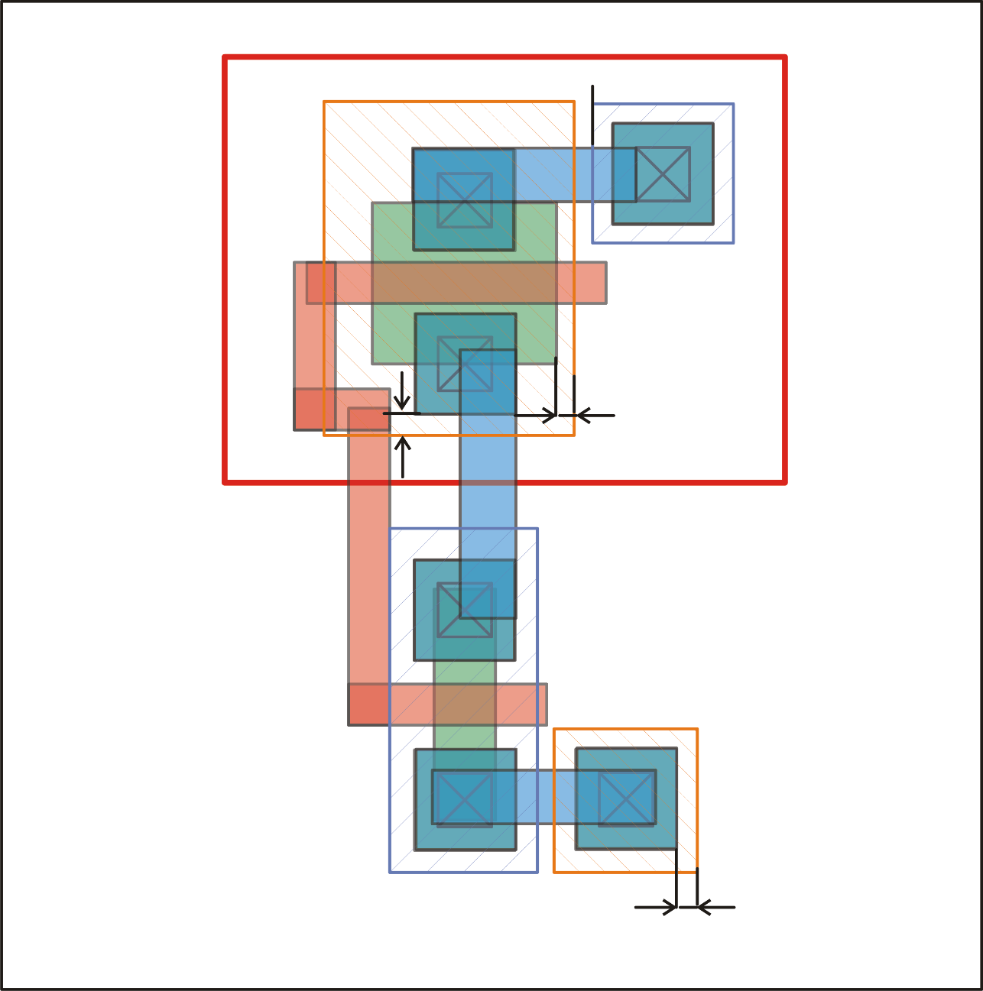
Same thing with p-plus active areas (p-plus implant)
W_{P}, L_{P}
drain/source
implants
substrate
contact
Minimum n-plus overlap of
active areas
W_{N}, L_{N}
substrate contact

Slide 15
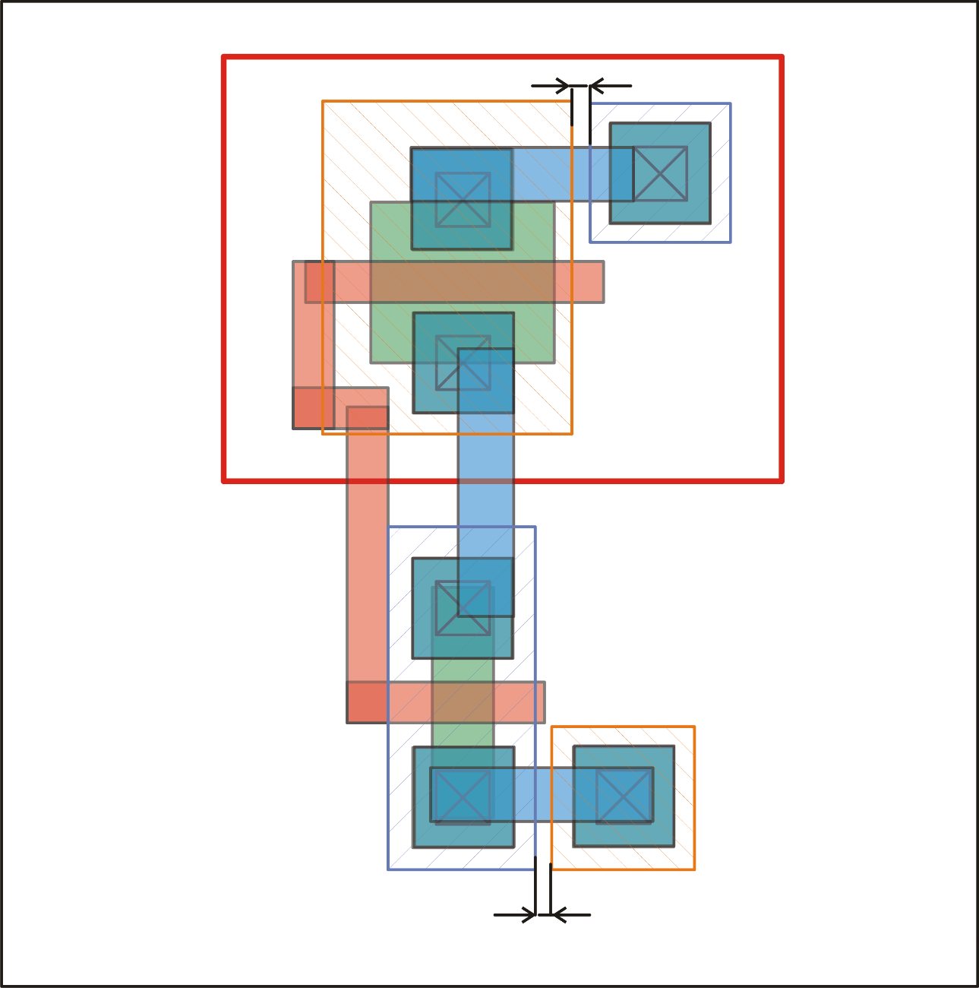
Same thing with p-plus active areas (p-plus implant)
W_{P}, L_{P}
Minimum n-plus to p-plus
spacing
W_{N}, L_{N}

Slide 16
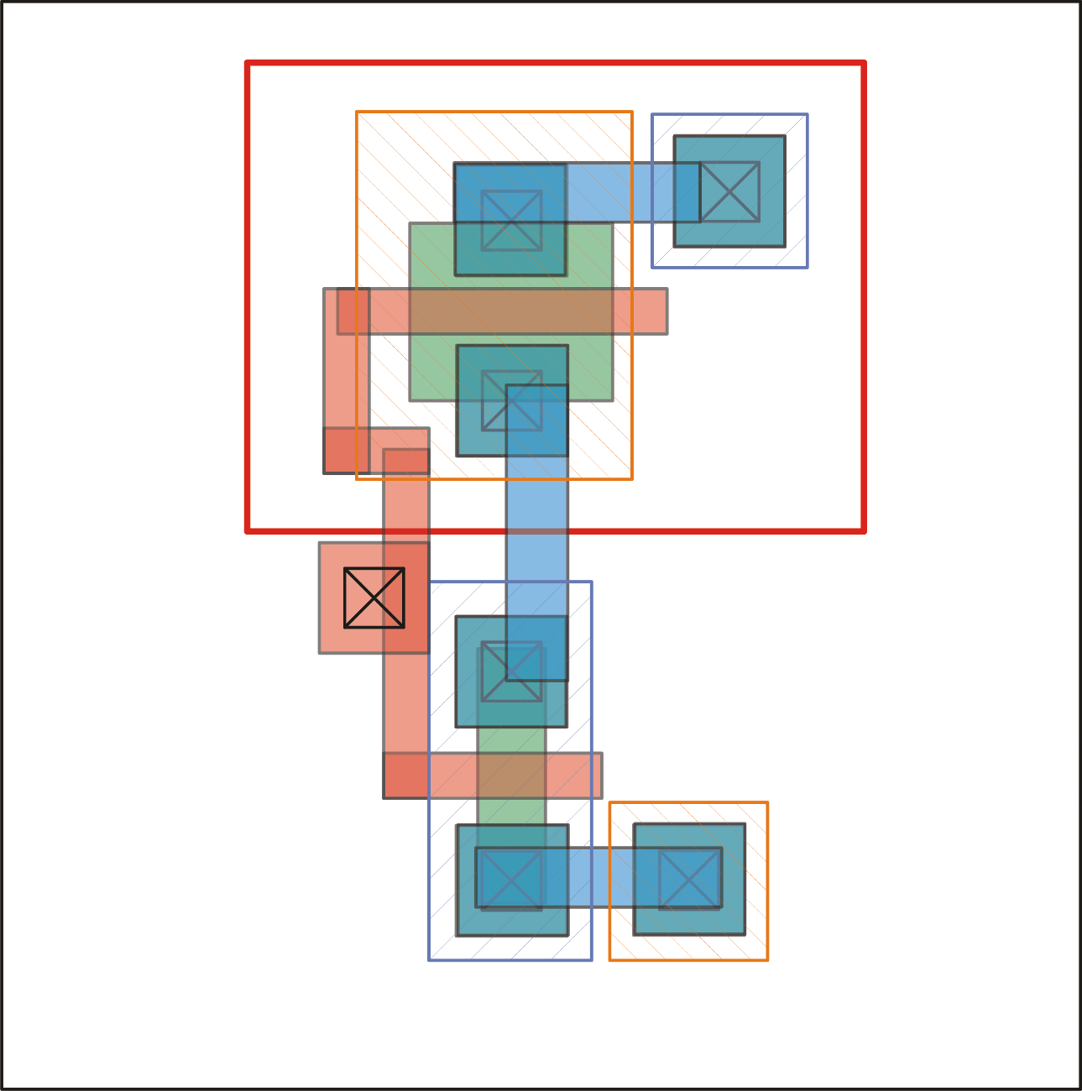
Create a poly-metal1 contact if required
W_{P}, L_{P}
W_{N}, L_{N}
Margin of contact to poly on every-side

Slide 17
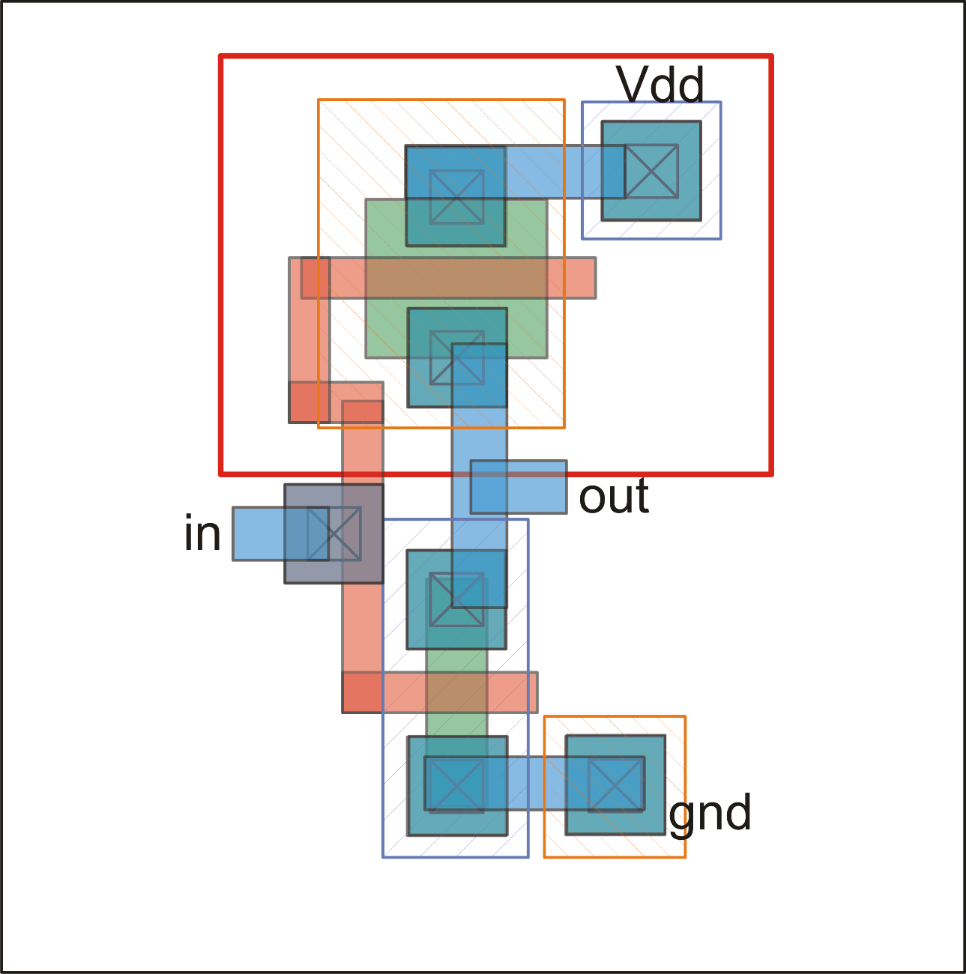
Create a poly-metal1 contact if required
W_{P}, L_{P}
W_{N}, L_{N}

