Slide 1
The CMOS Process
Planar CMOS process is used up to the 28 nm technology node.
For later technology nodes, 3D CMOS MOSFETs (FinFETs) are used.
Planar CMOS processes are still extensively used for analog and mixed-signal ICs.
Classification of planar CMOS processes: example
UMC CMOS n-well 0.18 μm 1P6M
Number of metal layers
Minimum channel length
Number of poly layers
Foundry name
Type of Well (n-well, p-well, triple-well)

Slide 2
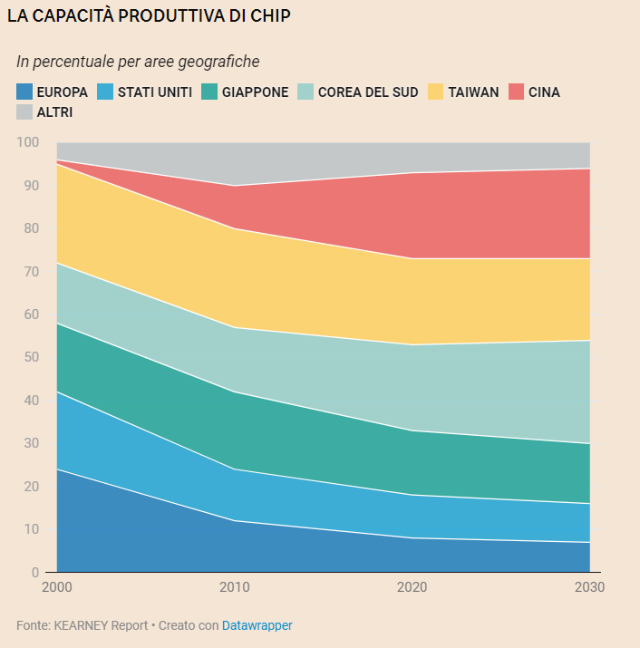
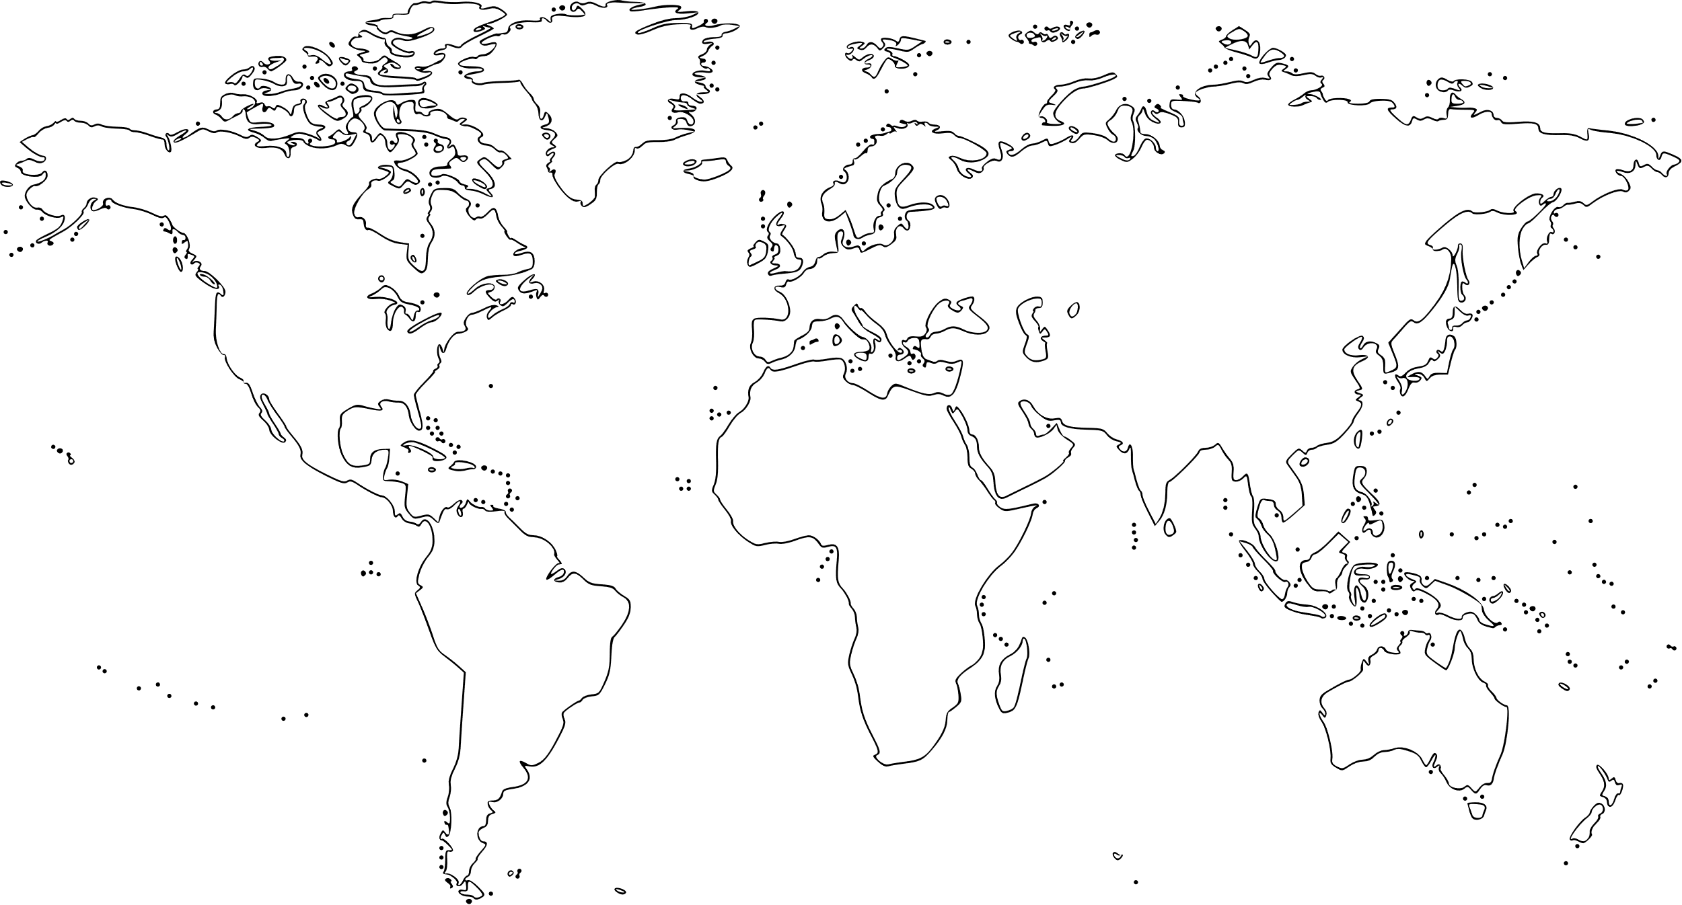
Semiconductor Fabrication Plants
TSMC
GF
UMC
INTEL
SAMSUNG
STM
Taiwan:
TSMC
UMC
MICRON
…

Slide 3
Technology node
Year | Node (nm) | Half-pitch (nm) | Gate Length L_{eff} (nm)
1997 | 250 | 250 | 250
1999 | 180 | 239 | 140
2001 | 130 | 150 | 65
2003 | 90 | 90 | 37
2005 | 65 | 90 | 32
2007 | 45 | 68 | 38
2009 | 32 | 52 | 29
L
Until 2000 the technology node represented the minimum channel length (gate length)
After 180 nm the technology node started representing the half-pitch
Since 2017 the technology node does not represent any geometrical dimension

Slide 4
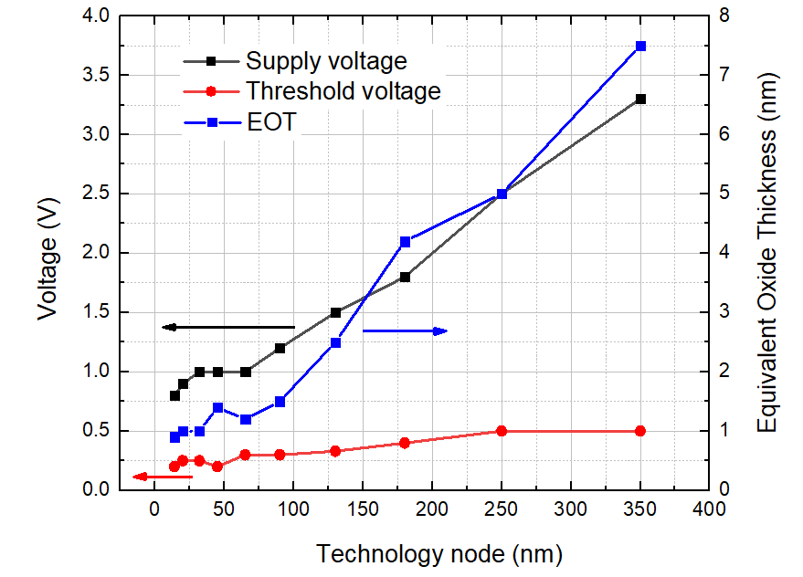
Technology Scaling
Smaller W and L → Higher transistor density, higher f_{T}
Lower Vdd and Vth → Lower dynamic power consumption, higher static power consumption
Lower tox → Higher gate leakage (from SiO2/PolySi to High-k materials/metal gate around 45 nm)

Slide 5
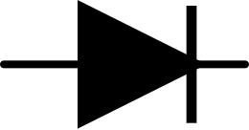
Simplified designer's view of a CMOS Process
We are considering a simple n-well (twin-Tub) 1P2M process
The starting substrate is p-type: all p-wells are shorted together since there are no insulation junctions with the substrate.
N-wells are insulated from the substrate if the latter is biased at the lowest voltage in the circuit.
A very lightly doped epitaxial layer is often present on top of a strongly doped wafer. P-wells are necessary to obtain the optimal doping for n-MOSFETS.

Slide 6
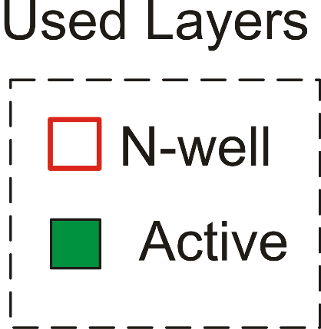
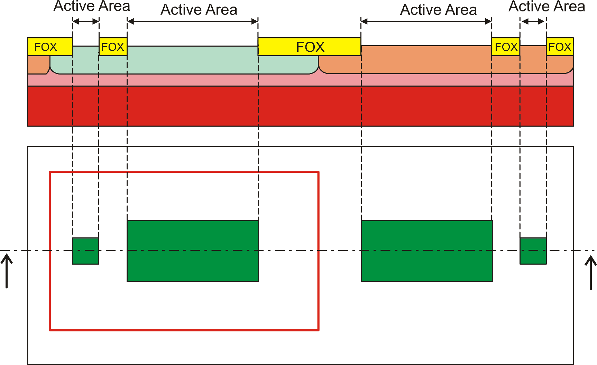
The active areas
Was FOX in older tech nodes
now: shallow trench isolation
Active areas are all of the same type.
They are specialized by other layers (e.g. n-well).
p-wells are often drawn automatically as not(n-well)
n-well
Top view

Slide 7
Polysilicon and gate oxide
poly over active area
MOSFET gate
poly out of active area
interconnection
The gate (thin) oxide is grown on all active areas.
After that, it is covered by the polysilicon layer
When the poly is patterned, the gate oxide remains only where polysilicon remains, forming the gate.
Only one layer (poly) is required to control the final result of this step.

Slide 8
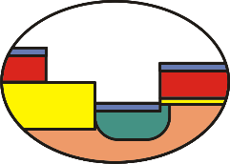
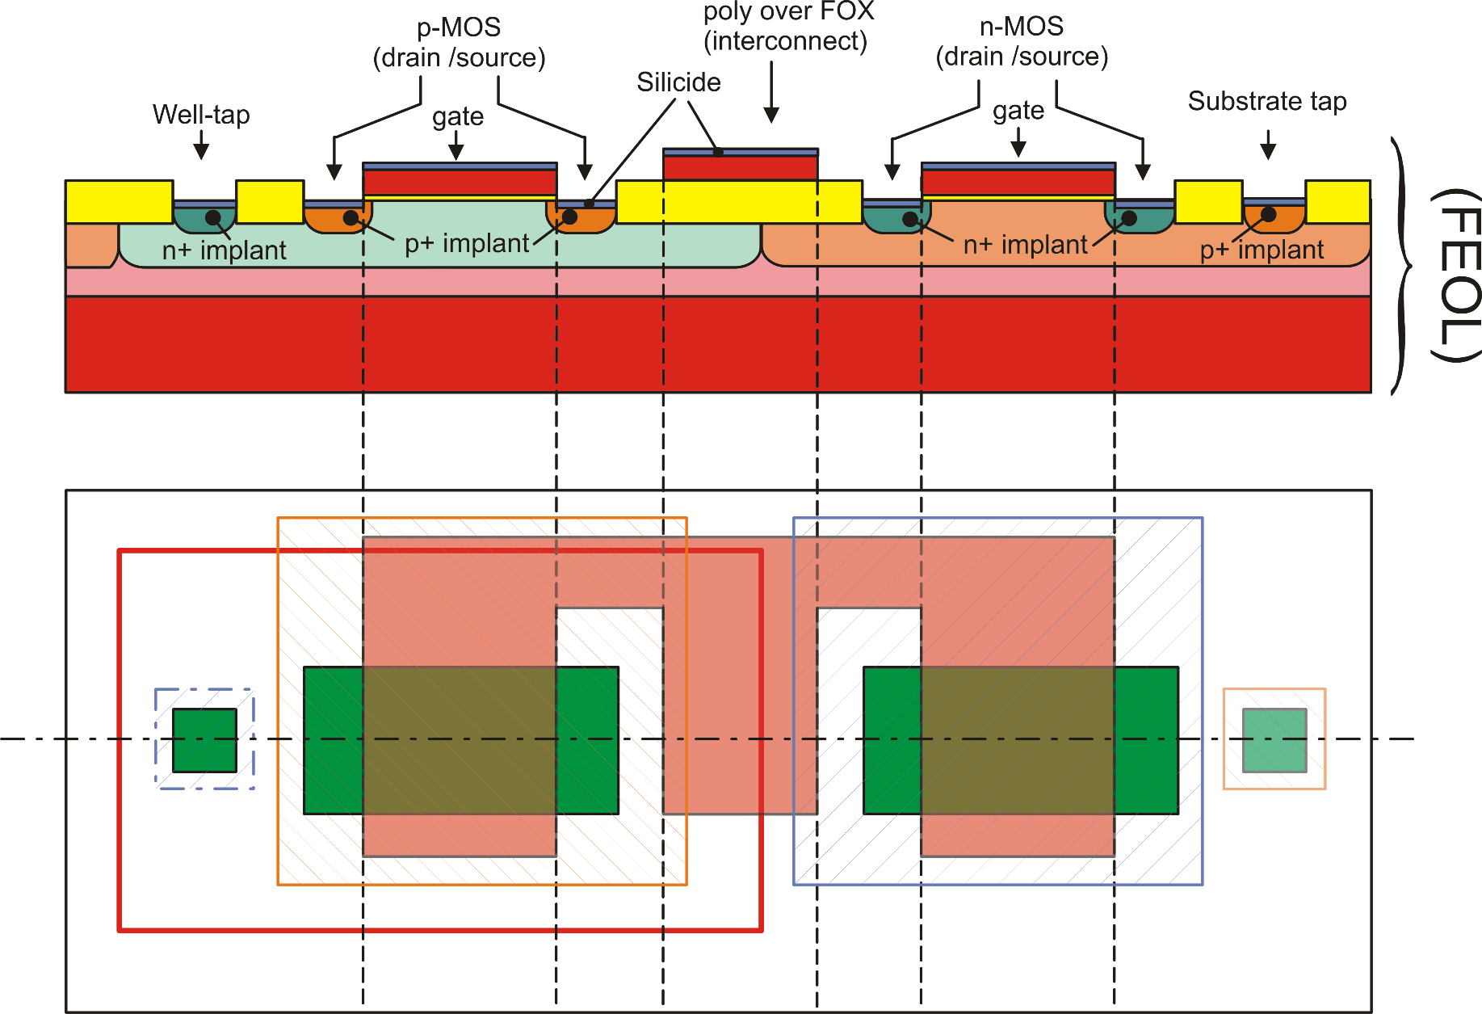
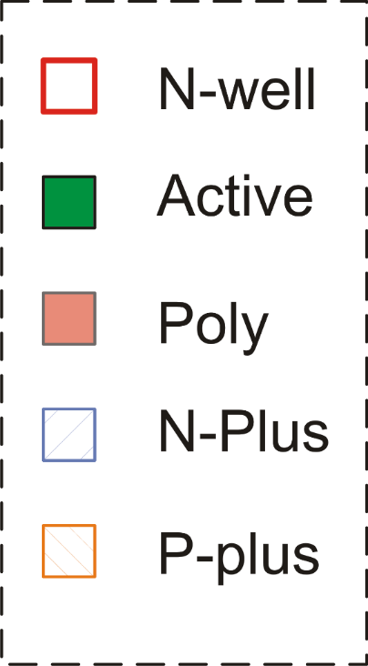
FEOL (Front-End Of the Line)
silicide

Slide 9
BEOL (Back End Of the Line) - Contacts
All devices created in the FEOL are covered by an insulating layer and holes are opened only where we want to contact them. These opening are the CONTACTS
Contacts can reach active areas (p+ or n+ doped portions of the substrate) or polysilicon (over the FOX).
Direct contact of polysilicon over the gates is not allowed
Contacts
Insulating
Layer
Thungsten
Plugs

Slide 10
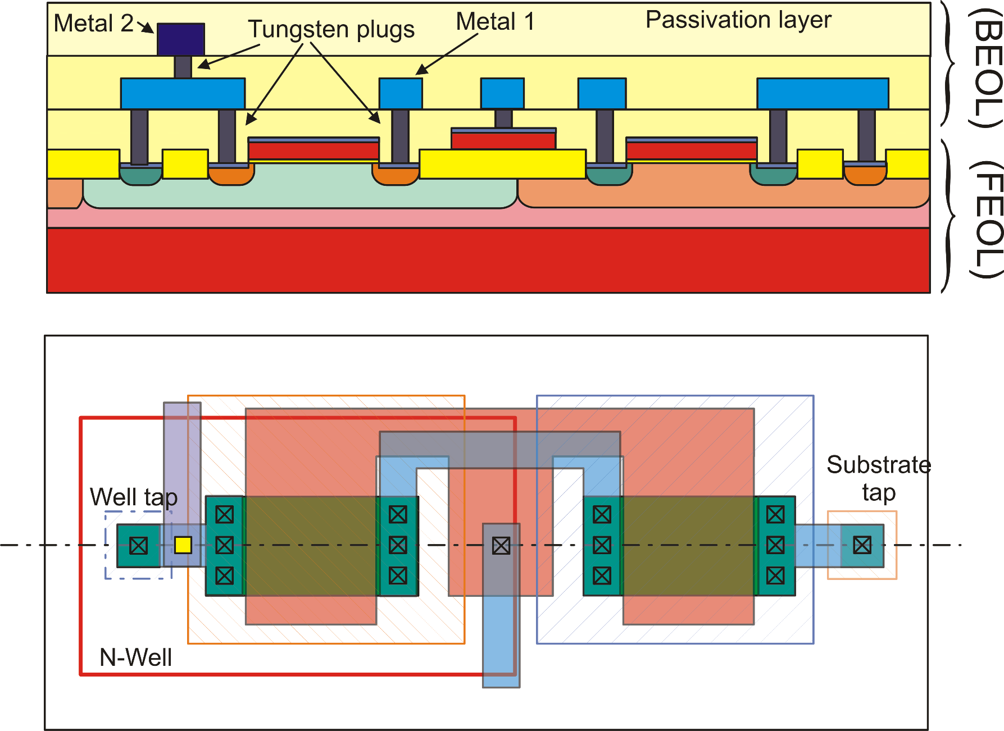
BEOL: The interconnections

Slide 11
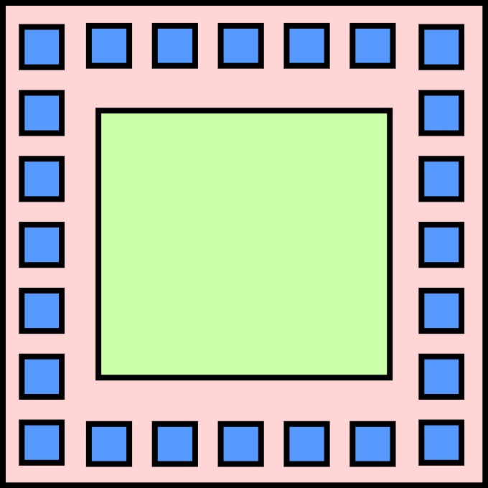
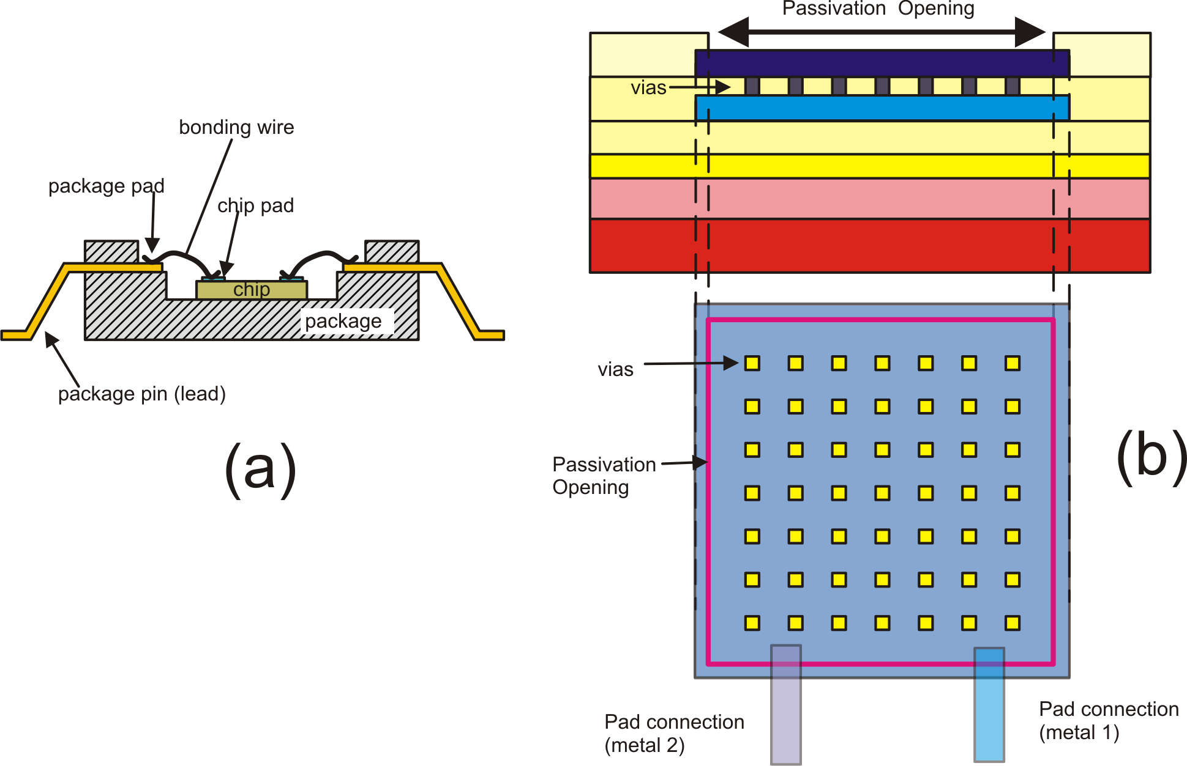
Bonding Pads
core
pads
(pad frame)
Layer: Passivation Opening

Slide 12
The Triple Well
n-well twin tub
n-well
n-well
buried well o buried layer

Slide 13
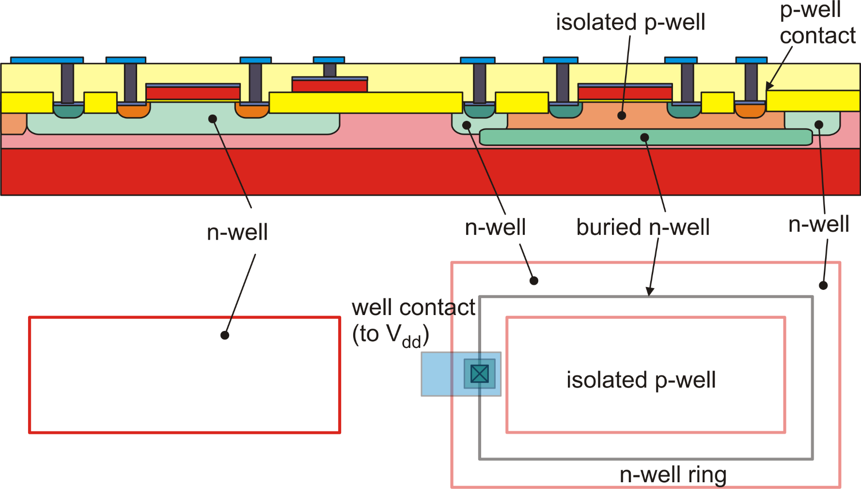
Triple Well: Multiple PWells and NWells at independent voltages

Slide 14
Bipolar processes
Technology | Available Devices | Notes
Bipolar | Vertical NPN, Lateral PNP | Used for precision and/or fast amplifier. Si-Ge versions for RF applications
Complementary Bipolar | Vertical NPN, Vertical PNP
BiFet | BJTs and JFETs | Used for precision / low bias current amplifiers

Slide 15
BiCMOS, BCD, SOI
Technology | Available Devices | Notes
BiCMOS | CMOS + BJTs | Mixed Signal ICs High speed digital line drivers
BCD | Bipolar, CMOS, DMOS | Smart Power
SOI Silicon on Insulator. | As CMOS, BiCMOS or BCD | High Voltage and Rad Hard (e.g. space applications)

Slide 16
Resistances in planar ICs
/ square
(sheet resistance)
Direction of the current
Number of
squares
W

Slide 17
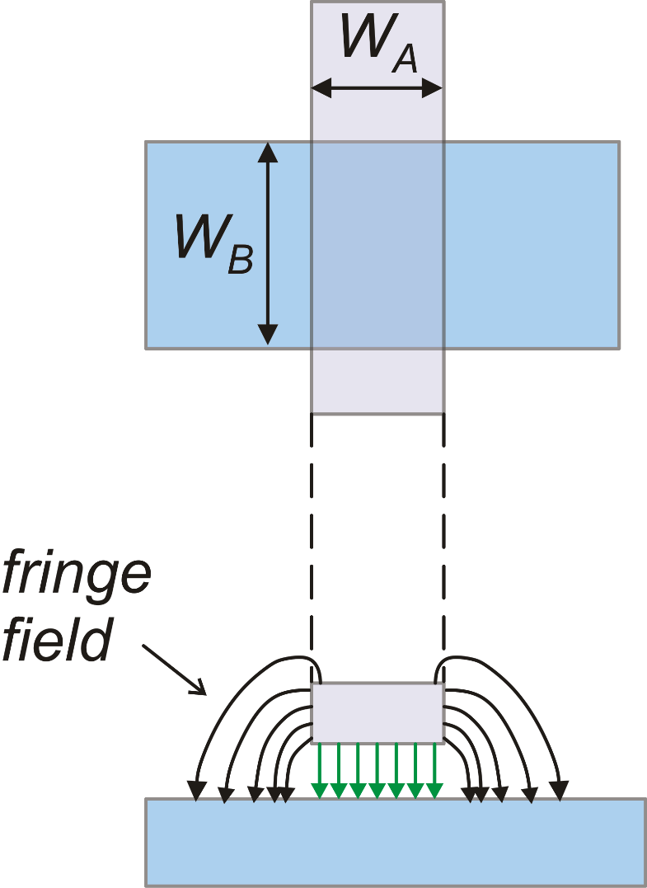
Vertical and lateral capacitances
Area
Perimeter
Capacitance per unit area
Capacitance per unit perimeter
(Fringe capacitance)

Slide 18
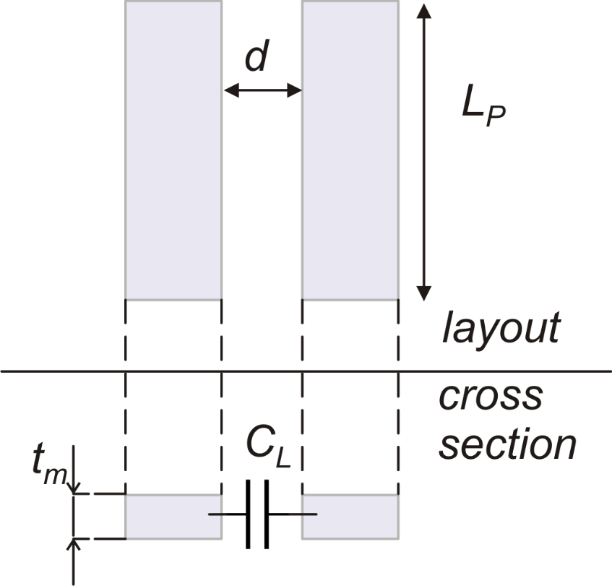
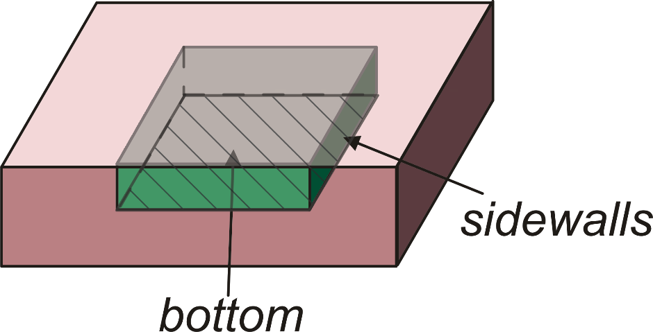
Lateral and Junction Capacitances
n (or p)
p (or n)
Lateral
Junction

