Slide 1
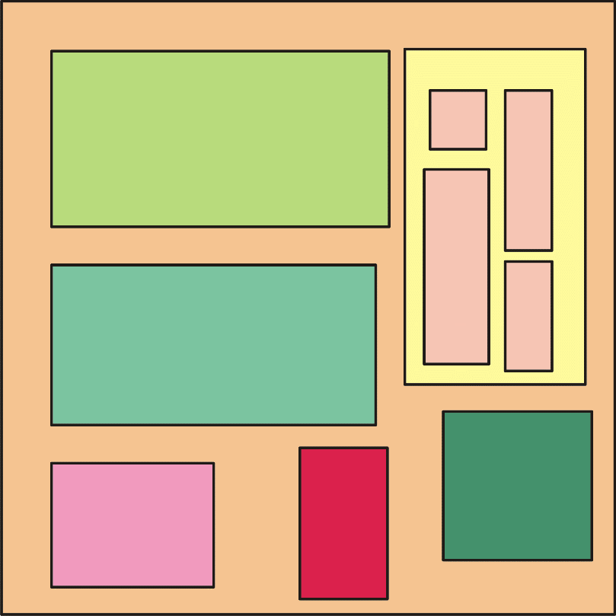
Design Flow of an Integrated Circuit
Integrated Circuit or "Chip" or "Die"
The cell is the most important
object in an integrated circuit
Even the chip is a cell: it is the
larger cell in the project and is
often called Top-Cell
Single substrate
Cells that form another larger cell
Sub units ("Cells")

Slide 2
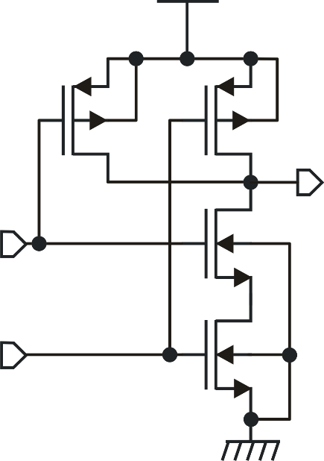
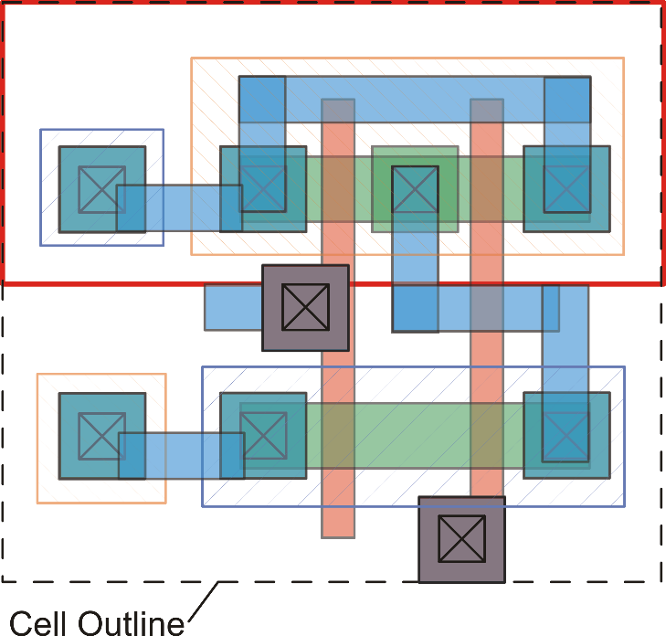
Cells and views
Cell: NAND GATE
Views
?
"Schematic view"
"Layout view"

Slide 3
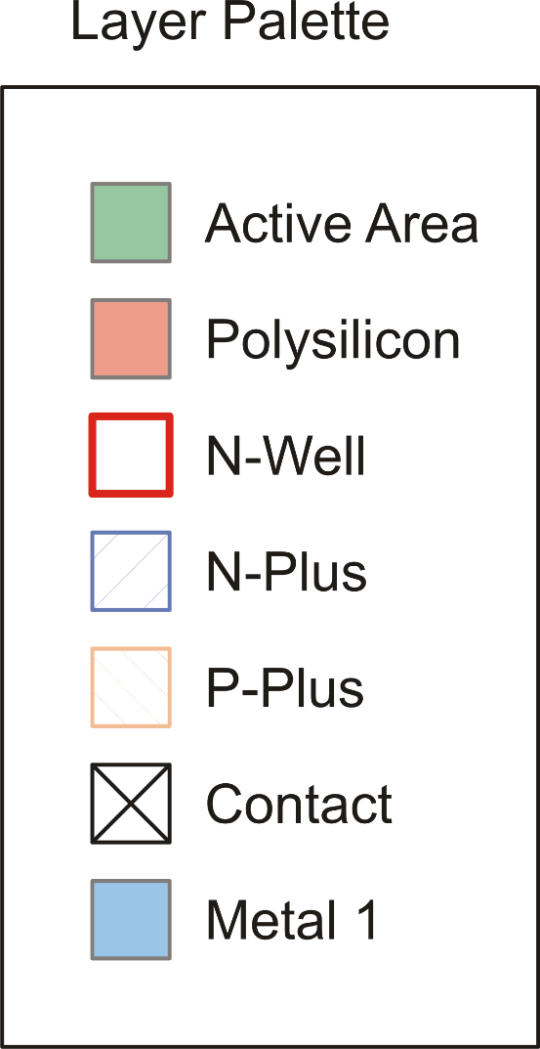
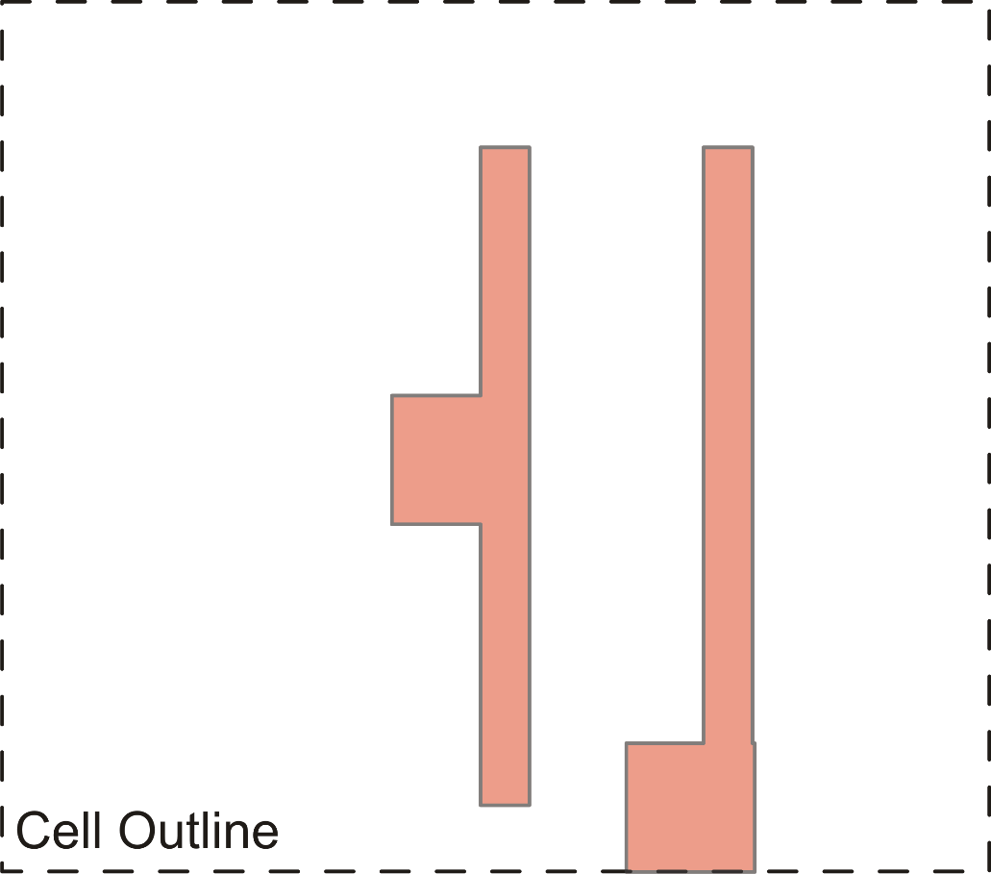
The layout view

Slide 4
Shapes and layers
Shapes
A shape selects a region of the cell area.
The layer associated to a shape tells specify what must be done in that region.
layer

Slide 5
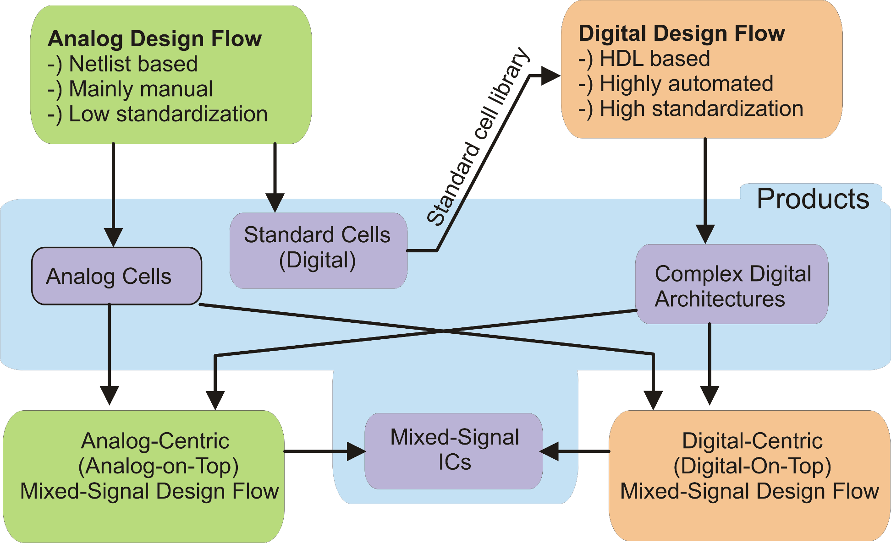
Design flows

Slide 6
EDA (Electrical Design Automation) Environment
Integrated Environment
(enables seamless communication
between tools)
Schematic Editor
CAD Tools (May be of different
vendors and still be perfectly
integrated through GUIs
(Graphical User Interfaces)
Electrical Simulator
Layout Editor
Verification Tools
PDK (Process Design Kit)
A series of files provided by the "silicon foundry" that customize the tools to make operation consistent with the chosen fabrication process

Slide 7
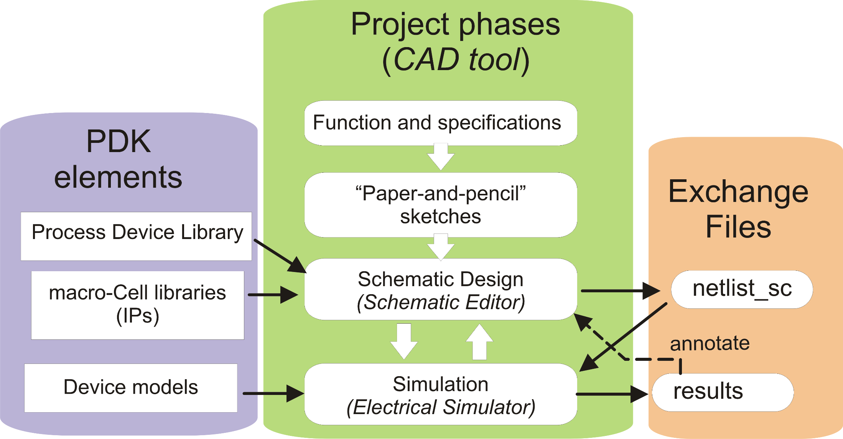
Analog Design Flow: Electrical Design

Slide 8
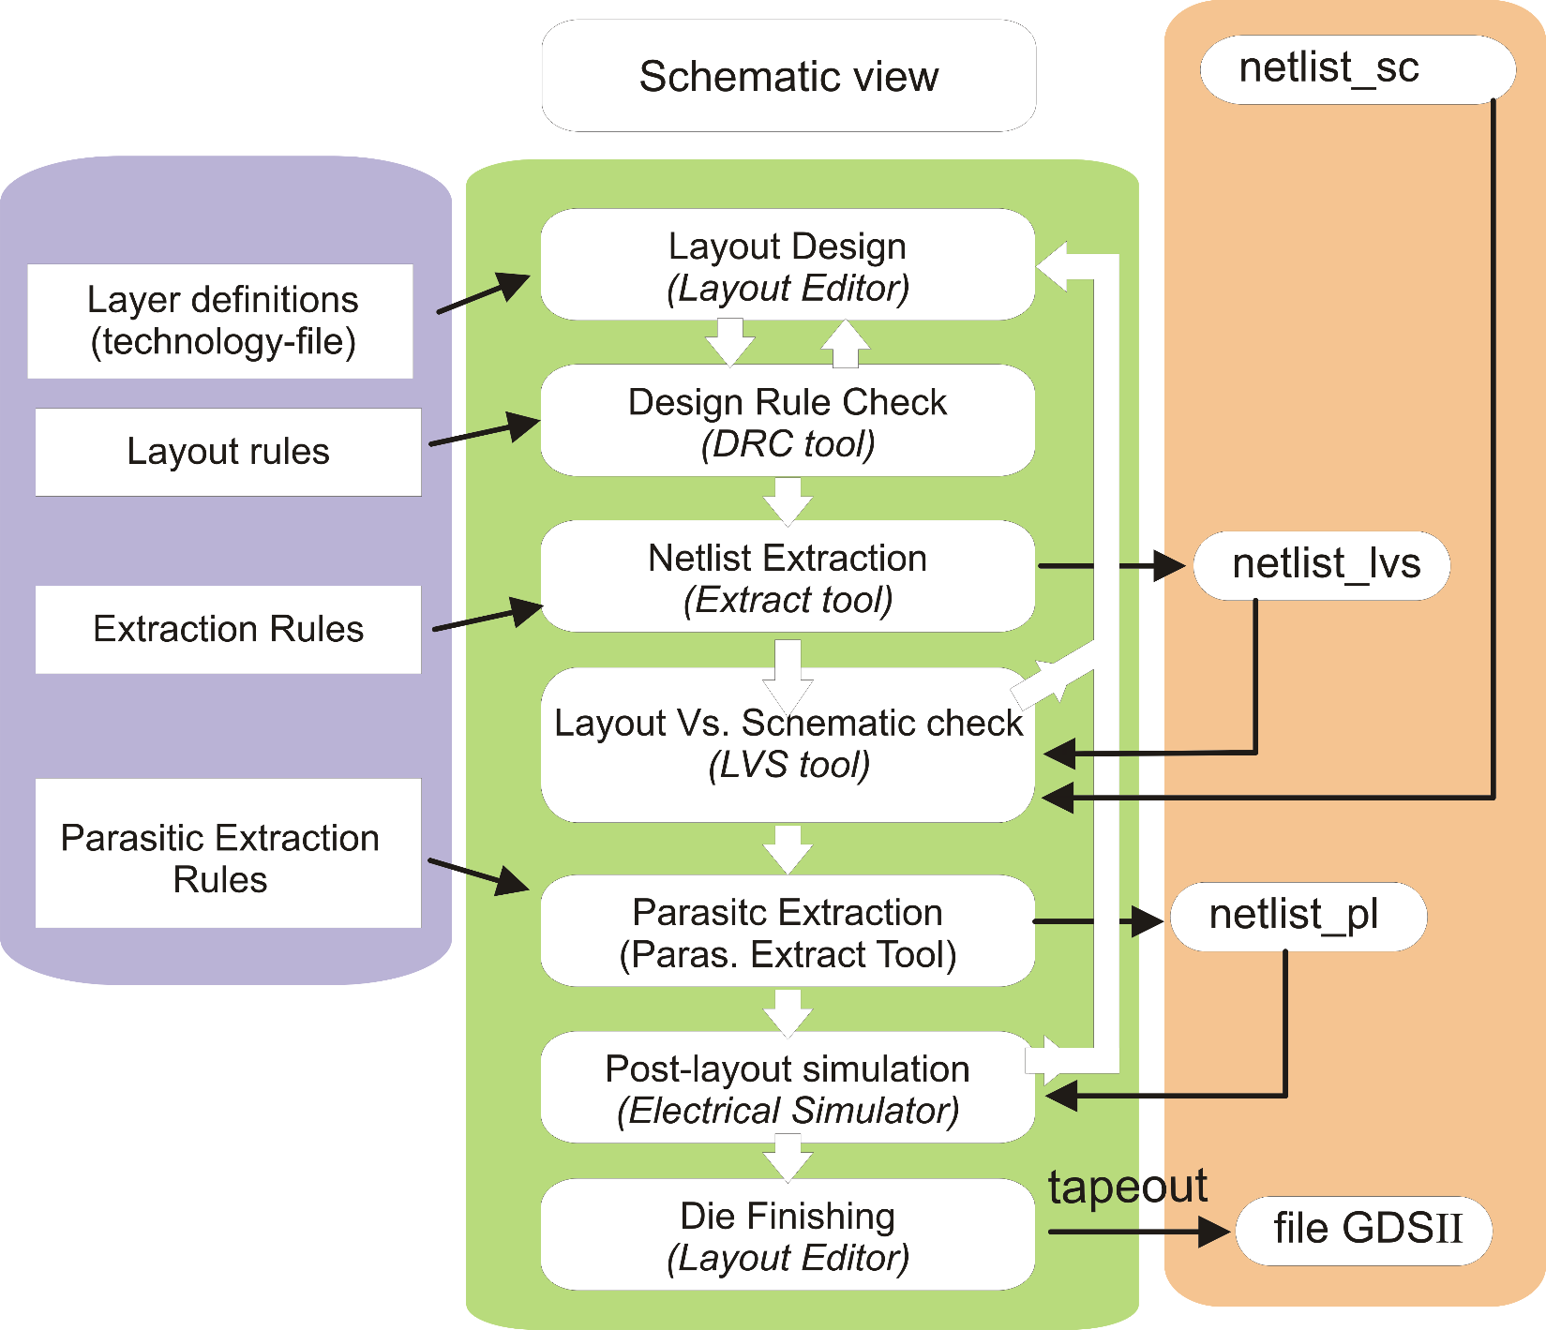
Physical Design
From Electrical Design
PDK
(PEX)
Optional operations
(for layout-critical designs)

Slide 9
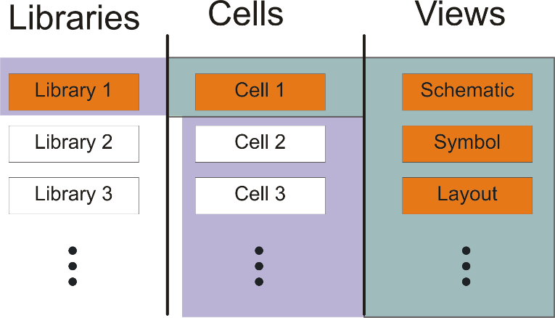
Structure of a project (= "design")
Libraries are containers for the cells that include additional information
about the technology. Library can be provided with the PDK (devices and
macrocells), with the CAD environment (ideal devices) or be created by the
designer / design group.

Slide 10
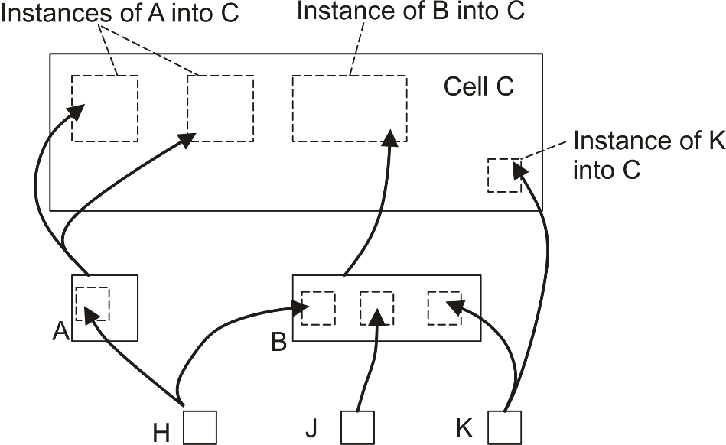
Structure of a project: Hierarchy
Structure of a project: Hierarchy
Structure of a project: Hierarchy
Cell C is higher than A and B in the hierarchy, since A and B are instantiated into C
Key concept:
INSTANCE
There is no hierarchical
relationship between
K and A

Slide 11
Instances: properties
Instances of the same cell are individual objects just as two distinct devices in a
printed circuit board
Library | Cell
my_design | C
….. | A
….. | B
…... | …..
Cell C
I1
I2
In the "library browser" the hierarchy is not visible: all cells appear as they were all at the same level.
I3
Cell A
Cell B
The only difference from real world is that modifying the original cell (e.g. Cell A) changes all the instances of A

Slide 12
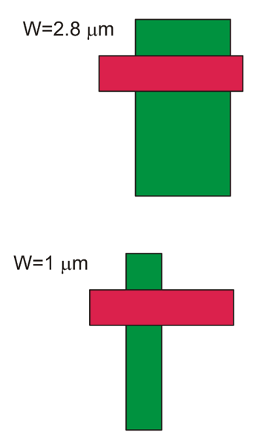
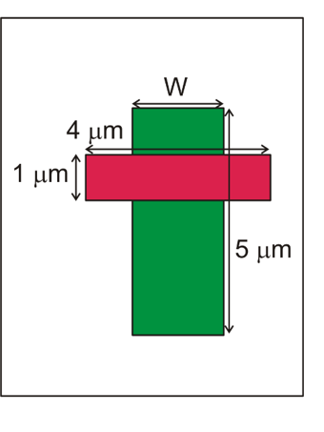
Parametric cells (P-cells)
P-cells have one or more dimensions assigned to a symbolic parameter (W in the example).
When a P-cell is instantiated, the value of all symbolic parameters should be chosen. In this way it is possible to create custom instances from a single P-cell.
P-cells are possible in both the schematic and layout view.
I1
I2
Cell A

Slide 13
Nested instances: terminology (Cadence and Spice)
this object is I0.I1
this object is I1.I1
A
I1
I0
H
I1
I1
I0
I1
I2
I0
I0
K
I2
I2
Z
B
I0
I0
I1
I2
I1
C (top-cell)
this object is I2
In some tools the "." is substituted by "/" , then I1.I0 becomes I1/I0

Slide 14
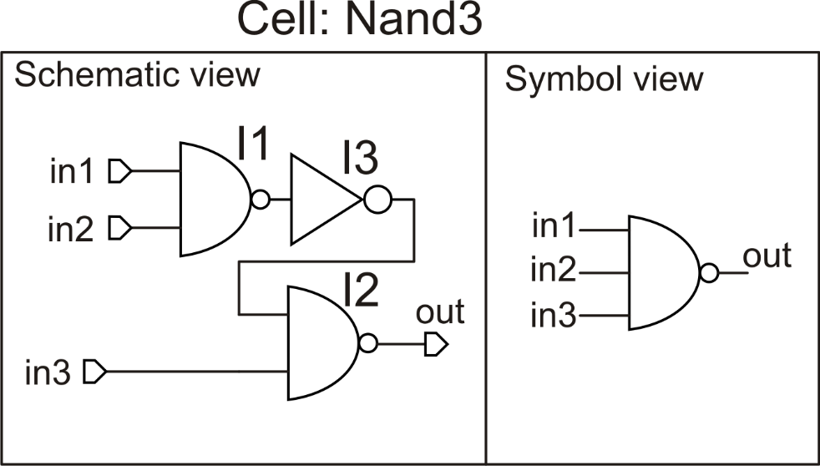
The schematic view
A schematic view is the representation of a cell as connection of simpler cells. Some cells do not have a schematic view because they cannot be resolved into simpler ones. They are the "atoms" of the design and are called "primitive cells" or "primitives".
In a schematic view, each cell that needs to be instantiated requires also a symbol view, where only the nodes used for the connections are displayed
The cell Nand3 is obtained as a connection of two simpler cells; Nand2 and Inverter

Slide 15
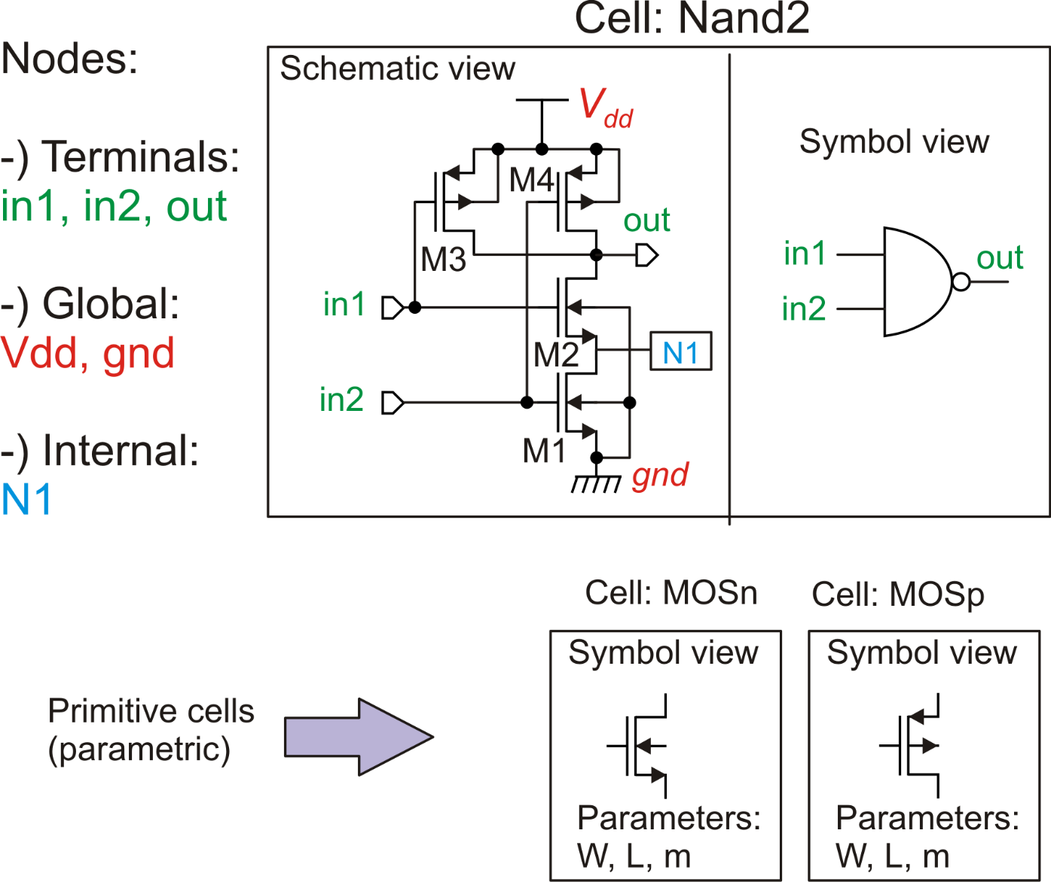
Elements of a schematic view
Note: internal nodes are automatically numbered and given a name such as:
N1, N2 ....
It is possible to force an internal node to have an arbitrary name by assigning a "label" to it
Assigning the same name (label) to different nodes is equivalent to connect them to form a single node.

Slide 16
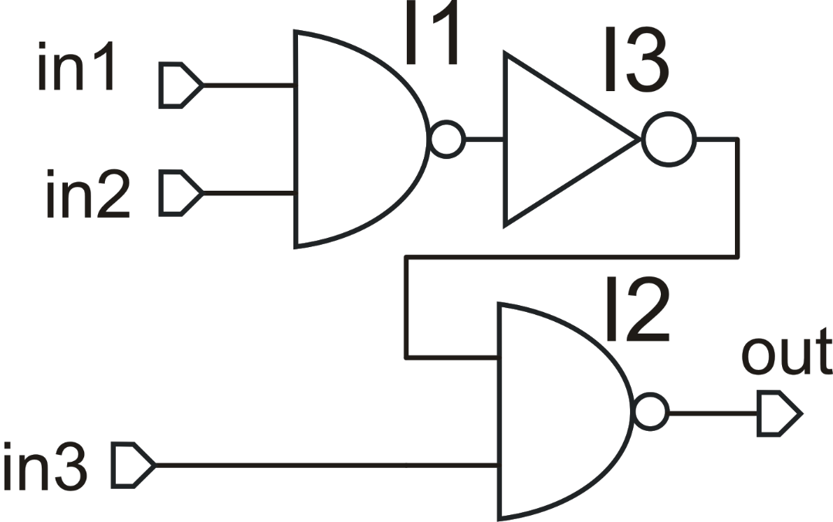
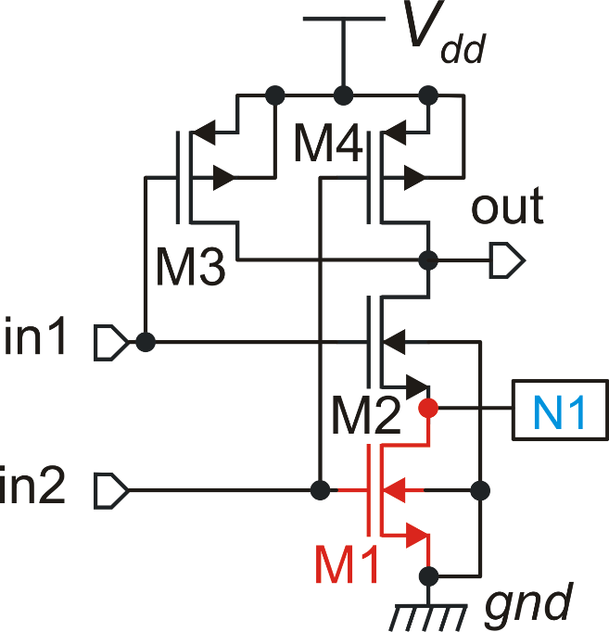
Access to internal nodes and devices: syntax
N1 I1.N1
M1 I1.M1
In a schematic editor, the word "net" is equivalent to "node"
N1 I2.N1
M1 I2.M1

Slide 17
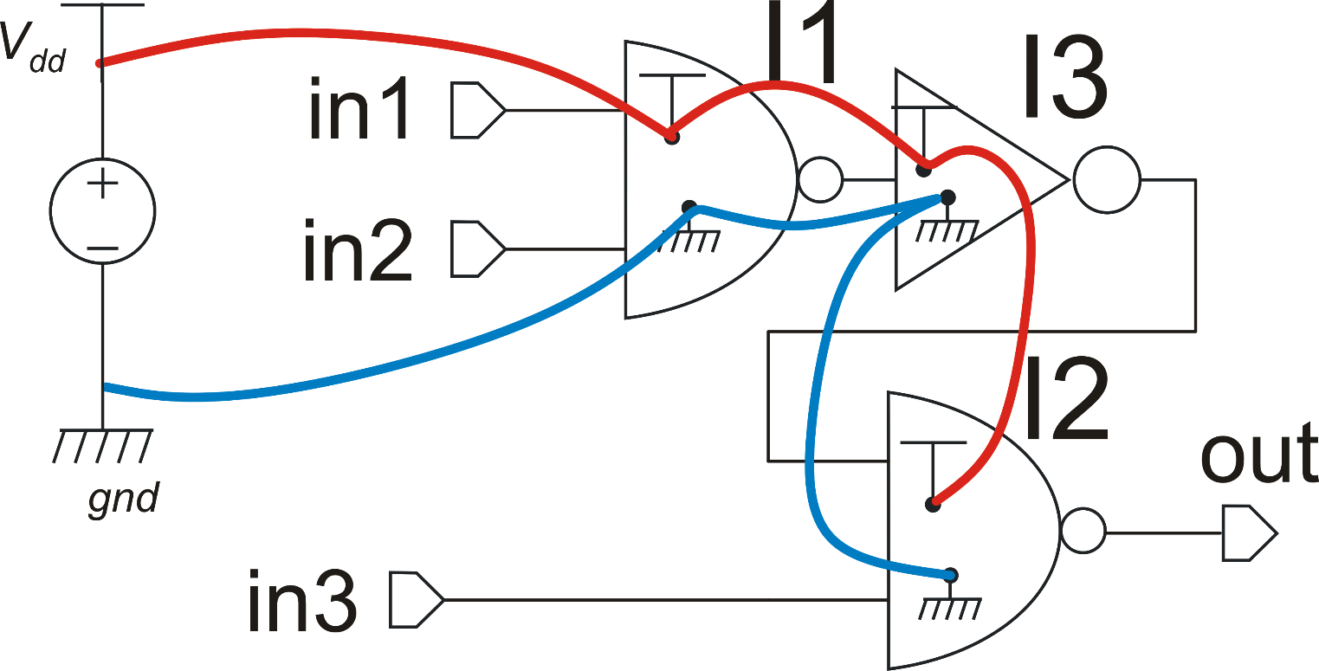
Global nodes
Power supply
voltage source
Global nodes of the same name (e.g. gnd) in different instances at whichever hierarchy level are all connected together with no need of specifying the connections (better readability of the circuit).

Slide 18
Elements of a Layout Editor
Type of layers
Technology or "Tooling" Layers. (Used to define the result of elementary process steps) i
Derived Layers (obtained by logical operations of other layers)
Service Layers (used to various purposes, e.g. mark shapes as pins or define the boundary of a cell)

Slide 19
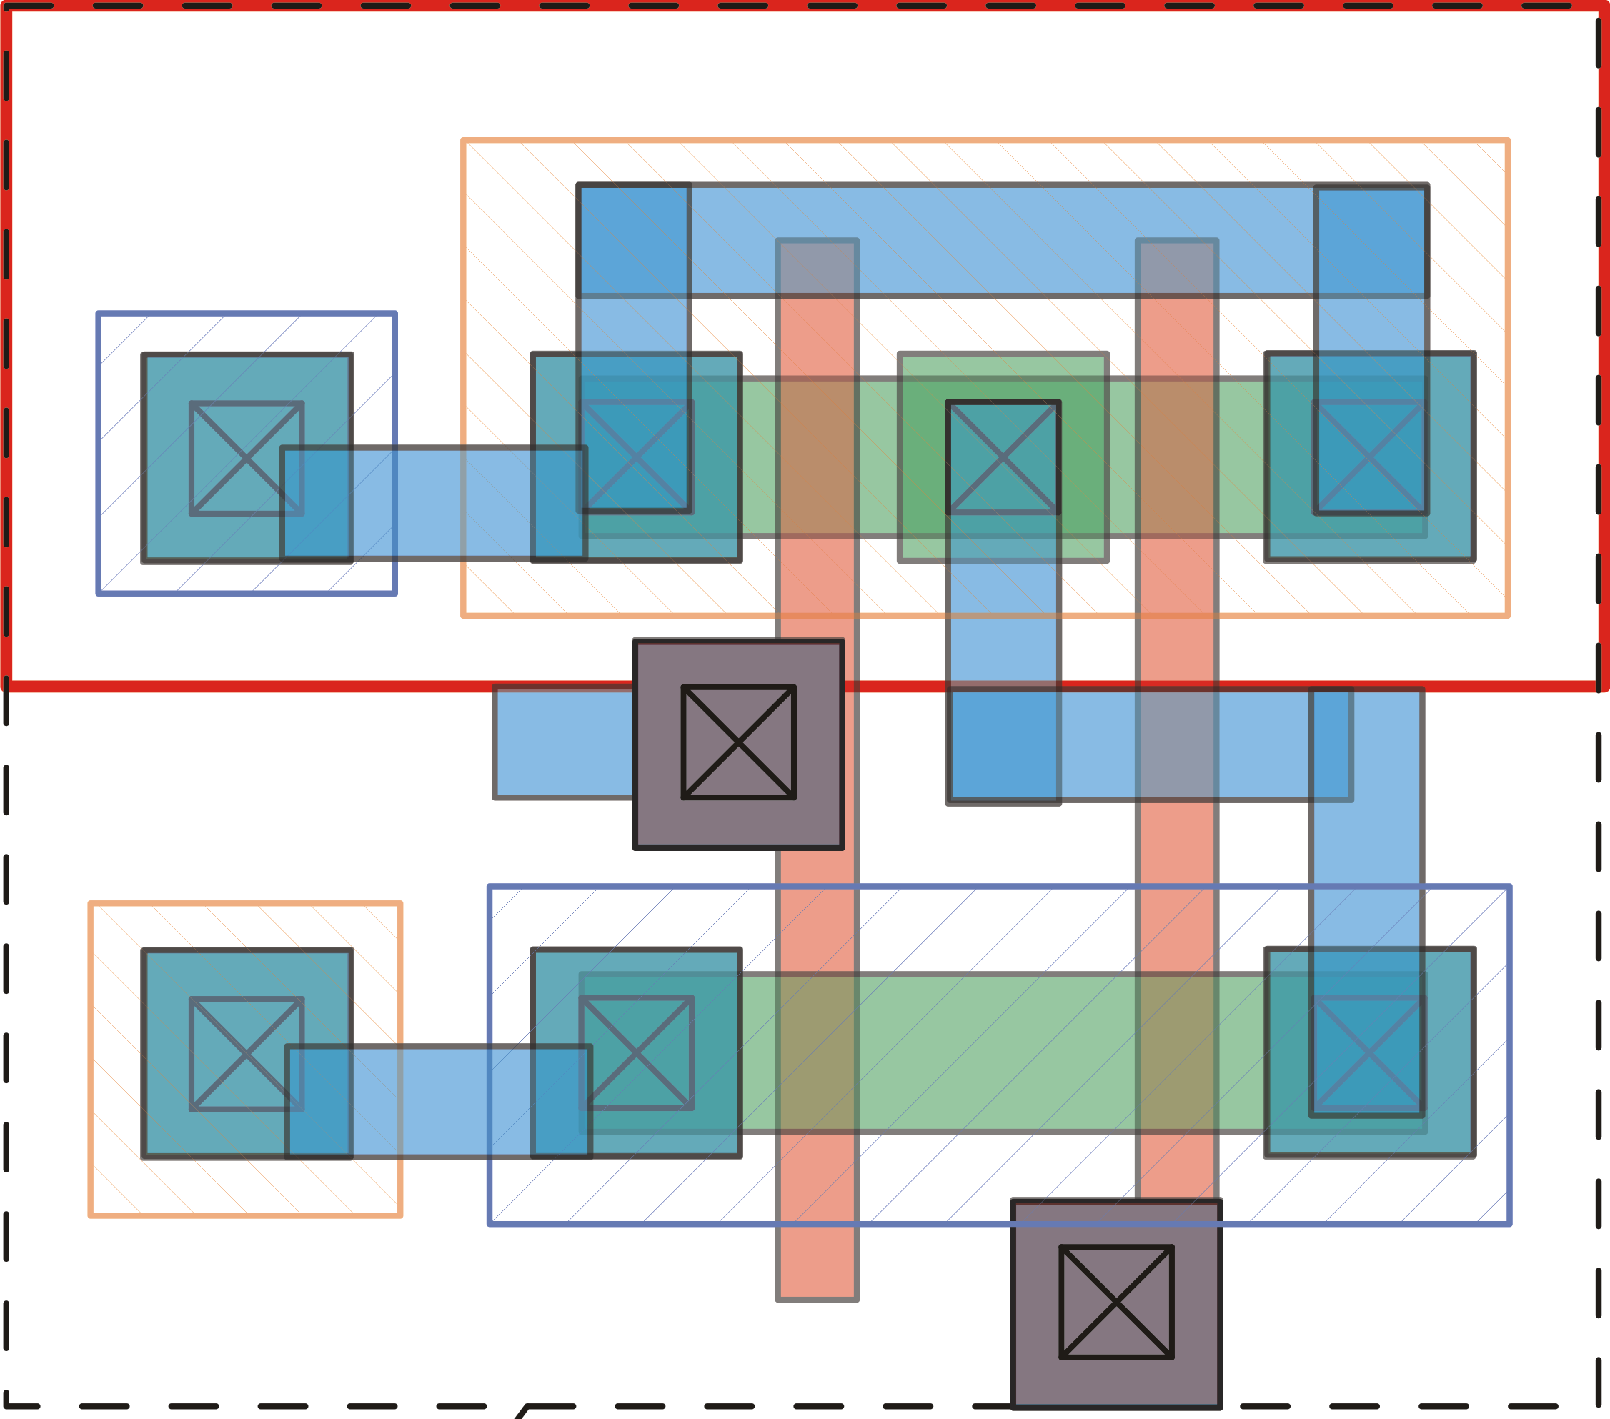
Instances in the Layout Editor
I0
I1
There is not a perfect equivalent of the "symbol" view in the layout. Therefore, the instantiated cells appear with all the complexity of the internal layout.
Instances can be connected, moved, rotated etc, but not modified.

Slide 20
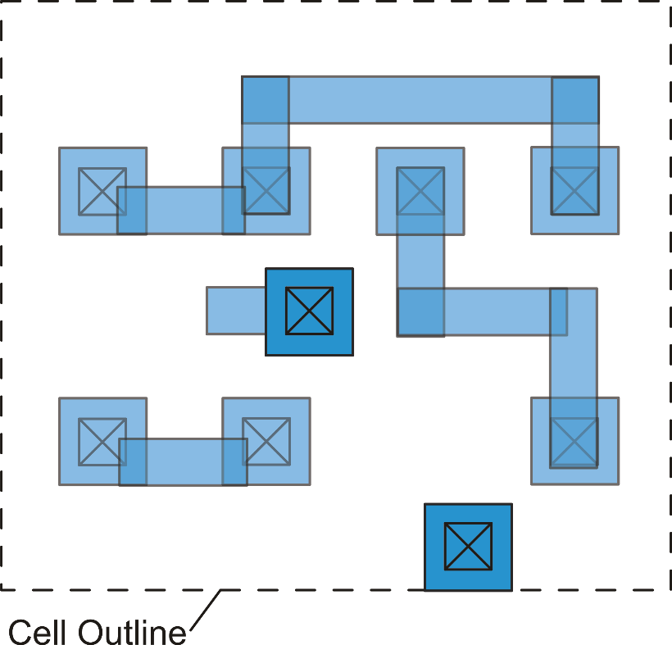
The "abstract" view
The abstract view is a simplified layout where only the layers used for interconnections are shown. The abstract view is used to hide the full content of the cell (to avoid cloning) or to simplify automatic place & rout operation.
While the symbol view is strictly required in a schematic design, the abstract view can be avoided all the cell that we have to instantiate own a full layout view

Slide 21
Layout elements: layers, shapes and masks
Tooling Layers directly affect the mask production but there is not an exact correspondence between the shapes of a layer and a single mask.
Shapes correspond to the final result on silicon. For example, if I draw a 1 μm wide polysilicon line, the corresponding mask can be wider or narrower to compensate for proximity effects or under-etch. The final result will be as close as possible to 1 mm.
A shape may indicate an object that requires more than one photolithographic step and then more than a single mask.
Shapes in more than 1 layer can be merged to form a single mask, or to produce different masks through logic combinations (AND, OR …). These operation are indicated as "mask merging rules".

Slide 22
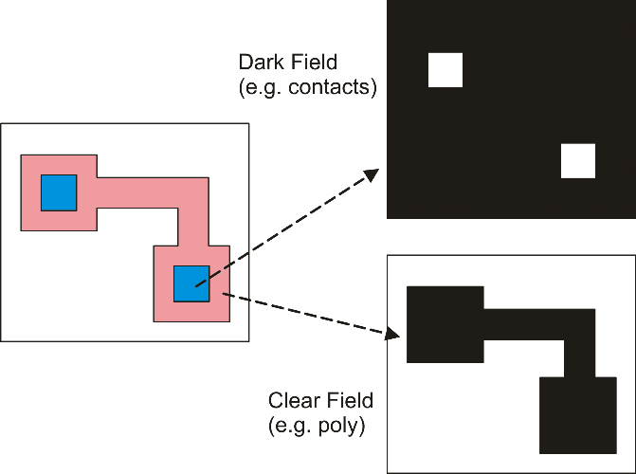
Dark Field, Clear Field
The shapes drawn with a
layer can be converted into
the dark pattern of the mask
on a clear background (=Clear Field)
or clear (transparent) patterns on a
opaque background (=Dark Field)

Slide 23
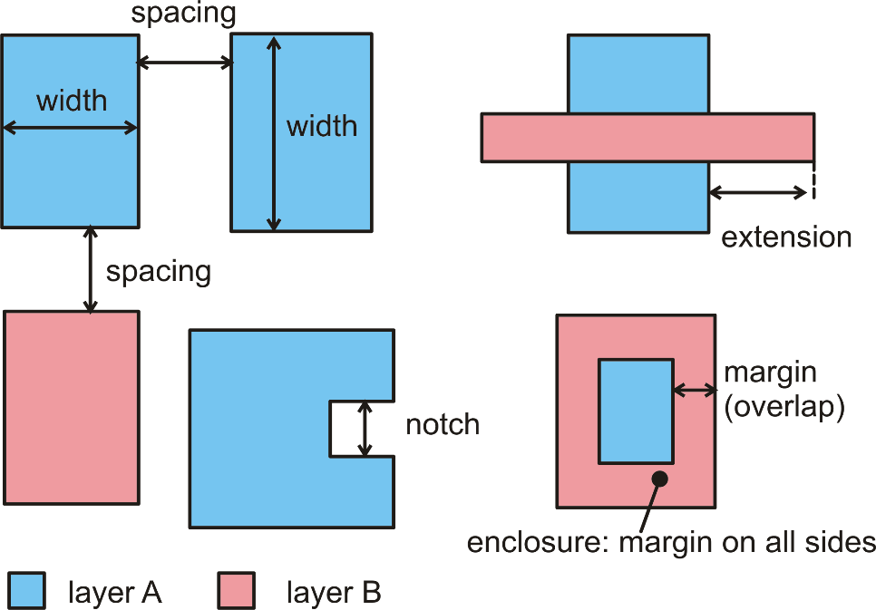
Topological Layout Rules (TLR)
Common rules
Topological Layout Rules indicate how to draw shapes that can be actually fabricated maintaining the function that the designer intend to obtain.
For example, conducting lines should be wide enough to guarantee that they are not interrupted in same points.

Slide 24
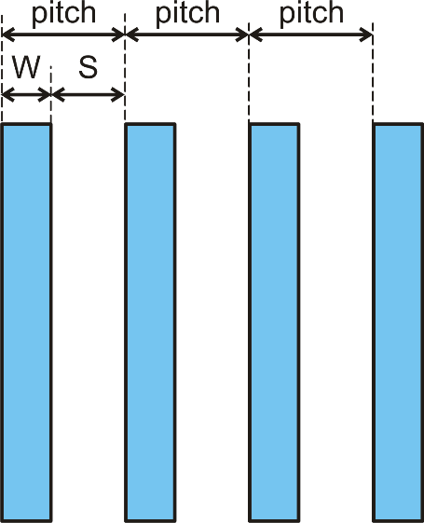
The pitch: combination of TLRs
Considering a particular layout object, that can be a single conducting line or even a complex memory cell, the pitch is the minimum step by which we can repeat that object without violating layout rules.
The picture shows the case of conducting lines, that can be stepped to form a data BUS.

Slide 25
Micron and Lambda (scalable) Rules
Micron rules are today the industrial standard. In Micron Rules, all Topological Layout Rules are expressly indicated in length units, typically microns (μm) or nanometers (nm).
Lambda rules, proposed by Mead and Conway, were popular in the 80s. In lambda rules, Topological Layout Rules are expressed as multiples of an elementary length called lambda (λ).

Slide 26
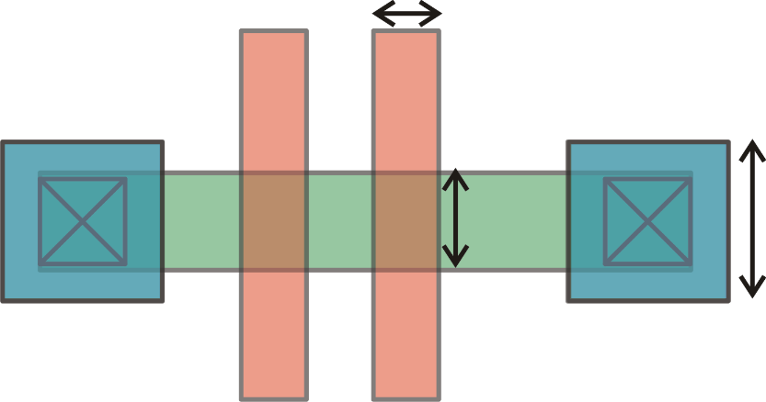
Lambda rules and uniform TLR scaling
2λ
λ=0.75 μm
1.5 μm
3λ
5λ
2.25 μm
3 μm
λ=1 μm
2 μm
3 μm
As the technology progresses to the next node, it is possible to use the same layout and simply change the value of lambda.
5 μm

Slide 27
Limits of Lambda Rules
Technology upgrade (one "node")
CMOS Process
0.13 μm
CMOS Process
0.18 μm
2λ
0.18 μm
× 0.72
0.13 μm
3λ
0.27 μm
× 0.81
0.22 μm
5λ
0.45 μm
× 0.89
0.40 μm
λ=??
λ=0.09 μm

Slide 28
Lambda Rules today
Starting from roughly the 1 μm technology node, TLR stopped to improve by a uniform factor. In order to save the scalability of the original layout designed with lambda rules, it would be necessary to scale all rules using the scaling factor of the TLR that have improved less (factor 0.89 in the previous example). This would turn into a layout of non-minimum area and part of the advantages of the technology progress would be lost.
For this reason, scalable rules (i.e., lambda rules) are used today only for educational purposes (e.g., in the American MOSIS program: ).
It is common practice of silicon foundry to update mature processes by applying a uniform shrink to all rules. This shrink is generally modest (e.g. new rules are multiplied by 0.9) and arrives when the technology has already advanced to a new node.

