Slide 1
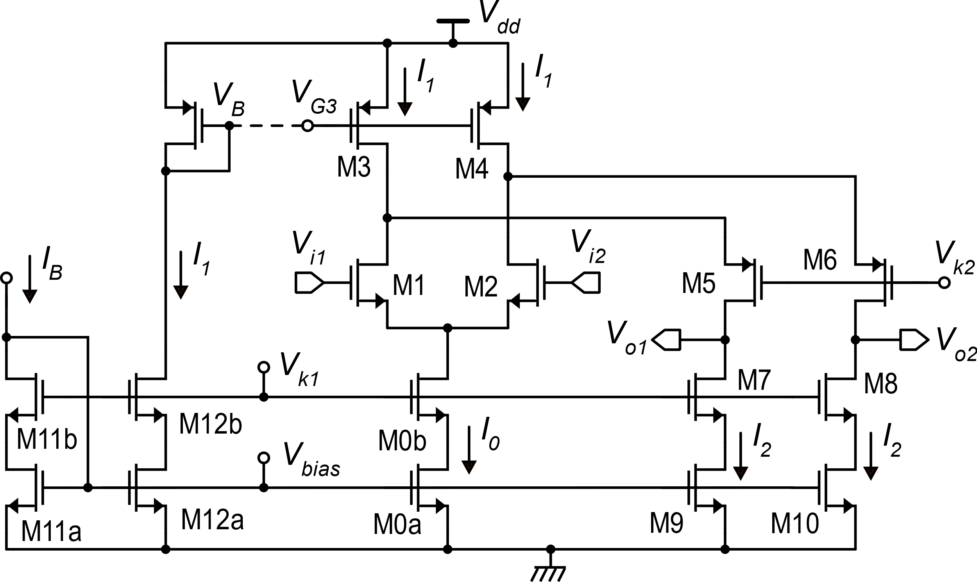
Single stage (OTA) fully differential op-amp
This connection will initially be made to analyze the V_{oC} problem. It will be later substituted by proper circuits
M13
V_{k1} and V_{k2} are constant bias voltages necessary for p and n cascode structures
Bias circuit
In the fully-diff. folded cascode this is a double current source and does not process the signal

Slide 2
Intuitive idea of the operating principle
Small-signal, differential mode analysis
M13
i_{d2}
i_{d1}

Slide 3
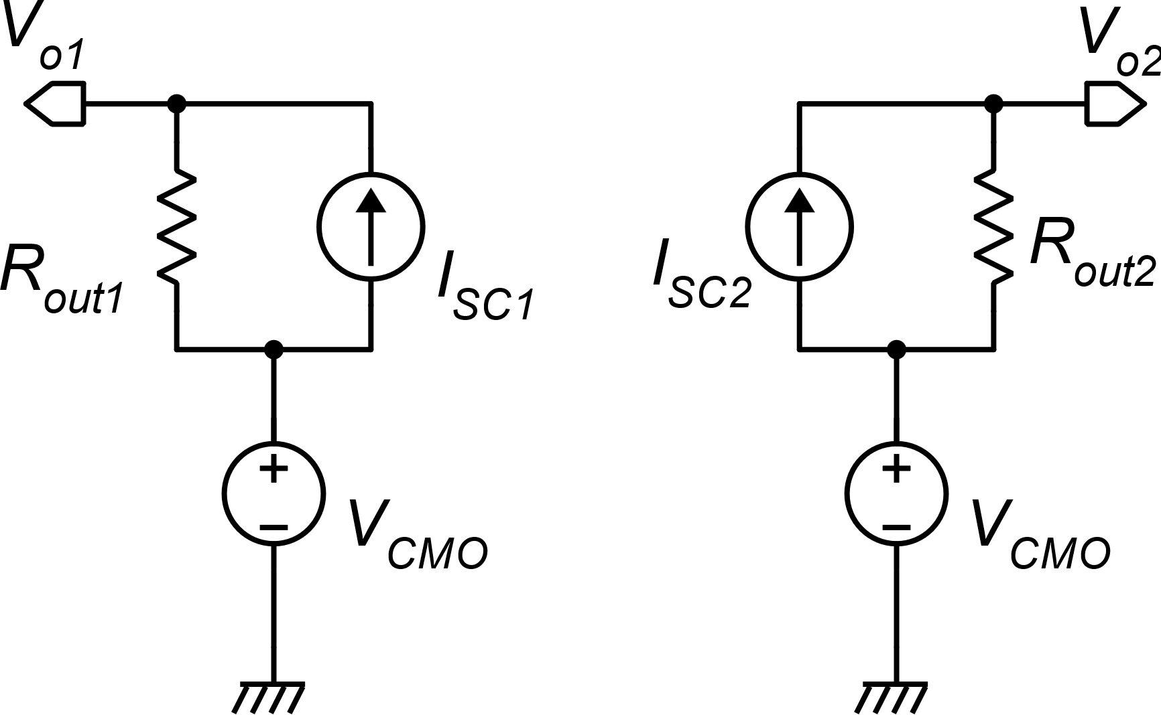
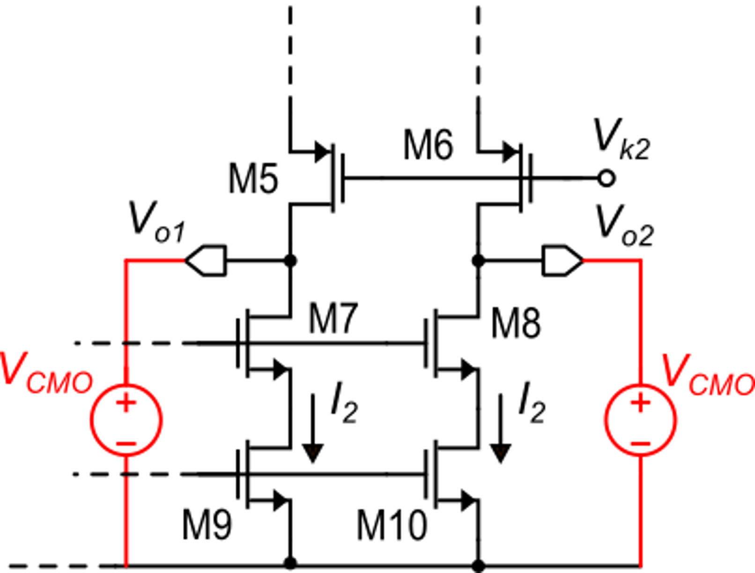
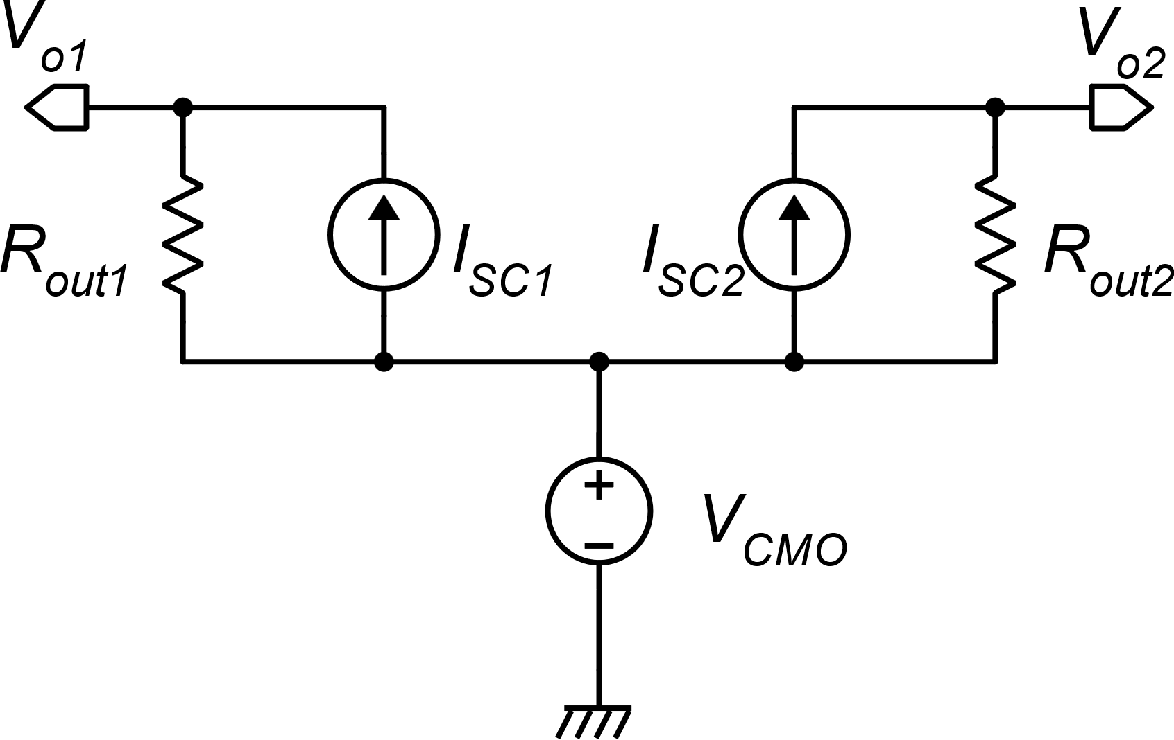
Including common mode / differential and quiescent / small signal components
I_{SC1}
I_{SC2}
We probe the output ports with voltage sources set to the desired output common mode voltage (V_{CMO})

Slide 4
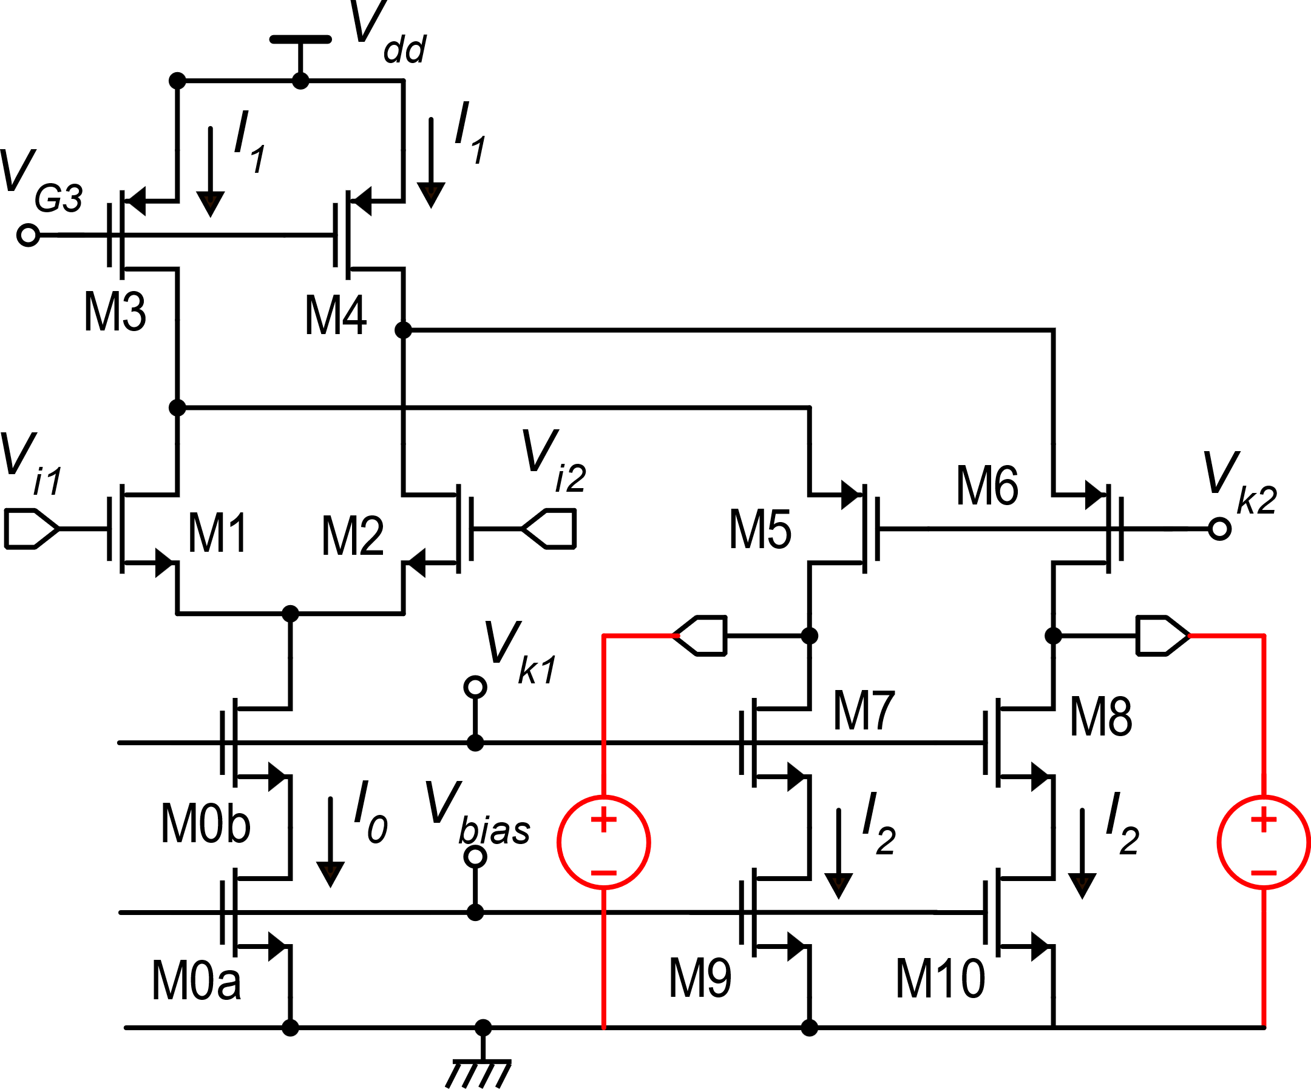
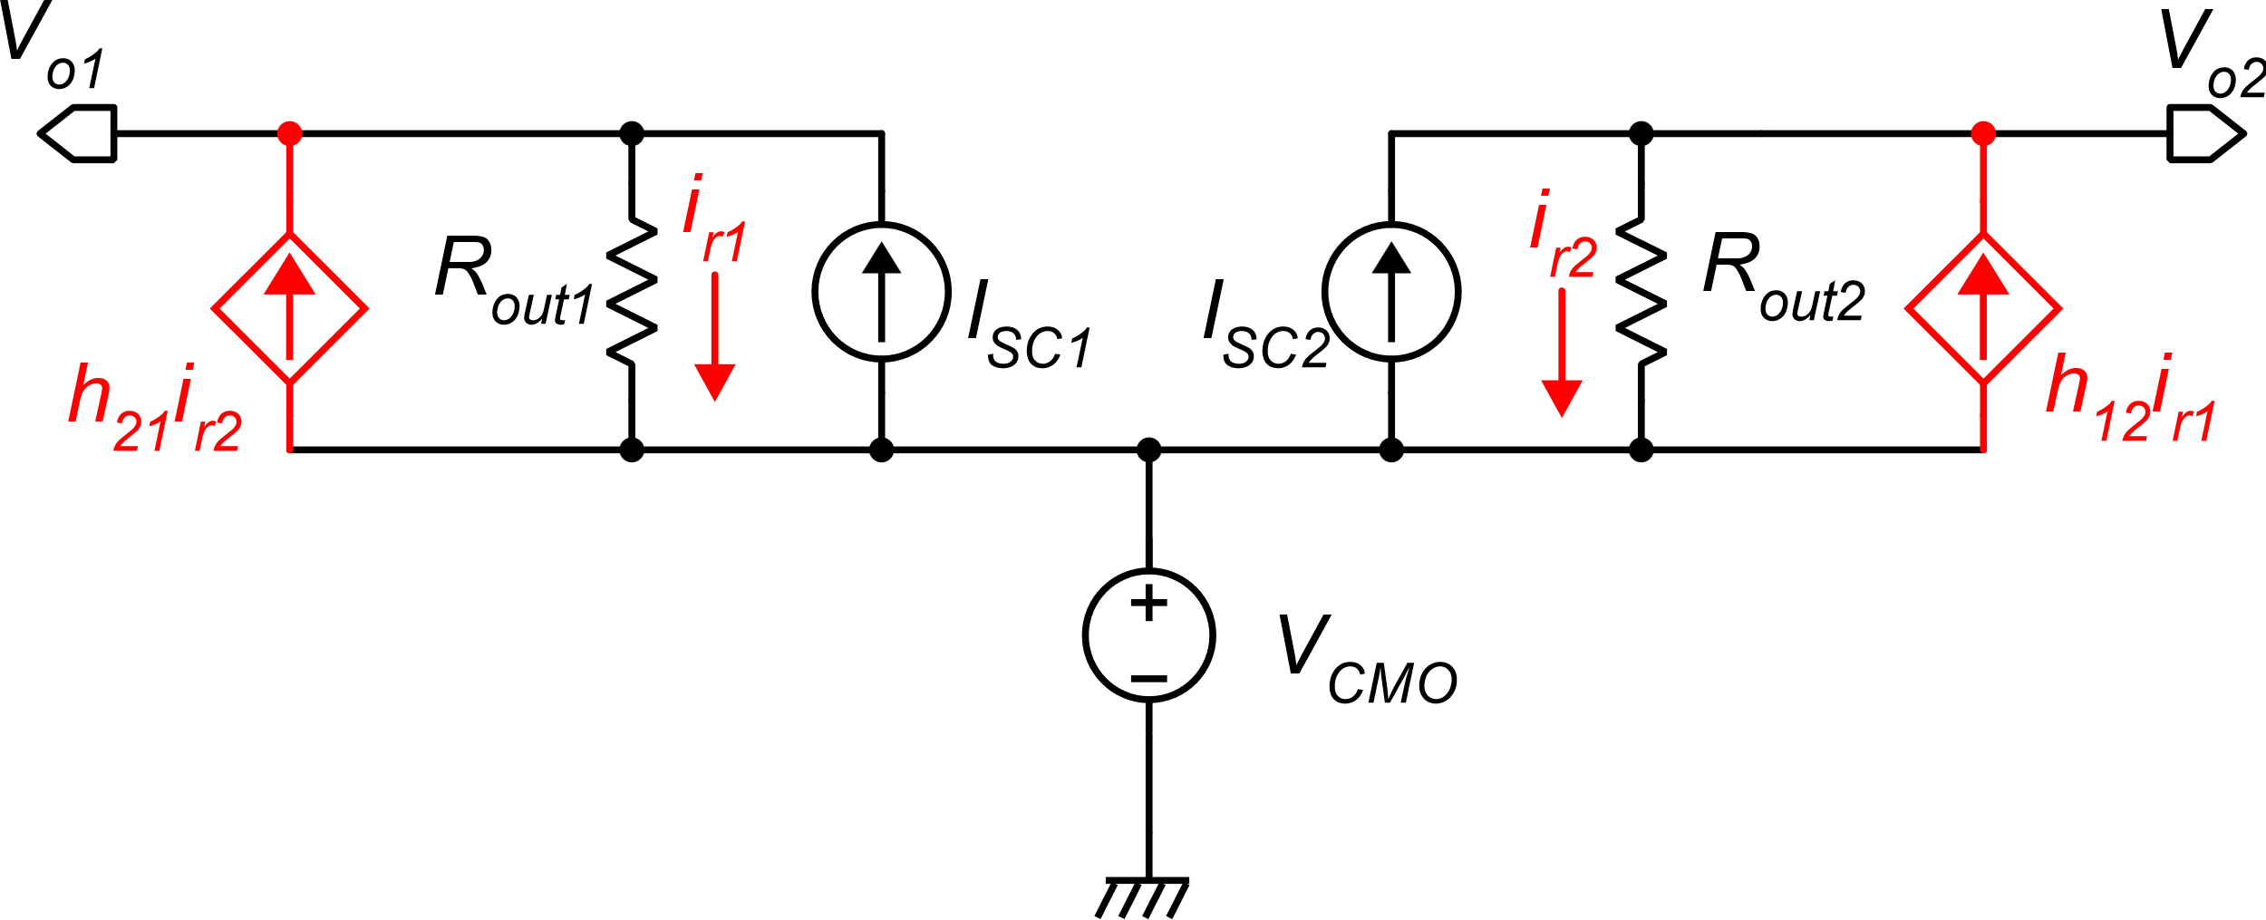
A more accurate model of the output resistances.
When calculating the output resistance, we note that part of the current injected by one voltage source flows into the other source.
It is possible to model this interaction by means of two current-controlled current sources (cccs)

Slide 5
Simplified model
It is possible to show that a moderate asymmetry between the two ports does not produce significant effects once an output common mode stabilization circuit is included.
For the sake of simplicity, in the following study we will use a reduced model where we neglect the effect of the cross-talk between the two output ports. It can be shown that it simply turns out into a slightly smaller gain.
We need to calculate the output short circuit currents

Slide 6
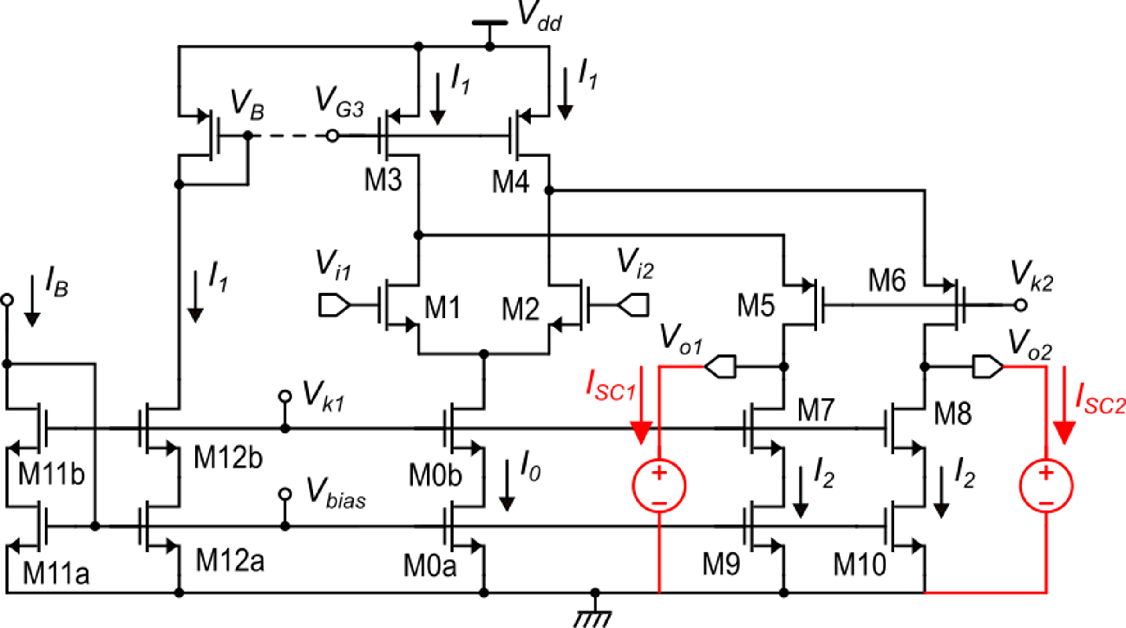
Output short circuit currents
Nominally:
M13

Slide 7
Output short circuit currents: real case with matching errors
Errors in the gain of current mirrors due to device mismatch
All the matching errors can be combined into only these two terms

Slide 8
Output short circuit currents: real case

Slide 9
Differential mode
−
+
Gain: A_{dd}=g_{m1}R_{out}
Offset:

Slide 10
Common mode
This is an unwanted term, because we want only V_{CMO}
By design:

Slide 11
Common mode error
I_{ε} is the sum of current mismatches of several current mirror
Error
In a current mirror:
I₀ is the output current of one of the several mirror that contribute to I_{ε}
just an example:
possible gain of a folded cascode :

Slide 12
Common Mode Stabilization
With the configuration that we have analyzed so far, the error in the common mode is too large for any practical application. It is very likely that the error exceeds the supply voltage, meaning that in quiescent conditions, both the outputs are saturated at either the upper or at the lower bound of the output range
A circuit that stabilizes the output common mode voltage to a value close to V_{CMO} is required.
This circuit is called Common Mode Feed-Back loop, or simply CMFB

Slide 13
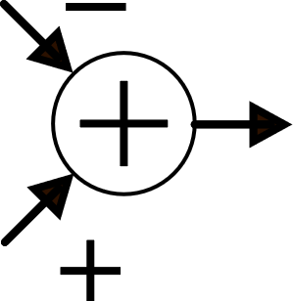
CMFB: the principle
The CMFB circuit, calculates V_{oc}, compares it with the target value V_{CMO} and adjust one of the bias currents ( I₁ , I₀, or I₂) to make V_{oc} ≅ V_{CMO}
M13
Generic transconductance

Slide 14
CMFB: the effect

Slide 15
CMFB: the effect
If g_{m}* is of the same order of g_{m1}, then the product g_{m}*R_{out} is of the same order as A_{dd}
Again, this is the ratio of one current mismatch (I_{ε}) over a full current (I_{D}*). We expect this ratio to be << 1
With the introduction of the CMFB, the error decreases from several Volt to a few mV

Slide 16
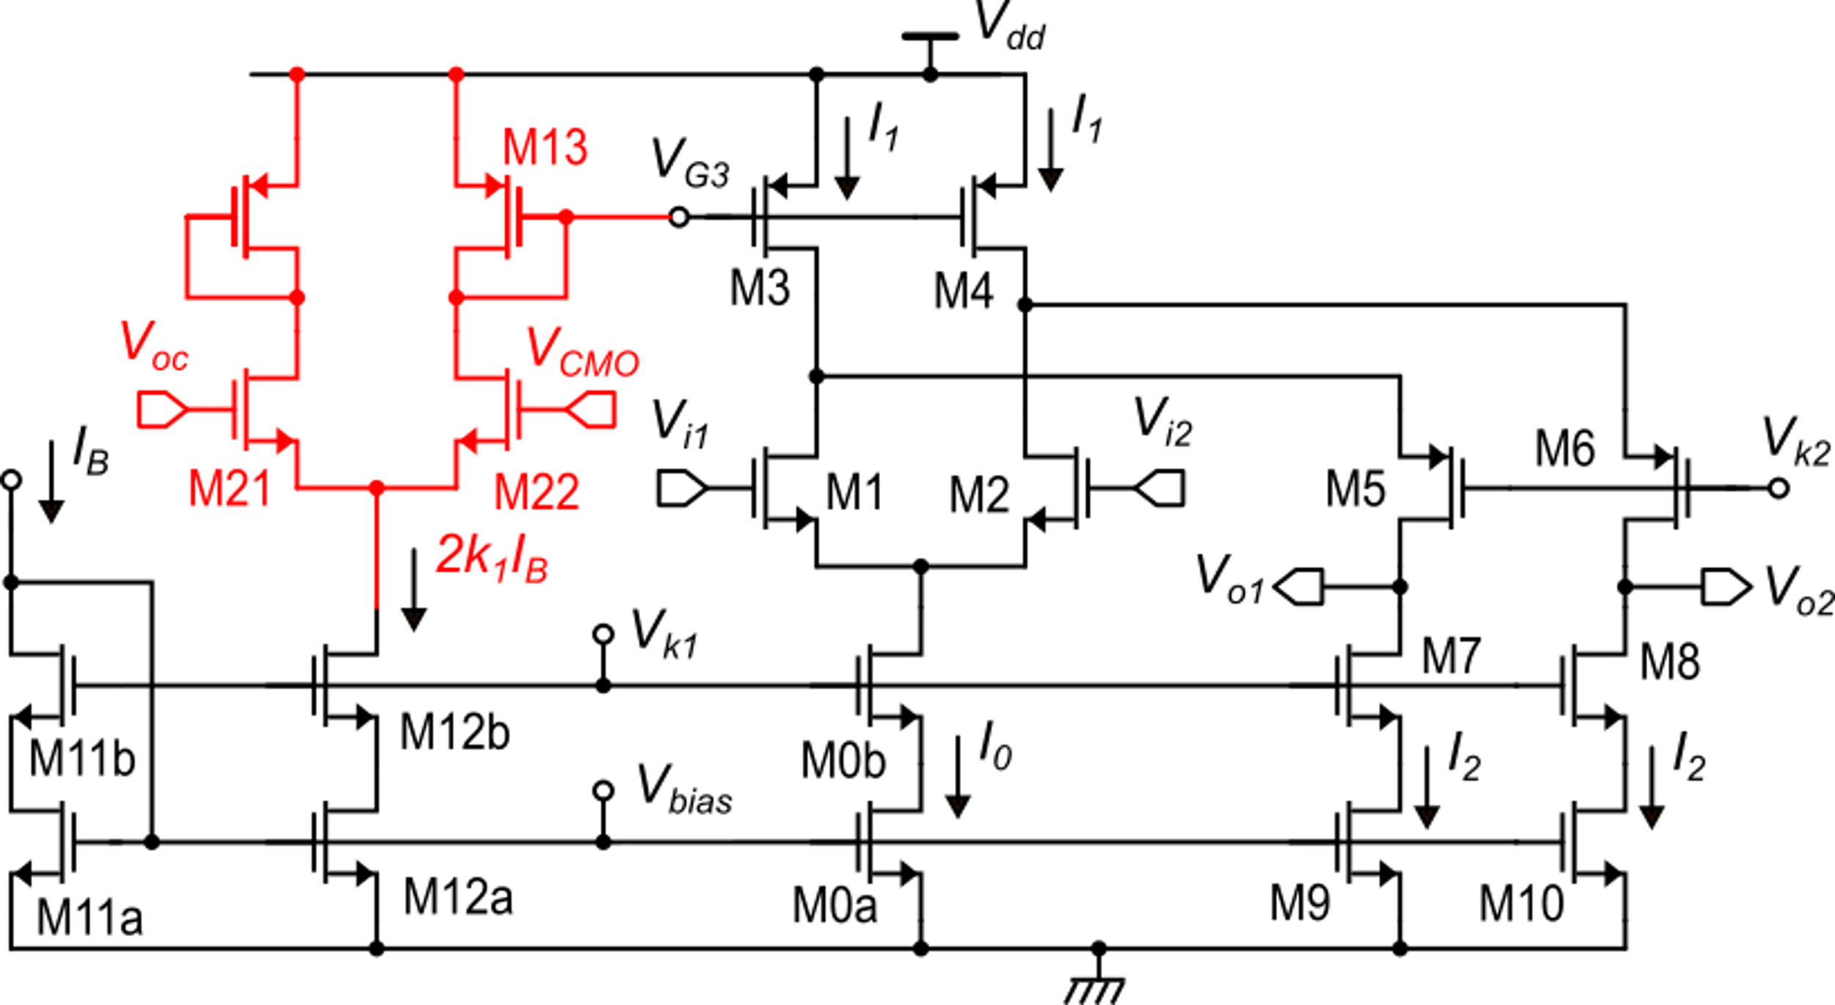
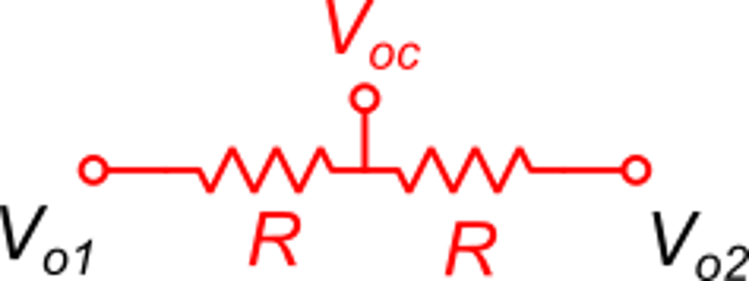
A first idea to obtain the CMFB
This is OK, but we need to produce V_{oc}. A resistor network can be used, but this load the amplifier, reducing the gain dramatically.
Applicable only when a resistor across the output terminals was already included in the design
(e.g. in in-amps)

Slide 17
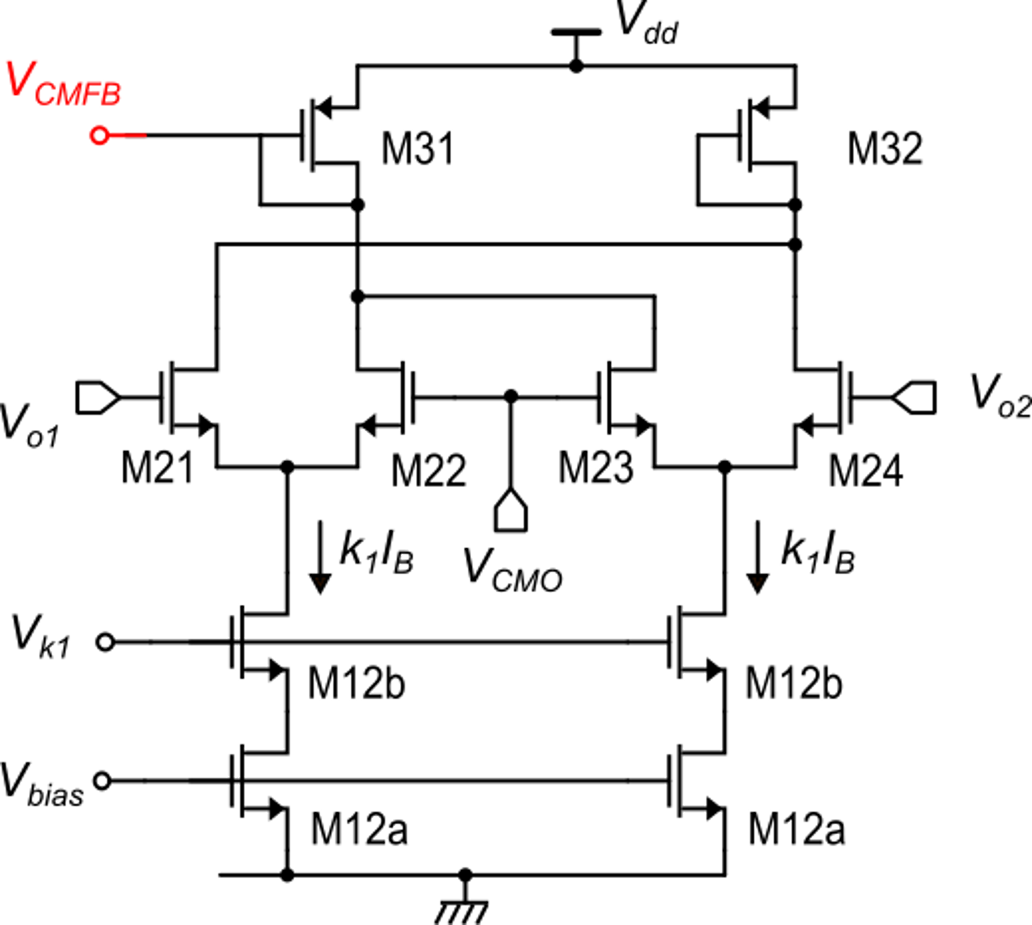
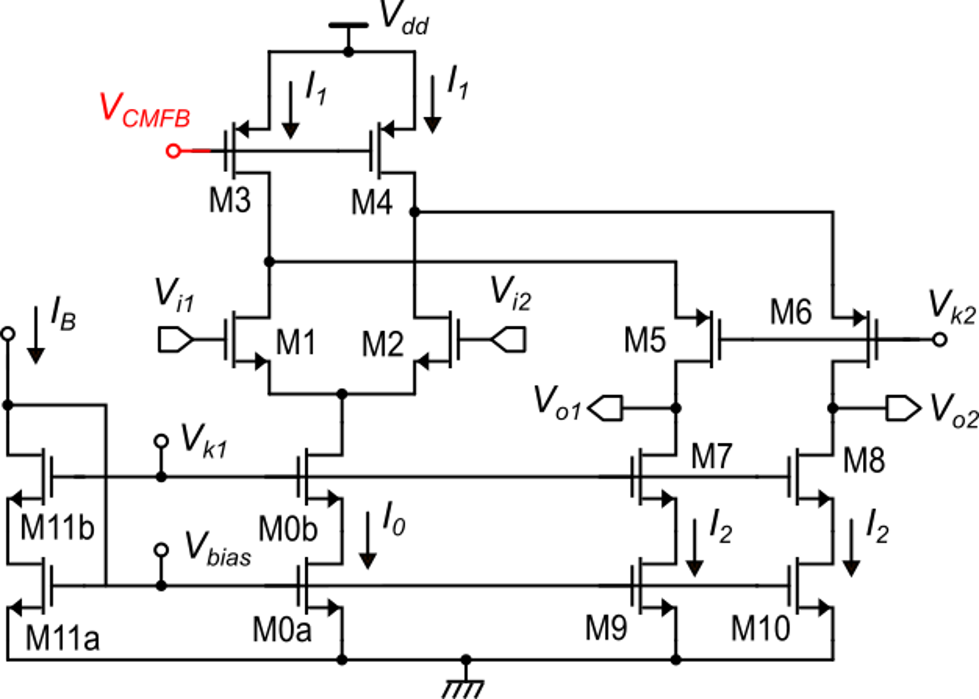
First solution: static CMFB
To simplify the analysis: M31=M3
Fully-differential single-stage op-amp
CMFB circuit

Slide 18
Analysis of the static CMFB
This is the required relationship
Note that:

Slide 19
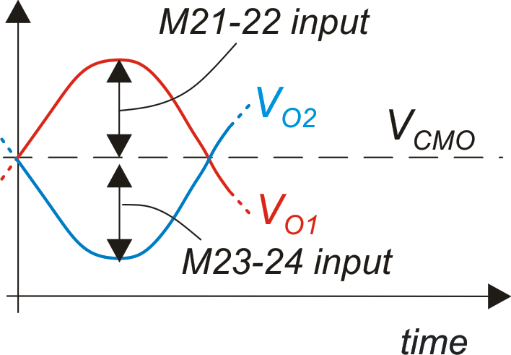
Limits of the static CMFB
Large output differential voltages cause the differential pairs to exceed their input linearity range, which is fraction of V_{dmax}
To set large V_{dmax}, we need large (V_{GS}-V_{t})₂₁, but we need also to satisfy:

Slide 20
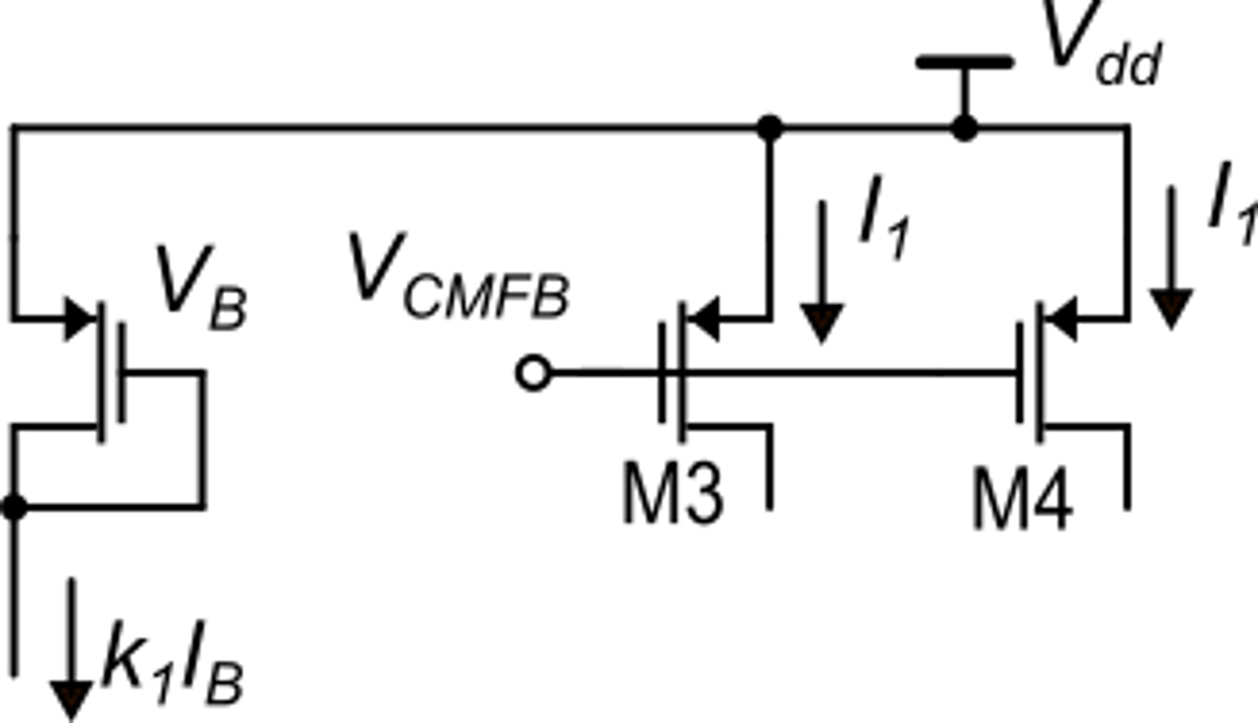
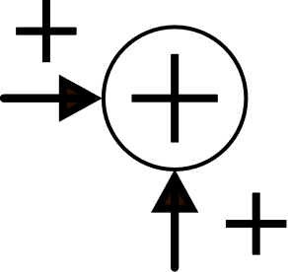
Dynamic CMFB
With the static CMFB, the maximum output differential voltage is much smaller than the actual capabilities of the folded cascode op-amp, which has potentially a rail-to-rail output range. Furthermore, a static CMFB increases the power consumption of the amplifier.
Dynamic CMFBs are based on passive switched capacitor networks.
Preliminary consideration
M13

Slide 21
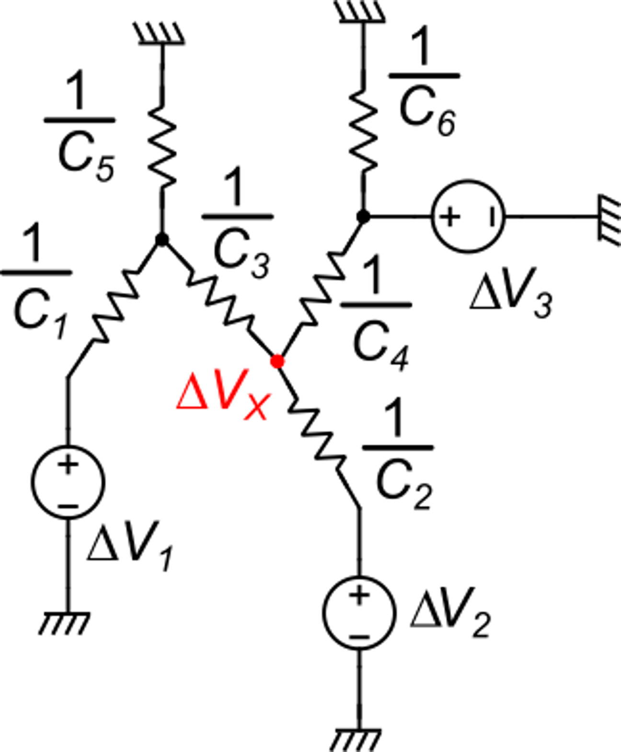
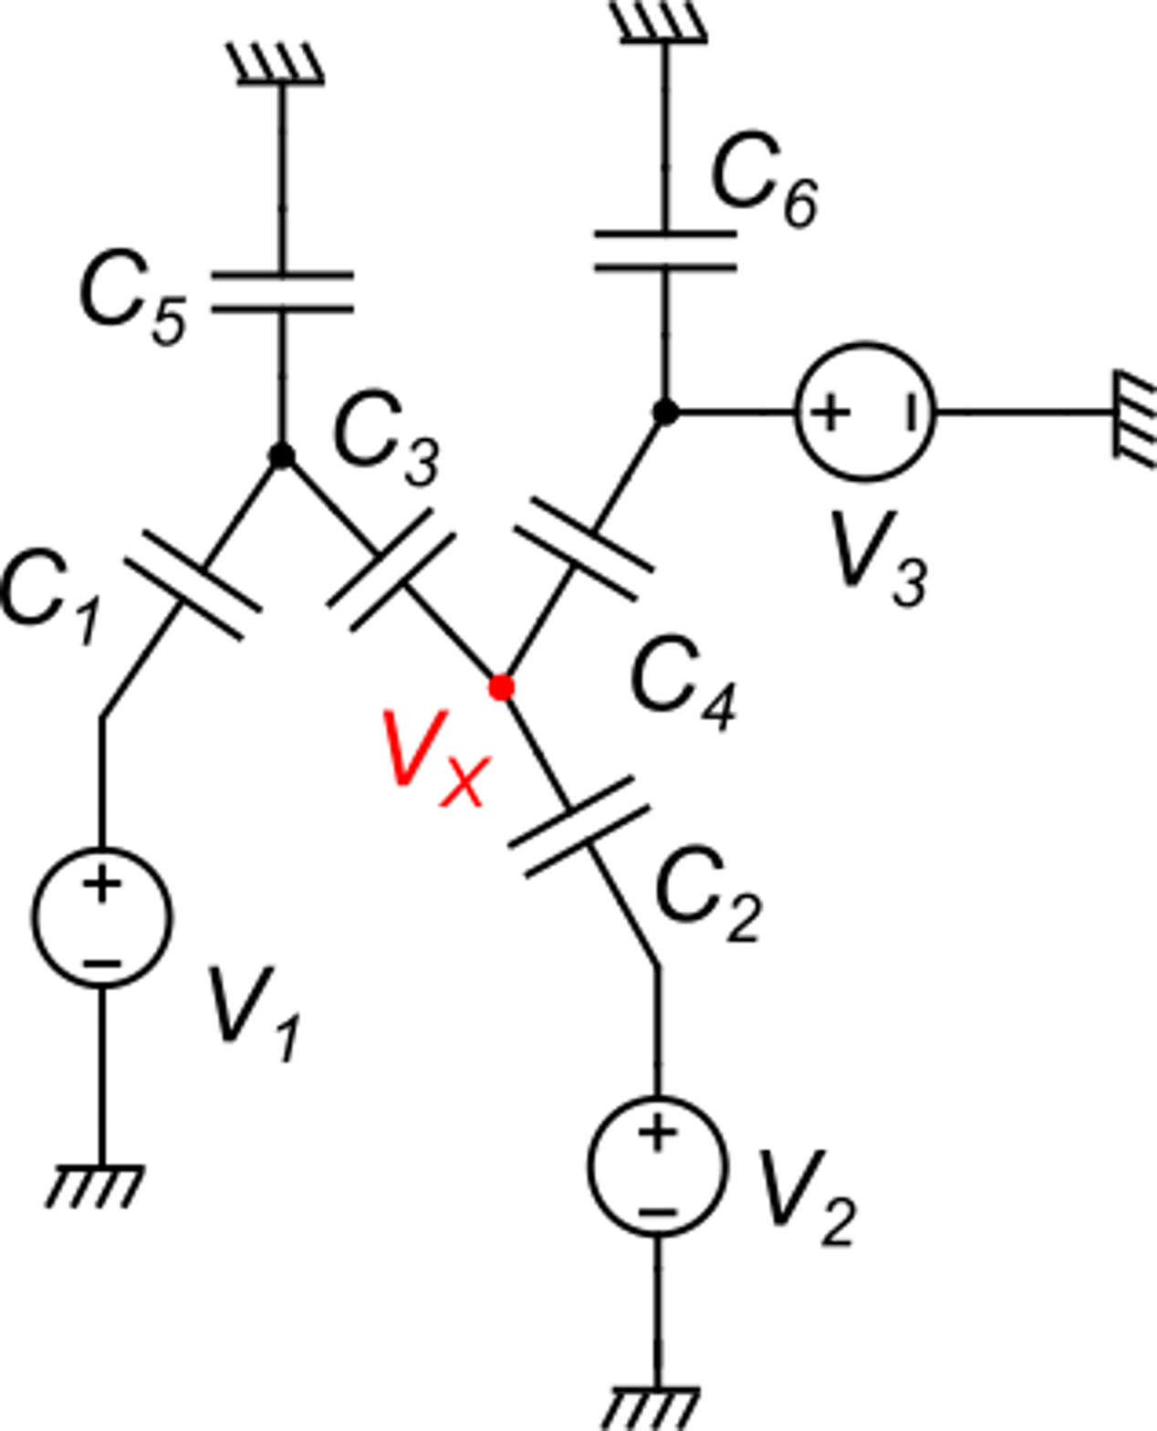
A premise: properties of all-capacitor networks
In a network made up by only capacitors and independent voltage sources, I cannot determine the value of nodal voltages (such as V_{X}), since it is affected by the initial voltages stored across the capacitors.
Given two instants t_{f} and t_{i}, let us define:
I can find the voltage variations between two instants, once the variations of the voltage sources are known. To this aim, an equivalent resistive network can be used

Slide 22
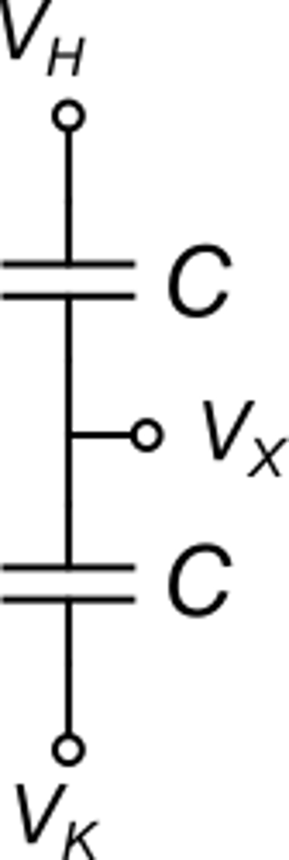
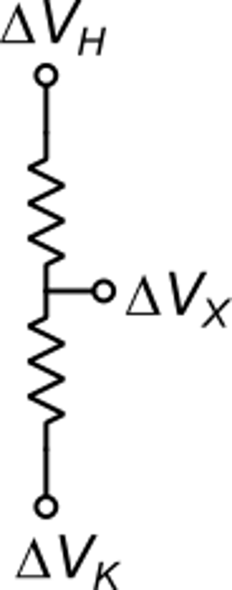
Dynamic CMFB: implementation
Let us consider
a capacitive voltage divider
M13
Target
Considering two phases: (1) = precharge, (2) = calculate V_{X}=V_{CMFB}

Slide 23
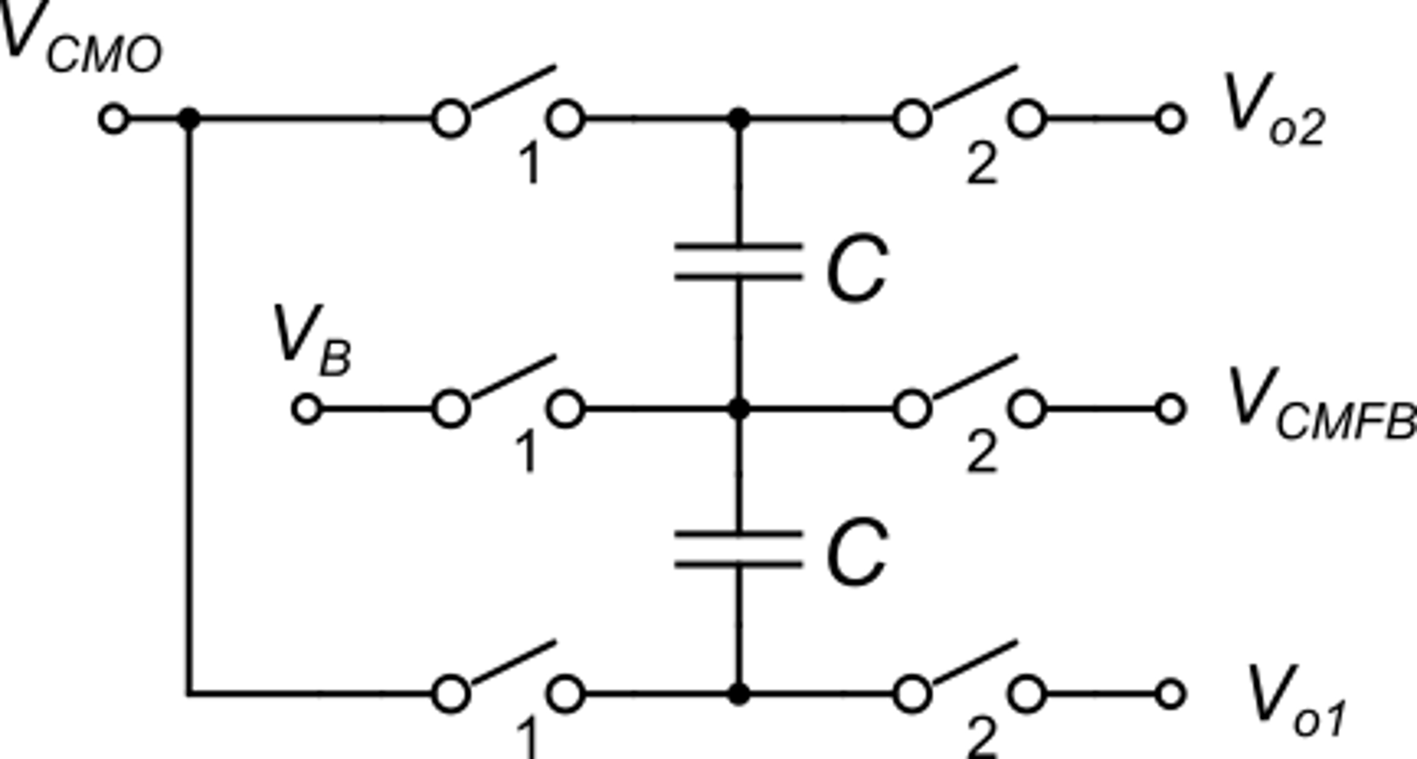
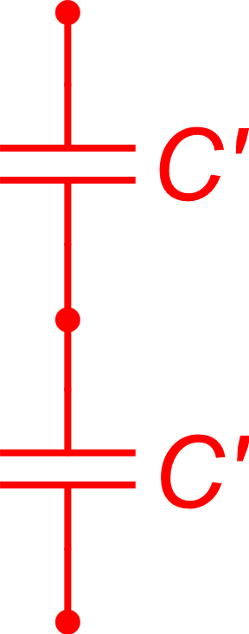
Dynamic CMFB: implementation
V_{CMO} is an input that has to be connected to the desired value (e.g. V_{dd}/2)
Capacitor C' are added to allow V_{CMFB} to track the variations of V_{oC} during phase 1, where it is disconnected from the outputs

Slide 24
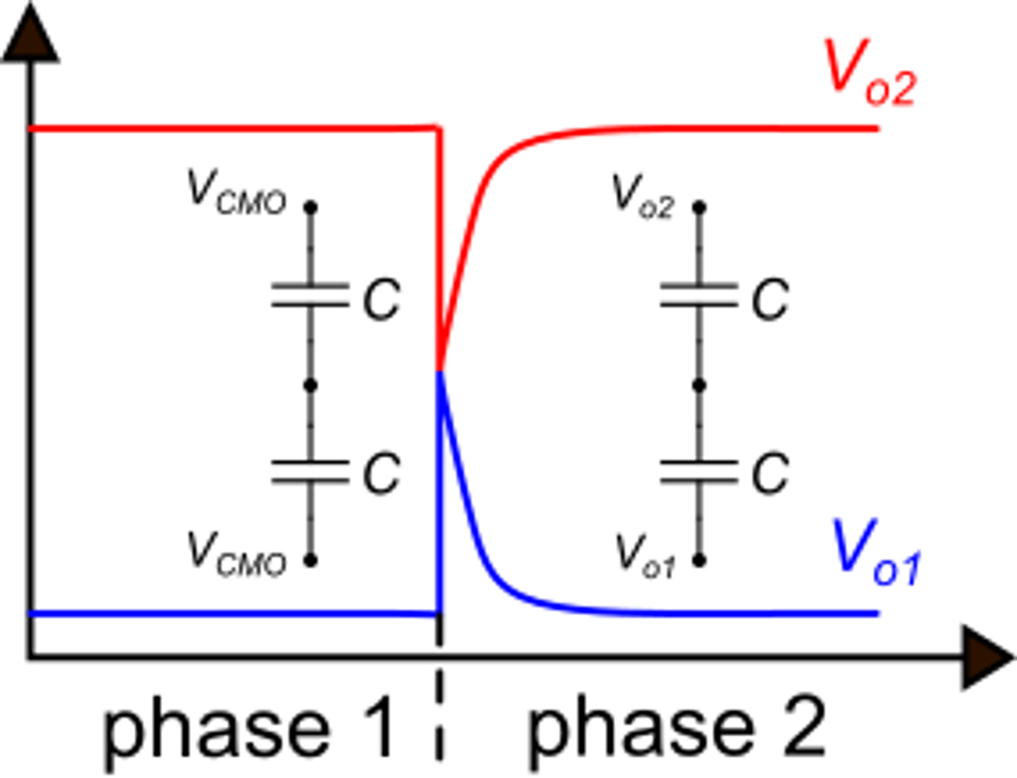
Dynamic CMFB: final considerations
Advantages:
It uses a passive networks: high linearity and no adverse effects on the available output range of the amplifier.
Static consumption is limited to the network that generates V_{B}, which can be biased with a very small current.
Drawback
At any transition from phase 1 to phase 2, the output terminals are temporarily shorted together. They have to recover by supplying current into the capacitors. The resulting spikes are not acceptable in a continuous time application. For an SC application, the transient must be finished when the output signal is sampled.

