Slide 1
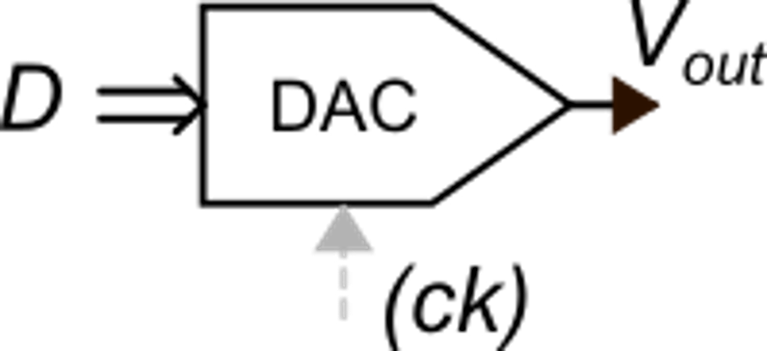
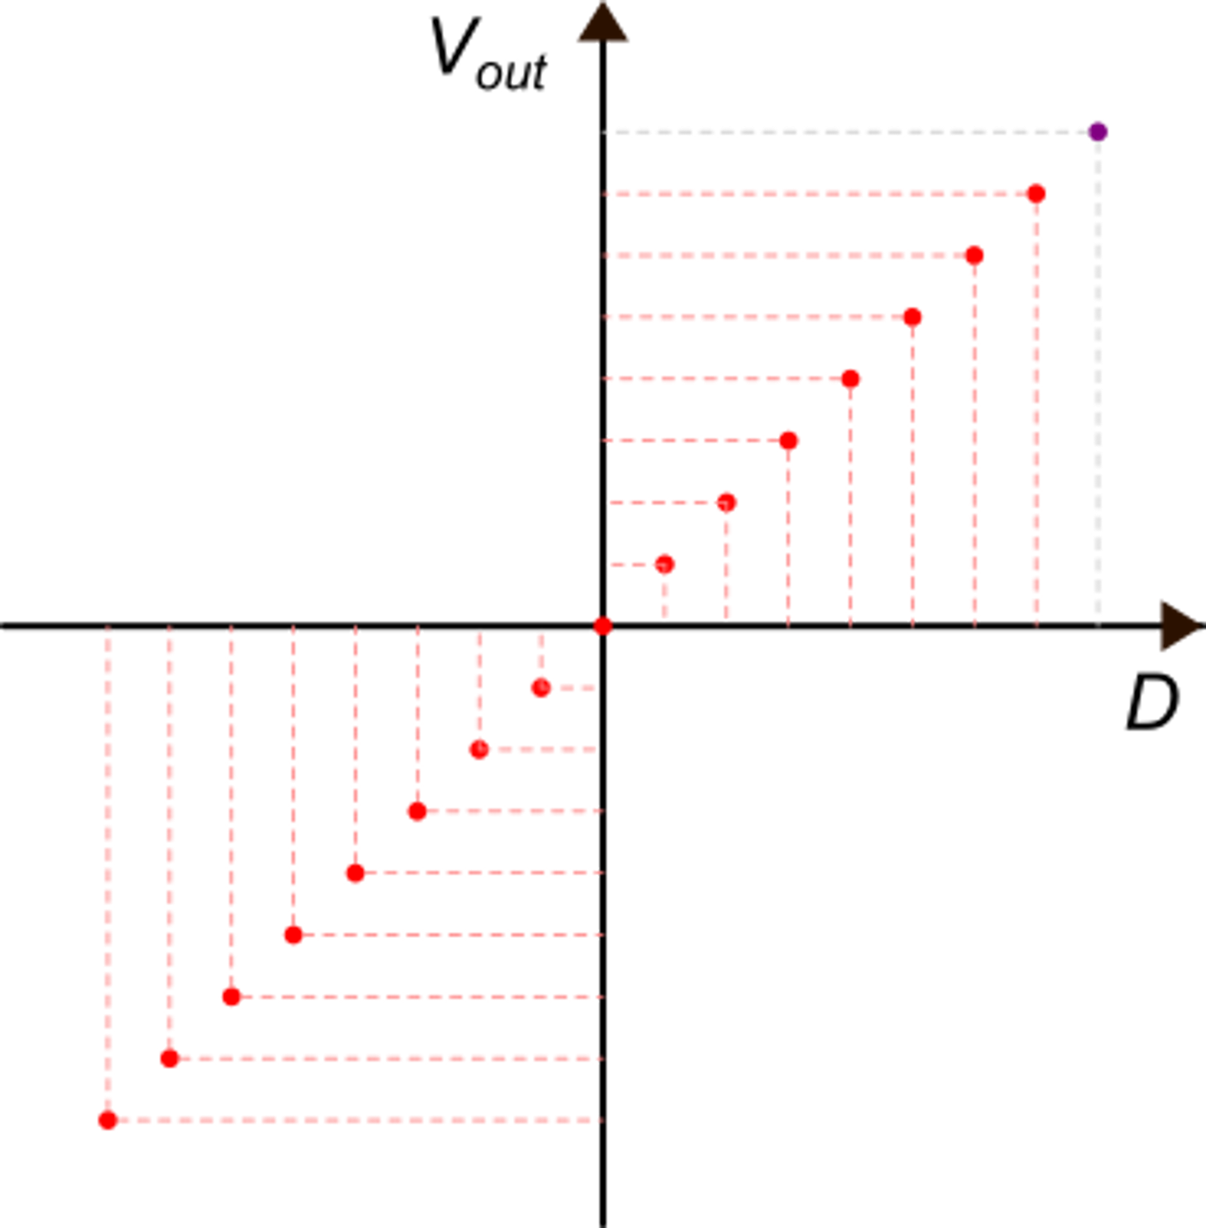
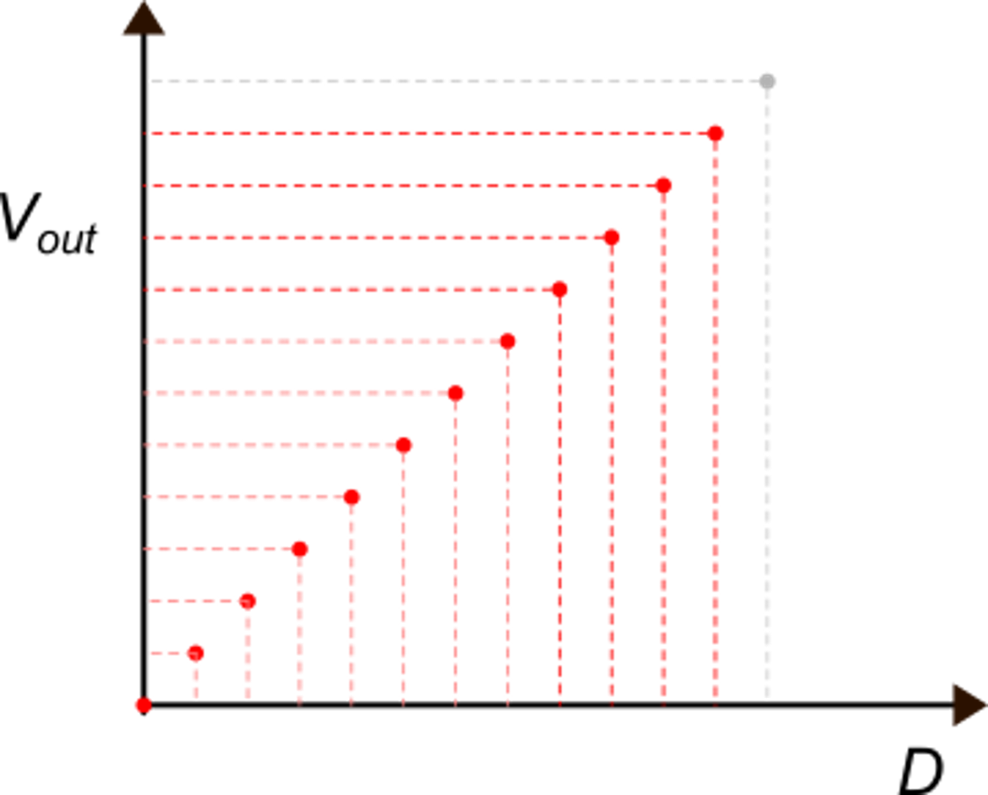
Digital to Analog Converters
Input: digital code
Output: analog signal
A clock can be present for synchronization reasons or to avoid glitches during data update
Ideal function:
n= nominal resolution (in number of bits)
bipolar output range
unipolar output range
V_{FS}
V_{FS}
D can be signed
e.g, two's complement

Slide 2
DAC applications
Digital to analog signal reconstruction: e.g. audio and video signals, actuator control (e.g. control of motors, solenoids, piezoactuators
Sensor excitation: generation of bias voltages, sinusoidal waveforms, etc)
Direct Digital Synthesis (DDS) of waveforms for telecommunications
Trimming of analog blocks (e.g. offset nulling)
Feedback components in ADCs

Slide 3
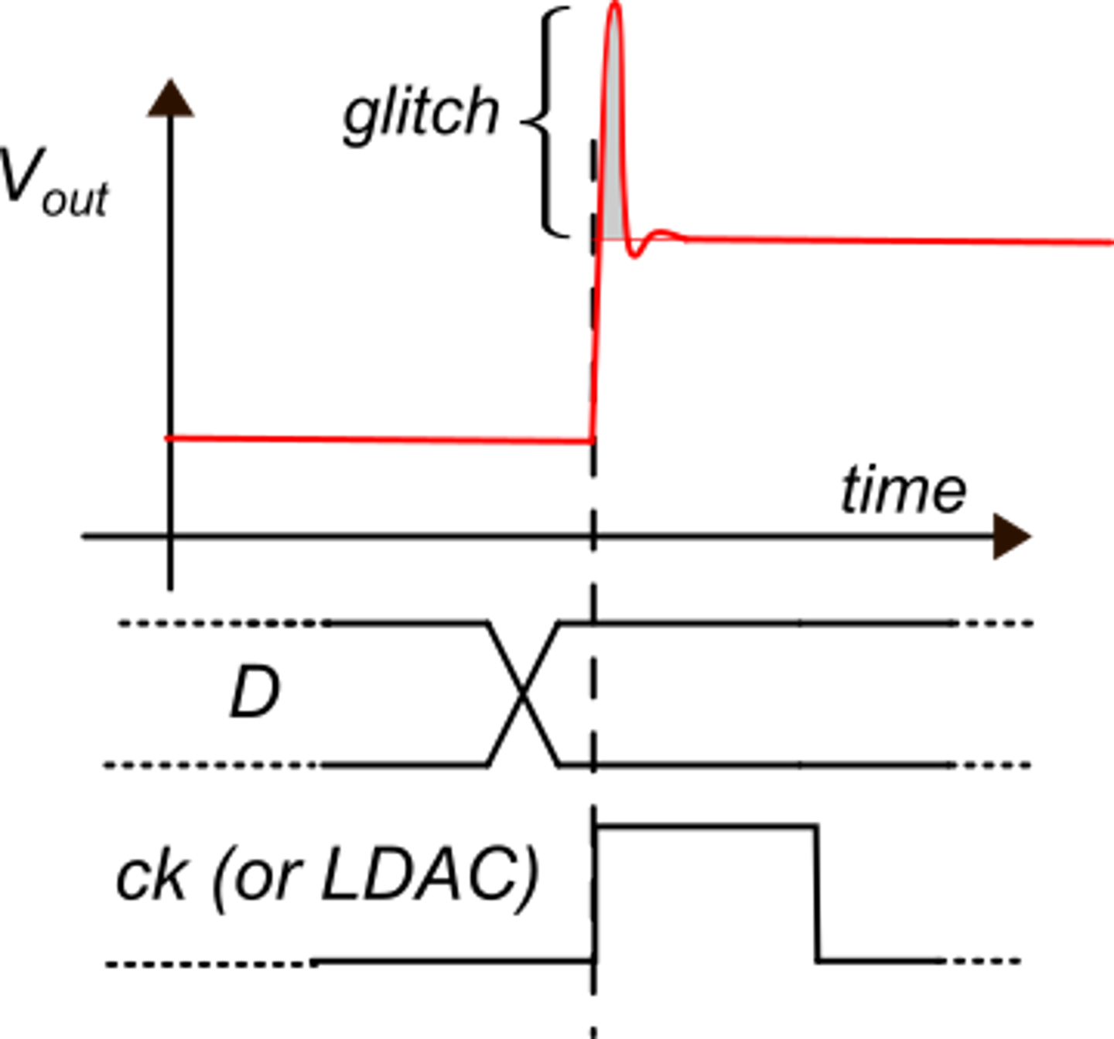
DAC performance parameters
DAC errors
Quantization error
Offset
Gain
Non-linearity
INL
DNL
Noise
Energy of the glitches $(\text{nV}∙\text{s})$
DAC speed: settling time, sample per seconds (sps),
Maximum output current
Power consumption

Slide 4
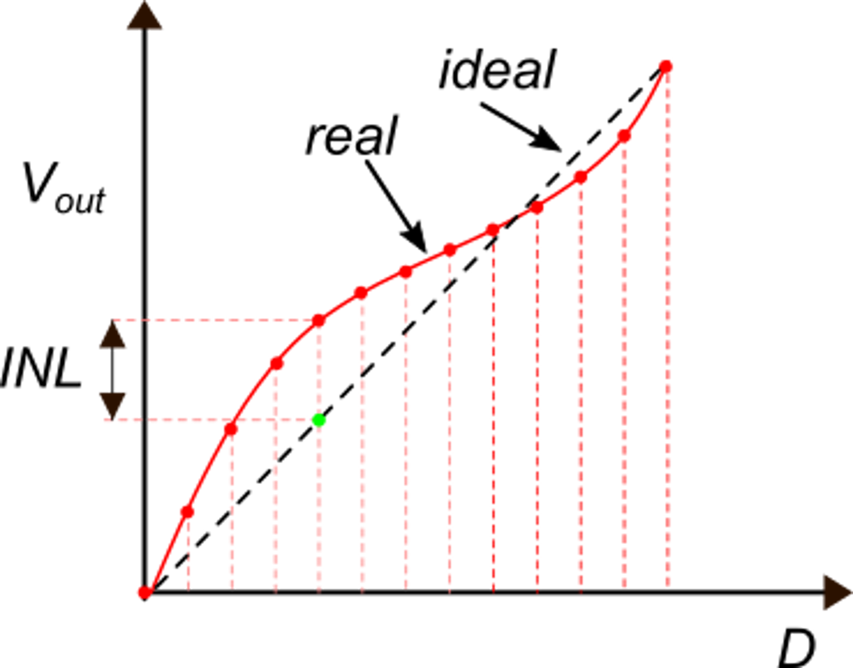
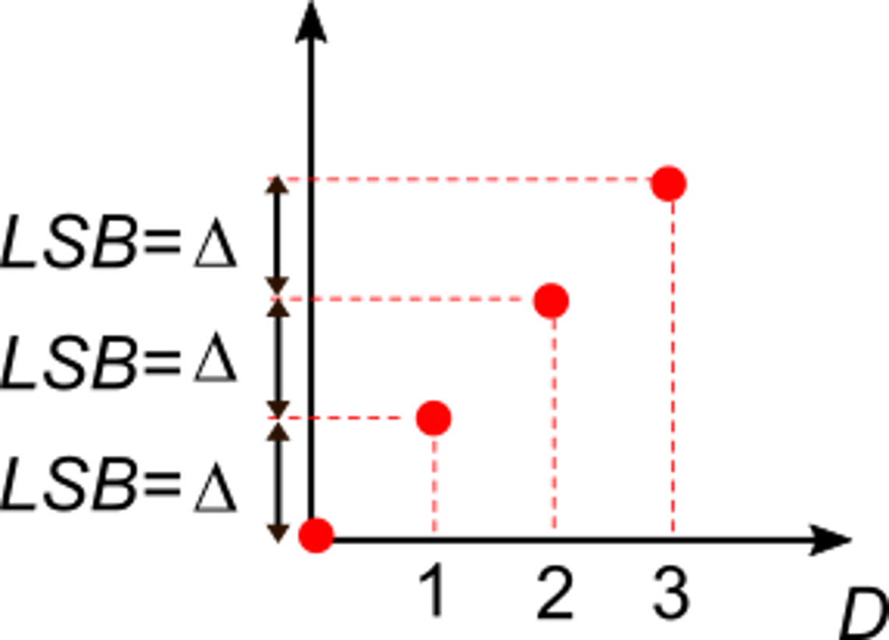
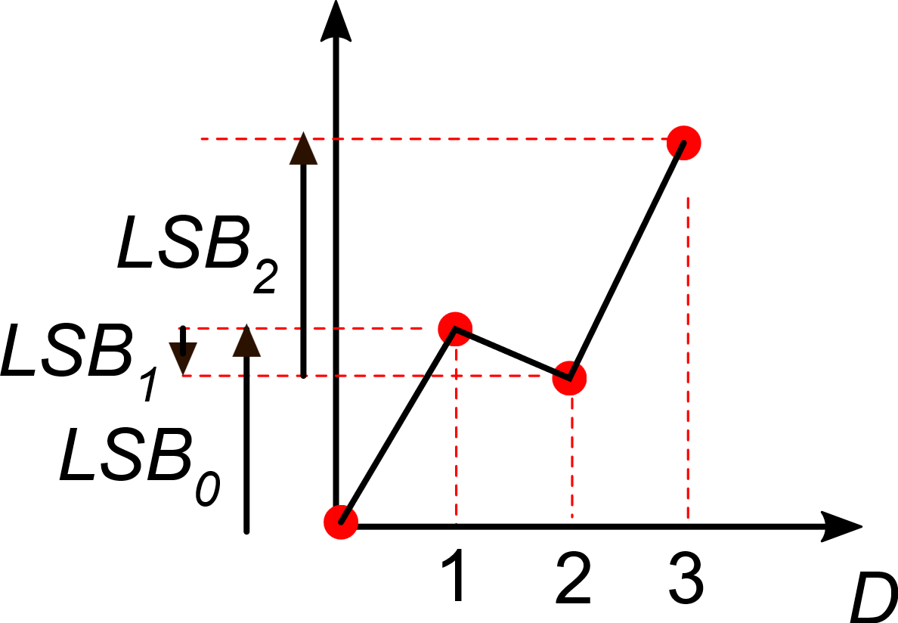
INL, DNL
Ideal case
(absence of non-linearity errors)
real case
INL
|DNL|> 1 LSB: non-monotonicity

Slide 5
DAC Architectures
Pros
Cons
Potentially non-monotonic
Suffer from the on-resistance of the switches
Reduced number of
resistor of similar value
R-2-R ladder
Guaranteed monotonic
Very large number of resistors
Resistor String
Low power consumption
Very fast. No need for resistors. Can be designed to be always monotonic
Current output. Flicker Noise
Current Steering
The output may be not available in the whole clock cycle. Large glitches
Optimal power vs speed trade-off
Switched Capacitors

Slide 6
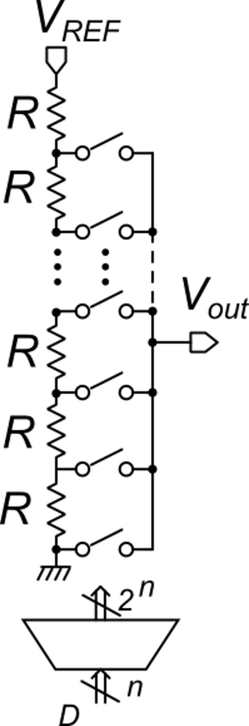
DAC resistor string
For any value of code D, only one switch at a time is on, selecting one of the 2^{n} voltage levels produced by the resistive divider
If code D turns on a certain switch, code D+1 turns on the switch placed in position up, then the output voltage can only grow
The monotonicity is guaranteed
Digital decoder

Slide 7
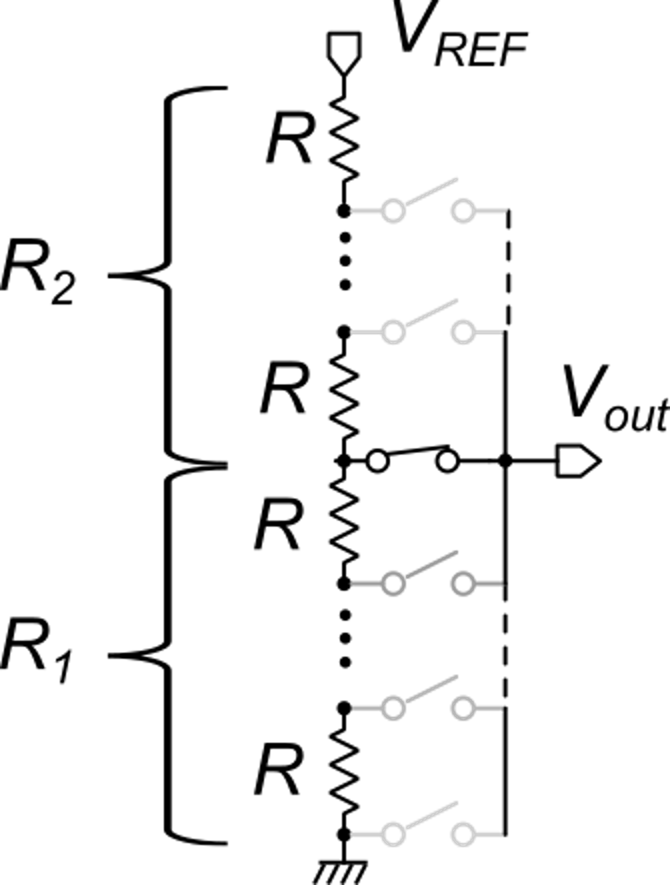
INL in a resistor string: a simple estimate
We consider a code that, in the ideal case, select the mid voltage:
Ideally
In a real case:

Slide 8
INL and resistor matching
In an n-bit DAC, to have an |INL|<1 LSB, the relative matching errors should be:
Example: 12 bit DAC:
Example: 16 bit DAC:
Unfeasible. Requires complicated post-production trimming
Feasible, with large area occupation

Slide 9
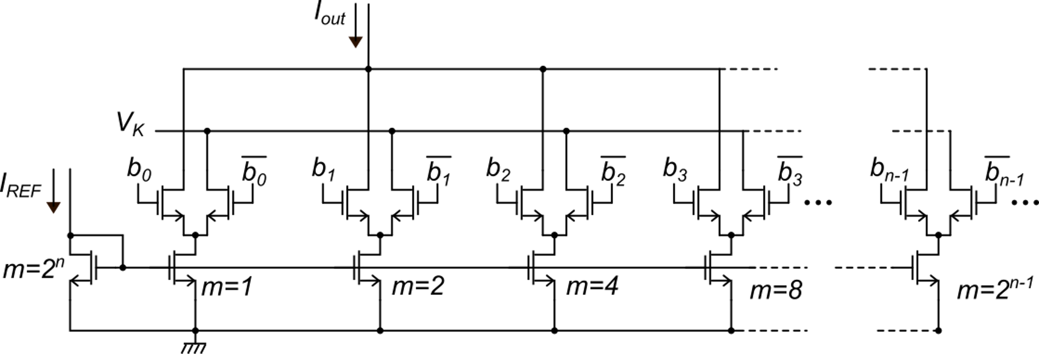
Current Steering DAC
The current of mosfets that are not routed to the output (their bit is 0), is not interrupted but is routed to a constant voltage (V_{k}) to keep the mosfet ready to be connected to the output in a short time
I₀
2I₀
It can be made monotonic-guaranteed by driving the 2^{n} mosfets of the array with thermometric coding
It suffers from the same INL problem of the resistor string DAC

Slide 10
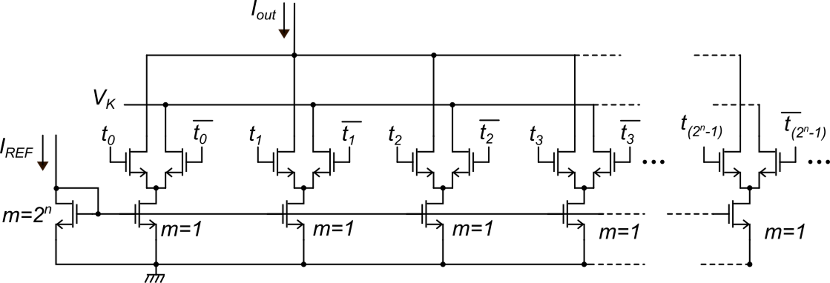
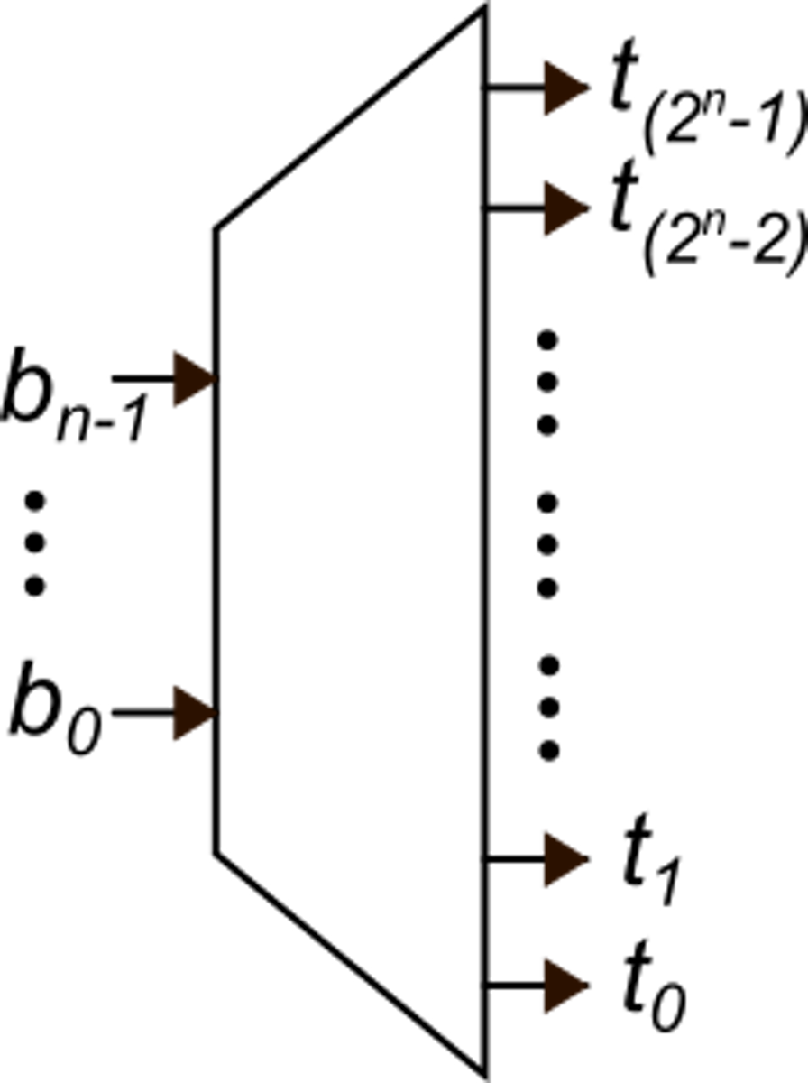
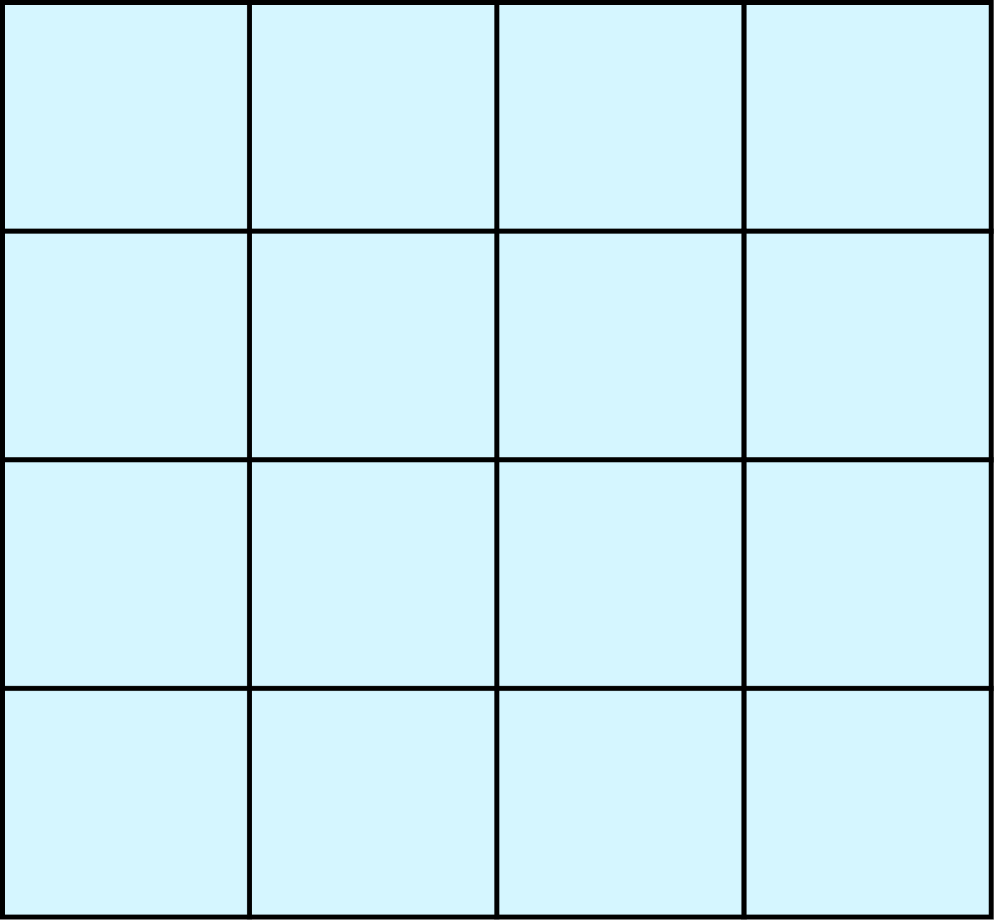
Thermometric coding
D
thermometric coding
2^{n} identical current sources I=I₀
randomly placed
into the matrix
D devices
of the matrix are routed to the output
The first D lines are
set to 1
If D is incremented by one, one more device is routed to the output: Iout increases. Monotonicity is guaranteed
2^{n} devices
(always in parallel)
2^{n} devices

Slide 11
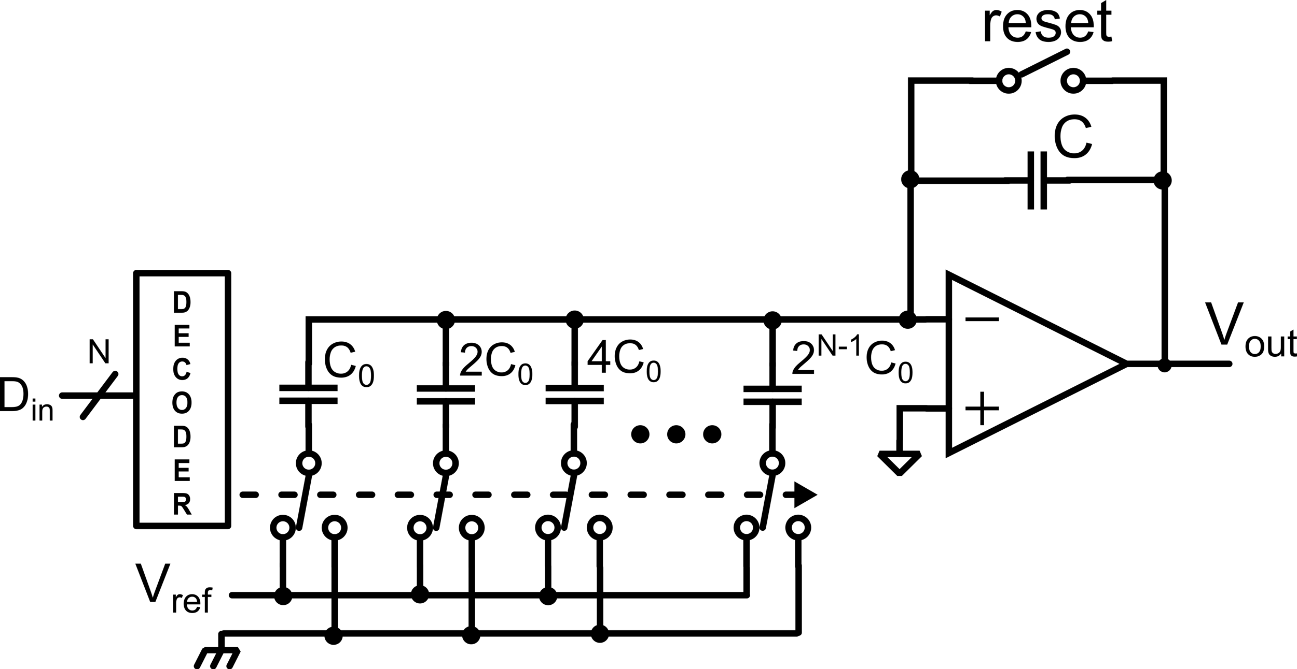
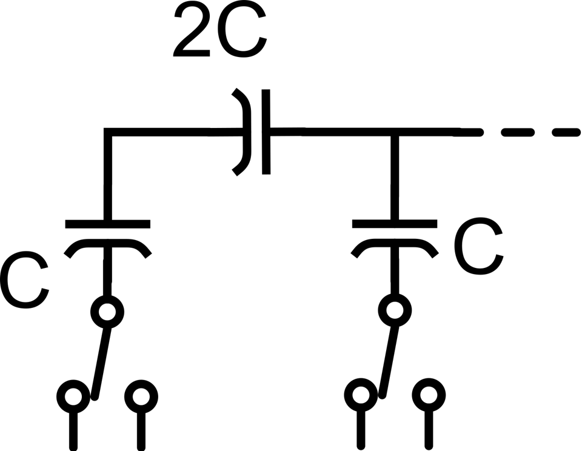
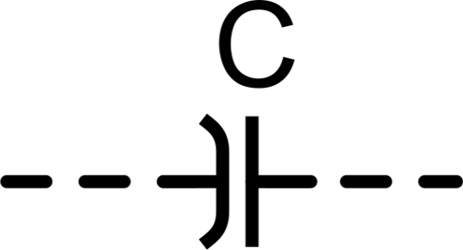
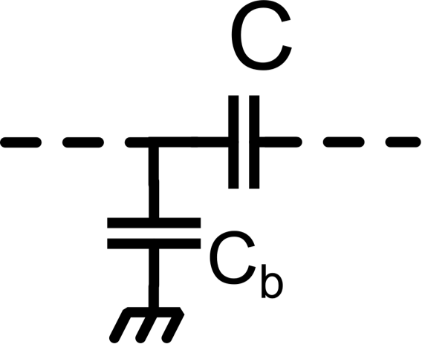
Capacitive DAC
Capacitor bank has better matching properties than resistor string
Low-power solution (no static consumption in the capacitor bank)
Output not always valid
Troubles with C-2C solutions due to parasitic capacitance of the bottom plate
$$V_{out}=V_{ref}\frac{C_{0}}{C}\sum_{i=0}^{N−1}{2^{i}D_{i}}$$

Slide 12
DAC Comparison
 | Type | Accuracy | Current consumption | Speed
Voltage | Resistor string, R-2R | Up to 12 bit | 1 μA – 1 mA | Up to 100 MS/s (limited by buffer)
Current | Current steering, I-2I | Up to 10 bit | 10 μA – 30 mA | Up to 10 GS/s
Charge | Capacitor bank | Up to 14 bit | 1 nA – 10 μA | Up to 100 MS/s (limited by buffer)

Slide 13
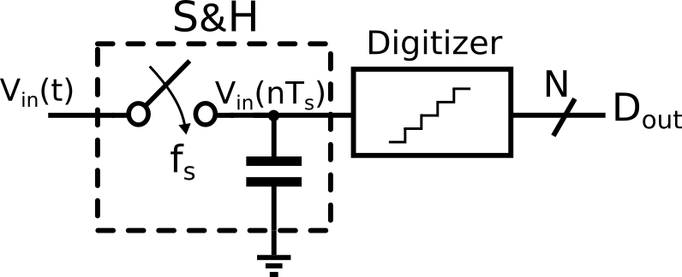
Analog to Digital Converters
Time-continuous Infinite levels
Time-discrete Finite number of levels
Sampling:
Nyquist-Shannon sampling theorem
Aliasing
Quantization:
Quantization noise
Analog-to-Digital converter

Slide 14
ADC applications
Measurements and data acquisition
Industrial (control systems, PLCs, …)
Sensor integration (robotics, IoT, …)
Commercial electronics (mobile phones, video and audio devices, microcontrollers …)
High-speed communications (data link, IF conversion…)

Slide 15
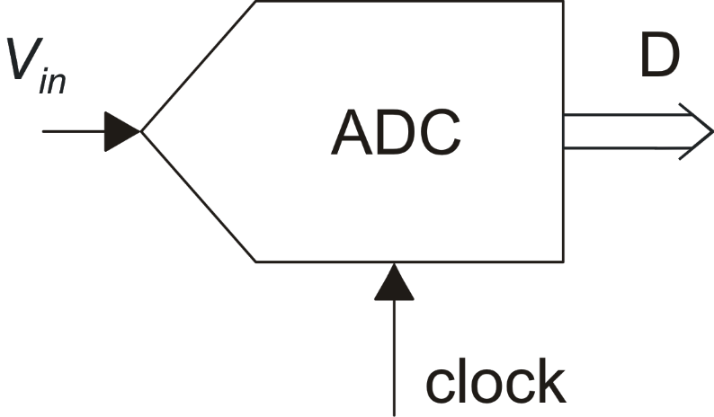
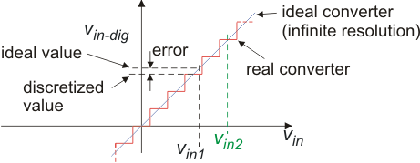
Analog to Digital Converters (ADCs)
The characteristic of an n-bit ADC
with no offset, gain, and non-linearity
errors (only quantization errors)
It is useful to refer to the
equivalent voltage of D
LSB
v_{in-dig} must be the best approximation of v_{in}, given the number of bit of D

Slide 16
ADCs - Main Performances
Speed Resolution Power consumption
$$B_{S}≤f_{s}/2$$
Effective Number of Bits
Signal to Noise And Distortion ratio
Depending on the ADC architecture:
Signal Bandwidth
Sampling frequency
Pipeline
Affected by:
quantization noise
electrical noise
harmonic distortion
Depending on f_{s}:
Nyquist Rate ADCs
Oversampling ADCs
SAR
Flash
Thermal noise limited
N: ADC resolution

Slide 17
Nyquist-Rate vs. Oversampling ADCs
The output code depends only on the last conversion. Previous conversions do not affect the present code
Nyquist Rate ADC:
$$f_{S}≅f_{s−Nyq}$$
Oversampling ADC:
The output code depends also on the previous history of sampled data.
$$f_{S}≫f_{s−Nyq}$$

Slide 18
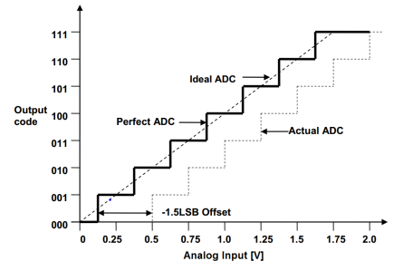
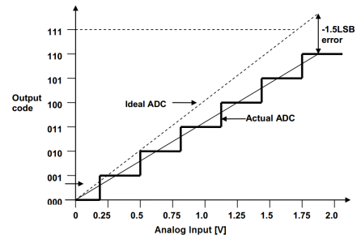
ADCs – Static Parameters
Offset error: difference between the actual ADC characteristic and the perfect ADC characteristic, evaluated at the zero transition
Gain error: difference between the last step midpoint of the actual ADC and the last step midpoint of the ideal ADC, after the compensation of the offset error
http://ww1.microchip.com/downloads/en/appnotes/atmel-8456-8-and-32-bit-avr-microcontrollers-avr127-understanding-adc-parameters_application-note.pdf

Slide 19
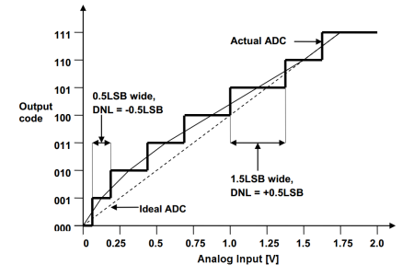
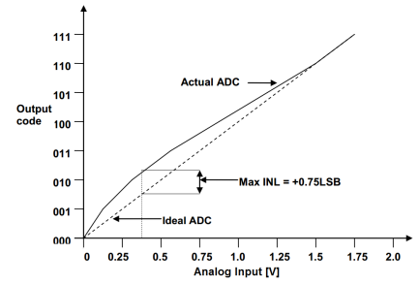
ADCs – Static Parameters
DNL error: difference in the step width between the actual characteristic and the ideal one
INL error: vertical difference between the actual input-output characteristic and the ideal one, after the compensation of the offset and gain error
http://ww1.microchip.com/downloads/en/appnotes/atmel-8456-8-and-32-bit-avr-microcontrollers-avr127-understanding-adc-parameters_application-note.pdf

Slide 20
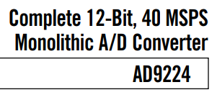
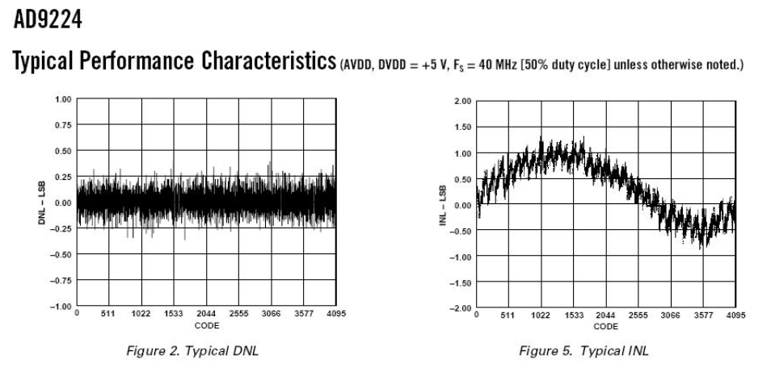
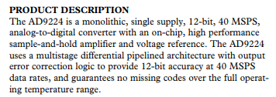
ADCs – Static Parameters

Slide 21
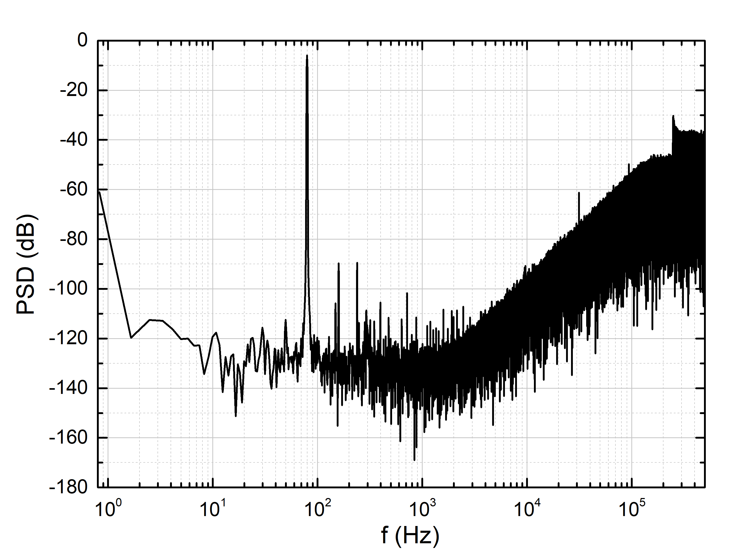
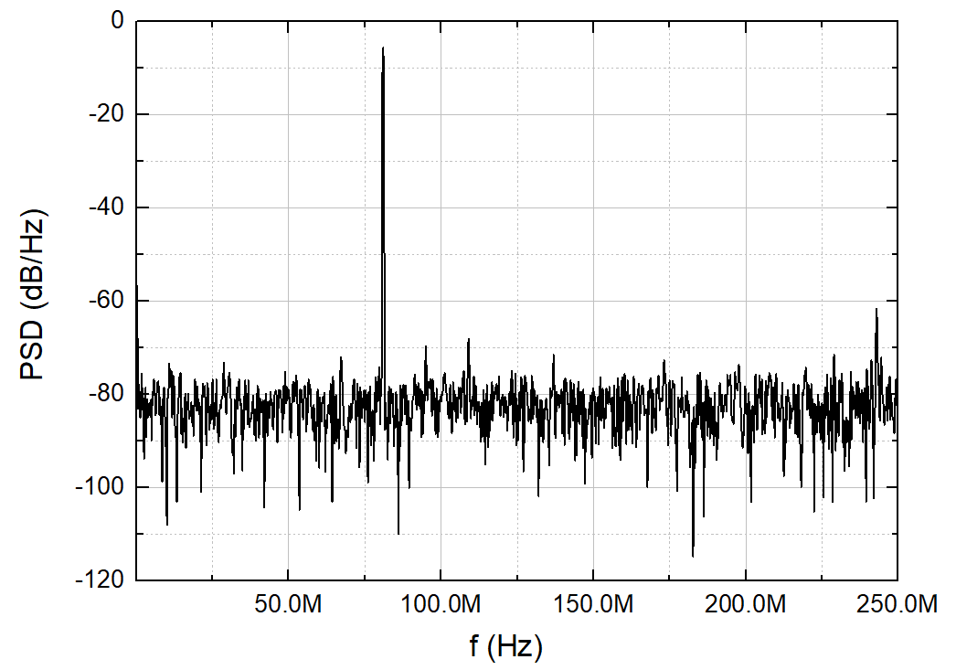
ADCs – Dynamic Parameters
$$THD=\frac{P_{D}}{P_{S}}$$
$$SINAD=\frac{P_{S}}{P_{N}+P_{D}}={\left({SNR}^{−1}+THD\right)}^{−1}$$
$$SNR=\frac{P_{S}}{P_{N}}$$
(or SNDR)
$$P_{N}=<v_{n}^{2}>=\int_{0}^{B_{S}}{S_{v_{n}}(f)df}$$
Nyquist-Rate ADC
Oversampling ADC
f_{s}= 500 MHz
SNR = 91.77 dB
SNR=46.52 dB
SINAD = 80.2 dB
SINAD=46.26 dB
THD = -80.51 dB
THD=-58.67 dB
f_{s}= 1 MHz
Bs = 250 MHz (=f_{s}/2)
Bs = 490 Hz (=f_{s}/2048)

Slide 22
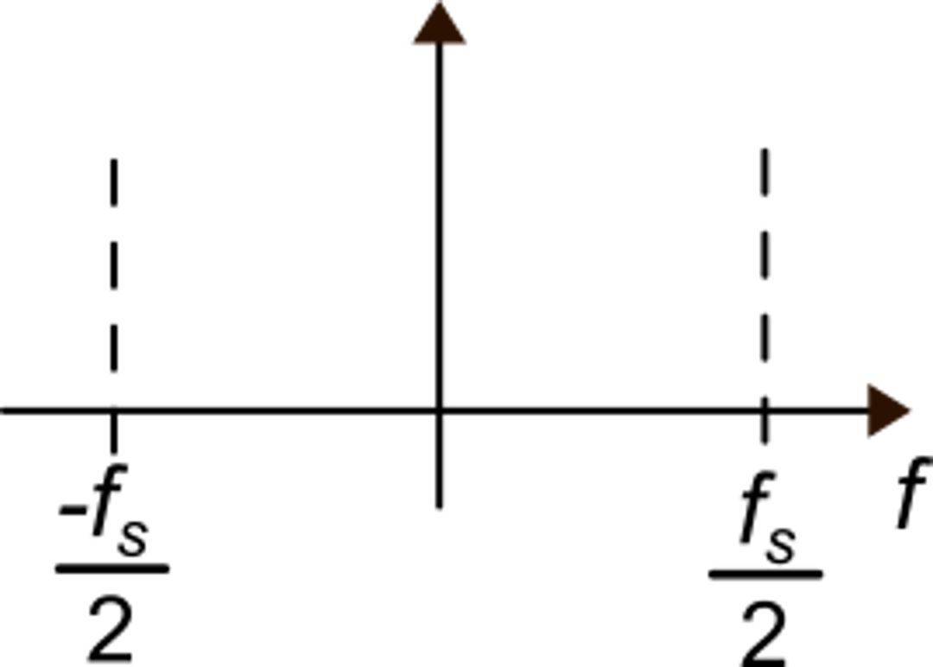
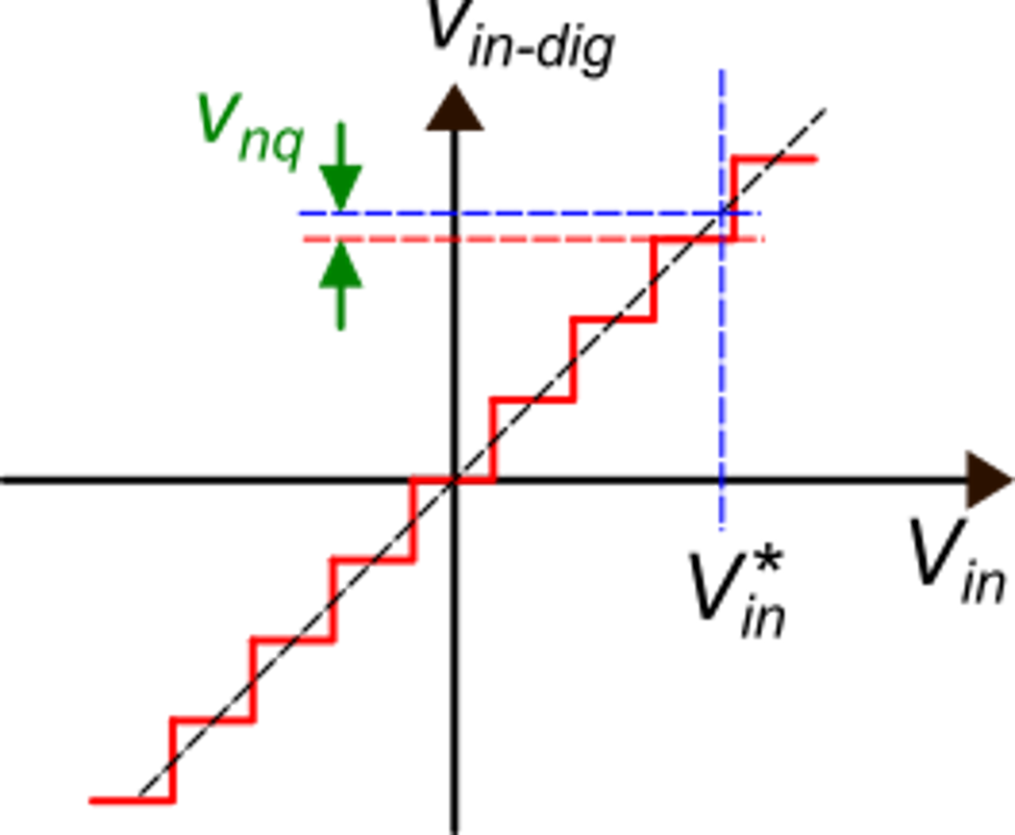
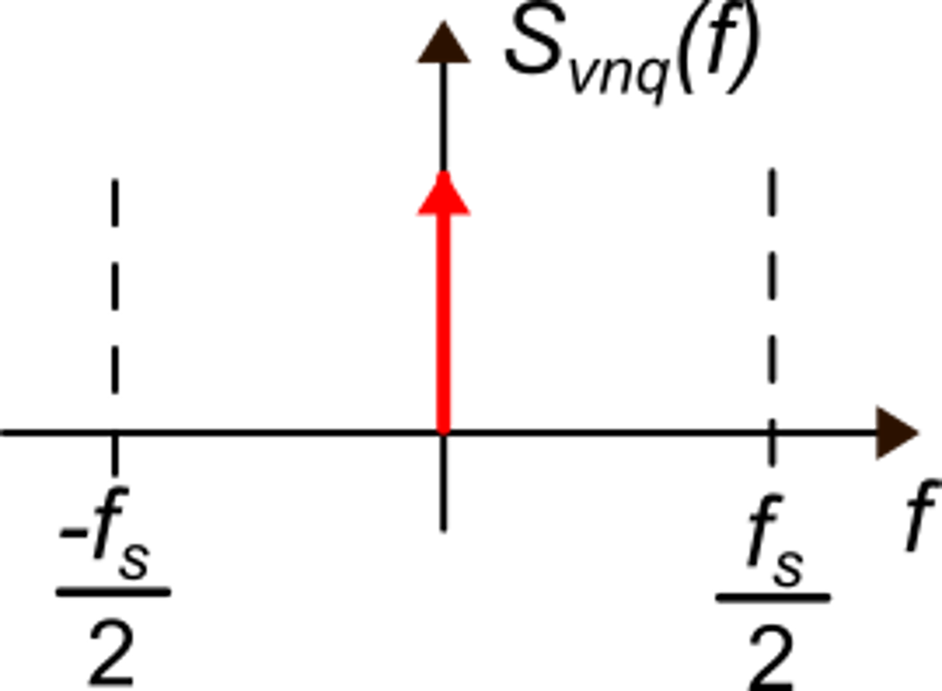
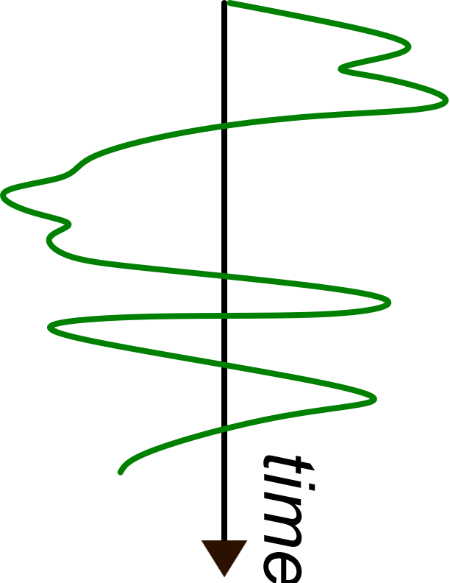
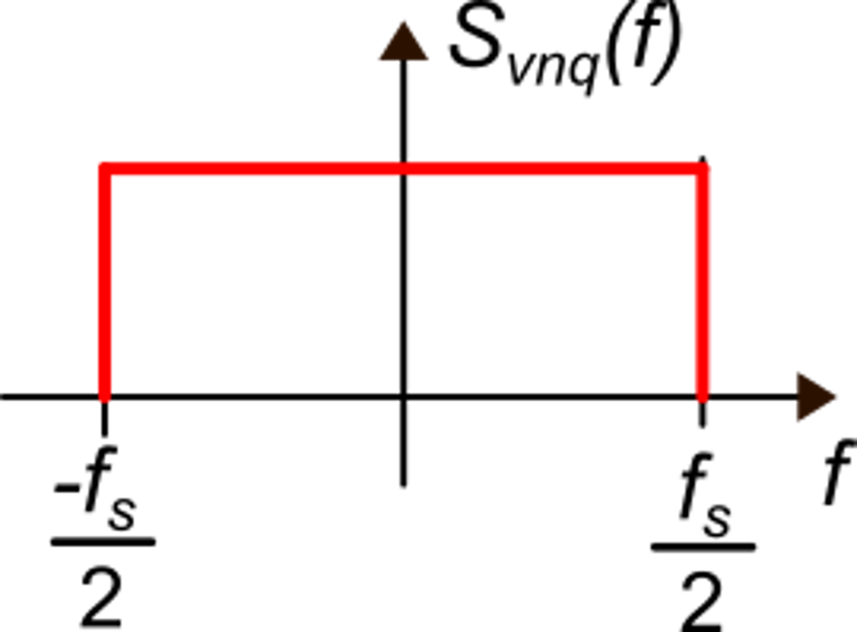
Quantization noise in the frequency domain
The v_{nq} spectrum
is a Dirac delta
Since the ADC samples the input data, the output frequency domain is
[-f_{s}/2,+f_{s}/2]
V_{in} is a dc signal
V_{in} is fast-varying signal
of magnitude >> LSB
Two extreme cases
uniform distribution

Slide 23
The uniform power spectral density (PSD) model for the quantization noise
$$\frac{∆^{2}}{12}\frac{1}{f_{s}}$$
This model is very useful and simple but should be applied with much care.
In real cases, the quantization noise depends on the input signal, and so does its spectrum.
The uniform spectral density model is acceptable when the input signal has magnitude and/or frequency such that the output levels are changed in a fast and almost random way.
This happens when the average time spent by the signal on a single level is short (of the order of the sampling time).
$$∆=\frac{V_{FS}}{2^{N}}=LSB$$

Slide 24
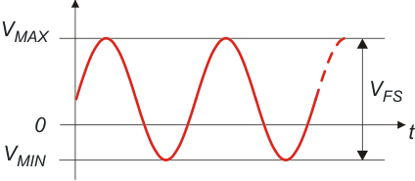
Signal to Noise Ratio and resolution
Input range of the ADC
$${SNR}_{max}=\frac{P_{MAX}}{<{v_{n}}^{2}>}$$
Considering only quantization noise:

Slide 25
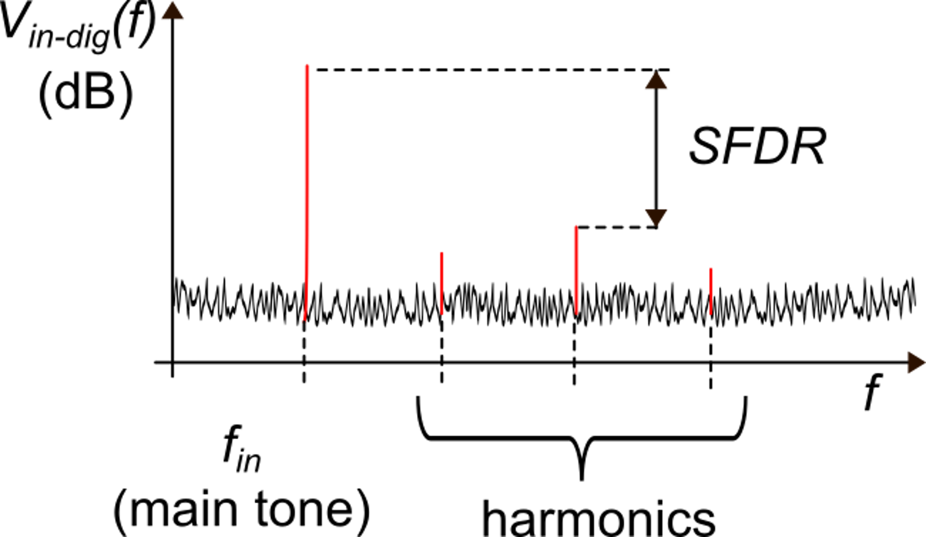
Effective Number Of Bits (ENOB)
Distortion and SFDR (spurious free dynamic range)
P_{D}=total power of the harmonics
Also indicated with SNDR
Quantization and electrical noise

Slide 26
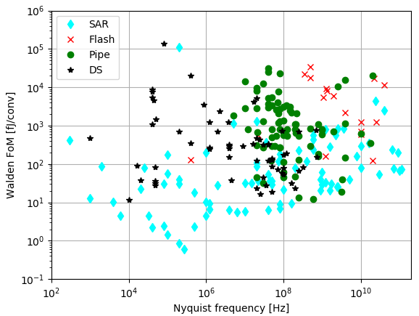
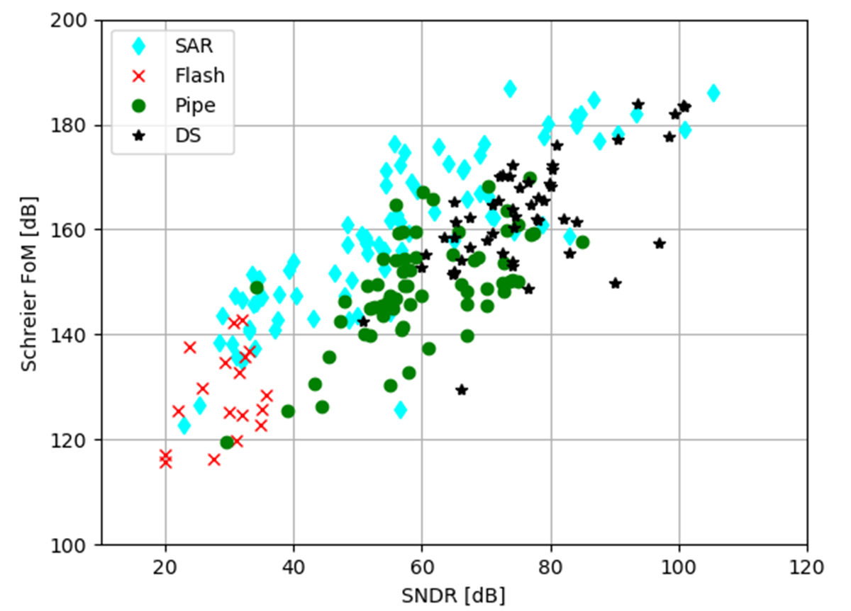
ADCs – Figure of Merits
Schreier FoM:
Walden FoM:
$${FoM}_{W}=\frac{P_{D}}{f_{s−Nyq}2^{ENOB}}$$
$${FoM}_{S}={\left.SNDR\right|}_{dB}+10\log\left(\frac{f_{s−Nyq}/2}{P_{D}}\right)$$
[J/conv]
[dB]

Slide 27
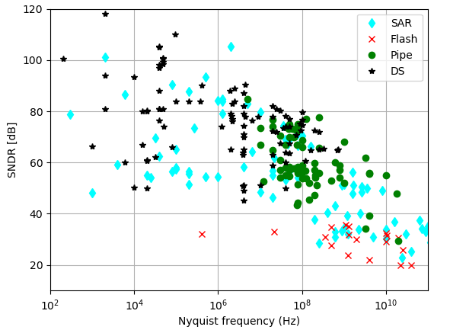
Comparison of different topologies
Mismatch limit of passive component
https://web.stanford.edu/~murmann/adcsurvey.html

Slide 28
Nyquist rate ADCs
N-bit ADC
Direct conversion:
Flash converters
1 cycle of comparison (fast but with low resolution)
Counting and Integrating ADCs:
Counting converters
Dual-slope
2^{N} cycles of comparison
(simple/accurate but slow)
Binary-Search Algorithm based:
Successive approximation converters (SAR)
Pipelined converters
N cycles of comparison
(good trade-off speed/resolution)

Slide 29
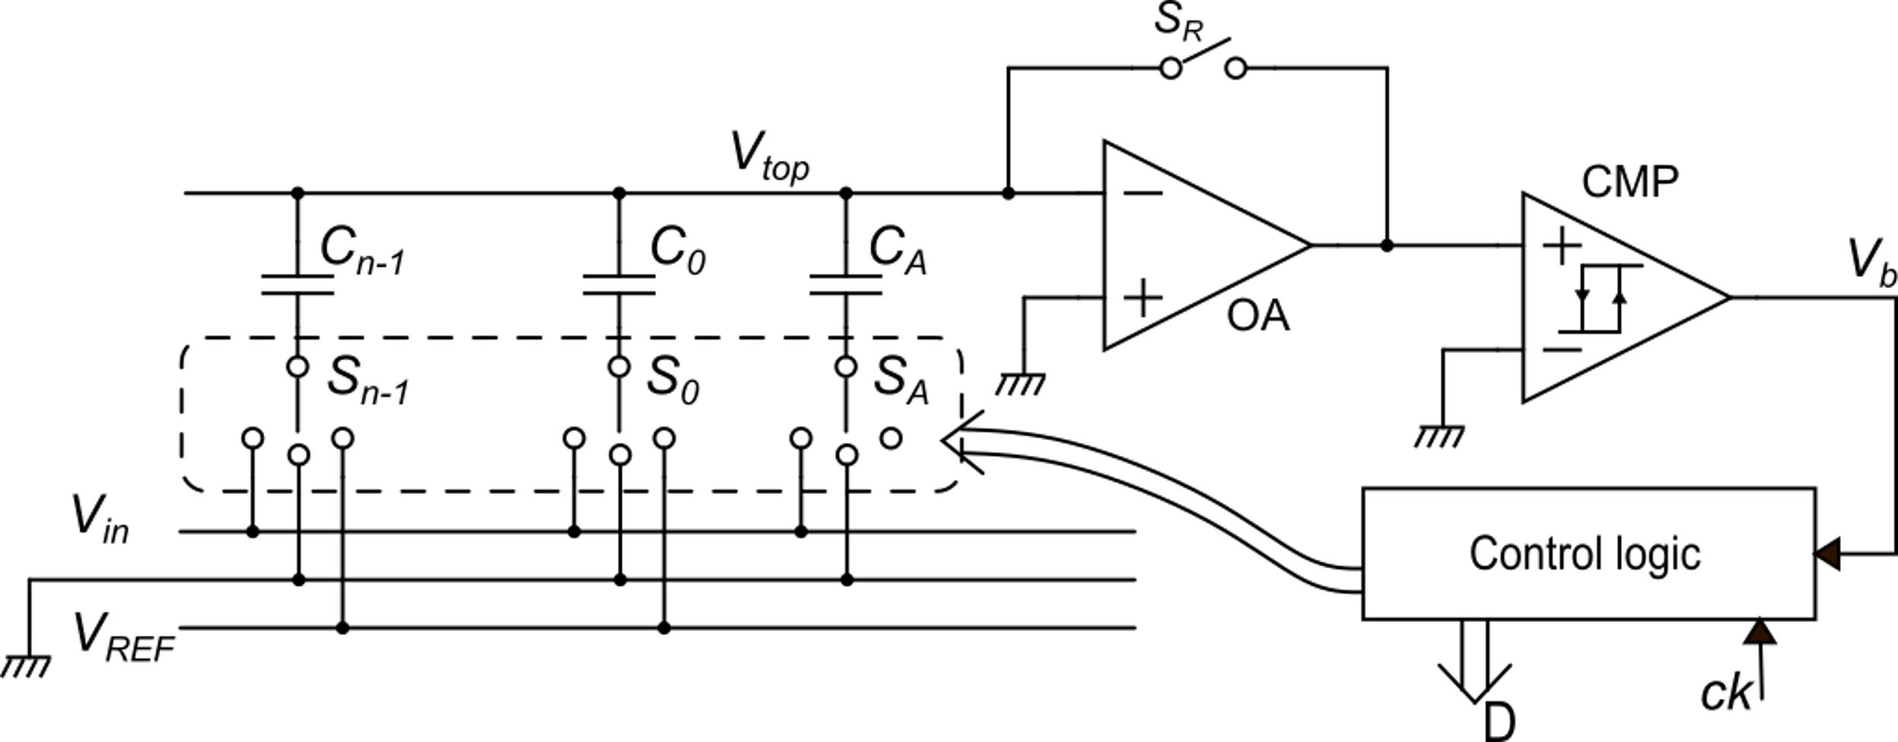
A very common SAR ADC: the charge-redistribution ADC
preamplified comparator
capacitive DAC

Slide 30
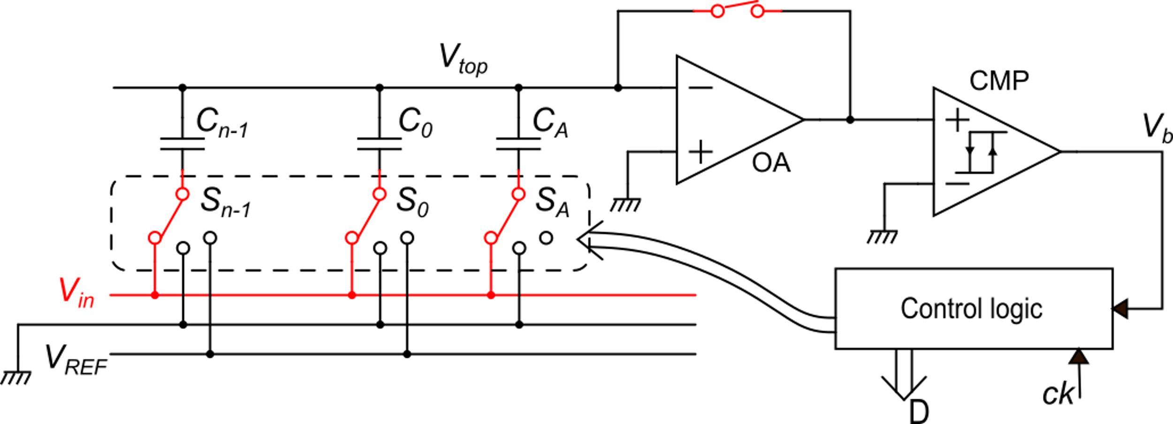
Reset phase
-v_{n}
The op-amp is closed
in unity gain
analog input signal V_{in} ≥ 0
All capacitors are in parallel, with one terminal connected to the input voltage V_{in}.

Slide 31
Sampling phase
The op-amp is placed in open loop configuration and the bottom plates of all capacitors are connected to gnd.
The voltage of the top plates (V_{top}) is free to evolve (it is floating, no current comes from the OP to V_{top})

Slide 32
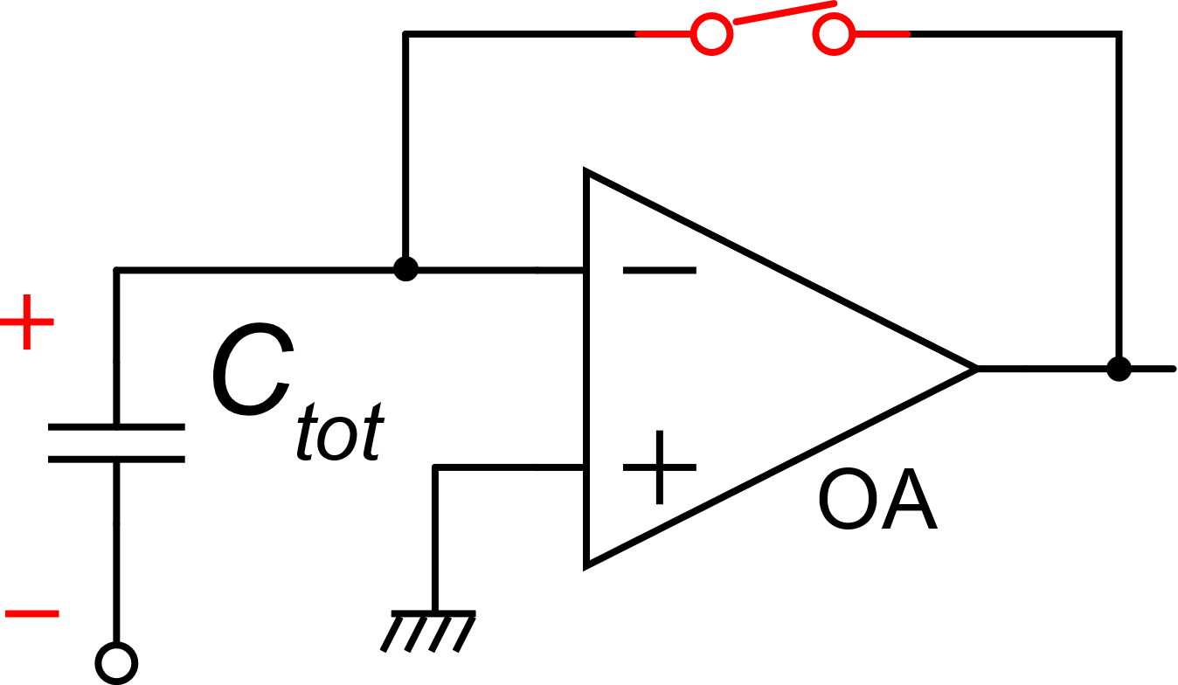
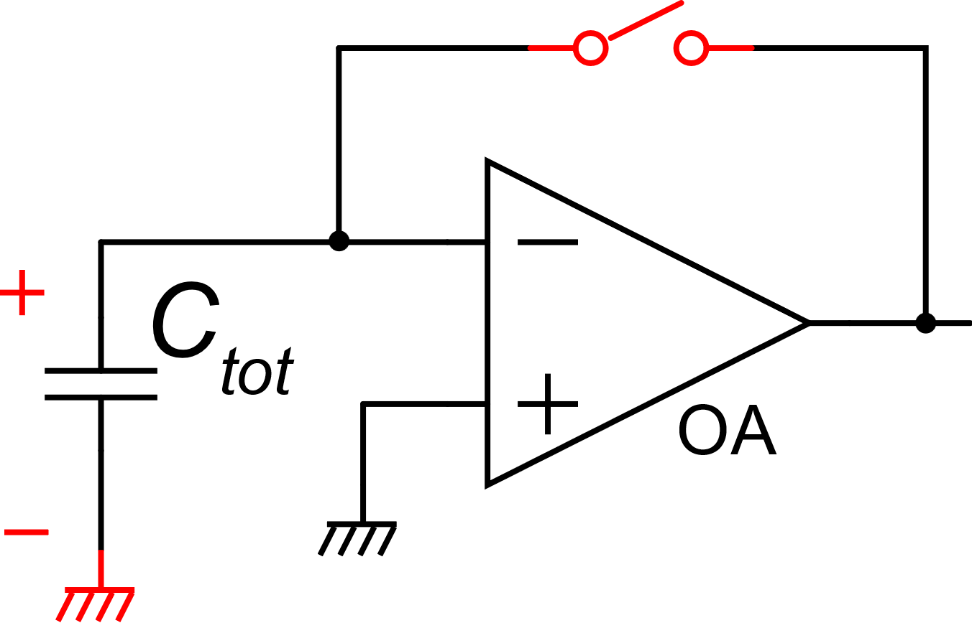
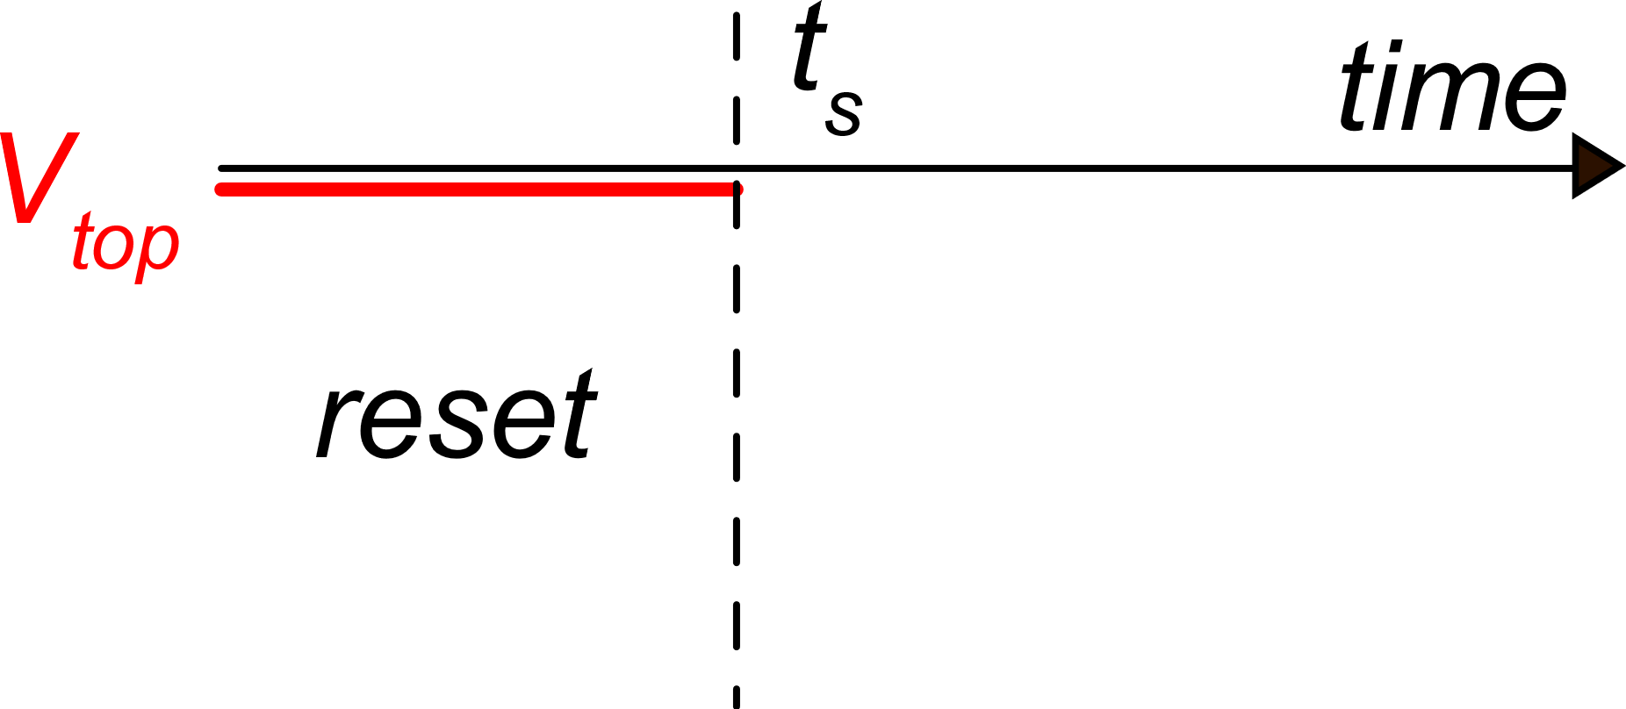
Top voltage in the sampling phase
The voltage on C_{tot}
does not change
Reset
Sampling

Slide 33
SAR phases
composite comparator
Sequence: SAR_{n-1} ...... SAR₀
Phase SAR_{k} begins by connecting the bottom plate of C_{k} to the reference voltage V_{REF} through switch S_{k}
This causes a jump in voltage V_{top}.
Bit k-th is the output of the composite comparator (V_{b}) at the end of phase SAR_{k}
If b_{k} =0 S_{k} comes back to gnd, else it remains at V_{REF}
Phase SAR_{k}

Slide 34
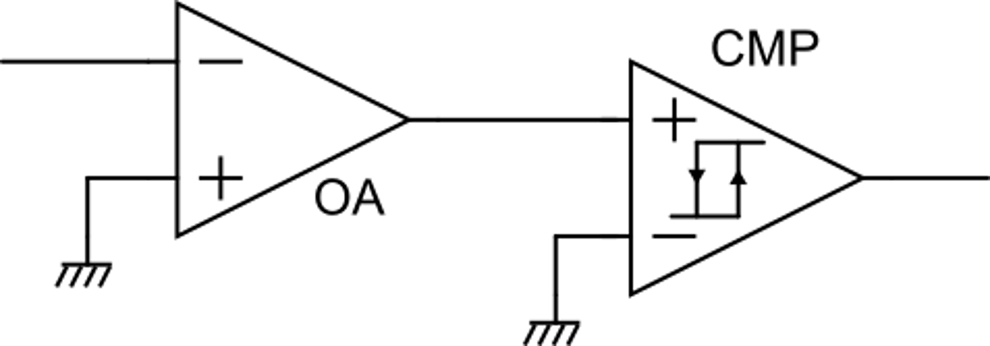
Composite comparator
V_{oA}=A(V_{iA}−v_{n})
V_{top}
The gain of OA is so large that the offset and hysteresis of CMP has negligible impact on the composite comparator characteristics.
V_{iA}
V_{b}

Slide 35
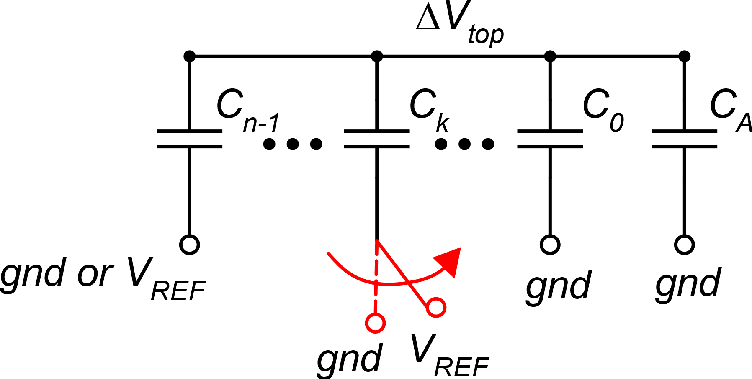
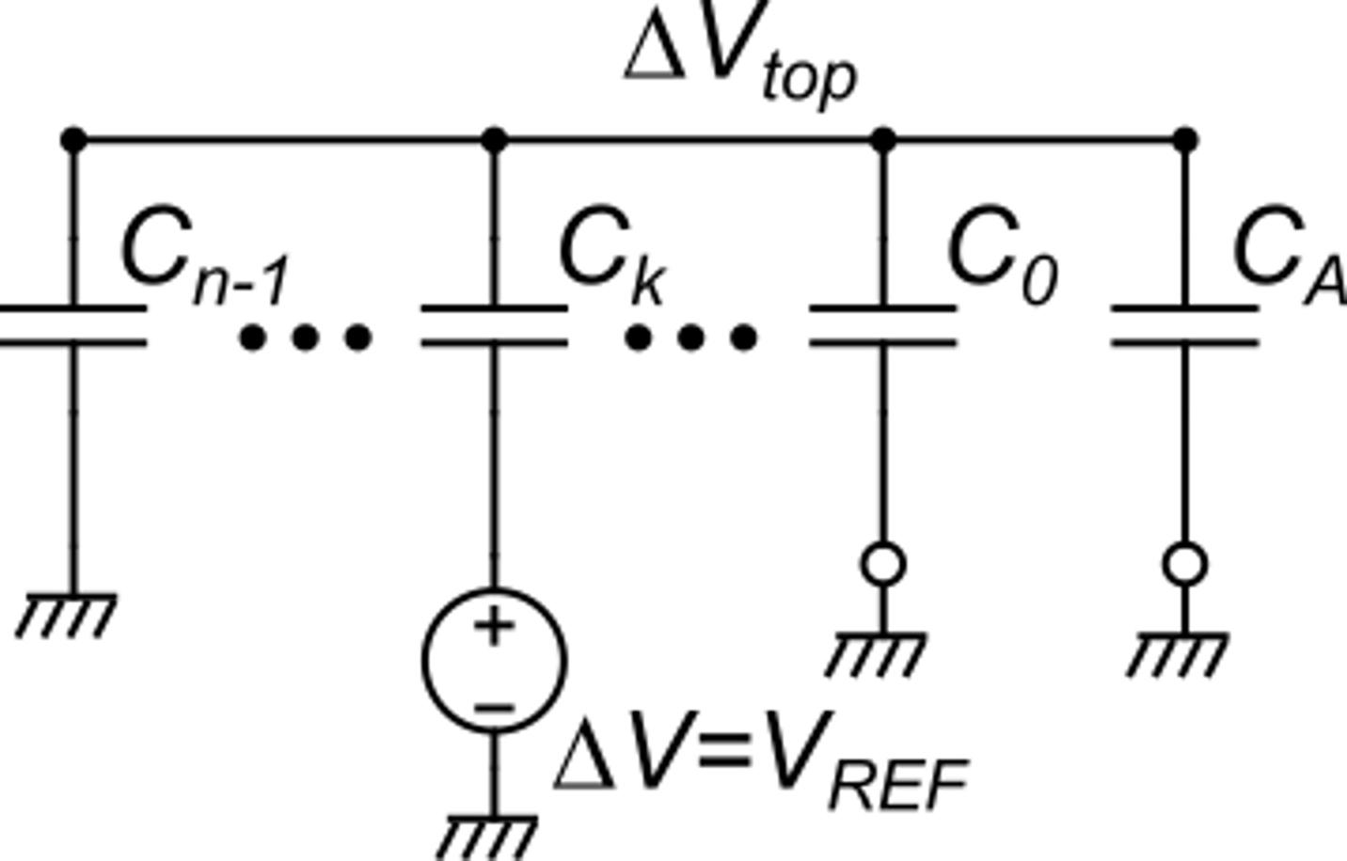
Phase SAR_{k}: calculation of the V_{top} jump
ΔV_{top} at phase SAR_{k}
All-capacitor network:
equivalent circuit for variations. Capacitors can be replaced by a resistors of value 1/C

Slide 36
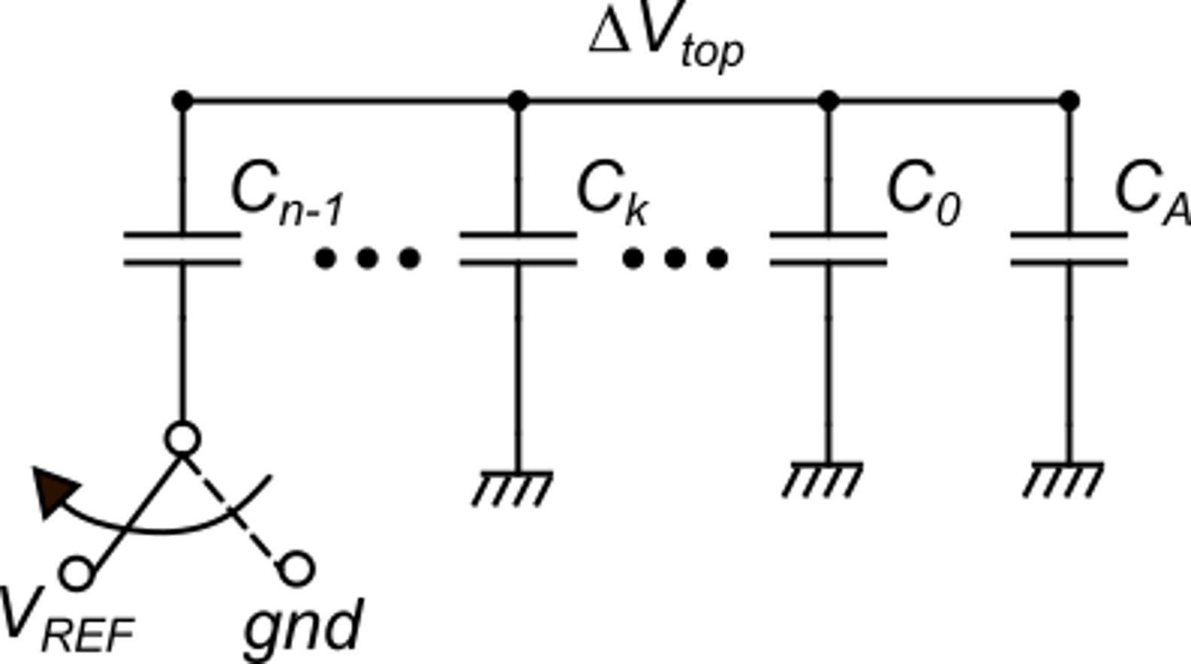
Phase SAR_{n-1}
V_{b}
from sampling phase
Decision for bit b_{n-1} (taken at time t_{n-1} = end of phase SAR_{n-1})

Slide 37
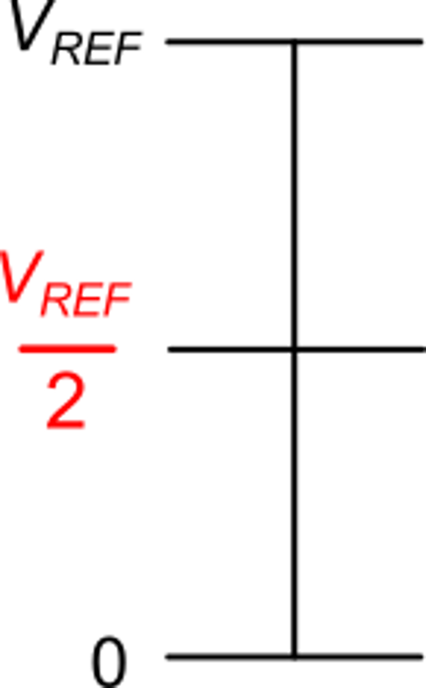
Phase SAR_{n-1}
possible values
of V_{in}(t_{s}) and resulting
value of b_{n-1}
b_{n-1}=1
Subtraction of two noise samples taken at different times: constant and correlated components are rejected (CDS).
b_{n-1}=0
Neglecting noise / offset components, the condition becomes:
This is in conformity with the successive approximation algorithm

Slide 38
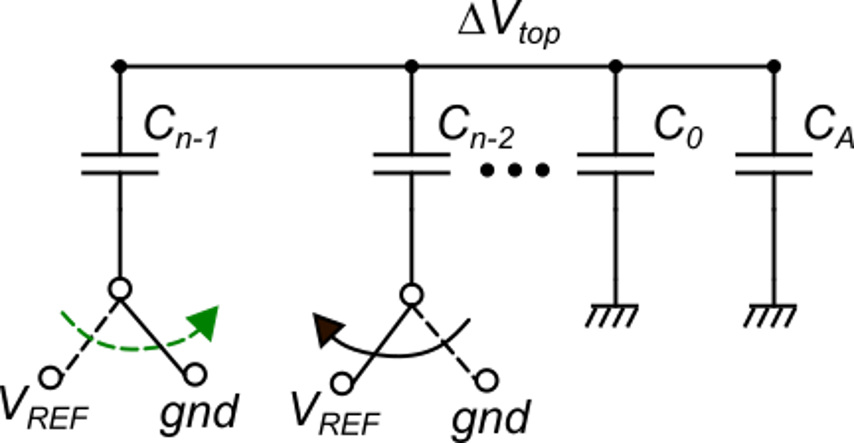
Phase SAR_{n-2}
V_{b}
Switch S_{n-1} goes back to gnd if b_{n-1}=0
Otherwise, it remains to V_{REF}
Decision : bit b_{n-2} =1 if:
If S_{n-1} comes back to gnd, it subtracts ΔV_{n-1} from V_{top}

Slide 39
Decision for b_{n-2}
V_{tst}(n−2)
b_{n-2}=1
if b_{n-1}=1 V_{tst}(n−2)=
b_{n-2}=0
b_{n-2}=1
if b_{n-1}=0 V_{tst}(n−2)=
b_{n-2}=0

Slide 40
Generalization
At k-th step (phase SAR_{k}) , bit b_{k} is determined from the comparison of V_{in}( t_{s} ) with:
At any step the increment is halved
Increments applied in previous phases and
maintained only if the corresponding bits are 1
At the last phase, SAR₀, the LSB (b₀) is determined and the conversion is complete. The bits determined in the successive phases are stored inside a register of the control logic and can be retrieved at the end of conversion.

Slide 41
Examples of conversion cycle
b_{n-1} = 1
b_{n-2} = 0

